Slide 1
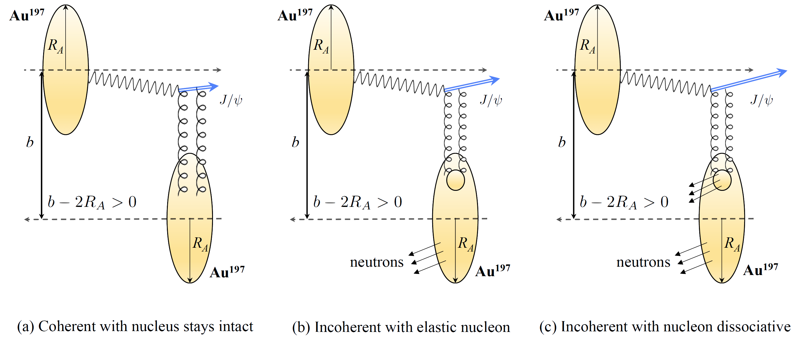
Probing nuclear parton density and fluctuation with ultra-peripheral collisions at RHIC
Kong Tu (BNL)
Notes:
Thank you for the introduction. Today It’s I am great honor to be here at Yale (IN PERSON) to talk about the research. This is the first in-person seminar visit that I have in the past couple of years. Not only meeting you in 3D is great, but I can also finally use my hands and fingers, and my laundry balls;-). By the way, they are nuclear matter..

Slide 2
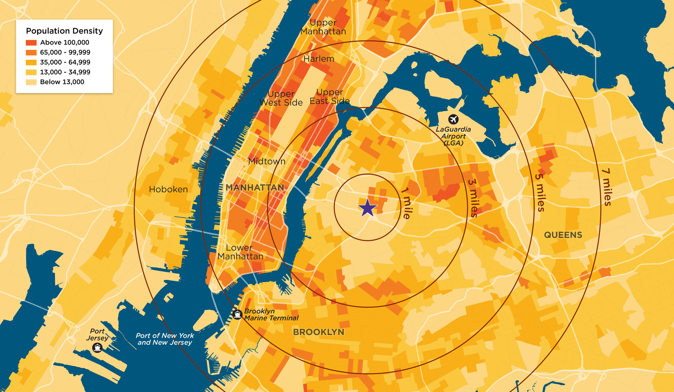

Slide 3
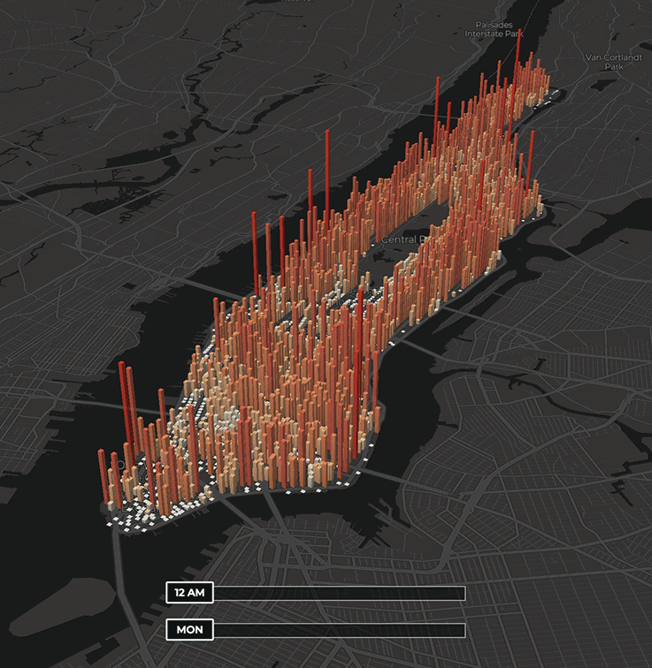
Average density and its day-by-day, hour-by-hour fluctuation are two distinct aspects of describing the Manhattan’s populations
Together, we have a full picture of the structure

Slide 4
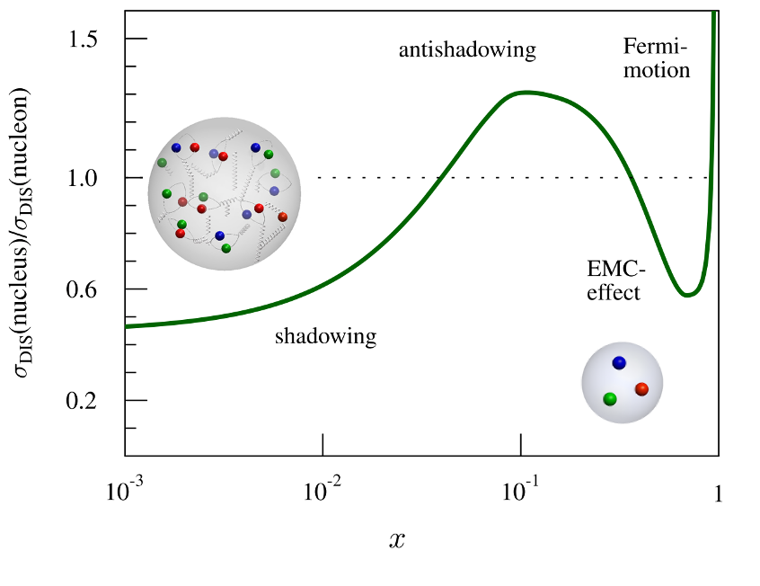
Motivation
LHC kinematics
Physics mechanism of modified parton densities in heavy nuclei - one of the most pressing questions in both hot and cold QCD community.
Photoproduction of Vector Mesons, e.g., J/𝛙, is considered a clean probe to the nuclear parton structures.
RHIC kinematics

Slide 5
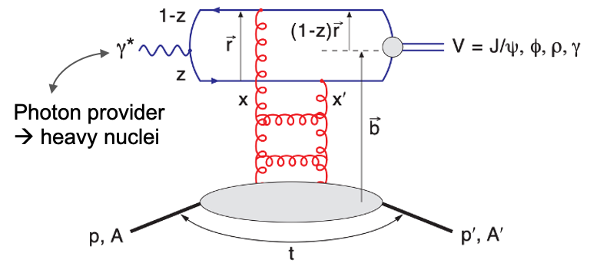
J/𝛙 photoproduction
At Leading Order, 2-gluon exchange
Coherent (target stays intact) | Incoherent (target breaks up)
Average nuclear parton density | Event-by-event parton density fluctuations
Momentum transfer (t) and transverse spatial position (b) are Fourier transforms of each other;
What can the coherent and incoherent J/𝛙 photoproduction at x ~ 0.01 tell us?

Slide 6
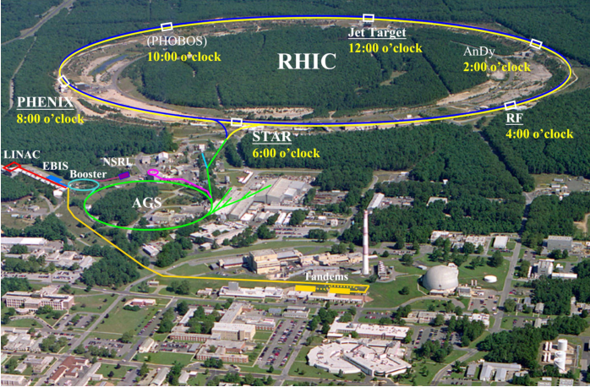
Ultra-Peripheral Collisions at RHIC
U²³⁸, Au¹⁹⁷, Zr⁹⁶ , Ru⁹⁶, d² at 200 GeV and pp at 510 GeV
A versatile program with different species, energy, and polarization.

Slide 7
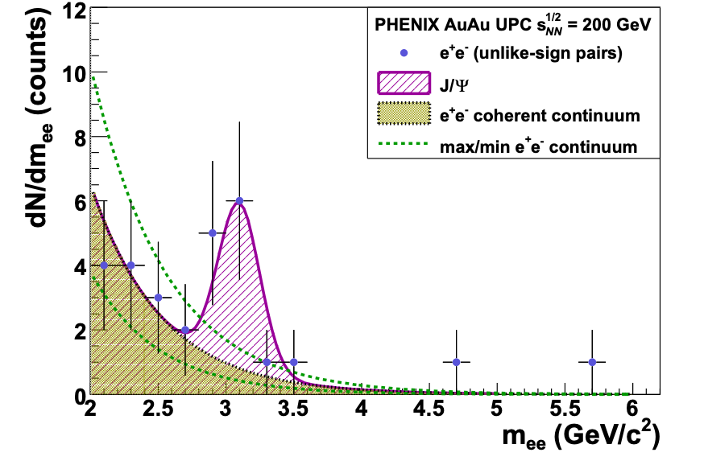
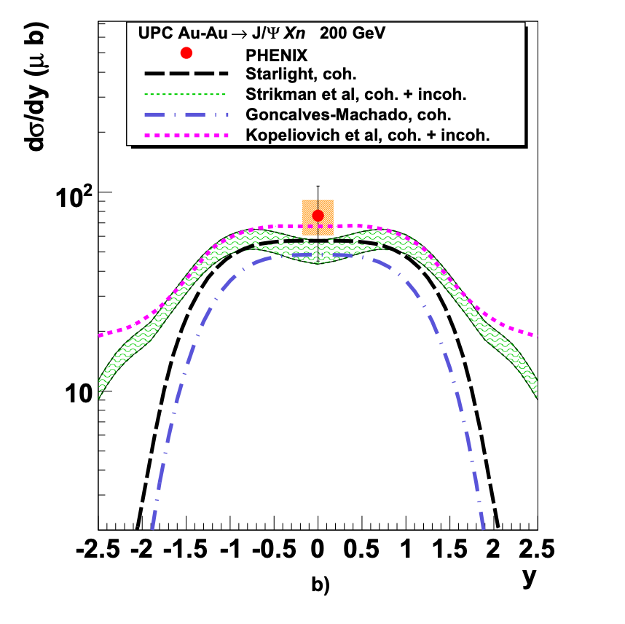
Early RHIC data from PHENIX
Phys. Lett. B 679 (2009) 321-329
Statistics was limited, coherent and incoherent were not separated, and with neutron selections

Slide 8
Separating coherent and incoherent J/𝛙
New
Low momentum transfer (p_{T}²) is dominated by coherent photoproduction.
For incoherent production at low p_{T}², it is extrapolated using different templates.
These differences, however, are small to the total incoherent production cross section.

Slide 9
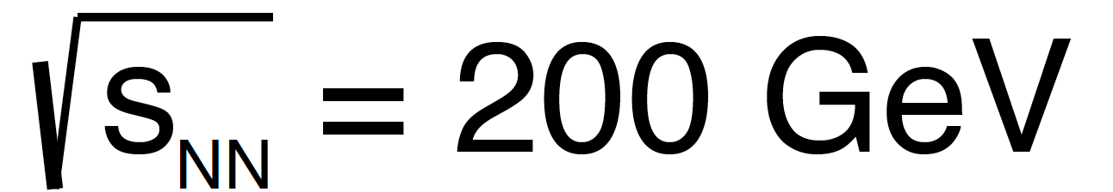
First measurement of y-dependence of J/𝛙 at RHIC
New
Important measurements to constrain theoretical models
Ratio of incoherent to coherent cross section largely cancels uncertainties both experimentally and theoretically
New studies show this ratio is sensitive to nuclear structure and nuclear deformation
(by W. Zhao et al. at a recent INT workshop)

Slide 10
AuAu UPCs: two-source ambiguity
Which nucleus provides the photon?

Slide 11
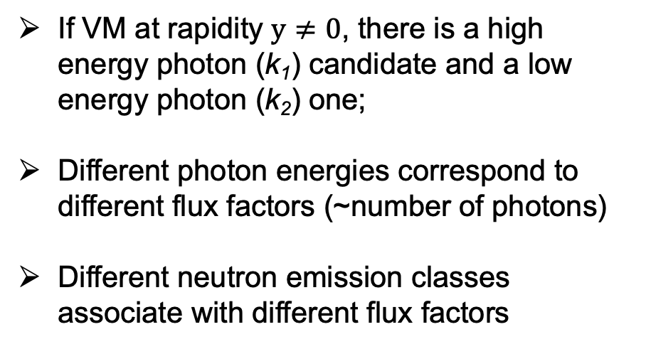
Photon flux and neutron emissions for coherent J/𝛙
If VM at rapidity $y≠0$, there is a high energy photon (k₁) candidate and a low energy photon (k₂) one;
Different photon energies correspond to different flux factors (~number of photons)
Different neutron emission classes associate with different flux factors
STARLight model
Neutron classes:
0n0n: no neutron on either side
0nXn: >=1 neutron on one side
XnXn: >=1 neutron on both sides

Slide 12

Photon flux and neutron emissions for coherent J/𝛙
New
New data tests nuclear breakup model and assumptions
If VM at rapidity $y≠0$, there is a high energy photon (k₁) candidate and a low energy photon (k₂) one;
Different flux factor (~number of photons) at different energy
Each process associates with neutron emission in an independent way
Coherent J/𝛙 production is independent of neutron emissions
Incoherent J/𝛙 production is highly correlated with neutron emissions (e.g., BeAGLE)
STARLight model
Neutron classes:
0n0n: no neutron on either side
0nXn: >=1 neutron on one side
XnXn: >=1 neutron on both sides
Reference to BeAGLE: Phys. Rev. D 106 (2022) 1, 012007

Slide 13
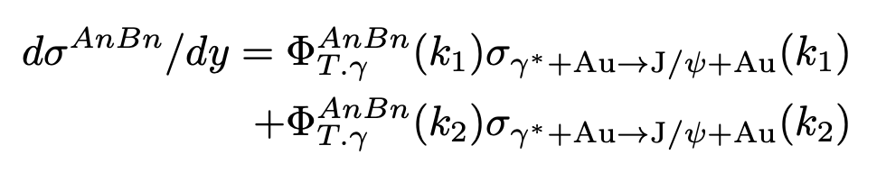
Neutron emission helps resolve the two-source ambiguity
Measurements
(slide 9)
Photon fluxes
(slide 11)
Unknowns
Eur. Phys. J C (2014) 74:2942
See also CMS talk on by Z. Ye
Need to measure differential cross section in y and in neutron emission classes; at least 2 equations to solve 2 unknowns.

Slide 14
Coherent J/𝛙 cross section vs energy W
New
STAR kinematics is unique to the low W region, while gluon saturation models generally focus on higher energy.
Shadowing model LTA describes the data very well. The suppression factor (data/IA) is ~ 60%
Sensitive to the transition region between high-x and low-x.
Reference to CGC: Phys. Rev. D 106 (2022) 7, 074019
Reference to LTA: 1) Guzey, Strikman, Zhalov, EPJC 74 (2014) 7, 2942 2. Strikman, Tverskoy, Zhalov, PLB 626 (2005) 72-79
(center-of-mass energy between photon and nucleon)

Slide 15
Incoherent J/𝛙 cross section vs p_{T}²
New
Compared to the H1 data with free proton. The suppression factor ~ is 40%. Stronger than that for coherent production.

Slide 16
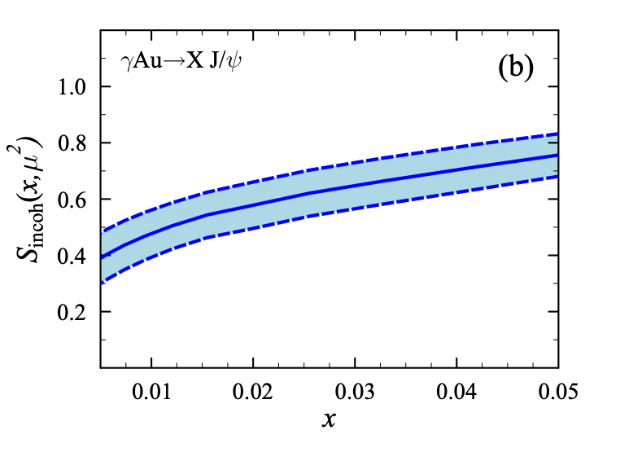
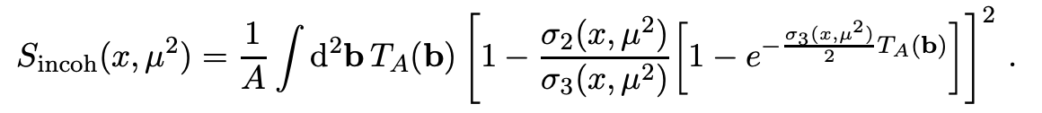
Shadowing in incoherent J/𝛙 photoproduction
This ratio is driven by multi-nucleon interactions, nuclear thickness function, diffractive parton distributions, etc.
(Phys. Rev. C 108 (2023) 2, 024904)
Intuitively, the incoherent J/𝛙 production is the convolution of: J/𝛙 production off a nucleon inside of a nucleus $⊗$ probability of the J/𝛙 survives on its way out of the nucleus.

Slide 17
Incoherent J/𝛙 cross section vs p_{T}²
New
Compared to the H1 data with free proton. The suppression factor ~ is 40%. Stronger than that for coherent production.
Models have found that the H1 data supports sub-nucleonic fluctuation.
[Phys. Rev. Lett. 117 (2016) 5, 052301]
STAR data shows the bound nucleon has a similar shape in p_{T}² as the free proton, indicating similar sub-nucleonic fluctuation in heavy nuclei.
[Phys. Rev. D 106 (2022) 7, 074019 ]

Slide 18
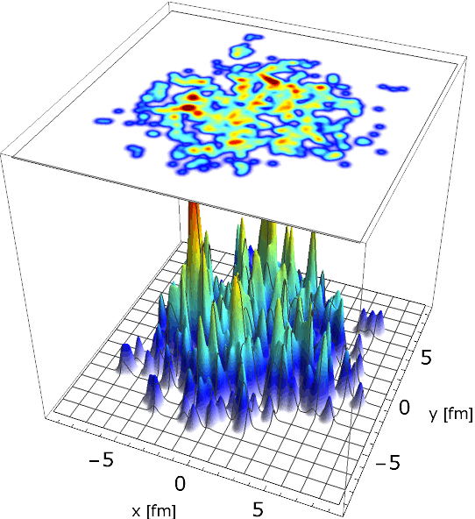
Incoherent J/𝛙 cross section vs p_{T}²
New
Sartre simulation
[made by A. Kumar (IIT, Delhi)]

Slide 19
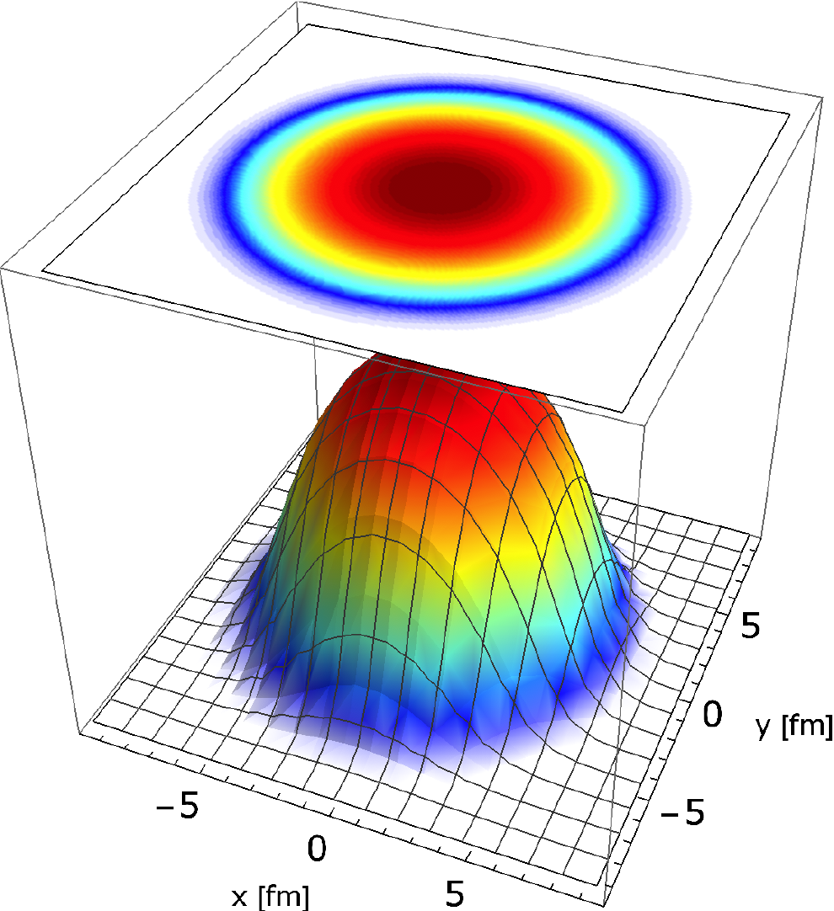
Summary – coherent and incoherent J/𝛙 photoproduction
STAR has made many first-time J/𝛙 measurements in UPCs at RHIC:
Strong nuclear suppression seen for both coherent (~ 40%) and incoherent (~60%) production.
Bound nucleon and free proton have similar shape in p_{T}² up to ~ 2.2 (GeV/c)²
Coherent is sensitive average parton density (or imagining if measure momentum) and Incoherent is sensitive to the parton density fluctuation.

Slide 20
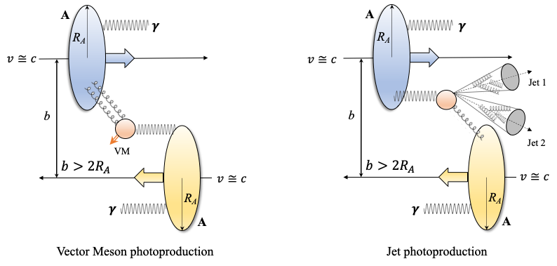
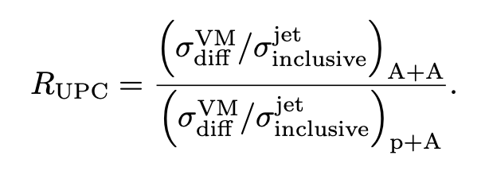
New observable – single & double ratio

Slide 21
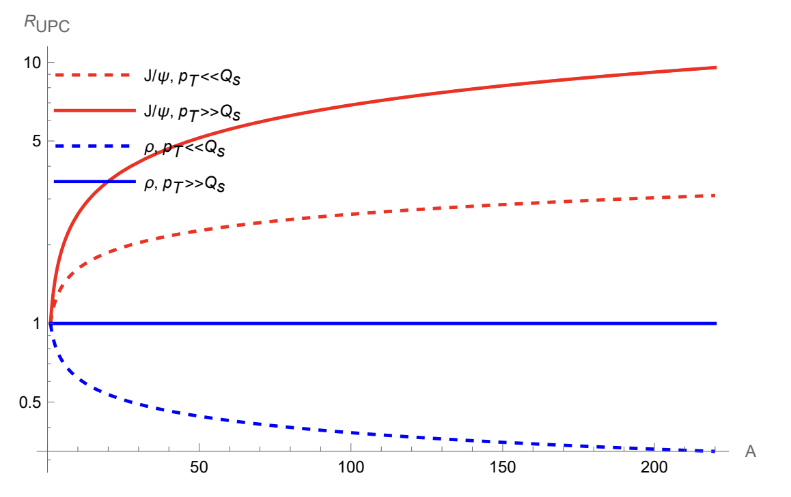
New observable – single & double ratio in UPCs
Quantitative prediction
x ~ 0.001
Non-saturation
Saturation
Yuri Kovchegov, Huachen Sun, ZT (2023)
(manuscript in preparation)

Slide 22
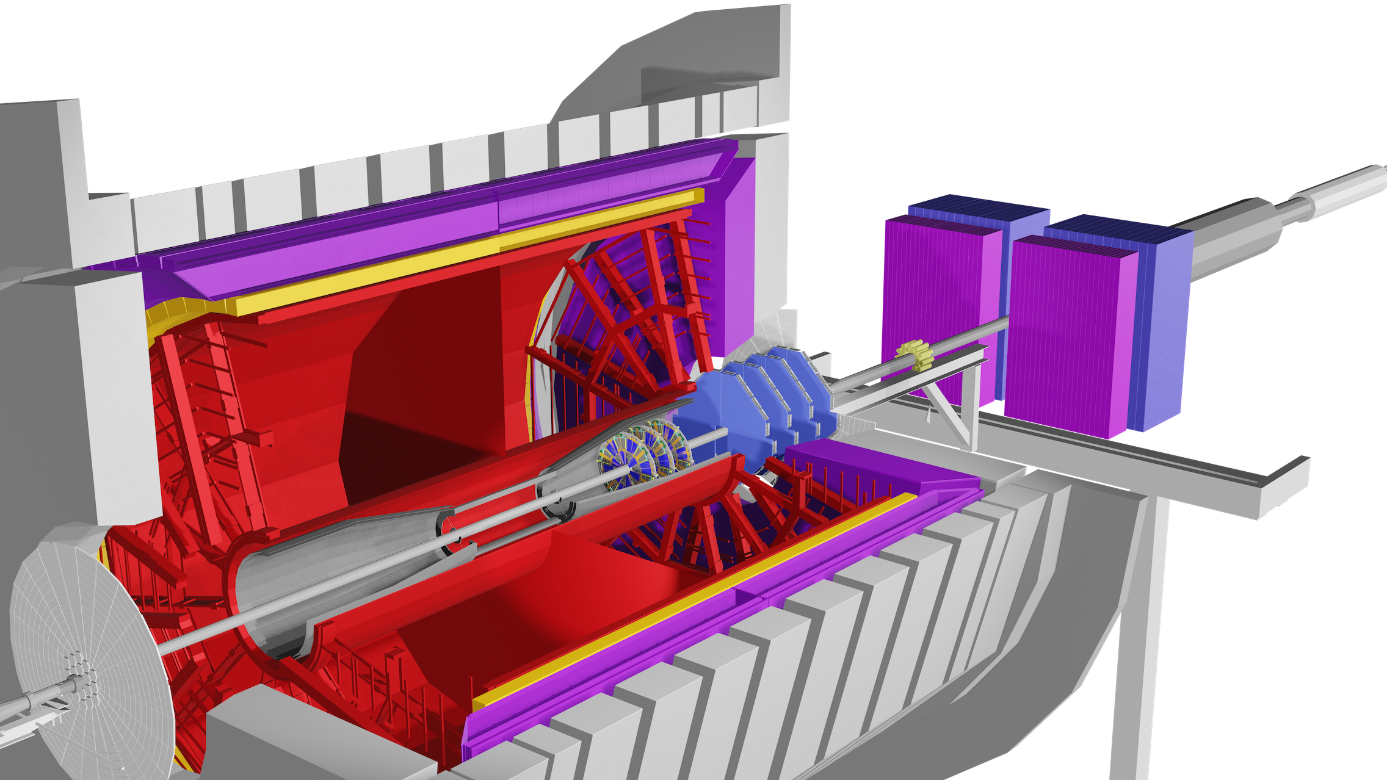
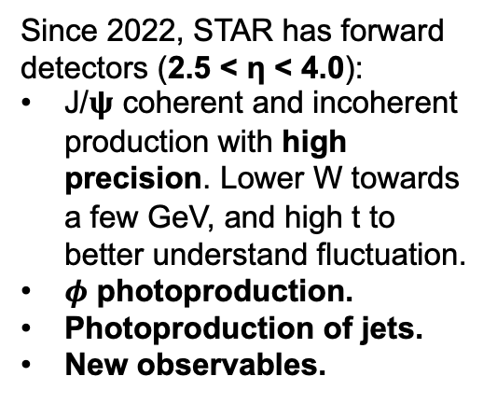
Future UPCs opportunities
Since 2022, STAR has forward detectors (2.5 < η < 4.0):
J/𝛙 coherent and incoherent production with high precision. Lower W towards a few GeV, and high t to better understand fluctuation.
$φ$ photoproduction.
Photoproduction of jets.
New observables.
RHIC 23-25
2023
2025
2029
2034+

Slide 23
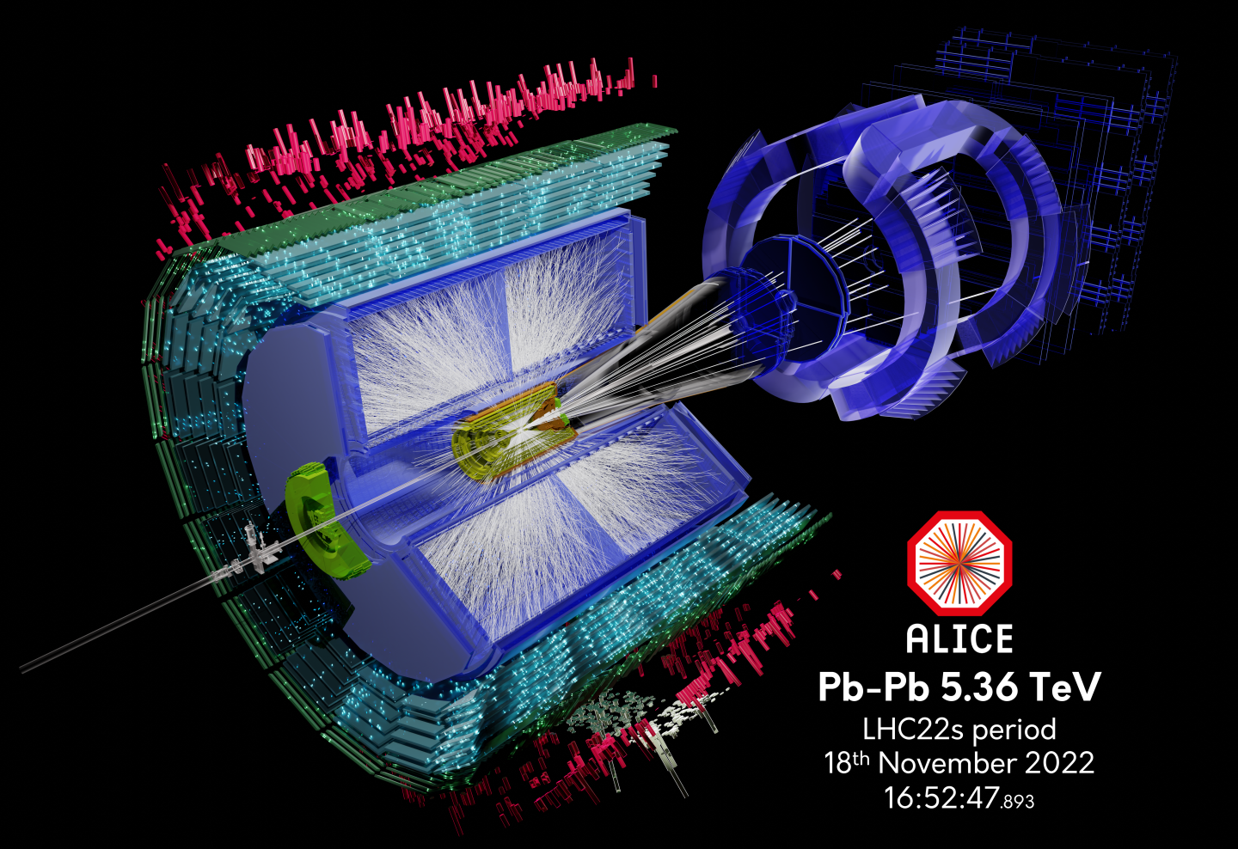
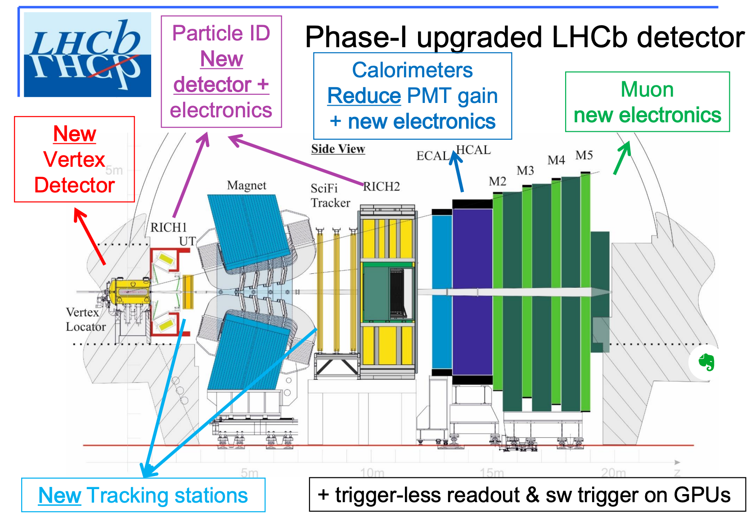
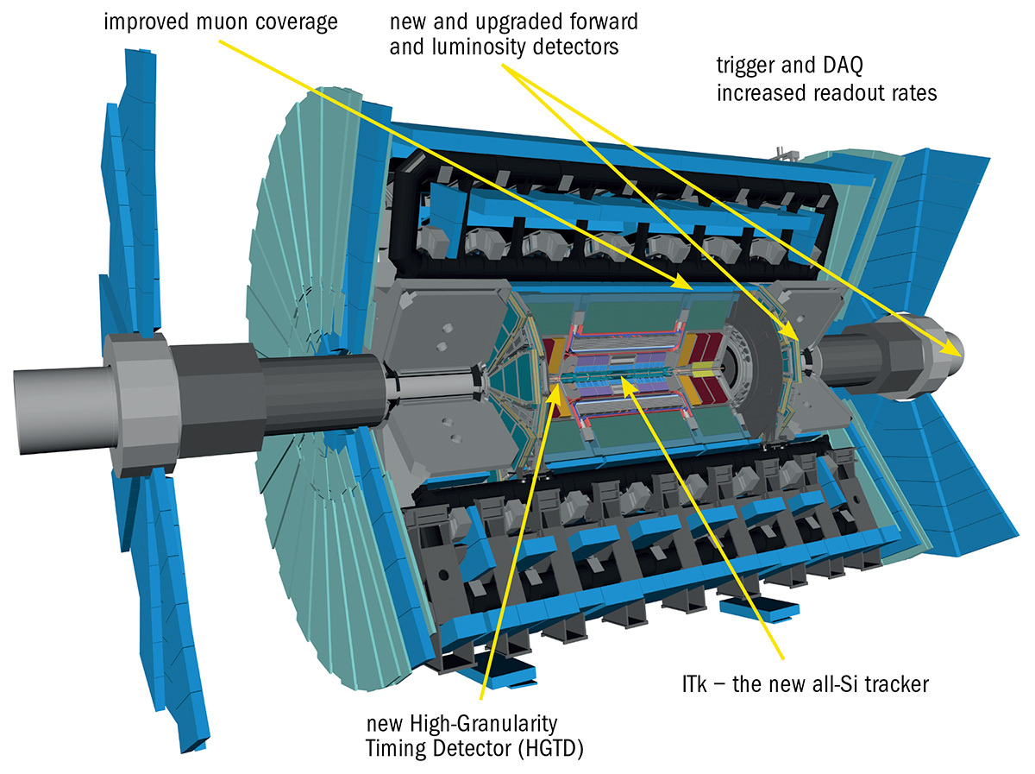
Future UPCs opportunities
Since 2022, STAR has forward detectors (2.5 < η < 4.0):
J/𝛙 coherent and incoherent production with high precision. Lower W towards a few GeV, and high t to better understand fluctuation.
$φ$ photoproduction.
Photoproduction of jets.
New observables.
All LHC experiments will have significant upgrades in Run 3 & 4 (e.g., wide acceptances, ALICE FoCal, etc.). Lower-x reach!
RHIC 23-25 & LHC Run 3
LHC Run 4
2023
2025
2029
2034+

Slide 24
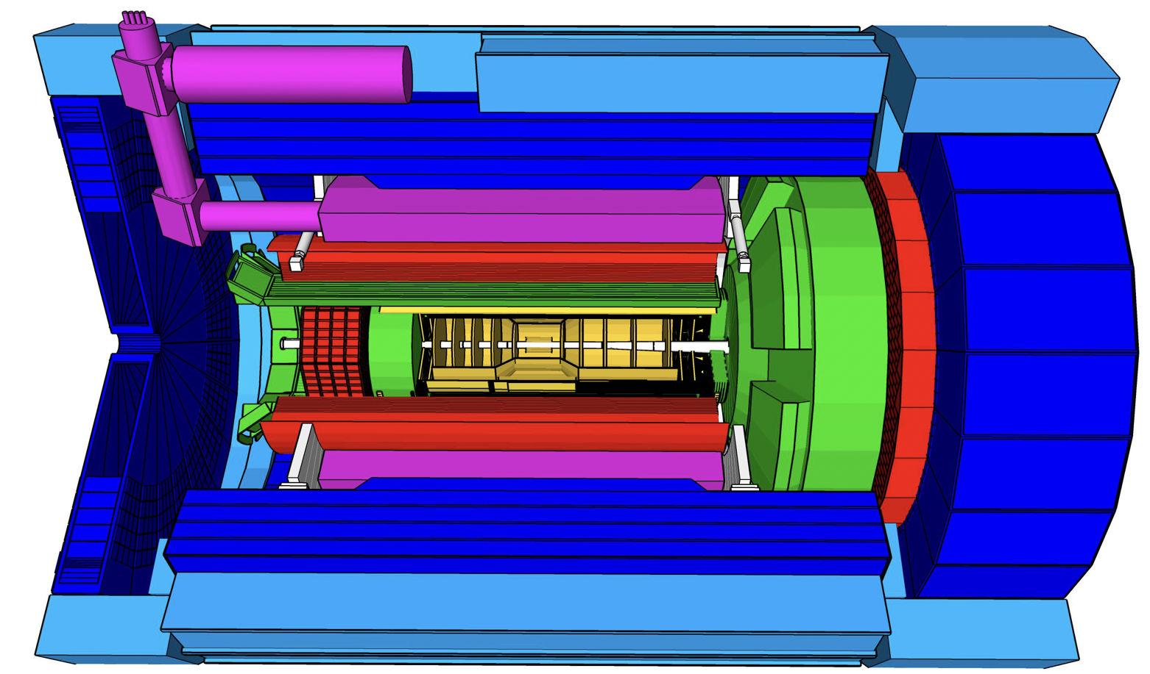
Future UPCs opportunities
EIC era
The ePIC detector and possible a 2nd detector: the ultimate machine for understanding saturation quantitatively with a wide variety of observables.
Since 2022, STAR has forward detectors (2.5 < η < 4.0):
J/𝛙 coherent and incoherent production with high precision. Lower W towards a few GeV, and high t to better understand fluctuation.
$φ$ photoproduction.
Photoproduction of jets.
New observables.
All LHC experiments will have significant upgrades in Run 3 & 4 (e.g., wide acceptances, ALICE FoCal, etc.). Lower-x reach!
RHIC 23-25 & LHC Run 3
LHC Run 4
2023
2025
2029
2034+

Slide 25
Special thanks to:
CGC: Heikki Mäntysaari, Farid Salazar, Björn Schenke
Sartre: Tobias Toll, Arjun Kumar
Nuclear shadowing: Vadim Guzey, Mark Strikman, Mikhail Zhalov
NLO pQCD: Topi Löytäinen et al.
Saturation observables: Brian Sun, Y. Kovchegov
For discussions and inputs.

Slide 26
Backup

Slide 27
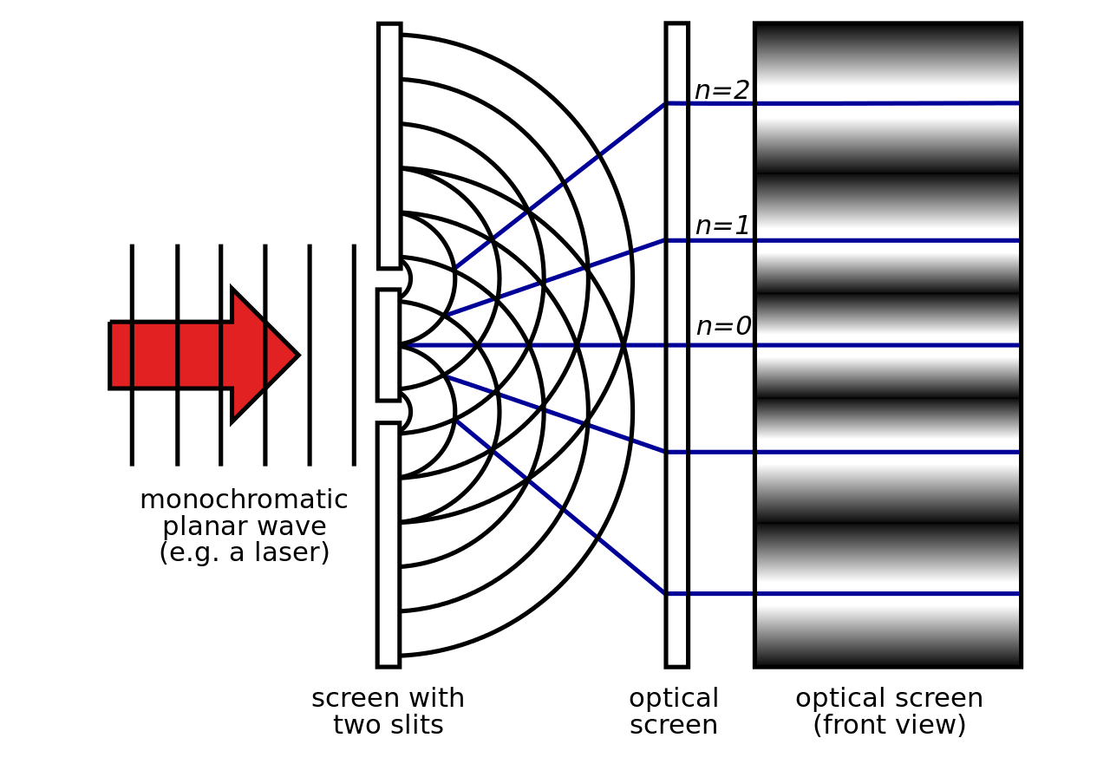
Two-source interference
New
Rapidity dependence is consistent with theory/model; interference effect is stronger if photon energies are similar.
First observed w. 𝝆⁰ in 2008 by STAR
(Phys.Rev.Lett.102:112301,2009)
Reference to CGC: Phys. Rev. D 106 (2022) 7, 074019

Slide 28
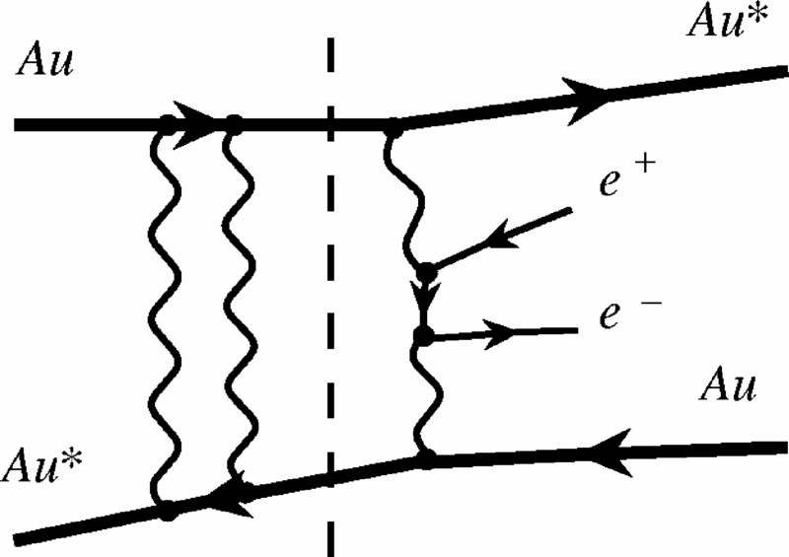
Neutron emissions in UPCs
Neutron classes:
0n0n: no neutron on either side
0nXn: >=1 neutron on one side
XnXn: >=1 neutron on both sides
or J/𝛙
UPCs have large contributions from QED Coulomb excitations

Slide 29
A full picture: coherent + incoherent
STAR data compared with four theory/MC models.
Sartre with sub-nucleonic fluctuation (s.n.f) & CGC are similar models but different by a normalization factor ~ 0.65.
Question to theorists: Why?
Reference to CGC: Phys. Rev. D 106 (2022) 7, 074019
Reference to LTA: arXiv:2303.12052

Slide 30
NLO calculation
New
Next-to-Leading Order (NLO) pQCD calculation, constrained by the LHC data
EPPS21 + scale at 2.39 GeV.
Only scale uncertainty shown.
Could not describe the STAR data at y = 0.
Reference to NLO pQCD calculation:
arXiv:2210.16048
Phys. Rev. C 106 (2022) 3, 035202

Slide 31
A full picture: coherent + incoherent
STAR data compared with four theory/MC models.
Sartre with sub-nucleonic fluctuation (s.n.f) & CGC are similar models but different by a normalization factor ~ 0.65.
Question to theorists: Why?
Full momentum region
STAR data is important to understand

Slide 32
Comparison to CGC

