Slide 1

Nucleon/nucleus 3D structure: overview from theoretical perspective
@ZhongboK
2nd Workshop on advancing the understanding of
non-perturbative QCD using energy flow
November 6 – 9, 2023

Slide 2
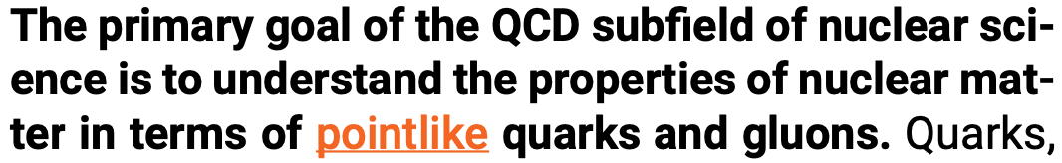

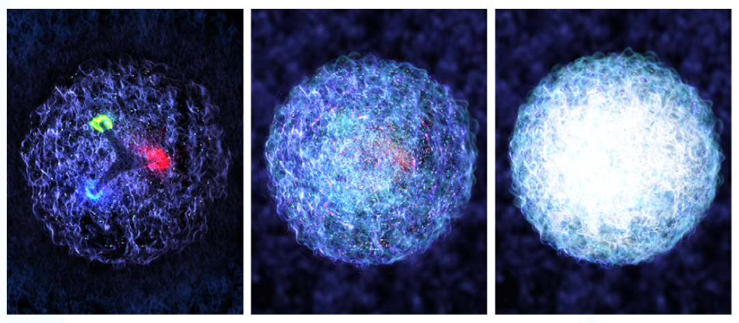
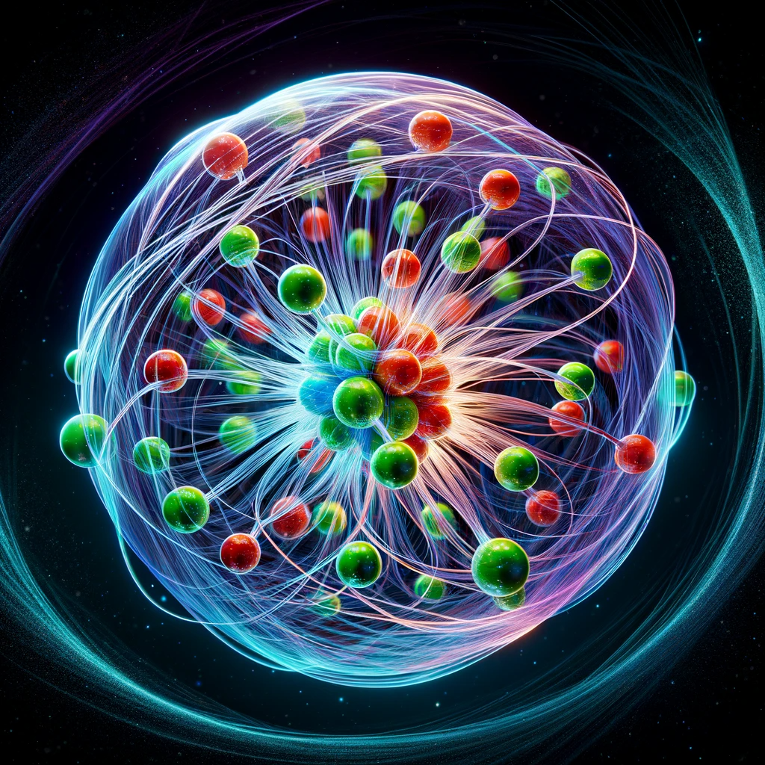
3D Structure of nucleon and nucleus
NSAC Long Range Plan 2023
An artistic rendering of the nucleon
A.I.’s imagination

Slide 3
Plan
TMD review
Threshold TMDs
Jet TMDs
Nuclear TMDs
Connection to EEC
  global (event shape) and local (in-jet)

Slide 4
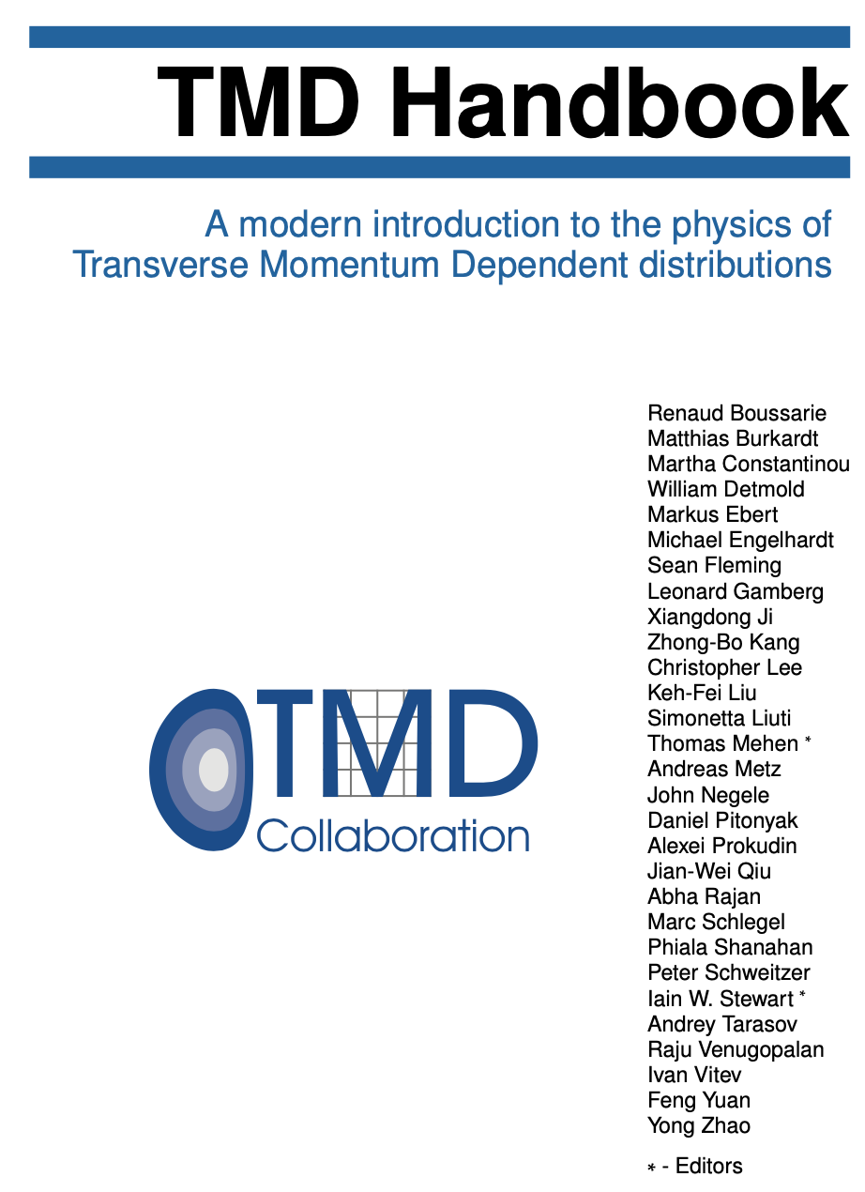
TMD Handbook
arXiv:2304.03302
Proton spin

Slide 5
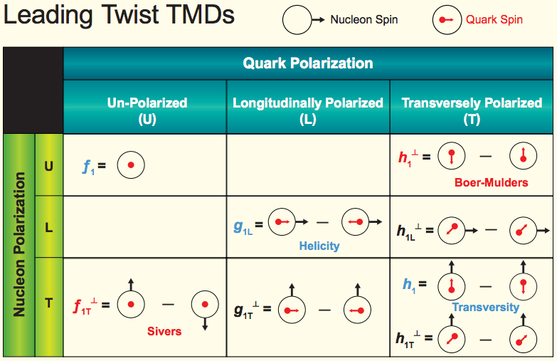
TMDs with polarization
TMD PDFs
Transversal Helicity
Quark Polarization
U L T
TMD FFs
Pion
Collins

Slide 6
TMD factorization
Drell-Yan production
mimic “parton model”

Slide 7
TMD Evolution
The modern version of TMD always contain soft function
  Two scales: standard renormalization scale and Collins-Soper scale
TMD evolution: two equations of these scales
  Collins-Soper kernel:
    Perturbative in small b (to 4 loops)
    Non-perturbative in large b: active lattice computations
Solution: need non-perturbative input
Moult, Zhu, Zhu, 2205.02249,
Duhr, Mistlberger, Vita, 2205.02242
e.g. Avkhadiev, Shanahan, Wagman, Zhao, 2307.12359, …

Slide 8
TMD global analysis
Outline of a TMD global analysis [lattice input on initial TMD and CS kernel]
Ansatz for TMDs at initial scale
Model ansatz for
non-perturbative
Collins-Soper kernel
Evolve TMDs to relevant scale with TMD evolution
Fourier transform back to momentum space
adjust parameters
all data points
calculate the cross section/asymmetry as well as χ²
Fourier transform numerical heavy
Kang, Prokudin, Sato, Terry, 1906.05949
Implemented by ResBos?
[Joshua Isaacson, 2022]
χ² minimum?
no
yes

Slide 9
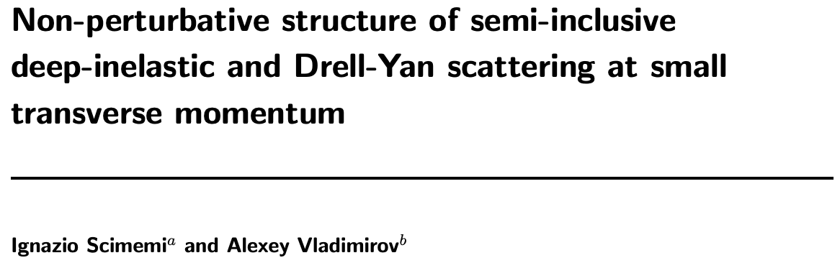
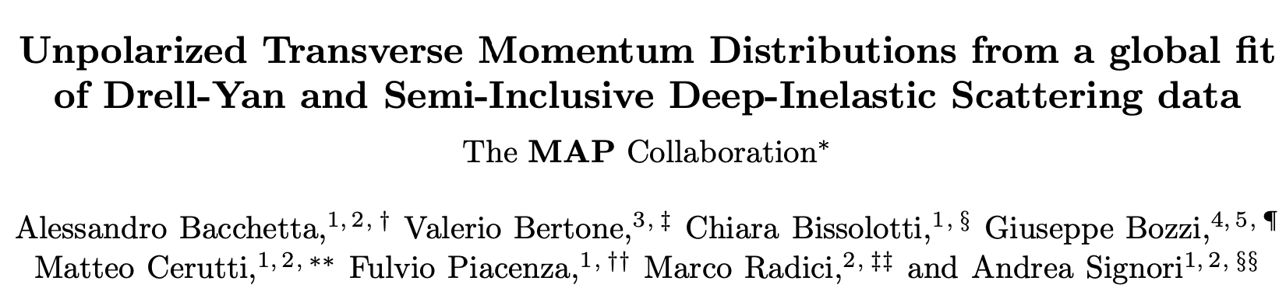
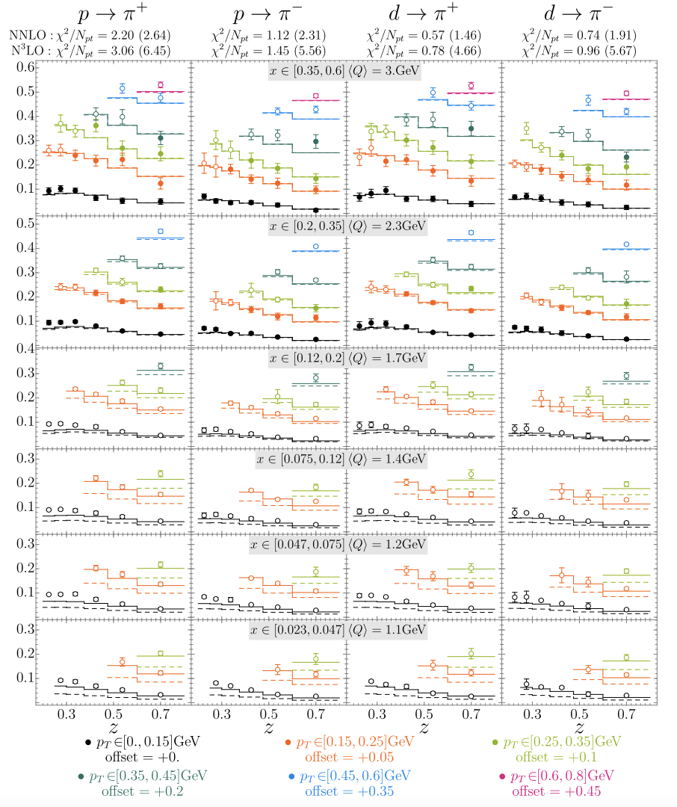
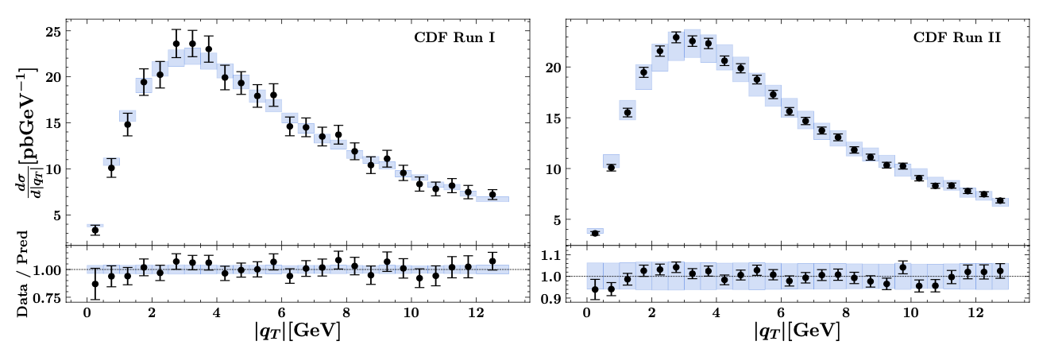
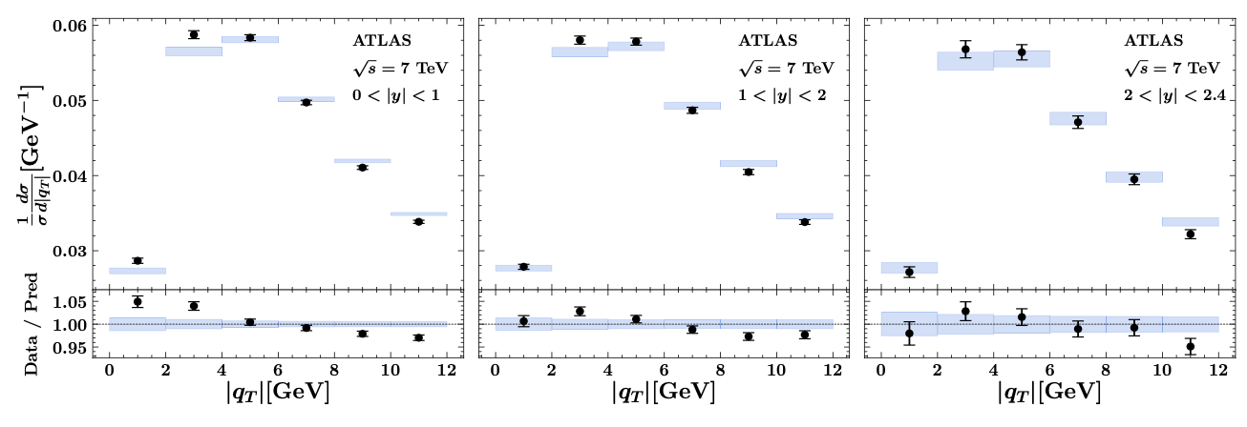
Unpolarized cross sections
Good fit achieved in the “TMD region” (N³LL)
JHEP (2020)
2206.07598
SIDIS
Drell-Yan

Slide 10
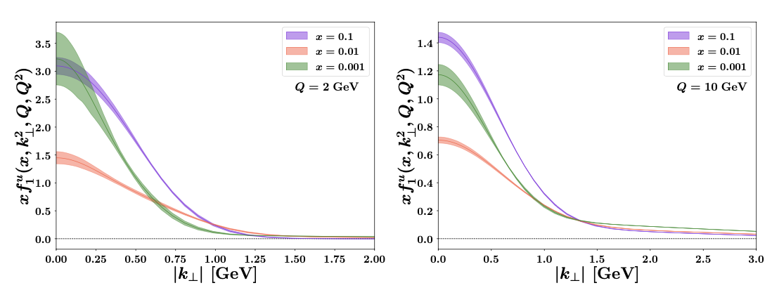

Unpolarized TMDs
Extracted unpolarized TMD PDFs and FFs
Useful tools
2206.07598
2103.09741

Slide 11
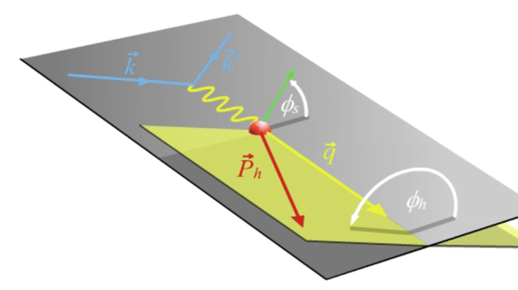
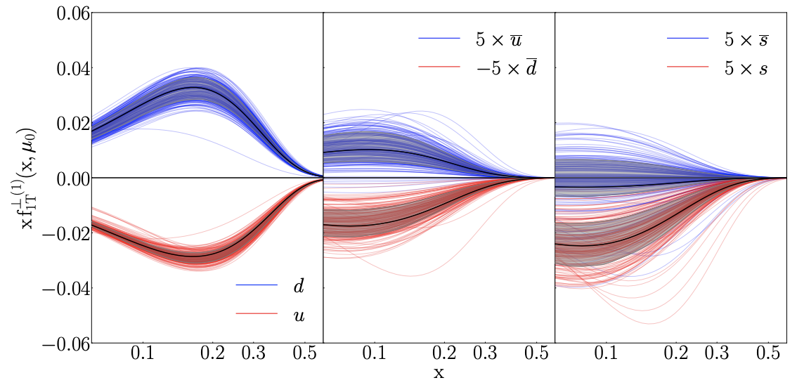
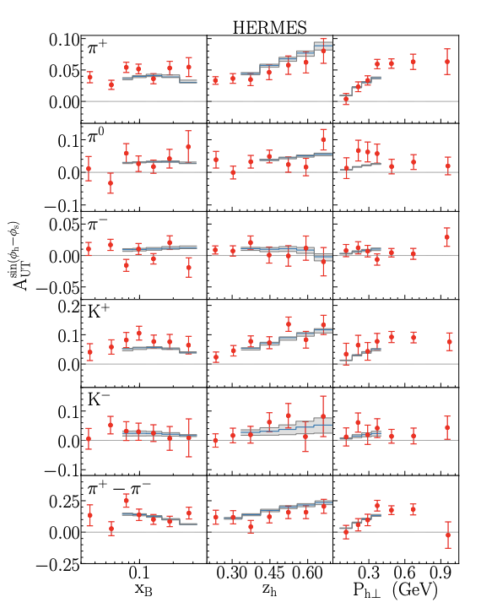
Progress from polarized TMDs
Sivers function
  Data: Jlab 12, HERMES, COMPASS, RHIC W boson
Echevarria, Kang, Terry, JHEP (2021)

Slide 12
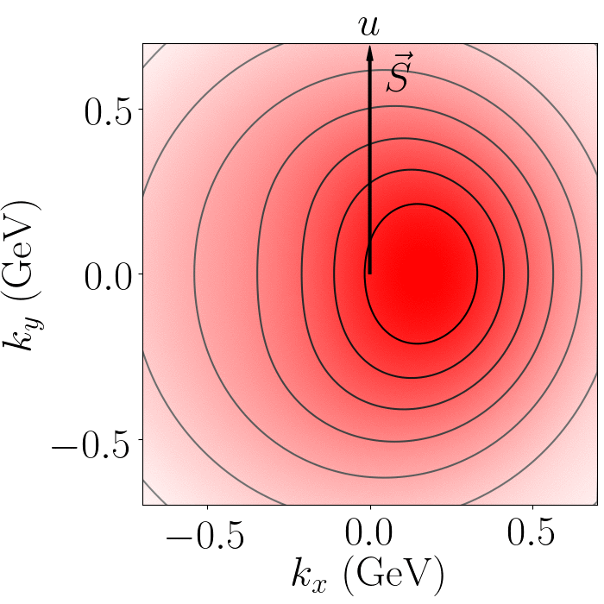
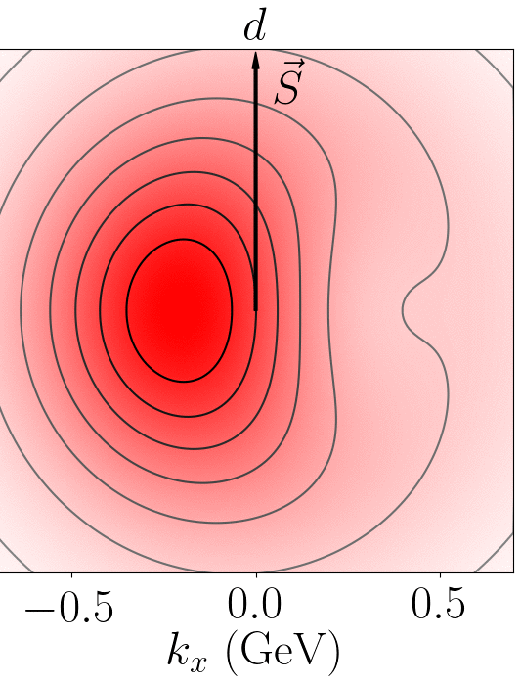
Distorted distribution
Sivers correlation leads to a distortion in u/d quark distribution
  Left or right shift

Slide 13
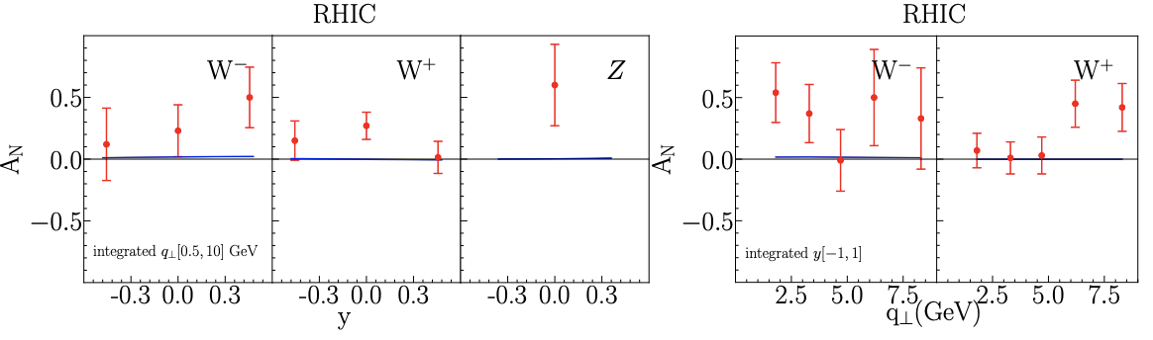
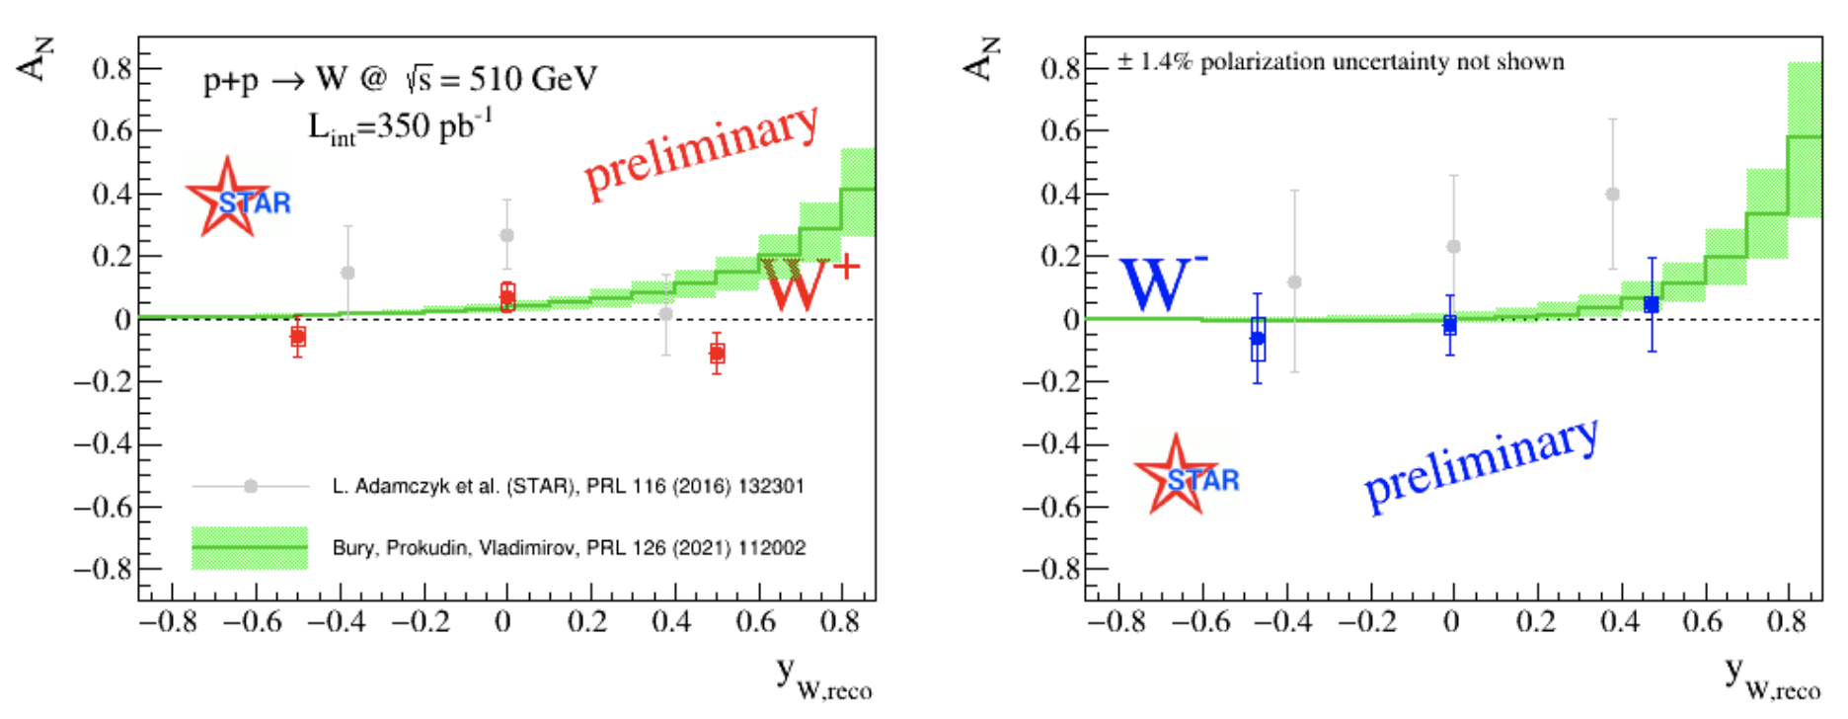
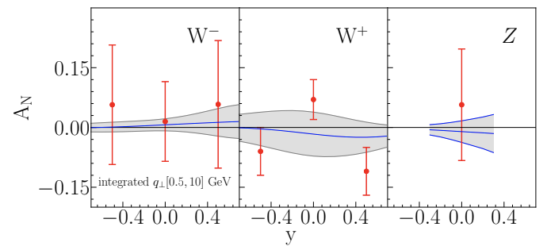
RHIC data: update
Previously, some tension in fitting (2016) RHIC W/Z data (very large asymmetry), but consistent with 2021 preliminary data
  Emphasizing the importance of the precision measurement
OLD data
NEW data
Bury, Vladimirov, Prokudin
Echevarria, Kang, Terry

Slide 14
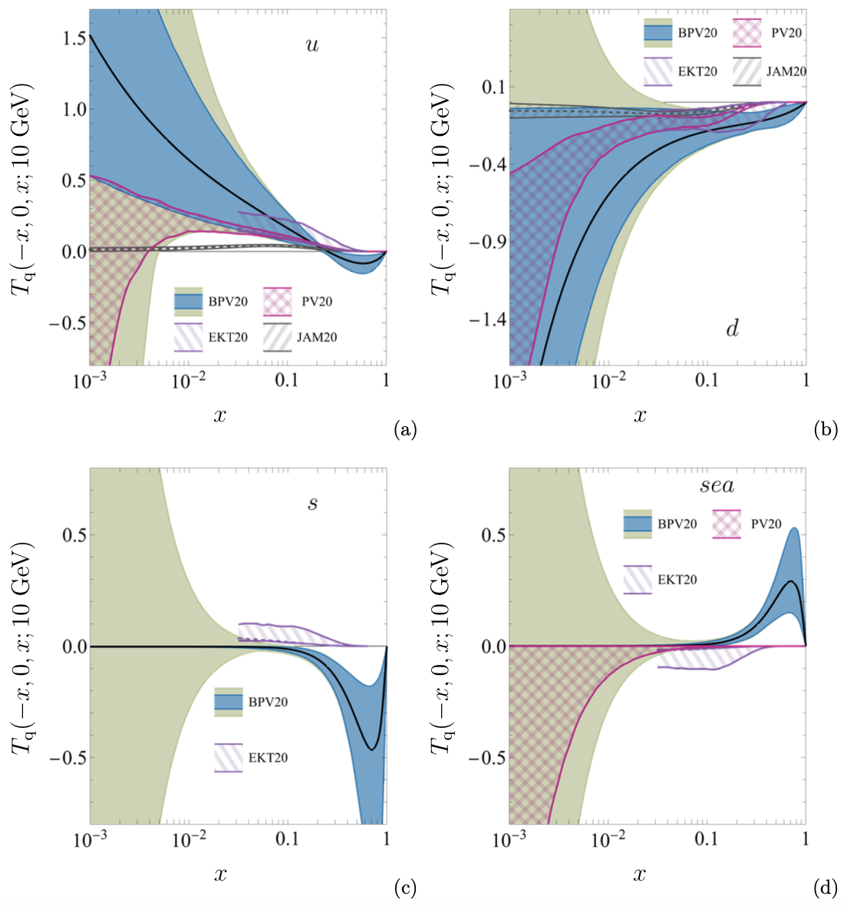

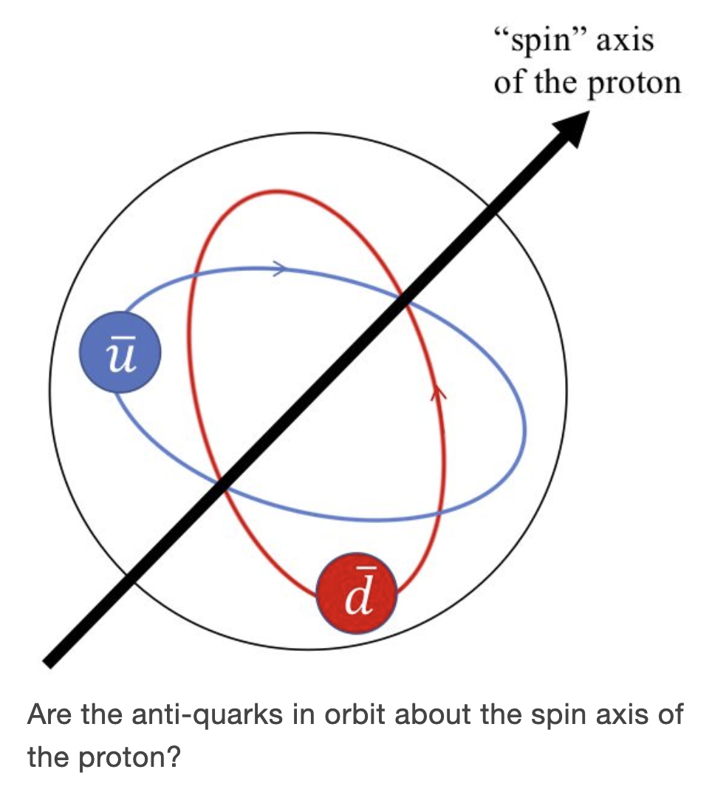
RHIC data: update
Major difference: sea quark in relatively large x region
This is precisely the main goal of SpinQuest/E1039 Drell-Yan experiment at Fermilab is to determine sea quark Sivers functions
Courtesy of A. Prokudin

Slide 15
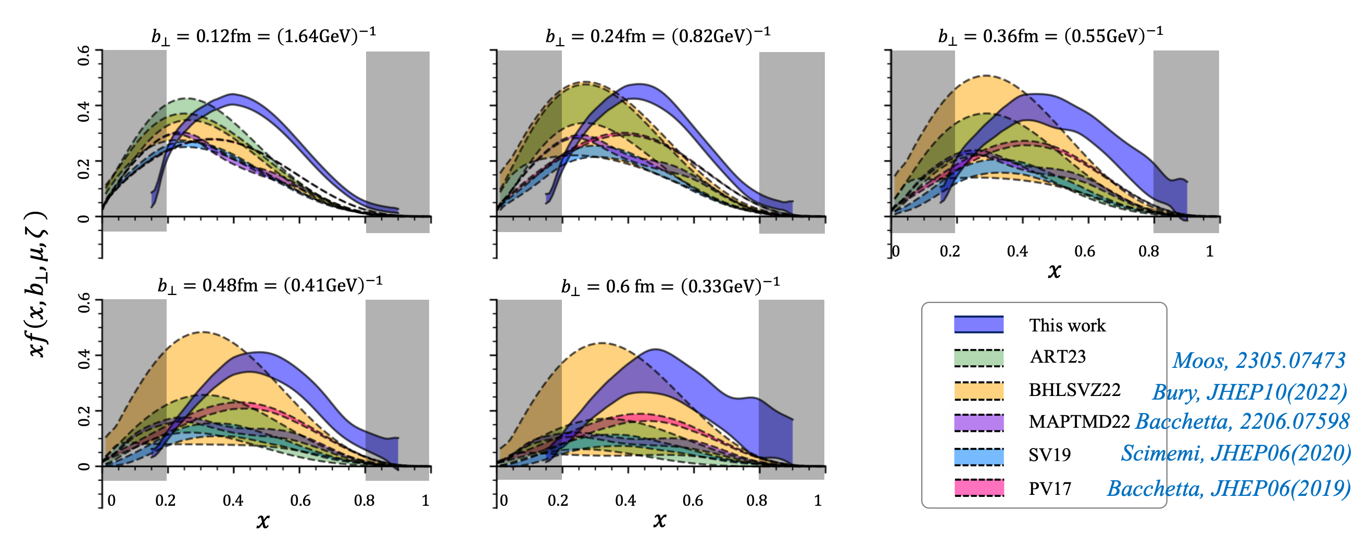
TMDs at threshold limit
Recent lattice computation shows: at large x, the lattice results are significantly different from existing TMD fits
  There might be effects that the existing fit/theory has not taken into account
LPC collaboration, 2211.02340

Slide 16


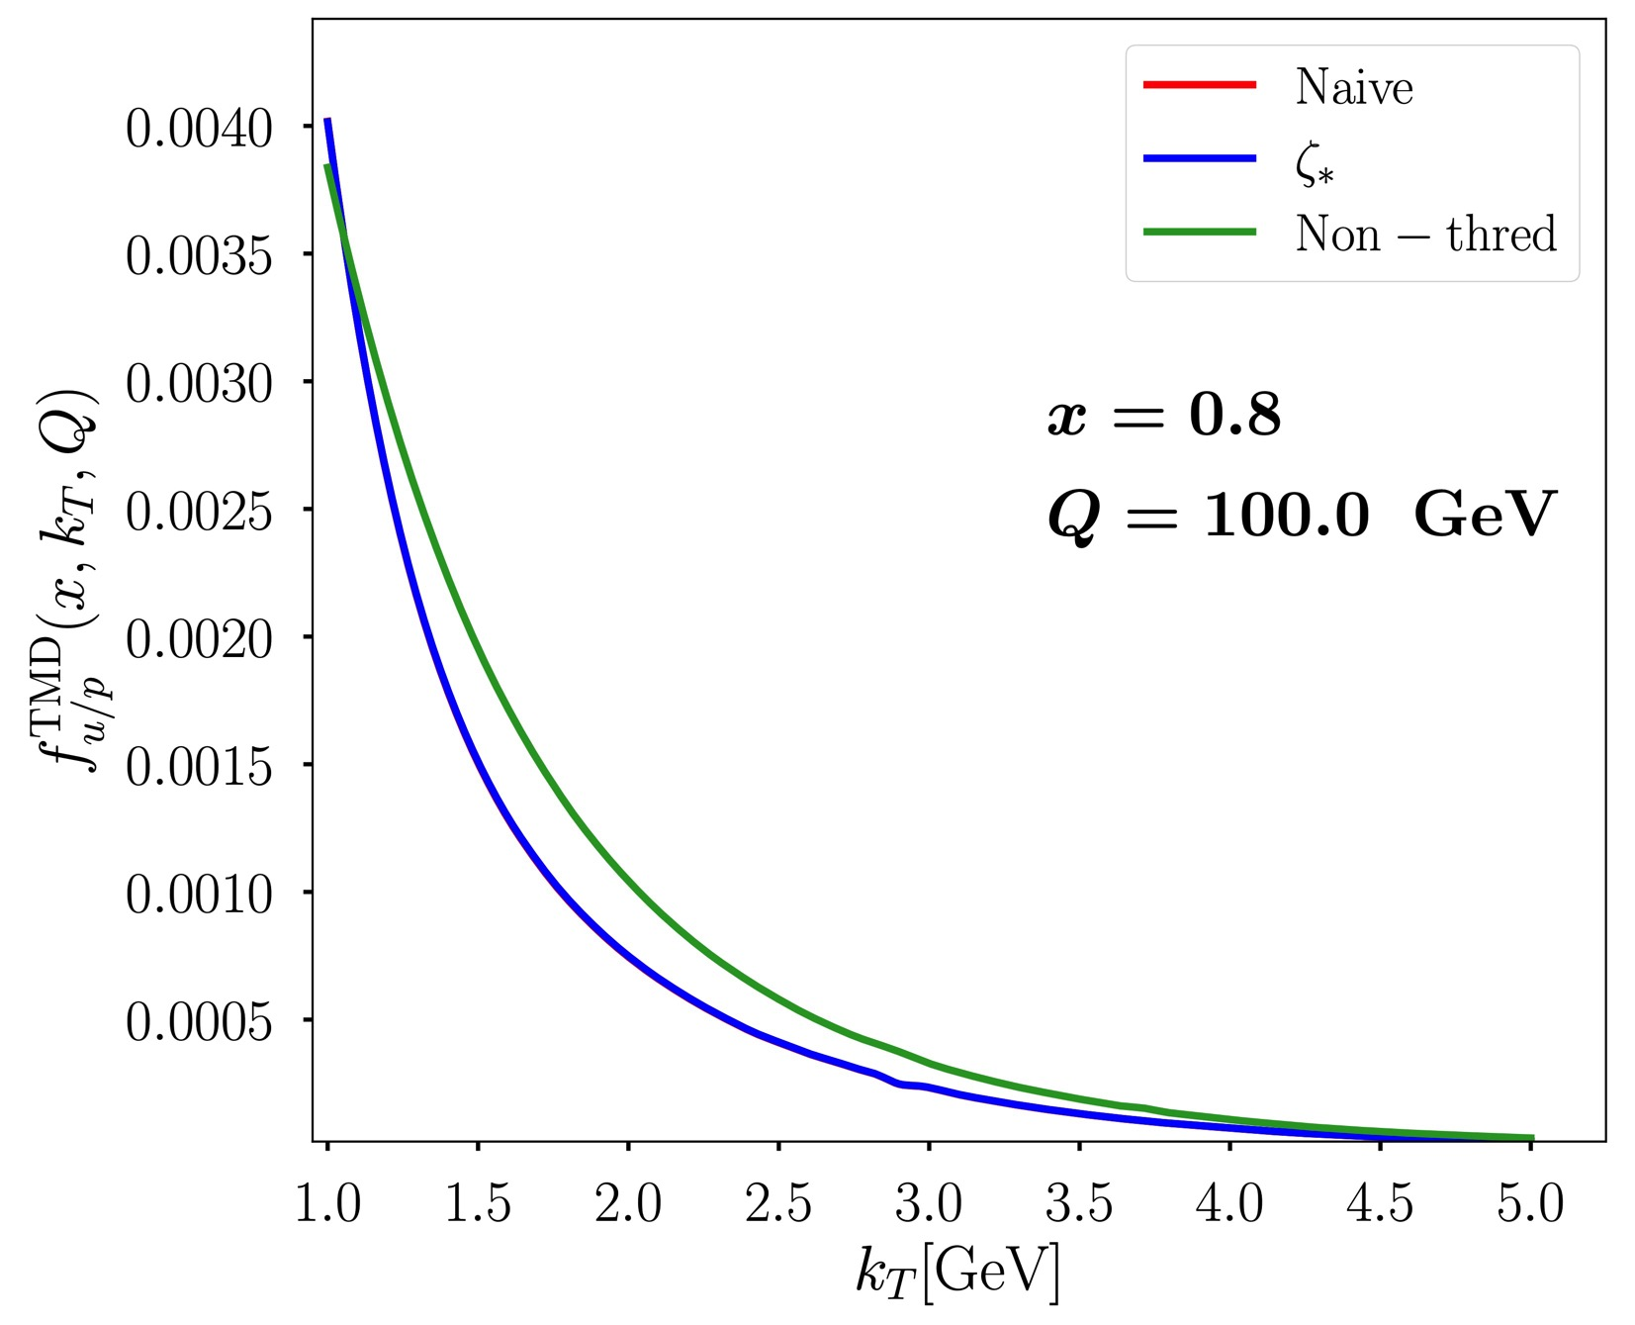
Threshold logs
Threshold logs ln(1-x) arises
  Handle it in Mellin space [becomes ln(N)]
  Find out the usual rapidity log , would become
    Check up to three loops
  Suggests us to replace the usual zeta by zeta/N² in the TMD evolution functions
    This new evolution equation (the replacement) would lead to the joint resummation of both TMD logs and threshold logs
Kang, Samanta, Shao, Zeng, 2211.08341, JHEP 2023

Slide 17


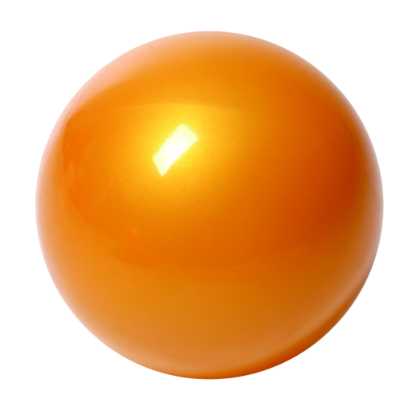
Many more processes
Standard processes: SIDIS, Drell-Yan, e+e-
  One could combine unpolarized + polarized scattering data
  Unpolarized cross section + spin asymmetry data to determine the Collins-Soper evolution kernel, further compare with the lattice data
In principle, one could further include jet production and hadron-in-jet
  e.g. back-to-back dijet production for TMDPDFs
  both unpolarized and polarized hadron distribution inside the jet
h₁
electron
p
p
p
h₂
h
quark

Slide 18
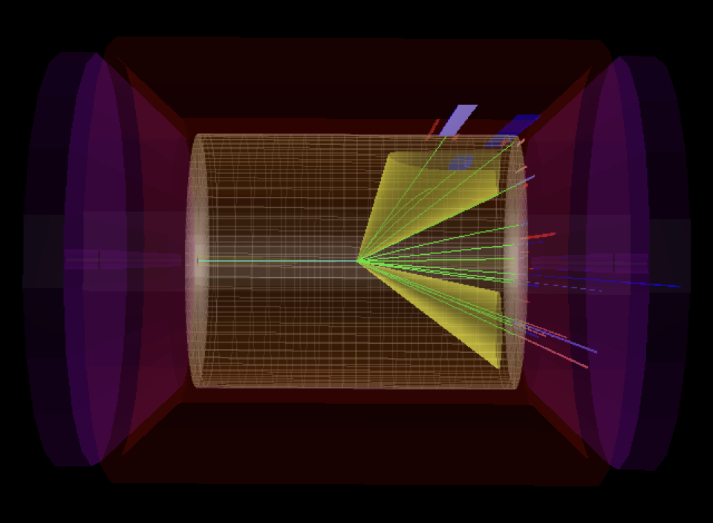
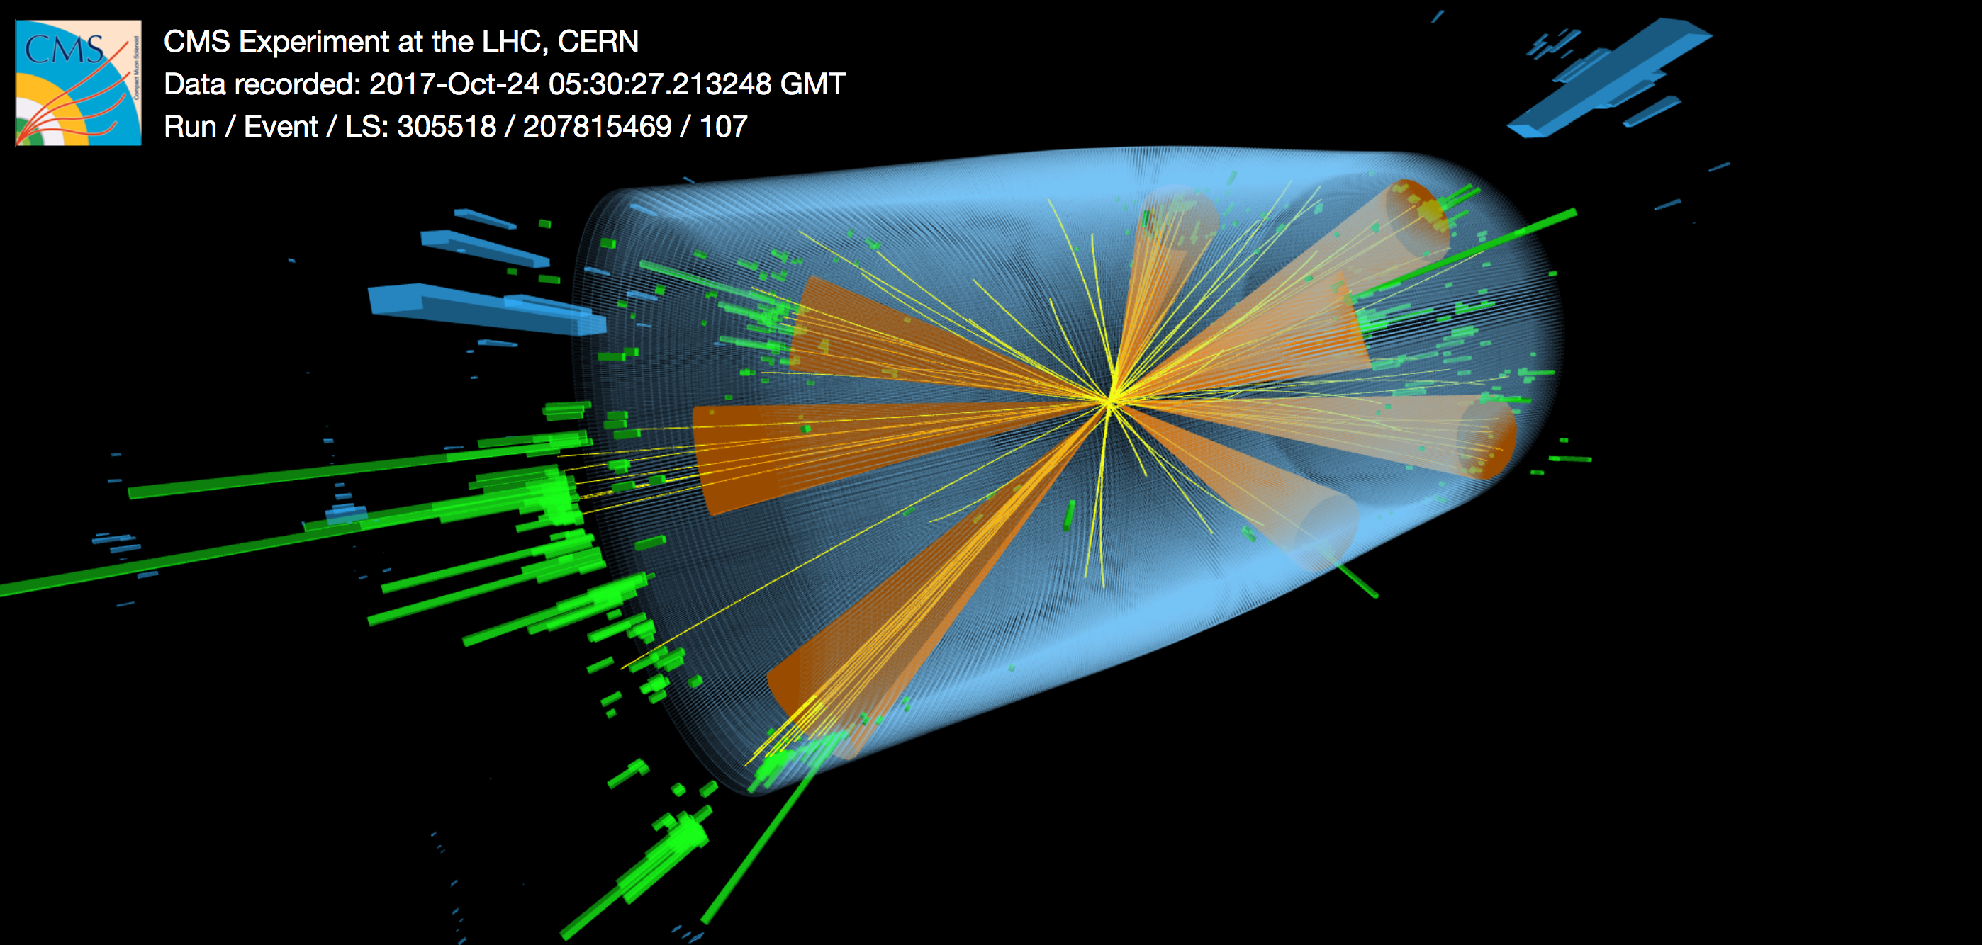
Jets are useful tools for TMD physics
Active study at the RHIC, LHC, and the future EIC
LHC
EIC

Slide 19
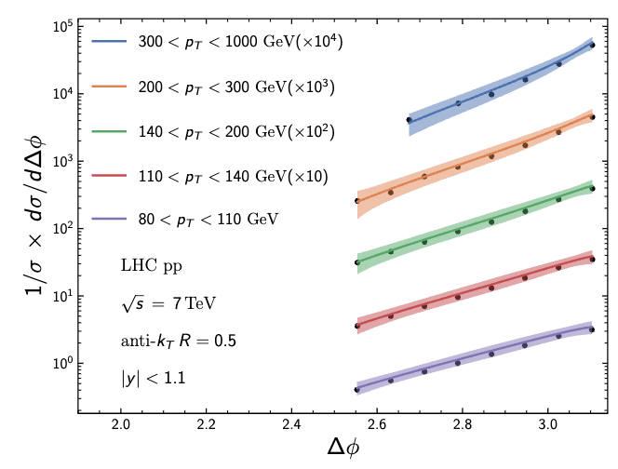
Dijet production: cross section
Take into account soft gluon radiation, and thus include TMD evolution
It seems to be working well with experimental data
  TMD factorization breaking is small?!
Kang, Lee, Shao, Terry, JHEP 2021, Gao, Kang, Shao, Terry, Zhang, JHEP 2023

Slide 20
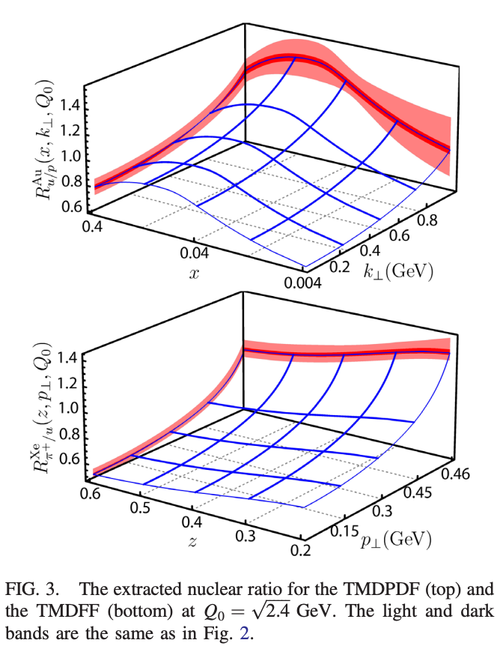
What about p+A collisions
TMD PDFs get modified in nuclear matter
  Modified the non-perturbative collinear PDFs [nuclear PDFs]
  Modified the non-perturbative Sudakov facor [S_{NP}]
Alrashed, Anderle, Kang, Terry, Xing, PRL 2022
Alrashed, Kang, Terry, Xing, Zhang, in preparation 2023

Slide 21
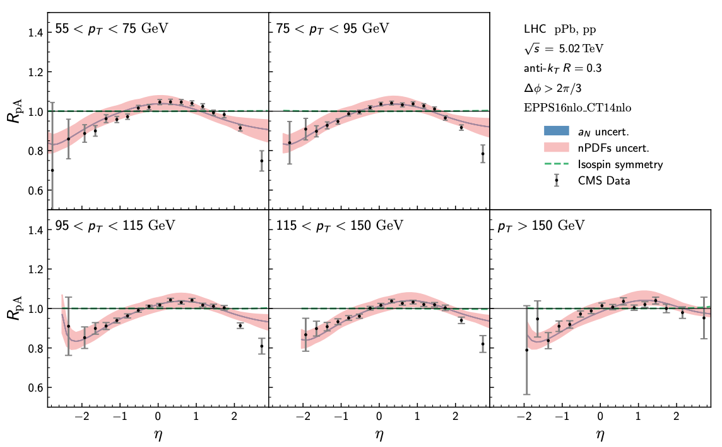
Dijet production in p+A collisions
The modification describes the LHC data well
Gao, Kang, Shao, Terry, Zhang, JHEP 2023

Slide 22
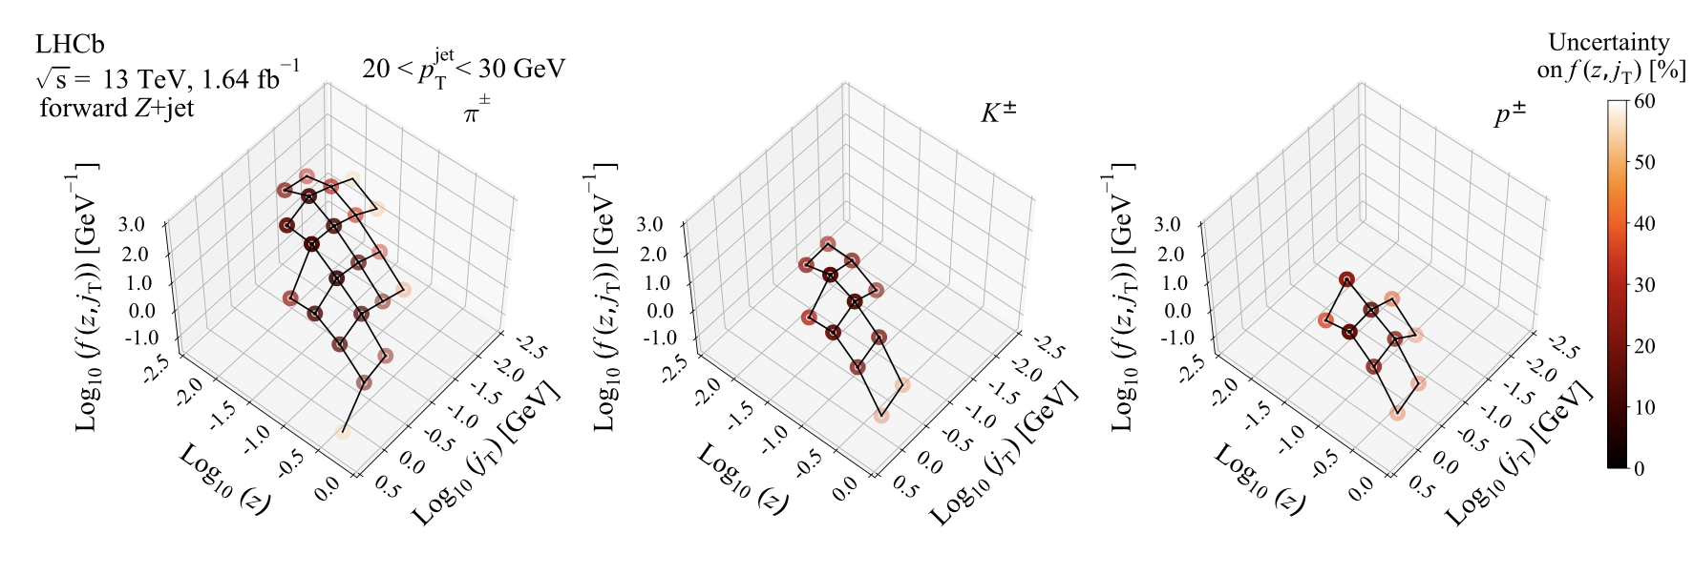
Jet fragmentation function at LHC
LHCb measurement Z-tagged jet production in pp collisions
LHCb, 2208.11691

Slide 23
Comparison with Z-tagged jets
Charged hadrons inside the jets
Kang, Xing, Zhao, Zhou, arXiv:2311.xxxxx

Slide 24
Nuclear modification of jet fragmentation
Distribution of hadron in jets: back-to-back Z+jet production in p+A collisions

Slide 25
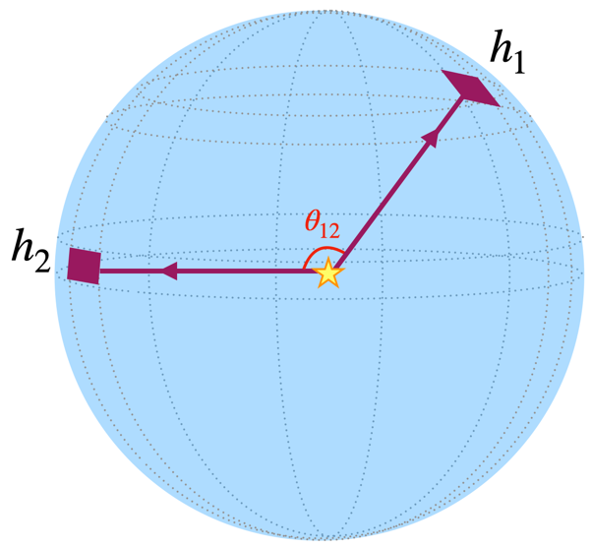
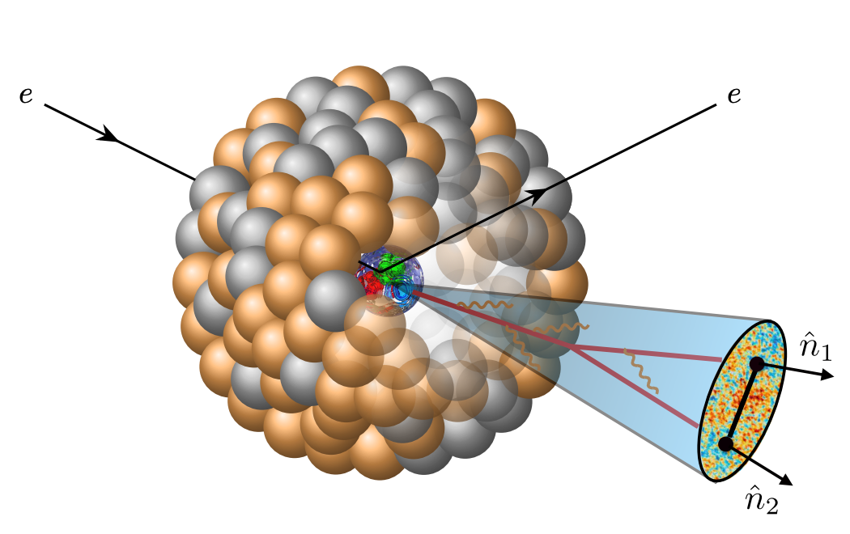
Energy Energy Correlator
Two types
  Global EEC
    One of the earliest infrared safe event shape observables
    Measure energy correlation as a function of the opening angle between pairs of particles
  Local EEC
    In-jet EEC: measure energy correlations for particles inside the jet

Slide 26
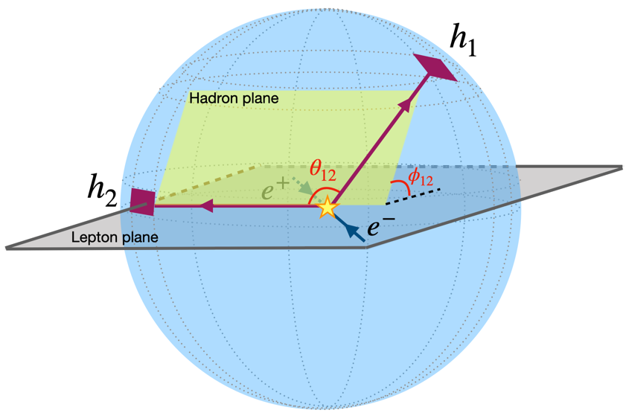
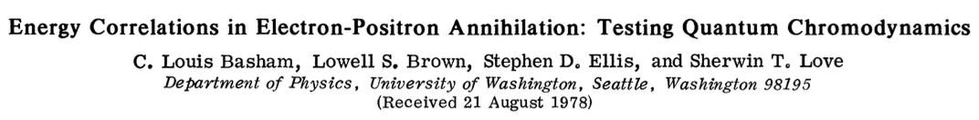
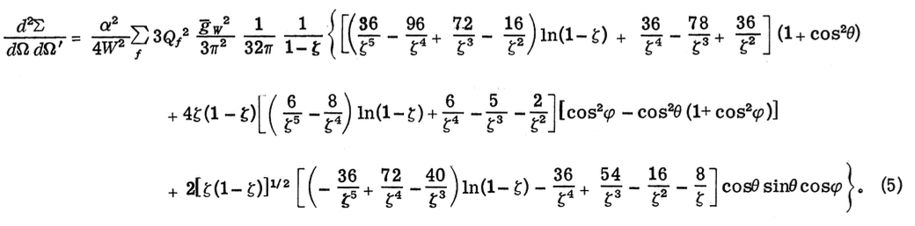
Azimuthal angle dependence of the EEC
Azimuthal angle dependence of EEC would allow us to probe TMD structure
  Azimuthal dependence is in the original paper, but forgotten afterwards
Kang, Lee, Shao, Zhao, 2310.15159

Slide 27
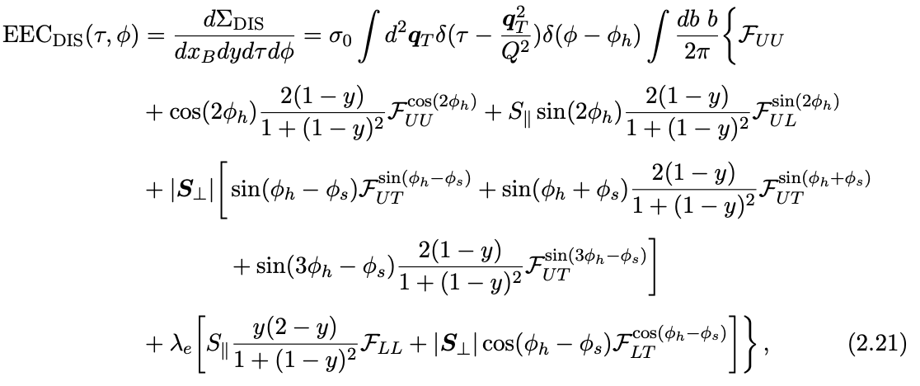
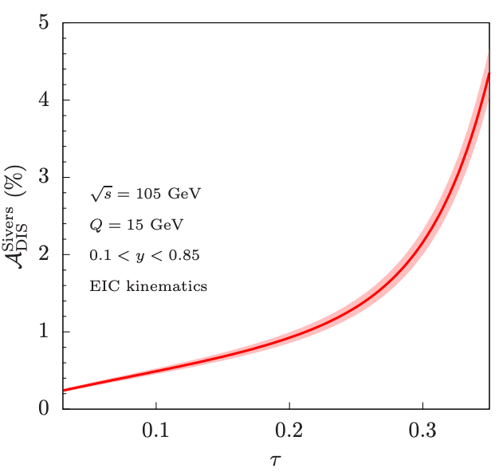
Azimuthal angle dependence of the EEC
EEC in DIS now can probe all unpolarized and polarized TMDs
Kang, Lee, Shao, Zhao, 2310.15159

Slide 28
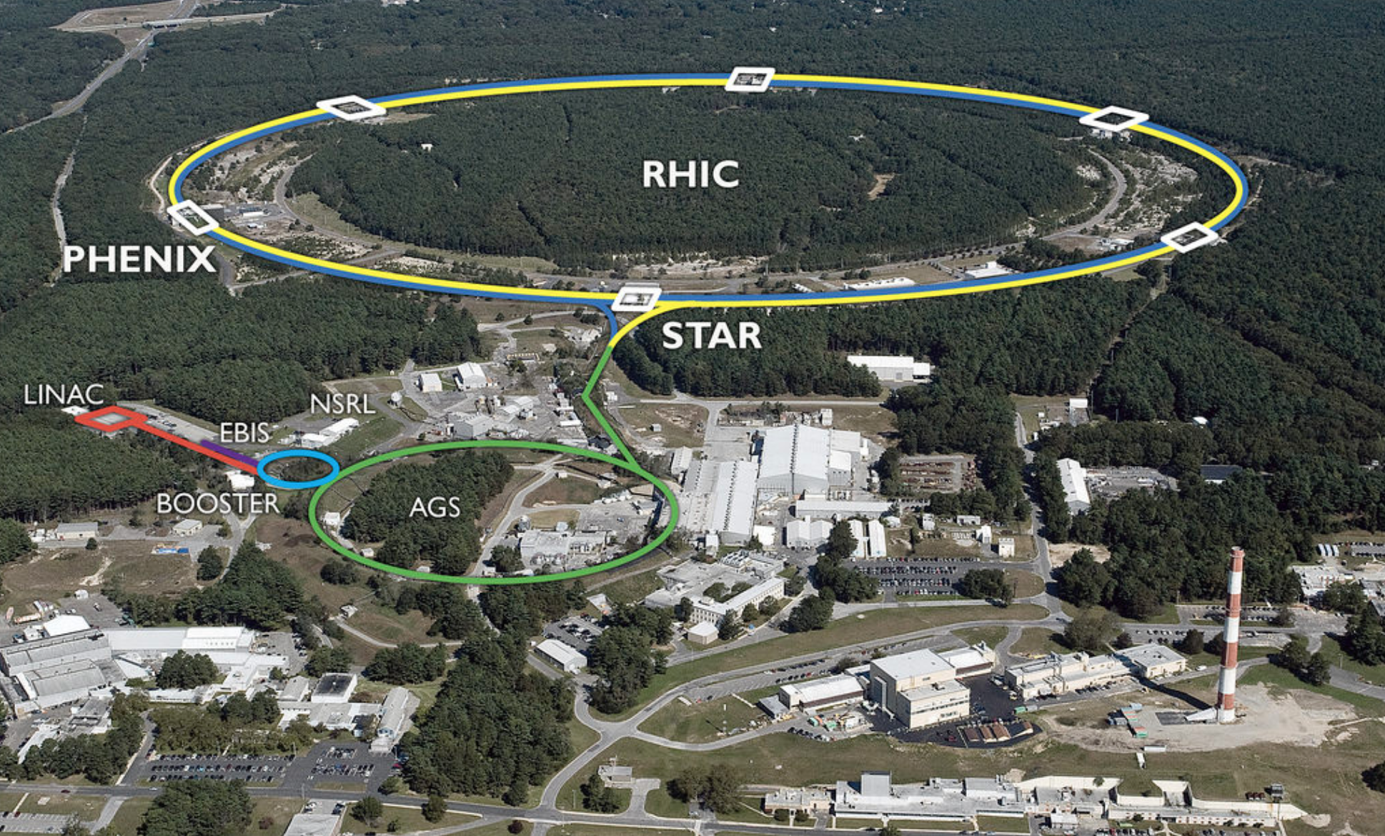
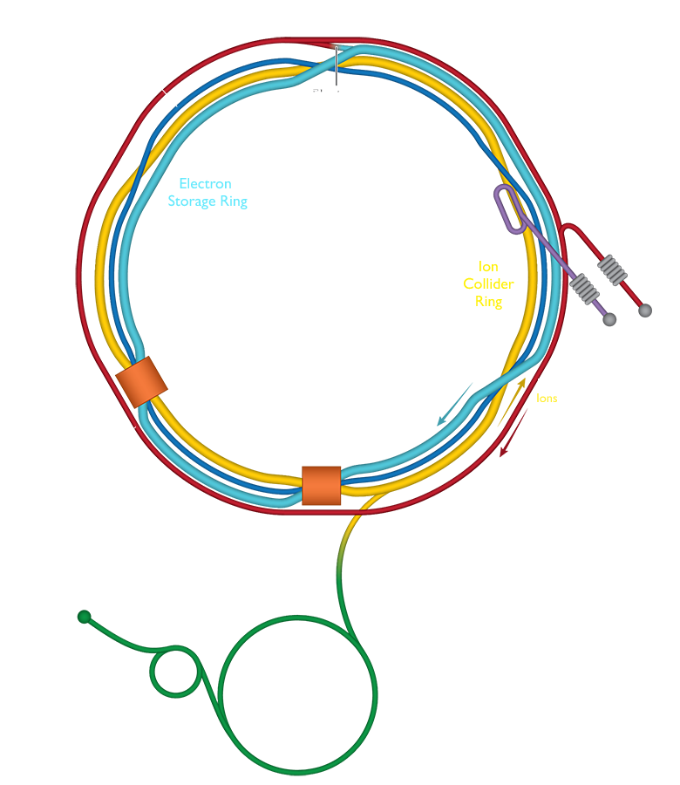

Summary
Great progress has been made for TMD structure of the proton
Current: HERMES, COMPASS, Jlab 12, HERA, RHIC spin, and LHC provide great experimental measurements for TMD physics
A lot of avenues for studying TMDs
  In-jet TMDs
  Azimuthal dependent EEC
  Threshold TMDs, Nuclear TMDs, …
Thank you!

