Slide 1

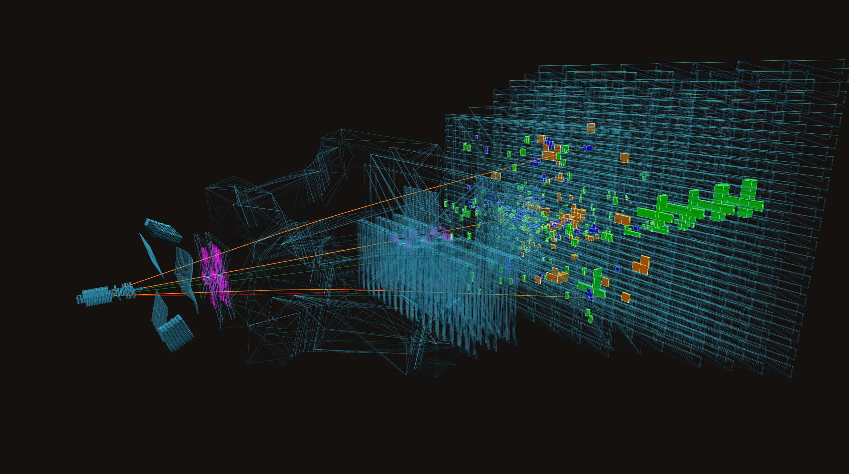


Open Heavy Flavor Highlights from LHCb
Julie Napora
On behalf of the LHCb Collaboration
jlnelson@lanl.gov
2nd Workshop on Advancing the Understanding of Non-Perturbative QCD Using Energy Flow

Slide 2
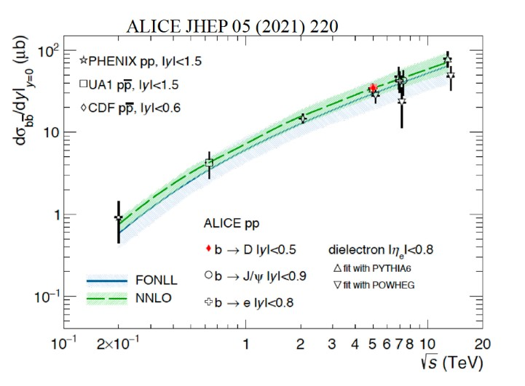

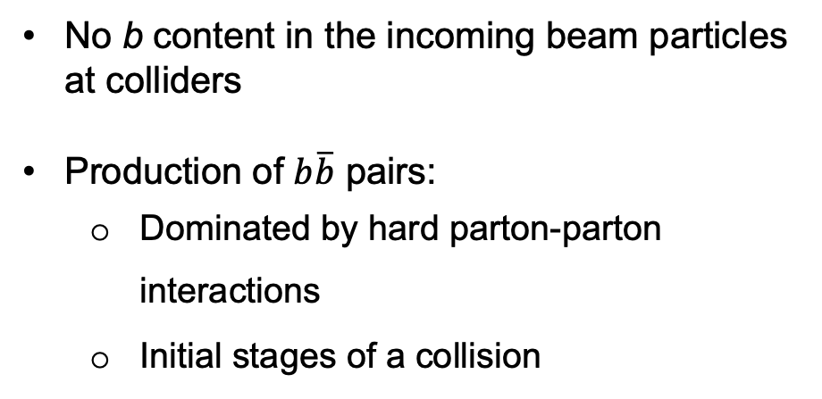
What we know
$$b\overline{b}$$
No b content in the incoming beam particles at colliders
Production of $b\overline{b}$ pairs:
  Dominated by hard parton-parton interactions
  Initial stages of a collision
Cross-sections are well described by theory calculations
We can use b quarks produced perturbatively to probe the non-perturbative hadronization process
2nd Workshop on Advancing the Understanding of Non-Perturbative QCD Using Energy Flow
Notes:
bbar pairs have been studied extensively and we know quite a bit about them. We know there is no
Production of $b\overline{b}$ pairs at large hadron colliders

Slide 3
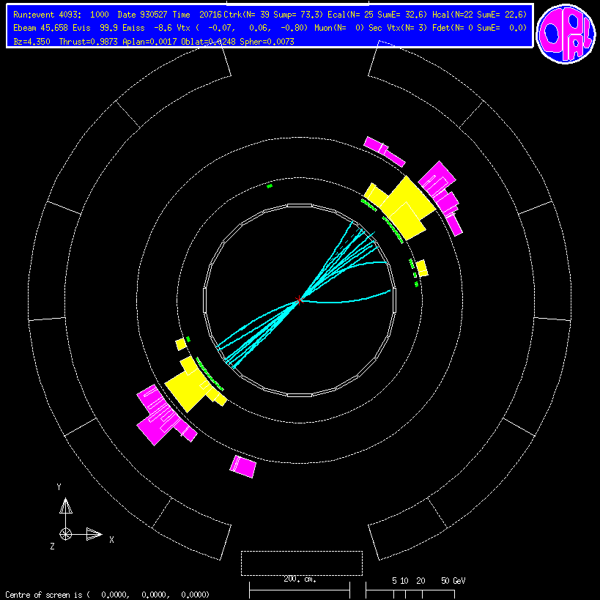




Quark confinement
LEP event display
$$q$$
Models of fragmentation are tuned precisely to data from $e^{+}e^{−}$ collisions
$${ e}^{+}$$
$${ e}^{−}$$
These models FAIL to describe particle production in proton+proton, proton+nucleus, and nucleus+nucleus collisions
$$\overline{q}$$
Quarks that overlap in position/velocity space to form color neutral hadrons
Fragmentation in vacuum
ALICE event display
Signature is enhanced baryon production (3 quark hadrons)
p
p
Alternative hadronization mechanism: coalescence
2nd Workshop on Advancing the Understanding of Non-Perturbative QCD Using Energy Flow
Notes:
The defining feature of QCD is that quarks and gluons cannot be observed freely due to color confinement.
In fragmentation, highly energetic quark pairs move away from until it becomes more energetically favorable to produce a quark out of vacuum to maintain color charge.
Which begs the question, is there an alternative hadronization mechanism at play in these cases? If you direct your attention to the plot on the bottom right, you will see that as we go from pp to heavy-ion collisions, the showers of particles produced becomes more dense, which is where we expect to see coalescence.

Slide 4
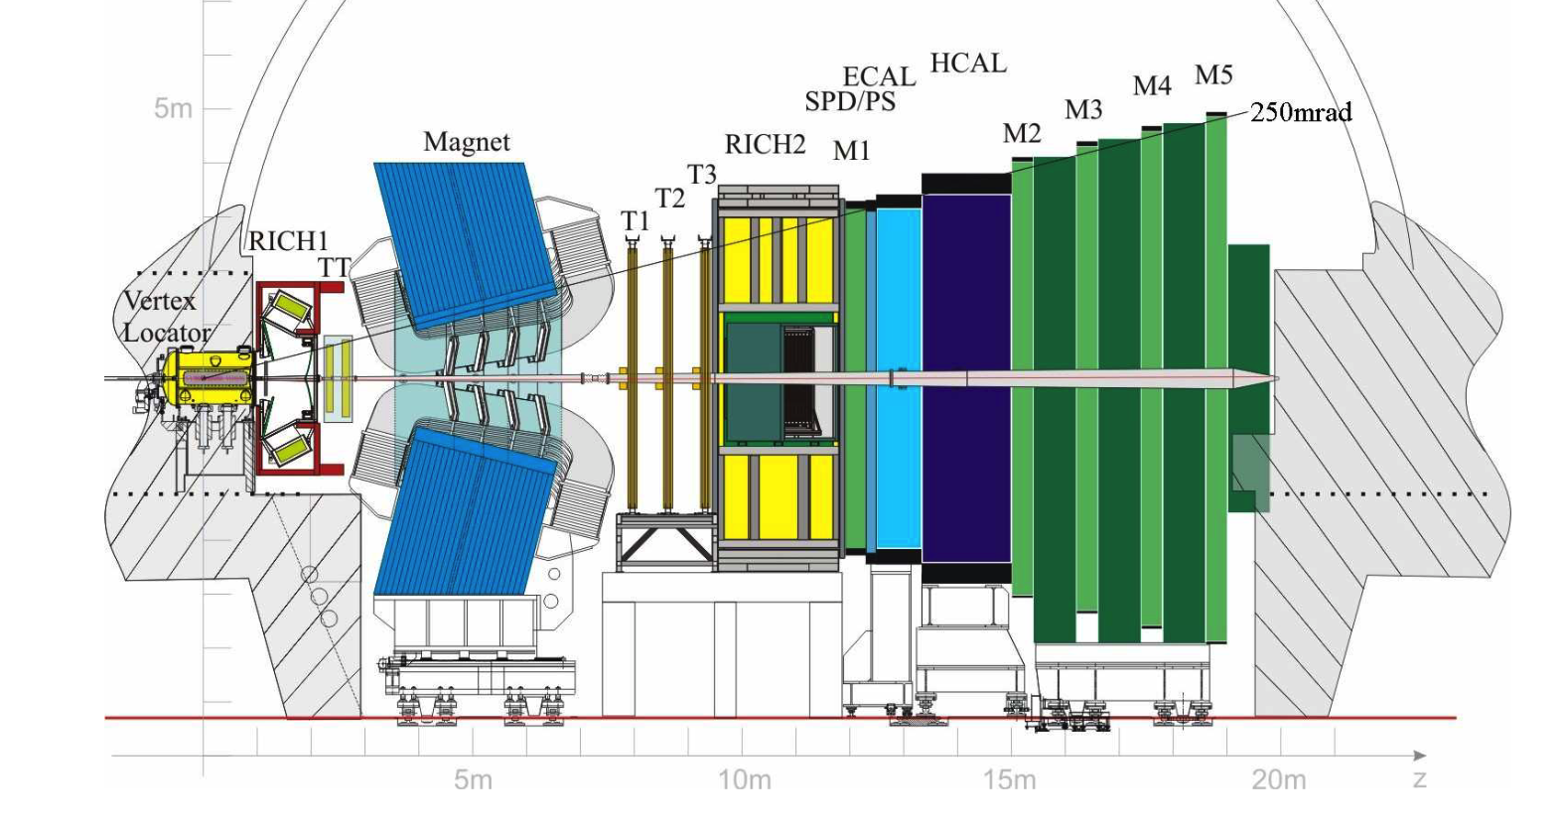
The Large Hadron Collider bottom (LHCb)
The LHCb Detector: Full tracking, particle identification, hadronic and electromagnetic calorimetry and muon ID in 2 < η < 5
Precision vertexing
Fast DAQ at forward rapidity
Fixed target
  p beams
  Pb beams
p_{T} > 0
LHCb has unique access to large sets of b baryons and mesons at low p_{T}
JINST 3 (2008) S08005
2nd Workshop on Advancing the Understanding of Non-Perturbative QCD Using Energy Flow
Notes:
The LHCb detector is uniquely well suited to study the hadronization of heavy quarks. With full particle ID, precision vertexing, and a high rate DAQ, the LHCb allows large samples of heavy quark decays to be recorded.

Slide 5
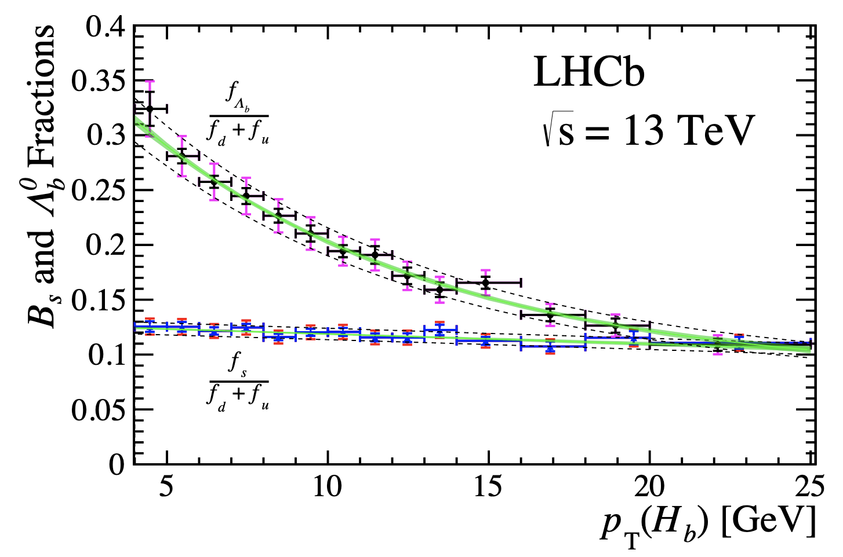
p
p
Bottom baryons at LHCb
LHCb-PAPER-2018-050, PRD 100 031102 (2019)
The very heavy b quarks move slowly at
low p_{T}
  Slower velocity
  Larger wavelength
  Greater overlap with bulk particles
Should be especially sensitive to coalescence
  Fragmentation in supressed
Previous LHCb measurements show dramatic variation of bottom baryon/meson ratio with p_{T}
Behavior is not explained by fragmentation alone!
2nd Workshop on Advancing the Understanding of Non-Perturbative QCD Using Energy Flow
Notes:
Small collision systems

Slide 6
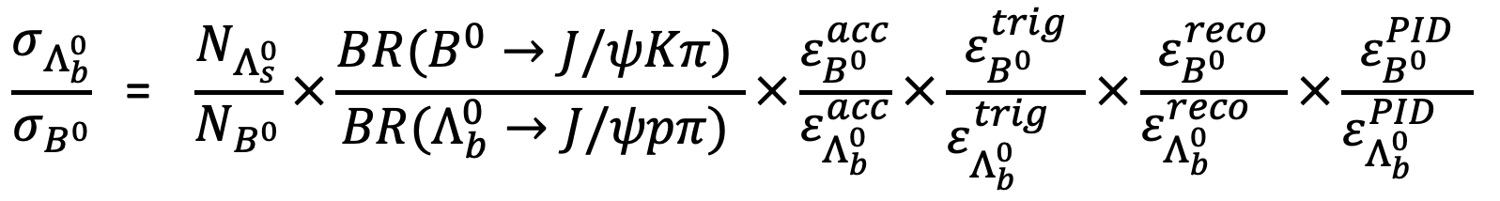
p
p
B baryon measurement
$$\frac{σ_{Λ_{b}^{0}}}{σ_{B^{0}}}\text{ = } \frac{N_{Λ_{s}^{0}}}{N_{B^{0}}}×\frac{BR(B^{0}→J/ψKπ) }{BR(Λ_{b}^{0}→J/ψpπ) }×\frac{ε_{B^{0}}^{acc}}{ε_{Λ_{b}^{0}}^{acc}}×\frac{ε_{B^{0}}^{trig}}{ε_{Λ_{b}^{0}}^{trig} }×\frac{ε_{B^{0}}^{reco}}{ε_{Λ_{b}^{0}}^{reco} }×\frac{ε_{B^{0}}^{PID}}{ε_{Λ_{b}^{0}}^{PID} }$$
Physics quantity of interest
Counts extracted by fitting mass spectra in multiplicity bins
Branching fractions from PDG
Efficiency calculations largely canceled out
2nd Workshop on Advancing the Understanding of Non-Perturbative QCD Using Energy Flow
Notes:
Final states mumupik and pk. Chosen specifically due to their similar decay

Slide 7
p
p
B baryon enhancement
arXiv:2310.12278
Hadronic decays show strong dependence on p_{T}
Experimental data agrees with pp data measured using semileptonic decays
Data agrees with pPb (within large uncertainties)
New!
Data agrees more with Relativistic Quark Model input to Statistical Hadronization Model calculations
  Could indicate there are additional baryons awaiting discovery
PRD 99 052011
PRD 100 031102(R)
arXiv:2209.13419 (He and Rapp)
2nd Workshop on Advancing the Understanding of Non-Perturbative QCD Using Energy Flow

Slide 8
B baryon enhancement
arXiv:2310.12278
arXiv:2310.12278
u
b
New!
New!
d
b
d
Expected in scenario where b quarks coalesce with light quarks to form baryons
Pure fragmentation limit is achieved
All multiplicity bins converge to LEP result at high p_{T}
High p_{T} b quarks do not overlap with other quarks and fragment in vacuum, like in $e^{+}e^{−}$
2nd Workshop on Advancing the Understanding of Non-Perturbative QCD Using Energy Flow
Notes:
Characterize our events using the VELO which is a silicon detector that measures charged particle multiplicity
Recover these fra
Here we are using the tracks reconstructed in the VELO detector, not the fully corrected physics quantity, dN/dy

Slide 9
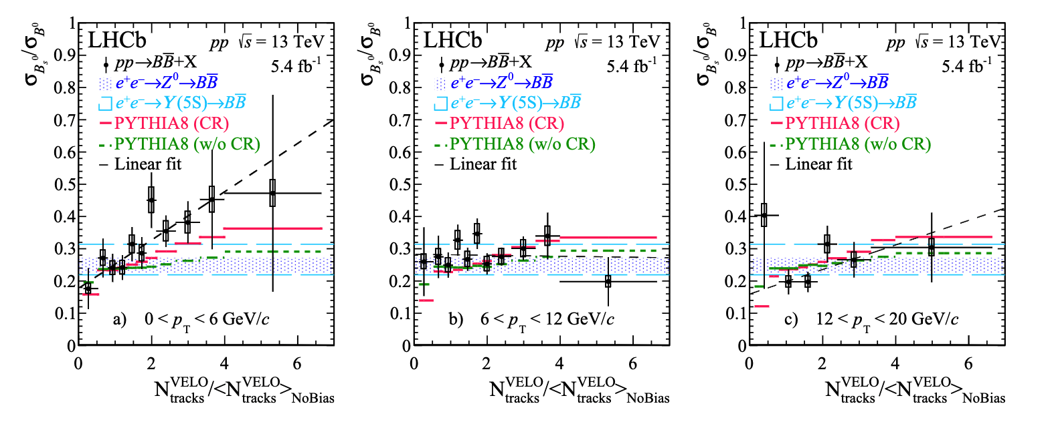

Strangeness enhancement
p
p
b
$$s$$
b
d
  Enhancement emerges with increasing particle density at lowest p_{T}
  Data is consistent with $e^{+}e^{−}$ value at very low multiplicity and high p_{T}
PRL 131 061901 (2023)
$e^{+}e^{−}→Z^{0} \& Υ(5S)→b\overline{b}$ shows fragmentation is universal!!
2nd Workshop on Advancing the Understanding of Non-Perturbative QCD Using Energy Flow
Notes:
If hadronization via coalescence emerges as a mechanism for forming final state $B$ hadrons, then the production rate of $B_{s}^{0}$ hadrons could increase relative to the production of $B^{0}$ hadrons as particle multiplicity increases at low $p_{T}$. Figure 1 shows the measured ratio of $B_{s}^{0} {\text{to} B}^{0}$ cross sections, $σ_{B_{s}^{0}}$/ $σ_{B_{}^{0}},$ as a function of charged particle multiplicity and $p_{T}$ along with the values from $e^{+}e^{−}$ collisions and PYTHIA8 calculations.
The fragmentation fractions measured at different e+e- colliders are all the same,

Slide 10
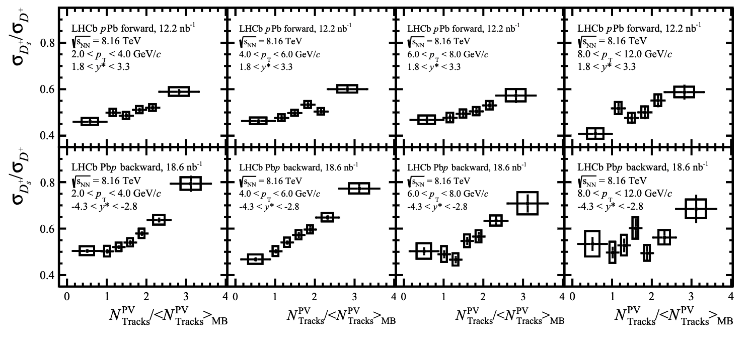
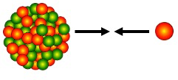
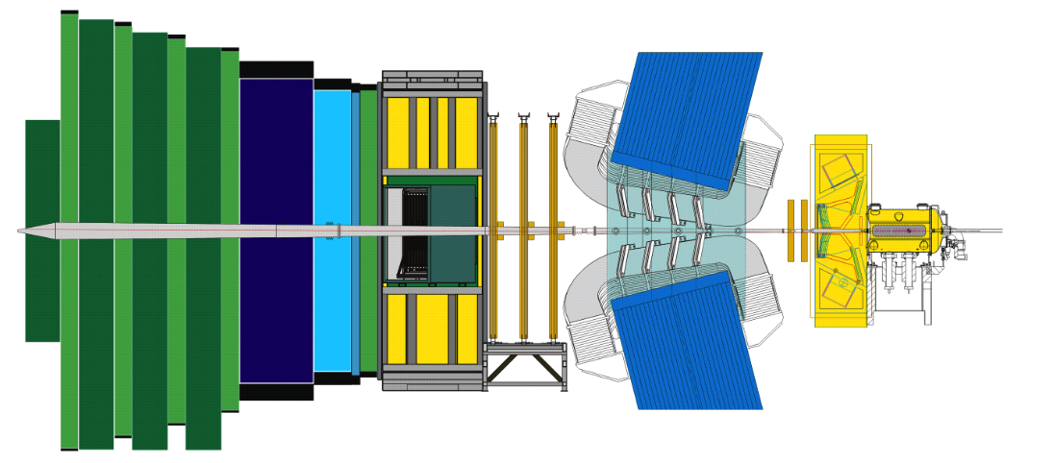
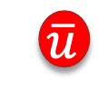

Strangeness enhancement in charm
LHCb-PAPER-2023-021-002
Pb
p
c
preliminary
$$\overline{s}$$
c
Pb
$$\overline{u}$$
p
  Low p_{T} regime shows greater enhancement of strangeness
  Enhancement with increasing particle density in heavy-ion collisions
  Greater enhancement in the denser hadronic environment (Pbp)
2nd Workshop on Advancing the Understanding of Non-Perturbative QCD Using Energy Flow
Notes:
Enhancement of charm is more pronounced at negative rapidity

Slide 11
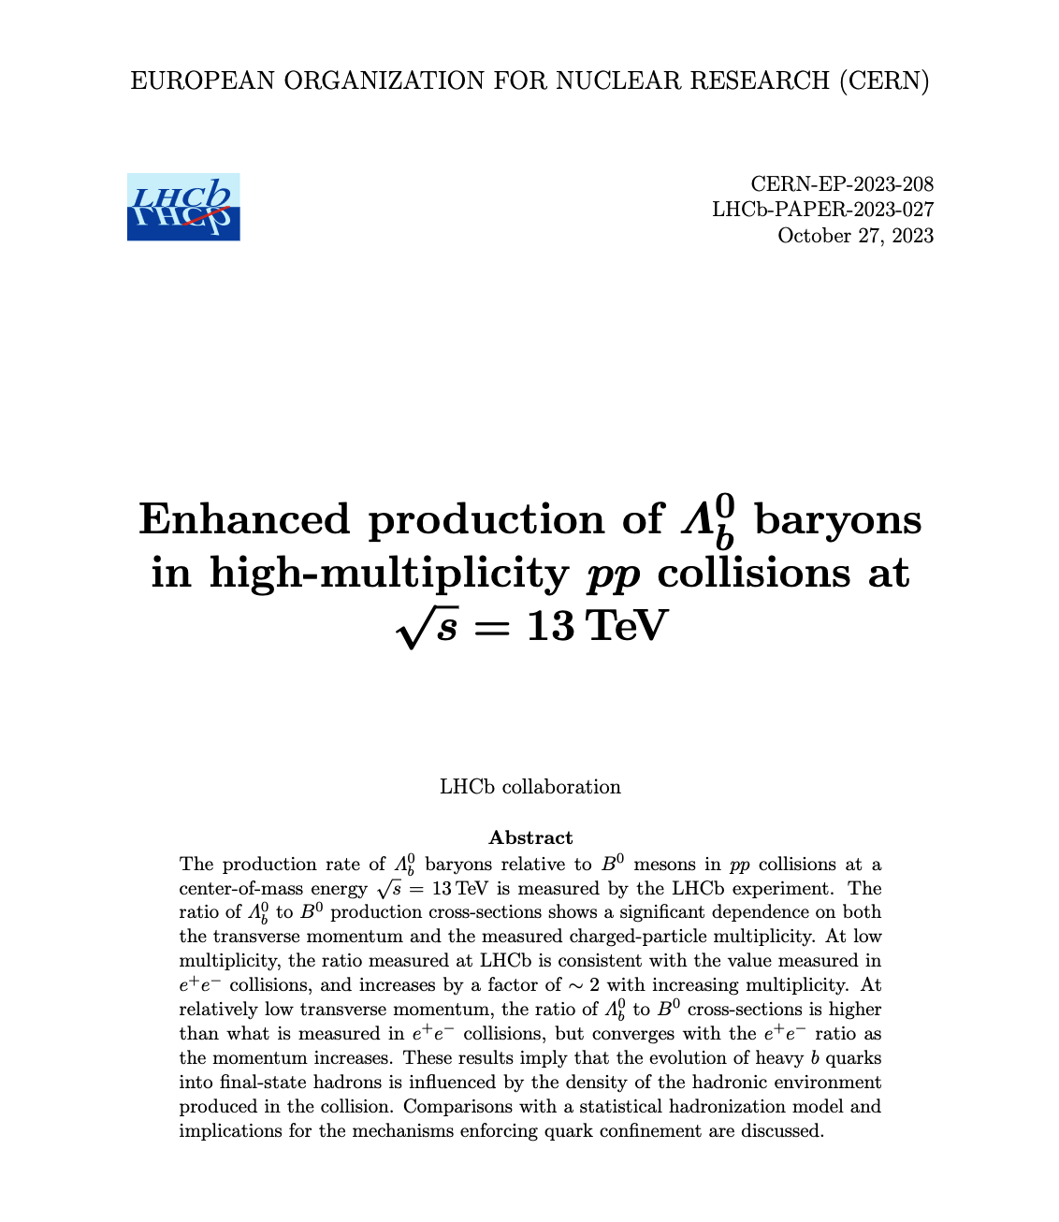

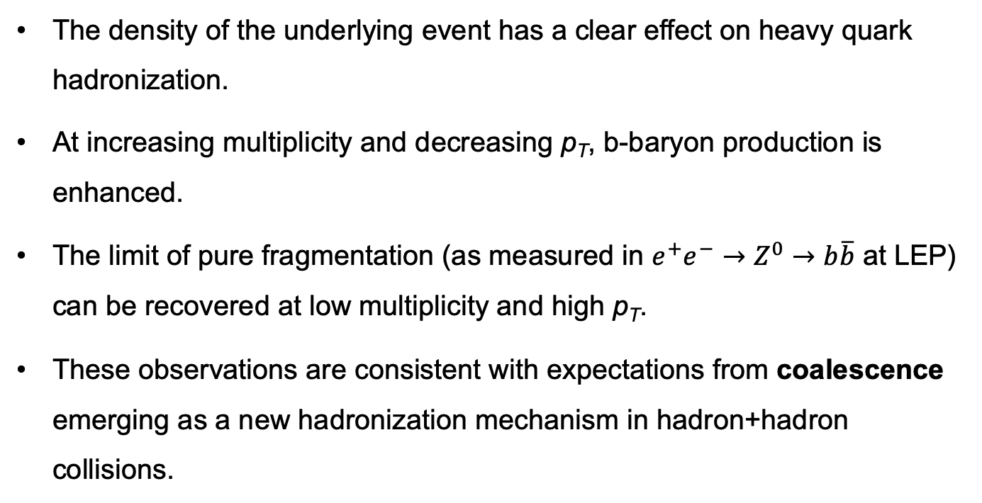
Summary
The density of the underlying event has a clear effect on heavy quark hadronization.
At increasing multiplicity and decreasing p_{T}, b-baryon production is enhanced.
The limit of pure fragmentation (as measured in $e^{+}e^{−}→Z^{0}→b\overline{b}$ at LEP) can be recovered at low multiplicity and high p_{T}.
These observations are consistent with expectations from coalescence emerging as a new hadronization mechanism in hadron+hadron collisions.
Submitted to Physical Review Letters!
At the LHC, we have shown that the density of the hadronic medium affects hadronization in pp and it will be interesting to see how the nucleus affects the hadronization process at EIC!!
Los Alamos National Laboratory is supported by the DOE/Office of Science/Nuclear Physics
Notes:
Tie to EIC –LHC pp collisions we have shown that the density of the hadron medium affects hadronization
It will be interesting to see how the nucleus affects the hadronization process

Slide 12
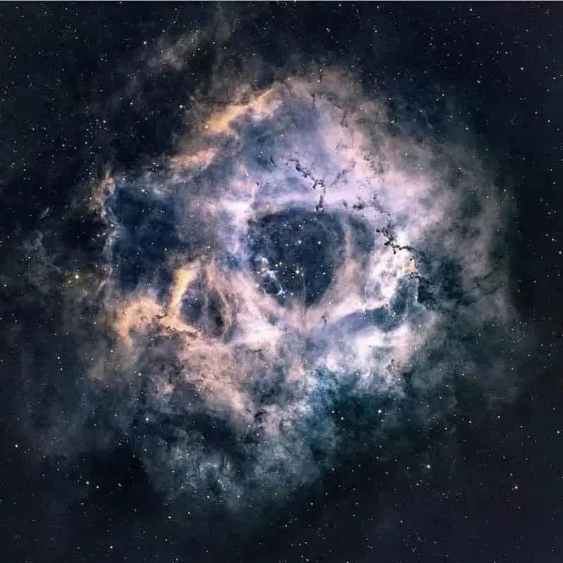
Back up

Slide 13
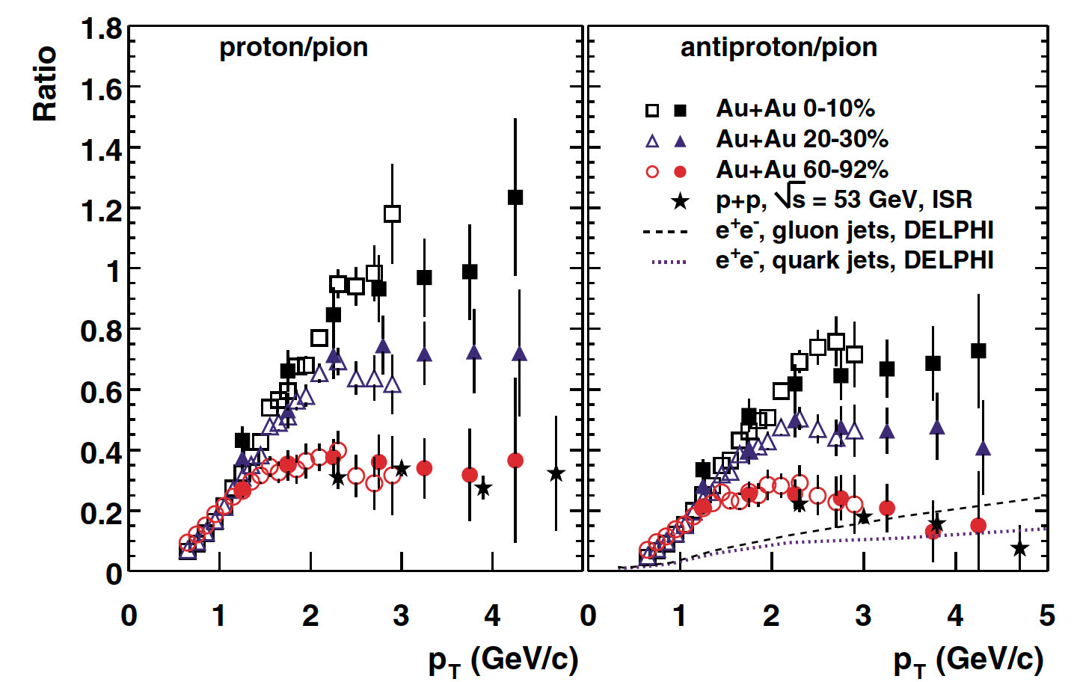
Baryon enhancement in heavy-ion collisions
Nuclear overlap in A+A collisions
Central collisions 0-10%
Semi-central collisions 20-30%
Peripheral collisions 60-92%
PHENIX PRL 91 172301 (2003)
Light flavor baryon production increases in more central collisions at RHIC
Models require quark coalescence in order to match baryon production rates

Slide 14
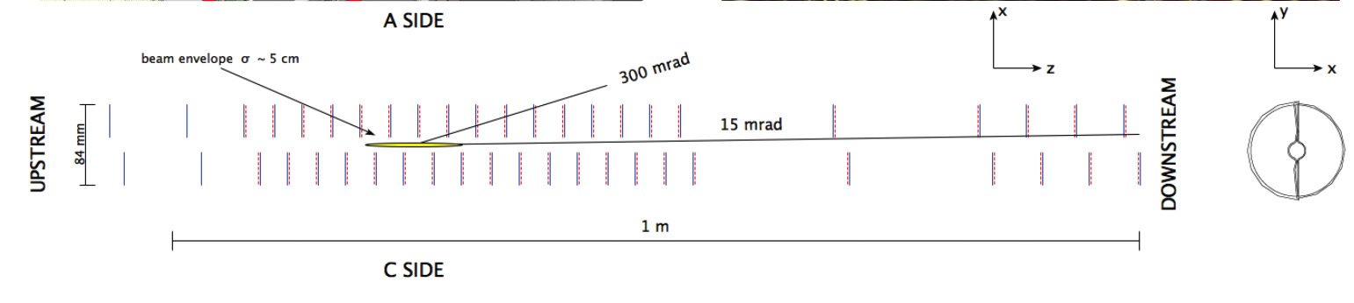
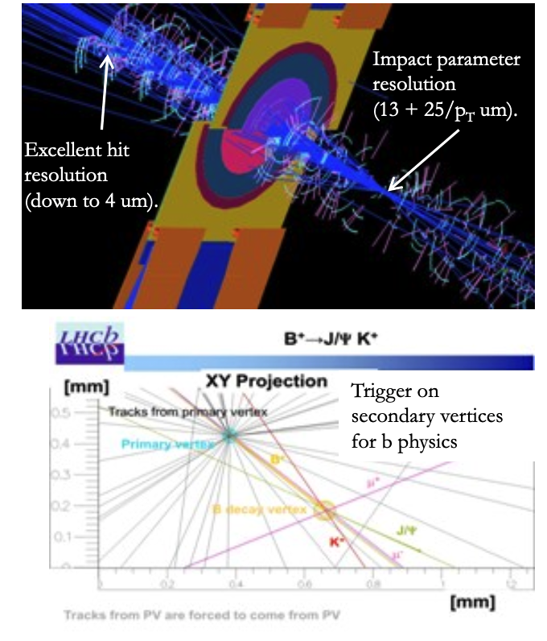
VELO tracks
VErtex LOcator
Surrounds interaction region
Precision tracking
Fast DAQ
Provides measurements of track coordinates to determine primary interaction vertices and secondary vertices
Selects bottom (beauty) and charm decays
Notes:
Here we are using the tracks reconstructed in the VELO detector, not the fully corrected physics quantity, dN/dy. Therefore, we prefer to keep the qualifier "measured"

Slide 15
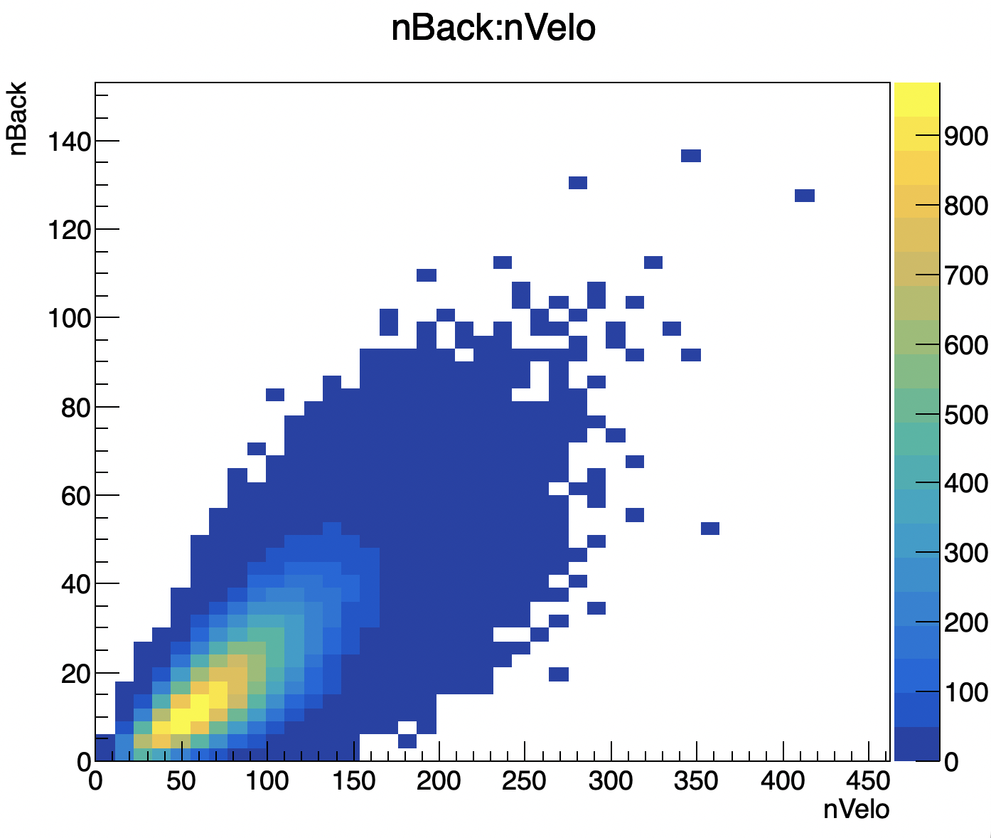
Multiplicity Metrics
−3.5 < η < −1.5
Strong correlation between nBack and nVelo
Similar behavior is seen using both metrics

Slide 16
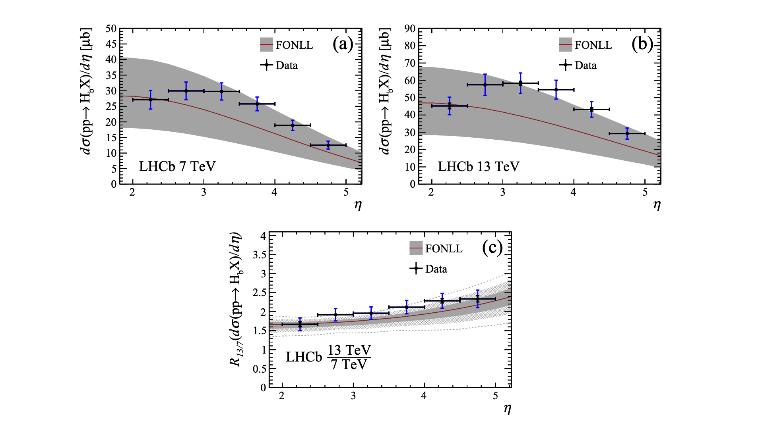
$b\overline{b }$Cross-section measurements at LHCb

Slide 17
Event characterization
Event distributions of nVELO and nBack
signal events with one reconstructed primary vertex

