Slide 1
Collinear matching relations for quark and gluon TMDs
Alessio Carmelo Alvaro
University of Pavia
Supervisors: B. Pasquini, S. Rodini
CFNS Summer School, students’ presentation session

Slide 2
TMDs and Matching Relations
Description of processes at low transverse momentum
No first principles derivation
Constraints on TMD functional form

Slide 3
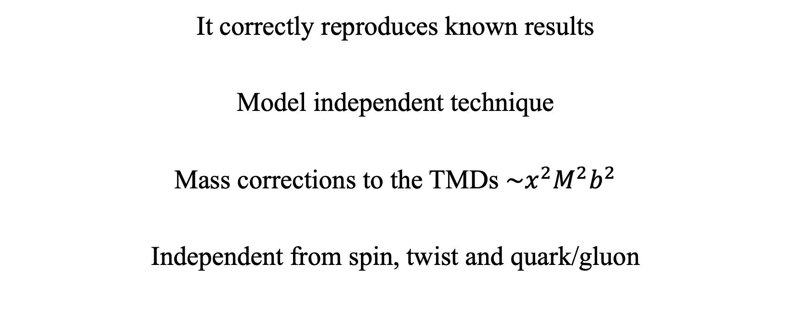
Features of the technique
It correctly reproduces known results
Model independent technique
Mass corrections to the TMDs $\sim x^{2}M^{2}b^{2}$
Independent from spin, twist and quark/gluon

Slide 4
Two examples for NLP quark TMDs

Slide 5
The actual project: gluon TMDs
Table 2.4 of R. Boussarie et al., TMD Handbook, 2304.03302

Slide 6
References
Description of the technique and application to quark twist-2 TMDs: V. Moos, A. Vladimirov, Calculation of transverse momentum dependent distributions beyond the leading power, 2008.01744 [hep-ph]
Extension to quark twist-3 TMDs: S. Rodini, A. C. Alvaro and B. Pasquini, Collinear matching for next-to-leading power transverse-momentum distributions, 2306.15052 [hep-ph]

