Slide 1
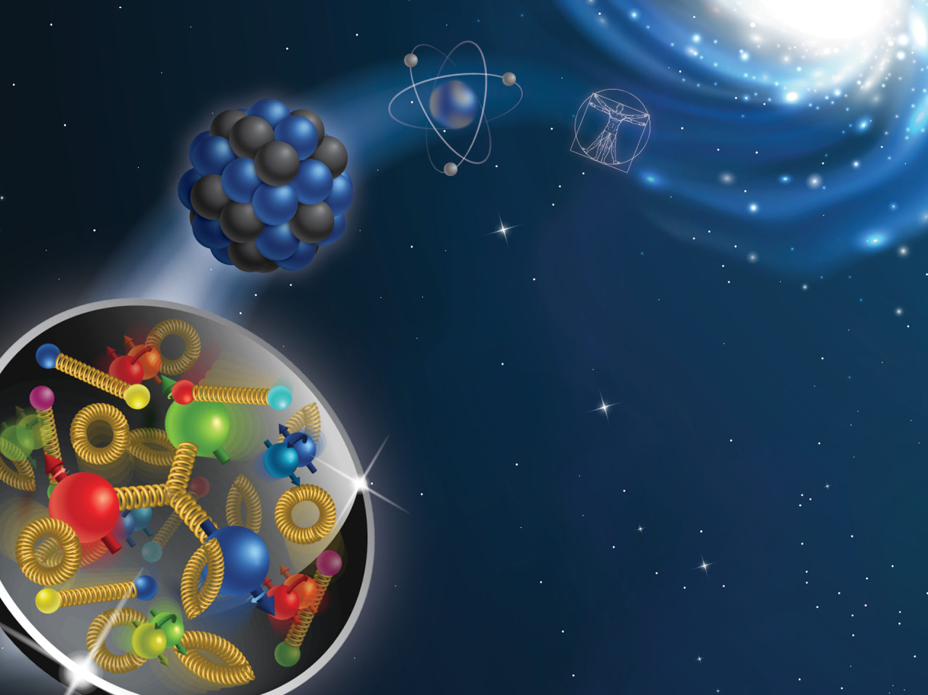
The 2024 CFNS Summer School on the Physics of the Electron-Ion Collider

Slide 2
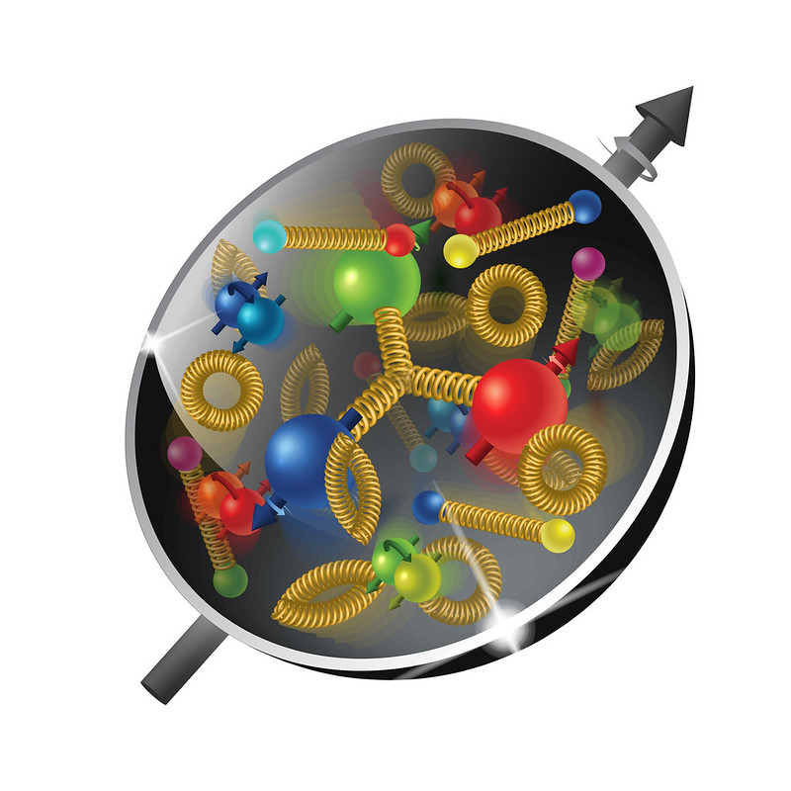
Welcome to the 2024 CFNS Summer School
It is our fifth school!
Welcome to the 2024 CFNS Summer School dedicated to the physics of the Electron-Ion Collider
The Electron-Ion Collider is at a very mature stage and your participation in the project is crucial for its success!
We have 36 in-person students this year and we are looking forward to a very productive school

Slide 3
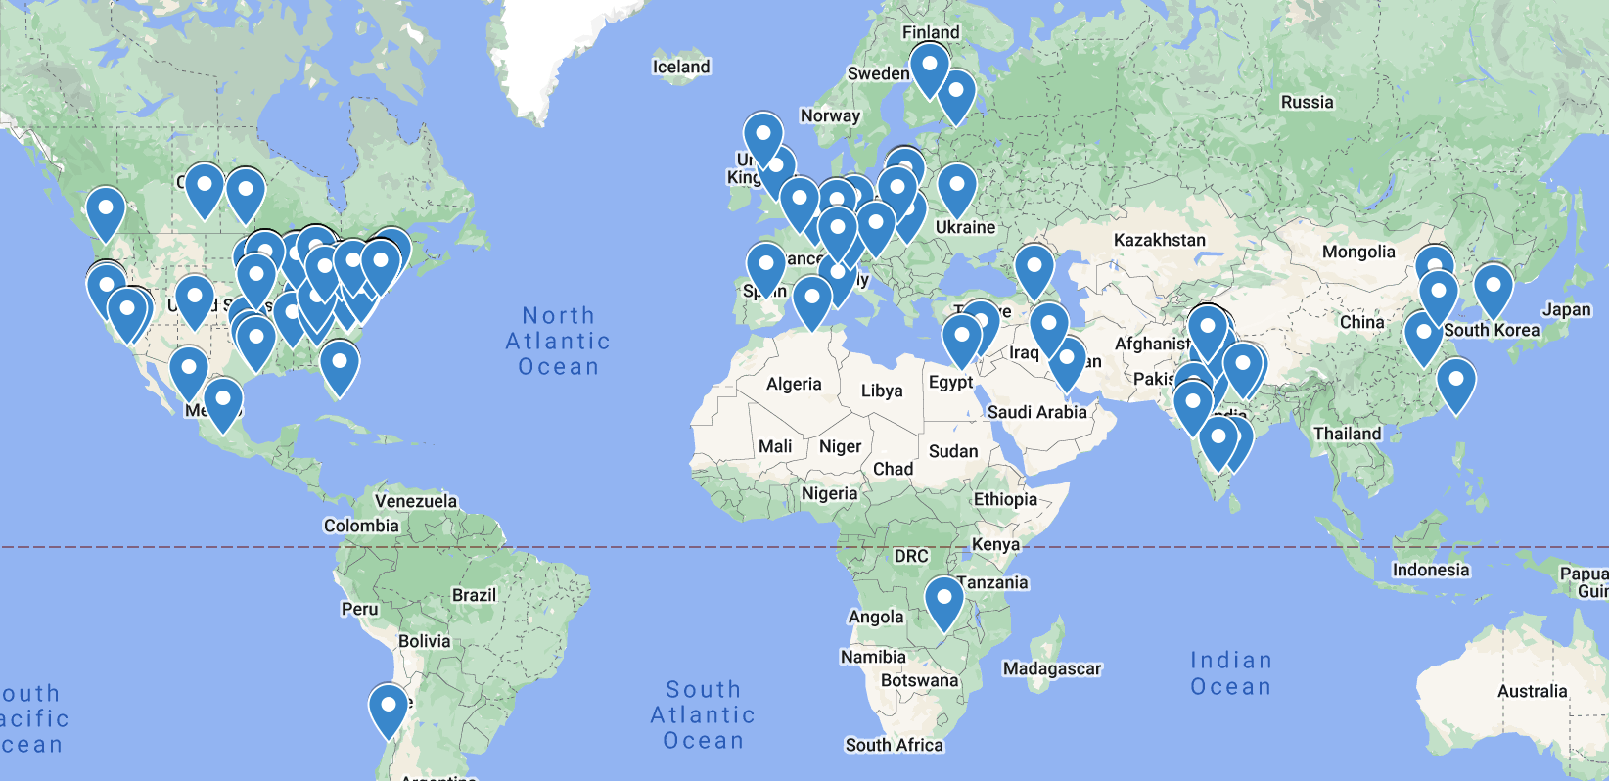
Geography of the school 2019-2023

Slide 4

The SCHool organizers
Organizing Committee:
Ross Corliss (SBU)
Abhay Deshpande (SBU, CFNS Director)
Wenliang “Bill” Li (SBU)
Fred Olness (SMU)
Alexei Prokudin (PSU Berks, Chair)
Administrative support:
Socorro Delquaglio (SBU)
Melissa Laguerre (SBU)

Slide 5
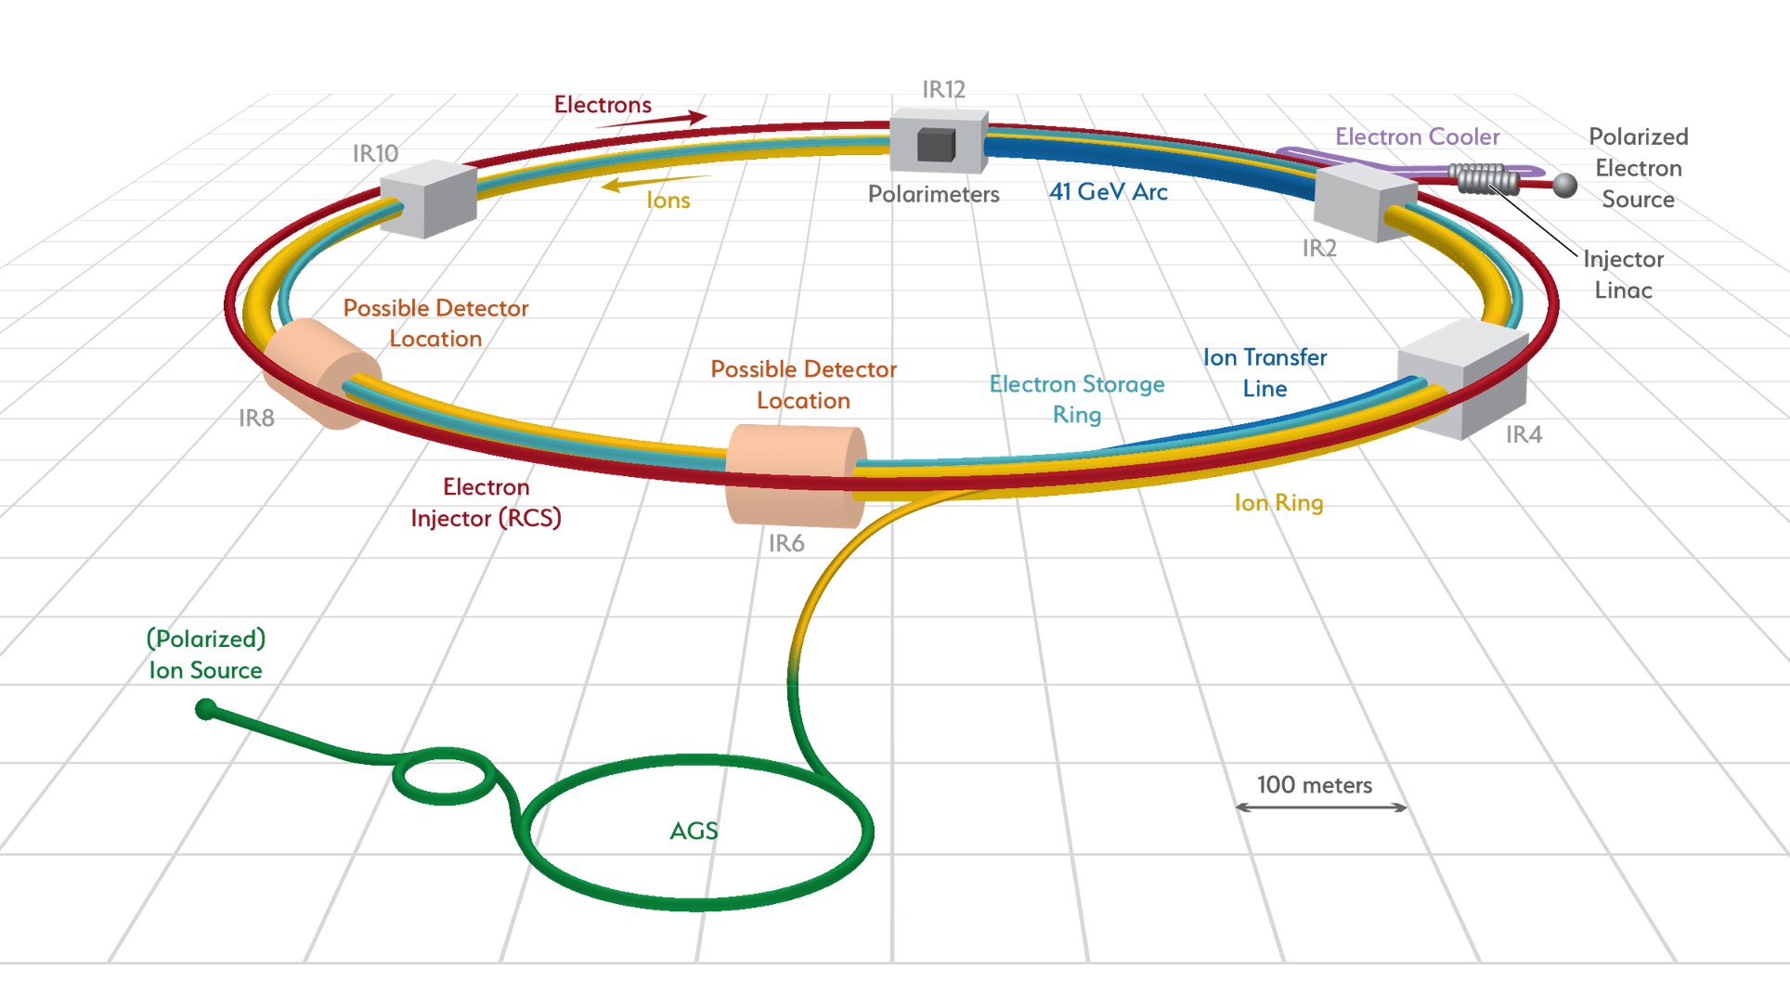
The electron-ion collider @ BNL
High luminosity: (~10³³ - 10³⁴ cm⁻² s⁻¹) (~1000 times that of HERA)
Variable CM energy: 20 — 100 GeV upgradable to 140 GeV
Highly polarized ~70% electron and ~70% nucleon beams
Ion beams from deuterons to heavy nuclei such as gold, lead, or uranium
Possibility of more than one interaction region (none of the major facilities operates with one detector only - important for discovery potential)
White Paper (2012)
Accardi et al, arXiv:1212:1701

Slide 6
The electron-ion collider: scientific questions
White Paper (2012)
Accardi et al, arXiv:1212:1701
How do the nucleonic properties such as mass and spin emerge from partons and their underlying interactions?
How are partons inside the nucleon distributed in both momentum and position space?
How do color-charged quarks and gluons, and jets, interact with a nuclear medium? How do the confined hadronic states emerge from these quarks and gluons? How do the quark-gluon interactions create nuclear binding?
How does a dense nuclear environment affect the dynamics of quarks and gluons, their correlations, and their interactions? What happens to the gluon density in nuclei? Does it saturate at high energy, giving rise to gluonic matter or a gluonic phase with universal properties in all nuclei and even in nucleons?

Slide 7
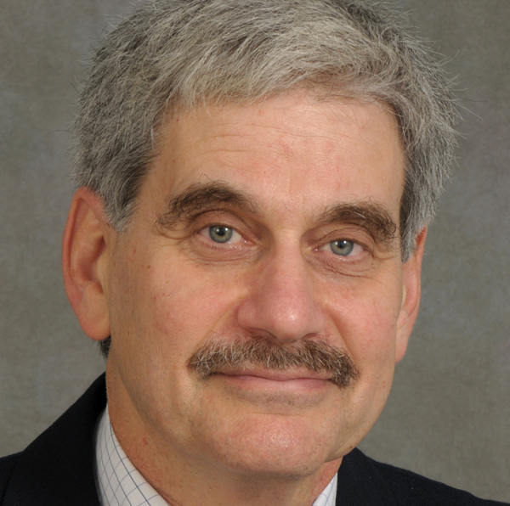
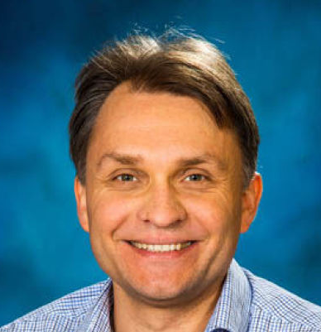
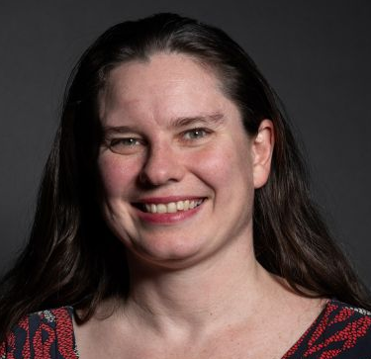
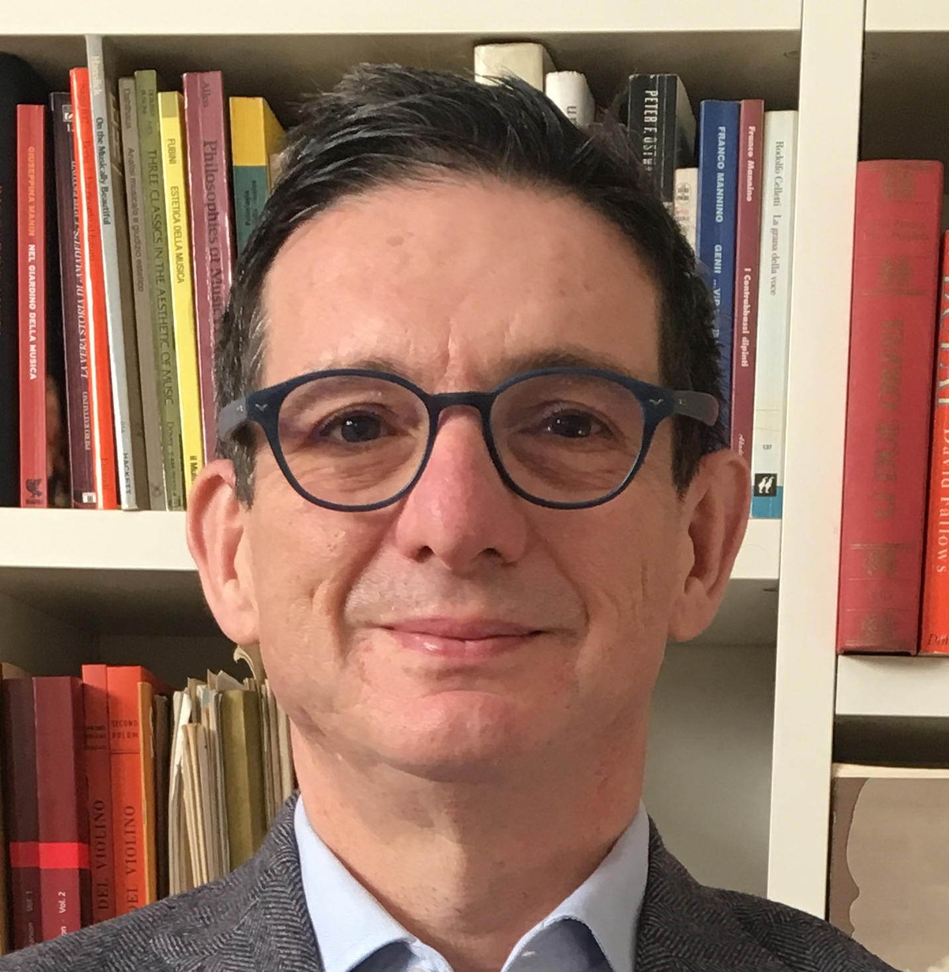
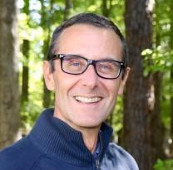
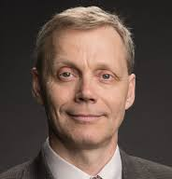
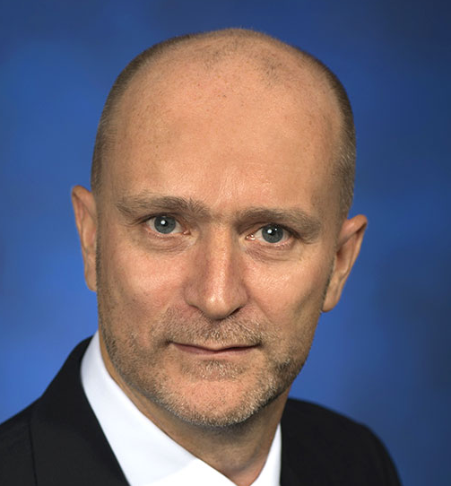
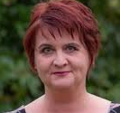

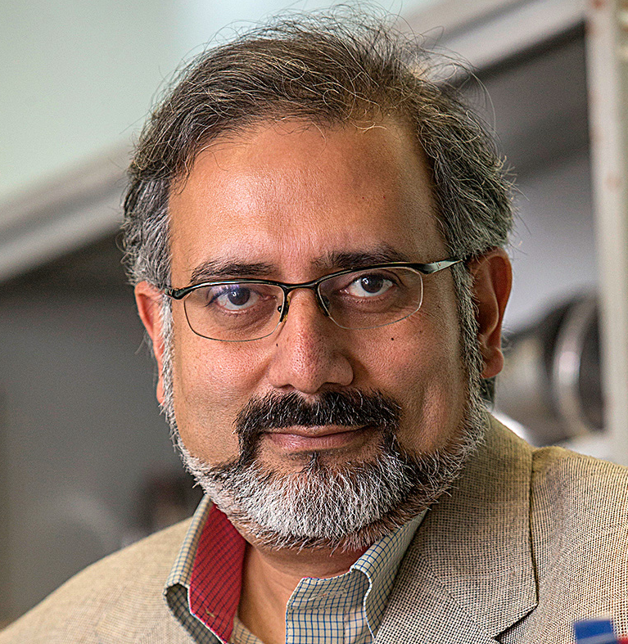
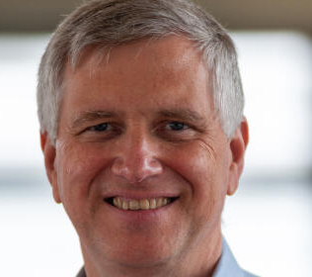
The SCHool lecturers: first week
George Sterman (SBU)
Alexei Prokudin (PSU)
Rosi Reed (Lehigh U.)
Stefano Forte (Milan U.)
Marco Battaglieri (Genova U.)
Sergei Nagaitsev (BNL)
Christoph Montag (BNL)
Yulia Furletova (JLab)
Adnan Bashir (Umich)
Abhay Deshpande (SBU/BNL)
Fred Olness (SMU)

Slide 8
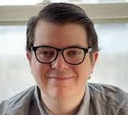
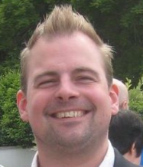
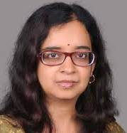
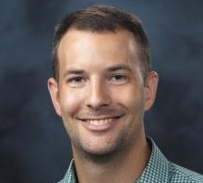
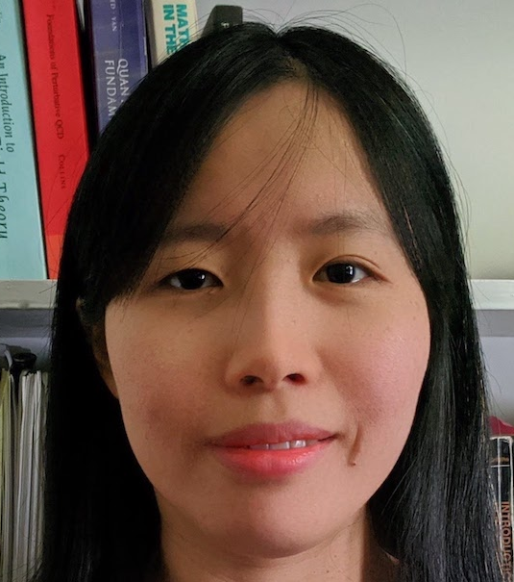
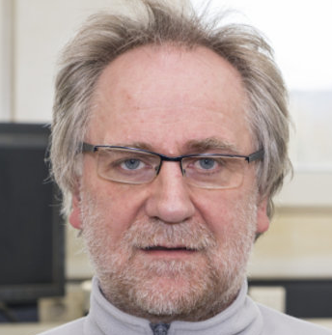

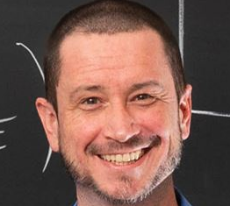
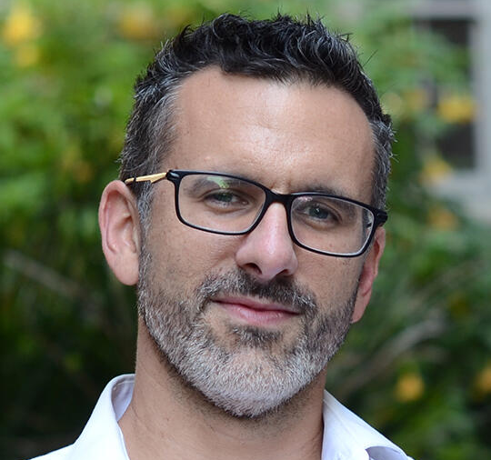
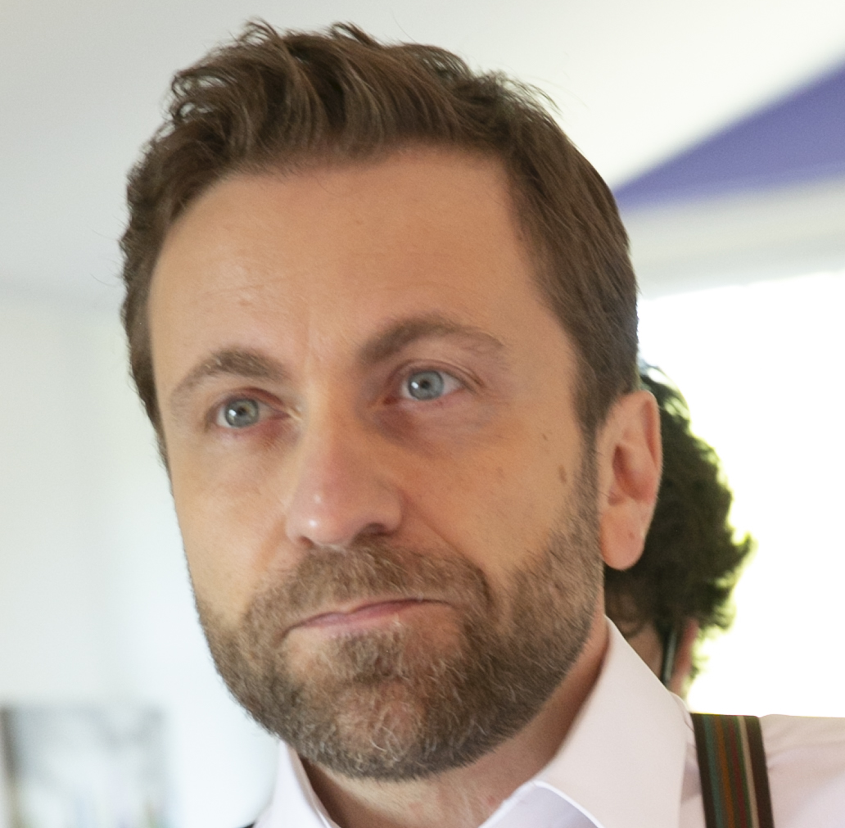
The SCHool lecturers: SECOND week
Alex Jentsch (BNL)
Kolja Kauder (BNL)
Asmita Mukherjee (IIT Bombay)
Joe Osborn (ORNL)
Sanghwa Park (JLab)
Frank Rathmann (BNL)
Luna Chen (Vanderbilt)
Matt Sievert (NMSU)
Raúl Briceño (Berkeley)
Giuseppe Bozzi (Cagliari)

Slide 9

the school schedule
The school runs in person 9:00 am - 3:30 pm ET US.
In the evening, we have recitations/discussion at 7:30 pm
(snacks & drinks are provided)
The program is posted on Indico: https://indico.cfnssbu.physics.sunysb.edu/event/111/timetable
Students’ presentations (optional) will be on Fridays, please, send us your titles.

Slide 10

Dining options: Lunch SUGGESTION
Meal cards are for food only, $40 per day
For food only!
Lunch Suggestion:
Since we have only 90mins for lunch, we suggest the
on-campus
SAC option.
We will lead you there after the morning lectures.

Slide 11
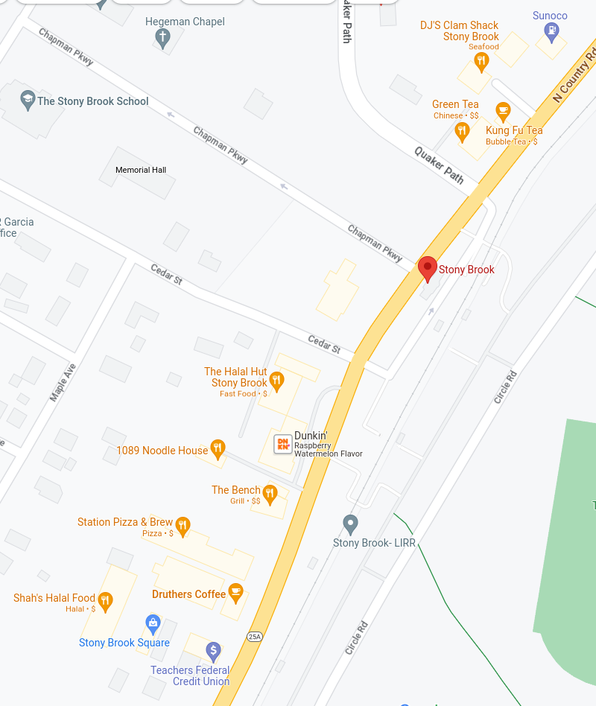
Dining options: DINNER SUGGESTION
Dinner Suggestion:
Since we have a bit more time for dinner,
you might want to try some of the off-campus options near the LIRR.
We then return at 7:30 for snacks and a relaxing discussion session

Slide 12
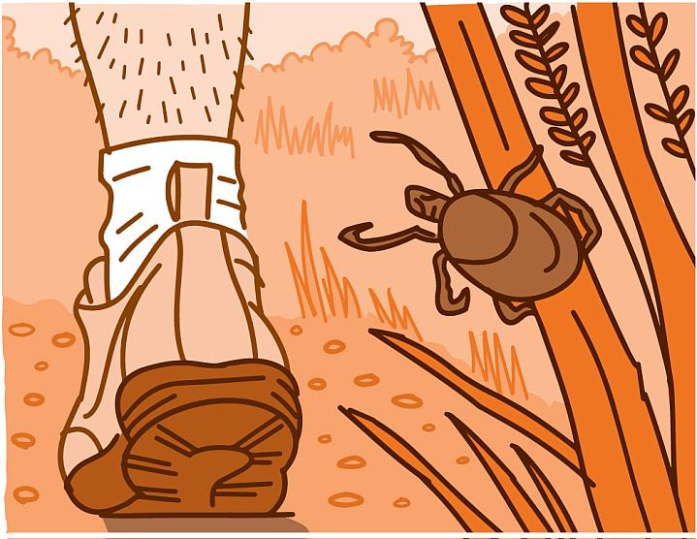
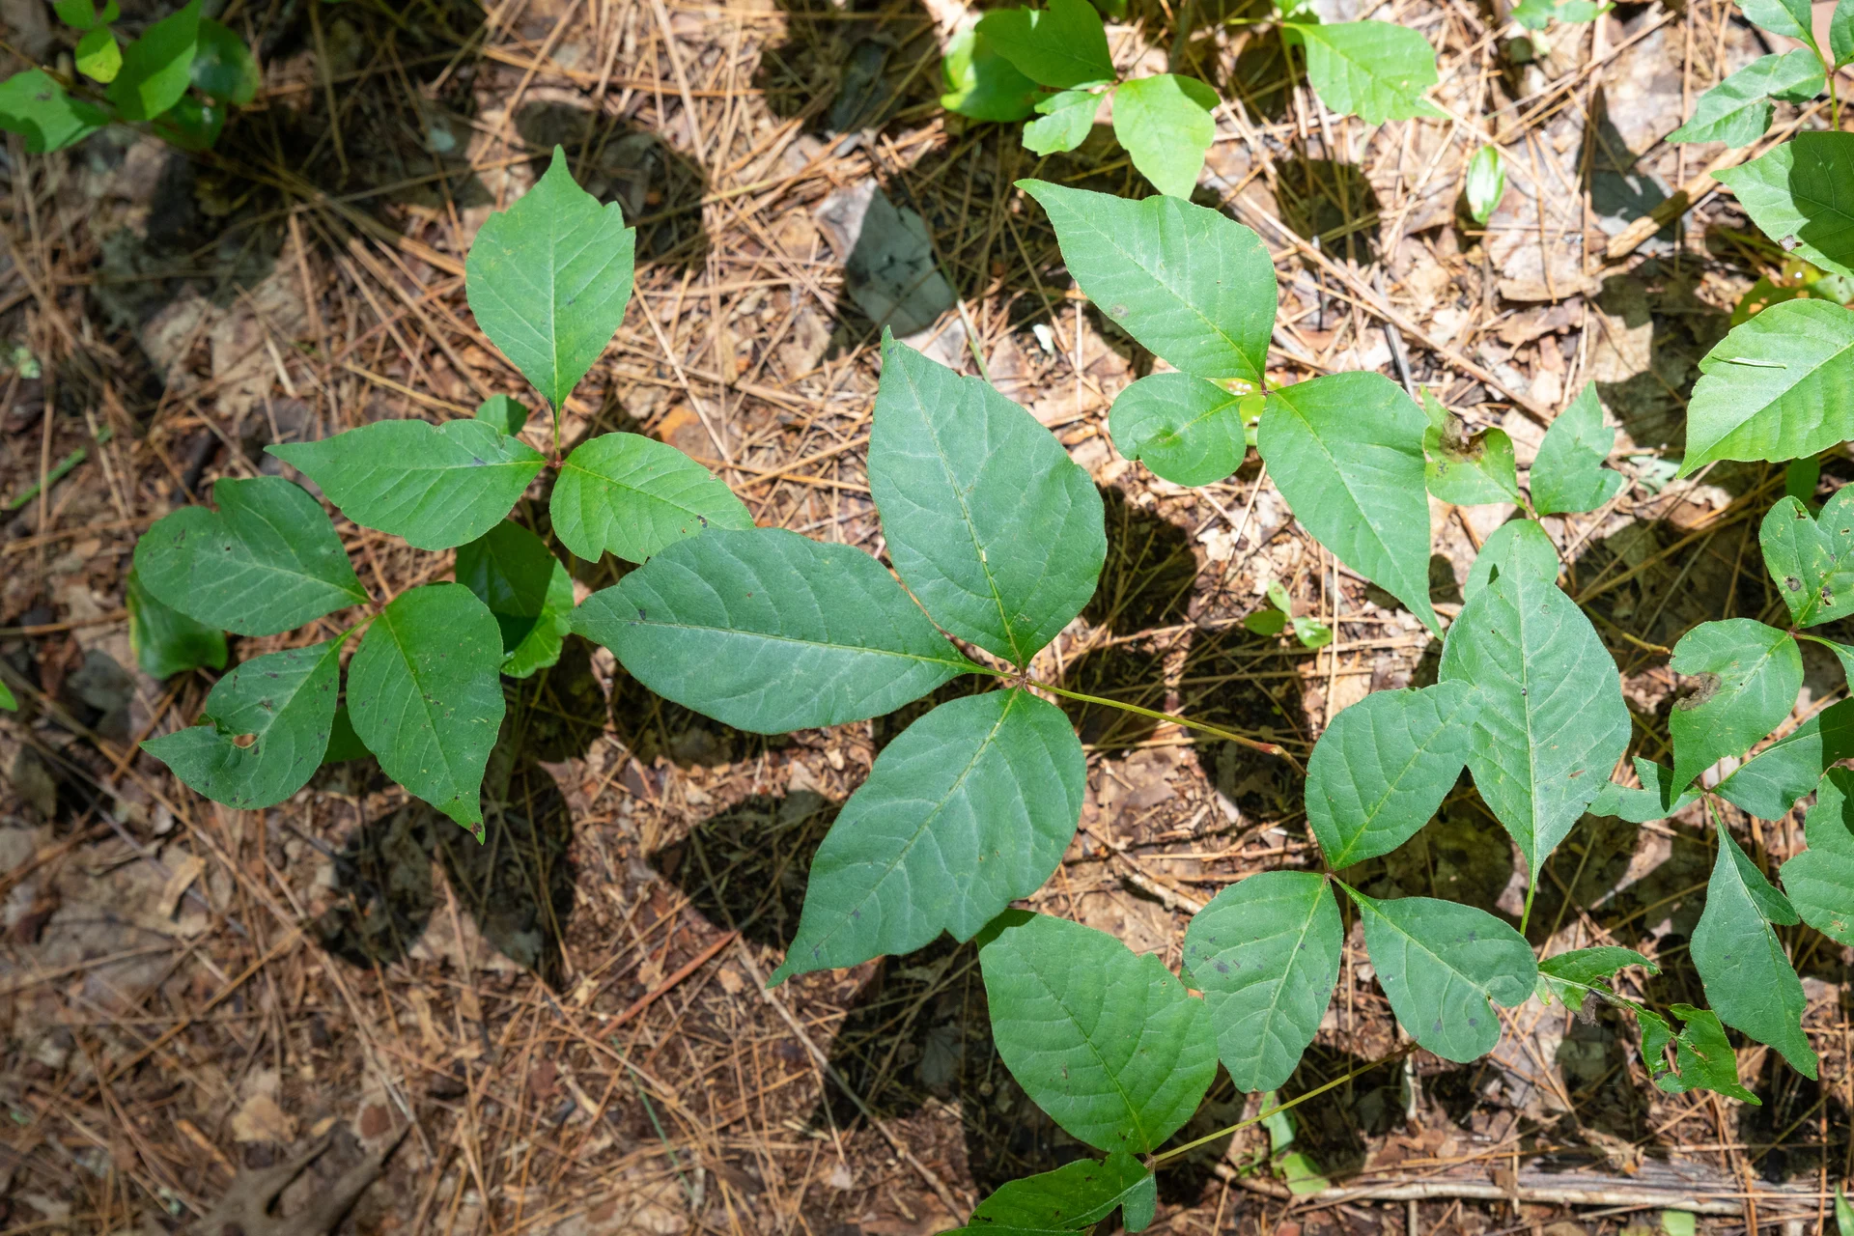
Warnings:
Beware
Ticks transmit lime disease. Seek for medical help if you are bitten.
Poison ivy causes a painful rash.

Slide 13
Welcome! We hope you will like the school and find it useful!

