Slide 1
The 2024 CFNS Summer School on the Physics of the Electron-Ion Collider

Slide 2
the 2024 CFNS Summer School
This year we have crossed the threshold of 200 students. In the last 5 years, including this year, we had 215 students in total. We also had more than 100 lecturers.
It makes the lectures/student ratio almost 1 lecturer per 2 students.
This year we have 36 students from 10 different countries in North America, Europe, Asia, and Australia. Our lecturers (21 of them) come from 4 different countries.

Slide 3
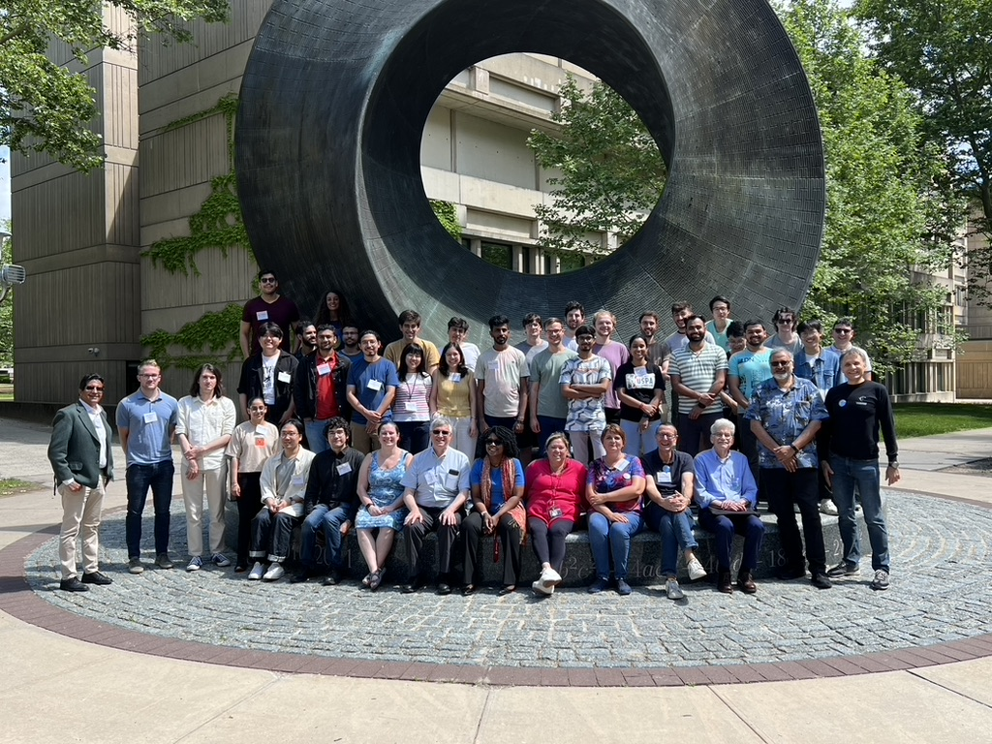
the 2024 CFNS Summer School

Slide 4
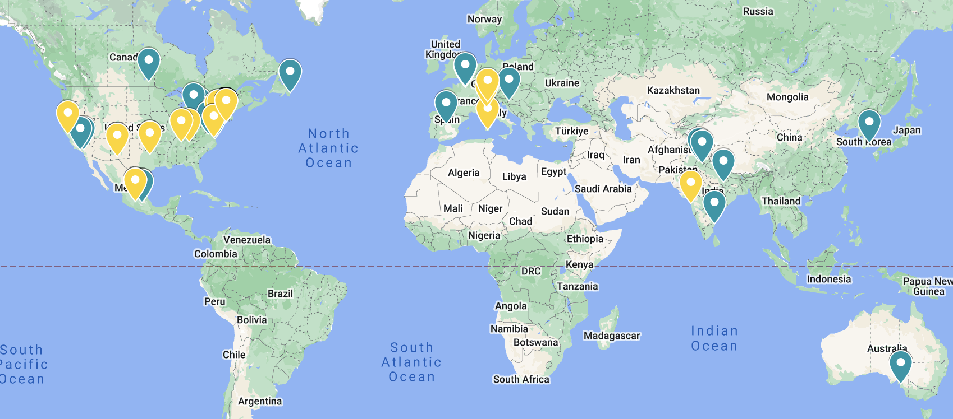
Geography of the 2024 school

Slide 5
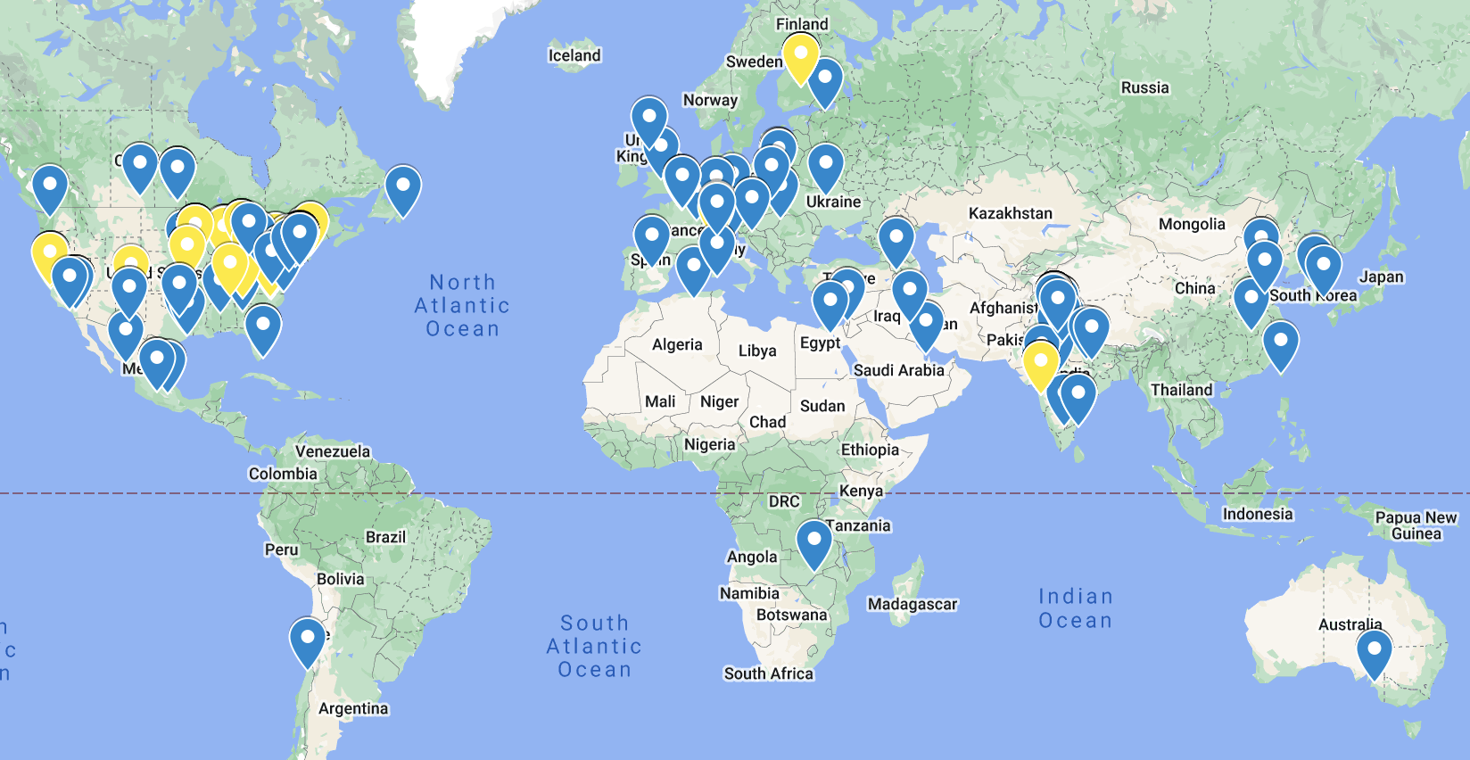
Geography of the school 2019-2024

Slide 6
Thank you, Socorro, and melissa!

