Slide 1
EIC Accelerator Physics – Part 1
Sergei Nagaitsev, BNL
CFNS School
6 June 2024
EIC:

Slide 2

About me – Sergei Nagaitsev
EIC Technical Director, Brookhaven National Lab
Jefferson Lab Professor, ODU Department of Physics (https://fs.wp.odu.edu/snagaits/)
Recent professional experience:
2023 – 2024 EIC Lead Scientist, Jefferson Lab
2018 – 2022 Head of Accelerator Science Programs, Fermilab
2015 – 2022 Professor Part-time, The University of Chicago – Accelerator Physics
2013 – 2018 Chief Accelerator Officer, Fermilab – Accelerator Division
Community service:
2020 Chair, APS DPB
2021 – 2022 Member, HEP Snowmass Study Steering Group

Slide 3
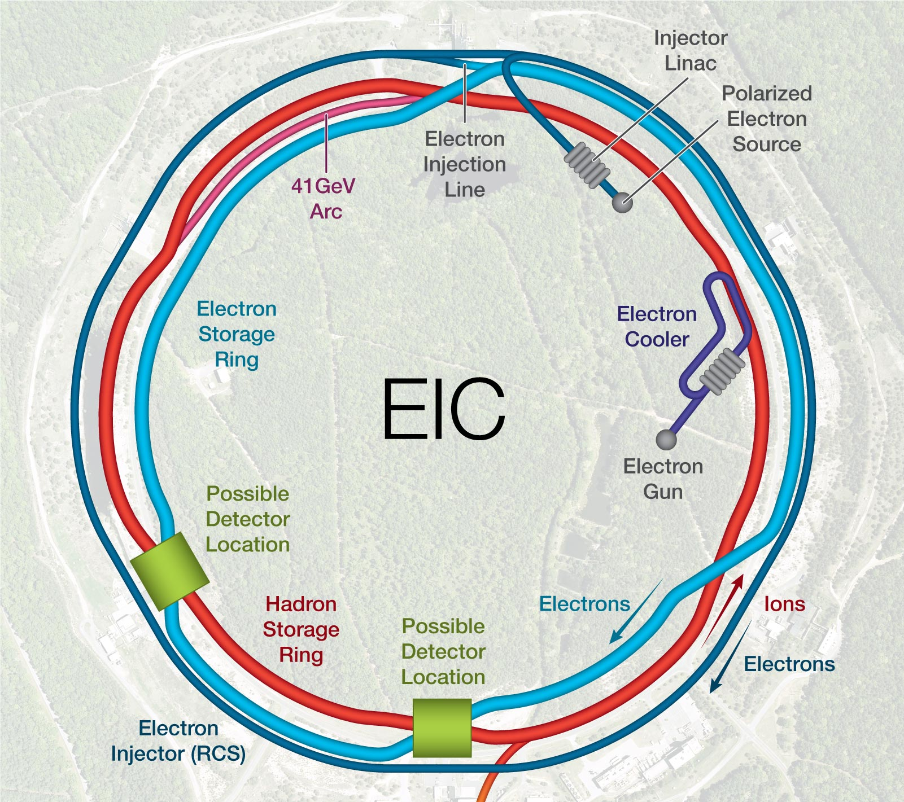
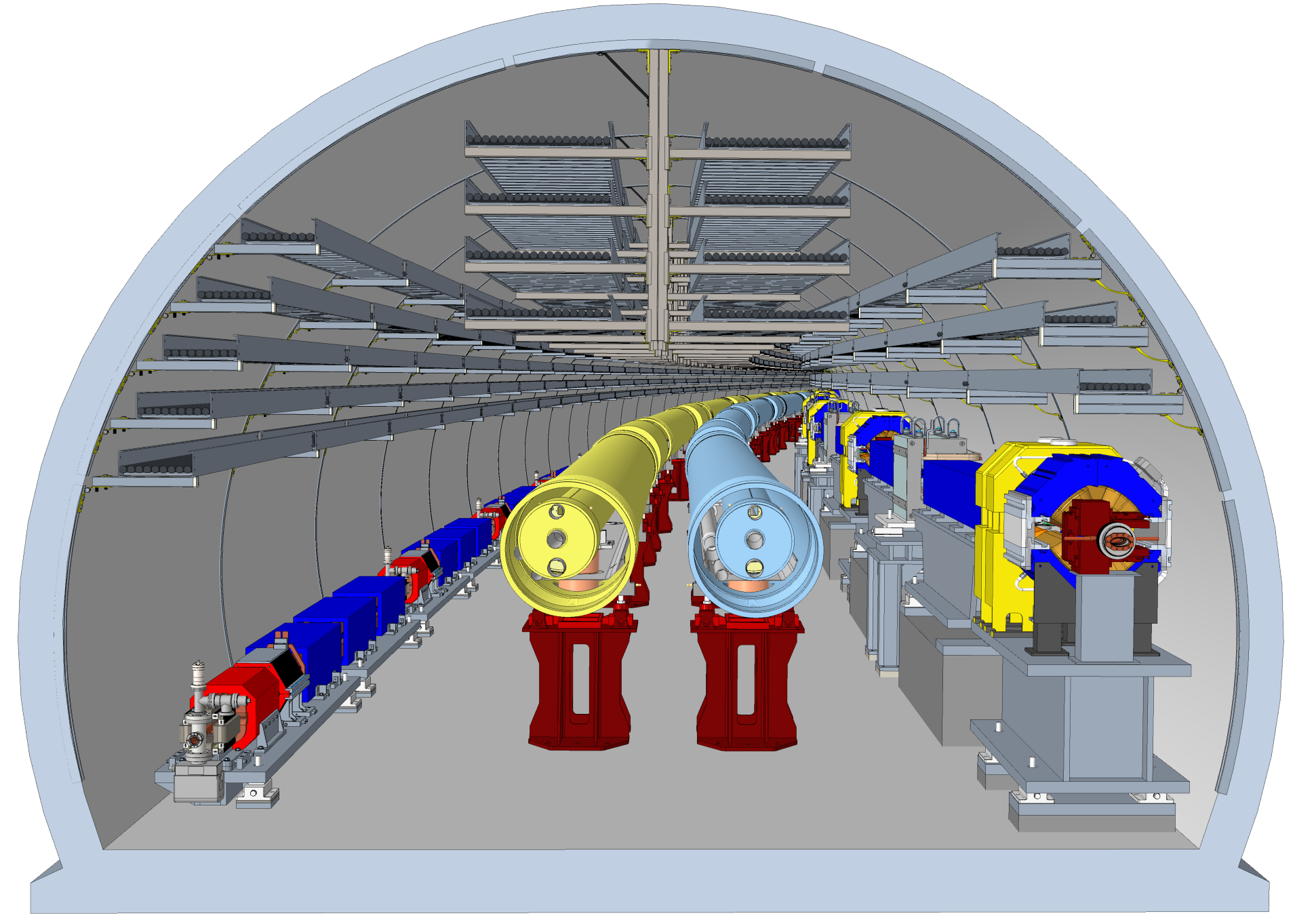
Outline (Part 1)
Accelerators – engines for discovery
EIC overview
  From an accelerator physicist ☺
Relevant accelerator physics
  Synchrotrons
  (Brief) beam dynamics
  Phase space, emittance, “beta”
Collider interaction regions
  ”Low-beta” squeeze
Future 2nd
Detector
Location
Future
Detector
Location
Primary
Detector
Location
Primary
Detector
Location

Slide 4

Engines of Discovery
Physics Today 73, 4, 32 (2020);

Slide 5
Nobel Prize Accounting: A high-level view on the influence of accelerators on physics
Reproduced from “The Influence of Accelerator Science on Physics Research,” Haussecker and Chao
Impact of accelerators on physics was measured through Nobel Prizes:
Criterion: Nobel awardee must have authored document citing accelerator contribution to work
Nobel’s directly influenced by Accelerators by 2009: 24
Average frequency of contribution of accelerators to Nobel in Physics: ~3 years
Nobel Prize Count
Count for Nobel Prize-winning researches or discoveries in physics from 1943 to 2009. (Haussecker and Chao, Phys Perspect. 13 (2011), p146)

Slide 6
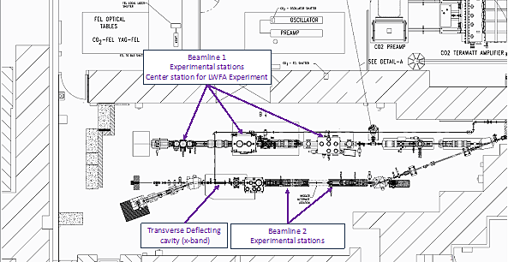
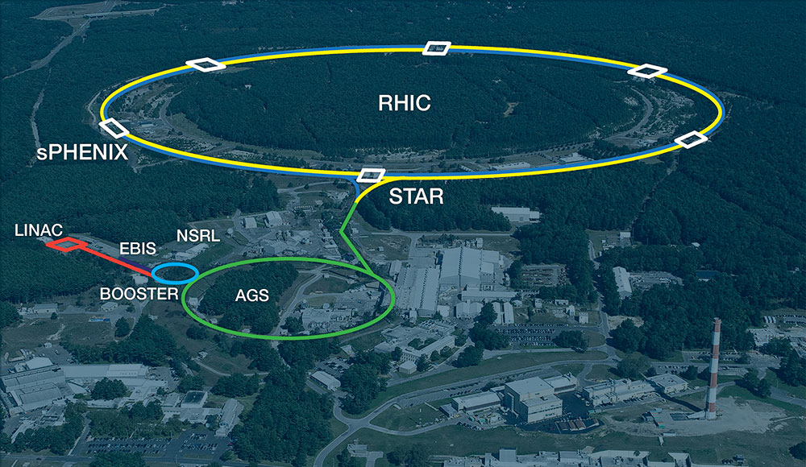

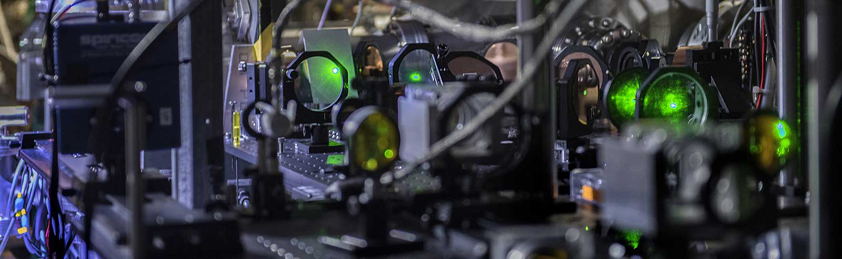
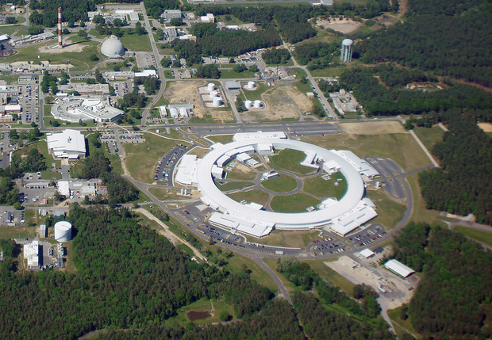
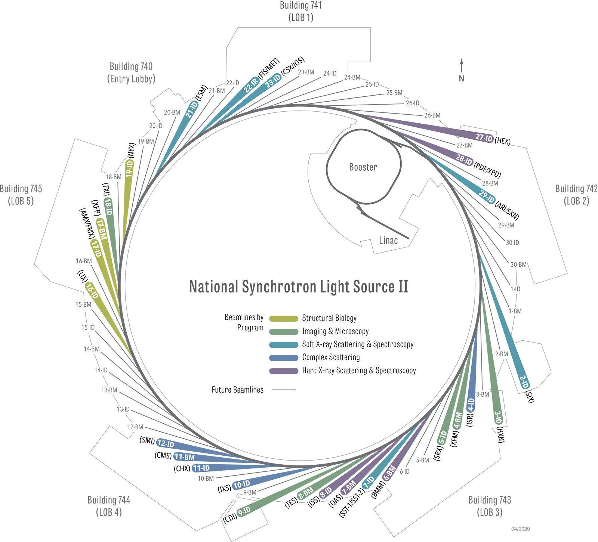
Accelerators: Engines of Discovery
A DOE User Facility for
Advanced Accelerator &
Laser Research
RHIC
A DOE User Facility to probe the
fundamental properties of nuclear matter
and to study what the universe may
have looked like in the first few
moments after its creation.
NSLS-II
A DOE User Facility to probe the fundamental
properties of matter, paving the way to new
scientific discoveries and innovations.

Slide 7

Accelerators are instruments for providing beams of charged particles – a highly-directed form of energy – to be used as probes and tools
Beams: e-,e+, p, pbar, ions, muons
N ~ 1 to 10¹⁴
Inventions,
development
Core Accelerator Technologies
Technologies
Vision, concept,
integration,
optimization,
construction
LHC, EIC,
NSLS-II
Projects
Particle beams behind physics discoveries
Physics Today 73, 4, 32 (2020)
Science
Discoveries,
research

Slide 8
Colliders: 31 colliders built since 1959
Center-of-mass energy is E_{CM}= 2E – available for ‘new physics’
7 colliders are in operation today, 2 under construction (EIC and NICA)
- LHC, RHIC, BEPC, Super-KEKB, DAFNE, VEPP-4M, VEPP-2000
April 26, 2024: a joint “Statement of Intent between the United States of America and the European Organization for Nuclear Research (CERN) concerning Future Planning for Large Research Infrastructure Facilities, Advanced Scientific Computing, and Open Science” was signed at The White House.
The SOI expresses an intention by the United States to collaborate on a future FCC Higgs Factory should the CERN Member States determine the project feasible.

Slide 9
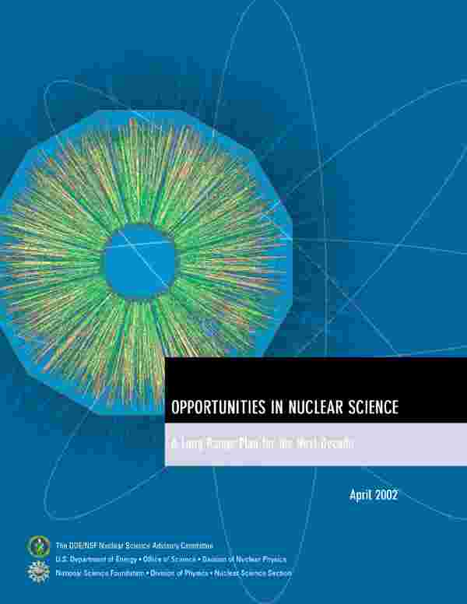
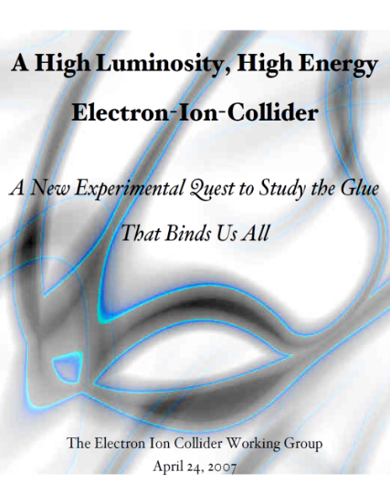
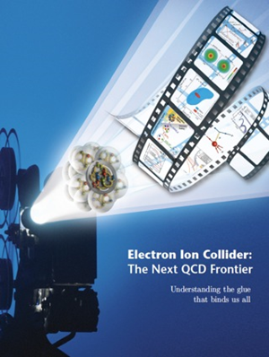

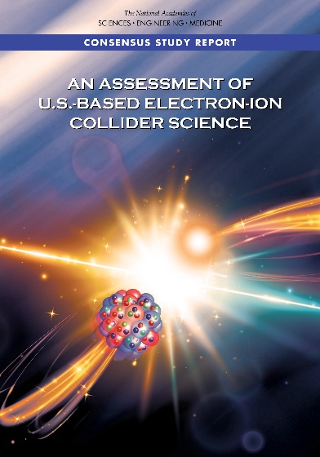

The Scientific Foundation for an EIC was Built Over Two Decades
2002
“a high-energy high-luminosity polarized EIC [is] the highest priority for new facility construction following the completion of FRIB.”
2007
The science questions that an EIC will answer are central to completing an understanding of atoms as well as being integral to the agenda of nuclear physics today.”
2009
2010
Gluons and the Quark Sea at High Energies
2012
2013
2015
Science Requirements and Detector Concepts for the EIC – Drives the requirements of EIC detectors
Major Nuclear Physics Facilities for the Next Decade
2018
2021
“…essential accelerator and detector R&D [for EIC] should be given very high priority
in the short term.”
NSAC
2023
We recommend the expeditious completion of the EIC as the highest priority for facility construction.
“We recommend the allocation of resources …to lay the foundation for a polarized Electron-Ion Collider…”
“..a new dedicated facility will be essential for answering some of the most central questions.”
March 14, 2013
“The quantitative study of matter in this new regime [where abundant gluons dominate] requires a new experimental facility: an Electron Ion Collider..”
Electron-Ion Collider..absolutely central to the nuclear science program of the next decade.
arXiv:2103.05419

Slide 10
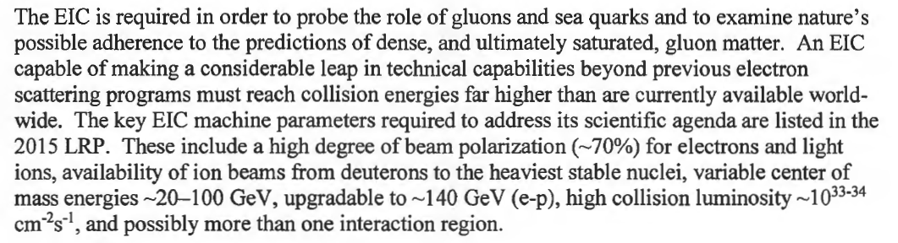
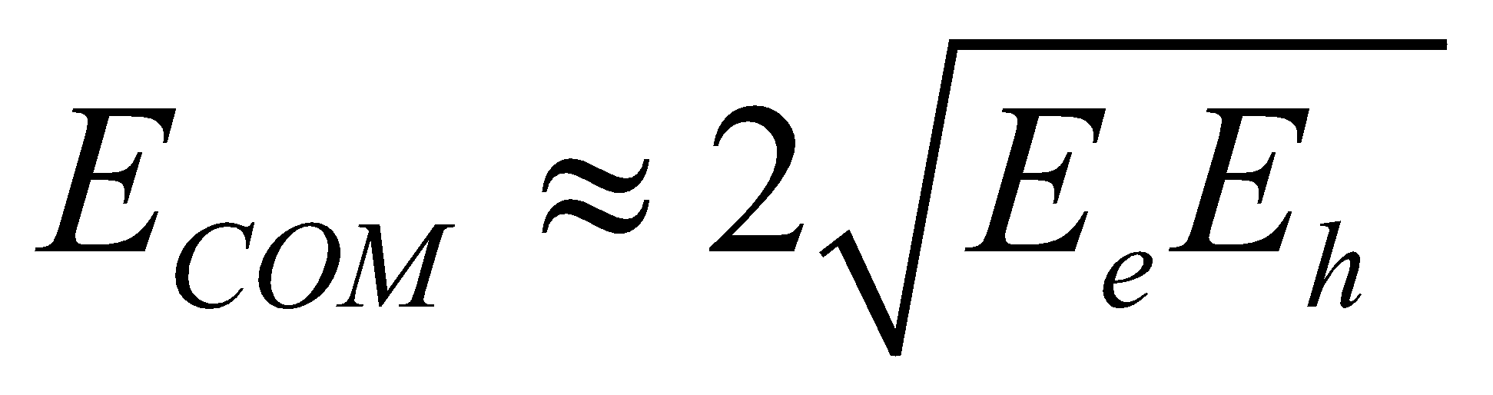
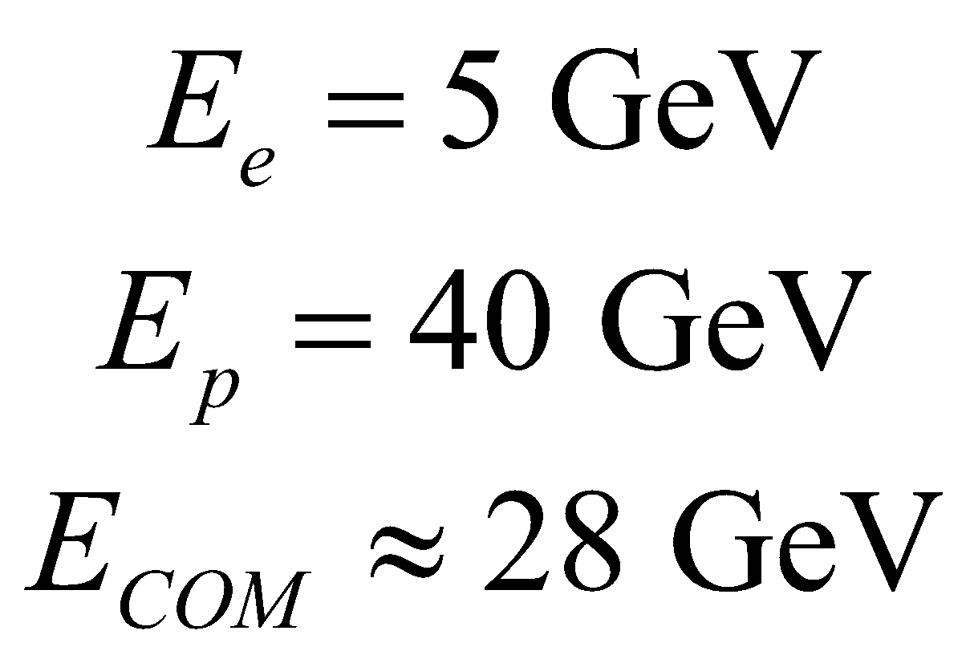
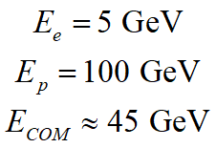
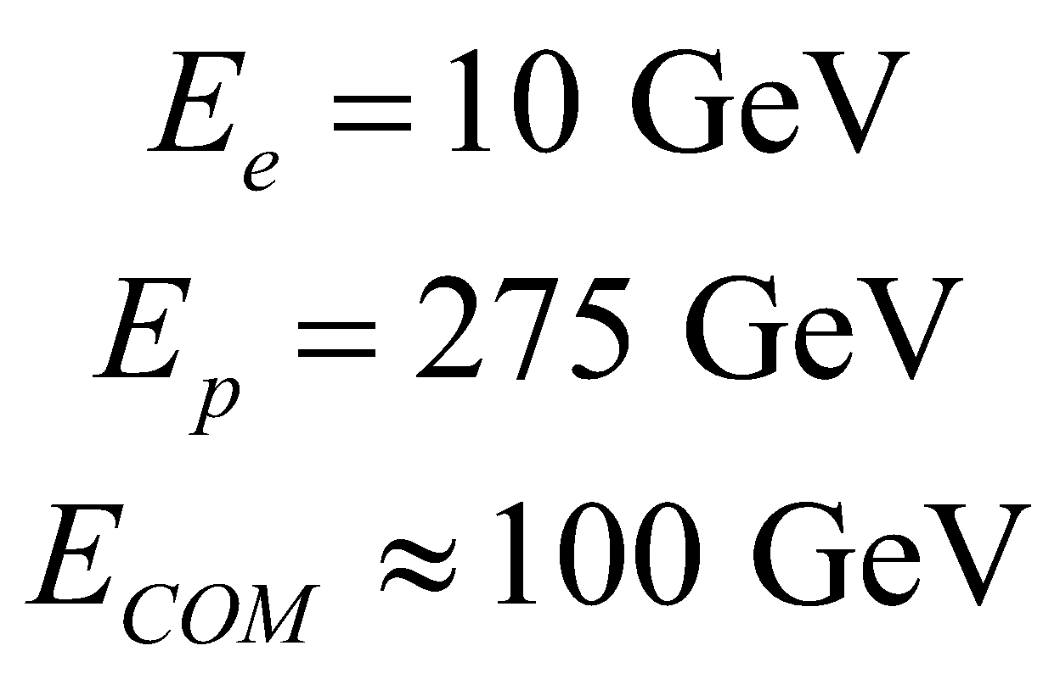
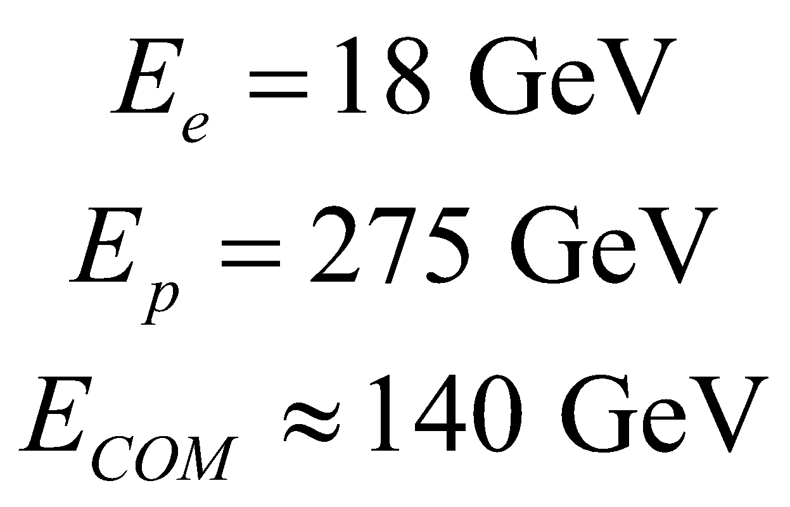
The DOE CD0 Mission-Need 2019

Slide 11
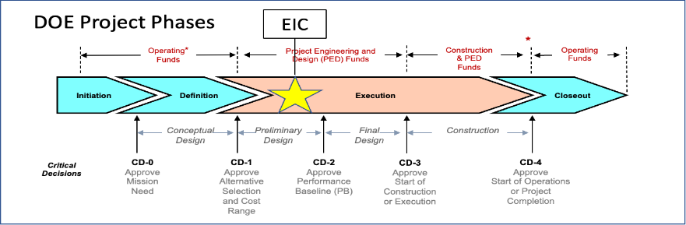
EIC Project Critical Decisions and Plans
CD-0, Mission Need Approved | December 2019
DOE Site Selection Announced | January 2020
CD-1, Alternative Selection and Cost Range Approved | June 2021
CD-3A, Long-Lead Procurement Approved | March 2024
CD-3B, Long-Lead Procurement Planned Approval | March 2025
CD-2/3, Performance Baseline/Construction Start Plan | End 2025
DOE Independent Project Review for CD-3B and Project Status on Jan 7-9, 2025.

Slide 12



EIC Requirements
EIC design goals
  High luminosity: L = (0.1-1)∙10³⁴ cm⁻² s⁻¹
    ➔ 10-100 fb⁻¹
  Collisions of highly polarized (>70%) e and p (and light ion) beams
    with flexible bunch by bunch spin patterns
  Large range of CM energies:
    E_{cm} = 20-140 GeV
  Large range of ion species:
    Protons – Uranium
  Ensure accommodation of a second IR
  Large detector acceptances; good background
    Hadron particle loss
    IR synchrotron radiation backgrounds
“High”
Unique
uniquely
challenging
“Low”
Diverse

Slide 13
EIC Accelerator Design Overview
Hadron storage ring (HSR): 40-275 GeV (existing)
  up to 1160 bunches, 1A avg beam current (3x RHIC, polarized)
  bright vertical beam emittance (1.5 nm); new vac sleeves
  hadron beam cooling
Electron storage ring (ESR): 5–18 GeV (new)
  up to 1160 polarized bunches
    high polarization by continual reinjection from RCS
  2.5 A avg beam current ➔ 9 MW SR power
  superconducting RF cavities
Rapid cycling synchrotron (RCS): 0.4-18 GeV (new)
  2 bunches at 1 Hz; spin transparent due to high periodicity
High luminosity interaction region (new; future 2nd IR)
  L = 10³⁴ cm⁻²s⁻¹ = 10 kHz-uba, superconducting magnets
  25 mrad crossing angle with crab cavities/crab crossing
  spin rotators (produce longitudinal polarization at IP)
Compare to 50 MW at FCC
Current 6x NSLS-II
Future 2nd
Detector
Location
Primary
Detector
Location

Slide 14
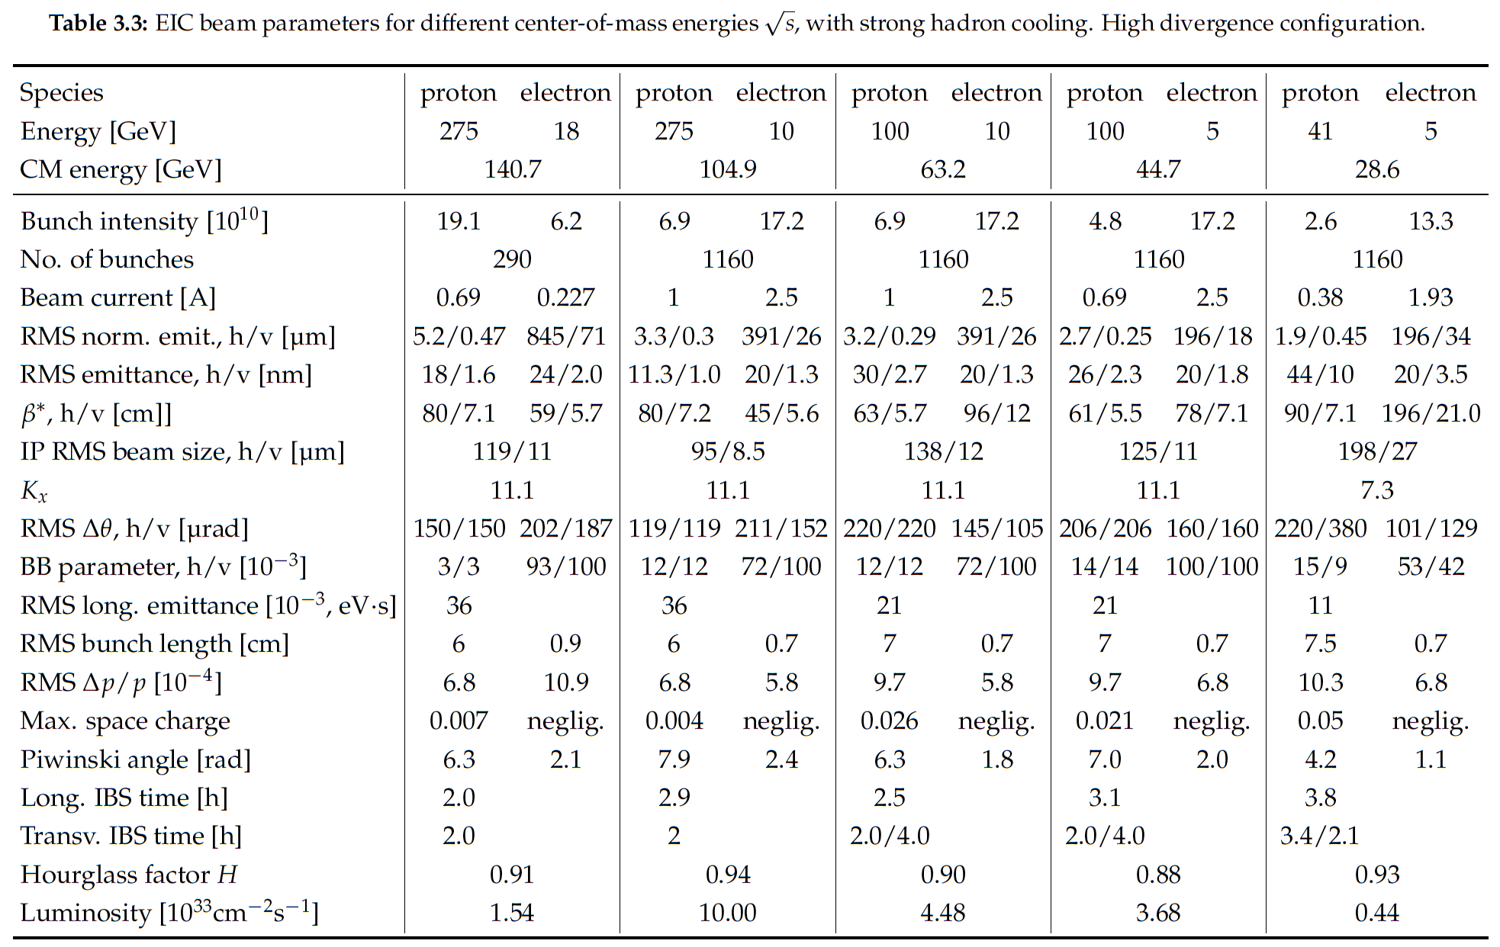
Notes:
LHC design 0.58A p (HL up to 1A), beam-beam parameter 3.4e-4 (3-5—3 HL-LHC)

Slide 15
Today’s plan
Beam sources
Beam energy
Luminosity
Beam transport (bending and focusing)
Beam size at IP
  Emittance
  ‘beta’ function
Maybe: beam stability

Slide 16
How to build particle accelerators?
In three easy steps:
One needs particles
Add acceleration
Add focusing
For colliders: add collisions

Slide 17
Nuclear and Particle Physics
The first “high-energy” accelerator, made by Cockroft and Walton, was immediately used to understand the atomic nucleus. They made the first artificially produced nuclear reaction:
p+Li -> 2He
Early accelerator developments were driven by the quest for higher and higher particle energies, which in turn was driven by developments in nuclear physics (through the 1960s) and then elementary particle physics (1960s-onward)
The largest accelerator is at CERN (LHC). It collides two proton beams of energy 7 TeV each.

Slide 18
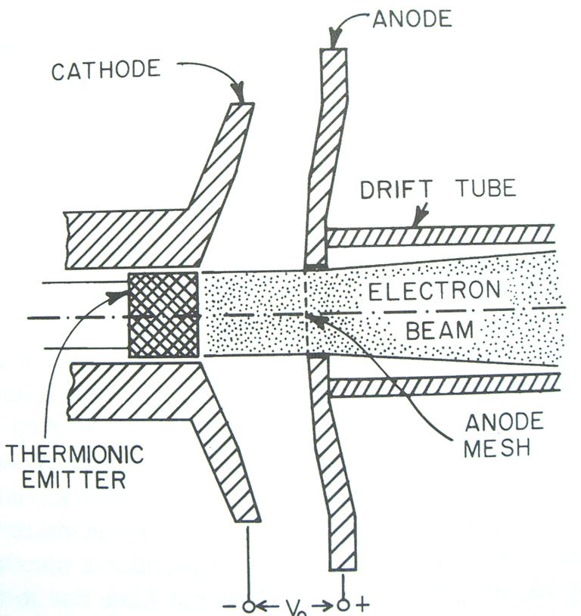
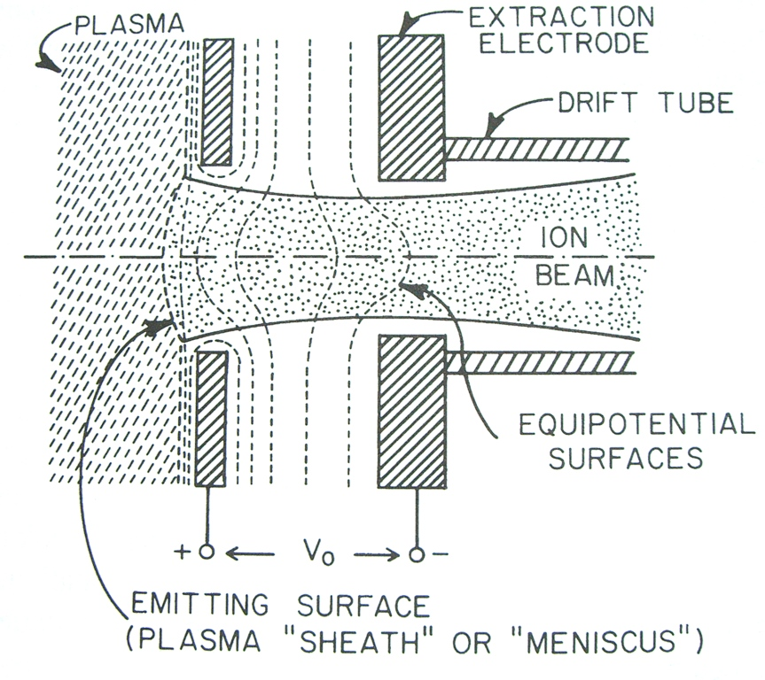
Particle sources
The simplest conceptual model of an electron beam source is a planar diode.
  Cathodes typically operate at 1400K (kT ≈ 0.12 eV)
  An effective work function is about 1.6 eV
Ion sources are generally more complex. The ions are typically extracted from the plasma of a gas discharge.

Slide 19
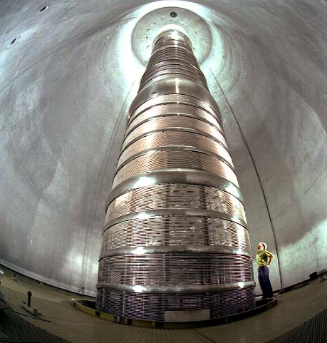
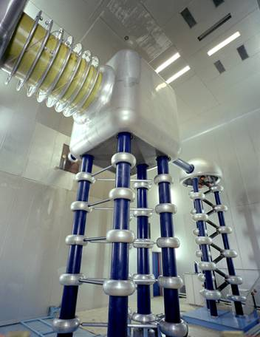
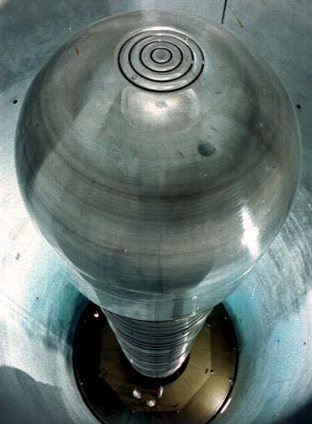
Potential-Drop Accelerators
These accelerators use at static, DC, potential difference between two conductors to impart a kinetic energy
L
+q
Earliest particle accelerators were the Cockcroft-Walton generator and the Van de Graaff generator
Highest voltage achieved is 25 MV
It is difficult to establish and maintain a static DC field of 20+ MV
E
+
-
100 ft
Van de Graff (tandem) generator
Cockroft-Walton generator

Slide 20
Cyclotron (Larmor) frequency
Frequency weakly depends on particle energy (for non-relativistic particles)
Led to invention of a cyclotron

Slide 21

The Cyclotron Concept
Sinusoidal voltage source
S
+
N
E
+
S
S
S
+
The Recipe:
A magnetic field to bend a particle around.
A sinusoidally varying electric field.
+

Slide 22
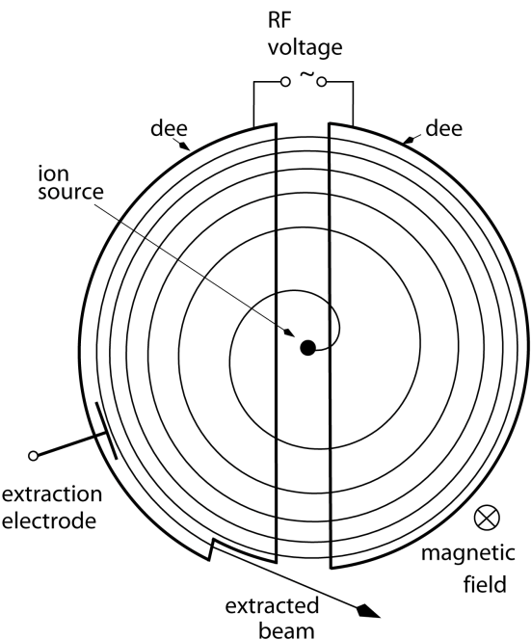
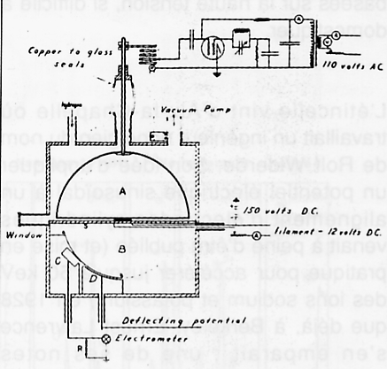
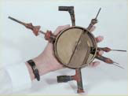
The First Cyclotron
First cyclotron (1931):
1 kV gap voltage
80 kV protons
4.5” in diameter

Slide 23
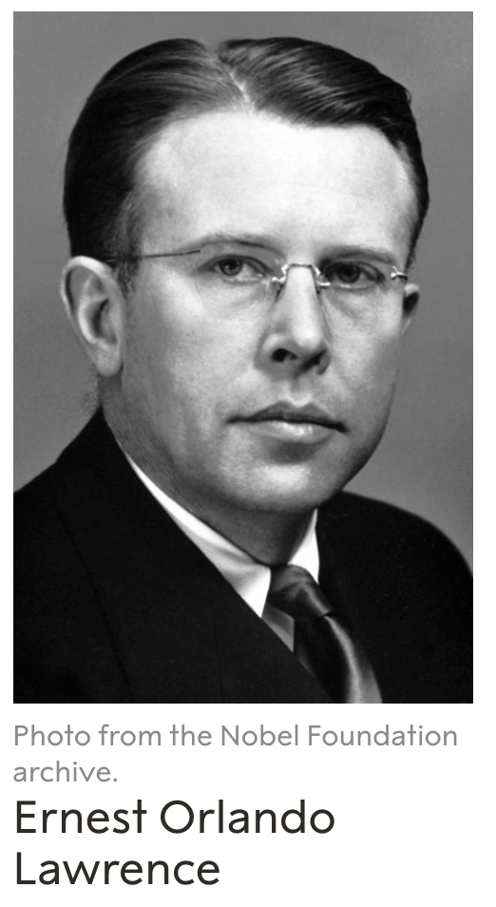
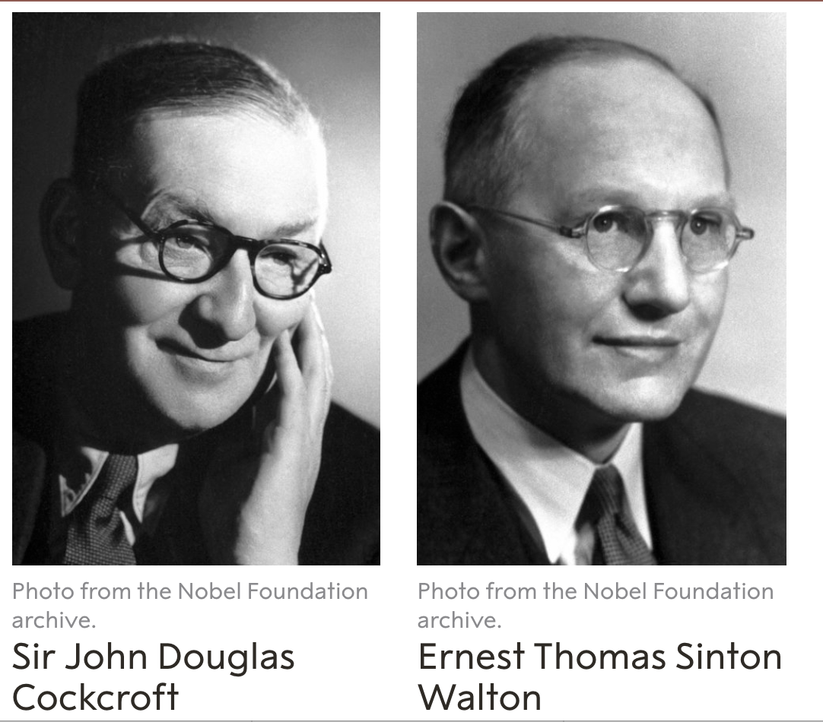
Origins of Accelerator Physics Earn Two Nobels
Two Nobels were awarded for advent of accelerator technologies
Nobel 1939
Nobel 1951
"for the invention and development of the cyclotron and for results obtained with it, especially with regard to artificial radioactive elements."
"for their pioneer work on the transmutation of atomic nuclei by artificially accelerated atomic particles."
https://history.aip.org/
Photo courtesy Lawrence Berkeley Lab

Slide 24
Acceleration by repeated application of time-varying accelerating fields
Two approaches for accelerating with time-varying fields
v
v
E
E
E
E
Circular Accelerators
Use one or a small number of Radio-frequency accelerating cavities and make use of repeated passage through them. This approach is realized in circular accelerators: Cyclotrons, synchrotrons and their variants
Linear Accelerators
Use many accelerating cavities through which the particle beam passes once:
These are linear accelerators

Slide 25
Beam rigidity
Beam rigidity plays an important role in beam dynamics. For example, the LHC beam is pc = 7 TeV.

Slide 26
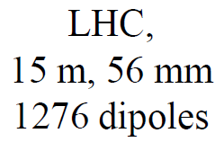
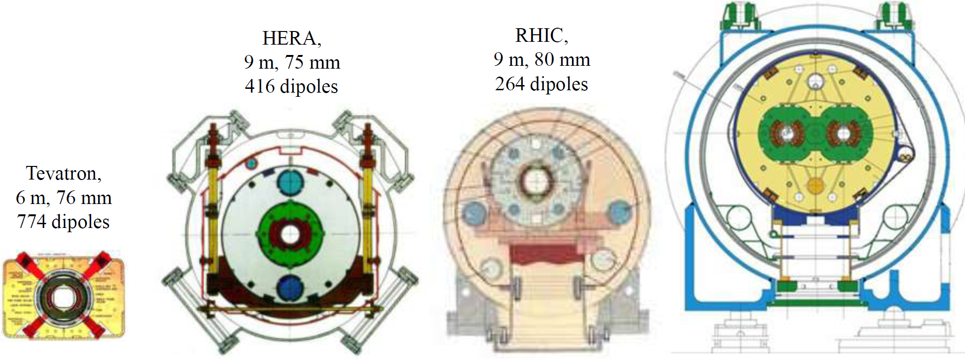
SC dipoles
8.3T
4.5T
5.3T
3.5T
4.5 K He, NbTi
+ warm iron small He-plant
NbTi cable
cold iron
Al collar
NbTi cable
simple & cheap
NbTi cable
2K He
two bores

Slide 27
EIC Accelerator Design Overview
Hadron storage ring (HSR): 40-275 GeV (existing)
  up to 1160 bunches, 1A avg beam current (3x RHIC, polarized)
  bright vertical beam emittance (1.5 nm); new vac sleeves
  hadron beam cooling
Electron storage ring (ESR): 5–18 GeV (new)
  up to 1160 polarized bunches
    high polarization by continual reinjection from RCS
  2.5 A avg beam current ➔ 9 MW SR power
  superconducting RF cavities
Rapid cycling synchrotron (RCS): 0.4-18 GeV (new)
  2 bunches at 1 Hz; spin transparent due to high periodicity
High luminosity interaction region (new; future 2nd IR)
  L = 10³⁴ cm⁻²s⁻¹ = 10 kHz-uba, superconducting magnets
  25 mrad crossing angle with crab cavities/crab crossing
  spin rotators (produce longitudinal polarization at IP)
Compare to 50 MW at FCC
Current 6x NSLS-II
Future 2nd
Detector
Location
Primary
Detector
Location

Slide 28
Notes:
LHC design 0.58A p (HL up to 1A), beam-beam parameter 3.4e-4 (3-5—3 HL-LHC)

Slide 29
Luminosity
Interaction rate per unit cross-section
For Gaussian cross-sections

Slide 30
Paraxial approximation in beams
Linear approximation for all transverse forces.
Ray transfer matrix analysis for beam optics
  Similar to light optics.
Thin lens
Drift space

Slide 31
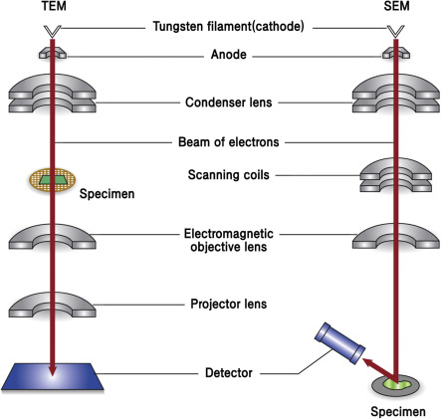
Example: electron microscopes
Various axially-symmetric lenses are used in EM’s

Slide 32
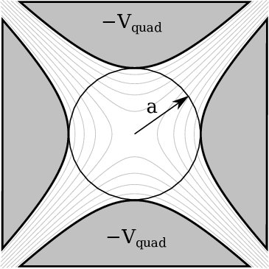
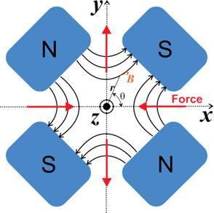
Quadrupoles
Consider examples of lenses:
  Electrostatic quadrupole
  Magnetostatic quadrupole

Slide 33
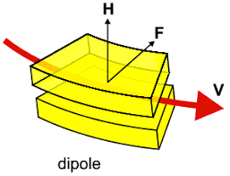
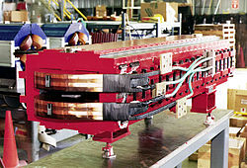
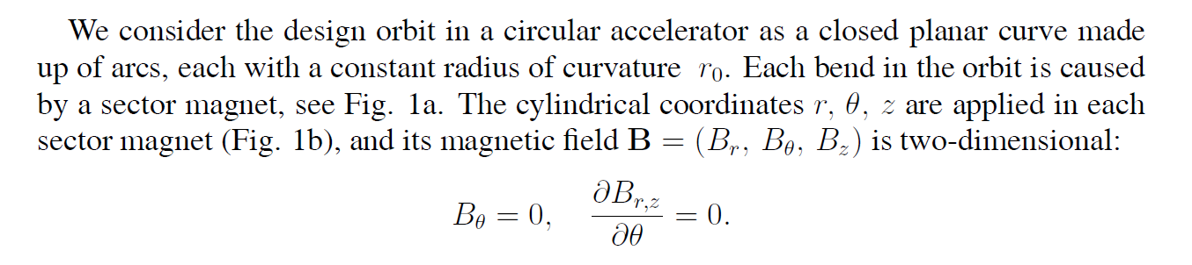
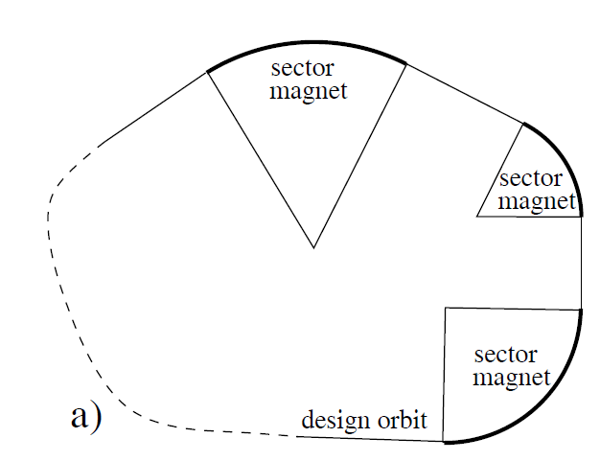
Bends (dipole magnets)

Slide 34
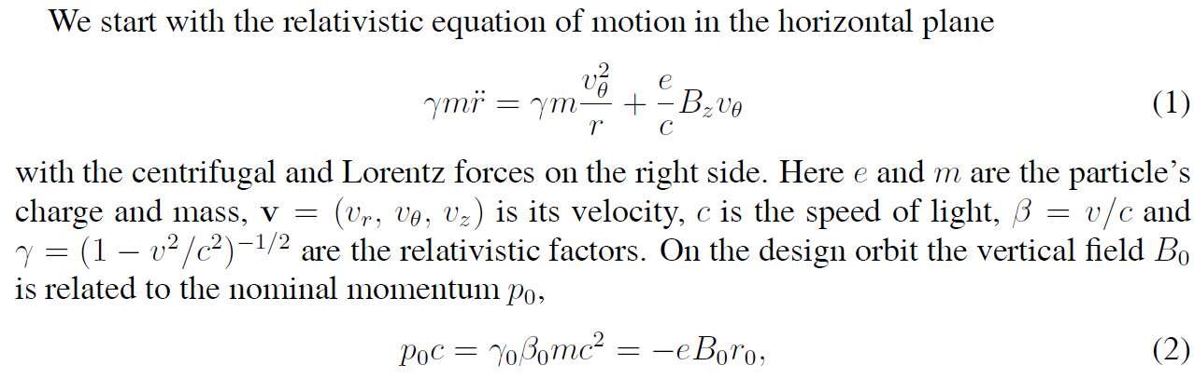
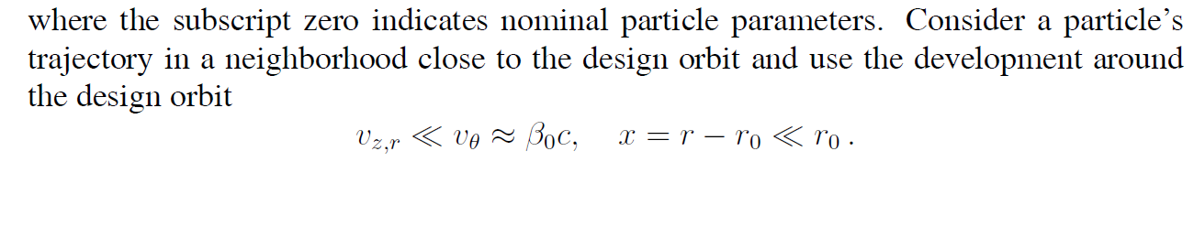
Dipole magnets
-

Slide 35
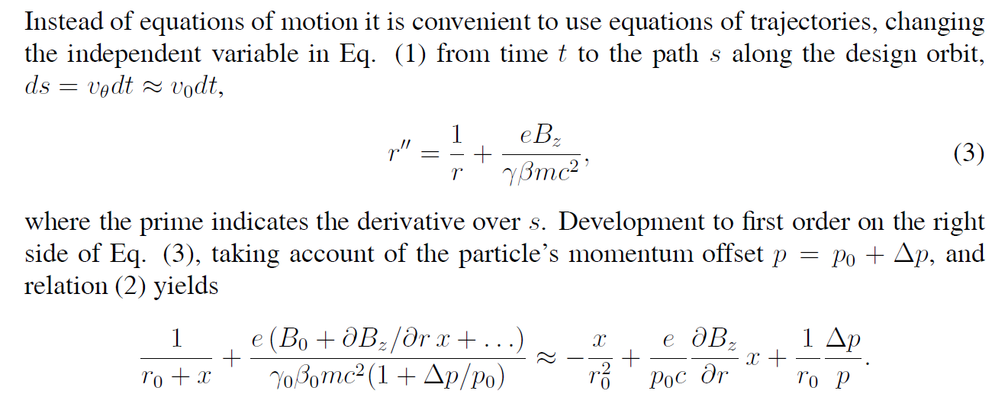
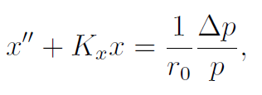
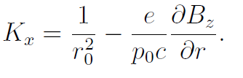
Dipole magnets
-
-
-
Thus, for x we obtain
+

Slide 36

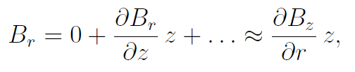
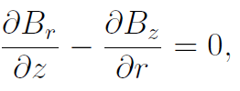
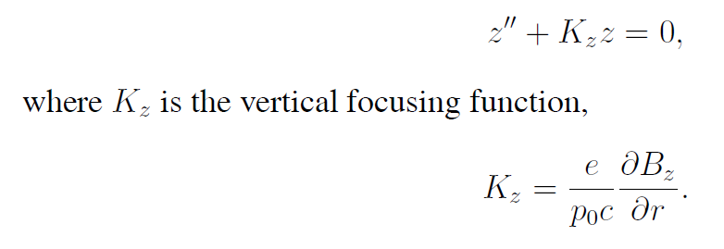
Dipole magnets
For z we have similar
-

Slide 37
Matrix elements
Drift space:
Harmonic oscillator:

Slide 38
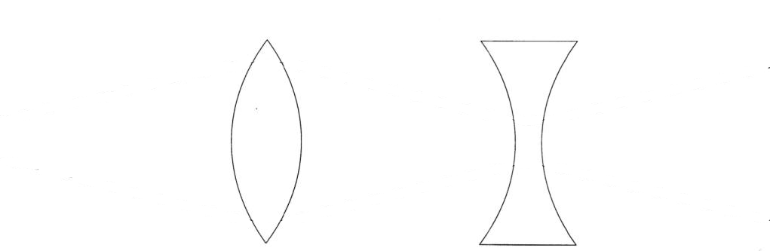
FODO
By convention horizontal focusing/defocusing is shown; vertical is opposite
Most accelerator lattices (including EIC) are designed in modular ways
  Design and operational clarity, separation of functions
One of the most common modules is a FODO module
  Alternating focusing and defocusing “strong” quadrupoles
  Spaces between are combinations of drifts and dipoles
  Strong quadrupoles dominate the focusing
  Periodicity is one FODO “cell”
  Horizontal beam size largest at centers of focusing quads
  Vertical beam size largest at centers of defocusing quads

Slide 39
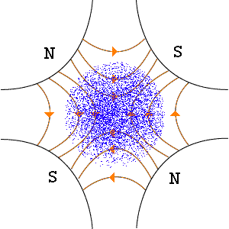
How To Get Net-Focusing from Quadrupoles???
The key is to alternate focusing and defocusing quadrupoles. This is called a FODO lattice (Focus-Drift-Defocus-Drift). :

Slide 40
Synchrotrons: Periodic Focusing Systems
Periodic focusing systems with periodic boundary conditions
  A long academic history!
  Solid state, quantum mechanics...
Periodic 1D linear focusing system
  Hill’s Equation (homogeneous)
  Overall synchrotron is periodic, as are repeated FODO “cells”
Symmetry is locally broken for “insertions”
  Match boundary conditions between sections with different K values (focusing)

Slide 41
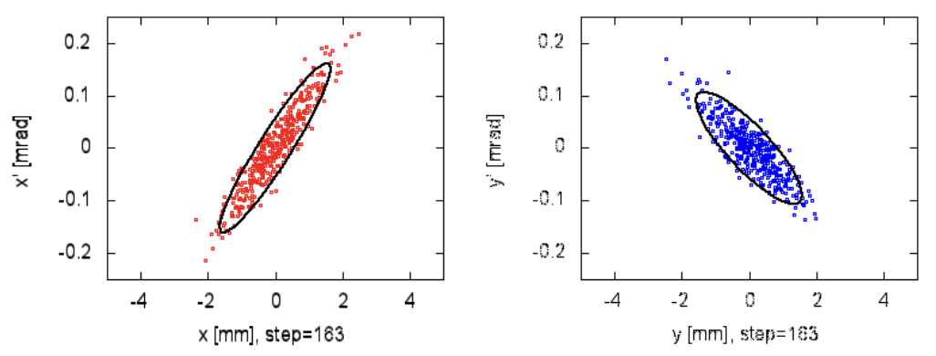
Phase Space and Emittance
Equations of motion are second-order differential equations
Like classical mechanics, particle trajectories are determined by their equation of motion (Hill’s equation) and two initial conditions
  Horizontal x’,y’ are angles
  Vertical
x’,y’ are small for high-energy accelerators
  Paraxial optics approximations apply
Transverse distributions are usually Gaussian
  RMS distribution ellipse area: emittance [mm-mrad]
Longitudinal similar but different

Slide 42
Notes:
LHC design 0.58A p (HL up to 1A), beam-beam parameter 3.4e-4 (3-5—3 HL-LHC)

Slide 43
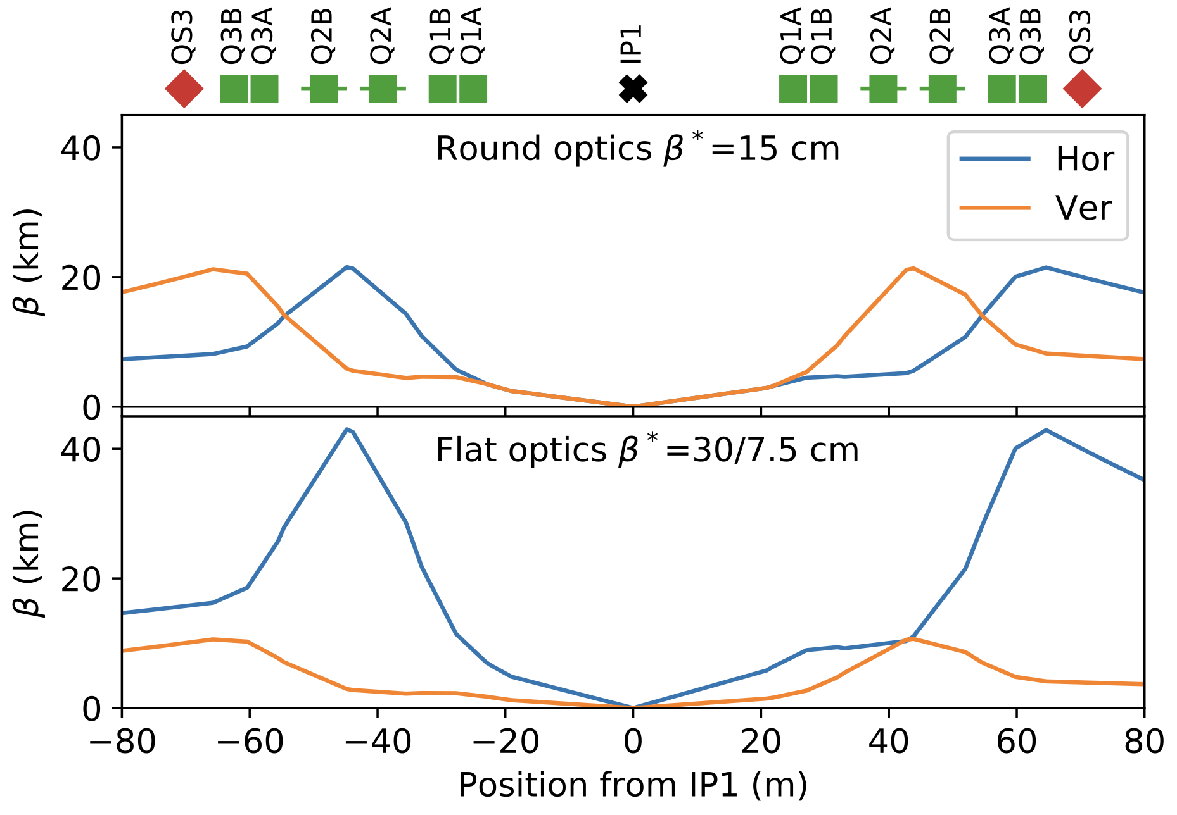
Beta star
magnets
beam
Beam size depends on emittance and optics “beta”:
  Look for kinks in beta function plots
PHYS. REV. ACCEL. BEAMS 23, 041001 (2020)

Slide 44
Beta in Free Space
Can minimum beam size be achieved in ”free space”
  Yes! We can demonstrate in free space
  Design tensions:
    Low beta* for high luminosity
    Proximity of quadrupoles to IP
    Large-aperture quads feasibility/quality
    (Beam divergence near IP; ”hourglass”)
    (Downstream secondary focus)

Slide 45



EIC Primary Interaction Region
Existing tunnel and
experiment halls
Focusing (quads)
as close to IP as
possible (~5m!)
Tensions in magnet
requirements:
high field
large apertures
e/p magnet
proximity near IP
Chromaticity:
focusing dependence
on particle energy
”Rear side”
Different
axis scales!
”Forward side”
25 mrad crab crossing
A. Parker (SULI)
D. Higinbotham

