Slide 1
EIC Accelerator Physics
- part 2
Christoph Montag, BNL
CFNS Stony Brook, 6/7/2024

Slide 2
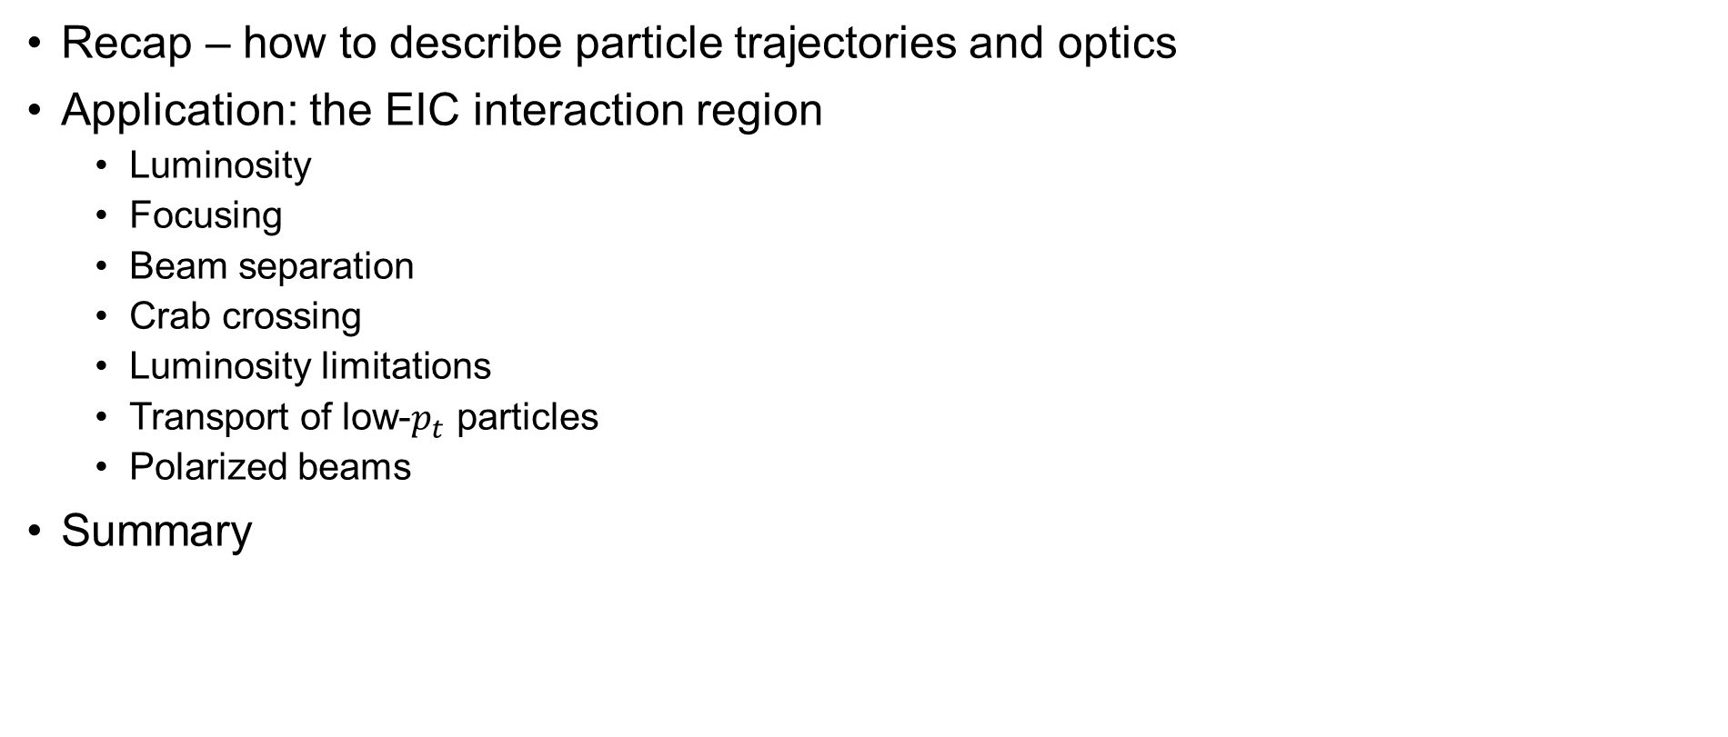
Outline
Recap – how to describe particle trajectories and optics
Application: the EIC interaction region
  Luminosity
  Focusing
  Beam separation
  Crab crossing
  Luminosity limitations
  Transport of low-$p_{t}$ particles
  Polarized beams
Summary
CFNS 2024
Christoph Montag

Slide 3
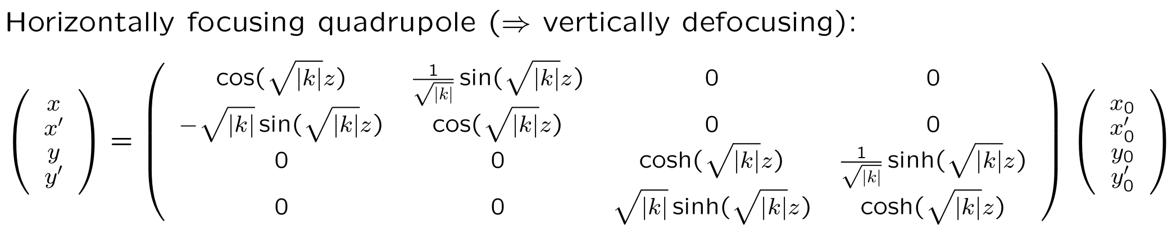
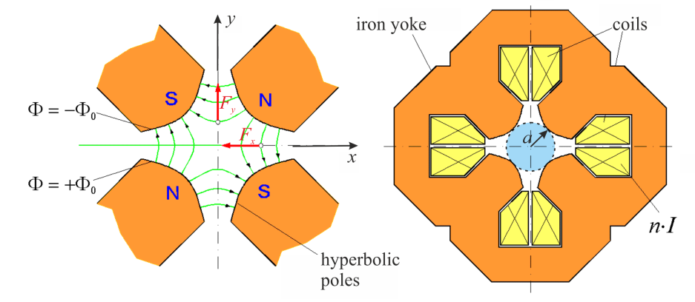
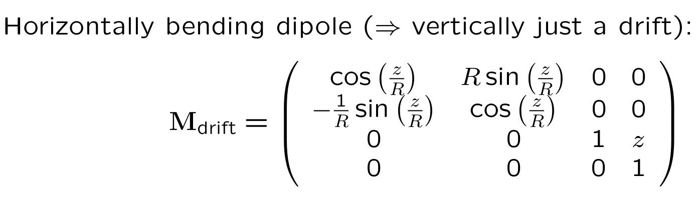
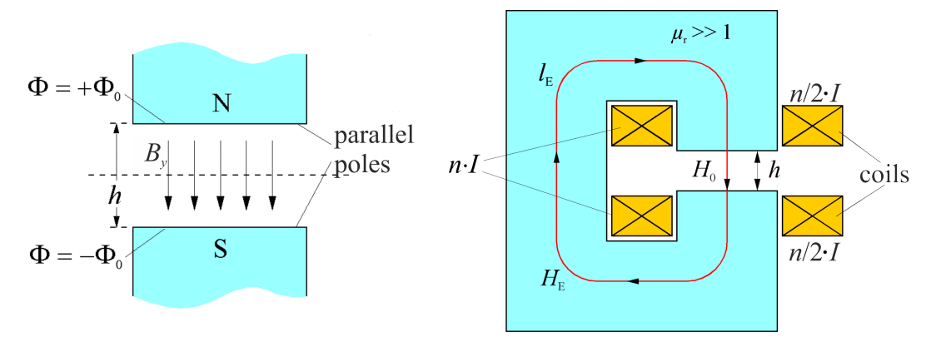
Recap – what have we learned so far?
(Linear) motion of single particles is described by transfer matrices:

Slide 4
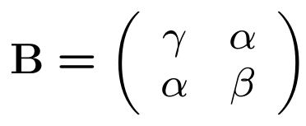

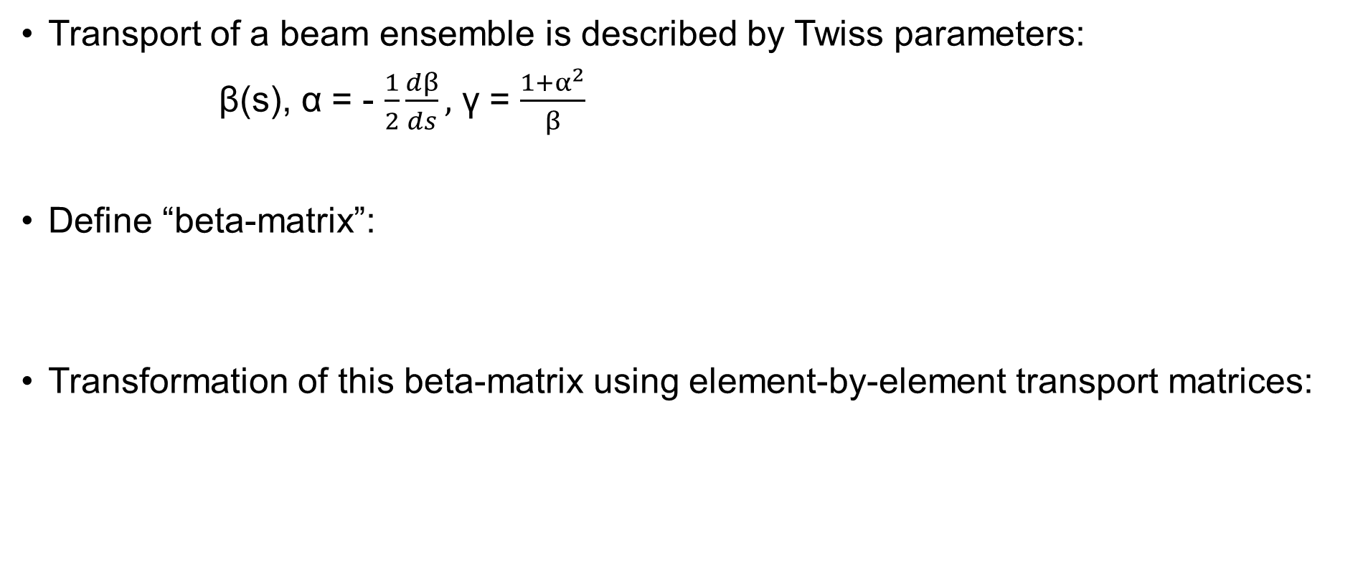
Transport of a beam ensemble is described by Twiss parameters:
β(s), α = - $\frac{1}{2}\frac{dβ}{ds},$ γ = $\frac{1+α^{2}}{β}$
Define “beta-matrix”:
Transformation of this beta-matrix using element-by-element transport matrices:

Slide 5
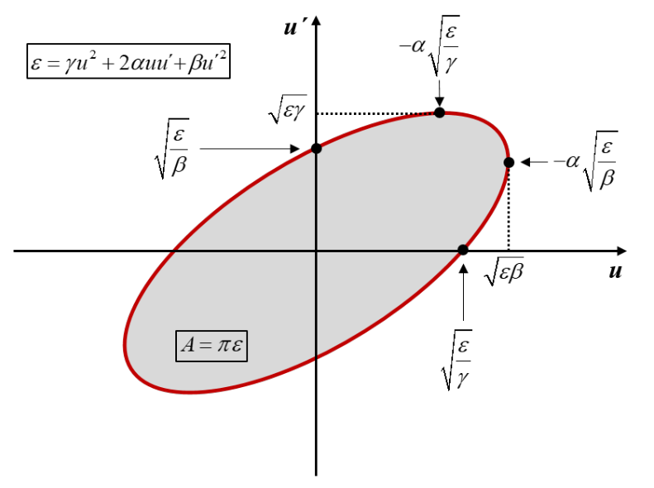
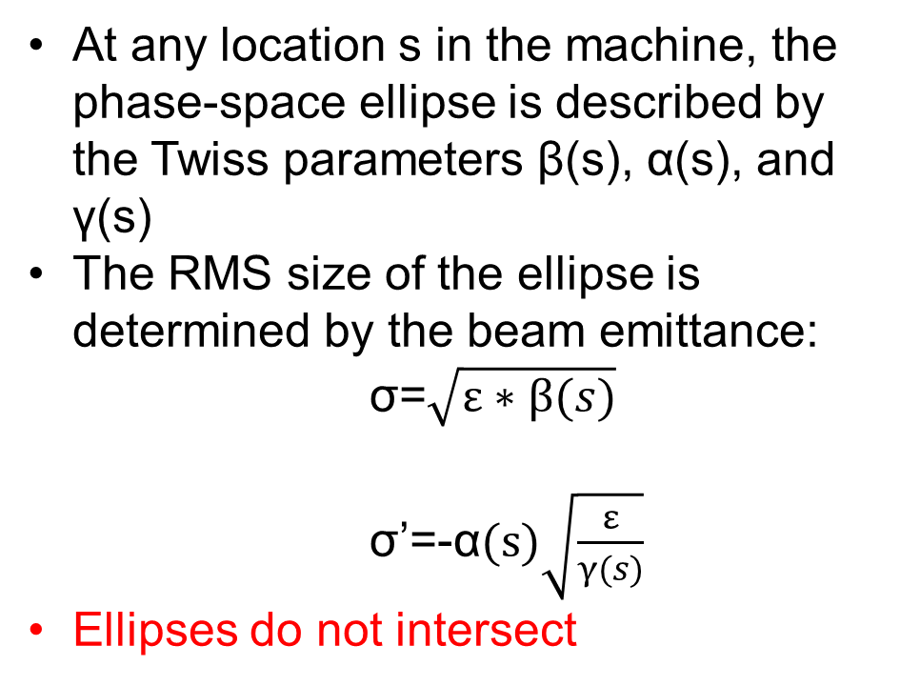
The Phase-space Ellipse
At any location s in the machine, the phase-space ellipse is described by the Twiss parameters β(s), α(s), and γ(s)
The RMS size of the ellipse is determined by the beam emittance:
σ=$\sqrt{ε∗β(s)}$
σ’=-α$(s)\sqrt{\frac{ε}{γ(s)}}$
Ellipses do not intersect

Slide 6
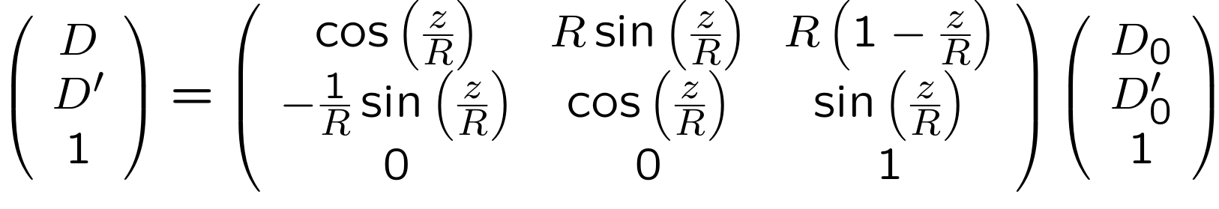
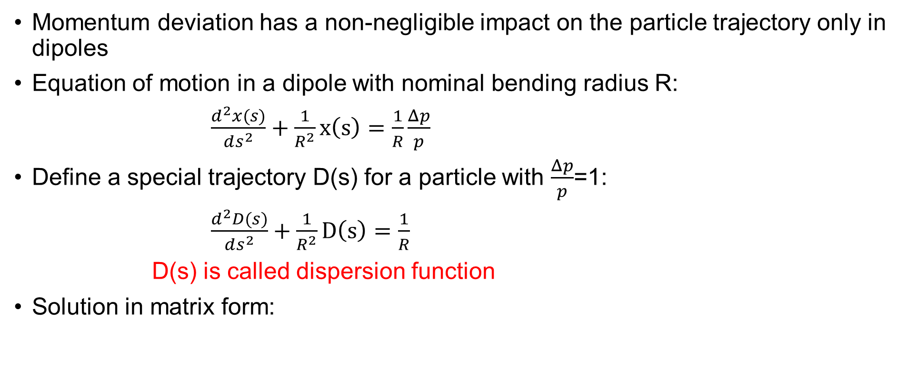
Dispersion
Momentum deviation has a non-negligible impact on the particle trajectory only in dipoles
Equation of motion in a dipole with nominal bending radius R:
$\frac{d^{2}x(s)}{ds^{2}}+\frac{1}{R^{2}}x\left(s\right)=\frac{1}{R}\frac{Δp}{p}$
Define a special trajectory D(s) for a particle with $\frac{Δp}{p}$=1:
$\frac{d^{2}D(s)}{ds^{2}}+\frac{1}{R^{2}}D\left(s\right)=\frac{1}{R}$
D(s) is called dispersion function
Solution in matrix form:

Slide 7
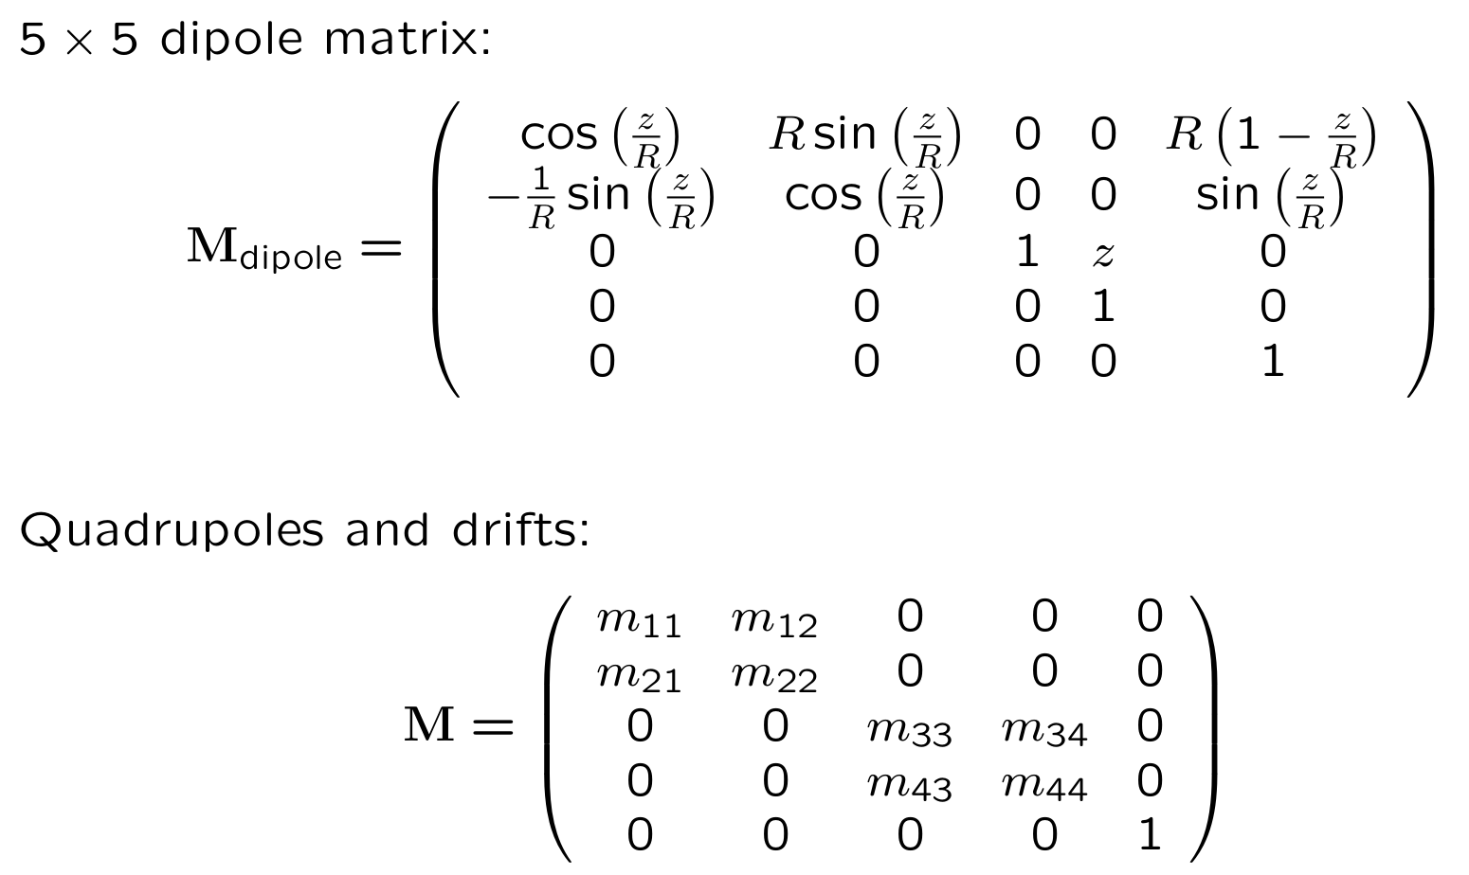
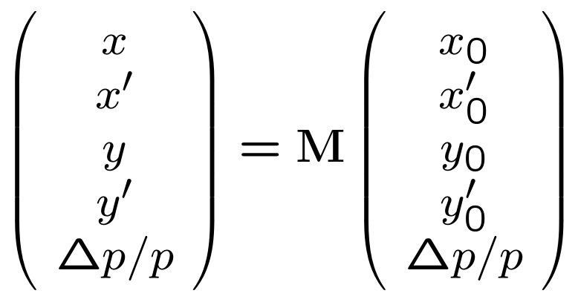

To describe the trajectory of an off-momentum particle, we add a 5th row and column to the 4x4 transport matrices:
The relative momentum offset $\frac{Δp}{p}$ is added as a 5th coordinate to the coordinate vector

Slide 8
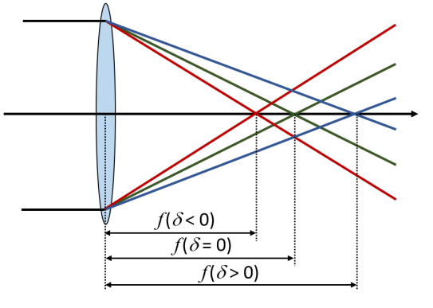
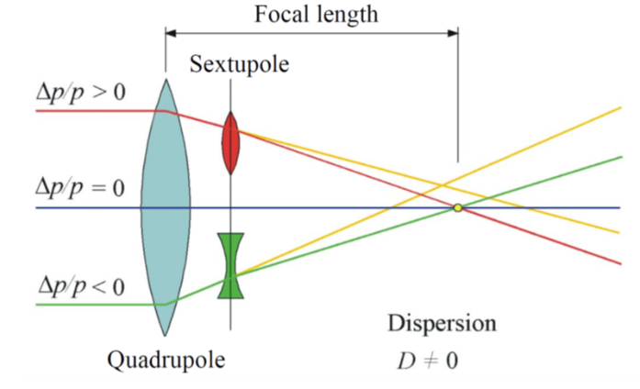
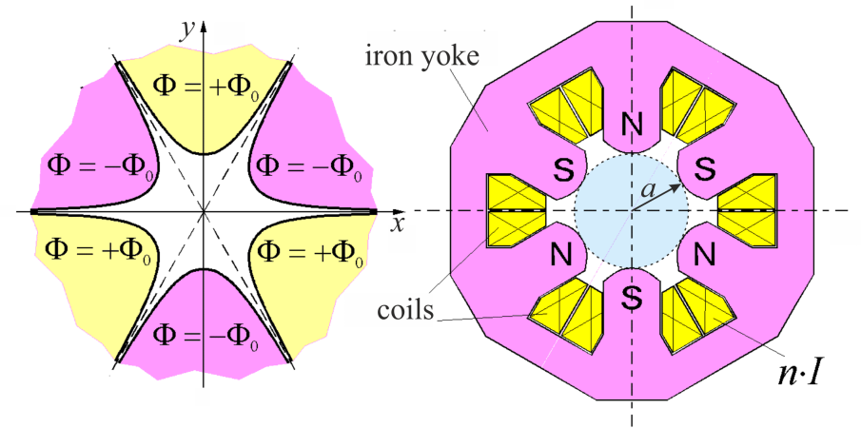
Chromaticity
Momentum offsets result in focusing errors – “chromaticity”
Particles with higher momentum get under-focused, those with lower momentum are over-focused
Chromaticity is proportional to the quadrupole strength, and to the β-function at that quadrupole
These focusing errors are corrected using sextupoles
Particles are transversely sorted by momentum due to dispersion
A sextupole can be considered a “position-dependent quadrupole”

Slide 9
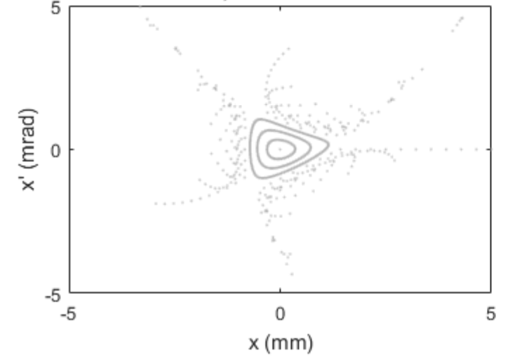
Dynamic Aperture
Sextupoles are non-linear elements
While small amplitude dynamics is still (almost) linear, large amplitude motion becomes more and more non-linear
Beyond a certain threshold, particle motion is unstable and particles are lost
This threshold is called “dynamic aperture”
Note: non-linear multipole errors due to magnet imperfections impact dynamic aperture as well

Slide 10
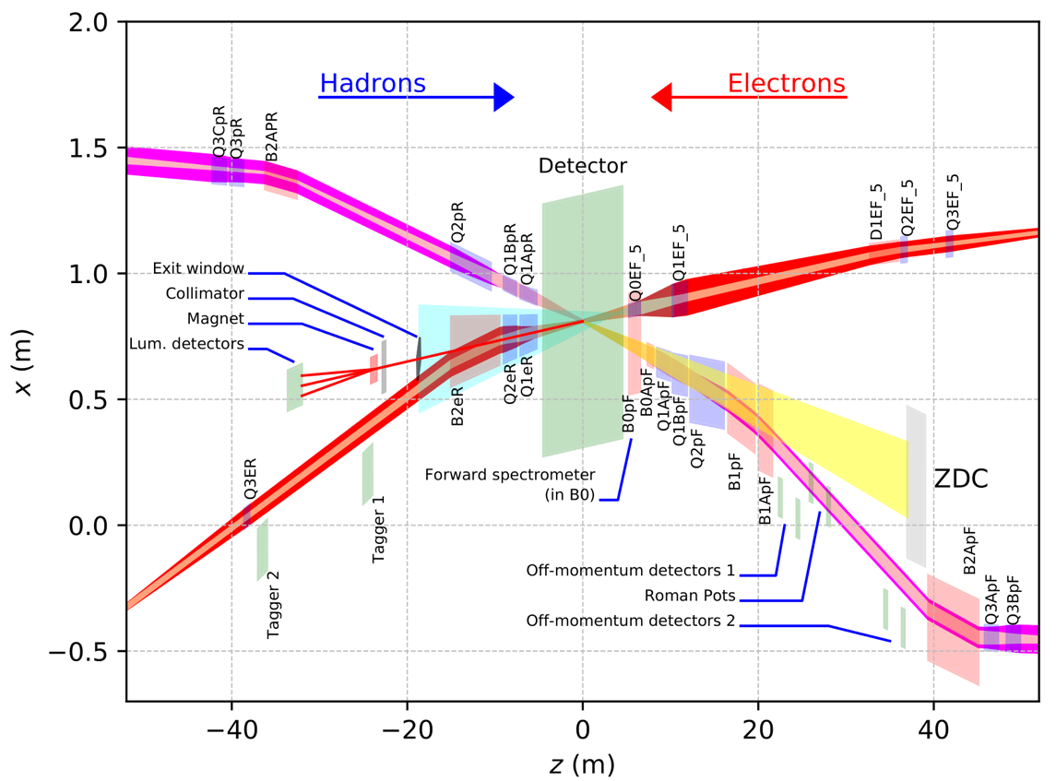
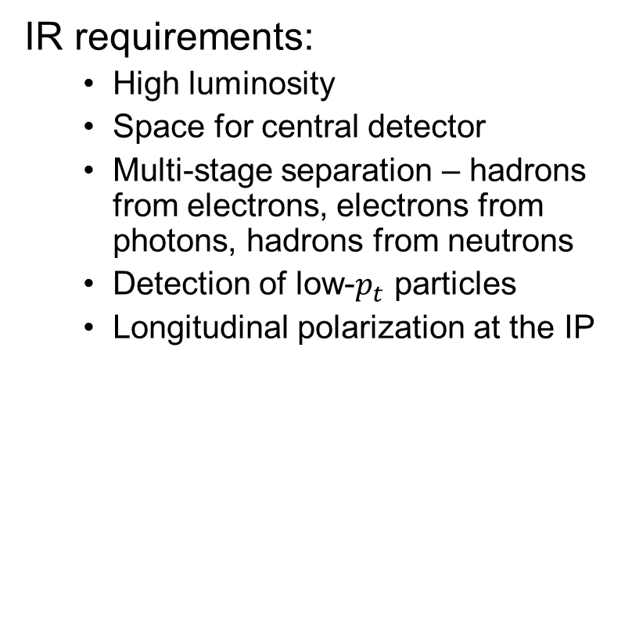
Tying it all Together - the Interaction Region
IR requirements:
  High luminosity
  Space for central detector
  Multi-stage separation – hadrons from electrons, electrons from photons, hadrons from neutrons
  Detection of low-$p_{t}$ particles
  Longitudinal polarization at the IP
”Rear side”
”Forward side”
Note different axis scales!

Slide 11
Luminosity
Maximize collision frequency (~100 MHz)
  Limited by kicker rise times
  Limited by parasitic collisions, injection system, etc.
Maximize particles per bunch (~10¹¹)
  Limited by sources, space charge
  Limited by collective effects
    Interaction of beam with impedances
    Also total currents: I_{1,2}=q_{1,2}N_{1,2}f_{coll} ~1-3A
Minimize beam sizes at IP (~100/10 um)
  Limited by IR focusing, magnets
  Limited by chromatic dynamic aperture
  Limited by emittance growth (IBS)

Slide 12
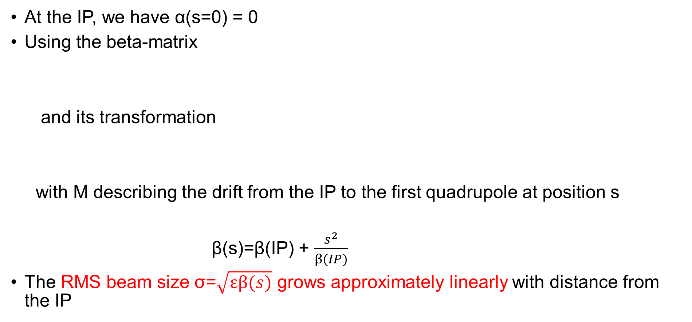
IR Focusing
At the IP, we have α(s=0) = 0
Using the beta-matrix
and its transformation
with M describing the drift from the IP to the first quadrupole at position s
β(s)=β(IP) + $\frac{s^{2}}{β(IP)}$
The RMS beam size σ=$\sqrt{εβ(s)}$ grows approximately linearly with distance from the IP

Slide 13
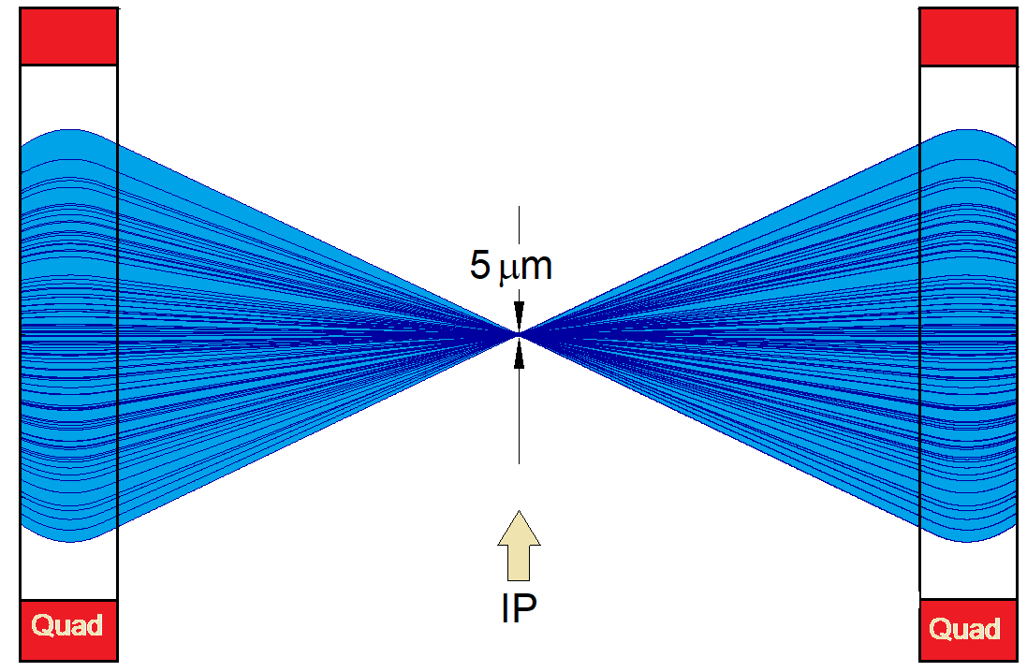
Important consequence:
The smaller β(IP), the larger it (and the beam) get at the first quadrupole
With the first quadrupole outside the central detector, s = 5 meters
The required quadrupole strength (=gradient) is nearly independent of β(IP), but the magnet aperture has to accommodate the large beam
Large aperture at fixed gradient means high magnetic fields at the poles
superconducting IR magnets
Reasonable limit is about 6 T at the pole
Also remember: chromaticity is proportional to β
need stronger sextupoles
reduced dynamic aperture

Slide 14
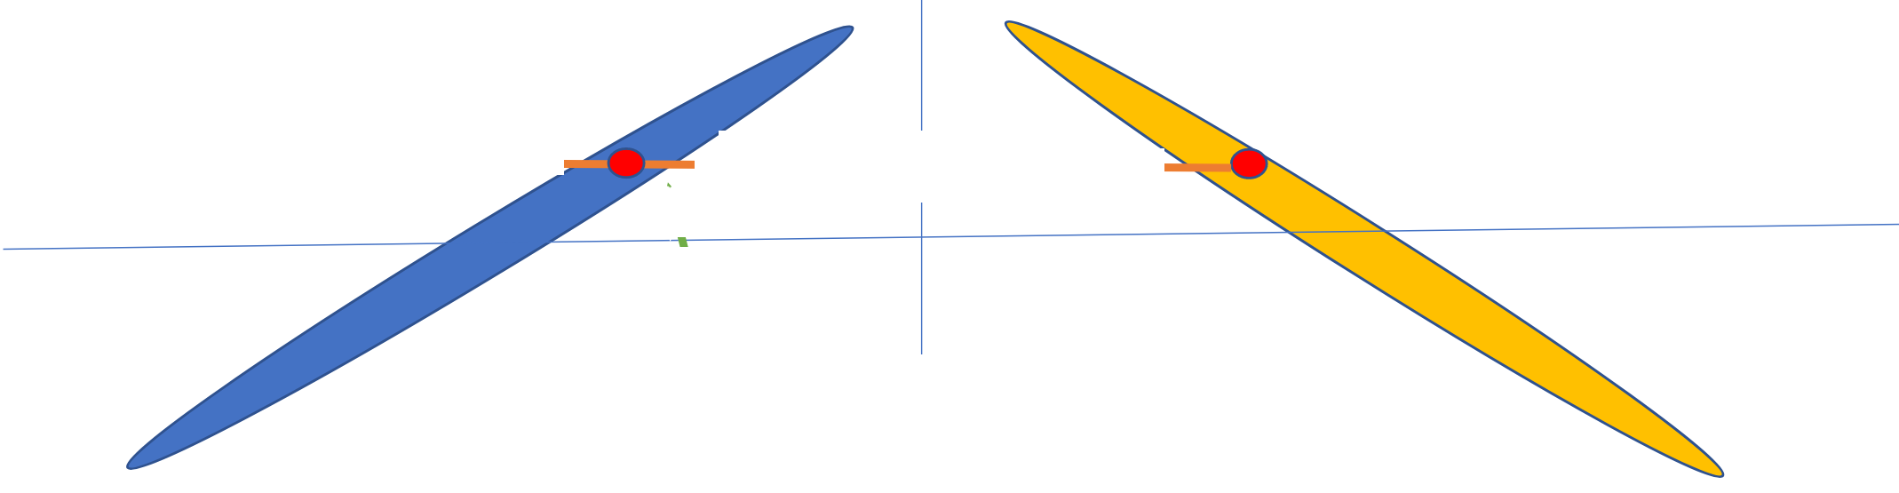
Beam Separation
Electron and hadron beams in EIC have vastly different energies
they need separate focusing channels at the IR
beams need to be separated close to the IP
Most effective, simple separation is a crossing angle (EIC: 25 mrad total crossing angle)
However, a crossing angle reduces the
overlap between the two beams and
therefore the luminosity

Slide 15
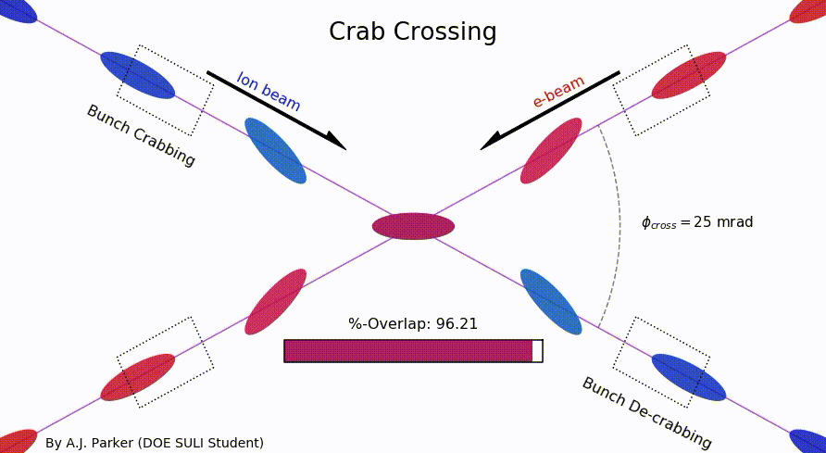
Crab Crossing
To restore head-on collisions despite the crossing angle, head and tail of each bunch are kicked in opposite directions when they approach the IP, using “crab cavities”
As a result, electron and hadron bunches are lined up with each other at the IP, as in a head-on collision scheme
This kick (or rotation) has to be un-done after leaving the IP
Note: “crab crossing” does not only restore the luminosity loss caused by the crossing angle, but it is also necessary for stable beam dynamics

Slide 16
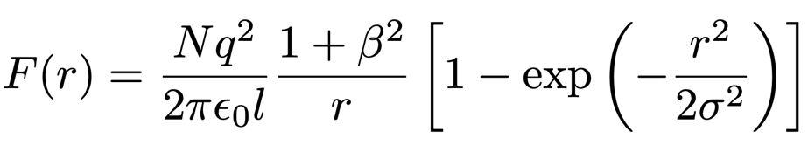
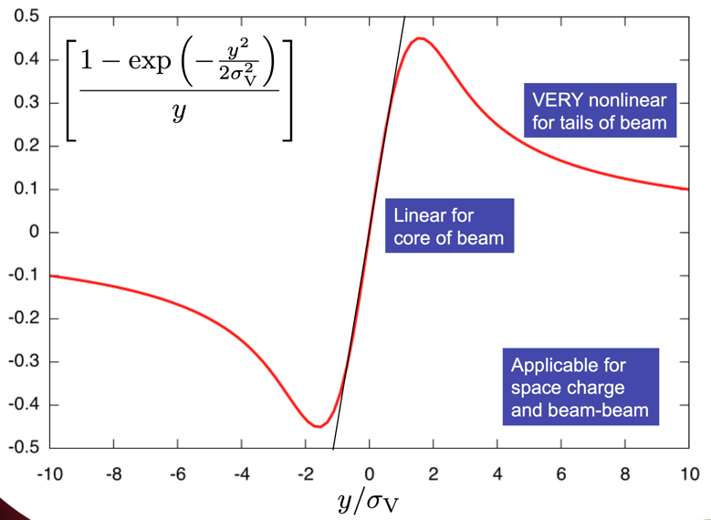
Luminosity Limitations: Beam-Beam
Colliding beams see each other’s collective charge distributions
Creates nonlinear beam-beam force and equation of motion similar to space charge
  Force is almost linear within ~1σ around beam center
  Highly nonlinear beyond ~1σ
  Vanishes for large amplitudes
  Amplitude dependent focusing
  Amplitude dependent tune
Tolerable “beam-beam tune spread” of 0.015 for hadrons, 0.1 for electrons limits highest EIC luminosity

Slide 17
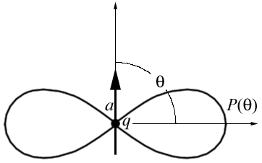
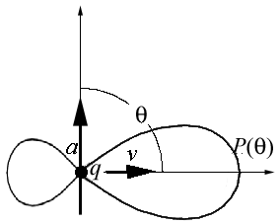
Lumi Limitations: Electron SR Power
Accelerated charged particles emit photons
  Electrons in synchrotron: radially accelerated
  Synchrotron radiation emitted in forward cone
    Cone opening angle
    Radiated power
  scaling much worse for electrons
    18 GeV e: =3.5x10⁴ vs 255 GeV p: =3x10²
Design: 9 MW @ 18 GeV (facility limit 10 MW)
Expensive: Power must be provided by SRF
Dipole Radiation
Perpendicular to charge acceleration
Radial
acceleration
Relativistic Boost
Synchrotron Radiation
Relativistically boosted dipole radiation

Slide 18
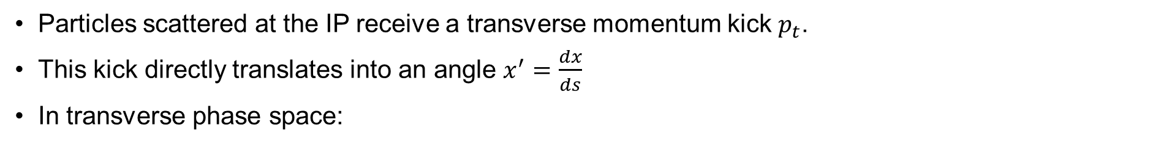
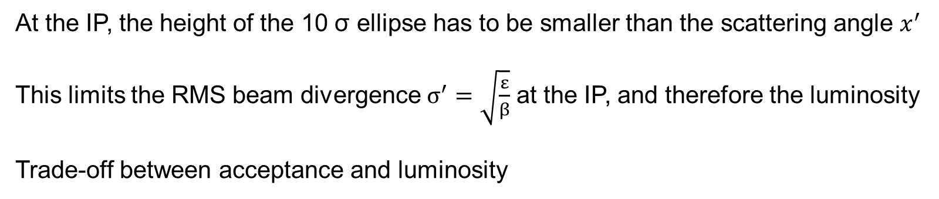
Transport of low-$p_{t}$ particles
Particles scattered at the IP receive a transverse momentum kick $p_{t}$.
This kick directly translates into an angle $x^{′}=\frac{dx}{ds}$
In transverse phase space:
A scattering event kicks the particle on a new phase space ellipse – same shape as before, same center, but different size
For detection at transverse position x at a Roman pot, this ellipse has to be “outside” the beam – typically at 10 σ
At the IP, the height of the 10 σ ellipse has to be smaller than the scattering angle $x^{′}$
This limits the RMS beam divergence $σ^{′}=\sqrt{\frac{ε}{β}}$ at the IP, and therefore the luminosity
Trade-off between acceptance and luminosity

Slide 19
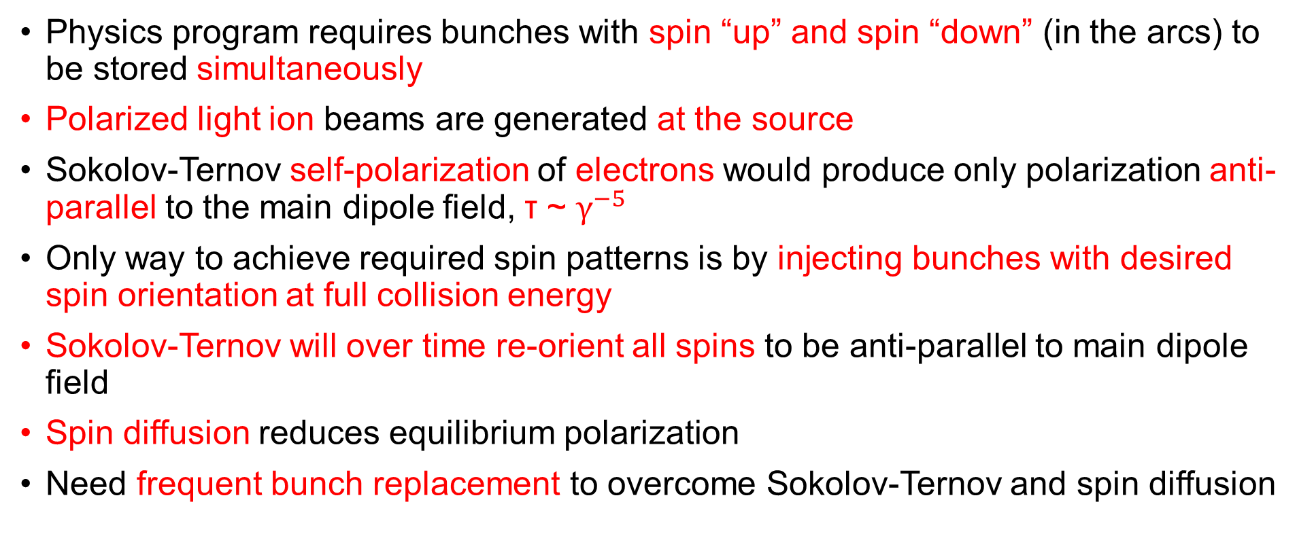
Polarized Beams
Physics program requires bunches with spin “up” and spin “down” (in the arcs) to be stored simultaneously
Polarized light ion beams are generated at the source
Sokolov-Ternov self-polarization of electrons would produce only polarization anti-parallel to the main dipole field, τ ~ $γ^{−5}$
Only way to achieve required spin patterns is by injecting bunches with desired spin orientation at full collision energy
Sokolov-Ternov will over time re-orient all spins to be anti-parallel to main dipole field
Spin diffusion reduces equilibrium polarization
Need frequent bunch replacement to overcome Sokolov-Ternov and spin diffusion

Slide 20
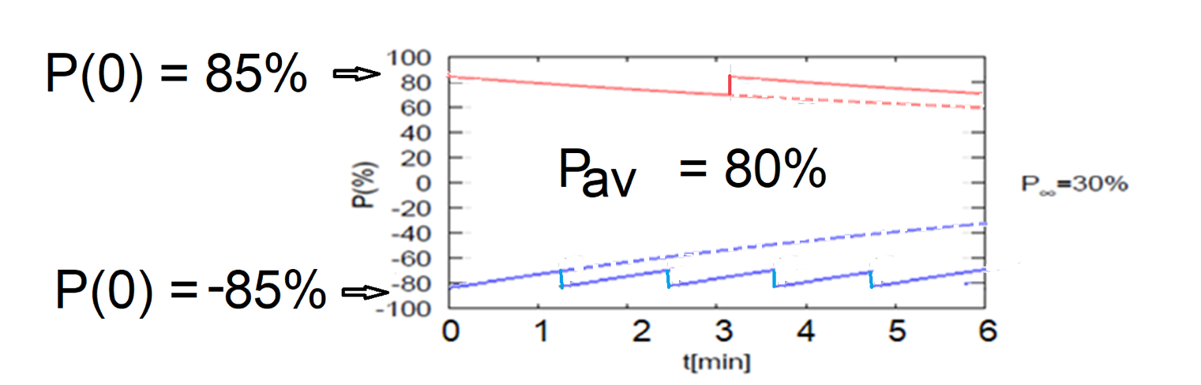
High Average Electron Polarization
Frequent injection of bunches with high initial polarization of 85%
Initial polarization decays towards P∞ < ~50%
At 18 GeV, every bunch is replaced (on average) after 2.2 min with RCS cycling rate of 2Hz
B P
B P
Refilled every 1.2 minutes
Refilled every 3.2 minutes
Re-injection
P_{av}=80%
P∞= 30%
(conservative)
P_{av}=80%
Re-injections

Slide 21
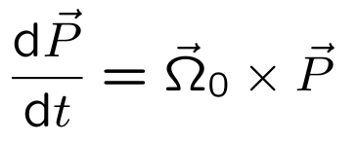
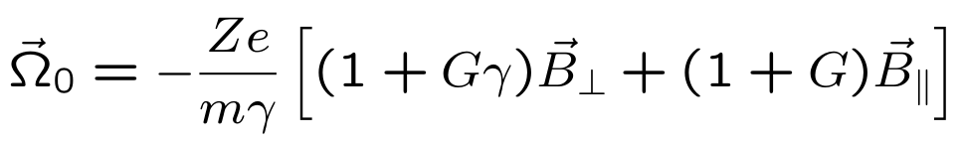
Spin Manipulation
Spin precession in magnetic fields is described by the Thomas-BMT equation
with
Spins want to be aligned with magnetic field lines
An orbit bending angle φ in a transverse field results in a spin rotation by Gγ*φ. Gγ is called the “spin tune”
Polarization in the arcs is vertical
Spin precession can be utilized to manipulate spin orientation

Slide 22
Polarization on the Ramp – Siberian Snakes
Depolarizing resonances lead to polarization loss on the ramp
In a nutshell, each particle in the beam samples magnetic fields with varying directions as it travels around the machine, which rotate the spin slightly away from the ideal, vertical direction
Over many turns, these effects would accumulate, and polarization would be lost
A “Siberian snake” rotates the spins by 180 degrees, so they point in the opposite direction. Simplest realization is a solenoid magnet.
As a result, the spin motion during one turn is (largely) reversed on the next turn, thus counteracting depolarizing effects
Caution: This is a severely simplified, hand-waving explanation of the effect of Siberian snakes! In reality, multiple snakes are needed to preserve polarization

Slide 23
Spin Rotators
Spins are vertical in the arcs, but experiments want longitudinal spin
Need spin rotators
For hadrons, helical dipoles serve as spin rotators (not covered here)
For electrons, spin rotators consist of a combination of solenoids and dipoles:
  Vertical spin from the arc is rotated into radial direction by a solenoid. The solenoid strength has to be matched to the beam energy
  A well-defined net dipole bending angle φ between solenoid and IP rotates the spin by 90 degrees into the longitudinal direction, using Gγ*φ=π/2
  On the opposite side of the IP, this process is reversed so spins are vertical in the arc again

Slide 24
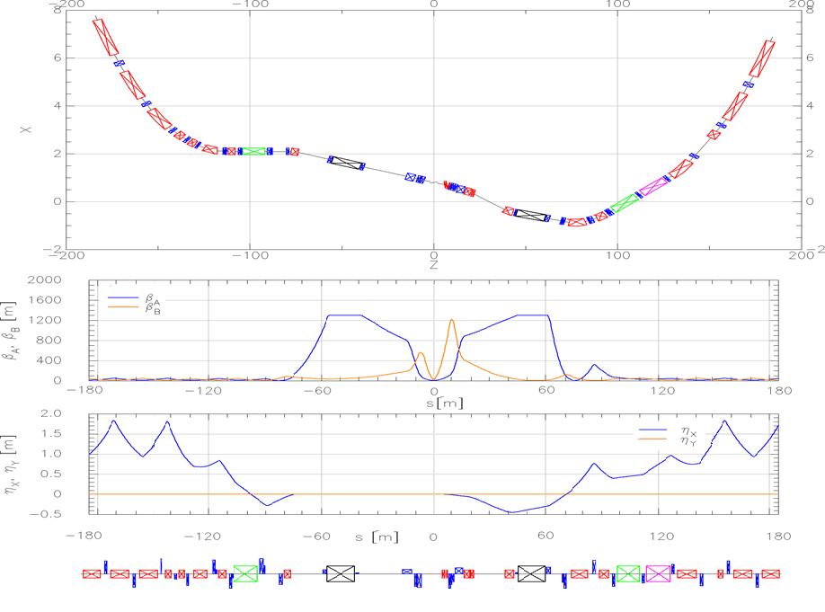
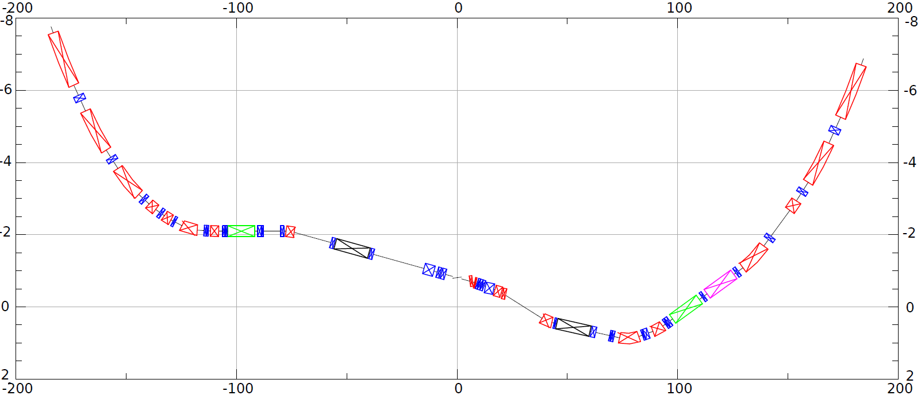
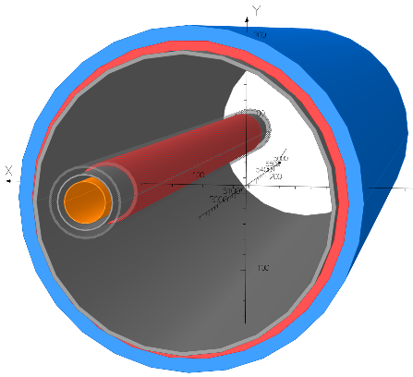
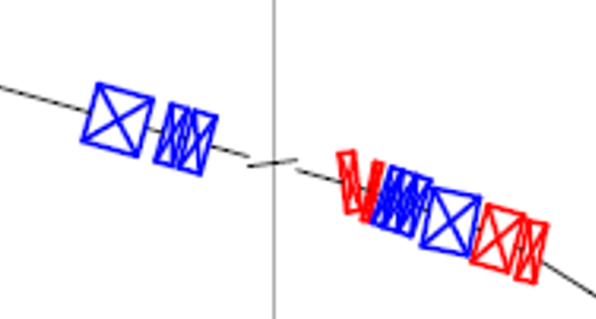
HSR layout in IR6
Forward and rear hadron lattice matched into RHIC
  Snake at correct angle
  Beta = 1300m at crab cavities
    Hor. phase advance 90º
  Matching Magnets
    Mostly repurposed RHIC magnets
    few additional magnets required (some SC)
    Some need re-cryostating
h
HSR Arc
Crab–in
Crab –out
HSR Arc
Spin
Rotator
Snake
matching
Off momentum Detectors
Spin Rotator
ESR Lumi-Monitor
matching
Approximate ESR path
Zero Deg Calorimeter
Detector region
B0pF spectrometer
Nov 2021 layout
3 Dipoles and 3 Quadrupoles in one shared cryostat

Slide 25
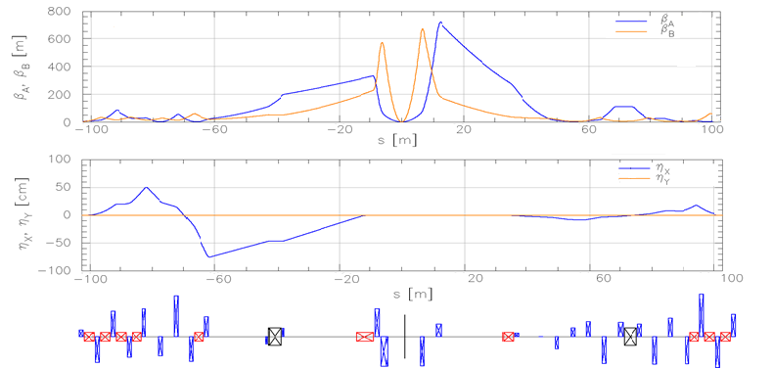
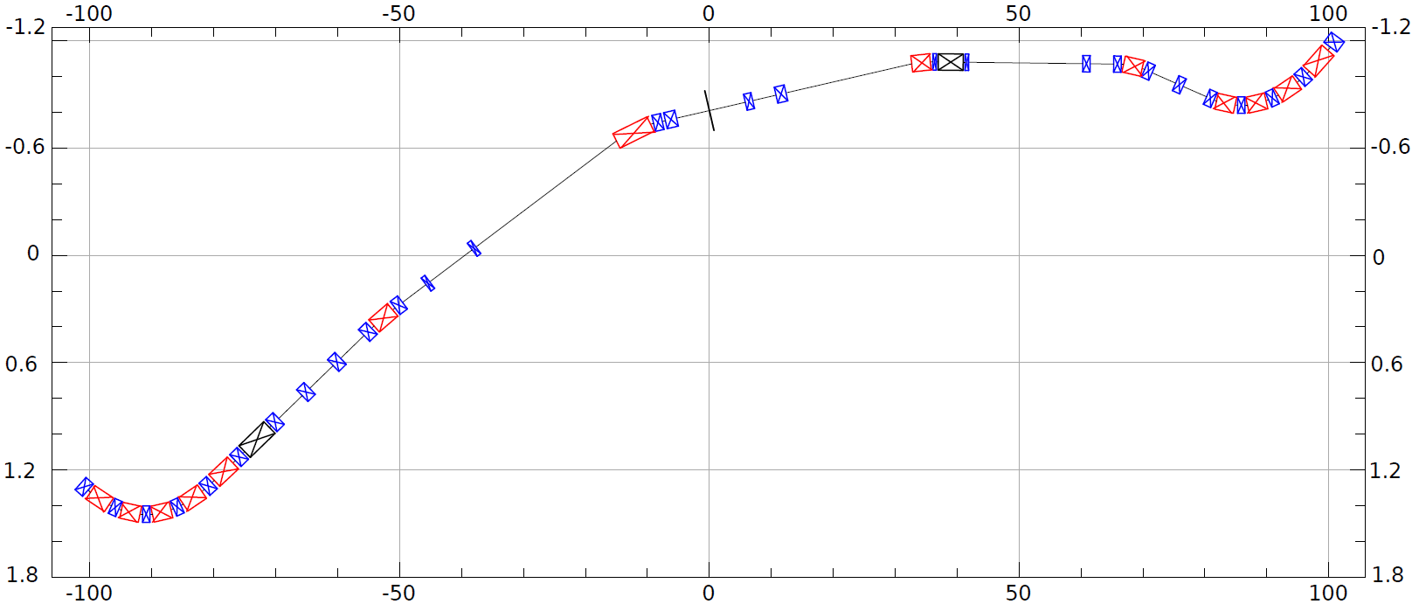
ESR layout in IR6
Design to:
Provide room for detector components
Mitigate synchrotron radiation issues
Provide longitudinal spin (new spin rotators)
Match into the arcs
Provide conditions for crabbing
Allow 3 rings and beam elements
e
~130m
Spin Rotation Solenoids
6GeV
Crab –in
IP Focusing
18GeV
Lumi-Monitor
B2eR
~130m
Spin Rotation Solenoids
E-taggers
Polarimeter Laser
Detector region
Longitudinal spin
B1eF
Crabbed beam.
Crab–out

Slide 26
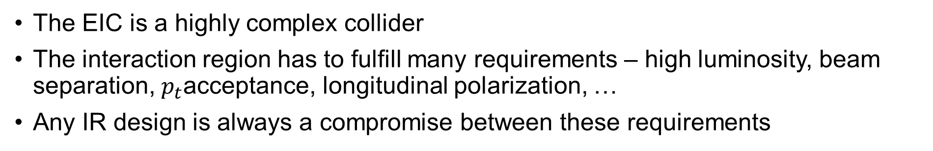
Summary
The EIC is a highly complex collider
The interaction region has to fulfill many requirements – high luminosity, beam separation, $p_{t}$acceptance, longitudinal polarization, …
Any IR design is always a compromise between these requirements
Any Questions?

