Slide 1


Hadron Polarization
Frank Rathmann
Brookhaven National Laboratory
CFNS Summer School on Physics of the Electron-Ion Collider
June 14, 2024
frathmann@bnl.gov

Slide 2
Outline
Introduction: A Polarized Electron-Ion Collider
Polarized Particle beams
Hadron Polarimetry
Outlook / Summary

Slide 3




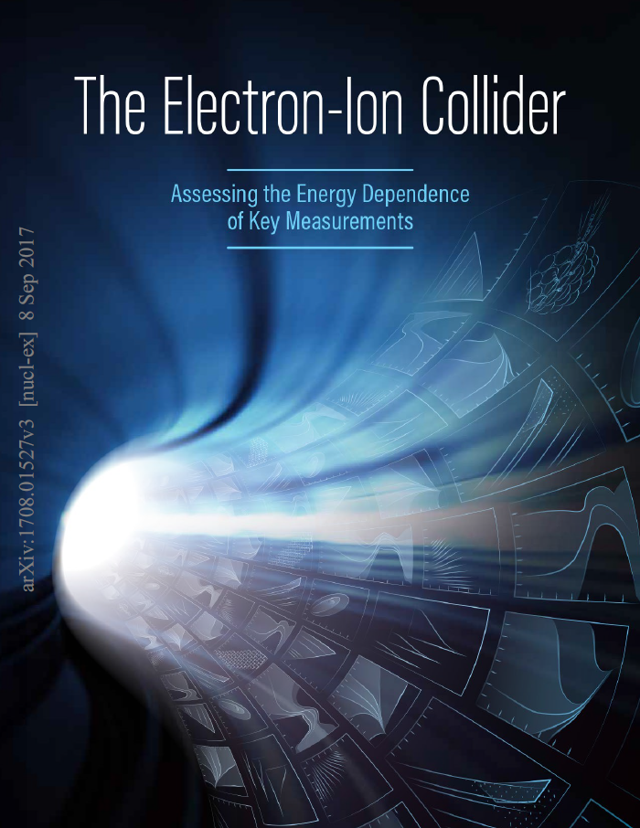




wiki.bnl.gov/EPIC/
❶ Emerging Nucleons
How are gluons, sea quarks, and their intrinsic spins distributed in space
and momentum in the nucleon?
❷ Nuclear Medium
How do colored quarks and gluons and colorless jets interact with the nuclear medium?
How does the nuclear environment affect quark and gluon distributions?
❸ Gluon Saturation
What happens to the gluon density at high energy?
Are the properties of a saturated gluonic state universal among all nuclei?
Nuclear Physics A1026 (2022) 122447

Slide 4
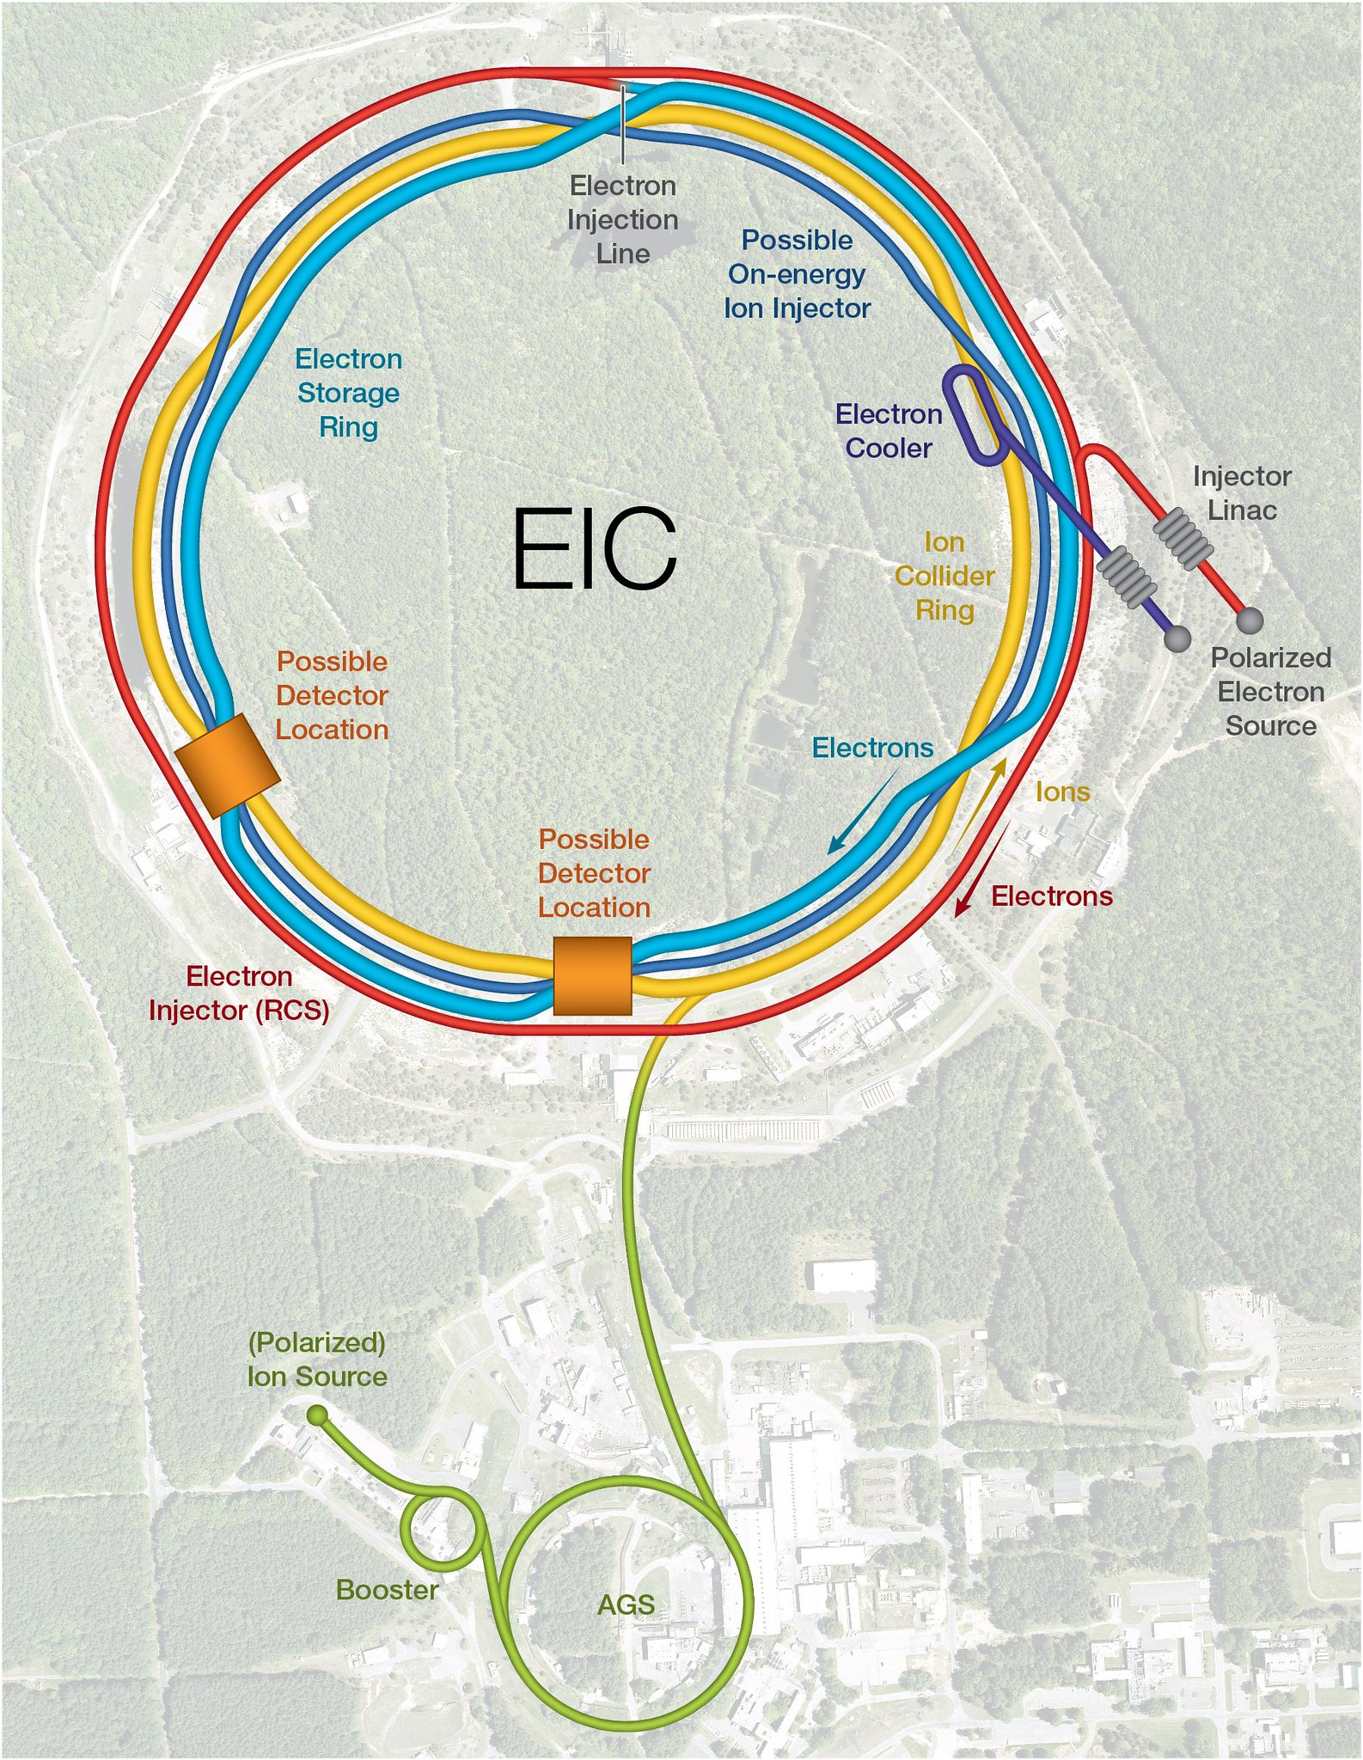
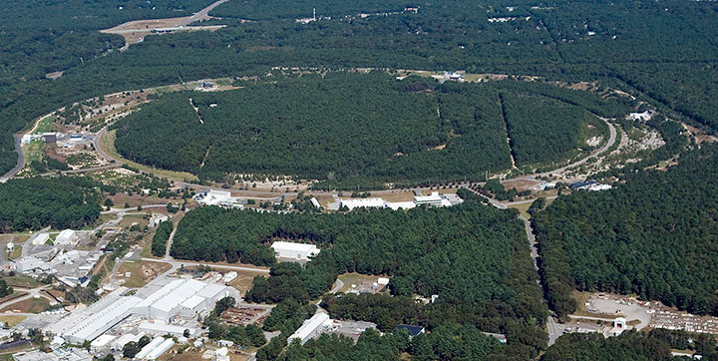
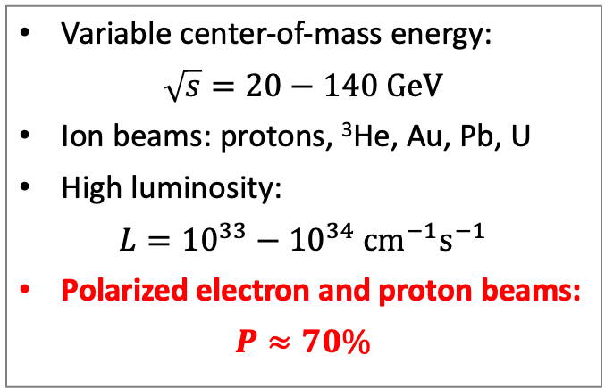
The Electron-Ion Collider
Variable center-of-mass energy:
$$\sqrt{s}=20−140 \text{GeV}$$
Ion beams: protons, ³He, $\text{Au}$, $\text{Pb}$, $\text{U}$
High luminosity:
$$L={10}^{33}−{10}^{34} {\text{c}\text{m}}^{−1}{\text{s}}^{−1}$$
Polarized electron and proton beams:
$$P≈70\%$$
Current location of RHIC at Brookhaven National Lab

Slide 5
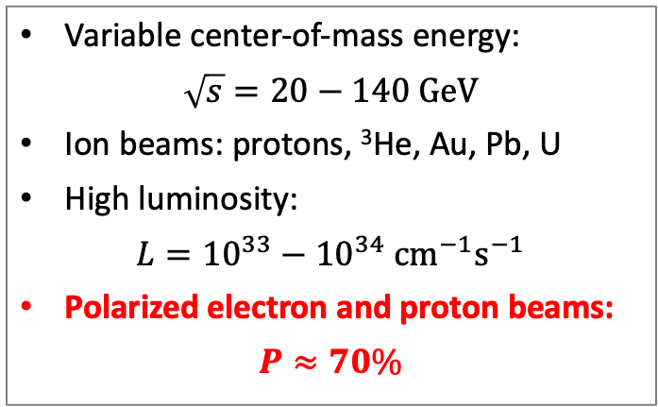
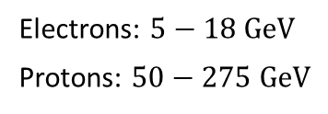
The Electron-Ion Collider
Variable center-of-mass energy:
$$\sqrt{s}=20−140 \text{GeV}$$
Ion beams: protons, ³He, $\text{Au}$, $\text{Pb}$, $\text{U}$
High luminosity:
$$L={10}^{33}−{10}^{34} {\text{c}\text{m}}^{−1}{\text{s}}^{−1}$$
Polarized electron and proton beams:
$$P≈70\%$$
protons
electrons
Electrons: $5−18 \text{GeV}$
Protons: $50−275 \text{Ge}\text{V}$

Slide 6
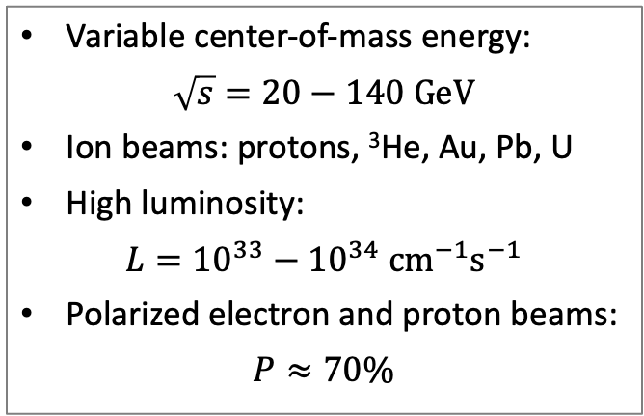
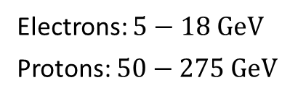
The Electron-Ion Collider
Variable center-of-mass energy:
$$\sqrt{s}=20−140 \text{GeV}$$
Ion beams: protons, ³He, $\text{Au}$, $\text{Pb}$, $\text{U}$
High luminosity:
$$L={10}^{33}−{10}^{34} {\text{c}\text{m}}^{−1}{\text{s}}^{−1}$$
Polarized electron and proton beams:
$$P≈70\%$$
Electrons: $5−18 \text{GeV}$
Protons: $50−275 \text{Ge}\text{V}$
But the energy of polarized protons leaving the source is only 10 keV…

Slide 7
2. Polarized High Energy Particle Beams

Slide 8
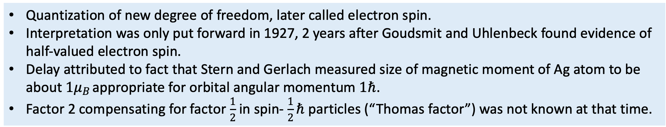
1922 Stern-Gerlach experiment
Setup and result of classical Stern-Gerlach experiment
Experiment showed for the first time the quantization of angular momentum:
Quantization of new degree of freedom, later called electron spin.
Interpretation was only put forward in 1927, 2 years after Goudsmit and Uhlenbeck found evidence of half-valued electron spin.
Delay attributed to fact that Stern and Gerlach measured size of magnetic moment of Ag atom to be about $1μ_{B}$ appropriate for orbital angular momentum $1ℏ$.
Factor 2 compensating for factor $\frac{1}{2}$in spin- $\frac{1}{2}ℏ$ particles (“Thomas factor”) was not known at that time.

Slide 9
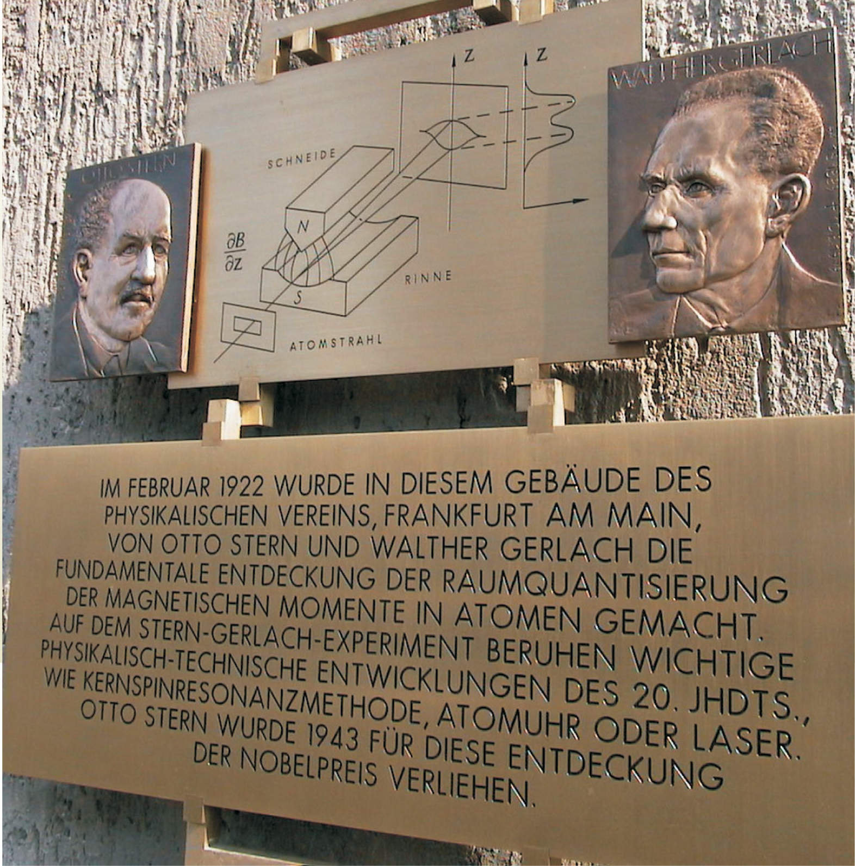
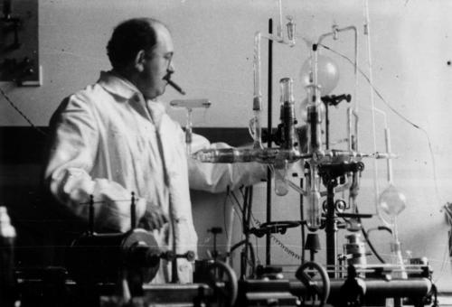

H. Schmidt-Böcking
Otto Stern “Physicist, lateral thinker, Nobel Prize winner”

Slide 10
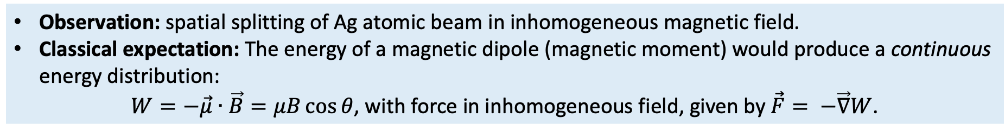
The classical Stern-Gerlach experiment
Observation: spatial splitting of Ag atomic beam in inhomogeneous magnetic field.
Classical expectation: The energy of a magnetic dipole (magnetic moment) would produce a continuous energy distribution:
$W=−\vec{μ}∙\vec{B}=μB\cos{θ}$, with force in inhomogeneous field, given by $\vec{F}= −\vec{∇}W$.
Surprisingly, two discrete energy values appeared:
  causing a deflection into an upper and a lower Ag spot.
  Quantum-mechanical dipole behaves completely different from a classical one.

Slide 11
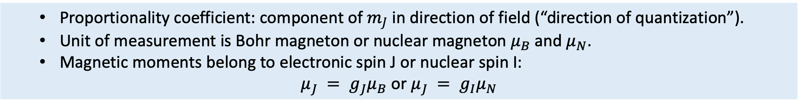
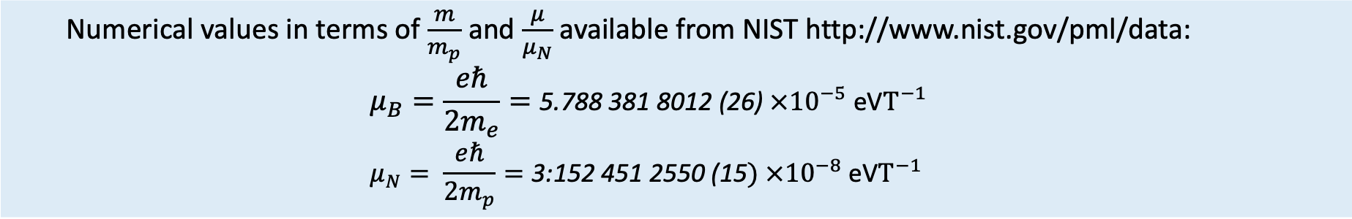
Magnetic moments $μ_{B}$ and $μ_{N}$
In a magnetic field, the energy of the system is proportional to the flux density $B$:
  Proportionality coefficient: component of $m_{J}$ in direction of field (“direction of quantization”).
  Unit of measurement is Bohr magneton or nuclear magneton $μ_{B}$ and $μ_{N}$.
  Magnetic moments belong to electronic spin J or nuclear spin I:
$μ_{J} = g_{J}μ_{B}$ or $μ_{J} = g_{I}μ_{N}$
Experimental values for Bohr magneton $μ_{B}$ and nuclear magneton $μ_{N}$
  Numerical values in terms of $\frac{m}{m_{p}}$ and $\frac{μ}{μ_{N}}$ available from NIST http://www.nist.gov/pml/data:
  $$μ_{B}=\frac{eℏ}{2m_{e}}=\text{5}\text{.}\text{788 381 8012 (26) }×{10}^{−5} \text{eV}T^{−1} \\ μ_{N}= \frac{eℏ}{2m_{p}}=\text{3:152 451 2550 (15}) ×{10}^{−8} \text{eV}T^{−1}$$
Convention
For positively charged particles and with $g > 0$ (e.g., protons) : spin and magnetic moment vectors are parallel.
For negatively charged particles (e.g., electrons) spin and magnetic moment vectors are antiparallel.

Slide 12
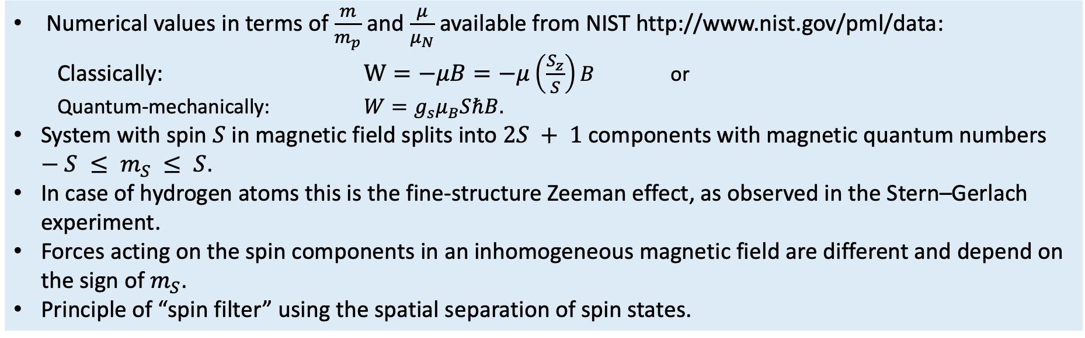
Separation of spin states in inhomogenous fields
The energy of a spin state $S$ in a magnetic field $B$ is:
Numerical values in terms of $\frac{m}{m_{p}}$ and $\frac{μ}{μ_{N}}$ available from NIST http://www.nist.gov/pml/data:
  Classically: $W=−μB=−μ\left(\frac{S_{z}}{S}\right)B$ or
  Quantum-mechanically: $W=g_{s}μ_{B}SℏB.$
System with spin $S$ in magnetic field splits into $2S + 1$components with magnetic quantum numbers $−S ≤ m_{S} ≤ S$.
In case of hydrogen atoms this is the fine-structure Zeeman effect, as observed in the Stern–Gerlach experiment.
Forces acting on the spin components in an inhomogeneous magnetic field are different and depend on the sign of $m_{S}$.
Principle of “spin filter” using the spatial separation of spin states.

Slide 13
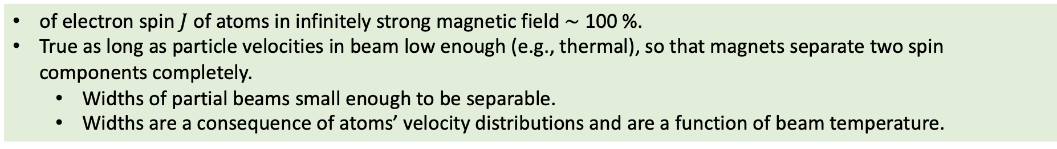
Sources of polarized atoms (ions)
For practical applications,
where high beam intensities are desired, Stern-Gerlach arrangement with separation in one dimension is replaced by systems with rotational symmetries, i.e., multipole fields.
Diaphragms eliminate the wrong components and transmit only the wanted states.
Stern-Gerlach filter acts as a nearly perfect polarizer.
Component with $m_{J}=±\frac{1}{2}$
of electron spin $J$ of atoms in infinitely strong magnetic field ∼ 100 %.
True as long as particle velocities in beam low enough (e.g., thermal), so that magnets separate two spin components completely.
  Widths of partial beams small enough to be separable.
  Widths are a consequence of atoms’ velocity distributions and are a function of beam temperature.

Slide 14
Energy levels of the H atom (not to scale!)
Fine structure: splitting of spectral lines due to electron spin and relativistic correction to Schrödinger Eq.
Lamb shift: interactions between virtual photons from vacuum energy fluctuations and electron moving around hydrogen nucleus in each of these two orbitals.
Hyperfine structure: arises from energy of nuclear magnetic dipole moment interacting with the magnetic field generated by the electrons.
Zeeman effect: splitting of a spectral line into several components in the presence of a static magnetic field.
Rydberg formula
Hyperfine
structure
Bohr
Fine Structure
Lambshift
Zeeman effect

Slide 15
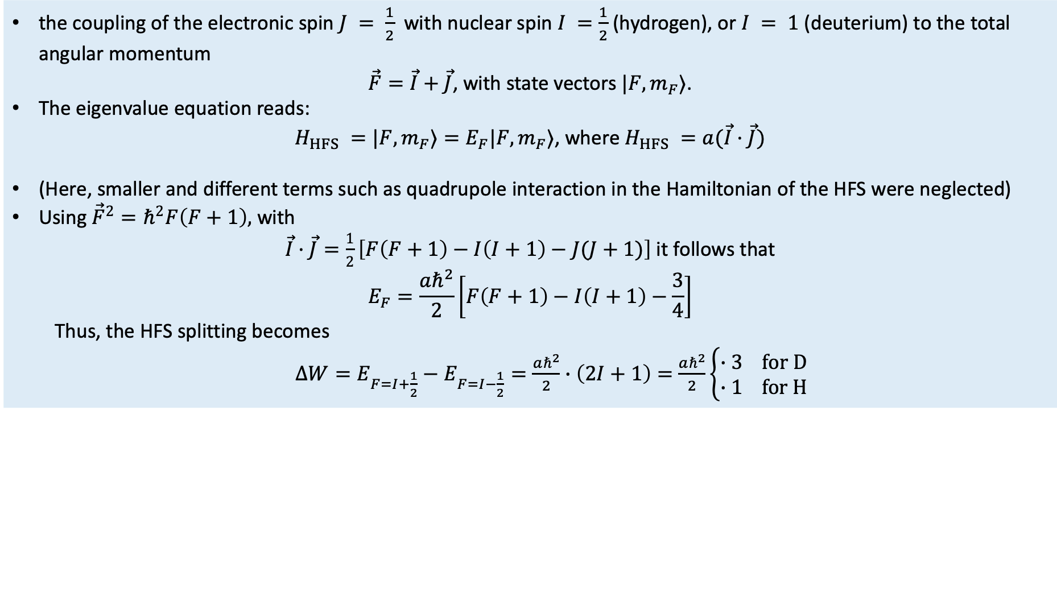
Hyperfine Structure (HFS) of hydrogen (deuterium)
The HFS is generated by
the coupling of the electronic spin $J = \frac{1}{2}$ with nuclear spin $I =\frac{1}{2}$ (hydrogen), or $I = 1$ (deuterium) to the total angular momentum
$\vec{F}=\vec{I}+\vec{J}$, with state vectors $|F,m_{F}⟩$.
The eigenvalue equation reads:
$H_{HFS} =|F,m_{F}⟩=E_{F}|F,m_{F}⟩$, where $H_{HFS} =a(\vec{I}·\vec{J})$
(Here, smaller and different terms such as quadrupole interaction in the Hamiltonian of the HFS were neglected)
Using ${\vec{F}}^{2}=ℏ^{2}F\left(F+1\right),$ with
$\vec{I}·\vec{J}=\frac{1}{2}\left[F\left(F+1\right)−I\left(I+1\right)−J(J+1)\right]$ it follows that
$$E_{F}=\frac{aℏ^{2}}{2}\left[F\left(F+1\right)−I\left(I+1\right)−\frac{3}{4}\right]$$
  Thus, the HFS splitting becomes
  $∆W=E_{F=I+\frac{1}{2}}−E_{F=I−\frac{1}{2}}=\frac{aℏ^{2}}{2}∙\left(2I+1\right)=$ $\frac{aℏ^{2}}{2}\left\{\begin{matrix}∙3 for D \\ ∙1 for H\end{matrix}\right.$

Slide 16
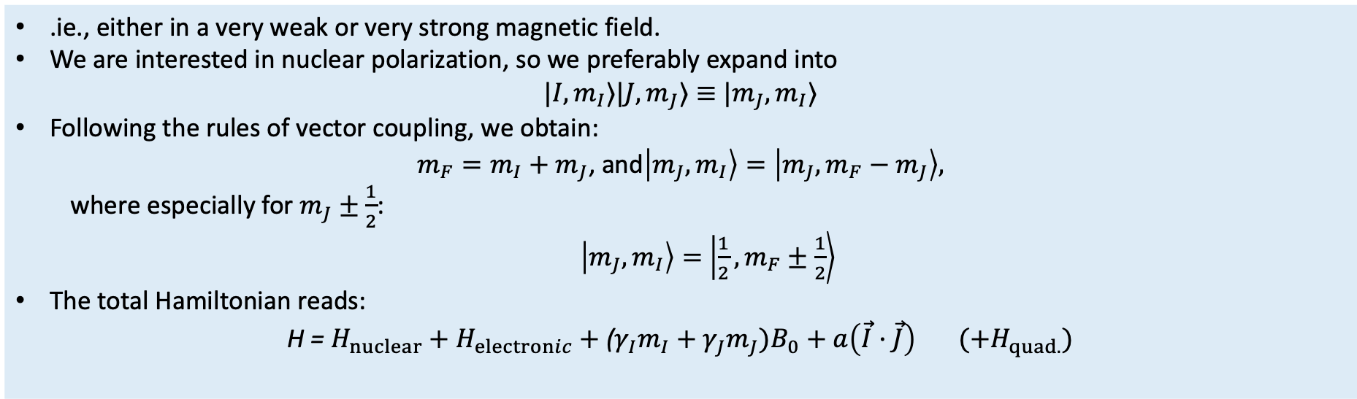
HFS in magnetic field (Zeeman Effect)
For arbitrary magnetic field, one expands into states with “good” quantum numbers:
.ie., either in a very weak or very strong magnetic field.
We are interested in nuclear polarization, so we preferably expand into
$|I,m_{I}⟩|J,m_{J}⟩≡$ $|m_{J},m_{I}⟩$
Following the rules of vector coupling, we obtain:
$m_{F}=m_{I}+$ $m_{J}$, and$\left|m_{J},m_{I}\right\rangle =\left|m_{J},m_{F}−m_{J}\right\rangle ,$
  where especially for $m_{J}±\frac{1}{2}$:
  $\left|m_{J},m_{I}\right\rangle =$ $\left|\frac{1}{2},m_{F}±\frac{1}{2}\right\rangle$
The total Hamiltonian reads:
$$\text{H}\text{ = }H_{nuclear}+H_{electronic}+\text{(}γ_{I}m_{I}+γ_{J}m_{J})B_{0}+a\left(\vec{I}·\vec{J}\right) (+H_{quad.})$$

Slide 17
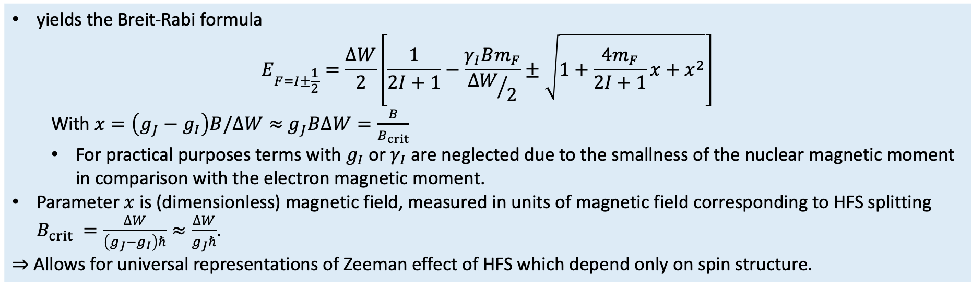
Breit-Rabi formula
Solution of Hamiltonian from previous equation
yields the Breit-Rabi formula
$$E_{F=I±\frac{1}{2}}=\frac{∆W}{2}\left[\frac{1}{2I+1}−\frac{γ_{I}Bm_{F}}{{∆W}/2}±\sqrt{1+\frac{4m_{F}}{2I+1}x+x^{2}}\right]$$
  With $x=\left(g_{J}−g_{I}\right)B/∆W≈$ $g_{J}B∆W=\frac{B}{B_{crit}}$
  For practical purposes terms with $g_{I}$ or $γ_{I}$ are neglected due to the smallness of the nuclear magnetic moment in comparison with the electron magnetic moment.
Parameter $x$ is (dimensionless) magnetic field, measured in units of magnetic field corresponding to HFS splitting $B_{crit} =\frac{∆W}{\left(g_{J}−g_{I}\right)ℏ}≈\frac{∆W}{g_{J}ℏ}$.
⇒ Allows for universal representations of Zeeman effect of HFS which depend only on spin structure.

Slide 18
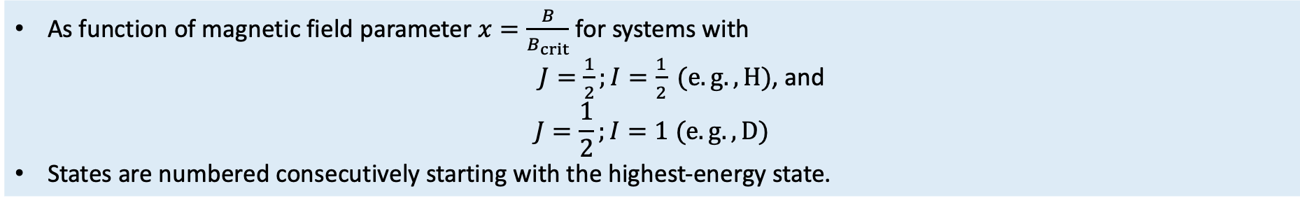
HFS of the H Atom
Zeeman splitting (Breit-Rabi diagrams) of the HFS
As function of magnetic field parameter $x=\frac{B}{B_{crit}}$for systems with
$J=\frac{1}{2};I=\frac{1}{2} (e.g., H)$, and
$$J=\frac{1}{2};I=1 (e.g., D)$$
States are numbered consecutively starting with the highest-energy state.

Slide 19
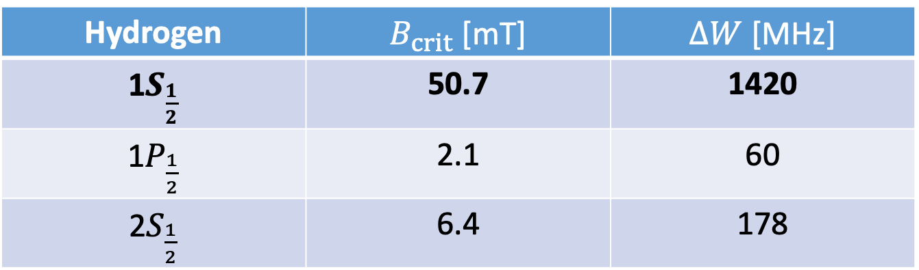
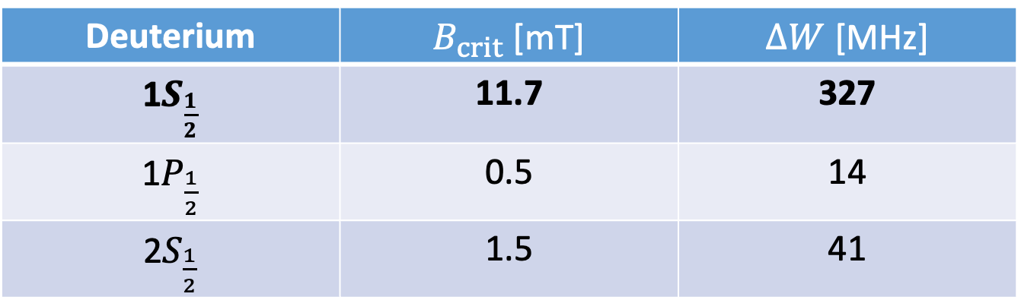
Values of $B_{crit}$ and $∆W$ for H and D atoms
For the three relevant states (shown on slide 14)
Hydrogen | $B_{crit}$ [mT] | $∆W$ [MHz]
1$S_{\frac{1}{2}}$ | 50.7 | 1420
1$P_{\frac{1}{2}}$ | 2.1 | 60
2$S_{\frac{1}{2}}$ | 6.4 | 178
Deuterium | $B_{crit}$ [mT] | $∆W$ [MHz]
1$S_{\frac{1}{2}}$ | 11.7 | 327
1$P_{\frac{1}{2}}$ | 0.5 | 14
2$S_{\frac{1}{2}}$ | 1.5 | 41

Slide 20
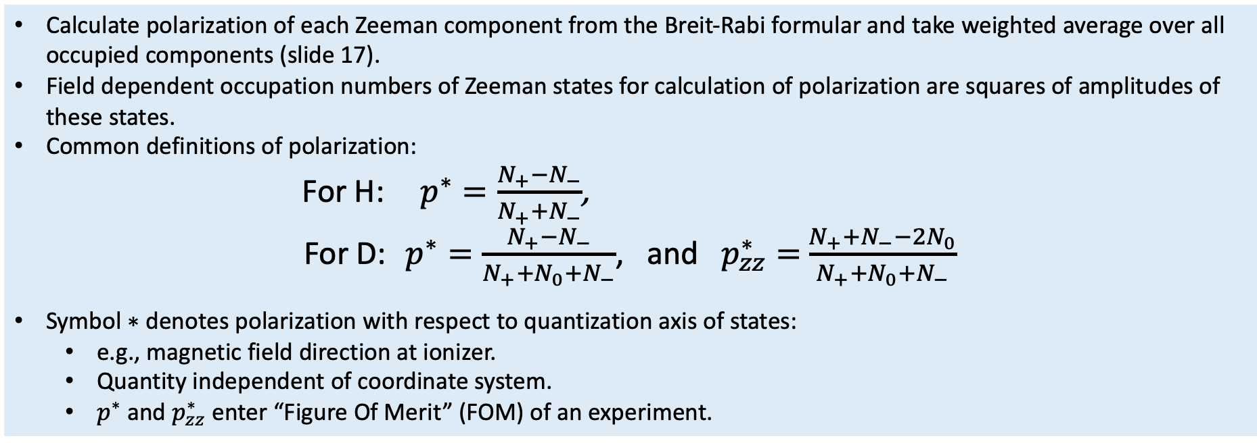
Calculation of polarization
System with coupled nuclear and electronic spins:
Calculate polarization of each Zeeman component from the Breit-Rabi formular and take weighted average over all occupied components (slide 17).
Field dependent occupation numbers of Zeeman states for calculation of polarization are squares of amplitudes of these states.
Common definitions of polarization:
For H: $p^{∗}=\frac{N_{+}−N_{−}}{N_{+}+N_{−}}$,
For D: $p^{∗}=\frac{N_{+}−N_{−}}{N_{+}+N_{0}+N_{−}}$, and $p_{zz}^{∗}=$ $\frac{N_{+}+N_{−}−2N_{0}}{N_{+}+N_{0}+N_{−}}$
Symbol ∗ denotes polarization with respect to quantization axis of states:
  e.g., magnetic field direction at ionizer.
  Quantity independent of coordinate system.
  $p^{∗}$ and $p_{zz}^{∗}$ enter “Figure Of Merit” (FOM) of an experiment.

Slide 21
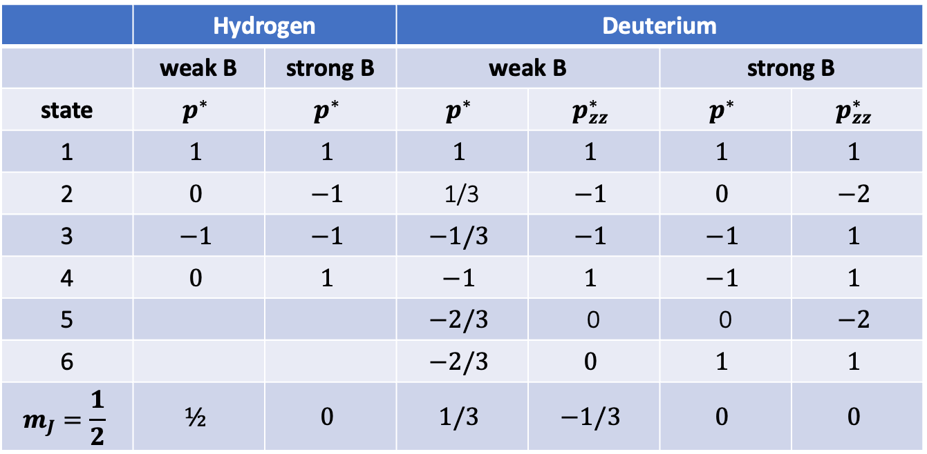
Nuclear polarization of H, D in weak and strong $B$ fields
 | Hydrogen |  | Deuterium
 | weak B | strong B | weak B |  | strong B
state | $$p^{∗}$$ | $$p^{∗}$$ | $$p^{∗}$$ | $$p_{zz}^{∗}$$ | $$p^{∗}$$ | $$p_{zz}^{∗}$$
1 | $$1$$ | $$1$$ | $$1$$ | $$1$$ | $$1$$ | $$1$$
2 | $$0$$ | $$−1$$ | 1/3 | $$−1$$ | $$0$$ | $$−2$$
3 | $$−1$$ | $$−1$$ | $$−1/3$$ | $$−1$$ | $$−1$$ | $$1$$
4 | $$0$$ | $$1$$ | $$−1$$ | $$1$$ | $$−1$$ | $$1$$
5 |  |  | $$−2/3$$ | 0 | 0 | $$−2$$
6 |  |  | $$−2/3$$ | $$0$$ | $$1$$ | $$1$$
$$m_{J}=\frac{1}{2}$$ | $$½$$ | $$0$$ | $$1/3$$ | $$−1/3$$ | $$0$$ | $$0$$
Last line shows polarization of atoms in all states focused by the system with electron spin $m_{J}=\frac{1}{2}$:
  States $\left|1\right\rangle +$ $\left|2\right\rangle$ for H, and
  $\left|1\right\rangle +$ $\left|2\right\rangle +\left|3\right\rangle$ for D.

Slide 22
Polarization of Zeeman states of H and D atoms
Polarization of each single Zeeman component of hydrogen and deuterium.
The hyperfine states are numbered as in the figure on slide 18. Field dependent occupation numbers of Zeeman states for calculation of polarization are squares of amplitudes of these states.
The polarization of an ensemble of particles (e.g., in a beam), which are in different Zeeman states is obtained by calculating the weighted average of all occupied components.

Slide 23
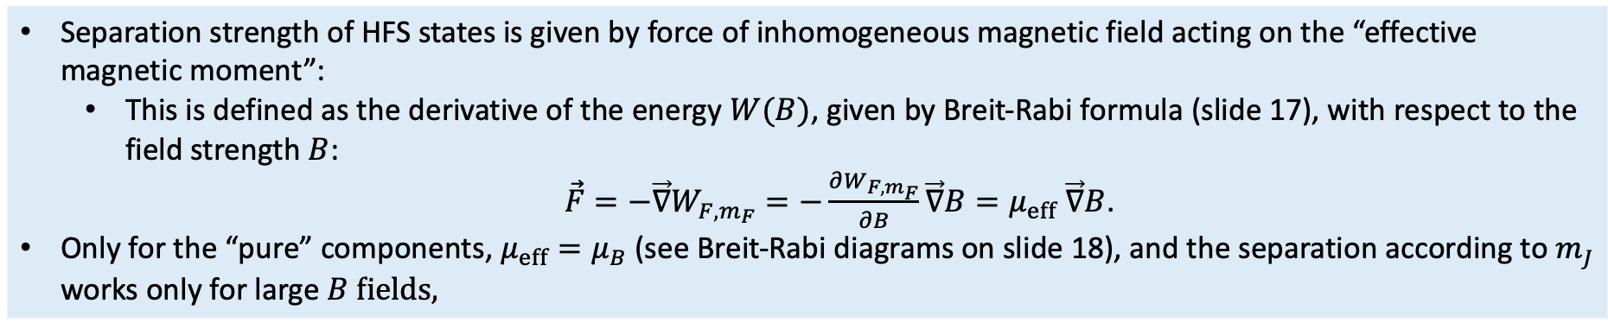
Stern-Gerlach separation of HFS states
In a ground-state atomic beam source:
Separation strength of HFS states is given by force of inhomogeneous magnetic field acting on the “effective magnetic moment”:
  This is defined as the derivative of the energy $W(B)$, given by Breit-Rabi formula (slide 17), with respect to the field strength $B$:
  $\vec{F}=−\vec{∇}W_{F,m_{F}}=−\frac{∂W_{F,m_{F}}}{∂B}\vec{∇}B=μ_{eff}$ $\vec{∇}B$.
Only for the “pure” components, $μ_{eff}=μ_{B}$ (see Breit-Rabi diagrams on slide 18), and the separation according to $m_{J}$ works only for large $B fields,$

Slide 24
Zeeman separation in multipole magnets
Some comments:
An efficient separation of Zeeman components uses two-dimensional multipole fields with a cylindrical symmetry (quadrupole or sextupole fields).
The principle of a polarized-ion source for use on accelerators was first formulated by Clausnitzer.
In sextupole magnets, lens-like focusing action on spin components of atoms possible, whereas other spin components are defocused.
Optics for magnetic moments of neutral atoms to optimize Stern-Gerlach systems
with features like beam transport, phase space, emittance, acceptance, in analogy to charged-particle optics in electric and magnetic fields.

Slide 25
Physics and techniques of atomic beam sources (ABS)
Overview
Production of H and D ground-state atomic beams,
Dissociators, beam formation and accomodation,
  RF discharge dissociators
State-separation magnets
RF transitions
Ionizers (not today)
Polarized (gas) targets and storage cells (not today)

Slide 26
Multipole fields
Historcally, Stern–Gerlach spin-state separation magnet worked only in one dimension:
Much higher atomic intensities are achieved with rotationally symmetric magnetic fields, i.e., by quadrupole and sextupole magnets acting in two dimensions.
Permanent magnets as well as electromagnets (including superconducting magnets) are used in sources.
Nowadays, almost all sources use advantages of modern permanent magnets, so-called “Halbach” magnets.

Slide 27
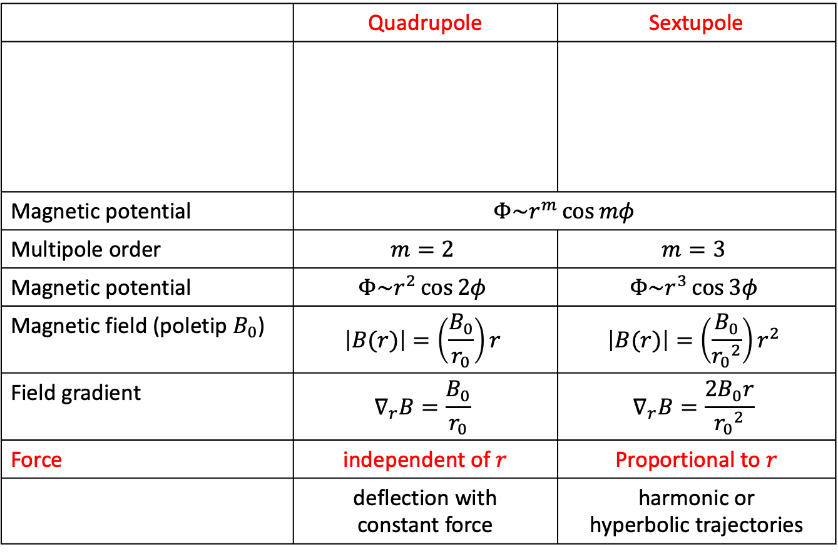
Quadrupole and sextupole magnets
 | Quadrupole | Sextupole
Magnetic potential | $$Φ\sim r^{m}\cos{mφ}$$
Multipole order | $$m=2$$ | $$m=3$$
Magnetic potential | $$Φ\sim r^{2}\cos{2φ}$$ | $$Φ\sim r^{3}\cos{3φ}$$
Magnetic field (poletip $B_{0}$) | $$\left|B(r)\right|=\left(\frac{B_{0}}{r_{0}}\right)r$$ | $$\left|B(r)\right|=\left(\frac{B_{0}}{{r_{0}}^{2}}\right)r^{2}$$
Field gradient | $$∇_{r}B=\frac{B_{0}}{r_{0}}$$ | $$∇_{r}B=\frac{{2B}_{0}r}{{r_{0}}^{2}}$$
Force | independent of $r$ | Proportional to $r$
 | deflection with constant force | harmonic or hyperbolic trajectories

Slide 28
Permanent magnets before 1980
Multipole magnets
Originally (i.e., prior to 1980), multipole magnets consisted of separate pole-pieces, formed by permanent magnets with high remanence (such as ALNICO V), ending in angular pole-tips from magnetically soft materials (such as soft iron or Vanadium-Permendur).
A soft-iron cylinder provided closing of the magnetic circuit. Typical pole-tip fields that could be reached were about 1 T.
Cross-section of a “classical” permanent sextupole magnet of length 25 cm.

Slide 29
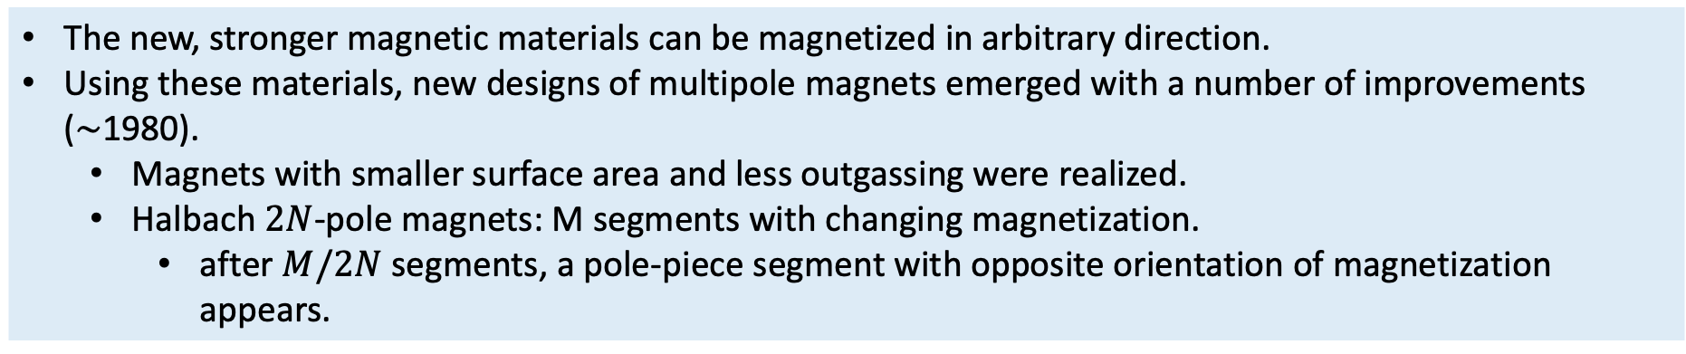
Halbach magnets
New rare-earth magnet material (Nd-Fe-B), developed by Sumitomo Cooperation, Japan:
The new, stronger magnetic materials can be magnetized in arbitrary direction.
Using these materials, new designs of multipole magnets emerged with a number of improvements (∼1980).
  Magnets with smaller surface area and less outgassing were realized.
  Halbach $2N$-pole magnets: M segments with changing magnetization.
    after $M/2N$segments, a pole-piece segment with opposite orientation of magnetization appears.
Three different magnetic materials used for ANKE ABS magnets.

Slide 30
System of sextupole magnets
Poletip field $B_{0}^{∗}$, inner diameter $∅_{0}$, outer diameter $∅_{1}$, magnet length $ℓ$, and distance $∆$from nozzle.
Presently, permanent magnets provide best way to produce large fields on small diameter.

Slide 31
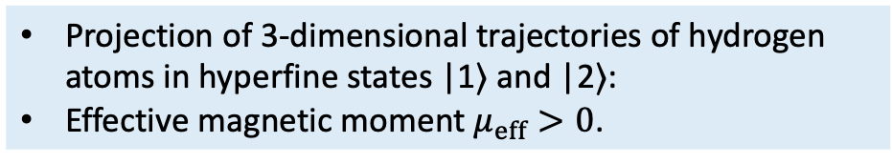
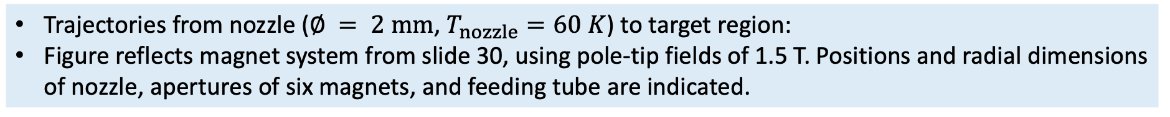
Designing a magnet system using tracking calculations
Modern polarized atomic beam sources use four to six separated short sextupoles:
Field strengths and location of magnets determined by tracking calculations, taking into account other requirements:
  overall space constraints, optimum pumping, insertion of RF transition units, etc.
Projection of 3-dimensional trajectories of hydrogen atoms in hyperfine states |1⟩ and |2⟩:
Effective magnetic moment $μ_{eff}>0$.
Trajectories from nozzle ($∅ = 2 mm$, $T_{nozzle}=60 K$) to target region:
Figure reflects magnet system from slide 30, using pole-tip fields of 1.5 T. Positions and radial dimensions of nozzle, apertures of six magnets, and feeding tube are indicated.

Slide 32
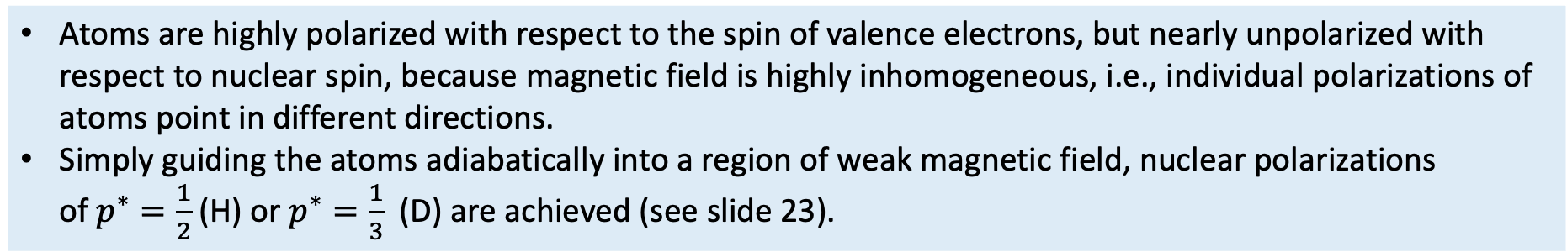
RF transitions I
Behind a Stern-Gerlach magnet system, still in a strong magnetic field:
Atoms are highly polarized with respect to the spin of valence electrons, but nearly unpolarized with respect to nuclear spin, because magnetic field is highly inhomogeneous, i.e., individual polarizations of atoms point in different directions.
Simply guiding the atoms adiabatically into a region of weak magnetic field, nuclear polarizations
of $p^{∗}=\frac{1}{2}$ (H) or $p^{∗}=\frac{1}{3}$ (D) are achieved (see slide 23).
High nuclear polarization requires changing of the occupation of hyperfine states:
Adiabatic-fast passage method, proposed by Abragam and Winter, induces transitions between different Zeeman hyperfine states.
This technique is employed in all atomic beam sources targets and provides a high nuclear polarization near the theoretical maximum.
Due to magnetic field gradients, the RF transitions are independent of the atom velocity.

Slide 33
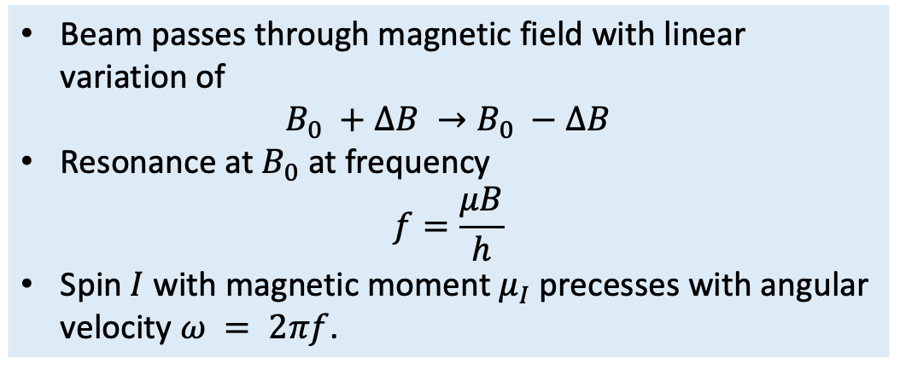
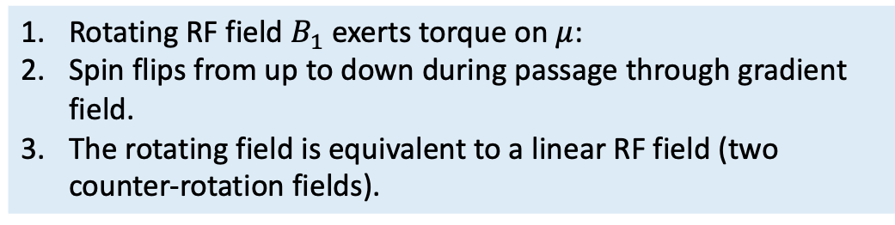
RF transitions II
Semi-classical picture:
Beam passes through magnetic field with linear variation of
$$B_{0} +∆B →B_{0} −∆B$$
Resonance at $B_{0}$ at frequency
$$f=\frac{μB}{h}$$
Spin $I$ with magnetic moment $μ_{I}$ precesses with angular velocity $ω = 2πf$.
Rotating RF field $B_{1}$ exerts torque on $μ$:
Spin flips from up to down during passage through gradient field.
The rotating field is equivalent to a linear RF field (two counter-rotation fields).

Slide 34
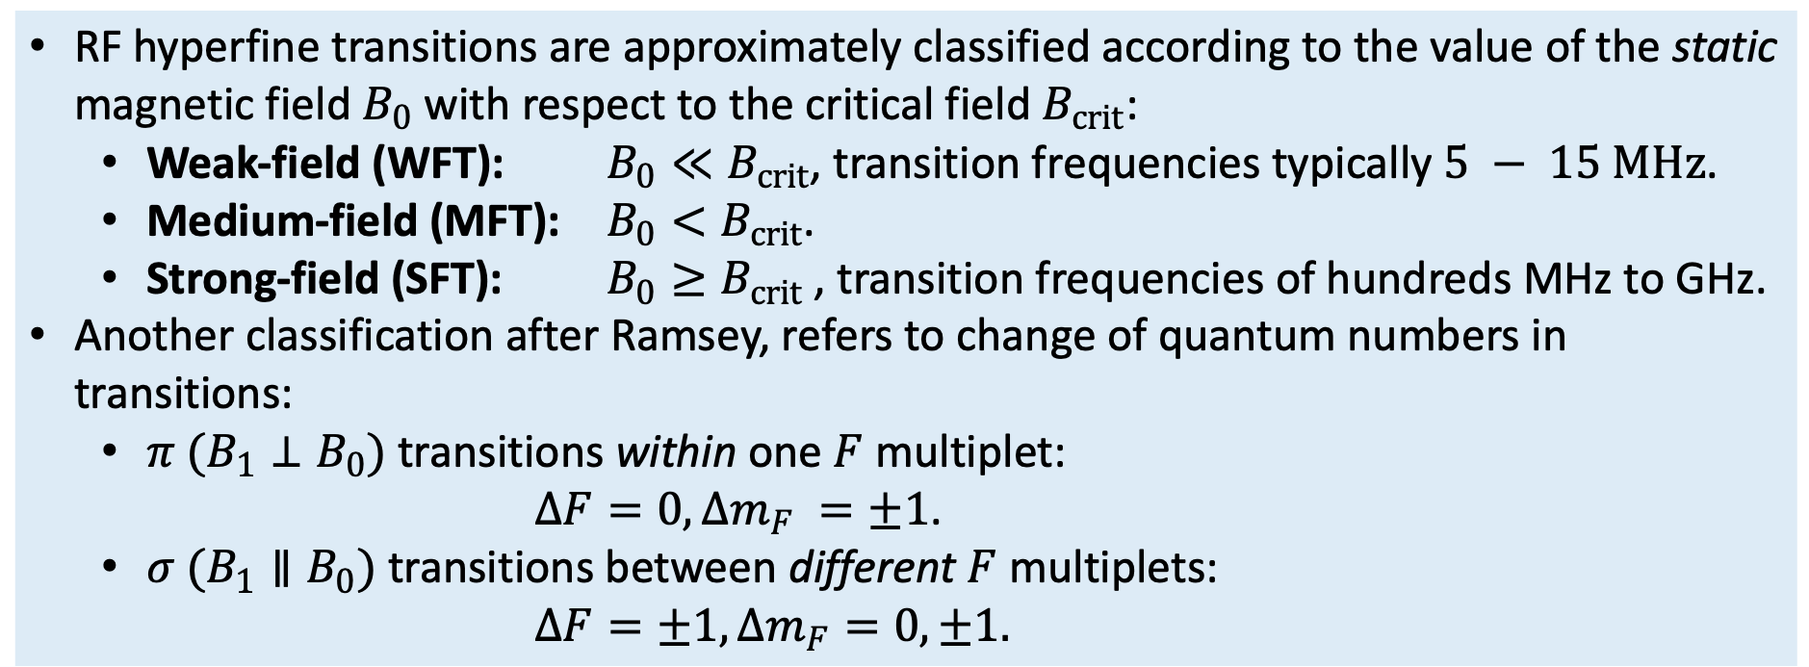
Classification of RF transitions
RF hyperfine transitions are approximately classified according to the value of the static magnetic field $B_{0}$ with respect to the critical field $B_{crit}$:
  Weak-field (WFT): $B_{0}≪B_{crit}$, transition frequencies typically $5 − 15 MHz$.
  Medium-field (MFT): $B_{0}<B_{crit}$.
  Strong-field (SFT): $B_{0}≥B_{crit}$, transition frequencies of hundreds MHz to GHz.
Another classification after Ramsey, refers to change of quantum numbers in transitions:
  $π (B_{1}⊥B_{0})$transitions within one $F$ multiplet:
  $∆F=0, ∆m_{F} =±1$.
  $σ (B_{1}∥B_{0})$transitions between different $F$ multiplets:
  $∆F=±1, ∆m_{F}=0,±1.$

Slide 35
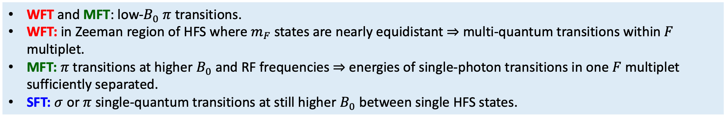
RF transition frequencies for H and D
WFT and MFT: low-$B_{0}$ $π$ transitions.
WFT: in Zeeman region of HFS where $m_{F}$ states are nearly equidistant ⇒ multi-quantum transitions within $F$ multiplet.
MFT: $π$ transitions at higher $B_{0}$ and RF frequencies ⇒ energies of single-photon transitions in one $F$ multiplet sufficiently separated.
SFT: $σ$ or $π$ single-quantum transitions at still higher $B_{0}$ between single HFS states.

Slide 36

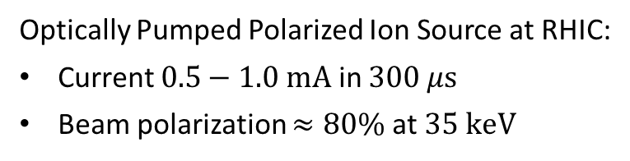




An Advanced Polarized Proton Source
A. Zelenski et al., J. Phys. Conf. Ser. 295 (2011) 012147
High brightness proton source
Focusing solenoid
Pulsed hydrogen neutralization cell
Superconducting solenoid 30 kG
Pulsed He-ionized cell
Optically pumped Rb cell
Sona shield
Sodium-jet ionizer
$$H^{+}$$
$$10 \text{keV}$$
$$H^{0}$$
$$10 \text{keV}$$
$$H^{0↑}$$
$$3 \text{keV}$$
$$H^{+↑}$$
$$3 \text{keV}$$
$$H^{+↑}$$
$$35 \text{keV}$$
Optically Pumped Polarized Ion Source at RHIC:
Current $0.5−1.0 \text{mA}$ in $300 μ\text{s}$
Beam polarization $≈80\%$ at $35 \text{keV}$
One proton bunch in RHIC

Slide 37
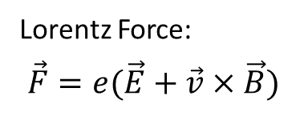
Particle Beam Optics
Lorentz Force:
$$\vec{F}=e(\vec{E}+\vec{v}×\vec{B})$$
Lattice to keep the particles on a circle.
There is a closed orbit.
Beam has a size and momentum spread.
Particles oscillate around the closed orbit (betatron oscillation).
acceleration
dipole magnets
F0D0 lattice and orbit envelope
injection
experiment
other magnets
Quadrupole magnets focus in one direction only.
Liouville’s theorem: The phase ellipse and the emittance of the beam are invariant.

Slide 38

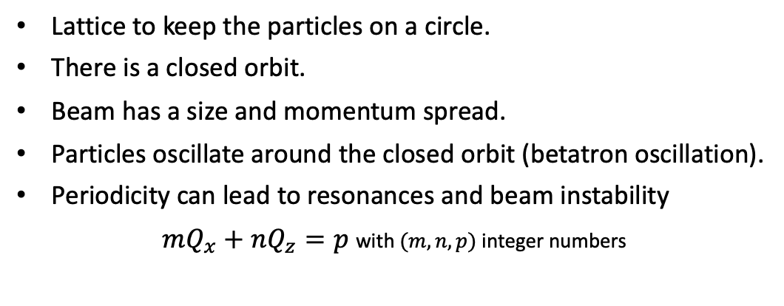





Particle Beam Optics
Lorentz Force:
$$\vec{F}=e(\vec{E}+\vec{v}×\vec{B})$$
Lattice to keep the particles on a circle.
There is a closed orbit.
Beam has a size and momentum spread.
Particles oscillate around the closed orbit (betatron oscillation).
Periodicity can lead to resonances and beam instability
$mQ_{x}+nQ_{z}=p$ with $(m,n,p)$ integer numbers
acceleration
dipole magnets
Optical resonances up to 3rd order
injection
experiment
particle trajectory
$$m+1$$
orbit
other magnets
possible
distortion
$$Q_{z}$$
working point
$$m$$
$$n$$
$$Q_{x}$$
$$n+1$$

Slide 39
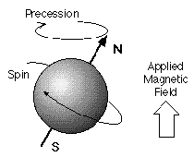
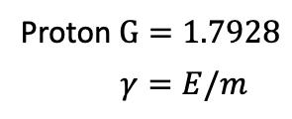
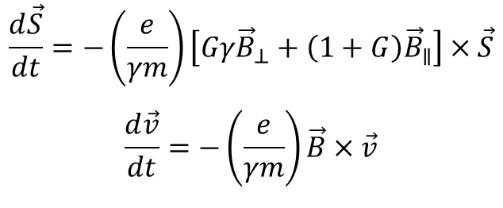
Particle Beam Optics & Spin
Lorentz Force:
$$\vec{F}=e(\vec{E}+\vec{v}×\vec{B})$$
Lattice to keep the particles on a circle.
There is a closed orbit.
Beam has a size and momentum spread.
Particles oscillate around the closed orbit (betatron oscillation).
Periodicity can lead to resonances and beam instability.
The magnetic moment of particles precesses in magnetic fields.
acceleration
dipole magnets
injection
experiment
$$\frac{d\vec{S}}{dt}=−\left(\frac{e}{γm}\right)\left[Gγ{\vec{B}}_{⊥}+\left(1+G\right){\vec{B}}_{∥}\right]×\vec{S}$$
$$\frac{d\vec{v}}{dt}=−\left(\frac{e}{γm}\right)\vec{B}×\vec{v}$$
other magnets
Proton $G=1.7928$
$$γ=E/m$$

Slide 40
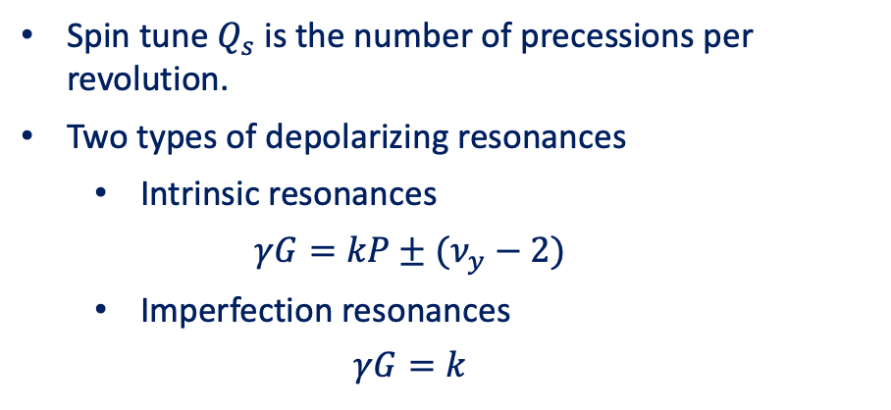
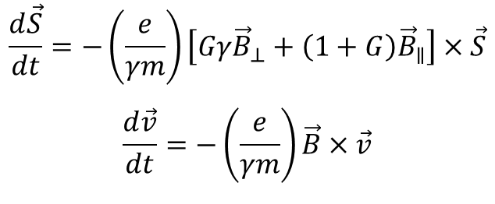
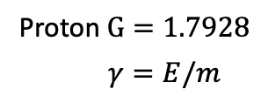
Depolarizing Resonances
Thomas-BMT equation:
$$\frac{d\vec{S}}{dt}=−\left(\frac{e}{γm}\right)\left[Gγ{\vec{B}}_{⊥}+\left(1+G\right){\vec{B}}_{∥}\right]×\vec{S}$$
$$\frac{d\vec{v}}{dt}=−\left(\frac{e}{γm}\right)\vec{B}×\vec{v}$$
L.H. Thomas “The kinematics of an electron with an axis.” The London, Edinburgh, and Dublin Philosophical Magazine and Journal of Science 3.13 (1927)
V. Bargmann, L. Michel, and V.L. Telegdi “Precession of the polarization of particles moving in a homogeneous electromagnetic field.” Physical Review Letters 2.10 (1959)
Proton $G=1.7928$
$$γ=E/m$$
Spin tune $Q_{s}$ is the number of precessions per revolution.
Two types of depolarizing resonances
  Intrinsic resonances
  $$γG=kP±(ν_{y}−2)$$
  Imperfection resonances
  $$γG=k$$
Resonance strength depends on the local orbit distortion, magnetic field, and crossing speed.
Number of resonances grows linearly with the top energy.

Slide 41
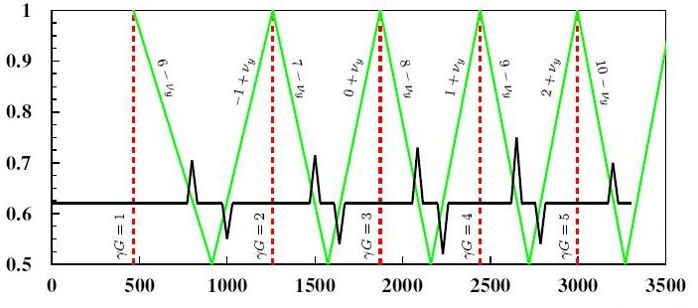
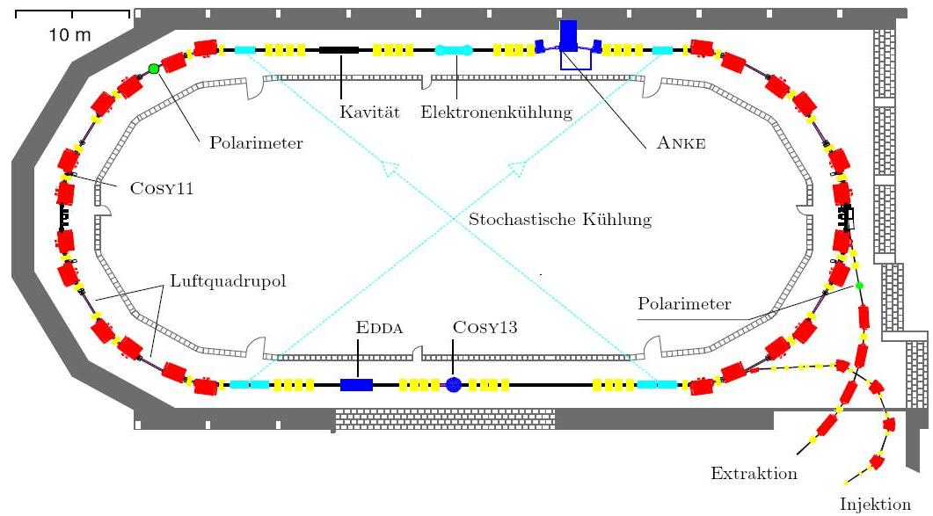
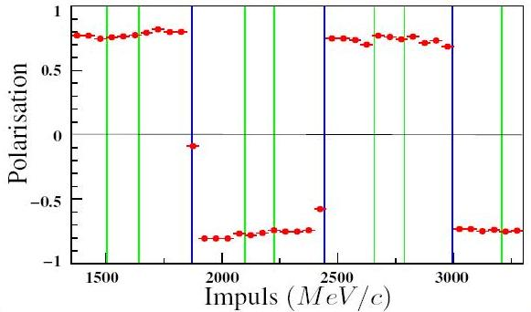
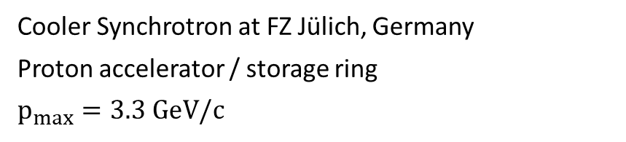

Example: COSY
Intrinsic resonances
Imperfection resonances
Cooler Synchrotron at FZ Jülich, Germany
Proton accelerator / storage ring
$$p_{max}=3.3 \text{Ge}\text{V}\text{/}\text{c}$$
Working point $q_{y}$
Momentum (MeV/c)
air quadrupole
Polarization
Momentum (MeV/c)

Slide 42
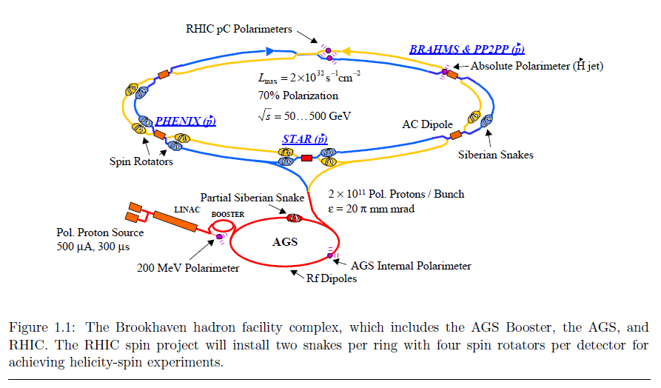
The Relativistic Heavy Ion Collider
“Configuration Manual Polarized Proton Collider at RHIC.” I. Alekseev et al. (2004)
250 GeV
25 GeV
200 MeV
35 keV

Slide 43
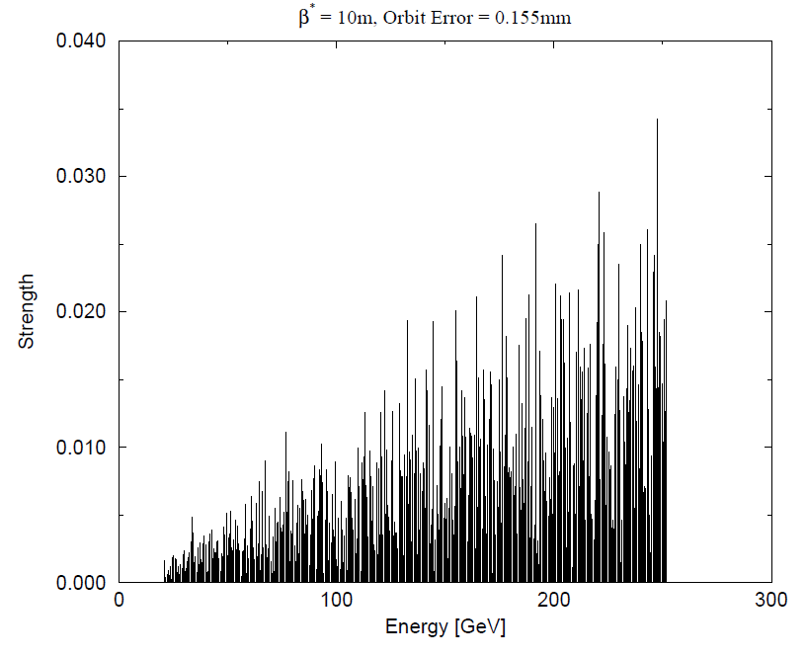
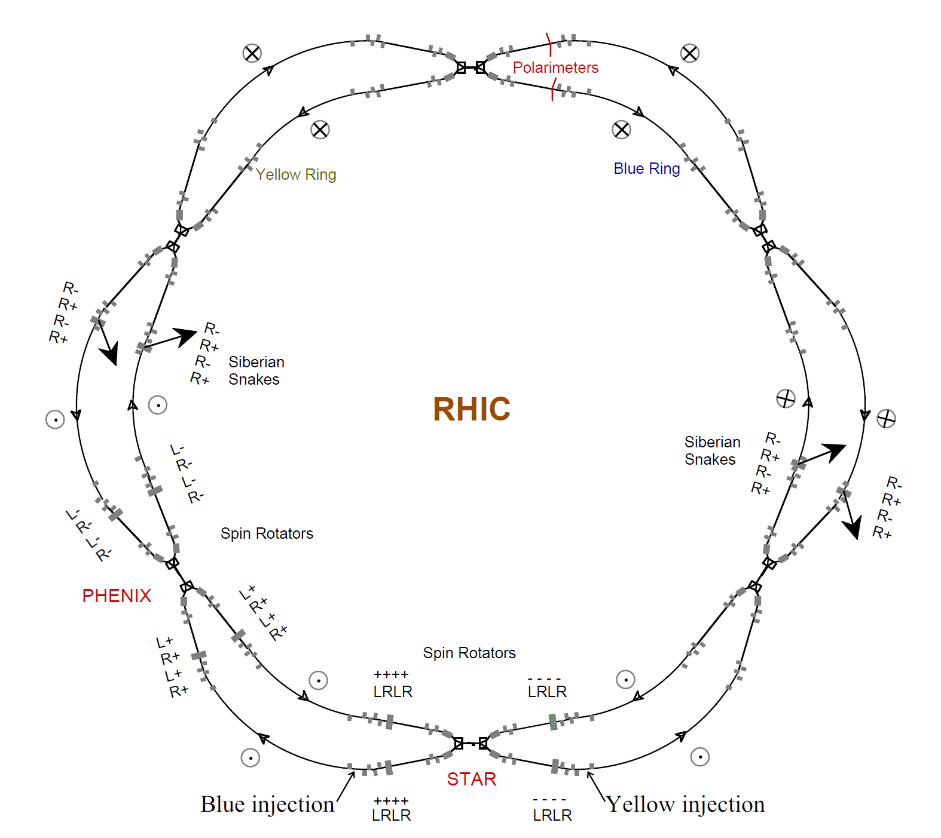


Spin Resonances in RHIC
Imperfection resonances
  $ν_{spin}=γG=n$
  integer $n$
Intrinsic resonances
  $ν_{spin}=γG=kP+ν_{y}$
  integer $k$
  Super-periodicity P
  vertical betatron tune $ν_{y}$

Slide 44


Resonance Mitigation
Deliberately advance the spin precession to avoid resonance conditions
Group of dipole magnets with alternating horizontal and vertical field directions which rotates the spin vector by 180°
Siberian Snakes: Ya. S. Derbenev, A.M. Kondratenko “Polarization kinematics of particles in storage rings.” Sov. Phys. JETP 37 (1973)
Strong AGS Snake

Slide 45



Spin Motion through Siberian Snake

Slide 46

RHIC Proton Polarization
During the first 250 GeV beam operation in 2009

Slide 47





Spin Motion through a Spin Rotator
$$\vec{S}$$
$$\vec{S}$$
Stable spin direction in a circular accelerator is vertical.
Experiments also require longitudinal polarization.
Spin rotators before and after each experiment.
Transverse polarization remnant can cause systematic uncertainties in physics observables.
$$\vec{p}$$
$$\vec{p}$$

Slide 48

Polarized Beams at EIC
Proton beam polarization has to be measured between $50−275 \text{Ge}\text{V}$.
Electron beam polarization has to be measured between $5−18 \text{GeV}$.
Each store may be 8 hours long. Possibly shorter?
The beams are bunched and will have alternating polarization states to reduce time-dependent systematic uncertainties.
Bunch spacing is around $10 \text{ns}$ (close to 1300 bunches in each ring).

Slide 49


Requirements for Polarimetry
Required:
  Absolute beam polarization
  $ΔP/P≈1\%$
Consider:
  Time-dependence (polarization decay)
  Bunch-by-bunch polarization
  Polarization profile of bunches
  Polarization during ramp (acceleration)
  Polarization vector at experiment
  Physics program includes options beyond $\vec{p}$ (spin $\frac{1}{2}$):
    $\vec{d}$ (spin 1) and ${3\vec{He}}^{++}$ (spin $\frac{1}{2}$)

Slide 50
3. Polarimetry of High Energy Hadron Beams

Slide 51




Polarization of Particle Bunches
A bunch of particles in vacuum travelling at almost the speed of light
Goes in circles, will be back in about $13 μ\text{s}$ ($78 \text{kHz}$).
?
For the determination of the polarization, we will have to devise an experiment which is spin-dependent.
Need a representative sample of scattered particles to make conclusive statements about the polarization.
Only a fraction of the scattering probability will depend on the spin: $σ^{↑↓}=σ_{0}±σ_{s}=σ_{0}(1±a_{s})$
It is convenient to introduce an asymmetry: $ε=(σ^{↑}−σ^{↓})/(σ^{↑}+σ^{↓})=a_{s}$
$$P=\frac{12−4}{12+4}=50\%$$

Slide 52






The Right Frame
Momentum and spin direction define a coordinate system.
  Longitudinal $L$
  Normal $N$
  Sideways $S$
$$S=N×L$$
$$ε=A_{N}∙P=\frac{N_{L}−N_{R}}{N_{L}+N_{R}}$$
left
$$s_{z}=N$$
right
refers to the projectile
$$p=L$$
Analyzing power $A_{N}$
Polarization $P=\frac{n^{↑}−n^{↓}}{n^{↑}+n^{↓}}$
(proton)

Slide 53




Transverse Single-Spin Asymmetries
Elastic scattering obeys parity conservation and time invariance.
Collision is symmetric (in the center-of-mass frame), recoil and ejectile are indistinguishable.
$$\frac{dσ}{dΩ}={\frac{dσ}{dΩ}}_{0}(1+P_{beam}A_{00N0}+P_{target}A_{000N})$$
ejectile, recoil, projectile, target
left
For elastic scattering:
$$A_{00N0}=A_{000N}$$
$$s_{z}=N$$
right
$$p=L$$
$$P_{Beam}=\frac{ε_{Beam}}{ε_{Target}}P_{Target}$$
(proton)
(proton)
Remember, we just call this $A_{N}$

Slide 54





Elastic Scattering at RHIC energies
Beam momentum is $100−250 \text{GeV}$.
Significant analyzing power exists in the Coulomb-Nuclear Interference region.
$$φ\left(s,t\right)=\left\langle λ_{C}λ_{D}\left|φ\right|λ_{A}λ_{B}\right\rangle$$
$$φ_{1}\left(s,t\right)=\left\langle +\frac{1}{2}+\frac{1}{2}\left|φ\right|+\frac{1}{2}+\frac{1}{2}\right\rangle$$
$$φ_{2}\left(s,t\right)=\left\langle +\frac{1}{2}+\frac{1}{2}\left|φ\right|−\frac{1}{2}−\frac{1}{2}\right\rangle$$
$$φ_{3}\left(s,t\right)=\left\langle +\frac{1}{2}−\frac{1}{2}\left|φ\right|+\frac{1}{2}−\frac{1}{2}\right\rangle$$
$$φ_{4}\left(s,t\right)=\left\langle +\frac{1}{2}−\frac{1}{2}\left|φ\right|−\frac{1}{2}+\frac{1}{2}\right\rangle$$
$$φ_{5}\left(s,t\right)=\left\langle +\frac{1}{2}+\frac{1}{2}\left|φ\right|+\frac{1}{2}−\frac{1}{2}\right\rangle$$
A. Poblaguev et al., Phys. Rev. D 79, 094014 (2009)
$$A_{N}\frac{ds}{dt}=−\frac{4π}{s^{2}}\text{Im}\left[φ_{5}^{em∗}\left(s,t\right)φ_{+}^{had}\left(s,t\right)+φ_{5}^{had∗}\left(s,t\right)φ_{+}^{em}(s,t)\right]$$
no-flip amplitude: $φ_{+}\left(s,t\right)=\frac{1}{2}\left[φ_{1}\left(s,t\right)\text{+}φ_{3}\left(s,t\right)\right]$

Slide 55



Elastic Scattering at RHIC energies
Beam momentum is $100−250 \text{GeV}$.
A significant analyzing power exists in the Coulomb-Nuclear Interference region.
Recoil comes out almost perpendicular to the beam direction.
A. Poblaguev et al., Phys. Rev. D 79, 094014 (2009)
Recoil angle $({90}^{∘}−θ)$
Kinetic energy of the recoil proton

Slide 56



An Absolute Polarimeter at RHIC / EIC
Polarized atomic hydrogen jet target (HJET)
$H_{2}$ source
Dissociator
RF unit
Holding field
Detectors
left
scattering plane
beam
$$s_{z}=N$$
right
$$p=L$$
(proton)
(proton)

Slide 57


HJET Setup for RHIC / EIC
atomic hydrogen target
Polarized atomic hydrogen jet target
Set of eight Hamamatsu $Si$ strip detectors
12 vertical strips
  $3.75 \text{mm}$ pitch
  $500 \text{μ}\text{m}$ thick
Uniform dead layer $≈1.5 \text{μ}\text{m}$
scattered proton
proton beam
100/250 GeV
Si strip detectors
≈ 0.7 cm
INNER
OUTER
75 cm
≈10 cm

Slide 58




Absolute Beam Polarization
detector
beam
$$ε=A_{N}∙P$$
$$P_{Beam}=\frac{ε_{Beam}}{ε_{Target}}P_{Target}$$
detector
beam
❶
Polarization independent background
$ε=\frac{N^{↑}−N^{↓}}{N^{↑}+N^{↓}+2∙N_{bg}}$ ⇒ $\frac{ε_{B}}{ε_{T}}=\frac{N_{B}^{↑}−N_{B}^{↓}}{N_{T}^{↑}−N_{T}^{↓}}$
❷
Polarization dependent background
$$ε=\frac{ε_{inc}−r∙ε_{bg}}{1−r}$$
background fraction $r=N_{bg}/N$
Background
Inclusive
SIGNAL
Background
SIGNAL
Inclusive

Slide 59

Measured Beam Polarizations

Slide 60



Additional Fast Polarimeters
beam
From our list of requirements:
Time-dependence (polarization decay)
Bunch-by-bunch polarization
Transverse polarization profile of bunches
Also has to be non-destructive!
Carbon polarimeters
Fast measurement
$$δP/P≈4\%$$
Beam polarization profile
Bunch-by-bunch
Polarization decay (time dependence)
Hydrogen jet polarimeter
Polarized target
Continuous operation
$δP/P≈5−6\%$ per 8 hours of operation
normalization

Slide 61






Fiber Target Polarimeters
Ultra-thin ribbon targets:
$$≈10 μ\text{m} x 100 \text{nm}$$
Target holder inside the beam pipe

Slide 62



From RHIC to EIC
Loss of increased asymmetry at lower energies, $A_{N}(−t)$
Reduced bunch spacing requires much better understanding of background
  Polarized or unpolarized
  Better: reject/suppress background
  Second detector layer to veto high energy particles
Punch through region

Slide 63


From RHIC to EIC
Loss of increased asymmetry at lower energies, $A_{N}(−t)$
Reduced bunch spacing requires much better understanding of background
  Polarized or unpolarized
  Better: reject/suppress background
Increased beam current is problematic for the fiber target
  Very limited cooling (radiation, thermal conductivity)
  Sublimation temperature $T_{Carbon}≈{2200}^{∘} C$
  Temperature saturates in a few $\text{ms}$
Can we find a target material that withstands higher temperatures?
Calculation by P. Thieberger, BNL

Slide 64
Outlook / Summary

Slide 65

Requirements and Delivery
 | Polarized HJET | Unpolarized HJET | Carbon polarimeter | Forward neutrons
Absolute beam polarization
Polarization decay
Transverse profile
Longitudinal profile
Polarization vector
Bunch polarization
(*) Increased systematics
(*) $A_{N}$ can be calculated, but needs to be confirmed; full background subtraction
(*) less accurate than pC
(*) depends on the target
(*) limited space for detectors with current magnet configuration

Slide 66

Recap: Hadron Polarimetry
Proton beam energies: $50−275 \text{Ge}\text{V}$
Combination of devices for
  Non-destructive
  Absolute polarization
  Fast measurements during store
  Bunch profile
  Local polarimetry at experiment
Potential for future polarized light ion beams
  Location allows for upgrades to the polarimeter setup

Slide 67
A Polarized Electron-Ion Collider
The EIC will be the first dedicated polarized electron-ion collider.
Polarimetry is an integral part of the collider design to meet the demands of the physics goals.

