Slide 1
Semi-classical tri- and tetra-quark
Xavier Artru Institut de Physique des deux Infinis de Lyon (IP2I) GIF animations by Marie-Christine Artru

Slide 2
MOTIVATION : The baryonic junction was first suggested by Nambu. Later, arguments for it were given by Imachi, Otsuki and Toyoda; X.A. ; Rossi and Veneziano, and others. Similar junctions have been introduced for cosmic strings [Copelan, Kibble and Steer, PRL 97 (2006)]. I my paper [Nucl. Phys. B85 (1975)] I said that the leading baryonic Regge trajectory, with the universal slope α’, is obtained if one branch is much longer than the two others. The referee said: OK, but it would be nice to have an explicit solution of the its classical equations of motions.
Soon after, P.A. Collins, J.F.L. Hopkinson and Tucker [Nucl. Phys. B85 (1975)] found such a solution, but in 5+1 dimension. I finally found a solution in 3+1 dimension, the rotating-vibrating fork, which I put in my movie La ballet des hadrons [CNRS IMAGES, 1981], but I did not yet published its derivation. This workshop
is an opportunity to do it : Thanks to the organizers !

Slide 3
A first model of triquark string :
the rotating ``mercedes’’ star
q
q
Angular momentum: J = M²/(6πκ) = (2/3) α’ M²
J
non-leading Regge trajectory
q
κ = 1 Gev/fermi = string tension
α’ = 1/(2πκ) = 1 GeV⁻² = universal Regge slope of mesons and baryons

Slide 4
A model for the leading baryon trajectory The rotating-vibrating fork
q
q
J
q

Slide 5
Quark and string motions in the rotating frame (massless quarks)
rotation axis
C
instantaneous string plane
A
q
q
J
B
q

Slide 6
1

Slide 7
2

Slide 8
3

Slide 9
4

Slide 10
5

Slide 11
6

Slide 12
7

Slide 13
8

Slide 14
9

Slide 15
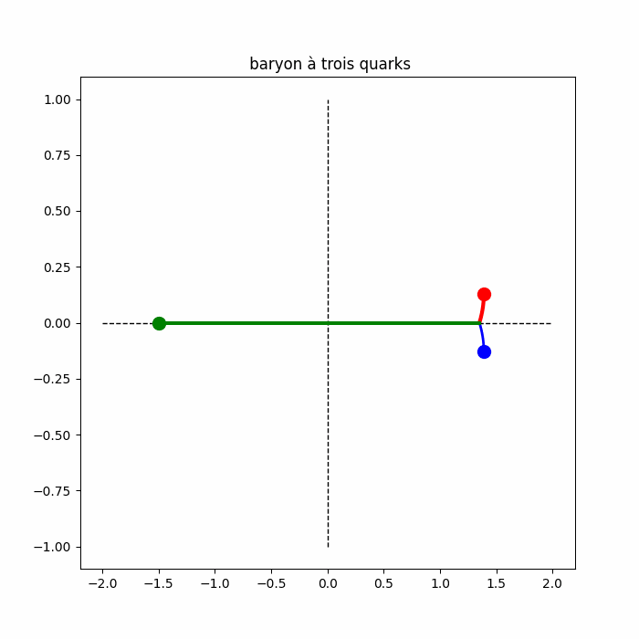

Slide 16
The parameters
z
C
Basic parameters :
+z_{max}
R and E₁= common energy
of the JAq₁ and JBq₂ branches
+v_{z}
Ω
A
Derived parameters :
q₁
Ω = 1/R, R₁ = R [1+3sin²ΩE₁]^{-1/2} ,
R_{J} = R₁ cos ΩE₁ , E₃ = energy of Jq₃ branch
tan ΩE₃ = -2 tan ΩE₁ ,
v_{z} = (√3/2) sin ΩE₃ ,
z_{max} = E₁ v_{z}
J
q₃
120º
0
B
q₂
-v_{z}
(all in units κ= 1)
-z_{max}
-R
0
R_{J}
R₁
r

Slide 17
Mass and angular momentum
- Mass : M = E₃ + 2E₁
- Angular momentum: J = ½ E₃R + E₁R₁²/R
Limit x_{J} => R : E₁ << M , J /M² => α’ => leading baryonic Regge trajectory
q₁
J
q₃
q₂

Slide 18
Tetraquark first solution : with 2 forks
Ω
-
q₁
q₃
-
J
J
-
O
q₄
q₂
R₃
R₁

Slide 19
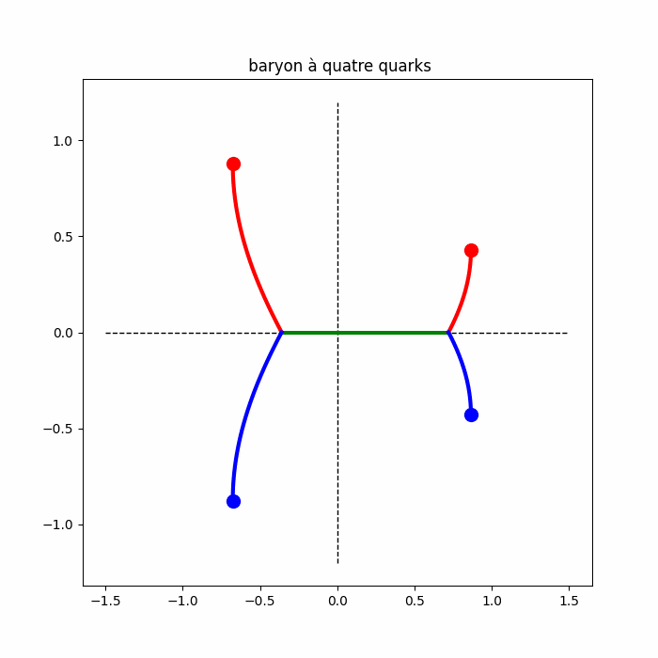

Slide 20
Second solution : the mixed ``fork-mercedes’’
Ω
-
q₃
-
q₁
J
J
-
q₄
Can be generalized to pentaquark :
q₂
q
q
J
-
J
J
q
q
and to hexaquark (di-baryon)
putting a third fork here
-
q

Slide 21
Quantization

Slide 22
Final state :
Discrete sum-over-histories (~ Feynman)
number of revolutions
5 6 7
Simple exemple: the rotating dumbbell
-
q
q
Period T and mass M related by M= κ T/2 ;
During time t= NT, the dumbell makes N revolutions
and comes back to the initial state.
Take N= t/T >> 1. The same final state can be obtained
by histories with different numbers N of revolutions
time
Each history has a quantum amplitude
a_{N} = |a_{N}| exp(iφ_{N}) with φ_{N} = NA( T(N) )
with T(N)= t/N ;
A(T) = string action during one revolution = κT²/4
The histories interfere constructively only if
T
φ_{N} - φ_{N+1} ≈ T . dA/dT – A = 2π × integer.
It gives the well-known quantizations of mass and spin :
M²/(2πκ) = α’M² = j = integer
Initial state

Slide 23
Application to the rotating-vibrating fork
Here we have 2 periods:
the rotation one T= 2πR
the vibration one T₁= 4z_{max}/v_{z} = 4E₁/κ,
The corresponding actions are:
- A₃(T,T₁) for the Jq₃ branch, - 2A₁(T,T₁) for the branches JAq₁ and JBq₂ .
(I do not write their formulas here)
Take a time t >> T and >> T₁ . The phase of the propagation amplitude is
φ(N,N₁) = N A₃( T(N), T₁(N₁) ) + 2N₁ A₁( T(N), T₁(N₁) )
Changing N or N₁ should change φ(N,N₁) by a multiple of 2π. - changing only N gives J = ½ E₃R + E₁R₁²/R = j (usual spin quatization)
- changing only N₁ gives κ |z_{max}|² = (π/2) ν

Slide 24
Can we speak of an effective diquark ?
The quantization rule κ (z_{max})² = (π/2) ν
bears on the average vertical size z_{max} of the Jq₁q₂ fork. - It also results from the Bohr-Sommerfeld rule,
applied to the vertical motion of Aq₁ and Bq₂ . - It looks as a quantization of the mass M_{D}
of an effective diquark representing the fork.
If we locate the diquark at J, with energy 2E₁ , we get
α’ M_{D}² = (4/3) ν
However, this location is somewhat arbitrary.
Different locations, on the segment JC below,
would give different results.
q
q
C
J
q

Slide 25
Conclusion
The rotating-vibrating fork is a stable 3-dimentional motion of the baryonic string.
It is a classical model for a baryon on the leading Regge trajectory.
It can be generalized to tetraquark, pentaquark, hexaquark (or di-baryon).
A semi-classical quantization of the triquark gives,
besides the ordinary quantization of spin,
that of the amplitude z_{max} of the vertical motion inside the fork. It can be directly applied to strings with more forks: the pentaquark and the hexaquark (dibaryon).
A phenomenological quantized diquark mass can be derived, however with some ambiguity.
This quantization methods ignores the zero-point transverse motions of the string pieces.
Thank you for your attention !

