Slide 1


What have we learned from BRAHMS on baryon stopping
Motivation
Experiment Setup brief
Results Brief
  Spectra
  Rapidity Densities
Net protons in pp.
Discussion of two component description
Comparison to models
Stopping in AuAU
Summary
F. Videbœk
Physics Department
Brookhaven National Laboratory
CFNS
22 January 2014

Slide 2
Motivation
The BRAHMS experiment ran in 2000-2006 at RHIC
  Still have some unpublished data that are interesting
p+p min bias distributions
  Energy dependence of basic cross sections
  Explore Data trends
  Comparison data for Heavy Ion experiments
PYTHIA /EPOS – Is often used as underlying description for HI event generators. Is this good?
Net proton and stopping processes, in particular rapidity dependence, but also energy dependence
Stopping in AA

Slide 3
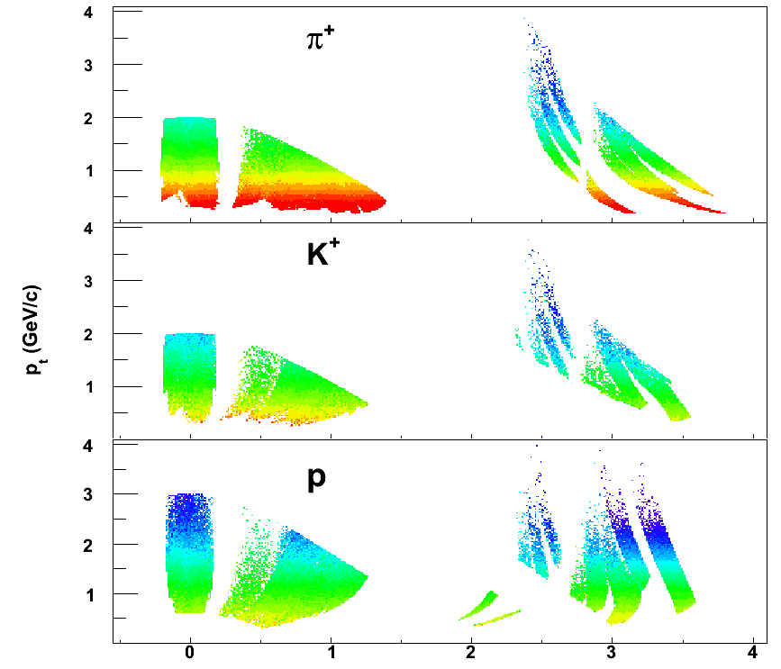
Conventional Spectrometers
  Small solid angle, moveable
  High resolution momentum determination
  Excellent PID using TOF and RICH
BRAHMS at RHIC completed datavtaking in 2006
Heavy Ion Au+Au,Cu+Cu,d+Au, p+p 200, 62.4 GeV
Transverse spin and min bias physics p+p 62.4, 200 GeV
y

Slide 4

Sample Spectra, coverage
y_{B} = 5.4, 4.2 at 200 and 62.4
Functional form that of Levy (Tsallis)
Thermal at low p_{T}, power-law at high.

Slide 5
Rapidity Densities
Extrapolate to unmeasured region using functional form.
Systematic Uncertainties are fairly large for pions
<p_{t}> yield coverage.
  Lowest p_{t} 300-400 MeV/c
  P 60-80% coverage
  Pi 40-60% coverage
FWHM(pi)>K+>K->p-bar
70-80% of p from Lambda are included in p spectra. Not corrected because Lambda’s are not measured at large rapidity
Notes:
Characteristics of distributions; phenix 200 gev values - vs 62.4 read up on text; systematics

Slide 6
Comparisons to other experiments
ISR 62.4 GeV
  Good agreement with mid rapidity data
  Also good agreement with a small overlap of at y~3.6 with Albrow et al for pi0 vs pi+/pi-
RHIC 200
  Comparison to STAR and PHENIX is satisfactory
  Very close to STAR in general 10-20% differences
Notes:
Add mental note of comparisons to STAR,PHENIX

Slide 7
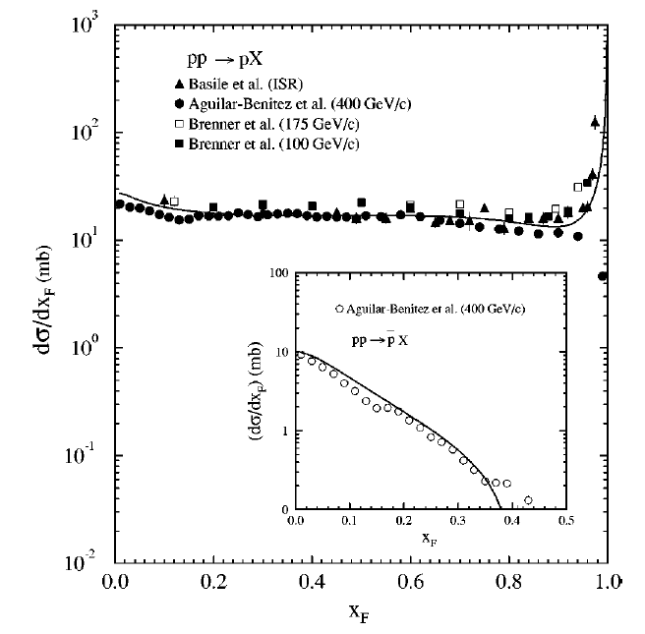
Scaling in pp
pp collision at lower energies exhibits a feature where dN/dx~constant with an integral of ~0.6-0.7
This implies: for constant <m_{T}> vs. rapidity that dN/dy~ exp(-y)
Notes:
Is cosh(y); On slide 5 I imagine that you are saying dn/dx for protons is ~constact,
dN/dx for pbars dies down above 0.4 => dN/dx for net proton is constant
above x=0.4 and the data confirms that statement from 17 to 200 GeV

Slide 8
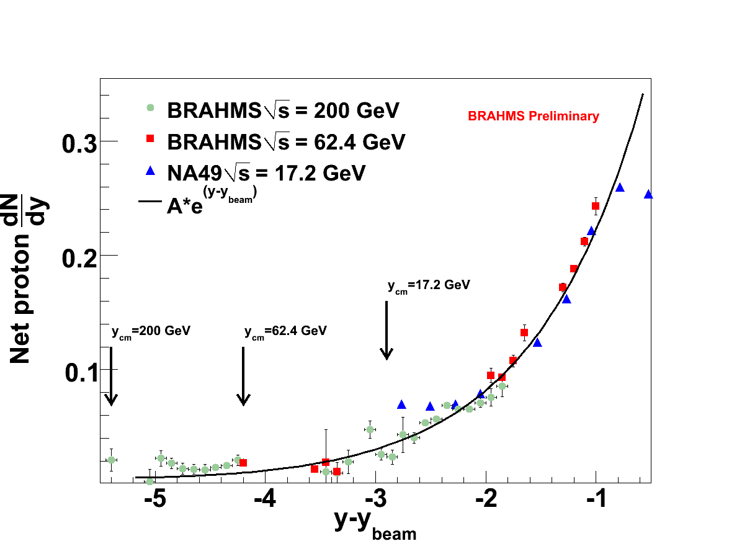
Scaling in pp
Collection of net-proton rapidity data for pp NA49, BRAHMS;
NA61 has similar measurements
Here are these data plotted vs. y-y_{beam}
Compared to A*exp(y-y_beam)
Description is actually quite good
The present data confirms this behavior at 200 GeV up to -dy of 2-3 and very well for 62 and 17.2 GeV
At larger dy this behavior is lower than the data
Notes:
Is cosh(y); On slide 5 I imagine that you are saying dn/dx for protons is ~constact,
dN/dx for pbars dies down above 0.4 => dN/dx for net proton is constant
above x=0.4 and the data confirms that statement from 17 to 200 GeV

Slide 9
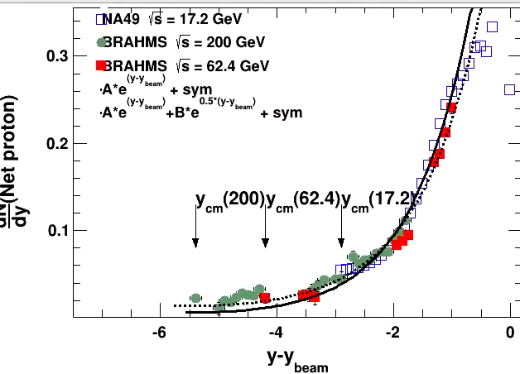
In view of recent work on Baryon Junction by e.g. STAR I decided to try to understand the cross section dependence of net-protons vs dy better
The exp(-dy) works well at low dy
  A=0.72
Use a two component description and take into account symmetrization
Exp(-a.dy) in addition to exp(-dy)
  A=0.5 for a=1 B=0.06 for a=0.5
This is actual a good description
Indicates a two-component picture is in play each dominating in low and high energy respectively

Slide 10
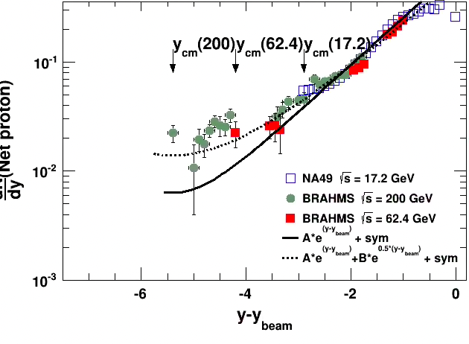
Default values for two-component and single component
It is obvious that the single exponential does not work at 200 GeV
Remember the data at y~0 are compared properly with curves due to symmetrized component

Slide 11
Extending to higher sqrt(S)
As you seen ALICE has a precise measurement of proton/anti-protons at 900 GeV of pbar/p and cross sections (and higher energies)
For an experimental discussion in pp at LHC energies see ALICE paper Eur.Phys.J.C.(2013) 73:2496. There are also measurements from CMS.
Let us include that in comparison and extend the the rapidity range

Slide 12
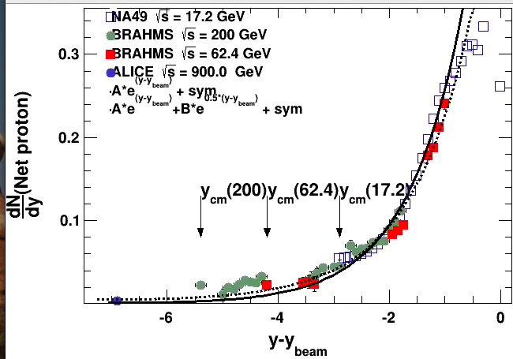
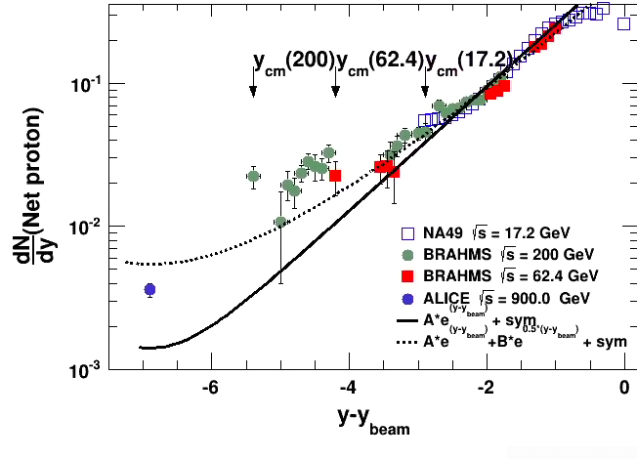
Extended to 900 GeV
The data are from the ALICE publication. The errors shown here from the error on the p-bar/p ratio.
The one and two-component function are calculated for y_{cm} = -6.9
The data are clearly in fair agreement with two component.

Slide 13
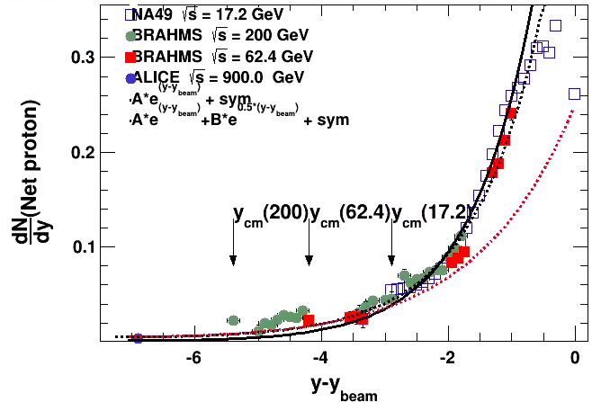
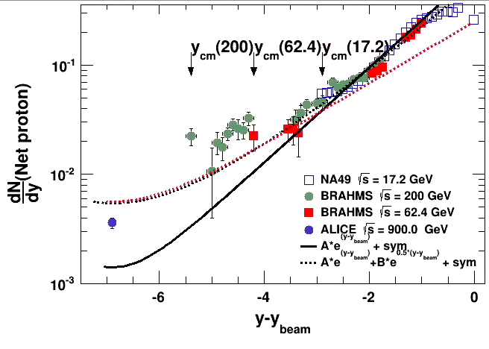
Default values for two-component with single 0.63
Compare to an exponential exp(-0.65dy)
This is not distinguishable from the the two-component fit from dy~-2 towards large dy
Fails badly at lower dy

Slide 14
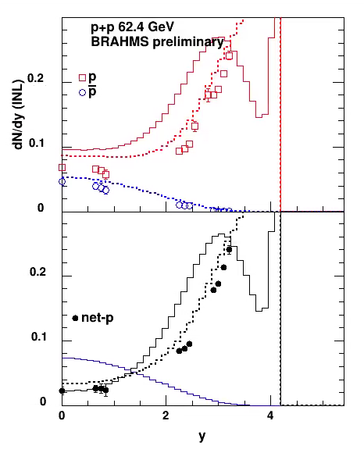
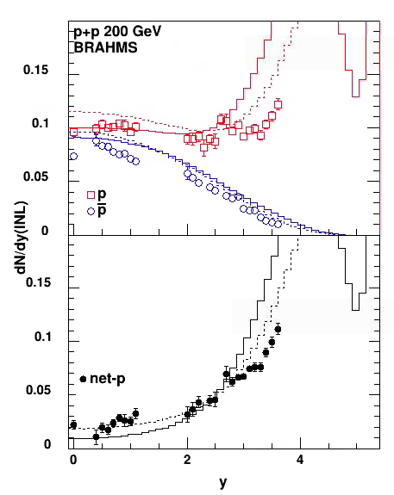
pp data and model comparison
pp proton data are compared to PYTHIA8 (full drawn curve) and EPOS 1.99 (dashed curve)
Net-protons are much better described EPOS. I do not know what mechanism causes this.
Many other models predict net-p distributions like PYTHIA
Notes:
Walk through each system

Slide 15
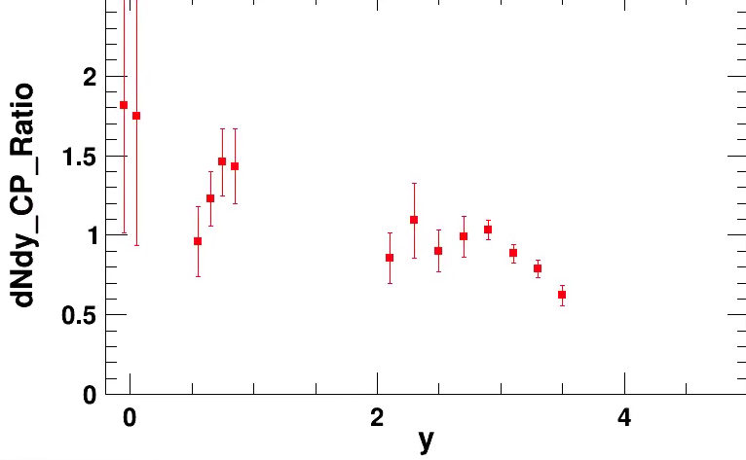
Au-Au Net-proton rapidity distributions
Net proton distributions deduced from the measured rapidity density distribution here shown for 0-10% and 60-80 % centrality.
The data are not feed-down corrected. About 80% of protons of lambda decays are included in proton yields
Notice the slow development with centrality of the shape from pp like to more protons at mid-rapidity. The60-80% shape is close to that of pp
This is very different from low energies
DNP 2021

Slide 16
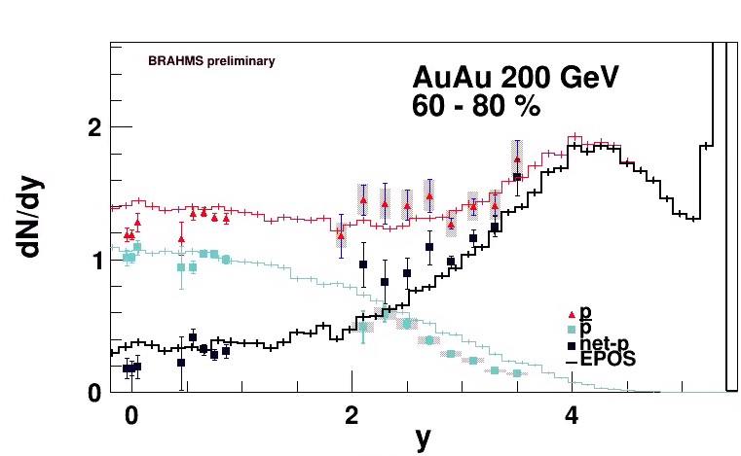
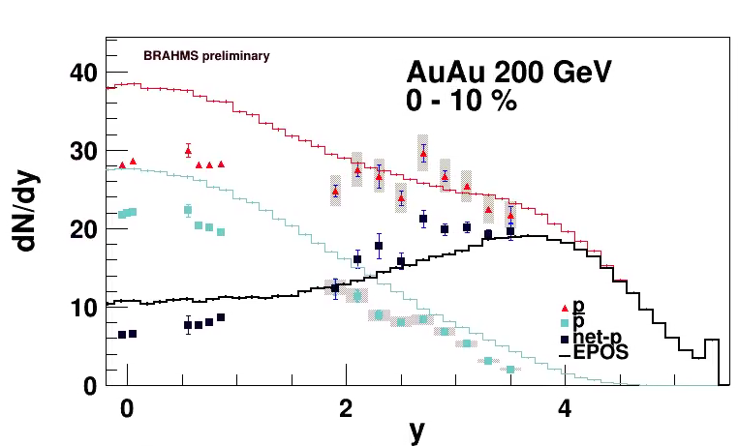
Net proton rapidity distributions.
Net proton distributions compared to model calculations from EPOS 1.99
Centrality cuts done similar to experimental data analysis; namely charge multiplicities near mid-rapidity.
The central collision is not so well described.
The rapidity loss can be evaluated by varying extrapolation to beam rapidity and calculate the yb-<y>
With the additional data in hand, it is estimated to be in the range 2.0-2.4

Slide 17
Summary
We have presented, mostly not published results from BRAHMS covering p and p-bar invariant spectra and rapidity density distributions at high rapidity's in pp and Au-Au collisions at 200 GeV.
The rapidity distributions are discussed in term of a two-component model.
The net-proton rapidity distributions are well described for low dy (<3) by an exp(-y) functional form.
For higher dy (>3) additional net proton yield is observed. A two component distribution is favored
These conclusions could be strengthened and quantified by improved analysis e.g. of 200 and 500 GeV data from STAR pp.
The EPOS gives a fair description of the net-proton distributions in AuAu collisions and at the same time describe the corresponding pp distributions well at 62 and 200 GeV
The net-proton distributions show a slow change with collision centrality with more net baryons appearing farther away from beam rapidity.

Slide 18
Discussion for workshop
What are prospects to get more precise data from 200 GeV data? 500 GeV?
How well do these data help to constrain a two-component model?
Are there other mechanism than baryon junctions that that would describe such long dy range behavior. Flux tubes? What is the mechanism in EPOS that makes it fit the data?
Questions? Discussion?

Slide 19
BACKUP and Surplus slides

Slide 20
Model comparisons
There are many models describing pp, and AA
We chose to examine PYTHIA, EPOS
Originally Pythia6, but by now Pythia8 with default tune that also describe aspect of LHC data well
Our paper will have many comparisons but for here just a few.

Slide 21
62.4 GeV
Pythia8 notice high rapidity8
Notes:
Over pretty good. Notice the high rapidity too

Slide 22
200 GeV
EPOS
Works well out of the box (EPOS 1.99, note EPOS LHC which is quite similar
Notes:
Out of the box works well

Slide 23
Model and data
Full drawn lines PYTHIA8 --- EPOS dashed
Pions and kaons well described
Net-protons only by EPOS
Most other models predict net-p like PYTHIA
Notes:
Walk through each system

Slide 24
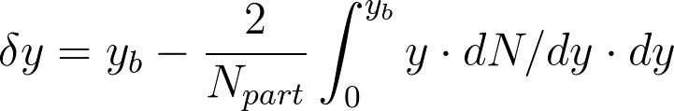
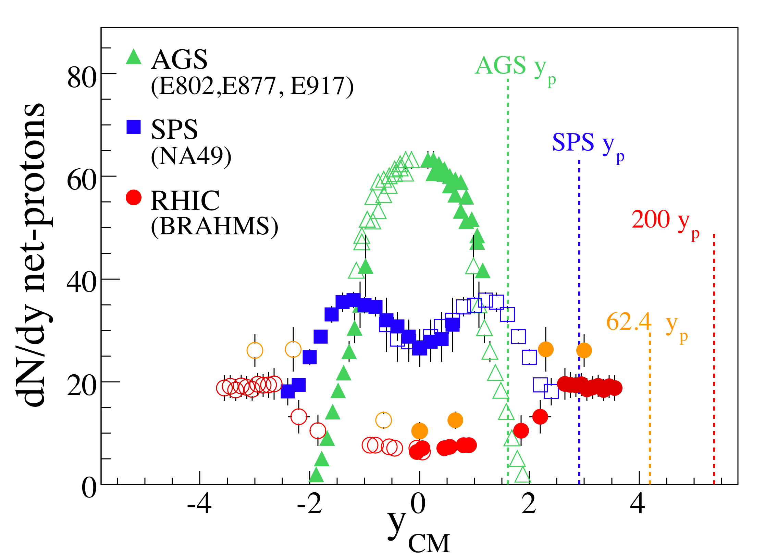
Previous data and energy loss
Phys. Rev. Lett. 93, 102301 (2004) & QM09
Phys. Lett. B677, 267-271 (2009)

