Slide 1
Baryon Production
in A Multi-Phase Transport (AMPT) Model
Zi-Wei Lin
East Carolina University
1st workshop on Baryon Dynamics from RHIC to EIC
Stony Brook University, January 22-24, 2024

Slide 2


Outline
Introduction of the AMPT model
Model results on baryon and electric charge stopping
Relations to quark stopping
On net-charge reconstruction
Summary
Mostly based on work with PhD student Mason Ross

Slide 3
A multi-phase transport (AMPT) model
was constructed as a self-contained kinetic description of heavy ion collisions:
  evolves the system from initial condition to final observables;
  has explicit parton stage and hadron stage;
  includes productions of all quark flavors & conserved charges in 3D;
  can address initial condition & dynamics/evolution in non-equilibrium.
A+B
Initial condition
Parton Cascade
Hadronization
Source codes at
https://myweb.ecu.edu/linz/ampt/
ZWL, Ko, Li, Zhang & Pal, Phys Rev C (2005);
ZWL & Zheng, Nucl Sci Tech (2021)
Hadron Cascade
Final particles
(momentum & spacetime at freezeout)

Slide 4
Structure of the default AMPT model
A+B
HIJING1.0:
minijet partons excited strings spectator nucleons
Dominated by hadronic
interactions
ZPC (parton cascade)
Partons freeze out
Hadronization (Lund String fragmn)
Extended ART (hadron cascade)
Hadrons freeze out (before a cut-off time);
strong-decay all remaining resonances
Final particles

Slide 5
Structure of the string melting AMPT model
A+B
HIJING1.0:
minijet partons excited strings spectator nucleons
Strings melt to q & qbar via intermediate hadrons
Dominated by partonic
interactions
ZPC (parton cascade)
Partons freeze out
Hadronization (Quark Coalescence)
Extended ART (hadron cascade)
Hadrons freeze out (before a cut-off time);
strong-decay all remaining resonances
Final particles

Slide 6
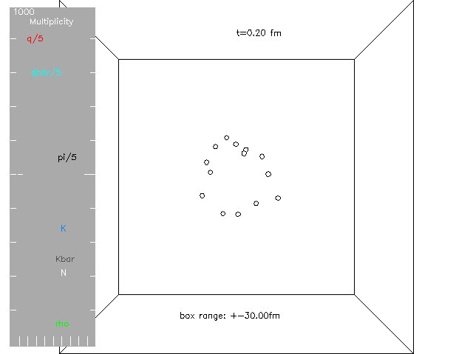
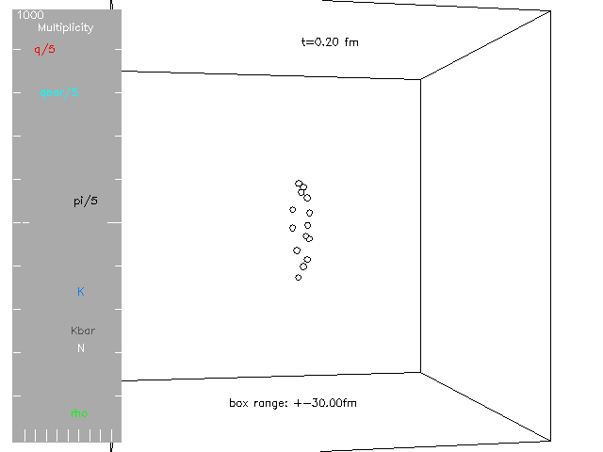
A central Au+Au event at 200 AGeV
from the String Melting AMPT model (applicable at high energies):
x-y z-x

Slide 7
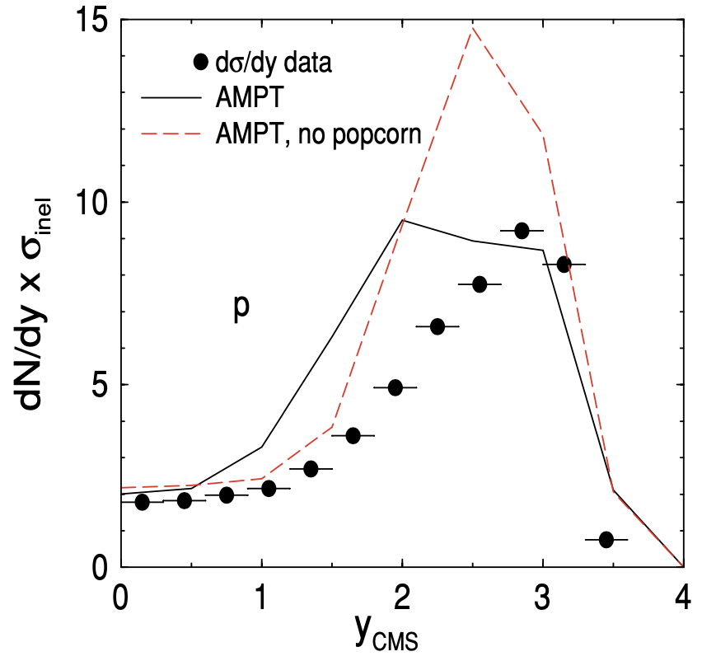
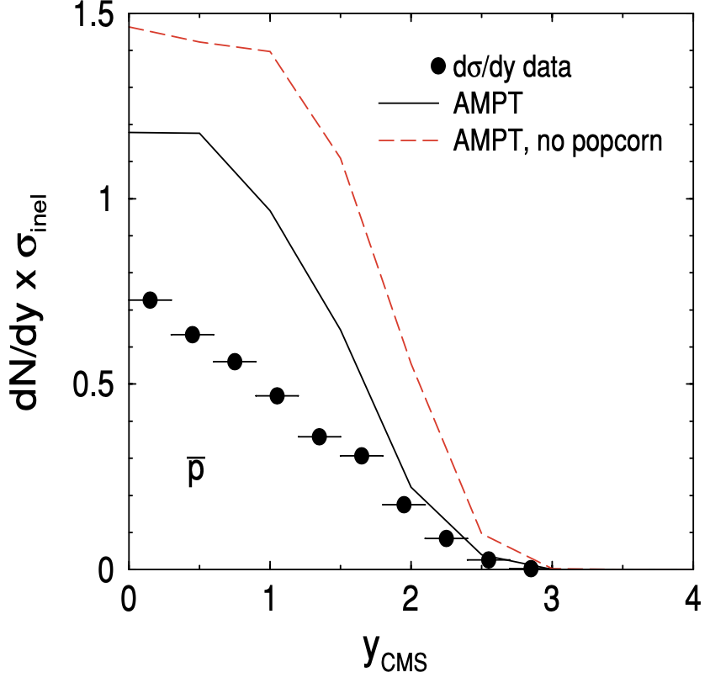
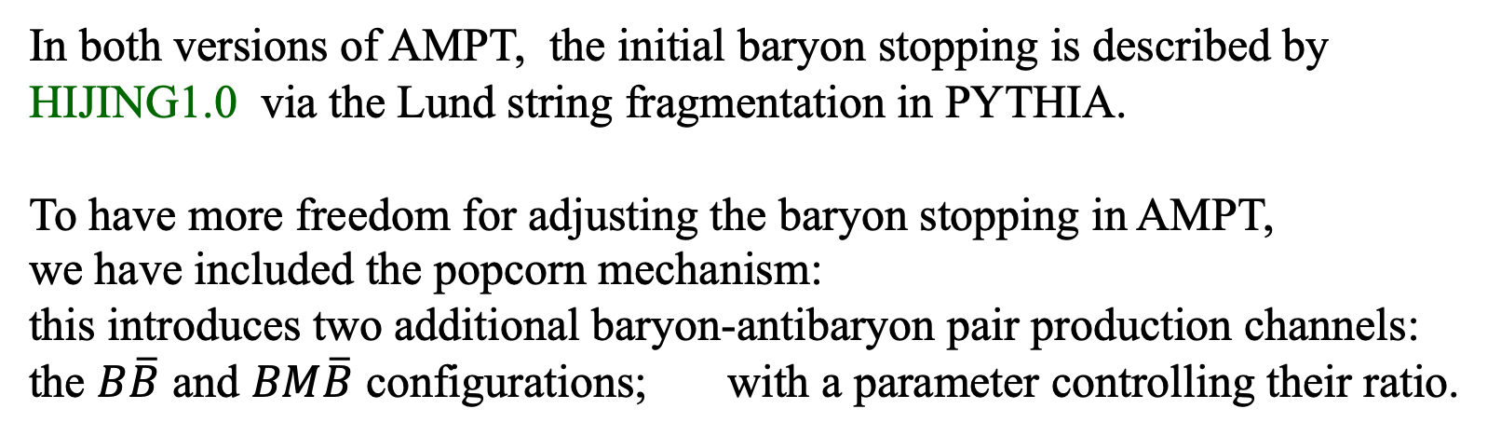
Baryon productions in AMPT
In both versions of AMPT, the initial baryon stopping is described by HIJING1.0 via the Lund string fragmentation in PYTHIA.
To have more freedom for adjusting the baryon stopping in AMPT,
we have included the popcorn mechanism:
this introduces two additional baryon-antibaryon pair production channels:
the $B\overline{B}$ and $BM\overline{B}$ configurations; with a parameter controlling their ratio.
pp collisions at P_{lab} = 400 GeV/c
The popcorn mechanism can help but is not enough.

Slide 8
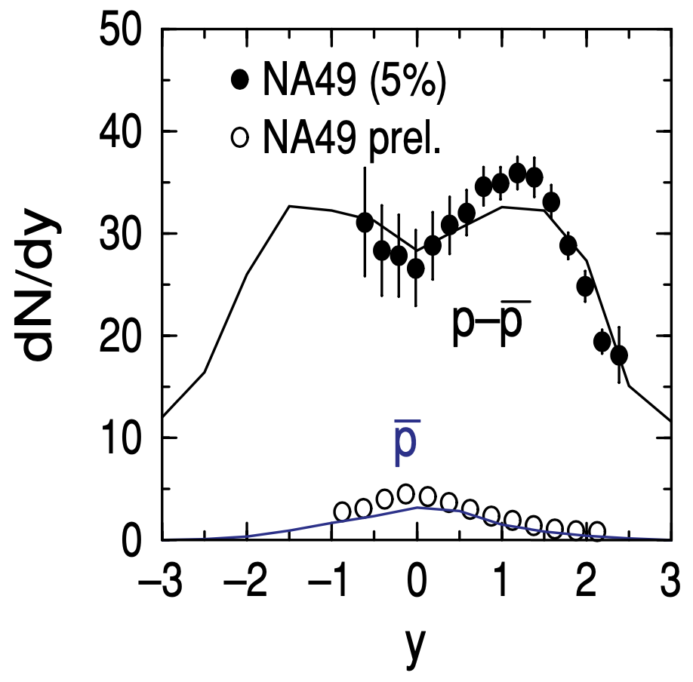
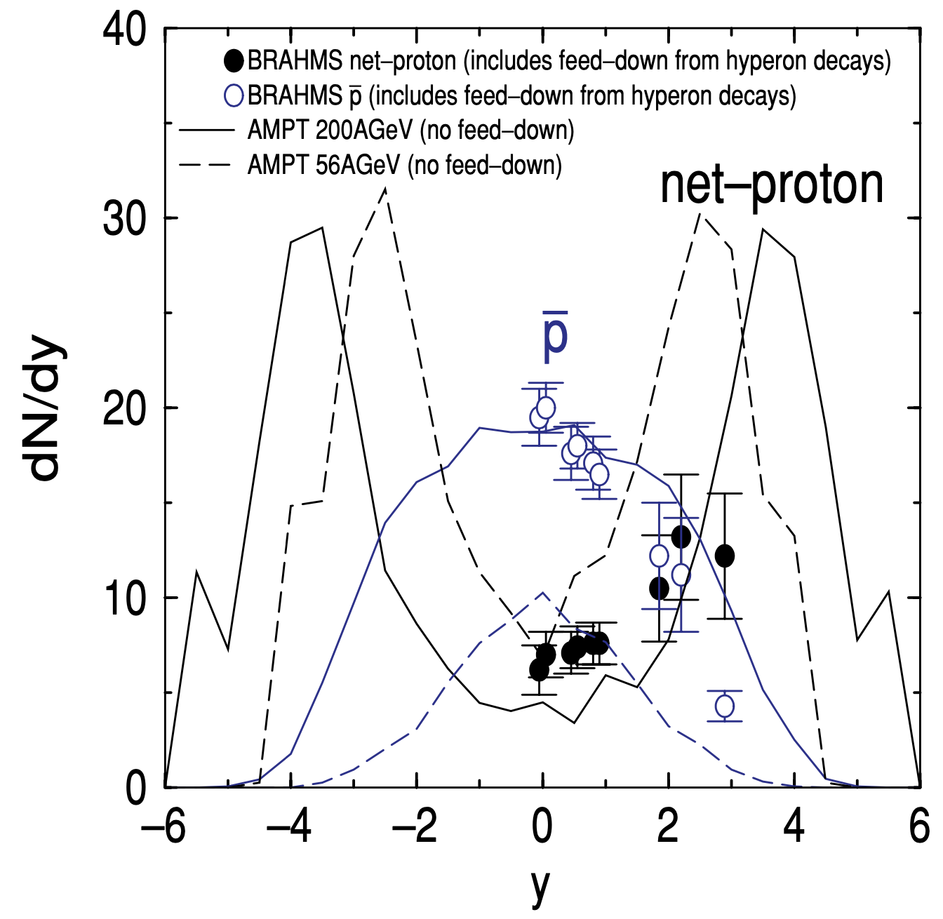
Baryon stopping in the default AMPT model
for AA collisions are often reasonable.
Central Pb+Pb collisions
at top SPS energy (17.3GeV)
Central Au+Au collisions
at RHIC energies

Slide 9
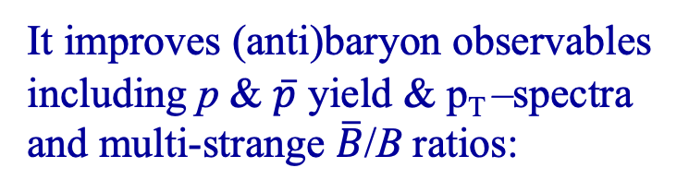
Baryon stopping in the string melting AMPT model
also depends on quark coalescence.
We have improved the
quark coalescence model in AMPT,
it is more physical and efficient,
especially for (anti)baryons.
It improves (anti)baryon observables
including p & $\overline{p}$ yield & p_{T} –spectra
and multi-strange $\overline{B}$/B ratios:
Y He & ZWL, Phys Rev C (2017)
There are still challenges, such as the low $\overline{p}$/p ratio at/below 200A GeV.

Slide 10
Results from string melting AMPT
Minimum-bias Zr+Zr collisions
B
⇢
B
Q
N_{B} or B: net-baryon number.
N_{Q} or Q: net-electric charge number.
Notes:
AMPT version CC-v25t7fu: has charge conservation and “Moved (anti)baryon coalescence in front of meson coalescence” (similar to new coalescence)

Slide 11
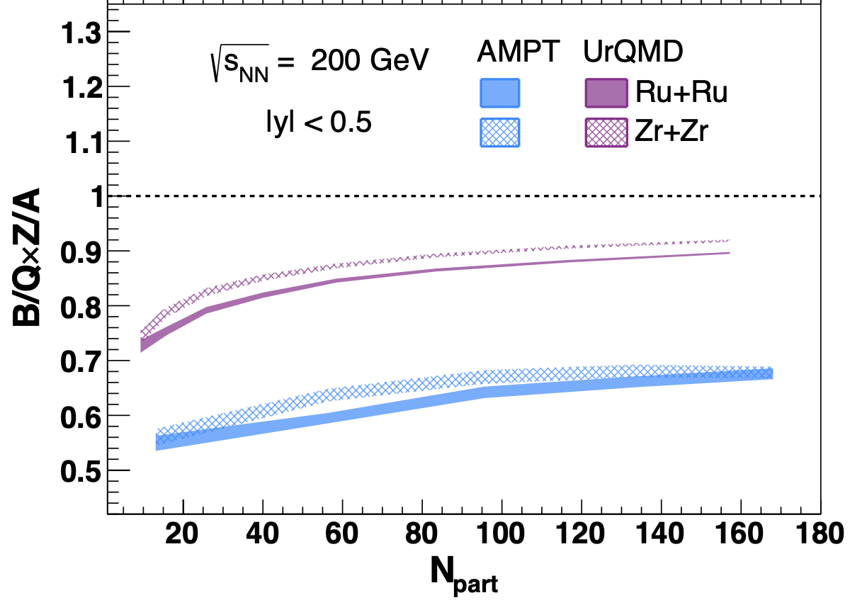
Ratio B/Q*Z/A has been proposed
to study baryon stopping.
Z. Xu, RBRC workshop on Physics Opportunities from isobar run (2022)
Ratio at mid-rapidity:
B/Q*Z/A < 1 in both models, for every centrality.
N. Lewis et al.,
2205.05685 [hep-ph]
More UrQMD results in
W. Lv et al., 2309.06445 [nucl-th]

Slide 12
Naive expectation for B/Q*Z/A
When we include all particles at all rapidities,
conservation laws give B = 2A and Q = 2Z,
so B/Q*Z/A=1.
This can be called the naive expectation.
It’s tempting to expect this to be true at any rapidity y,
but we already see strong deviations.

Slide 13
Ratio versus rapidity (for minimum bias events):
B/Q*Z/A changes strongly with y
Rescatterings and hadronization only modestly change the ratio
Default AMPT and string melting AMPT are qualitatively similar

Slide 14
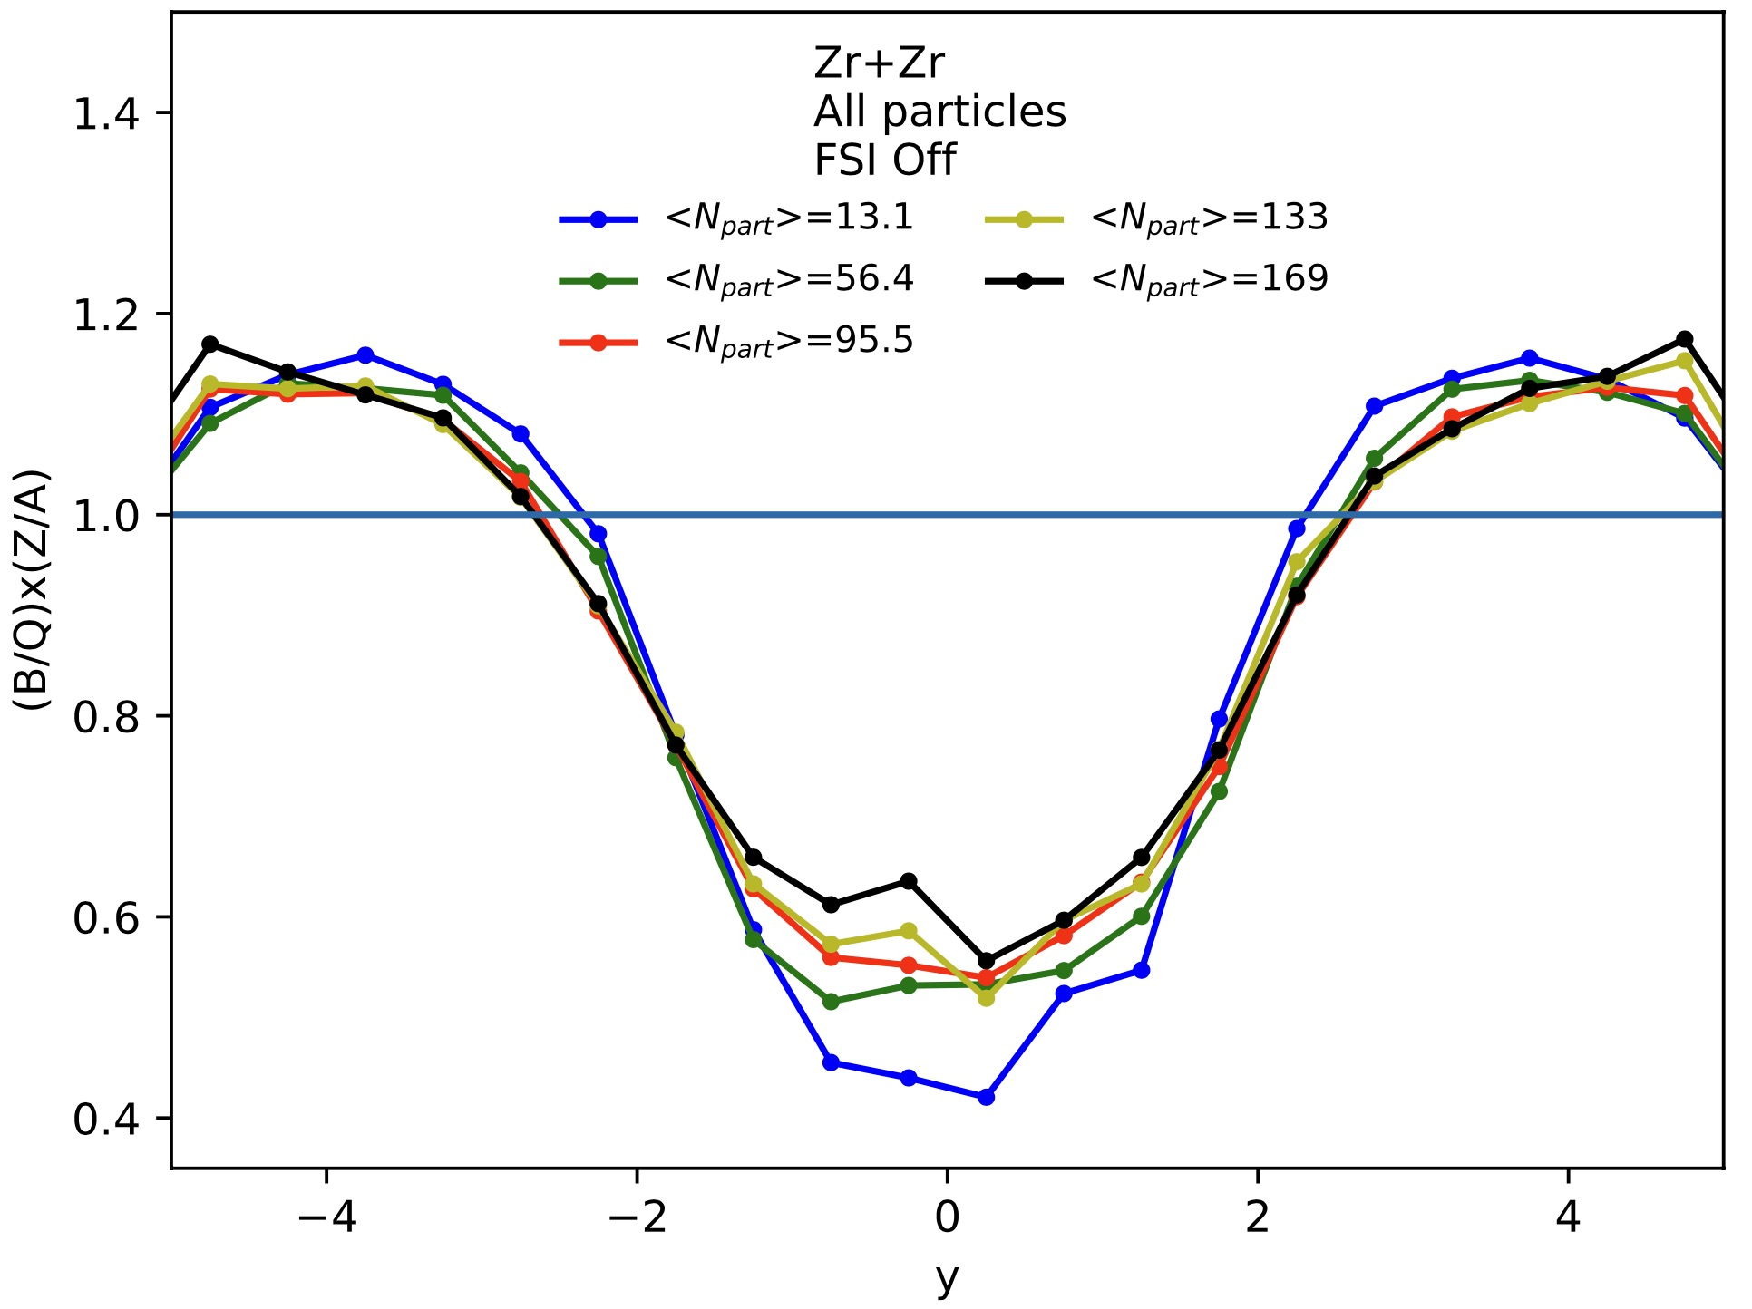
Ratio versus rapidity:
B/Q*Z/A changes only modestly with centrality
Notes:
This figure comes from not many (~50K) events.

Slide 15
For the difference between Zr and Ru isobars:
B/ΔQ*ΔZ/A
is qualitatively similar to B/Q*Z/A
UrQMD results from
N. Lewis et al., 2205.05685 [hep-ph]

Slide 16
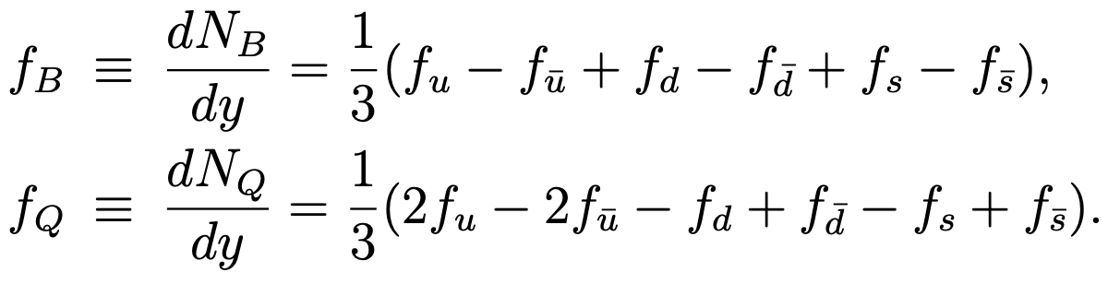
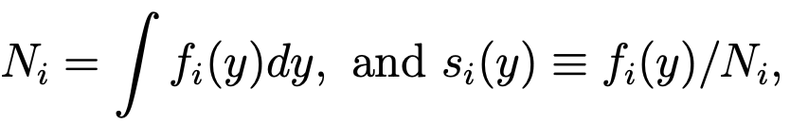
Relate B/Q*Z/A to quark stopping
We consider a quark matter under the conventional scenario:
baryon and electric charge are carried by quarks and antiquarks
while neglecting the baryon junction.
Let f_{i} ≡ f_{i} (y) ≡ dN/dy of quark flavor i, we then have
Let’s separate the dN/dy shape from the magnitude by writing
s_{i} (y) is the normalized dN/dy
& represents the stopping of quark flavor i

Slide 17
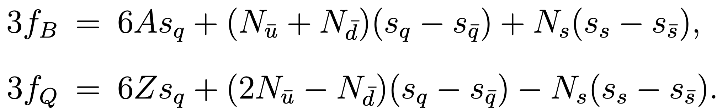

Consider “central” collisions, conservation laws give
Due to isospin symmetry of the strong interaction (& ignore neutron skin),
we assume that the relative stopping of u is the same as d :
Then we have
Note: $N_{u}$ can still be different from $N_{d}$.

Slide 18
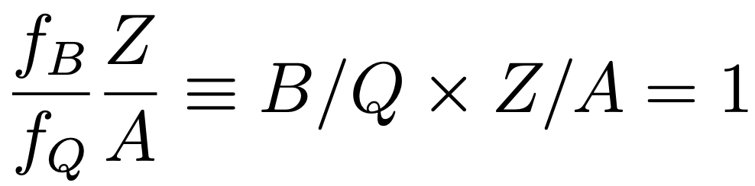
We consider two simple limits below.
A)
If we can neglect sea-quarks and strange quarks
(e.g., at very low energies):
we get the naive expectation (at any y):

Slide 19

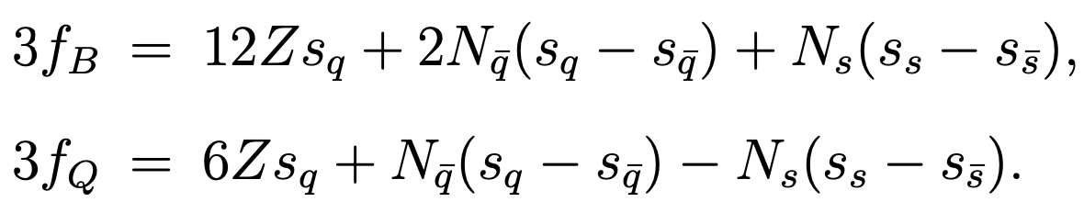
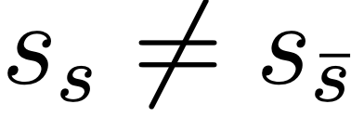
B)
For heavy ion collisions with A=2Z (like isobar ⁹⁶Cd+Cd),
isospin symmetry gives
so we have
Without the strangeness terms, we have (at any y)
B/Q*Z/A ≠ 1 (for isospin symmetric nucleus)
is due to (anti)strange quarks
and it means
Note: same conclusion for non-central events (when ignoring neutron skin)

Slide 20
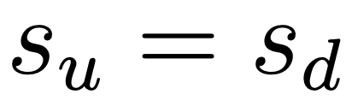
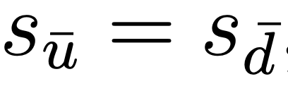
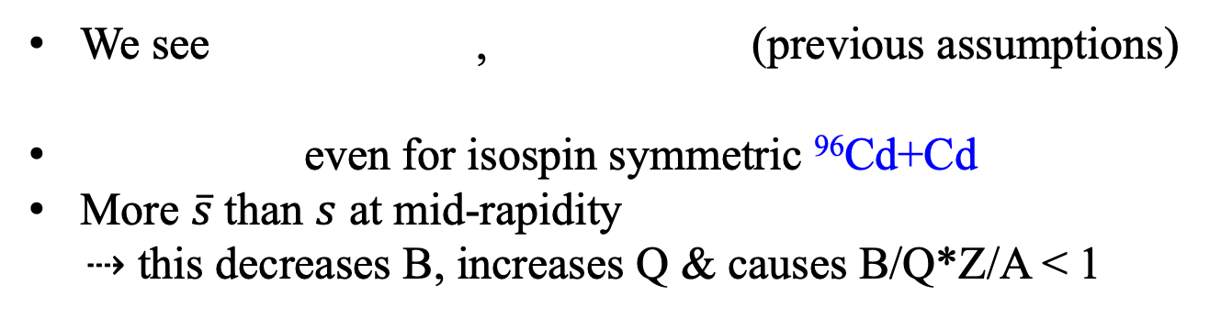
Quark results from string melting AMPT
for minimum-bias ⁹⁶Zr+Zr & ⁹⁶Cd+Cd
We see , (previous assumptions)
even for isospin symmetric ⁹⁶Cd+Cd
More $\overline{s}$ than $s$ at mid-rapidity
⇢ this decreases B, increases Q & causes B/Q*Z/A < 1
Notes:
Cd=Cadmium

Slide 21
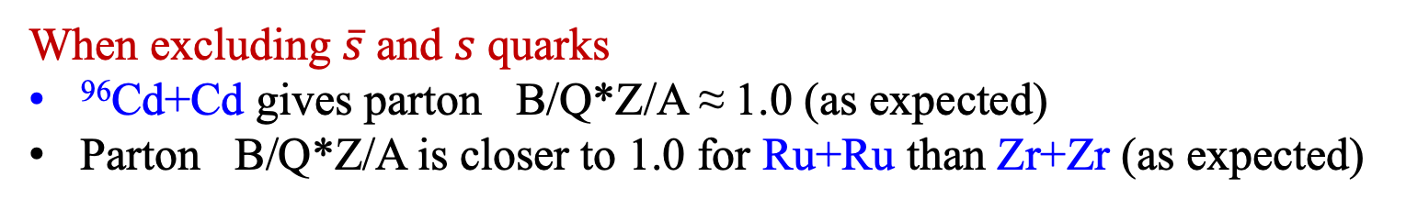
Results from string melting AMPT
for MB ⁹⁶Zr+Zr ⁹⁶Ru+Ru ⁹⁶Cd+Cd
When excluding $\overline{s}$ and $s$ quarks
⁹⁶Cd+Cd gives parton B/Q*Z/A ≈ 1.0 (as expected)
Parton B/Q*Z/A is closer to 1.0 for Ru+Ru than Zr+Zr (as expected)
⇢ B/Q*Z/A ≠ 1 is mainly due to

Slide 22
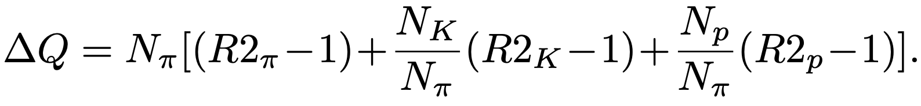
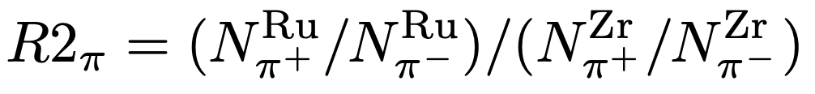
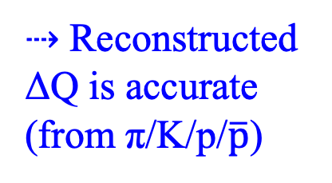
On reconstruction of net charges
Using AMPT results, we check the experimental reconstruction method
by comparing “Reconstructed” charge with the direct model result.
Net-electric charge reconstruction:
CY Tsang (for STAR)
at GHP 2023 &
Quark Matter 2023
⇢ Reconstructed
ΔQ is accurate
(from π/K/p/$\overline{p}$)

Slide 23

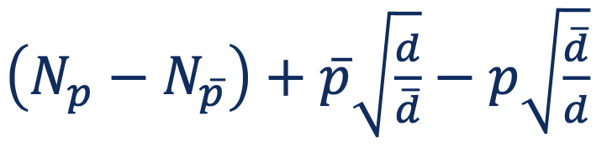
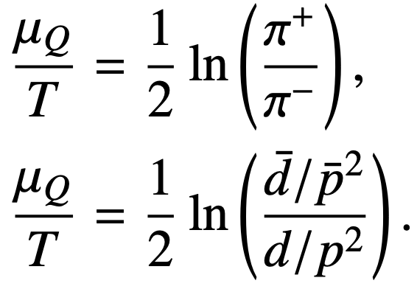
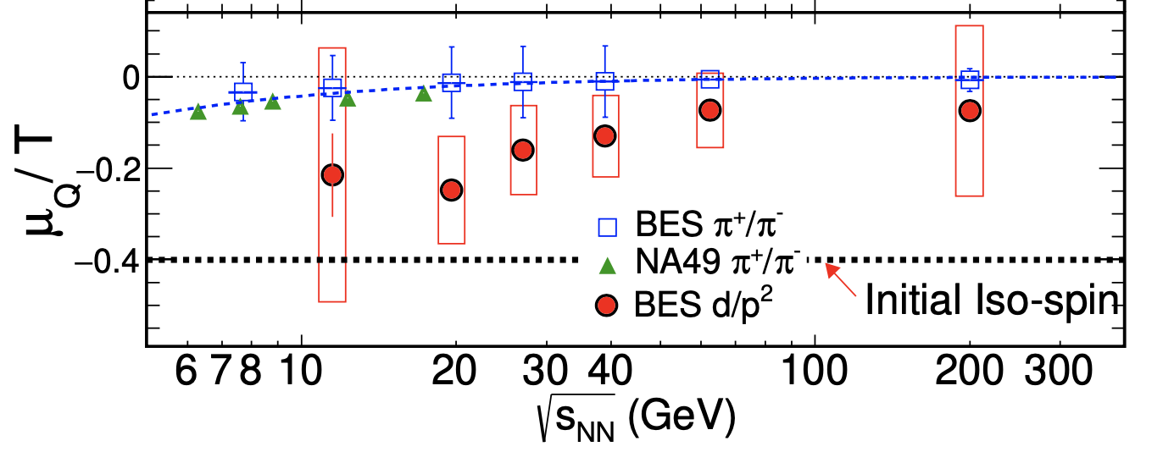
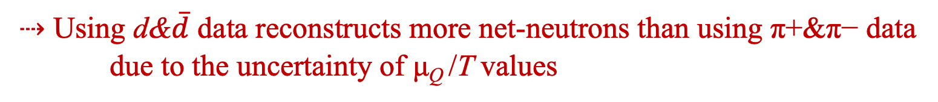
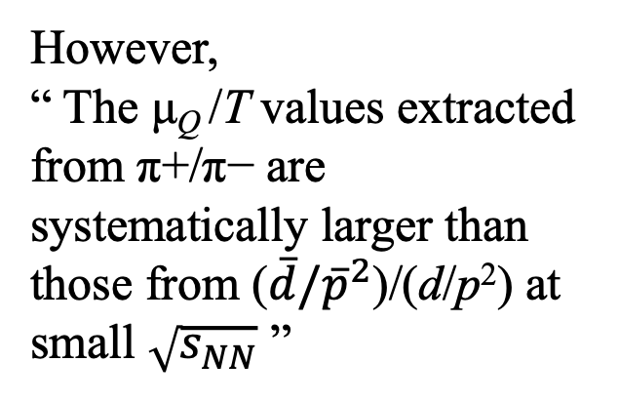
Net-baryon reconstruction:
CY Tsang (for STAR)
at GHP 2023 &
Quark Matter 2023
≈
This is based on
the thermal model:
STAR Collaboration,
Phys Rev C 99, 064905 (2019)
However,
“ The μ_{Q} /T values extracted from π+/π− are systematically larger than those from ($\overline{d}/{\overline{p}}^{2}$)/(d/p²) at small $\sqrt{s_{NN}}$ ”
Au+Au top 10%
⇢ Using d&$\overline{d}$ data reconstructs more net-neutrons than using π+&π− data
due to the uncertainty of μ_{Q} /T values
Notes:
“... although the uncertainties in the valuesextractedfrom(d ̄/p ̄2)/(d/p2)arelarge.”

Slide 24
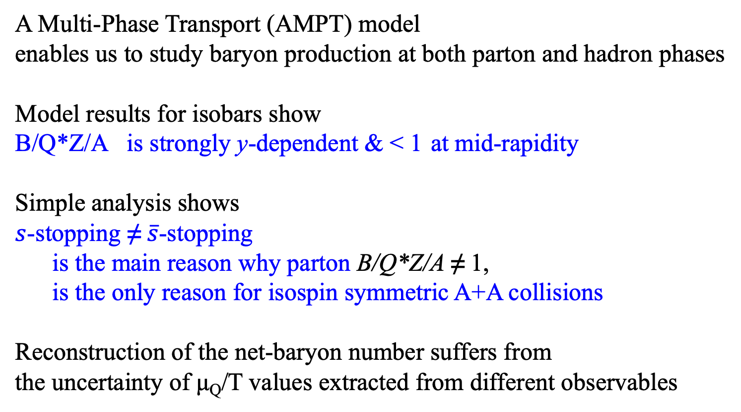
Summary
A Multi-Phase Transport (AMPT) model
enables us to study baryon production at both parton and hadron phases
Model results for isobars show
B/Q*Z/A is strongly y-dependent & < 1 at mid-rapidity
Simple analysis shows
$s$-stopping ≠ $\overline{s}$-stopping
is the main reason why parton B/Q*Z/A ≠ 1,
is the only reason for isospin symmetric A+A collisions
Reconstruction of the net-baryon number suffers from
the uncertainty of μ_{Q}/T values extracted from different observables
Thanks for your attention!

