Slide 1

Baryon Stopping and the Valence Quark Distribution at Small x
Yuri Kovchegov
The Ohio State University

Slide 2
Outline
Valence quark (flavor non-singlet) distributions at small x from a perturbative QCD calculation (Itakura, YK, McLerran, Teaney, 2003):
          Evolution equation;
          Small-x asymptotics of valence quark PDFs;
          Baryon stopping in heavy ion collisions.
        A detour into AdS/CFT: shock wave collisions and stopping (Albacete, YK, Taliotis, 2008-2009).

Slide 3
Valence quarks at small x: evolution equation

Slide 4
Dipole picture of DIS
x⁻
x⁺
Large q⁻ → large x⁻ separation
aka the “shock wave”

Slide 5
Dipole Amplitude
The total DIS cross section is expressed in terms of the (Im part of the) forward quark dipole amplitude N:
b is the Fourier conjugate to q
with t = - q², making the dipole
amplitude N similar to the GPDs
at zero skewedness.
Gribov, 1970; Bjorken and Kogut, 1973;
Frankfurt, Strikman 1988; Mueller 1990;
Nikolaev and Zakharov 1991
with rapidity Y=ln(1/x)

Slide 6
DIS in the Classical Approximation
The DIS process in the rest frame of the target nucleus is shown below.
with rapidity Y=ln(1/x)

Slide 7
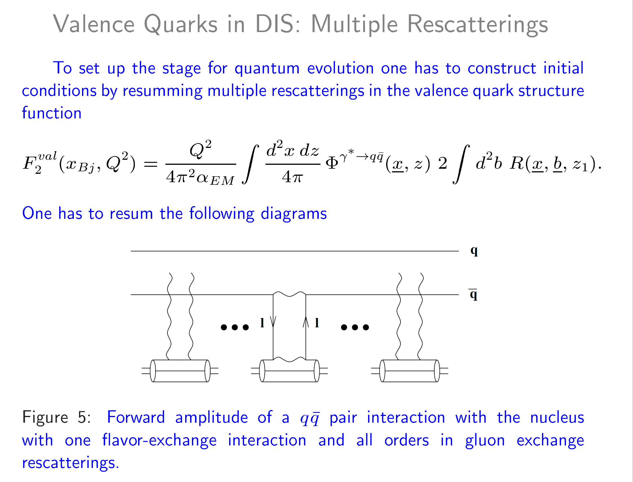
flavor non-singlet
F₂ structure function

Slide 8
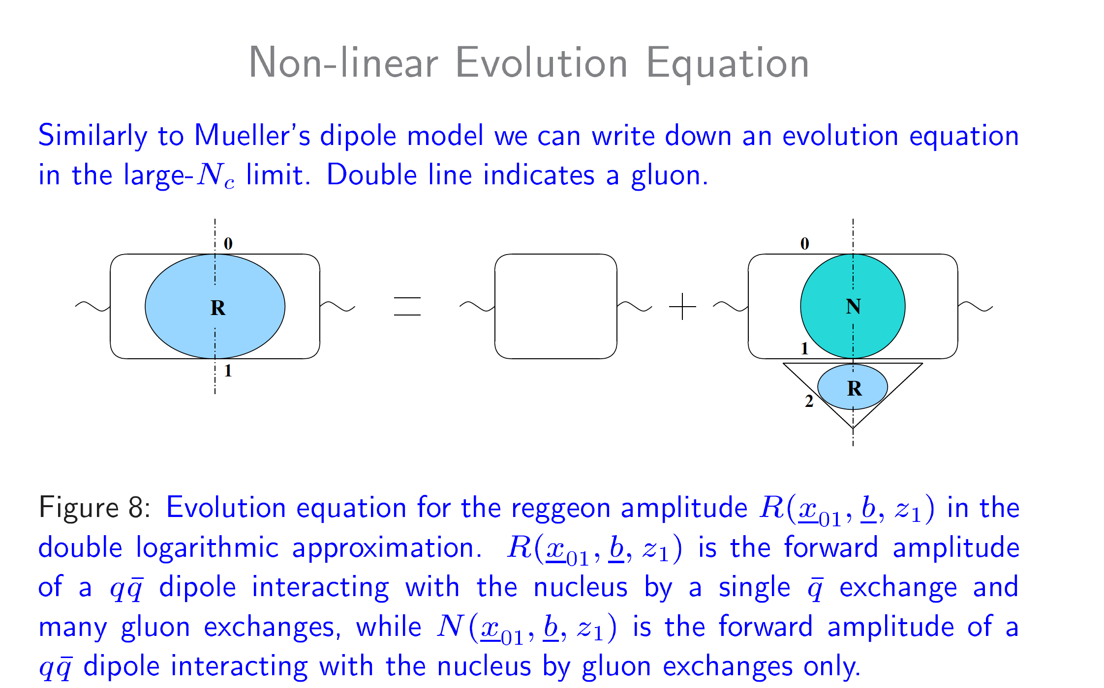
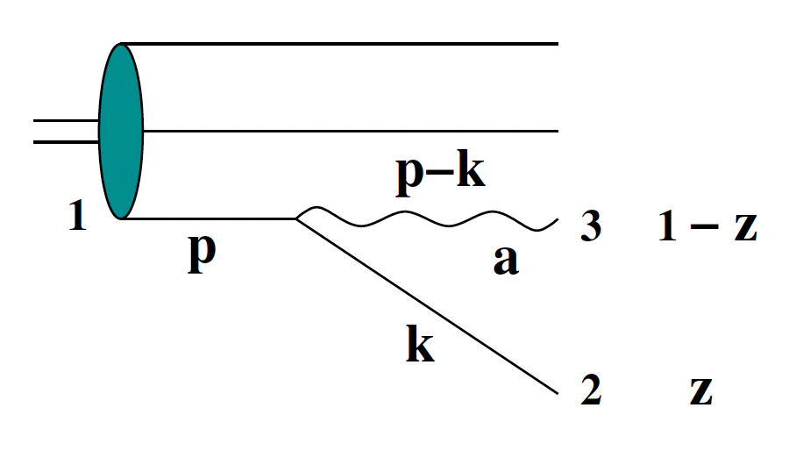

Slide 9
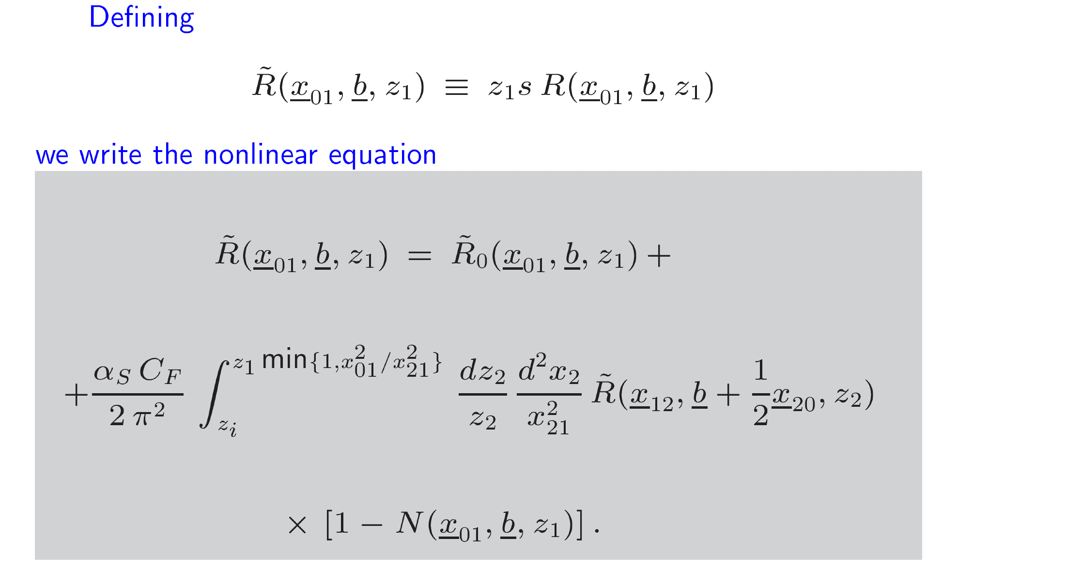
K. Itakura, YK,
L. McLerran, D. Teaney, 2003
N = unpolarized dipole
scattering amplitude,
obeys BK/JIMWLK
evolution
Double-logarithmic
evolution at large N_{c}.

Slide 10
Resummation Parameter
For helicity evolution the leading resummation parameter is different from BFKL, BK or JIMWLK, which resum powers of leading logarithms (LLA or SLA)
Reggeon evolution resummation parameter is double-logarithmic (DLA):
The second logarithm of x arises due to transverse momentum (or transverse coordinate) integration being logarithmic both in the UV and IR.
This was known before: Kirschner and Lipatov ’83; Kirschner ’84; Bartels, Ermolaev, Ryskin ‘95, ‘96; Griffiths and Ross ’99; Bartels and Lublinsky ‘03. It has been recently utilized in small-x evolution for helicity (YK, Pitonyak, Sievert ‘15-’18; Cougoulic, YK, Tarasov, Tawabutr ‘22), Sivers and Boer-Mulders functions (YK, Santiago, ’21-’22), transversity (Kirschner et al, ‘96; YK, Sievert ‘18), and OAM distributions (Boussarie, Hatta, Yuan ‘19; YK, Manley ’23; Manley ‘24).

Slide 11
Operator treatment
The same calculation can be done using the light-cone operator treatment (LCOT) formalism. The corresponding operator probably is
with the flavor non-singlet Reggeon dipole amplitude (note the relative minus sign):
Here

Slide 12
Flavor Non-Singlet Observables
In the flavor non-singlet case, all helicity observables again depend on the polarized dipole amplitude:
Polarized dipole amplitude is different (difference instead of sum):
This is related to the definition
YK, D. Pitonyak, M. Sievert, ‘16

Slide 13
Flavor Non-Singlet Evolution
Evolution equations end up being much simpler in the non-singlet case:
Analytical solution (in the DLA case, S=1) leads to (in agreement with Bartels et al, ‘95)
The resulting intercept is smaller than the flavor-singlet intercept.
YK, D. Pitonyak, M. Sievert, ‘16

Slide 14
Valence quarks at small x: asymptotics

Slide 15
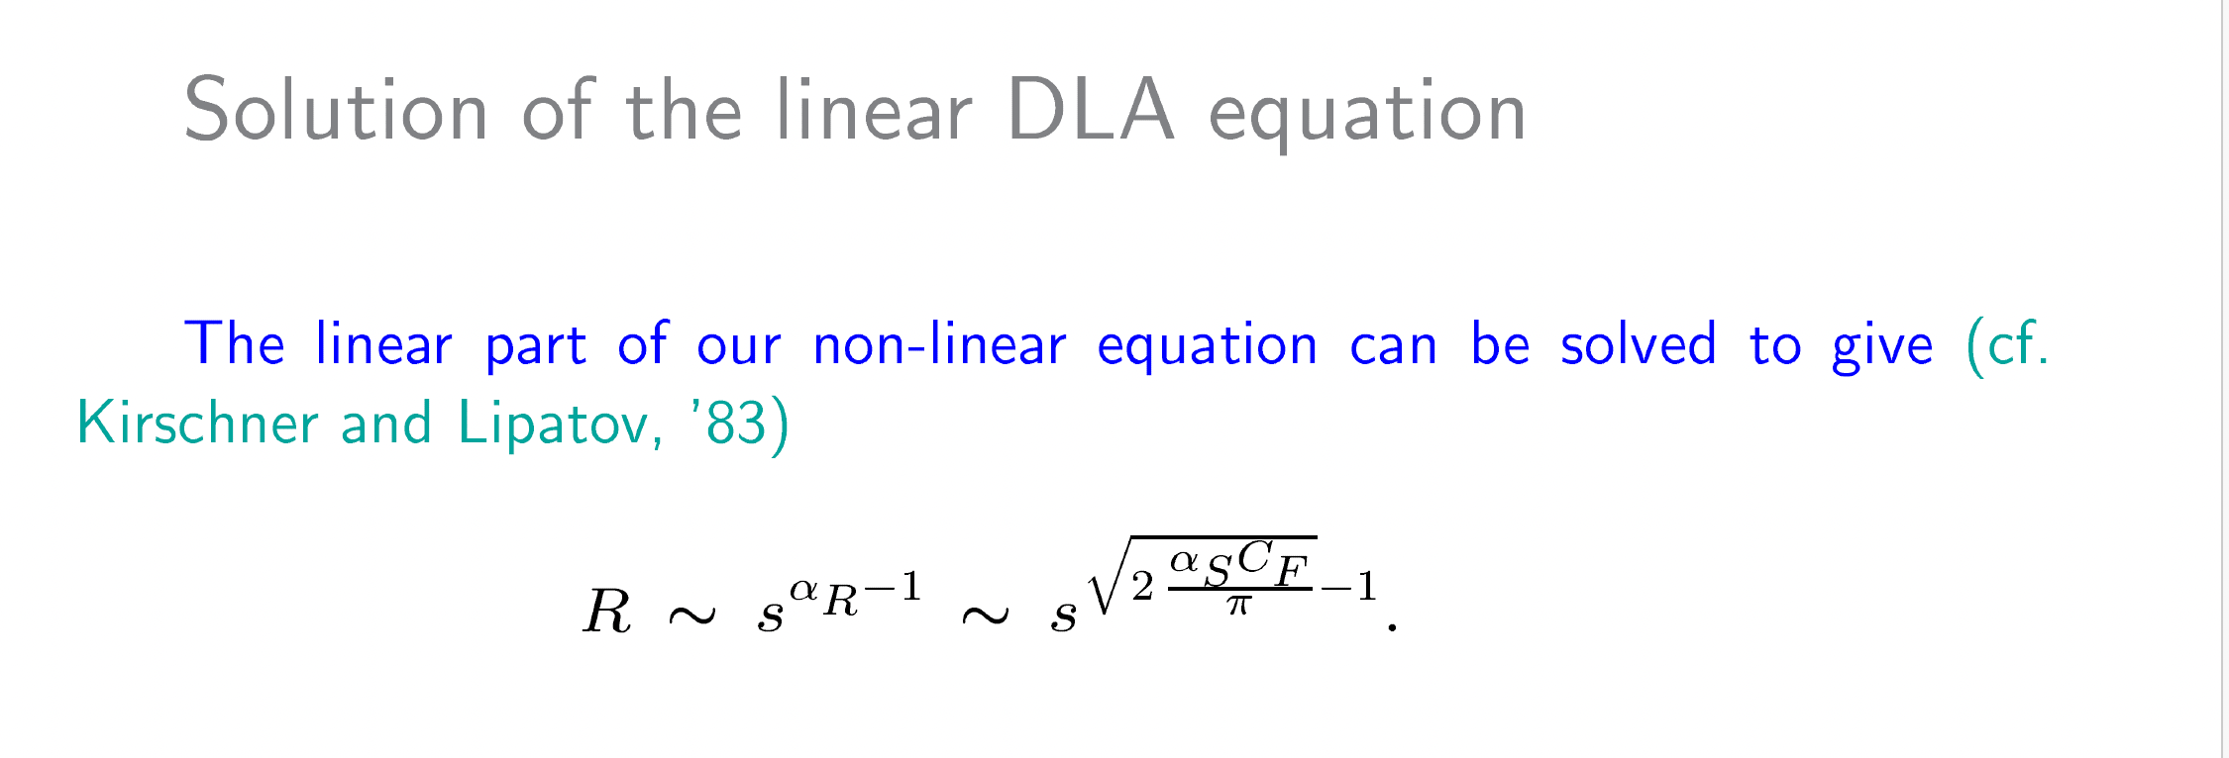
High energy asymptotics of the Reggeon amplitude
K. Itakura, YK,
L. McLerran, D. Teaney, 2003
Order–α_{s} correction to the intercept (the power) was found by R. Kirschner ‘95.

Slide 16
Small-x asymptotics of the valence quark PDFs
The above translates into
outside the saturation region.
Inside the saturation region q_{val} is negligibly small.
Note the same intercept as for Δq^{NS} , the flavor non-singlet quark helicity PDF.

Slide 17
Baryon stopping

Slide 18
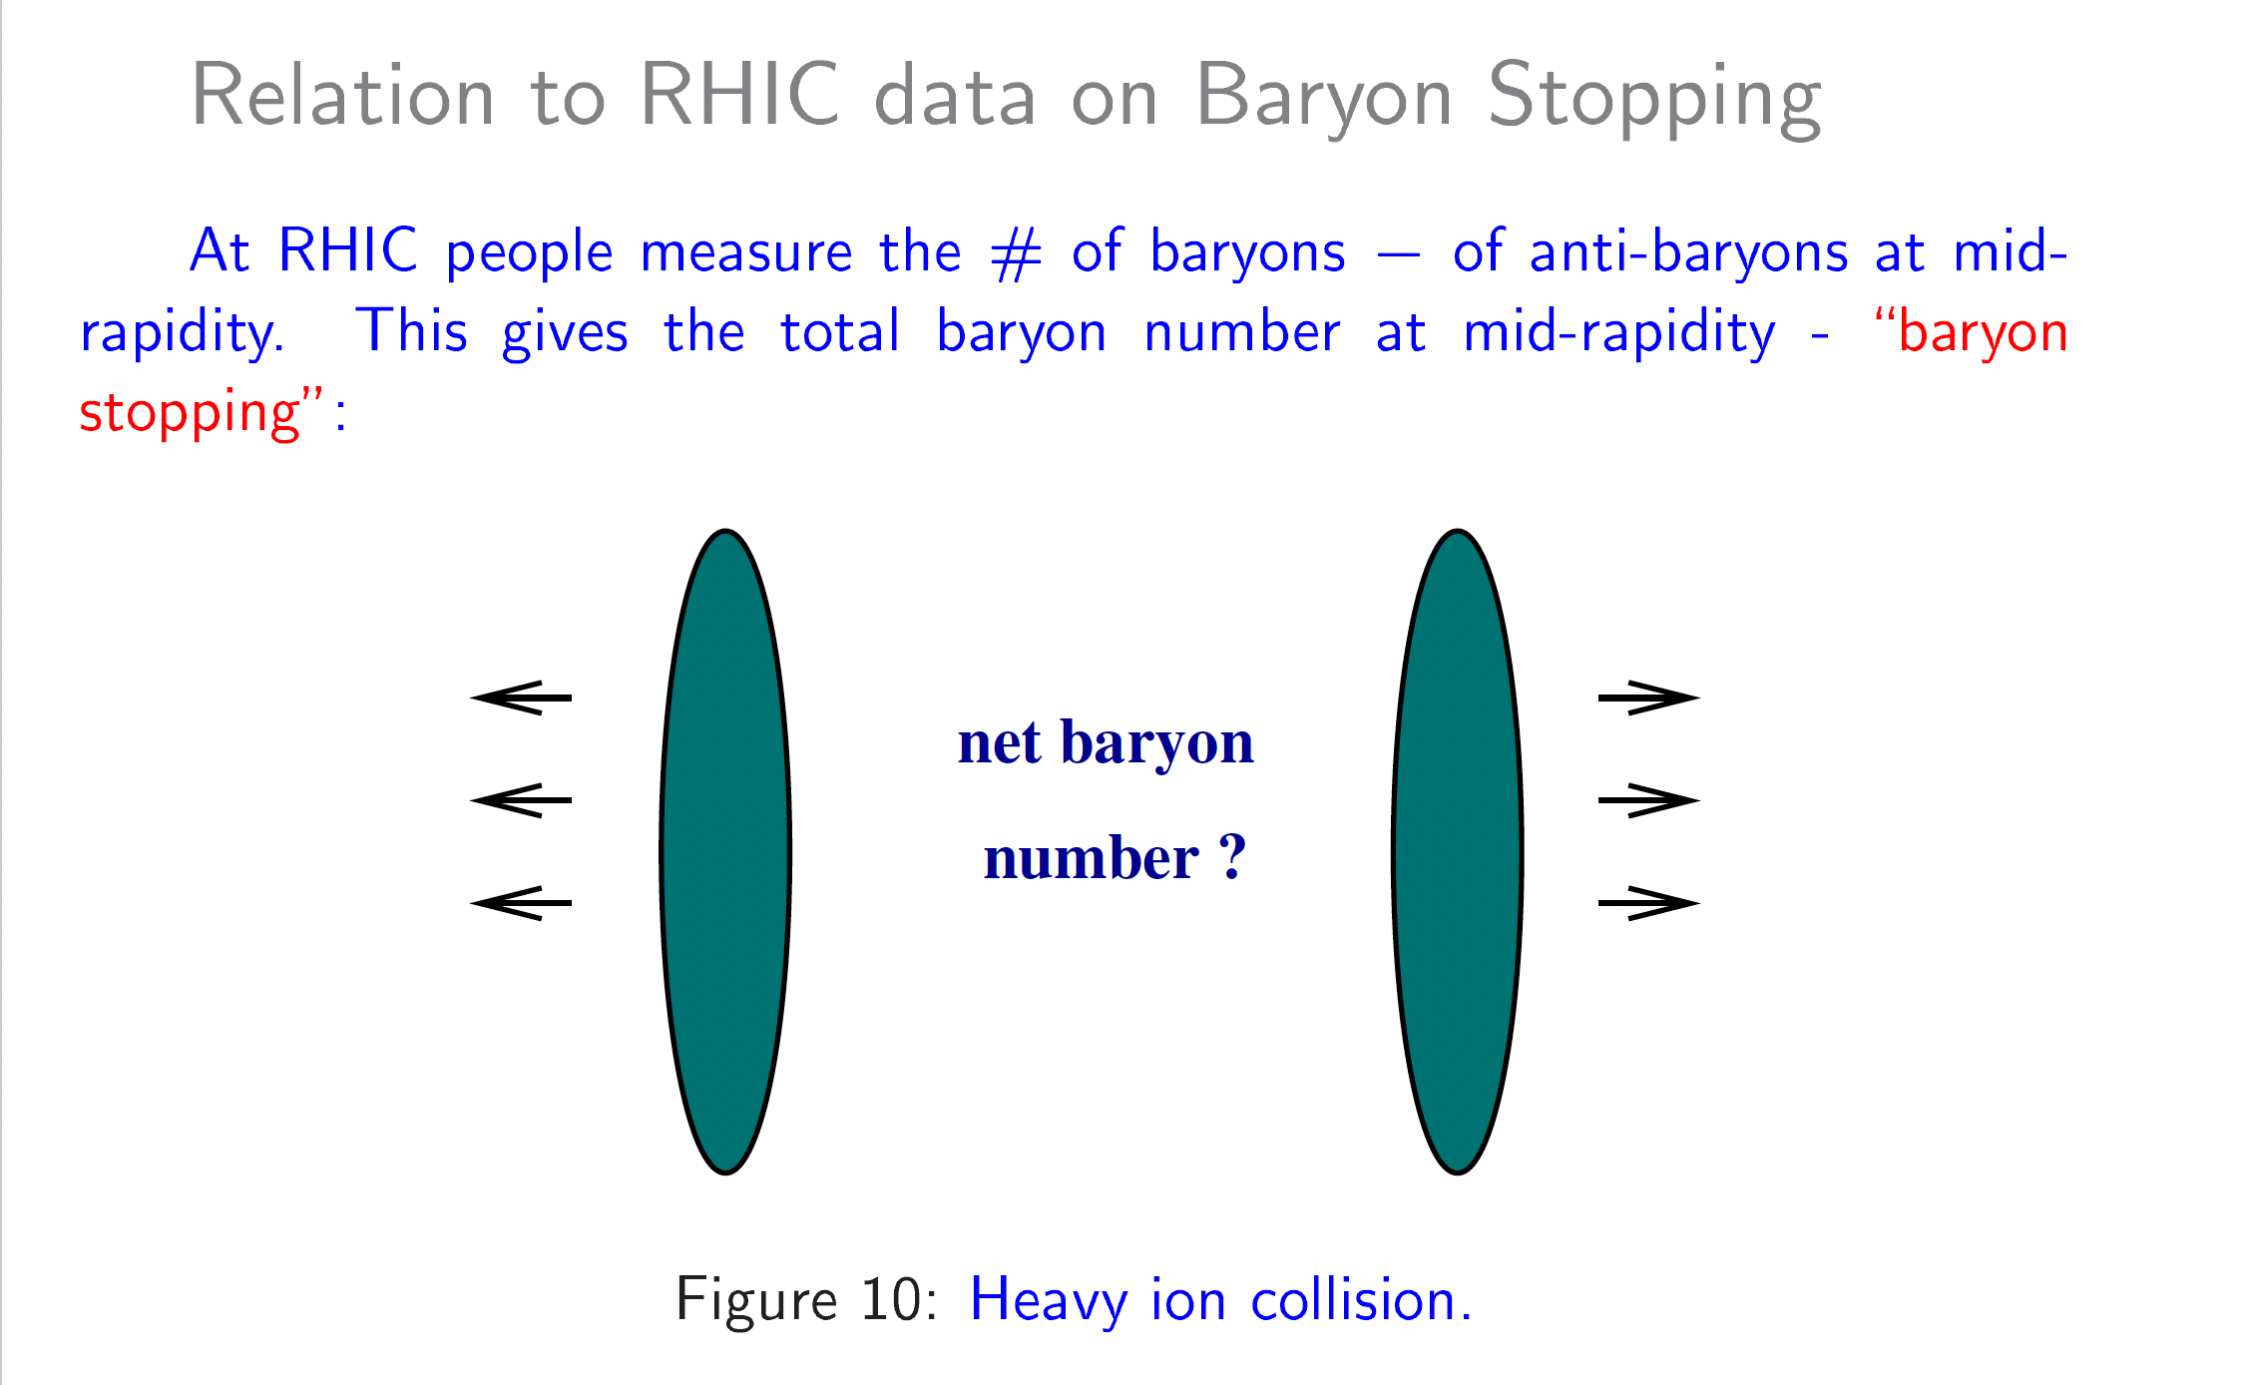

Slide 19
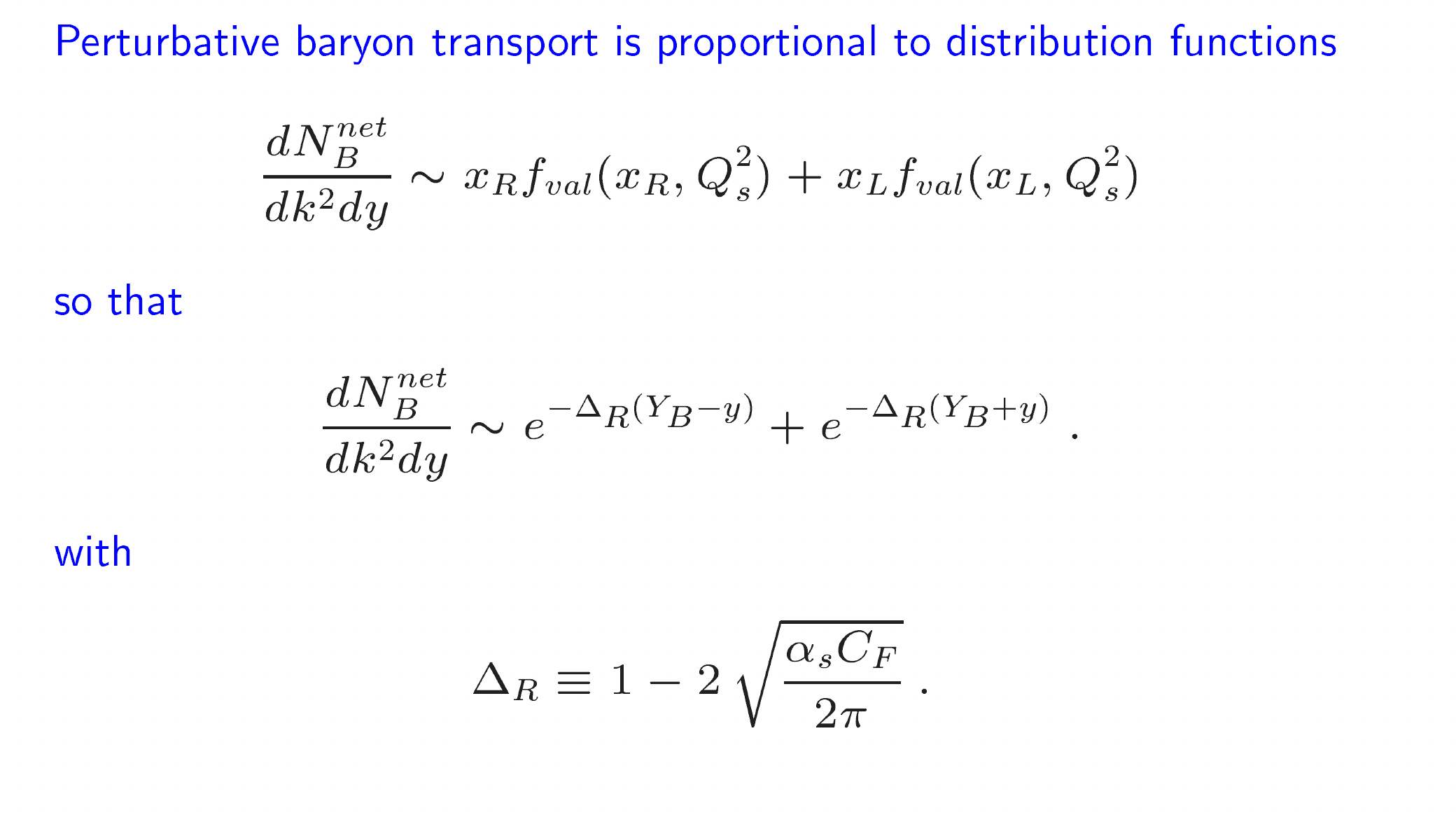
+/- Y_{B} is the beam rapidity

Slide 20
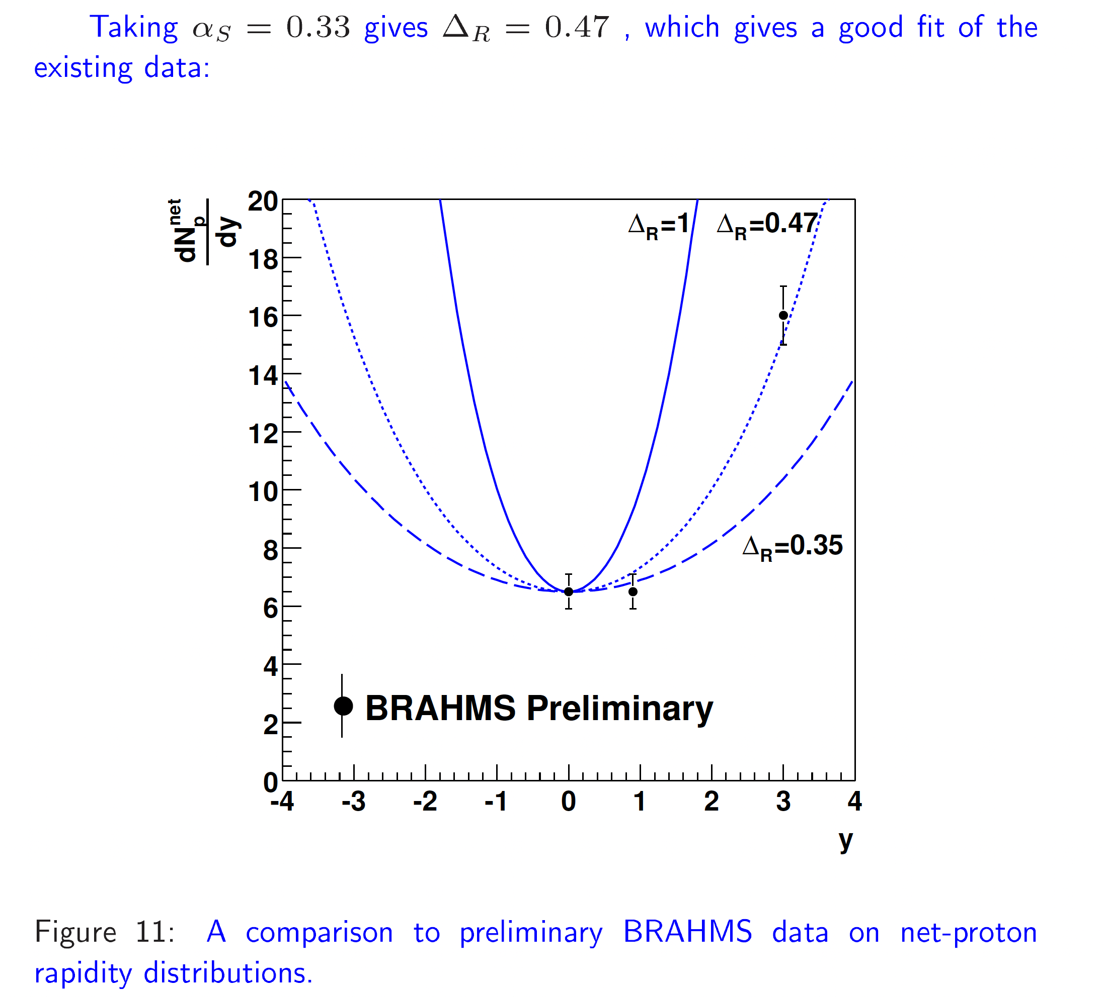
K. Itakura, YK,
L. McLerran, D. Teaney, 2003

Slide 21
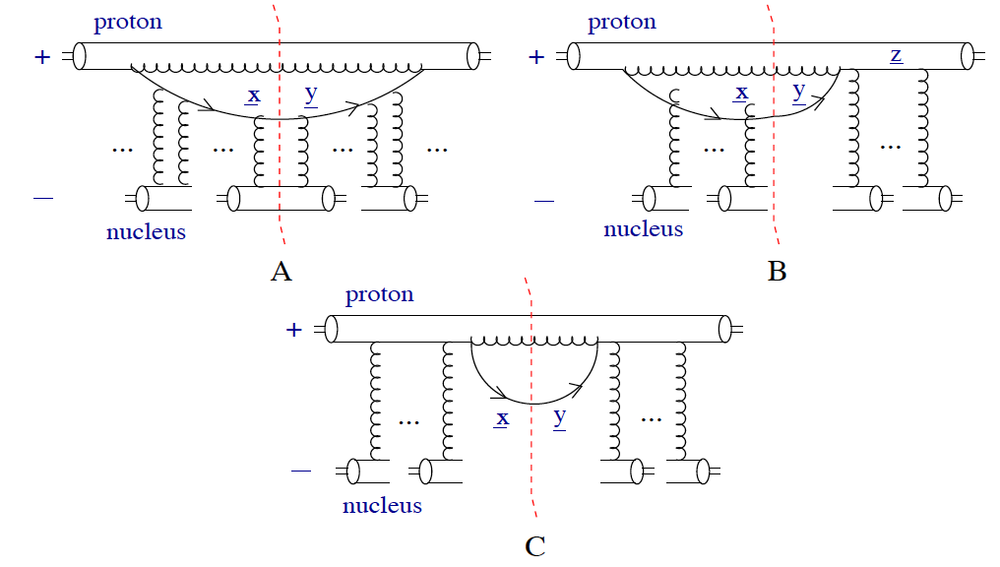
Production Cross Section
A more detailed calculation
for baryon production in
p+A collisions was done in
J. Albacete, YK,
hep-ph/0605053.

Slide 22
AdS/CFT Detour

Slide 23
Colliding shock waves in AdS
Considered by Nastase; Shuryak, Sin, Zahed; Kajantie, Louko,
Tahkokkalio; Grumiller, Romatshcke; Gubser, Pufu, Yarom.
I will follow J. Albacete, A. Taliotis, Yu.K.
arXiv:0805.2927 [hep-th], arXiv:0902.3046 [hep-th]

Slide 24
Model of heavy ion collisions in AdS
Imagine a collision of two
shock waves in AdS:
We know the metric of both
shock waves, and know that
nothing happens before the
collision.
Need to find the metric in the
forward light cone!
(cf. classical fields in CGC)
?
empty AdS₅
1-graviton part
higher order
graviton exchanges

Slide 25
Heavy ion collisions in AdS
empty AdS₅
1-graviton part
higher order
graviton exchanges

Slide 26
Physical shock waves
Simple dimensional analysis:
The same result comes out of
detailed calculations.
Grumiller, Romatschke ’08
Albacete, Taliotis, Yu.K. ‘08
Each graviton gives , hence get no rapidity dependence:

Slide 27
Physical shock waves: problem 2
Delta-functions are unwieldy. We will smear the shock wave:
Look at the energy-momentum tensor of a nucleus after collision:
Looks like by the light-cone time
the nucleus will run out of momentum and stop!

Slide 28
Proton-Nucleus Collisions in AdS

Slide 29
pA Setup
Consider pA collisions:

Slide 30
pA Setup
In terms of graviton exchanges need to resum diagrams like this:
cf. gluon production in pA
collisions in CGC!

Slide 31
Proton Stopping
What about the proton? Due
to our earlier result about
shock wave stopping
we should be able to see
how it stops.
And we do:
T⁺⁺ goes to zero as x⁺ grows large!

Slide 32
Proton Stopping
We get complete proton stopping (arbitrary units):
T⁺⁺
of the proton
X⁺
Albacete, Taliotis, Yu.K. ‘09

Slide 33
Exact Numerical Solution
Exact numerical solution of Einstein equations for two colliding shock waves in AdS₅ also exhibits stopping of the colliding “nuclei” (P. Chesler, L. Yaffe, ‘11):
energy
density
Note that this is not just baryon stopping:
this is ‘everything stopping’.
Still, may be relevant…?
time

Slide 34
Conclusions
Perturbative QCD at small x:
Non-perturbative approaches: AdS/CFT correspondence exhibits strong shock-wave stopping, translating into nuclear stopping, though not just for the baryon number.

