Slide 1
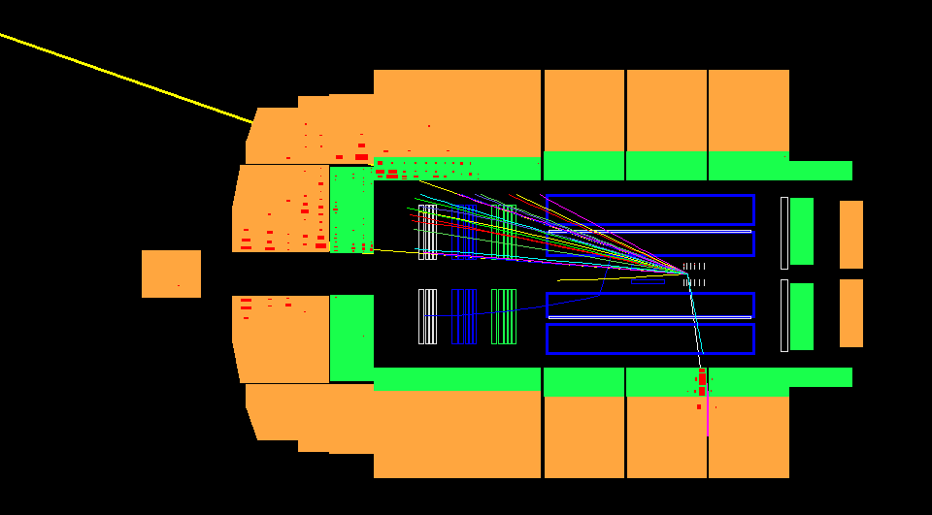
Baryon production at hera
erhtjhtyhy
Henry Klest
1st CFNS Workshop on Baryon Dynamics, SBU Jan 23, 2024

Slide 2
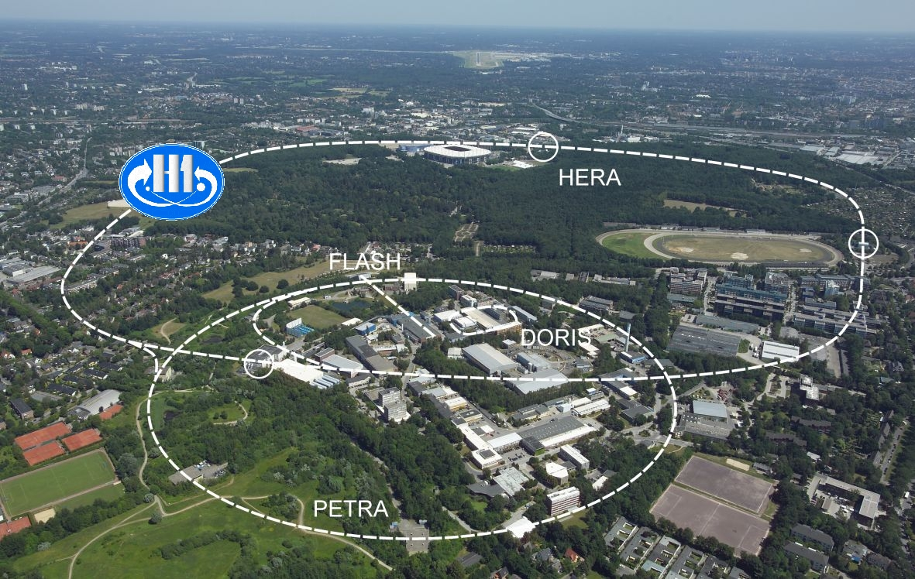
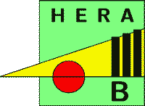

Slide 3
Four experiments and 30 years in one talk?!

Slide 4
All opinions are my own, not vetted by the collaborations!
I will try to summarize the relevant existing results from HERA, and provide some future possibilities
In all cases, I didn’t do these analyses and you should read the papers (in backup) for details!

Slide 5
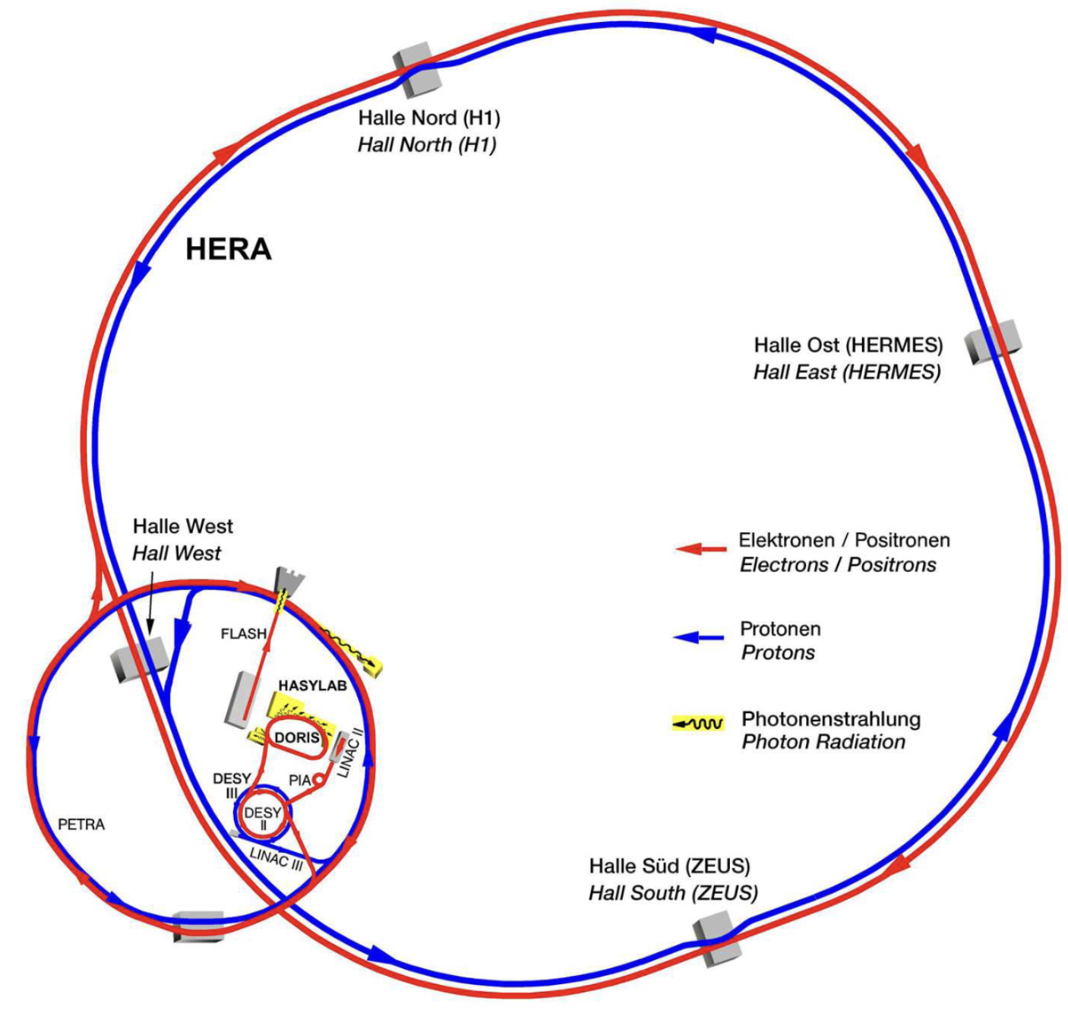
HERA
HERA: Hadron-Elektron-Ringanlage
Hadron-Electron Ring Accelerator
World’s only electron + proton collider
Located at DESY in Hamburg, Germany
Nominal energies of 27.6 GeV e^{-,+} on 920 GeV protons
$\sqrt{s}=$ 319 GeV
Ran from 1992-2007
Delivered ~1 fb⁻¹ of e+p collisions to the two general purpose experiments, H1 and ZEUS
Two fixed-target experiments
Hermes, utilizing electron beam
HERA-B, utilizing proton beam
Notes:
HERA Injected by PETRA, collider that discovered the gluon
Nature didn’t have new particles in store for HERA, HERA Legacy dominated by contributions to QCD

Slide 6
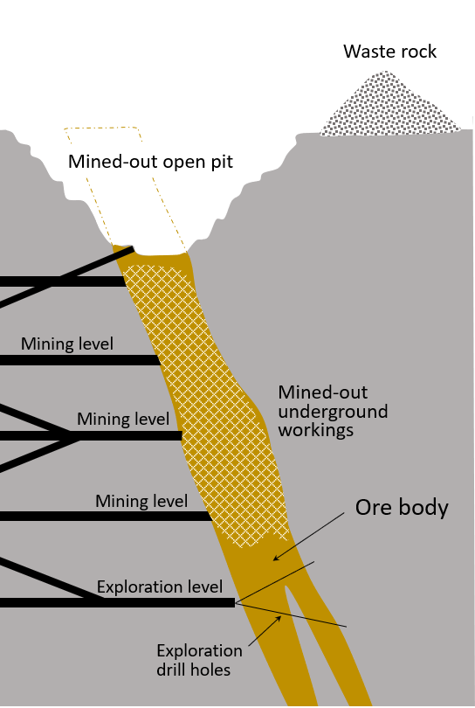
Why hera?
Several aspects make the HERA experiments an interesting place to mine for junctions
Can reach low-x (and know you were there!)
Valence quark contribution can be controlled with kinematics
Current & target fragmentation can be easily separated
Knowing event-by-event kinematics enables studying observables as functions of x, Q², p_{T}, $y, η$,etc…
Photoproduction & DIS both available
Photoproduction provides a “hadronic” probe that carries no baryon number itself
x
junctions

Slide 7
Why hera?
Beam species asymmetry
Baryon number enters from one side only*
No forward-backward ambiguity as in p+p
Diffraction
Know that baryon number was not transported in diffractive collisions
Can be used as a baseline
Large detector acceptances
Good reach in rapidity
Especially in rapidity loss $δy$
Variable proton beam energy
920, 820, 575, 460 GeV data exist
x
junctions
*This feature exists also in the $π+p/A$ collision system, begs revisiting fixed-target data

Slide 8
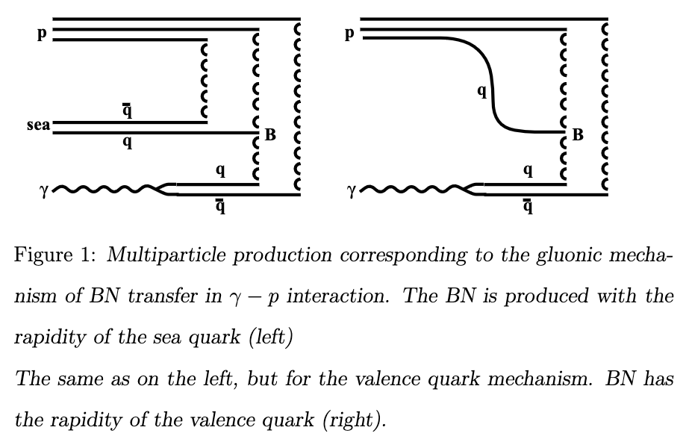
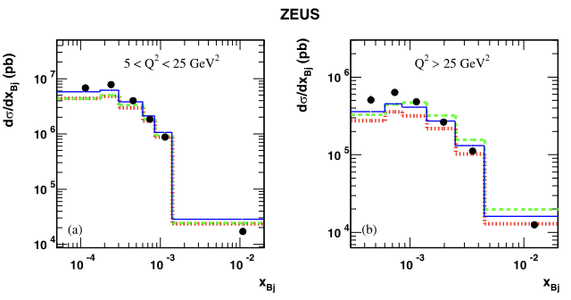
HERA Strategy
An e+p collision has total baryon number of 1
Reduces complexity and ambiguity of observables
Likelihood of striking a valence quark (or di-quark) and transporting it to midrapidity is small in DIS at HERA
Very high-x events, cross section tiny
HERA cross section dominated by low-x
An observation of a non-zero baryon-antibaryon asymmetry at low-x would be a strong indication in favor of the junction model
Non-zero asymmetry in current region of Breit frame would indicate the same
$$Λ+\overline{Λ}$$

Slide 9
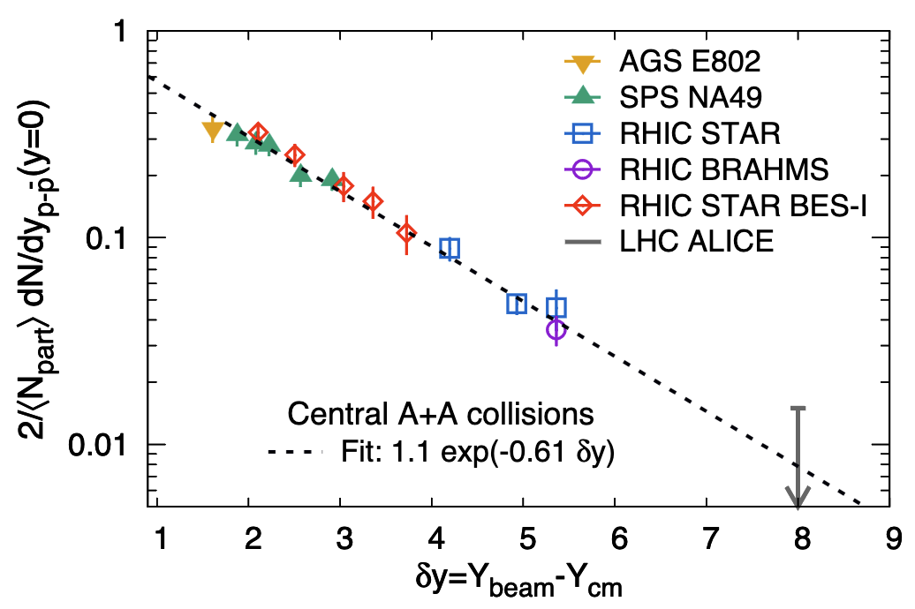
HERA Strategy
Expectation from A+A results is that at HERA rapidities, asymmetry should be very small
$y_{beam}=$ 7.5 for H1 & ZEUS
$δy$ between beam and central detectors ~ 6-9
A+A fit gives $1.1{∗e}^{−0.61∗δy}$
Expected asymmetry of 2% - 0.4%
However, A+A results generally integrate over x
e+p offers much better control
A 1% asymmetry could be built out of e.g. 0% at mid/high-x and 3% at low-x
HERA Accessible
HERA $y_{b}$

Slide 10
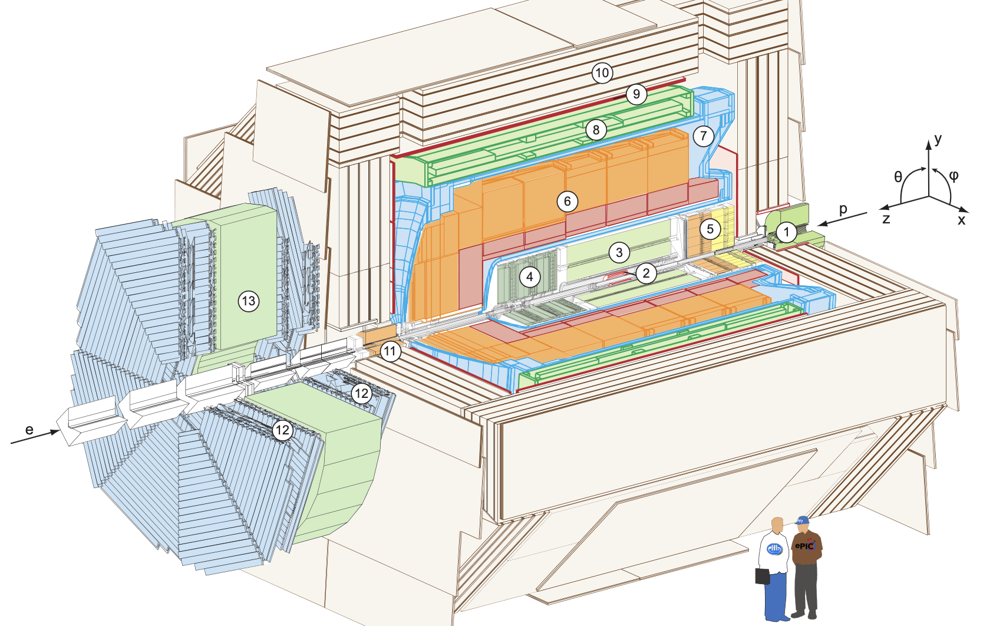
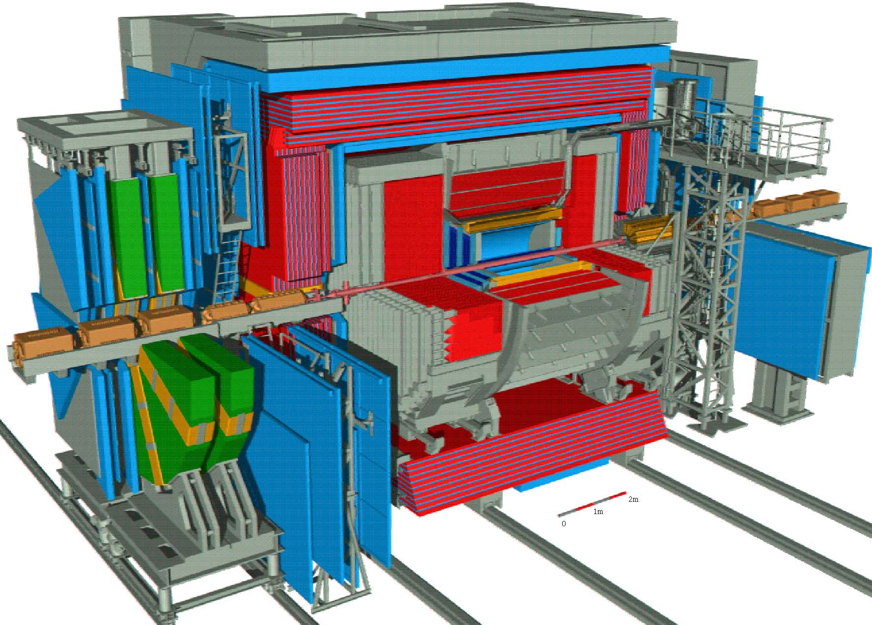
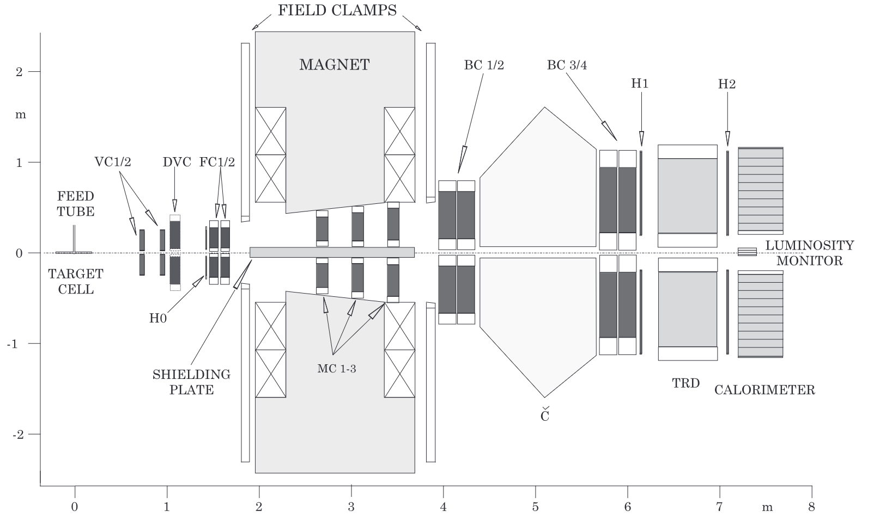
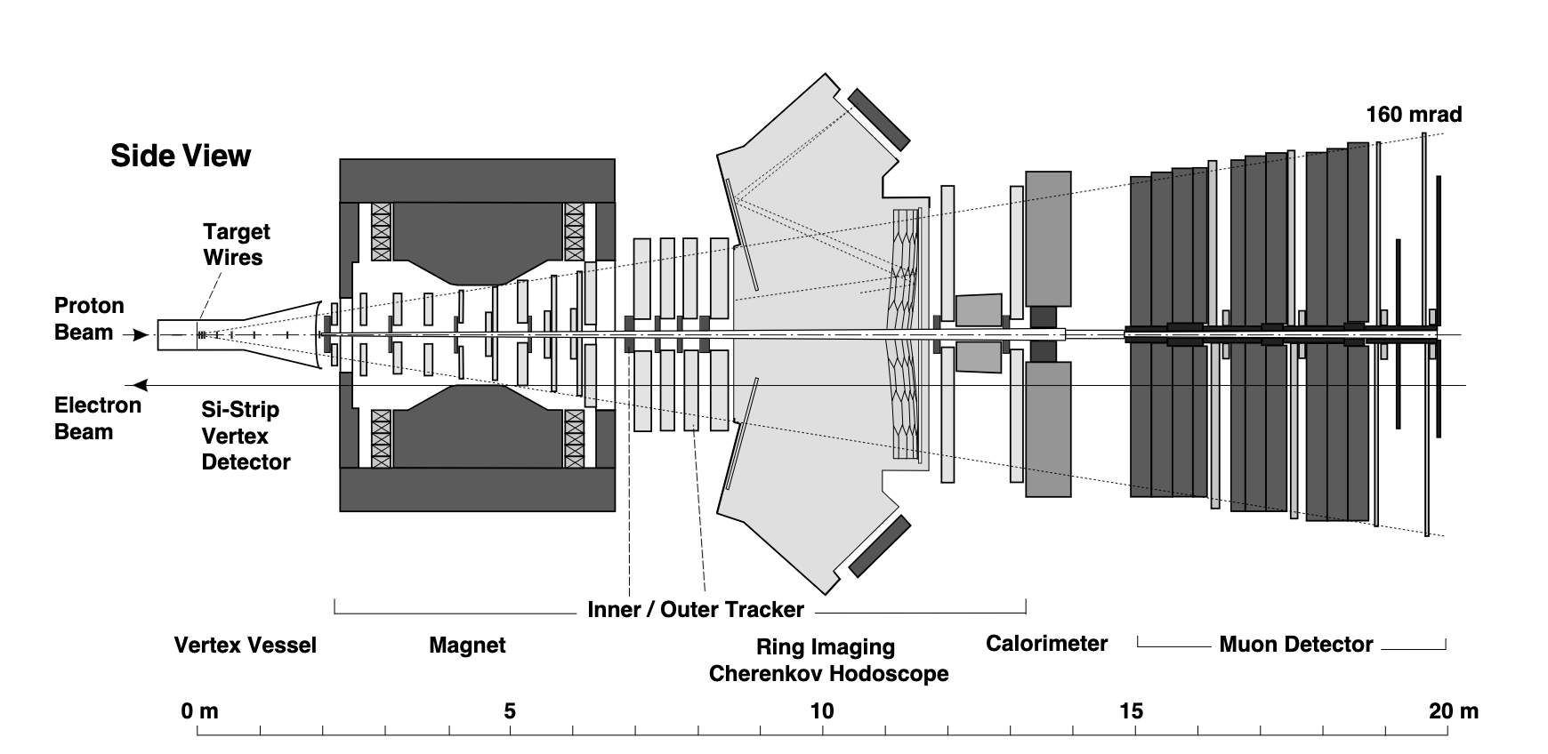

Slide 11
H1 & ZEUS
General-purpose hermetic detectors
Focus on calorimetry & tracking
PID only from dE/dx in tracking detectors
Large acceptance
Unfortunately, tracking only well understood in central regions ($\left|η\right|≤\sim 1.5$)
Still gives good control over $δy$
H1 & ZEUS never published studies of identified light hadrons
Some pitfalls, need precise description of backgrounds, detector material
Workhorse for baryon physics was PID via displaced vertices
$Λ$, K⁰

Slide 12
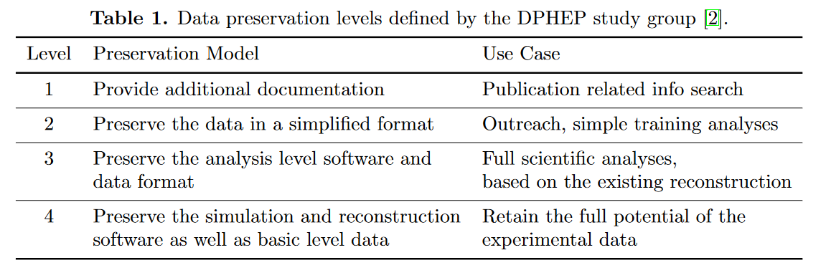
HERA Data Preservation
Preservation effort started in 2009
Miniscule investment (<1%) compared to running experiments, resulting in ~10% of the total physics results
H1 members have been a leading force in the DPHEP collaboration
”Level-4” preservation, retaining full potential to do analyses
Keep as much low-level information and documentation as possible, enabling “outsiders” to do analyses such as dN_{ch.}/dη
Full analysis software updated in 2020 to ROOT6, C++17
~1B events available
ZEUS falls between level 3 and 4
Data & Simulation NTuples
Pre-calibrated low level basic objects (e.g. calorimeters deposits, tracks)
Higher level composite objects (e.g. jets, lepton candidates)
360M events
HERMES less advanced than H1, ZEUS but still in principle analyzable
HERA-B data essentially inaccessible

Slide 13
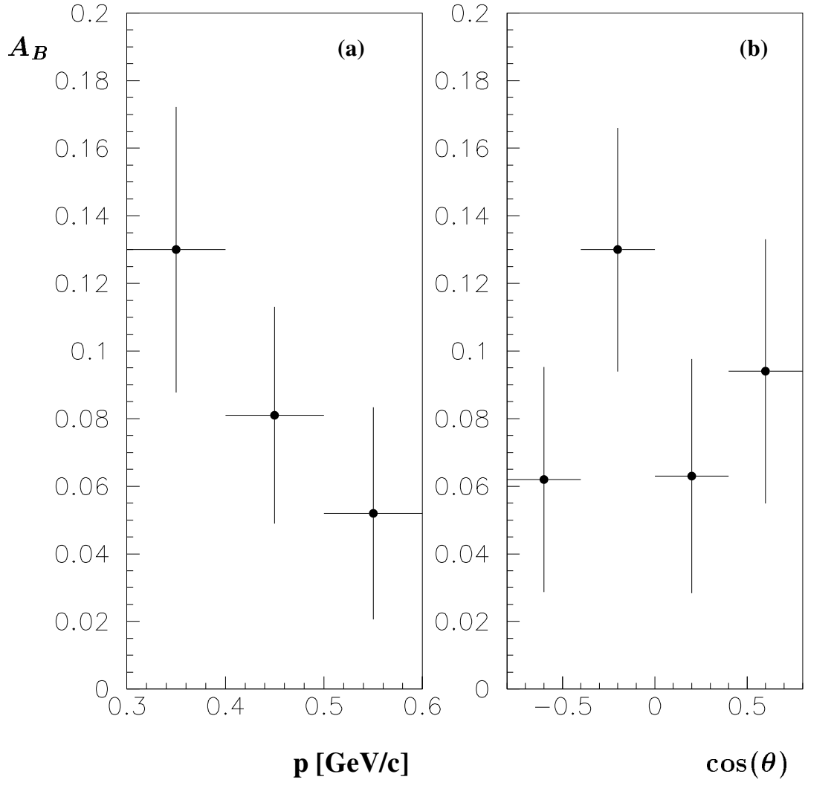
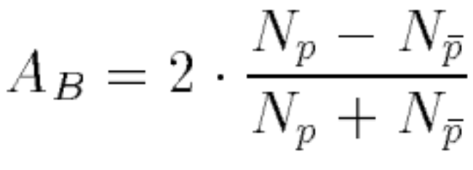
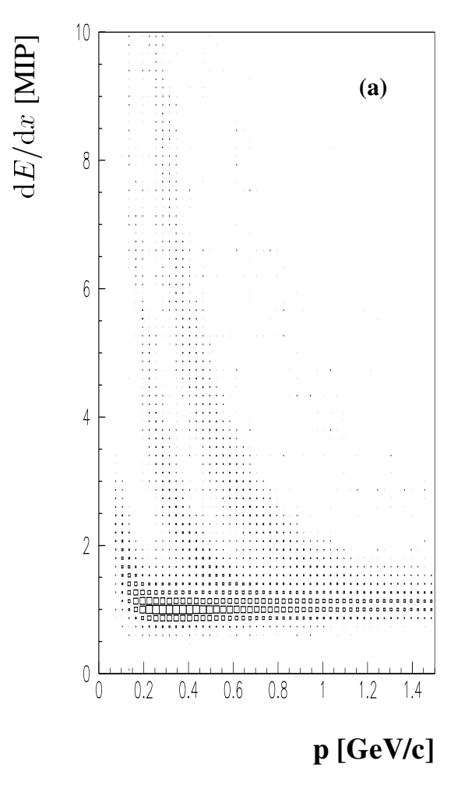
H1 Preliminary
Current understanding is that this analysis suffered from large hadron beam-gas backgrounds (p+A collisions at $\sqrt{s}$ = 40 GeV) that induced the asymmetry
There is a much-discussed preliminary H1 result from 1999 of the proton-antiproton asymmetry

Slide 14
H1 Preliminary
Current understanding is that this analysis suffered from large hadron beam-gas backgrounds (p+A collisions at $\sqrt{s}$ = 40 GeV) that induced the asymmetry
This measurement could be repeated today!
There is a much-discussed preliminary H1 result from 1999 of the proton-antiproton asymmetry

Slide 15
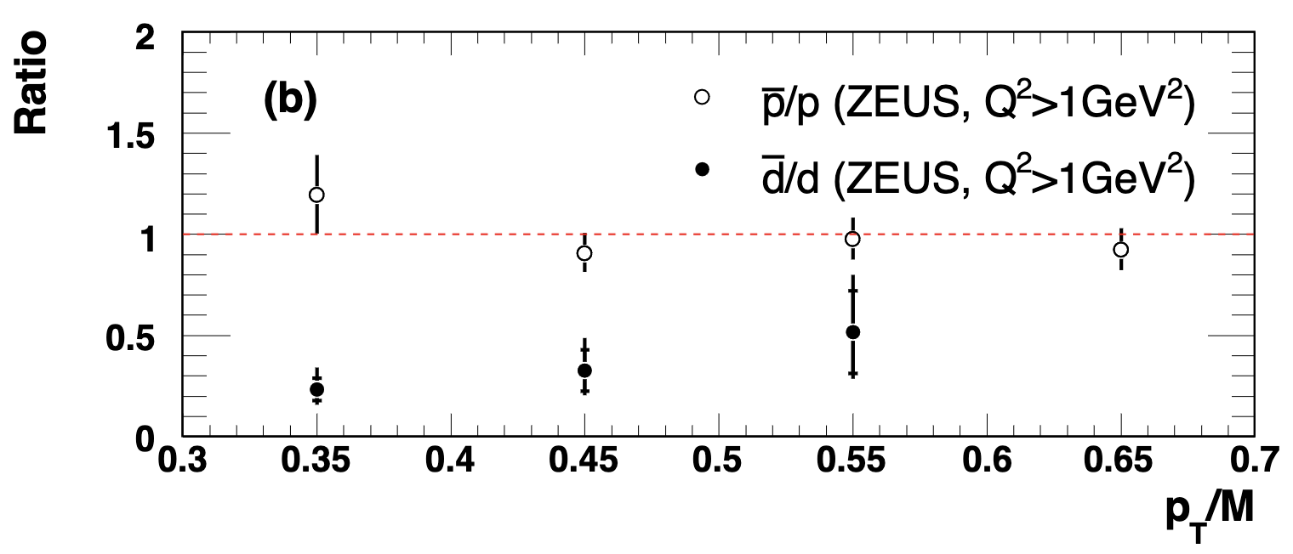
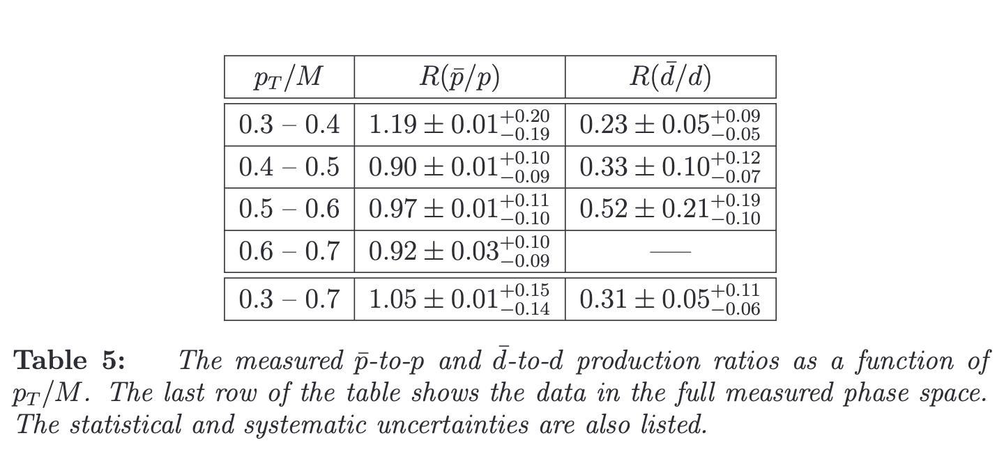
Zeus p&d in DIS
ZEUS measured antiproton/proton and antideuteron/deuteron ratios in 2007
Challenging measurement due to interactions with detector material
$p+n→d$ and $N+N→d+π$ reactions
Had to rely on extrapolations of cross sections from other materials using phenomenological models
$\overline{p}/p$ ratio consistent with 1
Large error bars O(10%), don’t have the precision to reach expected asymmetry of 7% from junction model
$\overline{d}/d$ ratio very low, around 0.3
Disagrees strongly with coalescence prediction that $\frac{\overline{d}}{d}={\left(\frac{\overline{p}}{p}\right)}^{2}$

Slide 16
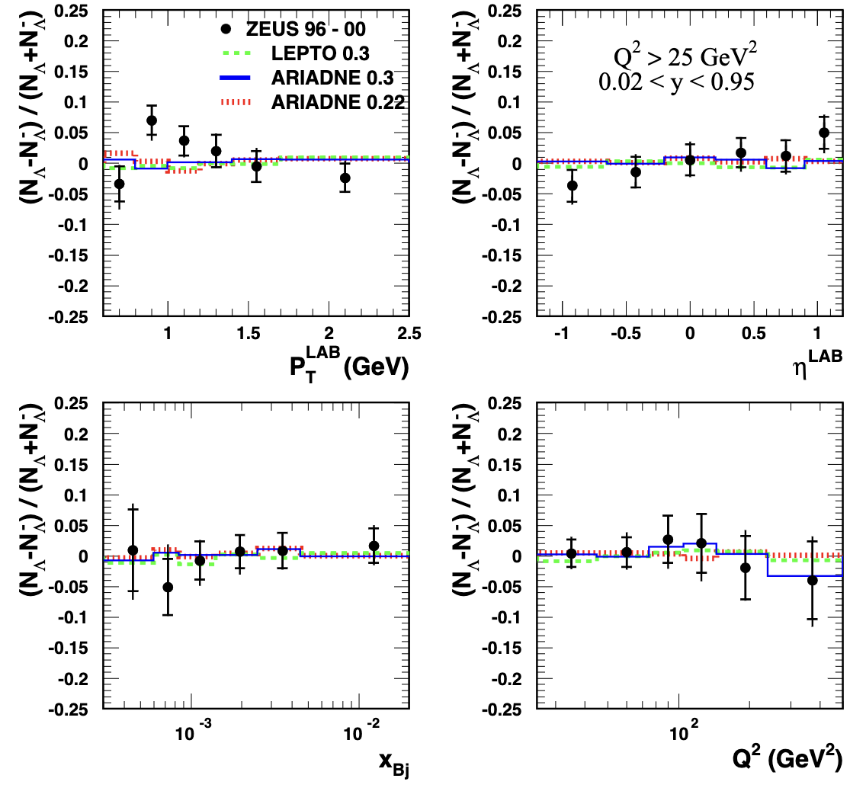
Strange Baryons
Extensive studies of $Λ \& \overline{Λ}$carried out by H1 & ZEUS
Minimal PID necessary due to displaced vertex
Initially targeted toward tuning strangeness suppression in MCs
$Λ$ an equal probe of baryon number
Junction model flavor agnostic
Hadronic interactions with detector material effect $p/\overline{p}$ ratio
Less the case for $Λ$, higher precision possible
HERA detectors were fairly thick
Existing measurements of asymmetries and cross sections vs. basically every kinematic quantity you could want
In the lab frame and in the Breit frame (separated current & target region)

Slide 17
$Λ$measurement phase space
y = inelasticity!!!!
H1: 49.9 pb⁻¹
2 < Q² < 100 GeV²
0.1 < y < 0.6
ZEUS: 121 pb⁻¹
Low Q²: 5 < Q² < 25 GeV²
0.02 < y < 0.95
High Q²: Q² > 25
0.02 < y < 0.95
Photoproduction: Q² < 1
0.2 < y_{JB} < 0.85
Coverage in DIS: $x>5×{10}^{−5}$
High Q²
Low Q²
PHP
Notes:
HFS at ~90 degrees = eta = 0, scattered electron in Lar (>2.7 Rad), relatively high energy > 11 GeV to ensure good reconstruction

Slide 18
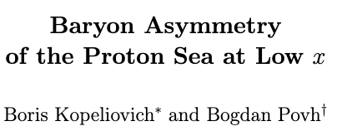
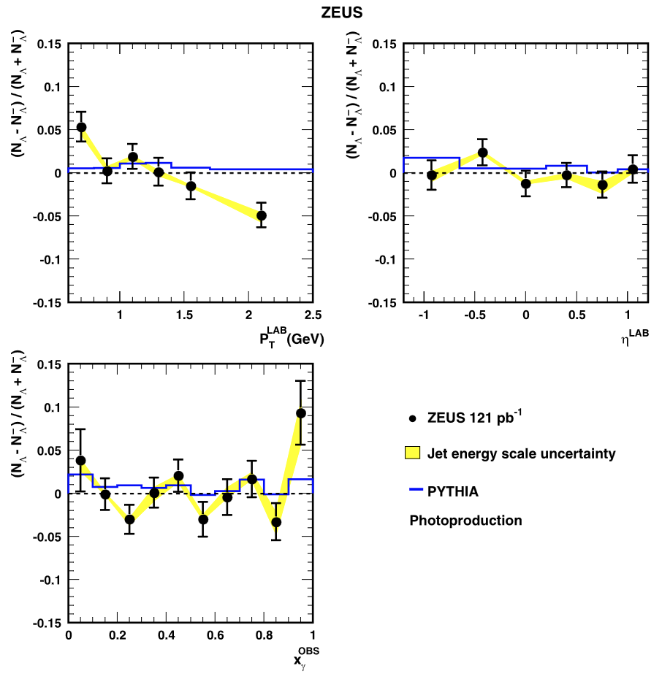
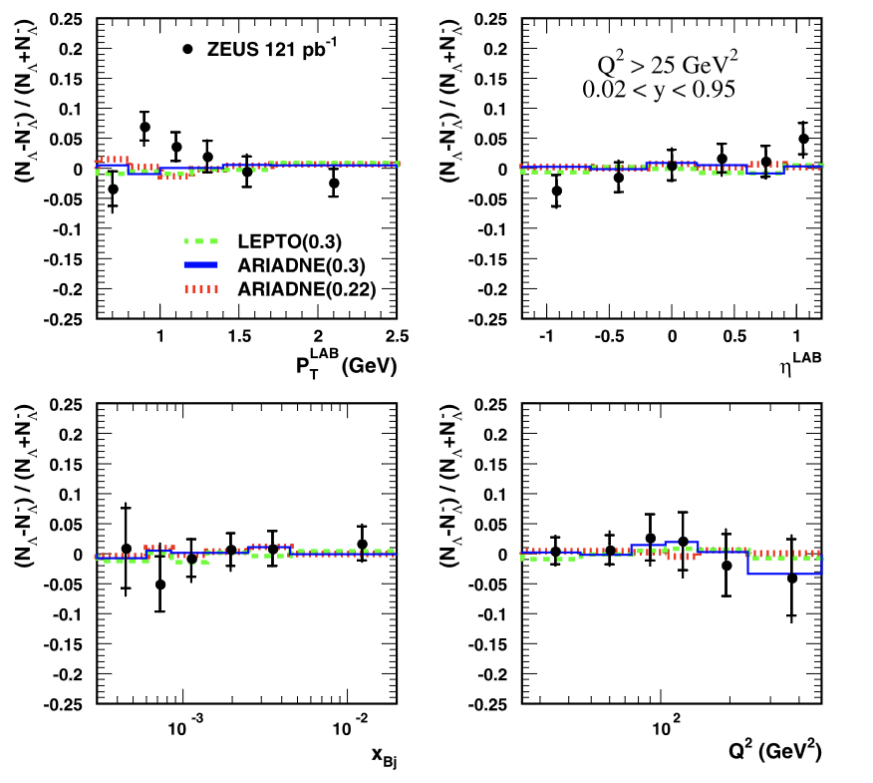
$Λ$measurement Results
Kopeliovich & Povh predict 3.5% asymmetry for DIS from baryon junction model
ZEUS results consistent with 0% in all three systems
All asymmetry measurements statistics dominated
Notes:
HFS at ~90 degrees = eta = 0, scattered electron in Lar (>2.7 Rad), relatively high energy > 11 GeV to ensure good reconstruction

Slide 19
$Λ$measurement Results
Kopeliovich & Povh predict 3.5% asymmetry for DIS from baryon junction model
ZEUS results consistent with 0% in all three systems
All asymmetry measurements statistics dominated
3x more data available for analysis!
Notes:
HFS at ~90 degrees = eta = 0, scattered electron in Lar (>2.7 Rad), relatively high energy > 11 GeV to ensure good reconstruction

Slide 20
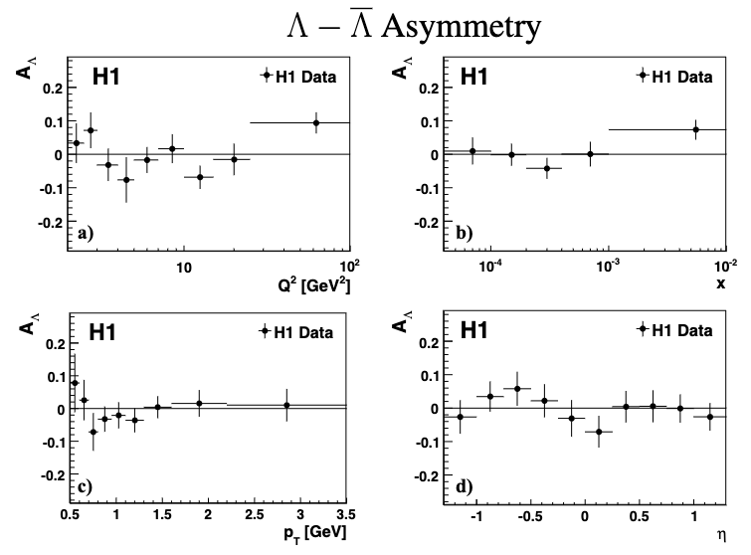
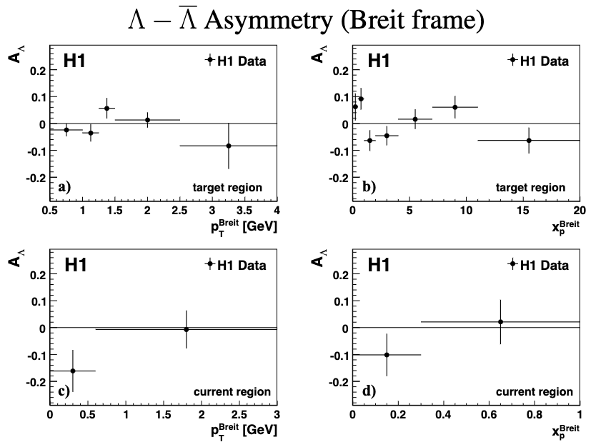
$Λ$measurement Results
Kopeliovich & Povh predict 3.5% asymmetry for DIS from baryon junction model
H1 results consistent with zero asymmetry in low Q² DIS
Studied both in the lab and the Breit frame
Notes:
HFS at ~90 degrees = eta = 0, scattered electron in Lar (>2.7 Rad), relatively high energy > 11 GeV to ensure good reconstruction

Slide 21
$Λ$measurement Results
Kopeliovich & Povh predict 3.5% asymmetry for DIS from baryon junction model
H1 results consistent with zero asymmetry in low Q² DIS
Studied both in the lab and the Breit frame
7x more data available for analysis!
(ongoing)
Notes:
HFS at ~90 degrees = eta = 0, scattered electron in Lar (>2.7 Rad), relatively high energy > 11 GeV to ensure good reconstruction

Slide 22
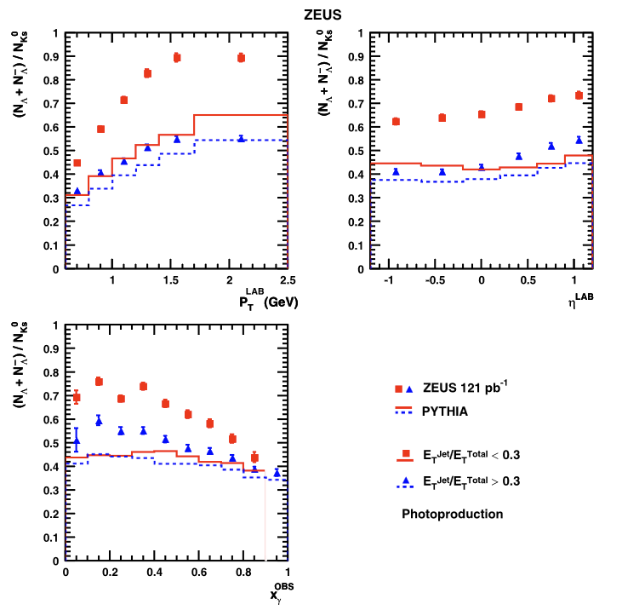
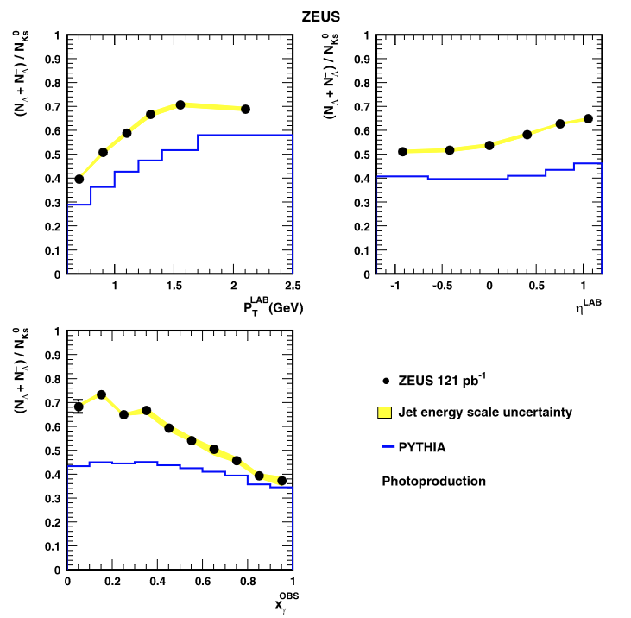
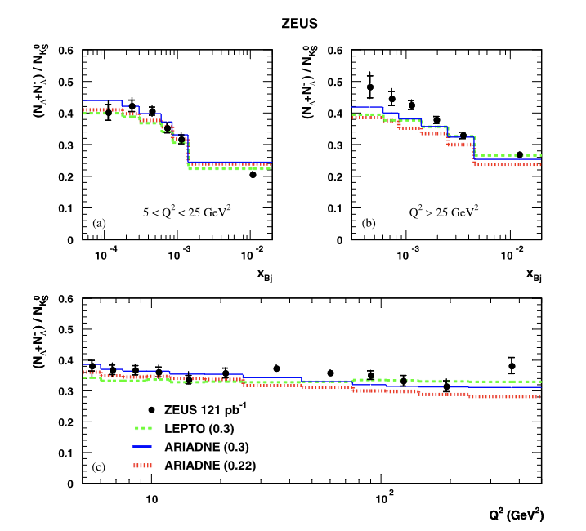
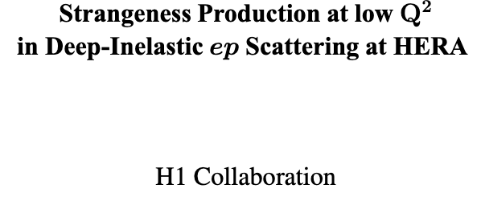
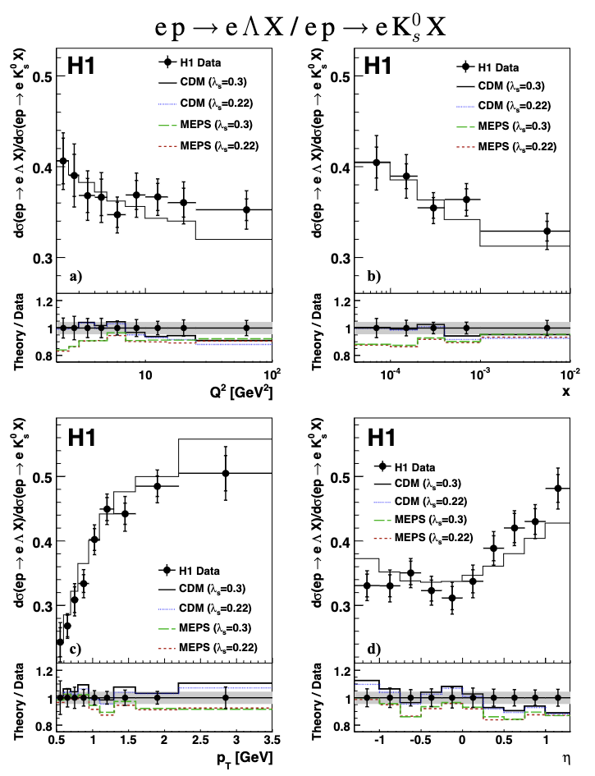
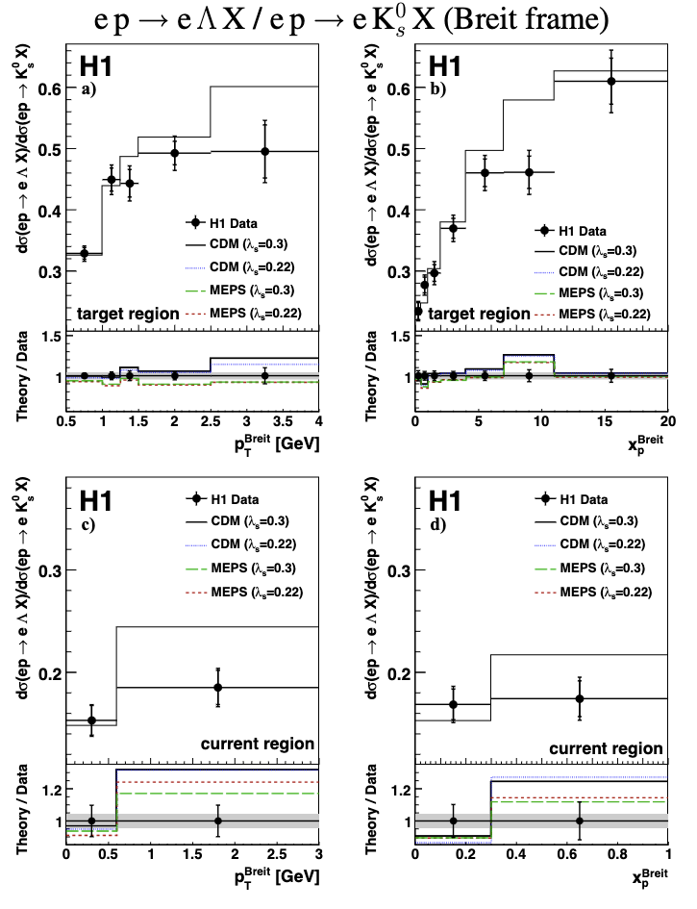
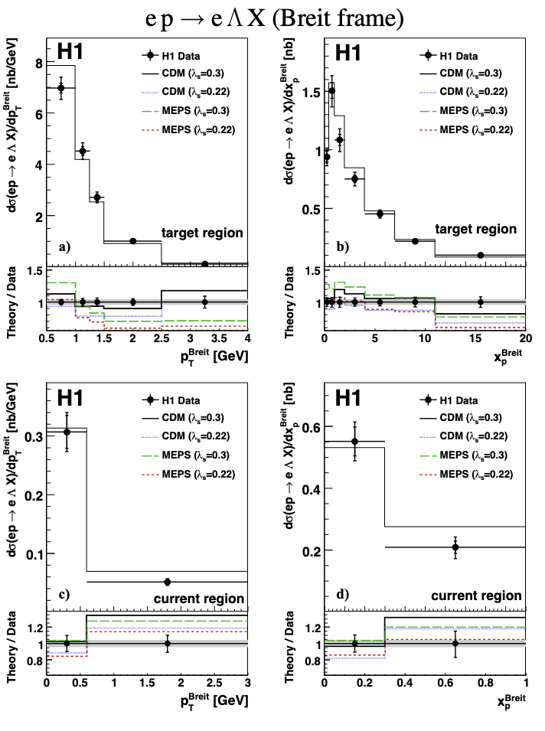
$Λ$measurement Results
Many more results contained in these papers
Notably baryon-to-meson ratios
Encourage you to check them out!
ArXiv links in backup slides
Broadly speaking, the MCs accurately capture the features of the data, i.e. no “unique” phenomena observed
Notes:
HFS at ~90 degrees = eta = 0, scattered electron in Lar (>2.7 Rad), relatively high energy > 11 GeV to ensure good reconstruction

Slide 23
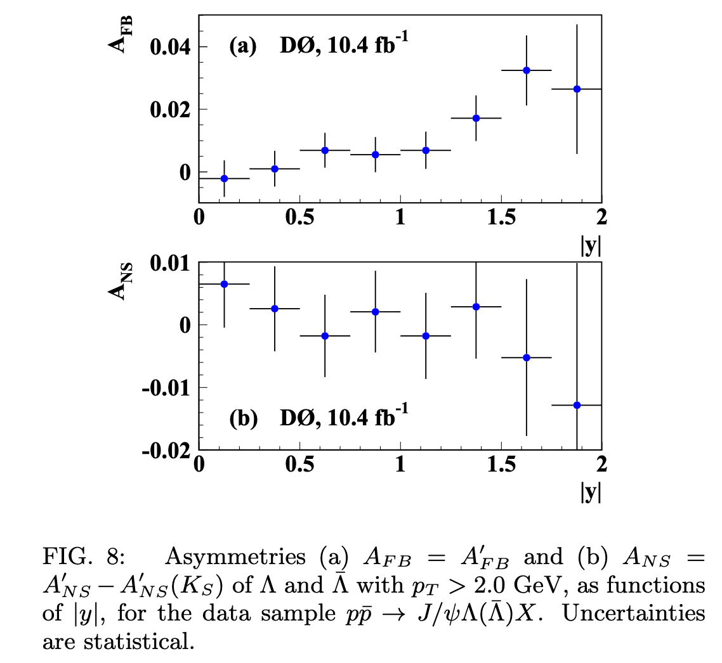
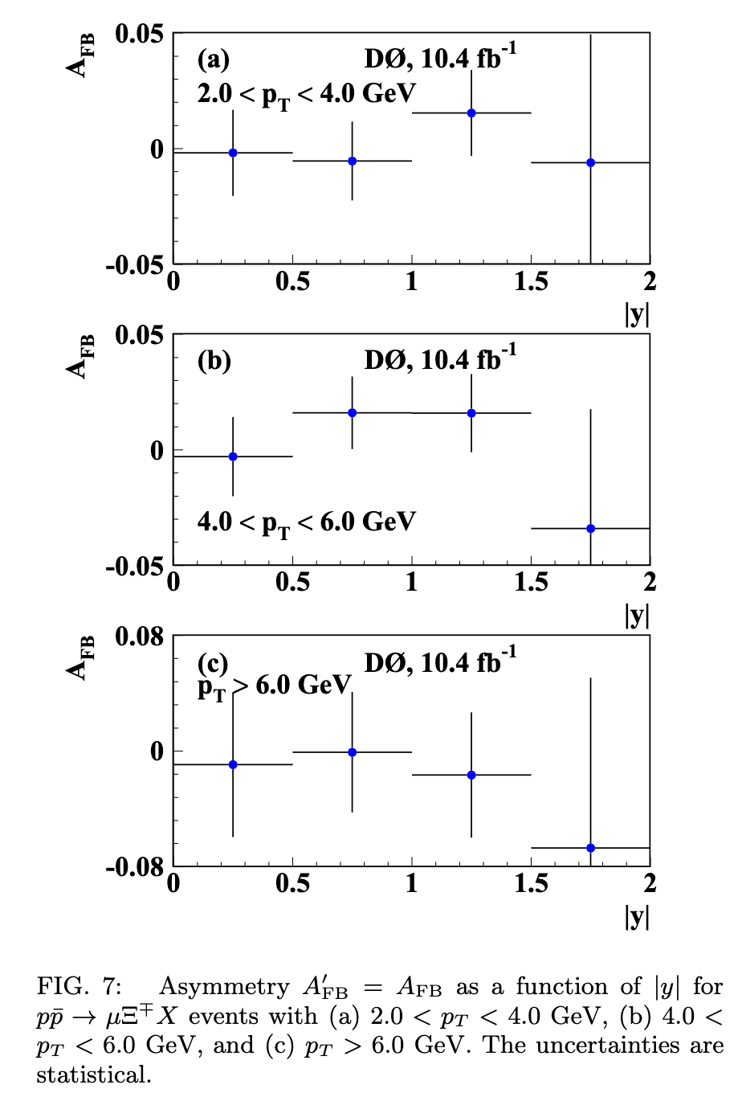
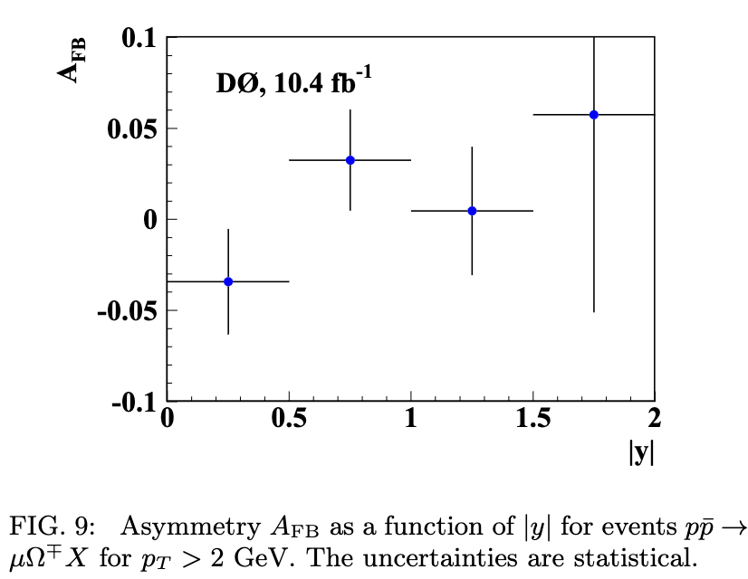
Bonus: tevatron
Asymmetry observed in production of $Λ,\overline{Λ}$
Interpreted as being consistent with strange quark coalescing with di-quark remnant
Not within the purview of my talk, but some very important data exist from the Tevatron
Similarly asymmetric collision system, with baryon number of +1 and -1 in the beams
Measured directional asymmetries of single, double, and triple strange baryons
arxiv.org/pdf/1511.05113.pdf
arxiv.org/pdf/1605.03513.pdf

Slide 24
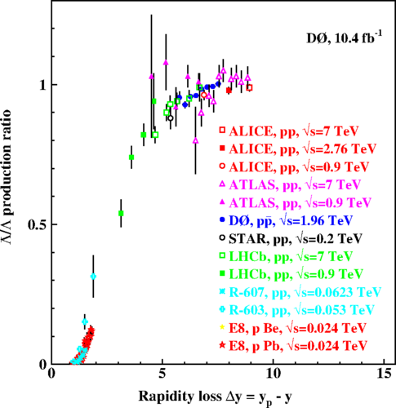
Putting it all together: $Λ$ Results
H1 & ZEUS measure no statistically significant asymmetry in DIS or photoproduction with few % uncertainties
In agreement with MC predictions, but not precise enough to rule out a 3.5% asymmetry
H1 & ZEUS

Slide 25
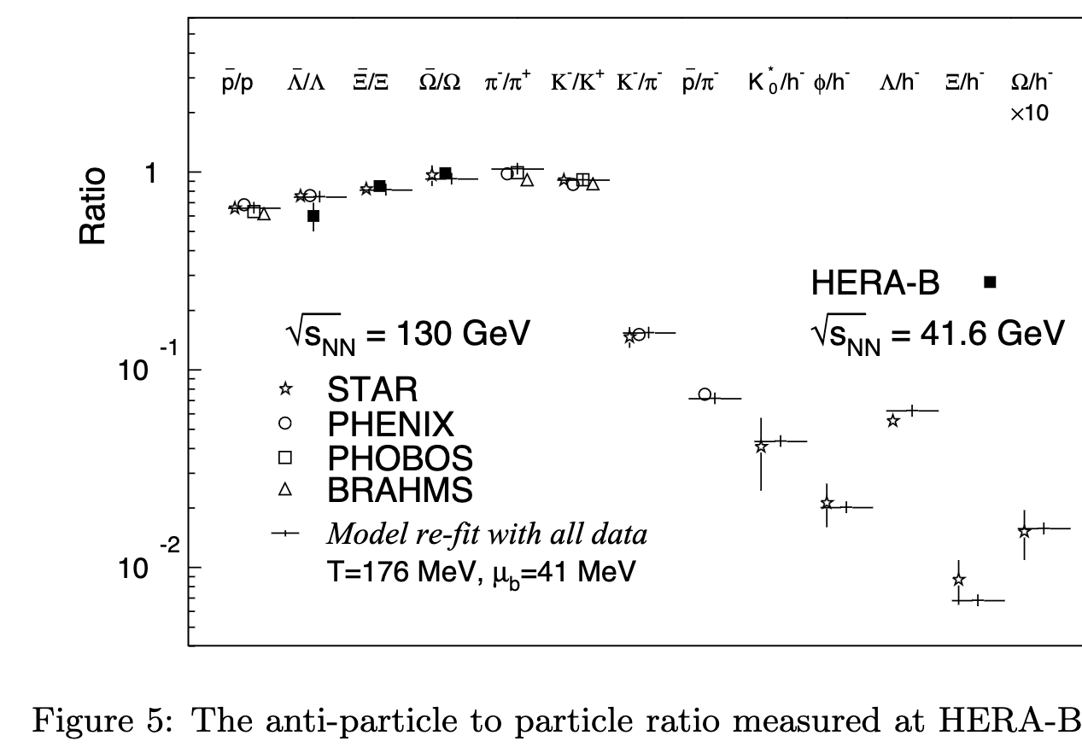
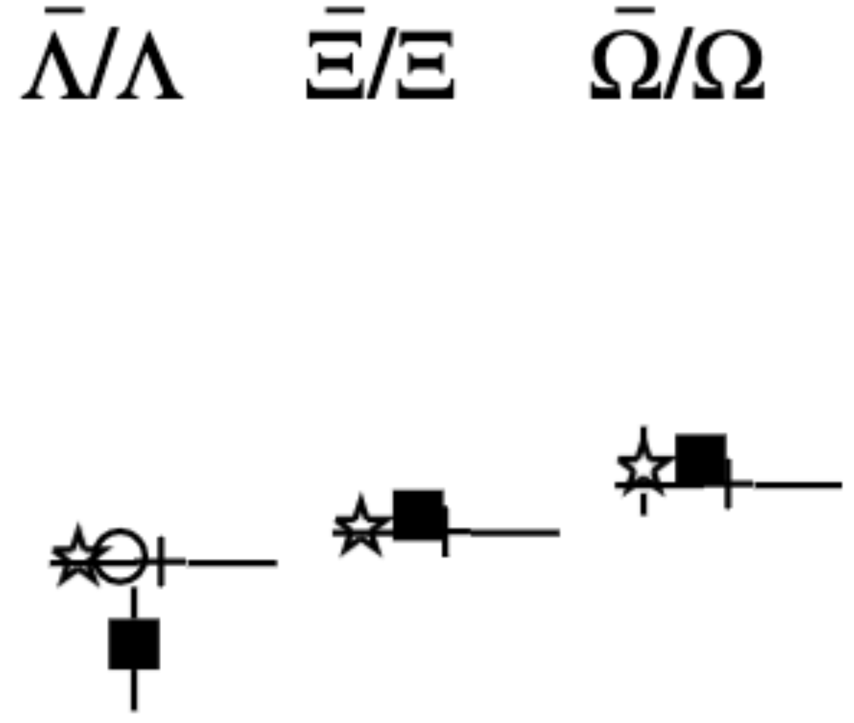
HERA-B
HERA-B results agree with STAR
Only $\overline{Λ}/Λ$ shows energy dependence ($\sqrt{s}$ = 130 vs. 41.6 GeV)
No significant A-dependence
Species | Carbon Target | Titanium Target | Tungsten Target
$\overline{Λ}/Λ$ | 0.51±0.05 | 0.52±0.05 | 0.47±0.05

Slide 26
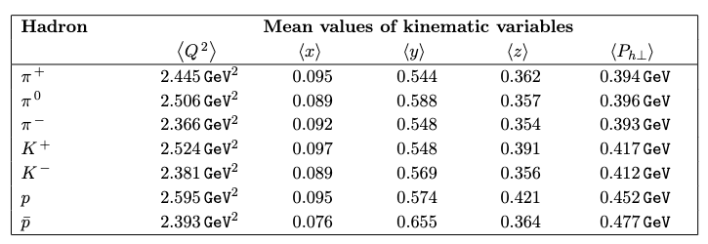
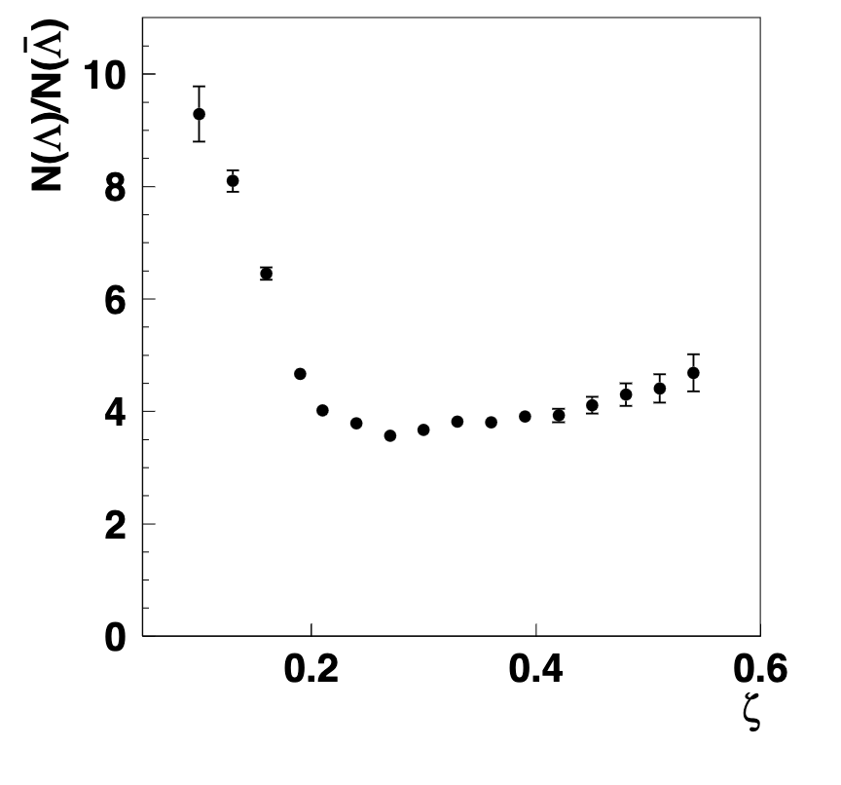
HERMES
Fixed target with 27.6 GeV electron beam
Similar kinematics to JLab
$\sqrt{s}$ = 7.2 GeV
Substantial raw yield of baryons to anti-baryons
Expected from phase space, but can’t draw quantitative conclusions since yields are uncorrected

Slide 27
Future Prospects
Data of H1, ZEUS, and HERMES is preserved and available for analysis thanks to significant investment from DESY
Anyone can join the collaborations and have access to the data!
Promising directions for future analyses:
Repeat proton/antiproton asymmetry measurement with better understanding of detectors and backgrounds
Strange baryons in diffractive DIS
Use as a baseline for non-diffractive DIS measurements
Proton energy scan data
Reach smaller beam rapidities
Utilize the whole HERA dataset!
Current H1 & ZEUS baryon publications use only ~1/4 of the whole dataset
Higher statistics to access e.g Ξ⁰, where diquark cannot be responsible
For asymmetry measurements where statistical uncertainty dominates, substantial improvements possible!

Slide 28
Conclusion
e+p and ɣ+p collisions are promising avenues to search for baryon junctions
There are a surprising number of relevant published results on baryon production mechanisms from HERA
With more on the way!
HERA data very easy to work with
Nice projects for students pre-EIC
Existing & upcoming HERA measurements nicely set the stage for the EIC!
EIC detectors, statistics, beam flexibility will make it the ultimate tool for these studies

Slide 29
References
H1: https://arxiv.org/pdf/0810.4036.pdf
ZEUS: https://arxiv.org/pdf/hep-ex/0612023.pdf https://arxiv.org/pdf/0705.3770.pdf
HERMES: https://arxiv.org/pdf/0704.3133.pdf
https://arxiv.org/pdf/1406.3236.pdf
HERA-B: https://arxiv.org/pdf/0812.0471.pdf

Slide 30
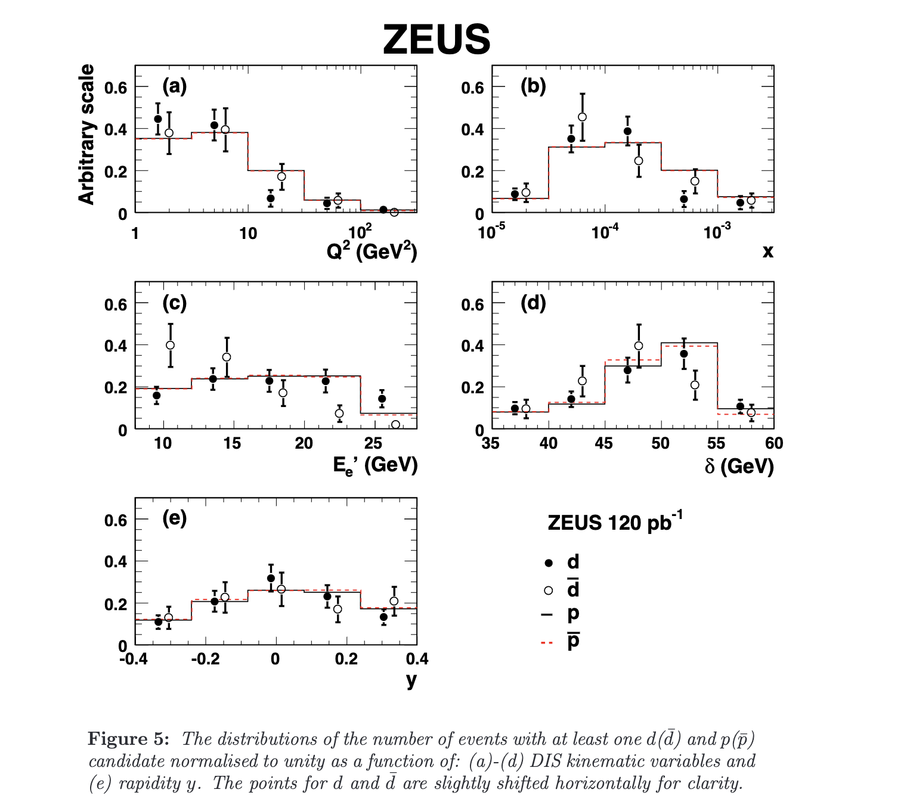

Slide 31
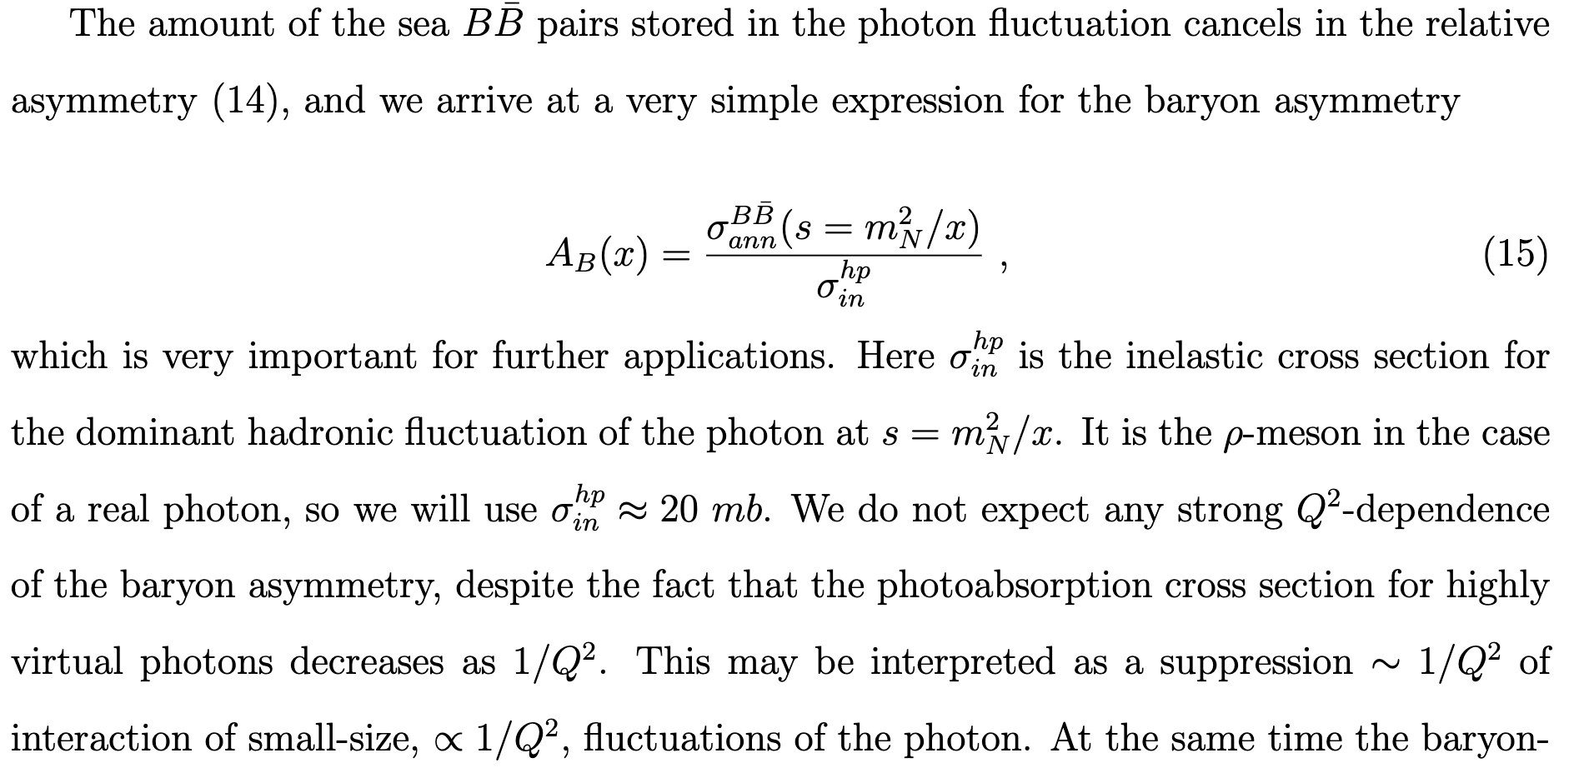
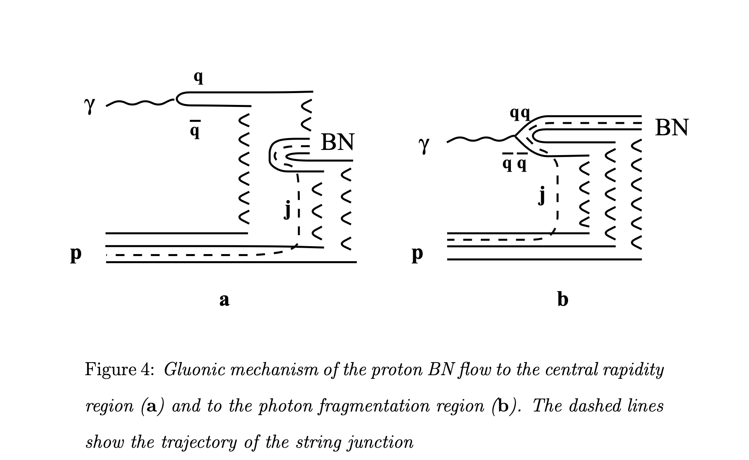
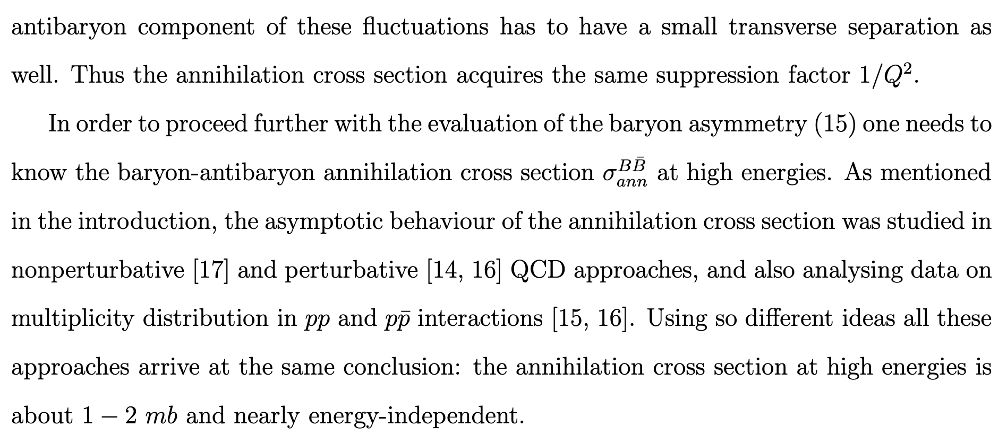

Slide 32
