Slide 1
Exploring Baryon Junctions with Net-Hyperon Production in STAR BES-I program
Chun Yuen Tsang
Brookhaven National Laboratory and Kent State University

Slide 2
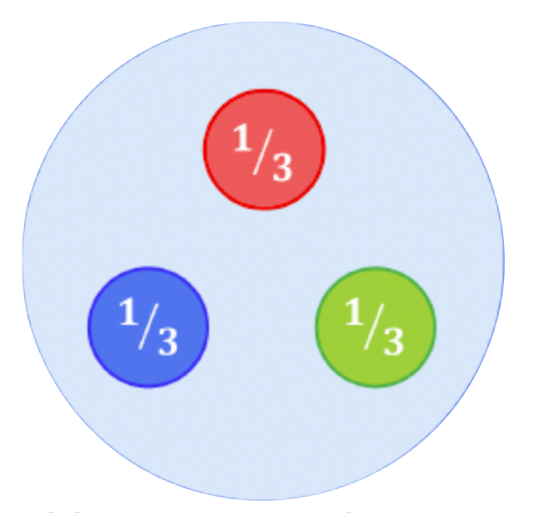
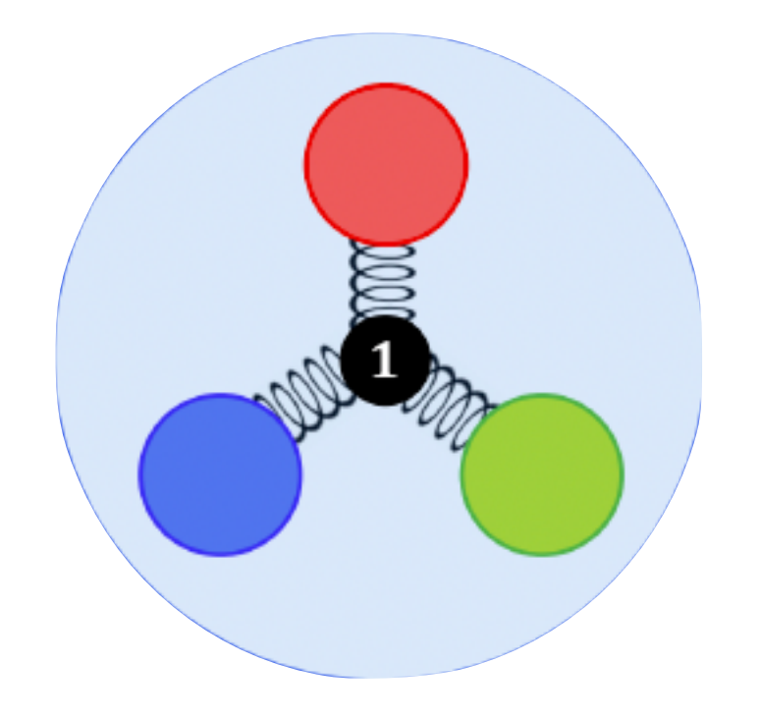
What carries baryon number, valence quark vs. baryon junction?
Valence quark
Baryon junction [1, 2]
Conventional picture
[1]: Artru, X. String Model with Baryons: Topology, Classical Motion. Nucl. Phys. B 85, 442–460 (1975).
[2]: Rossi, G. C. & Veneziano, G. A Possible Description of Baryon Dynamics in Dual and Gauge Theories. Nucl. Phys. B 123, 507–545 (1977)
Chun Yuen Tsang, APS DNP-JPS 2023

Slide 3
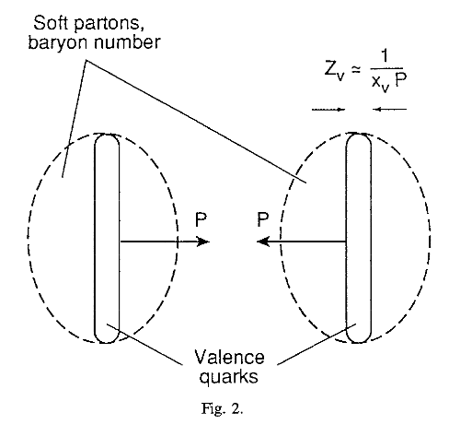
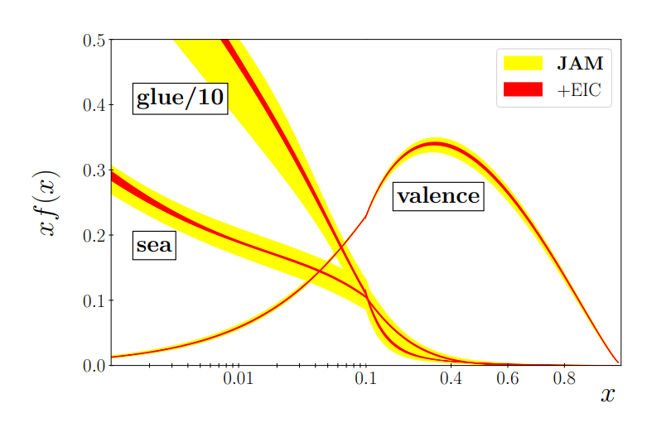

Baryon transport from junction
In valence quarks picture, valence quarks:
Carry majority of momentum
Contracted into "pancakes" at high energy
Less interaction time due to shortened longitudinal length
Junction picture:
Made of low-x gluons
Carries lower momentum
More interaction time with other partons
Enhanced baryon transport to mid-rapidity
D. Kharzeev, Physics Letters B 378, 238 (1996)
R. Abdul Khalek et al, arXiv:2103.05419 [physics.ins-det]
Chun Yuen Tsang, APS DNP-JPS 2023

Slide 4
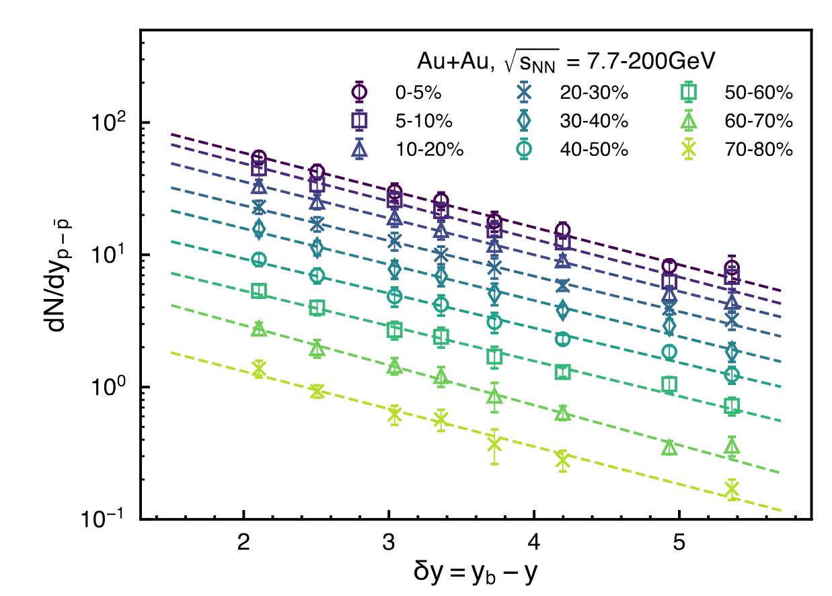
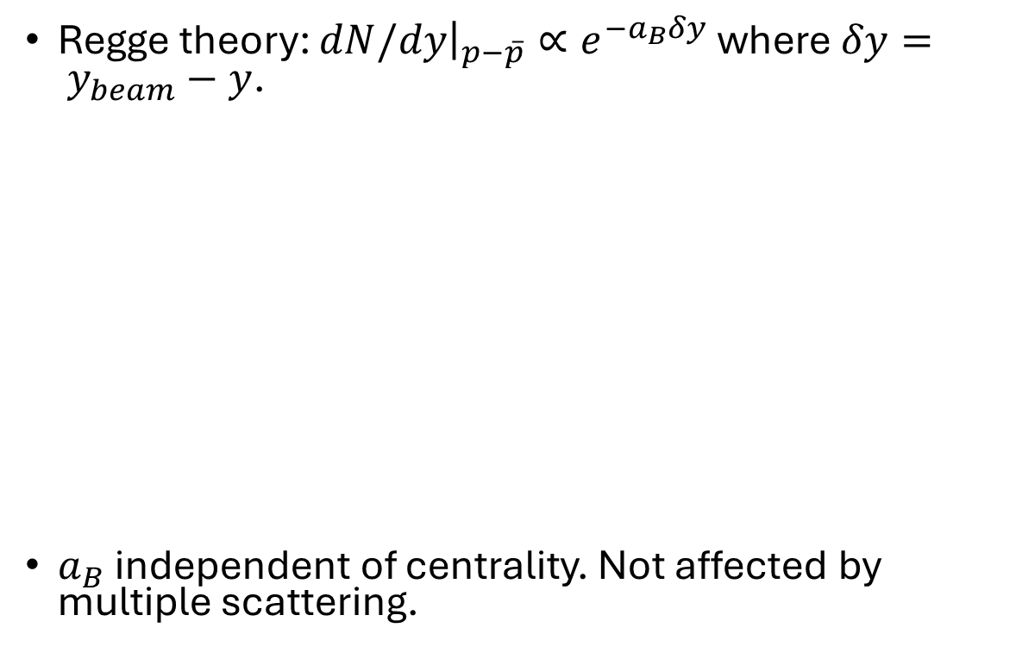
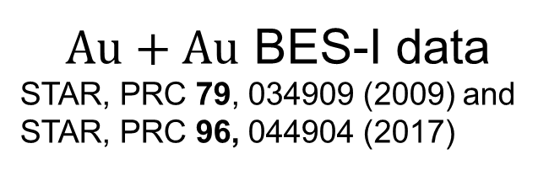
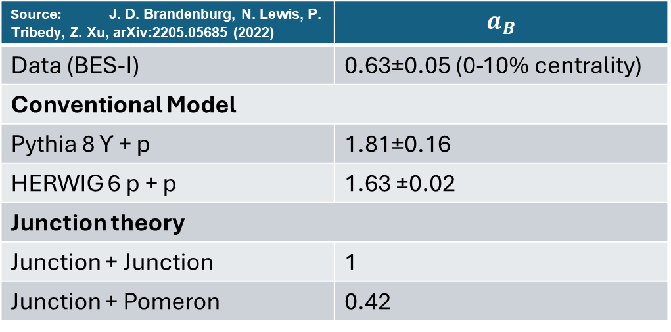
Previous observation: Net-baryon stopping is too strong for non-junction models.
$Au+Au$ BES-I data
STAR, PRC 79, 034909 (2009) and STAR, PRC 96, 044904 (2017)
Regge theory: $dN/dy{\left.​\right|}_{p−\overline{p}}∝e^{{−a}_{B}δy}$ where $δy= y_{beam}−y$.
$a_{B}$ independent of centrality. Not affected by multiple scattering.
Source: J. D. Brandenburg, N. Lewis, P. Tribedy, Z. Xu, arXiv:2205.05685 (2022) | $$a_{B}$$
Data (BES-I) | 0.63±0.05 (0-10% centrality)
Conventional Model
Pythia 8 ϒ + p | 1.81±0.16
HERWIG 6 p + p | 1.63 ±0.02
Junction theory
Junction + Junction | 1
Junction + Pomeron | 0.42
Figure from J. D. Brandenburg, N. Lewis, P. Tribedy, Z. Xu, arXiv:2205.05685 (2022)

Slide 5
Stopping behavior for hyperons?
Junction should be flavor blind [1]. Net-hyperon yield should follow similar stopping behavior if junction picture is correct.
Hyperon yields from BES-I has been published. Let’s try it.
[1]: J. D. Brandenburg, N. Lewis, P. Tribedy, Z. Xu, arXiv:2205.05685 (2022)

Slide 6
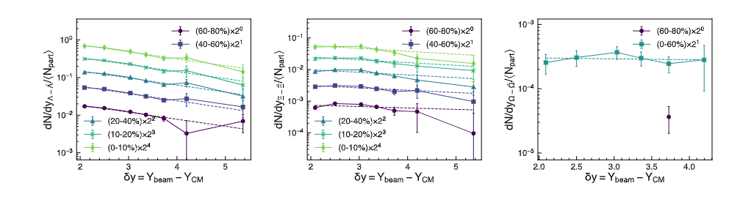
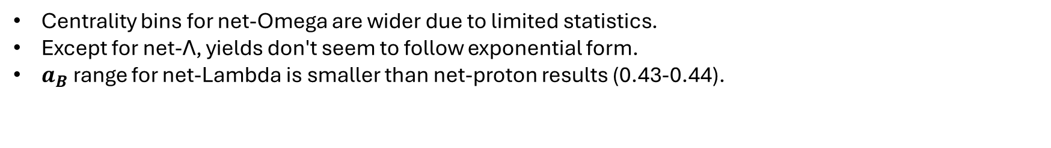
Stopping behavior for hyperons?
Data: Phys. Rev. Lett. 98, 062301 (2007), Phys. Rev. Lett. 108, 072301 (2012), Phys. Rev. C 102, 034909 (2020)
Centrality bins for net-Omega are wider due to limited statistics.
Except for net-Λ, yields don't seem to follow exponential form.
$a_{B}$ range for net-Lambda is smaller than net-proton results (0.43-0.44).

Slide 7
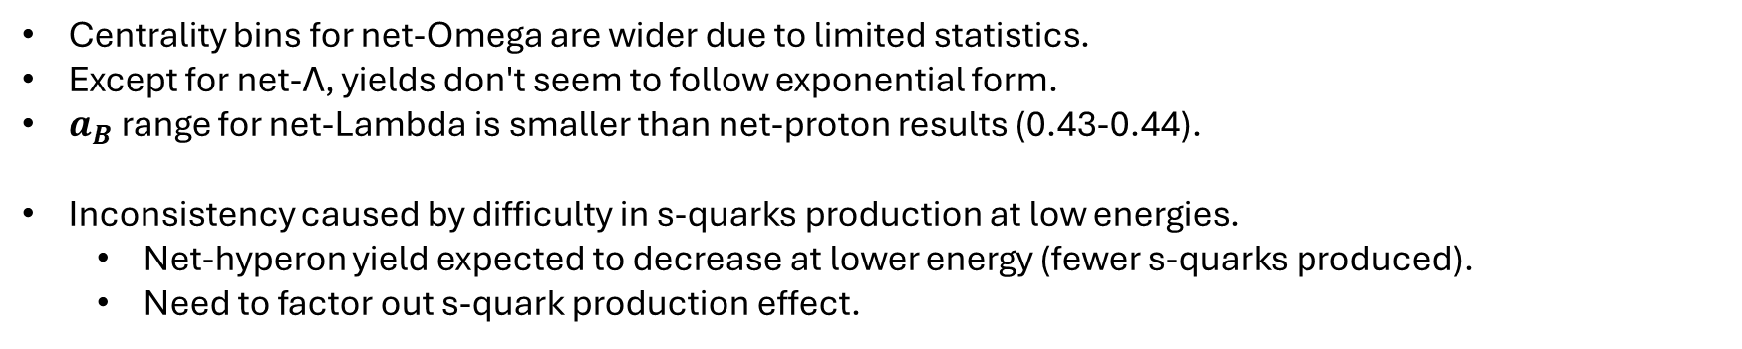
Stopping behavior for hyperons?
Data: Phys. Rev. Lett. 98, 062301 (2007), Phys. Rev. Lett. 108, 072301 (2012), Phys. Rev. C 102, 034909 (2020)
Centrality bins for net-Omega are wider due to limited statistics.
Except for net-Λ, yields don't seem to follow exponential form.
$a_{B}$ range for net-Lambda is smaller than net-proton results (0.43-0.44).
Inconsistency caused by difficulty in s-quarks production at low energies.
Net-hyperon yield expected to decrease at lower energy (fewer s-quarks produced).
Need to factor out s-quark production effect.

Slide 8
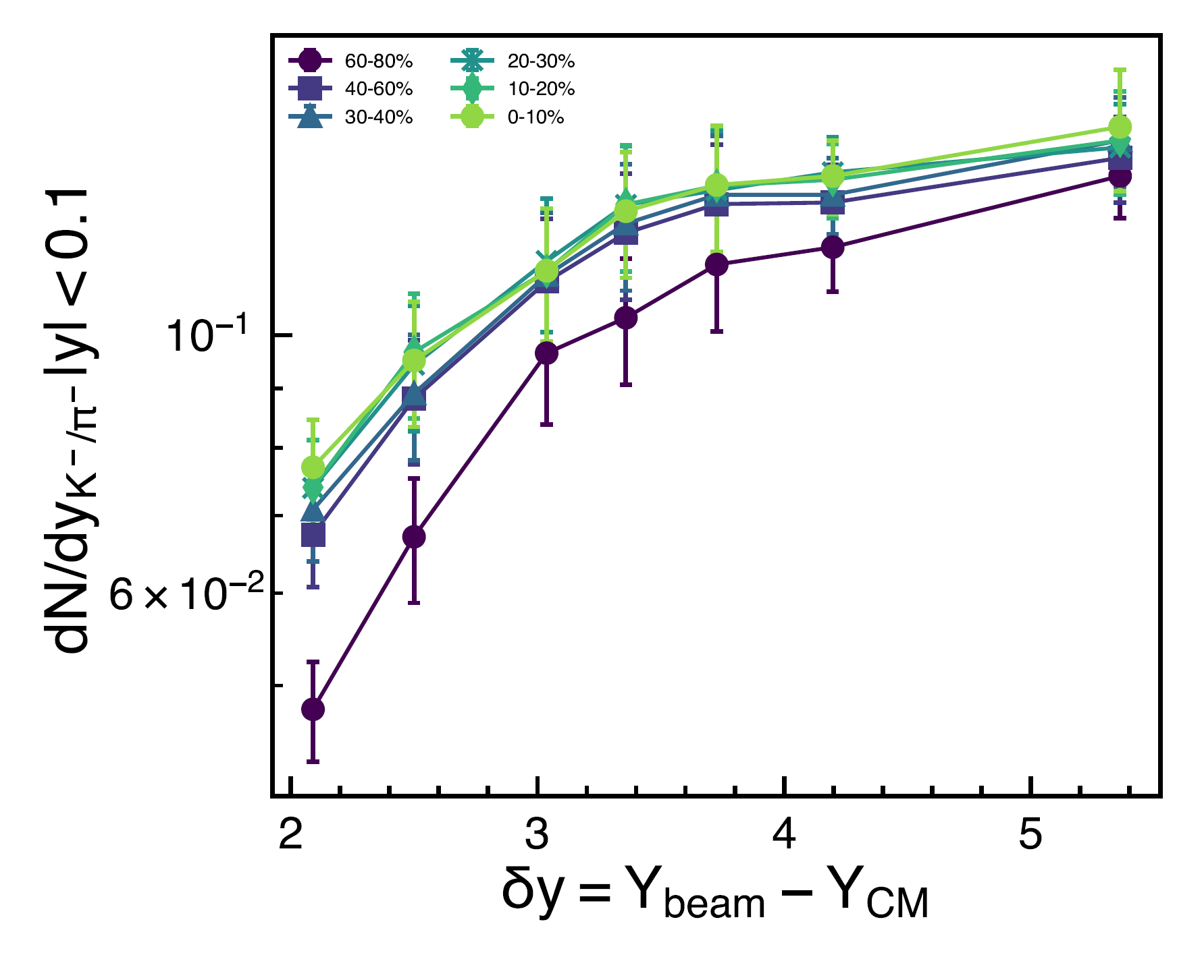

Correct for s-quark production with K⁻/ϖ⁻ ratio
Data: BES-I
Phys. Rev. C 96, 044904 (2017)
K⁻/ϖ⁻ ratio serves as a proxy to the difficulty in s-quark production.
K⁺ not used due to enhancement from associated production,
Net-yield is normalized by (K⁻/ϖ⁻)^{n}, where n = number of valence s-quarks.

Slide 9
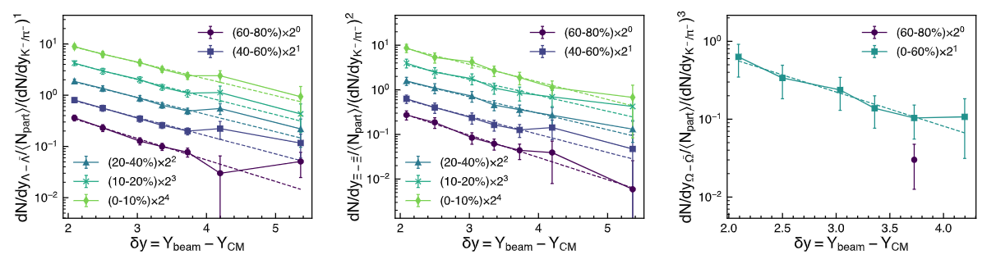
Normalized net-hyperons
Both net-Λ, net-Ξ and net-Ω now follows exponential dependence.
The slope depends on centrality only slightly.

Slide 10
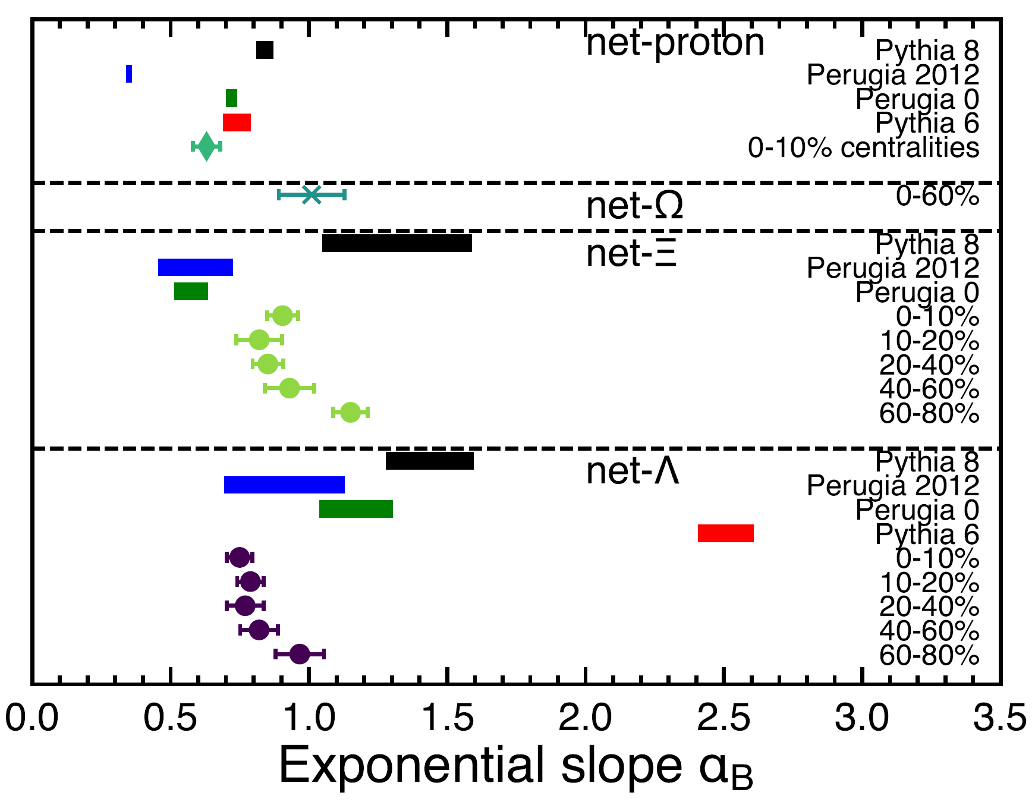
Comparison with model predictions (and net-proton result)
Some models are missing net-Ξ and net-Ω values.
Predicted normalized net-hyperon yields not exponential.
Similar slopes for different hyperons.
Slight disagreement with net-proton results (Possible K⁻/π⁻ proxy issue).
Similar slope supports junction hypothesis.
No Pythia version reproduces slope for all hyperons, protons.

Slide 11
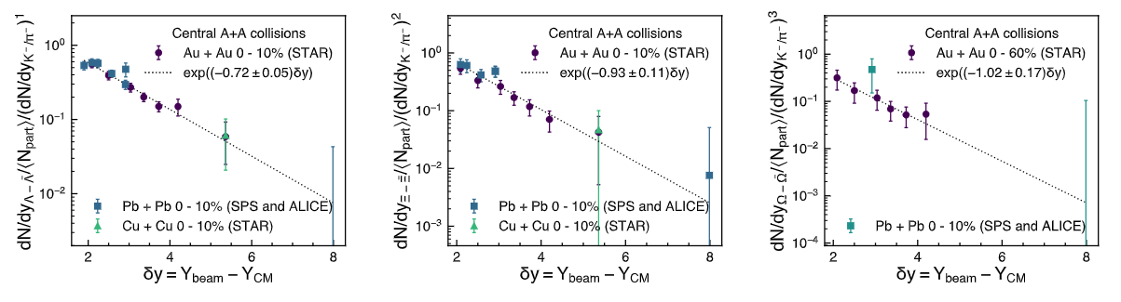
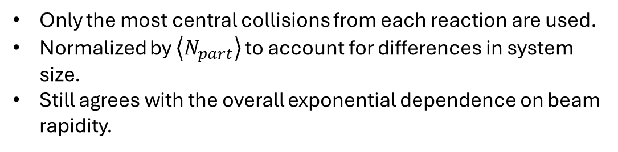
Extending our plots with other systems
Additional data:
Phys. Rev. C 78, 034918 (2008),
Journal of Physics G: Nuclear and Particle Physics 32, 427 (2006),
Schuchmann, S. (2016). Modification of K0s and Lambda (AntiLambda) Transverse Momentum Spectra in Pb-Pb Collisions at√ sNN= 2.76 TeV with ALICE. Springer.
Physics Letters B 728, 216 (2014),
Phys. Rev. Lett. 111, 222301 (2013),
Phys. Rev. C 66, 054902 (2002),
Phys. Rev. C 88, 044910 (2013).
Only the most central collisions from each reaction are used.
Normalized by $\left\langle N_{part}\right\rangle$ to account for differences in system size.
Still agrees with the overall exponential dependence on beam rapidity.

Slide 12
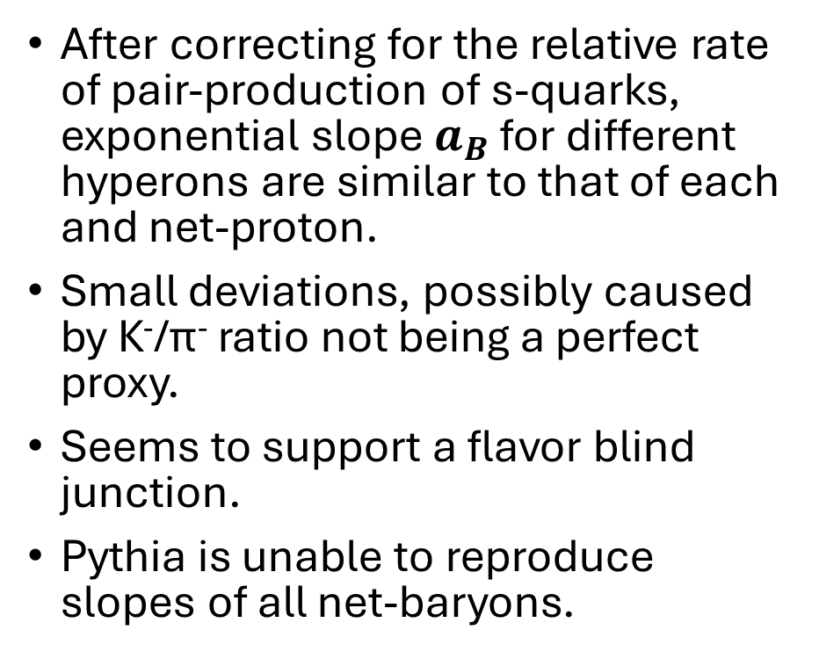
Conclusion
After correcting for the relative rate of pair-production of s-quarks, exponential slope $a_{B}$ for different hyperons are similar to that of each and net-proton.
Small deviations, possibly caused by K⁻/ϖ⁻ ratio not being a perfect proxy.
Seems to support a flavor blind junction.
Pythia is unable to reproduce slopes of all net-baryons.

Slide 13
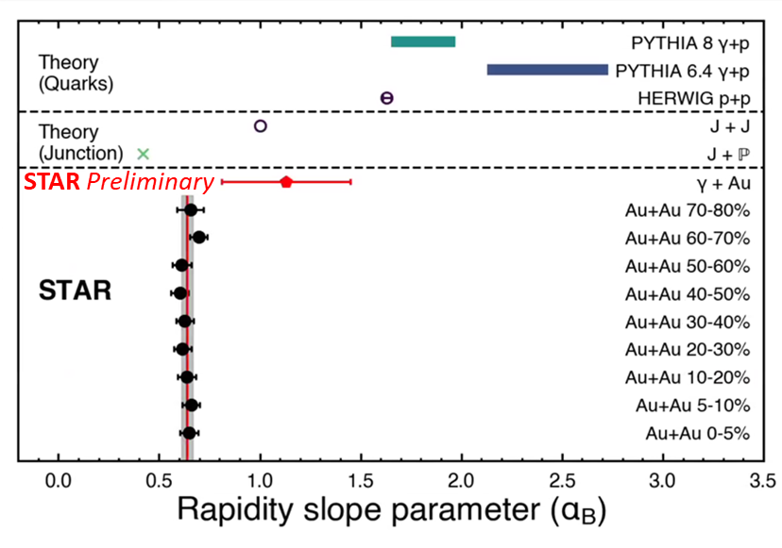
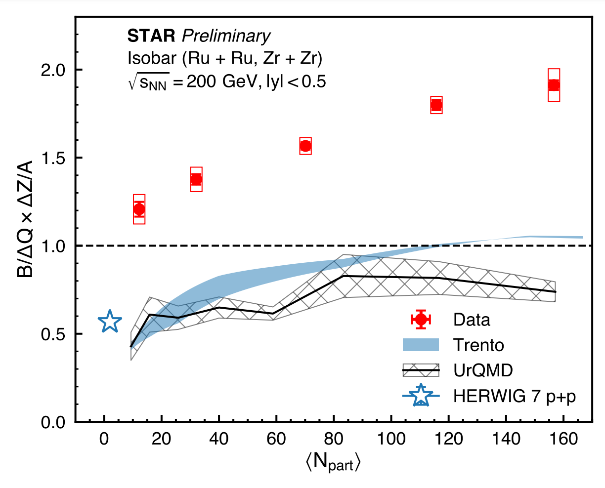
Conclusion (cont.)
More evidences are coming in.
Together they paint a compelling picture that junction is the preferred picture.

Slide 14
Backup slides

Slide 15
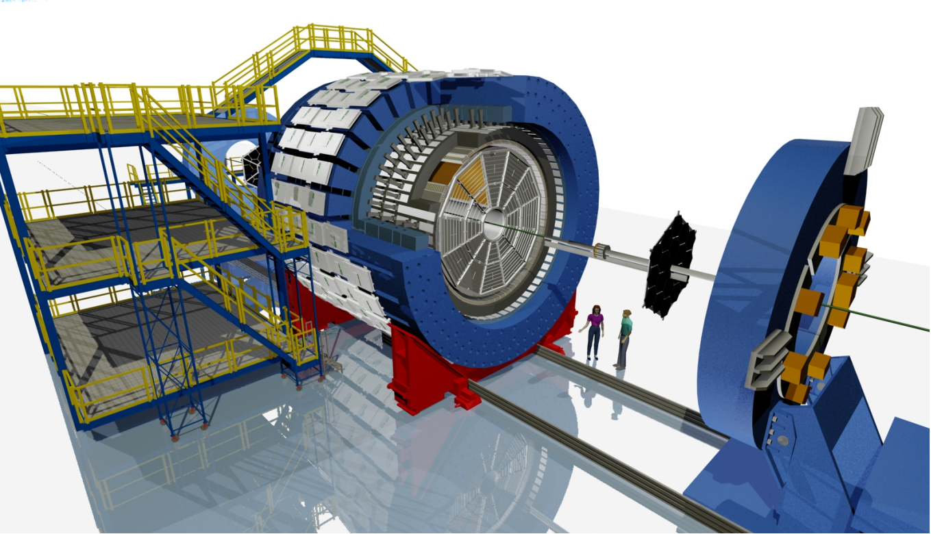
STAR detector
Time Projection Chamber (TPC)
Measures charged particle momentum with track curvature under B-field
Identifies particle with energy loss per unit length (dE/dx)
Time-Of-Flight (TOF)
Extends momentum range for particle identification
Pile-up rejection
Zero Degree Calorimeter (ZDC)
Detect forward neutrons for event selection
Beam-Beam counter (BBC)
Detector forward and backward beam fragments
Vertex Position Detector (VPD)
One on the east and one on the west.
Vertex location is calculated from the averaged time of particle detection on both sides.
Magnet
TPC
TOF
VPD
BBC
ZDC 18 m
Chun Yuen Tsang, APS DNP-JPS 2023

Slide 16
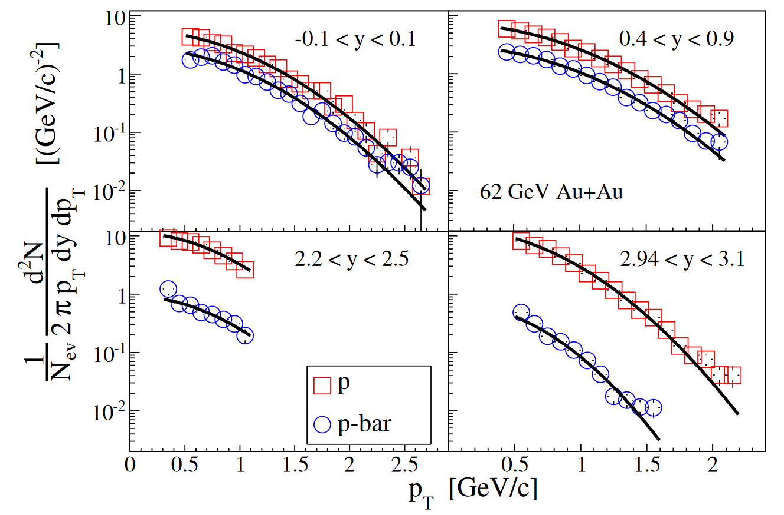
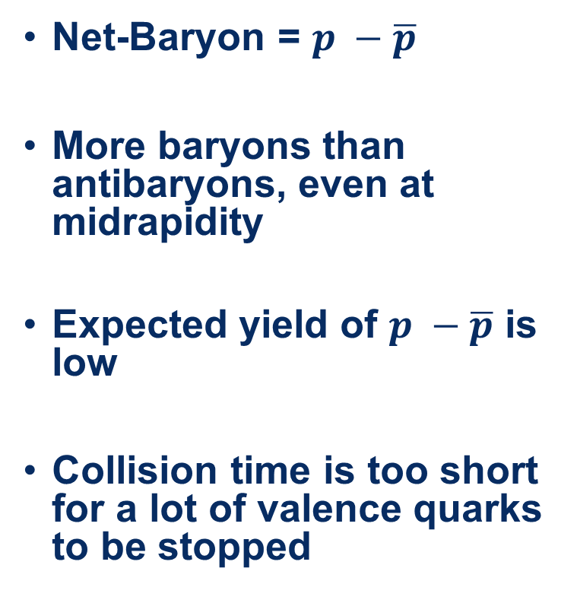
Net-Baryon at mid-rapidity
Net-Baryon = $p −\overline{p}$
More baryons than antibaryons, even at midrapidity
Expected yield of $p −\overline{p}$ is low
Collision time is too short for a lot of valence quarks to be stopped
BRAHMS Collaboration, Phys. Lett. B 677, 267-271 (2009)
Notes:
Some protons produced in proton-antiproton pairs, some baryons come from the colliding nuclei

Slide 17
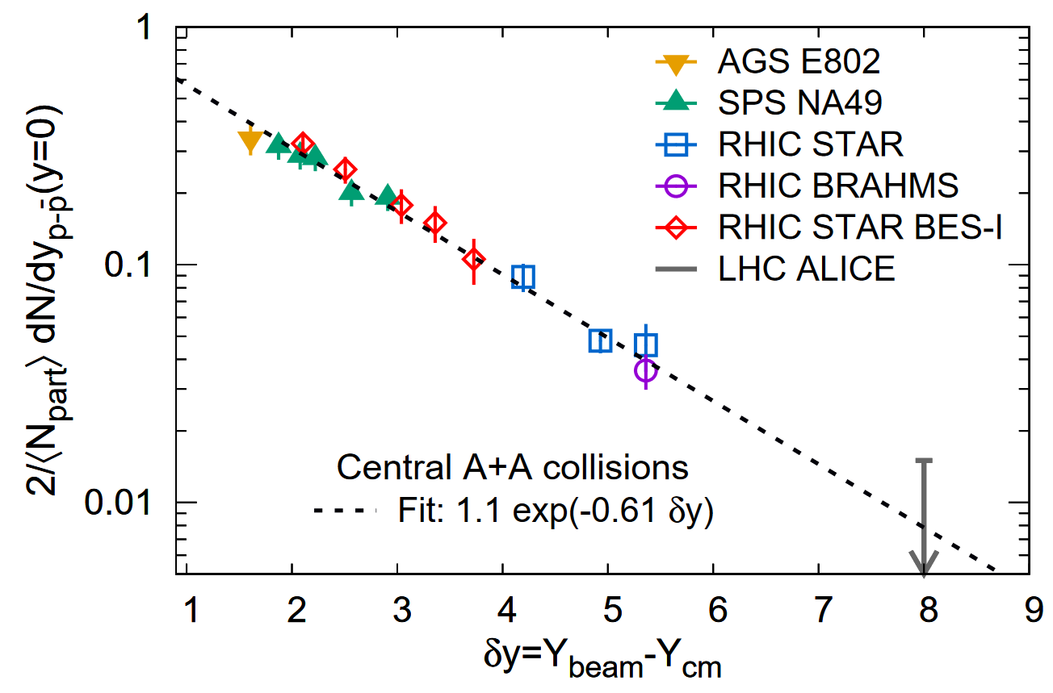
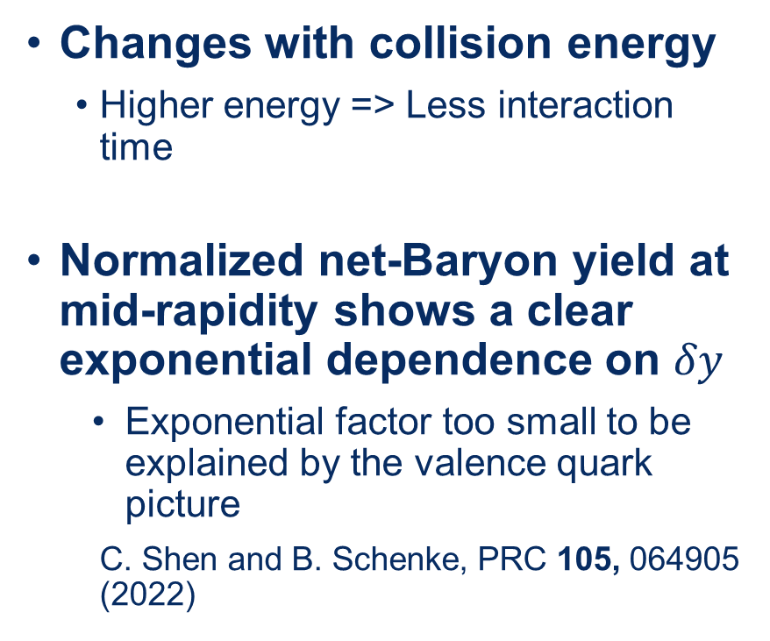
Net-Baryon at mid-rapidity
Changes with collision energy
Higher energy => Less interaction time
Normalized net-Baryon yield at mid-rapidity shows a clear exponential dependence on $δy$
Exponential factor too small to be explained by the valence quark picture
C. Shen and B. Schenke, PRC 105, 064905 (2022)
J. D. Brandenburg, N. Lewis,
P. Tribedy, Z. Xu, arXiv:2205.05685 (2022)

Slide 18
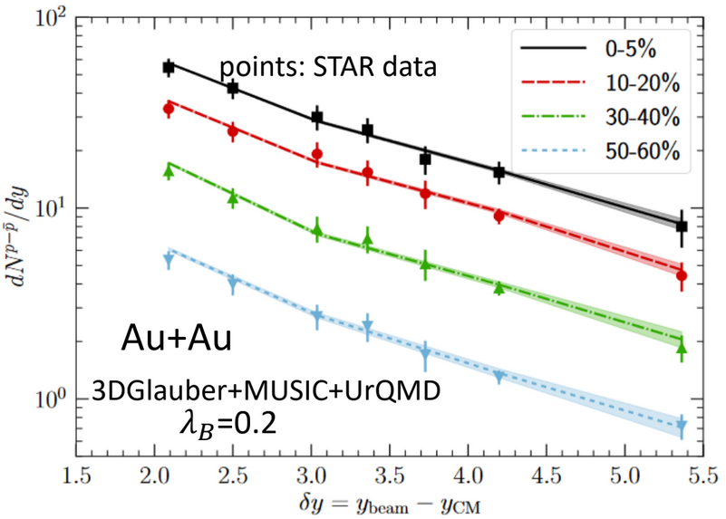
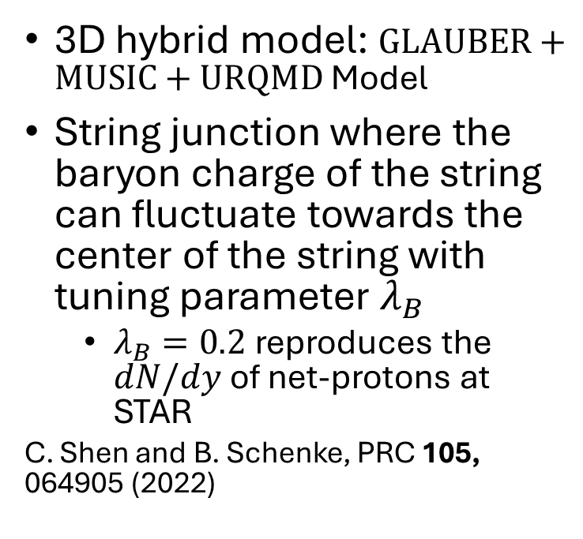
String junction model
3D hybrid model: $GLAUBER+MUSIC+URQMD$ Model
String junction where the baryon charge of the string can fluctuate towards the center of the string with tuning parameter $λ_{B}$
$λ_{B}=0.2$reproduces the $dN/dy$of net-protons at STAR
C. Shen and B. Schenke, PRC 105, 064905 (2022)
Plot from Wenbin Zhao, BES-Tea Seminar 2022
Chun Yuen Tsang, APS DNP-JPS 2023

Slide 19
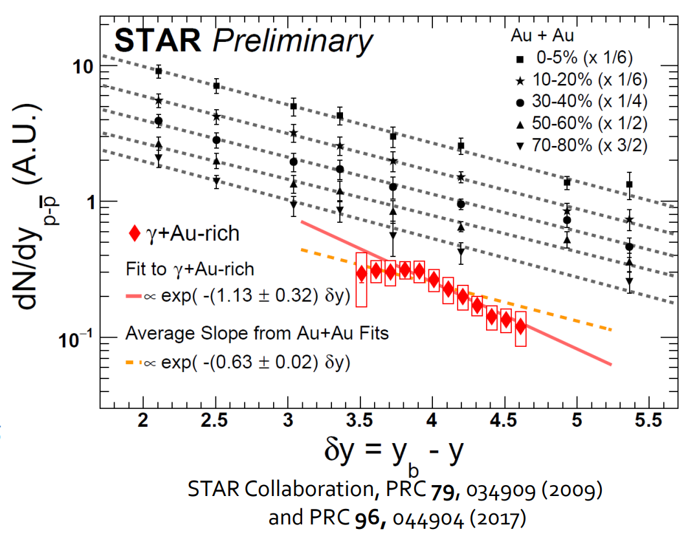
Gamma+Au and Au+Au on the same plot

Slide 20
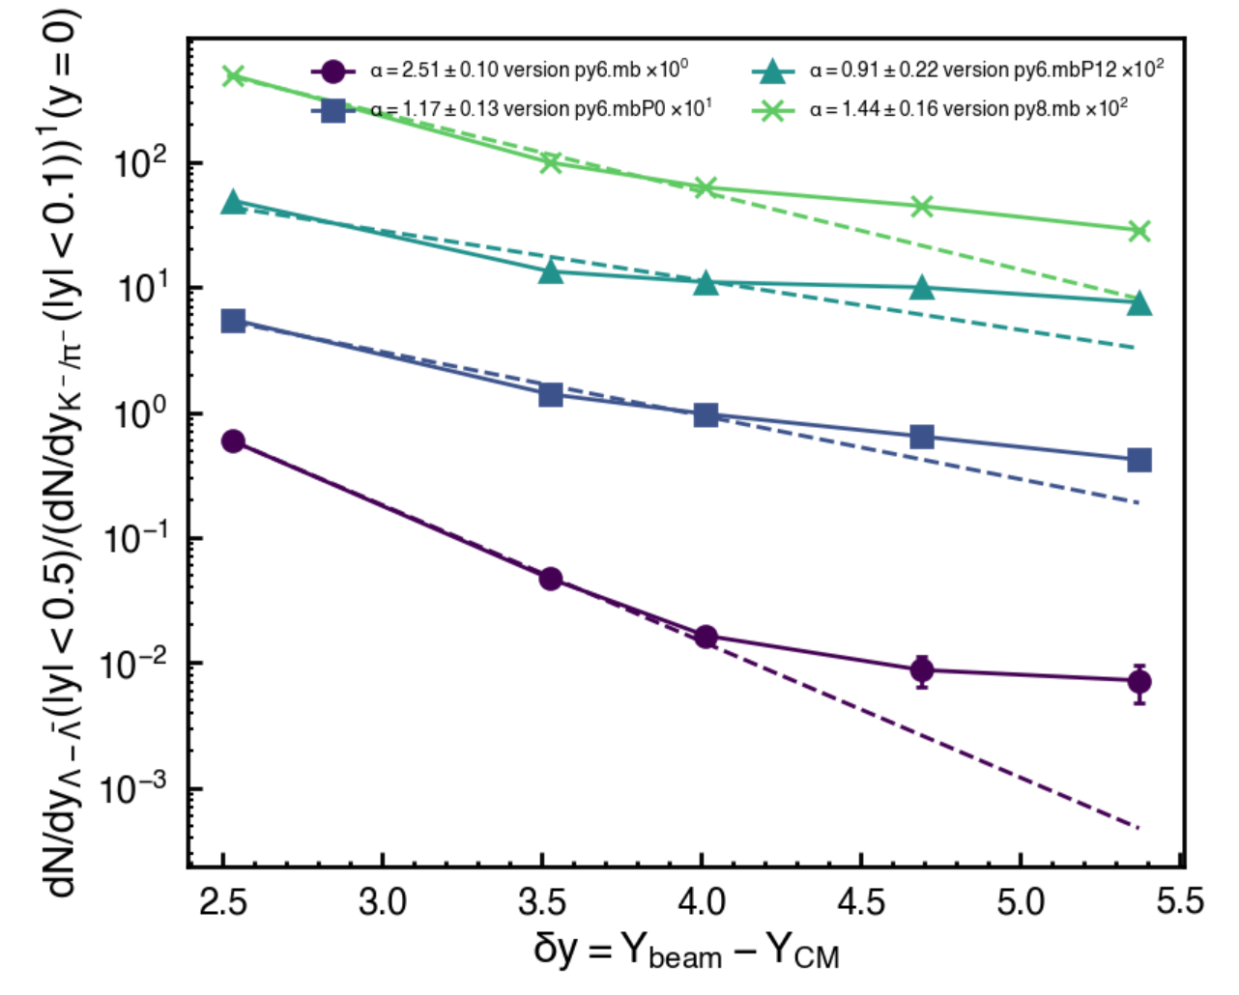
Pythia net-Lambda

Slide 21
Pythia net-Lambda

Slide 22
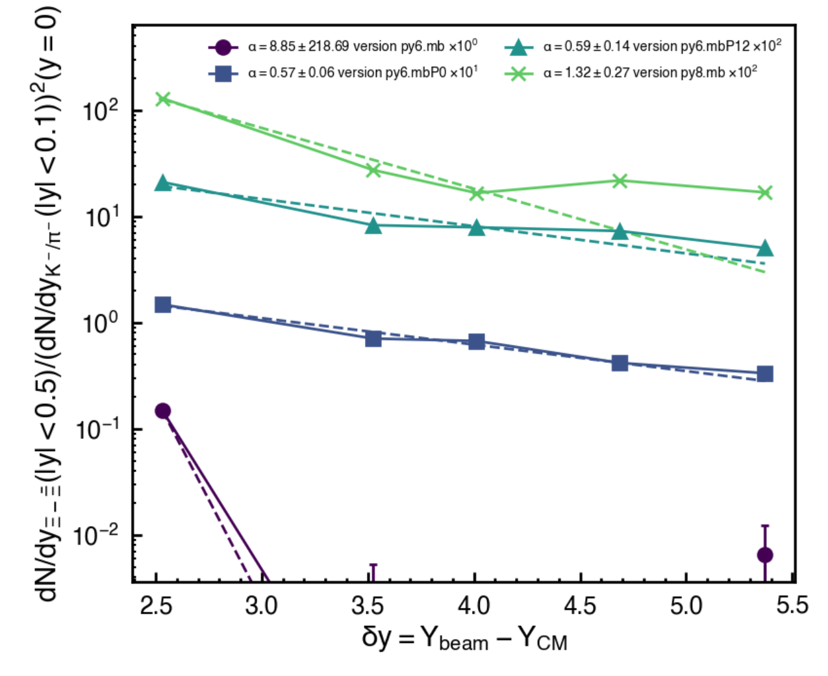
Pythia net-Xi

Slide 23
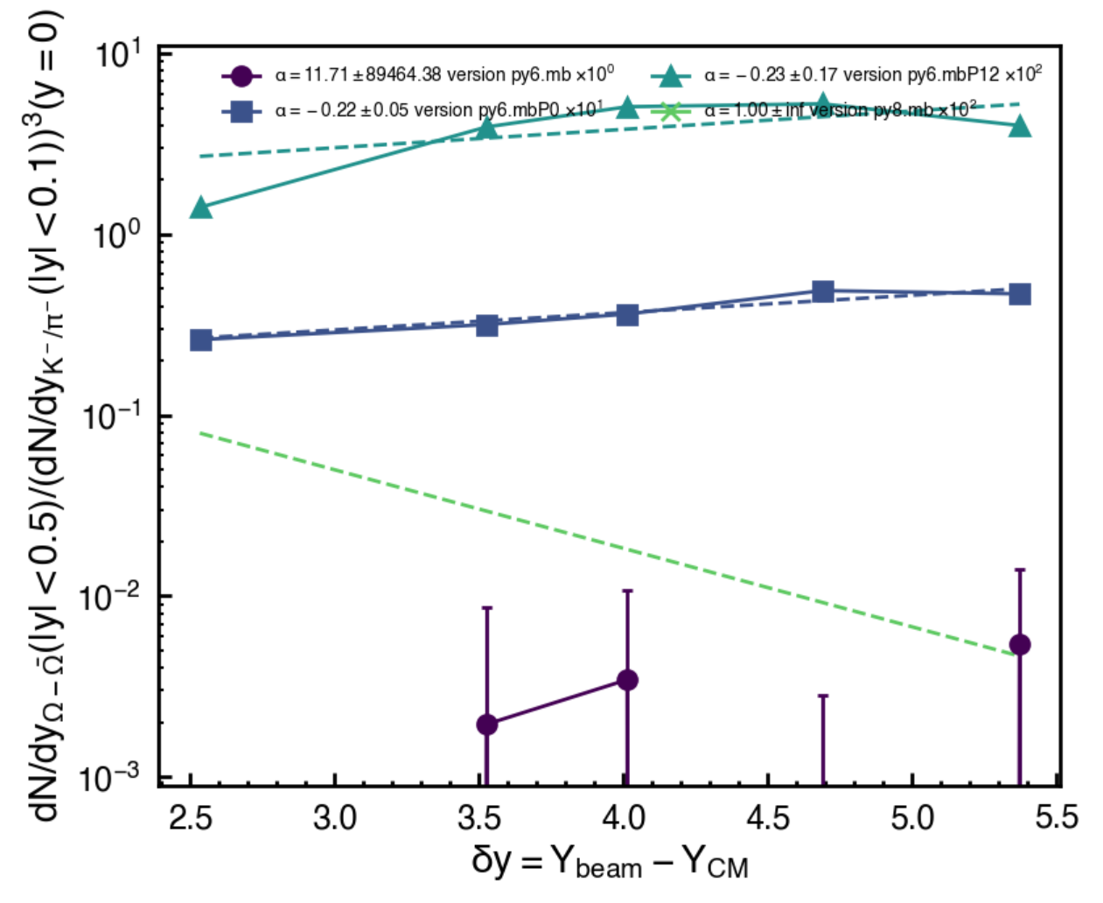
Pythia net-Omega

Slide 24
