Slide 1
Center for Frontiers in Nuclear Science Workshop Progress on the Production of Muon and Photon Beams for Applications in Muon-Ion Colliders https://indico.cfnssbu.physics.sunysb.edu/event/249/
Overview of Workshop and Updates on the Production
of Backscattered Photon Beams and Muon Beams at the EIC
Organizers
Ethan Cline, CFNS/Stony Brook
Allen Pierre-Louis, CFNS/Stony Brook
Paul Gueye, FRIB/Michigan State
Sekazi K. Mtingwa, InCREASE/TriSEED LLC

Slide 2
https://science.osti.gov/-/media/hep/hepap/pdf/202203/International_Benchmarking_HEPAP_2023112.pdf

Slide 3
FINDING
Frontier large-scale research facilities offer the most comprehensive method of answering fun- damental questions while exciting and inspiring a whole new STEM workforce.
RECOMMENDATION
A next-generation international flagship particle physics facility based in the U.S. would attract a whole new generation of scientists while boosting opportunities to train students and sustain a leading scientific workforce. The U.S. should not wait until DUNE is commissioned to embark upon its next major particle physics initiative but should move quickly to intensify its R&D program with the aim of accelerating progress in this direction to enable a timely decision.
[Same can be said about the Nuclear Physics Community and the EIC.]

Slide 4
NASEM BISO is Initiating a Survey on Barriers (eg. Visas)
That Hinder International Collaborations
Suggested Questions
https://docs.google.com/document/d/1YgshHo8oGLMMNNjzLZVF6oqHAuNNvHPr/edit?usp=drive_link&ouid=110885125108865005063&rtpof=true&sd=true
Please send your thoughts and suggestions to
sekazi.mtingwa@gmail.com

Slide 5
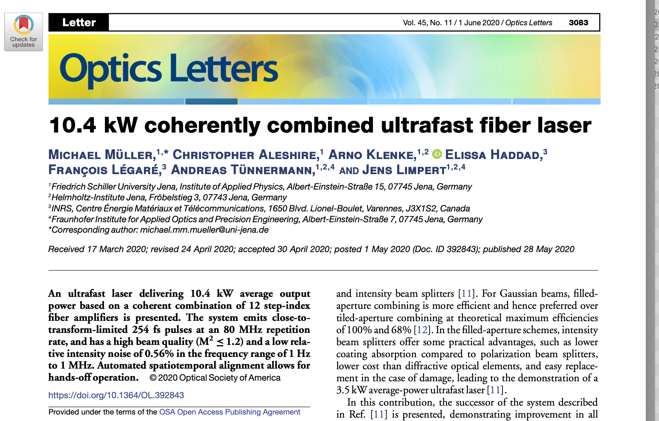

Slide 7
EIC Electron Beam Parameters (from EIC Design Study)

Slide 8
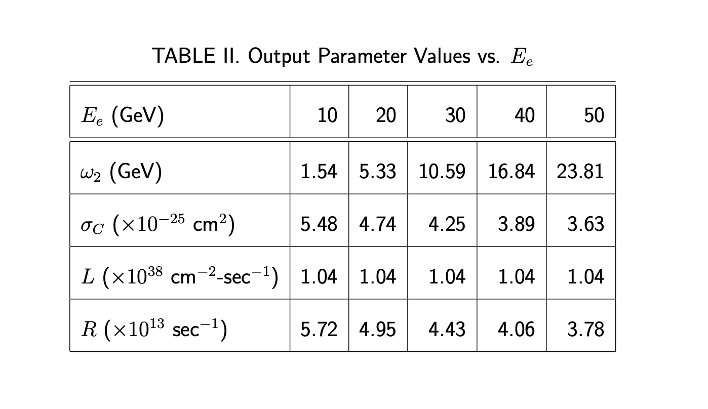
Previous Results

Slide 9
New Info from Christoph Montag at the EIC!!!
Hi Sekazi,
Let me try to answer your questions.
The emittances from the Design Report are still valid, at least to the 10-20% level. I guess that precision is good enough for your purposes. These emittances are purely transverse, so only in a dispersion-free region one can "define" them by sigma 2/beta.*
- The horizontal emittance in an electron storage ring is determined by the accelerator lattice, which means changing the emittance would require rebuilding the ring, based on a different lattice structure
- One could entertain the idea of having a dedicated electron-laser interaction point in one of the straight sections. In the worst case, that would have to be IR8 due to space constraints everywhere else, which would mean we would not have a second detector. But that would need ot be looked at. Depending on the required magnet-free length of the interaction region, the beta function there could be as small as a few centimeters if the focusing magnets can be close.
- The bunch length in the design report is slightly off; the correct number is 1 mm RMS. This is again given by the lattice and therefore "fixed".

Slide 11
GEANT Simulations

Slide 12
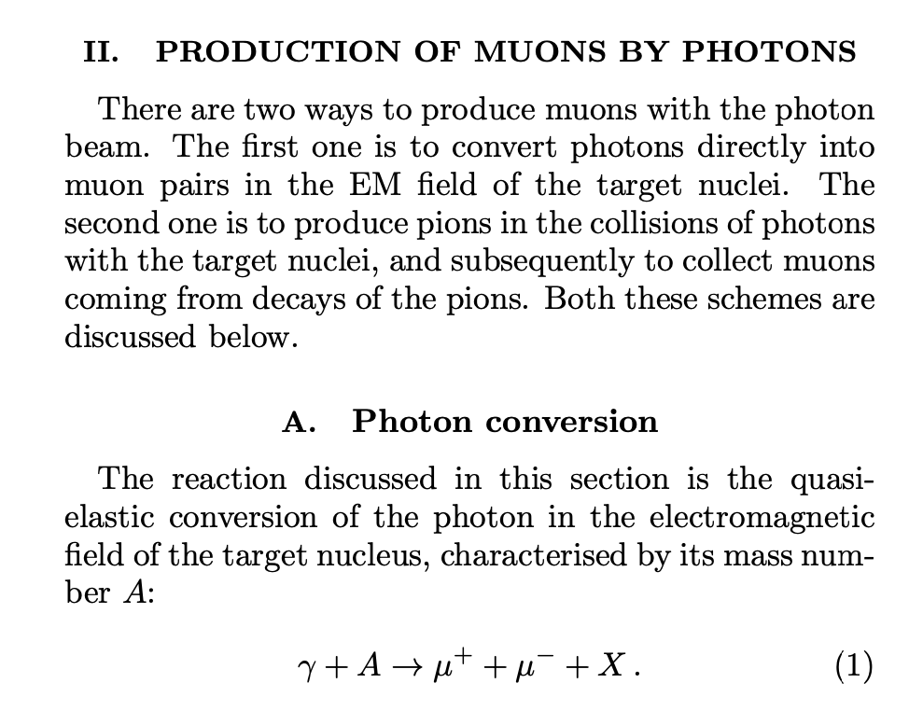
Gamma Factory high-intensity muon and positron source: Exploratory studies Armen Apyan,1, ∗ Mieczyslaw Witold Krasny,2, 3 and Wieslaw Placzek4

Slide 13
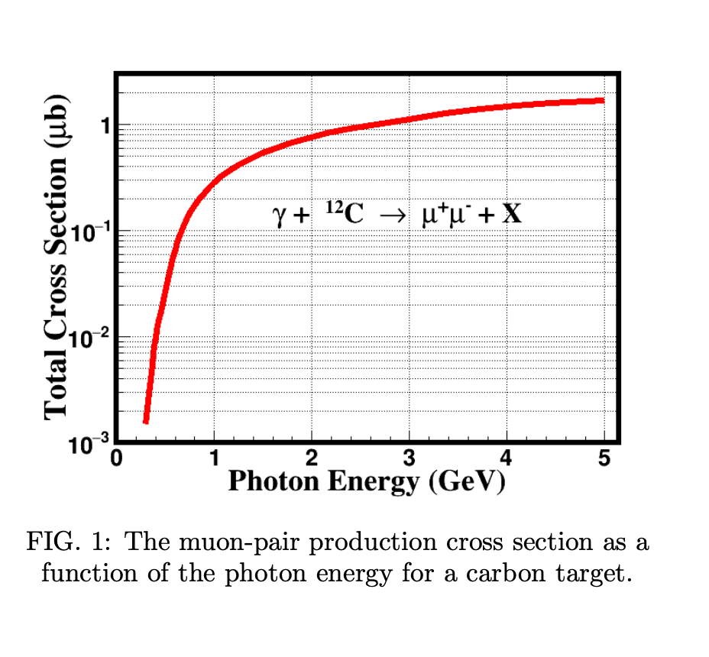

Slide 14
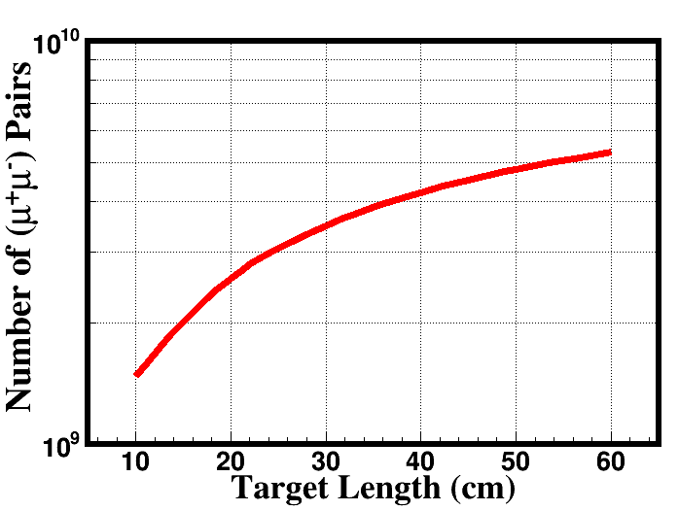
Number of muon pairs for 10^15 gamma/sec
E_e⁻⁻ = 18 GeV, E_gamma = 4.43838 GeV (Credit: Armen Apyan)
(Graphite Target, No cut for muon pairs collecting, Muons in full solid angle 4pi$)$

Slide 15
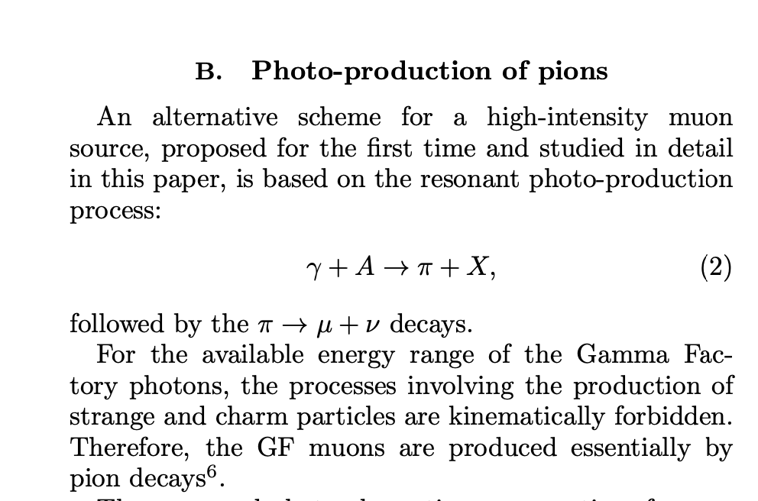
Gamma Factory high-intensity muon and positron source: Exploratory studies Armen Apyan,1, ∗ Mieczyslaw Witold Krasny,2, 3 and Wieslaw Placzek4

Slide 16
Gamma Factory high-intensity muon and positron source: Exploratory studies Armen Apyan,1, ∗ Mieczyslaw Witold Krasny,2, 3 and Wieslaw Placzek4

Slide 17
Gamma Factory high-intensity muon and positron source: Exploratory studies Armen Apyan,1, ∗ Mieczyslaw Witold Krasny,2, 3 and Wieslaw Placzek4

Slide 18
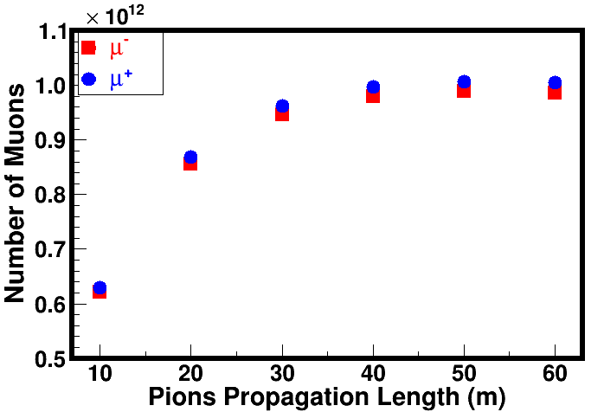
Number of muon pairs for 10^15 gamma/sec
E_e⁻⁻ = 4.5 GeV, E_gamma = 340 MeV (Credit: Armen Apyan)
(Graphite Target, No cut for muon pairs collecting, Muons in full solid angle 4pi$)$

Slide 19
Looking Forward
We have a few knobs to turn to increase the rate of muons to 10^14.
See next slide.

Slide 21
Thanks for Your Kind Attention.

