Slide 1
Current Status of Muon Collider Studies
J. Scott Berg
Brookhaven National Laboratory
Progress on the Production of Muon and Photon Beams for Applications in Muon-Ion Colliders
March 26, 2024

Slide 2
Outline
Introduction and motivation
Outline of a muon collider with progress highlights from IMCC annual meeting
Reminder of muon-ion collider challenges

Slide 3
Muon Collider Motivation
Recent strengthening of interest in physics at the 10 TeV scale
Would require ≈100 TeV CoM with protons
Electrons
  Would radiate too much in a ring
  A linear collider is long and expensive, plus beamstrahlung challenges
So instead use muons
  Fundamental particles, all energy goes to interaction
  Higher mass then electrons, so no radiation issues, bend in a ring
  But they’re unstable: everything must happen fast
  They’re difficult to make: keep losses low

Slide 4
Muon Colliders and P5
P5 was positive about muon colliders
From the draft report:
  “we recommend targeted collider R&D to establish the feasibility of a 10 TeV pCM muon collider.” Note they do not intend to close off other options for these energies (e.g., 100 TeV protons, plasma acceleration, ...)
  “With a 10 TeV pCM muon collider at Fermilab as the long-term vision...”
  “a goal of being ready to build major test facilities and demonstrator facilities within the next 10 years”
  “The US should pursue a leading role in the muon collider design effort, in concert with the International Muon Collider Collaboration (IMCC)”

Slide 5
Muon Colliders vs. Other Ring Colliders
Typical ring colliders are “factories”
  Make lots of bunches, spaced as closely as possible
  Each bunch has the maximum current allowed by beam-beam, collective effects, etc.
  Electrons and protons are easy to make and can be collided many times
Muon colliders can’t do this
  Muons are unstable and difficult to make
  Maximize luminosity by putting all particles in a single bunch
  Less concerned about beam disruption at collision since only need to survive 2000 collisions or so

Slide 6
The IMCC, MuCOL, and the US
IMCC is a CERN-led collaboration of many institutes to
  Determine the viability of a muon collider
  Put together a complete muon collider design
  Prepare and perform the required R&D including test facilities
MuCOL is an approved EU project that funds EU institutions to work on specific topics as part of the IMCC effort
In the US, we are preparing to ramp up muon collider efforts
  Beginnings of forming a collaboration
  Hoping for funding to ramp up starting in a couple years
  Attempting to begin some small amount of work via laboratory funding

Slide 7
Muon Collider Facility Overview
Proton driver creating high-power proton beam
Front end: create pions at target, capture muons, convert to bunch train
Cooling: reduce emittance, combine into one bunch
Acceleration: increase energy
Collider ring

Slide 8
Proton Driver
Challenge of the proton driver is having short bunches, high power, and large charge per bunch
Generally involves two final stages
  An accumulator ring, to gather the charge into a single bunch
  A compressor ring, to make that bunch very short (~2 ns)
  Some designs instead compress a few bunches, extract them into separate beamlines, and have them hit the target simultaneously
Studies have been very limited to this point
  There have been earlier designs showing one can achieve required parameters
  Designs tend to be site-specific, need to take into account existing proton infrastructure

Slide 9
Target and Initial Capture
Proton beam (1–4 MW) hits target, producing pions, decay to muons
Pions produced with a large angular and energy spread but a small spot size
Target is in a high field solenoid
(15–20 T), which tapers down to a
lower field to capture a large angular divergence

Slide 10
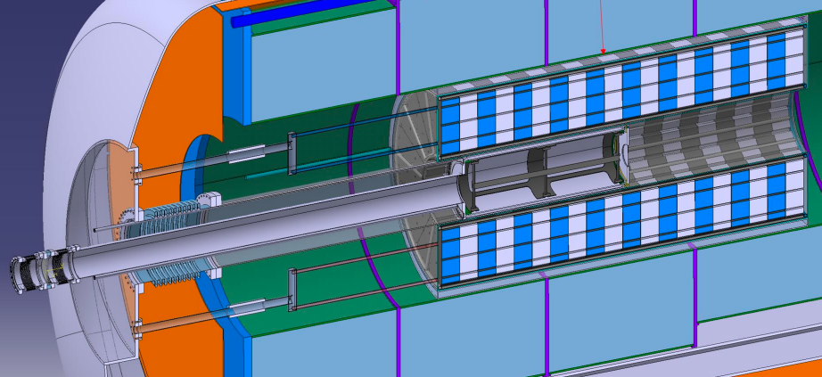
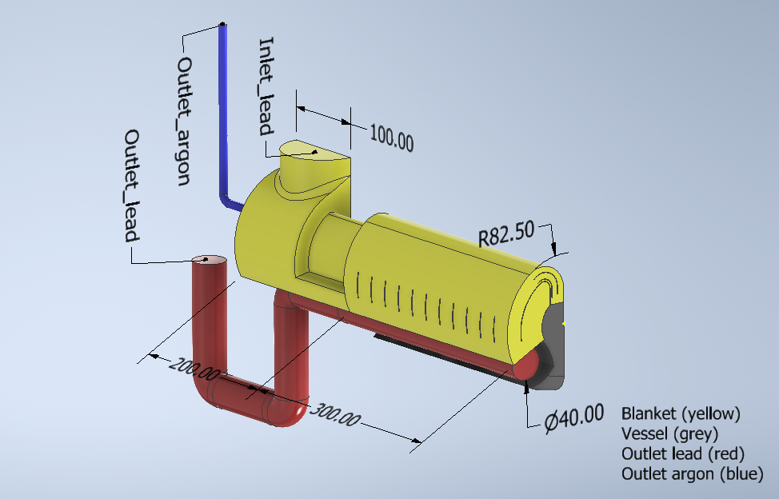
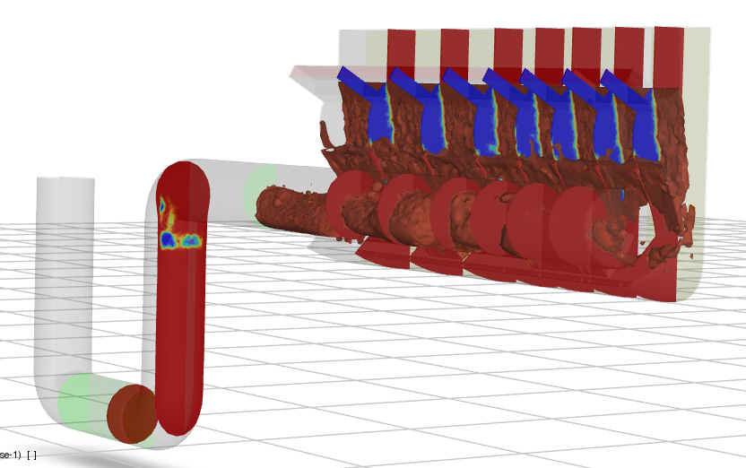
Target
Baseline design is a carbon target
  Extensive studies done on target,
  shielding for magnets, solenoid
  system, etc.
Heavy-metal systems maybe be
better at higher power
  Liquid lead waterfall being studied
  Fluidized tungsten powder

Slide 11
Chicane and Proton Beam Dump
The field tapers down from high to low field, then there is a particle selection chicane
  High energy protons to a dump
  Low energy pions and protons
  pass through
  An absorber captures low
  energy protons
Dumping the proton beam is
challenging
Must avoid losing desired
pions and muons

Slide 12
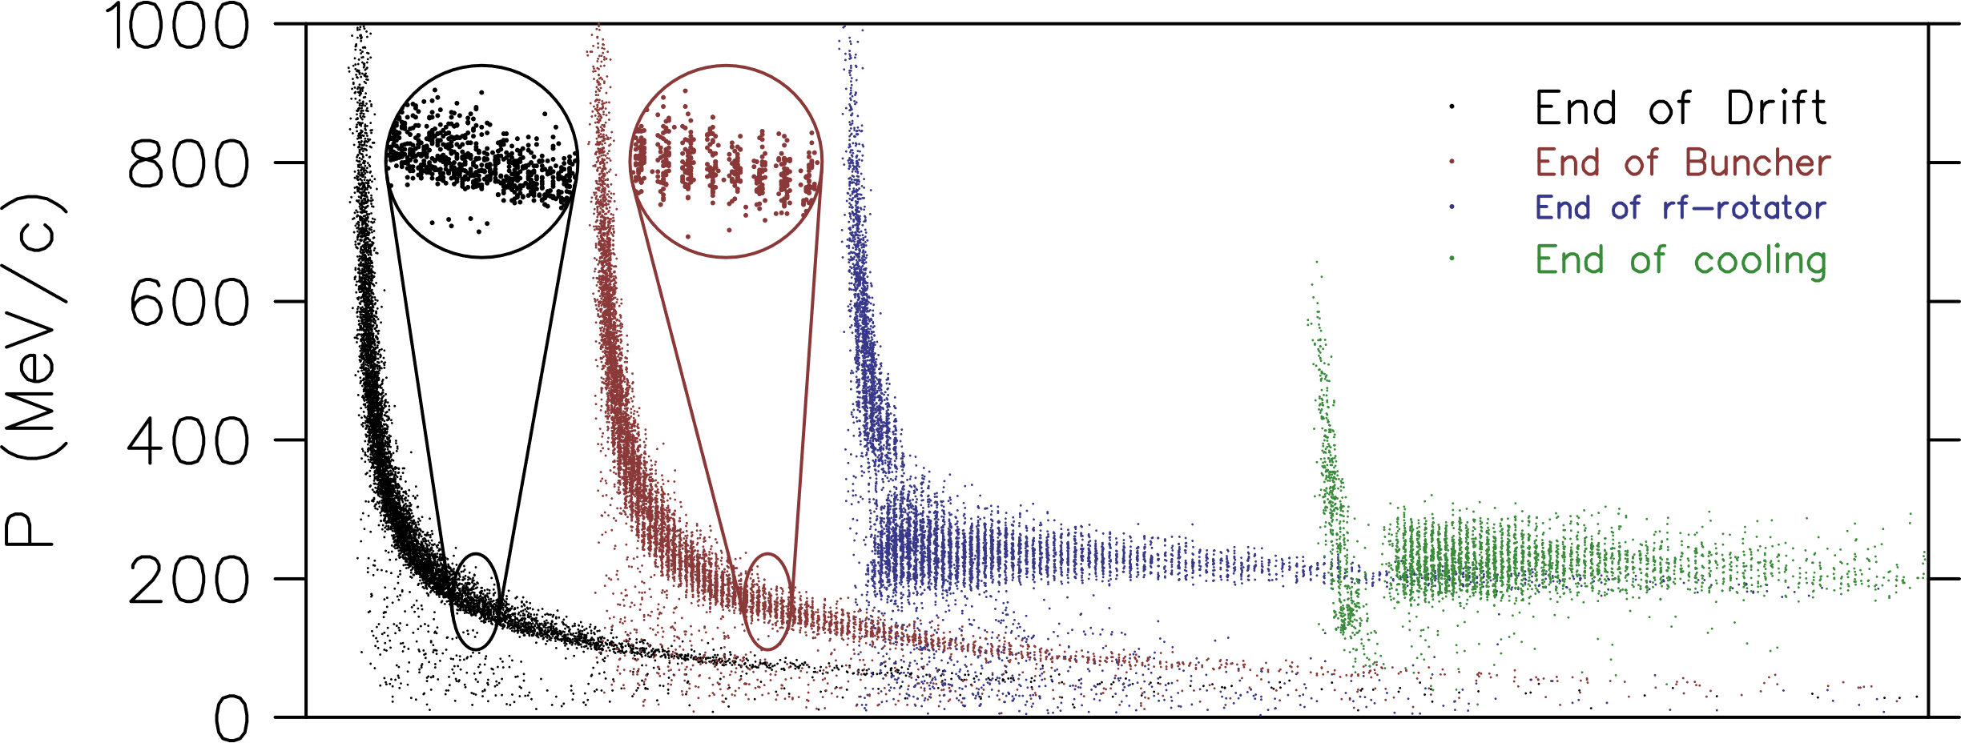
Capture of Bunch Train
Beam develops a time-energy correlation
RF cavities form bunches
Adjust RF frequencies to give bunches similar energies
Works for both
muon signs
Goal: optimize in
conjunction with
target, capture,
chicane

Slide 13
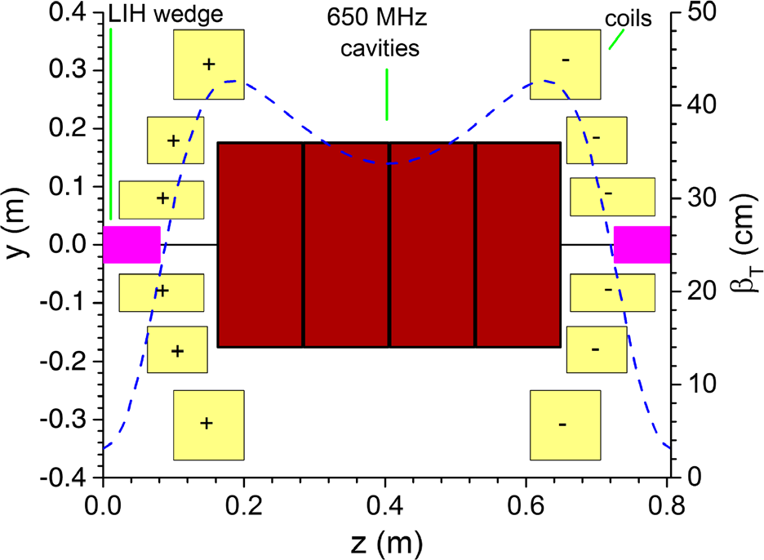
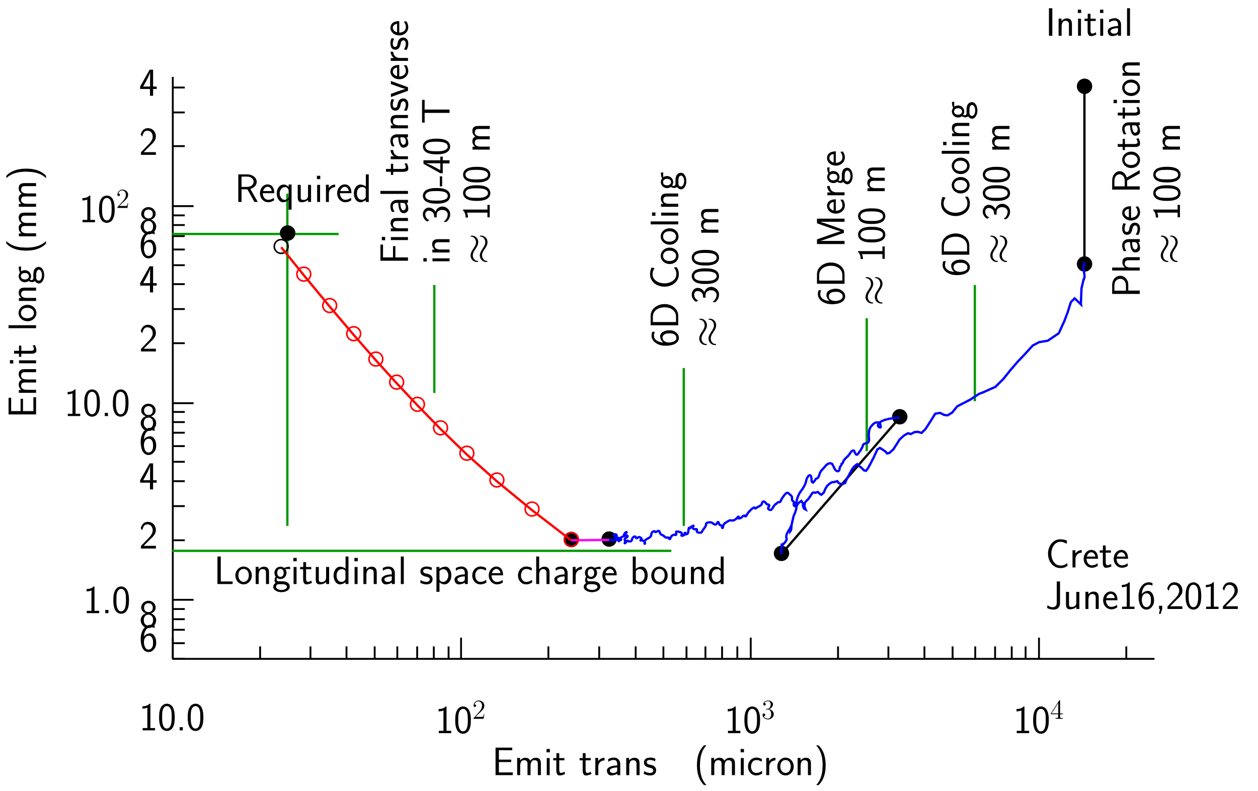
Ionization Cooling
Lose transverse and longitudinal momentum in absorber
  Large angular divergence in absorber relative to multiple scattering: strong focusing, high field
Restore longitudinal momentum in RF cavity
Dipole field and triangular absorber couple transverse to longitudinal, cool longitudinally
Cool bunch train, then merge to single bunch and cool more

Slide 14
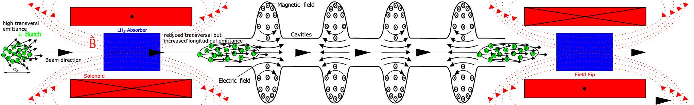
Ionization Cooling Stages
Initial HFOFO cooling, both signs
Charge separation
Rectilinear cooling channel: cool enough for bunch merge
Bunch merge
Rectlinear cooling channel: maximal cooling
Final cooling/emittance exchange

Slide 15
IMCC Cooling Work
Design work on rectilinear channel
  Including improved incorporation of engineering
  limitations
Improving final cooling channel design
Design of an ionization cooling demonstrator

Slide 16
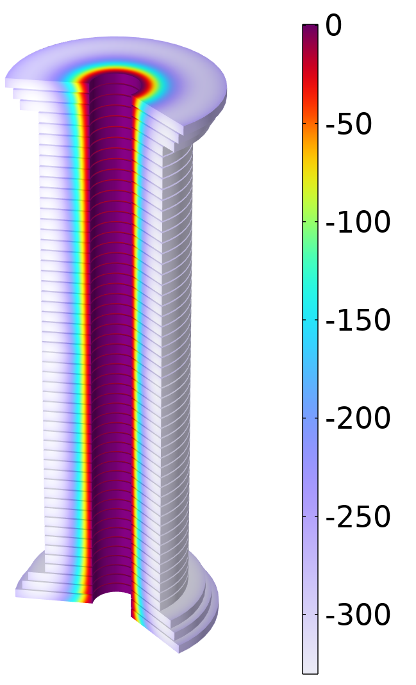
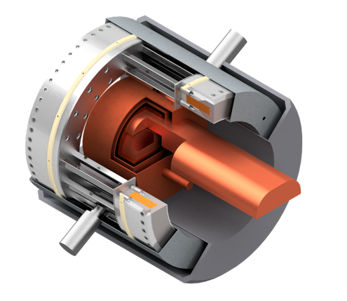
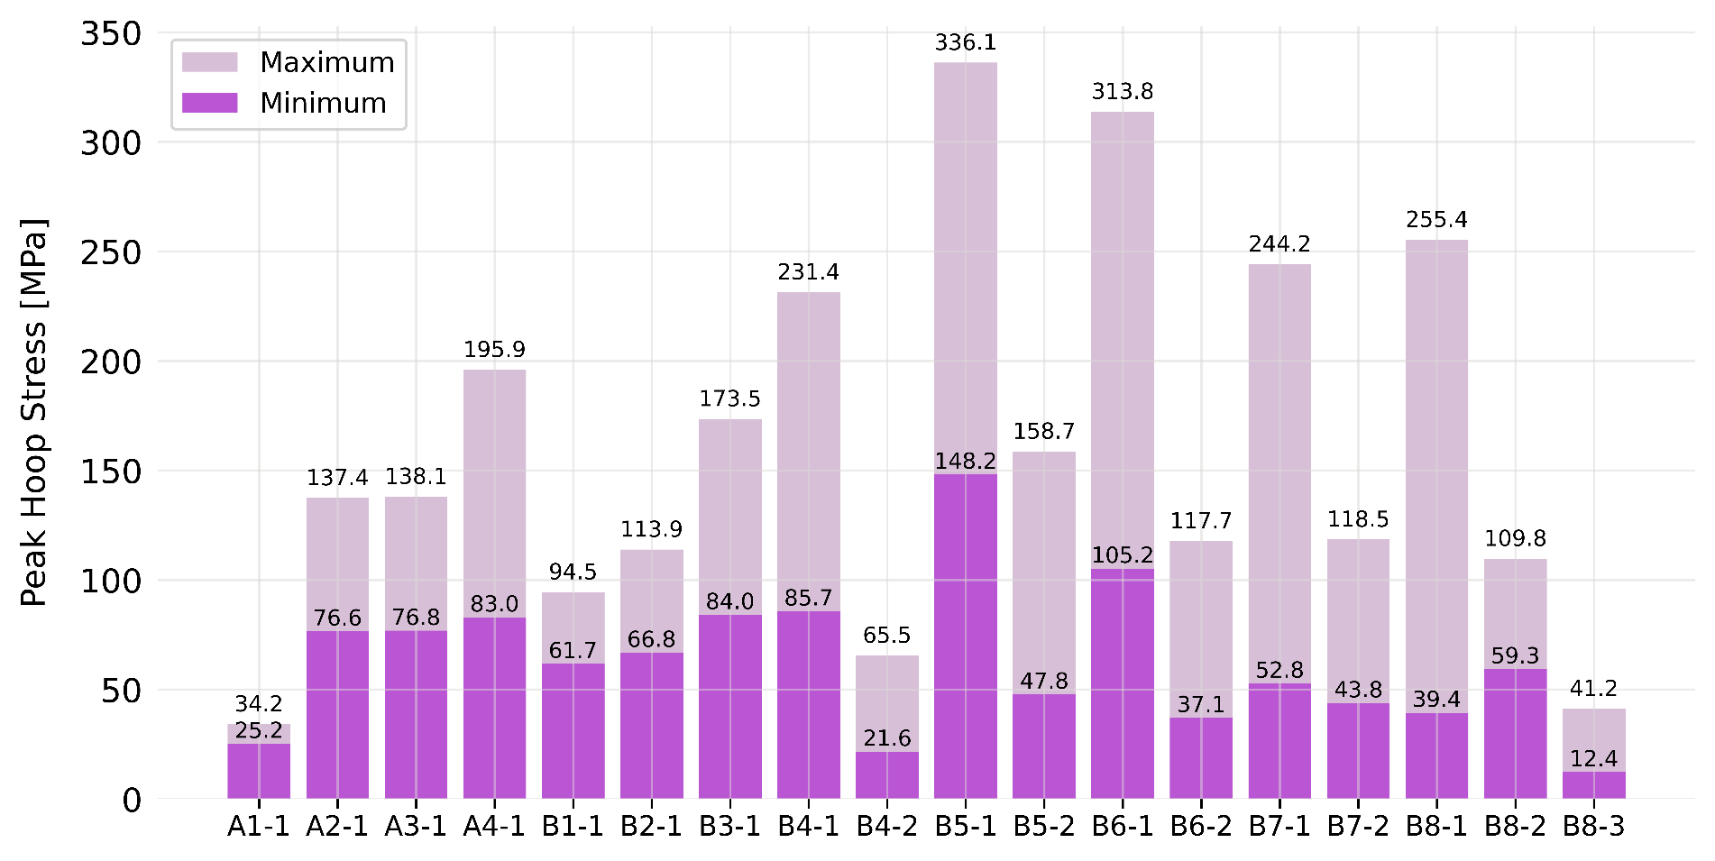
IMCC Cooling: Hardware Studies
Limitations of cooling solenoids from conductor engineering limits
Design of test stand for RF cavities in magnetic fields
Power delivery to RF cavities
Final cooling solenoid design

Slide 17
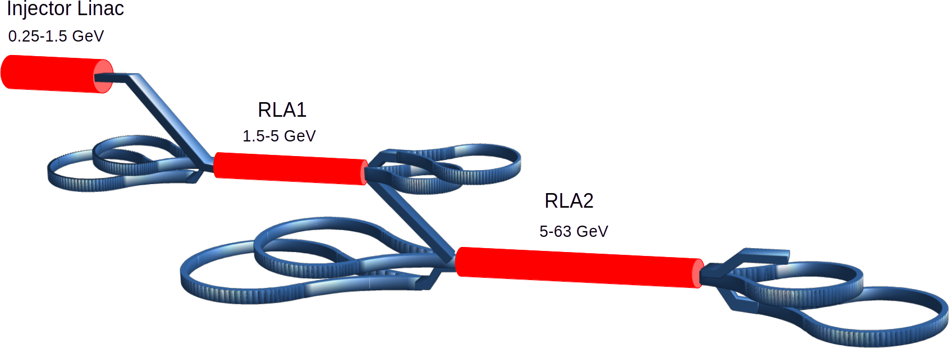
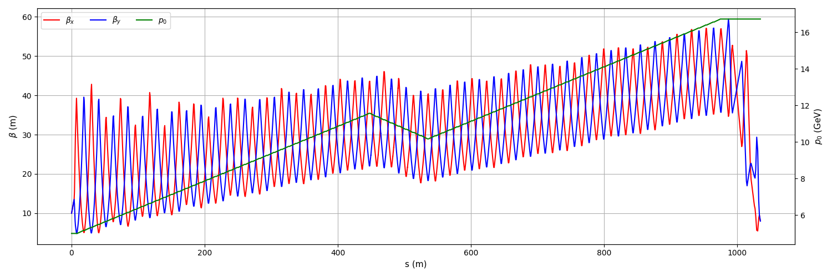
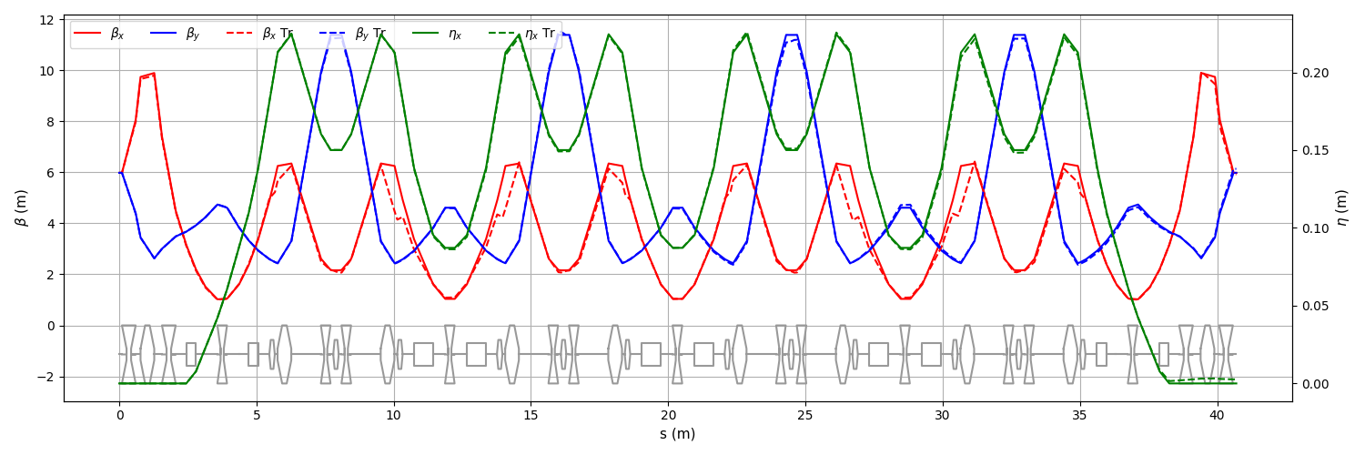
Low Energy Acceleration
Detailed studies of previous designs to 63 GeV
Add higher harmonic to linac to improve longitudinal behavior
Improved performance with more complex arc cell

Slide 18
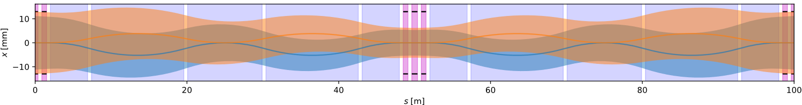
High Energy Acceleration: Hybrid Synchrotron
Need to accelerate in a ms time scale
Need a high average bend field
Alternate pulsed iron magnets with fixed field superconducting magnets
Lattice designs, unconstrained and constrained to Fermilab site

Slide 19
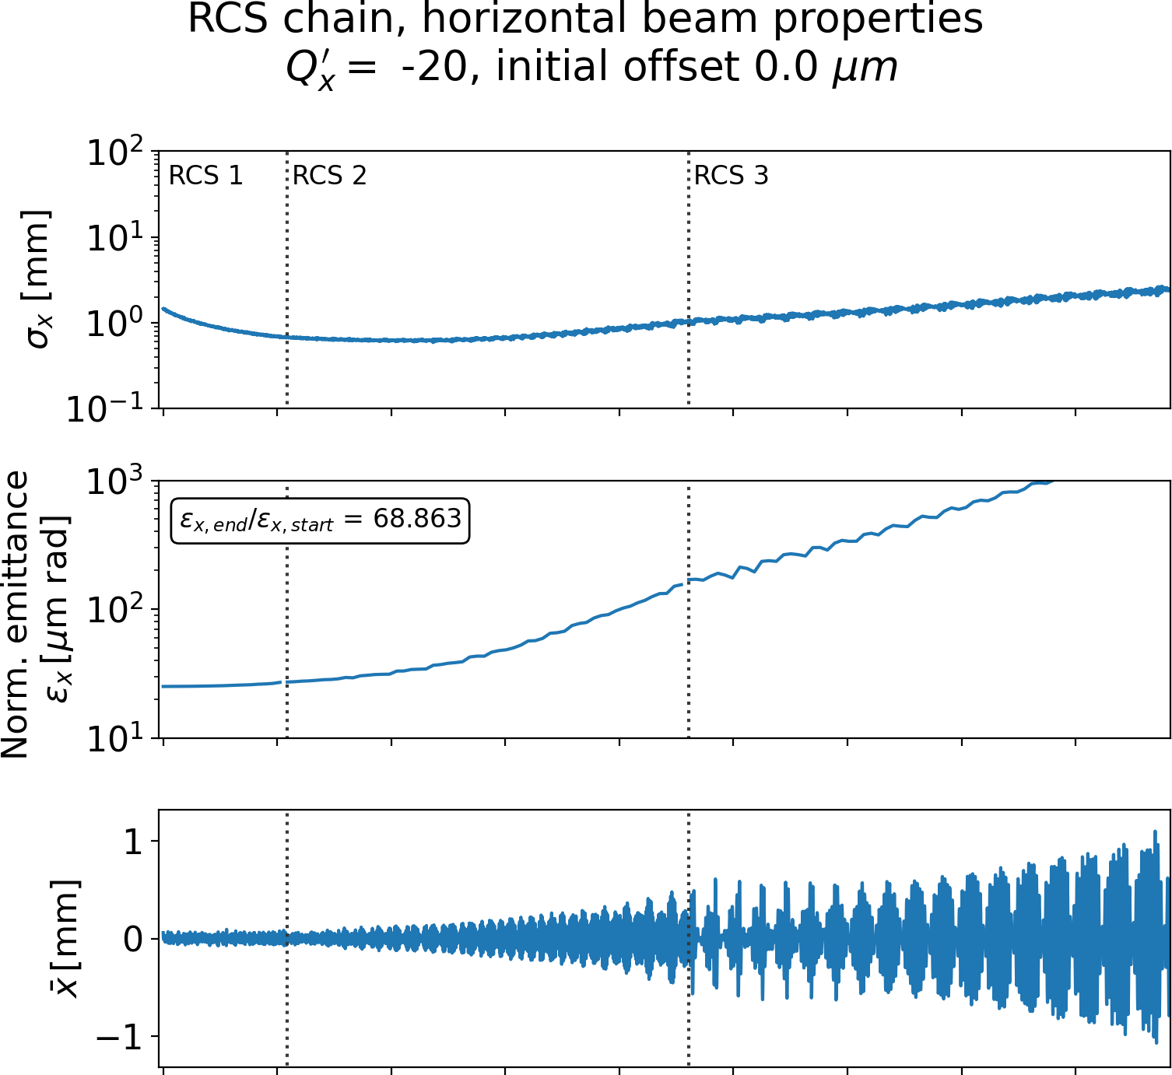
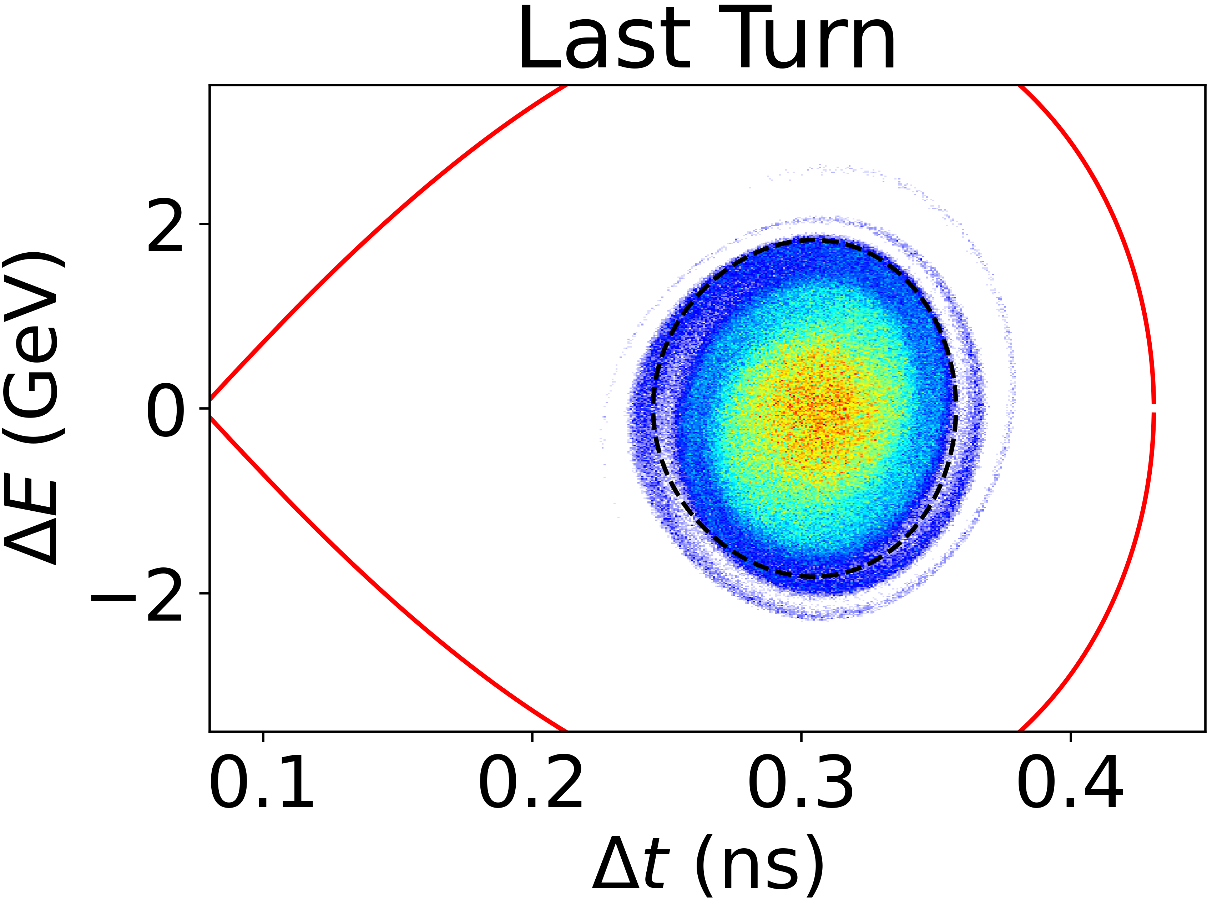
High Energy Acceleration: Hybrid Synchrotron
Extensive simulation work
  Collective effects from RF
  Effect of chromaticity (sextupoles)
Longitudinal dynamics

Slide 20
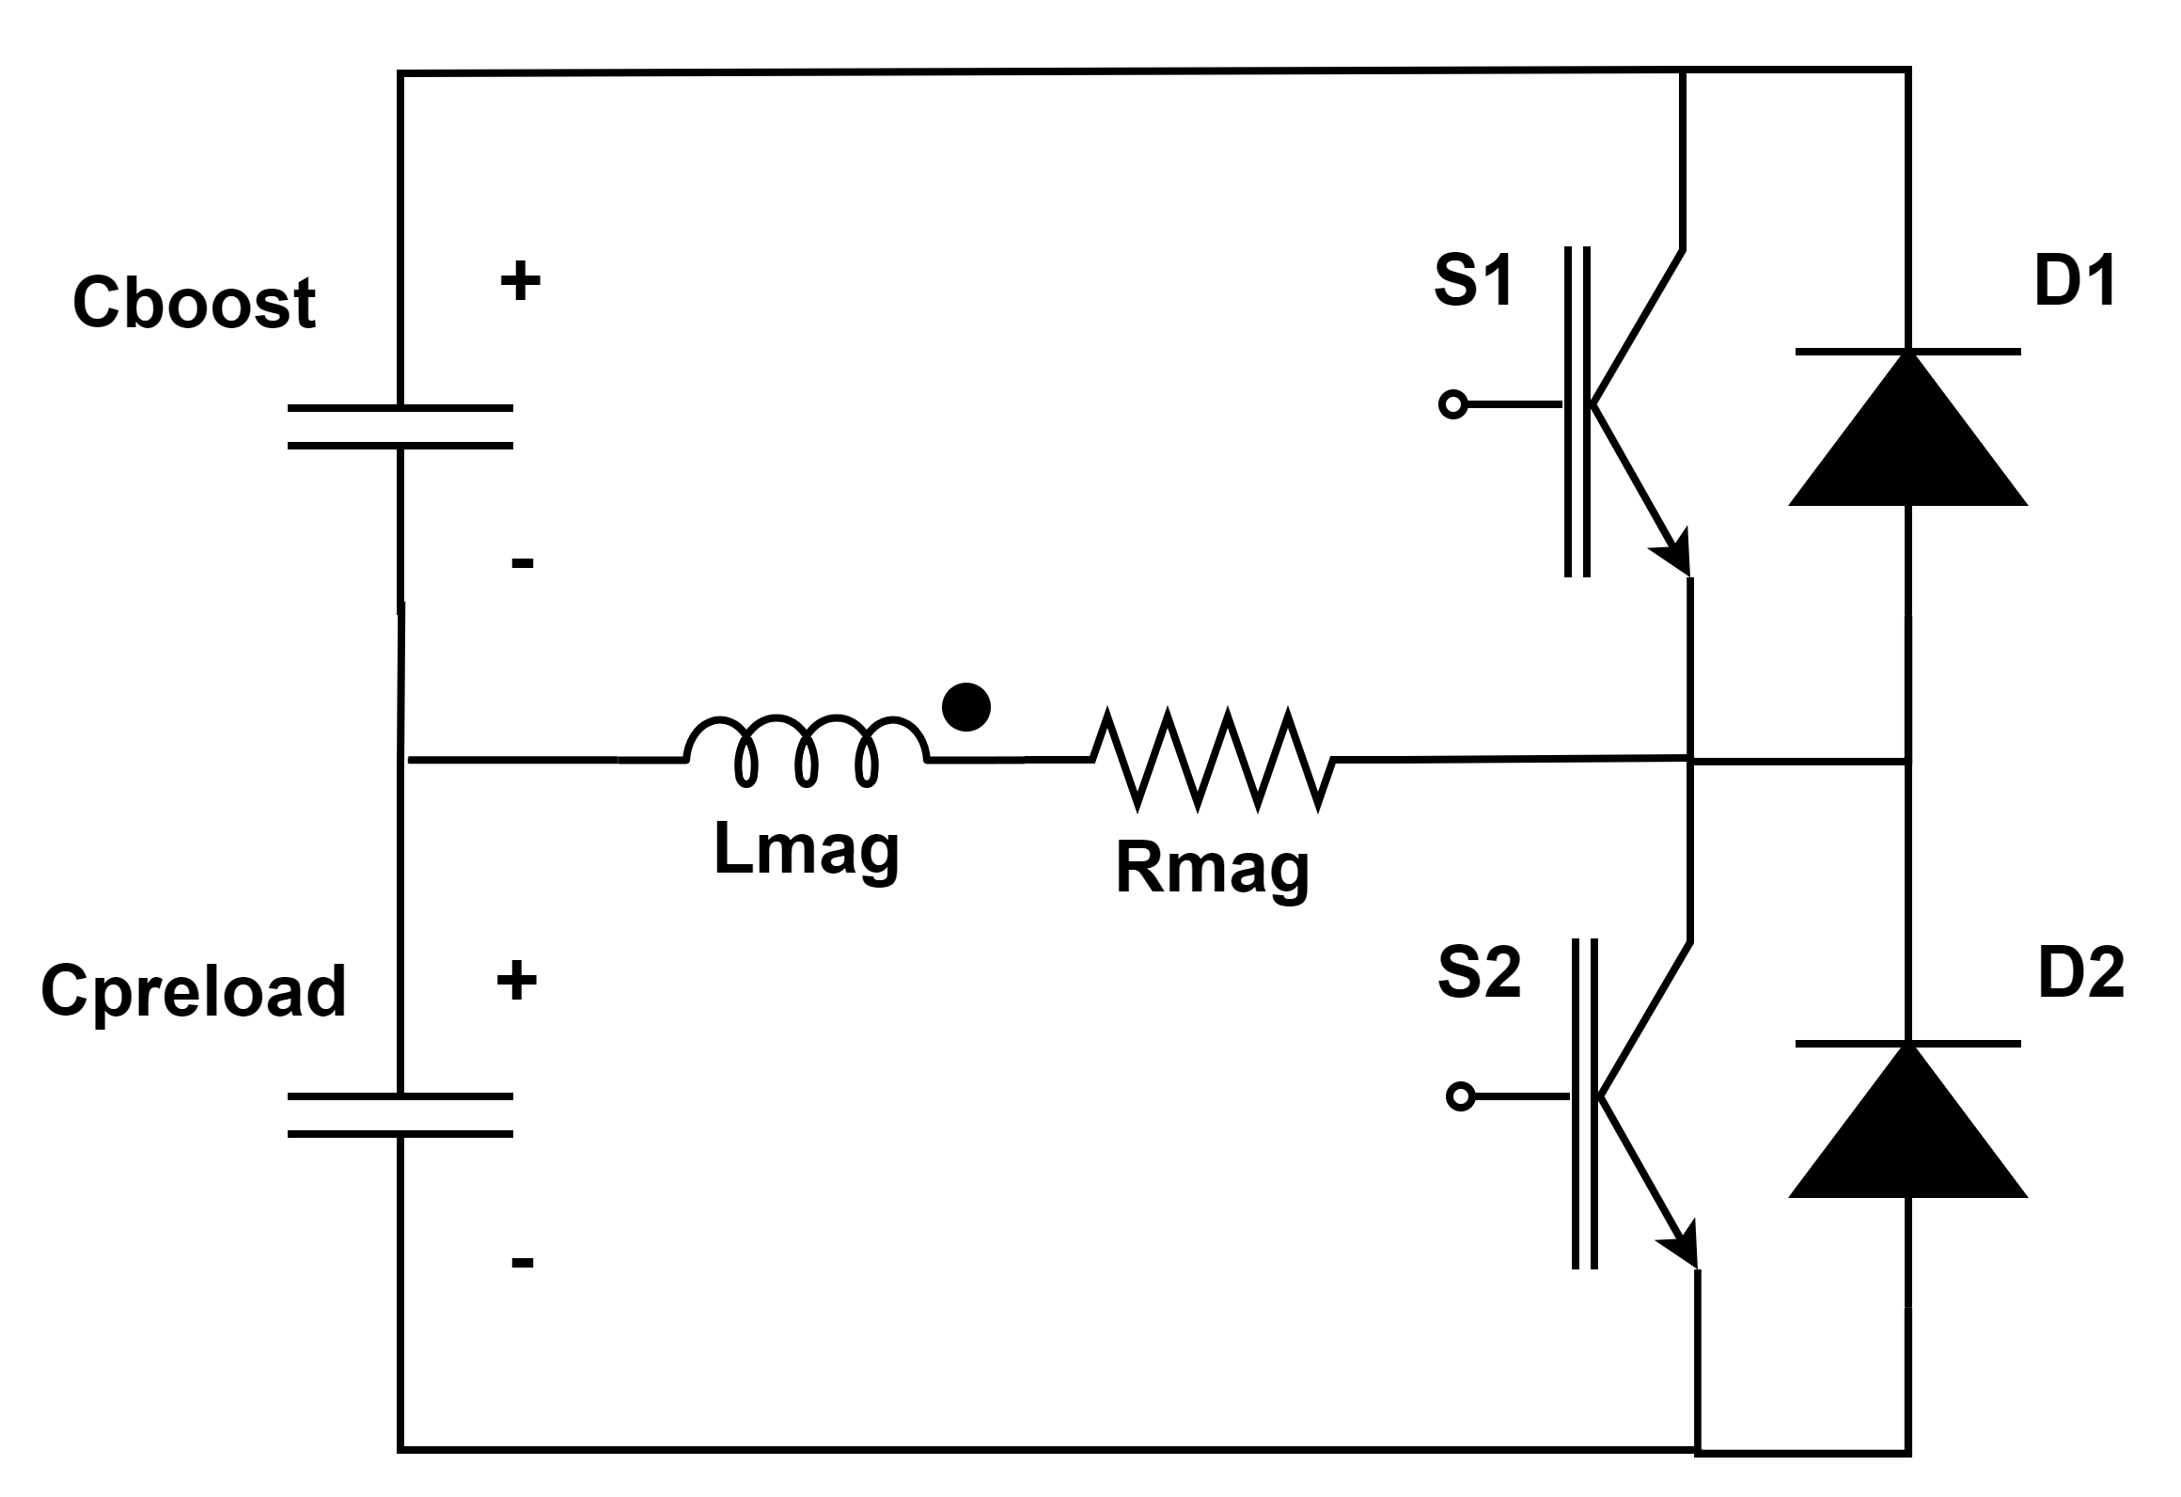
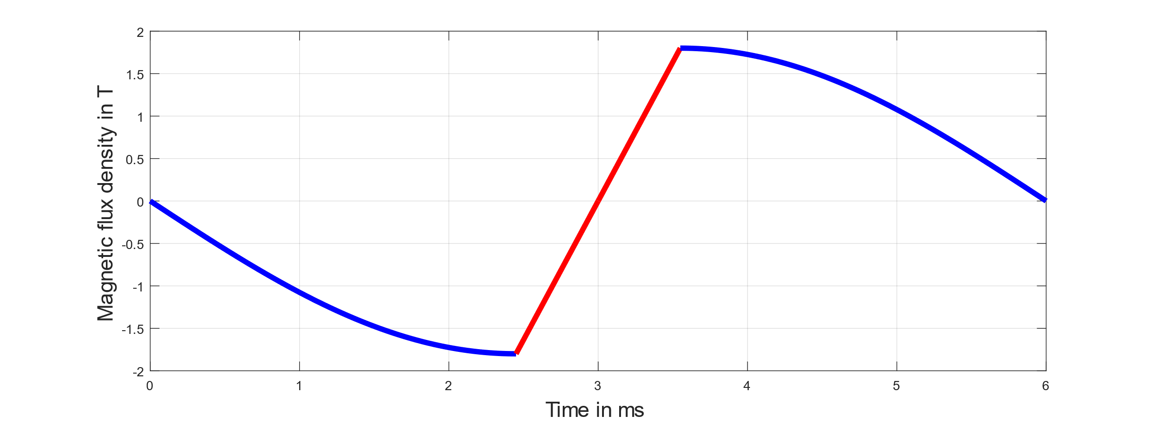
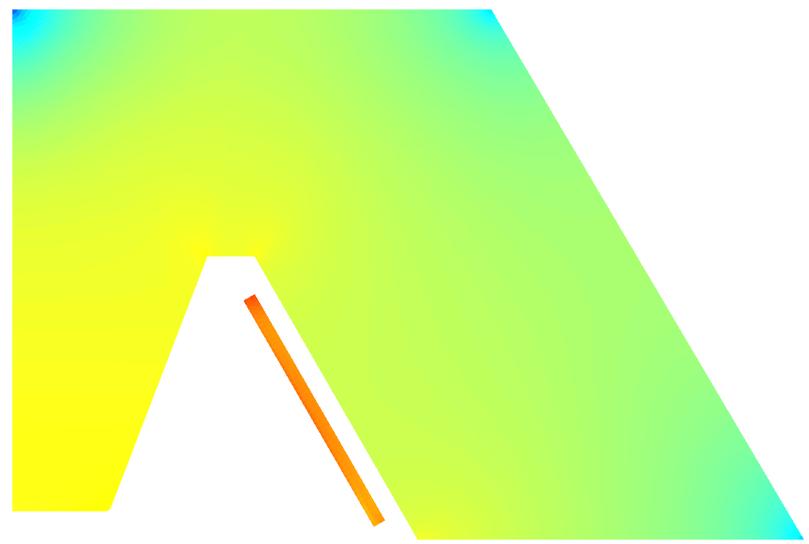
Hybrid Synchroton: Magnets and Power Supplies
Studies of iron magnet designs
Proposals for magnet power supplies
Beam simulations incorporating power supply imperfections
Proposals for hardware studies

Slide 21
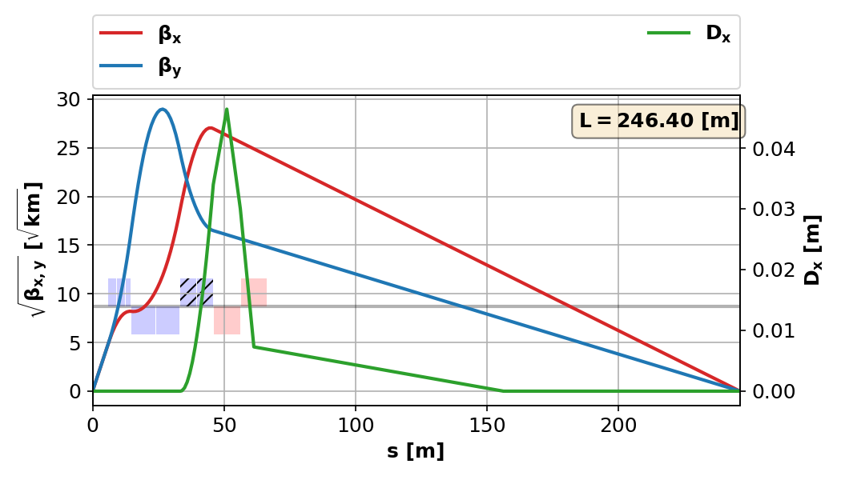
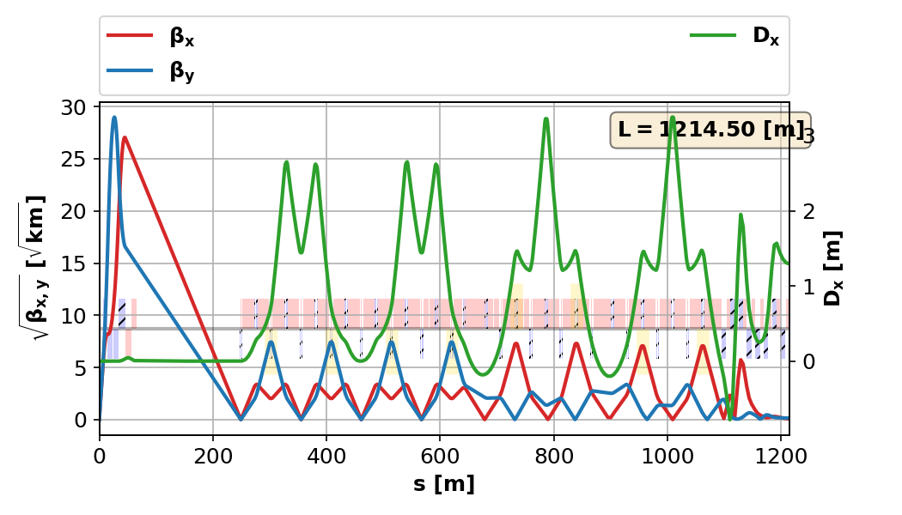
Collider Ring Design
Updated design: IR, chromatic correction, arcs
Simulations ongoing, beam-beam, collective, etc.

Slide 22
Many Other Activites
Backgrounds from muon decays in detector
Superconducting magnet studies throughout the machine
  Collider ring and target magnets amongst the most challenging
Studies of all RF systems
Focus on prototyping/demonstration facilities
  Most prominent is a cooling demonstrator with beam
  We’ve also discussed a 1.5-cell cooling cell prototype focused on engineering issues
  RF in magnetic field
  Pulsed magnets

Slide 23
The Muon-Ion Collider
Review Christoph Montag’s talk at the RICE Workshop: https://indico.cern.ch/event/1276216/contributions/5630563/
Important to re-think the machine parameters based on his discussions
Primary issue to face: difference in EIC and muon collider operating modes: short, high-intensity vs. long-lived
  Each muon bunch injection disrupts the proton/ion bunch it collides with
  Muons would be fine, you throw them away. Hadron bunch needs to be kept for hours, only cools slowly.
Initial impressions are that there would be significantly less luminosity than anticipated

Slide 24
Summary
P5 Support of 10 TeV “pCoM” colliders is expected to lead to a significant program in muon collider studies
The IMCC continues to make significant advances in muon accelerator design
We hope to have increased US participation in these studies over the next years
A muon collider facility could also host a muon-ion collider
  The current parameter set will need significant re-thinking to understand the potential performance of such a machine

