Slide 1
New Factor Potentially Affecting the Extraction of the Nuclear Charge Radii For a Number of Nuclei
Eugene Oks
Auburn University, USA

Slide 2
In the range of the nuclear charge 10 < Z < 80 there are seven doubly-magic (and thus spherical) nuclei: ⁴⁰Ca₂₀, ⁴⁸Ca₂₀, ⁴⁸Ni₂₈, ⁵⁶Ni₂₈, ⁷⁸Ni₂₈, ¹⁰⁰Sn₅₀, and ¹³²Sn₅₀ (tin).
In our paper published in 2023 in Nuclear Physics A (1040, 122758), it was shown that heavy hydrogenic ions containing one of these nuclei, have two flavors: the regular, well-known type and the new, second flavor.
This is similar to the existence of the Second Flavor of Hydrogen Atoms (SFHA) confirmed by four different types of atomic or molecular experiments, and evidenced by two different types of astrophysical observations – see, e.g., review in New Astronomy Reviews 2023, 96, 101673.
The SFHA have only the S-states: so, in accordance to the selection rules of quantum mechanics they do not couple to the electromagnetic radiation (except for the 21 cm spectral line): they remain dark.
The existence of the SFHA potentially affects the proton charge radius deduced from the electron-hydrogen scattering (Symmetry 2023, 15, 1760) – as it was reported at the 25th European Conference on Few-Body Problems in Physics in 2023 in Mainz.

Slide 3
Similarly, the second flavor of heavy ions has only the S-states (so that these ions remain dark just as the SFHA).
As an application of this fundamental result, we referred to the comparison between the nuclear charge radius r_{n,μ}, determined experimentally by the muonic x-ray transition energies, and the nuclear charge radius r_{n,e}, determined experimentally from the elastic electron scattering.
Below is some background information.

Slide 4
Analysis of atomic experiments related to the distribution of the linear momentum in the ground state of hydrogen atoms revealed a huge discrepancy.
Namely, the ratio of the experimental and previous theoretical results was up to tens of thousands (as pointed out in the paper in J. Phys. B: At. Mol. Opt. Phys. 2001, 34, 2235).

Slide 5
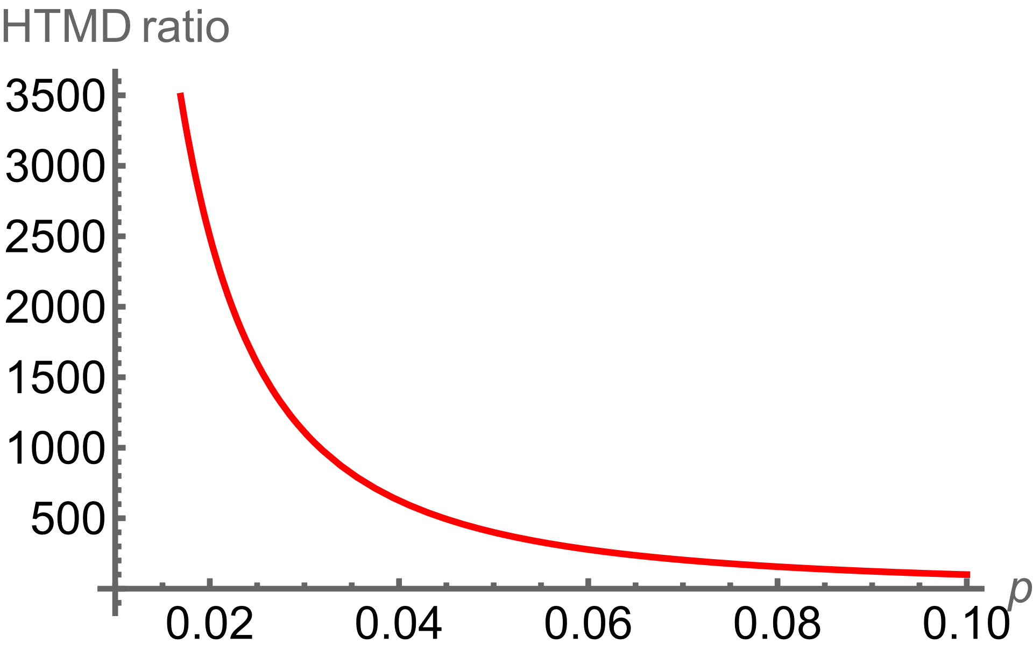
The figure above shows the ratio of the theoretical High-energy Tail of the linear Momentum Distribution (HTMD), calculated by Fock (1935), to the actual HTMD deduced from the analysis of atomic experiments for a great variety of collisional processes between hydrogen atoms and electrons or protons (Gryzinski, 1965).
The linear momentum p is in units of m_{e}c, where m_{e} is the electron mass and c is the speed of light.
It is seen that the relative discrepancy between the theory and experiments can reach many orders of magnitude: 3 or 4 orders of magnitude (!) – in the relevant range of p: m_{e}e²/ħ < p << m_{e}c.
Fock, Z. Physik 1935, 98, 145
Gryzinski, Phys. Rev. 1965, 138, A336

Slide 6
This was the motivation behind my theoretical results from that paper of 2001 in the JPB.
The standard Dirac equation of quantum mechanics for hydrogenic atoms or ions has two analytical solutions: 1) a weakly singular at small r; 2) a more strongly singular at small r.
The radial part R_{Nk} (r) of the coordinate wave functions has the following behavior at small r :
R_{Nk} (r) ∝ 1/r ^{1 + q} , q = 1±(k² – Z²α²)^{1/2,} (1)
Here N is the radial quantum number, Z is the nuclear charge, α is the fine structure constant, and k is the eigenvalue of the operator
K = β(2Ls +1) (2)
that commutes with the Hamiltonian (β is the Dirac matrix of the rank 4).
For the ground state (k = –1, N = 0) Eq. (1) reduces to
R_{0,–1} (r) ∝ 1/r ^{q} , q = 1 ± (1 – Z²α²)^{1/2} . (3)
So, the 1st solution has only weak singularity: q ≈ Z²α²/2 ≈ 0.000027Z² (the “regular” solution, for brevity).
The 2nd solution is really singular (q ≈ 2) and is usually rejected (the normalization integral diverges at r = 0).

Slide 7
p
The situation changes after allowing for the finite nuclear size.
For models where the charge distribution inside the nucleus (the proton) is assumed to be either a charged spherical shell or a uniformly charged sphere, the 2nd solution outside the proton is justifiably rejected: it cannot be tailored with the corresponding regular solution inside the nucleus.
In that paper of 2001 in the JPB, there was derived a general class of potentials inside the nucleus, for which the singular solution outside the nucleus can be actually tailored with the corresponding regular solution inside the nucleus at the boundary.
In particular, this class of potentials includes those corresponding to the charge distributions that have a peak at r = 0.
From experiments on the elastic scattering of electrons on protons (see, e.g., Simon et al (1980) and Perkins (1987)), it is known that the charge distribution inside protons does have a peak at r = 0.
Simon et al, Nucl. Phys. 1980, A333, 381
Perkins, Introduction to High Energy Physics; Addison-Wesley: Menlo Park, CA, USA, 1987, Sect. 6.5.

Slide 8
Thus, the regular solution inside the proton can be tailored with the singular solution outside the proton at the boundary.
So, in that paper of 2001 in JPB, there was derived analytically the corresponding wave function.
As a result, the huge multi-order discrepancy between the experimental and theoretical HTMD got completely eliminated.
The reason: for the singular solution outside the proton, a much stronger rise of the coordinate wave function toward the proton at small r translates into a much slower fall-off of the wave function in the p-representation for large p (according to the properties of the Fourier transform) than the scaling ~ 1/p⁶ predicted by Fock (1935).
Oks, J. Phys. B: At. Mol. Opt. Phys., 2001, 34, 2235

Slide 9
The corresponding derivation in that paper of 2001in JPB used only the fact that in the ground state the eigenvalue of the operator K is
k = –1.
Therefore, actually the corresponding derivation is valid not just for the ground state, but for any state of hydrogen atoms characterized by the quantum number k = –1.
Those are S-states (l = 0), specifically ²S_{1/2} states.
So, both the regular exterior solution and the singular exterior solution are legitimate not only for the ground state 1²S_{1/2}, but also for the states 2²S_{1/2}, 3²S_{1/2}, and so on, i.e., for the states n²S_{1/2}, where n = N + |k| = N + 1 is the principal quantum number ( n = 1, 2, 3, …).
Both the regular exterior solution corresponding to q = 1 – (1 – α²)^{1/2} and the singular exterior solution corresponding to q = 1 + (1 – α²)^{1/2} are legitimate also for the l = 0 states of the continuous spectrum.
All of these additional results were presented in our paper of 2020 in Research in Astronomy and Astrophysics (2020, 20(7), 109) published by the British IOP Publishing, where these results were applied to solving one of the dark matter puzzles. 20(7), 109

Slide 10
This second kind of hydrogen atoms having only the s-states was later called the Second Flavor of Hydrogen Atoms (SFHA). Here is why:
Both the regular and singular solutions of the Dirac equation outside the proton correspond to the same energy.
Since this means the additional degeneracy, then according to the fundamental theorem of quantum mechanics, there should be an additional conserved quantity.
In other words: hydrogen atoms have two flavors, differing by the eigenvalue of this additional, new conserved quantity: hydrogen atoms have flavor symmetry (Oks, Atoms 2020, 8, 33).
It is called so by analogy with quarks that have flavors: for example, there are up and down quarks.
For representing this particular quark flavor symmetry, there was assigned an operator of the additional conserved quantity: the isotopic spin I – the operator having two eigenvalues for its z-projection: I_{z} = 1/2 assigned to the up quark and I_{z} = –1/2 assigned to the down quark.

Slide 11
o
Thus, the elimination of the huge multi-order discrepancy between the theoretical and experimental distributions of the linear momentum in the ground state of hydrogen atoms constituted the first experimental evidence of the existence of the SFHA – since no alternative explanation for this huge discrepancy was ever provided.
There are also three additional experimental evidences from three different kinds of atomic experiments.
For all them, the SFHA-based explanation removed large discrepancies (up to a factor of two) between the experimental and previous theoretical results, while alternative explanations were never provided.
Thus, the SFHA does exist.

Slide 12
Now let us proceed to heavy nuclei.
In 1968 Bethe published the Thomas-Fermi theory for large nuclei (Phys. Rev. 167 (1968) 87).
The resulting Charge Density Distribution (CDD) had a plateau near the origin and then fell off towards the periphery.
In the intervening dozens of years, lots of further calculations of the CDD were performed for various nuclei by the Thomas-Fermi method, or by the extended Thomas-Fermi method, or by other methods.
These calculations resulted in the CDD having either a peak or a plateau (or nearly a plateau) near the origin and falling off to the periphery.
The exception is very heavy nuclei of the nuclear charge Z > 80, where the CDD exhibits a lateral maximum.

Slide 13
So, one could state that for the range 10 < Z < 80 (10 being conditionally chosen as the lower limit of validity of statistical approaches), the CDD in the nuclei has either a peak or a plateau (or nearly a plateau) near the origin and falls off to the periphery.
This kind of CDD yields potentials satisfying the condition (derived in my paper of 2001 quoted above), under which the singular solution of the Dirac equation outside the nucleus can be matched with the regular solution inside the nucleus for the S-states of the corresponding hydrogenlike ion.
This constitutes the theoretical prediction of possible second flavor of relatively heavy ions (SFHI).
In other words, relatively heavy ions may have flavor symmetry – just as hydrogen atoms really have.
This theoretical result has the fundamental importance in its own right.
Also, it could encourage experimentalists to perform experiments (e.g., analogous but not limited to those that proved the existence of the second flavor of hydrogen atoms) for the verification of the existence of the SFHI.
Below we provide an example dealing with the influence of the SFHI on the experimental determination of the nuclear charge radius.

Slide 14
Let us start by recalling the puzzle concerning the proton charge radius r_{p}, existing since year 2010 when the formfactor experiment by the group from Mainz (Bernauer et al, Phys. Rev. Lett. 105 (2010) 242001) yielded r_{p} ≈ 0.88 fm in distinction to the experiment based on the muonic hydrogen spectroscopy that resulted in r_{p} ≈ 0.84 fm (Pohl et al, Nature 466 (2010) 21).
In the subsequent years, various types of other experiments were conducted in this respect (such as, e.g., Zhan et al, Phys. Lett. B 705 (2011) 59; Antognini et al, Science 339 (2013) 417; Mihovilovic et al, Phys. Lett. B 771 (2017) 194; Fleurbaey et al, Phys. Rev. Lett. 120 (2018) 183001; Bezginov et al, Science 365 (2019) 1007; Xiong et al, Nature 575 (2019) 147; Brandt et al, Phys. Rev. Lett. 128 (2022) 023001).
Nevertheless, the ambiguity has not been eliminated, this fact being underscored in several reviews (e.g., Zhan et al, Phys. Lett. B 705 (2011) 59; Bernauer, EPJ Web of Conferences 234 (2020) 01001; Gao & Vanderhaenghen, Rev. Mod. Phys. 94 (2022) 015002).

Slide 15
In our paper of 2022 (Foundations, 2, 912) there was analyzed the situation where in addition to the muonic hydrogen spectroscopy experiments there would be also experiments on the elastic scattering of muons on hydrogen atoms.
It was pointed out that if there would be a difference in r_{p} , determined by the two different types of experiments, then the two results could be reconciled if there was a relatively small admixture of the second flavor of muonic hydrogen atoms in the experimental gas.
In our subsequent paper of 2023 (Symmetry, 15, 1760) there was analyzed the effect of the flavor symmetry of electronic hydrogen atoms on the corresponding elastic scattering cross-section and on the proton charge radius r_{p} deduced from the cross-section.
The obtained analytical results were used for reconciling two distinct values of r_{p} obtained in different electron elastic scattering experiments: the value of r_{p} = 0.88 fm from experiments by Bernauer et al (Phys. Rev. Lett. 2010, 105, 242001), by Zhan et al (Phys. Lett. B 2011, 705, 59), and by Mihovilovic et al (Eur. Phys. J. A 2021, 57, 107) with the value of r_{p} = 0.84 fm from the experiment by Xiong et al (Nature 2019, 575, 147), which is by about 4.5% smaller than 0.88 fm.
It was shown that if the ratio of the second flavor to the usual hydrogen atoms in the experimental gas would be about 0.3, then the extraction of r_{p} from the corresponding cross-section would yield by about 4.5% smaller value of r_{p} compared to its true value, which is the larger of the two.

Slide 16
In our other paper of 2023 (Nuclear Phys. A, 1040, 122758) there was provided a similar example illustrating the possible influence of the second flavor of heavy ions (SFHI) on the experimental determination of the nuclear charge radius for various nucleons.
Namely, there was consider a mixture of the SFHI in the ratio ε to the usual heavy hydrogenlike ions of the same mass and of the same nuclear charge Z.
In this situation, outside the nucleus, the radial part of the Dirac bispinor for the ground state can be written as follows:
f(r) ≈ – 2b^{5/4}{1/r^{b/2} – ε[R²/(5br^{2-b/2})]}/(1 + ε²)^{1/2}, (1)
g(r) ≈ 4b^{3/4}{1/r^{b/2} – ε[R²/(10br^{1-b/2} )]}/(1 + ε²)^{1/2}, (2)
where b = Z²α², α being the fine structure constant.
In Eqs. (1) and (2), R is the nucleon “sphere” radius, that is, the boundary between the regular solution of the Dirac equation in the interior region and the singular solution of the Dirac equation in the exterior region.
The proportionality relation between R and the nucleon charge radius r_{n} is specified later on.

Slide 17
We denoted as Δσ the change of the cross-section for the elastic scattering
of electrons on the relatively heavy hydrogenlike ions – the change caused by the presence of the SFHI.
If for the same nucleus there is a difference between the nuclear charge radius, determined experimentally by the muonic x-ray transition energies, and the nuclear charge radius, determined experimentally from the elastic electron scattering, such as the ratio of the latter to the former is (1 – a), where a << 1 (what could be the real situation, as specified below), then we sought the value of ε satisfying the following equation:
Δσ(ε, Z, R) = Δσ[0, Z, (1 – a)R].
To put it another way, the goal of solving the above equation with respect to ε was to demonstrate that from the same experimental cross-section, one can deduce either the smaller value of R while disregarding a possible share of the SFHI in the experimental target (i.e., at ε = 0) or a higher value of R at some finite value of ε.
We obtained the analytical solution of that equation with respect to ε as the function of Z, R, and a.
It is illustrated in the next slide.

Slide 18
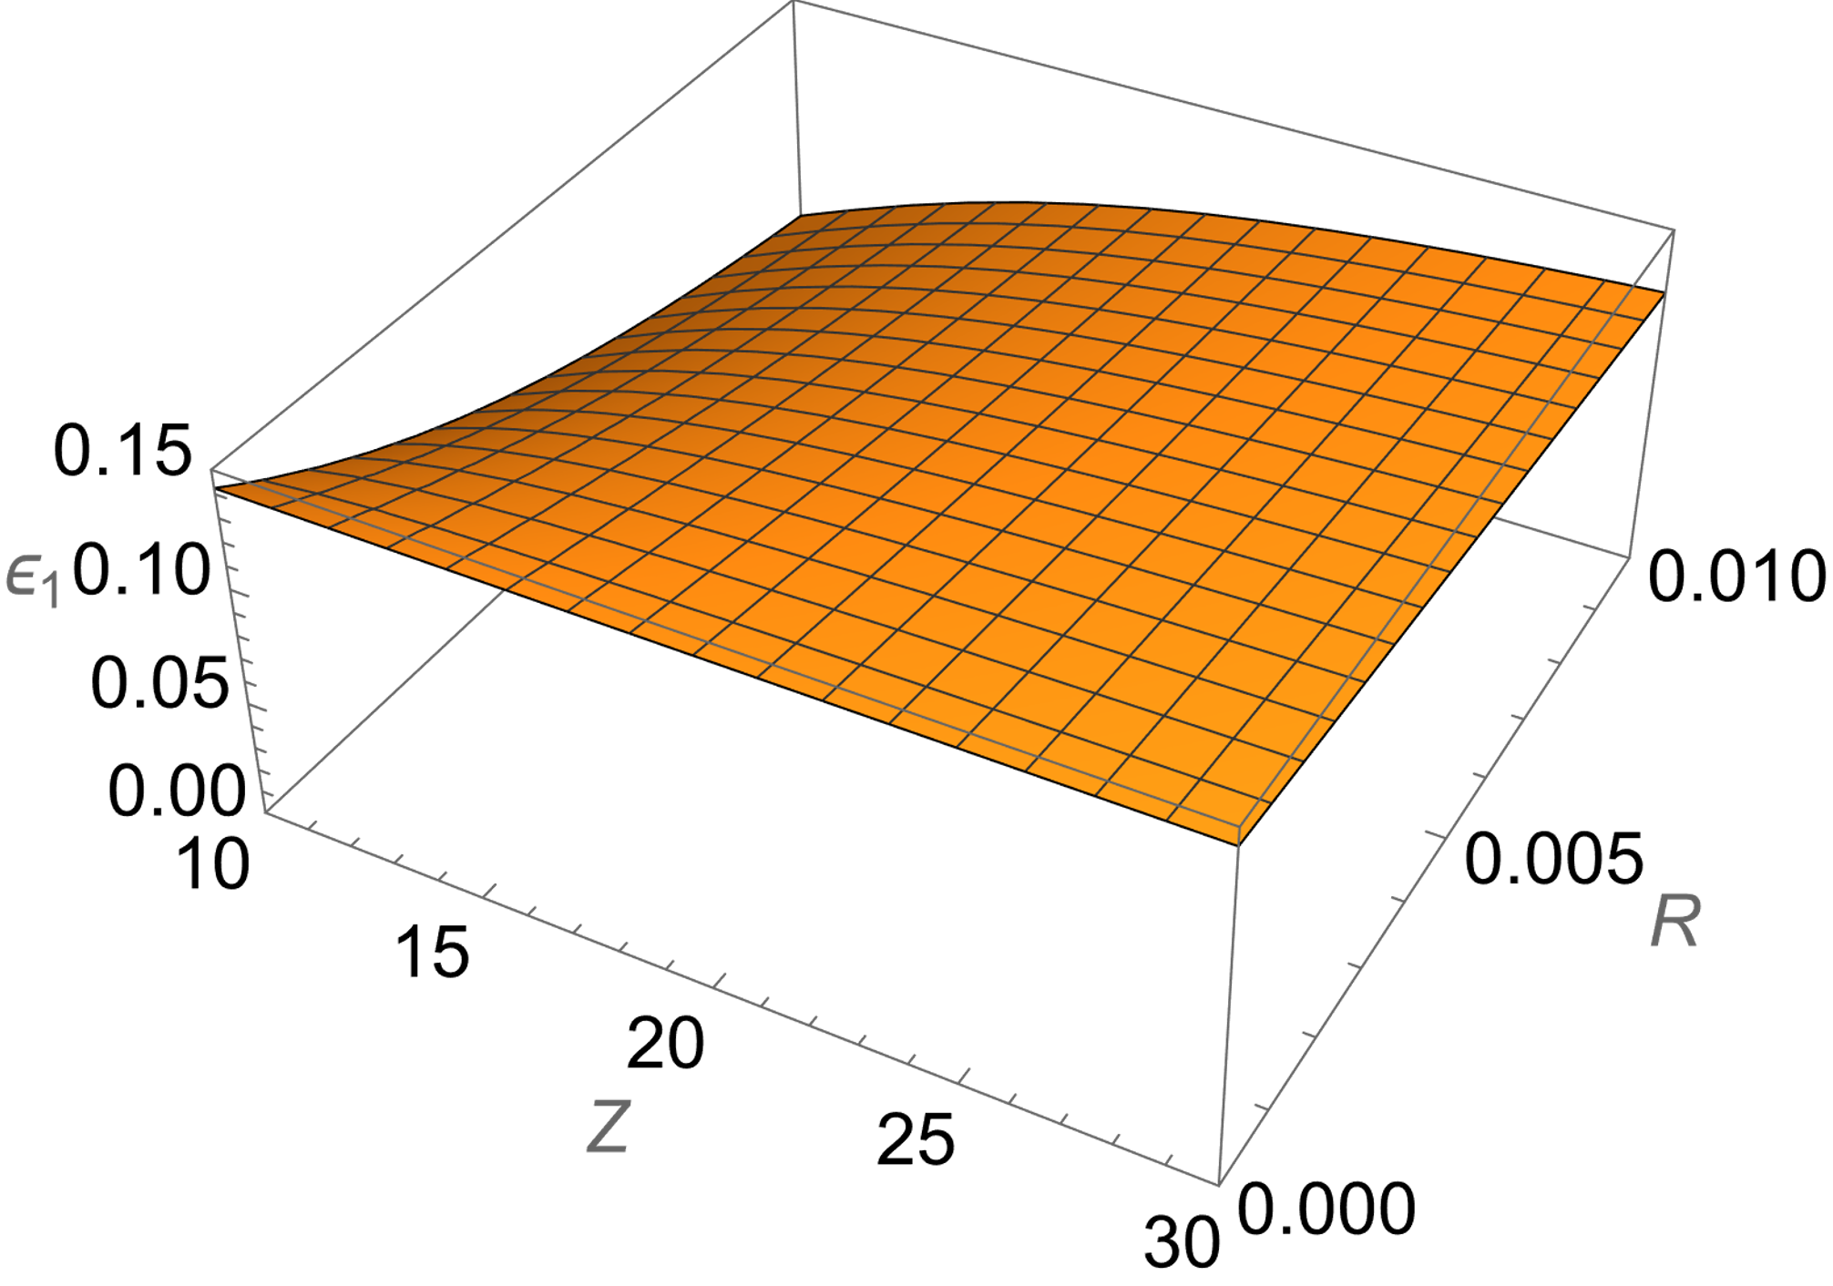
The share ε of the second flavor of the heavy ions in the experimental target, required for reconciling two different experimental values of the nuclear charge radius that are in the ratio of 0.99 to each other, versus the nuclear charge Z and the nucleon “sphere” radius R (in atomic units). The ratio 0.99 corresponds to the experiments discussed below.

Slide 19
For connecting the above illustrative example with reality, I refer to the actual comparison between the nuclear charge radius, determined experimentally by the muonic x-ray transition energies, and the nuclear charge radius, determined experimentally from the elastic electron scattering.
The theory of the SFHI assumes the spherical shape of the nuclei, so that it is fully applicable only to the doubly-magic (and thus spherical) nuclei, which in the above range 10 < Z < 80 are the following seven nuclei: ⁴⁰Ca₂₀, ⁴⁸Ca₂₀, ⁴⁸Ni₂₈, ⁵⁶Ni₂₈, ⁷⁸Ni₂₈, ¹⁰⁰Sn₅₀, and ¹³²Sn₅₀.
To the best of my knowledge, the nuclear charge radius, determined experimentally by the two above different methods, is available only for ⁴⁰Ca₂₀ and ⁴⁸Ca₂₀.

Slide 20
For ⁴⁰Ca₂₀, the nuclear charge radius, determined experimentally by the muonic x-ray transition energies, is r_{n,μ} = 3.4813 fm (Wohlfarht et al, Phys. Rev. C 23 (1981) 533), while the experimental determination from the elastic electron scattering yielded r_{n,e} = 3.450±0.010 fm – from de Vries et al paper (Atom. Data Nucl Data Tables 36 (1987) 495536) where the latter value was deduced from the experiment by the model independent analysis using the Fourier-Bessel expansion for the charge distribution.
The difference r_{n,μ} – r_{n,e} = 0.031 fm, corresponding to ~ 1%, is well beyond the experimental error margin.
For numerically estimating the share of the SFHI in the target, I used for the nuclear charge radius r_{n} the value of 3.47 fm (which is the mean value between the two different measured values).
After the translation into the atomic units, one gets r_{n} = 0.0000656.

Slide 21
The nuclear “sphere” radius R and the nuclear charge radius r_{n} are proportional to each other.
The value of R would be by the factor of (5/3)^{1/2} greater than r_{n} (it would be equal to 0.0000847) if the nucleus would be a uniformly charged sphere (what the nucleus is not).
The actual value of R should be between 0.0000656 and 0.0000847.
The interval 0.0000656 < R_{p} < 0.0000847 yields 0.1339 < ε < 0.1340, so that
ε ≈ 0.13
regardless of the specific value of R_{p} in the above interval.

Slide 22
For ⁴⁸Ca₂₀ the results are very similar. Namely, one has r_{n,μ} = 3.482 [49] fm and r_{n,e} = 3.451±0.009 fm, the latter value being also was deduced from the experiment by the model independent analysis using the Fourier-Bessel expansion for the charge distribution.
The difference r_{n,μ} – r_{n,e} = 0.031 fm, corresponding to ~ 1%, is again well beyond the experimental error margin.
The calculations similar to those for ⁴⁰Ca₂₀, yielded the same value:
ε ≈ 0.13
Thus, in both above examples, a relatively small admixture (~10%) of the SFHI in the target reconciles the values of the nuclear charge radius, measured by two different methods, in favor of the larger value.

Slide 23
CONCLUSIONS
Within the standard quantum mechanics, we extended the legitimacy of the second analytical solution of the Dirac equation outside the nucleus (the solution singular at small r) to heavy ions.
In other words, we predicted the existence of the second flavor of heavy ions and thus the flavor symmetry of these ions.
These ions have only the S-states.
Therefore, due to the selection rules of quantum mechanics they do not couple to the electromagnetic radiation: they remain dark.
This was done within the Standard Model of particle physics and without changing physical laws.
This theoretical result has the fundamental importance in its own right.
Also, it could encourage experimentalists to perform experiments (e.g., analogous but not limited to those that proved the existence of the second flavor of hydrogen atoms) for the verification of the existence of the second flavor of heavy ions.
The most probable candidates are ions whose nuclei are doubly-magic and thus spherical.

Slide 24
As an application of the above fundamental result, we referred to the comparison between the nuclear charge radius, determined experimentally by the muonic x-ray transition energies, and the nuclear charge radius, determined experimentally from the elastic electron scattering.
The comparison was possible for two spherical nuclei: for ⁴⁰Ca₂₀, as well as for ⁴⁸Ca₂₀.
In each case, the nuclear charge radius, determined experimentally
from the elastic electron scattering, turned out to be by about 1% smaller, than the nuclear charge radius, determined experimentally by the muonic x-ray transition energies, the difference being well beyond the experimental error margin.
We showed in both above examples, that a relatively small admixture (~10%) of the second flavor of heavy ions in the target reconciles the values of the nuclear charge radius, measured by two different methods, in favor of the larger value.

Slide 25
Thank you for your attention

Slide 26
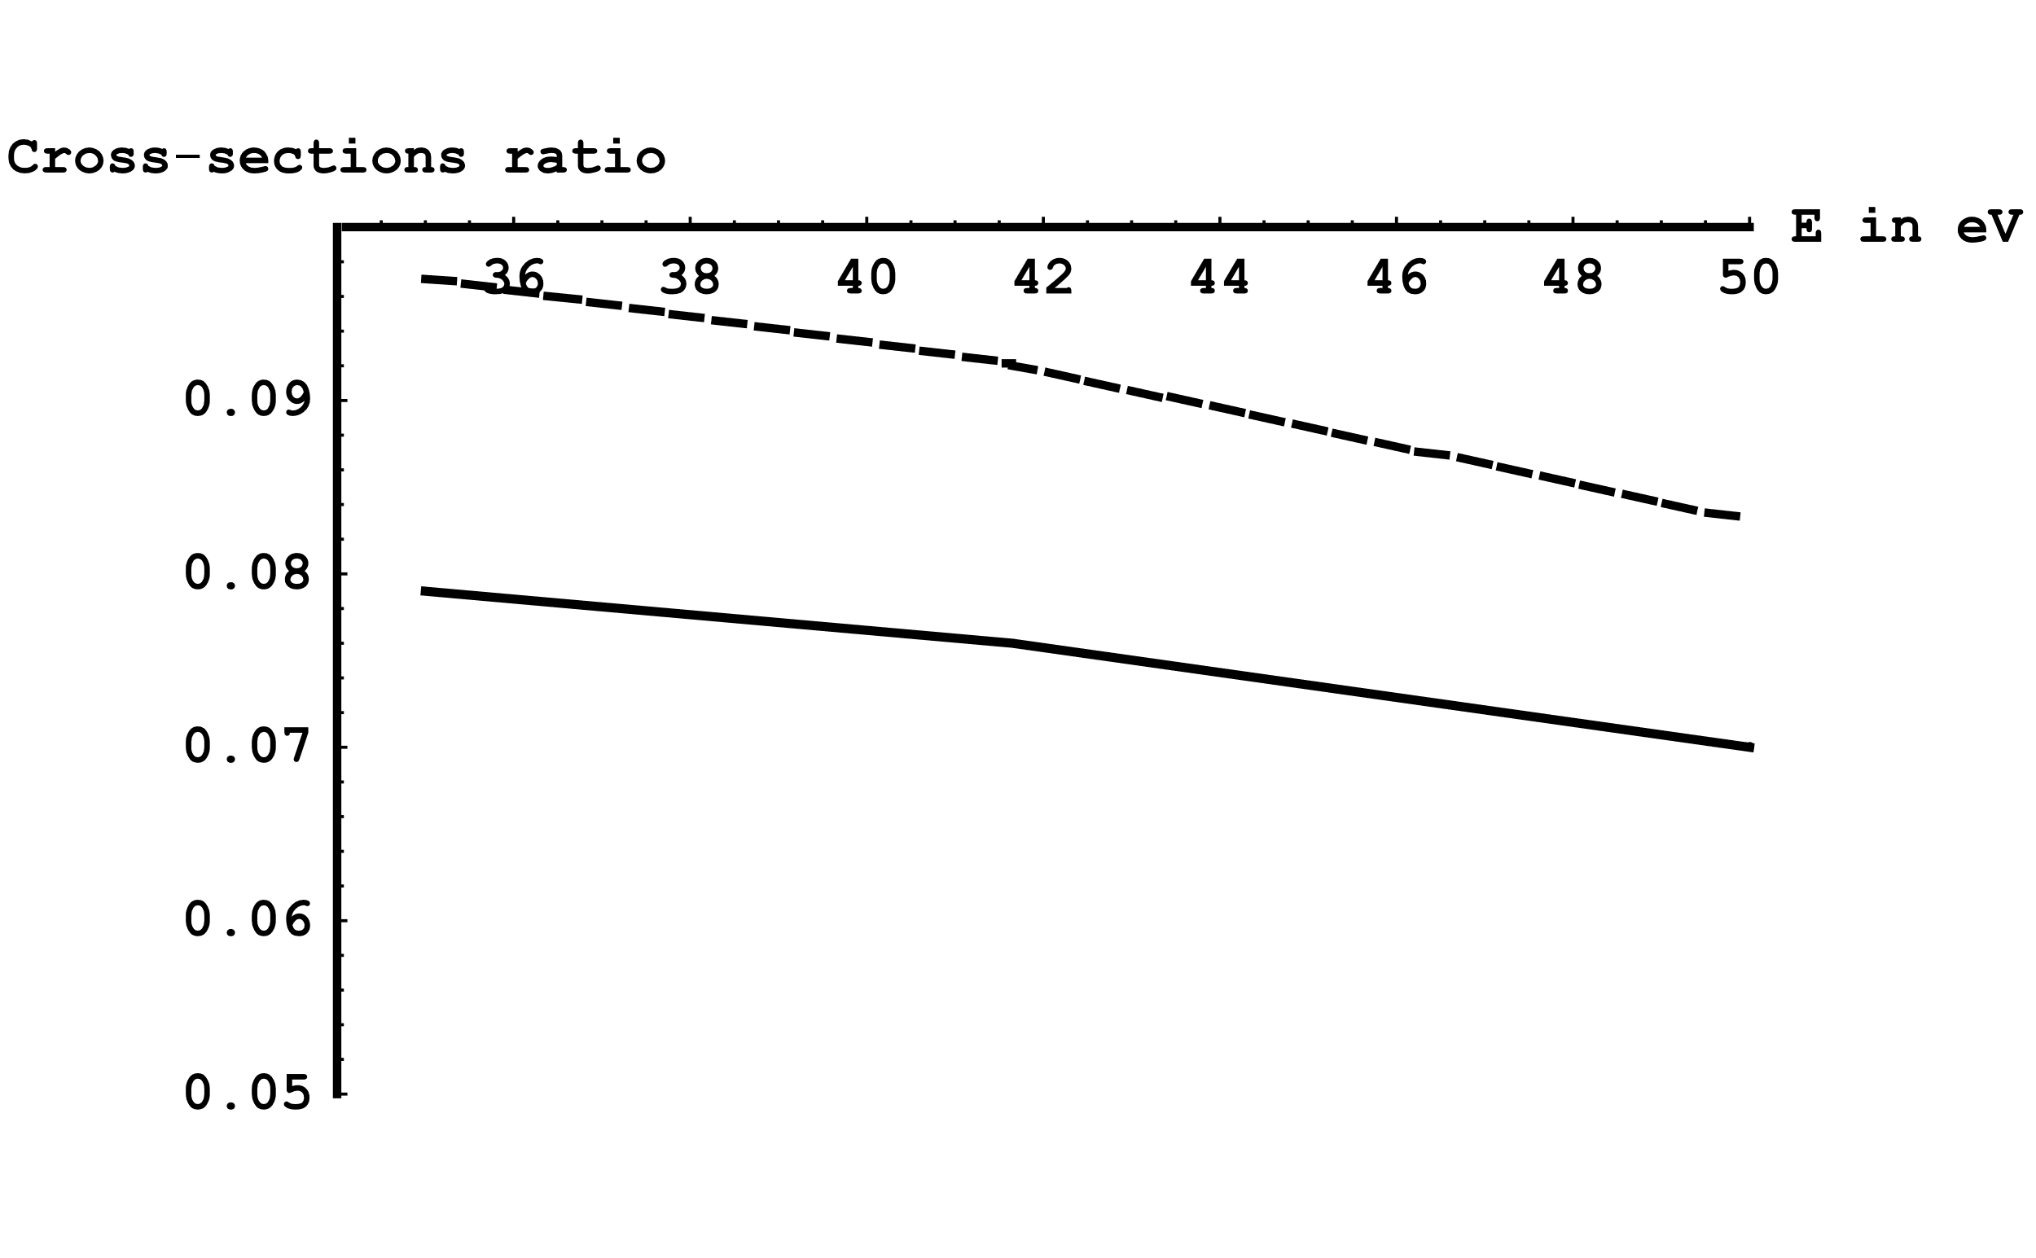
Experiments on the electron impact excitation of hydrogen atoms
The figure above presents the comparison of the experimental (Callaway and McDowell (1983)) and theoretical (Whelan et al (1987)) ratio of the cross-section σ_{2s} of the excitation of the state 2s to the cross-section σ_{2p} of the excitation of the state 2p.
The theoretical ratio (dashed line) is systematically higher than the experimental ratio (solid line) by about 20% - far beyond the experimental error margins of 9%.
Callaway & McDowell, Comments At. Mol. Phys. 1983, 13, 19
Whelan et al, J. Phys. B: At. Mol. Phys. 1987, 20, 1587

Slide 27
The experimental cross-section σ_{2s} for the excitation to the 2s state was determined by using the quenching technique: by applying an electric field that mixes the state 2s with the state 2p and then observing the emission of the Lyman-alpha line from the state 2p to the ground state.
The central point is the following. In the mixture of the SFHA with the usual hydrogen atoms, both the SFHA and the usual hydrogen atoms can be excited to the 2s state.
However, after applying the electric field, the mixing of the 2s and 2p states (followed by the emission of the Lyman-alpha line) occurs only for the usual hydrogen atoms.
This is because the SFHA has only the s-states, so that they do not contribute to the observed Lyman-alpha signal.

Slide 28
Therefore, measurements of the cross-section σ_{2s} in this way, should underestimate this cross-section compared to its actual value, while the cross-section σ_{2p} should not be affected by the presence of the SFHA (because it was measured directly, without applying the electric field), as I wrote in the paper in the Swiss journal Foundations (2022, 2, 541).
In that paper, I showed that the discrepancy between the experiments and the theory can be eliminated if in the experimental hydrogen gas, SFHA were present in the share ~ 40%.
No alternative explanation was ever provided.

Slide 29
The third evidence relates to experiments on the electron impact excitation of hydrogen molecules
I studied works on the excitation of the first two stable excited electronic triplet states of H₂: the state c ³Π_{u} and the state a ³Σ_{g}⁺.
The reason for the choice: the singlet states can get populated both by the direct excitation and by exchange between the incident electron and one of the molecular electrons. The triplet states can get populated only by the exchange, so that the corresponding theory is simpler for the triplet states.
I found that even the most advanced calculations - by the convergent close-coupling (CCC) method with the total number of states equal to 491 (Zammit et al, Phys. Rev. A 2017, 95, 022708) underestimate the experimental cross-sections (by Wrkich et al, J. Phys. B 2002, 35, 4695 and by Mason-Newell, J. Phys. B 1986, 19, L587) by at least a factor of two (!).

Slide 30
In my other paper in Foundations (2022, 2, 697) I showed that if in some hydrogen molecules one or both atoms would be the SFHA, then the above very significant discrepancy could be eliminated.
This is because for such “unusual” H₂ molecules, the corresponding theoretical cross-section is by a factor of three greater than for the usual H₂ molecules. Here is why:
Zammit et al (Phys. Rev. A 2017, 95, 022708) provided theoretical results not only for the convergent close-coupling method involving 491 states, but also for the CCC involving lesser number of states.
It showed that the decrease of the number of states involved in their calculations yields significantly greater excitation cross-sections than CCC(491).
This is because the less the number of states, the less are the interference effects.

Slide 31
This is the case for the “unusual” (SFHA containing) H₂ molecules: they have significantly lesser number of states (only the s-states) compared to the usual H₂ molecules.
Therefore, for such “unusual” H₂ molecules, the corresponding theoretical cross-section is by a factor of three greater than for the usual H₂ molecules.
I estimated that for eliminating that factor of two discrepancy between the experiment and the theory, the unusual hydrogen molecules should be present in the experimental gas in the share of ~ 30%.
No alternative explanation was ever provided.

Slide 32
For the lack of time, I only briefly mention the fourth experimental evidence of the existence of the SFHA: from experiments on the charge exchange between hydrogen atoms and low energy protons
The experimental cross-sections (Fite et al, Proc. Royal Soc. 1962, A268, 527) are noticeably greater than the theoretical ones by Dalgarno-Yadaf, Proc. Phys. Soc. (London) 1953, A66, 173).
Again, this discrepancy can be eliminated if the SFHA was present in the experimental gas (Oks, Foundations 2021, 1, 265).
The reason: the cross-section of the charge exchange with low energy protons is larger for the SFHA than for the usual hydrogen atoms.

Slide 33
The cross-section for the resonant charge exchange is (roughly) inversely proportional to the square of the ionization potential U_{ioniz} from the particular atomic state.
For the usual hydrogen atoms, U_{ioniz} increases due to the Stark shift by the field of the incoming proton.
However, the energy levels of the SFHA do not shift in the electric field (no Stark effect) – because of the selection rules for the s-states.
No alternative explanation was ever provided.

Slide 34
THE PRIMARY FEATURE of the SFHA: since the SFHA have only the s-states, then according to the well-known selection rules of quantum mechanics, the SFHA do not emit or absorb the electromagnetic radiation (with the exception of the 21 cm line) – they remain DARK.

Slide 35
More details: due to the selection rules, all matrix elements (both diagonal and non-diagonal) of the operator d of the electric dipole moment are zeros.
For this reason, the SFHA do not couple not only to the dipole radiation, but also to the quadrupole, octupole, and all higher multipole terms – because multipoles contain linear combinations of various powers of the radius-vector operator r of the atomic electron, which yield zeros in all orders of the perturbation theory.
For the same reason, the SFHA cannot exhibit multi-photon transitions.
This is because multi-photon transitions consist of several one-photon virtual transitions, each step being controlled by a matrix element of r, but all these matrix elements are zeros.

Slide 36
How the discovery of the SFHA can shed light on the possible nature of dark matter

Slide 37
There are three major types of astrophysical observations that resorted to an unknown matter (called dark matter) for the explanations.
The first two types are well-known: the flattening of the rotation curves of the galaxies and the gravitational microlensing.
The third type is relatively new, so let me remind you some details.
Bowman et al (2018) published a perplexing observation (within the Experiment to Detect the Global Epoch of Reionization Signature (EDGES)) of the redshifted 21 cm spectral line from the early Universe.
The amplitude of the absorption profile of the 21 cm line, calculated by the standard cosmology, was by a factor of two smaller than it was actually observed.
The consequence of this striking discrepancy was that the gas temperature of the hydrogen clouds was in reality significantly smaller than predicted by the standard cosmology.
Bowman et al. Nature 2018, 555, 67.

Slide 38
The absorption signal in the red-shifted 21 cm spectral line, observed by Bowman et al (2018), versus the cosmological red shift.

Slide 39
Barkana (2018) suggested that some unspecified dark matter collided with the hydrogen gas and made it cooler compared to the standard cosmology.
He estimated that for fitting the observations by Bowman et al (2018), the mass of these dark matter particles should not exceed 4.3 GeV. (For comparison: hydrogen atoms mass is 0.94 GeV.)
Thereafter McGaugh (2018) examined the results by Bowman et al (2018) and Barkana (2018) and came to an important conclusion.
Namely, the observations by Bowman et al (2018) constitute an unambiguous proof that dark matter is baryonic, so that models introducing non-baryonic nature of dark matter have to be rejected. (I am just conveying his conclusion; I present my view at the end of the talk.)
Barkana, Nature 2018, 555, 71
McGaugh Research Notes of the Amer. Astron. Soc. 2018, 2, 37

Slide 40
What if the unspecified baryonic dark matter, proposed by Barkana (2018) as the cooling agent, was actually the SFHA?
The SFHA do not couple to the electromagnetic radiation except for the radiative transitions between the two hyperfine sublevels of the ground state corresponding to the same 21 cm wavelength as for usual hydrogen atoms.
In Oks (2020) paper in Research in Astronomy and Astrophysics it was explained that in the course of the Universe expansion, the SFHA decouple from the Cosmic Microwave Background radiation (CMB) much earlier (because of having only the s-states) than the usual hydrogen atoms.
Because of this, the SFHA cool down faster than the usual hydrogen atoms (that decouple from the CMB much later). Here is why:
Oks, Research in Astronomy and Astrophysics 2020, 20, 109

Slide 41
Let us denote by a(t) the value of the expansion parameter of the Universe.
As the SFHA decouple from the CMB, their kinetic gas temperature T_{K,S} decreases proportional to 1/a²
In distinction, the CMB temperature decreases slower: proportional to 1/a.
Therefore, at the time when the usual hydrogen atoms decouple from the CMB, their kinetic gas temperature is greater than for the SFHA.
Therefore, the spin temperature (that controls the intensity of the absorption signal in the 21 cm line) is lower for the SFHA than for the usual hydrogen atoms.
In that paper of 2020, it was shown that this explains the observed anomalous absorption in the 21 cm line both qualitatively and quantitatively.
Oks, Research in Astronomy and Astrophysics 2020, 20, 109

Slide 42
The explanation based on the SFHA seems to be more specific and natural than adopting a possible cooling of baryons either by unspecified dark matter particles, as in paper by Barkana (2018), or by some exotic dark matter particles of the charge of the million times smaller than the electron charge, as in paper by Muñoz & Loeb (2018) and Liu et al (2018).
Besides, Liu et al (2019) estimated that if there are charged dark matter particles, they can only constitute ∼ 10^{–8} of the total dark matter energy density.
The most important: exotic dark matter particles of the charge of the million times smaller than the electron charge were never discovered experimentally, while the existence of the SFHA is evidenced by 4 different types of atomic/molecular experiments.
The “Occam razor principle” dictates that when several theories compete, the one that makes less assumptions has the upper hand (i.e., it is the most probable to correspond to reality).
Thus, the Occam razor principle favors the existing SFHA as as explanation of the observed anomalous absorption in the 21 cm line.
Muñoz & Loeb, 2018, Nature 557, 684
Liu et al, 2019, Phys. Rev. D, 100, 123011

Slide 43
Also, our explanation does not require an additional hypothetical radio background suggested by Feng & Holder (2018), Ewall-Wice et al (2018), Fialkov & Barkana (2019), and Reis, Fialkov & Barkana (2020).
Besides, Sharma (MNRAS, 481 (2018) L6) showed that the additional radio background cannot explain the 21-cm signal observed by Bowman et al – due to constraints from cooling of non-thermal electrons
In distinction, the existence of the SFHA is evidenced by 4 different types of atomic/molecular experiments.
Important: the theory of the SFHA is based on the standard quantum mechanics (the Dirac equation). It does not go beyond the Standard Model and does not resort to changing the physical laws.
So, again: the Occam razor principle favors the existing SFHA as as the explanation of the observed anomalous absorption in the 21 cm line.
Feng & Holder, 2018, Astrophys. J., 858, L17
Ewall-Wice et al, 2018, Astrophys. J., 868, 63
Fialkov & Barkana, 2019, Phys. Rev. Lett., 121, 011101
Reis, Fialkov & Barkana, 2020, MNRAS, 499, 5993
Sharma, 2018, MNRAS, 481, L6

Slide 44
Besides, there is another astrophysical observational puzzle that can be explained with the help of the SFHA.
Recently the Dark Energy Survey (DES) team created the most detailed map of the distribution of dark matter in the Universe.
Unexpectedly, the distribution turned out to be by few percent smoother, less clumpy than followed from the Einstein’s gravity (Jeffrey et al 2021).
This outcome prompted calls for new physical laws.
Jeffrey et al, Monthly Notices of the Royal Astronomical Society 2021, 505(3), 4626

Slide 45
Our model does not involve new physics. It deals with the dynamics of a system consisting of a large number of gravitating neutral particles not interacting electromagnetically, whose mass is equal to the mass of hydrogen atoms.
The central point of the model is a partial inhibition of the gravitation for a relatively small subsystem of the entire system – due to quantum effects.
Our estimate of the percentage of the pairs of particles, exhibiting the inhibition of the gravitational interaction and thus the inhibition of the unlimited “clumping”, is ≳ 2.5%.
This agrees with the percentage observed by the DES team: the few percent more smooth, less clumpy distribution of dark matter compared to the prediction of the general relativity.
The most viable candidate for the dark matter particles in this model is the SFHA that has only S-states and therefore does not couple to the electromagnetic radiation, so that the SFHA is practically dark.
Oks, Research in Astronomy and Astrophysics 2021, 10, 241

Slide 46
There are several final notes, as follows.
First, the SFHA is the candidate not necessarily for all dark matter.
In other words, the SFHA could represent only a part of dark matter, so that not each and every astrophysical observation (beyond the three major observations discussed above) has to be explained by the SFHA: just as any of other theories of dark matter does not explain all astrophysical observations.
It is well possible that the effects assigned to dark matter in different types of astrophysical observations do not have one universal cause, i.e., there is no one universal type of “dark matter”.
For more details I refer to our recent review in “New Astronomy Reviews” (Elsevier journal) published in 2023, 96, 101573.

Slide 47
This situation would not be unique.
For example, explaining a huge energy release during relatively short period of time in the most powerful solar flares required the hypothesis of the anomalous resistivity of the flare plasmas – the anomalous resistivity caused by the development of a Low-frequency Electrostatic Plasma Turbulence (LEPT).
The development of the LEPT in the most powerful solar flares was then confirmed in observations by the spectroscopic diagnostic (Koval & Oks, 1983).
However, explaining less powerful solar flares did not require the LEPT hypothesis and the LEPT in such flares was not detected spectroscopically.
Koval & Oks, 1983, Bull. Crimean Astrophys. Observatory 67, 78.

Slide 48
Second, there are galaxies that seem not having dark matter – see, e.g., Gibney (2022).
If these galaxies still cause gravitational microlensing, this can be explained, e.g., by Yahalom theory (2021) based on the retardation effects in general relativity or perhaps by another theory not developed yet.
Once again, none of the existing theories has to explain each and every astrophysical observation because dark matter could be a multi-faceted phenomenon.
Gibney, 2022, Nature, News 19 May
Yahalom, 2021, Symmetry 13, 1062

Slide 49
The following parable (fable) seems to be in order.
“A group of blind men heard that a strange animal, called an elephant, had been brought to the town, but none of them were aware of its shape and form. Out of curiosity, they said: "We must inspect and know it by touch, of which we are capable". So, they sought it out, and when they found the animal, they started touching it. The first person, whose hand landed on the trunk, said, "This animal is like a thick snake". For another one whose hand reached its ear, the animal seemed like a kind of fan. As for another person, whose hand was upon its leg, said, the elephant is a pillar like a tree-trunk. The blind man who placed his hand upon its side said the elephant, "is a wall". Another who felt its tail, described the animal as a rope. The last felt its tusk, stating the elephant is like a spear.”

Slide 50
Let us hope that in the near future, the bits and pieces of the astrophysical observations of the unknown substance will be combined into a more comprehensive understanding what is this multifaceted “elephant” called dark matter.

Slide 51
At any instant of time, the system of gravitating neutral particles has a subsystem of relatively isolated pairs of particles, i.e., pairs where the separation within the pair is much smaller than their distance to other particles.
The subsystem is open.
This means that after some time, some pairs would not qualify any more as the subsystem members (because they can no more be considered as relatively isolated), while some other pairs could become relatively isolated and qualify as new members of the subsystem.
Here the word “subsystem” means a subset of particle within the ensemble – the subset of pairs (not located in one particular volume) that are relatively isolated.

Slide 52
The pairs lose the energy by the gravitational radiation and the separation within the pair decreases.
This is similar to the classical description of a usual hydrogenic atom or ion: it emits electromagnetic radiation and the separation between the electron and the nucleus decreases.
While classically the latter process would lead to the fall of the electron into the nucleus, in the quantum description there arises the average minimum separation R_{min} (the Bohr radius in the case of hydrogen atoms), at which the “fall” of the electron into the nucleus stops:
R_{min} = ħ²/(μα). (1)
In Eq. (1), μ is the reduced mass of the pair and α is the coupling coefficient in the corresponding potential energy V:
V = – α/R. (2)

Slide 53
Similarly, for the pairs of gravitating particles of mass M, there is the average minimum separation, at which the gravitational radiation stops and there is no further decrease of the separation within the pair. In this situation, one has
μ = M/2, α = GM², (3)
(where G is the gravitational constant), so that
R_{min} = 2ħ²/(GM³). (4)
So, at the separation within the pair of the gravitation particles R ~ R_{min}, their further approach to each other stops.
This is equivalent to a partial inhibition of the classical gravitation.
The further “clumping” becomes inhibited for such pairs.
The estimated percentage of such pairs is ≳ 2.5%: the same percentage, by which the observed distribution of dark matter was less clumpy than in standard cosmology.
Because the subsystem of such pairs of hydrogen atoms is relatively small, this effect manifests only in some additional smoothness of the dark matter distribution, but it does not manifest in the rotation curves of galaxies.

Slide 54
The usual hydrogen atoms decouple from the Cosmic Microwave Background (CMB) radiation at the temperature T_{CMB,U} = αE₂₁, where E₂₁ = 3U_{i}/4 is the energy difference between the first excited and ground states and α ~ 10^{–1.5 (}the additional superscript U of T_{CMB,U} stands for usual hydrogen atoms).
To visualize: at T_{CMB} < T_{CMB,U} there are no more excited states of the usual hydrogen atoms to be radiatively coupled to the ground state.
The SFHA decouple from the CMB much earlier in the course of the Universe expansion (because of having only the s-states): when the CMB temperature was T_{CMB,S} > T_{CMB,U} (the additional superscript S of T_{CMB,S} stands for SFHA).
Let us denote by a(t) the value of the expansion parameter of the Universe.
As the SFHA decouple from the CMB, their kinetic gas temperature T_{K,S} decreases proportional to 1/a² (assuming an adiabatic expansion for simplicity).
In distinction, the CMB temperature decreases slower: proportional to 1/a.
Therefore, at the time when the usual hydrogen atoms decouple from the CMB, their kinetic gas temperature is greater than for the SFHA.

Slide 55
For representing the quark flavor symmetry, there was assigned an operator of the isotopic spin (isospin) I – the operator having two eigenvalues for its z-projection: I_{z} = 1/2 assigned to the up quark and I_{z} = –1/2 assigned to the down quark.
By analogy, in the case of the SFHA it seems reasonable to introduce a new operator: the operator of isohydrogen spin, abbreviated as isohyspin and denoted as I^{(h)}. Similarly to the isospin, the z-projection of the isohyspin operator has two eigenvalues: I^{(h)}_{z} = 1/2 assigned to the regular flavor of hydrogen atoms and I^{(h)}_{z} = –1/2 assigned to the singular flavor of hydrogen atoms.
The isospin (of quarks) couples to the strong force (strong interaction). This is logical because it is related to intra-nuclear physics, where the strong interaction plays the dominant role. As a result, the strong force can transform the up quark into the down quark and vice versa.

Slide 56
In distinction, the isohyspin does not relate to intra-nuclear physics: so, it would be logical to state that the isohyspin does not couple to the strong force/interaction – since the isohyspin relates to a hydrogen atom as the whole.
For the same reason, it would be logical to state that the isohyspin does not couple to the weak force/interaction.
Also there seems no ground to expect that the isohyspin would couple to the gravitational force/interaction.
As for the electromagnetic force/interaction, the (ordinary) spin couples to the magnetic field, but the isospin of quarks does not couple to the electromagnetic force/interaction.
Therefore, there seem to be no reason for the isohyspin to couple to the electromagnetic force/interaction either.
Consequently, there seem to be no reason for transitions between the two flavors of hydrogen atoms.

Slide 57
We consider an arbitrary spherically-symmetric interaction potential V(r), which takes two different forms in the interior region r < R and in the exterior region r > R.
The singular solution at r > R can be tailored with the regular solution at r < R at the boundary for the class of potentials satisfying the following condition:
_{R} ∞
∫ V(r′) r′ ² dr′ + (1 – E)r³ /3 ≈ { ∫ [V(r′)/ r′ ² ]dr′ – (1 + E)/r} ⁻¹,
⁰ ^{R}
where E is the total energy.
Those are potentials in the interior region that rise rapidly enough toward the boundary r = R.
Charge distributions having the peak at r = 0 generate one particular case of such potentials.

Slide 58
To avoid any confusion, I remind the following.
For the case of the corresponding Schrödinger equation, the ground state is non-degenerate as the consequence of the so-called “oscillation theorem”. This theorem proves that the ground state wave function has no nodes, from where it follows that the ground state is non-degenerate.
However, in the case of the Dirac equation, there need not be a nodeless eigenfunction for the ground state – because the oscillation theorem for the Dirac equation differs from the oscillation theorem for the Schrödinger equation – see, e.g., Rose-Newton paper.
Physically this difference is due to the fact that for the Schrödinger equation there is a lower bound for the discrete energy spectrum, while there is no lower bound in the case of the Dirac equation – because it allows infinite number of solutions of the energy E < – mc².
Rose, M.E.; Newton, R.R. Properties of Dirac wave functions in a central field. Phys. Rev. 1951, 82, 470.

Slide 59
Here is why the SFHA does not exhibit any Stark effect in any order of the perturbation theory.
In a uniform electric field F, the interaction term in the Hamiltonian of an atom is V = –dF, where d is the operator of the electric dipole moment of the atomic electron.
The SFHA has only the S-states. Therefore, due to the selection rules, all matrix elements (both diagonal and non-diagonal) of the operator d are zeros.
Thus, the SFHA does not exhibit Stark effect in a uniform electric field in any order of the perturbation theory.

Slide 60
In the non-uniform electric field of an ion of the charge Z separated from the SFHA by the distance R, the dipole interaction term (~ 1/R²) yields zero in all orders of the perturbation theory – for the same reason as in the case of the uniform electric field.
In the usual hydrogen atom, the next contribution (~1/R³) originates from the quadrupole interaction calculated in the first order and the higher contribution (~1/R⁴) is due to the following three sources: dipole interaction calculated in the second order, the quadrupole interaction calculated in the second order, and the octupole interaction calculated in the first order – as shown by Sholin (Optics Spectrosc. 1970, 26, 275).
However, for the SFHA, the quadrupole, octupole, and all higher multipole terms, containing linear combinations of various powers of the radius-vector operator r of the atomic electron, yield zeros in all orders of the perturbation theory – both diagonal and non-diagonal matrix elements of the operator r are zeros.

Slide 61
Before this third type of the astrophysical observations, there was a garden variety of hypotheses on dark matter – at least two dozens.
I covered all of the above hypotheses in my review article of 2021 in the Elsevier journal “New Astronomy Reviews” (93, 101632) and in my review published in 2021 by Nova Science Publishers as a chapter in the book “Advances in Dark Matter Research”.
Therefore, as the selection criterion I chose the “Occam razor principle”, which dictates that when several theories compete, the one that makes less assumptions has the upper hand (i.e., is the most probable to correspond to reality).
The overwhelming majority of theories on dark matter either introduce exotic, never discovered experimentally subatomic particles or change the physical laws.
To the best of my knowledge, there are only three theories that do not introduce exotic, never discovered experimentally subatomic particles and do not change the existing physical laws.

Slide 62
1. Self-interaction terms (non-linearities) in the General Relativity (GR) – Deur (2019) Europ. Phys. J. C 79, 883.
The gist of Deur’s idea is the following. The Lagrangian of the general relativity contains field self-interaction terms – similar to the self-interaction terms in quantum chromodynamics – that become important for very massive systems.
Their effects are unaccounted for in the studies of galaxies and galaxy clusters since the dynamical studies of these systems rely on Newton’s law of gravity.
Accounting for field self-interaction locally strengthens gravity’s binding, thereby making dark matter superfluous.
Deur expanded the Lagrangian density L_{GR} of the GR in terms of the gravity field φ as
L_{GR} = ∂_{α}φ∂^{α}φ + gφ ∂_{α}φ∂^{α}φ + g²φ² ∂_{α}φ∂^{α}φ,
where g is a coupling of the dimension 1/(energy)², g² being proportional to G (the Newton constant).
The 1st term is Newton’s gravity.
The other terms cause field self-interaction.

Slide 63
Deur noted that this Lagrangian is similar to the Lagrangian for the gluonic field in quantum chromodynamics (QCD) and that in the QCD the self-interaction terms increase the binding compared to the 1st term.
Deur showed that accounting for self-interaction automatically yields flat rotation curves for disk galaxies.
DISADVANTAGE of Deur’s theory:
it explains only 1 out of the 3 major types of astrophysical observations that resorted to dark matter (the flattening of the rotation curves of the galaxies), but not the other two types.

Slide 64
2. Retardation effects–Yahalom (Symmetry 2020, 12, 1693; 2022, 13, 1062 )
The gist of Yahalom’s idea of 2020 is the following.
Galaxies are huge physical systems with dimensions of many tens of thousands of light years.
Thus, any change of the mass with time at the galactic center (due to the accretion) will be noticed at the rim only tens of thousands of years later.
These retardation effects can explain the flattening of the rotation curves of the galaxies without postulating dark matter.
Yahalom showed that the effective retardation force F_{ret} is proportional to the 2nd time derivative of the mass M of the system:
F_{ret} = [G/(2c²)](d²M/dt²)r,
where r is a unit vector.
He wrote: “As the galaxy attracts intergalactic gas, its mass becomes larger and therefore dM/dt > 0. However, as the intergalactic gas is depleted, the rate at which the mass is accumulated must decrease and therefore d²M/dt² < 0.”
If so, then the retardation force is the attractive force.

Slide 65
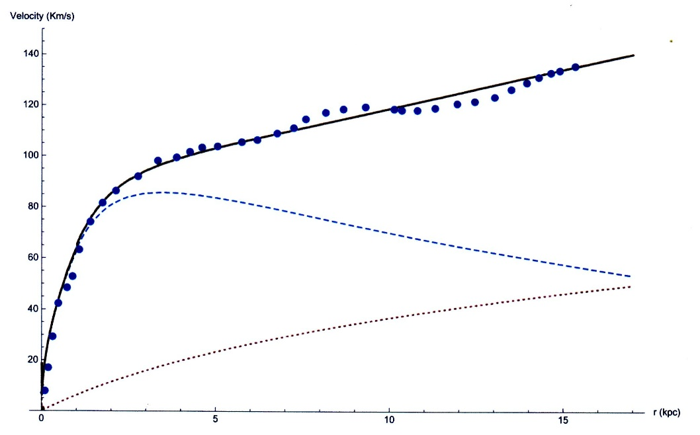
Plot of the galactic rotation velocity (km/s) versus the distance r(kpc)
This result for galaxy M33 was obtained assuming a sufficiently large |d²M/dt²| = 9.12 × 10¹⁶ kg/s².

Slide 66
In the next Yahalom (2022) paper he tried to show how the retardation effects can explain the gravitational microlensing.
He showed that the retardation effects create an additional force on the light ray in the direction perpendicular to it, usually thought to be caused by some dark matter mass M_{dark}.
This force can be produced by the retardation effects if (again) |d²M/dt²| would be sufficiently high:
[r²/(2c²)] |d²M/dt²| is equivalent to M_{dark}(r)
DISADVANTAGES of Yahaloms’s theory:
A) it makes an additional assumption of sufficiently large |d²M/dt²| = 9.12 × 10¹⁶ kg/s² (there are no direct measurement of the second temporal derivative of the galactic mass).
B) it explains only 2 out of the are 3 major types of astrophysical observations that resorted to dark matter (the flattening of the rotation curves of the galaxies and gravitational microlensing), but not the anomalous absorption in the 21 cm line from the early Universe.

Slide 67
SUMMARY
The overwhelming majority of theories on dark matter either introduce exotic, never discovered experimentally subatomic particles or change the physical laws, except the above three theories, which are therefore preferable from the viewpoint of the Occam razor principle.
Deur’s theory (self-interaction in GR): Great theory!
DISADVANTAGE: it explains only 1 out of the 3 major types of astrophysical observations that resorted to dark matter (the flattening of the rotation curves of the galaxies), but not the other two types.
Yahalom’s theory (retardation effects in GR): Great theory!
DISADVANTAGES:
A) it makes an additional assumption of sufficiently large |d²M/dt²| = 9.12 × 10¹⁶ kg/s² (there are no direct measurement of the second temporal derivative of the galactic mass). This is a minus from the viewpoint of the Occam razor principle.
B) it explains only 2 out of the are 3 major types of astrophysical observations that resorted to dark matter (the flattening of the rotation curves of the galaxies and gravitational microlensing), but not the anomalous absorption in the 21 cm line from the early Universe.

Slide 68
Hills et al (2018) expressed concerns about some aspects of the data processing by Bowman et al (2018), though it was admitted by Hills et al (2018) that their analysis does not prove that the feature identified by Bowman et al. (2018) is absent.
In response, Bowman et al (2018b) pointed out that they conducted tests that showed that the recorded absorption signal was indeed astronomical (rather than having to do with the data processing).
Bowman et al (2018) also wrote that they have data that exclude some of the alternative signal models proposed by Hills et al (2018).
Hills et al, Nature,2018, 564, E32
Bowman et al, Nature 2018, 564, E35

Slide 69
Problems with Singh et al 2021 SARAS 3 observations of the 21 cm line
Prof. Bowman (the Head of the EDGES team) in his private communication to me shared with me the following concerns with the Singh et al. paper:
1. The limited amount of data which causes low sensitivity and reduces options for testing for instrumental effects.
2. The narrow bandwidth that makes the 21cm parameter estimation weaker and less robust.
3. The lack of assessment of systematic errors in their parameter estimation.
Prof. Bowman added: “These experiments are extremely challenging. As we noted in the 2018 paper, we made many tests of the instrument and analysis before reporting our evidence of a detection.”

Slide 70
Problems with Singh et al 2021 SARAS 3 observations of the 21 cm line
At the SARAS 3, there was some unwanted contribution from receiver noise and thermal emission from water beneath the antenna, the antenna being floated on a large body of water (on lakes in Southern India).
The noise level at the SARAS 3 was 213 mK, which was several times higher than the noise level of 87 mK at the EDGES.
Radio Frequency Interference (RFI): At the SARAS 3 observing sites in India, substantial RFI was encountered up to 55 MHz and the spectrum was also unusable above 85 MHz. In distinction, in Australia (where the EDGES is located), there are no licensed digital TV transmitters below 174 MHz, what allowed Bowman et al (2018) to perform observations in the broader range of 50 – 100 MHz.
Singh et al, Nature Astronomy 2022, 6, 607

Slide 71
Out of other hypotheses, the one that came relatively close to having an experimental confirmation (by Adlarson et al (2014)), is the dibaryon hypothesis (hexaquarks).
However, Bugg (2014) pointed out logical flaws in the interpretation of that experiment as the discovery of the dibaryon and provided an alternative explanation to the experimental results of Adlarson et al (2014).
Adlarson, P. et al. Neutron-proton scattering in the context of the d∗(2380) resonance. Phys. Rev. C 2014, 90, 035204.
Bugg, D.V. An alternative explanation for the dibaryon suggested by experiments at the WASA facility at Julich. Eur. Phys. J. A 2014, 50, 104.

Slide 72
In our review article of 2021 in the Elsevier journal “New Astronomy Reviews” and in our review published in 2021 by Nova Science Publishers as a chapter in the book “Advances in Dark Matter Research”, in the section devoted to particle dark matter, I overviewed recent publications on sterile neutrinos, self-interacting dark matter, dibarions (hexaquarks), dark matter from primordial “bubbles”, primordial black holes as dark matter, axions escaping from neutron stars, and dark and usual matter interacting via the fifth dimension.
While discussing non-particle models of the cause of dark matter effects, I covered the modified Newtonian dynamics and modifications of the strong equivalence principles. I also considered exotic compact objects, primordial black holes, and retardation effects.

Slide 73
Deur’s theory should not be confused with the hypothesis of a self-interacting dark matter brought up by Spergel & Steinhardt (2000) and further modeled by Loeb & Weiner (2011) and by Yang et al (2020).
Their hypothesis assumes that dark matter particles interact through an unknown dark force.
Therefore, according to the Occam razor principle, the latter hypothesis is less favorable than Deur’s theory.
Spergel, D.N.; Steinhardt, P.J. Observational evidence for self-Interacting cold dark matter. Phys. Rev. Lett. 2000, 84, 3760.
Loeb, A.; Weiner, N. Cores in dwarf galaxies from dark matter with a Yukawa potential. Phys. Rev. Lett. 2011, 106, 17132.
Yang, D.; Yu, H.B.; An, H. Self-interacting dark matter and the origin of ultradiffuse galaxies NGC1052-DF2 and -DF4. Phys. Rev. Lett. 2020, 125, 11110

Slide 74
Deur:
“In summary, traditional analyses of internal galaxy or cluster dynamics employ Newton’s gravity that neglects the selfinteraction terms, and this may explain the need for dark matter.
Traditional analyses of universe evolution do use GR, but under the approximations of isotropy and homogeneity, which suppress the effects of the selfinteraction terms, and would by definition disregard any local phenomenon that could affect gravity’s field, such as field trapping.”

Slide 75
Yahalom (2022) emphasized that he did not consider a post-Newtonian approximation, in which matter travels at nearly relativistic speeds.
He considered the retardation effects and finite propagation speed of the gravitational field in the case of galaxies, where v/c ~ 10^{–3}.
He wrote: “Every gravitational system, even if it consists of subluminal entities, has a retardation distance, above which retardation cannot be neglected…The retardation distance is roughly 4.54 kpc for M33; other galaxies of different types have shown similar results.”

Slide 76
The 21 cm line mentioned above is of great interest in cosmology because it is the only known way to probe the "dark ages”.
Due to the redshift, this line is observed on Earth at frequencies from 200 MHz to about 9 MHz.
The 21 cm line is the radiative transition between the two hyperfine levels of the hydrogen ground state.
It is the spin-flip transition between parallel and antiparallel configurations of the electron and proton spins.

Slide 77
I remind that matter does not bend light itself:
mass bends spacetime
light follows the curvature of spacetime, resulting in the lensing effect

Slide 78
Why the SFHA can be excited to the 2s state by electron impact
For example, in the Born approximation, the excitation amplitude from 1s to 2s is controlled by (see, e.g., Geltman & Hidalgo, JPB 4 (1971) 1299)
∫dr exp[i(k_{p} – k_{q})r] ₁F₁[ime²/(ħ²k_{q}); 1; ik_{q}r+ik_{p}r] y₀(10,20|r), (1)
where
_{r} ∞
y₀(10,20|r) = (1/r) ∫ dr₁R₁₀(r₁)R₂₀(r₁) r₁ + r ∫ dr₁R₁₀(r₁)R₂₀(r₁)/r₁ . (2)
⁰ ^{r}
The value of y₀(10,20|r) does not vanish for the usual hydrogen atoms and for the SFHA.
While the 1st integral in (2) might resemble the matrix element of r₁ and it would be zero if the upper limit would be infinite, in reality the integration is in finite limits, which is why the result is not zero.

Slide 79
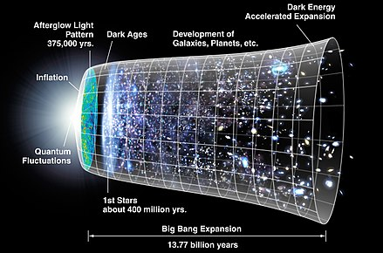
In this picture of the evolution of the Universe, which is now about 14 billion years old, the recombination epoch (see the label Afterglow Light in the top left corner) is just about 370,000 years after the Big Bang.
It followed by “Dark Ages” for about 400 million years.

Slide 80
The existence of the SFHA was evidenced/proven in 4 different types of atomic/molecular experiments. What about the universe?
The presence of the SFHA at the universe age of about 200 Myr is evidenced by the observation by Bowman et al (2018) and its theoretical analysis by Barkana (2018), McGaugh (2018), and then Oks (2020). This fact does not contradict to cosmological constraints, as explained below.
The SFHA in the universe got produced at the end of the recombination epoch (at the universe age of 370000 yr) just as the usual hydrogen atoms. In particular, this means that at the period of the nucleosynthesis, that ended at the universe age of about 20 minutes, the SFHA did not exist – so that the SFHA cannot contradict to any concepts on the nucleosynthesis.
The SFHA represents most of the baryonic dark matter (DM). It is known that at the end of the recombination epoch, the ratio of non-baryonic DM to baryonic DM was about factor of 5 (see, e.g., Arbey-Mahmoudy review of 2021).
So, this ratio
R₁ = (nonbarDM)/(barDM)
is finite, not infinite: there is a baryonic DM. It should be noted that the above ratio R₁ ~ 5 was deduced from the detailed map of the Cosmic Microwave Background (CMB) and thus refers to the end of the recombination epoch.

Slide 81
Now let us consider the ratio
R₂ = (totalDM)/UM,
UM standing for the Usual Matter.
From astrophysical observations follows that R₂ was about factor of 5 at the end of
the recombination epoch (as deduced by the Planck Collaboration) and still is about factor of 5 at the current epoch – see, e.g., Siegel 2022 (https://bigthink.com/starts-with-a-bang/dark-matter-decaying-dark-energy/).
Since the production of the SFHA, required for explaining the perplexing
observation by Bowman et al (2018), occurred at the end of the recombination epoch, i.e., at the time corresponding to value of R₂ ~ 5 deduced by the Plank Collaboration, then the SFHA was already included in the value of R₂ (deduced by the Plank Collaboration) as a part of the total DM (i.e., as the part of the numerator in the R₂).
Then the fact that in the current epoch the observationally determined value of R₂ is
still about the factor of 5 simply means that the SFHA still exists now and is the same part of the numerator in the R₂, as at the end of the recombination epoch.
Thus, the formation of the SFHA at the end of the recombination epoch did not
contradict to the ratio R₂: the formation of the SFHA was automatically accounted for in the ratio R₂ deduced by the Plank Collaboration.

Slide 82
Next, let us consider the ratio
R₃ = (barDM)/UM.
If R₁ ~ 5 and R₂ ~ 5, it is easy to estimate that R₃ ~ 0.8.
For removing the huge multi-order discrepancy between the experimental high-
energy tail of the linear momentum distribution in the ground state of hydrogen atoms and the previous theories, the ratio of the SFHA to the usual hydrogen atoms in the experimental gas is required to be ~ 1 (Oks, 2001, J. Phys. B: At. Mol. Opt. Phys. v. 34, p. 2235).
For removing the significant discrepancy between the experimental cross-sections
of the excitation of hydrogen atoms by electrons and the previous theories, the ratio of the SFHA to the usual hydrogen atoms in the experimental gas is required to be ~ 0.8 (Oks, 2022, Foundations v.2, p. 541).

Slide 83
So, if the ratio
R₄ = SFHA/(usual H) ~ (0.8 – 1),
and since hydrogen abundance in the universe is 74% (while the rest is represented by helium and other chemical elements), then it is easy to estimate that the ratio
R₅ = SFHA/[(usual H) + (other chemical elements)],
which is the same as SFHA/UM, is
R₅ ~ (0.6 – 0.7).
From the comparison of the estimated ratio SFHA/UM ~ (0.6 – 0.7) with the
estimated above ratio (barDM)/UM ~ 0.8, one can conclude the following:
1) the SFHA can constitute most of the baryonic DM in the current epoch;
2) in addition to the SFHA, there is still possible a share of another type of baryonic DM.

Slide 84
It is commonly accepted that in the universe the baryonic DM currently resides mostly in galactic halos. Thus, the SFHA in the universe currently resides mostly in galactic halos.
Besides, old neutron stars could very slowly generate new specific, described in detail baryonic DM in the form of the SFHA.
Some old neutron stars would release it into their tiny atmospheres, while some other old neutron stars release it into the interstellar medium.
So, this is where the SFHA can reside in the universe as well.

