Slide 1
LAPPD and HRPPD update: performance measurements
Mark Popecki, Stephen Clarke, Cole Hamel
Incom, Inc.
05-08-2024

Slide 2
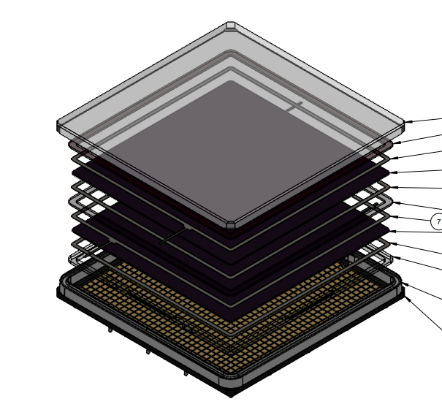
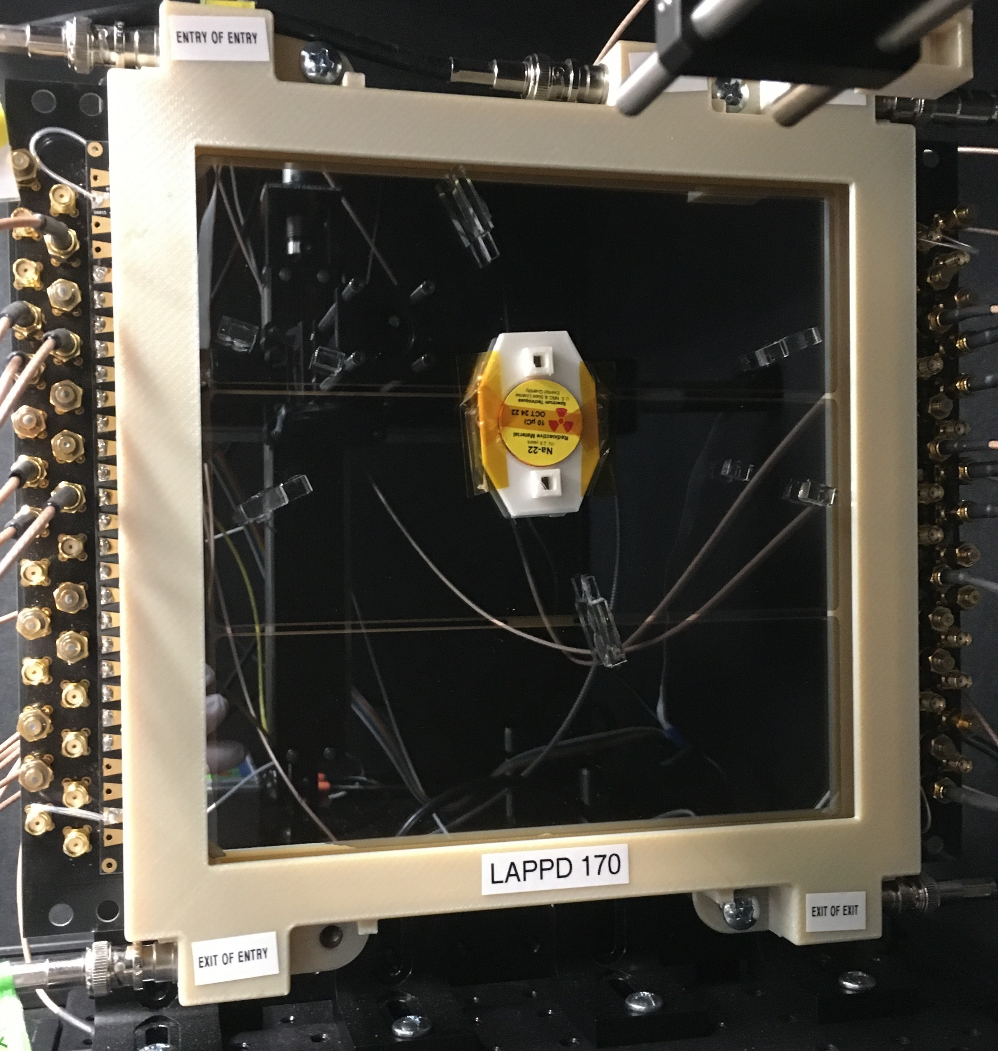
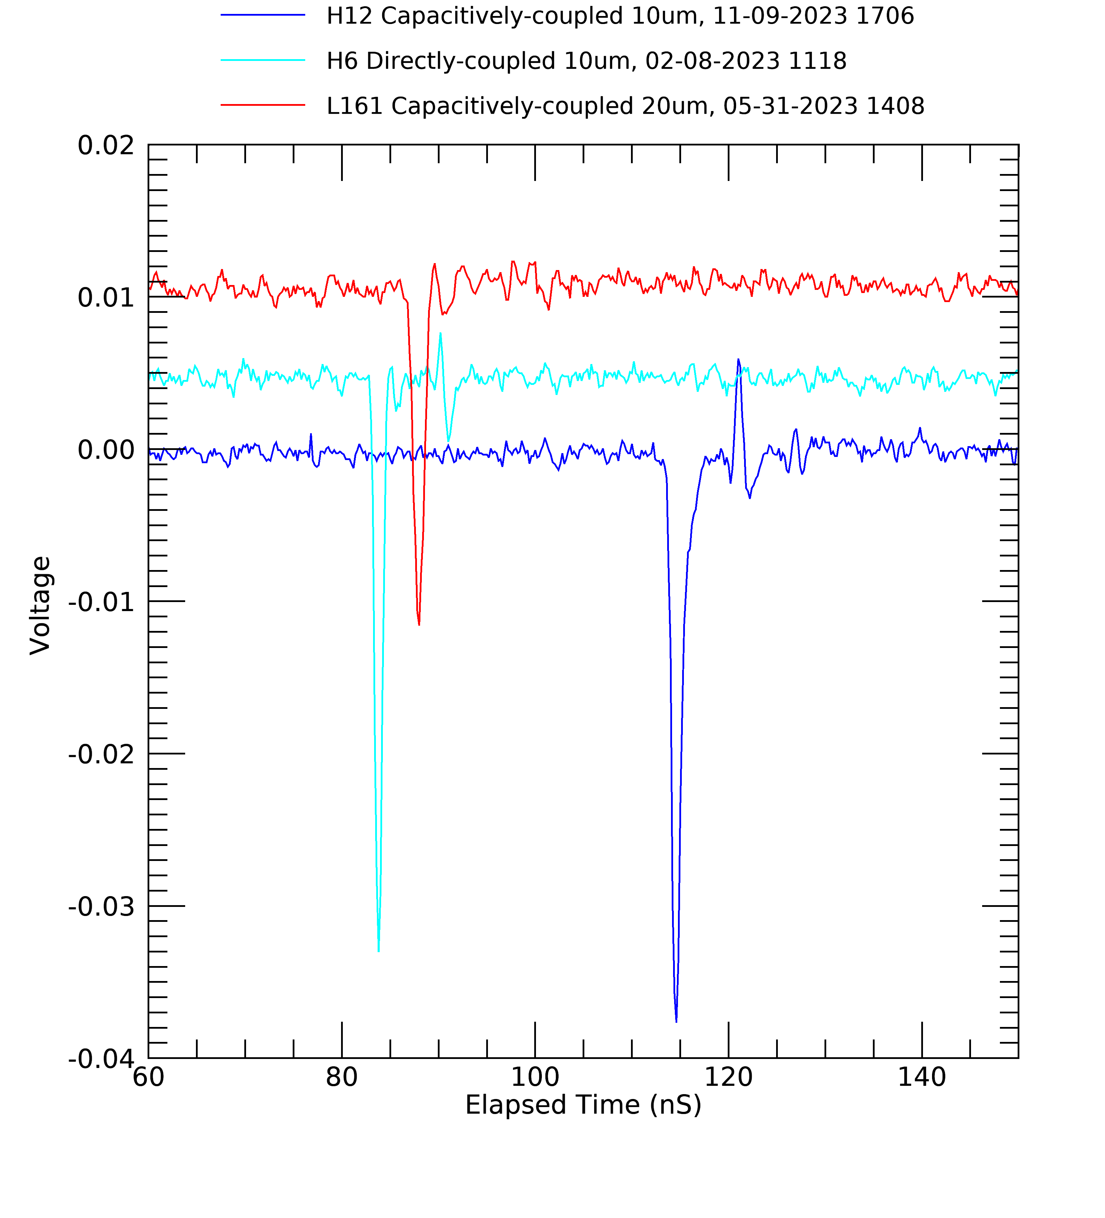
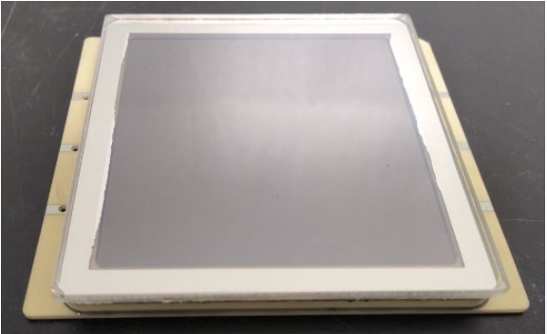
LAPPD and HRPPD
HRPPD models:
10 cm square
No support structures in window
10 um MCPs
Directly coupled through ceramic anodes, with ~3mm discrete pixels
Capacitively-coupled, with 2 mm thick anode
LAPPD models:
20 cm square
Internal stripline
Capacitively-coupled (CC) with anodes of 5 mm thick glass or 2 mm thick ceramic.
Typically 20 um MCPs.
CC signal board is user-changeable.
Both types:
Excellent pulse waveforms – good for timing
High gain, suitable for strong magnetic fields.
High QE, ~27% or more at 365 nm
Directly-coupled HRPPD, with a 32x32 array of ~3mm discrete pixels.
Capacitively-coupled LAPPD, arranged for PET concept testing
Capacitively-Coupled HRPPD, present version

Slide 3
HRPPD Recent Results: Directly Coupled Anode

Slide 4
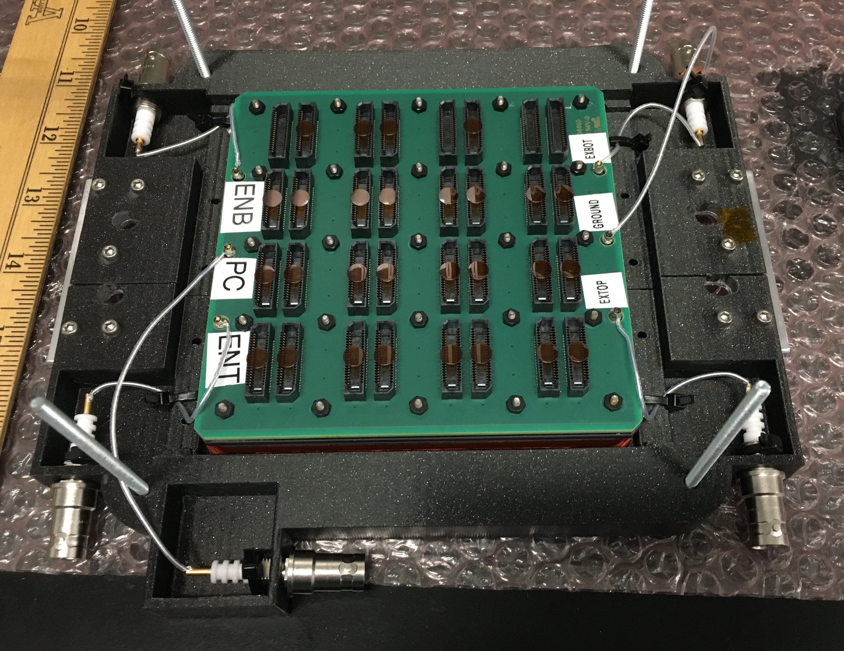
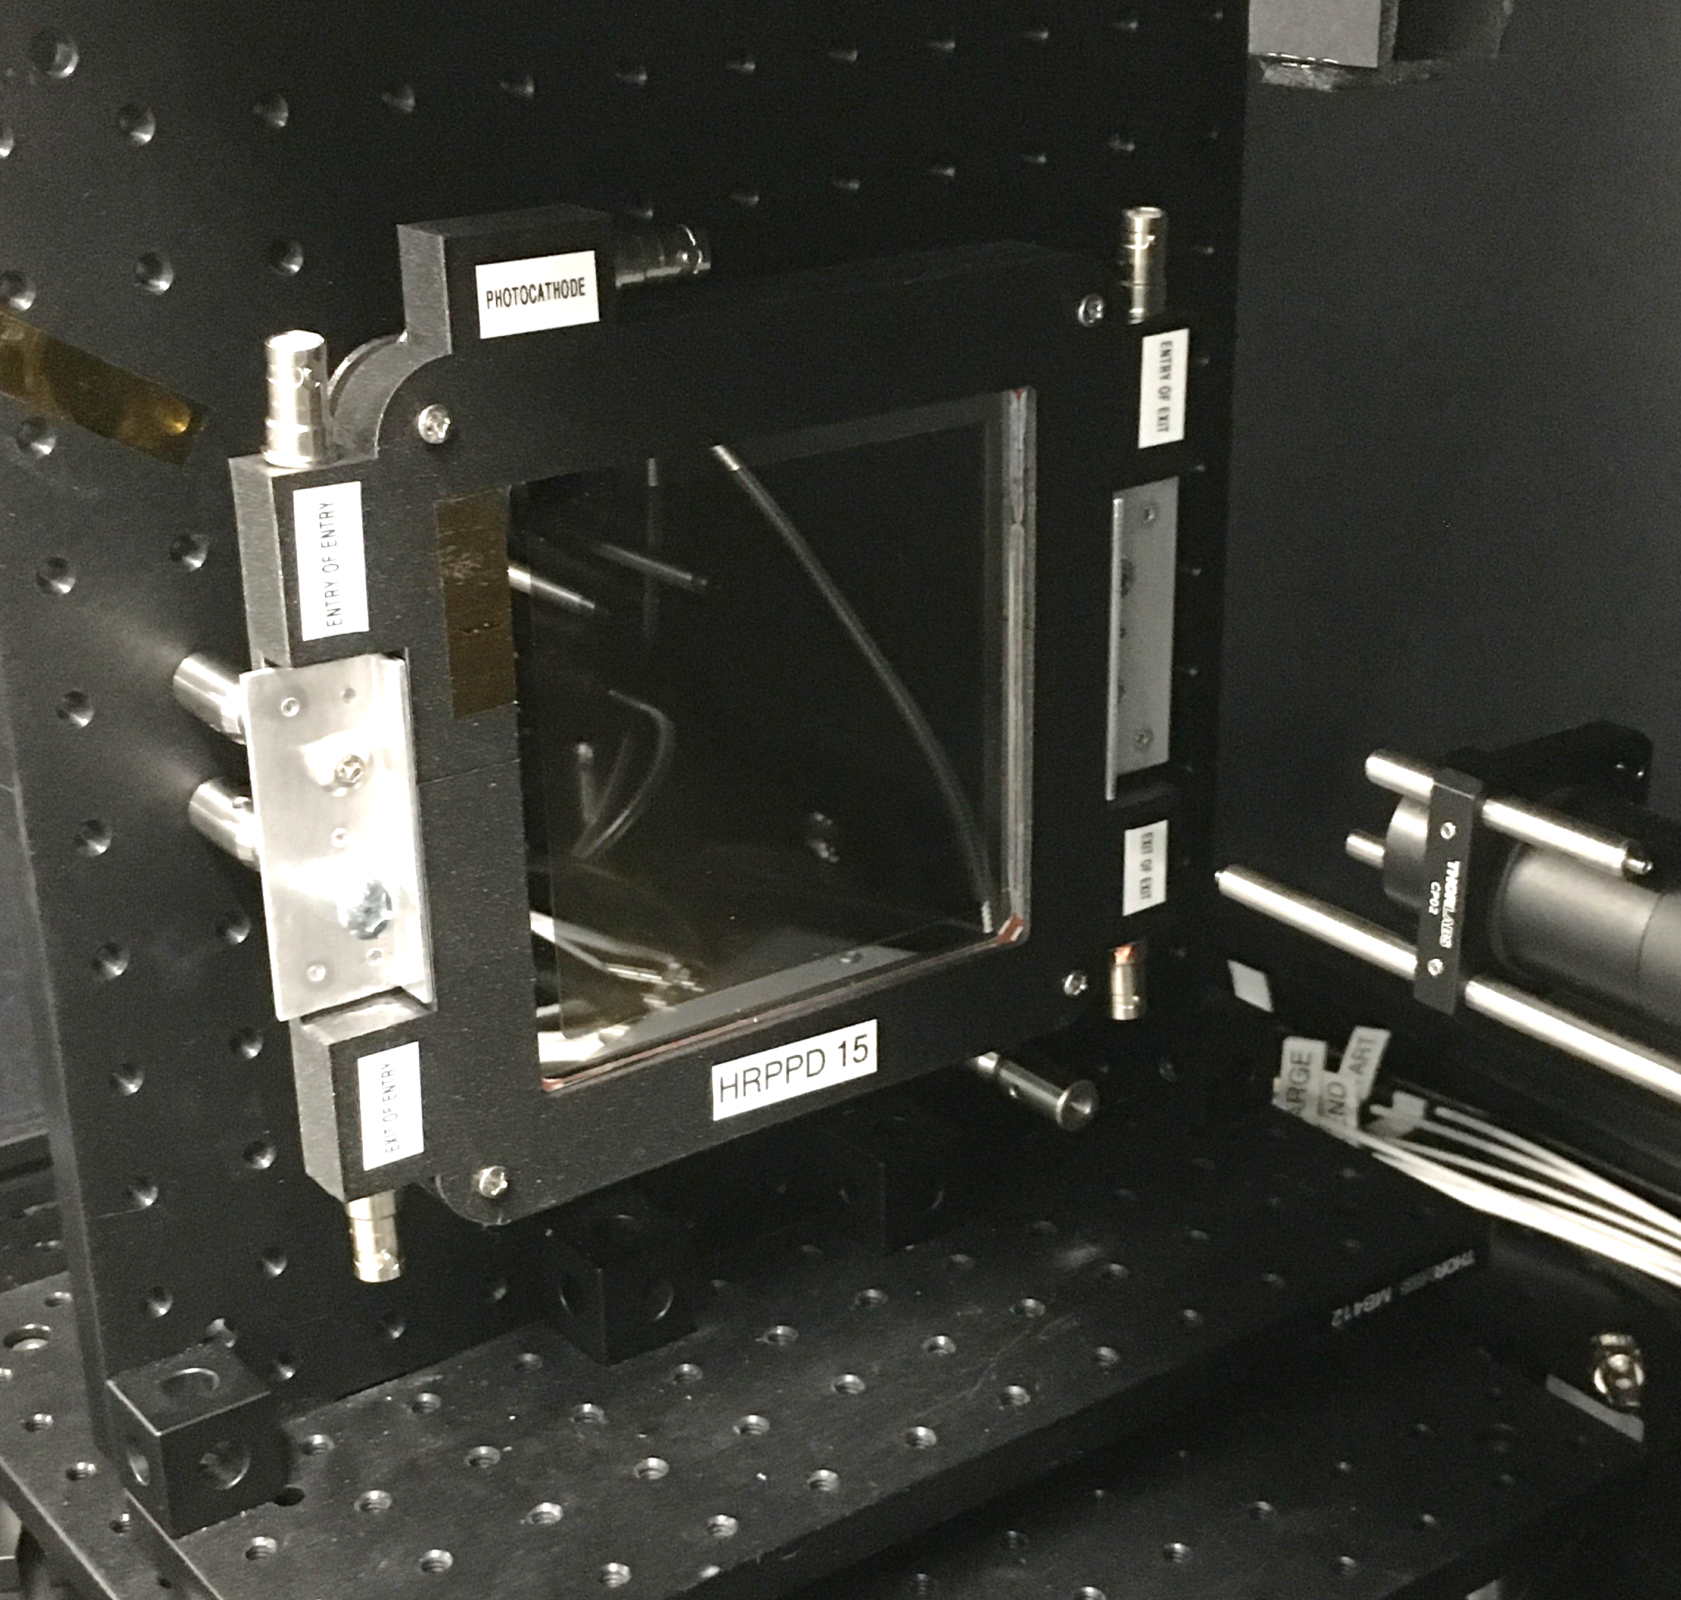
Recent Results: HRPPD DC-Coupled
Signal board – interface to user-designed electronics board
Five devices delivered to the EIC project for evaluation.
1024 individual pixels were brought out to the rear side of the anode, and collected in 16 groups.
The ceramic anode functioned as a multi-layer circuit board.
A signal board connected to the ceramic anode and further collected signals to Samtec connectors.
This signal board is the interface to a user-designed electronics board.
Incom connected DRS4 electronics to selected pixels.
A custom housing was prepared to securely hold the HRPPD and connect high voltages and signal cables.
Samtec sockets on signal board
Samtec mating connectors

Slide 5
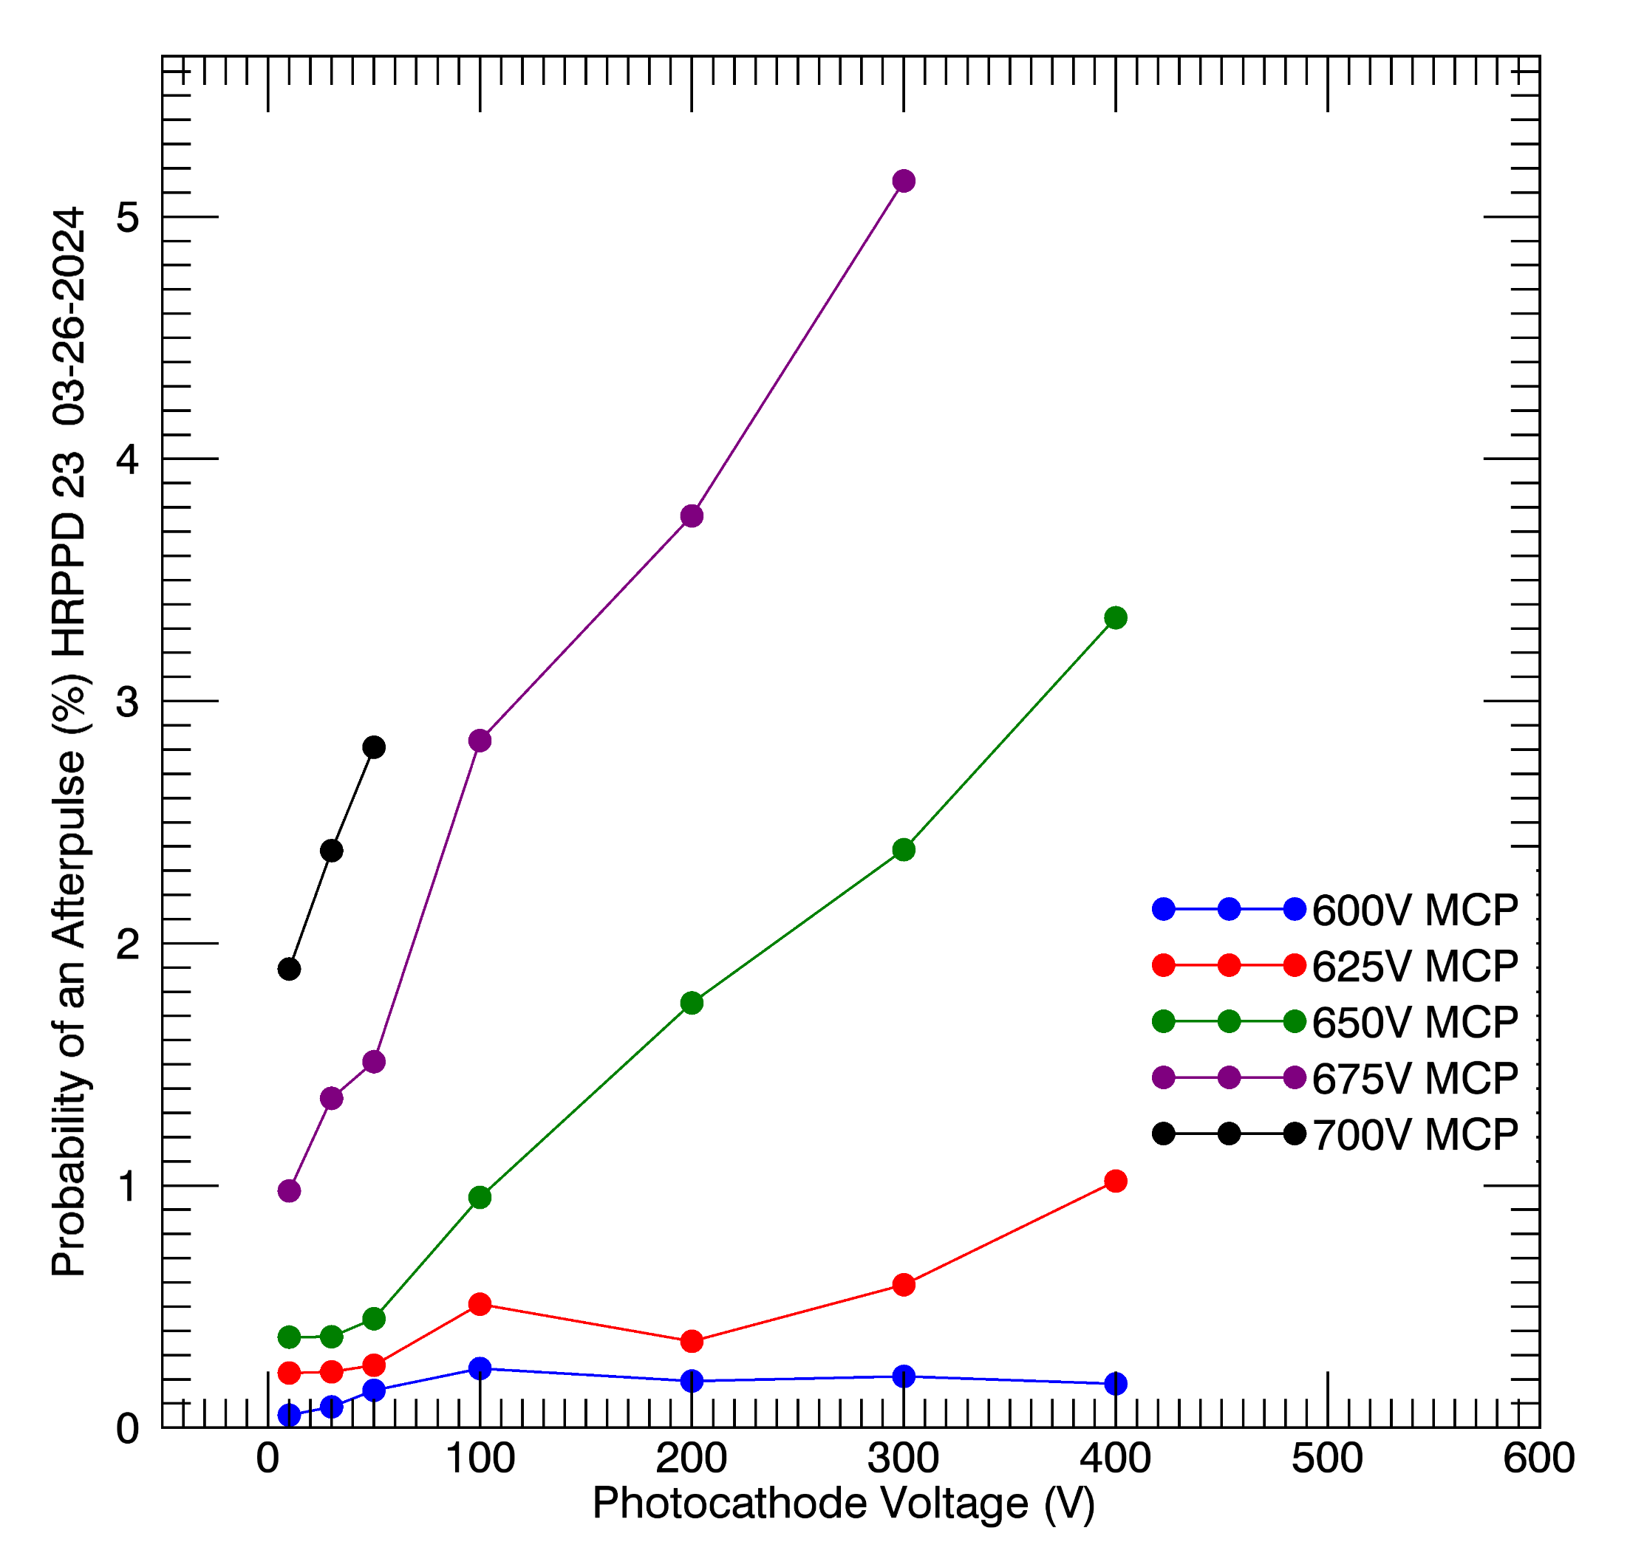
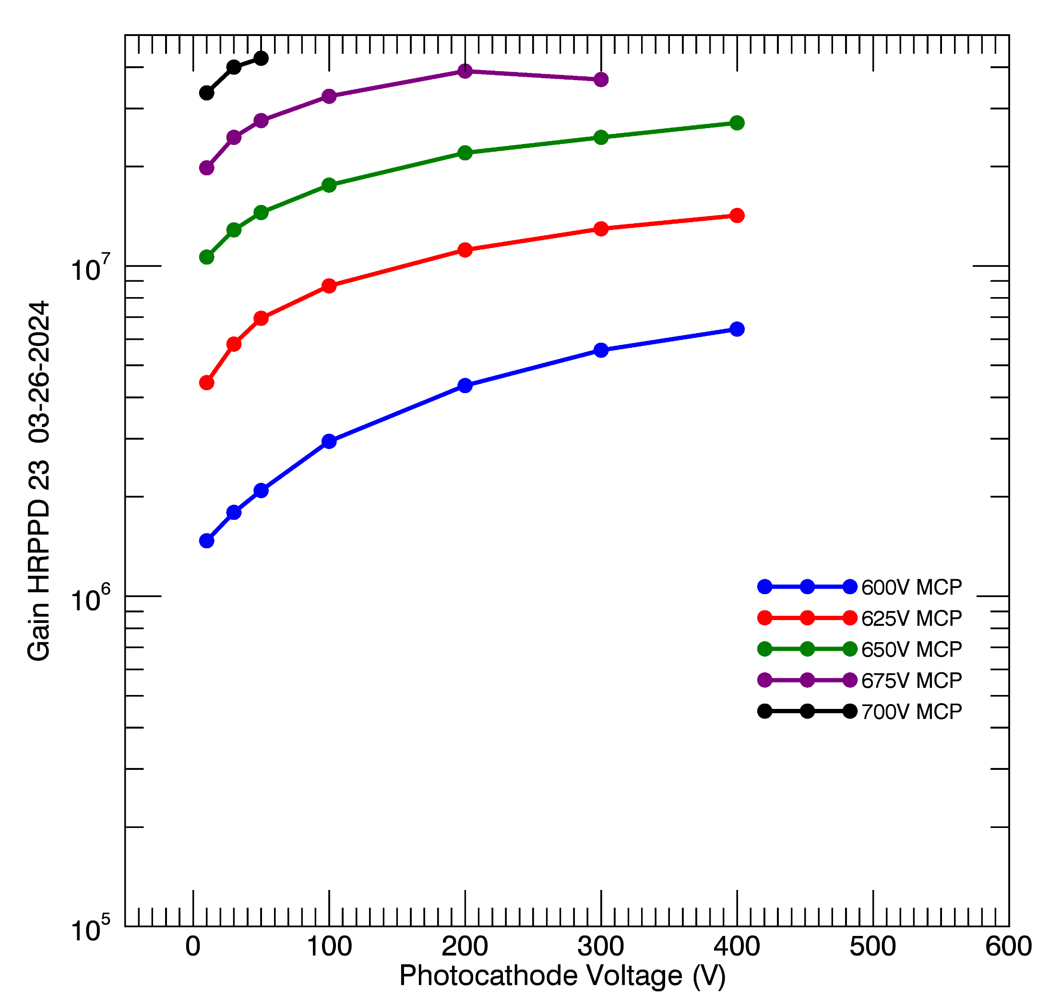
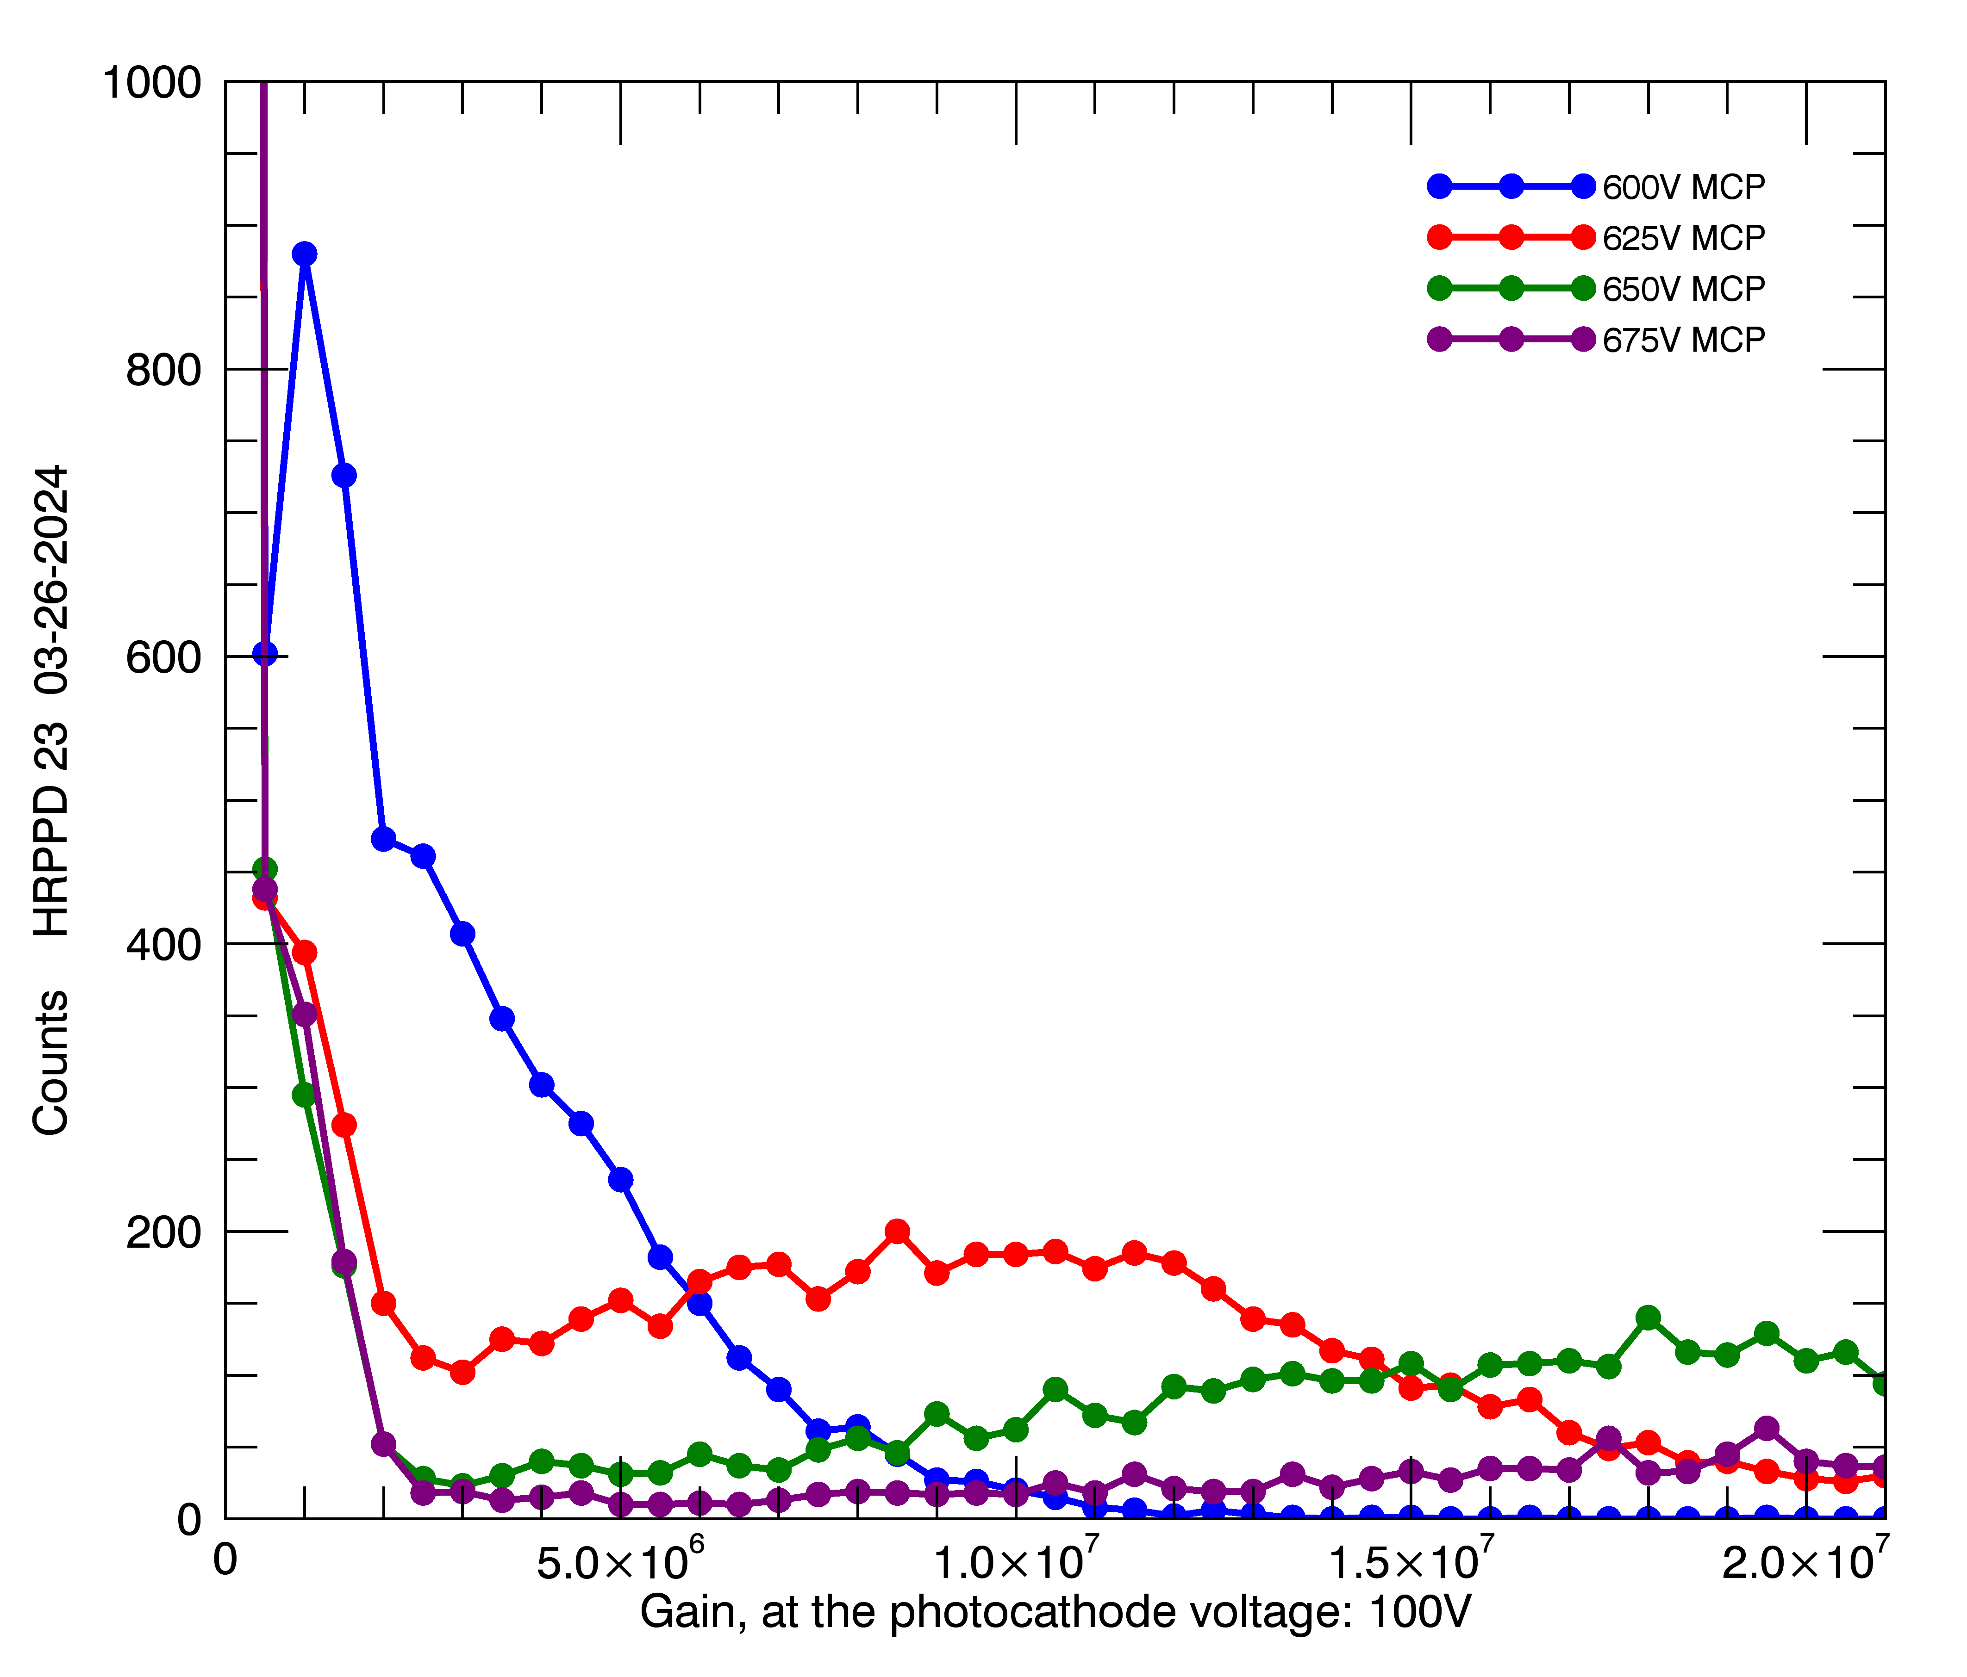
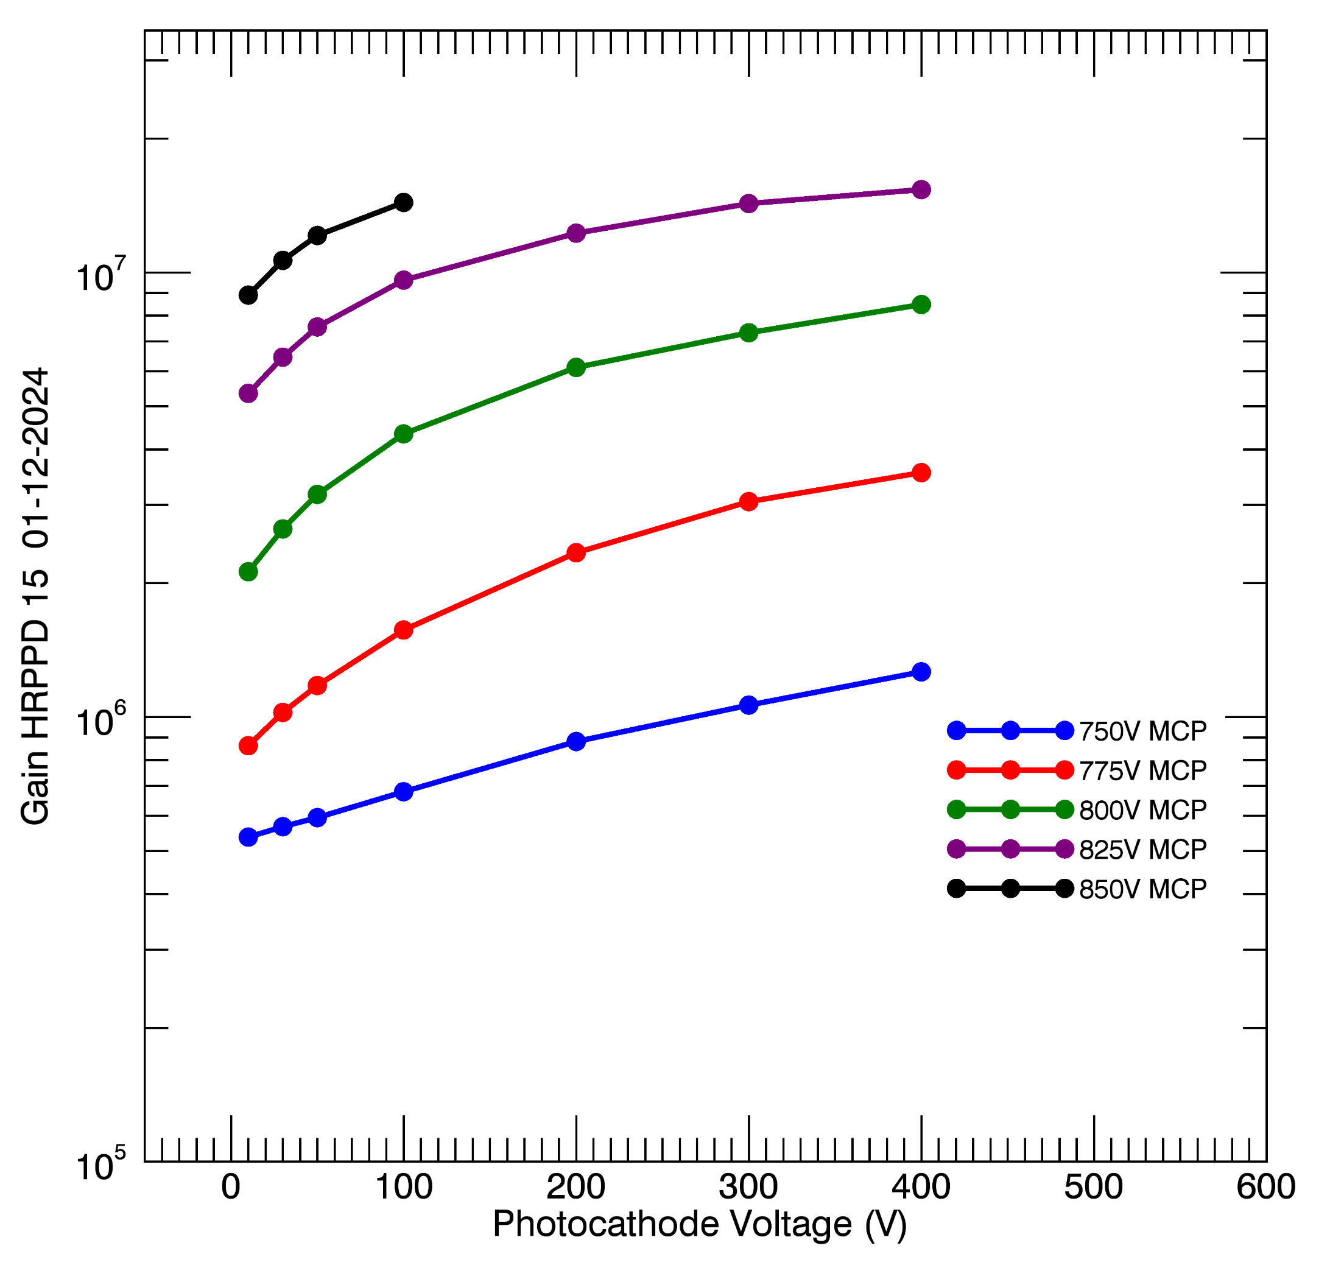
Gain vs. MCP and Photocathode Voltage and Afterpulse Rate
HRPPD 23
Afterpulsing
High gain
Operating MCP voltages are remarkably low on HRPPD 23.
The resistive film on these MCPs is known as Chem-5.
It was developed under a project to reduce coefficient of thermal resistance.
Chem1 is the existing resistive film.
The combination of the Chem5 resistive film and MgO emissive film produces a high gain in sealed devices.
Operation at lower MCP voltages may reduce afterpulsing, extending the life of the photocathode.
Life testing of Chem5 HRPPDs is planned.
Chem5
HRPPD 23
HRPPD 23
Chem1
HRPPD 15

Slide 6
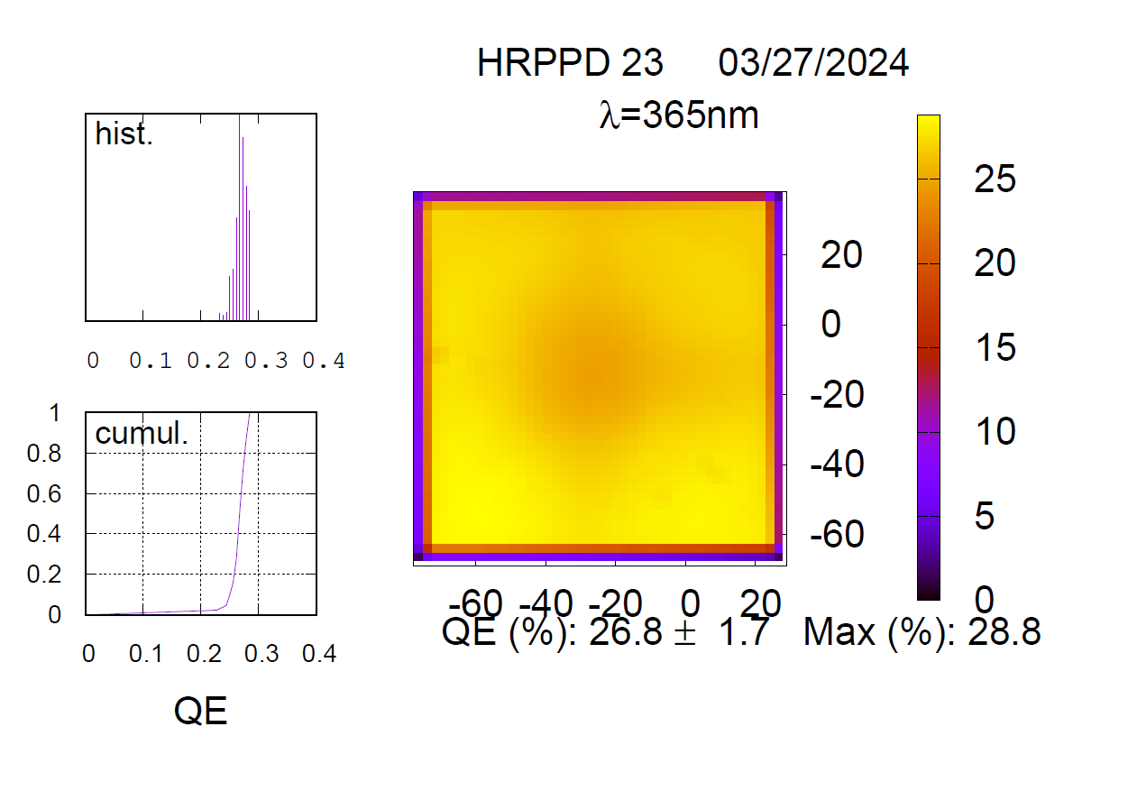
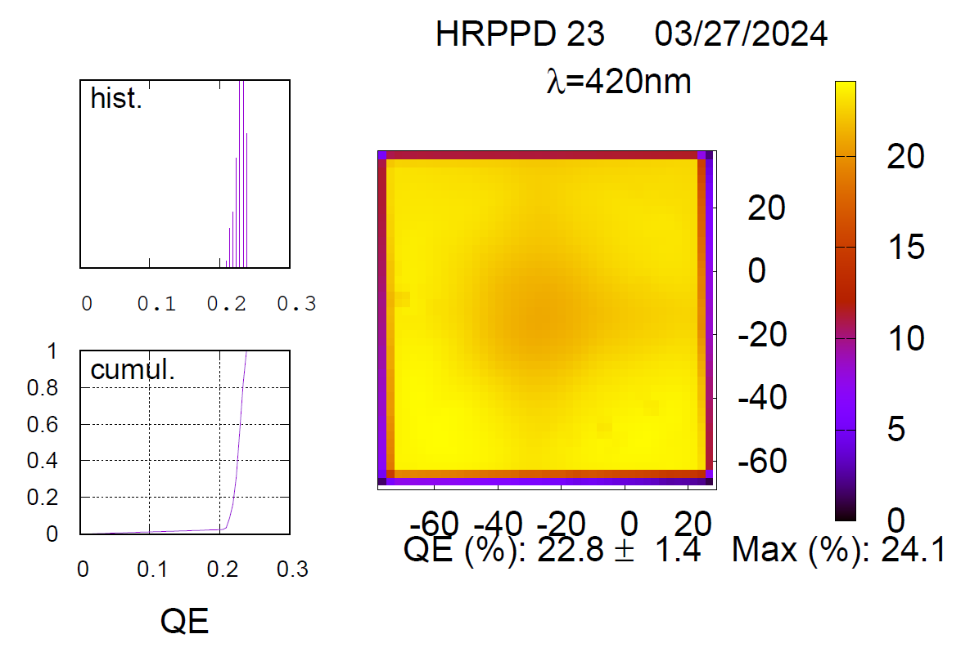
Quantum Efficiency
Quantum efficiency for all five delivered units at 365 nm: 27-37%
Average over five units: 33%.

Slide 7
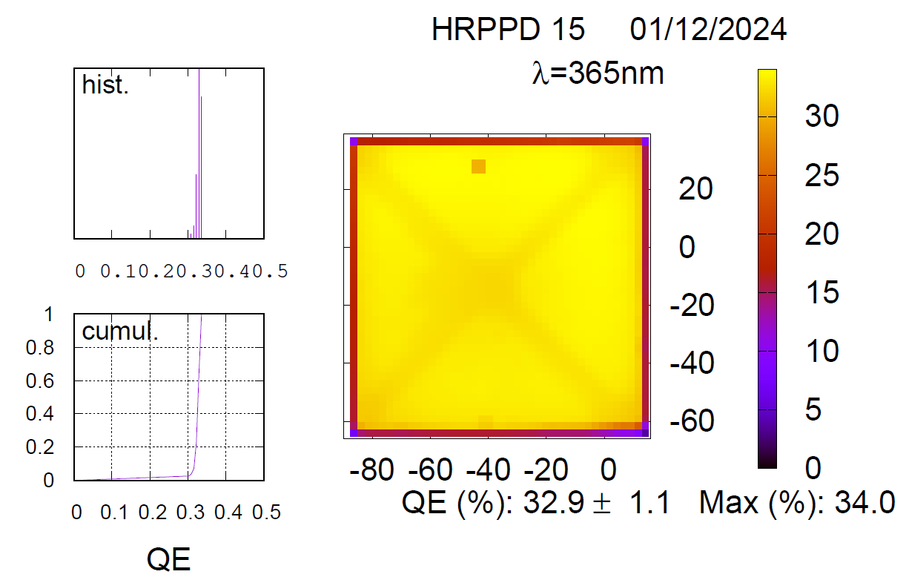
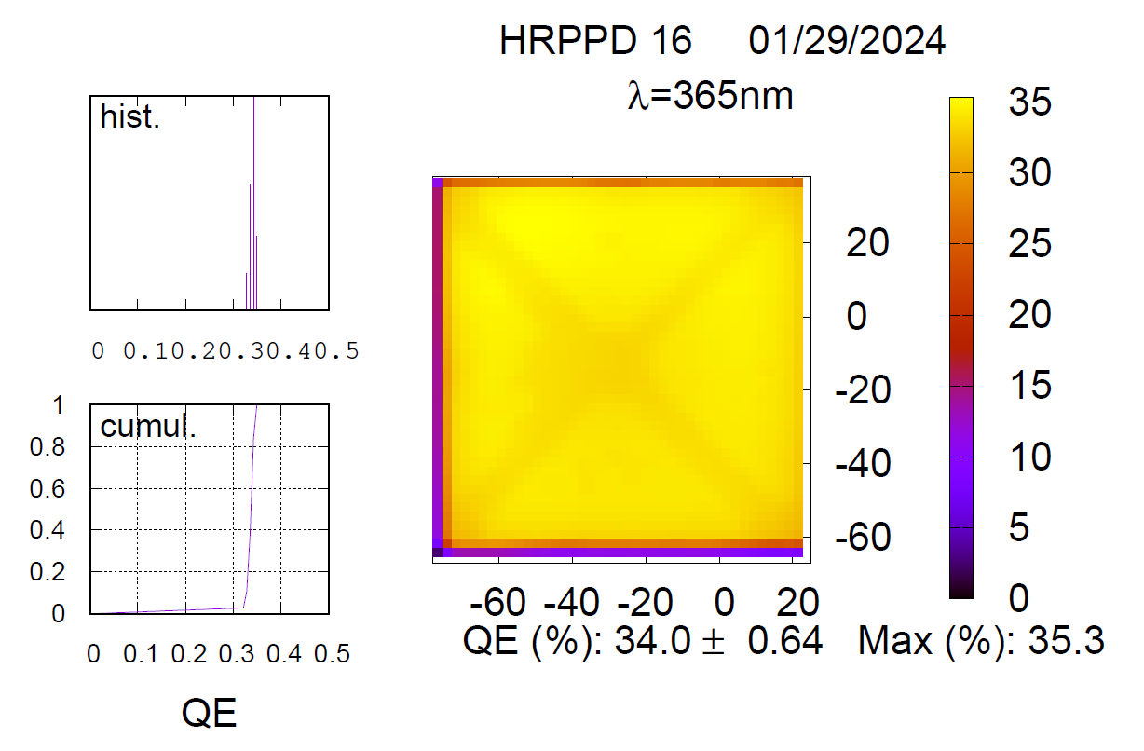
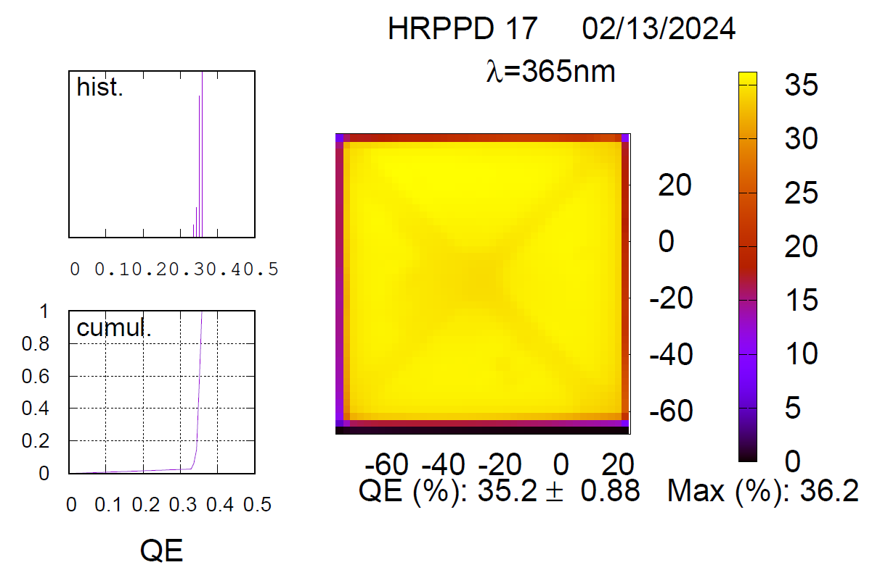
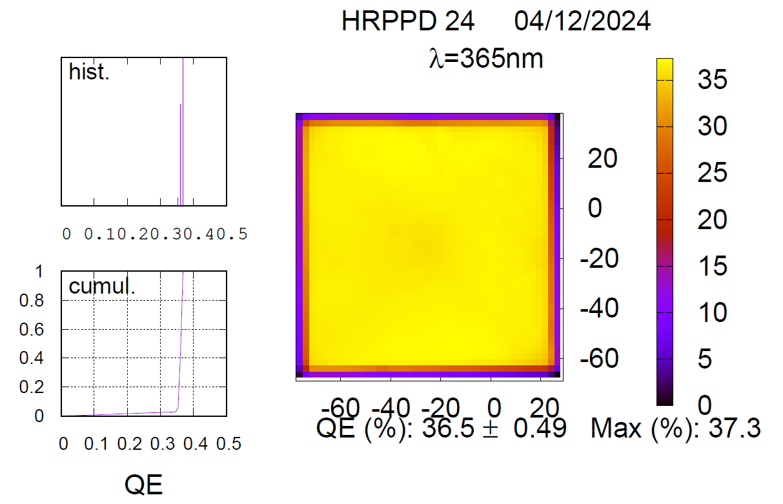
Quantum Efficiency

Slide 8
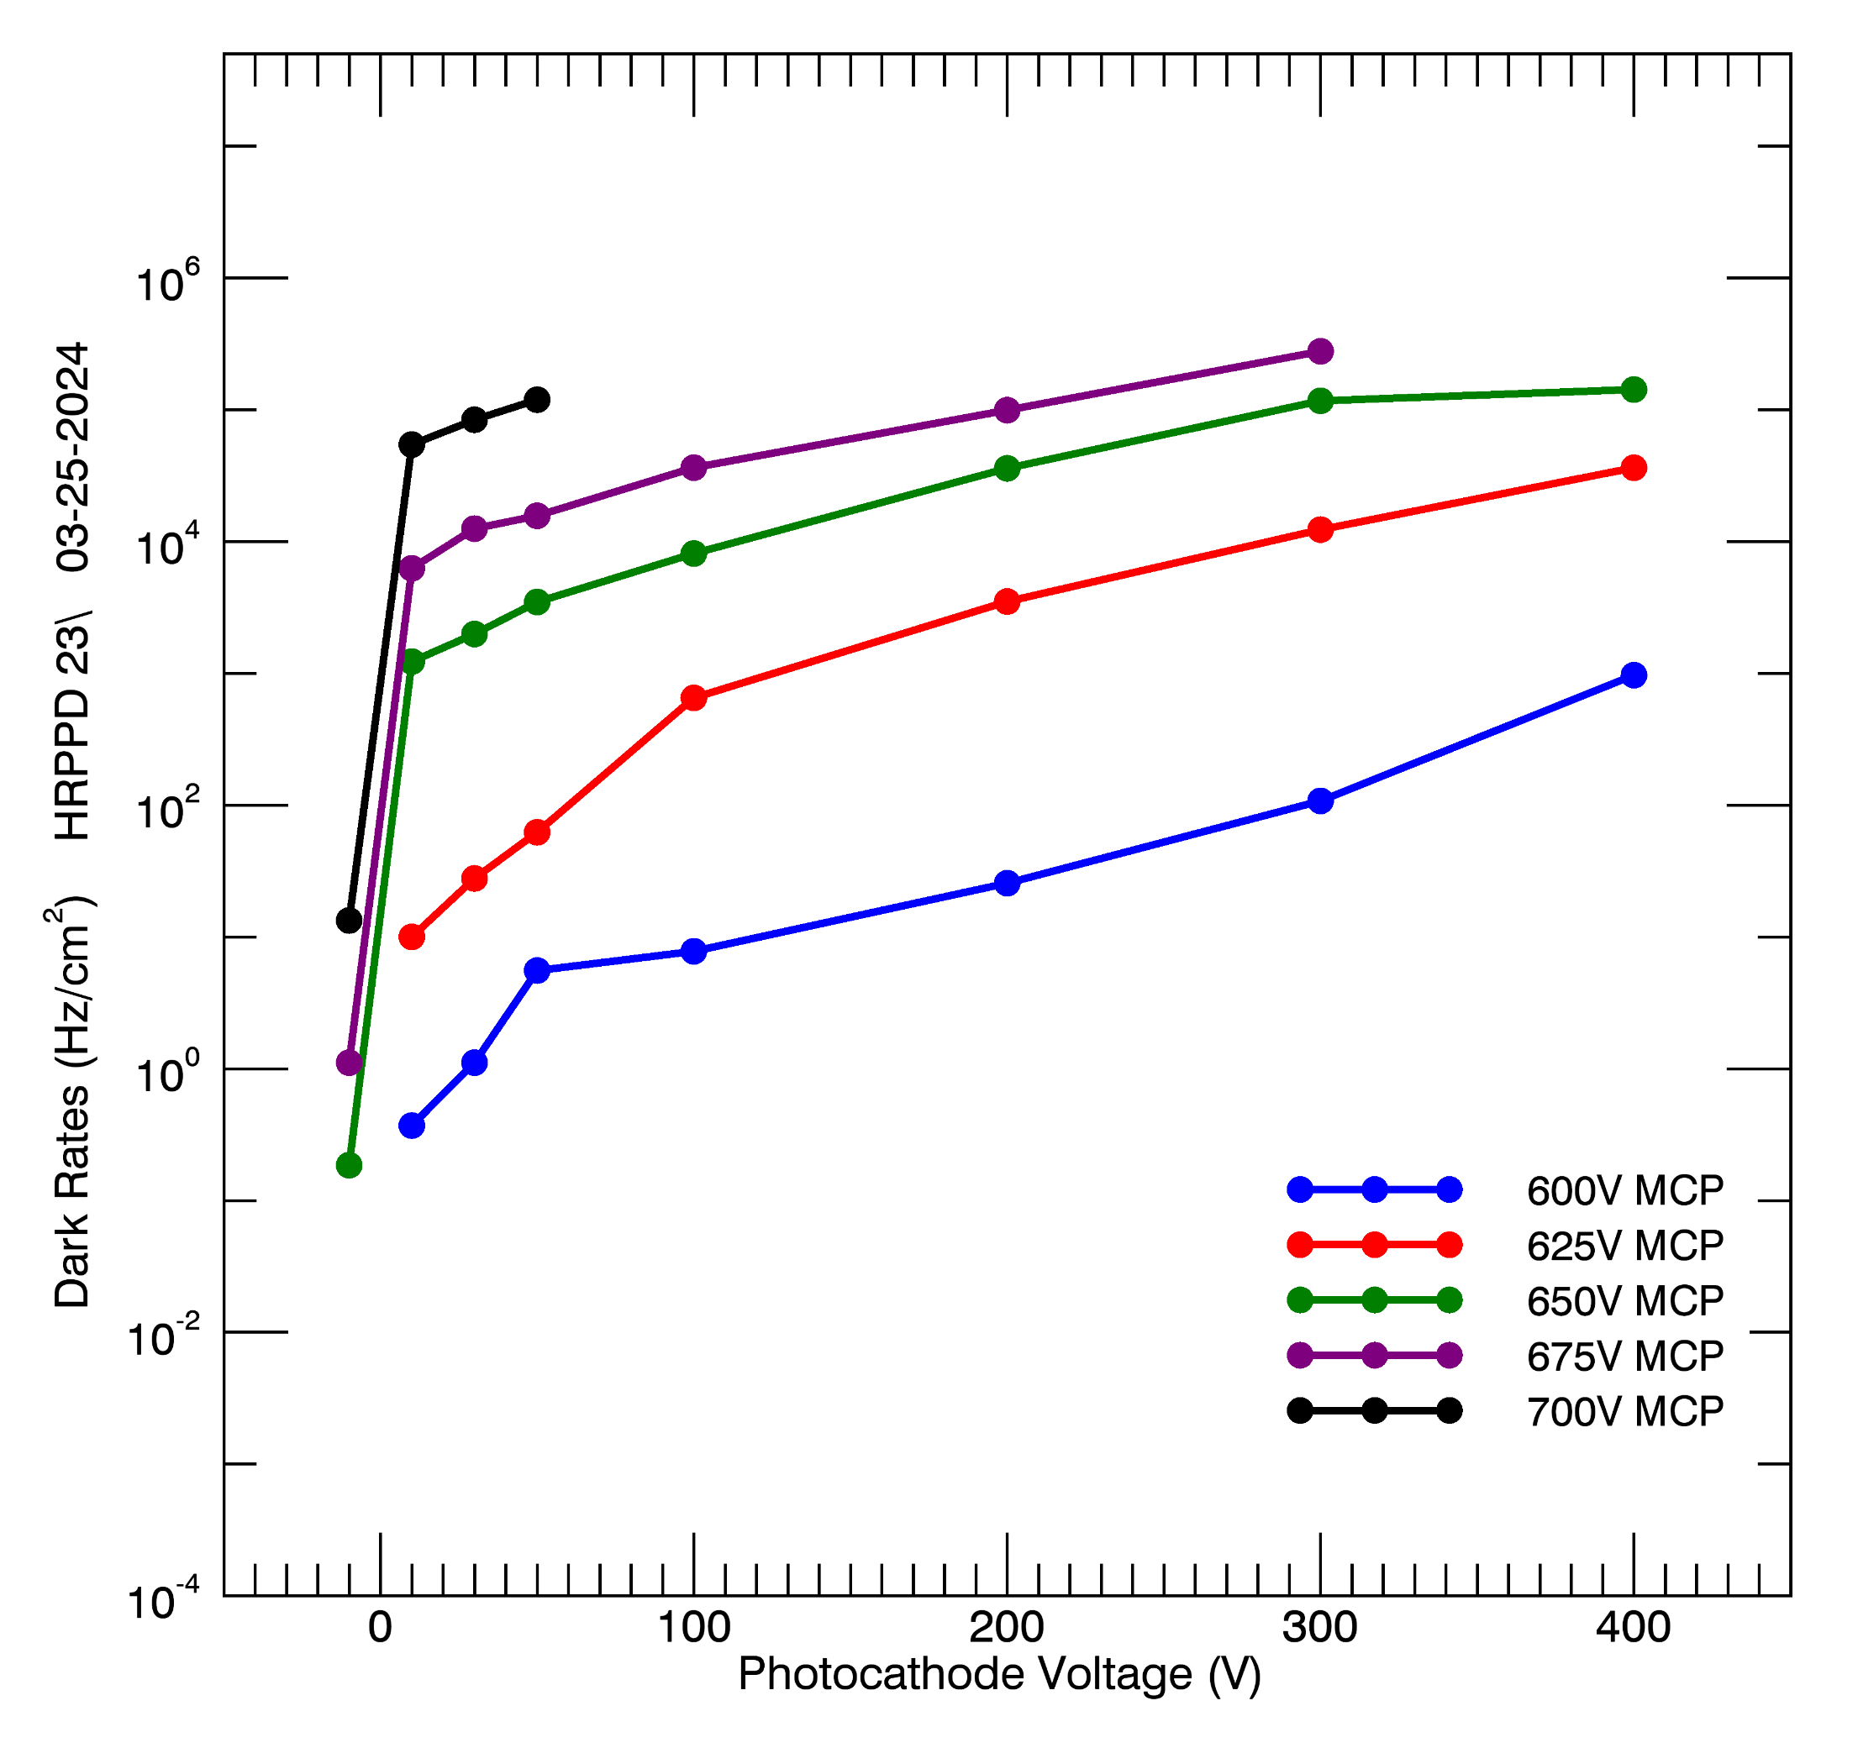
Dark Rates
Dark rates increase with MCP and photocathode voltage.
Dark rates at mid-E6 gain are ~700 Hz/cm²
HRPPD 23
HRPPD 23

Slide 9
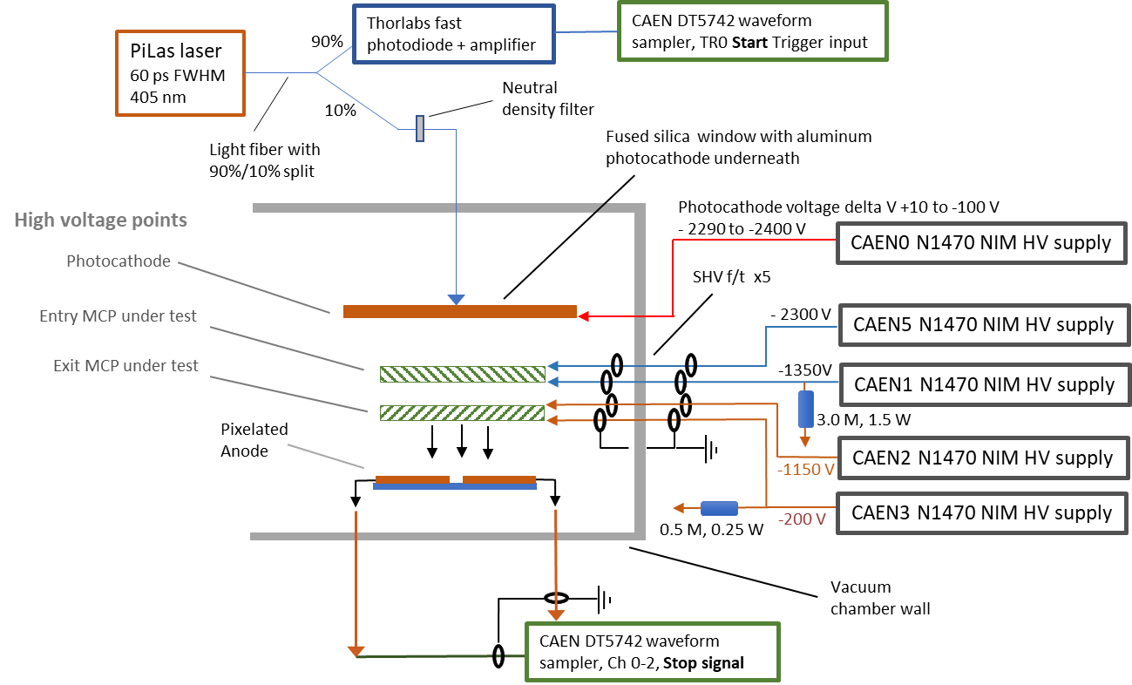
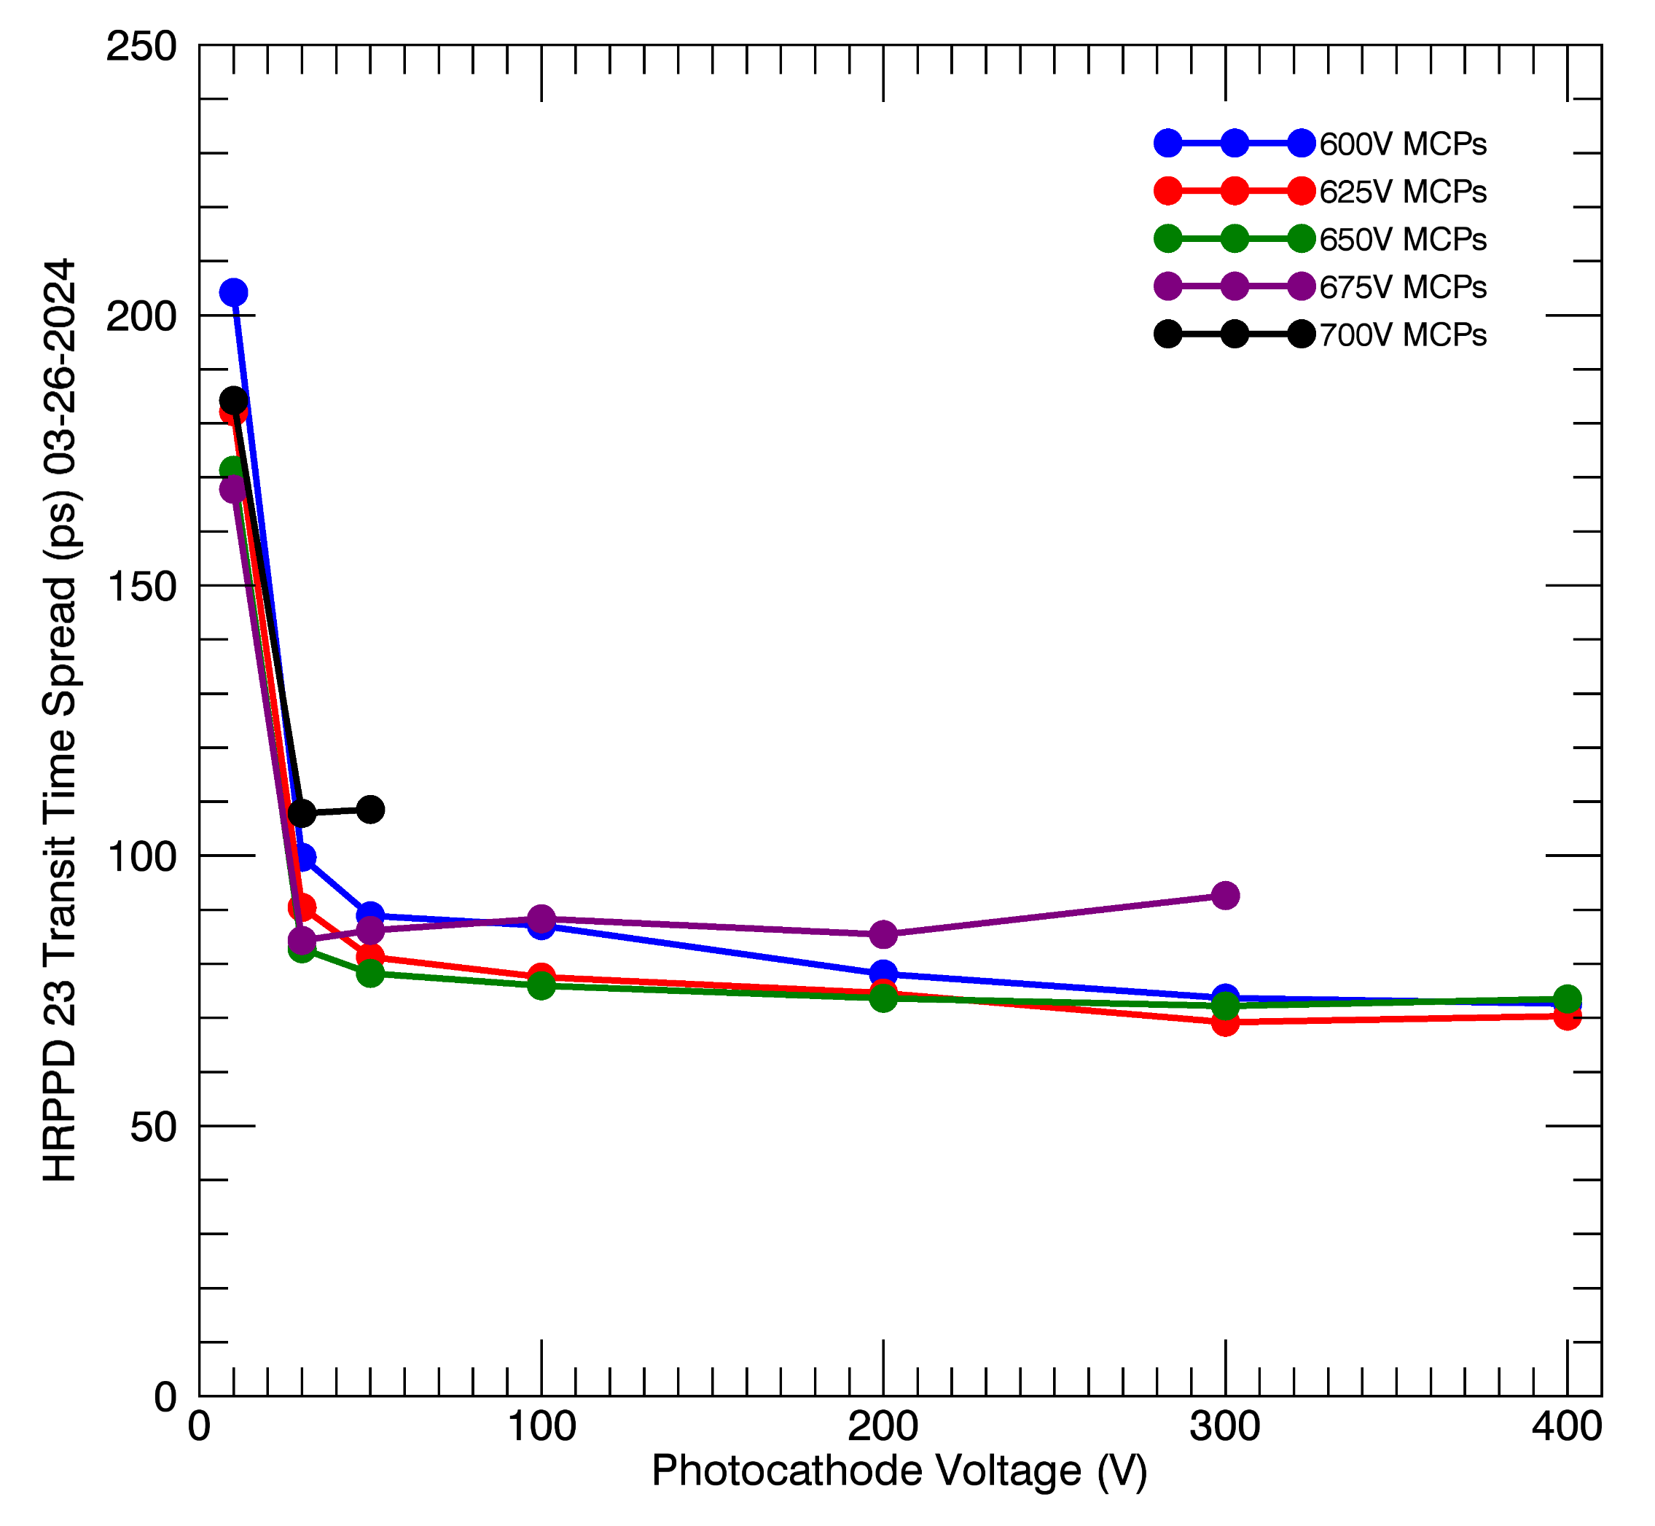
Timing
TTS Measurement
Minimum transit time spread is ~69 ps with no corrections.
Subtracting the laser pulse width and electronics uncertainty: 58 ps.
Uncertainty in laser diode monitor will be measured.
Chem5
Gain

Slide 10
Dark Rates
Summary
Gain
HRPPD # | Operating Voltage Range (V/MCP) | Dark Rates @ 1X10^6 Gain (Hz/cm^2) | EIC Standard – Dark Rates
15 | 750-850 | 160 | ≤ 2E3Hz/cm^2 at ≥ 10^6 Gain
16 | 625-725 | 0.18
17 | 600-700 | 19
18 | 825-975 | 3.60
23 | 600-700 | 0.37
24 | 575-700 | 69
HRPPD # | Operating Voltage Range (V/MCP) | Gain Range at ≥ 100V Bias on Photocathode (PC)
15 | 750-850 | 6.5E5 – 1.4E7
16 | 625-725 | 9.2E5 – 1.3E7
17 | 600-700 | 1.0E6 – 1.8E7
18 | 825-975 | 9.6E5 – 1.4E7
23 | 600-700 | 2.9E6 – 3.7E7
24 | 575-700 | 6.8E5 – 2.2E7
Quantum Efficiency
Timing
HRPPD # | QE @ 365nm (Avg./Max.) | Std. Dev. | EIC Standard – Avg. QE Each Tile
15 | 32.9%/34% | 1.1% | 27%
16 | 34%/35.3% | 0.64%
17 | 35.2%/36.2% | 0.88%
23 | 26.8%/28.8% | 1.7%
24 | 36.5%/37.3% | 0.49%
AVG All 5 | 33.1% |  | 30%
HRPPD # | Transit Time Spread (lowest recorded, in ps) | EIC Standard – TTS
15 | 59 | ≤60 ps, validated at BNL utilizing a femtosecond laser
16 | 59
17 | 58
18 | 68
23 | 58
24 | 70

Slide 11
LAPPD Recent Results: Transit Scan for Gain

Slide 12
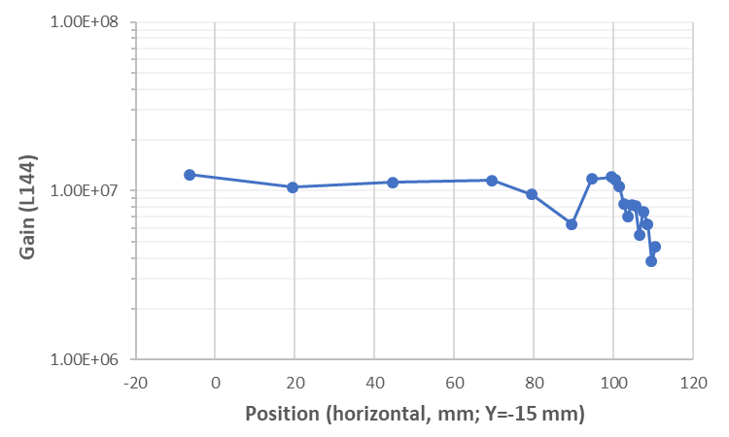
Transit Scan
Measure gain uniformity across the window, to the edge.
Gain may decrease at the edges because the planar symmetry between the MCP and anode ends there.
Gain measured at one set of operating voltages, in steps across the window to the metallized edge.
Step a ~1 mm diameter laser spot across the window.
Edge of window
Gain is stable across the window, except for a decrease ~10 mm before the edge.
A signal is observed when the laser spot is beyond the edge of the window – internal light reflection in the window?
Perform a preliminary electrostatic Simion simulation of the edge area to see where electrons might go.

Slide 13
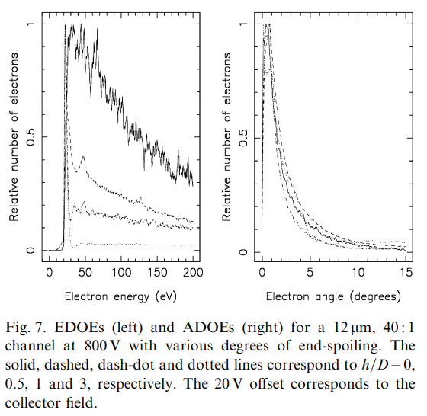
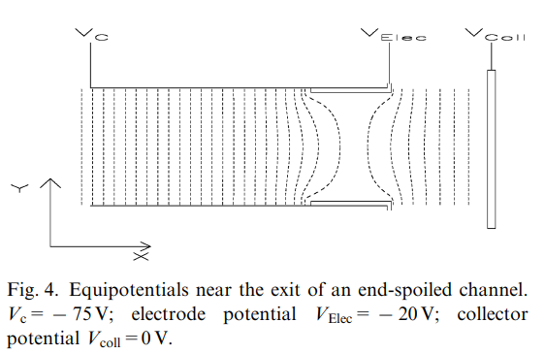
Energy and Angle Distribution of MCP Electrons
The output electrons have energies between:
2-3 eV from electrons that scattered the last time near the exit of the microchannel
and ~200 eV, for electrons that scattered last higher up in the microchannel.
The distribution depends in part on the endspoiling depth of the metal contact on the surface of the MCP.
Incom MCP endspoiling depth is ~1 diameter (see arrow at right)
The angle distribution is ~2 degrees half-angle.
G.J. Price, G.W. Fraser / Nuclear Instruments and Methods in Physics Research A 474 (2001) 188–196

Slide 14
Parallel Plane MCP and Anode – No Support Material
Photocathode
MCP
-200 V
MCP
2 eV electrons
Cone distribution, 1 deg Half Width
0 V
Low energy MCP electrons are steered slightly inwards at the edge
Higher energy MCP electrons exhibit less steering.
In practice, however, MCPs must be supported – then parallel planes become planes that are terminated in walls.
Anode
Photocathode
MCP
-200 V
MCP
200 eV electrons
Cone distribution, 1 deg Half Width
6.3 mm
0 V
Anode
Photocathode
6.35 mm
MCP
-200 V
Anode
MCP
2 eV electrons
Cone distribution, 1 deg Half Width
0 V
LAPPD edge v3 anode same edge as MCP.pa#

Slide 15
Introduction of walls at the edge
Photocathode
Add structures to the edge
Allow potential to vary by height:
insulators in an electric field,
possible surface charging.
Lateral electron steering at the edge, toward the structures.
Electrons at the right edge of the MCP are not reaching the anode – loss of gain.
Voltages may be applied at the left counter steer electrons back to the anode
There may be time of flight variations at the edge.
MCP
-200 V
MCP
-134V
Approximation of potentials on insulators in an electric field, from surface charging.
2 eV electrons
Cone distribution, 1 deg Half Width
-105 V
6.3 mm
-70 V
Anode
0 V
Photocathode
MCP
-200 V
MCP
Enforce potentials externally to steer electrons back into the detection area.
-195V
-100 V
-40 V
-5 V
Anode
0 V

Slide 16
Summary – Gain Transit
Preliminary electrostatic modeling suggests that MCP output electrons can be steered away from the anode, resulting in a loss of measured gain.
The simple electrostatic simulation does not yet reproduce the edge behavior observed in the LAPPD, although light reflection within the window is not included.
Potentials on the support sidewall will strongly influence electron motion – these must be well known.
If electron steering is occurring because of wall charging, it may be compensated by applying a counter-steering potential on the outside of the walls.

Slide 17
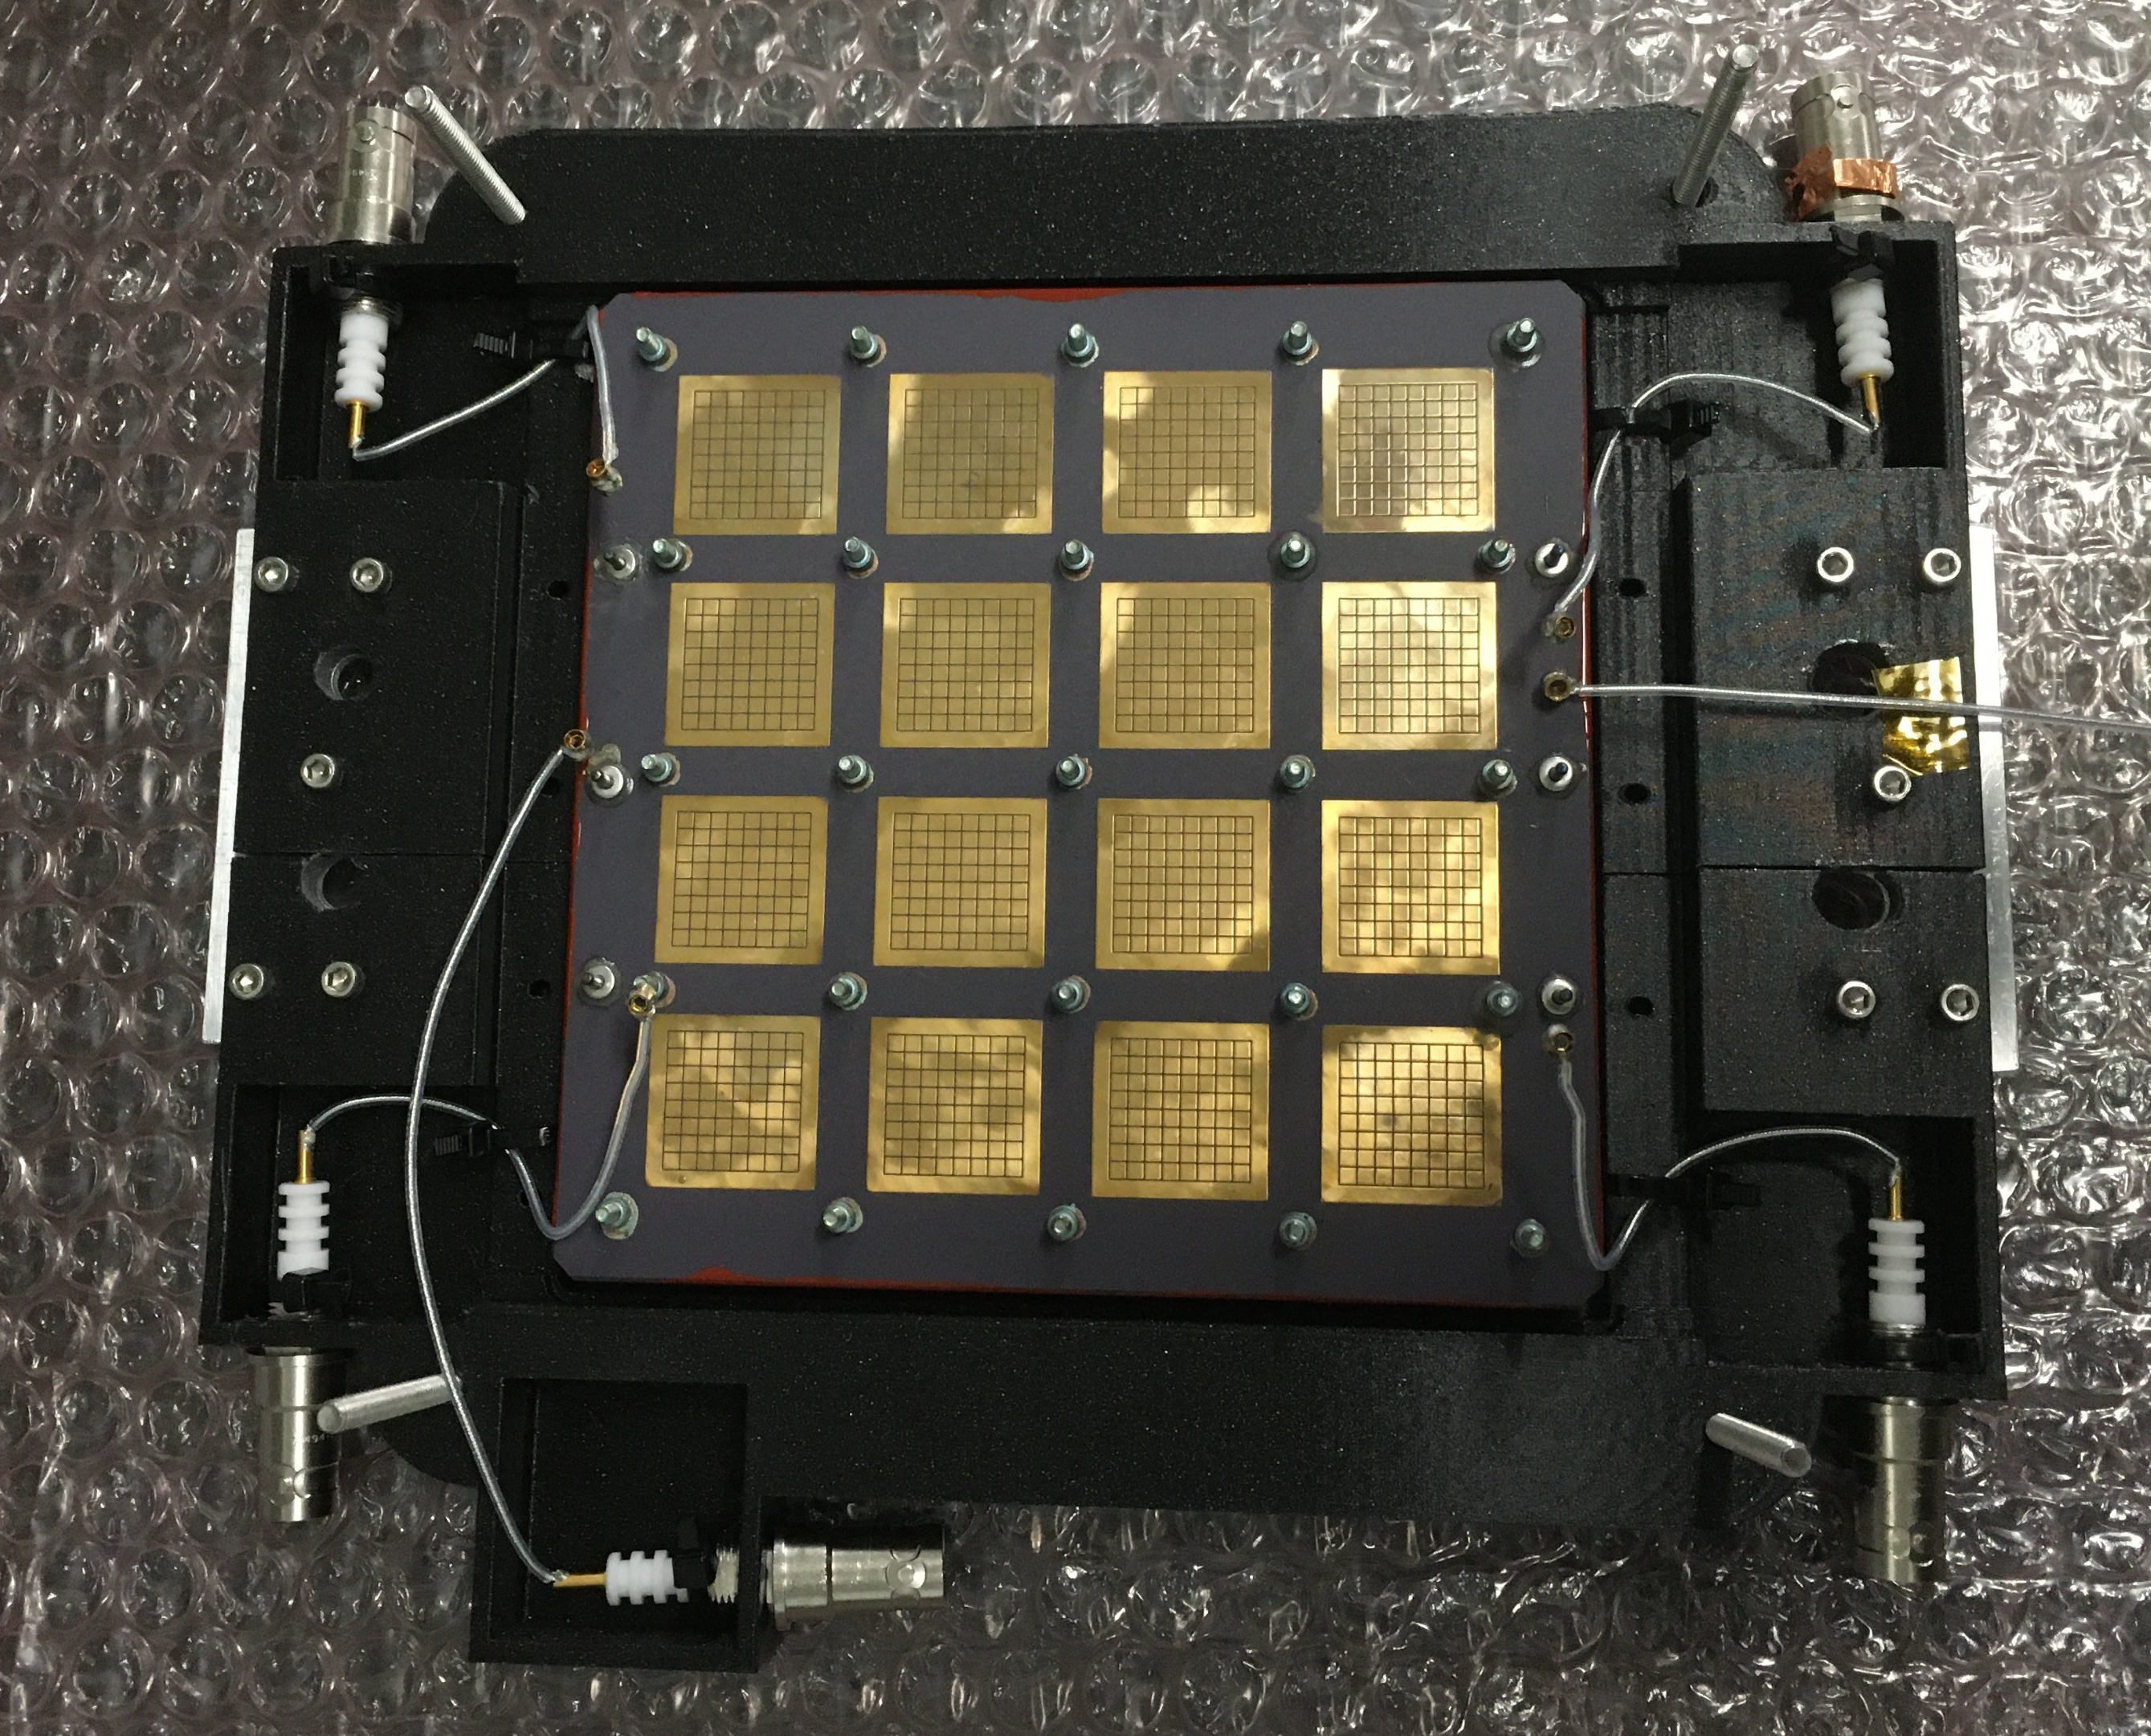
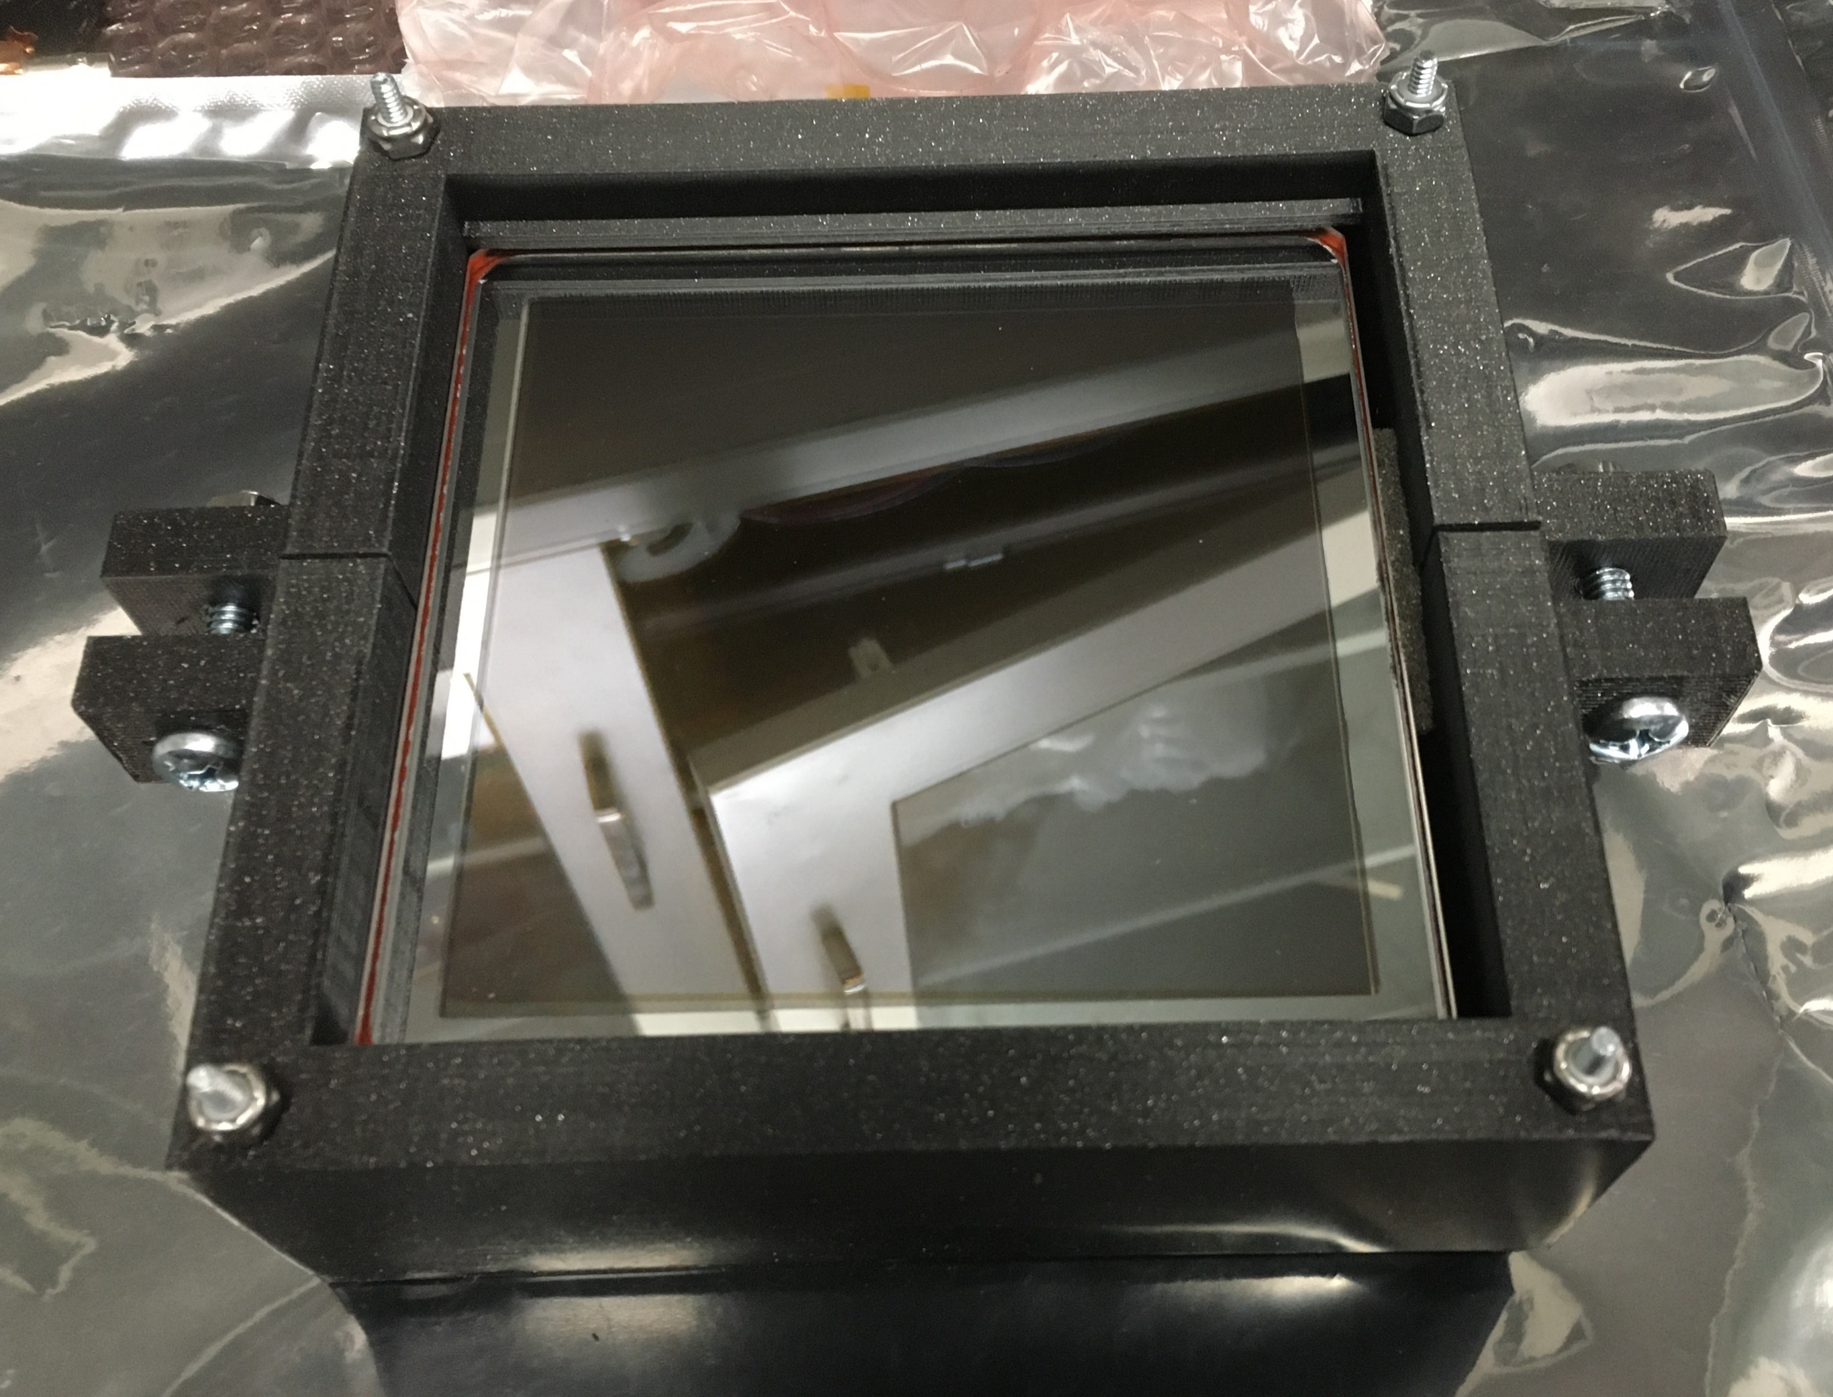
Summary: HRPPD Production
Five directly-coupled HRPPDs were delivered to the EIC project for evaluation.
Quantum efficiency was high for all units, with an average of 33% at 365 nm across the five.
Gain was high at low MCP voltages, providing margin for operation in a magnetic field.
Low voltage MCP operation may reduce afterpulsing, therefore extending the life of the photocathodes. Life testing will be performed on additional devices.
A ceramic multilayer anode and signal board have been developed to collect 1024 discrete pixels into a manageable connection interface. Electronics appropriate to any application may be mated to the signal board.
Early development issues with board attachment occurred, and will be addressed in the next revision of the ceramic anode.
HRPPD 18

