Slide 1
Bottomonium suppression in p-Pb collisions at LHC energies
Sabin Thapa
Kent State University
Primary references: M. Strickland, S. Thapa, & R. Vogt (2024). Bottomonium suppression in 5.02 and 8.16 TeV p-Pb collisions, arXiv:2401.16704.
S. Thapa, R. Vogt, M. Strickland, R. Rapp, B. Wu, & J. Boyd (In Prep). Semi-classical treatment of bottomonium suppression in p-Pb collisions.

Slide 2
Outline
INTRODUCTION & MOTIVATION
COLD NUCLEAR MATTER EFFECTS
Nuclear Modification of Parton Distribution Functions (nPDFs)
Energy Loss & Momentum Broadening
HOT NUCLEAR MATTER EFFECTS
Quantum Transport Model
Semi-Classical Transport Model
RESULTS
CONCLUSION & OUTLOOK

Slide 3
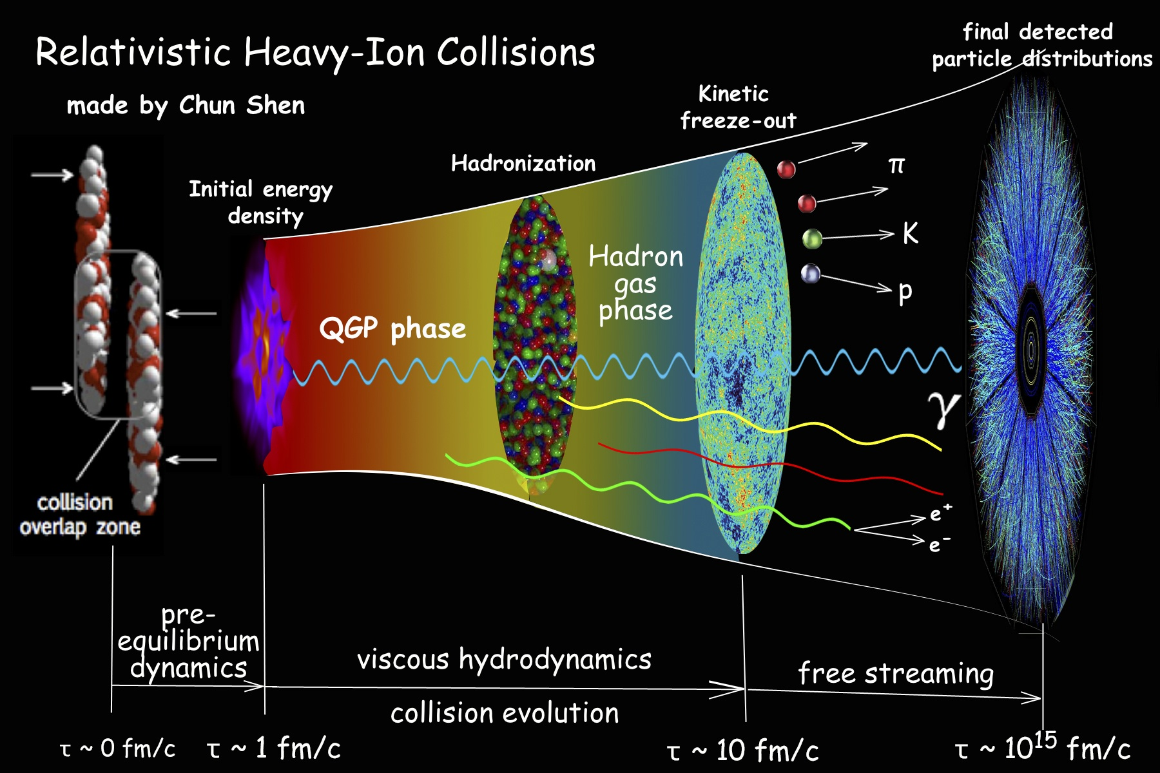
INTRODUCTION & MOTIVATION
Asymptotic freedom of QCD ➔ deconfined phase of QCD matter at high temperature / density, called QGP
Provides a glimpse of the early universe when it was in this state
To Study QGP: heavy-ion collision experiments at RHIC and LHC
Hard probes of QGP: heavy quarks, quarkonia, and jets
(Pic credit: Paul Sorensen and Chun Shen, 1304.3634)

Slide 4
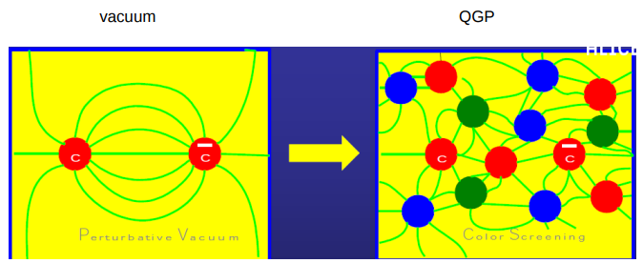
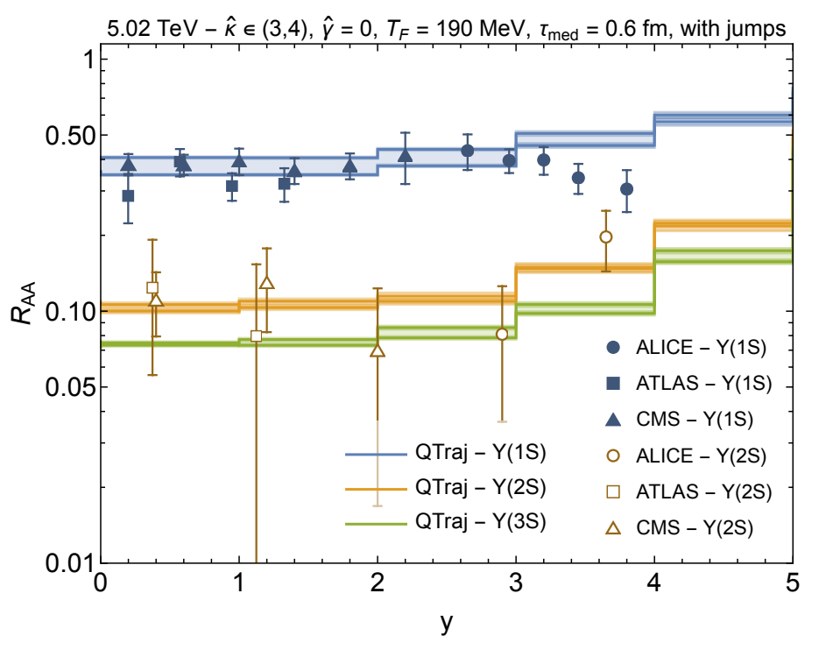
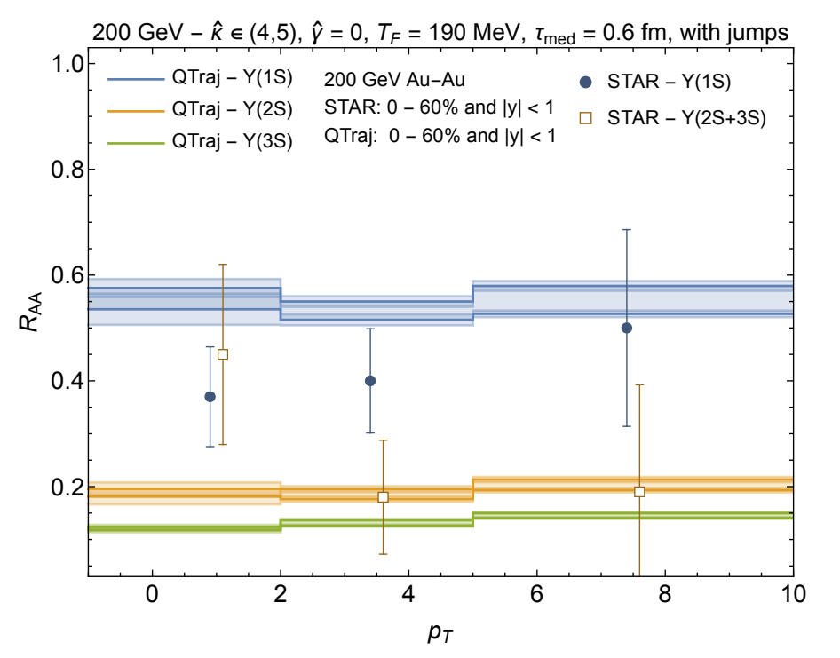
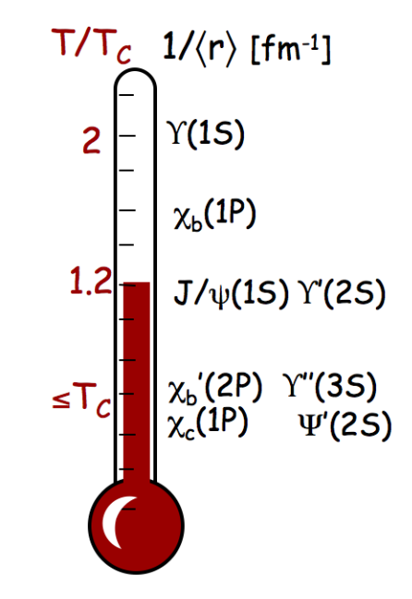
INTRODUCTION & MOTIVATION
Matsui, Satz (1986): Quarkonia inside QGP suppressed due to color screening → Quarkonia dissociation (static) in hot medium
Sequential melting of Quarkonia States in Pb-Pb Collision at LHC energies (& RHIC energies) ➔ QGP Formation
Recent Understanding: Other dynamical effects may be more important: large spectral widths
Lattice calculations: No thermal mass shift for bottomonia, but large widths
Both at LHC & RHIC energies, QGP effect cannot explain the experimental observations on the quarkonium (Upsilon here) suppression; we need to understand the possible effect of cold nuclear matter, and disentangle it from the hot nuclear matter effect
Mocsy, Petreczky, and Strickland, 1302.2180
M. Strickland & S. Thapa (2023) 2305.17841

Slide 5
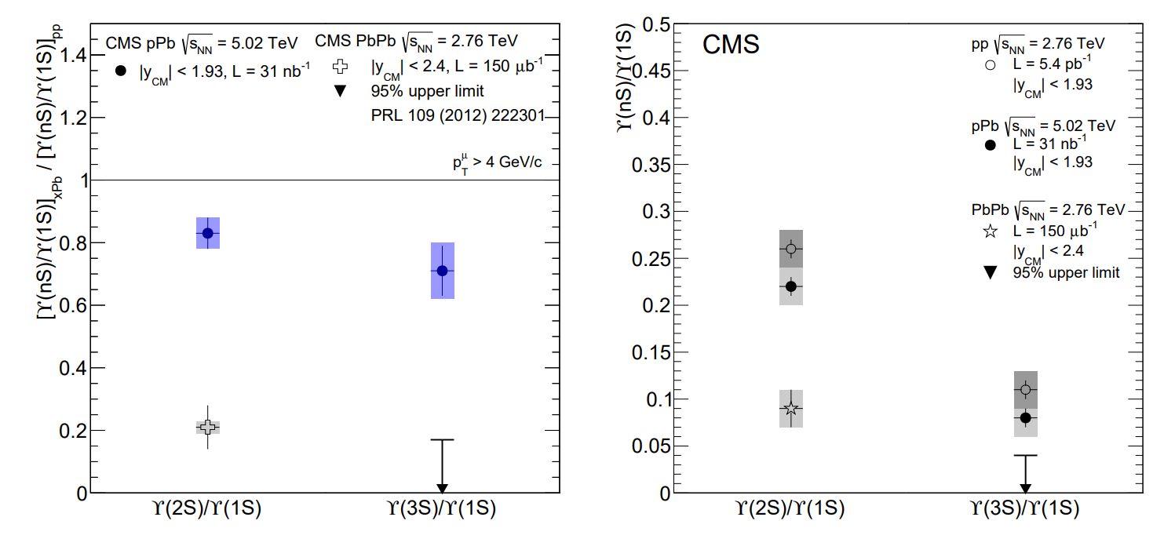
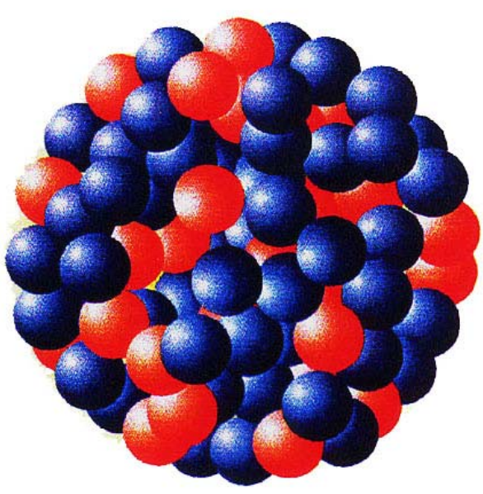
INTRODUCTION & MOTIVATION
Observables at RHIC and LHC reveal a smooth transition between proton-proton, proton-nucleus, and nucleus-nucleus collisions
In p-Pb collisions at LHC energies, excited bottomonium states Υ(2S) and Υ(3S) are suppressed more than the ground state Υ(1S)
At low energies or small systems, relative suppression may arise from final-state interactions, potentially involving hot QGP effects.
Possibility of formation of short-lived QGP in p-A collisions. ​
The p-Pb ratios are larger than the corresponding Pb-Pb ones. Suggest stronger final state effects on the excited Upsilon states in p-Pb vs p-p; more studies needed on Upsilon yields in pp and peripheral Pb-Pb events.
CMS Collaboration, 1312.6300, 2202.11807

Slide 6
COLD NUCLEAR MATTER (CNM) EFFECTS
Nuclear Modification of Parton Distribution Functions (nPDFs)
NLO EPPS21 nPDFs used.
NLO EPPS21 has 24 fit parameters, for 49 total sets: one central set and 48 error sets.
The p-A cross section by Color Evaporation Model (CEM) given by,
Eskola et al. (2021). 2112.12462
The Υ production p-p cross section by Color Evaporation Model (CEM):
Bound Nucleon parton density:
Partonic cross section for initial state ij with,
Nuclear modification of parton densities
CT10 proton PDFs used
Lai, Hung-Liang et al (2010), 1007.2241
Free proton parton density:

Slide 7
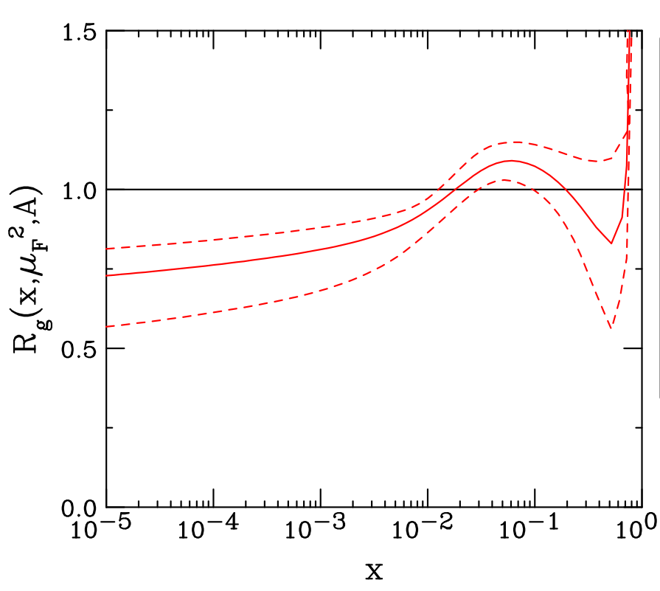
COLD NUCLEAR MATTER (CNM) EFFECTS: nPDFs
EPPS21 ratios
Bjorken x vs y for quarkonium production
Ballpark LO estimate for $g + g → Υ\left(1s\right)$ $$x_{1,2} = \frac{M}{\sqrt{s_{NN}}}e^{±y_{CM}}$$
Proton-going: x₂ < 0.01 → shadowing Lead-going: 0.02 < x₁ < 0.3
Gavai, Kharzeev, Satz, Schuler, Sridhar, Vogt (1995). hep-ph/9502270
Ma & Vogt (2016). 1609.06042

Slide 8
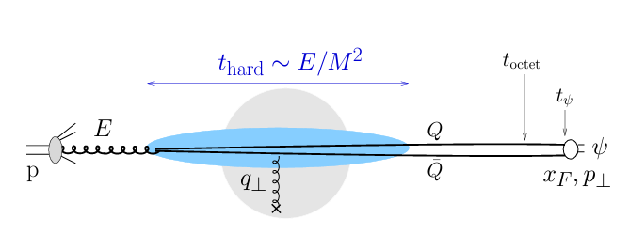
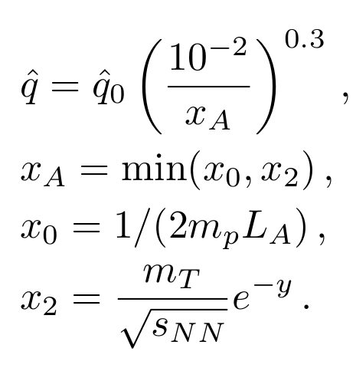
Energy Loss & Momentum Broadening
In terms of the rapidity shift δy and transverse momentum broadening δp_{T}, the quarkonium double differential cross section in p-A collision with respect to that in p-p collisions:
Arleo, Kolevatov, Peigne, Rustamova (2013), 1304.0901
Arleo & Peigne, Rustamova (2013), 1212.0434
q̂ = transport coefficient,
L_{A} = effective path length of nucleus A
Transverse momentum broadening:
Proton-proton cross-section parameterized as:
=10.41 fm for Pb (A = 208)
Transverse momentum broadening in pA collision:
For Υ states ,
8

Slide 9
HOT NUCLEAR MATTER EFFECTS: QGP Effects on Quarkonia
Why HNM in p-A? ➔ Differences in Upsilon state suppression in HNM are bigger than can be obtained from CNM effects
Quarkonium Suppression in the QGP​
Quarkonia (Bottomonia, Charmonia) states propagate through QGP, & interact with the nuclear medium
Bound states can break up and may regenerate due to in-medium transitions induced by in-medium gluon absorption and emission ➔ Sequential Suppression
Different approaches to study the quarkonium dynamics in the QGP: Quantum & Semi-Classical
Bottomonia are excellent probes of the QGP
Bottomonium states produced locally (hard processes) at early times
Large mass (m ~ 10 GeV), system is non-relativistic (v << 1, v_{b} ~ 0.1) ➔ exploit the scale separation ➔ systematic description by EFTs (heavy quark effective theory like pNRQCD)
The masses of bottomonia (m ~ 10 GeV) much higher than the temperature generated in Heavy Ion Collisions (T < 1 GeV) ➔ Bottomonium production dominated by initial hard scatterings. Produced very early times ➔ provide history of what’s happening in the plasma
Both closed and open bottom production is quite rare in RHIC and LHC energy Heavy Ion Collisions ➔the probability regeneration of bottomonia through statistical recombination is much smaller than for charm quarks; less model uncertainty.
E. Emerick, X. Zhao, and R. Rapp, 1111.6537
Mocsy, Petreczky, and Strickland, 1302.2180

Slide 10
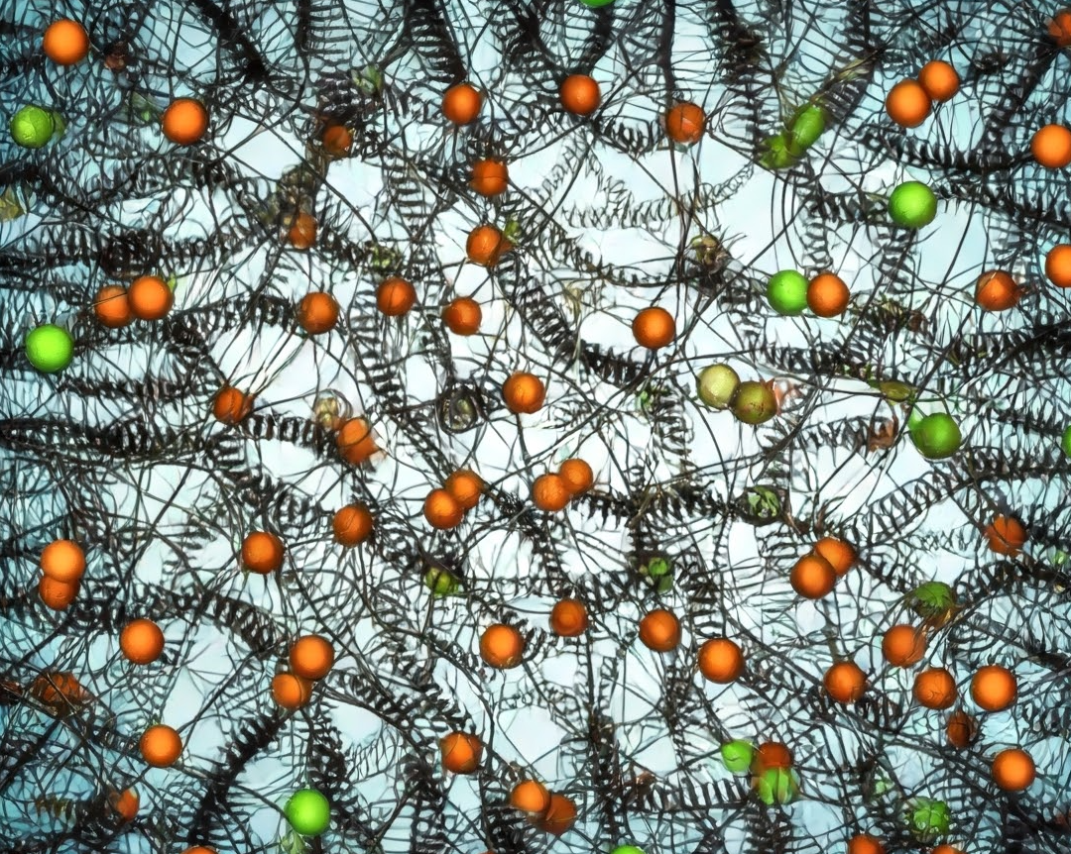
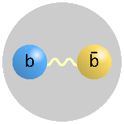
HOT NUCLEAR MATTER EFFECTS: QGP Effect in the Quarkonia
Quantum Transport Model:
KSU-Munich Approach (OQS + pNRQCD)
Environment / Bath : QGP
Bottomonium system is an open quantum system: it interacts with the QGP medium / environment
HI
Reduced Density Matrix of the System:
(Non-Unitary Evolution)
Open Quantum System: Bottomonium
HS
Lindblad Master Equation: Open Quantum System (OQS) + pNRQCD
HE
Following the hierarchy of scales, M >> 1/a₀ >> (π) T ∼ m_{D} >> E_{b}, at NLO pNRQCD in E_{b} / T, the Lindblad-Gorini-Kossakowski-Sudarshan Master Equation:
[1] Bra mbilla, Escobedo, Islam, Strickland, Tiwari, Vairo & Vander Griend (2022/23), 2205.10289, 2302.11826 , Strickland &Thapa (2023), 2305.17841, Omar et al. (2021) QTRAJ 1.0, 2107.06147
[2] G. Lindblad, Commun. Math. Phys. 119, 48 (1976); V. Gorini, A. Kossakowski, and E.C. Sudarshan, J. Math. Phys. 17, 821 (1976)
Hamiltonian of the System
Density Matrix of the (open) Bottomonium System
Jump Operators

Slide 11
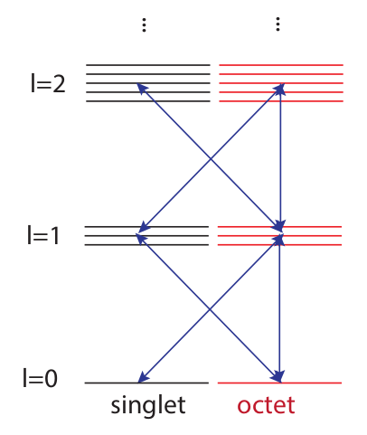
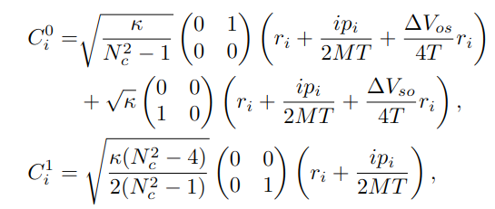
KSU-Munich Approach: OQS + pNRQCD
Reduced density matrix & Hamiltonian of the system (decomposed into singlet & octet):
Transport Coefficients:
QTRAJ-NLO 2205.10289, QTRAJ 1.0 2107.06147
The imaginary part of the potential causing the decay of the Upsilon states in the medium (dynamical screening from QGP medium), and depend on the transport coefficients, kappa and gamma.
kappa: k(T) heavy quark momentum diffusion coefficient responsible for the large thermal width in the QGP medium,
gamma: γ(T) (dispersive counterpart of kappa) responsible for the thermal mass shift (= 0 for Upsilon states)
Larsen, Meinel, Mukherjee, Petreczky (2019) 1908.08437
Bala, Kaczmarek, Larsen, Mukherjee, Parkar, Petreczky, Rothkopf, Weber (2022) 2110.11659
Jump/Collapse Operators:
➔ Effect of the medium causing transition between singlet & octet states
In addition to kappa and gamma as inputs, we also have the temperature experienced by the bottomonium state along its propagation through the QGP (along with its physical trajectories coupled to background 3D viscous hydrodynamical evolution)

Slide 12
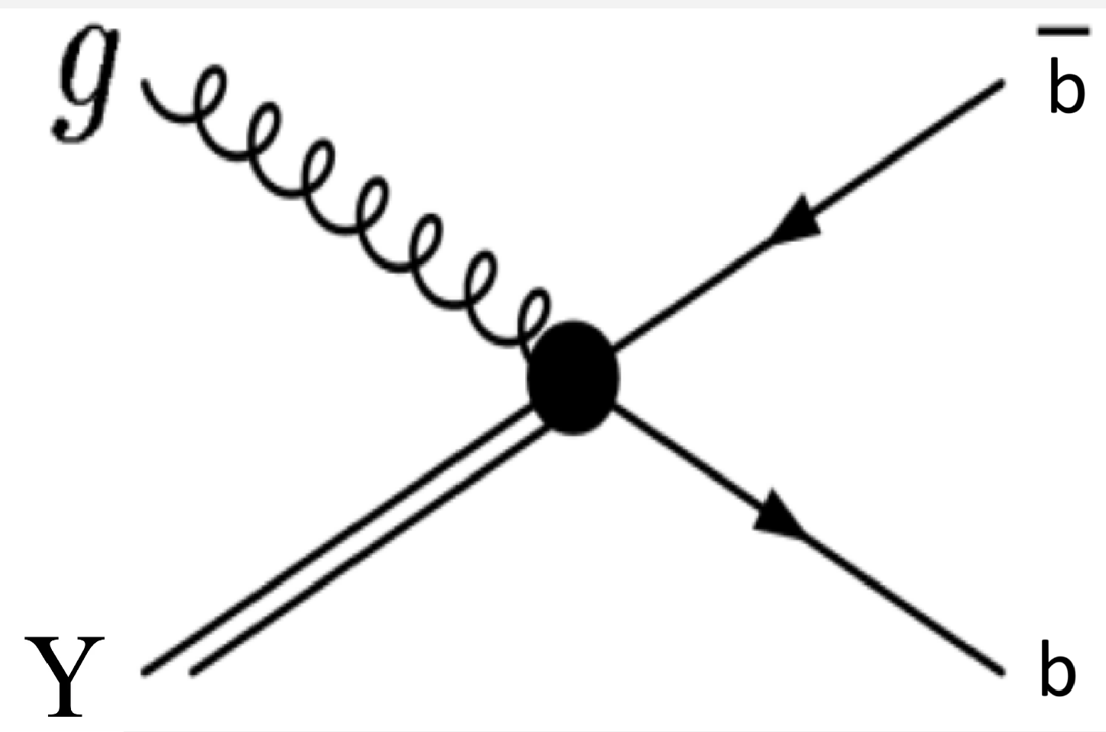
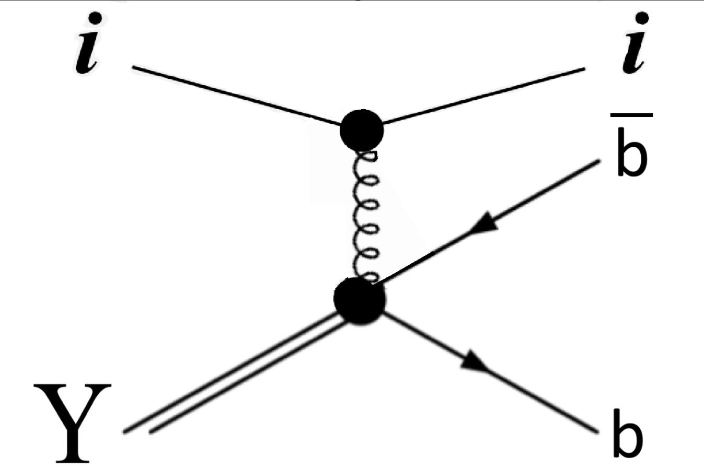
HOT NUCLEAR MATTER EFFECTS: QGP Effect in the Quarkonia
Semi-classical Transport Model: TAMU
Rapp, Zhao, Emerick (2012) 1111.6537, Du, He (2017/18), 1706.08670, 1808.10014
Rapp, Wu (2024) 2404.09881
Kinetic Rate Equation for an Upsilon State in terms of loss and gain terms: describes the evolution of number of quarkonia states in the QGP as a function of time
Equilibrium Limit ➔ Depends on bbbar cross section and the thermal environment (QGP fireball)
Reaction Rate ➔ Medium effect on bound Upsilon states (cause decay of bound states into unbound bbbar pairs)
Large binding (E_{B} >= T)
Gluo-dissociation (singlet-to-octet)
Small binding (E_{B} <= m_{D})
Quasi-free dissociation
Primordial Suppression:
Regeneration:
Primordially produced Upsilon states that survive the QGP fireball expansion:
Solution of this gives the number of regenerated Upsilon states:

Slide 13
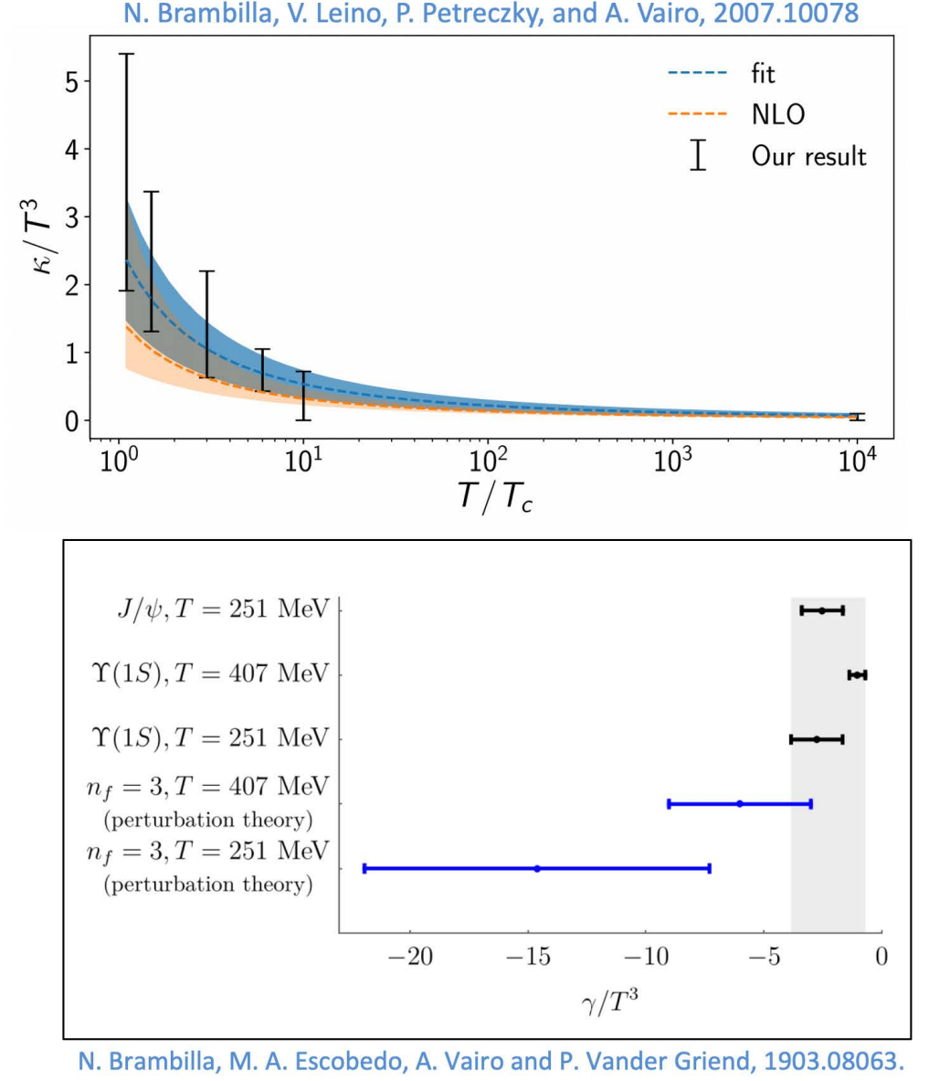
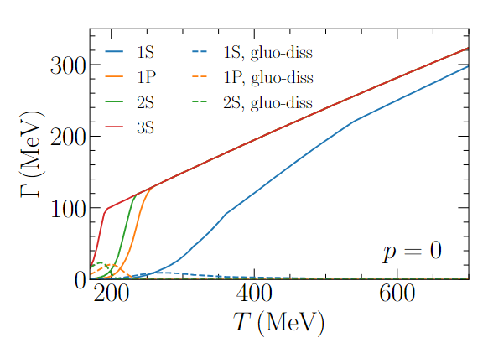
Reaction Rates of Bottomonia in KSU-Munich & TAMU
KSU-Munich Approach
TAMU Approach
In this approach, the effect of the QGP medium in the quarkonia states (Upsilon (nS)) are encoded in the heavy quark transport coefficients: kappa & gamma) [constrained by the Lattice QCD calculations]
Here, hot QGP effect encoded in the inelastic reaction rate (Γ) & Equilibrium Number
Reaction Rates: Calculated in two different scenarios, both evaluated within the thermodynamic T-matrix approach by TAMU group
First approach: based on finite-temperature internal-energy potential from the quarkonium interaction, use lQCD constraints for the bottom-quark mass and bottomonium binding energies, use quasifree approximation to compute the bottomonium dissociation rates using a perturbative coupling to the thermal medium
Kappa value from the NLO fits to recent lattice measurements of heavy quark transport coefficient ➔ related to the heavy quark diffusion constant
The value of gamma is less constrained, and taken to be 0 (no mass shift for Upsilon)
Reik, Rapp (2010), 1005.0769
Second scenario: Recent calculations with in-medium potential constrained by lQCD data, using Wilson Line Correlators (WLCs) (Upcoming)
Z. Tang, B. Wu, & R. Rapp, Quarkonium spectroscopy in the quark-gluon plasma (2025), in preparation.

Slide 14
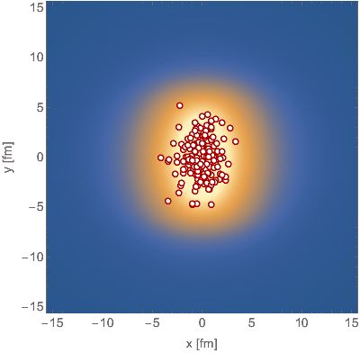
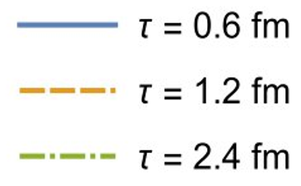
Background Evolution: (3+1)D aHydro
Temperature evolution for the QGP background provided by anisotropic hydrodynamics.
Quasiparticle anisotropic hydrodynamics (aHydroQP): good description of identified hadron spectra.
Alqahtani, Nopoush, Strickland (2017), 1712.03282
Alqahtani, Nopoush, Strickland (2015), 1509.02913

Slide 15
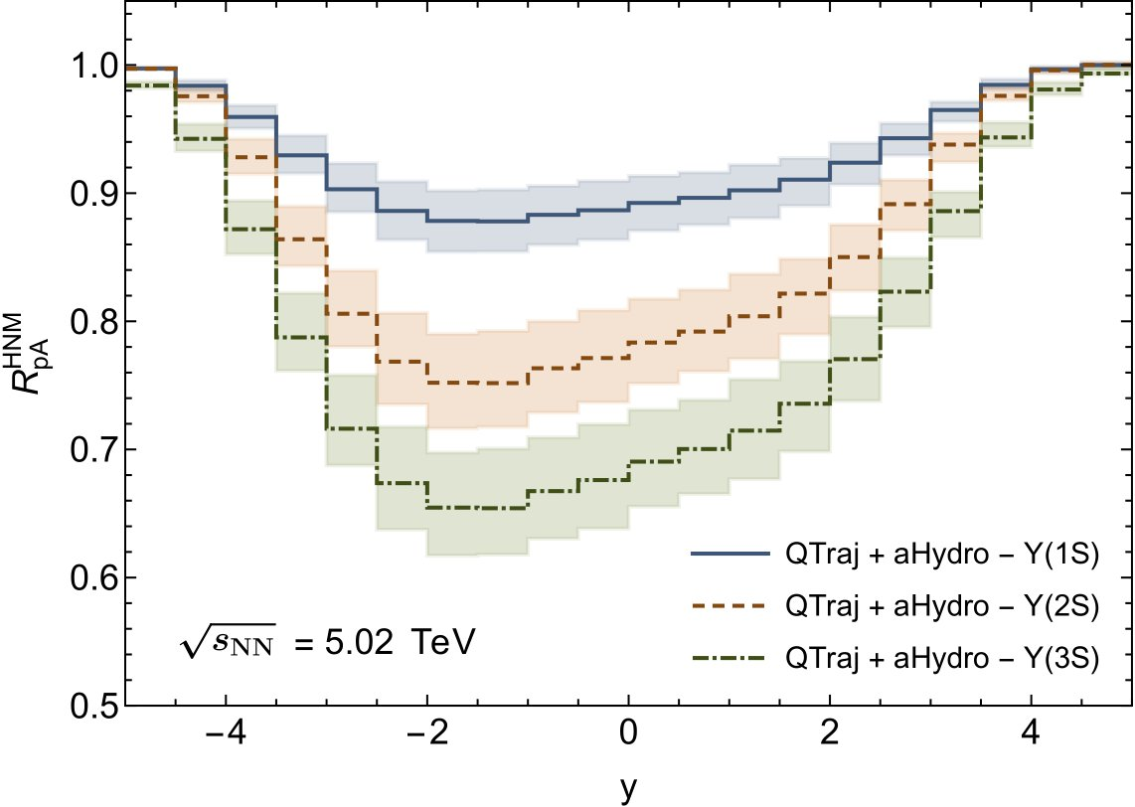
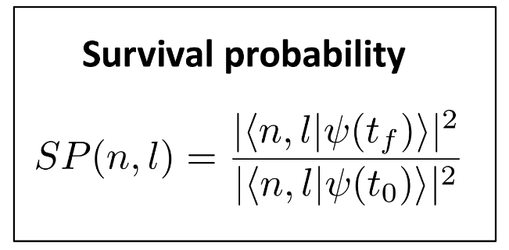
Quarkonium Suppression in the QGP
Shoot bottomonia through the plasma
Calculate Survival Probability as a function of transverse momentum (p_{T}) and rapidity (y).
QTRAJ 1.0, 2107.06147​ QTRAJ-NLO, 2205.10289
QGP-induced suppression of Bottomonium States (using QTraj + aHydro) at 5.02 TeV p-Pb collision

Slide 16
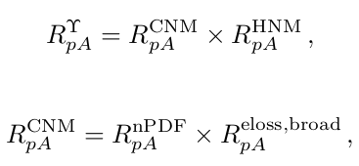
Combining All the Effects
After calculating all the effects separately, we can get the total suppression of the Bottomonia states as,

Slide 17
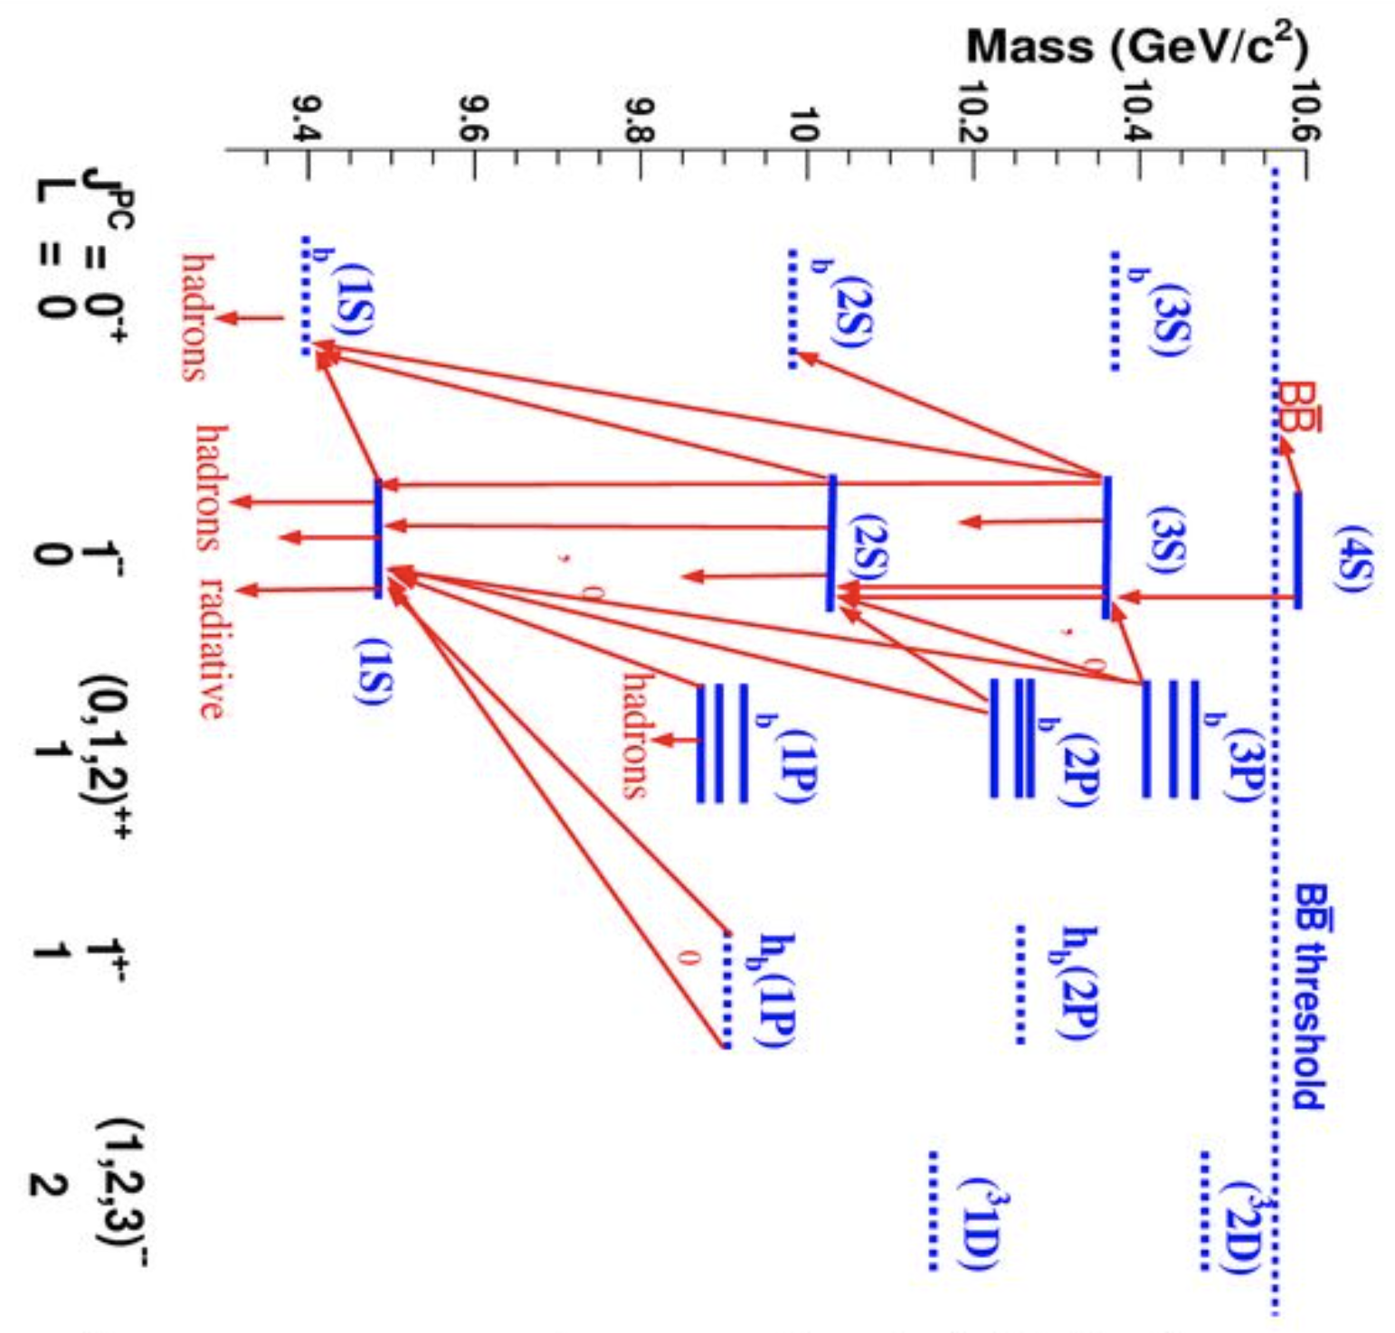
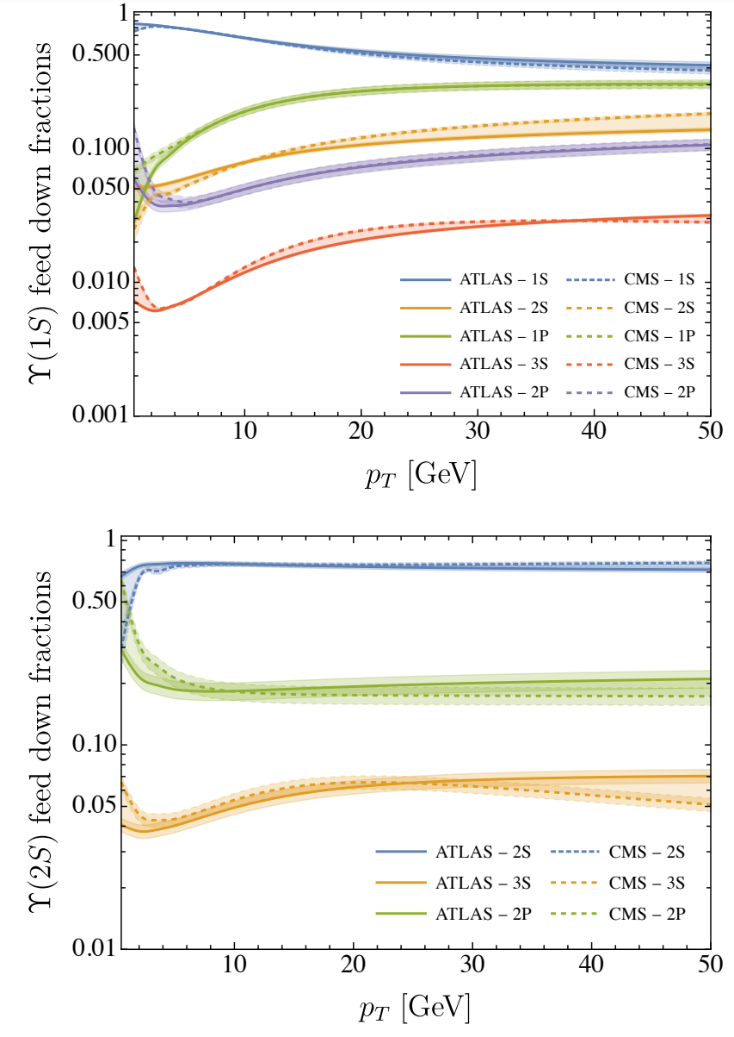
Feed-down Contribution
Approx. 75% of 1S and 2S yield from direct production, but important feed-down contributions from the 1P and 2P states. We include all known excited state feed-down channels.
Υ(1S, 2S) feed-down fractions as a function of transverse momentum (pT):
Feed-down contribution:
Boyd, Thapa, and Strickland (2023), 2307.03841

Slide 18
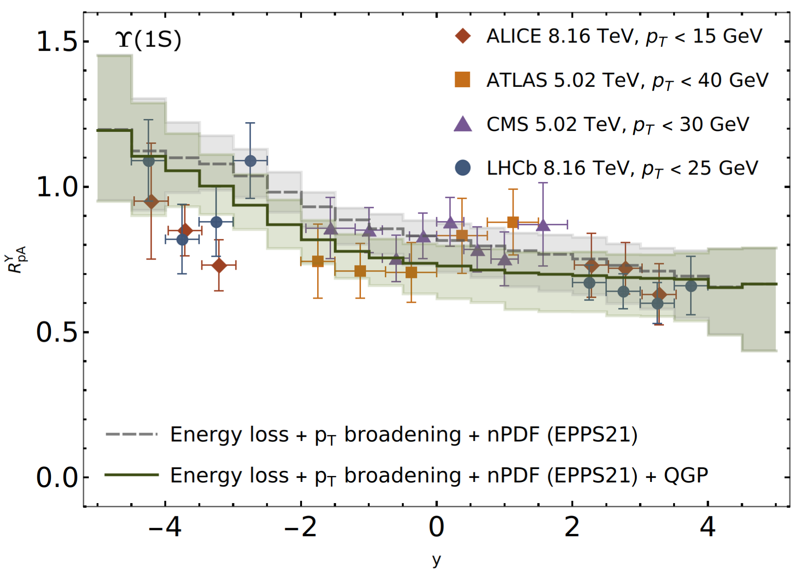
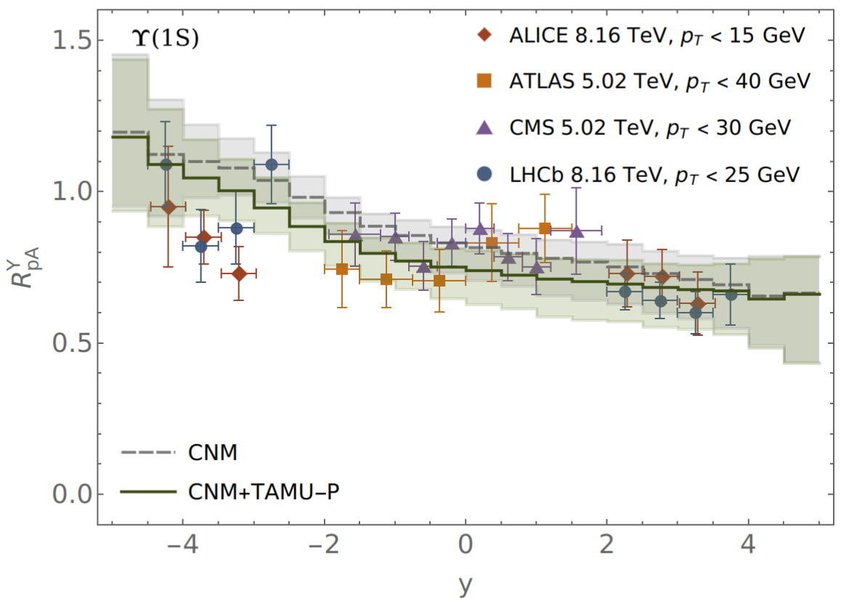
RESULTS: R_{pA} vs y
Strickland, Thapa & Vogt (2024). Bottomonium suppression in 5.02 and 8.16 TeV p-Pb collisions, 2401.16704.
Thapa, Vogt, Strickland, Rapp, Wu, Boyd (In Prep). Semi-classical treatment of bottomonium suppression in p-Pb collisions.

Slide 19
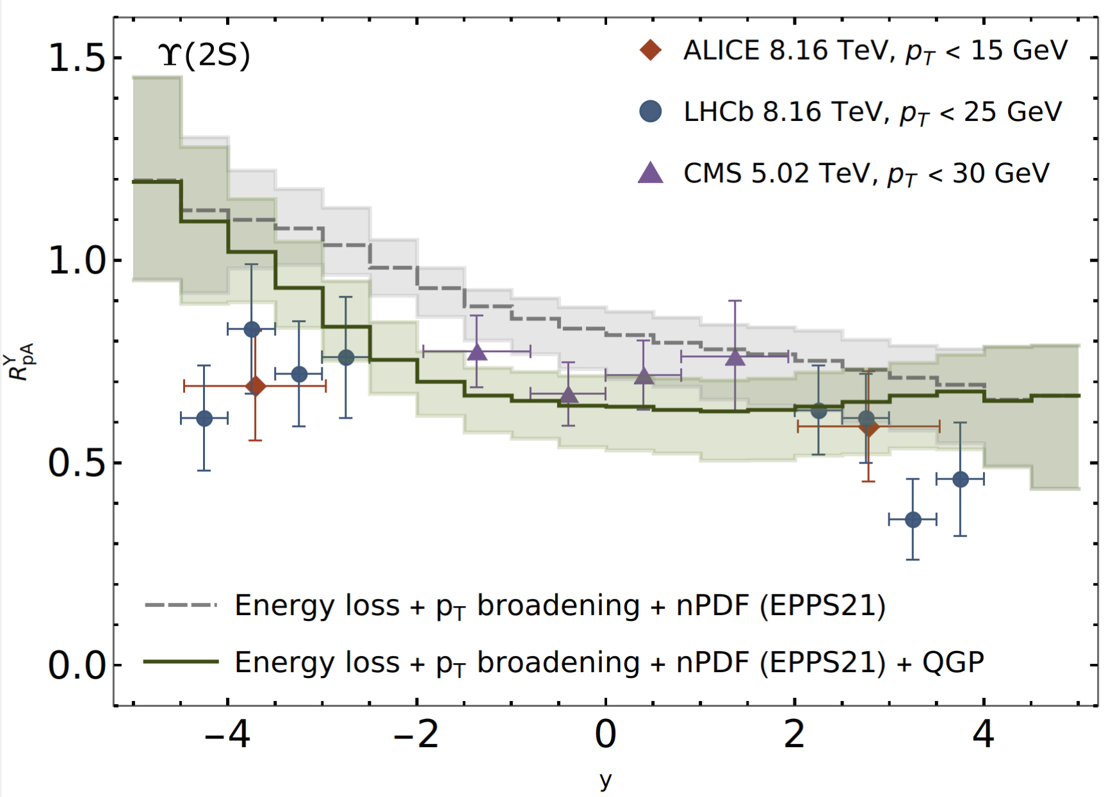
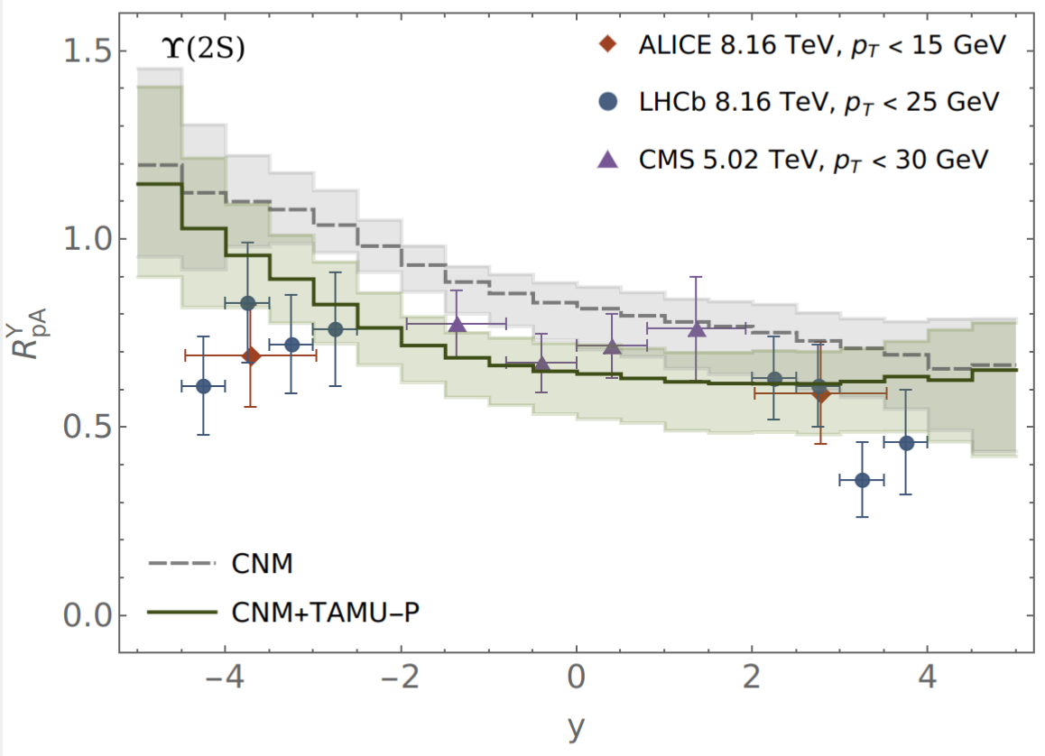
RESULTS: R_{pA} vs y
Thapa, Vogt, Strickland, Rapp, Wu, Boyd (In Prep). Semi-classical treatment of bottomonium suppression in p-Pb collisions.
Strickland, Thapa & Vogt (2024). Bottomonium suppression in 5.02 and 8.16 TeV p-Pb collisions, 2401.16704.

Slide 20
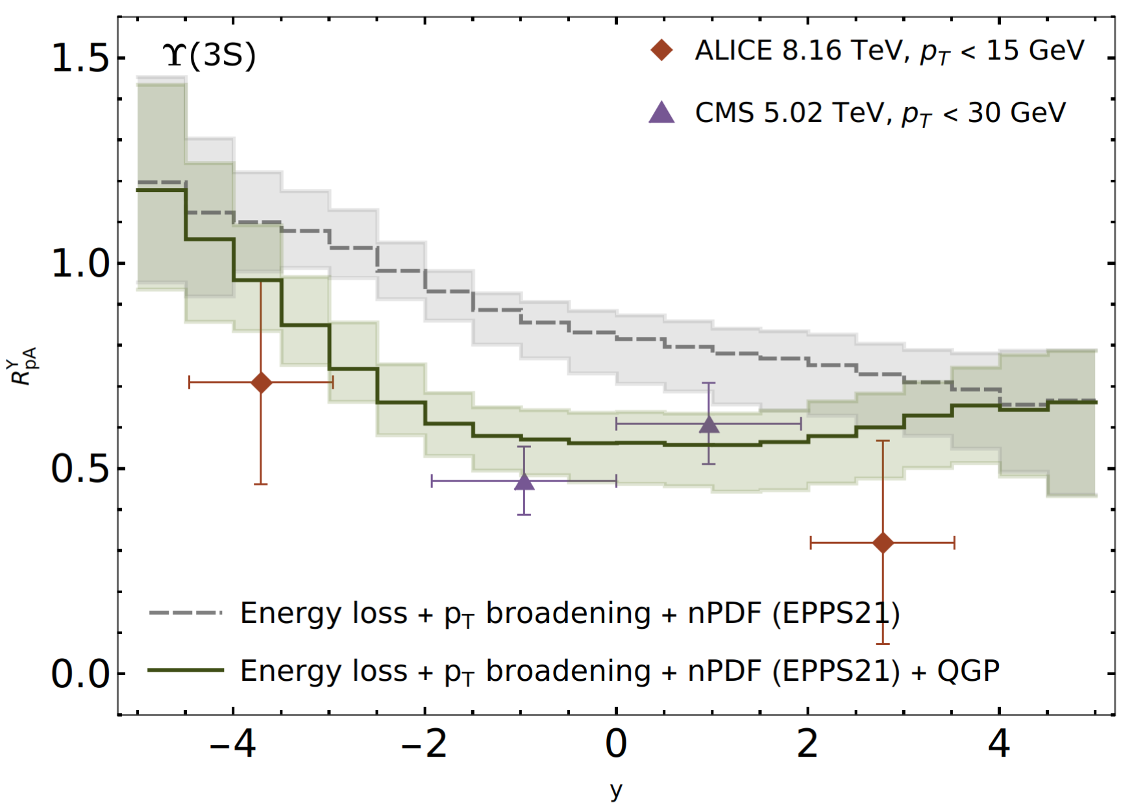
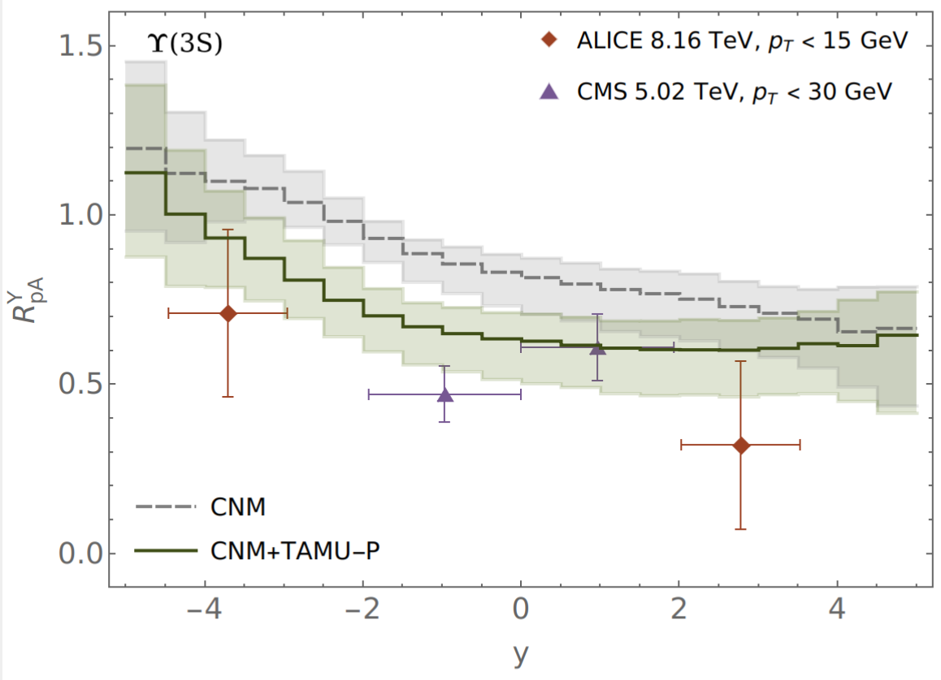
RESULTS: R_{pA} vs y
Strickland, Thapa & Vogt (2024). Bottomonium suppression in 5.02 and 8.16 TeV p-Pb collisions, 2401.16704.
Thapa, Vogt, Strickland, Rapp, Wu, Boyd (In Prep). Semi-classical treatment of bottomonium suppression in p-Pb collisions.

Slide 21
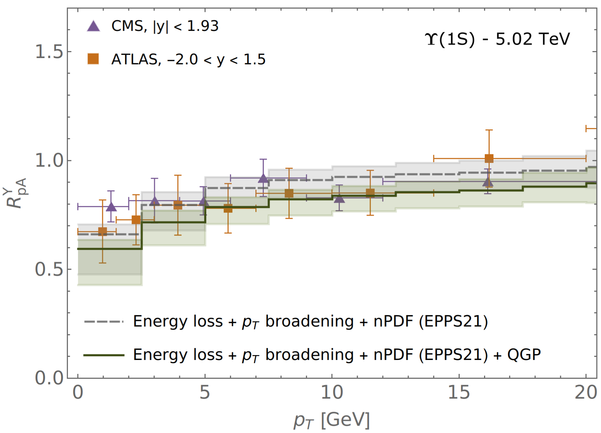
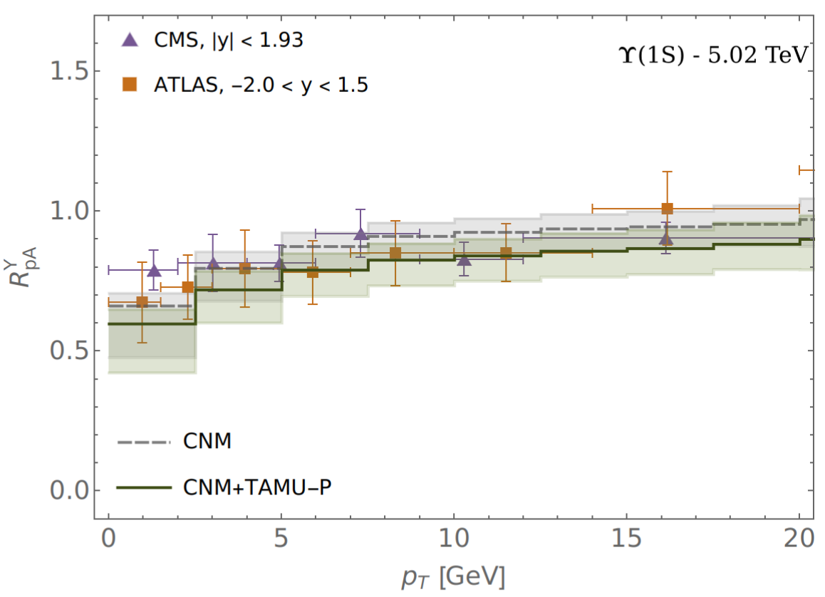
RESULTS: R_{pA} vs p_{T}
Strickland, Thapa & Vogt (2024). Bottomonium suppression in 5.02 and 8.16 TeV p-Pb collisions, 2401.16704.
Thapa, Vogt, Strickland, Rapp, Wu, Boyd (In Prep). Semi-classical treatment of bottomonium suppression in p-Pb collisions.

Slide 22
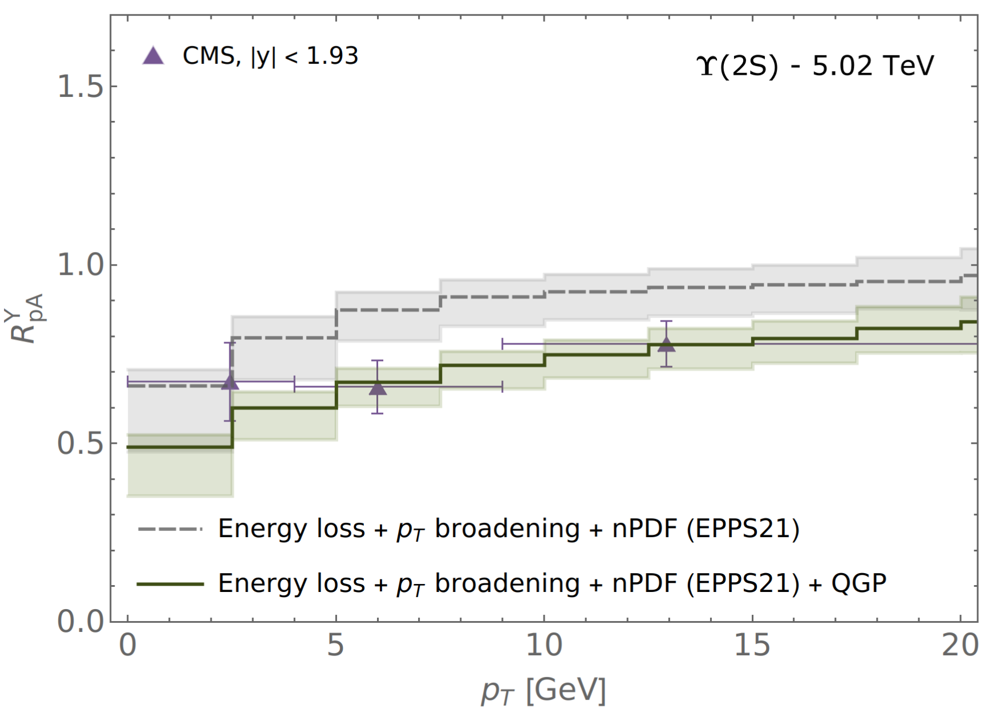
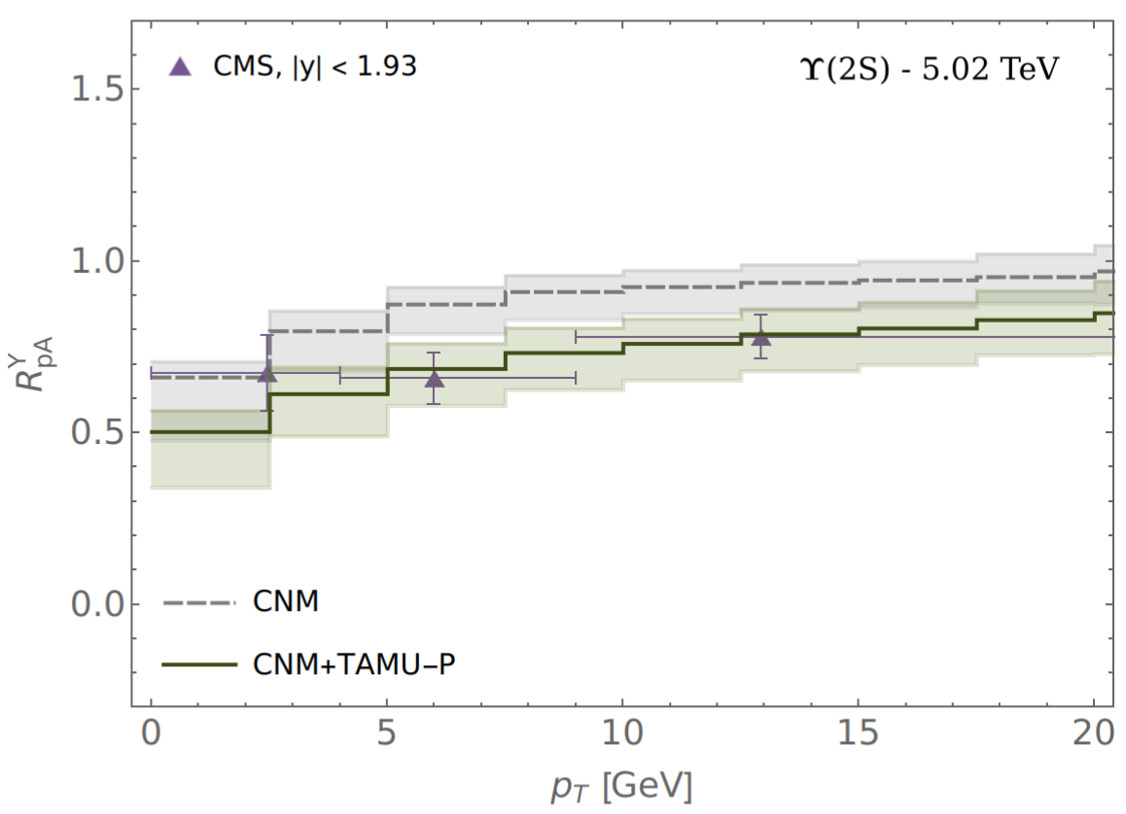
RESULTS: R_{pA} vs p_{T}
Strickland, Thapa & Vogt (2024). Bottomonium suppression in 5.02 and 8.16 TeV p-Pb collisions, 2401.16704.
Thapa, Vogt, Strickland, Rapp, Wu, Boyd (In Prep). Semi-classical treatment of bottomonium suppression in p-Pb collisions.

Slide 23
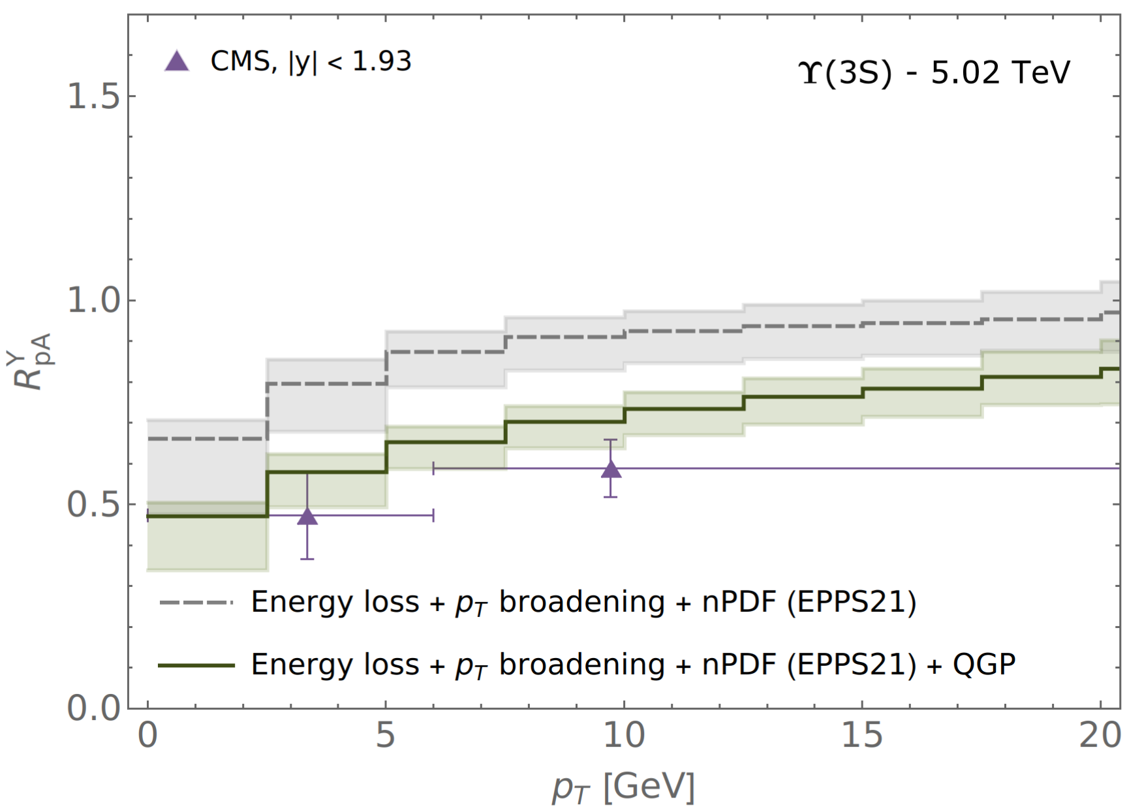
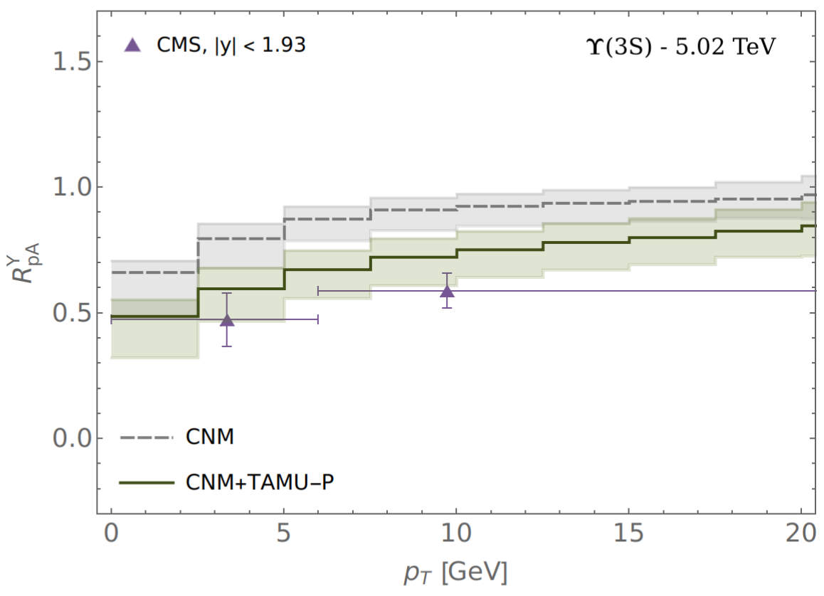
RESULTS: R_{pA} vs p_{T}
Strickland, Thapa & Vogt (2024). Bottomonium suppression in 5.02 and 8.16 TeV p-Pb collisions, 2401.16704.
Thapa, Vogt, Strickland, Rapp, Wu, Boyd (In Prep). Semi-classical treatment of bottomonium suppression in p-Pb collisions.

Slide 24
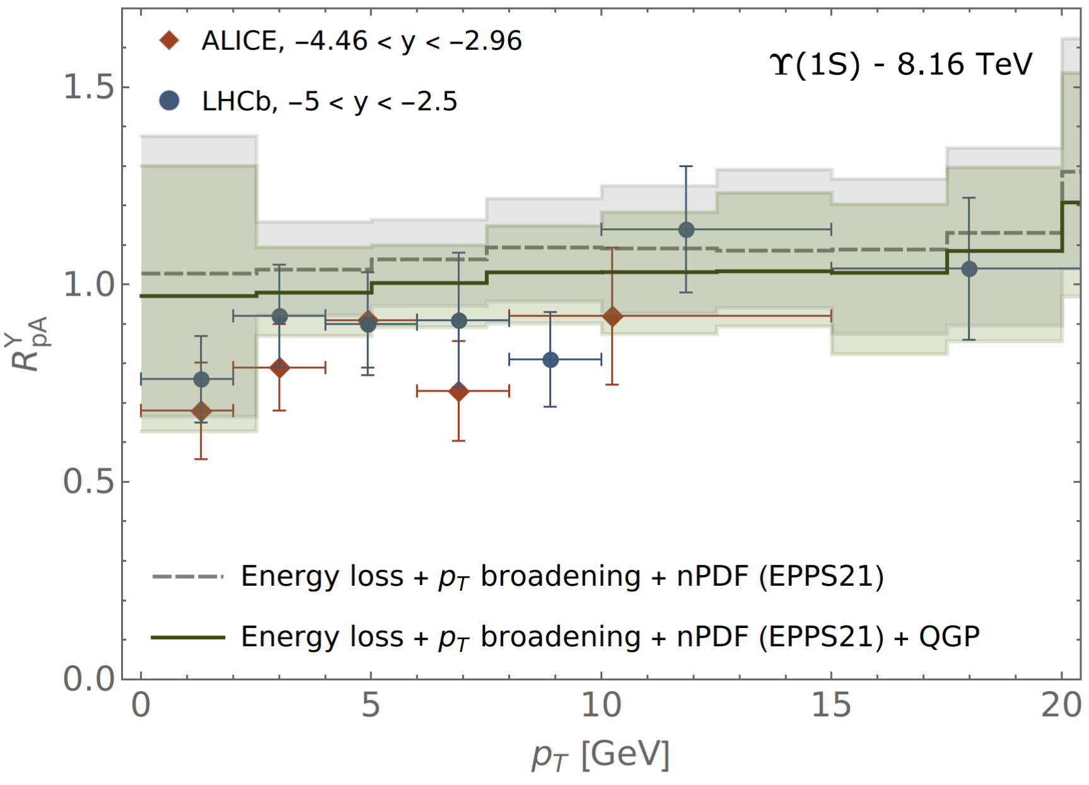
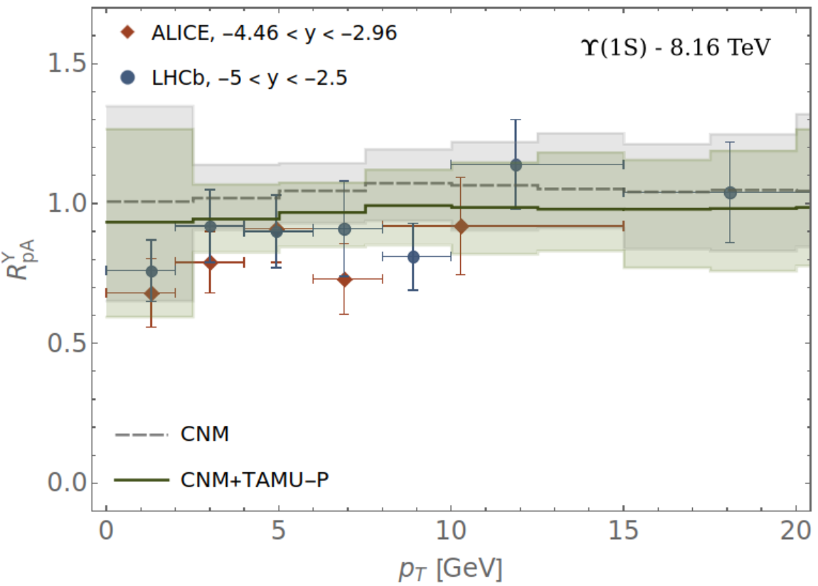
RESULTS: R_{pA} vs p_{T}
Thapa, Vogt, Strickland, Rapp, Wu, Boyd (In Prep). Semi-classical treatment of bottomonium suppression in p-Pb collisions.
Strickland, Thapa & Vogt (2024). Bottomonium suppression in 5.02 and 8.16 TeV p-Pb collisions, 2401.16704.

Slide 25
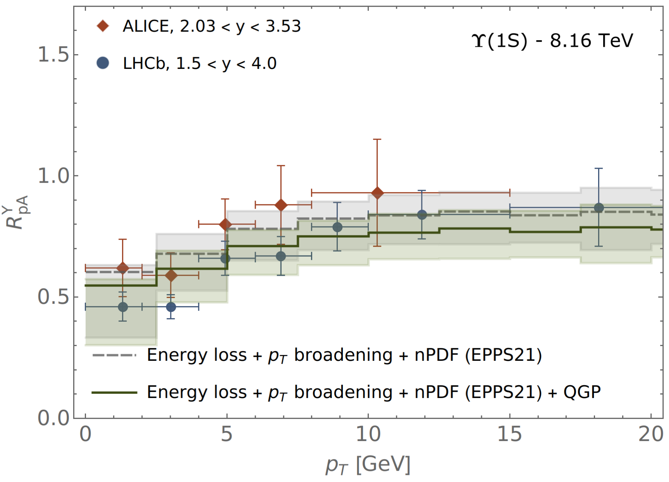
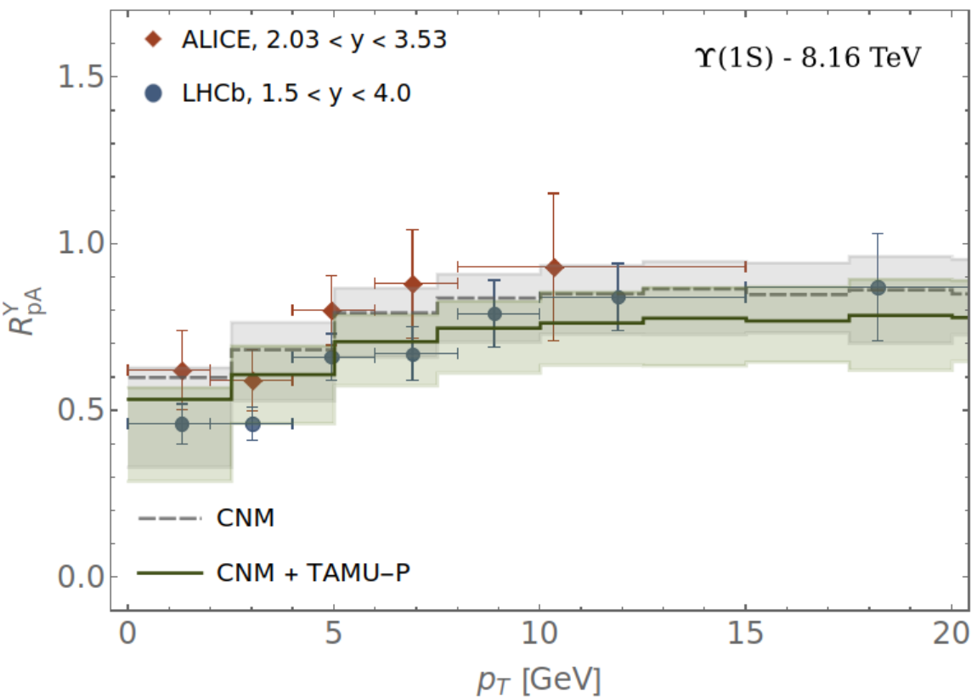
RESULTS: R_{pA} vs p_{T}
Strickland, Thapa & Vogt (2024). Bottomonium suppression in 5.02 and 8.16 TeV p-Pb collisions, 2401.16704.
Thapa, Vogt, Strickland, Rapp, Wu, Boyd (In Prep). Semi-classical treatment of bottomonium suppression in p-Pb collisions.

Slide 26
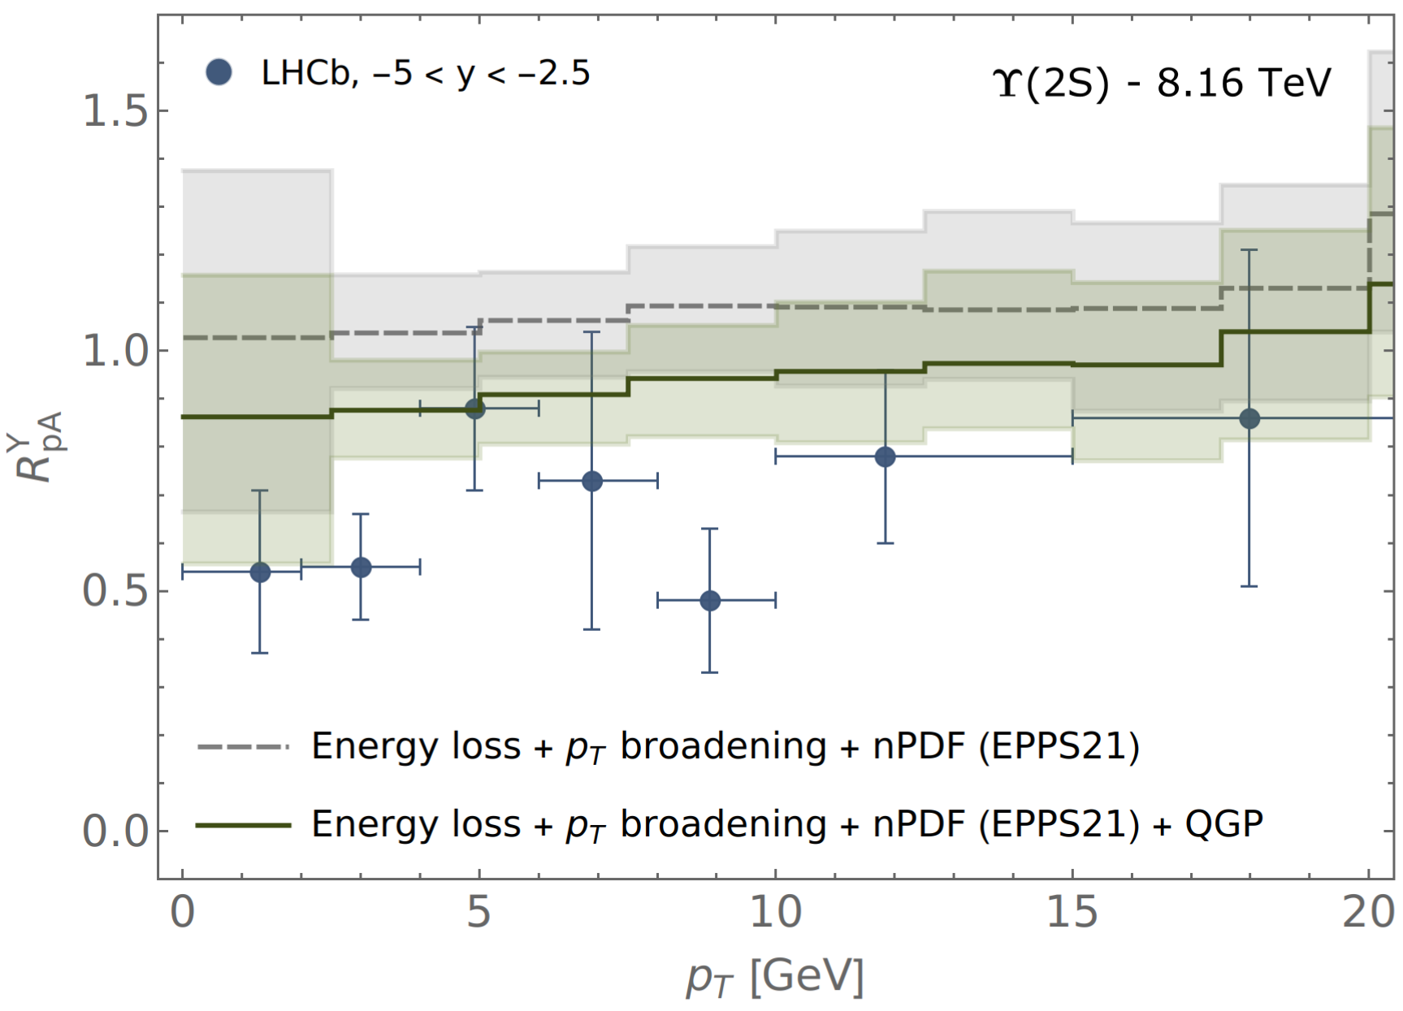
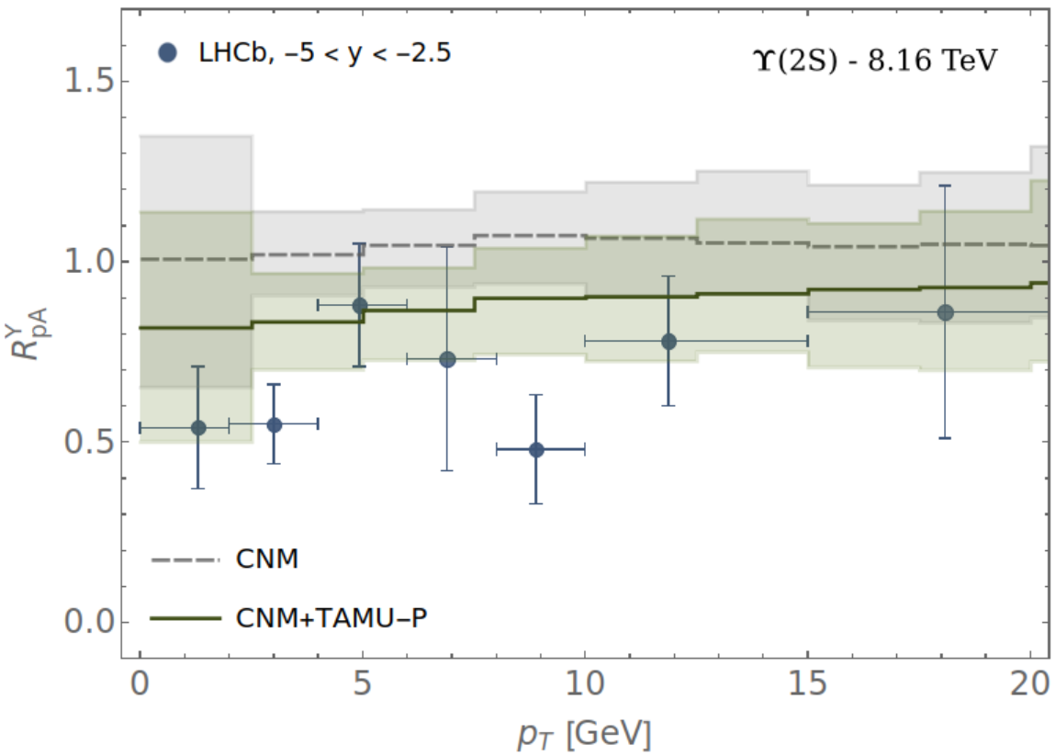
RESULTS: R_{pA} vs p_{T}
Strickland, Thapa & Vogt (2024). Bottomonium suppression in 5.02 and 8.16 TeV p-Pb collisions, 2401.16704.
Thapa, Vogt, Strickland, Rapp, Wu, Boyd (In Prep). Semi-classical treatment of bottomonium suppression in p-Pb collisions.

Slide 27
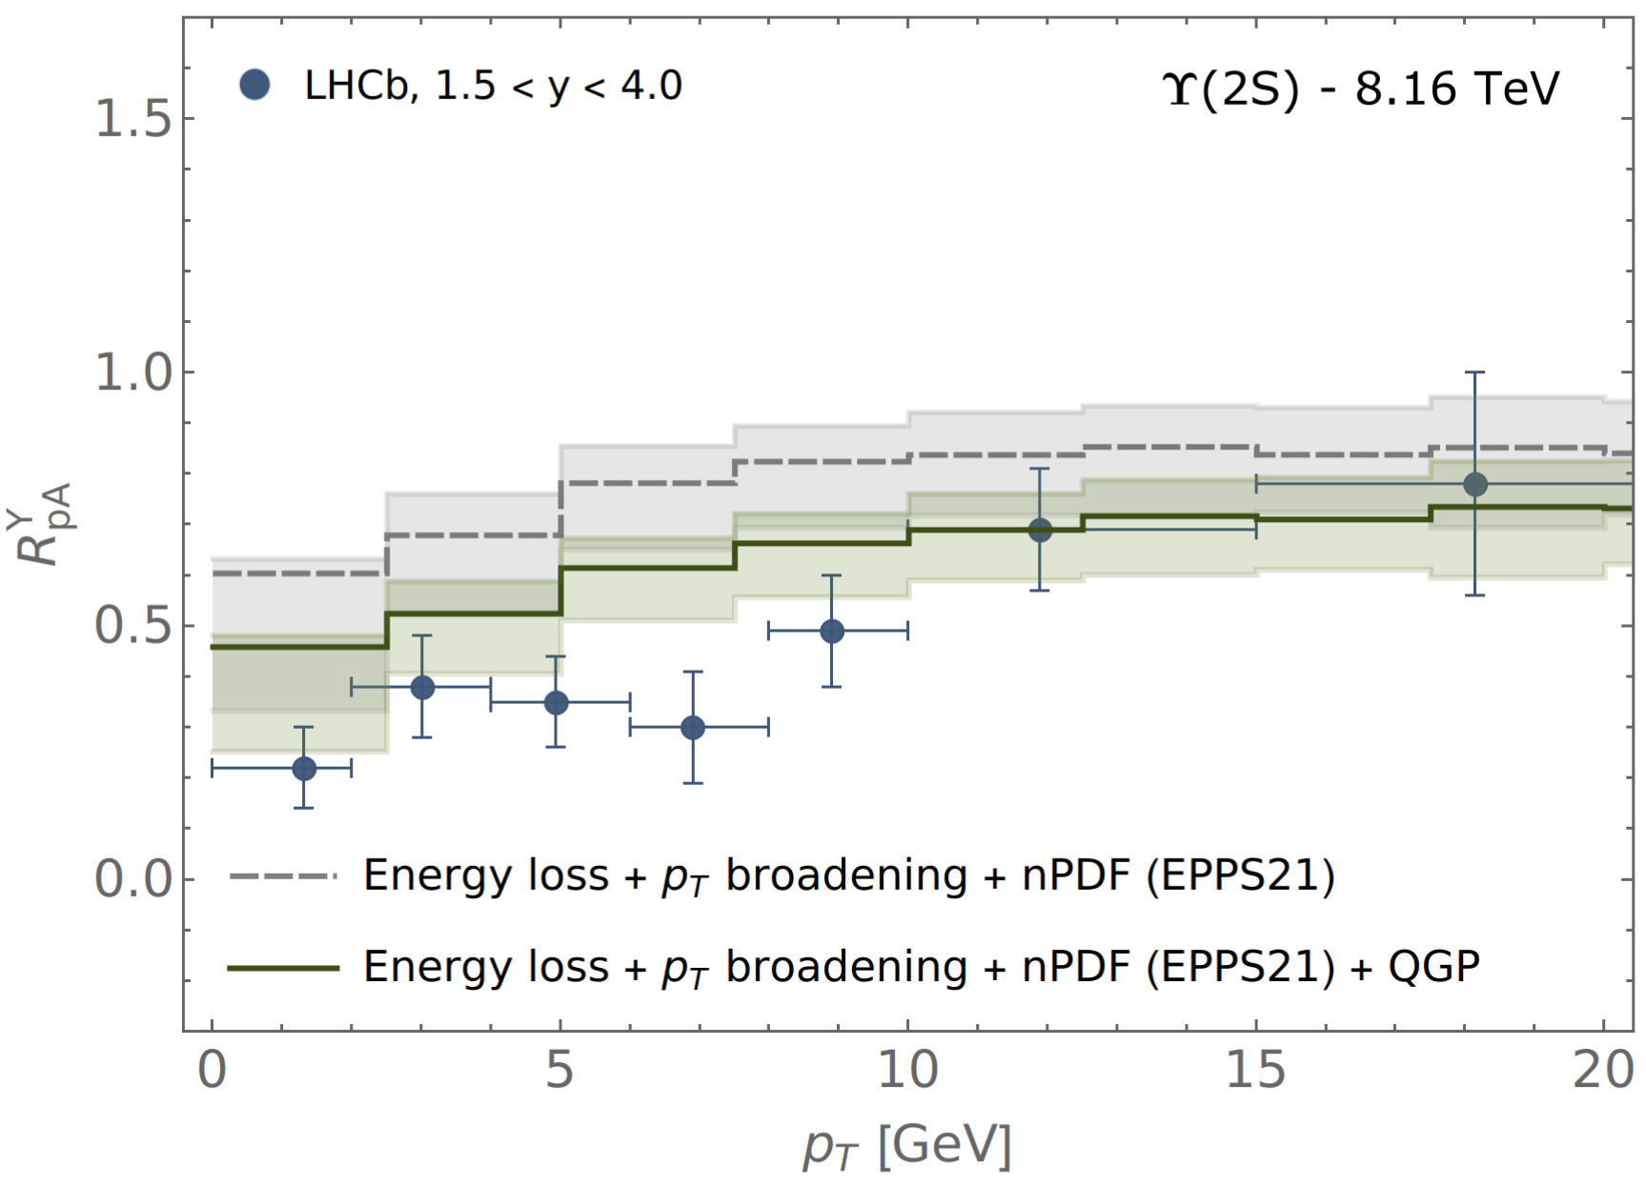
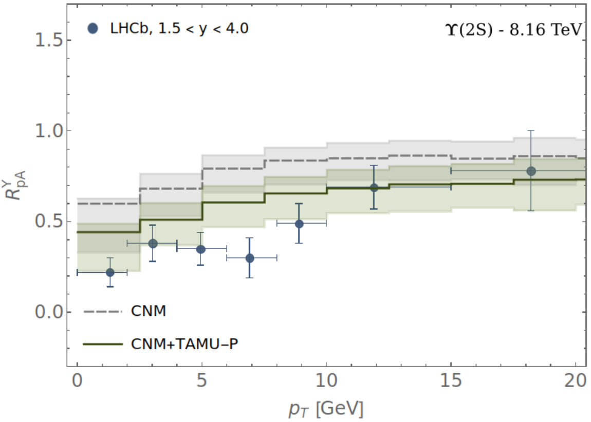
RESULTS: R_{pA} vs p_{T}
Strickland, Thapa & Vogt (2024). Bottomonium suppression in 5.02 and 8.16 TeV p-Pb collisions, 2401.16704.
Thapa, Vogt, Strickland, Rapp, Wu, Boyd (In Prep). Semi-classical treatment of bottomonium suppression in p-Pb collisions.

Slide 28
CONCLUSIONS & OUTLOOK
Including all the effects (CNM and HNM effects) provides reasonable description of available data given current experimental and theoretical uncertainties.
For Υ(1S), final state interactions with QGP gives a small correction to the CNM effects (nPDF, Coherent Energy Loss, and Transverse Momentum Broadening).
But for the Υ(2S) and Υ(3S) states, including QGP-induced suppression together with the CNM effects is essential to explain the experimental data.
Provides further evidence for the production of a hot, but short-lived QGP in the p-Pb collisions.
Examined the reaction rates from TAMU in small collision system, consistent predictions from both KSU-Munich & TAMU approaches.
Outlook:
Systematic understanding of pA collision helps in the understanding the AA collision.
In AA collisions QGP-induced suppression is the dominant effect, but CNM effects should be included for quantitative understanding.

Slide 29
Thank you!

Slide 30
Backup slides

Slide 31
Energy Loss and Momentum Broadening
When passing through a medium (hot QGP, cold nucleus, …),
a parton can lose energy due to collisions (Bjorken (1982)
and / or via induced gluon radiation (Gyulassy, Wang (1993) nucl-th/9306003)

Slide 32
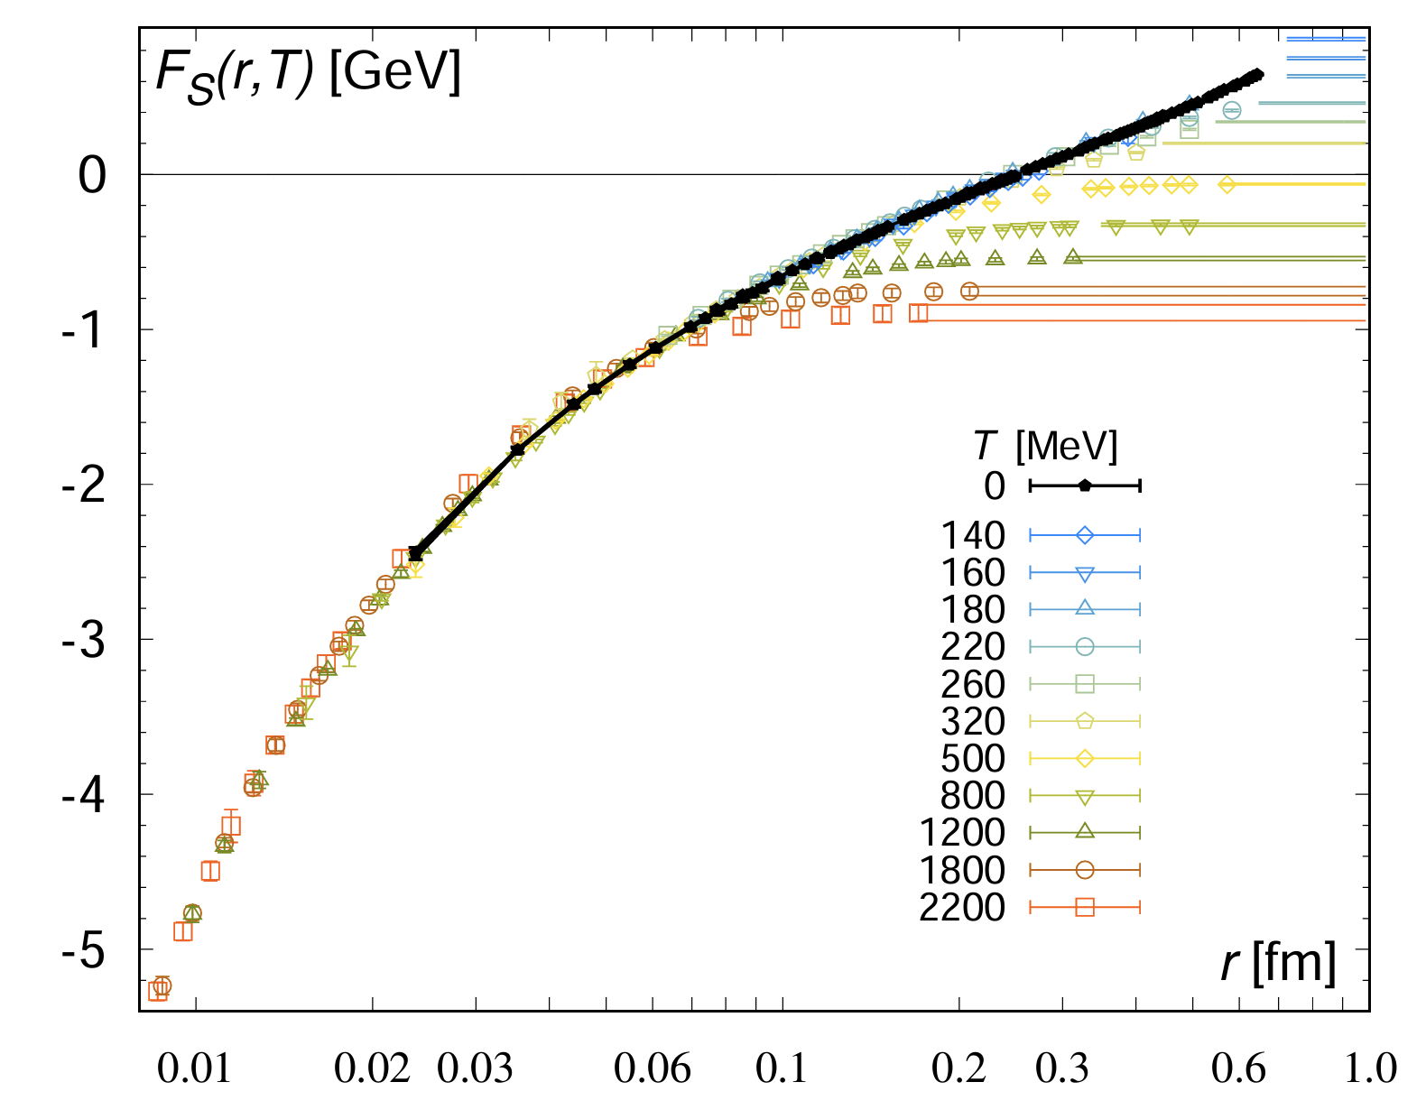
Quarkonia inside QGP
Mocsy, Petreczky, and Strickland, 1302.2180
A.Bazavov, N.Brambilla P.Petreczky, A.Vairo, J.H.Weber, 1804.10600

Slide 33
pNRQCD
Separation of Scales
Separation of scales in vacuum: M >> Mv >> Mv²
 | QCD
 | NRQCD | G.Bodwin, E.Braaten, G.Lepage, hep-ph/9407339
 | potential-NRQCD | N.Brambilla A.Pineda, J.Soto, A.Vairo hep-ph/9907240
M
Perturbative matching
Mv ∼ 1/r
Non-perturbative matching (long-range quarkonium)
Perturbative matching (short-range quarkonium)
Mv² ∼ E
Markovian Process
(During system relaxation, environment correlation has lost)
Medium relaxation time / Environment correlation time: τ_{E} ∼ 1/T
Intrinsic Time Scale of System: τ_{S} ∼ 1/ (Mv²) ∼ 1/ (w_{i} – w_{j})
System relaxation time: τ_{R} ∼ 1/self-energy [<p(t)> ∼ e^{−t / t_rel} ]
Inside QGP: thermal scales: T
Case 1: MV >> T Quantum Optical Limit (τ_{R}>> τ_{E} & τ_{R}>> τ_{S} )
Case 2: T >> Mv² Quantum Brownian Motion (τ_{R}>> τ_{E} & τ_{S}>> τ_{E} )
System = Quarkonium (Bottomonium)

Slide 34
KSU-Munich Approach: OQS + pNRQCD
Lindblad Master Equation: Open Quantum System (OQS) + pNRQCD
Following the hierarchy of scales, M >> 1/a₀ >> (π) T ∼ m_{D} >> E_{b}, at NLO pNRQCD in E_{b} / T, the Lindblad-Gorini-Kossakowski-Sudarshan Master Equation [1, 2]:
Jump Operators:
Hamiltonian of the System
Density Matrix of the (open) Bottomonium System
Jump Operators
Reduced density matrix:
[1] Brambilla, Escobedo, Islam, Strickland, Tiwari, Vairo & Vander Griend (2022/23), 2205.10289, 2302.11826 , Strickland &Thapa (2023), 2305.17841, Omar et al. (2021) QTRAJ 1.0, 2107.06147
[2] G. Lindblad, Commun. Math. Phys. 119, 48 (1976); V. Gorini, A. Kossakowski, and E.C. Sudarshan, J. Math. Phys. 17, 821 (1976)
Transport Coefficients:
System Hamiltonian:

Slide 35
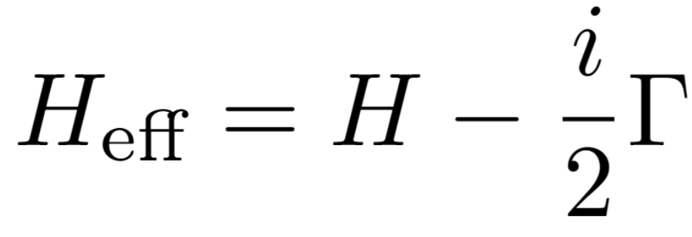
KSU-Munich Numerical Solution: Quantum Trajectories (QTraj)
Partial and Total decay widths:
Reorganize Lindblad equation by defining
Sampled 3D trajectories for bottomonium states → Monte Carlo (MC) Sampling
Initial transverse positions for the bottomonium production in p-Pb sampled using MC using binary collision overlap profile of proton and Pb nucleus.
Initial transverse momentum and momentum rapidities → MC sampled using distribution function (used in pp-parametrization).
Temperature evolution ➔ 3+1D aHydroQP
Quantum Dynamics of each sampled physical trajectories → Using NLO Qtraj → Solve the real-time 3D Schrödinger equation with a complex potential and stochastically sampled jumps →Lindblad equation\
Then find the survival probability of S-and P-wave states
Non-unitary “no jump” evolution
Can treat this “quantum jump” term stochastically
Can be reduced to the solution of a large set of “quantum trajectories” in which we solve a 1D Schrödinger equation with a non-Hermitian Hamiltonian 𝑯_{𝐞𝐟𝐟}, subject to stochastic quantum jumps.
Jump Operators (also called Collapse/Lindblad operators) encode transitions between different color/angular momentum states (obeying selection rules)
The evolution with the non-Hermitian 𝐻_{eff} preserves the color and angular momentum state of the system (but not norm).
For each physical trajectory (path through the QGP), we average over a large set of independent quantum trajectories
L = 40 GeV⁻¹
Points: 2048
Physical Trajectories: 160,000
Six collapse operators:
1. singlet → octet
2. octet →singlet
3. octet →octet.

Slide 36
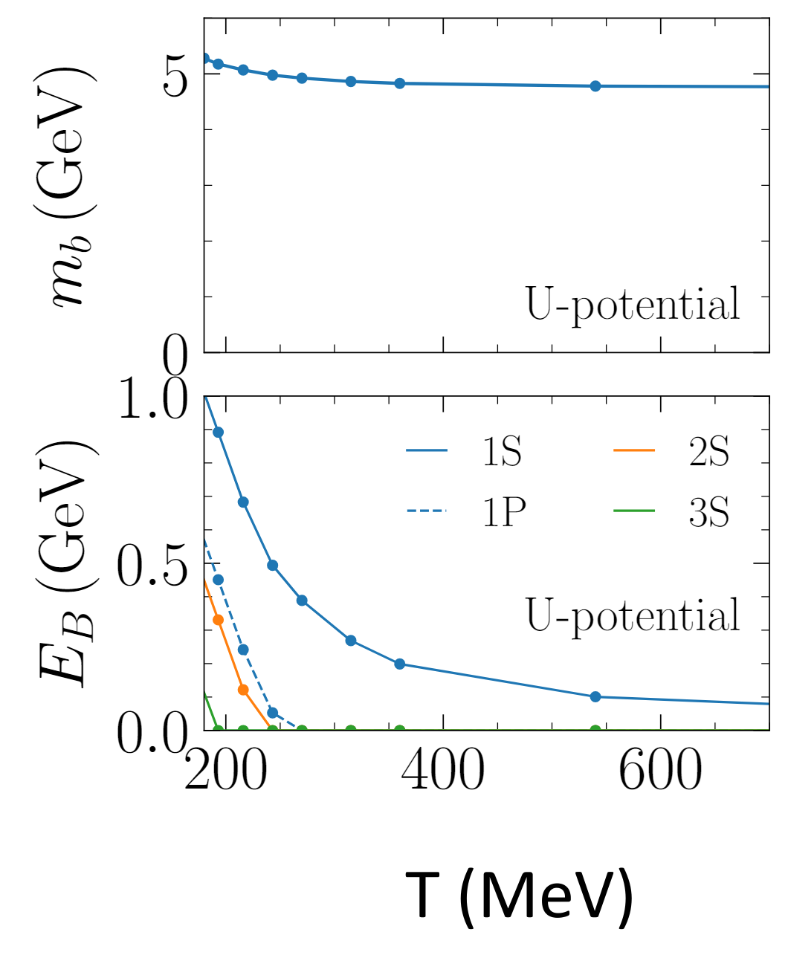
TAMU Approach
Bottom-quark mass and binding energy of different bottomonium states as a function of temperature from internal-energy potentials constrained by lQCD data.
The first one is based on the finite-temperatureinternal-energy potential for the quarkonium interaction for which binding energies and heavy-quark masses have been calculated in [2] utilizing constraints from Euclidean quarkonium correlator ratios from thermal lattice QCD (lQCD), cf. the upper panels of Figure (right side) for the bottom-quark mass and bottomonium binding energies as a function of temperature. This information has been employed in a quasifree approximation to calculate the bottomonium dissociation rates using a perturbative coupling to the thermal medium (assumed to be made of massive light-quark and gluon quasiparticles) via Born diagrams for inelastic p + Y → p + b +b-bar scattering (where p are the thermal partons, i.e., light anti-/quarks and gluons) and gluon dissociation g + Y → b + b-bar (where g are the gluons). These rates have been widely usedin transport calculations of quarkonium production in heavy-ion collisions for charmonia, bottomonia and B_{c} mesons, yielding a fair description of avail-able data from heavy-ion collisions at the SPS, RHIC and the LHC.
[1] X. Du, M. He, R. Rapp (2017), 1706.08670
[2] F. Riek & R. Rapp (2018), 1005.0769

Slide 37
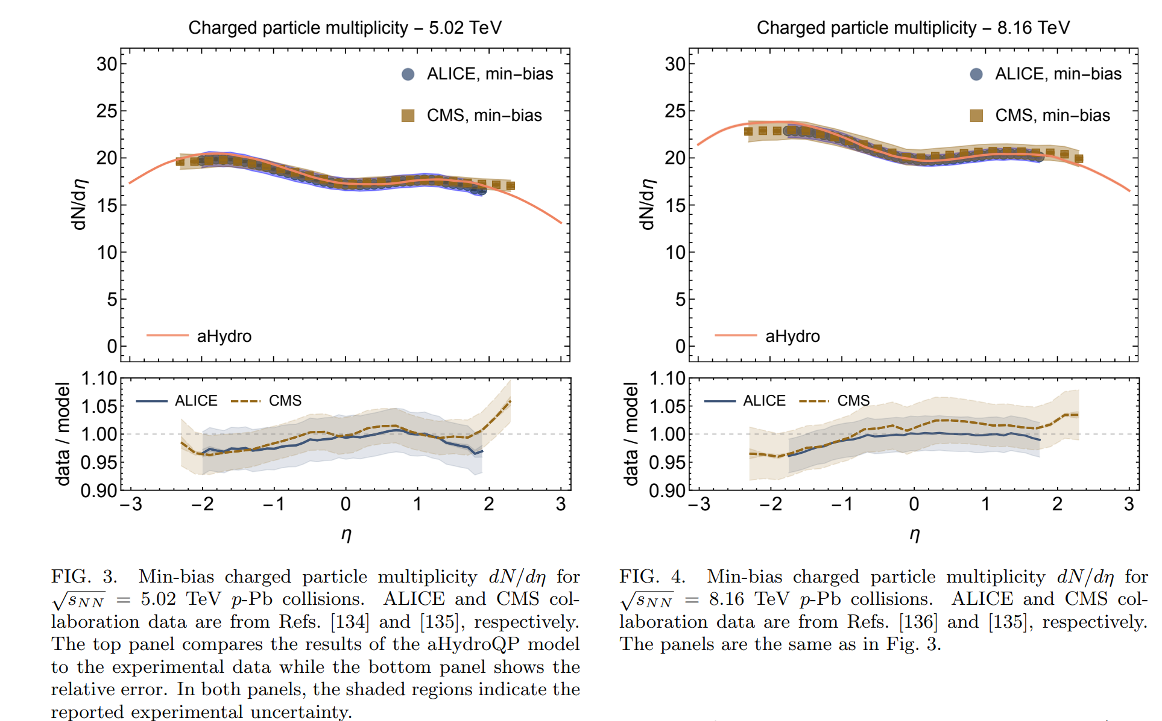
(3+1)D aHydro

Slide 38
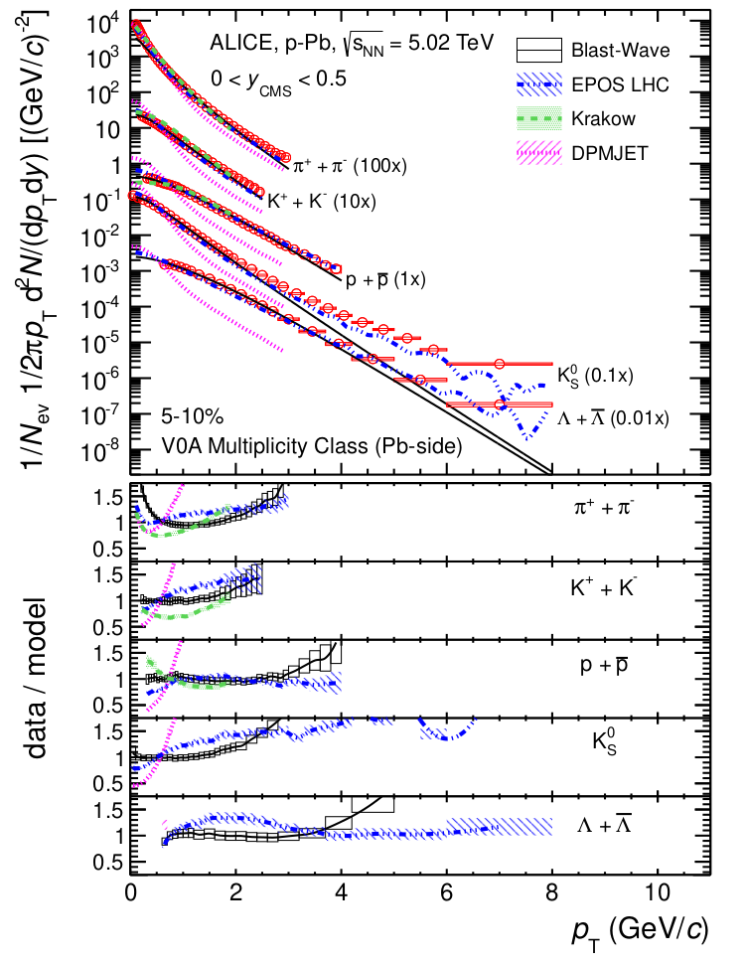
(3+1)D aHydro
CMS Collaboration (2014) 1307.3442
ALICE Collaboration (2013) 1307.6796

Slide 39
Future: AA Collision
In AA collision at RHIC & LHC, the forward and backward rapidities, some additional effects needed!
M. Strickland & S. Thapa (2023) 2305.17841

