Slide 1
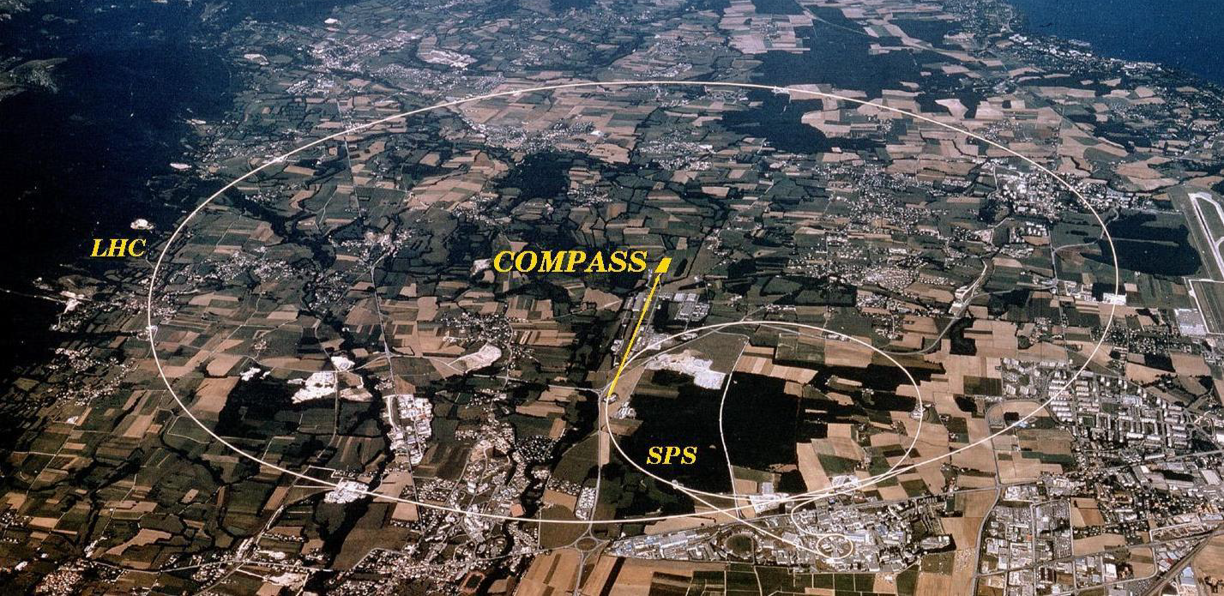
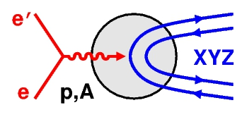




News on hadron spectroscopy from COMPASS and prospects for AMBER at CERN
Jan Friedrich
Technische Universität München
14 April 2025
on behalf of the COMPASS and AMBER Collaborations

Slide 2
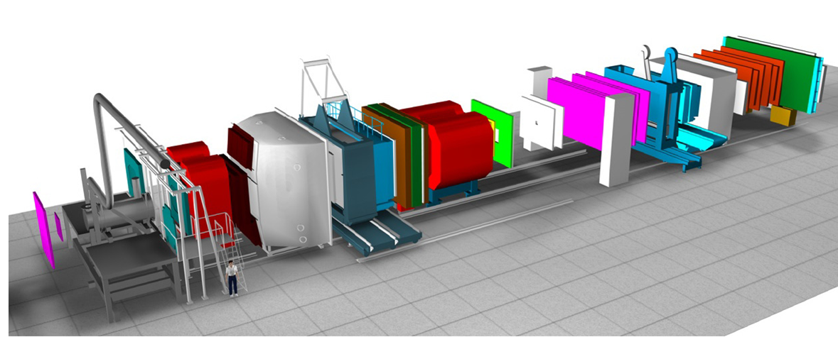
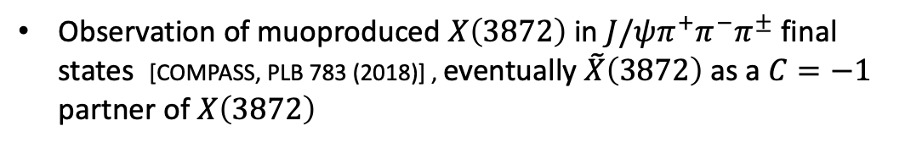
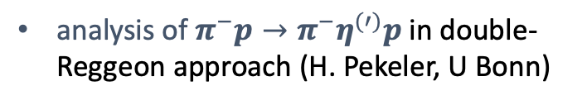
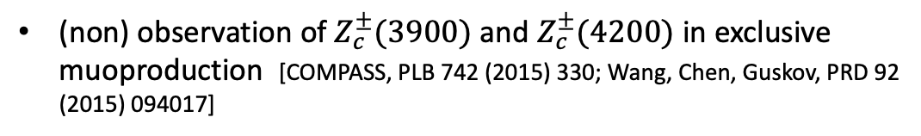

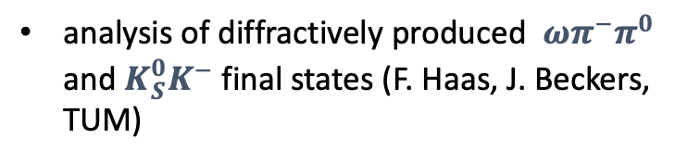
News on hadron spectroscopy from COMPASS
COMPASS now in analysis phase
many analyses on the different physics fields intensively pursued
analysis of $π^{−}p→π^{−}η^{(′)}p$in double-Reggeon approach (H. Pekeler, U Bonn)
Not covered in this talk (cf. talk of Boris Grube on the previous 2022 workshop, https://indico.bnl.gov/event/14792):
analysis of diffractively produced $ωπ^{−}π^{0}$ and $K_{S}^{0}K^{−}$ final states (F. Haas, J. Beckers, TUM)
(non) observation of $Z_{c}^{±}(3900)$ and $Z_{c}^{±}(4200)$ in exclusive muoproduction [COMPASS, PLB 742 (2015) 330; Wang, Chen, Guskov, PRD 92 (2015) 094017]
news on the spin-exotic $π_{1}(1600)$
Observation of muoproduced $X\left(3872\right)$in $J/ψπ^{+}π^{−}π^{±}$ final states [COMPASS, PLB 783 (2018)] , eventually $\tilde{X}\left(3872\right)$ as a $C=−1$ partner of $X\left(3872\right)$

Slide 3
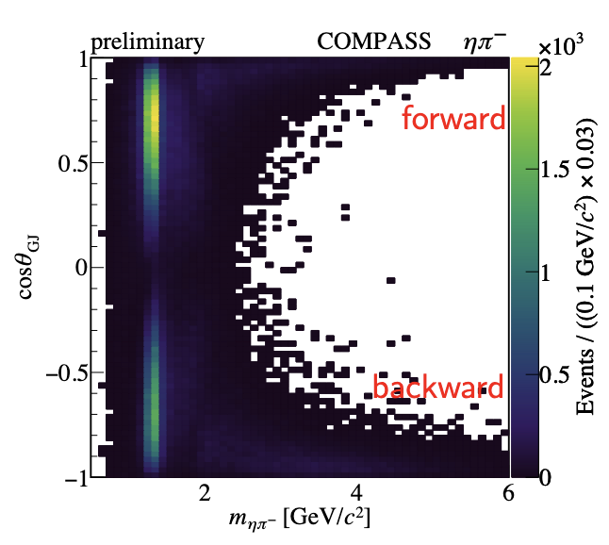
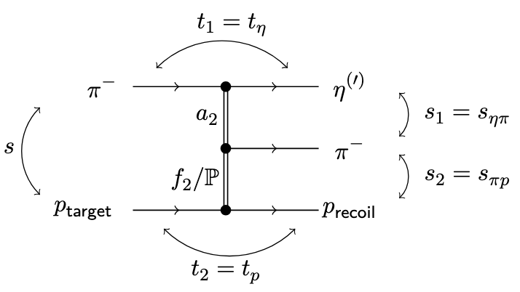
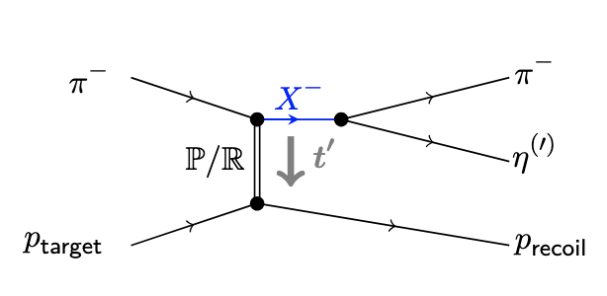
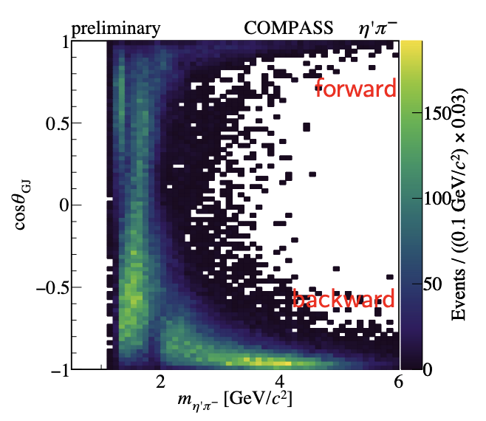
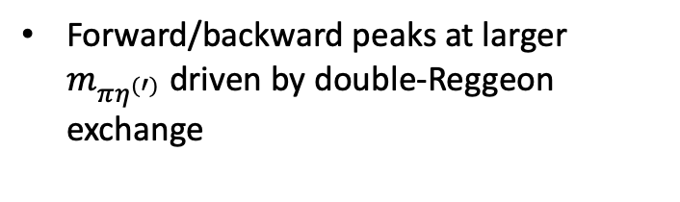
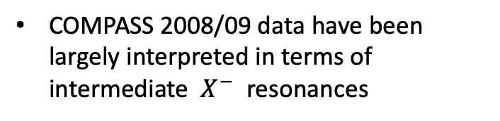
Further analysis of $π^{−}p→π^{−}η^{(′)}p$
COMPASS 2008/09 data have been largely interpreted in terms of intermediate $X^{−}$ resonances
Forward/backward peaks at larger $m_{πη^{(′)}}$ driven by double-Reggeon exchange
Analysis in cooperation with JPAC (associated members of COMPASS)

Slide 4
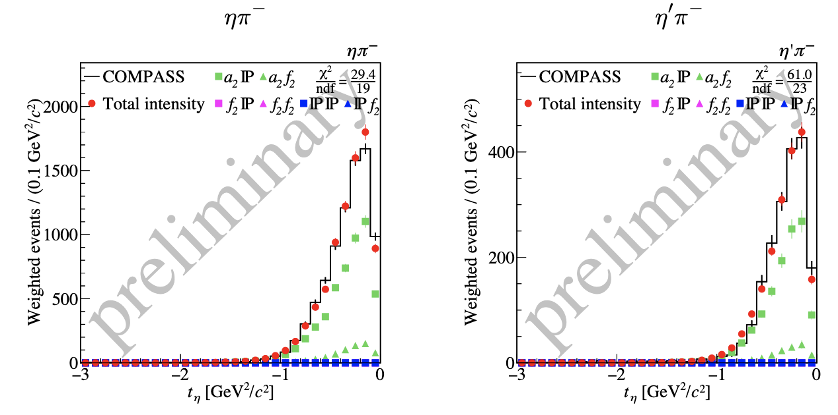
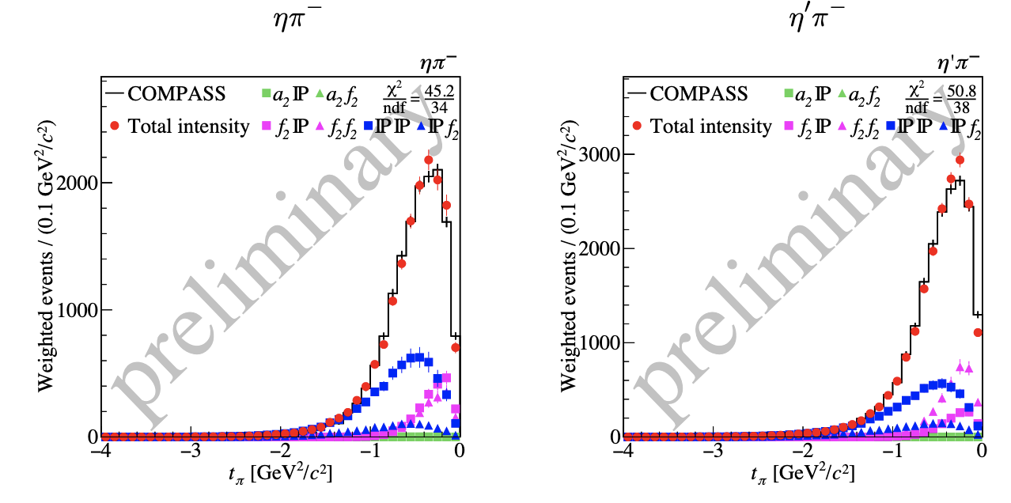
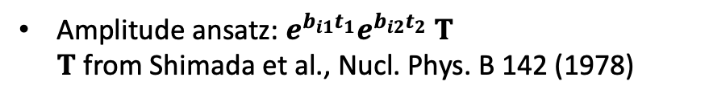


Further analysis of $π^{−}p→π^{−}η^{(′)}p$
Amplitude ansatz: $e^{b_{i1}t_{1}}e^{b_{i2}t_{2}} T$
$T$ from Shimada et al., Nucl. Phys. B 142 (1978)
Forward: Pomeron/$a_{2}$ dominated
Backward: significant $f_{2}$ contribution
Global fit with 13 parameters sufficient for a good description of our data

Slide 5
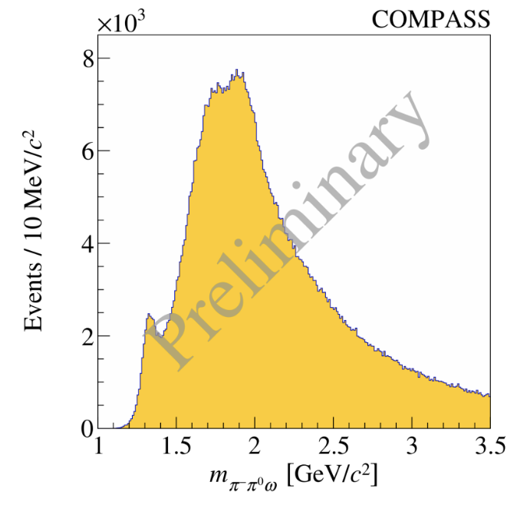
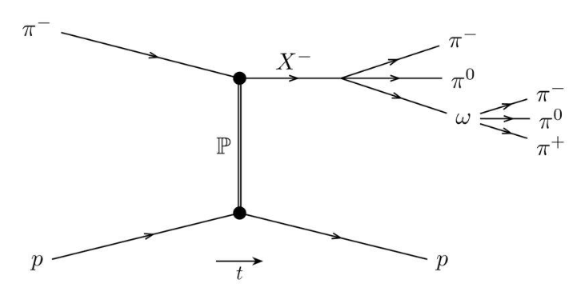
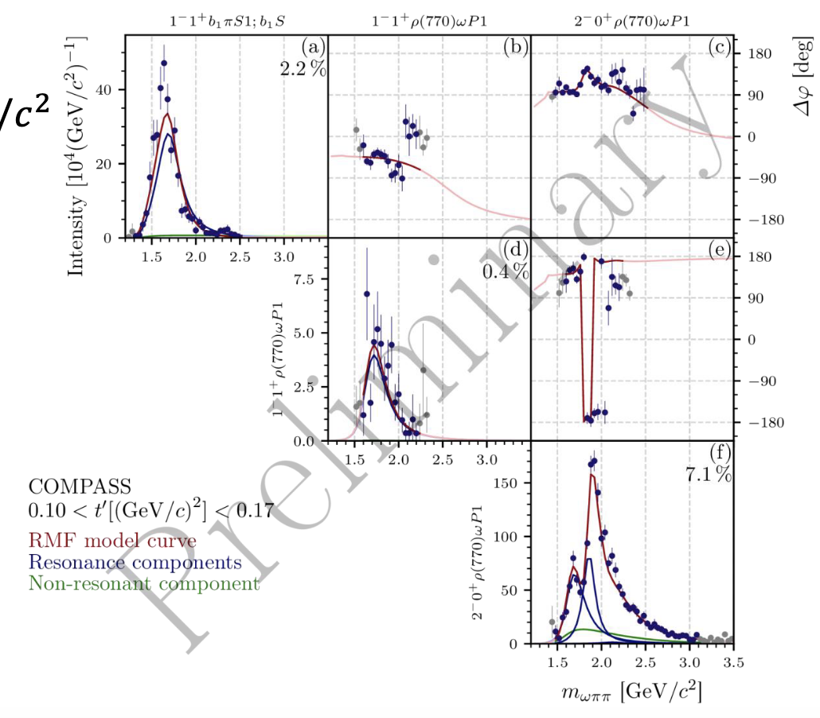
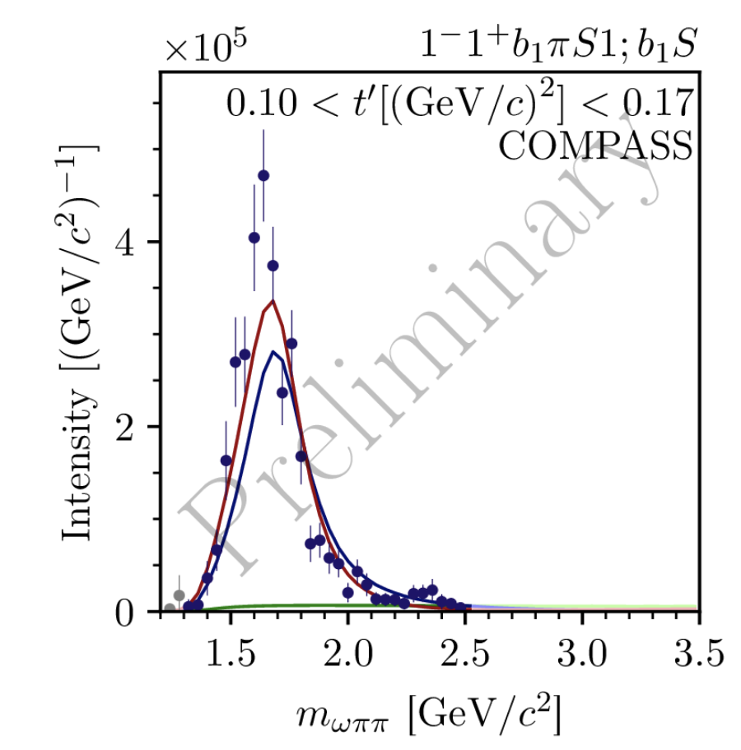
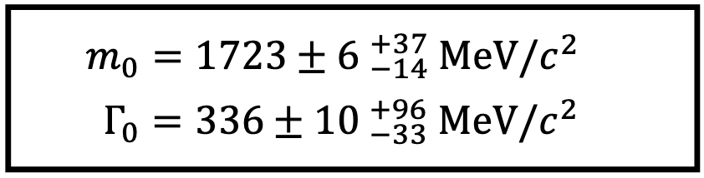


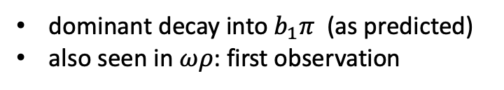
Resonance model fit of $ωπ^{−}π^{0}$
C$lear π_{1}\left(1600\right)$ signal
No indication for $π_{1}\left(2015\right)$ as claimed by BNL E852
dominant decay into$b_{1}π$ (as predicted)
also seen in $ωρ$: first observation

Slide 6
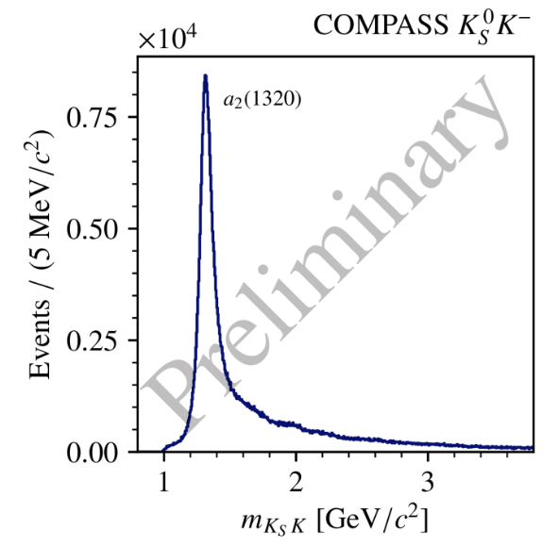
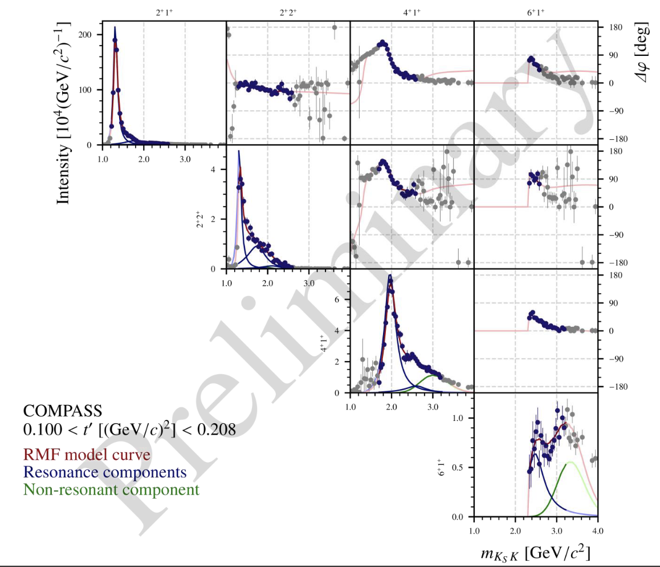
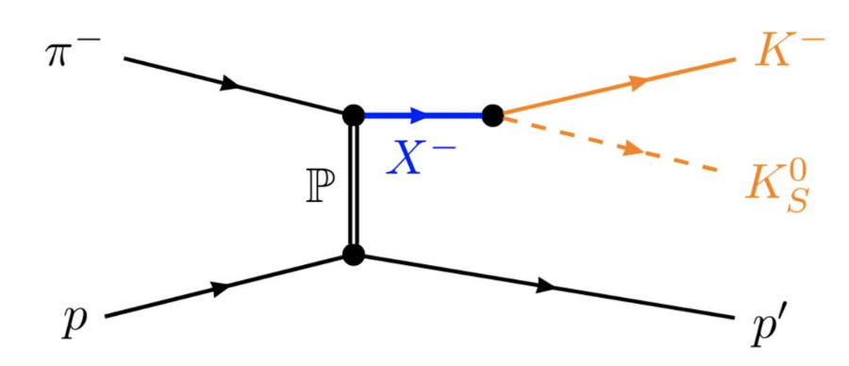
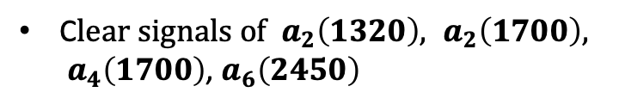

Partial-wave analysis of $K_{S}^{0}K^{−}$
C$lear signals of a_{2}\left(1320\right), a_{2}\left(1700\right), a_{4}\left(1700\right)$, $a_{6}\left(2450\right)$
evidence for $a_{2}^{′′}$ at 2124 MeV and $a_{4}^{′}$ at 2608

Slide 7
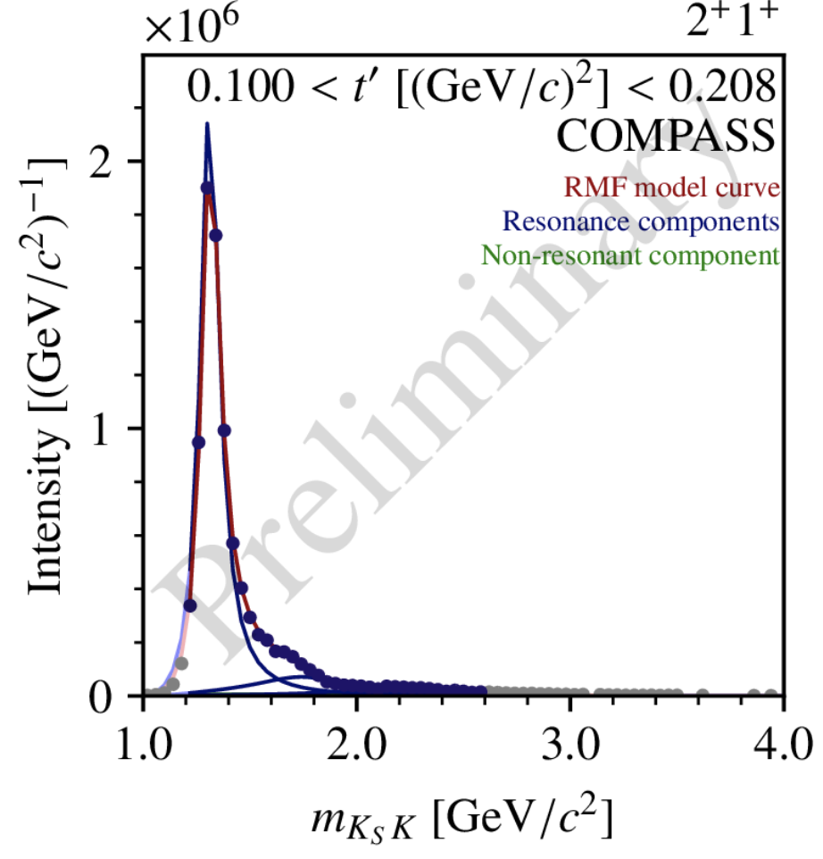
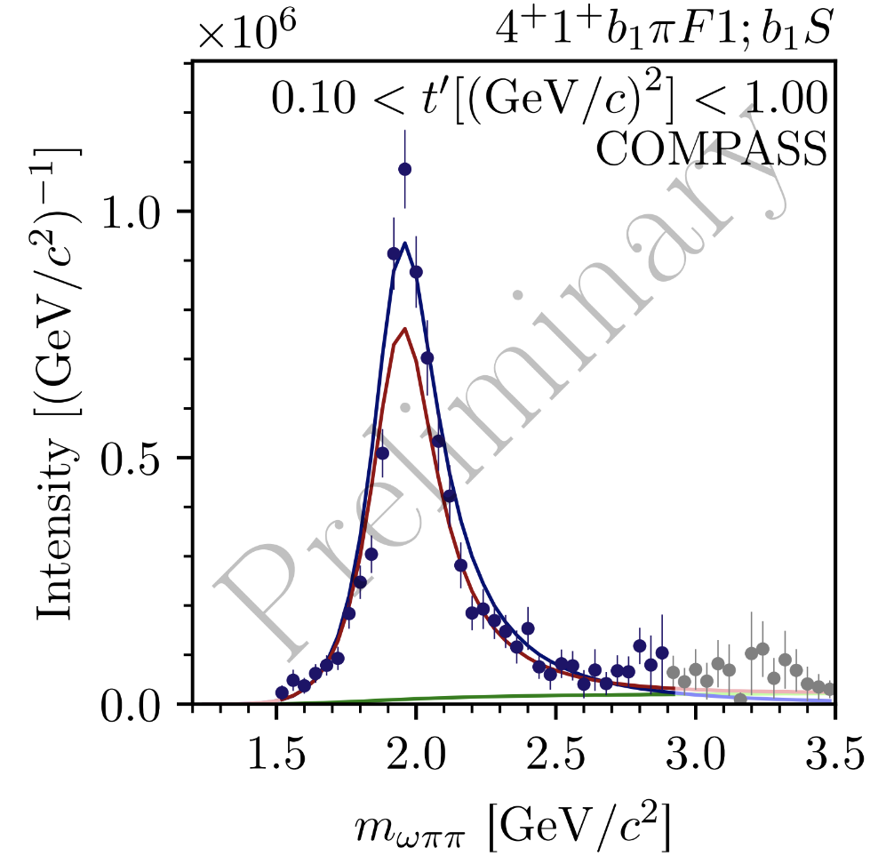
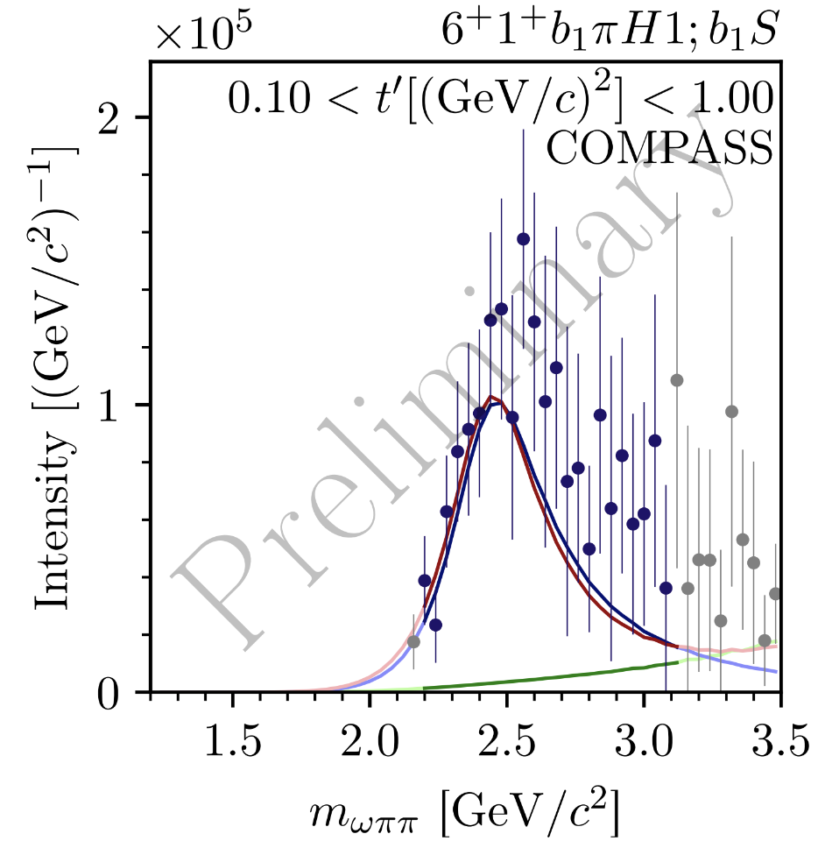
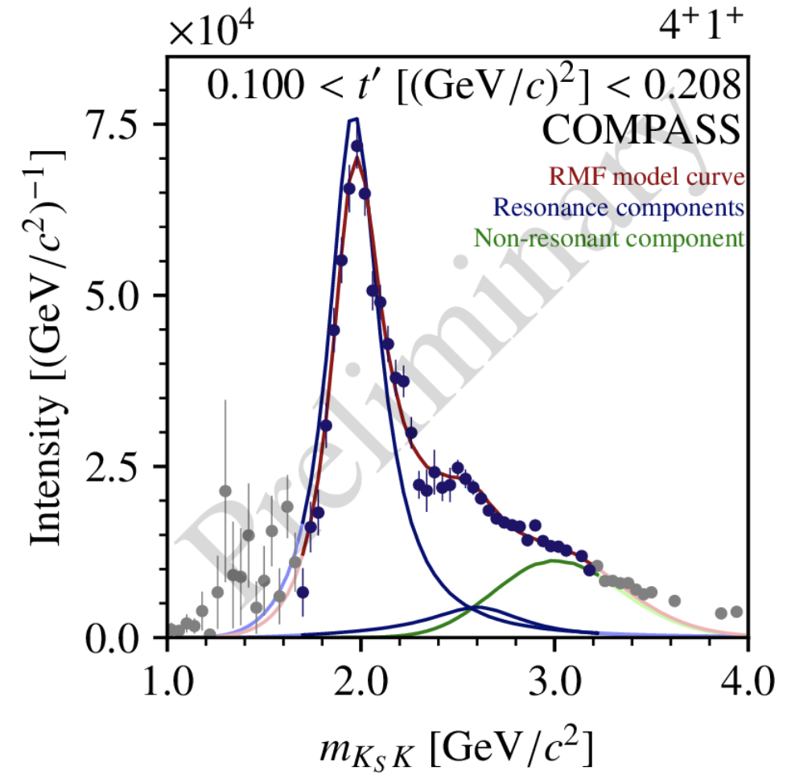
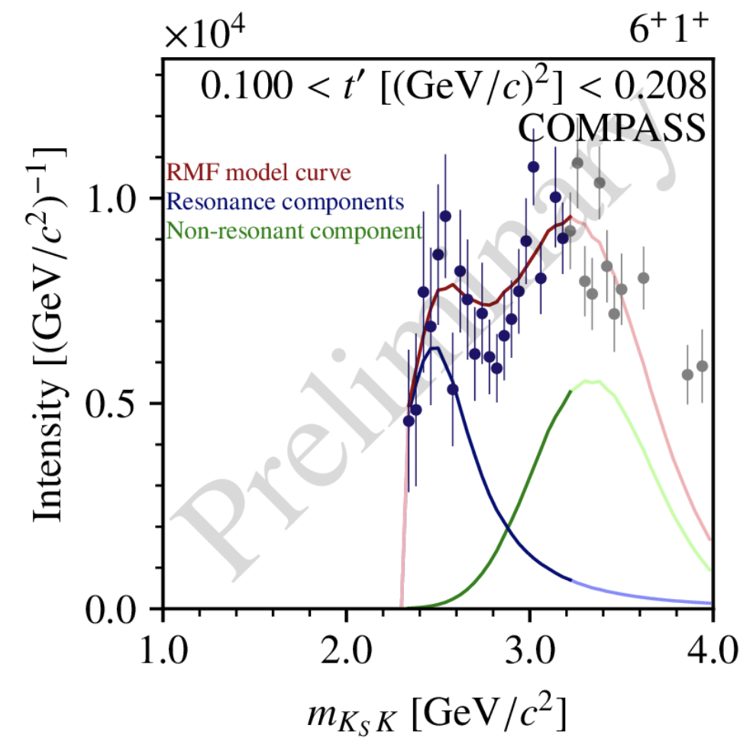
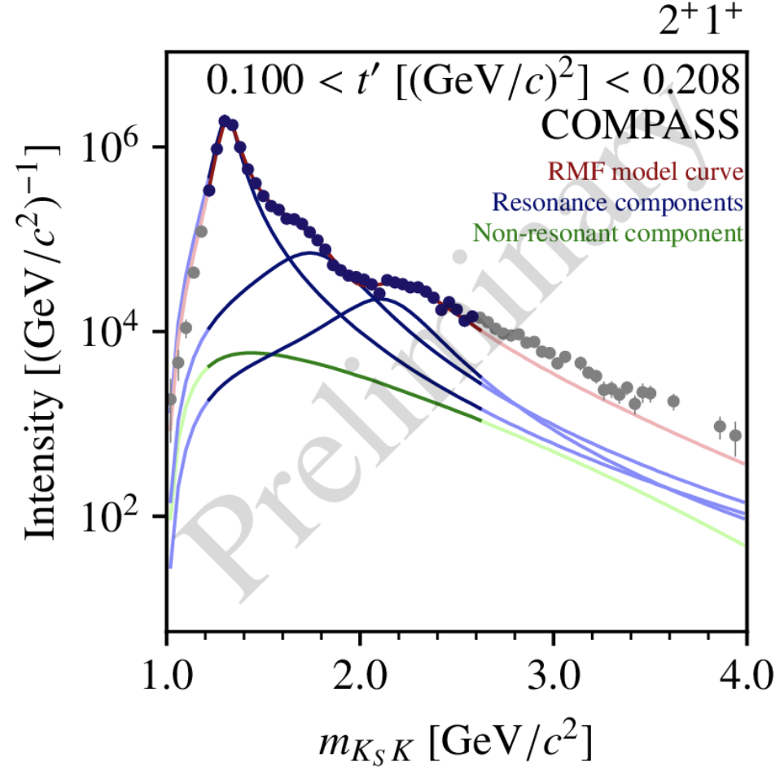
Common signals in $K_{S}^{0}K^{−}$ and $ωπ^{−}π^{0}$

Slide 8
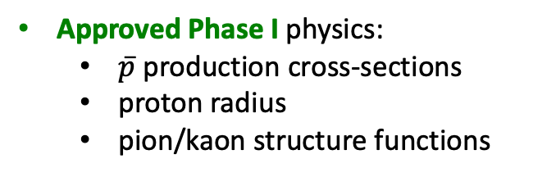
Apparatus for Meson and Baryon Experimental Research
AMBER has been approved as NA66 experiment in December 2020
the Collaboration consists of ~200 physicists from 34 institutes
at the M2 beamline at SPS muon and hadron beams 60 – 250 GeV
AMBER inherited, extends and modernizes the 2-stage spectrometer of the COMPASS collaboration
Approved Phase I physics:
  $\overline{p}$ production cross-sections
  proton radius
  pion/kaon structure functions
Intended Phase II physics (>LS4):
  strange-meson spectroscopy
  kaon polarizability
  prompt-photon production

Slide 9
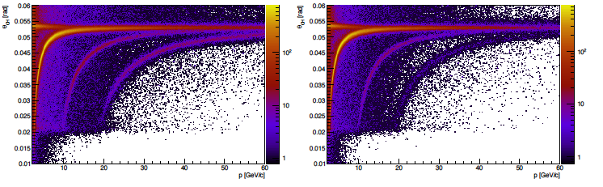
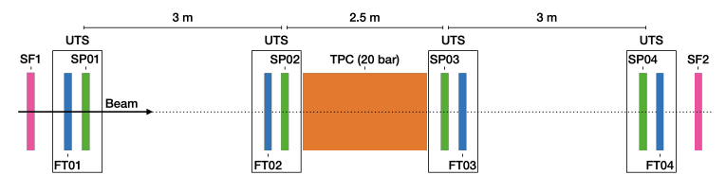
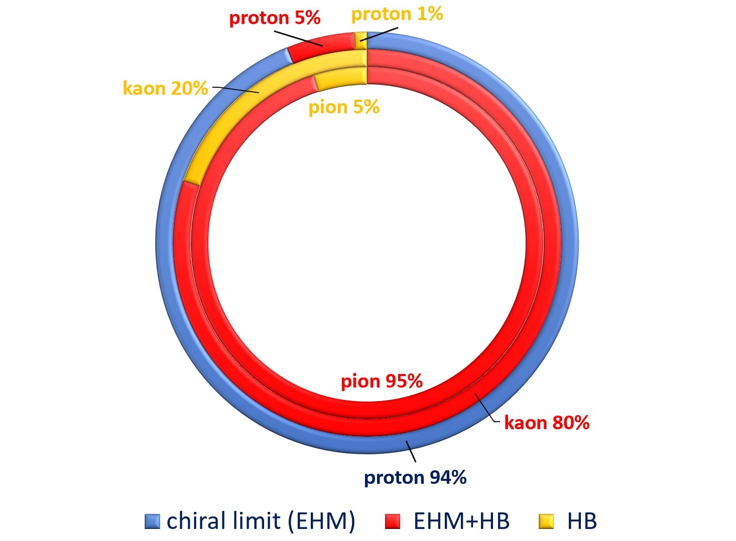
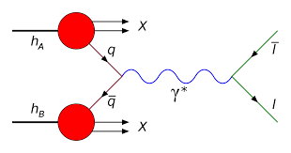










AMBER Phase-1 in a nutshell
Anti-proton production cross sections in p-He and p-p collisions for constraining cosmic dark-matter search data: unique data sets in unexplored beam momentum range 60-250 GeV, successful p-He data taking in 2023, p-p and p-D in 2024
$$π^{+}$$
$$K^{+}$$
$$π^{−}$$
$$K^{−}$$
$$p$$
$$\overline{p}$$
RICH PID: Cerenkov angle vs. momentum
Proton radius via muon-proton scattering, recoiling proton and scattered muon are measured in coincidence: unique in terms of systematics control
beam tracking
$μ′$ tracking
$μ$
$p$
$μ′$
Pion and kaon partonic structure via Drell-Yan processes: separate valence and sea contributions in unprecedented precision
Mass budgets: emergence of the light-hadron masses is linked to both the QCD partonic structure and to confinement
plot courtesy C. Robert

Slide 10

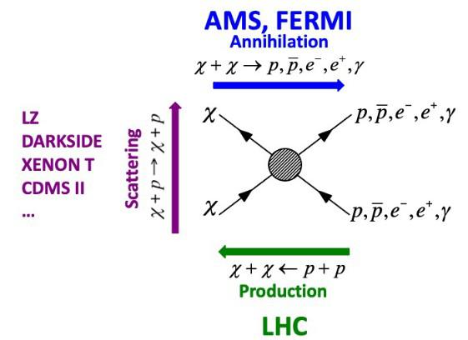

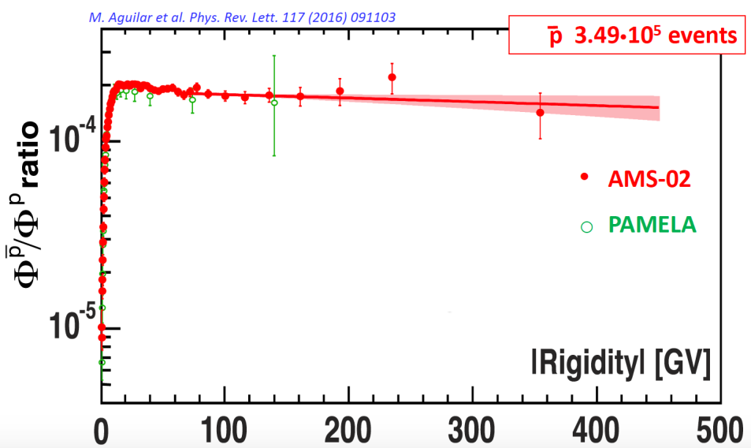
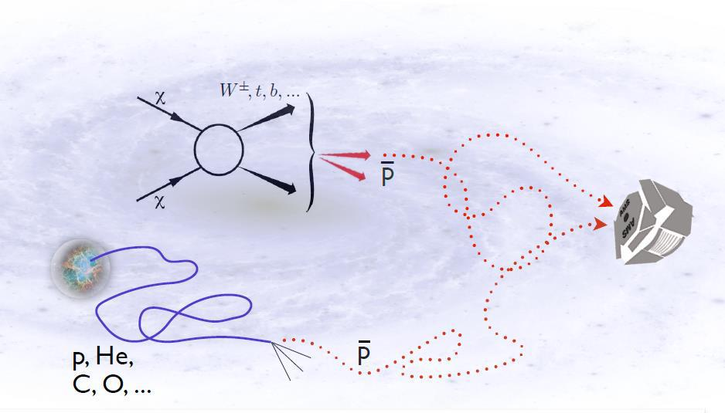
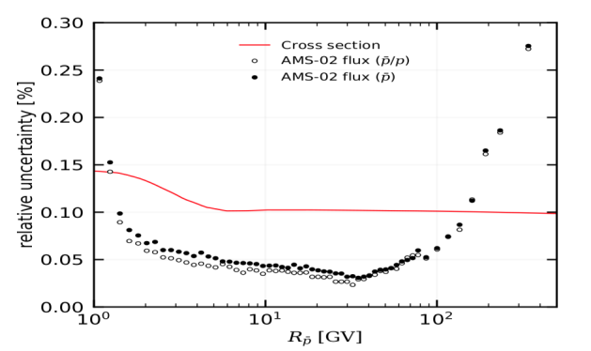
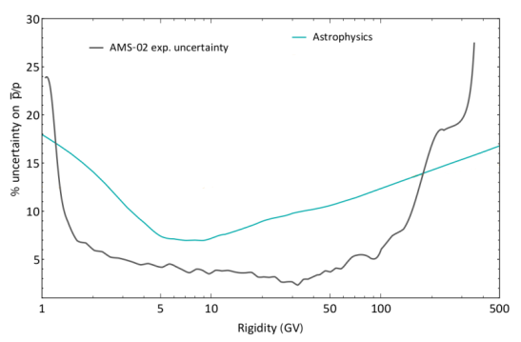

Antiproton production cross-sections for dark-matter searches
AMBER:
Data for p-He collisions taken in summer 2023
Data for p-p and p-D taken in 2024
propagation
cross section

Slide 11
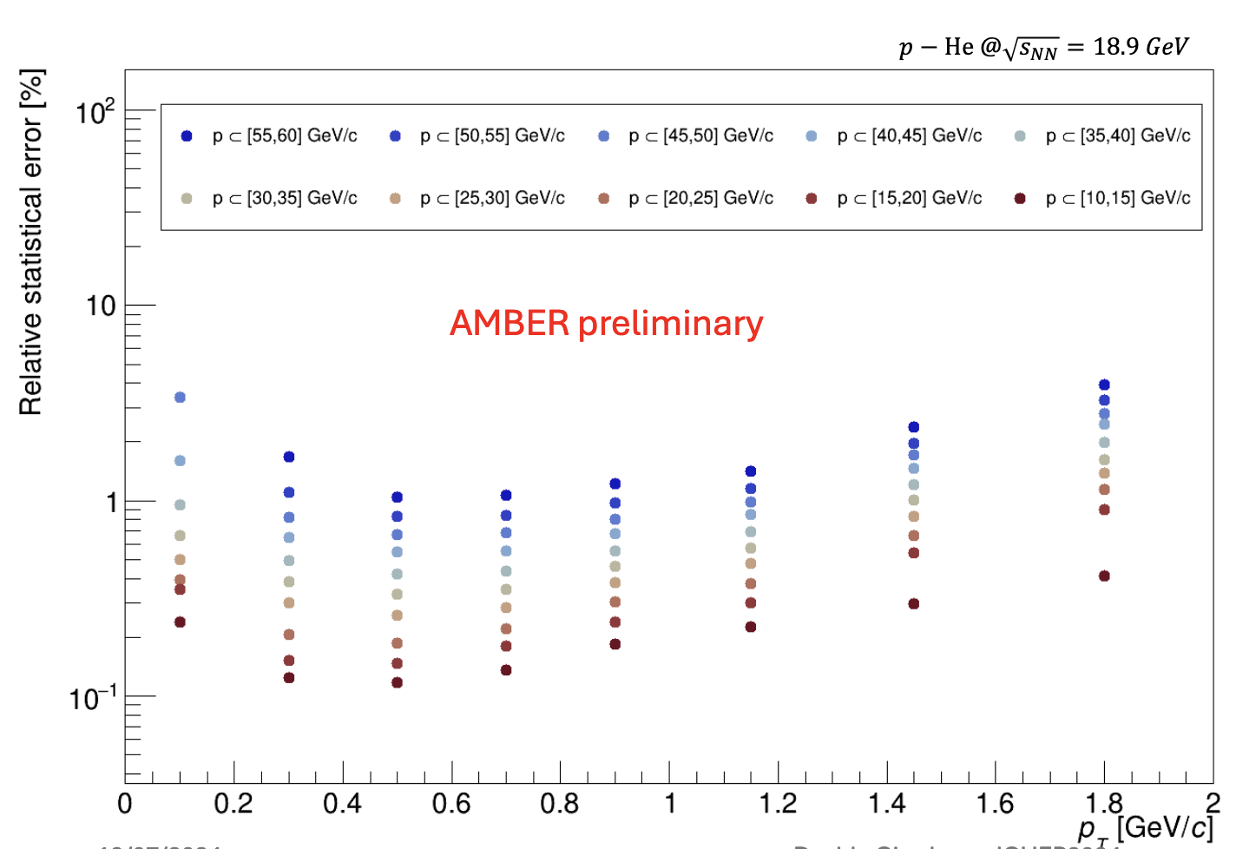
Antiproton production cross-sections: uncertainty estimates
A preliminary analysis shows that we collected ~6million antiprotons in
  p [10, 60] GeV/c
  p_{T} [0, 2] GeV/c
Statistical uncertainty in most bins < 1%
Leading systematic uncertainties expected from:
  Luminosity
  RICH

Slide 12



Measurement of $G_{E}^{p}$ at small $Q^{2}$
Proton Radius Experiment at Jefferson Lab
AMBER projected uncertainty
figure: J. Bernauer

Slide 13
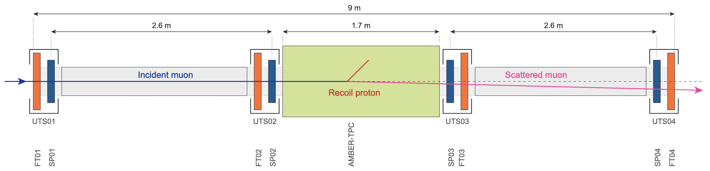
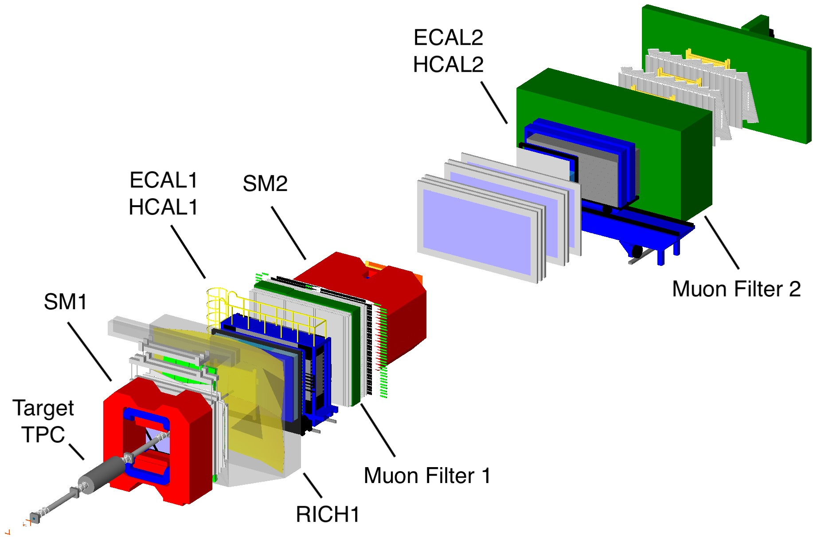
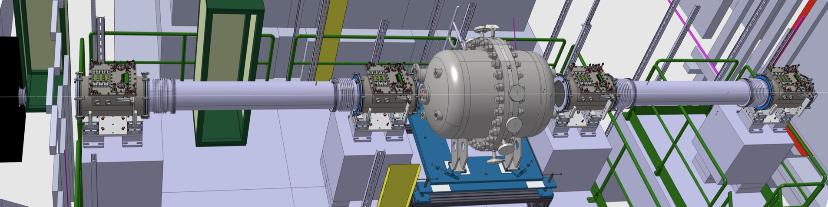
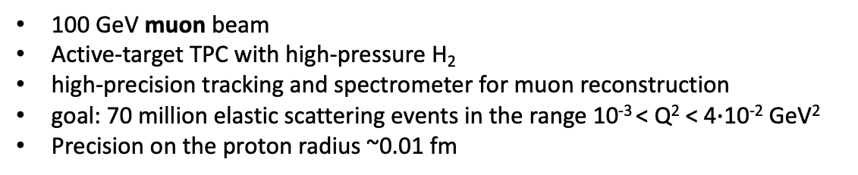
Basic Idea of the AMBER measurement
100 GeV muon beam
Active-target TPC with high-pressure H₂
high-precision tracking and spectrometer for muon reconstruction
goal: 70 million elastic scattering events in the range 10⁻³ < Q² < 4$∙$10⁻² GeV²
Precision on the proton radius ~0.01 fm

Slide 14
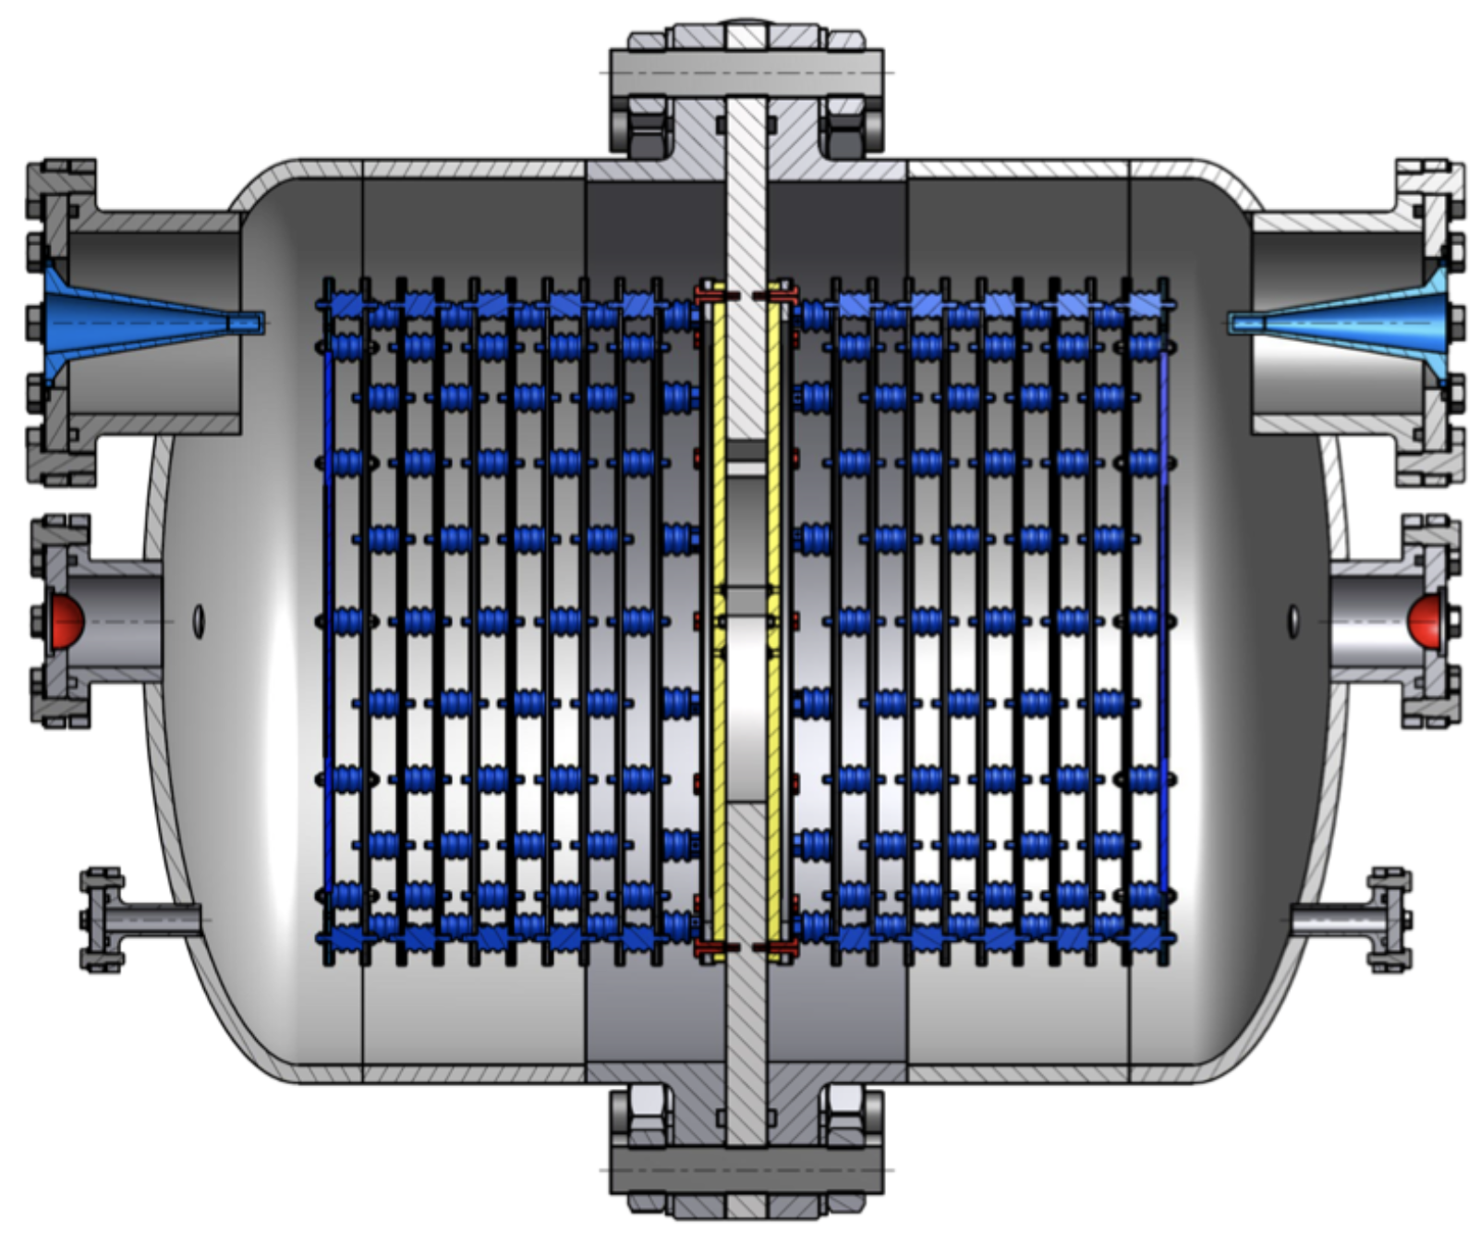
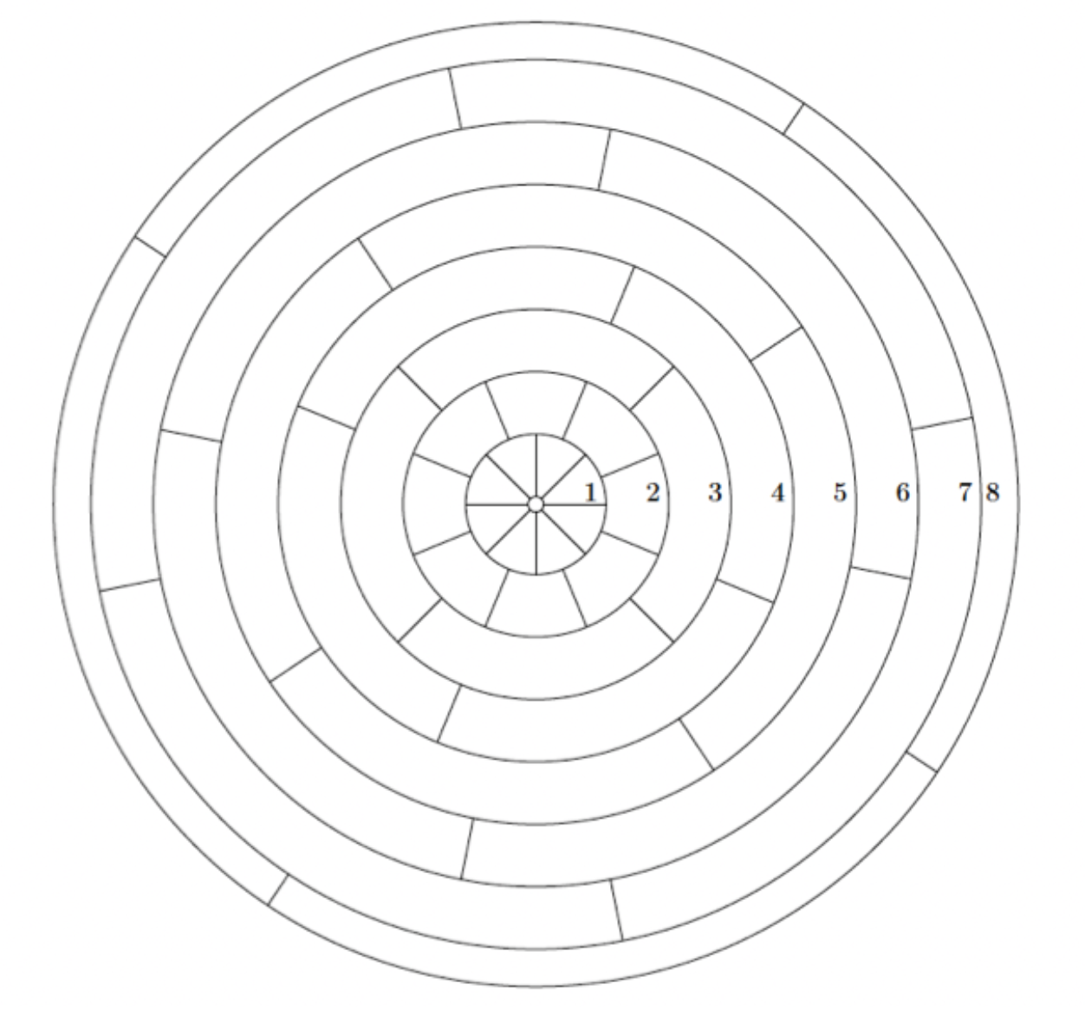
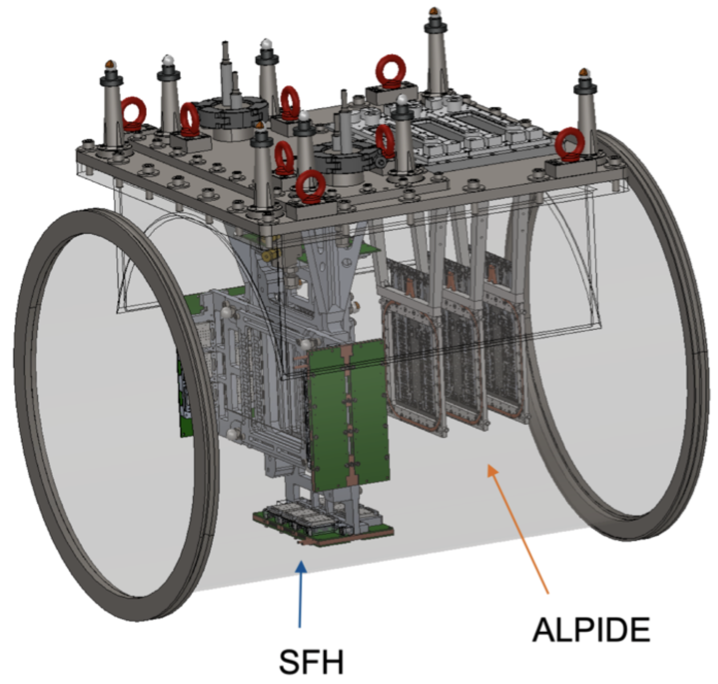
New Equipment for PRM
High-pressure hydrogen TPC
Operation at 20 bar hydrogen pressure
design with 2 drift cells
Segmented anode plane
reconstruction of proton recoil energy with ~50 keV precision
Unified Tracking Stations
Determine scattering angle of muon
Consists of several layers of silicon pixel detectors (ALPIDE) and a scintillating-fiber hodoscope (SFH)
Free-running DAQ
streaming data acquisition on first level: all detectors deliver data without external trigger
high-level trigger on computer farm

Slide 15

TPC layout

Slide 16



New High-Pressure Time Projection Chamber
CAD of the new AMBER TPC
Cooperation with GSI/FAIR (Germany), later usage is foreseen at FAIR/R3B
Successful overpressure tests at the production site (up to 32 bar)
Leak rate under pressure and preliminary checks done at GSI, now transported to CERN
Factory Acceptance Test at the Danish production site, May 2024

Slide 17


Electrode and Readout Anode Structure
Assembly currently ongoing at CERN
at two positions, $α$sources are to be implemented that will provide calibration signals during data taking

Slide 18

Assembly of the TPC

Slide 19

Assembly of the TPC

Slide 20


Hydrogen Gas Purification
Tests in 2023 with the old IKAR TPC and a new purification unit
the increase of the amplitude from the $α$ sources is a measure of the purity of the detector gas
stronger effect by the cathode source (longer drifts)

Slide 21


Scintillating-Fiber Hodoscope

Slide 22



Simulation of the PRM Setup
The AMBER setup for the Proton Radius Measurement has been implemented in a GEANT4 Monte-Carlo simulation
from the reconstructed MC data, the achieveable resolution in $Q^{2}$ has been studied and found better than 15% in the targeted range $Q^{2}>{10}^{−3} GeV^{2}$ for both TPC pressure settings at 4 and 20 bar
the geometrical acceptance is found to be flat in the relevant $Q^{2}$ range

Slide 23




Tests and Schedule for PRM Data Taking
2018
2018: First measurement of hydrogen TPC in high-energy muon beam
2021: First test run with IKAR TPC and already existing tracking detectors from COMPASS $→$ correlation between proton energy and muon scattering angle
2023: Test run with new free-running DAQ (IKAR TPC, new tracking detector prototypes)
2024: Tests of detector prototypes
2025/26: Physics run with new TPC and final UTS
2021
Figures: C. Dreisbach PhD Thesis (2022)

Slide 24


Test Data Analysis
With the 2021 test data, the correlations of the muon scattering and the proton recoils in the IKAR TPC were studied in detail
in the coincidence time, the effect of the drift in the TPC gas could be identified, this will serve to control the purity of the elastic scattering events
the expected correlations in $E_{kin}=Q^{2}/2M_{p}$ and in the azimuthal angle could also be shown

Slide 25



Radiative Corrections for $μp$ Scattering
Radiative corrections <1% for muon-proton scattering $Q^{2}<0.04 GeV^{2}$
Calculations by N. Kaiser (TUM) J. Phys. G 37 115005 (2010)
Full MC generator foreseen – intensity forward bremsstrahlung photons can be checked in the experiment
Collaboration with McMule team on implementation of higher-order corrections for the AMBER kinematics

Slide 26

On the agenda for AMBER phase 2: Hadron charge radii

Slide 27



Spectroscopy plans for AMBER phase 2: intense kaon beams
Worldwide unique experiments:
measure kaon quark and gluon PDF (DY, prompt photons)
spectroscopy of $K_{J}, K_{J}^{∗}$in diffractive production
electromagnetic/Primakoff reactions with kaons
Requirements:
Highest possible intensity of K in secondary beam
  RF separation
  conventional mixed beam: optimize transport
High-efficiency / high-purity beam particle identification
Final-state PID at higher momenta (depending on beam momentum)
Full solid-angle coverage for photons / electrons

Slide 28



COMPASS kaon spectroscopy results
COMPASS:
11 strange mesons found ⇒ results to be published soon
evidence for 3 excited 𝐾𝐾 states
quark model only predicts 2: 𝐾(1460) , 𝐾(1830)?
𝐾(1690) supernumerary ⇒ candidate for exotic strange meson
Triangular singularity?
[COMPASS, M.G. Alexeev et al., PRL 127, 082501 (2021)]

Slide 29


Kaon spectroscopy plans at AMBER
COMPASS:
11 strange mesons found ⇒ results to be published soon
evidence for 3 excited 𝐾𝐾 states
quark model only predicts 2: 𝐾(1460) , 𝐾(1830)?
𝐾(1690) supernumerary ⇒ candidate for exotic strange meson
statistically and systematically limited: 720k events, PID
AMBER Phase-2:
Beamline upgrade (NA-CONS)
Improved beam K identification
Improved final-state K identification
Full solid-angle coverage for photons / electrons
Goal: $20 × {10}^{6}$ exclusive $K^{−} π^{−}π^{+}$events

Slide 30



Summary
New results from COMPASS partial-wave analysis in $ωπ^{−}π^{0}$ and $K_{S}^{0}K^{−}$
NA66/AMBER at CERN has started its Phase-1 of a broad hadron physics programme at M2
Data taking for anti-proton production cross-sections in p-He, p-p and p-D completed, analysis ongoing
Proton Radius Measurement
  first running in 2025, high-statistics data taking planned for 2026
Plans for a strange-meson spectroscopy program at AMBER Phase-2
https://home.cern/news/news/physics/meet-amber

Slide 31
Backup

Slide 32

mass dependence of the double-Reggeon contributions

Slide 33

propagation to the full $\cos{θ_{GJ}}$ spectrum

Slide 34

The $π_{1}\left(1600\right)$in the different channels accessible to COMPASS

Slide 35


AMBER Collaboration and timelines
Successor of
with appropriate extensions and modernisations
at the CERN M2 beamline
~200 physicists from ~34 institutes

Slide 36
Impact of photon emission on the muon-proton correlation

Slide 37




Drell-Yan and pion PDFs at AMBER
Beams of positively and negatively charged pions to separate valence and sea contribution:
di-lepton
pion
$$\frac{Σ_{sea}}{Σ_{val}}=\frac{{4σ^{π^{+}C}−σ}^{π^{−}C}}{{−σ^{π^{+}C}+σ}^{π^{−}C}}$$
nucleon
250k DY events expected (current available statistics 25k events)
First precise and direct measurement of the sea quark distribution in the pion
190 GeV pion beam
Di-muon mass resolution of 100 MeV
dedicated talk (M. Chiosso) in the Nucleon Structure in DIS parallel session

Slide 38





The ideas of the Phase-2 proposal
Kaon structure via the Drell-Yan process
Gluon structure of pions and kaons via prompt photons
Primakoff reactions to investigate kaon-photon coupling: kaon polarisability, $F_{KKπ}$
Generalized Parton Distributions in DVCS and HEMP
Meson charge radii via electron scattering in inverse kinematics
Spectroscopy of mesons with strangeness
Diffractive production of vector mesons and di-jets to study distribution amplitudes

Slide 39


Beam PID by CEDARs
from: P. Jasinski, PhD thesis
High-efficiency and high-purity beam particle identification is of key importance in all scenarios of hadron beams
Optimum operation not only concerns mechanics and optics (temperature stabilization, photon detection), but as well parallelism of the incoming beam $→$ material budget of the beamline

Slide 40

Exotic mesons

Slide 41

Limitations at COMPASS

Slide 42

COMPASS: 𝑲⁻ 𝝅⁻ 𝝅⁺

Slide 43

Setup for strange-meson spectroscopy

Slide 44

Kinematics for different beam particles

