Slide 1
One Born-Oppenheimer effective theory
for all multiquark states
Exotic heavy meson spectroscopy and structure with EIC
April 15, 2025
Abhishek Mohapatra (TU Munich)
In collaboration with Matthias Berwein, Tommaso Scirpa, Nora Brambilla & Antonio Vairo (TUM)
Phys. Rev. D 110, 094040 (2024) (Editors Suggestion)
&
arXiv 2411.14306 (Under review at PRL)

Slide 2
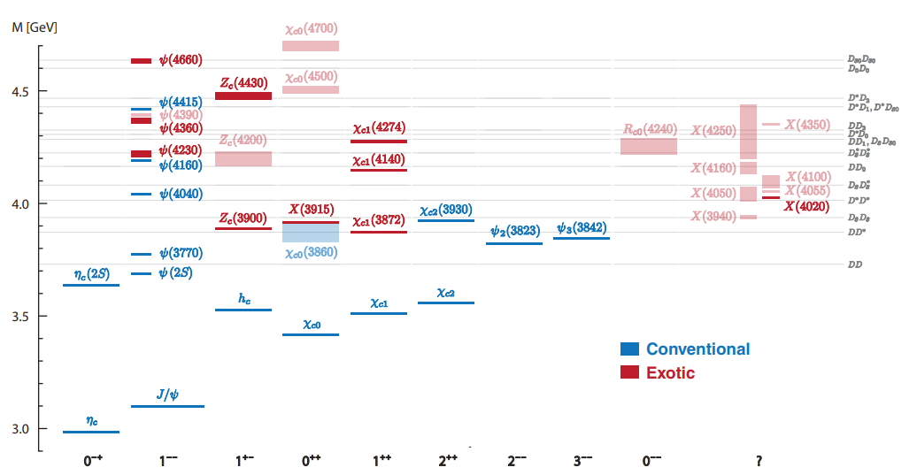
Exotic mesons
Recent count:
54 in $c\overline{c}$ sector
5 in $b\overline{b}$ sector
4 with all $c$ and $\overline{c}$
1 with two charm quarks.
Eichmann, Fischer, Heupel, Santowski, Few Body Syst. 61 (2020)
Lebed talk on Monday (April 14)

Slide 3
Born-Oppenheimer EFT

Slide 4
BOEFT: Exotic Hadron
Exotic hadron $(Q\overline{Q}X,QQX, …..)$, $X$: any combination of light quark and gluons (LDF) for color singlet.
Hierarchy of scales in hybrids:
LDF
$$\overline{Q}$$
$$r∼1/mv$$
$$Q$$
Mass of heavy quark: $m$
Energy scale for LDF: ${\text{Λ}}_{\text{QCD}}$
Relative momentum between heavy quarks: $mv ∼1/r$
Heavy Quark kinetic energy scale: $mv^{2}$
Heavy quarks static with
respect to light quarks or gluons
Time-scale for dynamics of $\text{Q}\overline{\text{Q}}:∼\frac{\text{1}}{\text{m}{\text{v}}^{\text{2}}}\text{≫}\frac{1}{{\text{Λ}}_{\text{QCD}}}$
Born-Oppenheimer (BO) Approximation
Braaten, Langmack, Smith Phys. Rev. D. 90, 014044 (2014)
Juge, Kutti, Morningstar, Phys. Rev. Lett. 90, 161601 (2003)
Notes:
A complete understanding of exotic quarkonia in terms of these pictures has not yet been obtained

Slide 5
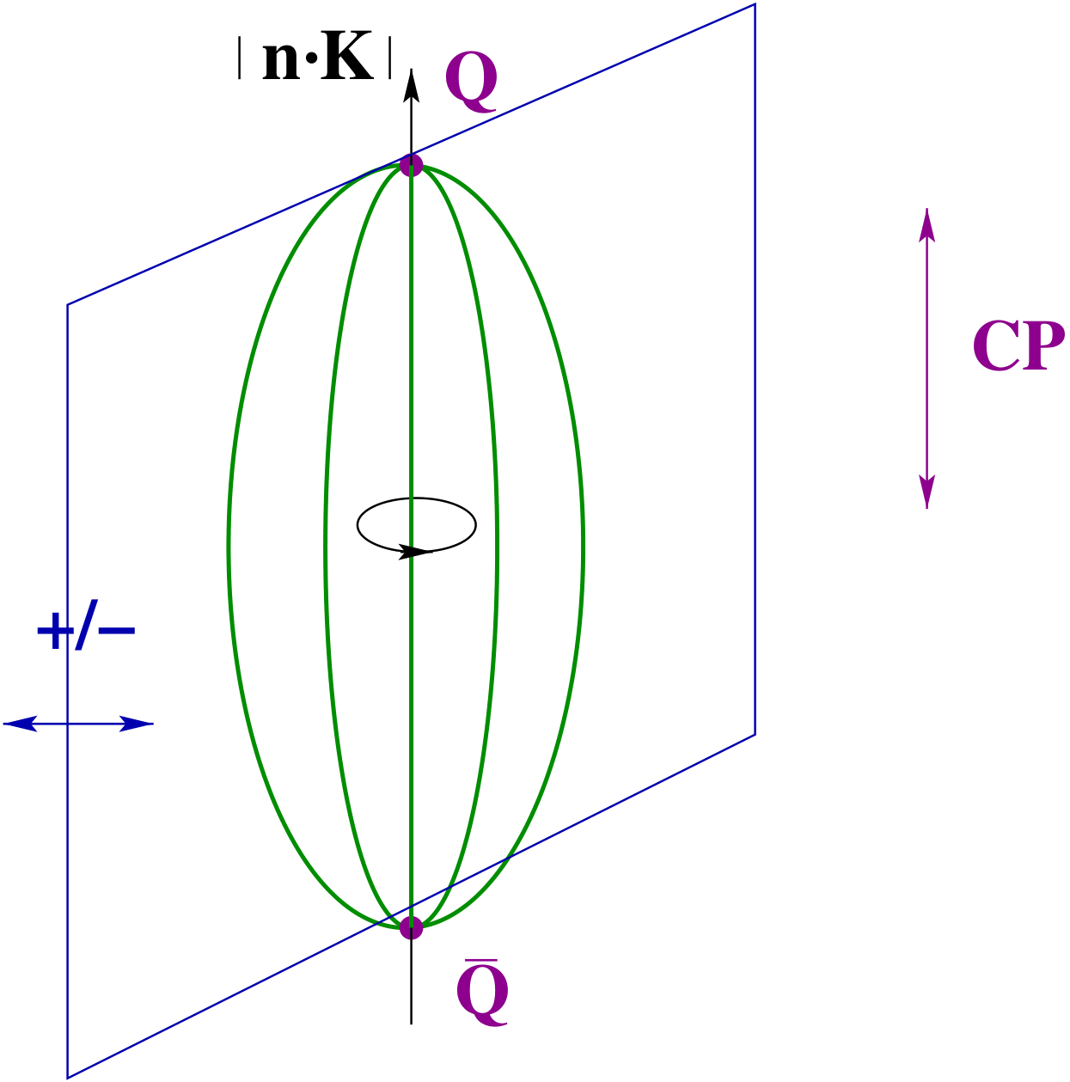
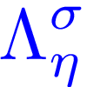
BOEFT: Quantum #’s
BO-quantum number ($\text{r}≠\text{0}$): heavy quarks static, Cylindrical symmetry group $D_{∞h}$
Labelling LDF static energies:
Absolute value of component of LDF angular momentum $K$
$$\left|r⋅K\right|≡Λ=0, 1, 2,…….. (or Σ, Π, Δ, Φ,…..)$$
CP
Product of charge conjugation and parity ($CP$):
$η=+1 \left(g\right),$ $−1 \left(u\right)$
$σ$: Eigenvalue of reflection about a plane containing static sources.
$$σ=P {\left(−1\right)}^{K_{light}}=±1$$
Born, Oppenheimer, Annalen der Physik 389 (1927)
Landau, Lifshitz & Pitaevskii, QM book
Examples:
$$K^{PC}$$
$$Λ_{η}^{σ}$$
Spherical symmetry restored in $\text{r}→\text{0}$ limit:
Labelled by LDF quantum #’s:
$$0^{++}$$
$$Σ_{g}^{+}$$
$$0^{+ −}$$
$$Σ_{u}^{+}$$
$$1^{+ −}$$
$${\{ Σ}_{u}^{−}, Π_{u} \}$$
$$2^{−−}$$
$$\{ Σ_{g}^{−}, Π_{g}, Δ_{g} \}$$
Notes:
D_{infinity}h-→cylindrical symmetry group. O(3)*C: spherical symmetry group. In the centreof-mass system gluonic excitations between static quarks are, therefore, classified according to representations of O(3)× C, which we summarize by L, the angular momentum, CP and reflection with respect a plane passing through the quark-antiquark axes5x

Slide 6
Exotic Hadron
Berwein, Brambilla, AM, Vairo, Phys. Rev. D. 110, (2024), 094040
$$Q\overline{Q}X$$
$$QQX$$
$Q$
$\overline{Q}$
Total angular momentum
of $\text{Q}\overline{\text{Q}}\text{X}$or $\text{Q}\text{Q}\text{X}$:
$Q$
$Q$
r
r
color:
color:
X = gluon $→$ Hybrid
X = $q_{3}$ $→$ Double heavy baryon
X = ${\left(q\overline{q}\right)}_{8}→$ Tetraquark ( Molecule, compact..)
X= ${\left(\overline{q}\overline{q}\right)}_{3} /{ \left(\overline{q}\overline{q}\right)}_{\overline{6}}→$ Tetraquark
X = ${\left(qqq\right)}_{8}→$ Pentaquark ( Molecule, compact..)
X= ${\left(qq\overline{q}\right)}_{3} /{ \left(qq\overline{q}\right)}_{6}→$ Pentaquark
and so on
and so on
X₈ : Adjoint hadrons (gluelump, adjoint meson, adjoint baryon….)
X_{3 / 6} : triplet or sextet hadrons (meson, baryon….)
BOEFT can address all these states with inputs from Lattice QCD
Notes:
Non-relativistic because v~alpha<<1. This can be seen from the virial theorem.
Top quark mass ~ 180 GeV. Top quark unstable and short-lived and decays into bottom quark + W-boson.

Slide 7
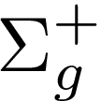
BOEFT
BOEFT Lagrangian:
Berwein, Brambilla, AM, Vairo, Phys. Rev. D. 110, (2024), 094040
Castellà , Soto Phys. Rev. D. 102, 014012 (2020)
Brambilla, Krein, Castellà , Vairo Phys. Rev. D. 97, (2018)
Gap of order ${\text{Λ}}_{\text{QCD}}$ allows us to focus individually on
low-lying states corresponding to quarkonium, hybrid,
tetraquark etc.
$L_{mixing}:$ Mixing between different states with similar masses and same quantum-numbers.
Ex: Hybrid-quarkonium mixing, Tetraquark-hybrid &
Tetraquark-quarkonium mixing etc.
$$Δ∼Λ_{QCD}$$
$$E∼mv^{2}$$
R. Oncala, J. Soto, Phys. Rev. D96 014004 (2017)
Ajeli, Brambilla, AM, Vairo, In preparation
$Σ_{g}^{+}$ is the usual Cornell potential
$Σ_{u}^{−}$: similar to Cornell potential except repulsive octet behavior at small distances.
Notes:
In the static limit, quarkonium (the lowest potential ) and heavy hybrids (the remaining potentials) do not mix by construction (they are built as orthogonal states). Hence, the mixing must be due to 1/m corrections to the Born-Oppenheimer approximation

Slide 8
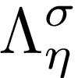
BOEFT
Berwein, Brambilla, AM, Vairo, Phys. Rev. D. 110, (2024), 094040
BOEFT Lagrangian:
LDF-quantum #:
BO-quantum #:
Projection vectors for $D_{∞h}$ :
BO potentials: Potential between $Q \& \overline{Q}$due to LDF (light quarks, gluons).
v
Born-Oppenheimer (BO)
potential:
v
Static Energy
Spin-dependent potentials
Brambilla, Lai, Segovia, Castellà, Phys. Rev. D. 101, (2020)
Brambilla, Lai, Segovia, Castellà, Vairo Phys. Rev. D. 99, (2019)
Soto, Valls,
Phys. Rev. D 108 (2023)
Castellà , Soto
Phys. Rev. D. 102, (2020)
Notes:
In the static limit, quarkonium (the lowest potential ) and heavy hybrids (the remaining potentials) do not mix by construction (they are built as orthogonal states). Hence, the mixing must be due to 1/m corrections to the Born-Oppenheimer approximation

Slide 9
BOEFT
Berwein, Brambilla, AM, Vairo, Phys. Rev. D. 110, (2024), 094040
Good quantum numbers:
$K:$ LDF angular-momentum or spin
$L_{Q}:$ orbital-angular momentum of $QQ$ or $Q\overline{Q}$ pair.
BO-orbital momentum:
Heavy quark Spin: $S_{Q}$ (HQSS limit)
Total angular momentum:
Coupled Equations (spin-averaged) for lowest Hybrids ($\text{Q}\overline{\text{Q}}g$) and Tetraquarks ($\text{QQ}\overline{\text{qq}}$ or $\text{Q}\overline{\text{Q}}\text{q}\overline{\text{q}}$):
LDF quantum # K=1
parity $σ_{P}$:
Opposite
parity $−σ_{P}$ :
Berwein, Brambilla, Castellà , Vairo Phys. Rev. D. 92 (2015)

Slide 10
BOEFT
Berwein, Brambilla, AM, Vairo, Phys. Rev. D. 110, (2024), 094040
Coupled Equations (spin-averaged) for Doubly Heavy Baryons ($\text{QQ}\text{q}$) & Pentaquarks ($\text{QQ}\overline{\text{q}}\text{qq}$ or $\text{Q}\overline{\text{Q}}\text{qqq}$):
LDF quantum # K=1/2
LDF quantum # K=3/2
parity $σ_{P}$:
Opposite
parity $−σ_{P}$ :
Castellà , Soto Phys. Rev. D. 102, 014013 (2020)
Castellà , Soto Phys. Rev. D. 104, 074027 (2021)

Slide 11
$X\left(3872\right)$ & $T_{cc}^{+} (3875)$

Slide 12
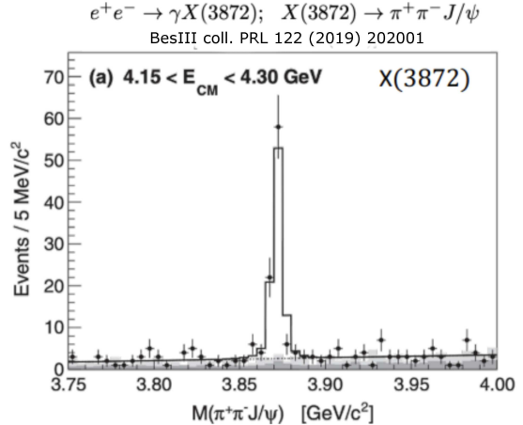
First XYZ exotic state seen by Belle
Phys. Rev. Lett. 91, 262001 (2003)
Quark content $c \overline{c}$ + light quarks
Quantum numbers: J^{PC}=1⁺⁺ (Isospin=0)
LHCb, Phys. Rev. Lett. 110, 222001 (2013)
LHCb, Phys. Rev. D. 92, 011102 (2015)
Mass extremely close to D^{*0}D⁰ threshold (within 100 keV)
LHCb, JHEP 08 (2020) 123

Slide 13
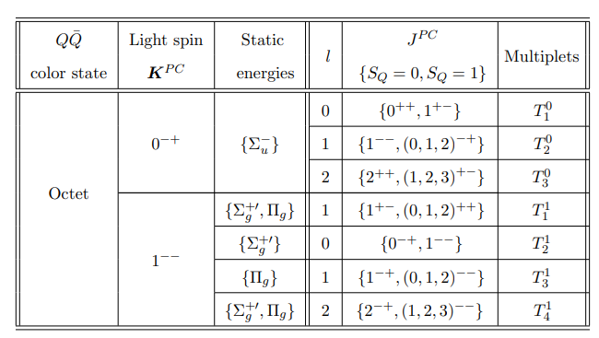
BOEFT: $Q\overline{Q}q\overline{q}$ multiplets
$$q\overline{q}$$
Isospin-1 channel:
$$Z_{c} \left(3900\right),Z_{c} \left(4200\right), Z_{b}\left(10610\right),$$
$Z_{b}\left(10610\right)$states:
Mixing between K^{PC} = $0^{− +}$ and K^{PC} = $1^{− −}$
Light-quark spin-symmetry !!
Voloshin, Phys. Rev. D. 93, 074011 (2016)
Braaten, Bruschini Phys. Lett. B 863 (2025) 139386
Berwein, Brambilla, AM, Vairo, Phys. Rev. D. 110, (2024), 094040
Isospin-0 channel:
$χ_{c1}\left(3872\right),$ $X_{b}$
Brambilla, AM, Scirpa, Vairo 2411.14306
Notes:
tti

Slide 14
BO potentials: Tetraquarks
LDF
$$Q$$
$$r$$
$$Q$$
$$\overline{Q}$$
$$\overline{Q}$$
As $r→∞$
2- meson state
Consider $\text{Q}\overline{\text{Q}}\text{q}\overline{\text{q}}$ system:
BO-quantum # $Λ_{η}^{σ}$ as $r→0$:
BO-quantum # $Λ_{η}^{σ}$ for meson-antimeson as $r→∞$
$$\text{Q}\overline{\text{Q}}$$ (color) | Light Spin ${\text{K}}^{\text{PC}}$ | $Λ_{η}^{σ}$ ($D_{∞h}$)
Octet | $0^{− +}$ | $$Σ_{u}^{−}$$
 | $1^{− −}$ | $$\{Σ_{g}^{+}, Π_{g}\}$$
s-wave+s-wave
Ex. $D\overline{D}$ threshold
Meson-antimeson have same BO-quantum # $Λ_{η}^{σ}$ !!!
Berwein, Brambilla, AM, Vairo, Phys. Rev. D. 110, (2024), 094040
Braaten, Bruschini Phys. Lett. B 863 (2025) 139386

Slide 15
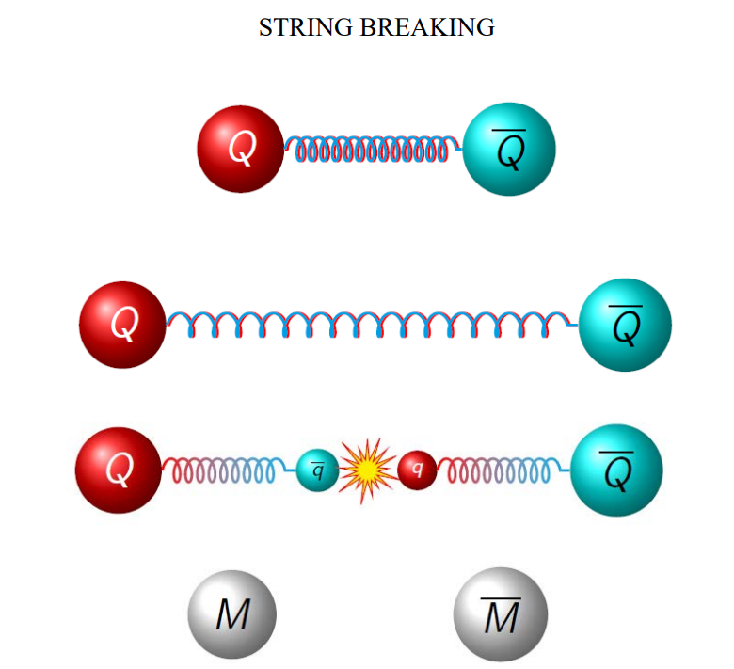
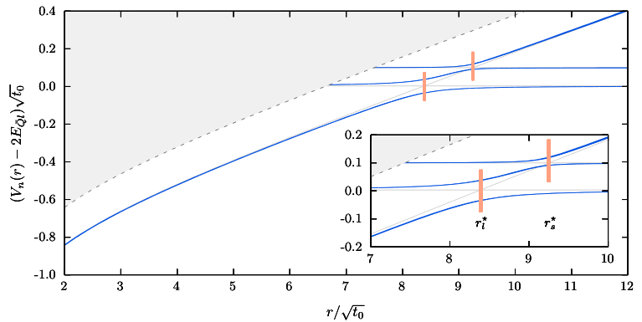
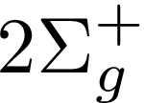
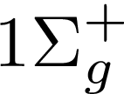
Quarkonium and Tetraquarks
String breaking: quarkonium & meson-antimeson
Bulava, Hoerz, Knechtli, Koch, Moir,
Morningstar, Peardon, Phys. Lett. B. 793 (2019)
Bulava, Knechtli, Koch,
Morningstar, Peardon, Phys. Lett. B. 854 (2024)
Ground state + Pions
Figure from R. Bruschini talk
String breaking radius $≈$ 1.22 fm
Avoided crossing between static energies with same BO-quantum # $Σ_{g}^{+}$
Notes:
Lattice spacing: 0.063 fm

Slide 16
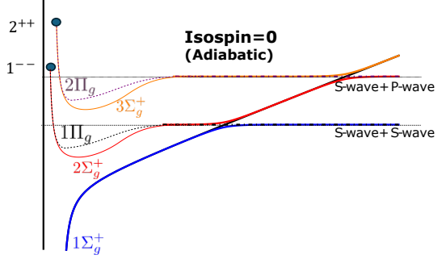
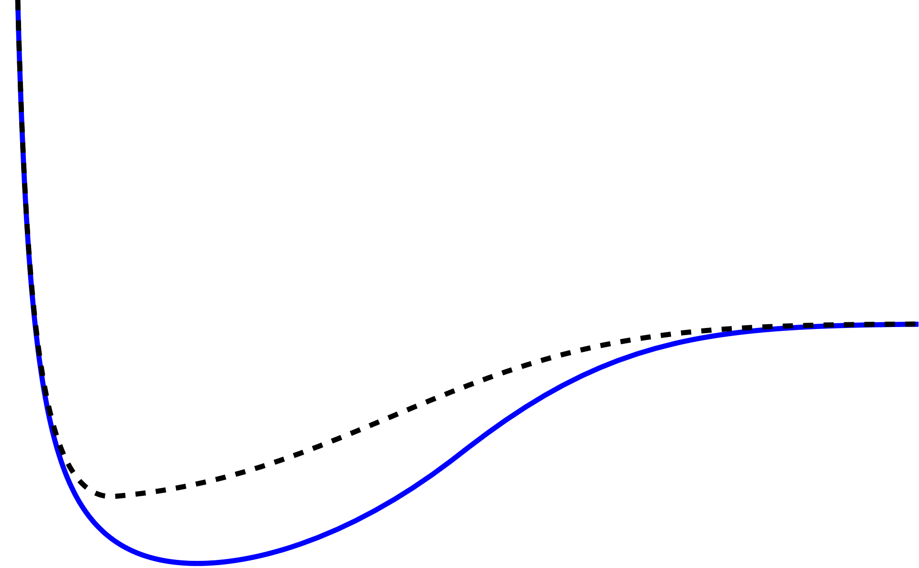
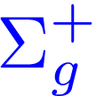
Tetraquarks
$$0^{− +}$$
Isospin=1
Key Takeaways: Tetraquark static energy behavior
Repulsive behavior at small r ($r→0$)
S-wave +S-wave
Heavy meson pair threshold at large r ($r→∞$)
Avoided crossing with quarkonium static energy (Isopsin=0)
$$1^{−−}$$
Isospin=1
S-wave +S-wave
Berwein, Brambilla, AM, Vairo, Phys. Rev. D. 110, (2024), 094040
Braaten, Bruschini Phys. Lett. B 863 (2025) 139386

Slide 17
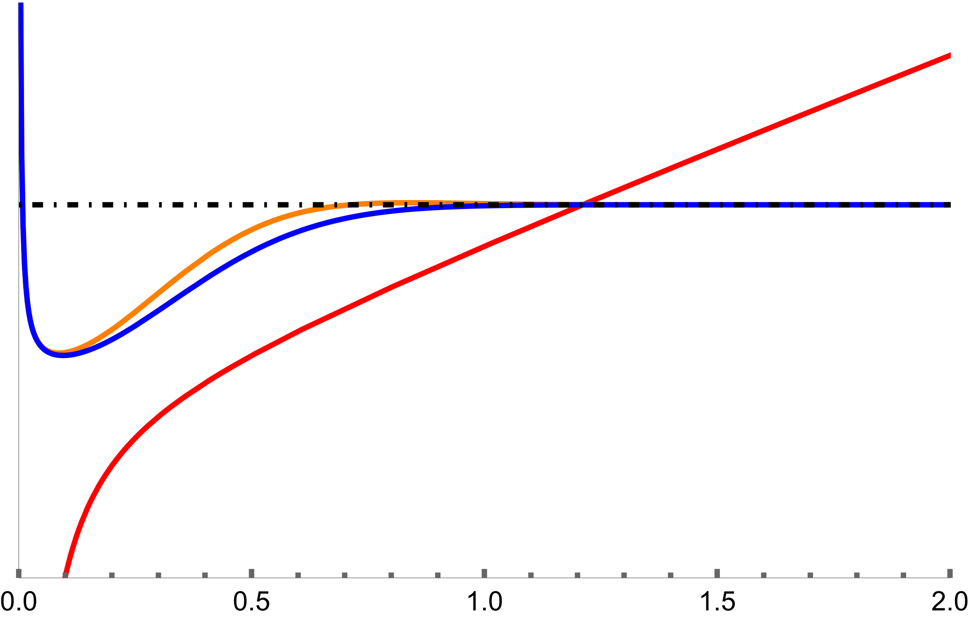
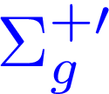
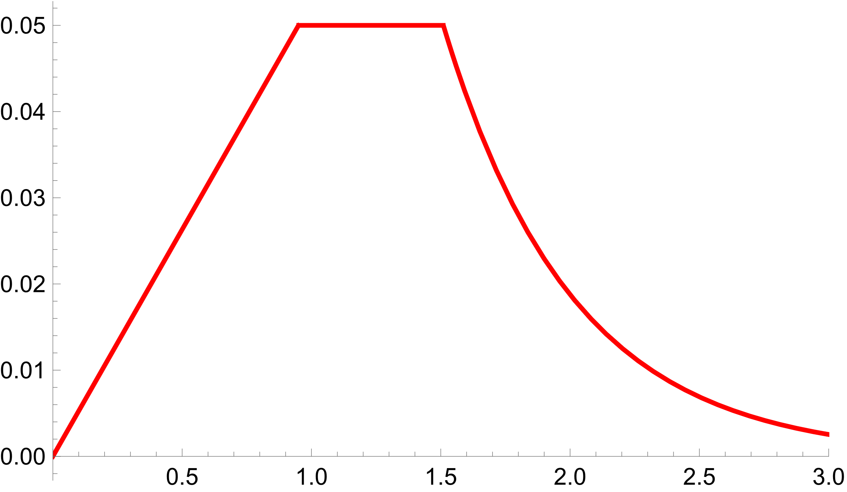
Brambilla, AM, Scirpa, Vairo 2411.14306
Berwein, Brambilla, AM, Vairo, Phys. Rev. D. 110, (2024), 094040
Coupled-channel Equations: spin-averaged
Diabatic potentials
$$l=1$$
Mixing potential g(r)
$r_{c}≈1.2$ fm
$$r_{c}$$
$$g(GeV)$$
Parametrization of Mixing potential g(r)
Short-distance $r→0$ behavior fixed by pNRQCD
Castellà, Phys. Rev. D. 106, (2022), 094020
Around $r_{c}$: fixed to lattice QCD value
r (fm)

Slide 18
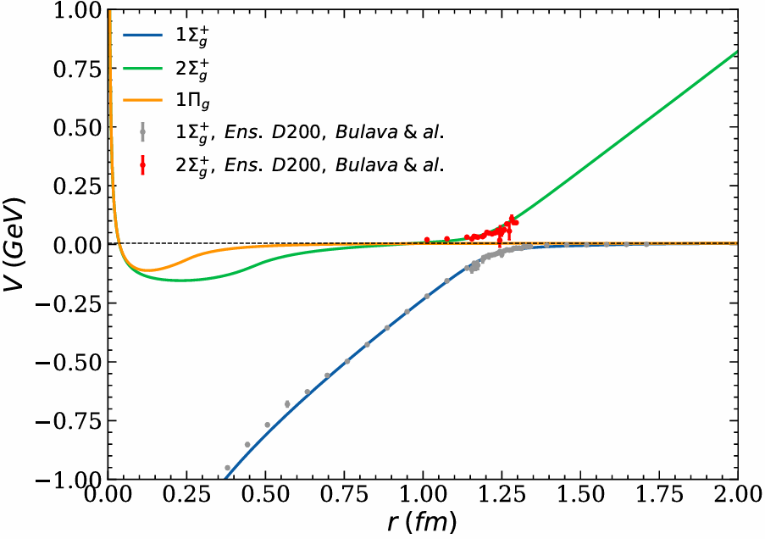
Brambilla, AM, Scirpa, Vairo 2411.14306
Alasiri, Braaten, AM,
Phys. Rev. D 110, 054029 (2024)
Adiabatic potentials
Berwein, Brambilla, AM, Vairo, Phys. Rev. D. 110, (2024), 094040
Coupled-channel Equations:
$$∝Λ_{a}^{1^{−−}}$$
Adjoint ${\left(q\overline{q}\right)}_{8}$ energy
: $Λ_{a}^{1^{−−}}≈−228$ MeV
$$l=1$$
Results:
Lattice inputs on string breaking from
Bulava et al Phys. Lett. B. 854 (2024)
Quarkonium percentage:${\left|ψ_{Σ}\right|}^{2}≈ 8−13 \%$
Tetraquark percentage: ${\left|ψ_{Σ^{′}}\right|}^{2}≈ 38 \%$, ${\left|ψ_{Π}\right|}^{2}≈ 54 \%$
Radius $∼15$ fm.
Deeper state in bottom sector: 15 MeV below spin-isospin averaged $B\overline{B}$ threshold.

Slide 19
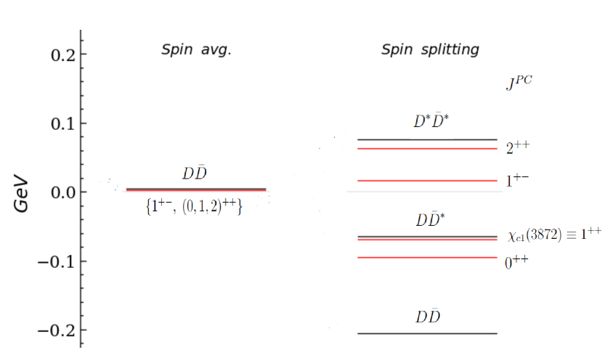
Brambilla, AM, Scirpa, Vairo 2411.14306
Results:
Using lattice QCD spin-splitting
results for hybrids ($Q\overline{Q}g$)
Quarkonium percentage: ${\left|ψ_{Σ}\right|}^{2}≈ 8−13 \%$
Tetraquark percentage: ${\left|ψ_{Σ^{′}}\right|}^{2}≈ 38 \%$, ${\left|ψ_{Π}\right|}^{2}≈ 54 \%$
Radius $∼15$ fm.
Adjoint ${\left(q\overline{q}\right)}_{8}$ energy: $Λ_{a}^{1^{−−}}≈−228$ MeV:
No bound states in higher
multiplets $T_{2}^{1},T_{3}^{1}$, $T_{4}^{1}$ ….
$1^{+ +}$ state: Identified with $χ_{c1}(3872)$
$1^{+ −}$ state: Mass around 3.957 (11) GeV. Identified with X(3940) ?
Multiplet $T_{1}^{1}$: {$1^{+ −}, {\left( 0, 1, 2\right)}^{+ +}$}
$2^{+ +}$ state: Mass around 4.004 (14) GeV.
$0^{+ +}$ state: Mass around 3.846 (11) GeV. Also indicated in the lattice calculations: Prelovsek et al JHEP 06 (2021) 035.

Slide 20
Brambilla, AM, Scirpa, Vairo 2411.14306
We naturally get $8−13 \%$ quarkonium component
in $χ_{c1}(3872)$ due to avoided level crossing
Quarkonium percentage: ${\left|ψ_{Σ}\right|}^{2}≈ 8−13 \%$
Tetraquark percentage: ${\left|ψ_{Σ^{′}}\right|}^{2}≈ 38 \%$, ${\left|ψ_{Π}\right|}^{2}≈ 54 \%$
Radius $>15$ fm.
Radiative decays:
Our estimate: $R_{γψ}=2.99±2.36$ (assuming only through $χ_{c1}\left(2P\right)$ component)
LHCb: $R_{γψ}=1.67±0.25$
Aaij et al arXiv: 2406.17006
Compositeness:
BES III: $Z={0.18}_{−0.23}^{+0.20}$
EMPPR: $\text{0.052 }\text{< }\text{Z}\text{ < }\text{0.14}$
Agreement with our $8−13 \%$ quarkonium (compact) component
Ablikim et al. Phys. Rev. Lett 132, 151903 (2024)
Esposito, Maiani, Pilloni, Polosa, Riquer
Phys. Rev. D 105, L031503 (2022)
Lattice QCD:
$c\overline{c}$ operator along with $D{\overline{D}}^{∗}$ relevant for $χ_{c1}(3872)$ signal
Padmanath, Lang, Prelovsek Phys. Rev. D 92, 034501 (2015)
Prelovsek and Leskovec Phys. Rev. Lett 111, 192001 (2013)

Slide 21
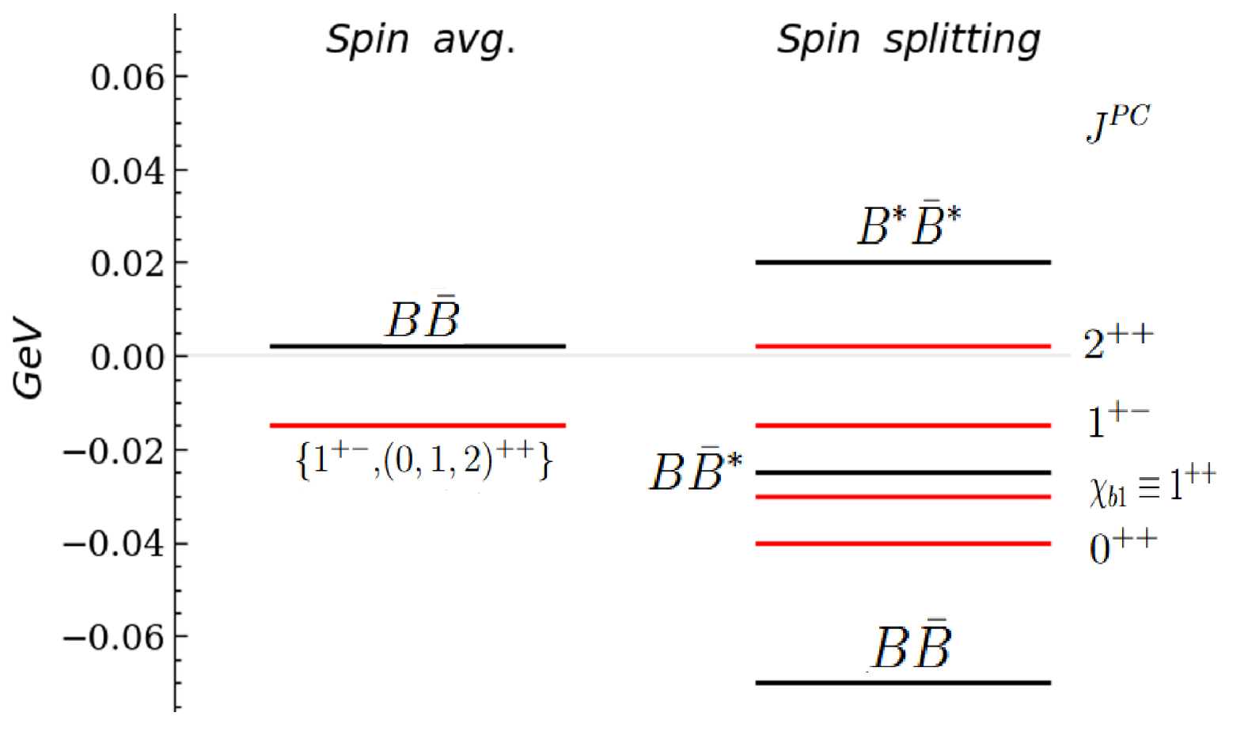
Brambilla, AM, Scirpa, Vairo 2411.14306
Using lattice QCD spin-splitting
results for hybrids ($Q\overline{Q}g$)
Results with
adjoint meson energy $≈−228$ MeV
Quarkonium percentage: ${\left|ψ_{Σ}\right|}^{2}≈1.5 \%$
Tetraquark percentage:
${\left|ψ_{Σ^{′}}\right|}^{2}≈45.4 \%$, ${\left|ψ_{Π}\right|}^{2}≈ 53.1 \%$
$$2^{++}$$
$1^{+ +}$: identified with $X_{b}$: Mass around 10.595 GeV
$1^{+ −}$ state: Mass around 10.612 GeV.
Multiplet $T_{1}^{1}$: {$1^{+ −}, {\left( 0, 1, 2\right)}^{+ +}$}
$2^{+ +}$ state: Mass around 10.635 GeV.
$0^{+ +}$ state: Mass around 10.576 GeV.

Slide 22
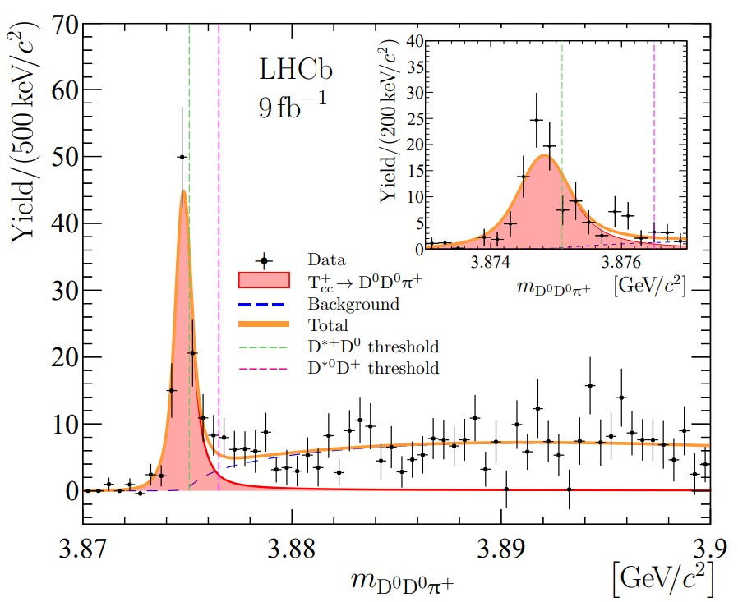
First doubly charmed tetraquark seen by LHCb
Exotic quark content $cc\overline{u}\overline{d}$
Consistent with isoscalar with J^{P}=1⁺
Longest lived Exotic particle: $Γ∼50$ keV
Mass below D^{*+}D⁰ threshold and very narrow

Slide 23
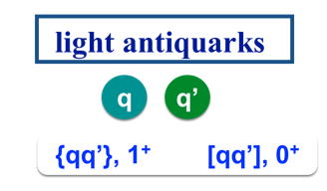
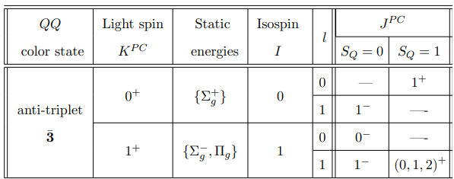
BOEFT: $QQ\overline{q}\overline{q}$ multiplets
Berwein, Brambilla, AM, Vairo, Phys. Rev. D. 110, (2024), 094040
Defines the Born-Oppenheimer
static potentials $Σ_{g}^{+}, \{Σ_{g}^{−}, Π_{g}\}$
“Bad diquark”
“Good diquark”
Bad diquark – Good diquark
$≈$ 200 MeV
$J^{P}$ for $T_{cc}^{+}$

Slide 24
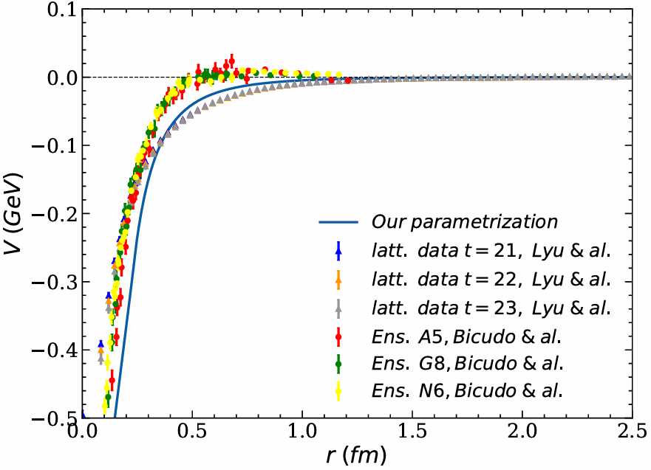
Berwein, Brambilla, AM, Vairo, Phys. Rev. D. 110, (2024), 094040
Brambilla, AM, Scirpa, Vairo 2411.14306
Schrödinger Equation:
$$l=0$$
Results:
$T_{cc}$ state : $320$ keV below DD threshold
Radius $∼8$ fm or larger.
Deeper bound state in bb sector: $T_{bb}$ 116 MeV below BB threshold.
Deeper bound state in bc sector: $T_{bc}$ 25 MeV below DB threshold.
Critical good diquark energy: $Λ_{t}^{0^{+}}≈−478$ MeV
Lyu, Aoki, Doi, Hatsuda, Ikeda, Meng, Phys. Rev. Lett. 131, 161901 (2023)
Bicudo, Marinkovic, Mueller, Wagner, arXiv 2409.10786
Lüscher Method: pion mass 280 MeV: virtual state ${9.9}_{−7.1}^{+3.6}$ MeV below $\text{D}{\text{D}}^{\text{∗}}$ threshold
Padmanath & Prelovsek , Phys. Rev. Lett. 129, 032002 (2022)
HALQCD collaboration: pion mass 146 MeV: virtual state ${59}_{−99 −67}^{+53 +2}$ keV below $\text{D}{\text{D}}^{\text{∗}}$ threshold
physical pion mass 135 MeV: bound state
Lyu et al, Phys. Rev. Lett. 131, 161901 (2023)
Notes:
Lattice data pion mass around 200 MeV

Slide 25
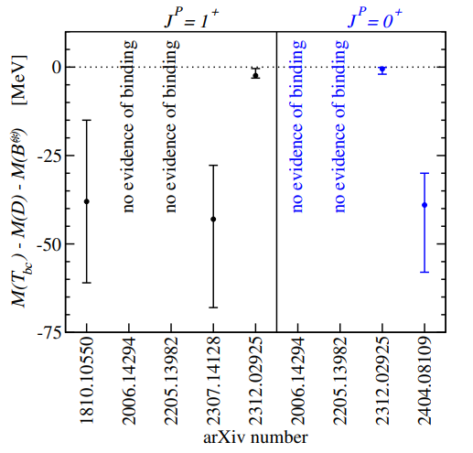
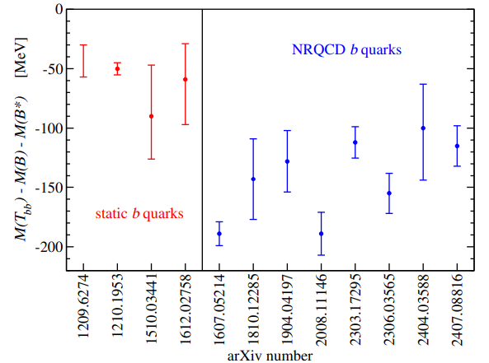
$T_{bb}$ & $T_{bc}$
Brambilla, AM, Scirpa, Vairo 2411.14306
$T_{bc}$ binding energy comparison:
$T_{bb}$ binding energy comparison:
$$J^{P}=1^{+}$$
2411.14306
2411.14306
EFT and heavy-quark-diquark symmetry prediction
for $T_{bb}$: $133±25$ MeV
Our result 25 MeV for both $J^{P}=\{0^{+}, 1^{+}\}$
Braaten, He, AM, Phys. Rev. D. 103, 016001 (2021)
Figures from Randy Lewis talk: LepageFest 2024

Slide 26
Pentaquarks

Slide 27
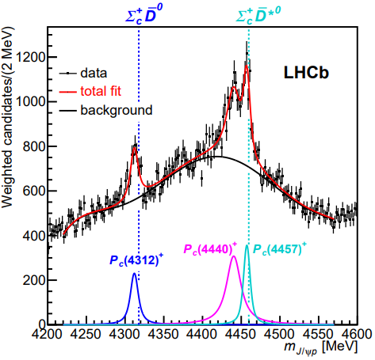
Pentaquark
Observed states
4 states with isospin $I=1/2$:
$P_{c\overline{c}}{\left(4312\right)}^{+}$, $P_{c\overline{c}}{\left(4380\right)}^{+}$, $P_{c\overline{c}}{\left(4440\right)}^{+}$, $P_{c\overline{c}}{\left(4457\right)}^{+}$
2 states with isospin $I=0$: $P_{c\overline{c}s}{\left(4338\right)}^{0}$
$P_{c\overline{c}s}{\left(4459\right)}^{0}$
$J^{P}$ quantum numbers not established
except $P_{c\overline{c}s}{\left(4338\right)}^{0}$
PDG 2025
LHCb, Phys. Rev. Lett. 122, (2019), 222001
Notes:
GlueX aims to study pentaquark states through s-wave channel photoproduction.

Slide 28
Brambilla, AM, Vairo, in preparation
Pentaquark
Berwein, Brambilla, AM, Vairo, Phys. Rev. D. 110, (2024), 094040
Lowest pentaquark multiplets:
No lattice QCD results on
adjoint baryon mass: $Λ_{({1/{2)}}^{+}}$ and $Λ_{({3/{2)}}^{+}}$
Treat them as free parameter to
reproduce $P_{c\overline{c}}$ spectrum.
Coupled-channel Equations $k^{P}=({1/{2)}}^{+}$:
Coupled-channel Equations $k^{P}=({3/{2)}}^{+}$:
$$l=1/2$$
$$l=3/2$$

Slide 29
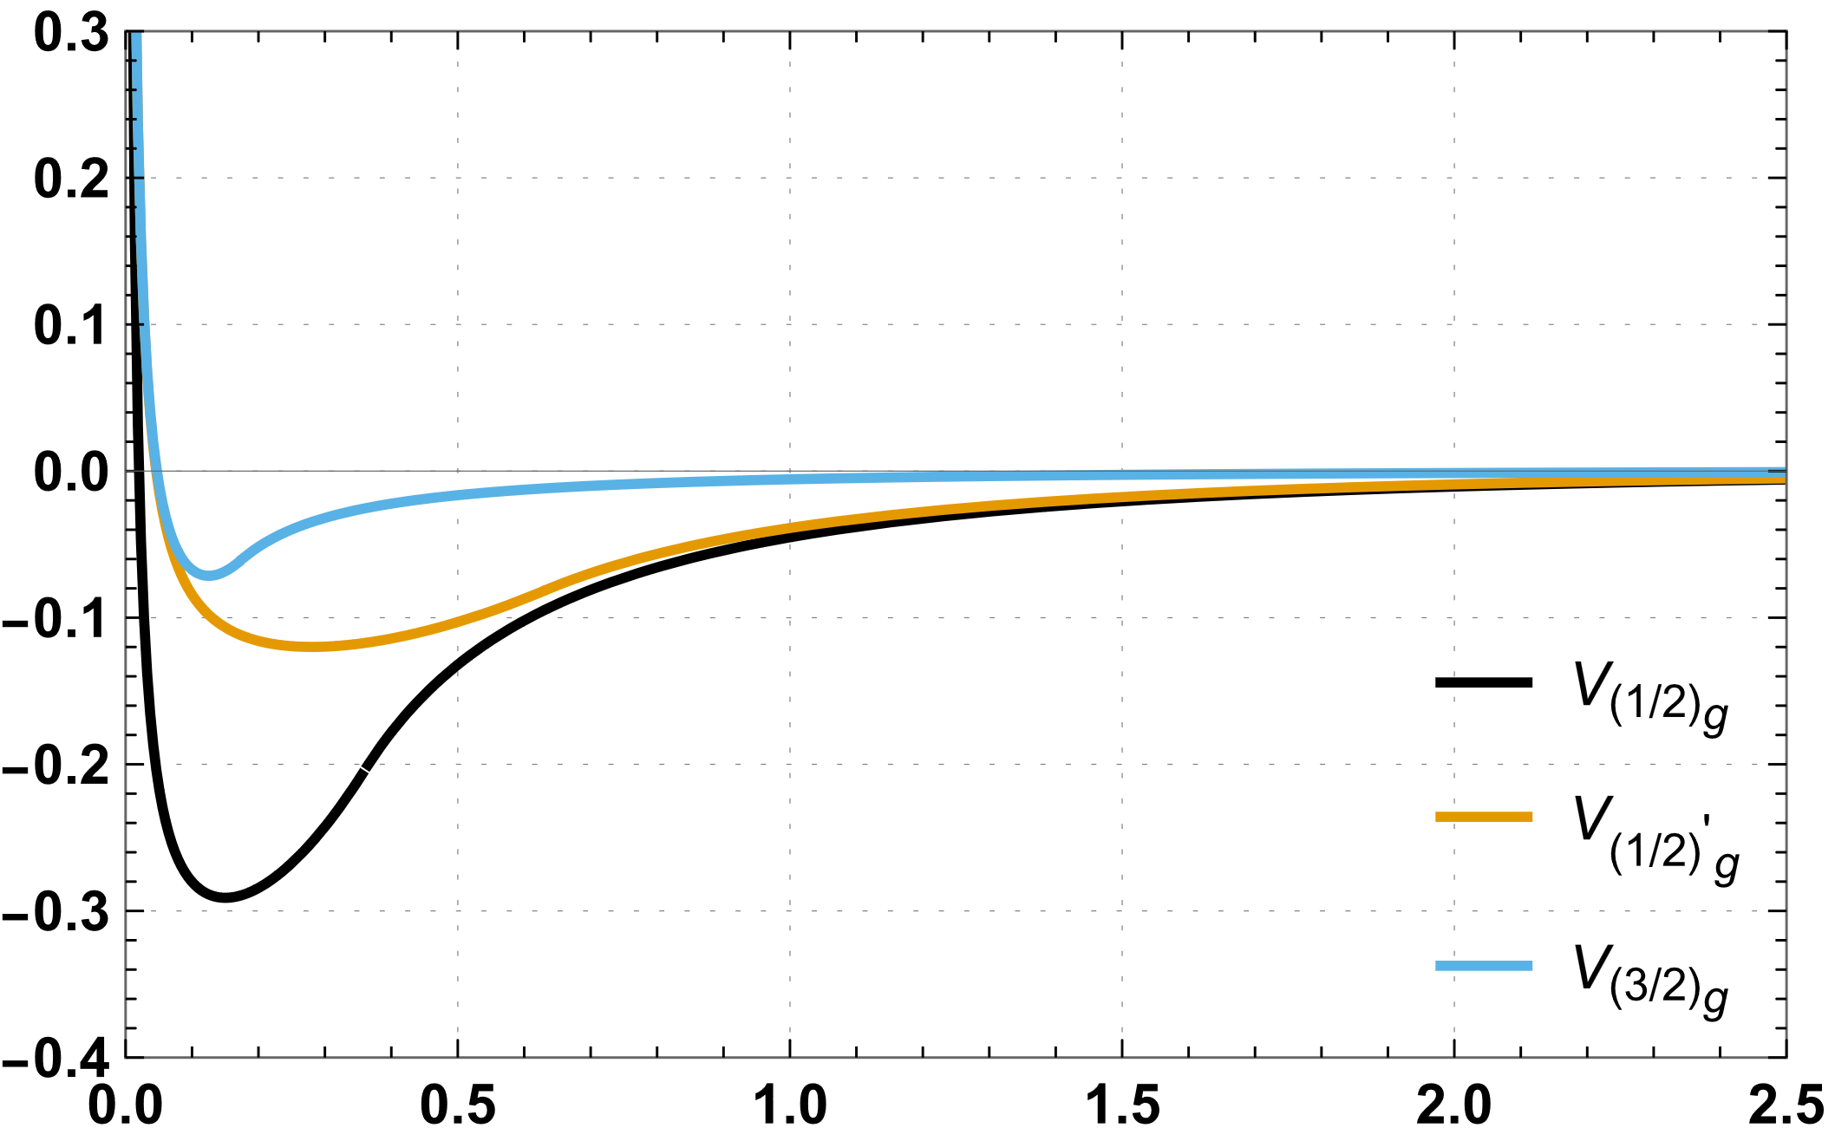
Pentaquark
Brambilla, AM, Vairo, in preparation
$V(r)$ [Gev]
Mev
After including spin corrections:
$$∝Λ_{{\left(3/2\right)}^{+}}^{b}$$
$$4527$$
$$∝Λ_{{\left(1/2\right)}^{+}}^{b}$$
$$4462$$
$$P_{c\overline{c}} (4457)$$
$$P_{c\overline{c}} (4440)$$
$r$ [fm]
${\left(qqq\right)}_{8}$ energy:
$Λ_{{\left(1/2\right)}^{+}}^{b}≈−364$ MeV, $Λ_{{\left(3/2\right)}^{+}}^{b}≈−159$ MeV
$$4386$$
$$P_{c\overline{c}} (4380)$$
$$4321$$
Decay studies to $Λ_{c}−D^{(∗)}$ and $J/ψ$ $+X$ ($X:$ light hadrons) under progress.
$$P_{c\overline{c}} (4312)$$
$$J^{P}$$

Slide 30
Hybrids

Slide 31
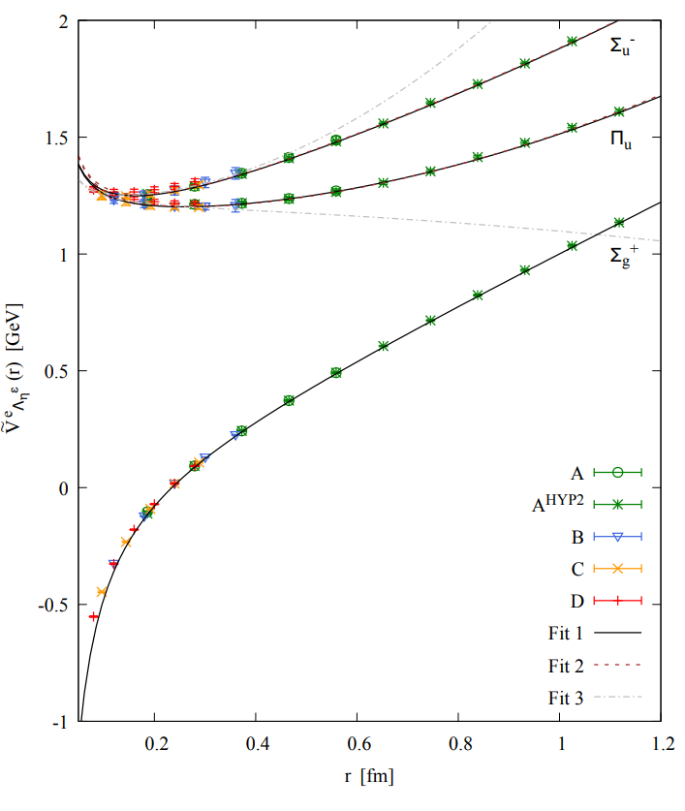
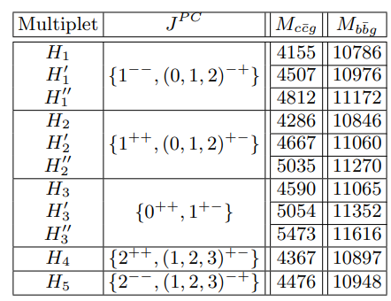
BOEFT: Hybrids
Coupled Schrödinger Eq:
$Λ$- doubling:
opposite parity states non-degenerate.
Schlosser and Wagner Phys. Rev. D. 105, (2022)
Brambilla, Lai, AM, Vairo Phys. Rev. D 107, 054034 (2023)

Slide 32
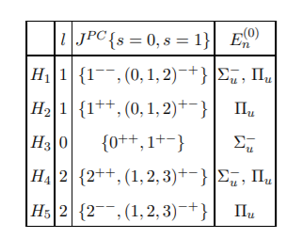
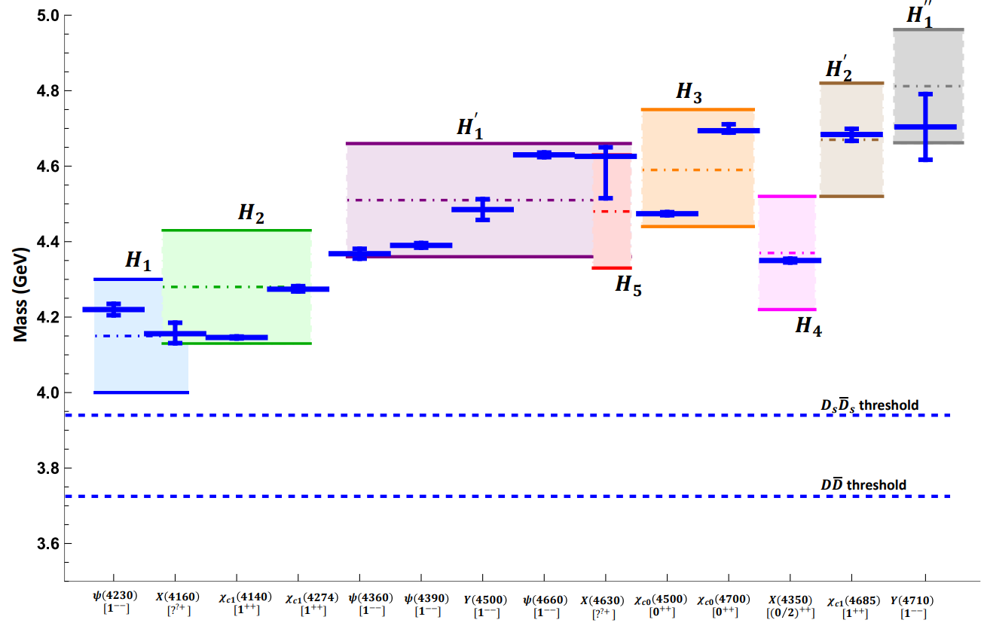
BOEFT: Hybrids
Charmonium hybrids: comparison with experimental results:
PDG 2022
Brambilla, Lai, AM, Vairo
Phys. Rev. D 107, 054034 (2023)
Berwein, Brambilla, Castellà , Vairo Phys. Rev. D. 92, 114019 (2015)

Slide 33
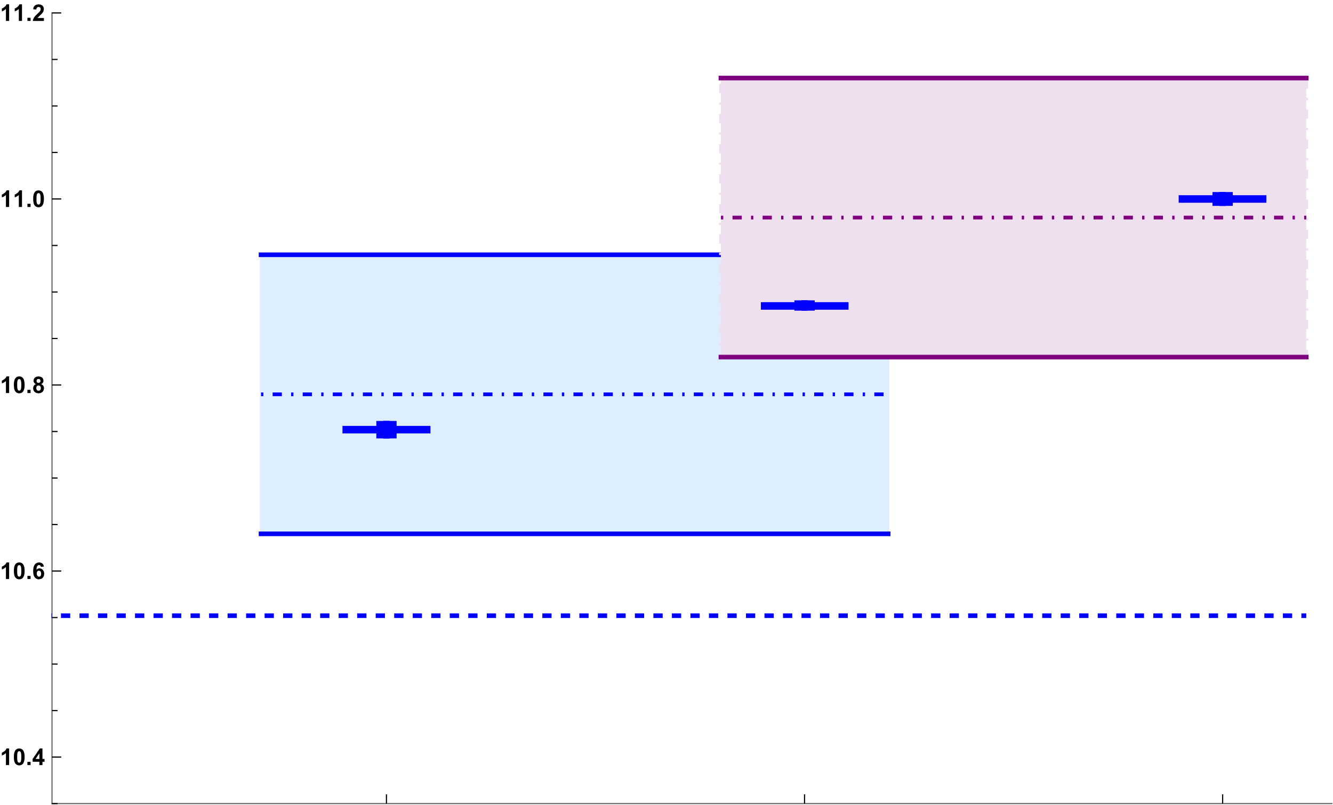
BOEFT: Hybrids
Bottomonium hybrids: comparison with experimental results:
$$H_{1}^{′}$$
$$H_{1}$$
Mass (GeV)
$B\overline{B}$ threshold
Brambilla, Lai, AM, Vairo
Phys. Rev. D 107, 054034 (2023)
Berwein, Brambilla, Castellà , Vairo Phys. Rev. D. 92, 114019 (2015)
$$Υ\left(10753\right)$$
$$[1^{−−}]$$
$$Υ\left(10860\right)$$
$$[1^{−−}]$$
$$Υ\left(11020\right)$$
$$[1^{−−}]$$
PDG 2022

Slide 34
Hybrid Decays
Brambilla, Lai, AM, Vairo Phys. Rev. D 107, 054034 (2023)
Spin-conserving decay due to $r⋅E$ term :
DISCLAIMER!!!
Decay to open-flavor threshold
states not accounted here.
$|S_{H}=1> −−→|S_{Q}=1>$
$|S_{H}=0> −−→|S_{Q}=0>$
R. Oncala, J. Soto,
Phys. Rev. D96, 014004 (2017).
J. Castellà, E. Passemar,
Phys. Rev. D104, 034019 (2021)
$$〈H_{m}\left|r\right|Q_{n}⟩=\sqrt{T^{ij}{\left(T^{ij}\right)}^{†}}$$
Spin-flipping decay due to $S.B$ term:
$|S_{H}=1> −−→|S_{Q}=0>$
$|S_{H}=0> −−→|S_{Q}=1>$
Depends on overlap of quarkonium and hybrid wavefunctions.
Semi-inclusive Hybrid-to-Quarkonium transition decay rate
= spin-conserving + spin-flipping decay rates.
Our estimate of decay rate are lower-bounds for the total width of hybrids

Slide 35
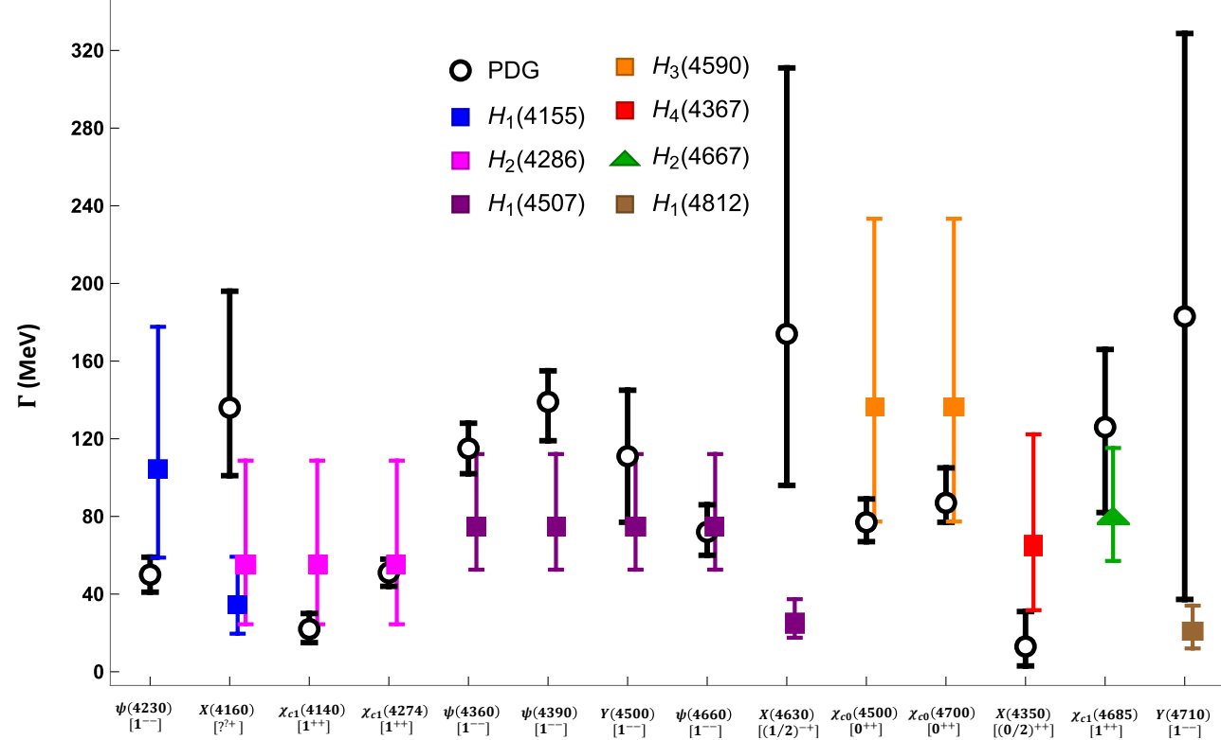
Results
Brambilla, Lai, AM, Vairo Phys. Rev. D 107, 054034 (2023)
Semi-inclusive process:
$H_{m}→Q_{n}+X$; $Q_{n}$: low-lying quarkonium (states below threshold) & X: light hadrons.
$H_{m}→Q_{n}+X$
spin-conserving + spin-flipping decays
=
lower bound on the total decay widths of hybrids which is compared with inclusive rate of physical states in PDG.
Notes:
Spin singlet member of the H2 multiplet, the spin-conserving decay leads to spin singlet ηc(1S) quarkonium in the final state and the spin-flipping decay leads to spin triplet χc(1P) quarkonium in the final state. However, these 681 states: χc1(4140) and χc1(4274) only decays to ϕJ/ψ which disfavours the hybrid interpretation. It has been suggested that these states could be isospin−0 charmonium tetraquark state.
The JPC quantum number of X(4160) have not yet been determined. However, the charge conjugation and mass suggest that it can be a candidate for the spin triplet 1−+ member of the H1 multiplet or the spin singlet 1++ member of the H2 multiplet. Since, X(4160) only decays into D∗ ¯D∗ mesons, this disfavors hybrid interpretation and favors a molecular interpretation of this state

Slide 36
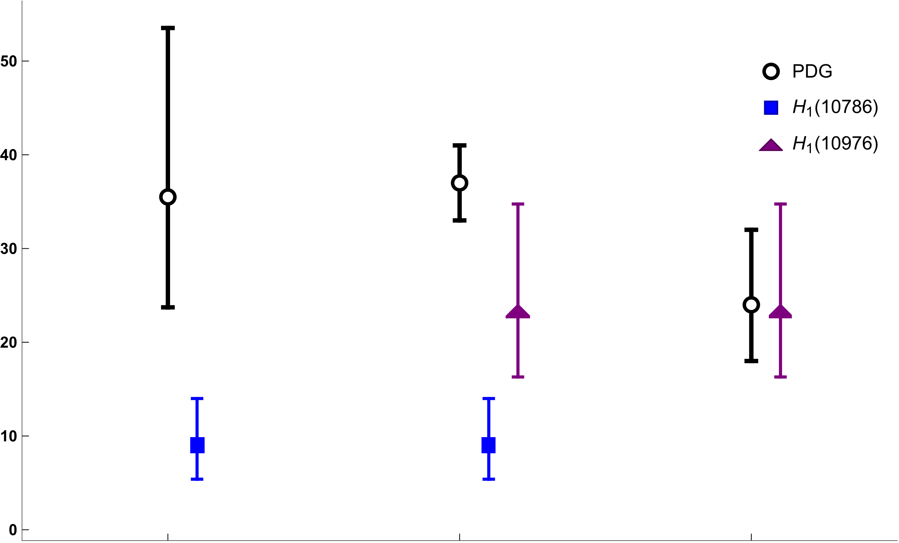
Results
Brambilla, Lai, AM, Vairo Phys. Rev. D 107, 054034 (2023)
Semi-inclusive process:
$H_{m}→Q_{n}+X$; $Q_{n}$: low-lying quarkonium (states below threshold) & X: light hadrons.
$H_{m}→Q_{n}+X$
spin-conserving + spin-flipping decays
=
lower bound on the total decay widths of hybrids which is compared with inclusive rate of physical states in PDG.
$Γ$ (MeV)
Disclaimer
$Υ(nS)$+Dipion transition rules out
pure hybrid interpretation for $Υ(10753)$
$$Υ\left(10753\right)$$
$$[1^{−−}]$$
$$Υ\left(10860\right)$$
$$[1^{−−}]$$
$$Υ\left(11020\right)$$
$$[1^{−−}]$$
Belle II, JHEP 07, 116 (2024) (2023)
Notes:
Upsilon(10753): Candidate of upsilon(3d) quarkonium state. And upsilon(10860) candidate for upsilon (5s) quarkonium state.

Slide 37
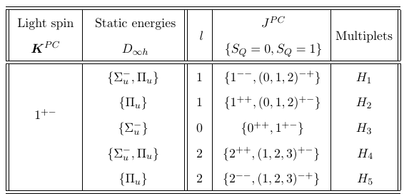
Hybrid: Mixing with heavy-light
Hybrid decays to s-wave + s-wave meson pairs:
Conventional Wisdom: Hybrid decays to two S-wave mesons forbidden!
Kou & Pene, Phys Lett B 631 (2005)
Page, Phys Lett B 407 (1997)
Farina, Tecocoatzi, Giachino, Santopinto & Swanson, Phys Rev D 102 (2020)
Decay allowed based on BO-quantum #
Bruschini Phys. Rev. D 109 L031501 (2024)
J. Castella JHEP 06, 107 (2024)
Hybrid
BO-quantum # $Λ_{η}^{σ}$ for threshold
s-wave+s-wave
Ex. $D\overline{D}$ threshold
$Σ_{u}^{−}$ component in hybrids couple with $Σ_{u}^{−}$ component in
s-wave+s-wave !!!!
Notes:
Hybrid-quarkonium mixing can introduce corrections to the selection rules of Kou and Pene.
Hybrid and meson-antimeson threshold states should have narrow avoided crossing since $g→q\overline{q}$

Slide 38
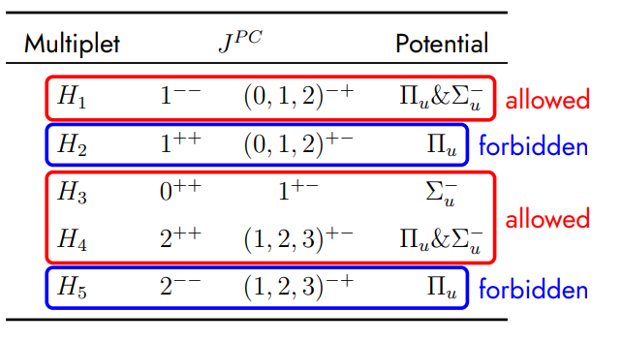
Hybrid: Decays to heavy-light
Taken from R. Bruschini talk: Exotic hadron spectroscopy 2024, Swansea
Bruschini Phys. Rev. D 109 L031501 (2024)
Recent lattice computation for $c\overline{c}$ hybrid $1^{− +}$ decay to
Shi et al. Phys. Rev. D 109, 094513 (2024)
Notes:
Hybrid-quarkonium mixing can introduce corrections to the selection rules of Kou and Pene.
Hybrid and meson-antimeson threshold states should have narrow avoided crossing since $g→q\overline{q}$

Slide 39
Summary/Outlook
Born-Oppenheimer EFT: Tool based on QCD and Born-Oppenheimer approximation to study Exotic states.
Behavior of tetraquark / pentaquark static energies (Lattice needs to confirm the small r behavior!):
$\text{Q}\overline{\text{Q}}$ systems: Repulsive behavior at small r ($r→0$). Avoided crossing quarkonium static energy (isospin=0).
$\text{QQ}$ systems: Attractive (Triplet) or repulsive (sextet) behavior at small r ($r→0$).
Heavy meson pair or heavy meson baryon threshold at large r ($r→∞$).
$\text{Q}\overline{\text{Q}}$ systems: Avoided crossing between tetraquark and quarkonium static energy (Isospin=0).
New results regarding $χ_{c1}(3872)$, $T_{cc}^{+}(3875)$ and $P_{c\overline{c}}$ pentaquark states.
Extend BOEFT approach for production studies:
1) understanding hadro-production of $χ_{c1}(3872)$, and $T_{cc}^{+}(3875)$.
2) photo-production studies relevant for EIC collider, Glue X. More
difficult than hadro-production studies !!!

Slide 40
What is an XYZ Meson ???
X Y Z
Figure from Eric Braaten talk: Charm 2020 conference
Thank you!!
Perhaps Born-Oppenheimer can address whole pattern !!! .

Slide 41
Backup Slides

Slide 42
BOEFT
Berwein, Brambilla, AM, Vairo, Phys. Rev. D. 110, (2024), 094040
Radial Schrödinger equation:
Mixing different static energies with same LDF-quantum #:
Mixing term $M_{λ^{′}λ}$: from angular momentum piece:
Coupling static states with different BO-quantum numbers $Λ_{η}^{σ}$
Mixing term $M_{λ^{′}λ}$: Angular momentum $L^{2}$ spherically symmetric
but static states have cylindrical symmetry

Slide 43
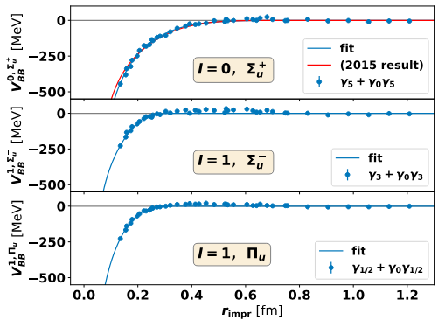
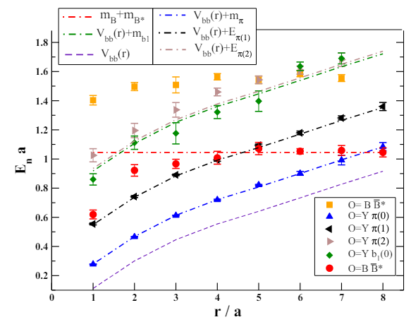
BO potentials
$$I=0, Σ_{g}^{+}$$
$$I=1, Σ_{g}^{−}$$
$$I=1, Π_{g}$$
Isospin=1
Mueller et al, PoS LATTICE2023, 64 (2024)
Prelovsek, Bahtiyar, Petkovic, Phys. Lett. B. 805, (2020)
Bicudo, Cichy, Peters, Wagner, Phys. Rev. D. 93, (2016)
Tetraquark / pentaquark BO potentials:
Quark configurations can be rearranged to have two hadron state.
Similarity with molecular physics. Molecules going to constituent atoms when internuclear
separation very large.

Slide 44
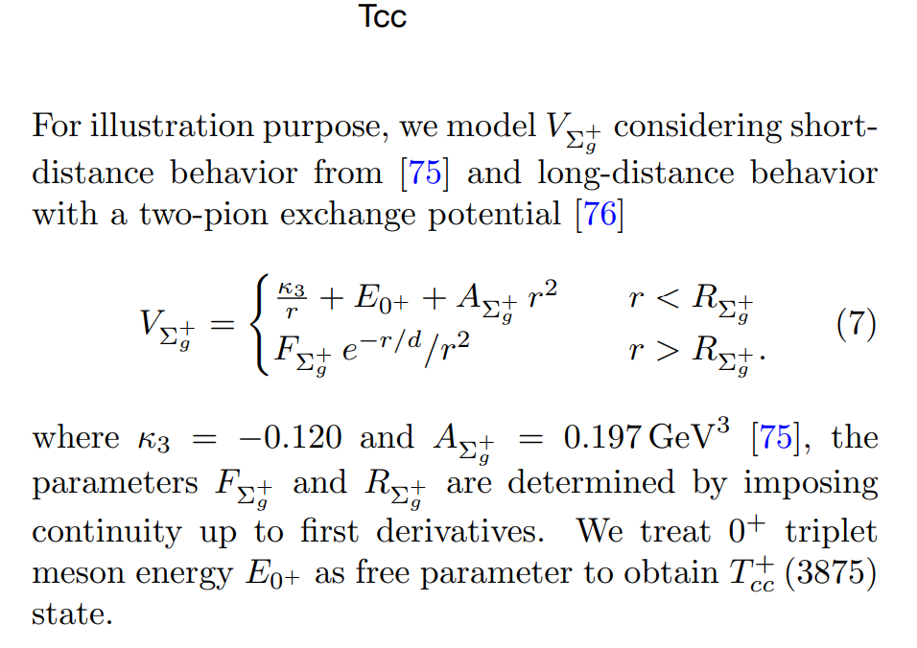
Brambilla, AM, Scirpa, Vairo 2411.xxxxx

Slide 45
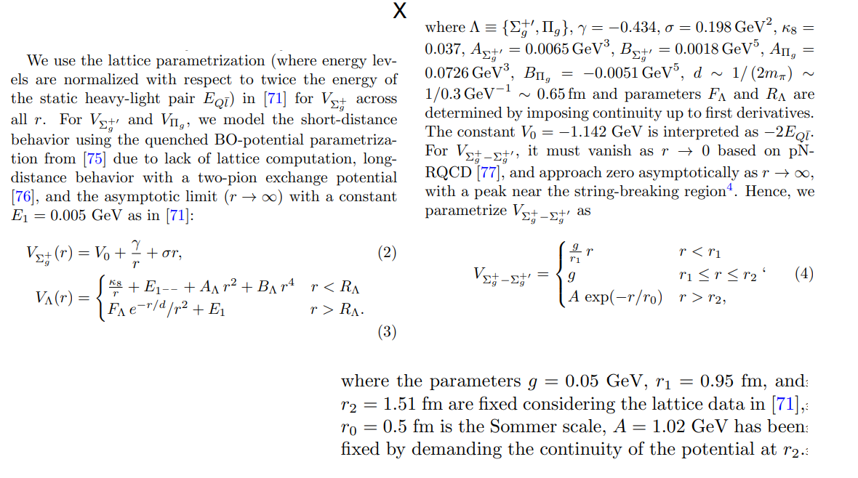
Brambilla, AM, Scirpa, Vairo 2411.xxxxx

Slide 46
BOEFT: Lattice Operators
Berwein, Brambilla, AM, Vairo, Phys. Rev. D. 110, (2024), 094040
NRQCD operator (gauge invariant) for exotic hadron $Q\overline{Q}X$ or $QQX$ :
: LDF (gluon or light-quarks) operator characterizing X based on quantum # $κ$ (isospin, color etc..)
: Projection vectors for projecting onto cyclindrical symmetry $D_{∞h}$ representations.
$${(x}_{1}, −T/2)$$
$${(x}_{1}, T/2)$$
$${(x}_{1}, −T/2)$$
$${(x}_{1}, T/2)$$
$$H(0,−T/2)$$
$$H(0,T/2)$$
$${(x}_{2}, −T/2)$$
(a)
$${(x}_{2}, T/2)$$
$${(x}_{2}, −T/2)$$
(b)
$${(x}_{2}, T/2)$$
Quarkonium
Wilson loop for exotics
Notes:
Non-relativistic because v~alpha<<1. This can be seen from the virial theorem.
Top quark mass ~ 180 GeV. Top quark unstable and short-lived and decays into bottom quark + W-boson.

Slide 47
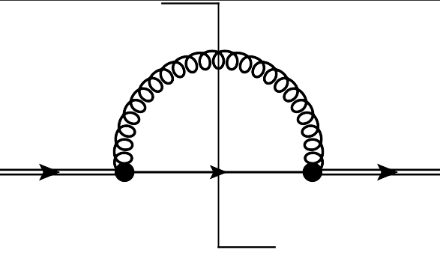
Hybrid Decays
Brambilla, Lai, AM, Vairo Phys. Rev. D 107, 054034 (2023)
BOEFT can describe decays of hybrids to quarkonium.
Semi-inclusive process: $H_{m}→Q_{n}+X$; $Q_{n}$: low-lying quarkonium (states below threshold) & X: light hadrons.
$ΔE$: Large energy difference $⇒ΔE≡ E_{H_{m}} −E_{Q_{n}}≿$ 1 GeV.
Hierarchy of scales: $\text{∆}\text{E} \text{≫ }{\text{Λ}}_{\text{QCD}}≫mv^{2}$
Constituent gluon of the hybrid is a spectator.
Perturbative computation
matching pNRQCD and BOEFT:
Virtual gluon resolves color structure of
$\text{Q}\overline{\text{Q}}$pair ($r→0$) in quarkonium and
hybrid in short-distance limit
$≡$ Im
$$H_{m}$$
$$H_{m}$$
$$Q$$
r
$\overline{Q}$
octet
singlet
octet
Quarkonium Singlet
pNRQCD
BOEFT
Hybrid Octet
Decays are computed from local imaginary terms in the hybrid potential (BOEFT potential).
DISCLAIMER!!!
Decay to open-flavor threshold states
not accounted here.
Optical theorem:
Notes:
The exclusive decay widths Γ(Hm → Qn) may be computed by selecting a suitable decay channel in the right-hand side of the above equation.

