Slide 1

Semi-classical methods:
Heavy Quarkonia and Exotics
CFNS 25’

Slide 2
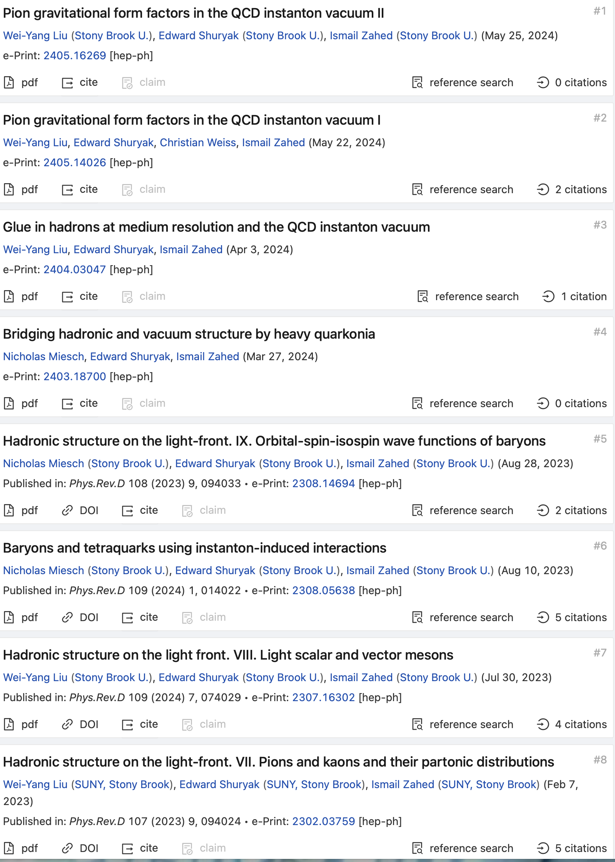
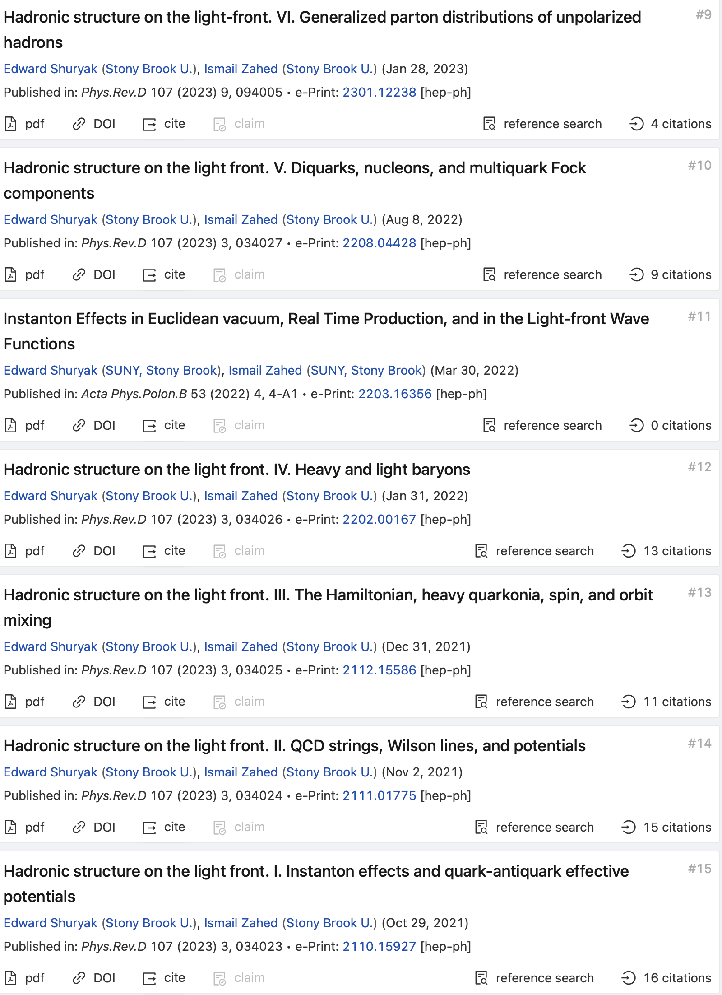
Program: ILM @ EIC

Slide 3
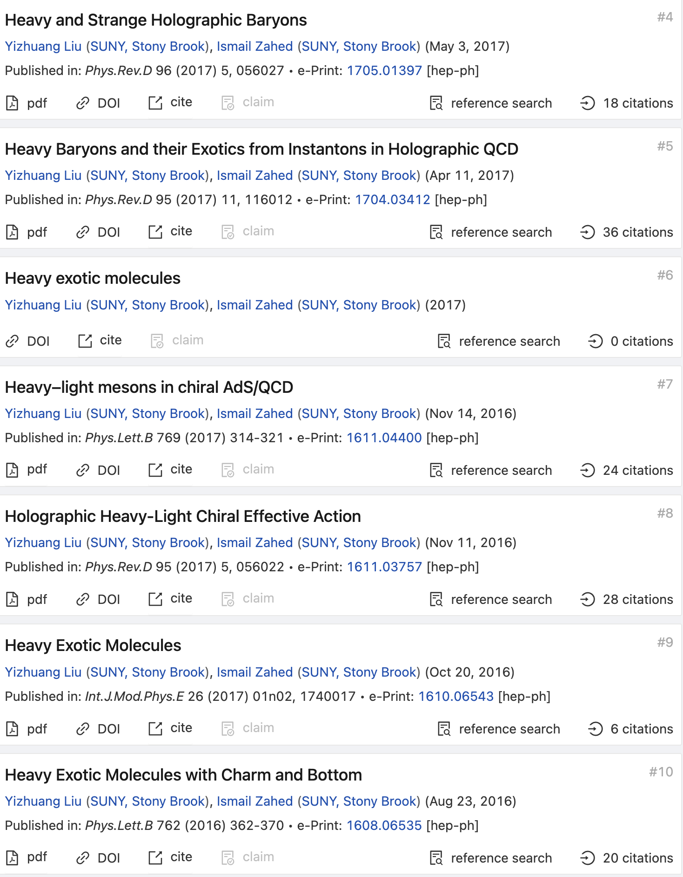
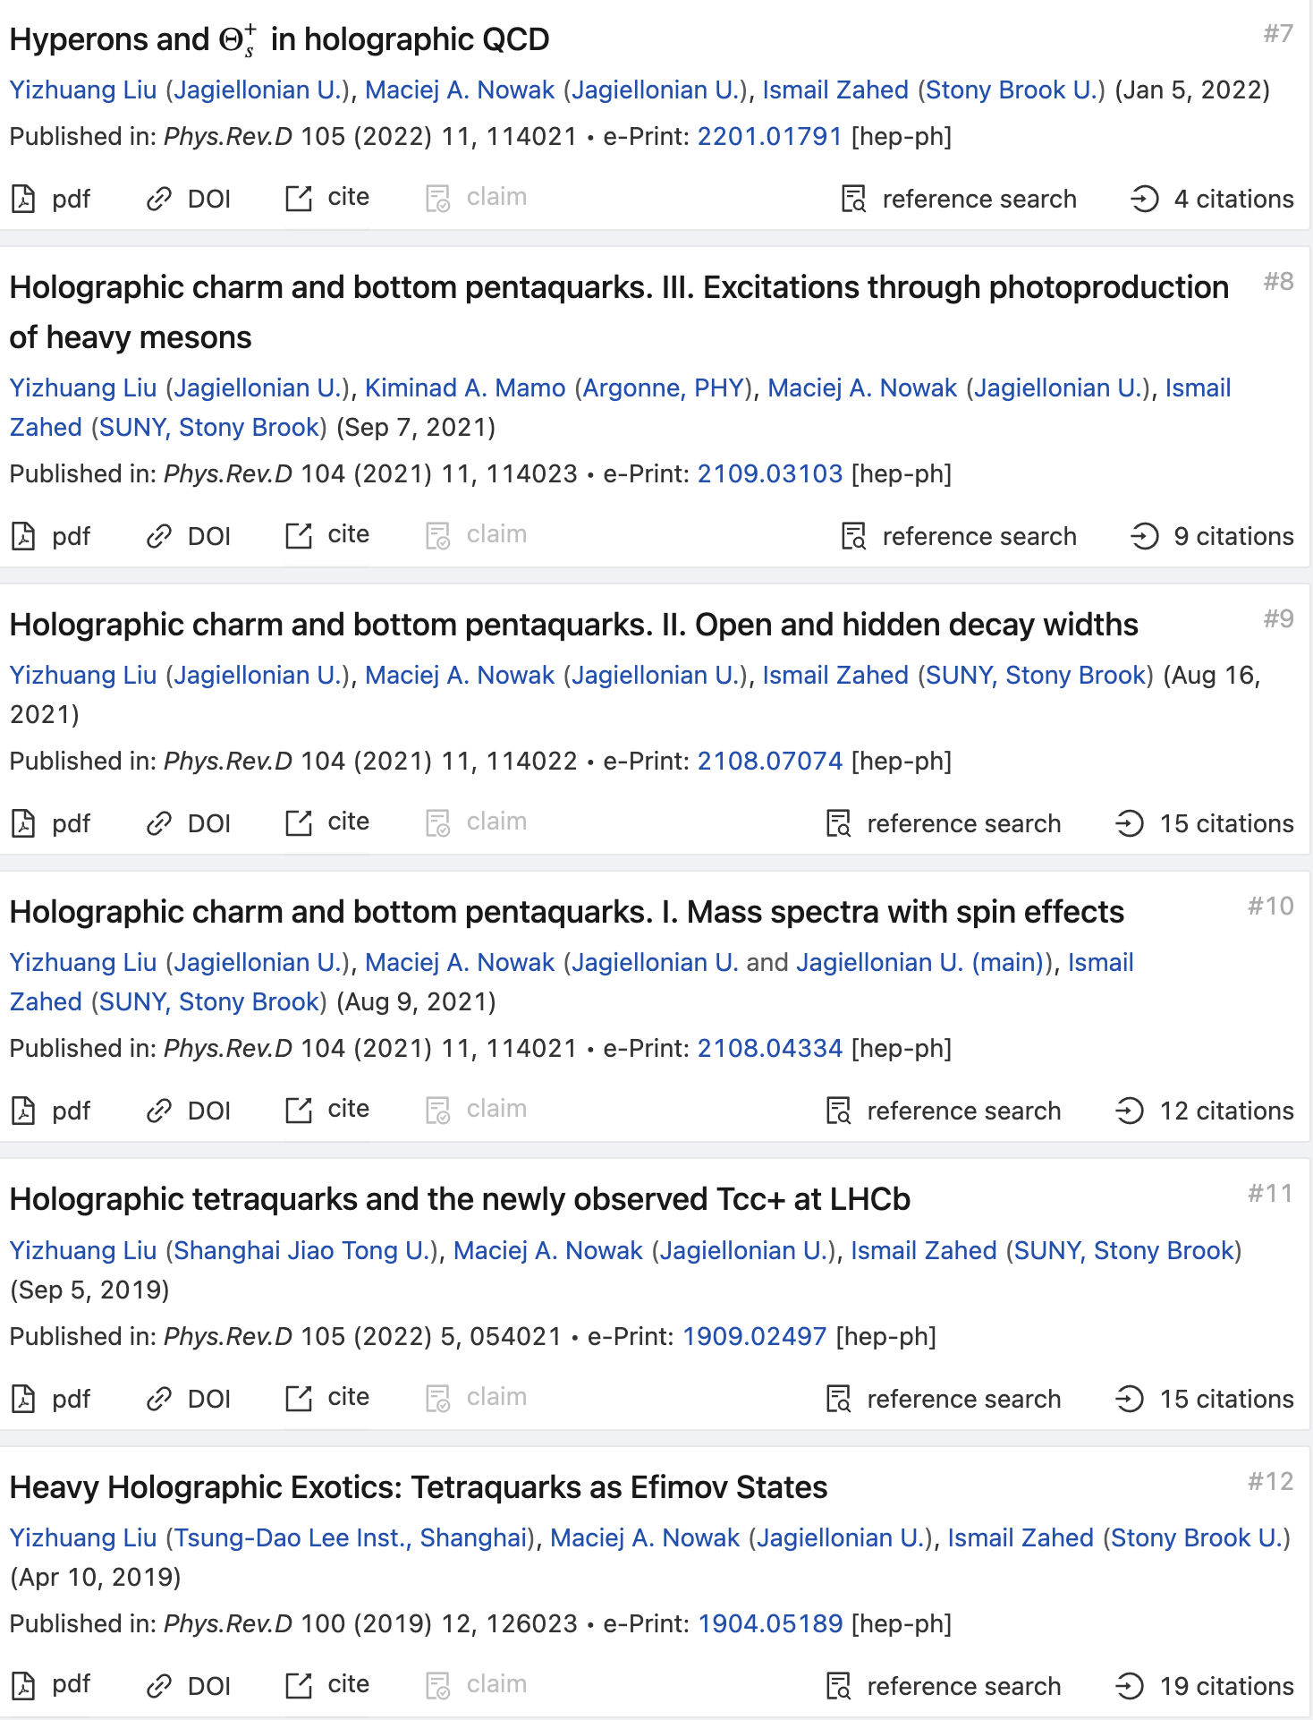
Program: hQCD

Slide 4
Outline
Vacuum Glue
Heavy QQ, QQQ
Heavy QQQQ

Slide 5
Potentials from the glue

Slide 6
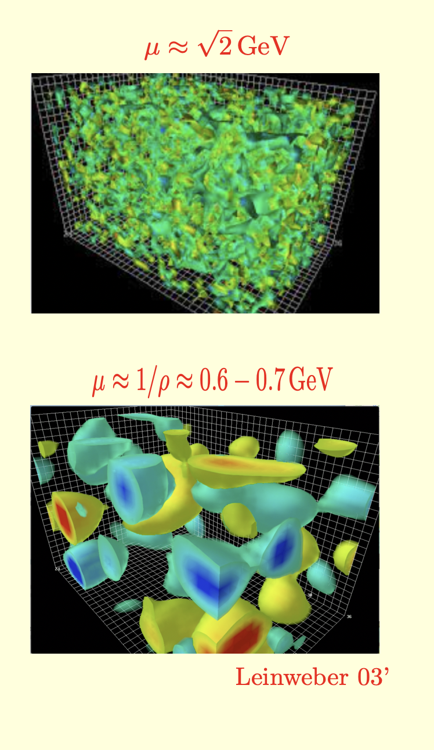
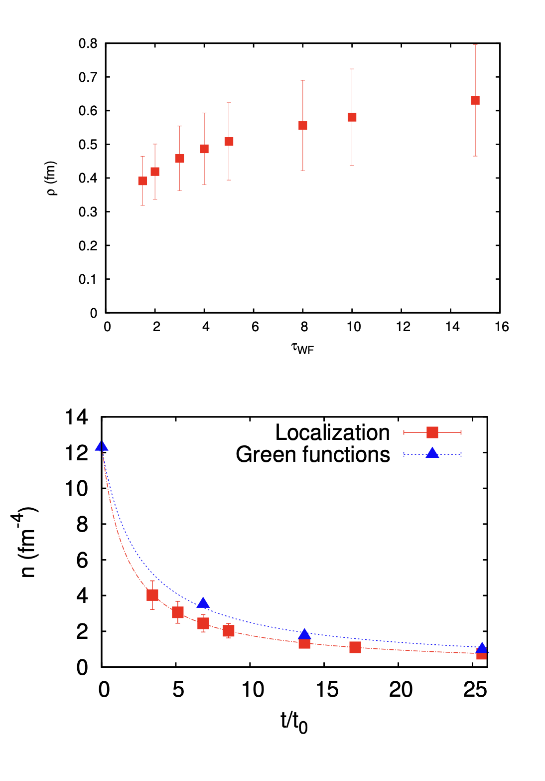
ILM from Lattice
Topologically active vacuum
QCD Topological landscape

Slide 7
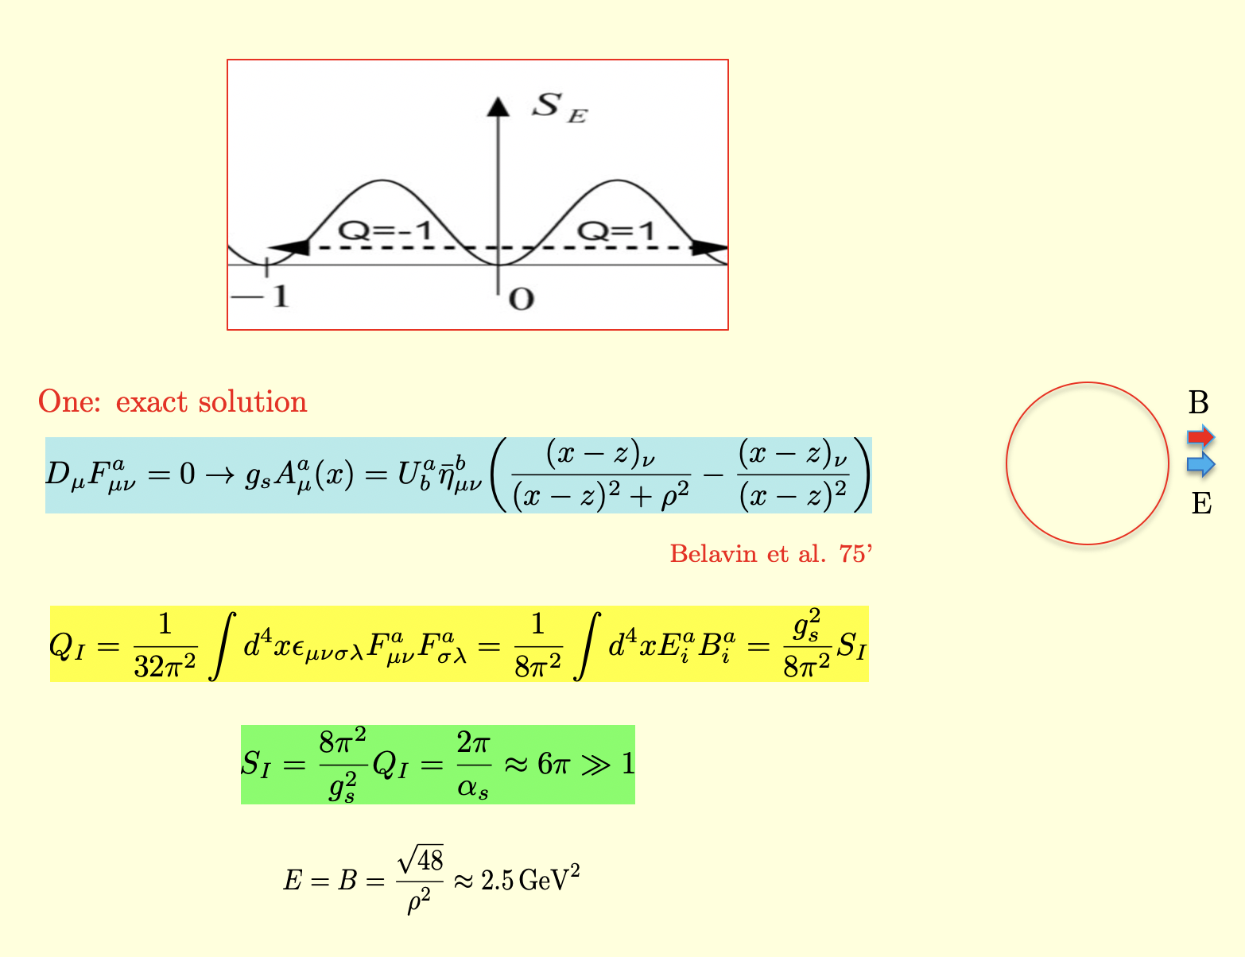
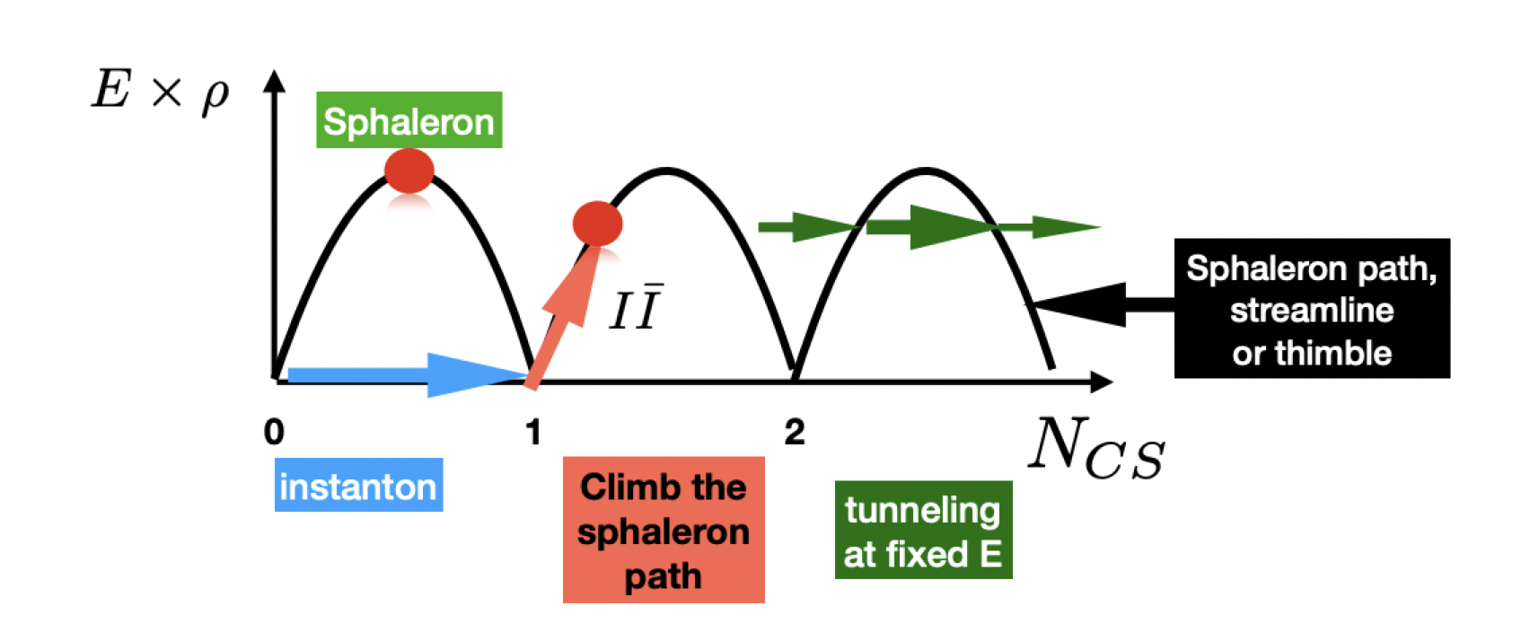
4D topology
Instantons: what are they?
QCD Topological landscape

Slide 8
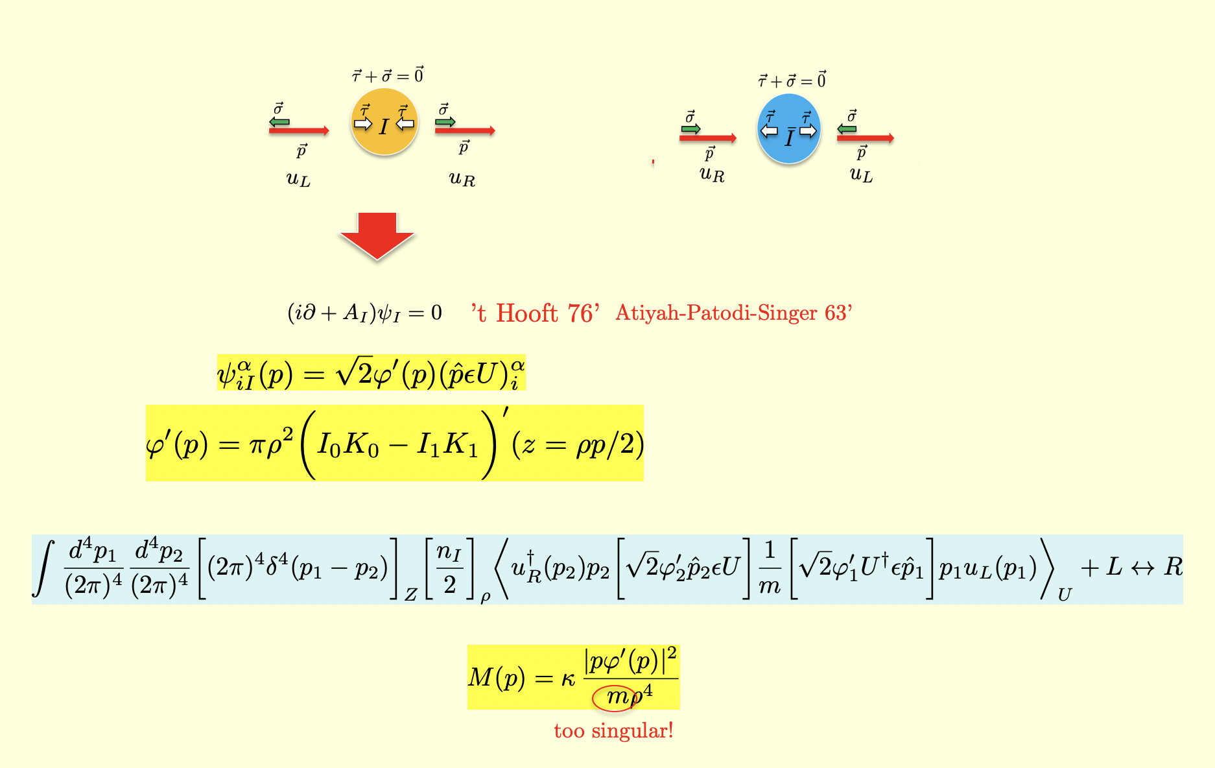
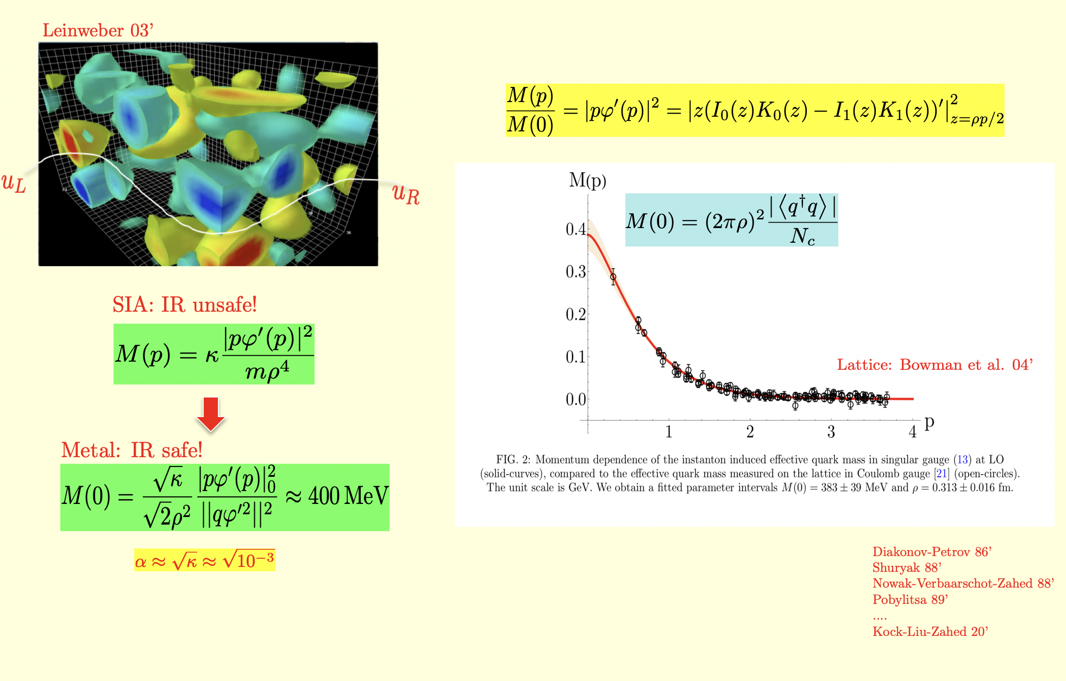
Emergent mass from I, Ibar
Emergent mass: ZM
Emergent mass: quasi-ZM

Slide 9

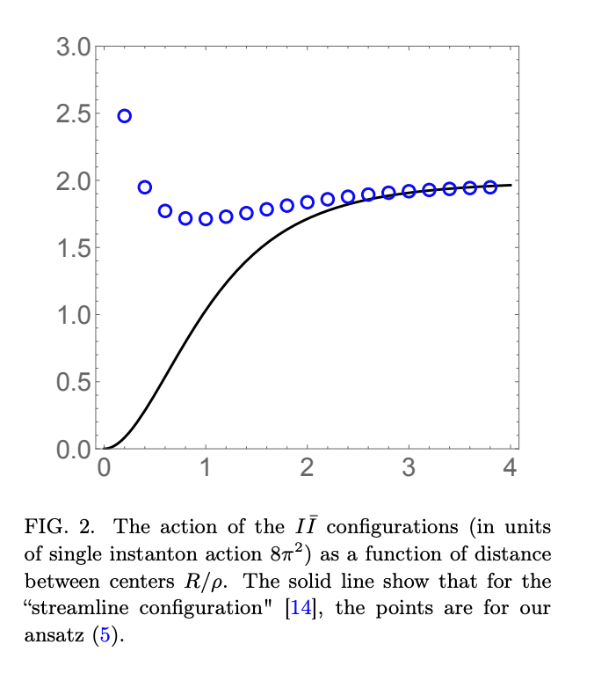
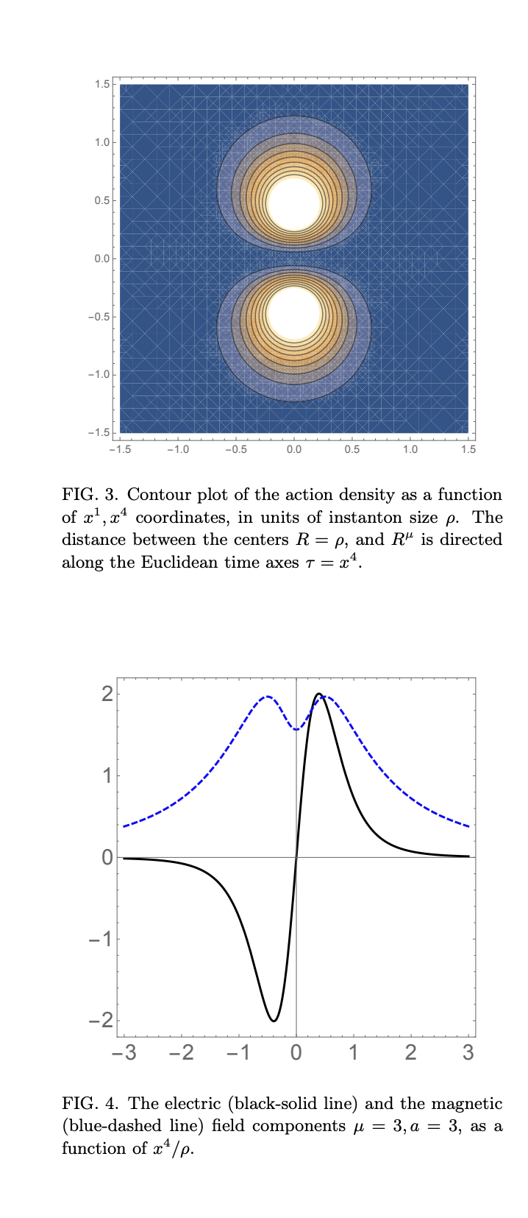
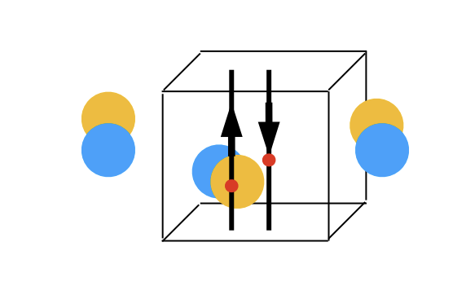
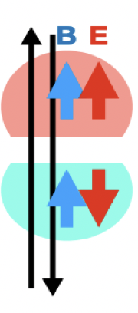
IIbar Molecules

Slide 10
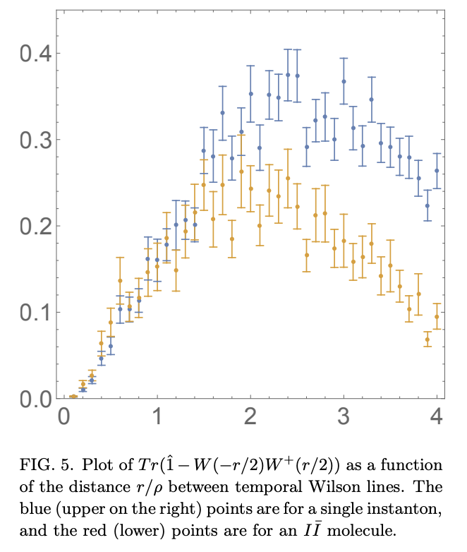
Molecular potential
I vs IIbar
Central IIbar potential

Slide 11
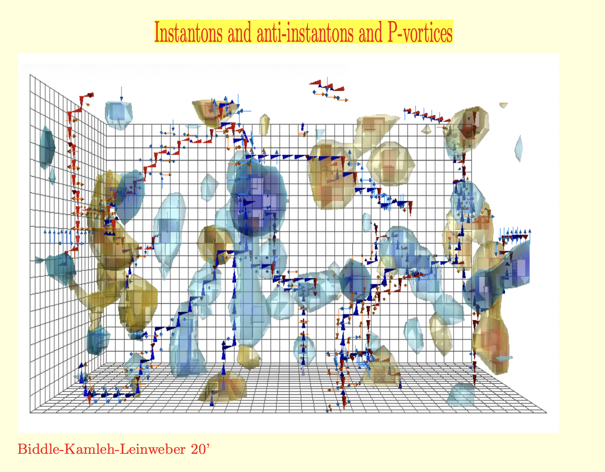
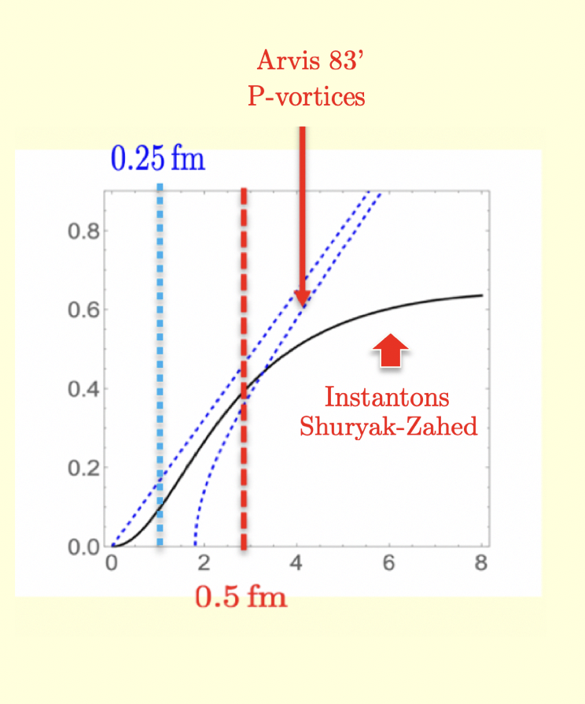
What about confinement: Center vortices
Topology: 4D and 2D
Effective QQ: central

Slide 12
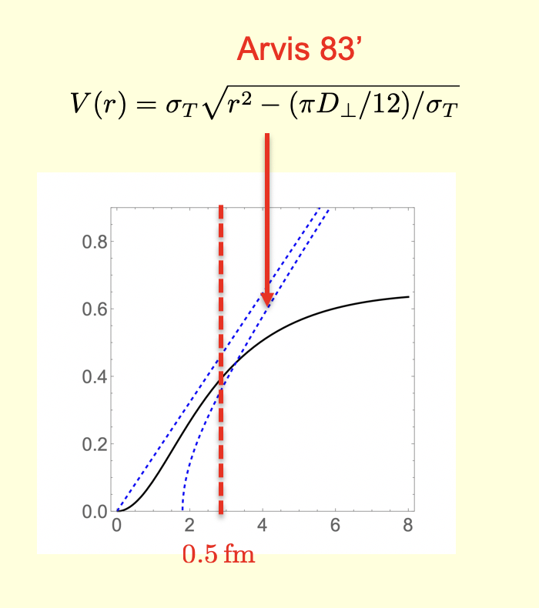
Dense ILM
Central potential
Shuryak-Zahed 20’, 21’, 22’
See also:
Callan et al. 78’
Eichen-Feinberg 81’
Diakonov et al. 89’
Musakhanov et al. 16’
Shuryak-zahed 21’

Slide 13
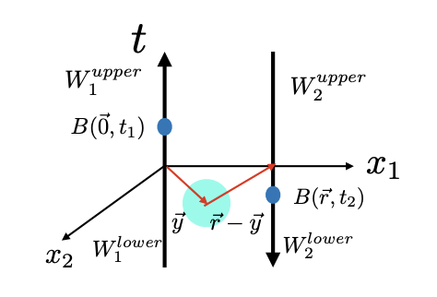
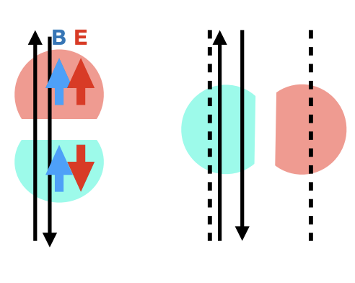
Spin-dependent potentials

Slide 14
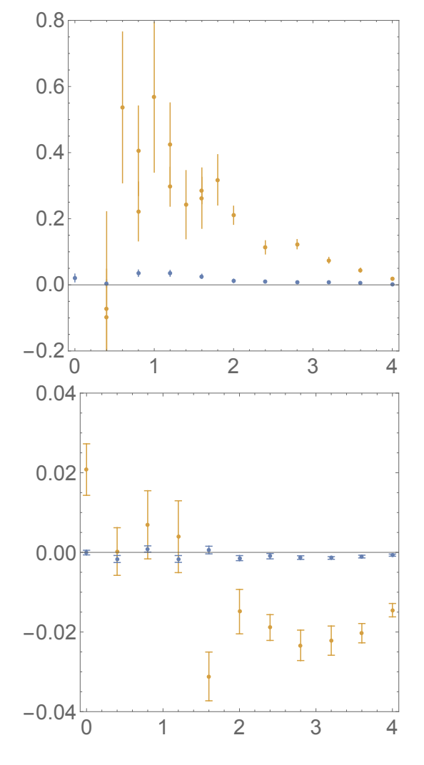
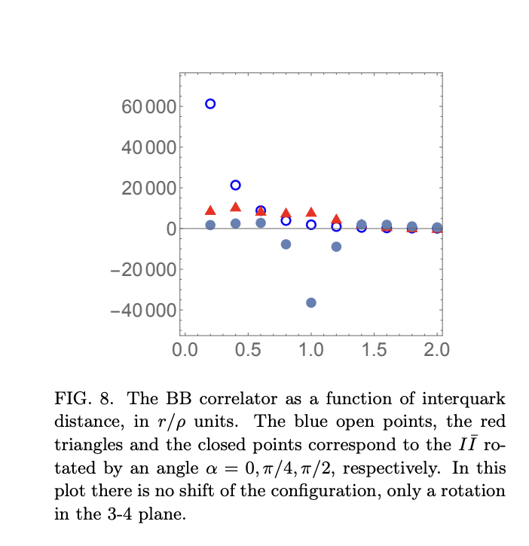
Spin-orbit potential
Spin-Spin potential
V2’-O
V1’-S
Shuryak-Zahed 22’

Slide 15
Quarkonia: QQ

Slide 16
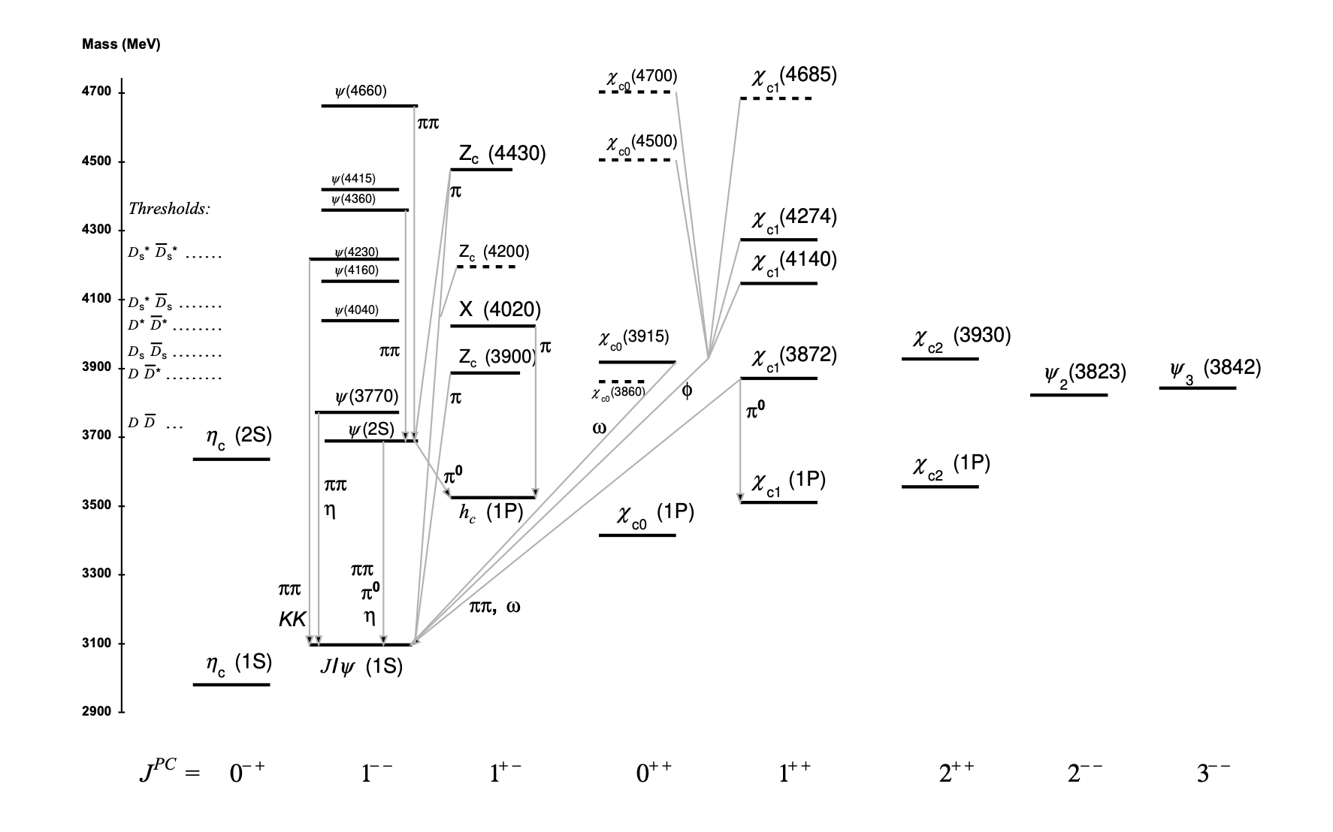
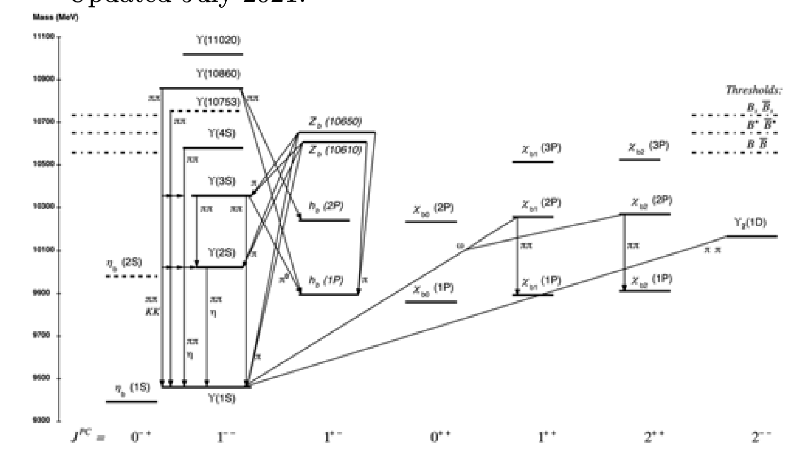
Charmonia and Bottomonia

Slide 17
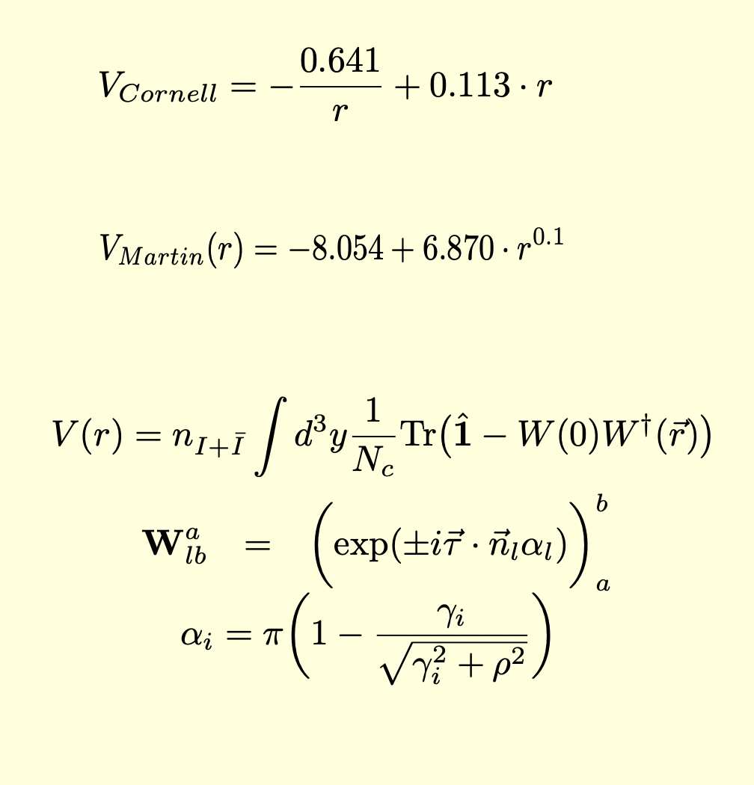
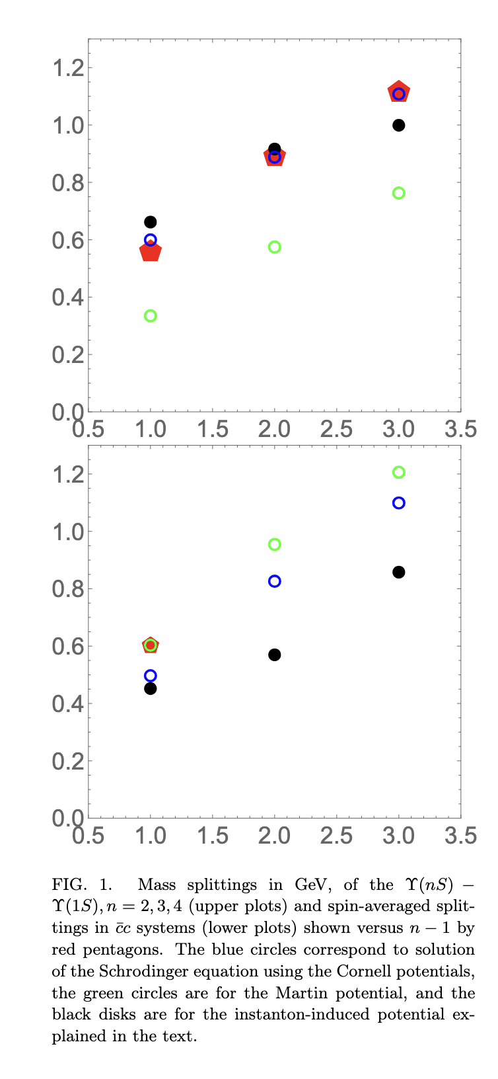
Central and no spin
Quarkonia

Slide 18
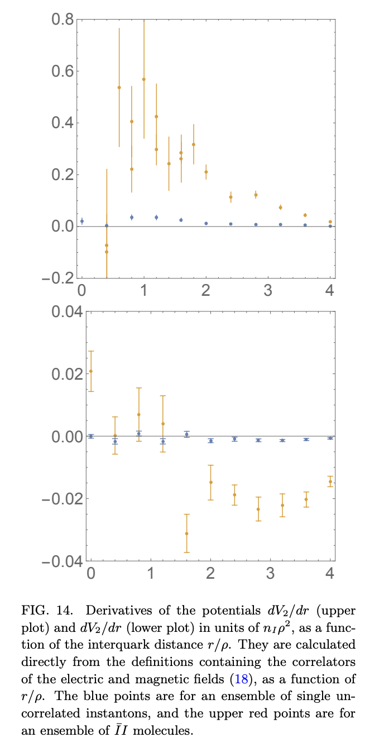
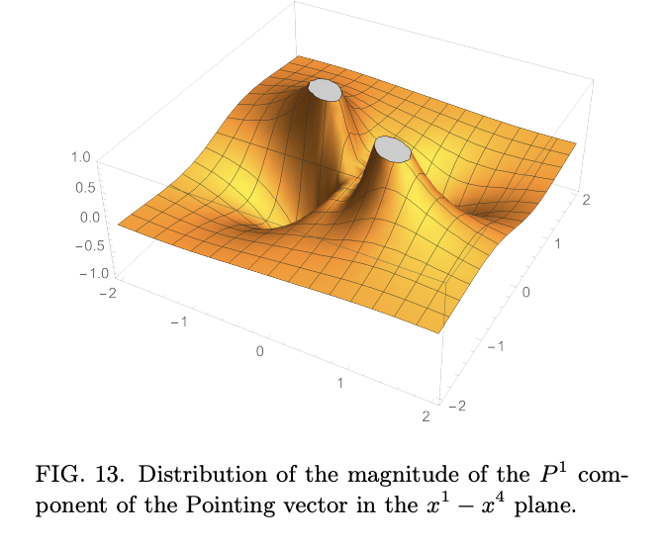

EB correlators:
Lattice:

Slide 19
Quarkonia: QQQ

Slide 20
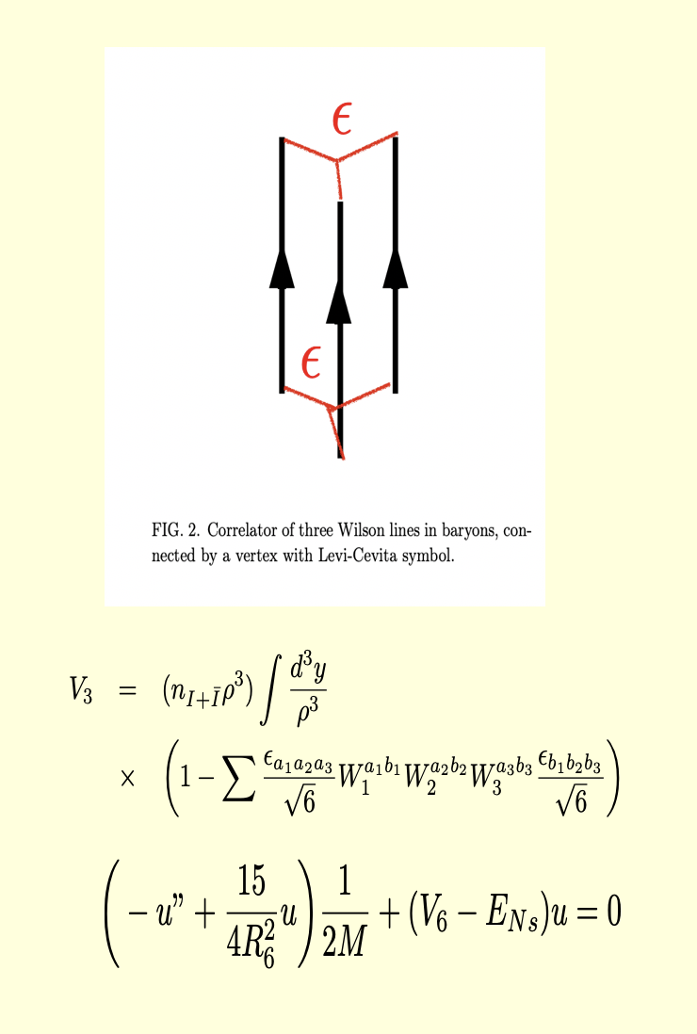
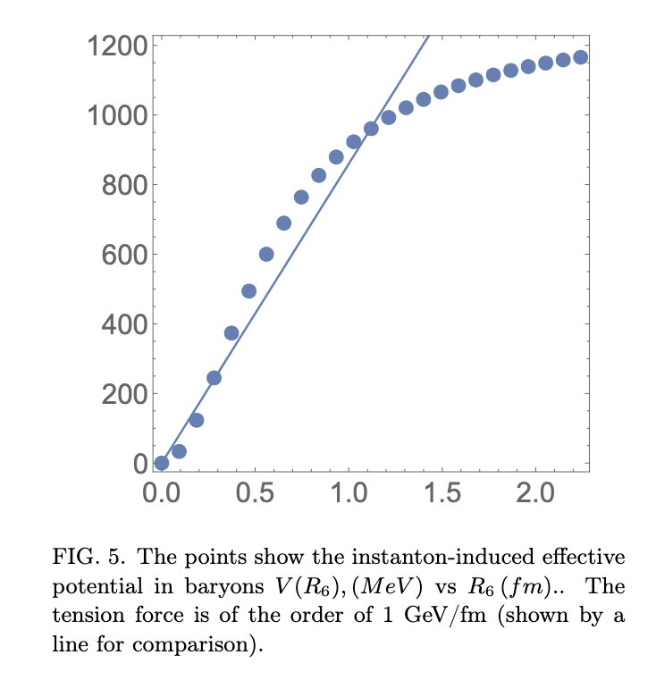
Heavy QQQ

Slide 21
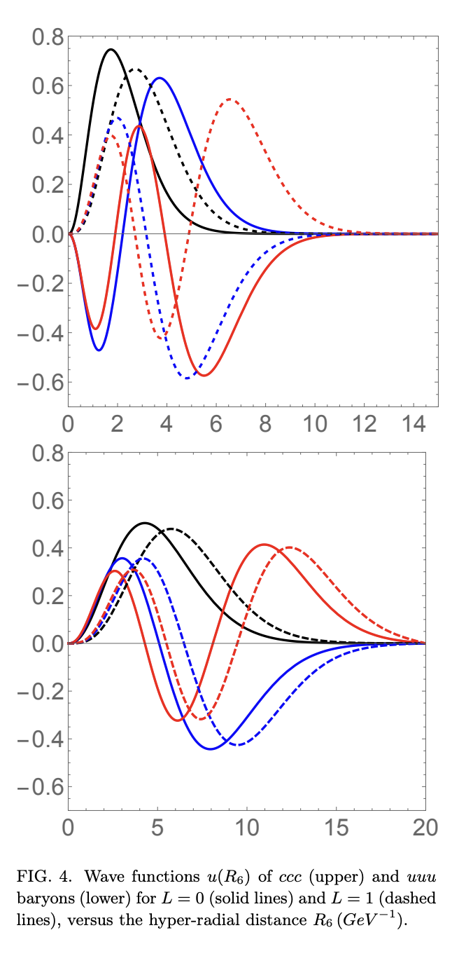
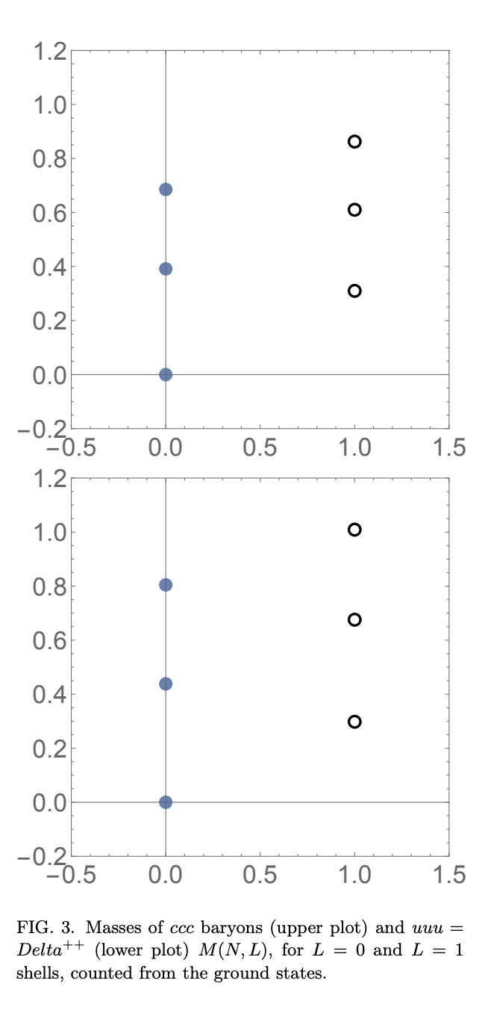
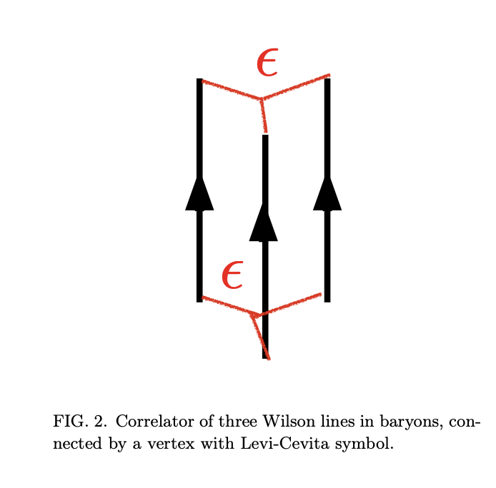
Heavy CCC, uuu

Slide 22
Tetraquark: CCCC

Slide 23
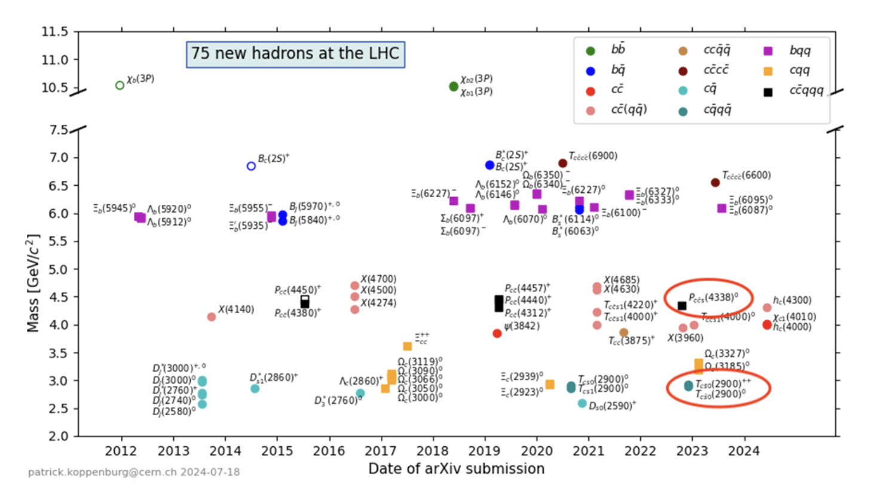
Exotics @ LHC

Slide 24
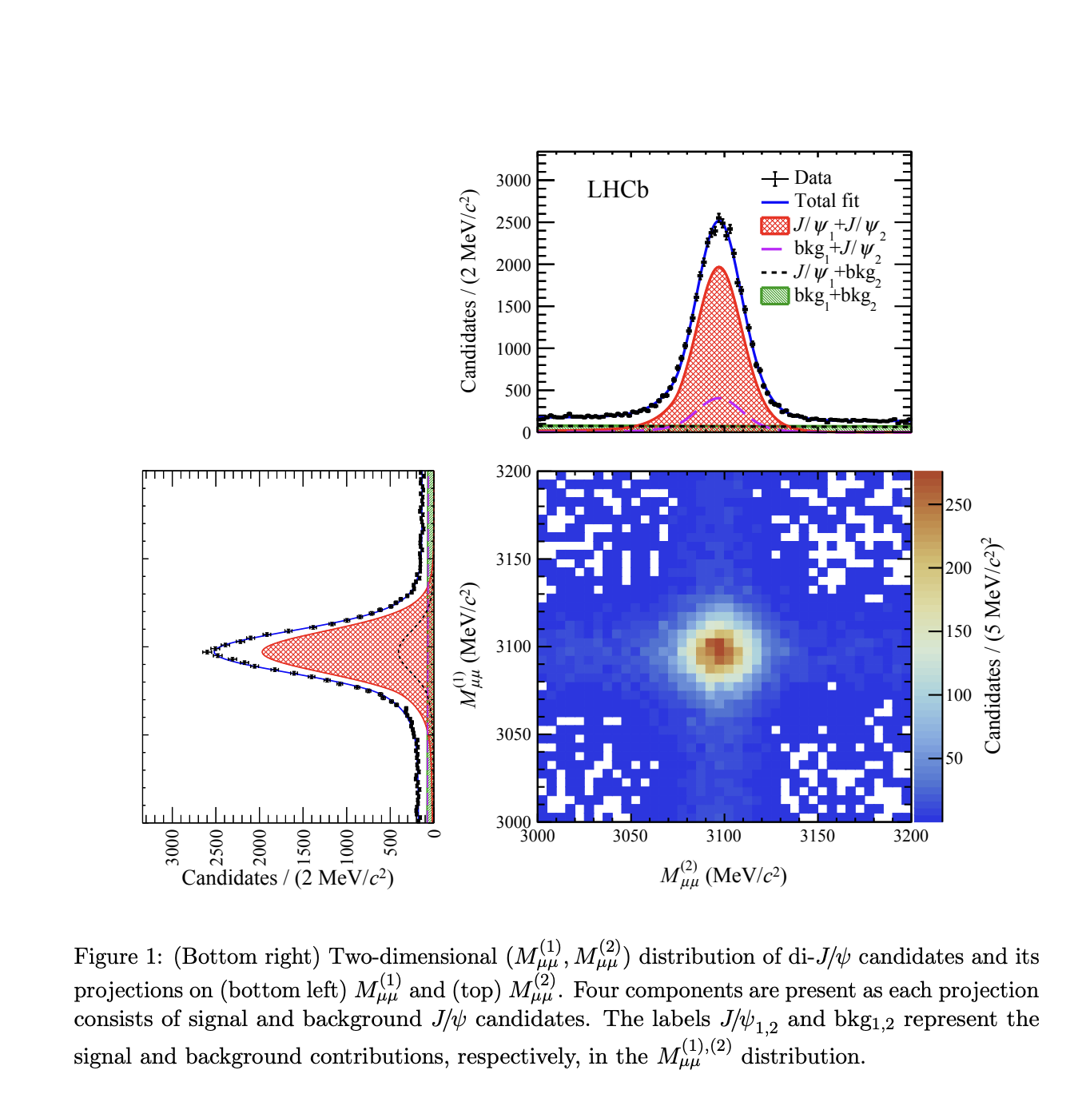
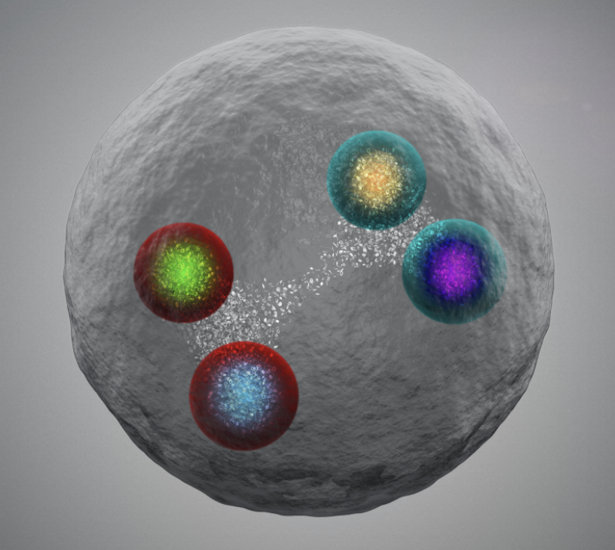
Triplet charm tetraquarks

Slide 25
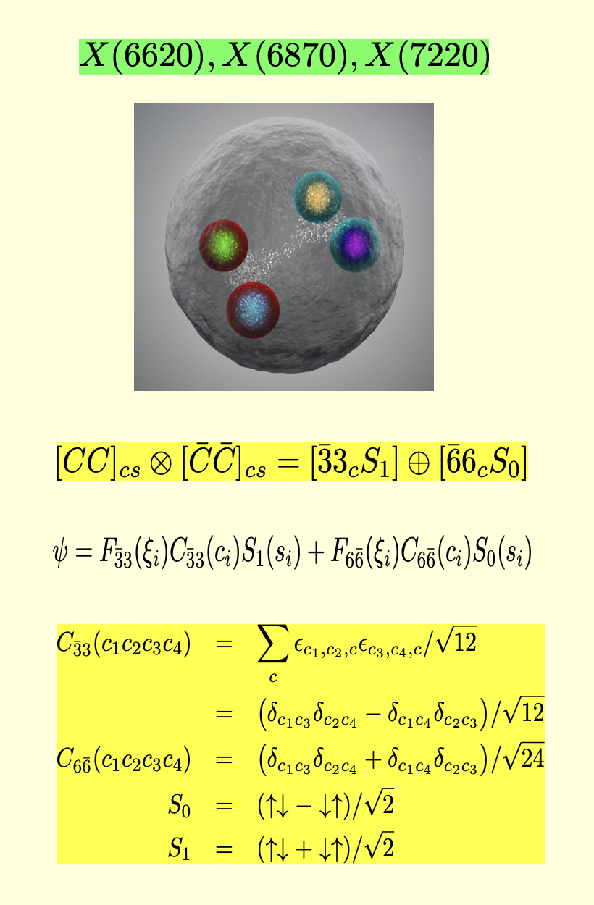
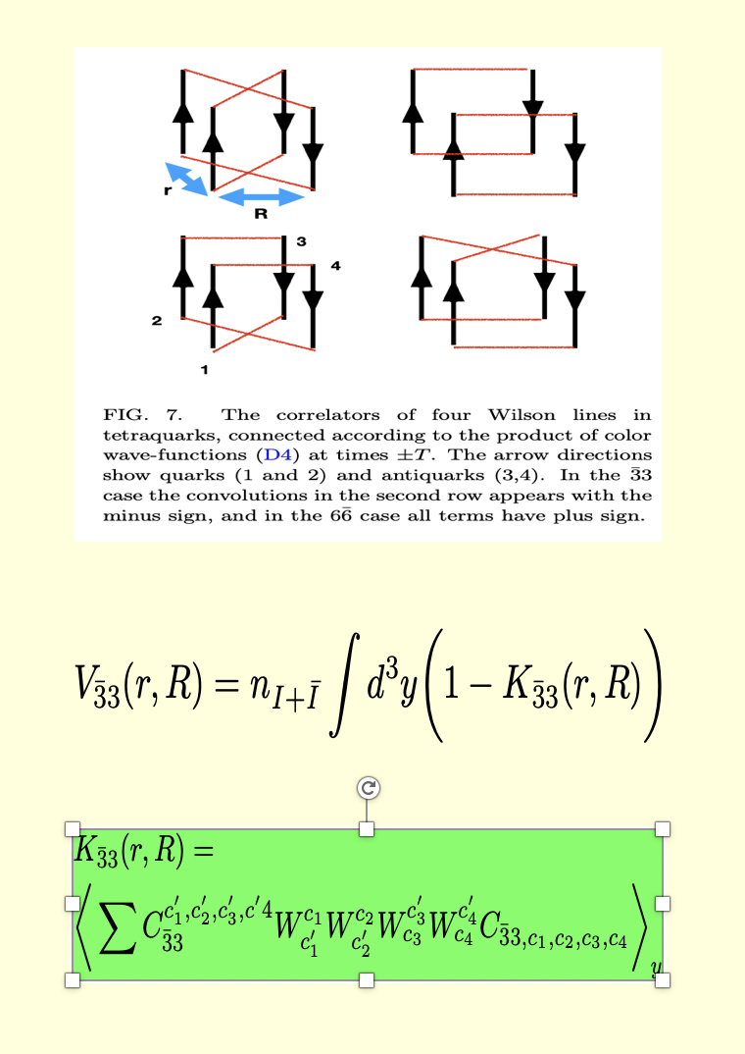
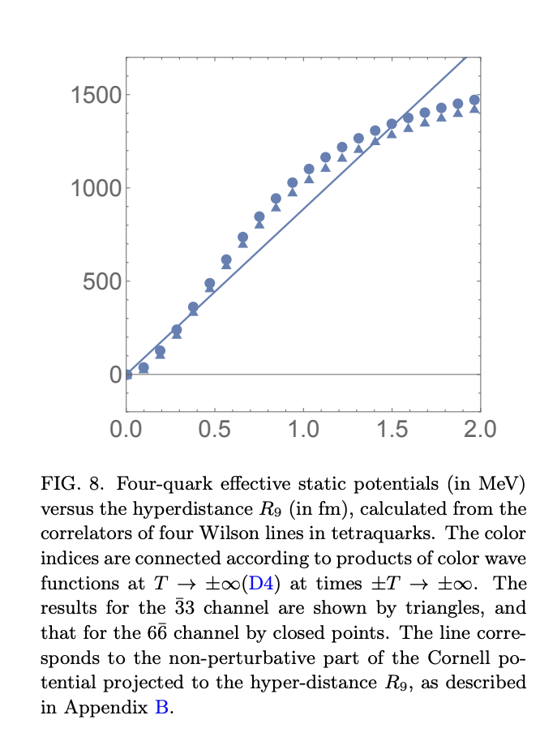
Analysis in dILM using K-potential

Slide 26
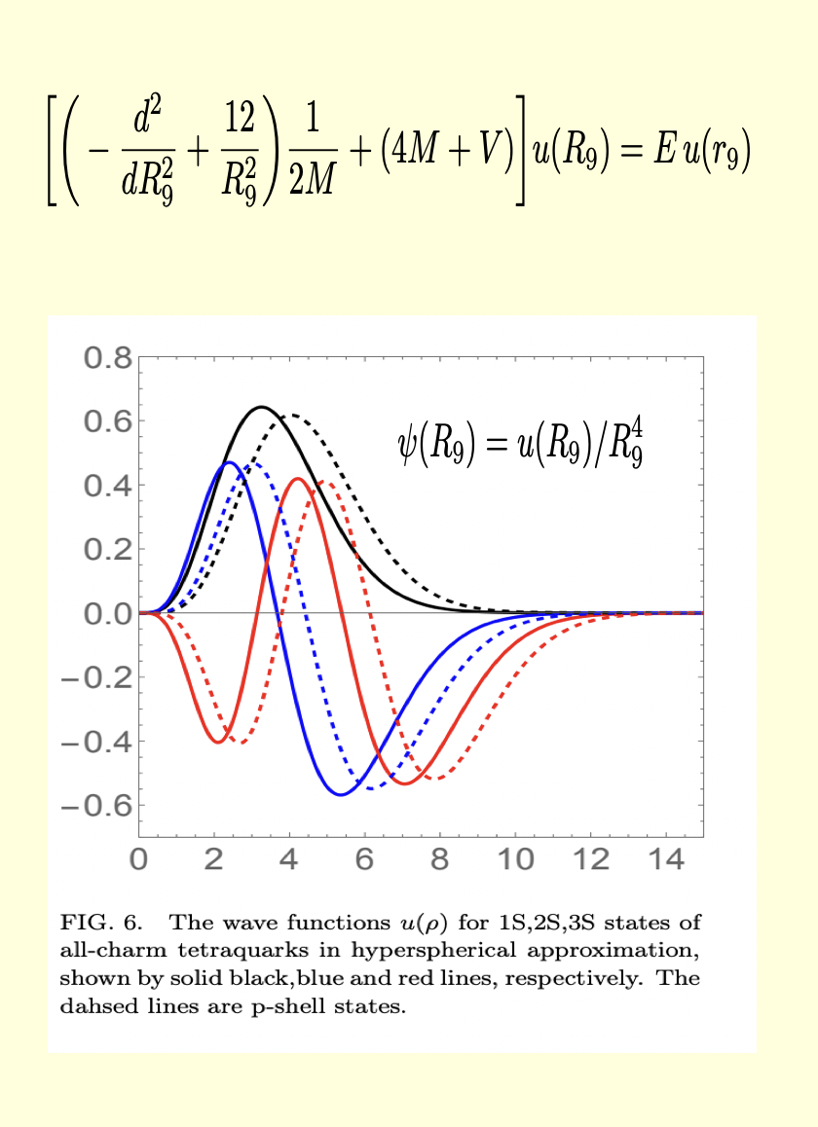
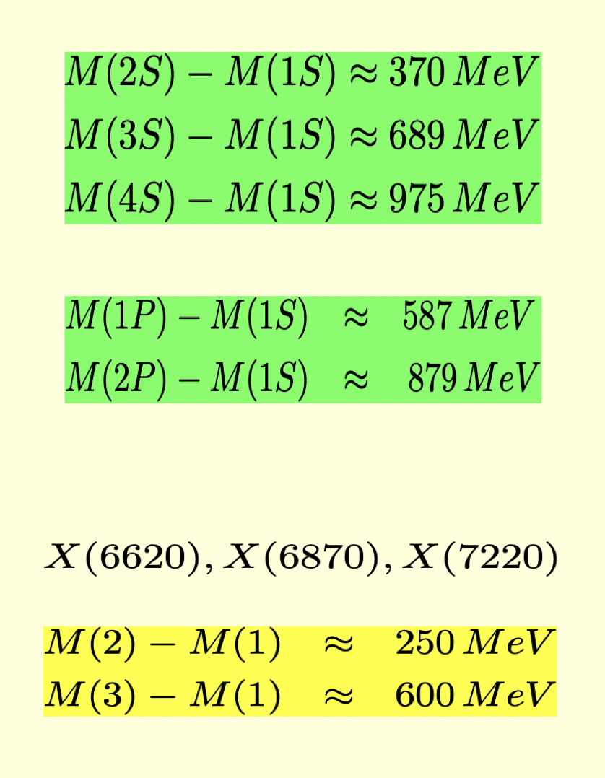
TCCCC spectrum
Badalin et al. 87’
Miesch-Shuryak-Zahed 24’

Slide 27
Summary
Vacuum : 4D, 3D, 2D
Mass, spin, .. : I, Ibar, IIbar
QQ,QQQ, QQQQ : bound in dILM

