Slide 1

The search for non-linear QCD evolution: EIC+LHC
Peter Jacobs
Lawrence Berkeley National Laboratory
UC Berkeley
In collaboration with:
  Raymond Ehlers, LBNL/UCB
  Andreas van Hameren, Krakow
  Florian Jonas, LBNL/UCB
  Krzysztof Kutak, Krakow
  Farid Salazar, Temple
  Bjoern Schenke, BNL/SBU

Slide 2
Is this the correct description of the low-x structure of matter?
How do we test it experimentally?
→
QCD phenomena evolve only logarithmically in x and Q²
  → experimental study of non-linear QCD evolution requires “logarithmically broad” coverage in (x,Q²)
Universality: correct theoretical description must self-consistently describe measurements of multiple observables at low (x,Q²) in multiple collision systems
Multi-messenger program: combine measurements from e-A DIS and diffractive interactions at EIC, with forward p-A collisions at RHIC and LHC

Slide 3
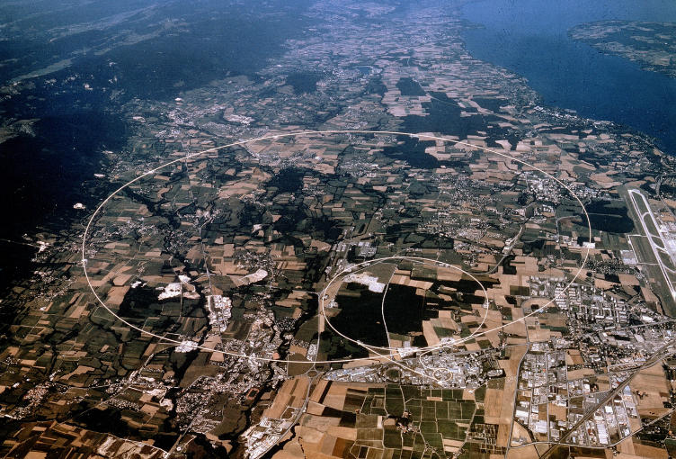
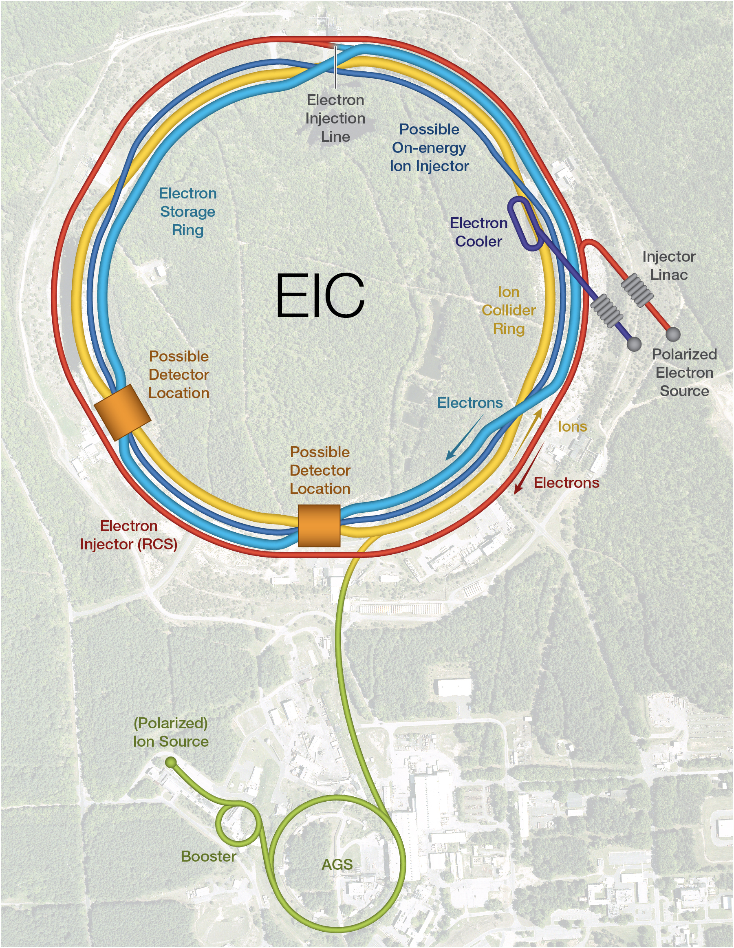

Complementary for low-x physics?

Slide 4
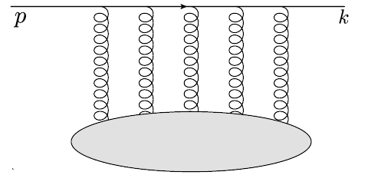



Theoretical interpretability: dipole formalism
Forward p+A:
Inclusive π⁰, jet, direct γ
γ+jet
balanced di-jet,…
e+A DIS
Interaction cross section
Structure Functions F₂, F_{L}
Multiple processes in e-A DIS and forward p-A are described theoretically by the same dipole-medium forward scattering amplitude T_{LO} → calculable beyond LO
Compare e-A DIS and forward p-A: universality
Dipoles in DIS:
Gribov, Sov. Phys. JETP 30 (1970) 709-717
Bjorken and Kogut, Phys. Rev. D 8 (1973) 1341
Frankfurt and Strikman, Phys. Rept. 160 (1988) 235
A. H. Mueller, Nucl. Phys. B 335 (1990) 115
Nikolaev and Zakharov, Z. Phys.C 49 (1991) 607
Dipoles in particle production:
Kopeliovich, Tarasov and Schafer, Phys. Rev. C 59 (1999) 1609
Gelis and Jalilian-Marian, Phys. Rev. D66 (2002) 014021
Kovchegov and A. H. Mueller, Nucl. Phys. B 529 (1998) 451
Kopeliovich, Raufeisen and Tarasov, Phys. Lett. B 503 (2001) 91

Slide 5
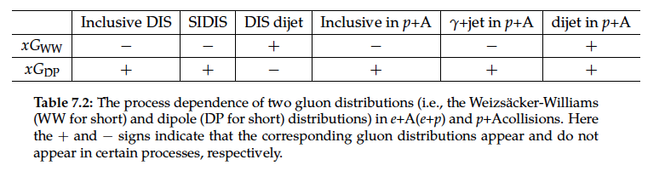
EIC Yellow Report: e+A DIS vs forward p+A
Nucl. Phys. A1026 (2022) 122447
Dominguez, Xiao and Yuan 1009.2141
Dominguez, Marquet, Xiao and Yuan 1101.0715
Sect. 7.5.4: Low-x gluons and factorization in eA (ep) vs pA and AA
“…pA collisions can serve as a gateway to the EIC as far as saturation physics is concerned, and it also plays an important and complementary role in the study of these two fundamental gluon distributions (Weiszacker-Williams and Dipole)…The small-x factorization in DIS and pA collisions is expected to hold at higher order [1228], since the higher-order corrections do not generate genuine new correlators in the large Nc limit.”
quadrupole
dipole

Slide 6
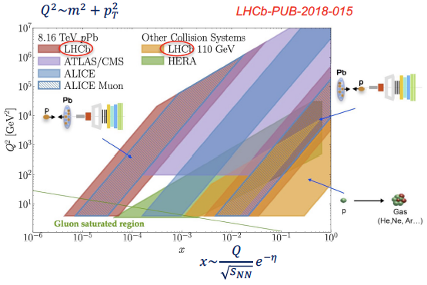
LHC Run 2/3 measurements at low x

Slide 7
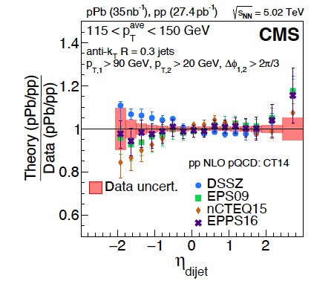
CMS: forward di-jets in p+Pb
Phys. Rev. Lett. 121, 062002 (2018)
arXiv:1805.04736
Significant discrimination of nPDF implementations
DSSZ w/o gluon EMC effect: disfavored
EPS09: EMC implementation compatible with data
nCTEQ15: overshoots EMC and anti-shadowing effects
EPPS16 similar to EPS09 w/ relaxed constraints; larger nPDF uncertainties

Slide 8
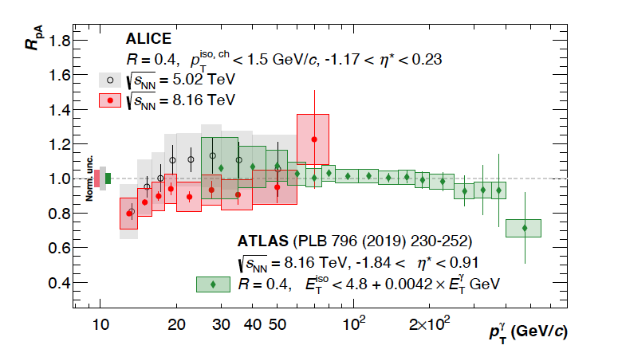

ALICE: prompt photon production in p+Pb
ALICE arXiv:2502.18054
~2$σ$ suppression for $x$~3 $×$10⁻³

Slide 9
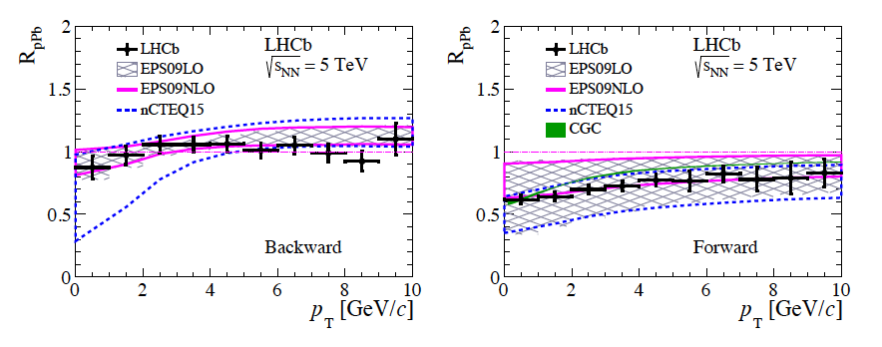
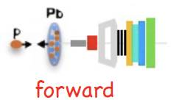
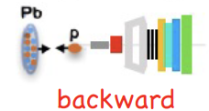
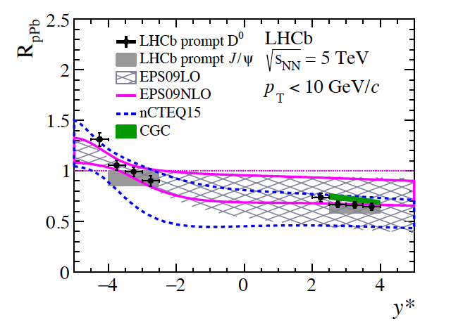
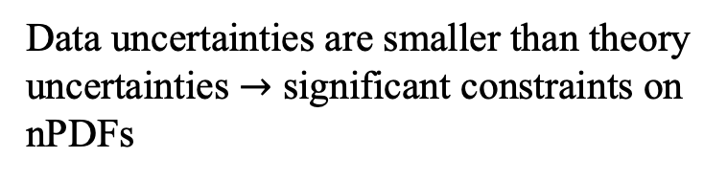
LHCb: D⁰ production in p+Pb
R_{pPb}: yield ratio p+Pb/pp
JHEP 10 (2017) 090
arXiv:1707.02750
Data uncertainties are smaller than theory uncertainties $→$ significant constraints on nPDFs

Slide 10
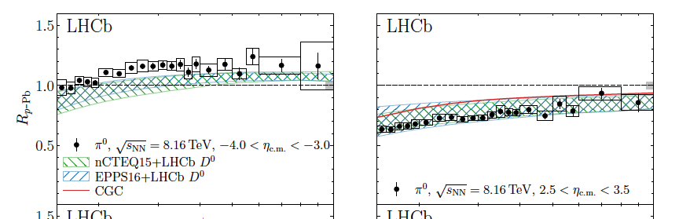
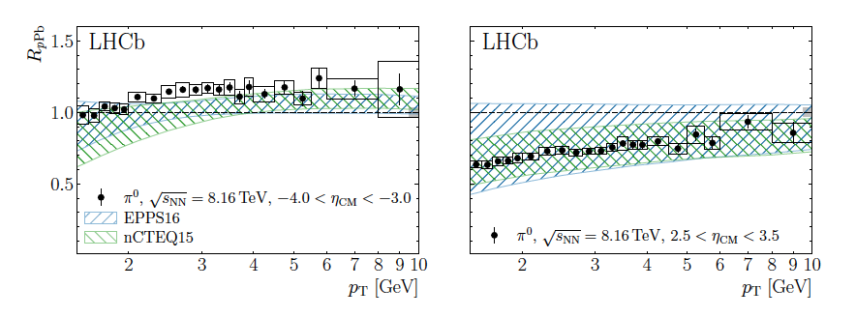
nPDFs: impact of LHCb D⁰ data
PRL 131 (2023) 042302
arXiv:2204.10608
Compare nPDFs to LHCb π⁰ data with and without reweighting by LHCb D⁰ data
Reweighting with LHCb D⁰ data
Low-x: marked reduction in systematic uncertainties
Without LHCb D⁰ data

Slide 11
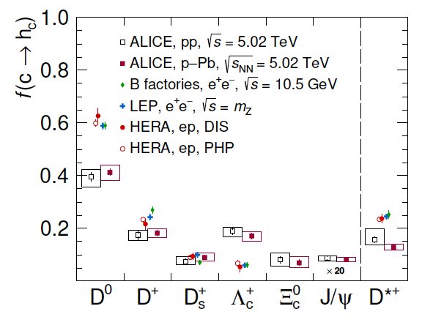
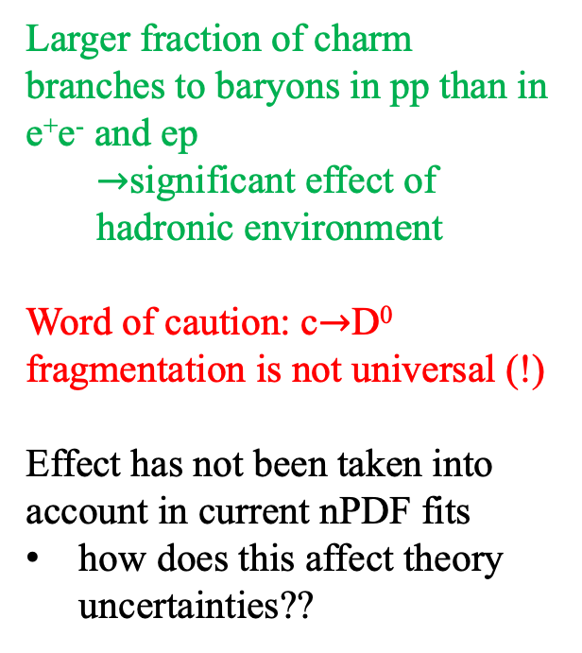
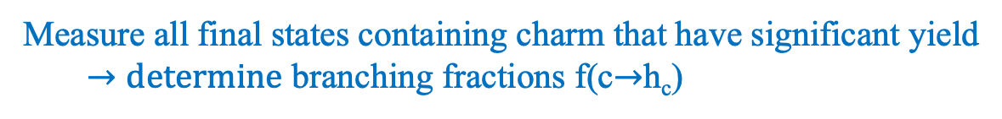
ALICE: charm fragmentation in p+p collisions
Eur.Phys.J.C 84 (2024) 12, 1286
Measure all final states containing charm that have significant yield
  $→determine$ branching fractions f(c$→$h_{c})
Larger fraction of charm branches to baryons in pp than in e⁺e⁻ and ep
  $→$significant effect of hadronic environment
Word of caution: c$→$D⁰ fragmentation is not universal (!)
Effect has not been taken into account in current nPDF fits
how does this affect theory uncertainties??

Slide 12
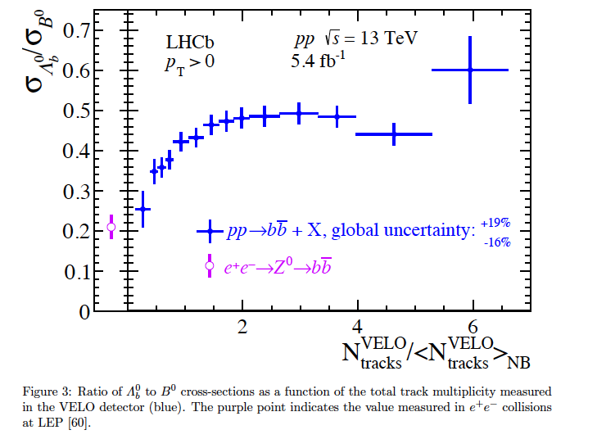
LHCb: beauty fragmentation in pp
Phys.Rev.Lett. 132 (2024) 8, 081901
Ratio of beauty baryon/meson yield vs Event Activity
Same picture in the beauty sector: relative branching into baryons vs. mesons depends on the hadronic environment!

Slide 13
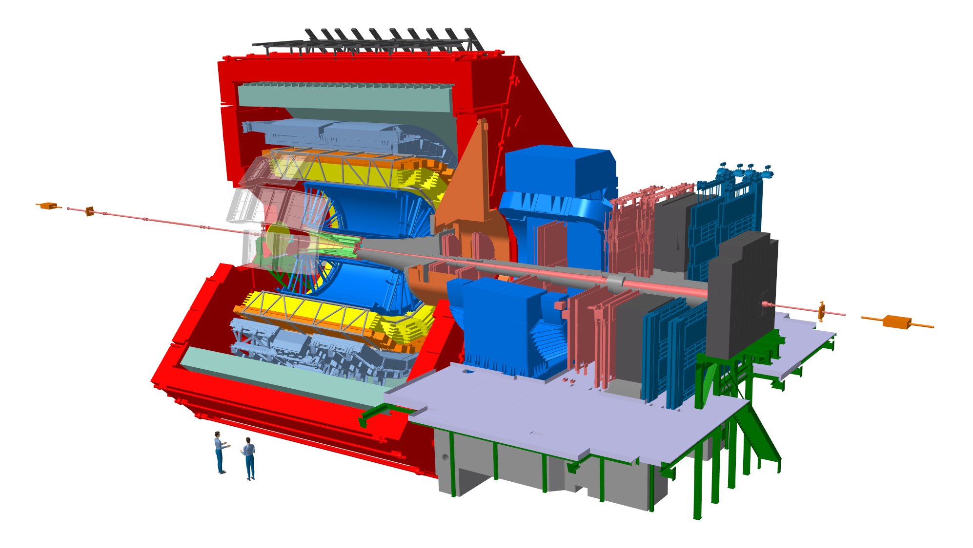
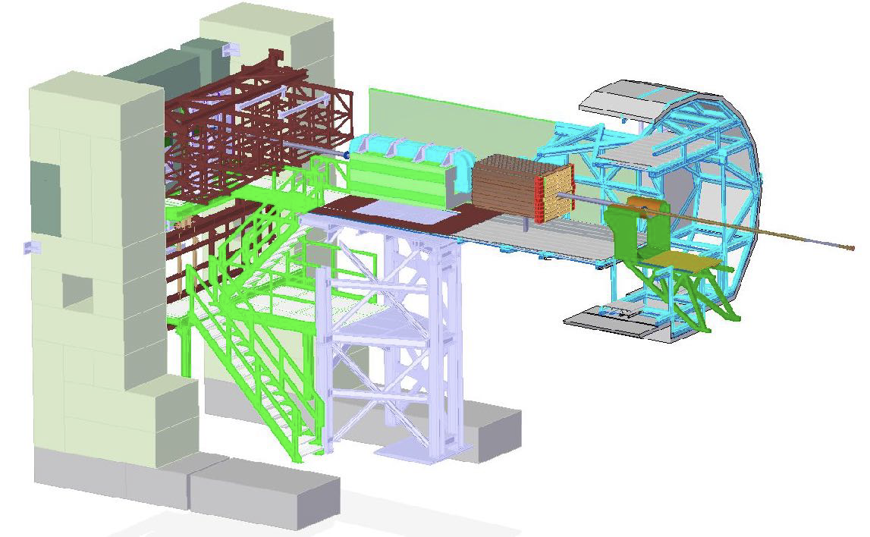
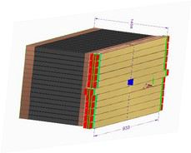
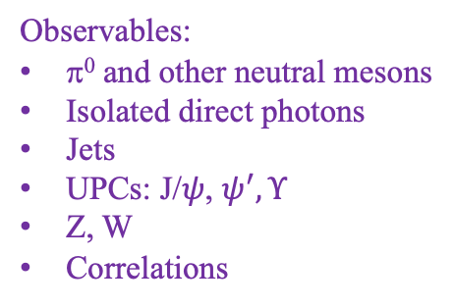
The ALICE Forward Calorimeter (FoCal) upgrade
Letter of Intent: CERN-LHCC-2020-009
Physics Program: ALICE-PUBLIC-2023-001
https://inspirehep.net/literature/2661418
Physics Performance: ALICE-PUBLIC-2023-004
Technical Design Report: ALICE-TDR-022
CERN-LHCC-2024-004
FoCal-E: high granularity Si-W sampling calo
FoCal-H: conventional metal-scintillator sampling calo
FoCal
(not to scale)
3.4<η<5.8
Main physics goal: study universal structure of matter at low-x
Flagship measurement: isolated direct photons for p_{T}>~2 GeV/c at very forward η
Observables:
π⁰ and other neutral mesons
Isolated direct photons
Jets
UPCs: J/$ψ$, $ψ^{′}, Υ$
Z, W
Correlations
  Installation: LHC Long Shutdown 3 Operation: LHC Run 4 (start 2029)

Slide 14
LHC Run 4 projections
ALICE FoCal upgrade

Slide 15
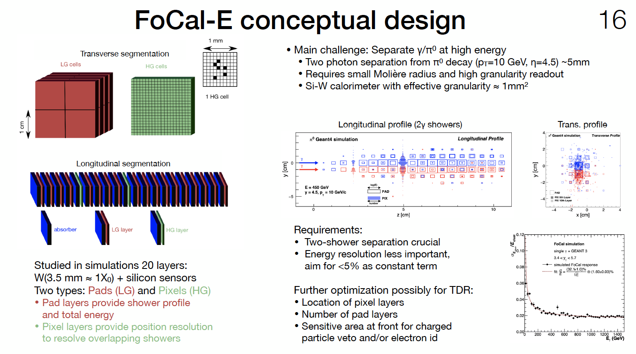
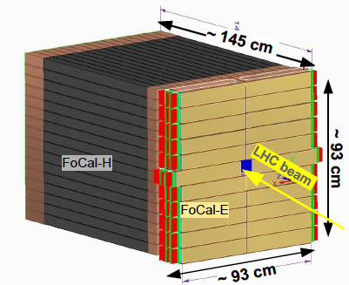
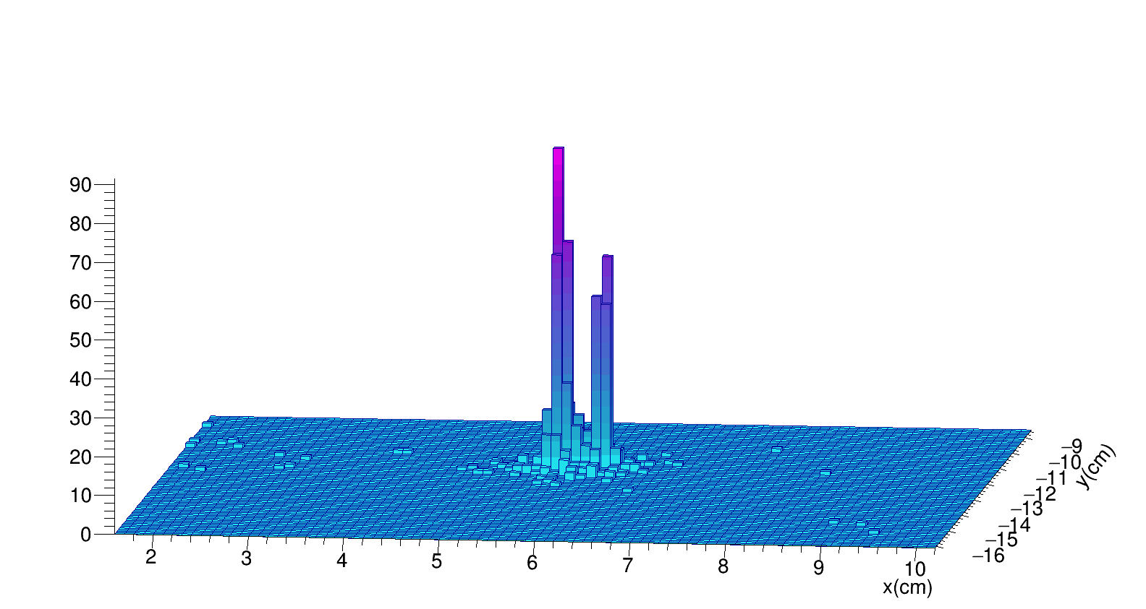
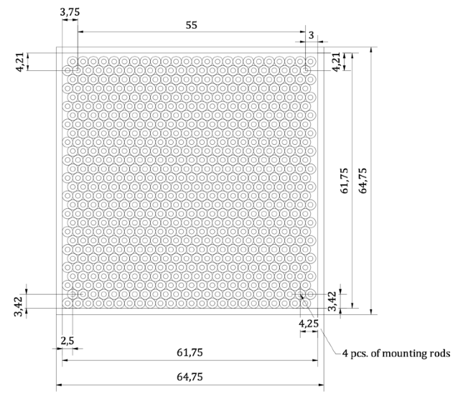
FoCal structure
Separate γ/π⁰ at high energy:
π⁰ (p_{T}=10 GeV, η=4.5): two-γ separation ~5mm
  → need small Molière radius, high granularity
FoCal-E:
W absorber: 20 layers ~ 20 X₀
Si sensor:
  18 low-granularity pad layers
  2 high-granularity pixel layers (3 x30 μm²)
FoCal-H: scintillation fibres embedded in Cu tubes
π⁰
η=5
p_{T}=10 Gev/c

Slide 16
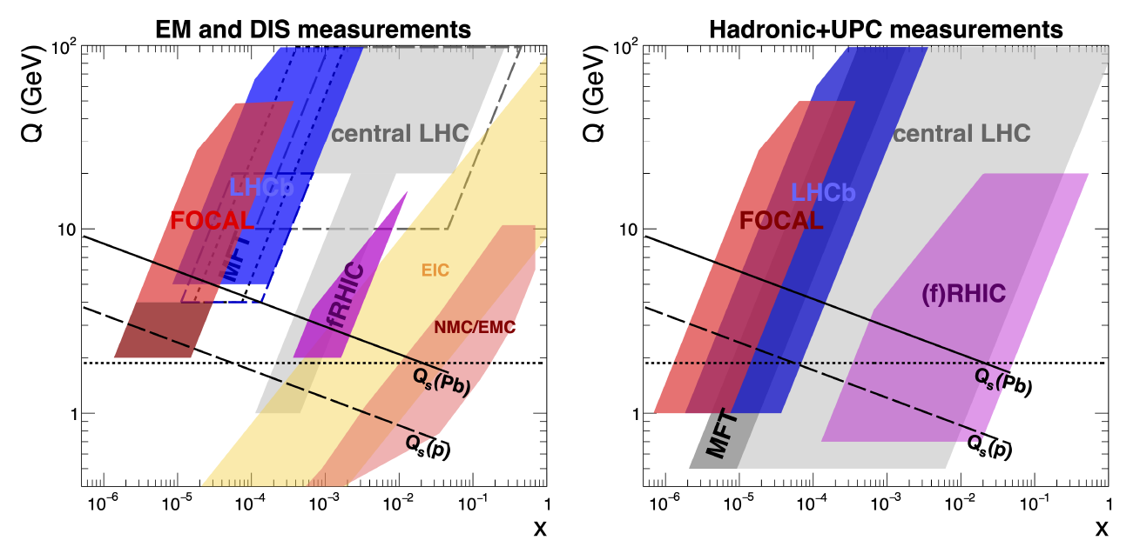
Run 4 experimental acceptance
EM in hadronic collisions: direct γ, DY

Slide 17
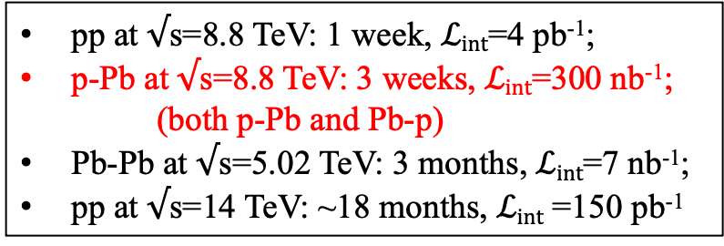
FoCal production rate projections
Integrated luminosity: current projections
Inclusive channel rates
“Round number” int lumi
pp at $√$s=8.8 TeV: 1 week, $ℒint$=4 pb⁻¹;
p-Pb at $√$s=8.8 TeV: 3 weeks, $ℒint$=300 nb⁻¹;
    (both p-Pb and Pb-p)
Pb-Pb at $√$s=5.02 TeV: 3 months, $ℒint$=7 nb⁻¹;
pp at $√$s=14 TeV: ~18 months, $ℒint$ =150 pb⁻¹
Significant rate for inclusive γ, π⁰ and jet production, from very low to very high p_{T}
Forward kinematics:
large energy deposition in calorimeter

Slide 18
Partonic kinematics: γ in FoCal
p_{T} dependence
Inclusive γ_{dir}
η dependence
γ+jet: FoCal vs Central Barrel
FoCal has flexibility to tune partonic kinematics over significant range
  → overlap with EIC kinematics

Slide 19
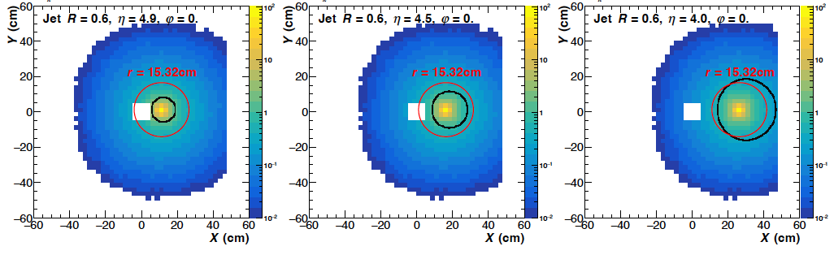
Jets in FoCal
Very forward jet measurements are extremely challenging:
hadronic shower transverse profile width ~15 cm, independent of η
but profile in (x,y) of jet with fixed R in (η,φ) shrinks at high η
Average hadronic shower profile of single π⁺ with E=500 GeV in FoCal at various η
η=4.9
η=4.5
η=4.0
Black: contour of jet with R=0.6 in (η,φ)
Red: nuclear interaction length of Cu; contains ~81% of shower energy

Slide 20
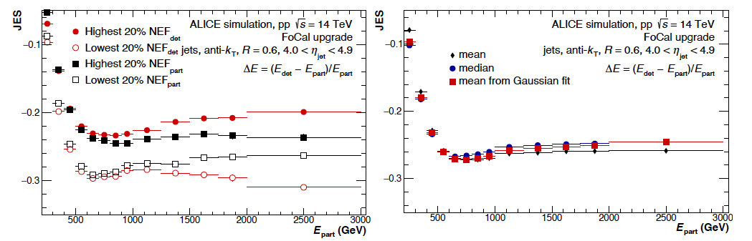
Jets in FoCal: Jet Energy Scale
Jet performance metric:
Misses >25% of jet energy
complex calibration
systematics of model-dependent corrections?

Slide 21
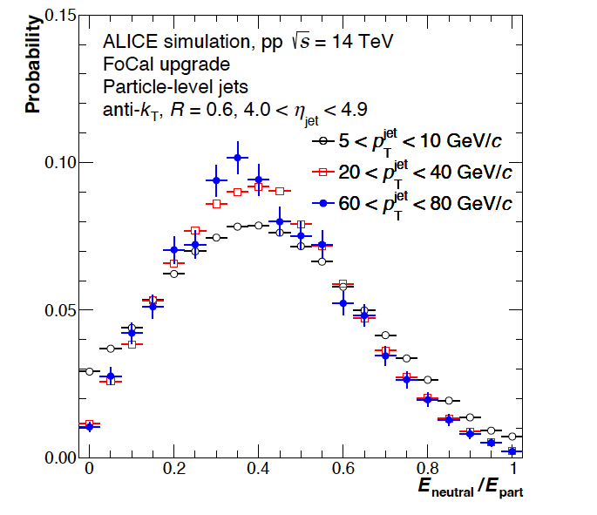
JES mitigation: Neutral Energy Fraction
NEF: fraction of jet energy carried by EM shower
Mitigation strategy:
utilize tighter transverse profile of EM shower and excellent FoCal-E spatial resolution
bias jet selection by Neutral Energy Fraction (NEF)
NEF probability
JES
Theory issues: does NEF cut break factorization? How to model?

Slide 22
Other channels under study

Slide 23
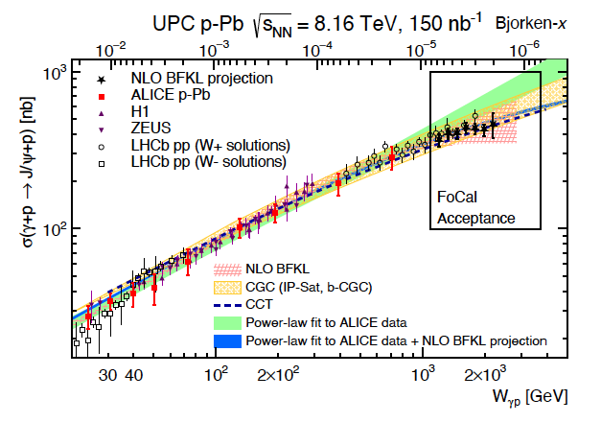
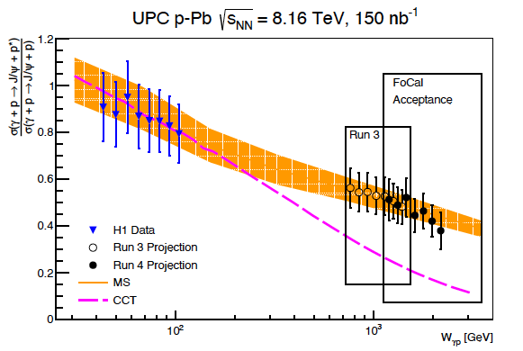

UPCs in FoCal: photoproduction of J/$ψ, ψ′$
A. Bylinkin, J. Nystrand and D. Tapia Takaki, J. Phys. G 50 (2023) 055105
FoCal extends reach in W_{γp}
Explores region where saturation effects may be significant
Coherent vs incoherent scattering: dissociative production

Slide 24
Big-picture question: how can we discriminate non-linear from linear QCD evolution?
Fast-forward 10 years: lots of beautiful new data
ep, eA: F₂, F_{L}, diffractive,…
pA from EIC+forward RHIC/LHC: photons, di-jets, UPCs,…
How will we use these vast and heterogenous datasets optimally to search for non-linear evolution and quantify its effects?
Following slides provide components of the answer

Slide 25
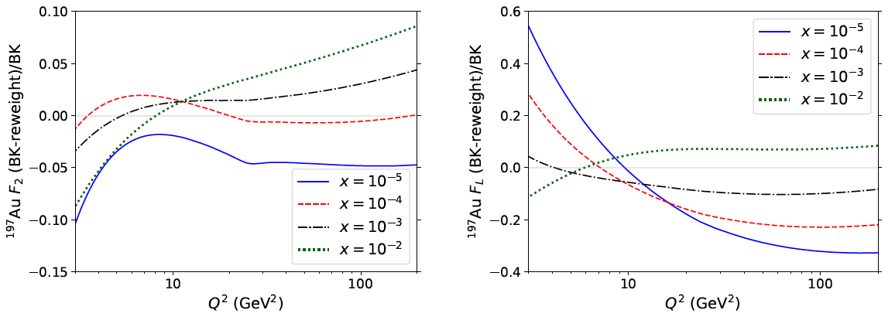
Non-linearity via DIS structure fns
Armesto et al.
PRD 105 (2022) 11, 114017
arXiv:2203.05846
Example: what is the sensitivity of DIS Structure Functions for discriminating linear and non-linear evolution?
Toy model:
Compute F₂ and F_{L} in EIC and LHeC kinematics; no exp. uncert
Both collinear factorization and CGC (non-linear) approaches
Match at x~10⁻² and Q²~10Q_{s}²
Evolve away from matching region and compare
Relative difference of nonlinear and linear evolution
¹⁹⁷Au F₂
¹⁹⁷Au F_{L}
EIC
EIC
EIC: F₂ difference ~few percent; F_{L} difference ~10% $→$challenging

Slide 26
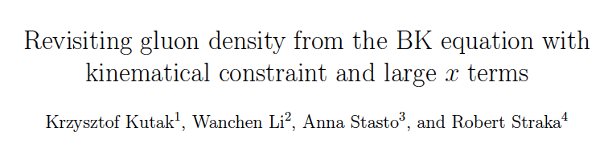
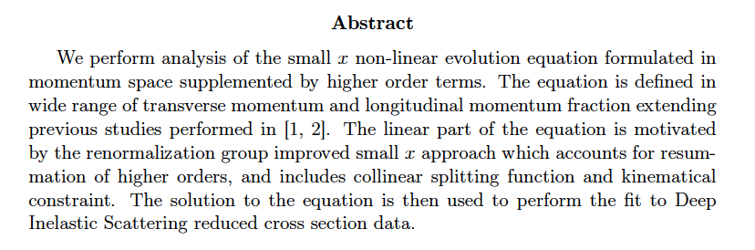
arXiv:2502.15465

Slide 27
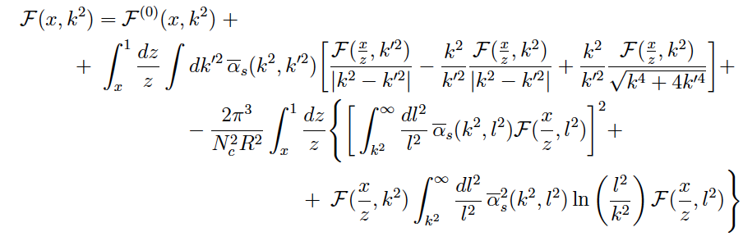

Evolution of unintegrated gluon density: BK equation
arXiv:2502.15465
Evolution in x at transverse momentum k
starting distribution
Linear
evolution
Non-linear evolution
Ansatz for starting distribution (Golec-Biernat/Wuesthoff)
Fit parameters
Fit to HERA reduced x-section data data

Slide 28
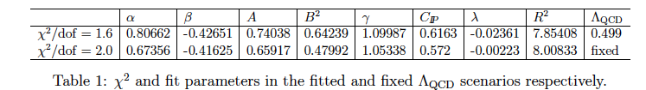
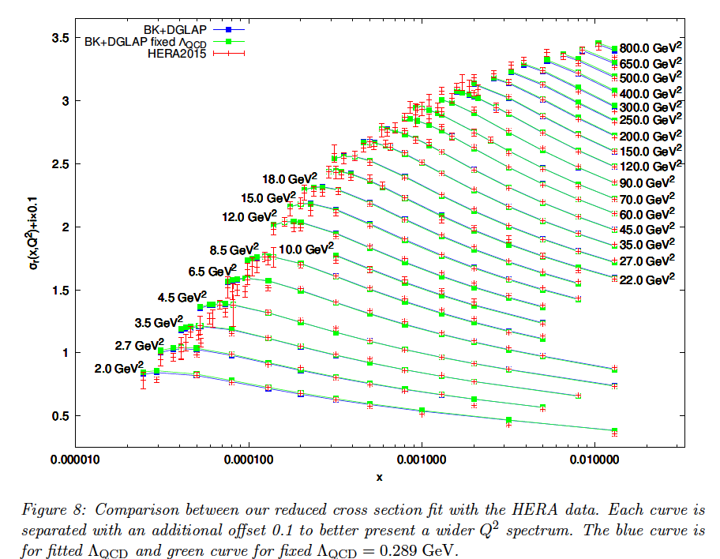
BK evolution fit to HERA data
arXiv:2502.15465
Computationally intensive
F2 calculation: each point in (x,Q²) takes about 1 s.
Full calculation: 3 days on GPU GeForce Titan Z.
Good fit to data
consistent description over vast kinematic range
How to define uncertainty?

Slide 29
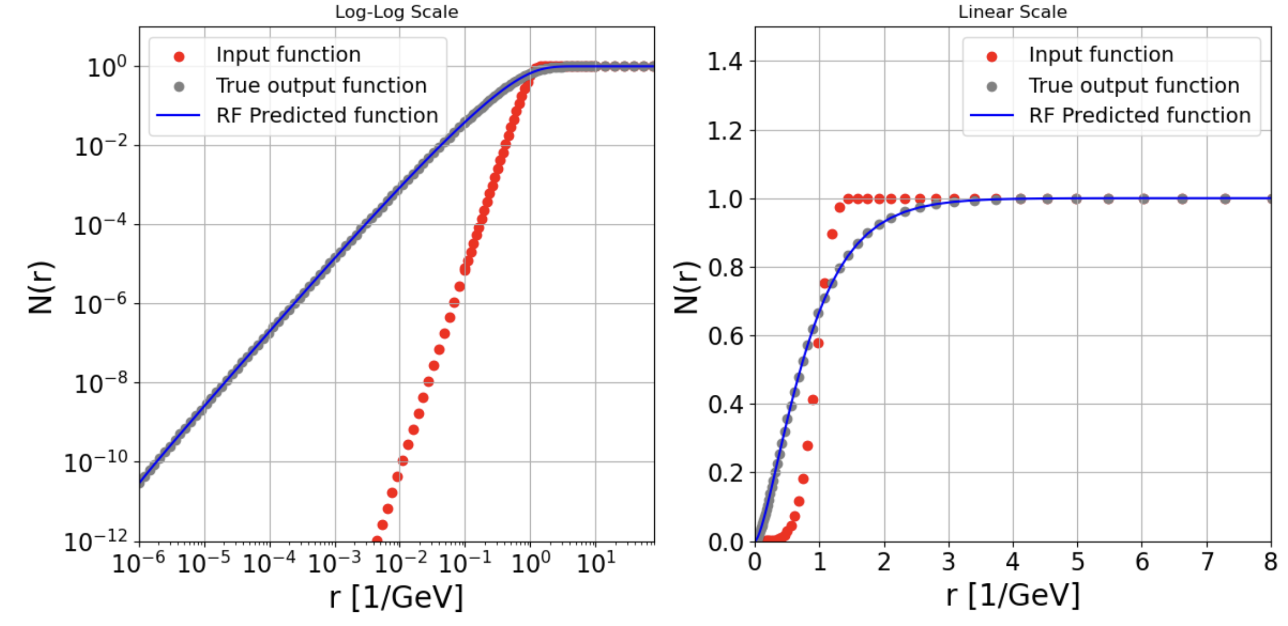
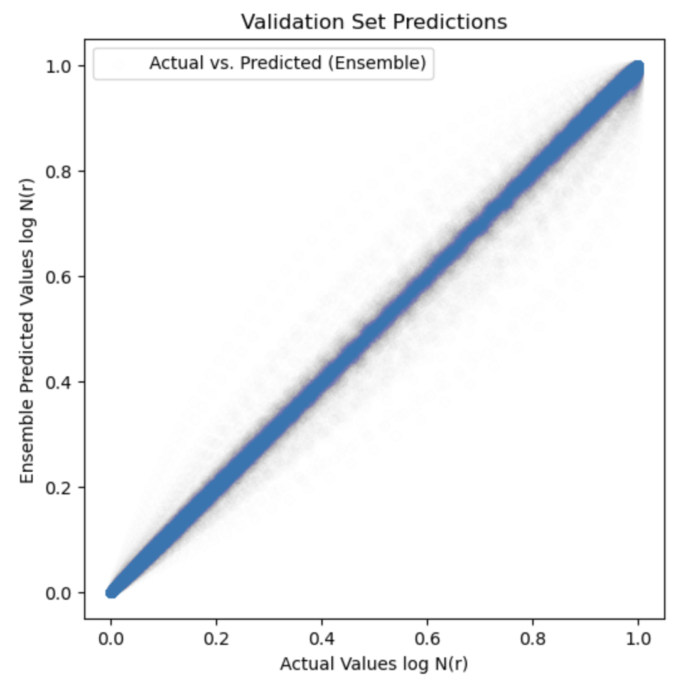

BK evolution of dipole amplitude: acceleration using Machine Learning
Bjoern Schenke
Data: dipole N(x₀,r) → BK-evolved amplitudes N(x,r)
formulated as fn of dipole size r; previous slides utilize k_{T}
currently leading-log BK; NLL to be implemented
Train ML model (Random Forest) to predict evolved dipole amplitude → fast x-evolution
Performance of ML vs. full evolution calculation
$$x={10}^{−2}→{10}^{−6}$$

Slide 30
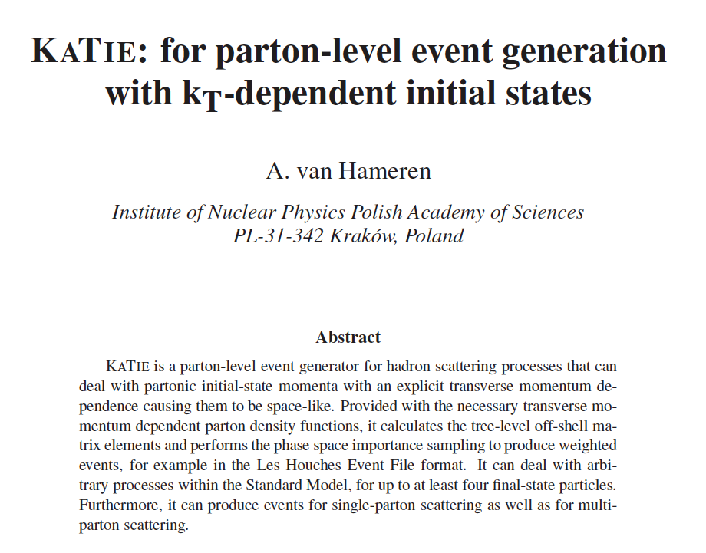
arXiv:1611.00680

Slide 31
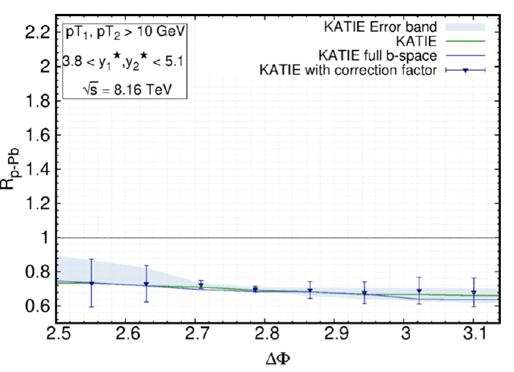
Katie calculation: Forward di-jets in FoCal acceptance
Al-Mashad et al., arXiv:2210.06613
Balanced di-jet acoplanarity
KaTie
Improved TMD (iTMD) framework
Sudakov resummation
NP effects: jet showering, hadronization (PYTHIA)
characteristic theory uncertainty

Slide 32
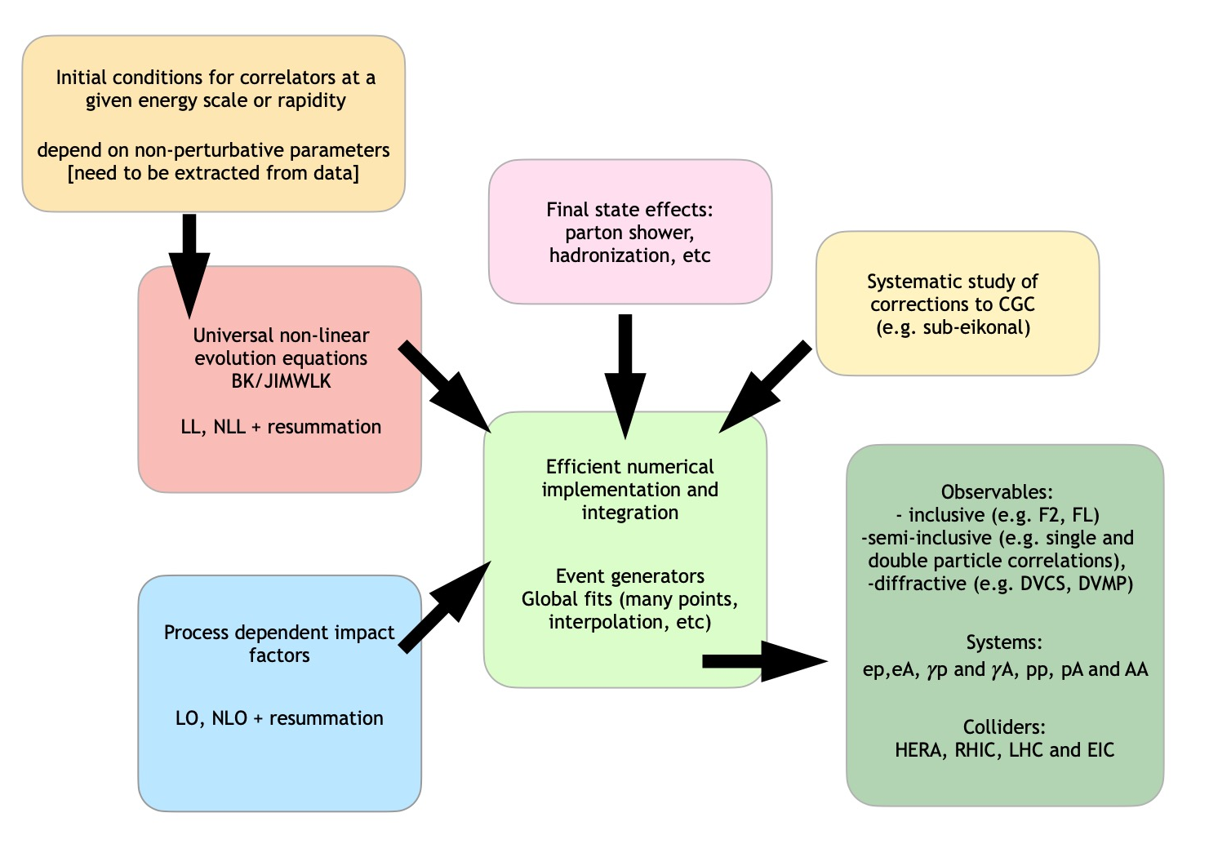
Workflow for comprehensive low-x analysis
Goal:
model tension
parameter constraints
Additional essential ingredient: theory uncertainties!
KaTie
Bayesian inference;
AI/ML
quadrupole/JIMWLK
dipole/BK

Slide 33
Rigorous connection of data and models:
Bayes’s Theorem
For a given model, what parameters are most compatible with experimental data?
Bayesian Inference: combine knowledge of theory and experiment to constrain parameters
Likelihood
Prior knowledge of model parameters
Posterior: probability density of parameters giving best description of the data
Likelihood incorporates covariance of data uncertainties, theory uncertainties

Slide 34
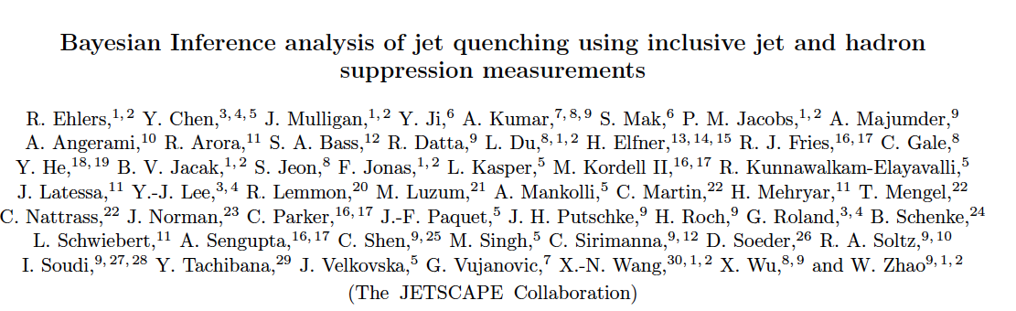
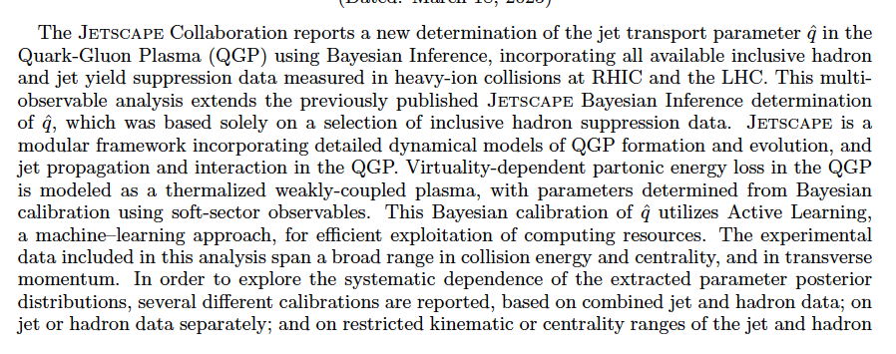
arXiv:2408.08247

Slide 35
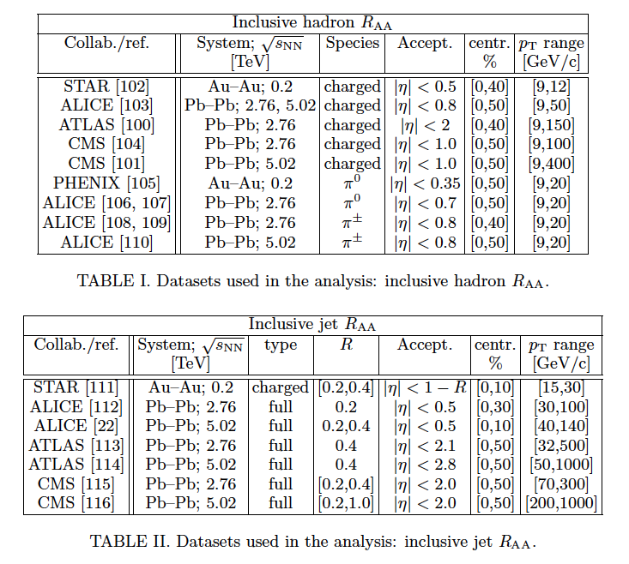

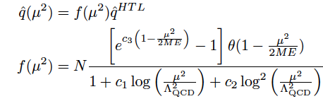
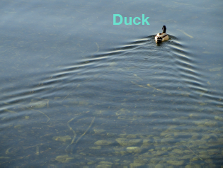
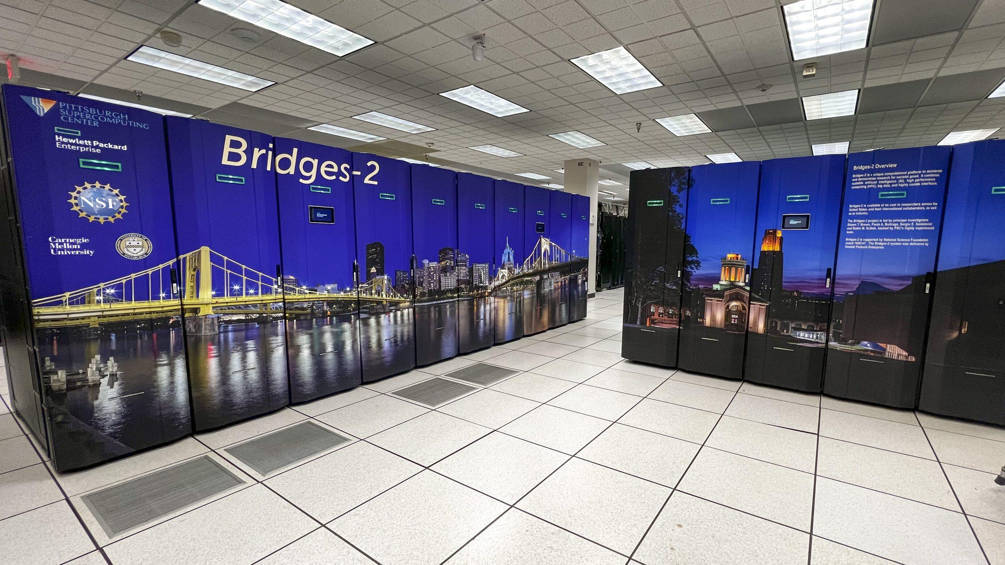


Ingredients
Comprehensive dataset
Virtuality-dependent $\hat{q}$
Hydrodynamics (QGP)
Massive computing
~5M HPC core hours
AI/ML: Active Learning

Slide 36


Slide 37

Comprehensive fit
Overall reasonable agreement, some tension

Slide 38



Big picture lesson: extracted value of depends on the probe
$\hat{q}$ is not a universal QGP transport coeff.!
→ back to the theory drawing board…

Slide 39
Summary
Goal:
model tension
parameter constraints
Additional essential ingredient: theory uncertainties!
KaTie
Bayesian inference;
AI/ML
quadrupole/JIMWLK
dipole/BK

Slide 40
Backup

Slide 41


CMS: forward di-jets in p+Pb
Phys. Rev. Lett. 121, 062002 (2018)
arXiv:1805.04736
Nuclear effects: yield ratio p+Pb/pp
η>0: proton direction $→$low-x in Pb
EMC
shadowing
anti-shadowing
EPS09: gluon EMC effect based on PHENIX π⁰
DSSZ: does not incorporate gluon EMC effect
gluon EMC effect directly observable!

Slide 42


ATLAS: forward di-jets in p+Pb
arXiv:2309.00033
Events classified by Event Activity (EA) based on forward E_{T} (“centrality”)
R_{CP}: ratio of yields for high/low EA
scaled by Glauber-model factor assuming EA is geometric in origin
Di-jet kinematics:
y_{b}=pair boost
y*=half-separation in rapidity
Striking scaling of high-EA yield suppression at large <x_{p}>
Driven by color fluctuations in proton wavefunction
  $→$new probe of color transparency

Slide 43


π⁰ production in p+Pb
PRL 131 (2023) 042302
arXiv:2204.10608
nCTEQ15, EPPS16: both incorporate LHCb D⁰ data
Forward (Pb low-x):
good agreement w/ both linear QCD and CGC
Backward (Pb high-x):
poorer agreement: additional nPDF constraints
ch hadron yield enhanced vs π⁰
characteristic of heavy-ion collisions $→r$adial flow? baryon enhancement?

Slide 44


EPPS21
Eskola et al., EPJ C82 (2022) 5, 413
arXiv:2112.12462
Includes LHC p+Pb data:
  5 TeV: CMS forward di-jet, LHCb D⁰ @ 5 TeV;
  8 TeV: CMS W
Dramatic improvement in uncertainties relative to EPPS16

Slide 45


Di-hadron correlations RHIC and LHC
Stasto, Wei, Xiao, and Yuan, Phys. Lett. B784 (2018) 301
STAR, Phys. Rev. Lett. 129 (2022) 09250
FoCal
Dilute-dense LO + Sudakov
probes quadrupole operator
fits STAR data similar to left panel
Small broadening effect: experimentally challenging
NLO needed for theory uncert.
A-dependent recoil yield suppression
no significant azimuthal broadening (!)

Slide 46


Partonic kinematics: γ, π⁰ (FoCal); D-meson (LHCb)

Slide 47


14 TeV pp collisions: forward isolated photons
Compare two recent PDF fits: tension in FoCal acceptance
FoCal provides unique constraints of pp PDFs
FoCal probes x ~5x10⁻⁷
sensitive to saturation effects even in pp collisions?

Slide 48



FoCal direct photon performance
Background rejection:factor~10
γ_{dir}/all >50% → high precision measurement
Prompt photon PID cuts:
invariant mass (IM)
shower shape (SS)
isolation: EM + Hadronic
Isolation p_{T}
π⁰ efficiency
π⁰
η=5
p_{T}=10 Gev/c
Good π⁰ efficiency

Slide 49


FoCal and nPDFs
Bayesian reweighting of nNNPDF3.0 using FoCal pseudo-data
Significant reduction in uncertainties
Systematically independent of D-meson constraint
no hadronization effects
$→U$niversality test of low-x formalisms

Slide 50






Slide from Krakow
Example: the ITMD factorization for di-jets
High energy factorization and forward jets
The color structure is separated from kinematic part of the amplitude by means of the color decomposition.
The TMD gluon distributions are derived for the color structures following
P1
P. Kotko K. Kutak , C. Marquet , E. Petreska , S. Sapeta, A. van Hameren,
JHEP 1509 (2015) 106
A. van Hameren, P. Kotko, K. Kutak, C. Marquet, E. Petreska
JHEP 12 (2016) 034
P2
gauge invariant amplitudes with kt and TMDs
For CGC derivation see
Altinoluk, Bussarie, Kotko ‘19
Example for g* g → g g
Formalism implemented in
Monte Carlo programs KaTie
by A. van Hameren
Proton
Colinear
Very forward large x
F is gluon TMD at low x
CGC enters into F
H is hard coeff (pert)

Slide 51

R_{pPb}: forward π⁰, γ
Ducloué, Lappi, and Mäntysaari,
Phys. Rev. D97 (2018) 054023
LO Dipole-CGC calculation
π⁰
isolated γ
Solid/dashed: isolation R=0.4/0.1
Significant difference in low p_{T} suppression between π⁰ and isolated γ
Different production channels have different sensitivity to saturation
π⁰: p_{T} >> Q_{sat}
Direct γ: qg → γg; k_{T}~ Q_{sat}
Authors: picture may change @ NLO
Lesson for FoCal/LHCb: both measurements should be done

Slide 52



Forward γ+jet
KaTie calculations (I. Ganguli et al., arXiv:2306.04706)
γ+jet distributions:
P-Pb vs pp
p_{T}: negligible modification
Δφ: b-to-b suppression
γ+jet: R_{pPb} vs Δφ
recoil jet p_{T} dependence
Compare to di-jet: dipole vs quadrupole TMD
R_{pPb}
γ+jet

