Slide 1
Machine Learning Applications for Improving Accelerator Operations for the EIC
Weijian (Lucy) Lin
PI: Kevin Brown
Probing the frontiers of nuclear physics with AI at the EIC (II)
Mar 21, 2025

Slide 2
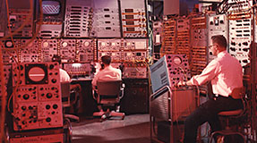
Motivation
Particle accelerator – kilometer-scale machine with thousands of coupled components to generate and preserve beam with very precisely defined qualities (e.g., energy, emittance, luminosity etc.)
Traditionally maintained with many hours of manual tuning, taking time away from data collection
Constantly varying complex system – no constant set of routine, needs real-time adjustments

Slide 3
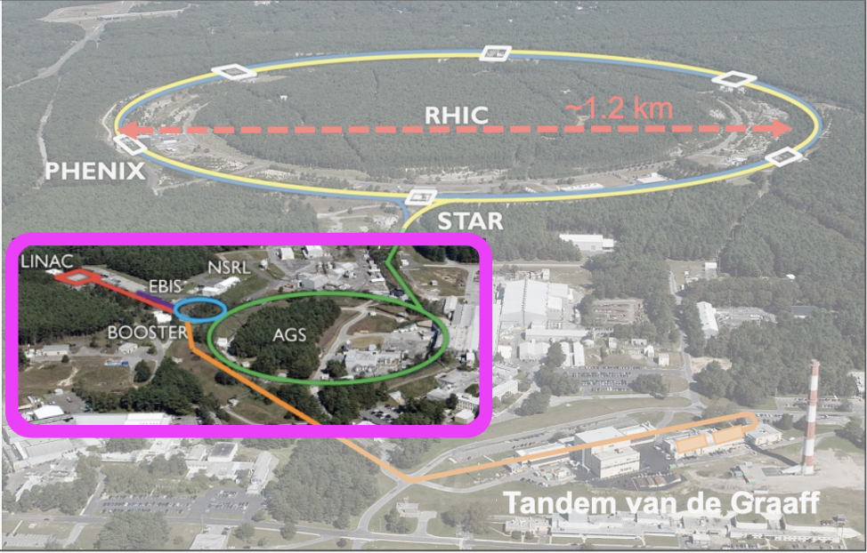
Motivation
Alternating Gradient Synchrotron (AGS) and its Booster serve as part of the injector compound for RHIC and future EIC
 | Max Energy [GeV] | Pol. At Max Energy [%]
Source+Linac | 1.1 | 82-84
Booster | 2.5 | ~80-84
AGS | 23.8 | 67-70
RHIC | 255 | 55-60
Loss in polarization along the chain
Machine Learning (ML) techniques can be used to optimize beam luminosity, quality, and polarization in RHIC and EIC
Difficulty in improving beam quality:
polarimeter measurement is slow and has big error bars
tuning involves many control parameters and is mostly done by hand

Slide 4
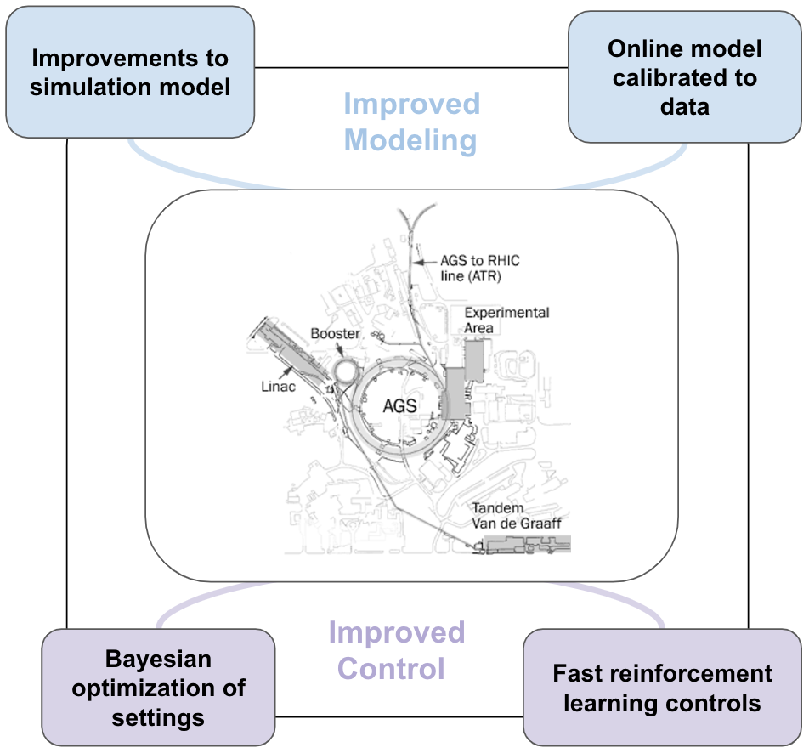
Improve Operations with ML
Figure-of-merits (FOM) for ML algorithms (“experimental outputs”): emittance, beam intensity, polarization
Possible areas where ML is useful:
Cooling optimization
Injection optimization
Digital-twin & Error detection
Electronic Logbook upgrade
Useful ML methods:
Bayesian Optimization (BO)
Neural Network (NN)
Reinforcement Learning (RL)
Natural Language Processing (NLP)

Slide 5
Cooling Optimization

Slide 6
Low Energy RHIC electron Cooling (LEReC)
Cornell DC Gun
LEReC is used to increase the luminosity, it was successfully improved the luminosity in 2020 and 2021 runs
704 MHz e-bunches are created in the 400 keV Cornell gun, and delivered to the cooling sections (20 meter), where they co-travel with ion bunches
➔ The new EIC pre-cooler layout follows the same principle, profiting form the same ML techniques

Slide 7
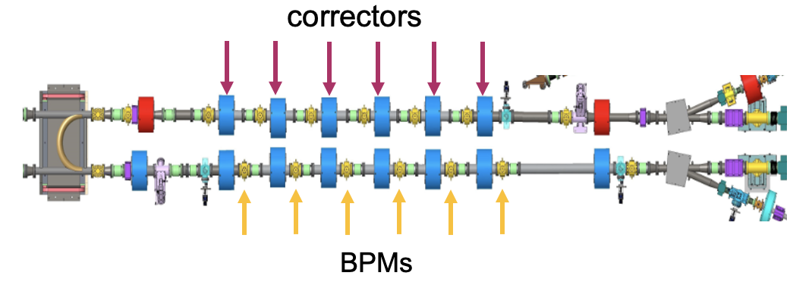
LEReC experiment settings
Only the first 4 BPMs are considered due to limited machine time
Cooling rate:$λ={(1/\overline{δ})(\overline{dδ}}/{dt)}$
Ions are assumed in the center position (x=0, y=0)
Goal: use Bayesian optimization (BO) to maximize $−λ$ by aligning electron orbit with ion orbit

Slide 8
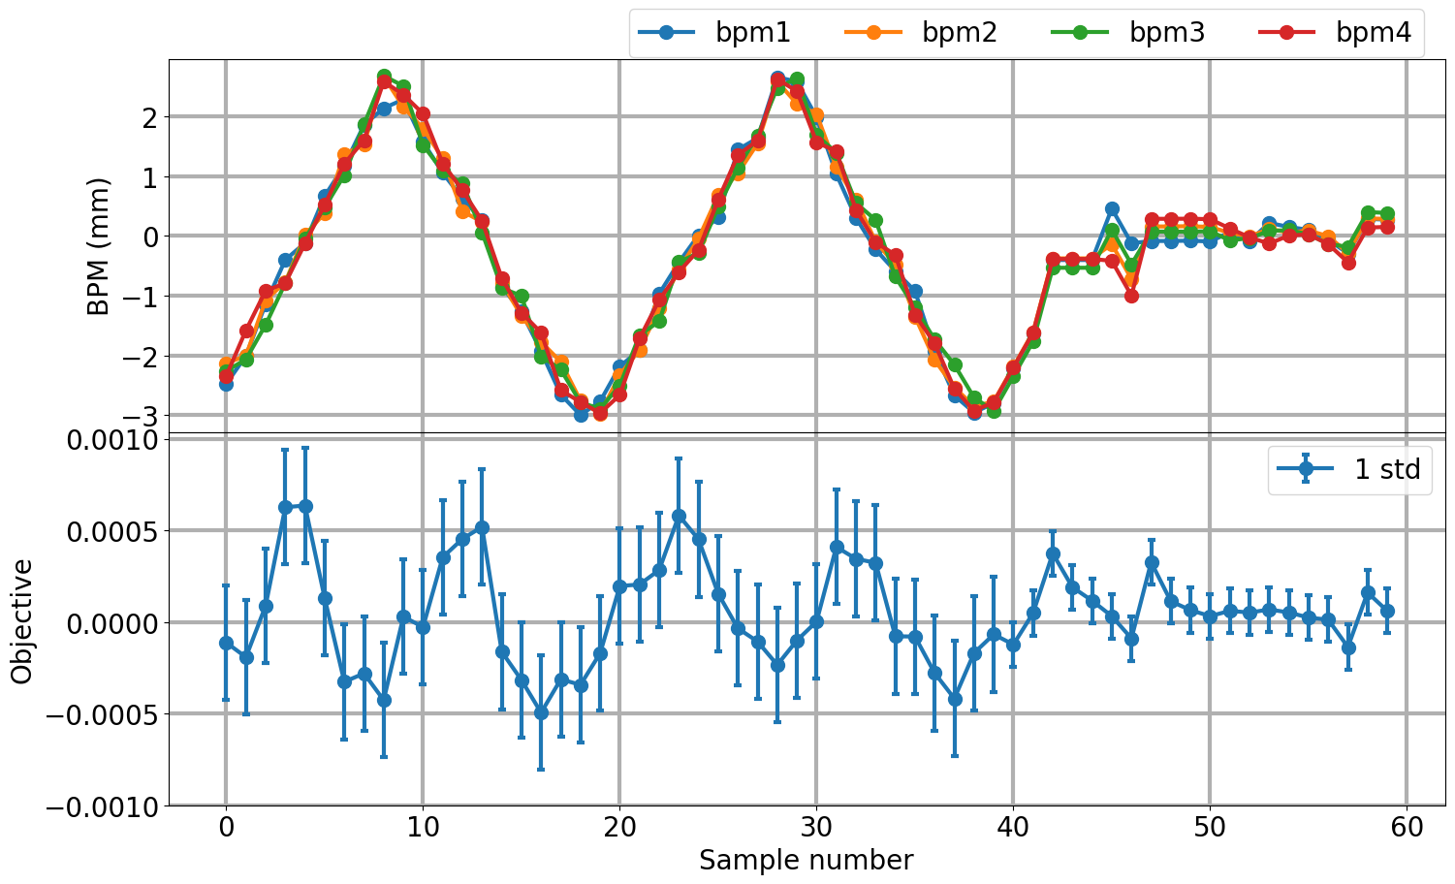
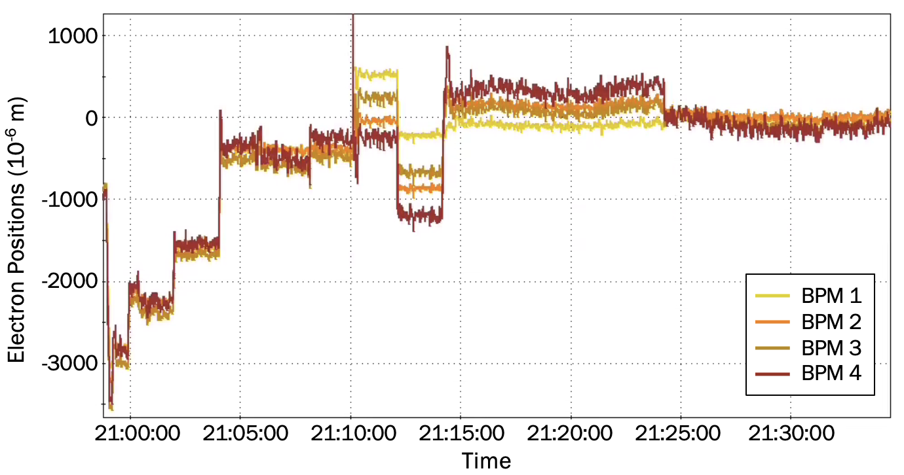
LEReC experiment results
Avg. Number = 15
equilibrium
Bayesian optimization algorithm trained with 40 initial samples to optimize transverse cooling rate $λ$
The system reaches optimal status when cooling rate balances the IBS-driven growth rate, so $λ$ approaches 0 once the system reaches equilibrium
Algorithm converged quickly (reach close neighborhood in 3 steps)
Tune electrons from the farthest positions to the center and maintain the trajectories

Slide 9
Coherent electron Cooling
Designed to cool 26.5 GeV/u ion beam circulating in RHIC’s yellow ring.
CeC CW SRF accelerator with unique SRF electron gun generates electron beams with quality sufficient for the current experiment and for the future EIC cooler
Time-resolved diagnostics beamline is used to provide high precision measurements of electron beam quality

Slide 10
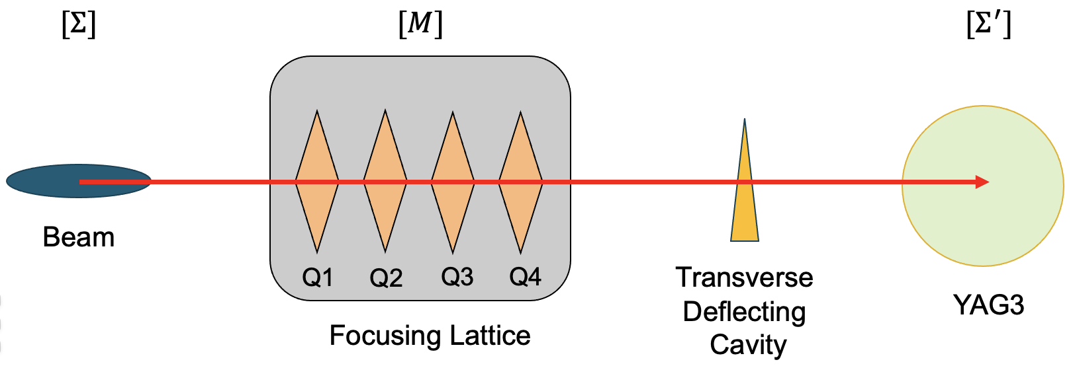
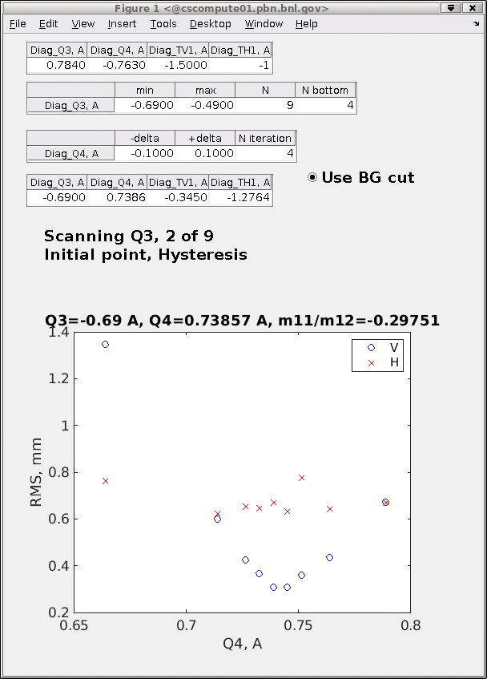
Quadrupole scan with two quads
Scan two quads (Q3, Q4) with opposite polarity $→$ keep beam focused vertically
Find quad combination settings that gives best vertical focusing
Find best Q3-Q4 combinations with sequential scans: 1) scan 13 Q3 settings; 2) for each Q3 setting, scan 9 Q4 settings
Time taken: ~ 5 minutes for each Q3 setting, > 1 hour for an entire scan routine

Slide 11
Speed up quad scan with Neural Network
Time consuming sequential scans
Train a ML model to establish mapping between quadrupole settings and beam size
Trained ML model predicts best Q3-Q4 combinations without additional scans
Useful for faster general beam tuning & as starting point of optimization
Artificial Neural Network
$$\left[\begin{matrix}Q3 \\ Q4 \\ ⋮\end{matrix}\right]$$
$$\left[\begin{matrix}σ_{x} \\ σ_{y} \\ ⋮\end{matrix}\right]$$
Quadrupole (or other tunable) settings
Desired beam properties

Slide 12
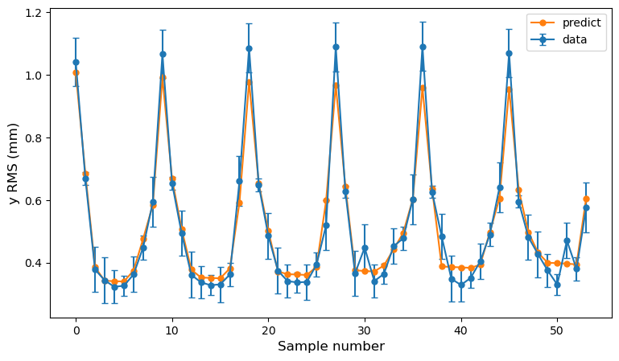
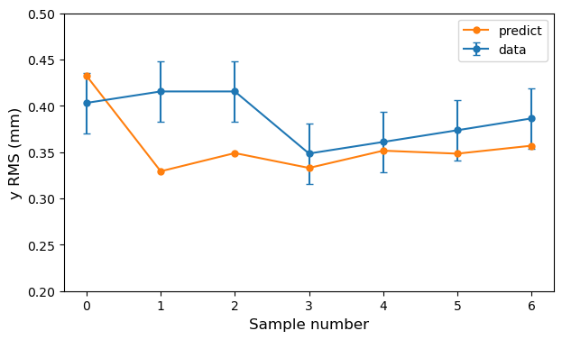
New CeC routine test results
First 6 rounds: 54 saved data points
Trained NN accuracy on 54 data points: 93.65%
Tested 7 proposed Q3-Q4 combo settings
Obtained Y RMS values around 0.3 – 0.4 mm range: satisfactory preliminary results
Successfully cut scan time by 50%
Remaining 7 rounds: 7 data points using Q3-Q4 settings predicted by NN model

Slide 13
Injection Optimization

Slide 14
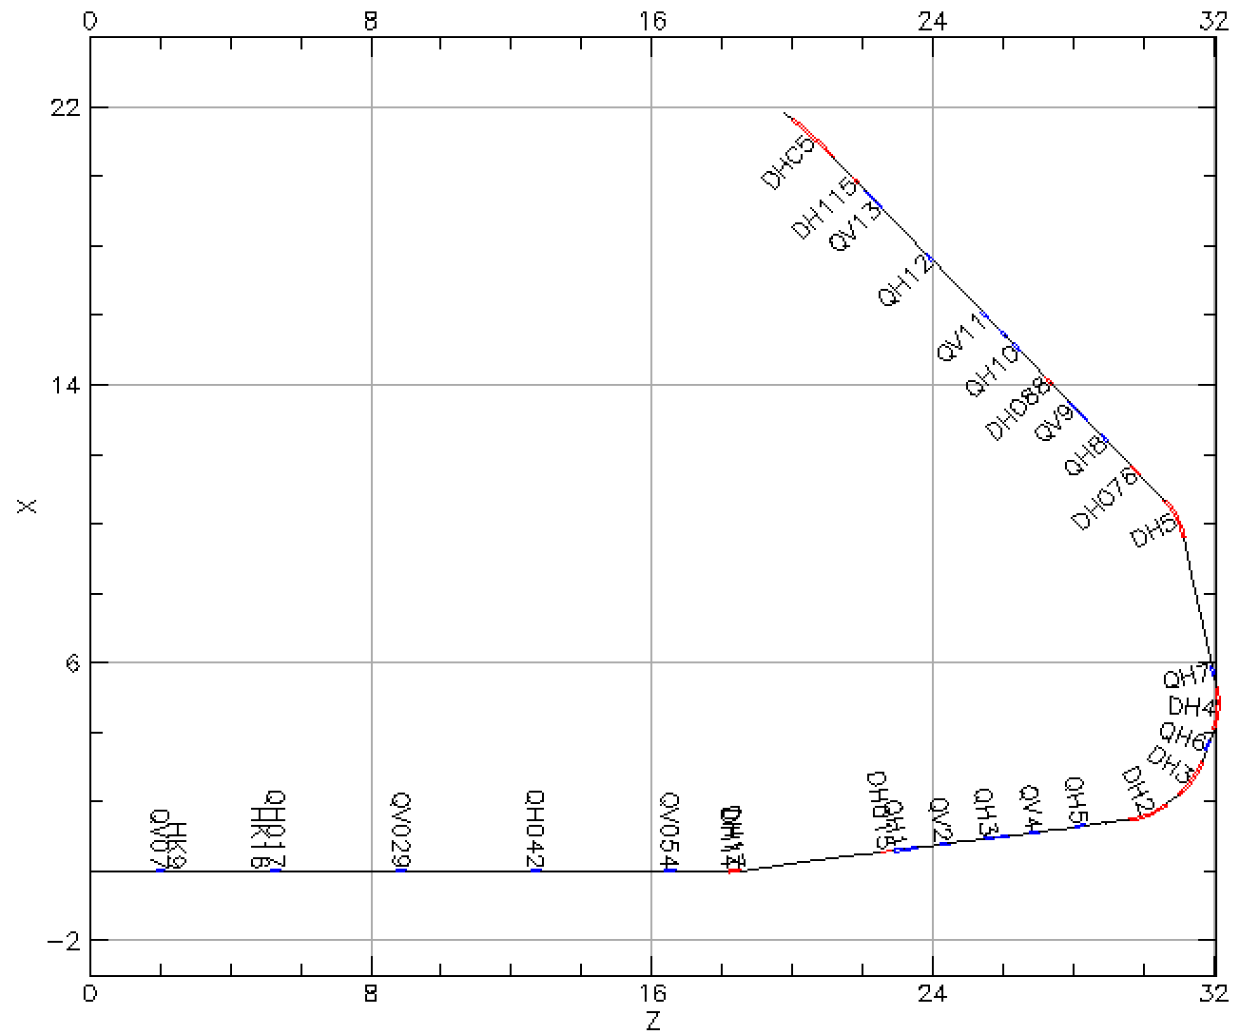
Booter injection
scrape
Booster injection process sets maximum beam brightness for rest of acceleration through RHIC
Known emittance effect on polarization loss
Intentional horizontal and vertical scraping reduce emittance to RHIC requirements
Goal: minimize emittance / maximize beam intensity after scraping
Controls: Linac to Booster (LtB) transfer line optics
Method: Bayesian optimization (BO)
To Booster
$126°$
bend
From Linac

Slide 15
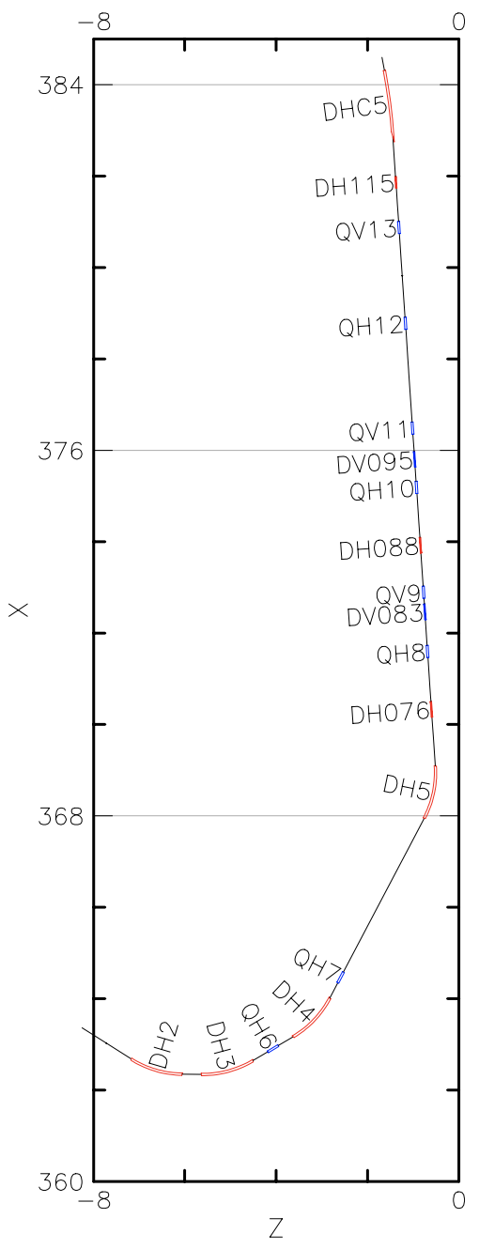
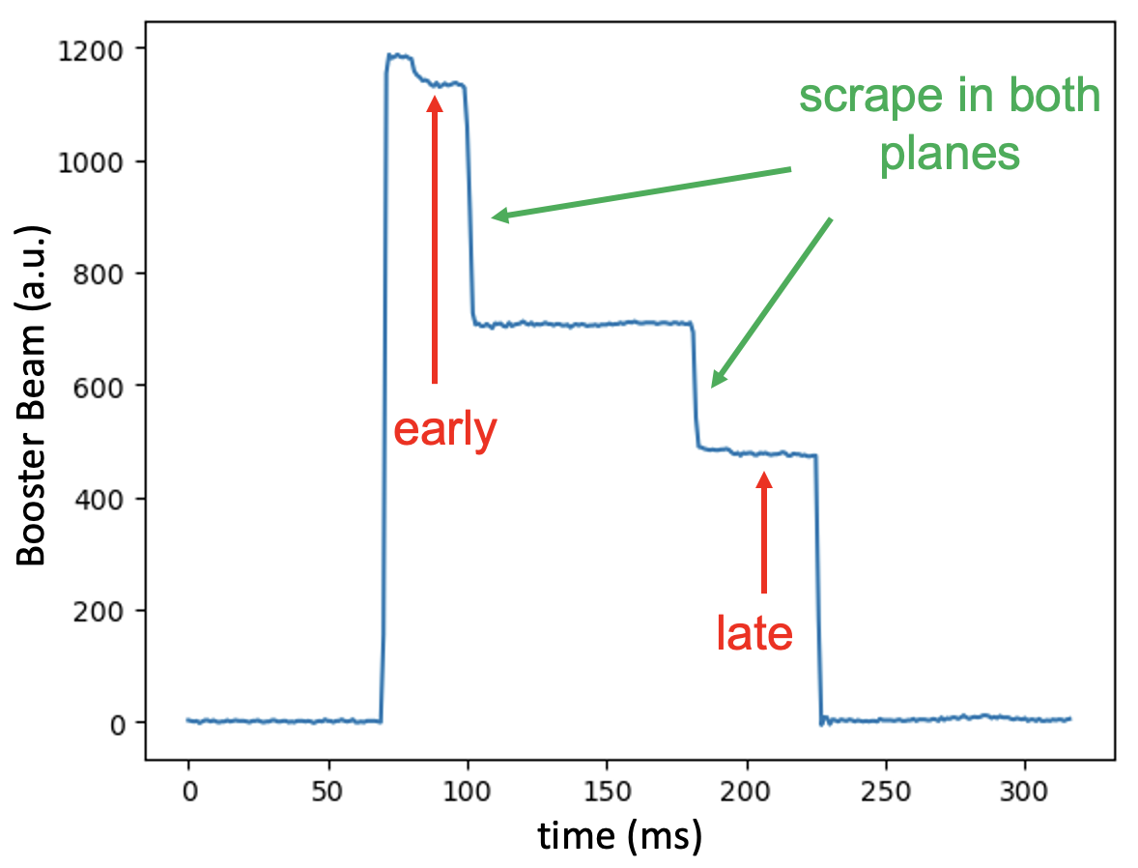
LtB controls and measurement
Booster
13 quadrupoles and 16 correctors between Linac and Booster
Common practice to improve Booster injection efficiency: tune last few correctors at the end of the LtB line
Criteria to check injection efficiency: Booster early and late intensity

Slide 16
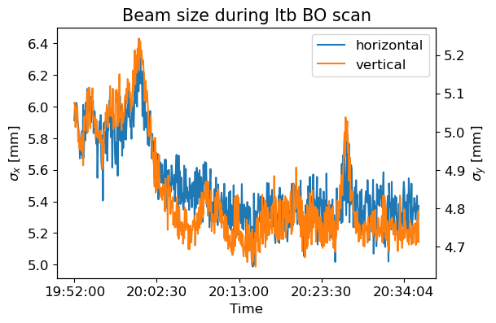
LtB optimization: 2 correctors + 2 quadrupoles
Controls: Power supply currents of two correctors and two quadrupoles at the end of the LtB line
Beam size decrease in both planes in the BtA line in correspondence with intensity increase

Slide 17
Electron Beam Ion Source
Heavy ion source to replace Tandem as pre-injector for RHIC
 |  | Injection [fc96] | Extraction [xf14]
1 | IonLens20-40kV | ✓ | ✓
2 | DeflPlatBias | ✓ | ✓
3 | 16PoleX | ✓ | ✓
4 | 16PoleY | ✓ | ✓
5 | Gridded_Lens | ✓ | ✓
6 | Horiz_Bend_Defl | ✓ | ✓
7 | Inter_Vert_Defl | ✓ | ✓
8 | Inter_Vert_Defl_Lower | ✓ | ✓
9 | Horiz_Sphere_Bend | ✓ | ×
10 | RFQ_Horiz_Bend | × | ✓
11 | LEBT_Solenoid | × | ✓
 | Total Variables | 9 | 10
LION
EBIS Injection Line (fc96)
EBIS
EBIS Extraction line (xf14)
RFQ
MEBT
Linac
HEBT

Slide 18
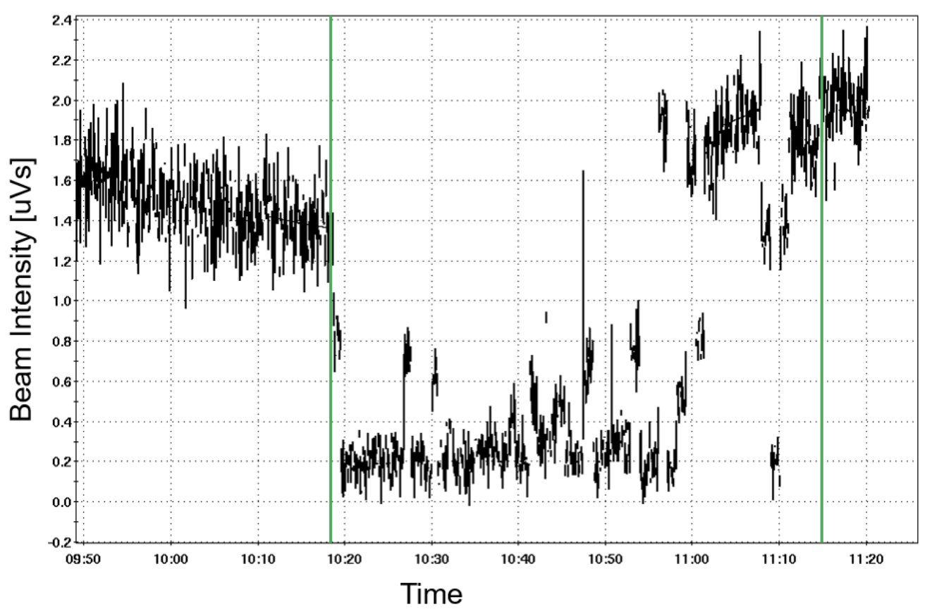
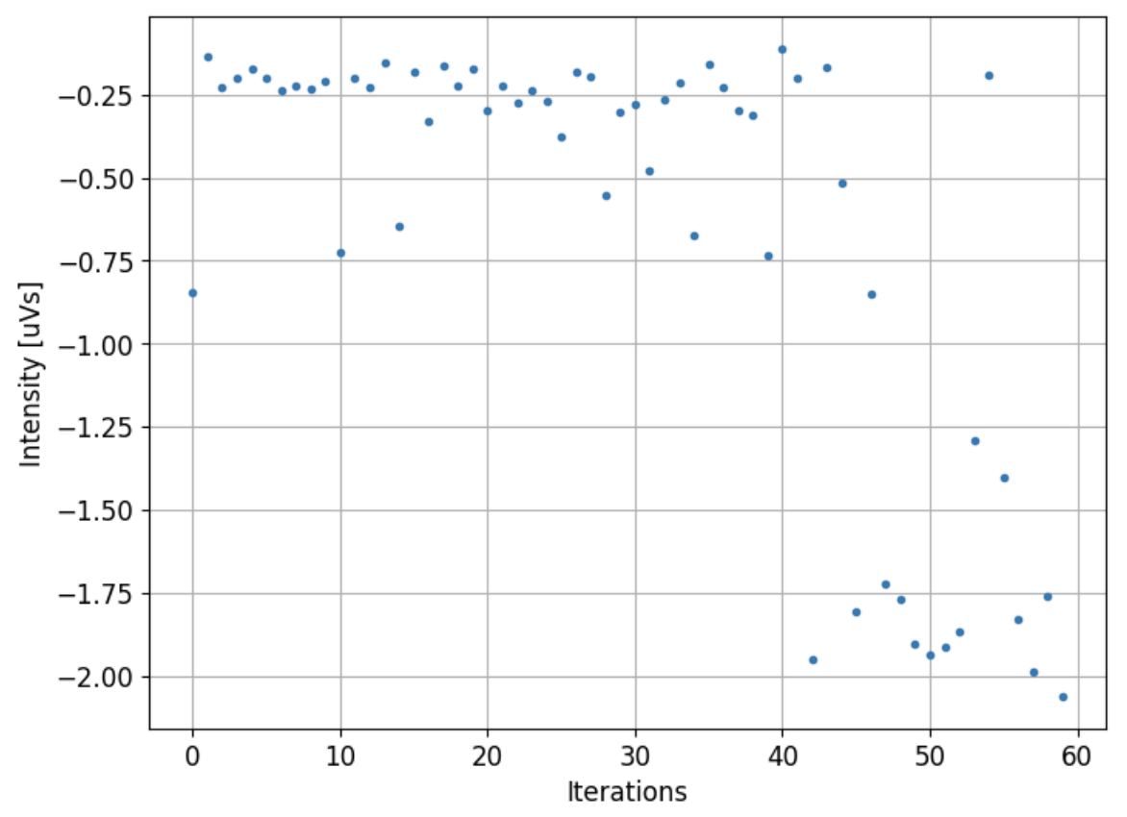
EBIS extraction line optimization
~2.0
1.4
xf14 intensity
Objective
~43% improvement after optimization
10 control parameters measured at xf14 were used to maximize ion beam intensity
Objective is average intensity over 4 super-cycles (6.6 sec per cycle), multiplied by a negative scaling factor, BO algorithm aims to minimize objective
43% improvement observed after 60 iteration (~57 minutes)

Slide 19
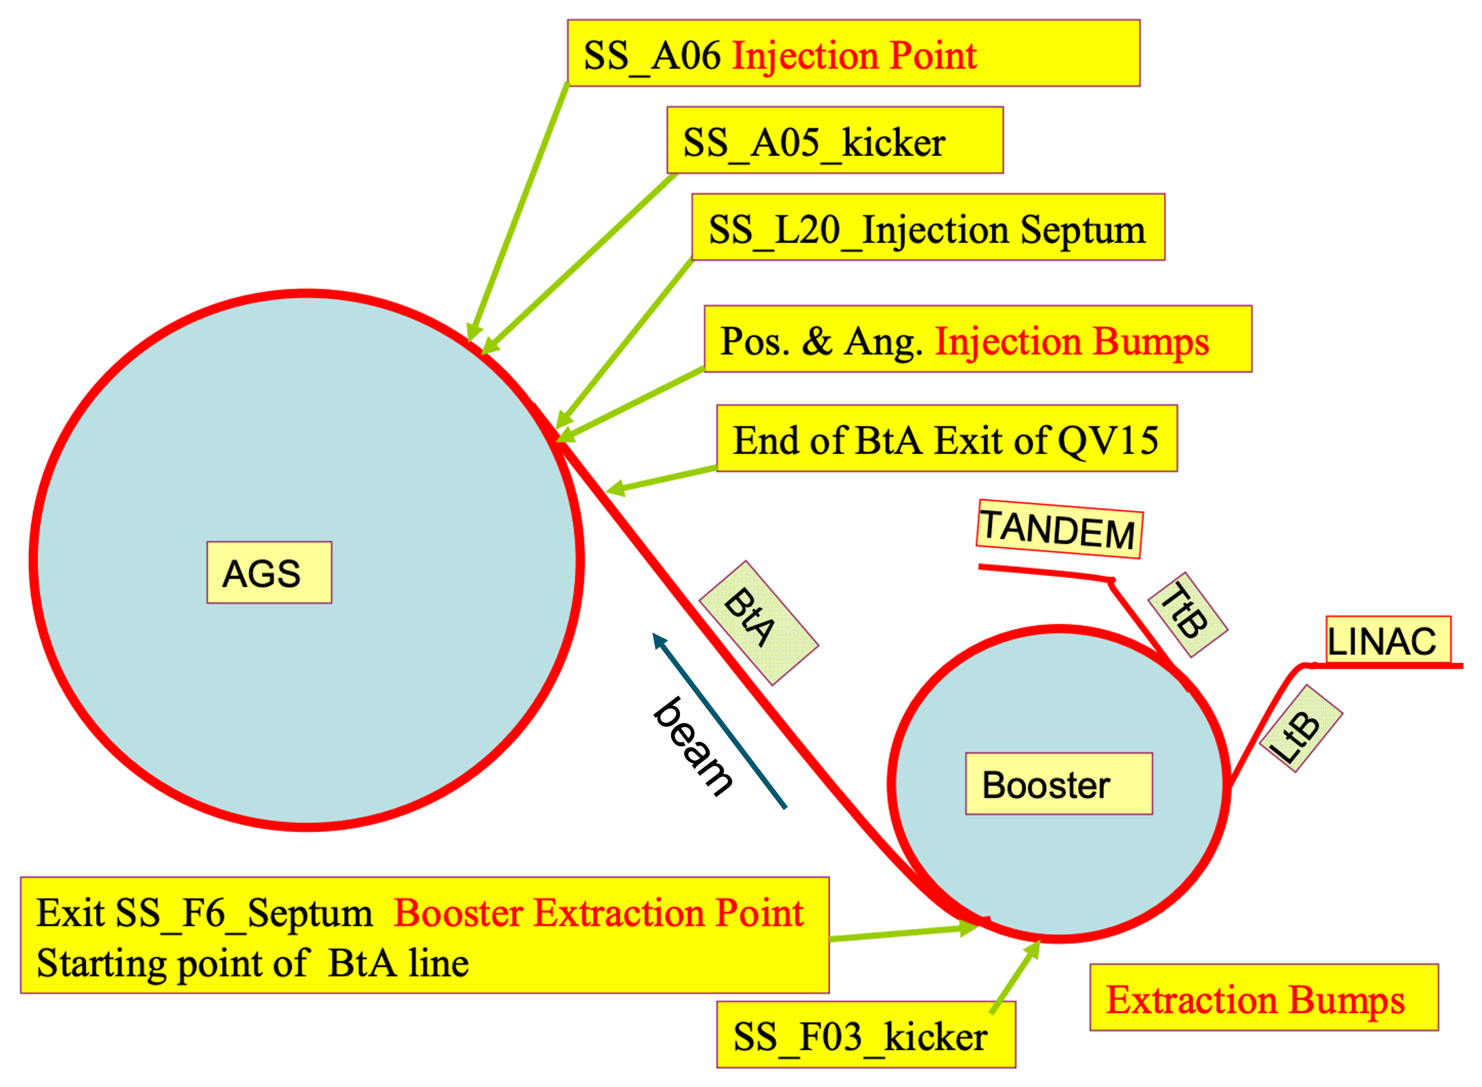
AGS injection
Extraction septum at F6 in Booster, injection septum at L20 in AGS, no scraping
Multi-wires MW006, MW060, MW125, MW166
Emittance measured by AGS Ionization Profile Monitor (IPM)
Goal: maximize beam brightness in the AGS
Controls: Booster to AGS (BtA) transfer line optics

Slide 20
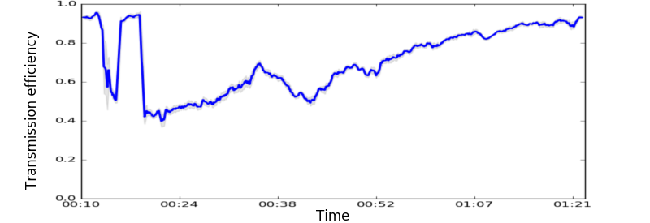
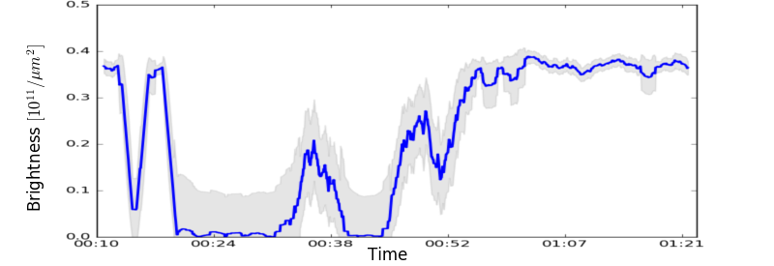
BtA optimization: 4 correctors
Controls: Power supply currents of two vertical and two horizontal correctors.
Target: Increase brightness. Increase intensity and decrease beam size.
Method: Ruin initial settings, use Bayesian optimization to re-optimize settings.
Results: Automatically achieved previous maximum brightness and intensity in $<130$ iterations with new settings

Slide 21
Digital-twin and Error detection

Slide 22
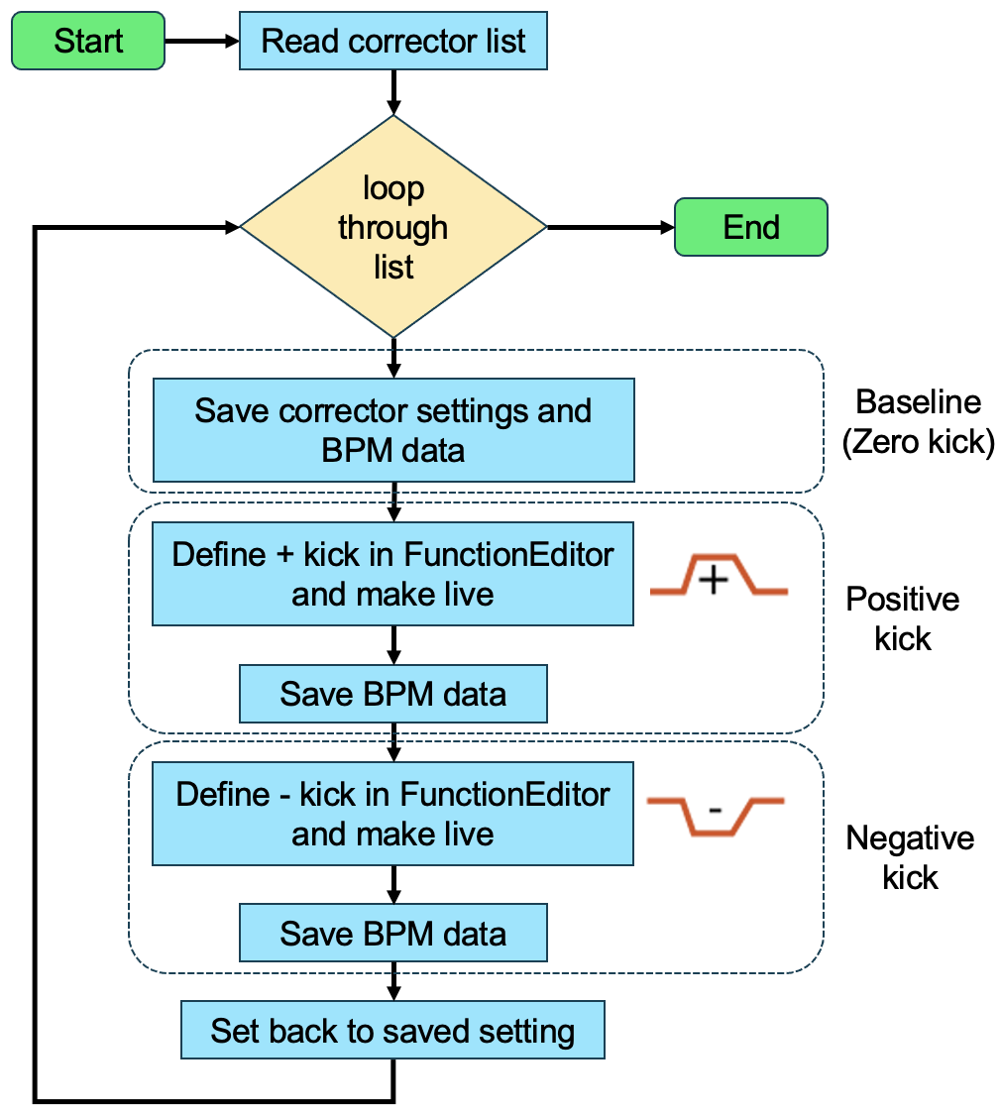
Orbit responses measurement script
Script development with Collider Accelerator Department (CAD) Controls Group
Can be easily adapted to other accelerators at BNL
Script sets three corrector settings: positive, zero, negative; and save corresponding orbits
All magnet settings (including dipoles and quadrupoles etc.) are saved for model calibration for digital-twin

Slide 23
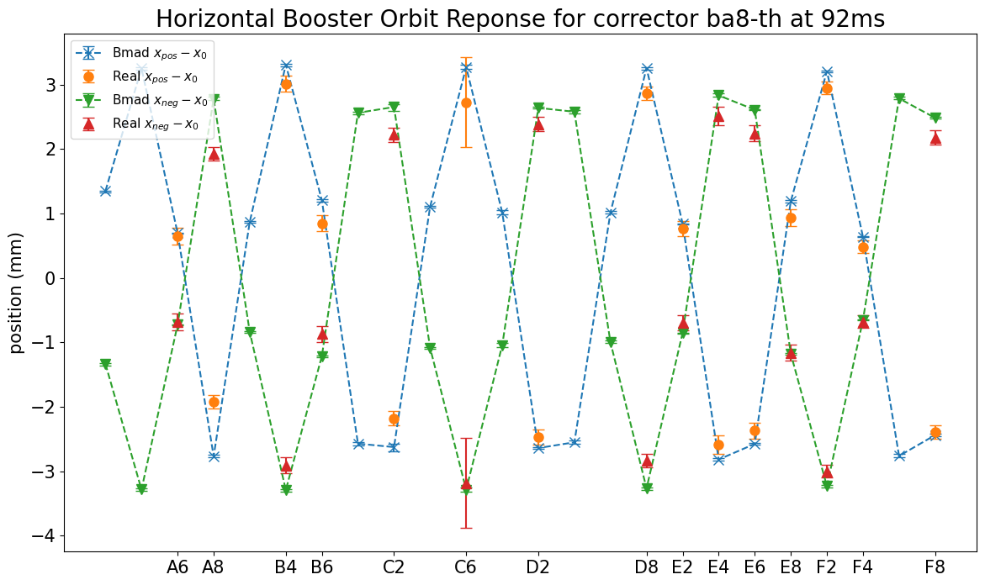
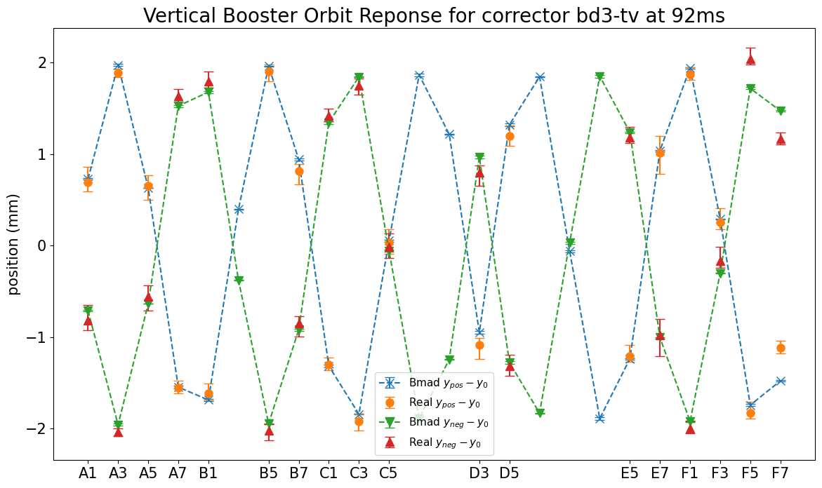
Orbit response data in AGS Booster
Good agreements between AGS Booster data and Bmad model are reached, despite some faulty BPMs
Small discrepancies (within 1 mm) beyond error bars is being investigated to better calibrate model to real machine
Goal: produce accurate real-time predictions for operators and give tuning suggestions to improve beam quality

Slide 24
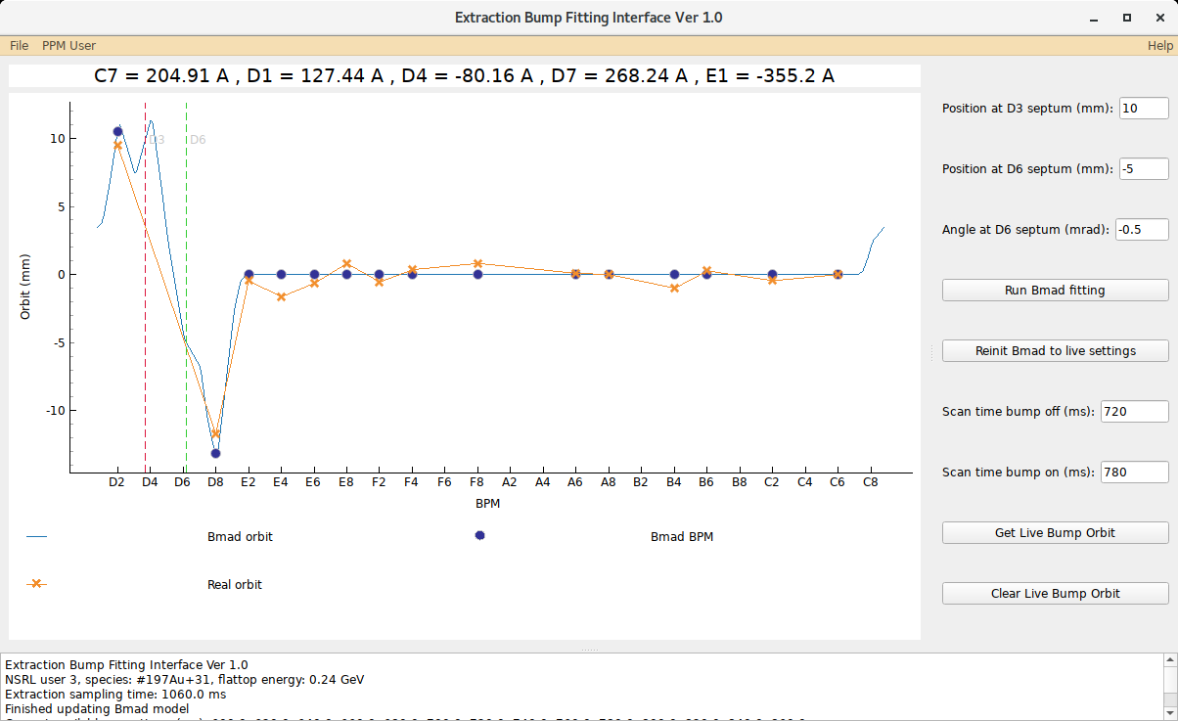
Extraction bump fitting interface
NASA Space Radiation Laboratory (NSRL) takes beam from AGS Booster via slow extraction
Current extraction bump gives large residual orbit
Goal: tune bump setting by specifying desired beam position and angle at extraction septum

Slide 25
Bunch Merging

Slide 26
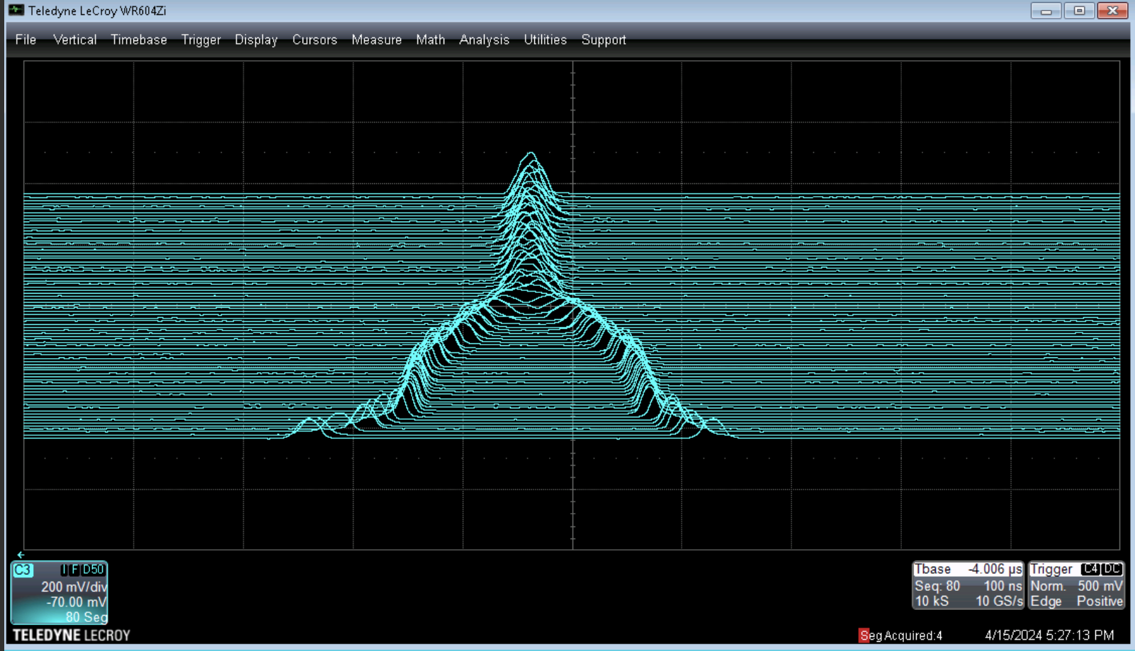
AGS bunch merging
Before transferring to AGS, beam bunch is split into 2 longitudinally to reduce the space charge effect $→$ reduce emittance $→$ improve polarization
Bunches are later merged in the AGS
Tuning requires expert knowledge, is time consuming, and tend to drift over time
Controls: RF voltages & phases
Goal: Obtain good merged bunch profile
Emittance preservation
No particle lost, Gaussian, no baby bunches
Stable final bunch profile
Merged in the center, not shifting left/right or bouncing up/down
end of merge
end of squeeze & start of merge
start of squeeze
Real mountain range data showing 2-to-1 bunch merge in AGS
Wall current monitor (WCM) generates voltage vs time signal. Each separated in time by N turns (N accelerator periods)

Slide 27
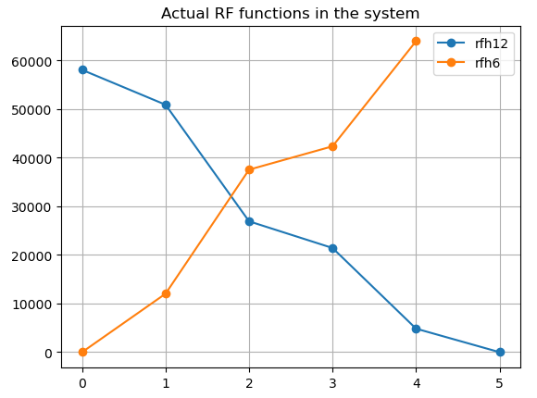
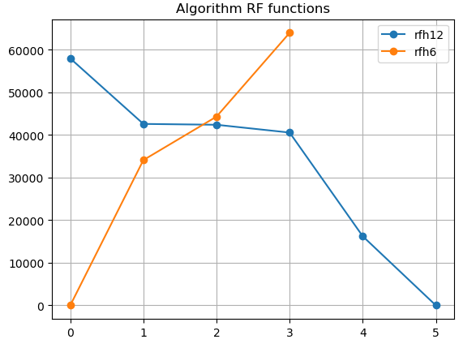
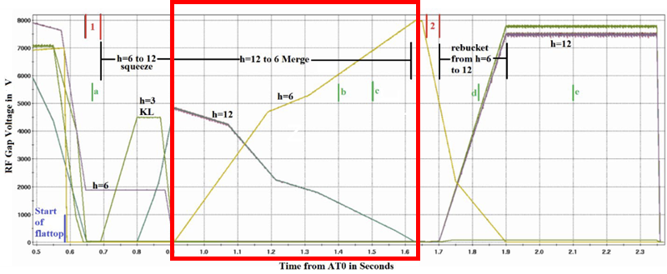
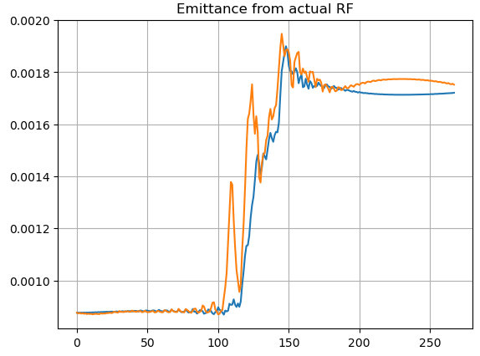
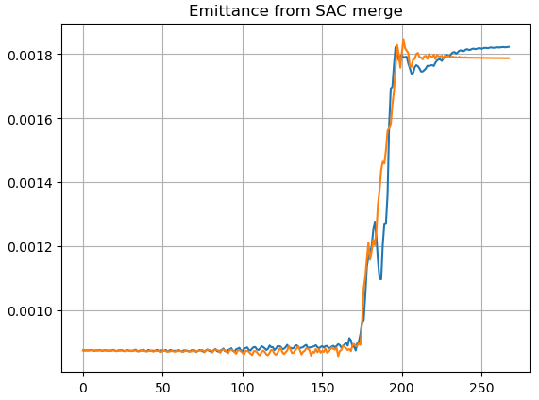
Bunch merge simulation results
Julia simulator of the bunch merge process
Soft Actor-Critic (SAC) agent to minimize emittance growth: 10,000 initial samples + 4,000 training steps
Able to learn target functions pretty well
Target functions
Agent learned functions

Slide 28
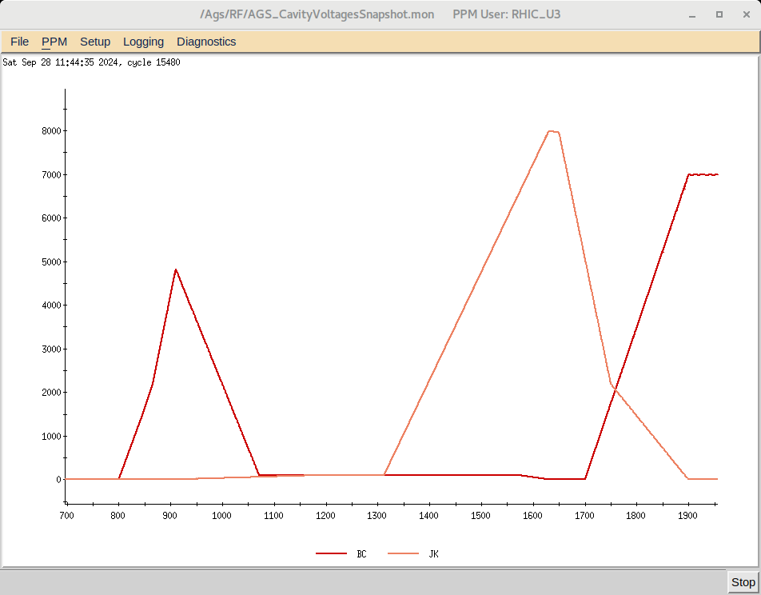
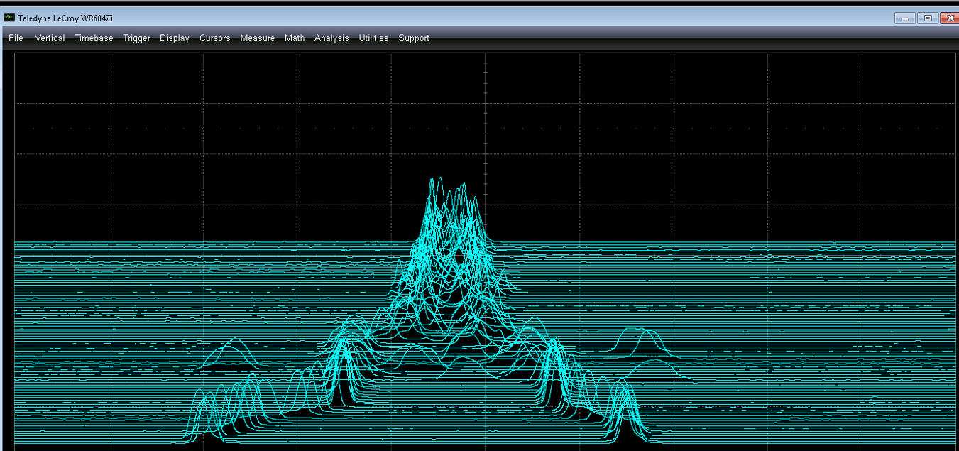
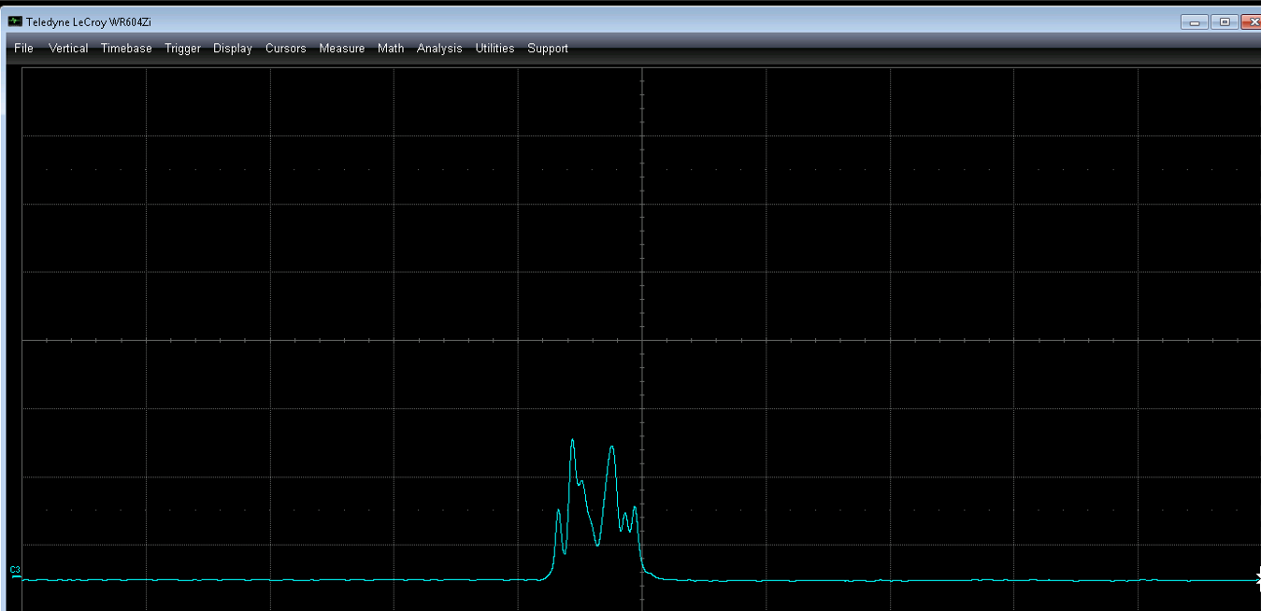
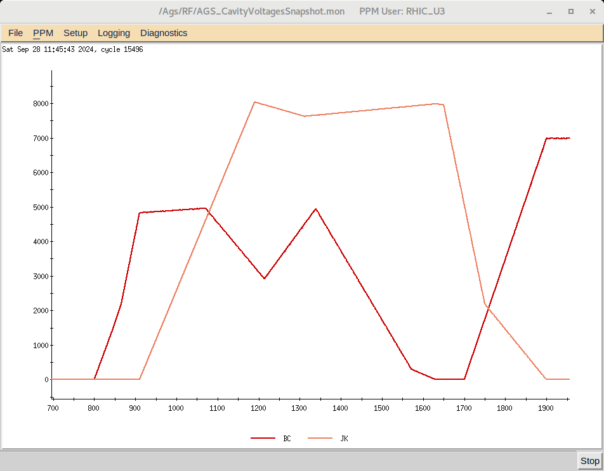
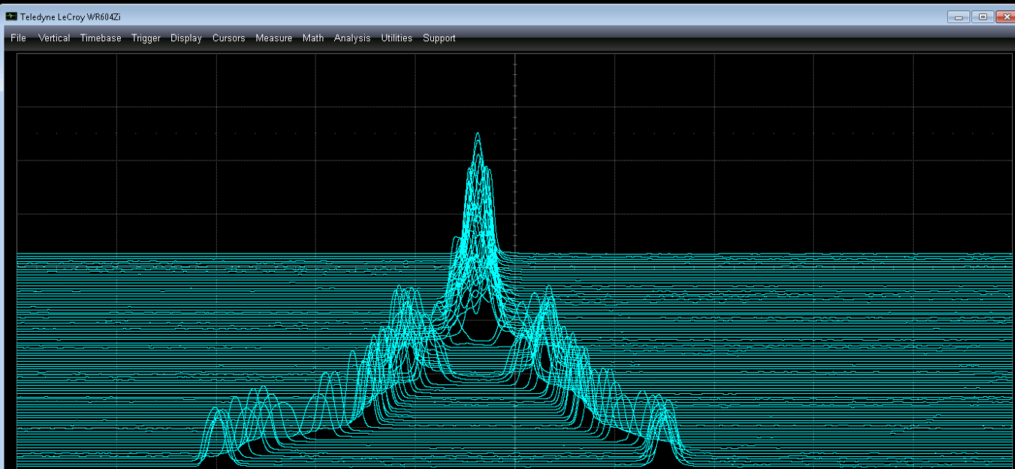
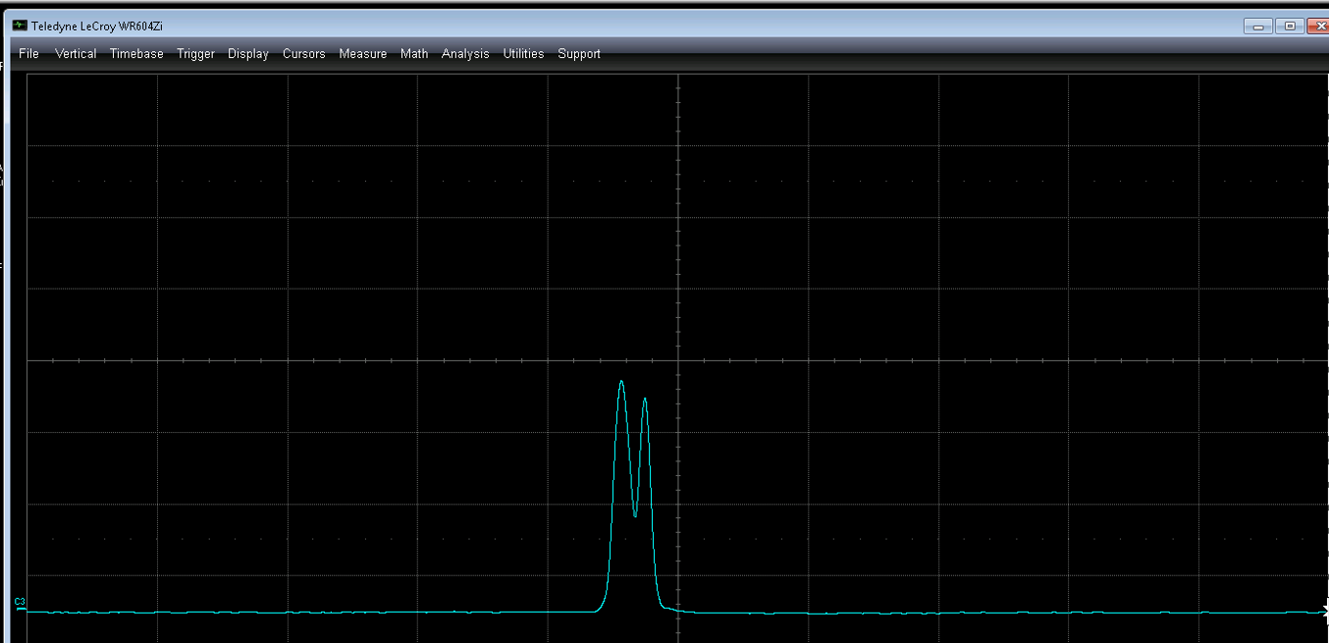
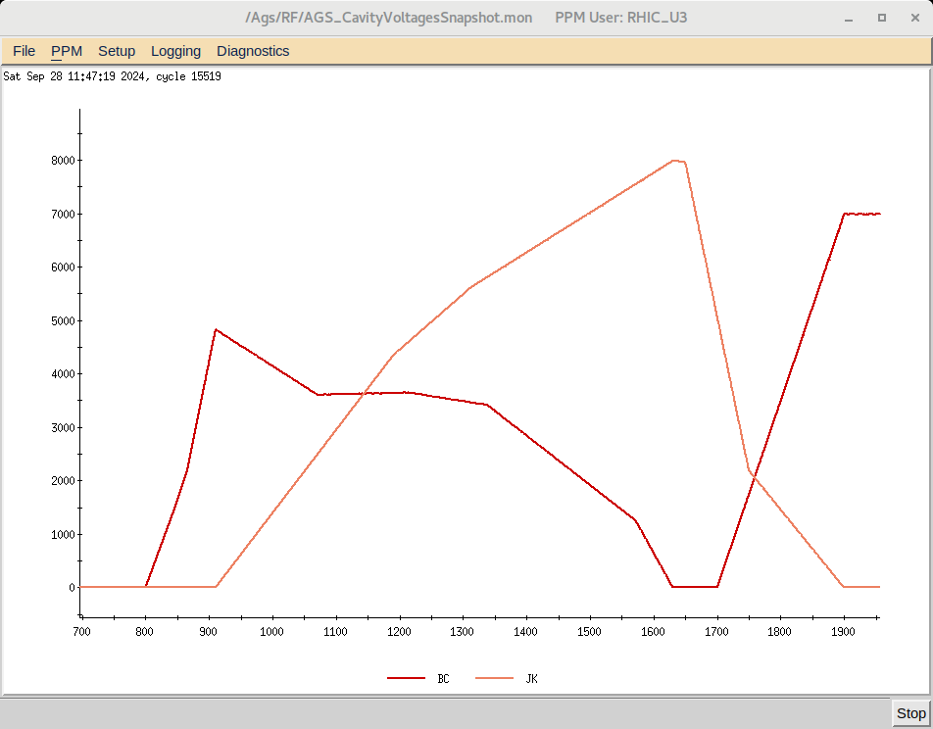
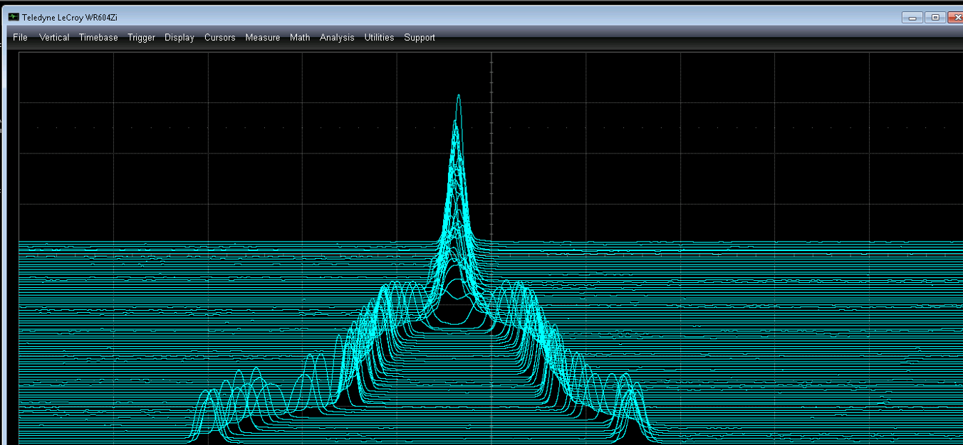
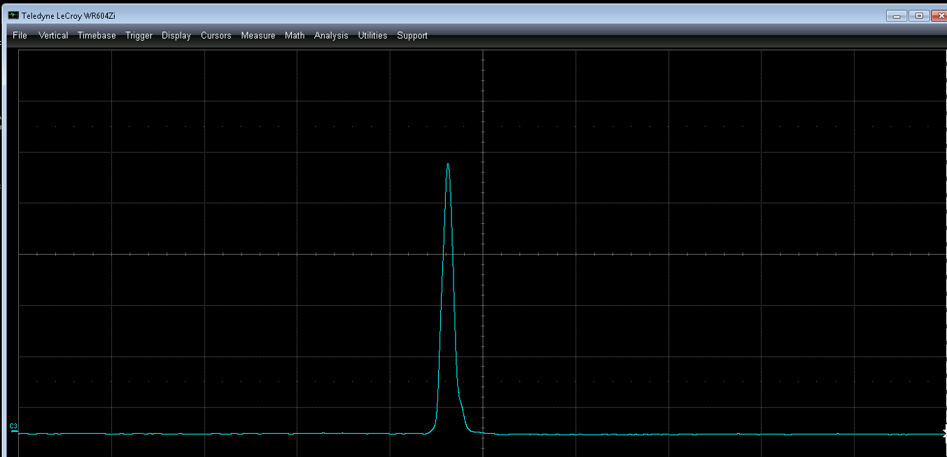
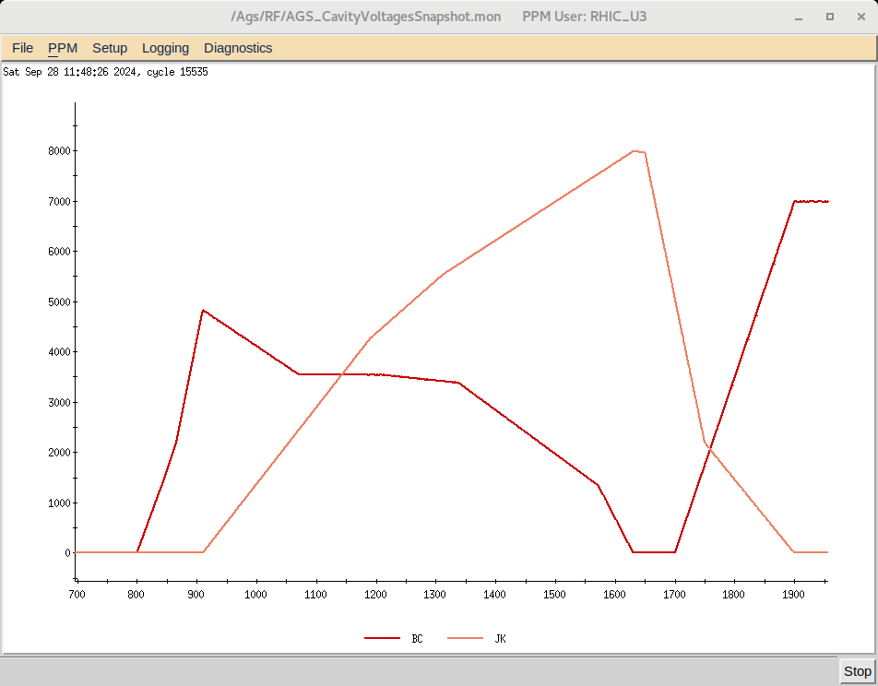
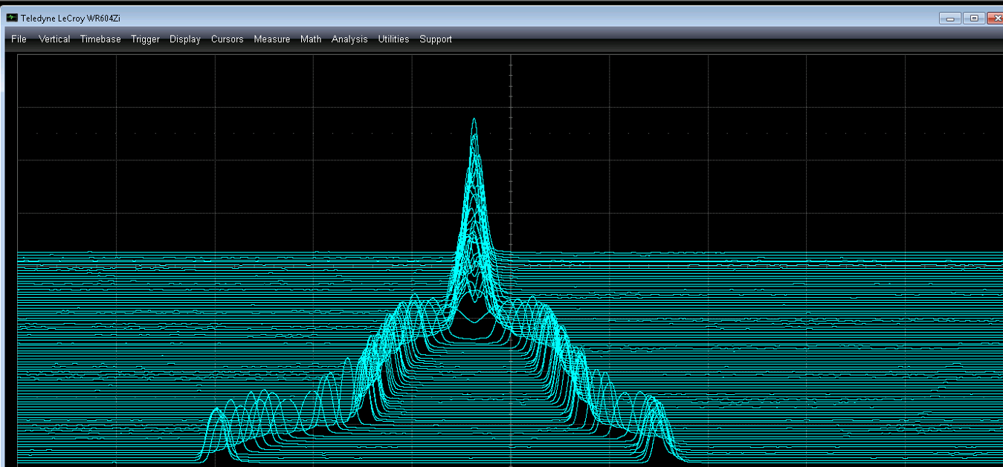
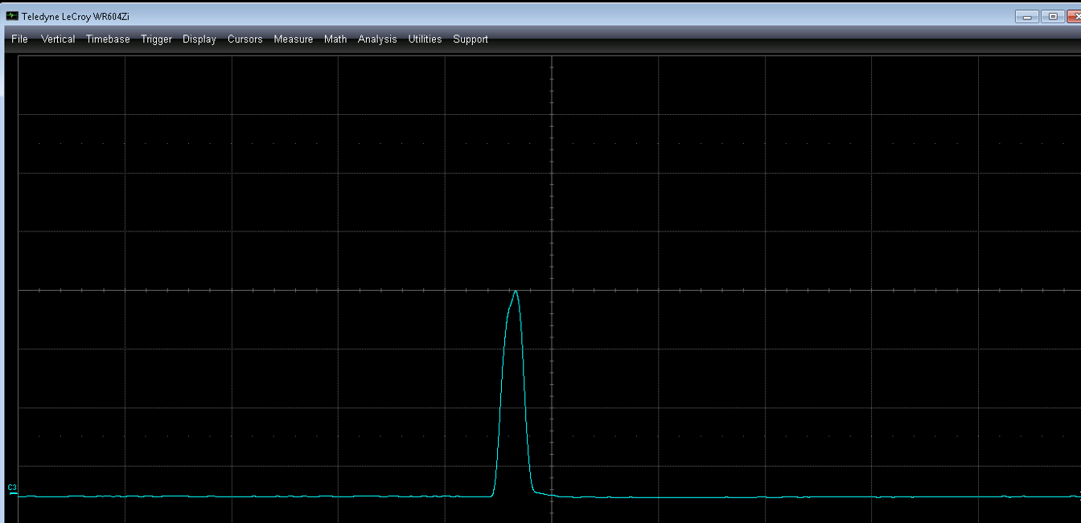
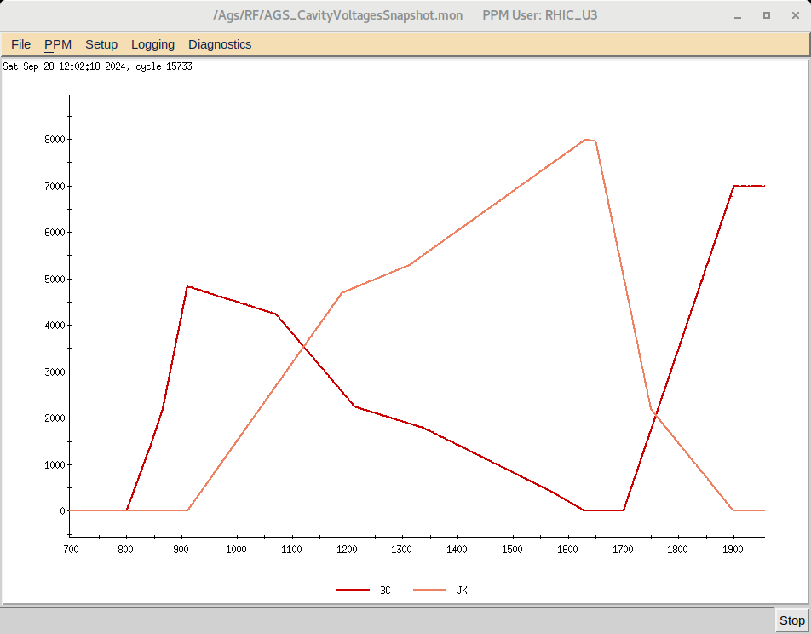
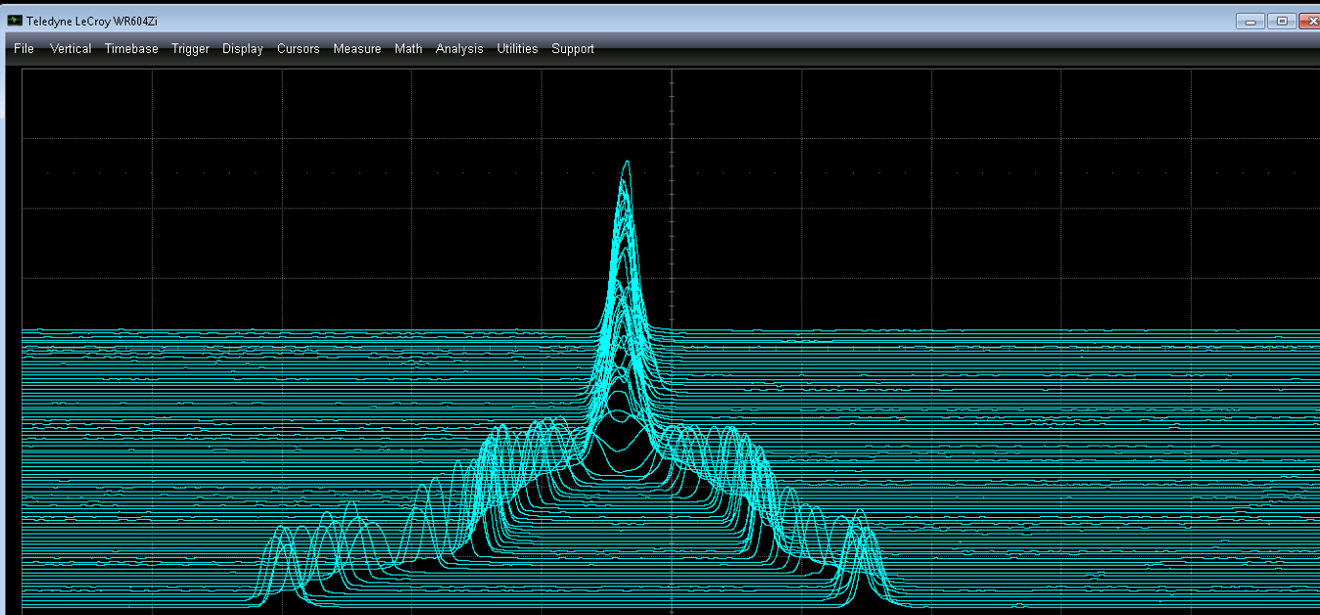
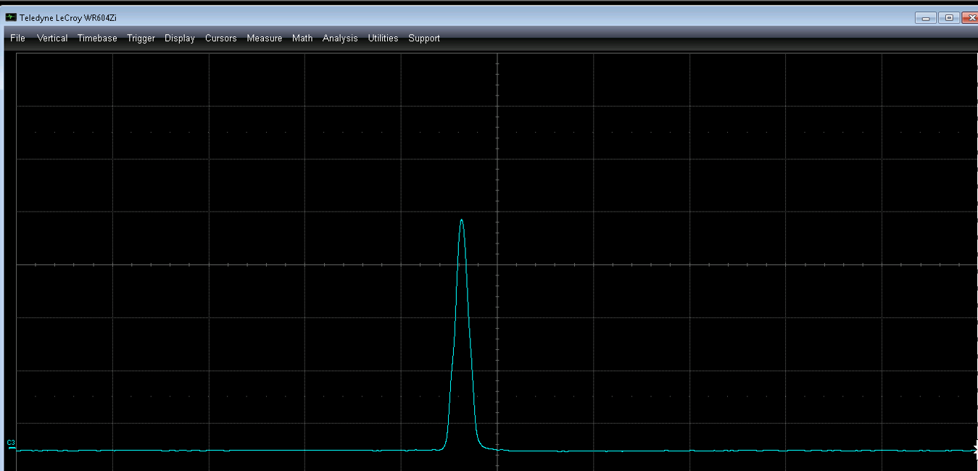
RF functions
Bunch traces
Last trace
Machine test – Julia agent
Initial
RF cavities voltages are initially set to close to 0 during merge period to intentionally decrease merge quality
RL agent trained on the Julia simulator is applied to correct RF settings
RL agent manage to find good RF settings, produce result similar to established machine optimum
1st step
2nd step
3rd step
Original

Slide 29
Electronic Logbook Upgrade

Slide 30
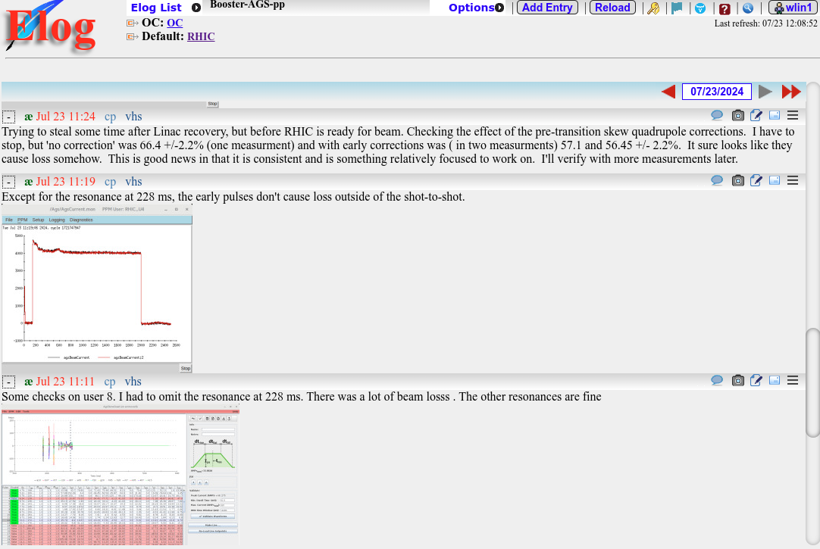
Electronic Logbook
Record information ranging from meeting notes, to do lists, and critical operations
Current search feature only provides exactly what a user enters, difficult to find related entries without the exact words
Goal: provide custom sets of entries based on users’ interactions with the system

Slide 31
Elog search upgrade workflow
Elog Database
This assumes we have ALL entries from ALL elogs (e.g., RHIC, Machine Learning, personal elogs etc.)
NLP Preprocessing
Removes any punctuation, stop words, and empty entries. Tokenize each entry & save this information.
Doc2Vec Model
Gensim Doc2Vec model trains 100 epochs. Returns the top few similar elog entries.
Classification
SKLearn MultinomialNB classifier predicts any entry’s tag.
Similar Entries
Return similar entries in order by most similar.

Slide 32
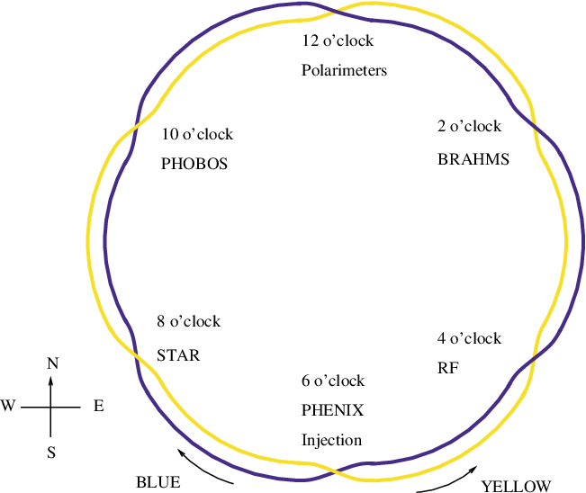
Similarity by word
Polarization
Blue
Background ~ 70%
Beta ~ 69%
Polarimeter ~ 64%
Bunch ~ 63%
Excitation ~ 63%
Coherence ~ 62%
Emittance ~ 60%
Yellow ~ 94%
RHIC ~ 87%
Ramp ~ 84%
Power ~ 84%
Run ~ 82%
Fill ~ 80%
Delay ~ 79%

Slide 33
Summary
Machine learning methods have been developed and tested at multiple experiments and accelerators at the RHIC complex
Promising results indicate that ML algorithms can be powerful tools for various optimization problems, suitable for fast and complicated tuning in real time
Digital-twin development is underway to establish accurate models for different accelerators, with a focus on the injection compound, which will remain for the EIC
Better understanding of beam behavior in the early stages of the acceleration chain
Facilitate offline development of optimization routines
Important beam qualities such as emittance and polarization will benefit from incorporation of ML algorithms in the control system

Slide 34
Publications
[1] Y. Gao, W. Lin et al., “Applying Bayesian Optimization to Achieve Optimum Cooling at the Low Energy RHIC Electron Cooling System”, Physical Review Accelerators and Beams 25, 014601 (2022).
[2] W. Lin et al., “Simulation Studies and Machine Learning Applications at the Coherent electron Cooling experiment at RHIC”, in Proc. IPAC'22, Bangkok, Thailand, Jun. 2022, pp. 2387-2390.
[3] Y. Gao et al., “Bayesian optimization calibration of ionization profile monitor at the AGS complex”, in Proc. IPAC'23, Venice, Italy, May 2023, pp. 4444-4447.
[4] W. Lin et al., “Machine learning applications for orbit and optics correction at the Alternating Gradient Synchrotron”, in Proc. IPAC'23, Venice, Italy, May 2023, pp. 4460-4463.
[5] W. Lin et al., “AGS Booster model calibration and digital-twin development”, in Proc. IPAC’24, Nashville, TN, May 2024, pp. 3449-3452.
[6] R. Roussel, W. Lin et al., “Bayesian Optimization Algorithms for Accelerator Physics”, arXiv:2312.05667 [physics.acc-ph]
[7] X. Gu et al., “Enhancing beam intensity in RHIC EBIS beamline via GPTune machine learning-driven optimization”, in Proc. IPAC'24, Nashville, TN, May 2024, pp. 118-120.
[8] J. Maldonado et al., “Towards unlocking insights from logbooks using AI”, in Proc. IPAC'24, Nashville, TN, May 2024, pp. 3579-3582.

Slide 35
Thank you!

