Slide 1
Early Science at the EIC
Search for BSM at the EIC
CFNS Workshop, July 22-24, 2025
Abhay Deshpande
Associate Laboratory Director, Nuclear and Particle Physics
EIC Science Director
July 24, 2025

Slide 2
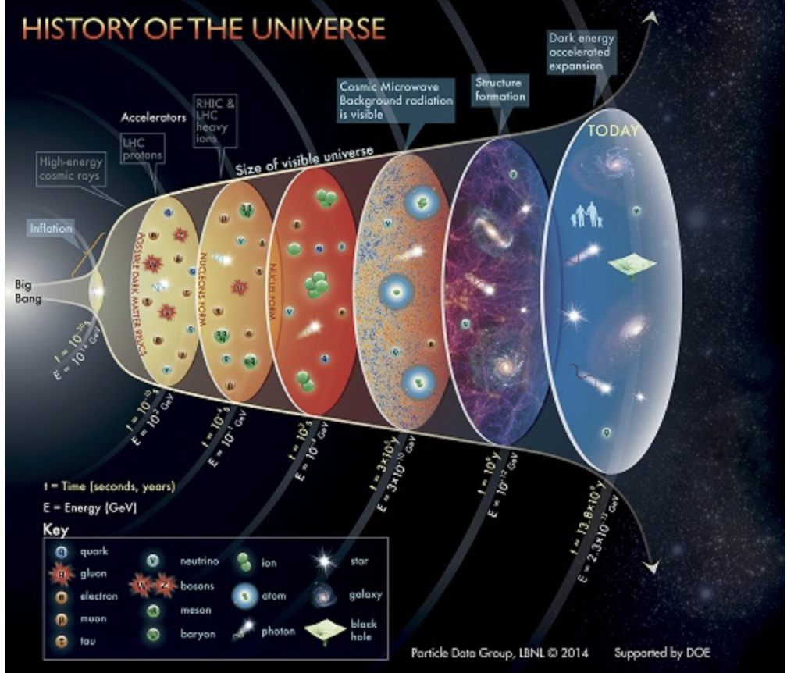
RHIC & EIC
Facilities with complementary scientific missions
To study Quark Gluon Plasma and its properties – early universe
How do the quarks and gluons interact and form protons, neutrons and all the nuclei (the visible universe)
  Understanding the origin of proton’s spin, mass, and critical role of gluons .
RHIC
EIC
Two accelerator facilities (current & future) colliding different particles but with a common vision to understand the origin & emergence of the visible matter universe

Slide 3
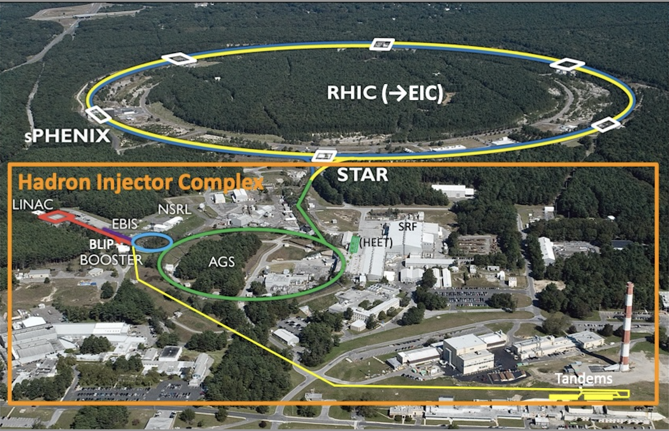
Relativistic Heavy Ion Collider (RHIC)
Basic scientific research woven with direct benefits to society
Uniquely flexible and
only hadron collider in
US for exploration of
Quark Gluon Plasma
and proton (spin) structure
Injectors also used for
application programs:
LINAC: Brookhaven Linac Isotope Producer: (medical and other Isotope production)
Booster NASA Space Radiation Lab for space radiation studies
Tandem for industrial/academic users
R&D for future facilities
and application
sources, beam cooling, polarized beams, …

Slide 4
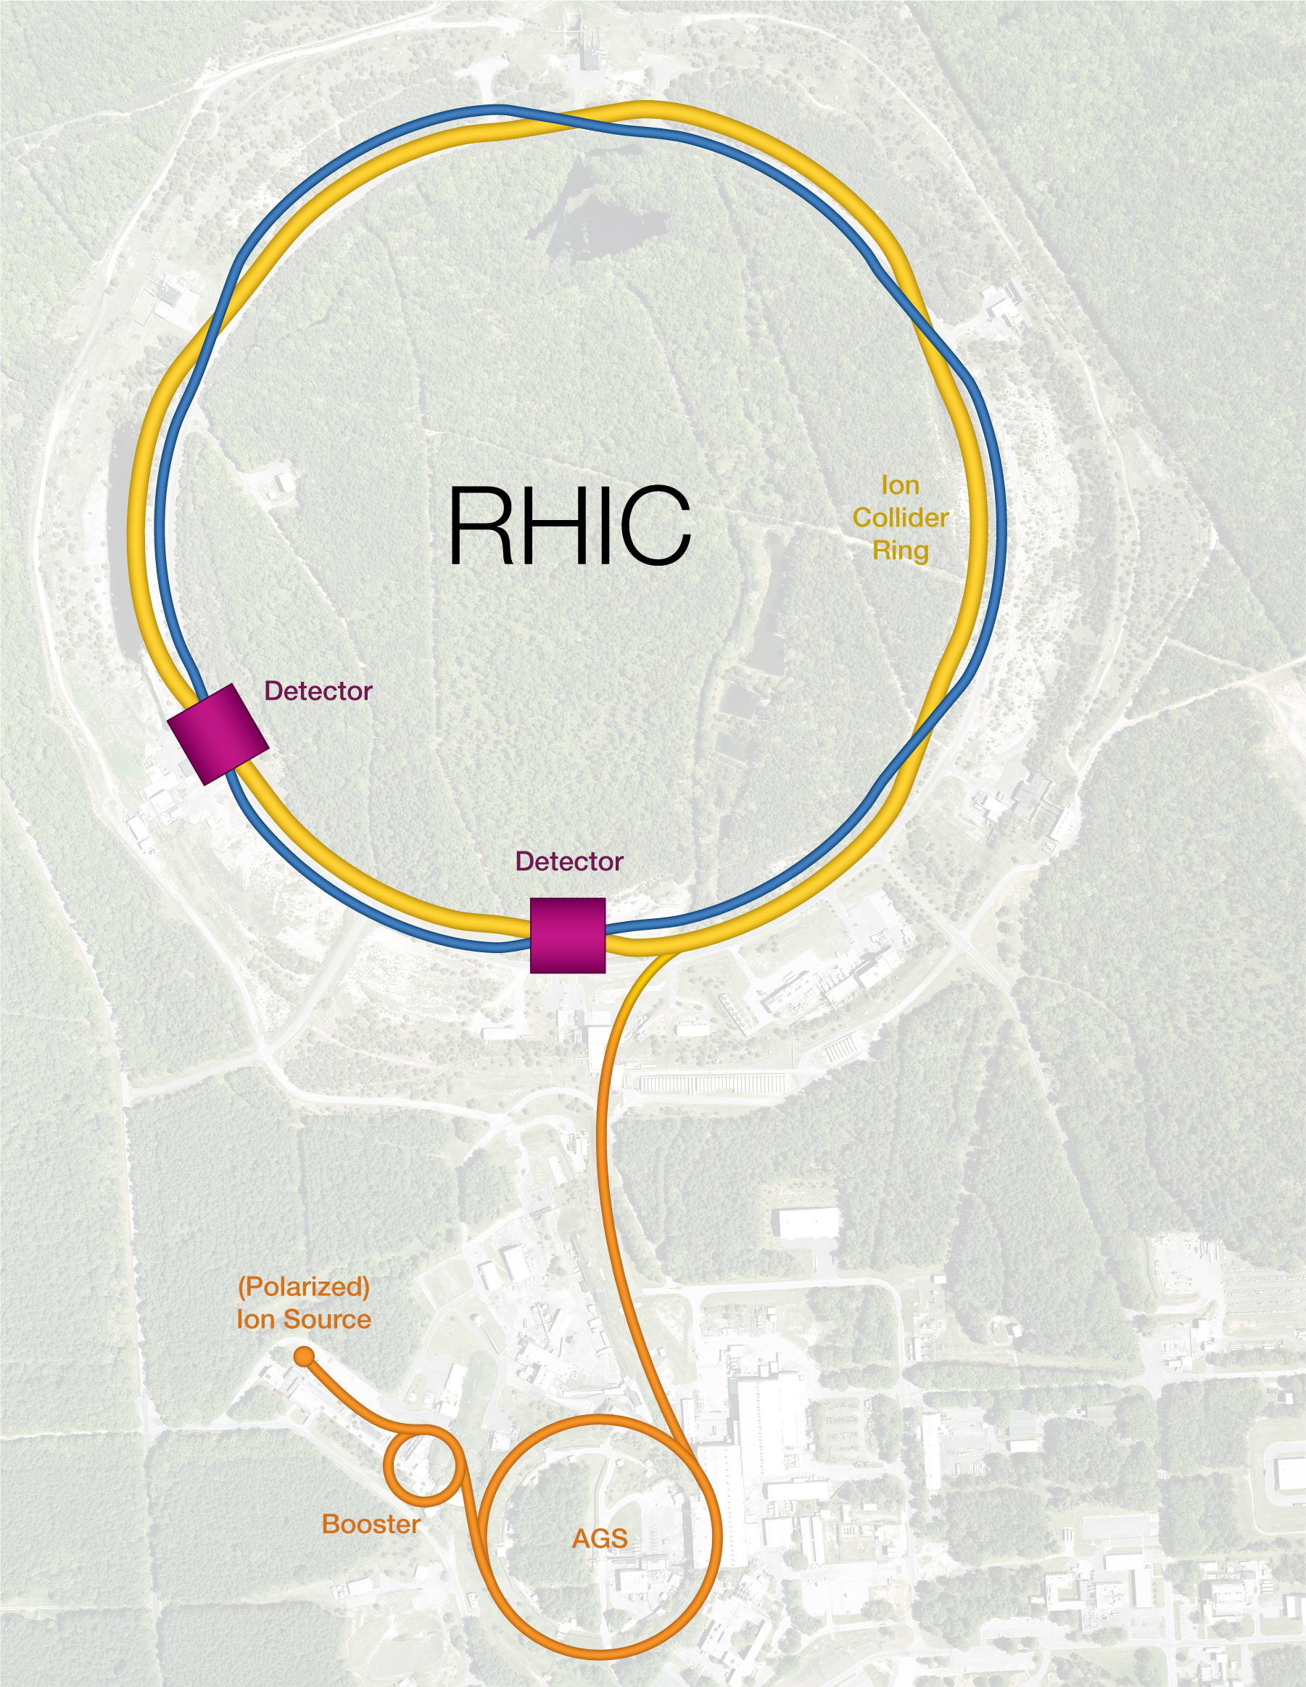
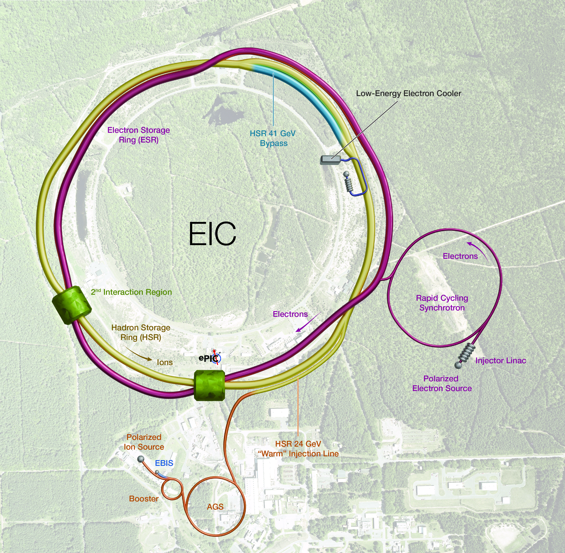
Transition from RHIC to Electron Ion Collider (EIC) in 2026
Re-Use the existing tunnel
Minimal modification to the hadron beam complex (yellow)
New electron beam facility
Build on the ~$2B investment

Slide 5
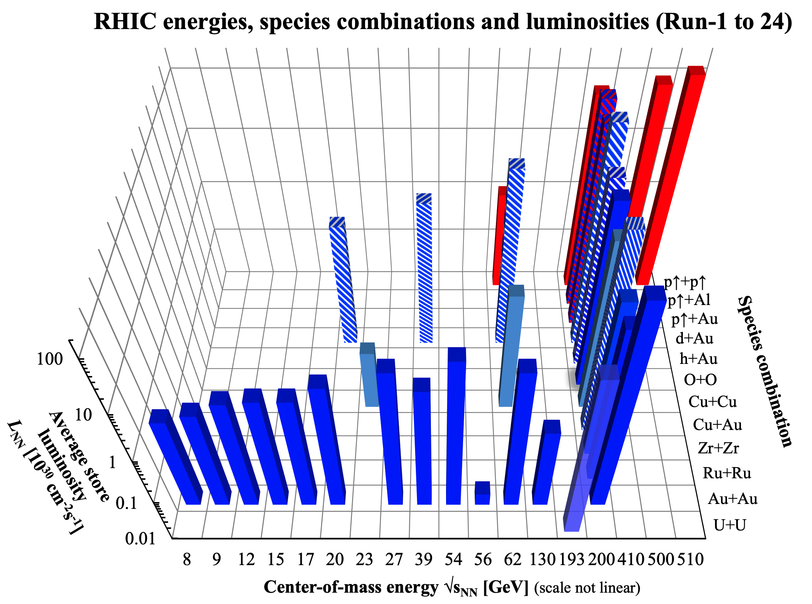
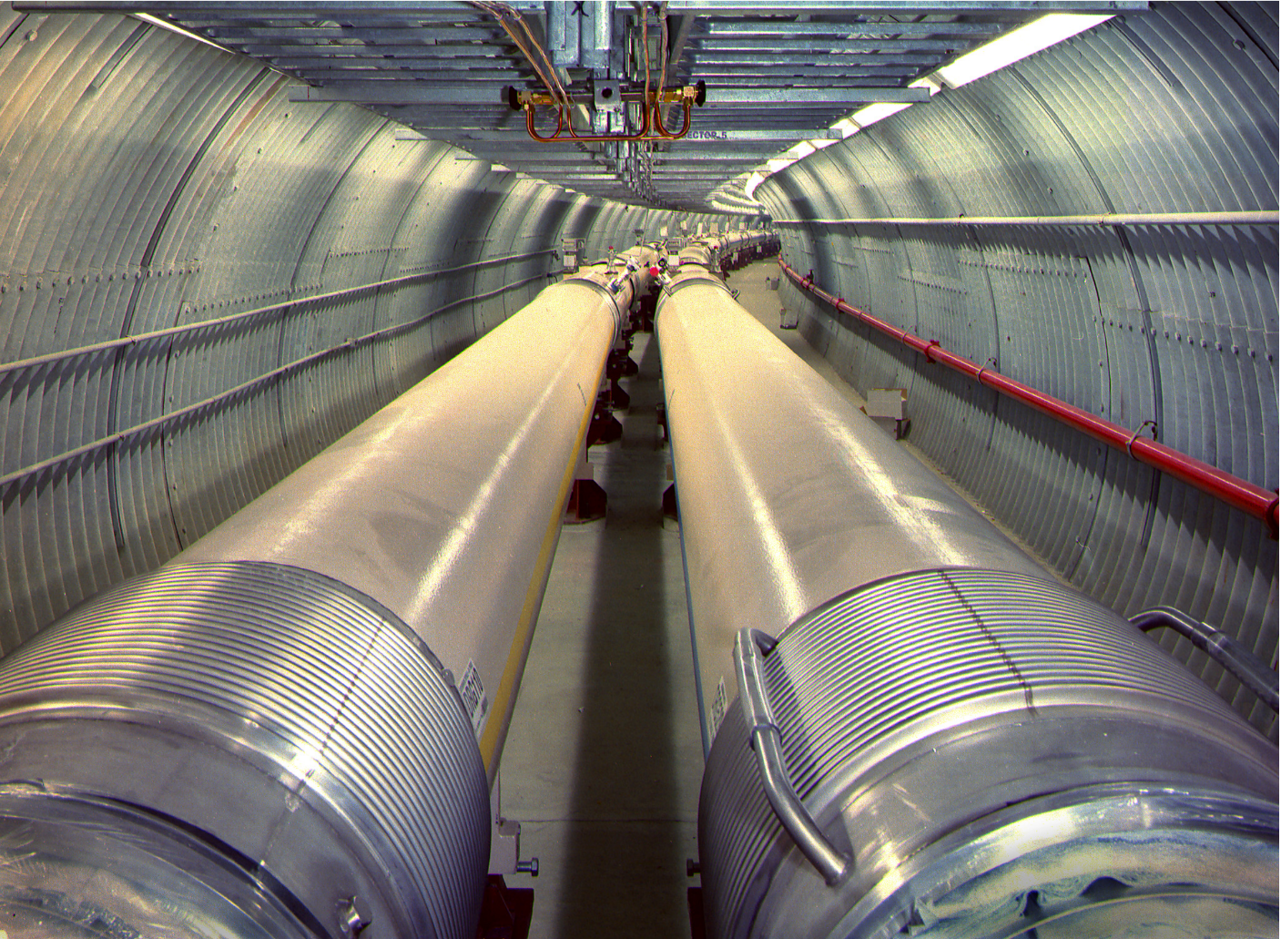
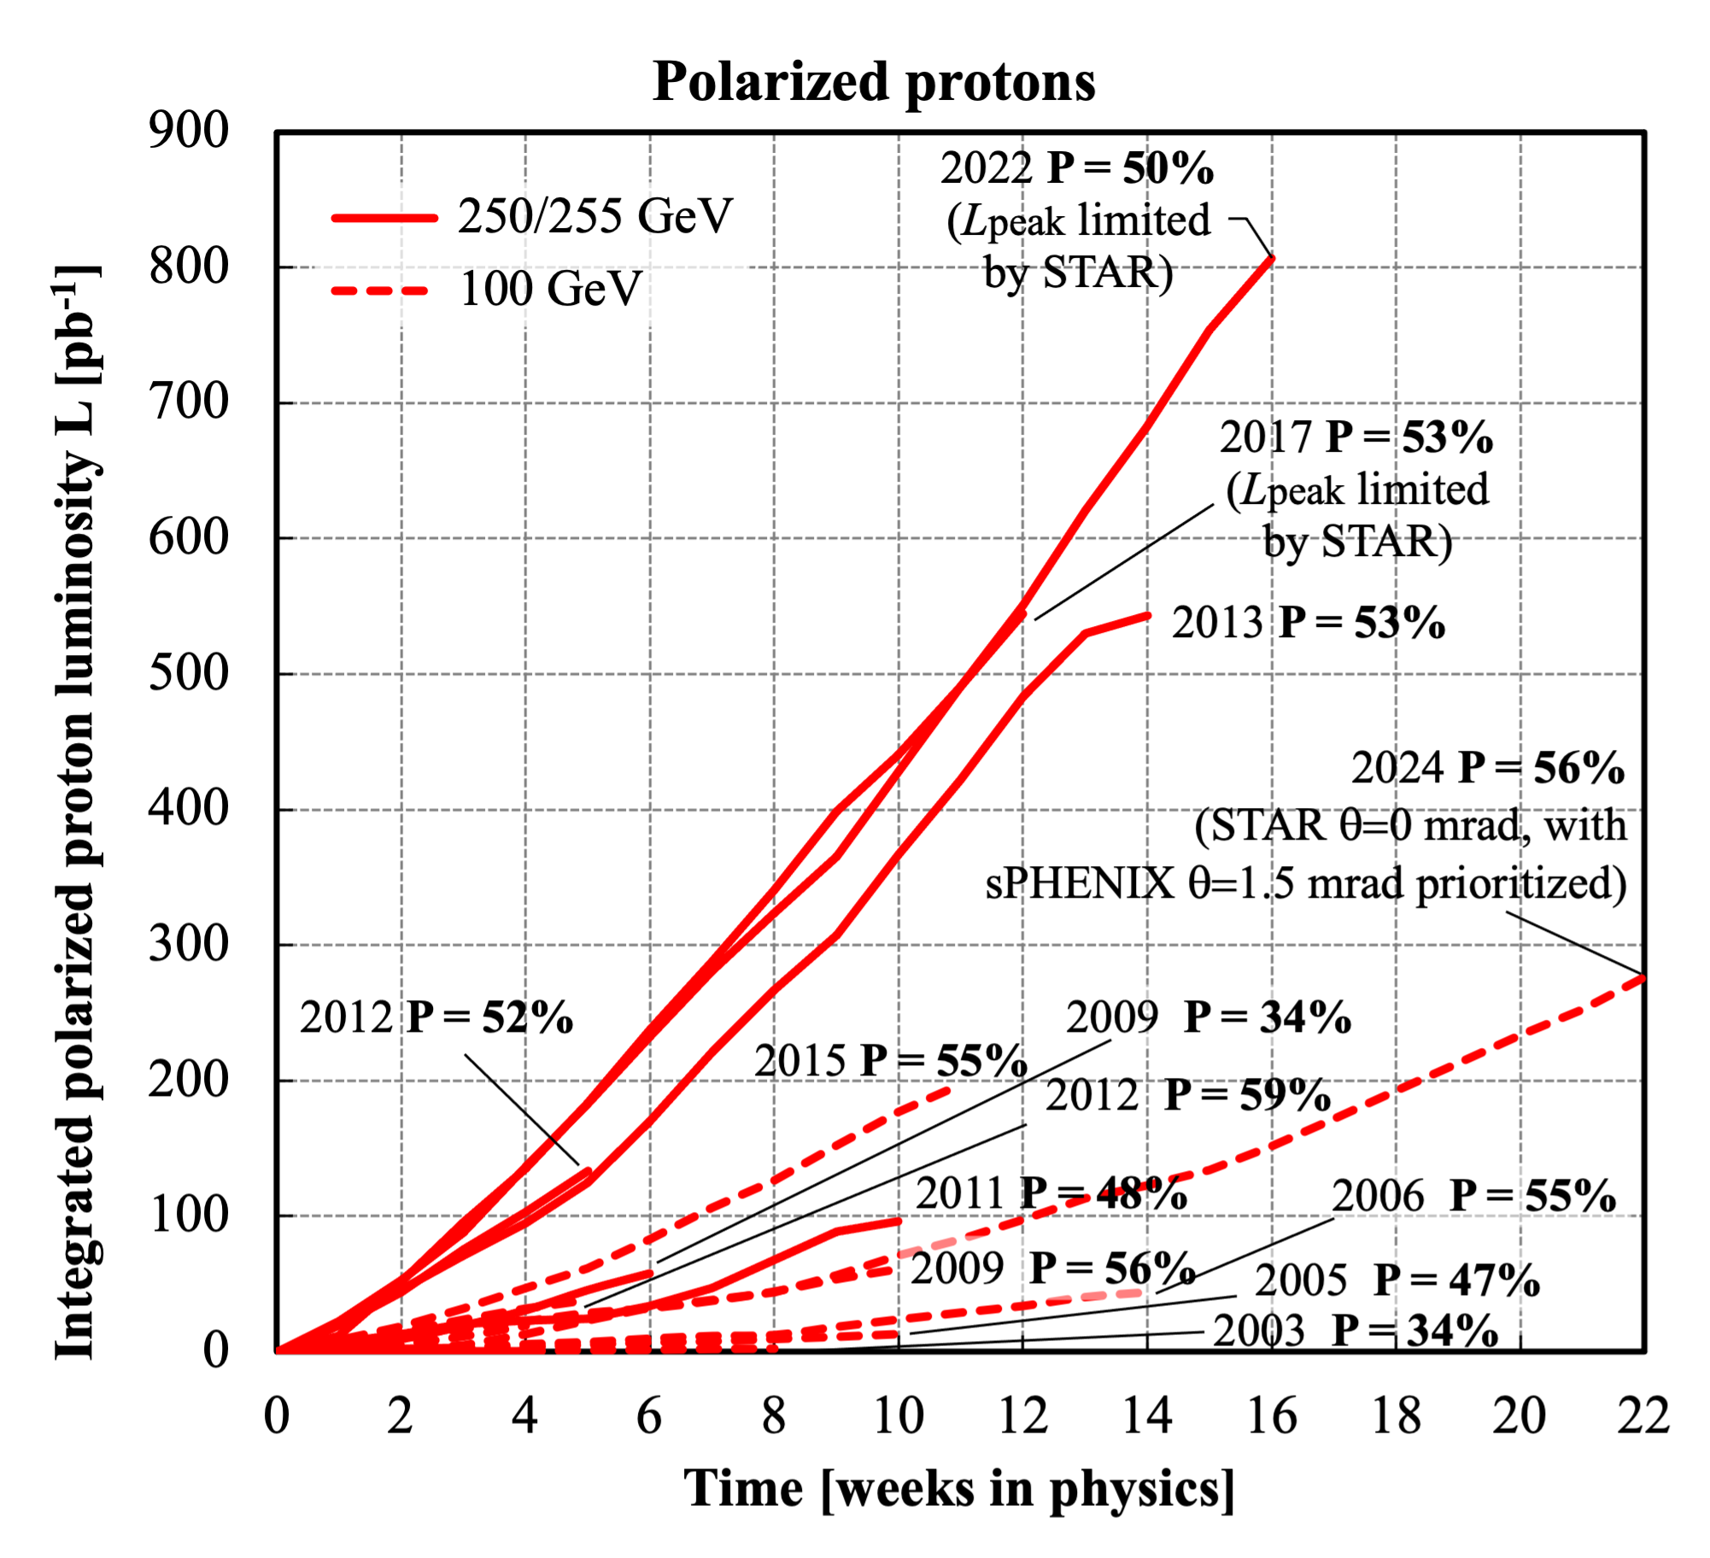
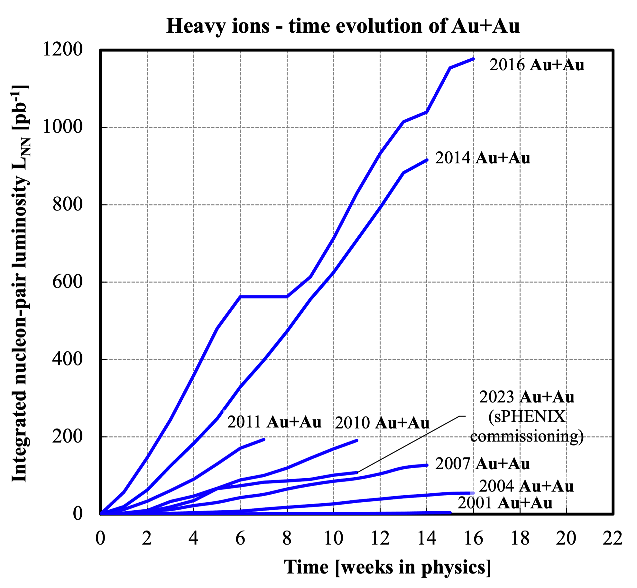
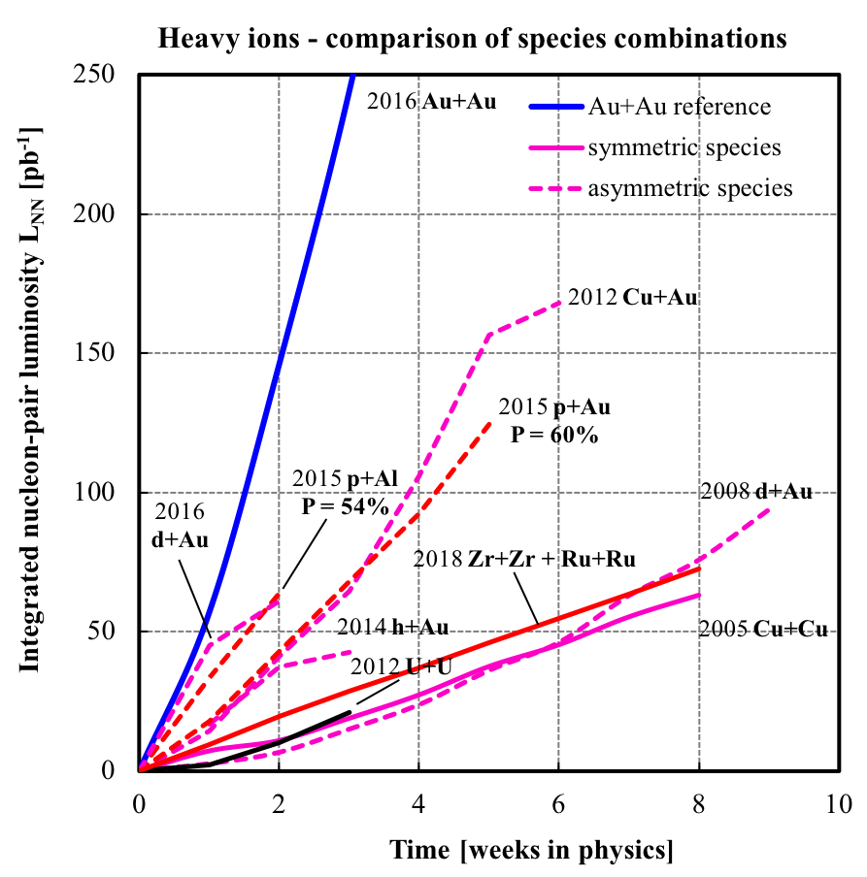
The Most Versatile Collider Ever Built

Slide 6
Vision:
The Electron Ion Collider
BNL is fully committed the common vision of realizing a high-luminosity, high-energy polarized electron ion collider, as early as it is fiscally and technically possible

Slide 7
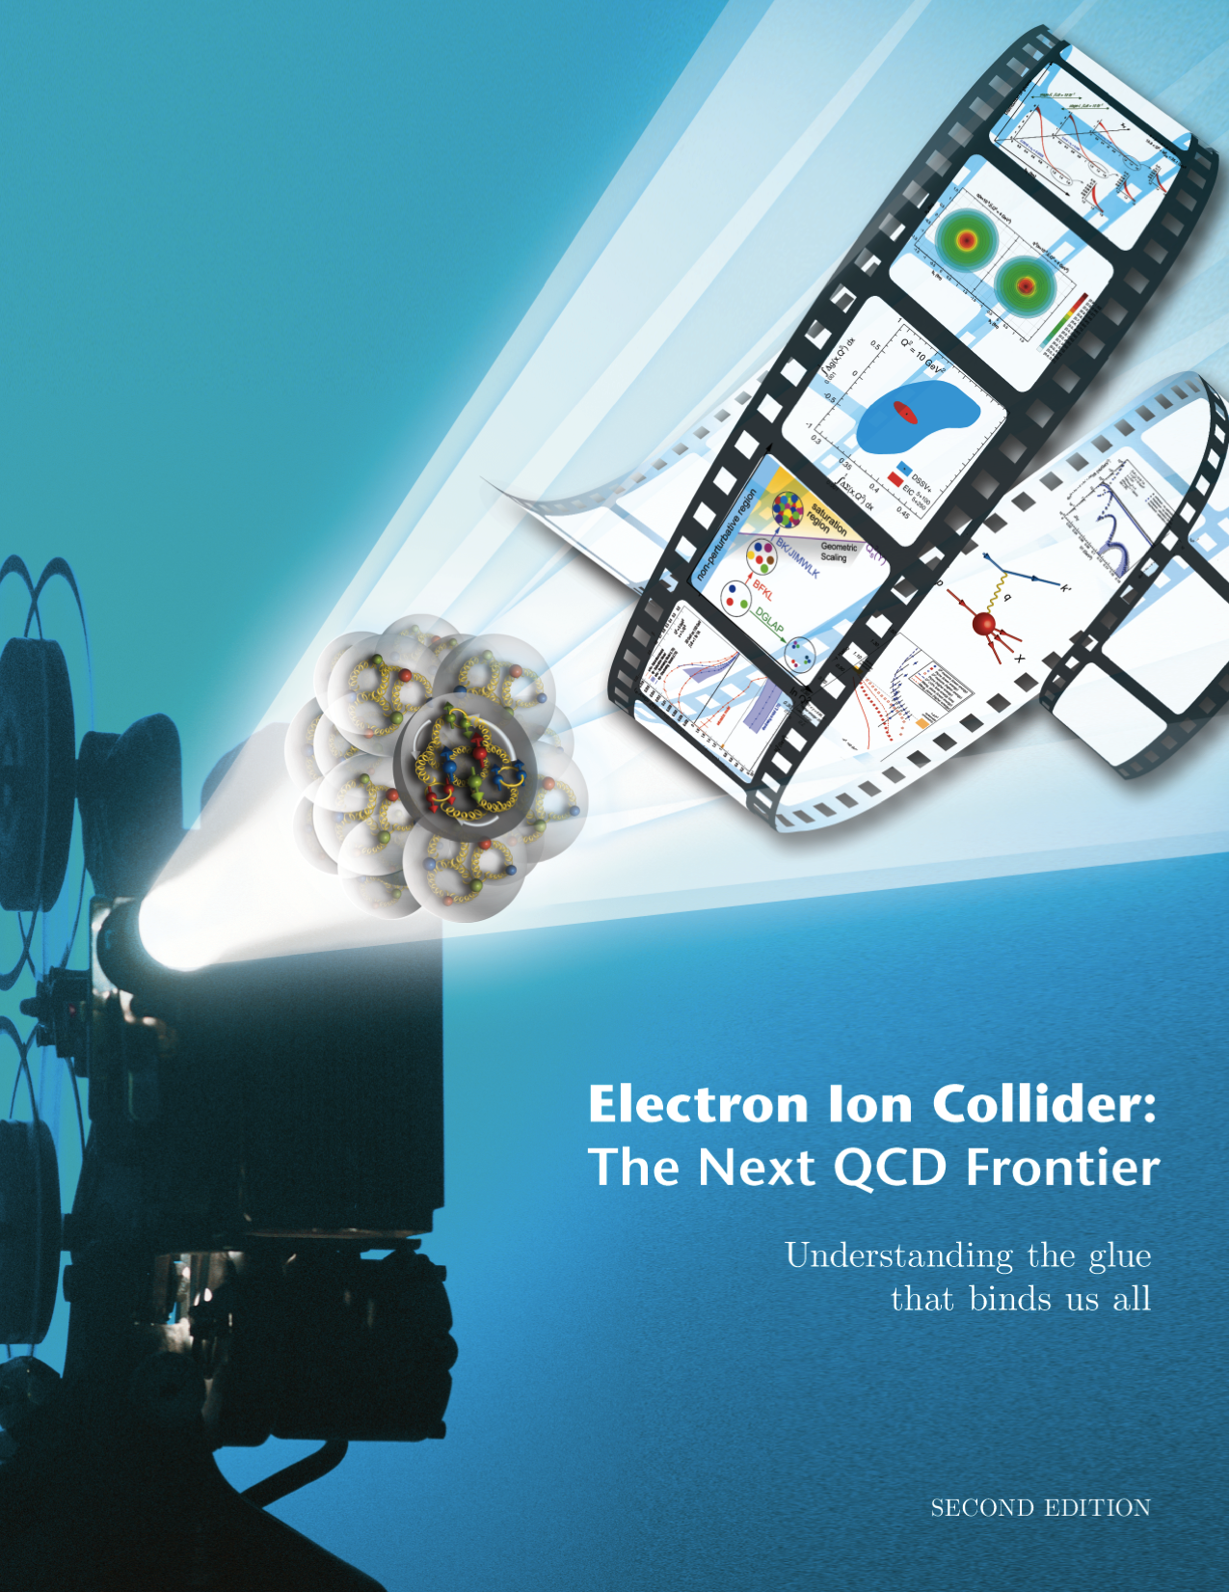
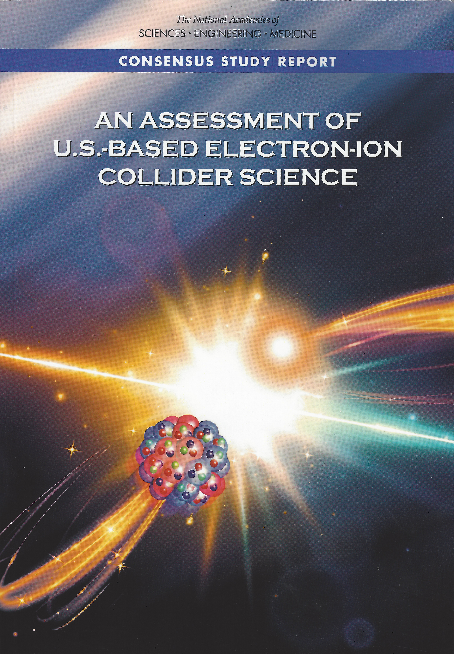
National Academy’s Assessment, July 2018
Electron Ion Collider Science:
Origin of nucleon spin & 3D imaging of partons
Understanding the origin of mass of the visible universe
Intense gluon fields ➔ novel gluonic matter?
Machine Design Parameters:
High luminosity: up to 10³³-10³⁴ cm⁻²sec⁻¹
  a factor ~100-1000 times HERA
Broad range in center-of-mass energy: ~20-100 GeV upgradable to 140 GeV
Polarized beams e-, p, and light ion beams with flexible spin patterns/orientation
Broad range in hadron species: protons…. Uranium
Up to two detectors well-integrated detector(s) into the machine lattice
EIC science:
compelling, fundamental
and timely

Slide 8
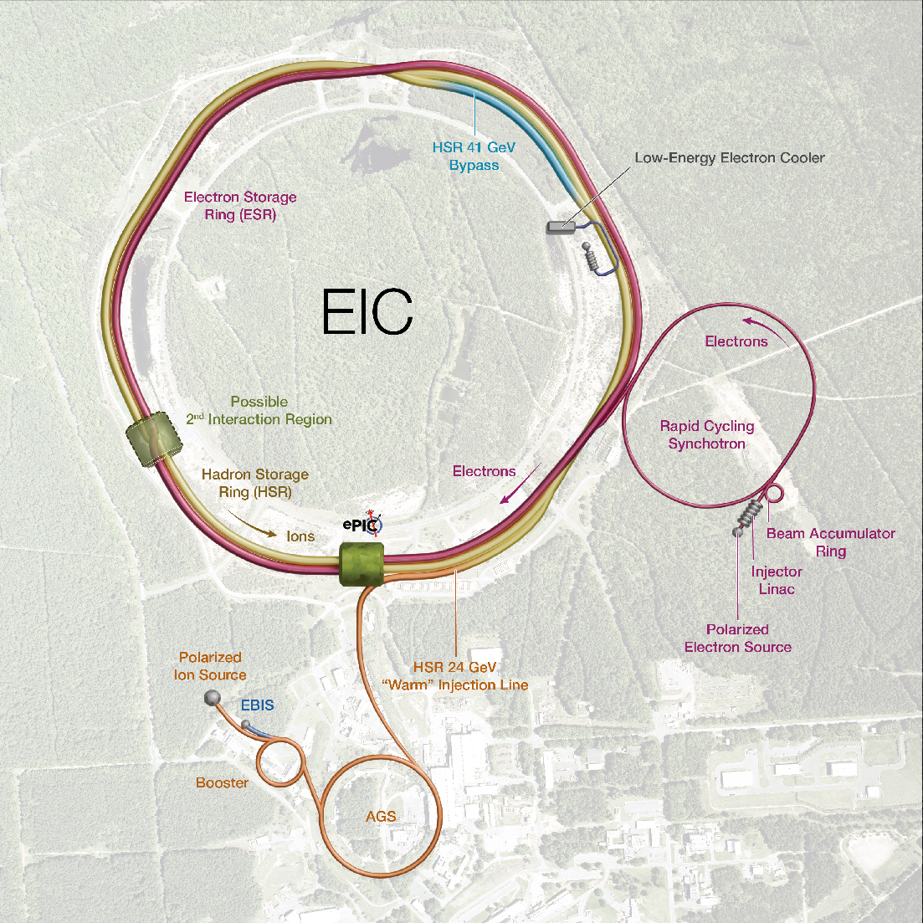


Present EIC Concept (2025)
Ultimate EIC Performance Parameters:
High Luminosity: L= 10³³ – 10³⁴cm⁻²sec⁻¹
Highly Polarized Beams: 70%
Large Center of Mass Energy Range: Ecm = 28 – 140 GeV
Large Ion Species Range: protons – Uranium
Large Detector Forward Acceptance and Low-Background Conditions
Possibility to Implement a Second Interaction Region (IR)
Accelerator Status at a glance:
Polarized ion/proton source
Ion injection and initial acceleration systems – Linac (200 MeV), Booster (1.5 GeV), AGS (25 GeV)
Hadron Storage Ring (40-275 GeV) – HSR
Electron Pre-Injector (750 MeV linac)
Beam Accumulation Ring (750 MeV) – BAR
Electron Rapid Cycling Synchrotron (0.75 GeV – top energy) – RCS
Electron Storage Ring (5 GeV – 18 GeV) – ESR
Interaction Region(s) – IR
Hadron Cooling System
Protons: ~40 – 275 GeV
Electrons: 5 – 18 GeV

Slide 9
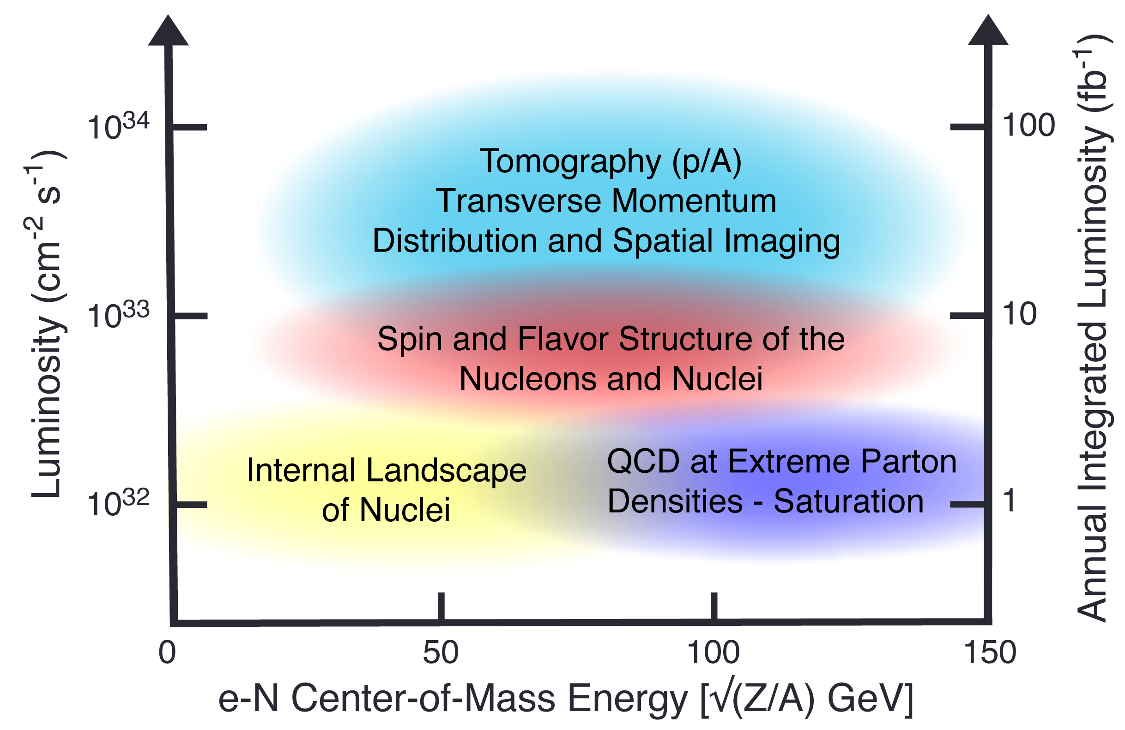
Summary: EIC Physics:
CM vs. Luminosity vs. Integrated luminosity

Slide 10
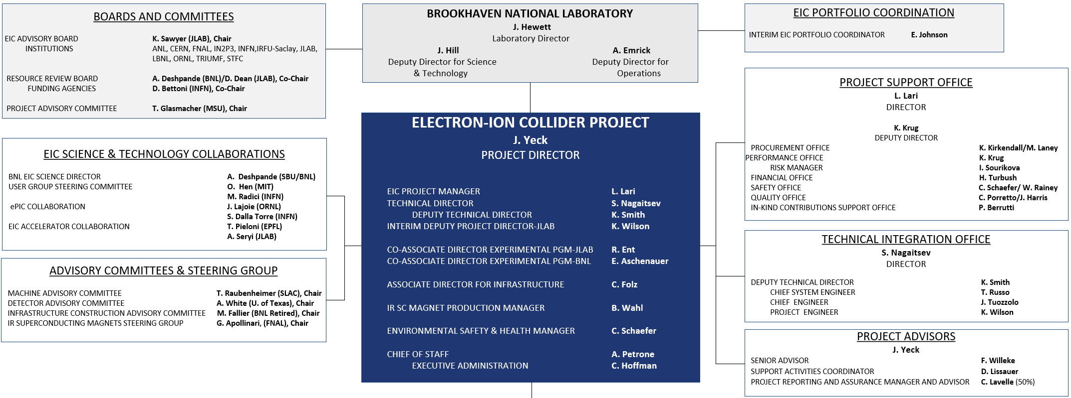
EIC Project Delivery Organization
Leadership of subprojects superimposed on the existing EIC project organization
Significant technical scope in Infrastructure, Accelerator Systems, RF, Cryogenics delivered in multiple subprojects.
Stronger technical integration effort will be required.

Slide 11
EIC Project Delivery Requirements
Requirements:
EIC is a single, integrated line-item project.
Subprojects have well-defined deliverables, interfaces, and KPPs.
Subprojects enable start of the EIC science program.
Subproject plans are consistent with DOE annual funding guidance.
EIC Line-Item Project Scope:
Accelerator Storage Rings
Electron Injector
Interaction Region (IR) Integration – SC Magnets, RF Crab Cavities
Detector (ePIC)
Start Science Program
Energy and Luminosity Ramp-up (CD-4)

Slide 12
Project Delivery Strategy
Project Delivery Strategy: Deliver the full EIC facility scope as part of the line-item construction project using subprojects and the phased completion of the EIC project scope. The strategy enables the start of the EIC science program during collider commissioning and for the concurrent completion of the full capability required to meet the DOE Mission Need.
Global Project Integrated Support, CD-3A, CD-3B, Commissioning …. (L. Lari)
 | NYS Infrastructure Project (C. Folz)
First SP |  | Accelerator Storage Rings – Infrastructure, HSR, ESR, Install (C. Folz, SPM)
 |  |  | Detector, Integration, Install (R. Ent and E. Aschenauer, POCs)
 |  |  |  | IR SC Magnets, Crab Cavities, Install (S. Nagaitsev, POC)
 |  |  |  | Electron Injector – Infras., LINAC, RCS, Install (Q. Wu, POC)
Last SP |  |  |  |  |  |  | Energy and Luminosity Ramp-up (K. Wilson, POC)

Slide 13
EIC Construction Project
CD-3x & NYS Scope | CD-3A, Long Lead Procurement | 3A: ~40% scope in ASR; ~6% IR; 54% in DET
 | CD-3B, Long Lead Procurement | 3B: ~75% scope in ASR; 25% DET
 | NYS Civil Construction Project | Site Preparation work and construction of Service Buildings and support systems related to the ASR subproject.
Initial Science Program Scope | Accelerator Storage Rings (ASR) | Hadron Storage Ring Modifications, Electron Storage Ring (10 GeV) and related infrastructure.
x | Detector (DET) | ePIC Detector including SC magnet, detector systems, and integration and installation.
 | Interaction Region (IR) | Interaction Region including the SC magnets and 197 MHz crab cavities.
x | Electron Injectors (EIN) | Electron Injectors (LINAC, BAR & RCS @ 10 GeV) and related infrastructure.
Full Scope | Energy and Luminosity Ramp-up (ELR) | Accelerator scope required to increase Energy (18GeV e-, RCS SRF & Cryo, 394 MHz crab cavities, 41 GeV by-pass, ESR and HSR RF amplifiers, etc.)
PM & CX | Project Management and Global Services (PMG) | Project and Technical integration support to entire project and integration and beam commissioning.
In-Kind Contribution Plan: 5% or more of the accelerator scope and 30% of the detector scope. New accelerator opportunities.
13

Slide 14
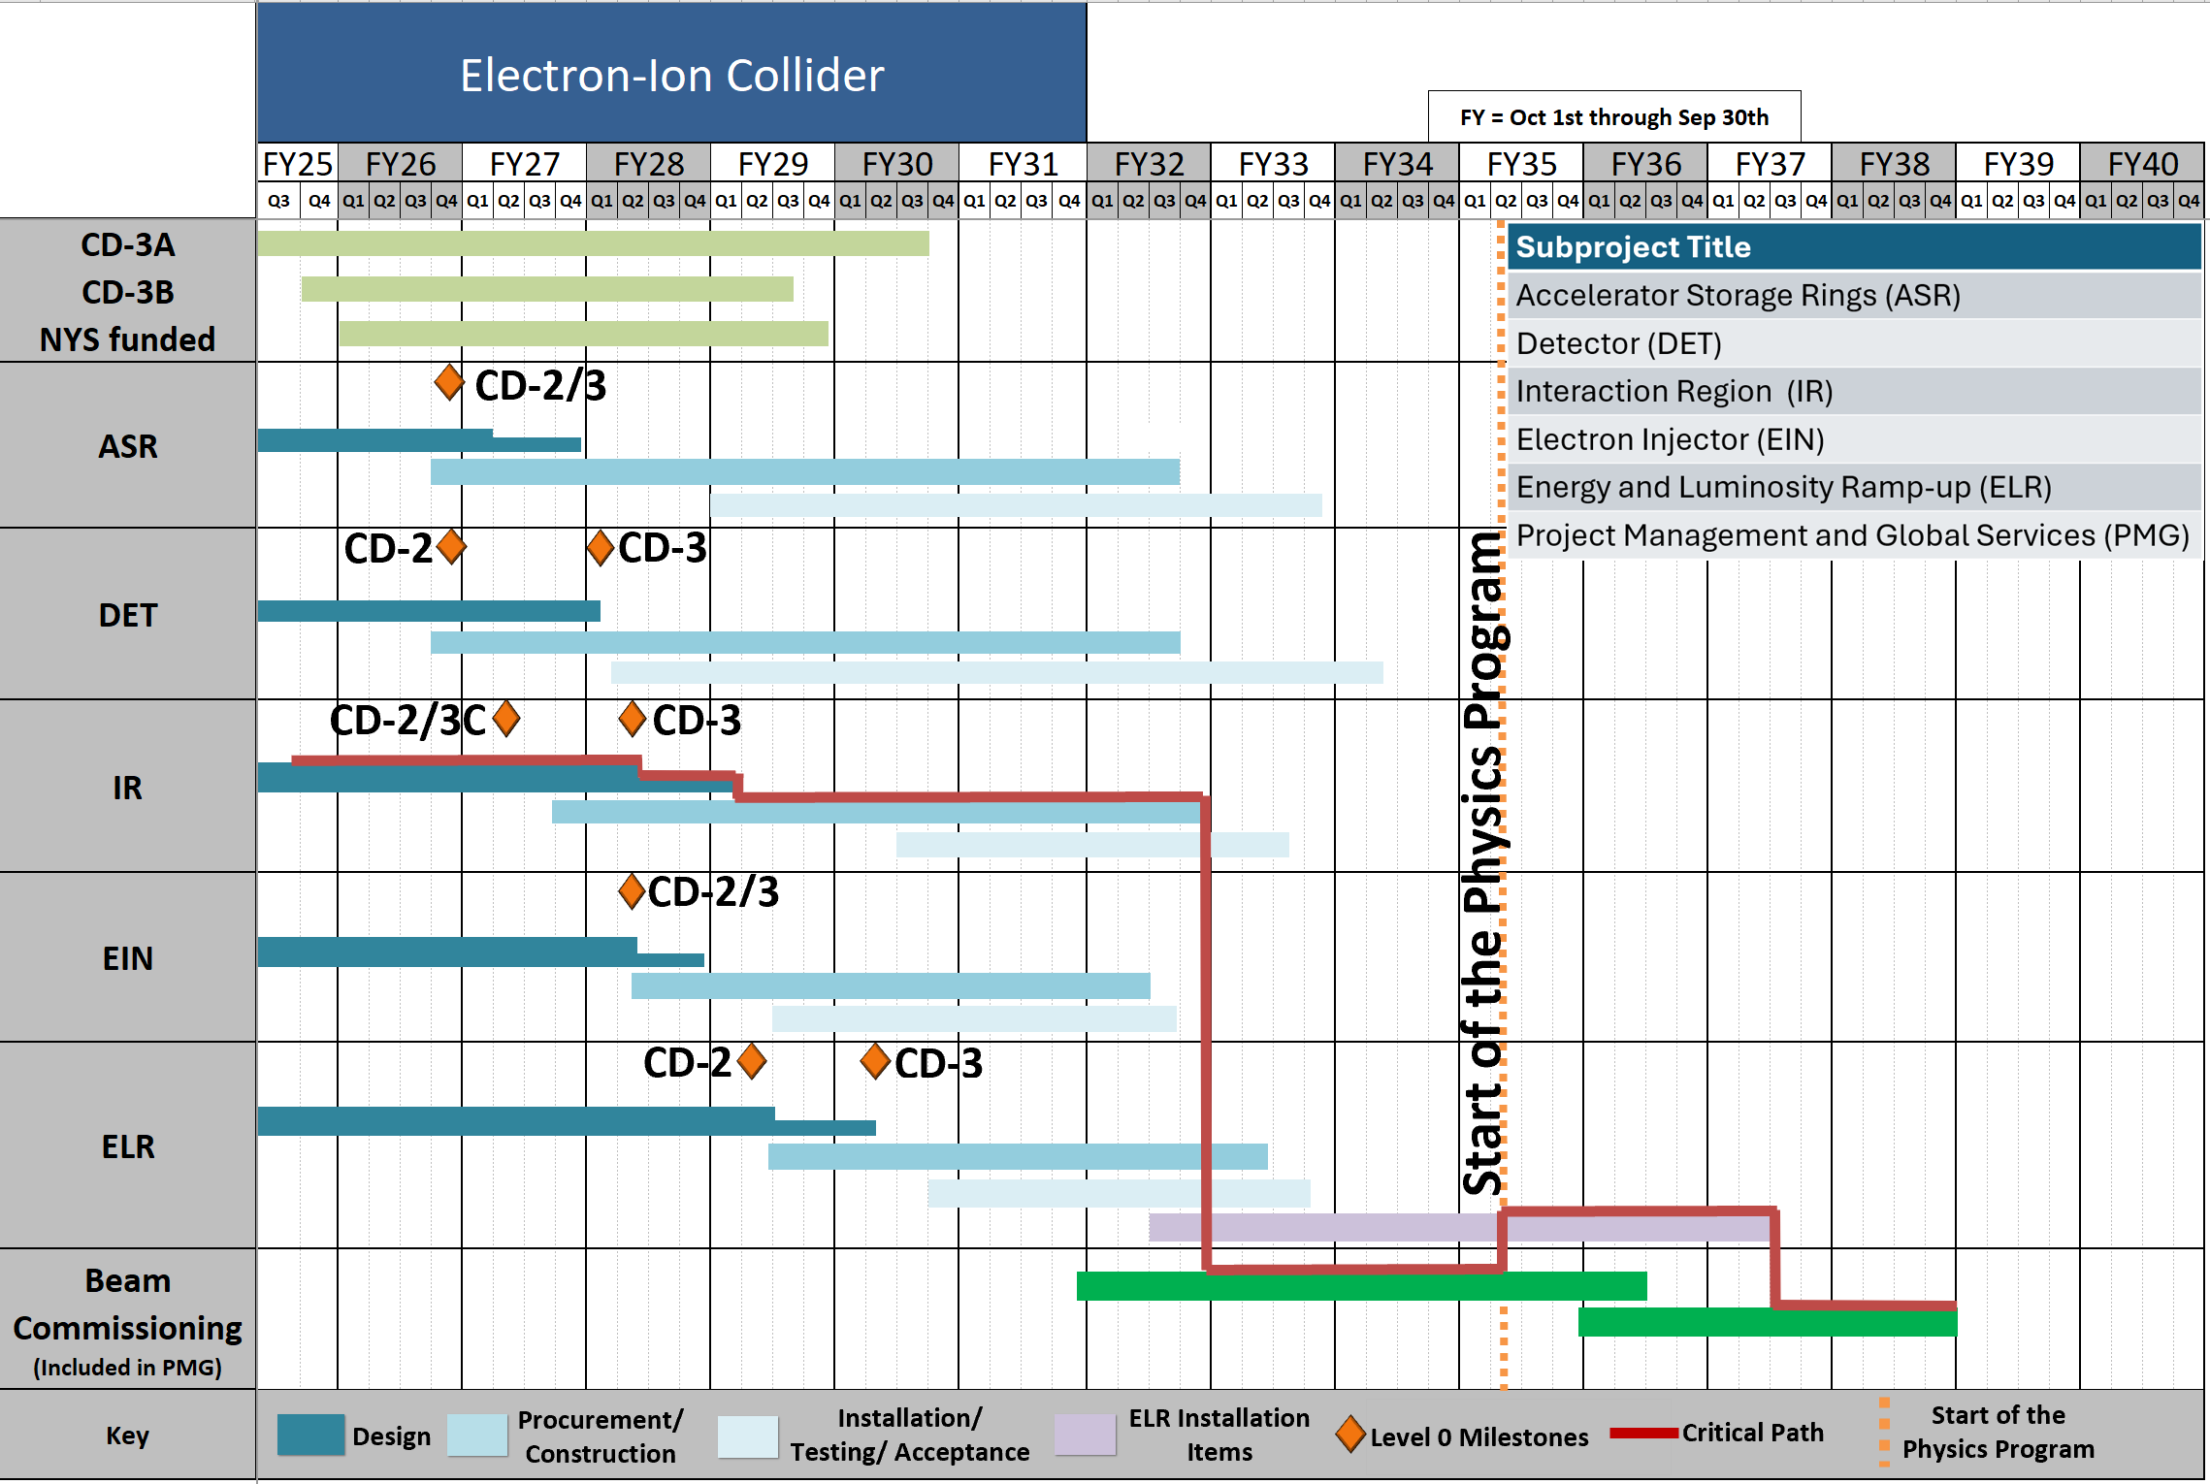
EIC Reference Schedule - Subprojects

Slide 15
EIC Early Science Program Reach:
All components of the NAS Report Science will start
1
2
Limit 1
Delay of hadron low-energy bypass
3
Limit 2
Delayed RF for
18 GeV e
Limit 3
Delayed 28 nC and low energy hadron beam cooling
Early Science
15

Slide 16
All Colliders Ramp Up
No collider turns on at the design beam parameters. The ramp up from safe set of parameters to the design parameters can take up to five years. RHIC, LHC, HERA, Tevatron, LEP – all are examples of this.

Slide 17
Project and collaboration will work out the details, but dictated by accelerator needs and safety considerations
A guiding principle: Each of the early years should bring in some new machine component or capability that allows new physics to begin.
Year 1: 10 GeV electrons x 115 GeV/u heavy ion beams (Ru or Cu)
  Highest early energy of electron (with polarization setup requirements)
  Choice of Heavy dictated by the beam path centered in the magnet
  Unprecedened nuclear DIS at the highest energy could begin

Slide 18
Years 2 and beyond….
Year 2: Commission proton polarization, improve e-polarization
  10 GeV polarized electrons x 130 GeV/u Deuterons
  10 GeV polarized electrons x 130 GeV/u transverse polarized protons
  D-PDFs, transverse momentum distributions in protons
Year 3: Commission hadron spin rotators: longitudinal proton polarization
  Possibility to have polarized e on transverse and longitudinal polarized protons
  Longitudinal spin structure of proton, Delta-G, from scaling violations, jets, α_{s}
Year 4: Commission hadron ring for non-centered nuclei
  10 GeV electrons on 100 GeV/u Au and any other nucleus if Au succeeds
  10 GeV polarized e on 250 GeV polarized protons (transverse & longitudinal)

Slide 19
Years 5 and beyond….
Year 5: Commission polarized 166 GeV He-3
  First measurements of neutron spin structure function, first Bjorken
  Any e-A collision
Years 4 and 5: Add additional RF power etc. to reach the 18 GeV for e to reach 140 GeV in e-p Center of Mass.
Year 6: Commission ESR and HSR for max energy and beam currents
  Possible 18 GeV polarized e on 275 GeV polarized protons
Year 7: introduce and commission 41 GeV bye pass
  Possible 5 GeV e x 41 GeV transverse polarized protons

Slide 20
Comment on the selection of beam parameters:
Beam parameter dictated by the desire to have safe early operation, while accelerator operators learn to run a high current machine
Low luminosity earlier, beams easiest to center in beam pipe minimal energy variations etc. all stem from the safety considerations both for the machine elements and the detector elements (particularly those closest to the beam)
I still feel giving us a possibility of having one new experimental feature every year would enable exciting physics every year in the first few years (and later, when maximum parameters are realized)

Slide 21
Early Science to Full EIC capability
Transition over 6-7 years with early science
year 7
year 5, 6
Year 5
Delayed 28 nC and low energy hadron beam cooling
Year 5
Year 5, 6
Delayed RF for
18 GeV e
Year 7
Delay of hadron low-energy bypass
Early Science
Year 1-5
21

Slide 22
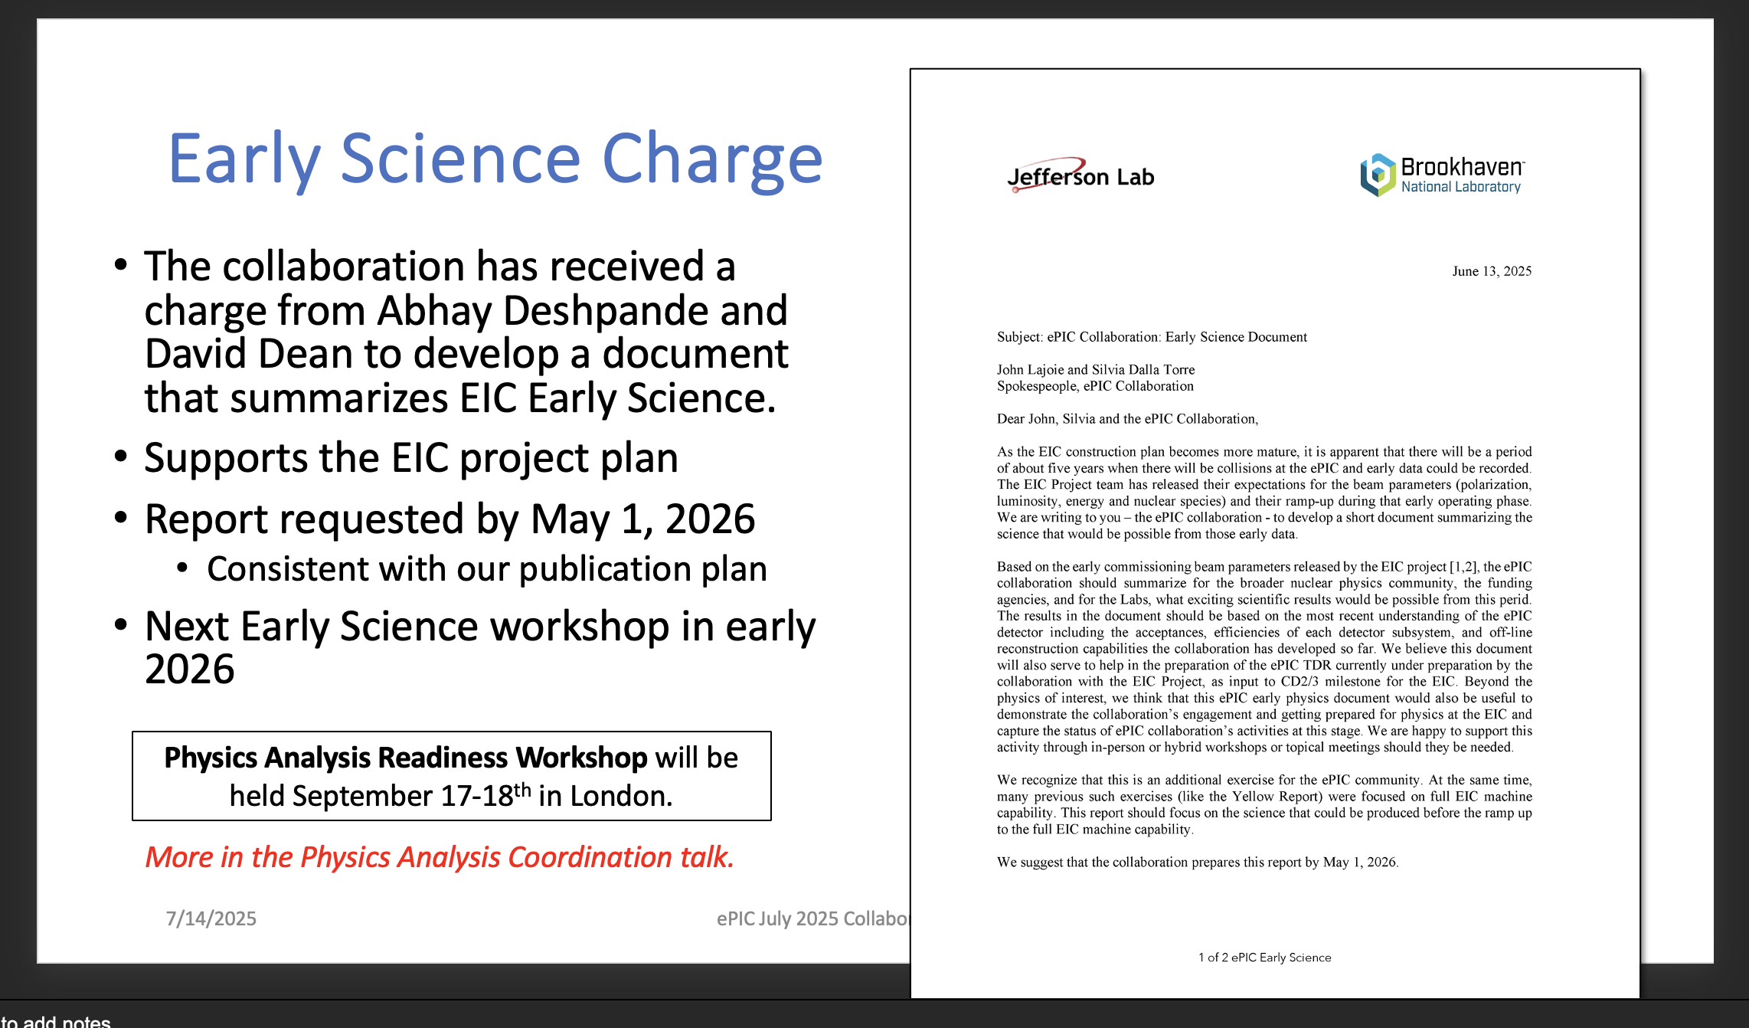
John Lajoie

Slide 23
Thank you!

