Slide 1
Electron Ion Collider
Sergei Nagaitsev
EIC Technical Director
March 10, 2025

Slide 2
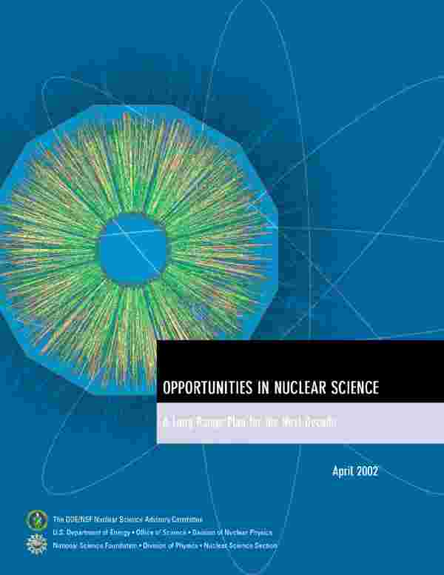
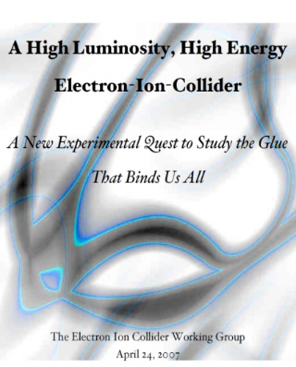
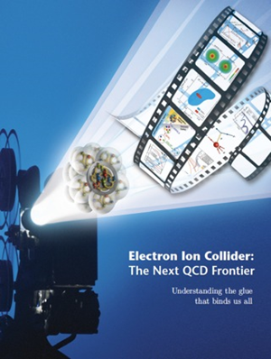

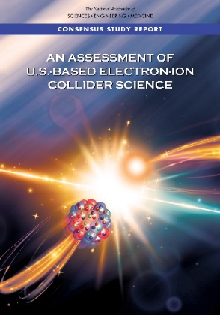

EIC Scientific Case Built Over Decades
2002
2007
2009
“We recommend the expeditious completion of the EIC as the highest priority for facility construction.” (Nuclear Science Advisory Committee, 2023)
2010
2012
Gluons and the Quark Sea at High Energies
2013
NSAC
2015
Major Nuclear Physics Facilities for the Next Decade
2018
2021
2023
March 14, 2013
“The science questions that an EIC will answer are central to completing an understanding of atoms as well as being integral to the agenda of nuclear physics today.” (National Academy of Sciences, 2018)
arXiv:2103.05419
EIC will be the only operating particle collider in the U.S. and likely the only large collider
to be built in the world in the next 20-30 years.
2

Slide 3
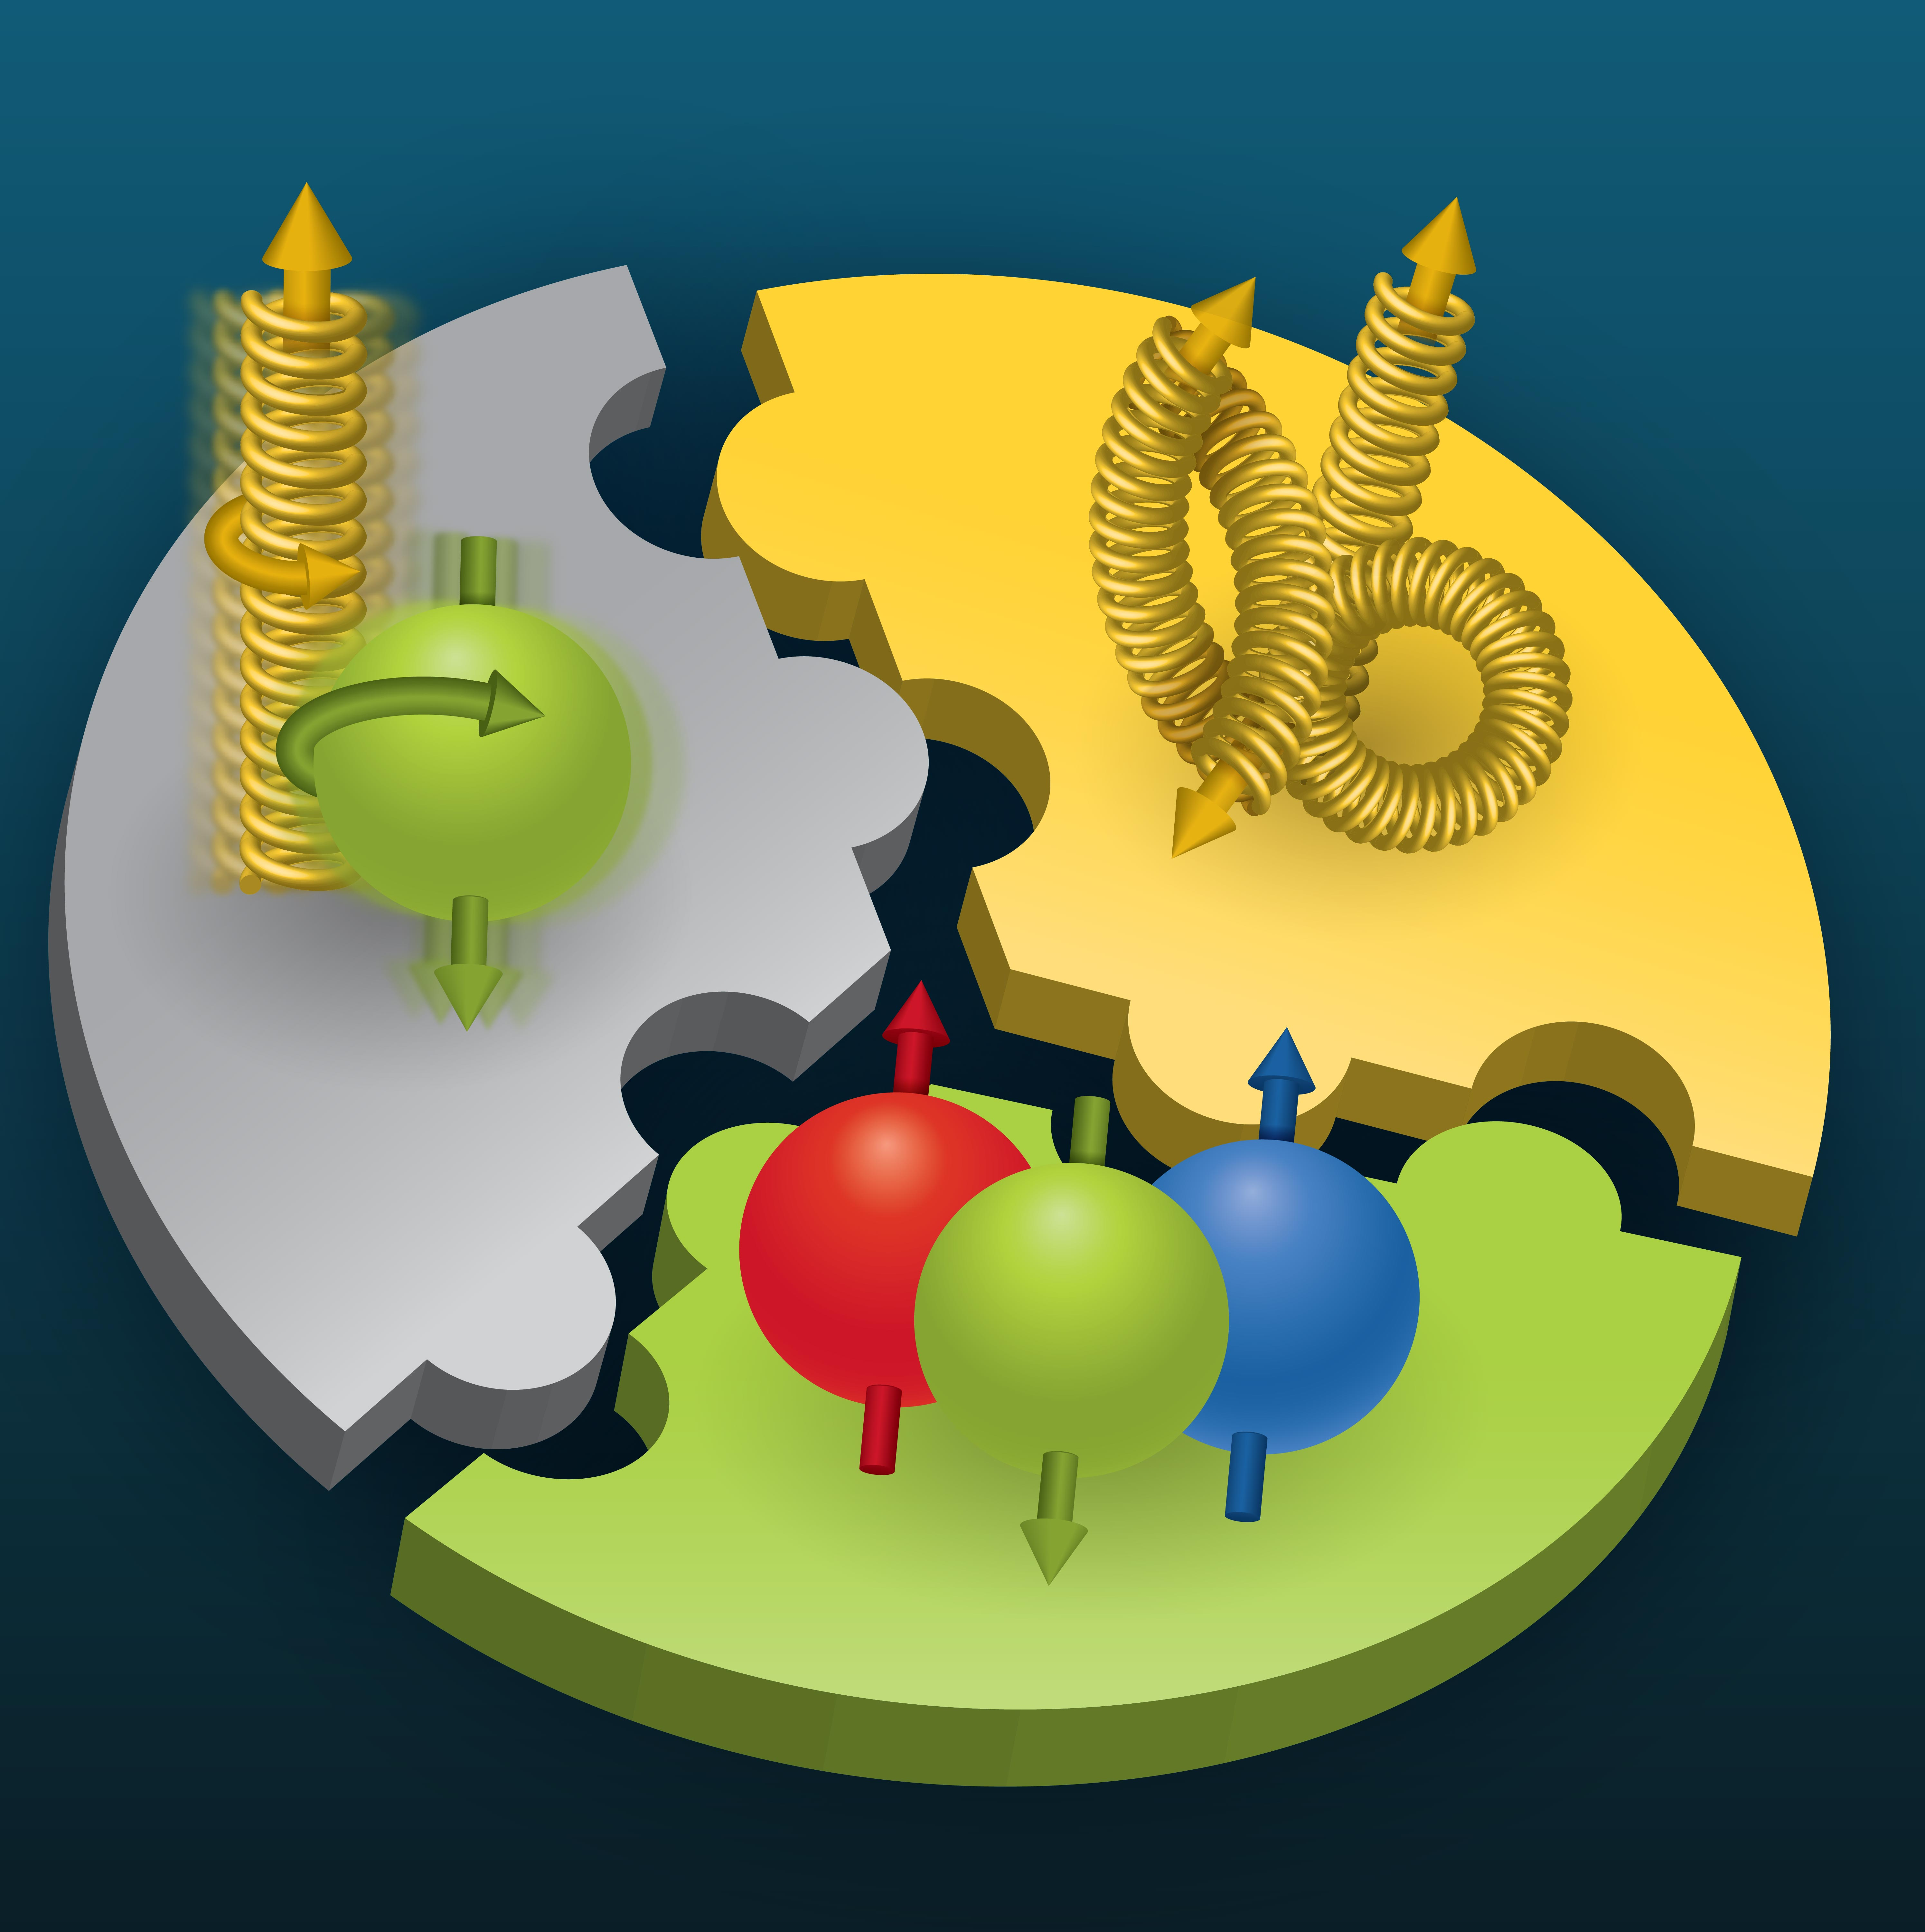

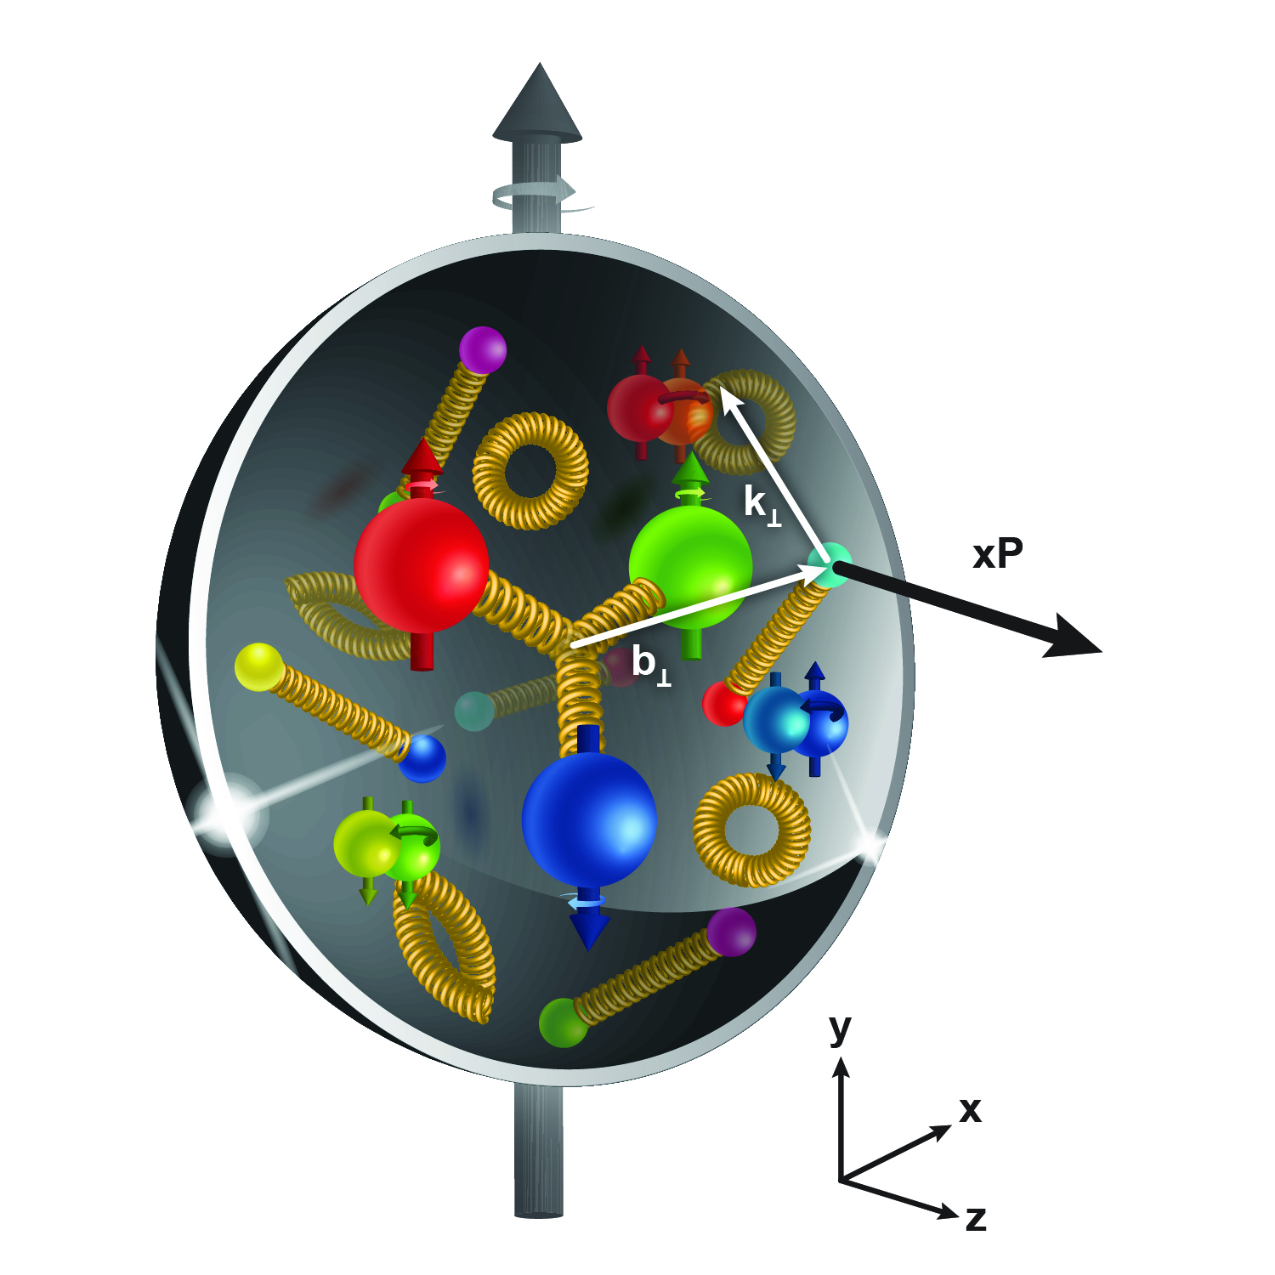
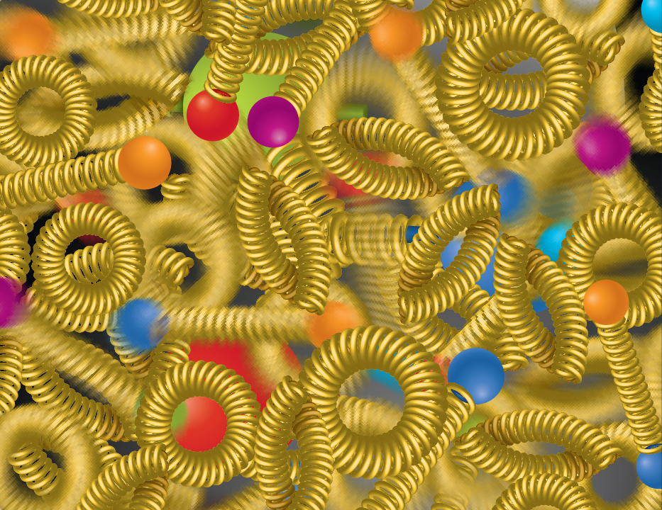
Compelling EIC Science (National Academy Report)
How do quarks, gluons, and orbital angular momentum contribute to proton spin?
Spin is a fundamental property of matter.
All elementary particles,
but the Higgs, carry spin.
Spin cannot be explained by a static picture, rather the interplay between the properties and interactions of quarks and gluons inside
the proton.
Does the mass of visible matter emerge from quark-gluon interactions?
Atom: Binding/Mass = 0.00000001
Nucleus: Binding/Mass = 0.01
Proton: Binding/Mass = 100
The EIC will determine an important term contributing to the proton mass, the so-called quantum chromodynamics (QCD) trace anomaly.
How can we understand QCD dynamics and the relation to confinement?
EIC will image quarks and gluons in 3D in space and momentum inside the nucleon and nuclei and uncover how the nucleon properties emerge from quarks and gluons and their interactions.
How do quark-gluon interactions create nuclear binding?
Is the structure of a free and bound nucleon the same?
How do quarks and gluons, interact with a nuclear medium?
How do the confined hadronic states emerge from these quarks and gluons?
Does gluon density in nuclei saturate at high energy?
How many gluons can fit in a proton?
How does a dense nuclear environment affect the quarks and gluons, their correlations and interactions?
=
gluon
splitting
?
gluon
recombination
3

Slide 4
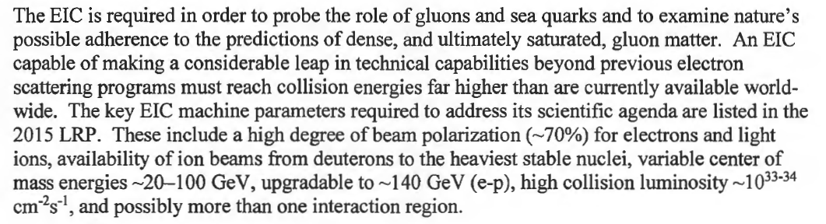
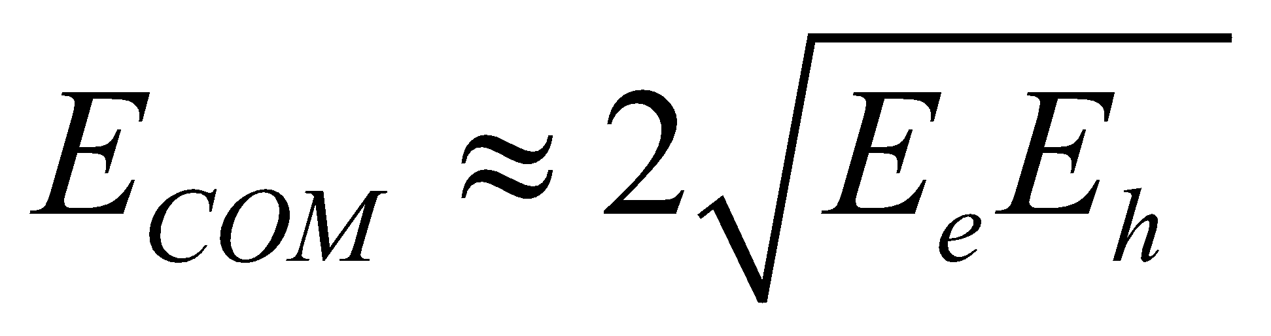
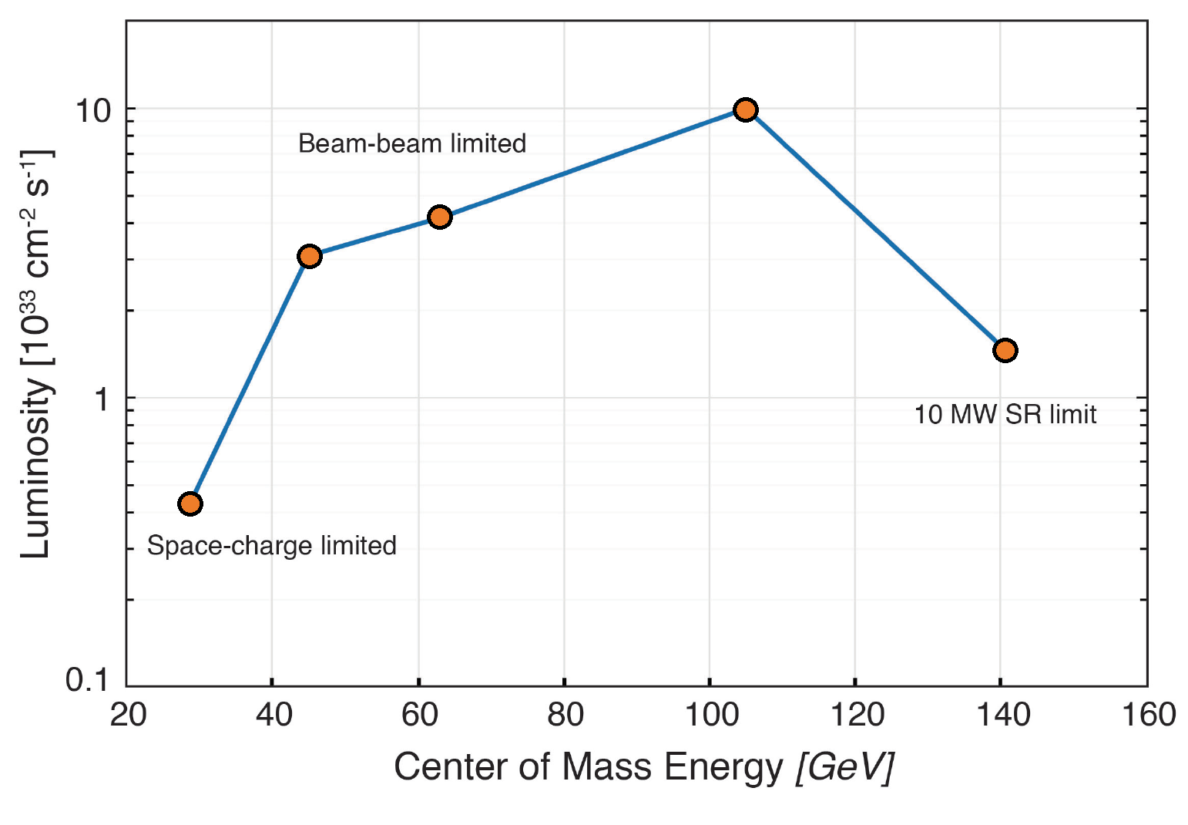
The DOE CD-0 Mission-Need Statement (MNS) 2019
10x275
5x100
10x100
18x275
Bunch charges: 28 nC (10 GeV, e) and 11 nC (275 GeV, p)
5x41
EIC peak luminosities (CDR)

Slide 5
The DOE CD-0 Mission-Need Statement (MNS) 2019
10x275
5x100
10x100
18x275
The 2021 Conceptual Design Report describes a path to EIC ultimate performance which interprets the MNS in a broadest way (10³³⁻³⁴ cm⁻² s⁻¹).
5x41
EIC peak luminosities (CDR)

Slide 6
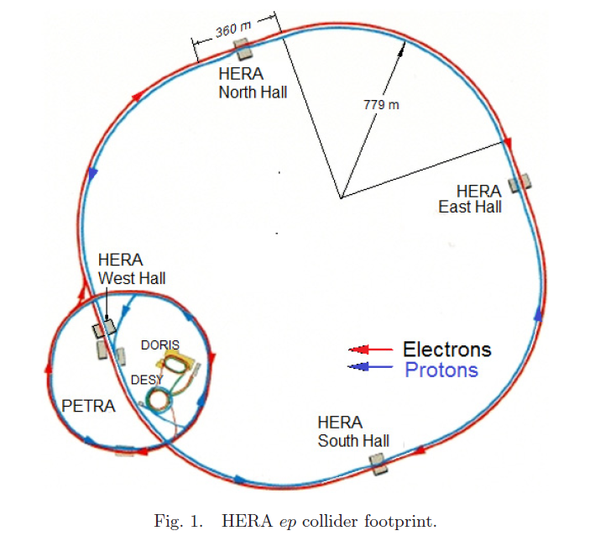
HERA (1992 – 2007)
920 GeV protons (unpolarized)
27.5 GeV electrons (self-polarized by
the Sokolov-Ternov effect)
Peak luminosity: ~5x10³¹ cm⁻²s⁻¹

Slide 7
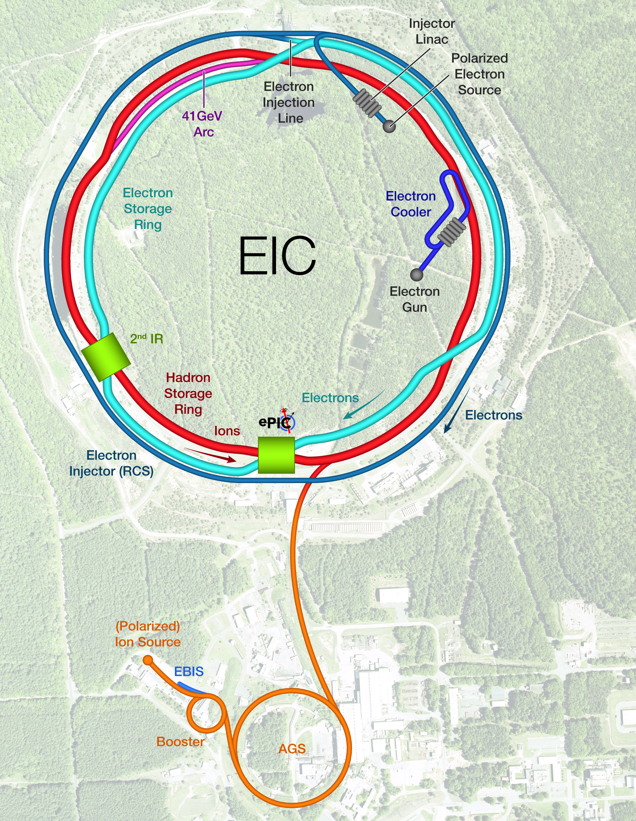
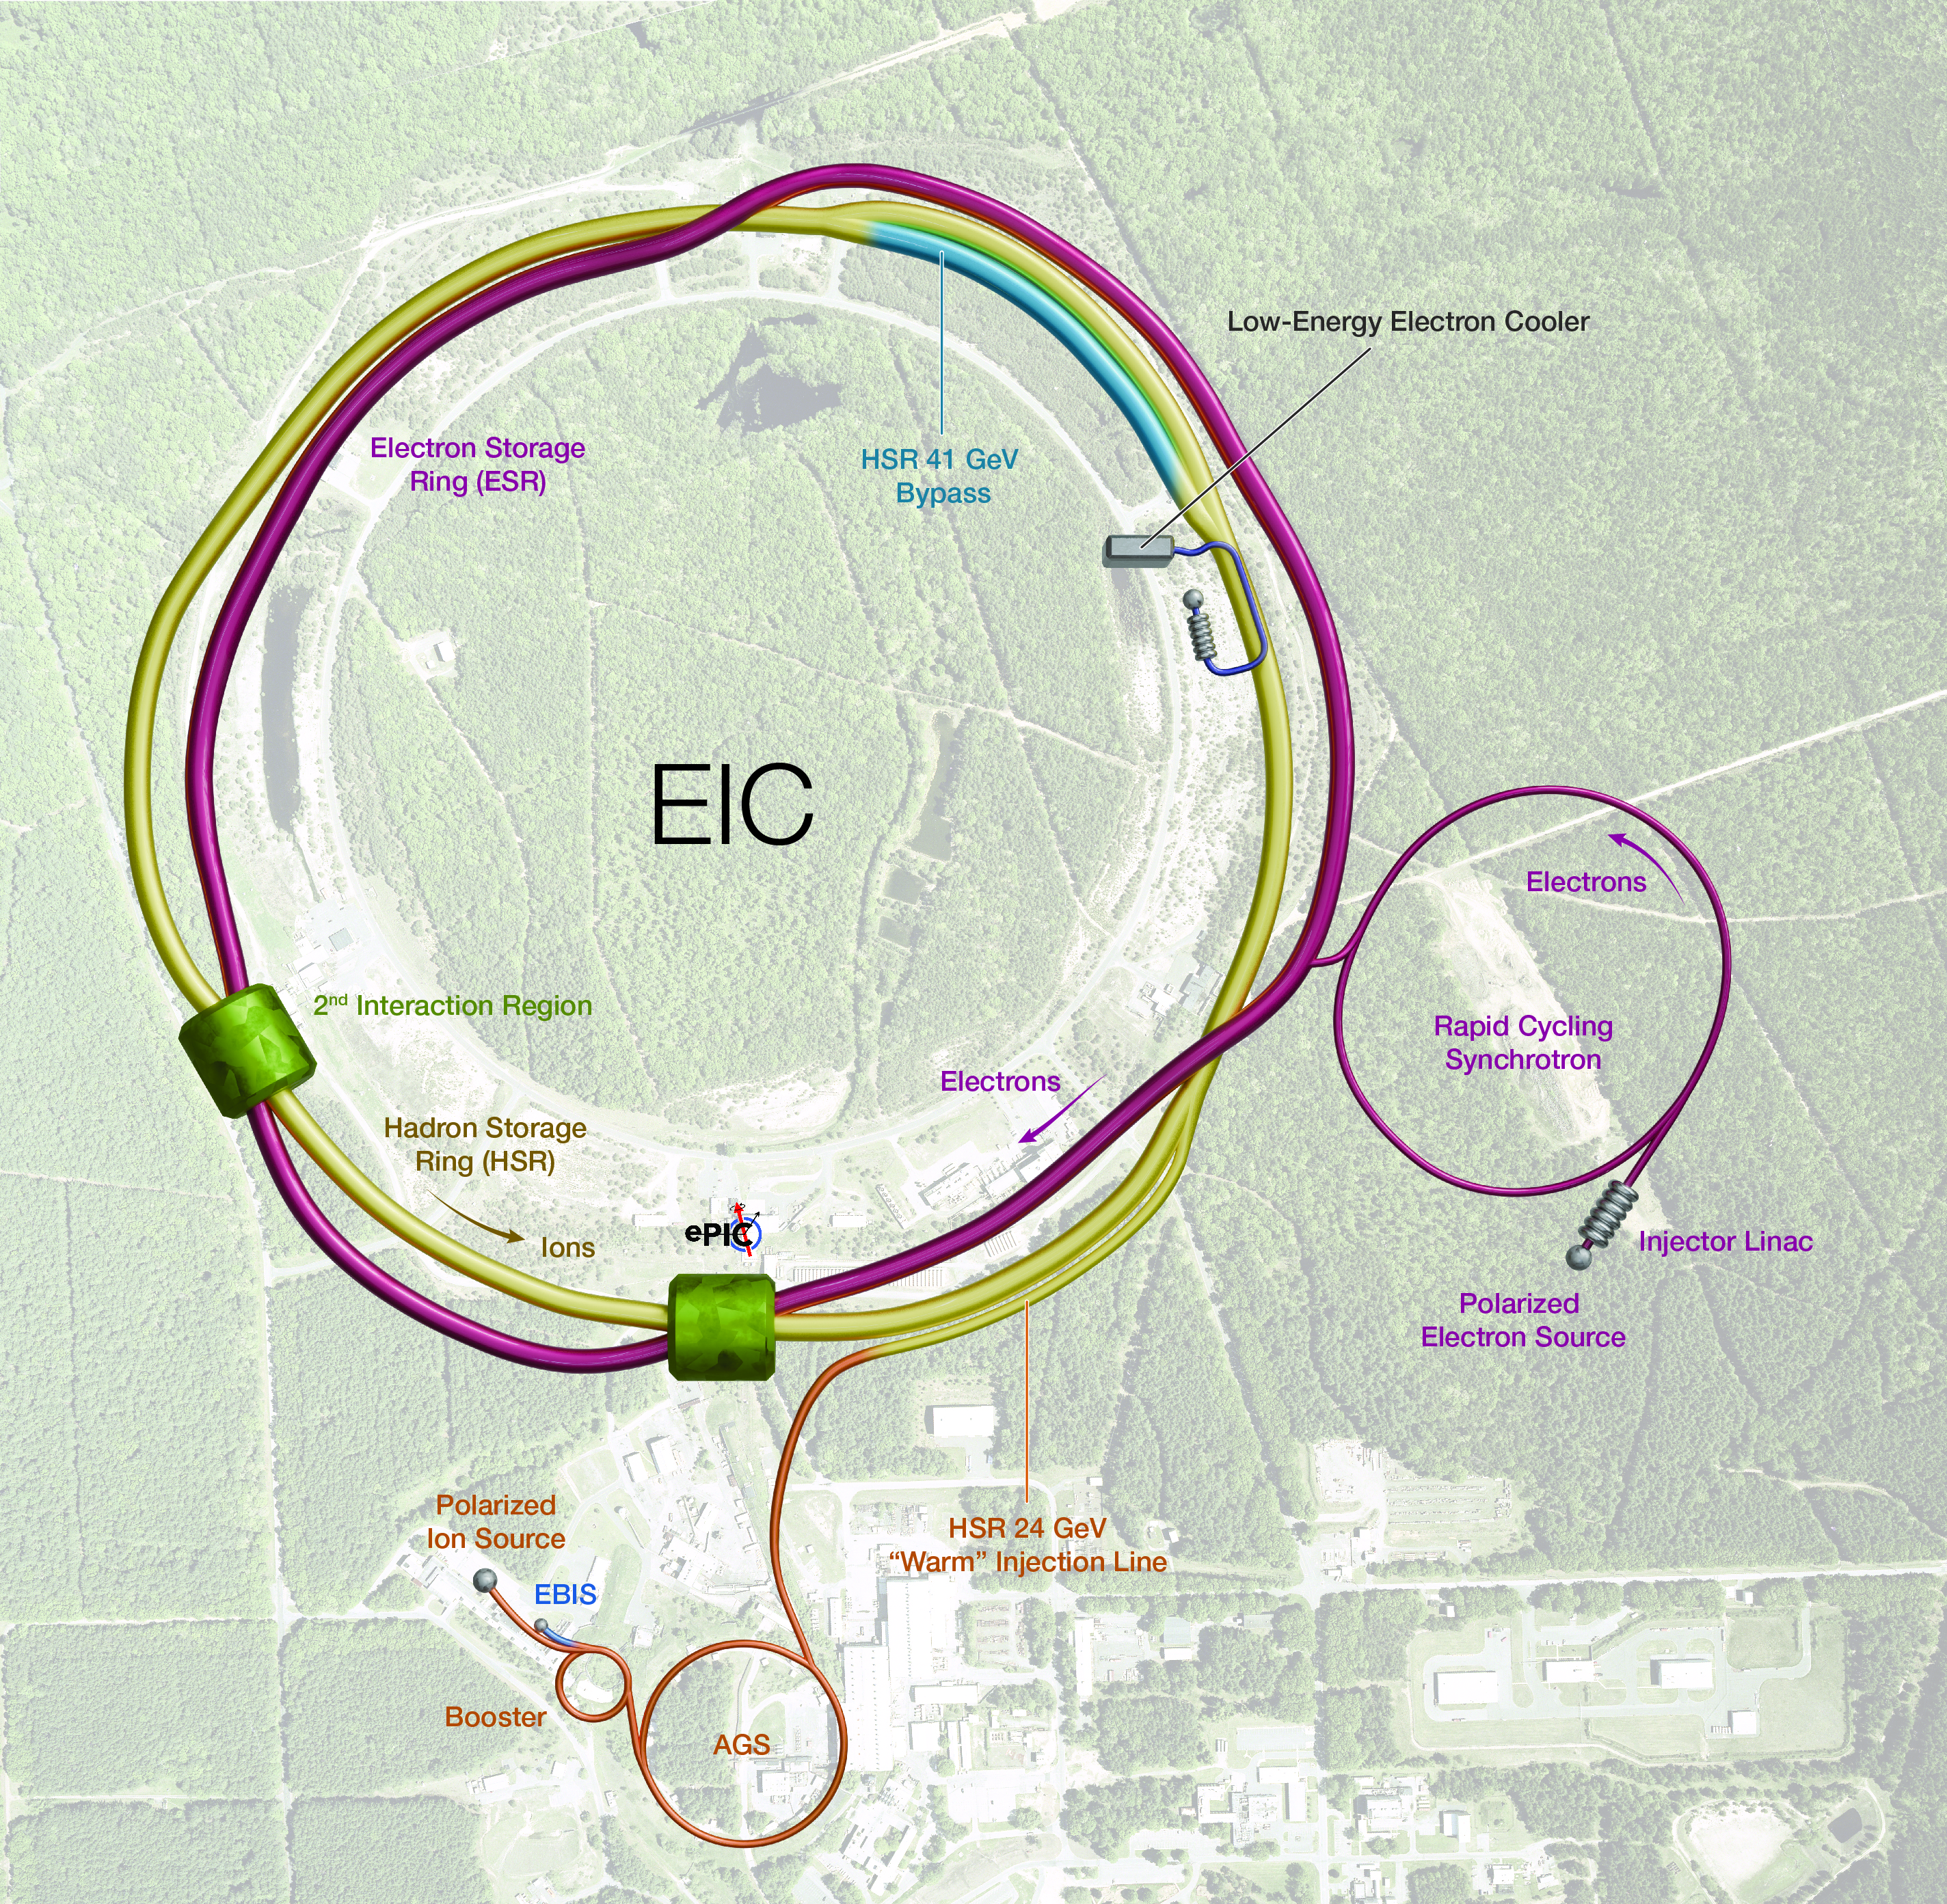
EIC: present concept
2023
2025
1
3
4
2
Protons: ~40 – 275 GeV
Electrons: 5 – 18 GeV

Slide 8
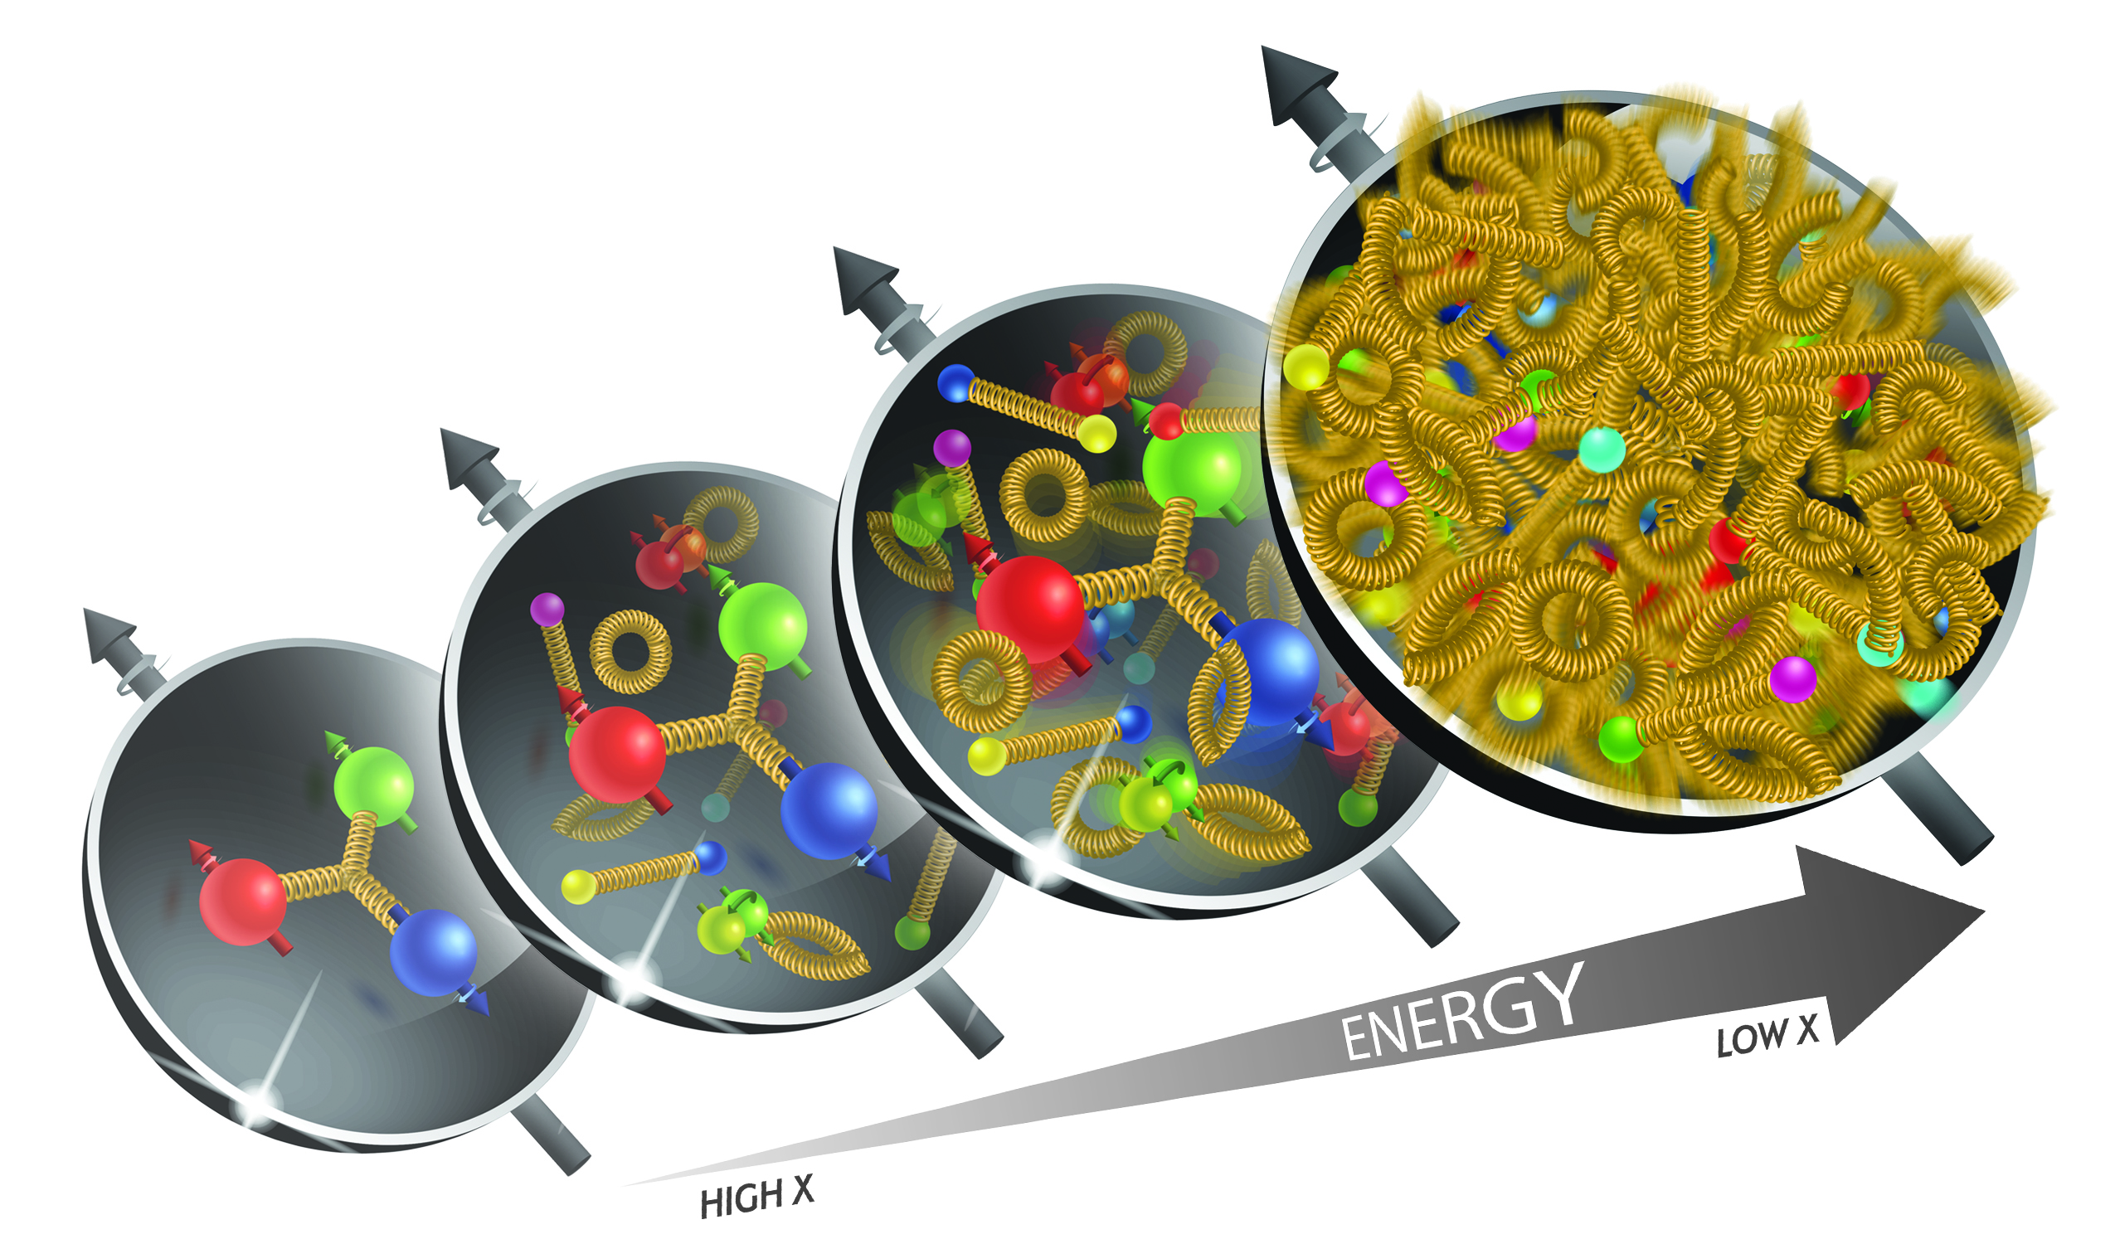
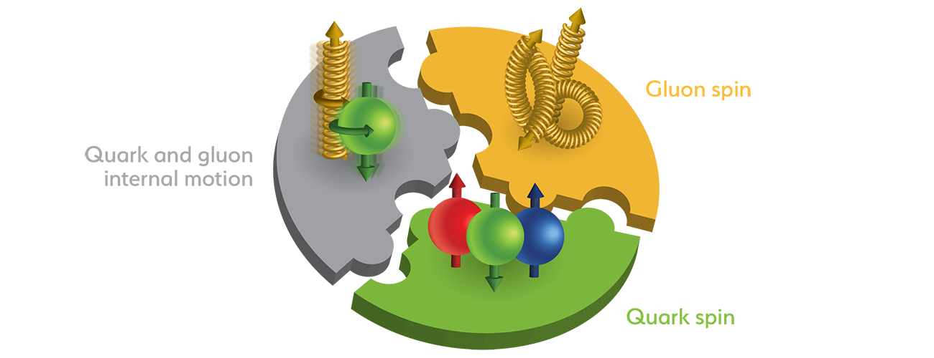
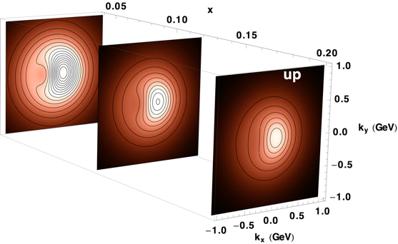
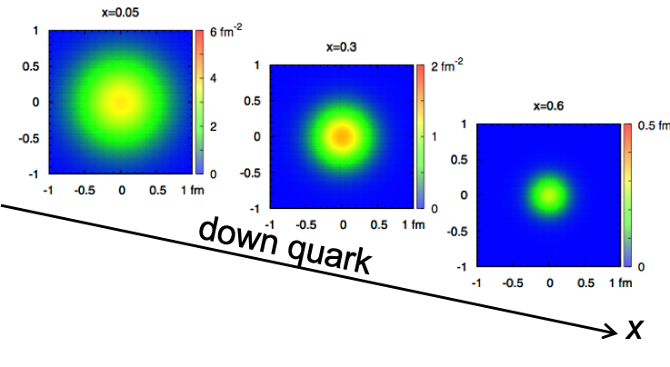
EIC Accelerator Performance Needs
wide center-of-mass energy √s: 20 – 140 GeV :
map the out nucleon and nuclei structure from high to low x
polarized electron and hadron (p, He-3) beams:
access to spin structure of nucleons and nuclei
Spin vehicle to access the spatial and momentum structure of the nucleon in 3d
Full specification of initial and final states to probe q-g structure of NN and NNN interaction in light nuclei
nuclear beams: d to Pb
accessing the highest gluon densities → saturation
quark and gluon interact with a nuclear medium
high luminosity 10³³-10³⁴ cm⁻²s⁻¹ :
mapping the spatial and momentum structure of nucleons and nuclei in 3d
access to rare probes, i.e. Ws
large acceptance (0.2 – 1.3 GeV) through forward focusing IR magnets
spatial imaging of nucleons and nuclei
gluon emission
gluon recombination
?
=

Slide 9
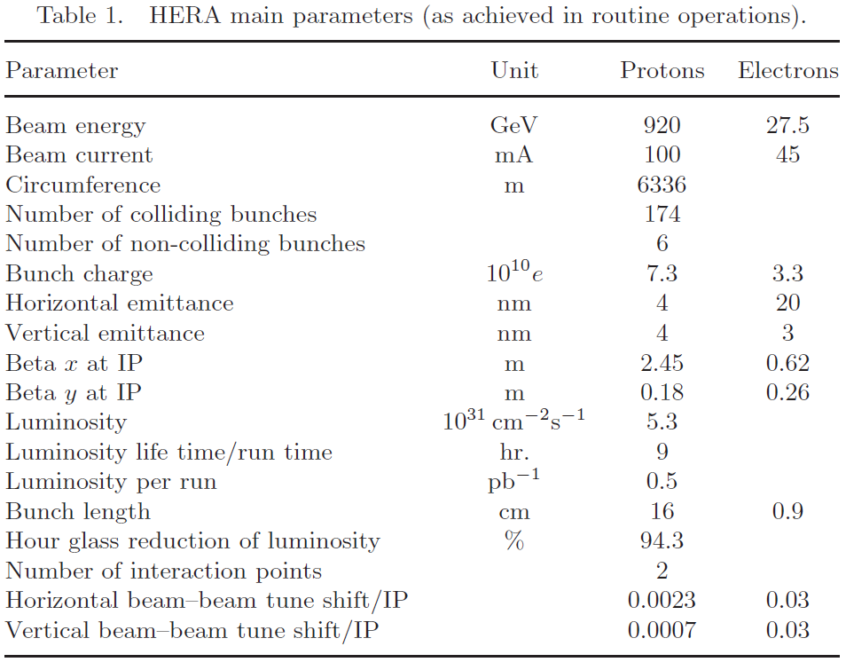
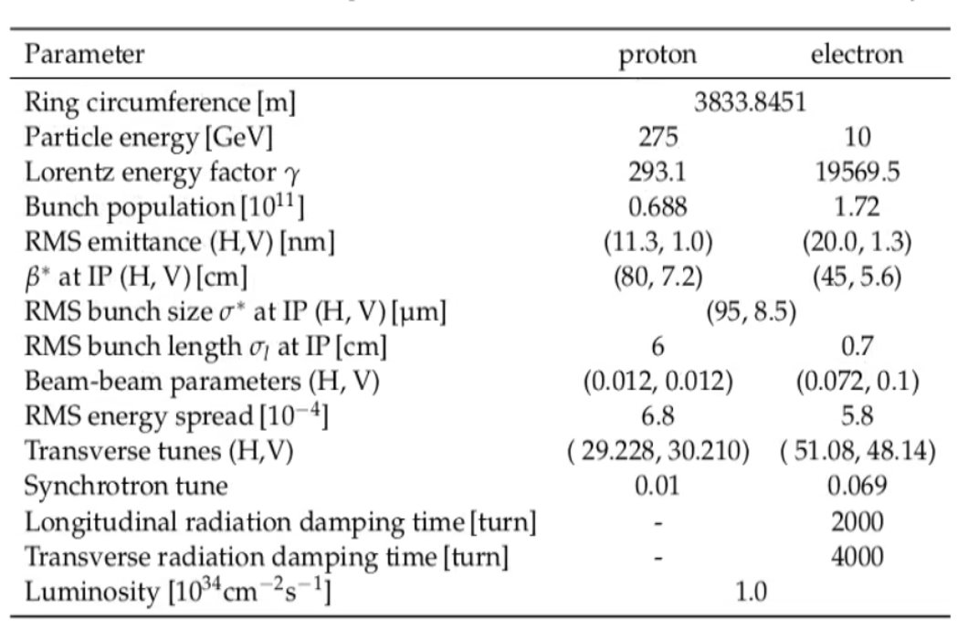
HERA vs EIC
EIC main parameters

Slide 10
HERA vs EIC: key parameters
HERA EIC FACTOR
Circumference (km) 6.3 3.8 1.7
Number of bunches 174 1160 6.7
Proton bunch charge (nC) 11.7 11 1
Electron bunch charge (nC) 5.3 28 5.3
Bunch length (cm), p/e 16/0.9 6/0.7
Beta at IP (cm), proton H/V (cm) 245/18 80/7.2
Beta at IP (cm), electron H/V (cm) 62/26 45/5.6
Proton emittance, (nm, rms) 4/4 11/1
Electron emittance, (nm, rms) 20/3 20/1.3
Energy (COM), GeV 320 105
Luminosity, x10³¹ cm⁻²s⁻¹ 5.3 1000 190
60
~3

Slide 11
Key EIC accelerator physics concepts
Flat hadron bunches (10:1 emittance ratio)
Large crossing angle (25 mrad)
Beam-beam limits for both beams (0.1 e/ 0.01 p)
Spin preservation from source to collisions (protons and electrons)
Upgrade path: hadron cooling at collisions
These are the key concepts that allow to attain luminosity of ~10³⁴ cm⁻²s⁻¹ and maintain high polarization at collisions

Slide 12
Key EIC Accelerator Technology Areas
Hadron Beam Cooling
Spin-transparent optics
  High polarization for both beams from source to collisions
  Swap-out injection for electron bunches (at 1 Hz) to maintain high polarization
Crab cavities
  Large-size, complex geometries;
  Very tight phase and amplitude noise requirements
IR magnets (large aperture, 2K SC magnets)

Slide 13
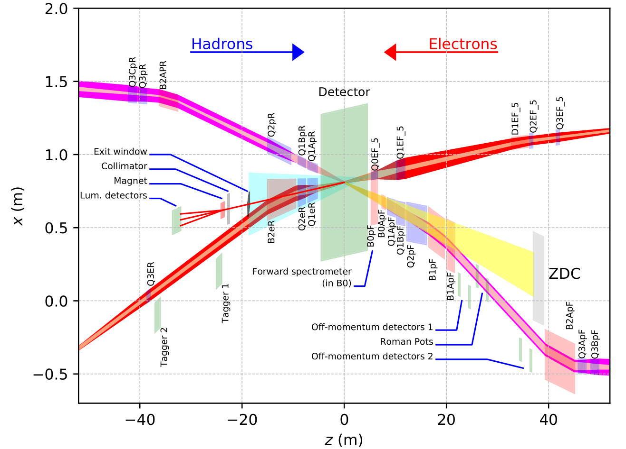
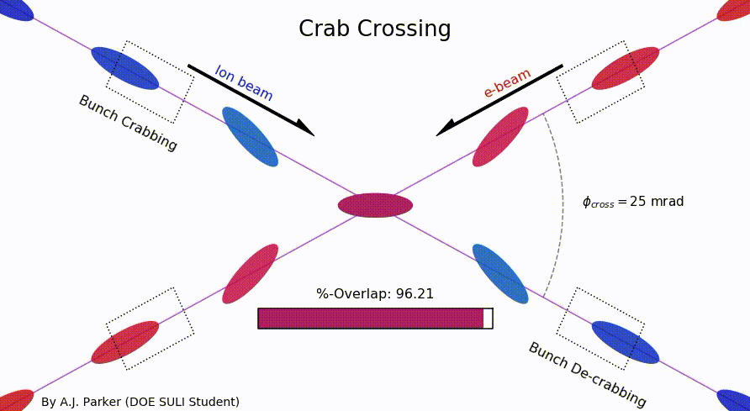
EIC IR Layout
High Luminosity:
  25 mrad crossing angle
  Small β* for high luminosity
  with limited IR chromaticity contributions
  Large final focus quadrupole aperture
  Machine Detector Interface
  Large detector acceptance
  Forward spectrometer
  No magnets within - 4.5 / +5 m from IP
  Space for luminosity detector, neutron detector, “Roman Pots”

Slide 14
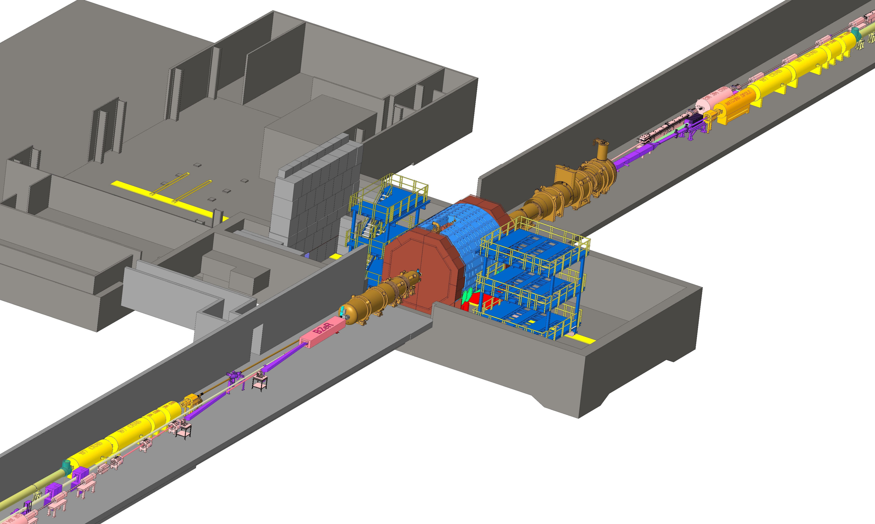
EIC Near-detector IR Layout

Slide 15

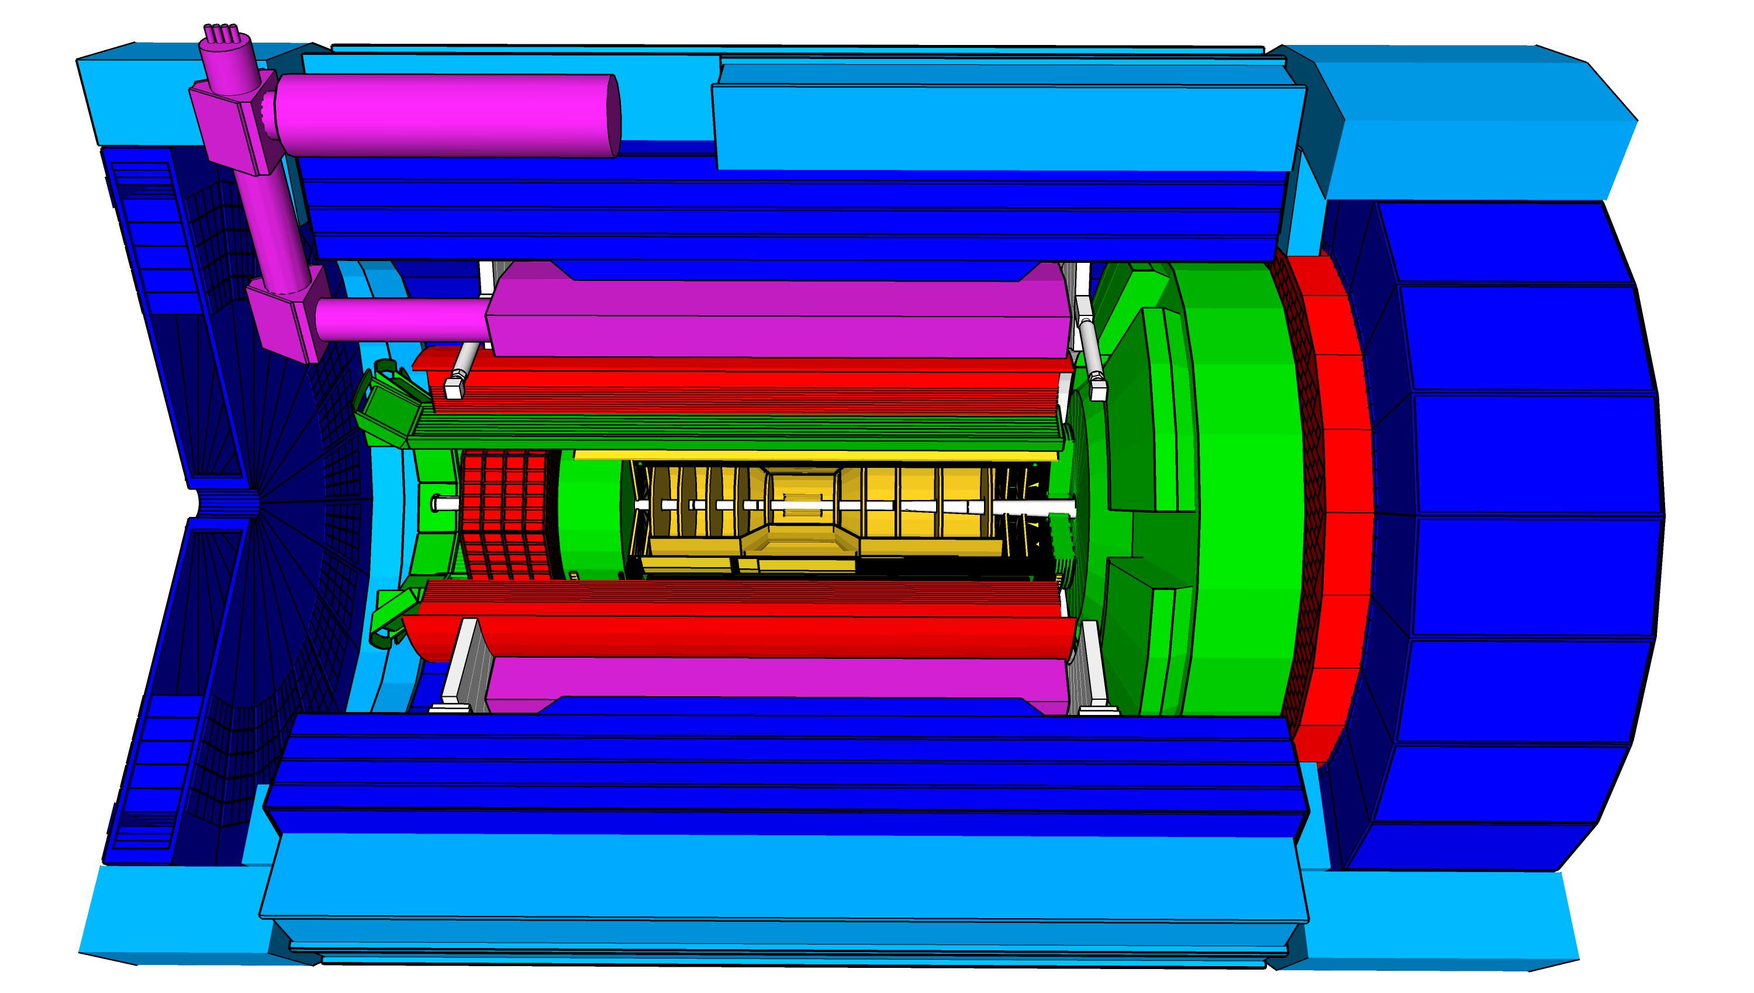
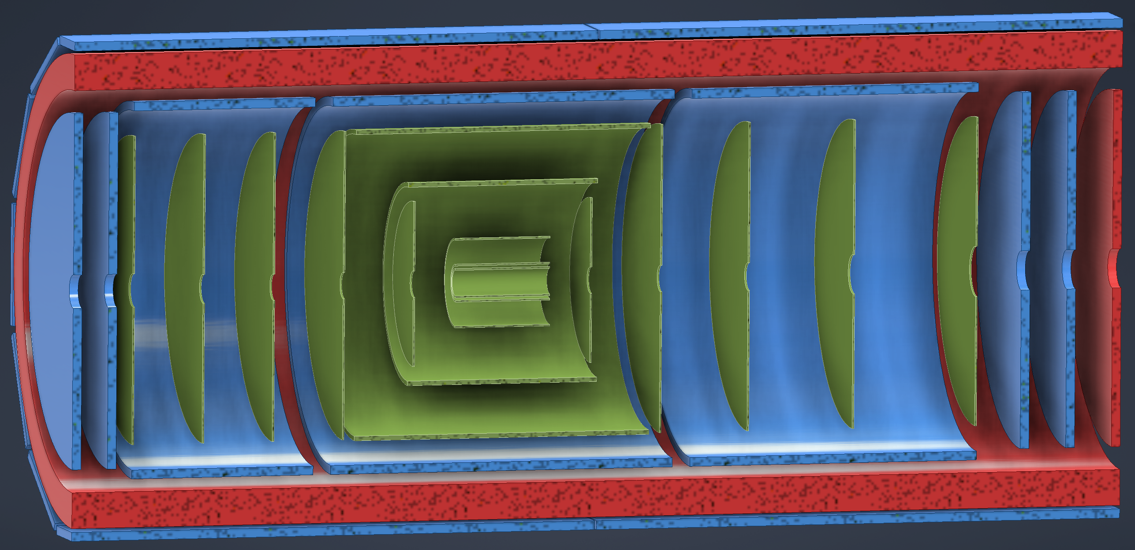
ePIC Baseline Technologies
Vertex detector → Identify primary and secondary vertices,
  Low material budget: 0.05% X/X₀ per layer;
  High spatial resolution: 10 mm pitch CMOS Monolithic Active Pixel Sensor
Central tracker → Measure charged track momenta
  MAPS – tracking layers in combination with micro pattern gas detectors
  MPGD: m-RWell or MicroMegas
electron and hadron endcap tracker → Measure charged track momenta
  MAPS – disks in combination with micro pattern gas detector disks
Particle Identification → pion, kaon, proton separation on track level
  RICH detectors (modular and dual radiator RICH, DIRC) & Time-of-Flight
  high resolution timing detectors (LAPPS, LGAD) 10 – 30 ps
  novel photon sensors for RICHs: LAPPD & SiPMs
Electromagnetic calorimeter → Measure photons (E, angle), identify electrons
  PbWO₄ Crystals (backward) with SiPM readout,
  W/SciFi Spacal (forward), Barrel: Pb/SciFi+imaging part using ASTROPIX
Hadron calorimeter → Measure charged hadrons, neutrons and K_{L}⁰
  challenge achieve ~50%/√E + 10% for low E hadrons (<E> ~ 20 GeV)
  Steel/Sc & W/Sc sandwich sandwich with longitudinal segmentation & SiPM readout
DAQ & Readout Electronics: trigger-less / streaming DAQ
  Integrate AI into DAQ → cognizant Detector
Very forward and backward detectors → scattered particles under very small angles
  Silicon tracking layers in lepton and hadron beam vacuum
  Zero – degree high resolution electromagnetic and hadronic calorimeter
Polarimetry
  Lepton: integrated transverse and longitudinal Compton polarimeter
  Hadron: absolute and relative hadron polarimetry in the CNI region
hadronic calorimeters
solenoid coils
ToF, DIRC,
RICH detectors
world’s first
at
e/m calorimeters
MPG & MAPS trackers
Radius/Distance from IP
world’s first
at
world’s first
at
world’s first
at
world’s first
at
9.5m
MAPS Barrel + Disks
MPGD Barrels + Disks
AC-LGAD based ToF

Slide 16
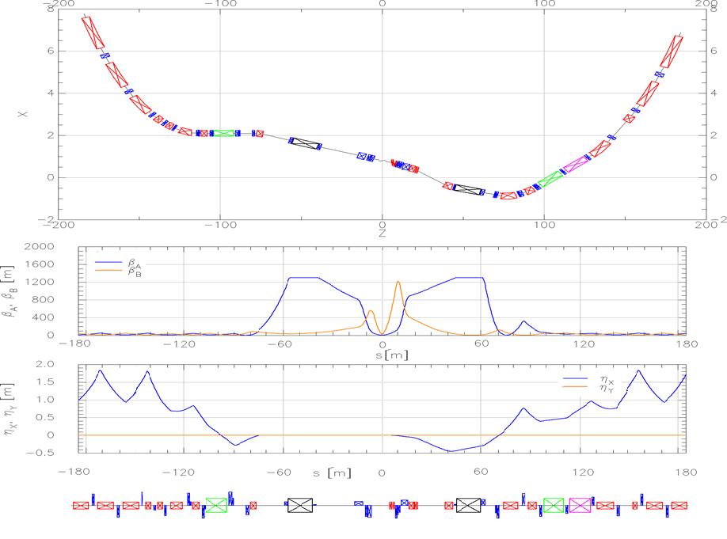
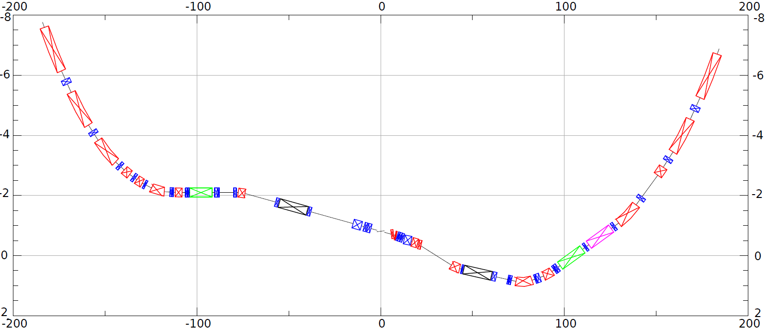
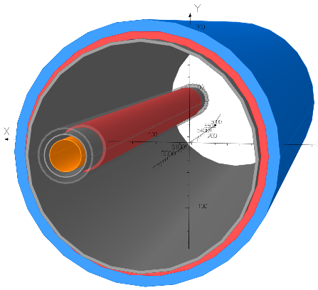
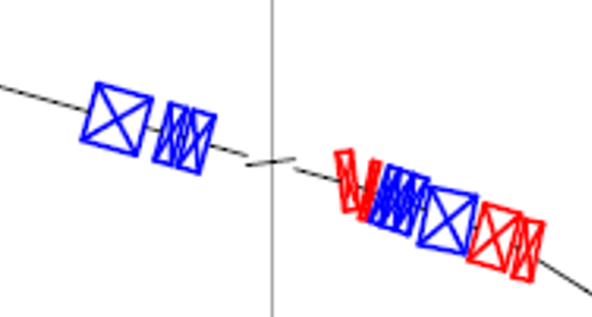
HSR layout at IR
Forward and rear hadron lattice matched into RHIC
  Snake at correct angle
  Beta = 1300m at crab cavities
    Hor. phase advance 90º
  Matching Magnets
    Mostly repurposed RHIC magnets
    few additional magnets required (some SC)
    Some need re-cryostating
h
HSR Arc
Crab–in
Crab –out
HSR Arc
Spin
Rotator
Snake
matching
Off momentum Detectors
Spin Rotator
ESR Lumi-Monitor
matching
Approximate ESR path
Zero Deg Calorimeter
Detector region
B0pF spectrometer
Nov 2021 layout
3 Dipoles and 3 Quadrupoles in one shared cryostat

Slide 17
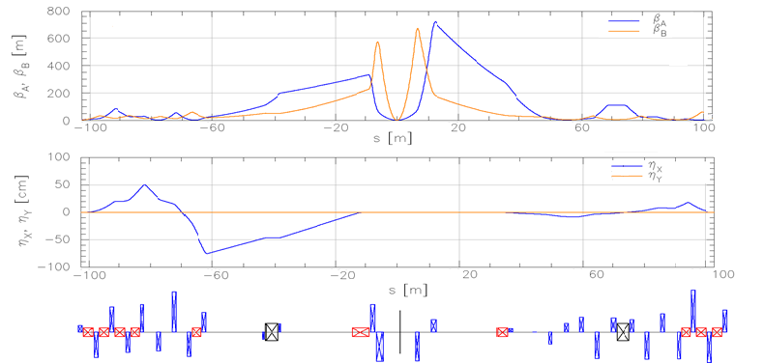
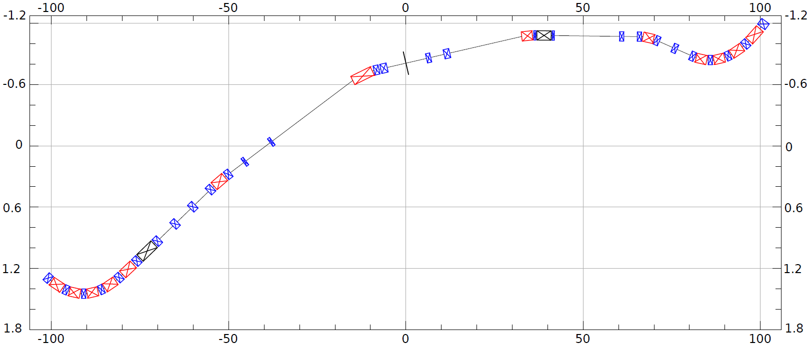
ESR layout at IR
Design to:
Provide room for detector components
Mitigate synchrotron radiation issues
Provide longitudinal spin (new spin rotators)
Match into the arcs
Provide conditions for crabbing
Allow 3 rings and beam elements
e
~130m
Spin Rotation Solenoids
6GeV
Crab –in
IP Focusing
18GeV
Lumi-Monitor
B2eR
~130m
Spin Rotation Solenoids
E-taggers
Polarimeter Laser
Detector region
Longitudinal spin
B1eF
Crabbed beam.
Crab–out

Slide 18
From RHIC to EIC

Slide 19
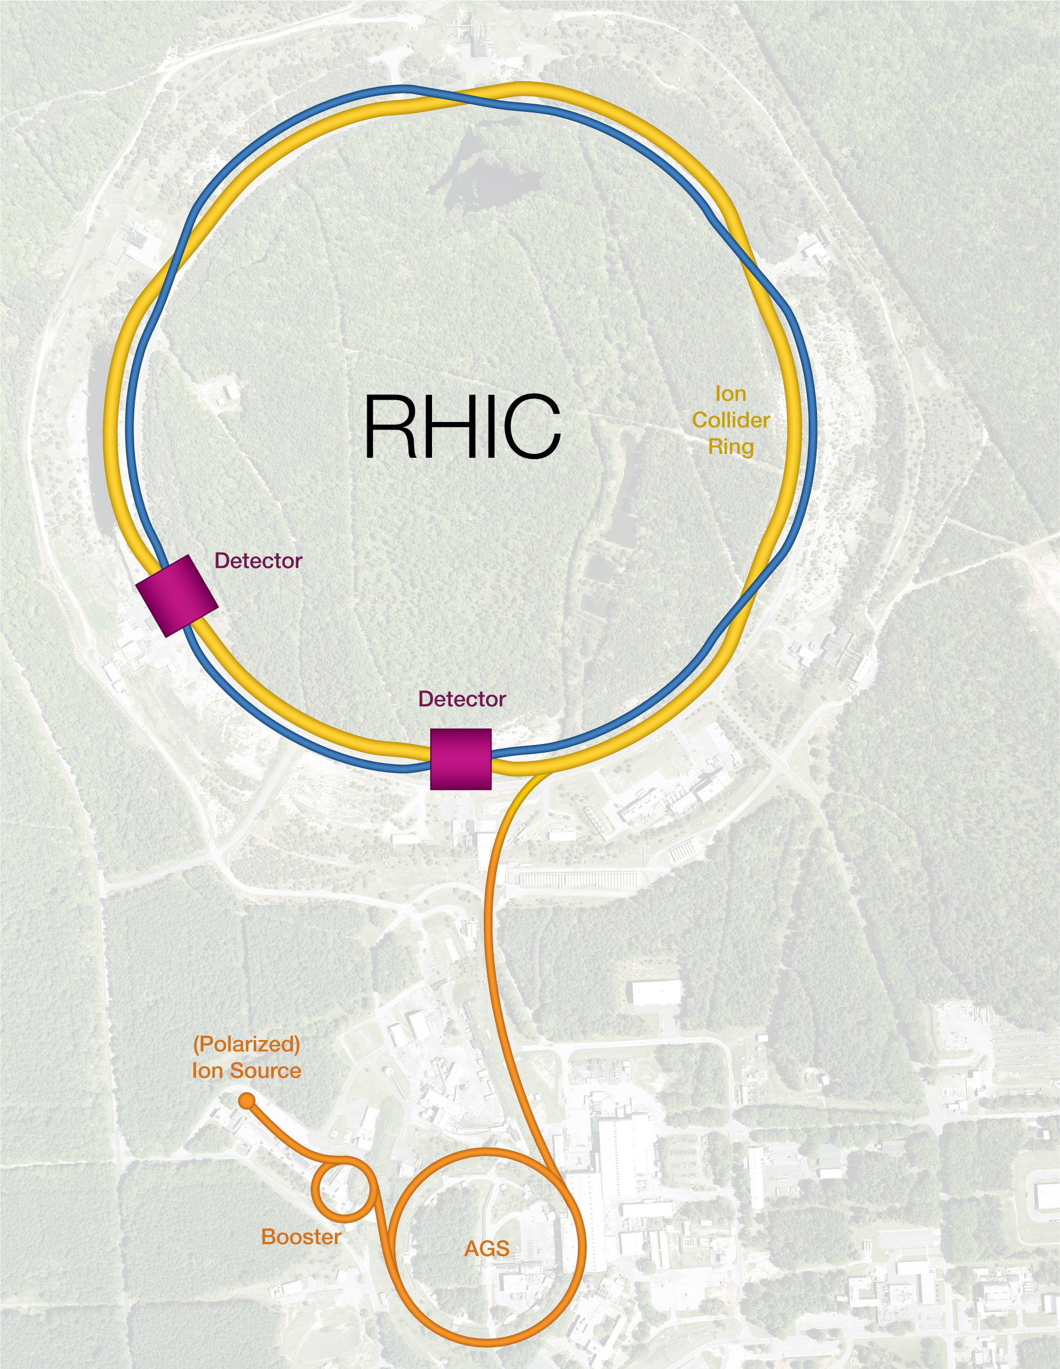
Relativistic Heavy Ion Collider (RHIC)
Existing tunnel and infrastructure
Two SC storage rings
  3.8km circumference
Energy up to 255 GeV protons, or 100 GeV/n gold
110 bunches/beam
Ion species from protons to uranium
EIC is based on the existing RHIC facility.
60% proton polarization – world’s only polarized proton collider (developing He3)
  Needs to be upgraded to 70% (outside of KPPs)
Exceeded design luminosity by a factor of 44
6 interaction regions, 2 detectors
In operation since 2001; operations will end in 2025

Slide 20
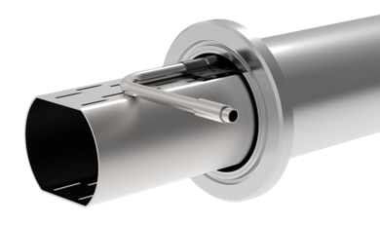
From RHIC to HSR
Tripled beam current, shorter bunch length, shorter bunch distance, ‘flat’ beams with small vertical emittance
EIC HSR to be composed of existing arcs of the Yellow RHIC ring (remove unused magnets)
Insert sleeves coated with copper and amorphous carbon into superconducting magnet beam pipes to improve conductivity and reduce secondary electron yield (-> electron cloud)
Add new RF cavities
Add hadron cooling to create ‘flat’ bunches
Add crab cavities, new IR SC magnets
Add a collimation system
CD-3A: Actively Cooled Beam
Screen Material procurement

Slide 21
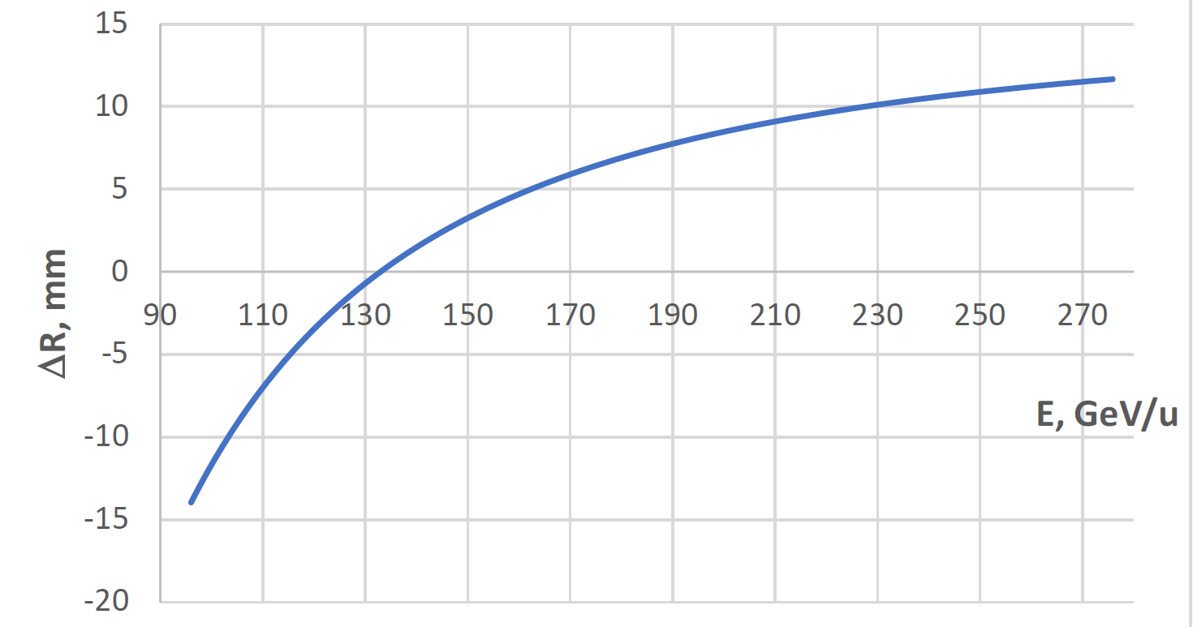

Beam Energy and Average Orbit Radius in the HSR
20 mm
130 GeV
100 GeV
store
275 GeV
70 mm $∅$ beam pipe
Since the electron revolution frequency is fixed, the hadron orbit must be adjusted with energy to keep the collisions in sync.

Slide 22
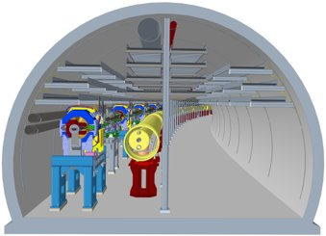
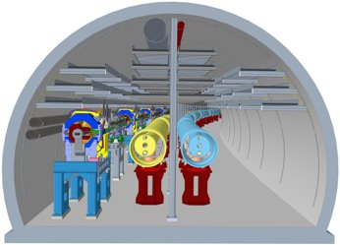
The 41-GeV ‘bypass’
Sector 1 without and with the 41-GeV bypass line

Slide 23
Flat proton bunches
Compared to HERA, the EIC CDR implements two new critical ideas:
  Flat proton bunches at collisions (to match the electron beam dimensions) – this helps with the peak luminosity.
  Continuous proton beam cooling during collisions to maintain matched beam dimensions – this helps with the average luminosity.

Slide 24
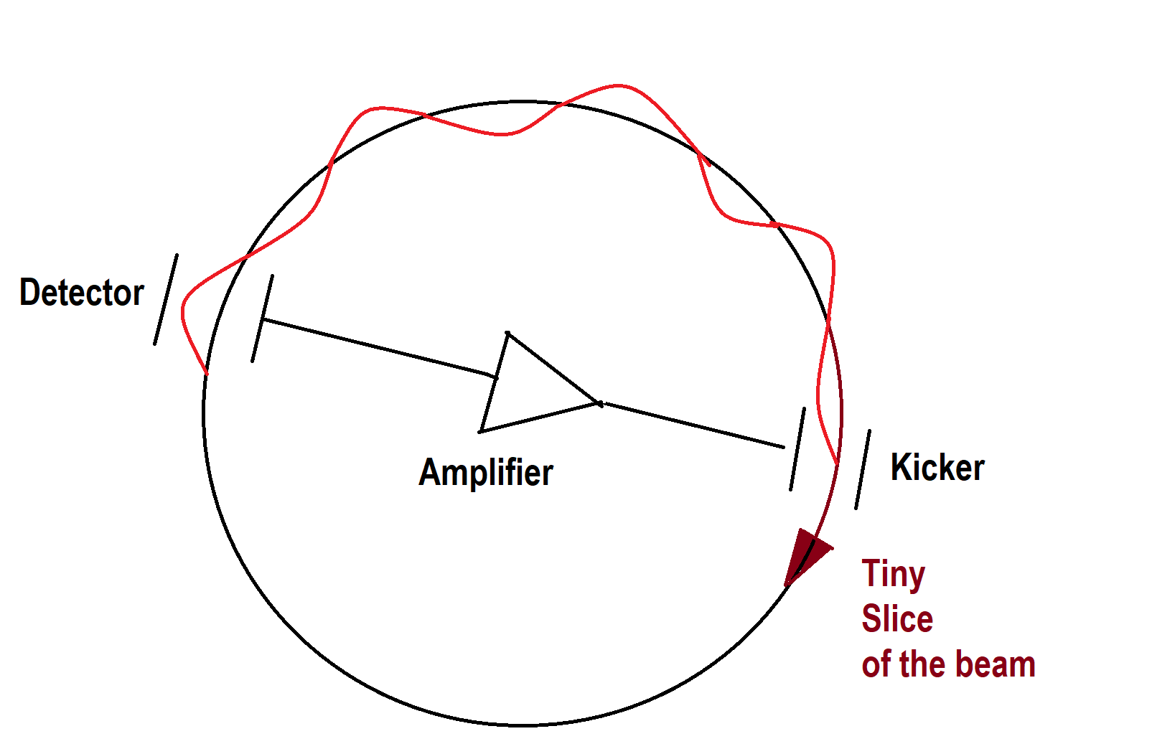
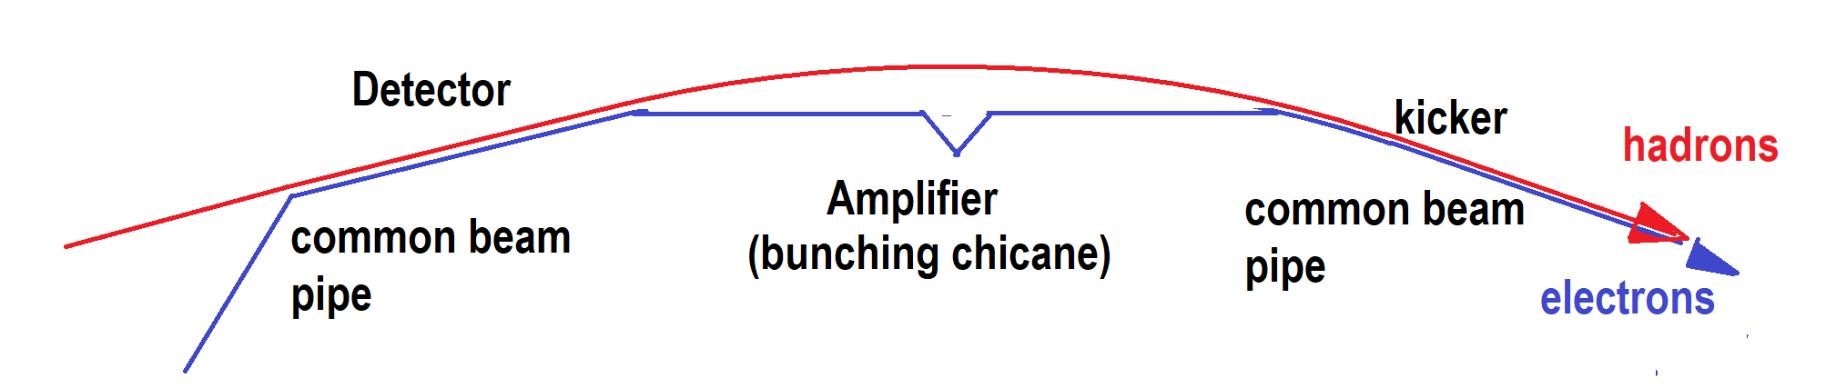
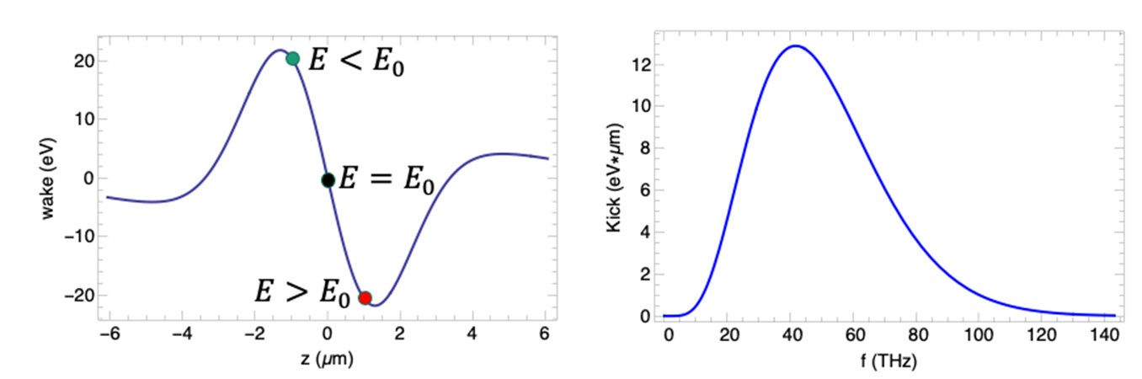
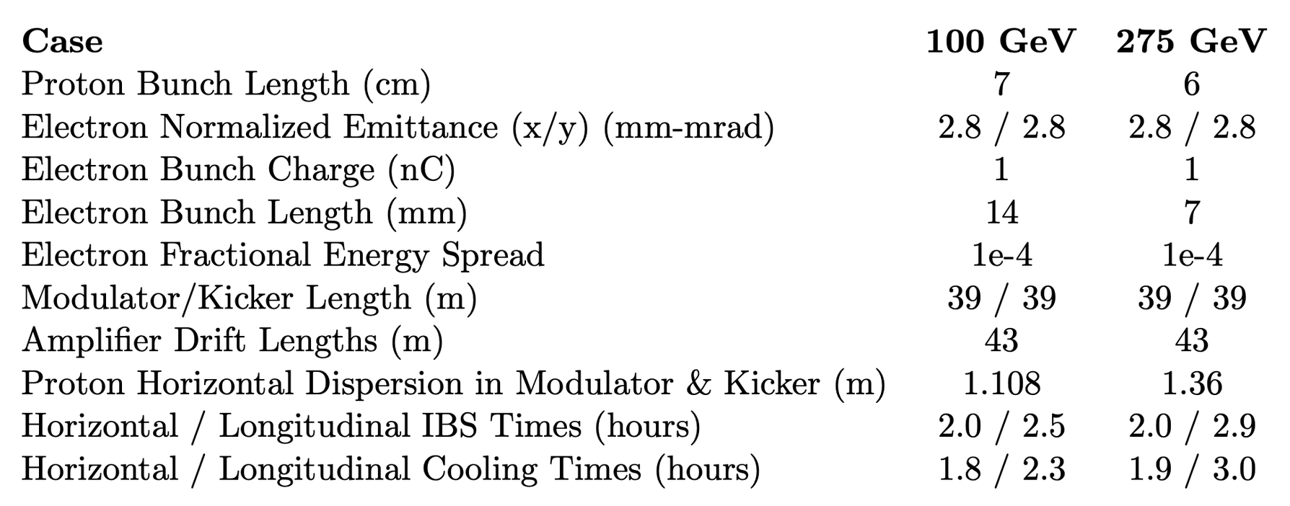
Strong Hadron Cooling at collisions (100 GeV & 275 GeV)
H⁺
E<E₀
E>E₀
Modulator
Kicker
R₅₆
R₅₆
R₅₆
e⁻
The primary concept is based on coherent electron cooling with microbunching amplification
  It’s a type of stochastic cooling based on transit time between the modulator and the kicker. Typical bandwidth of ~40 THz, compared to ~10 GHz (conventional SC).
  This is a longitudinal-only cooling scheme. Cooling in x and y requires coupling/sharing of cooling.
  This concept is very similar to the OSC experiment in IOTA at Fermilab

Slide 25
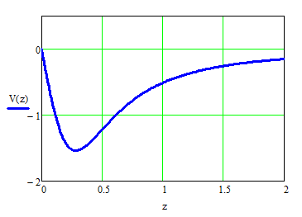
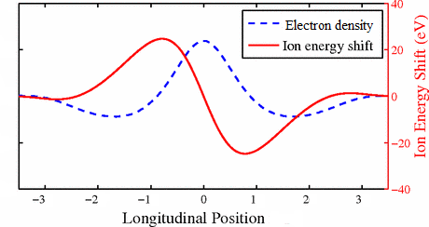
Force for a proton at the center of the electron beam
Initial modulation after “Modulator”
Kick in the “Kicker” section
Amplification with
some limited BW
Achievable cooling times of about 1 hour for 275 GeV protons

Slide 26



SHC: Background Info
2021: The EIC CDR focuses on SHC as a preferred alternative to (1) create flat bunches and (2) maintain emittance during collisions.
2023: We realize that SHC is too slow to create flat bunches at collision energy. Added a low-energy electron cooler (13 MeV) at injection, combined with SHC-CEC.
2024: SHC has remaining unresolved technical challenges. We developed a detailed luminosity model with and without SHC at collisions. Model assumes flat bunches, created by a low-energy electron cooler.
HSR Magnets
CS2 ~60m
(SHC Kicker)
HSR SHC Chicane
CS1 ~60m
(SHC Modulator)
HSR Magnets
HSR Magnets
PreCooler 13 MeV
U- turn
Electron beam direction
SHC 55-150 MeV
Electron beam direction
SHC/Precooler shared returning ERL loop
IP2
E=13, 55, 150 MeV

Slide 27
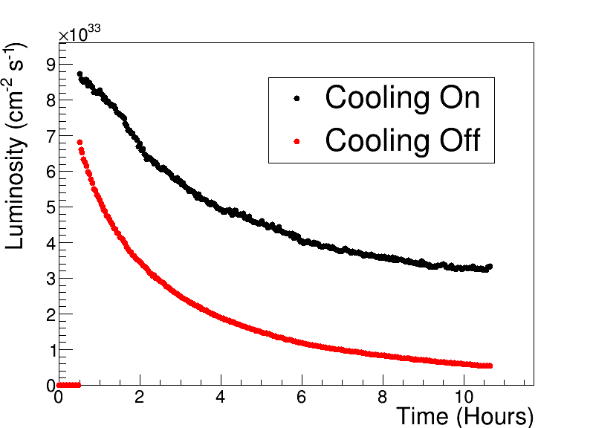
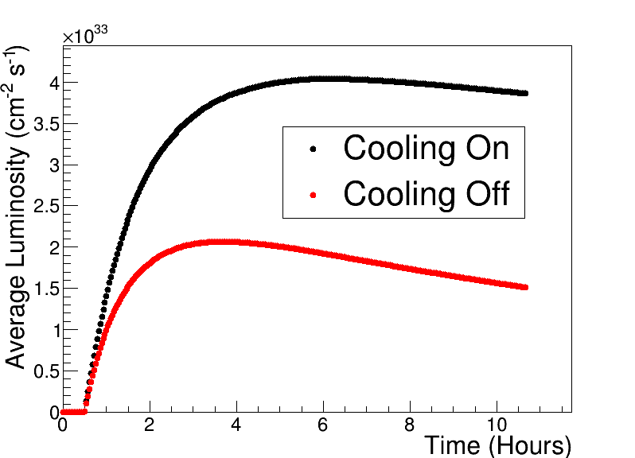
Luminosities w/wo SHC for 275 GeV p on 10 GeV e (example)
Starting collisions with “flat” proton bunches and 28-nC e bunches
See W. Bergan’s talk in SC2
SHC
SHC
ESR fill
Each store starts with 30 mins. precooling and 30 mins. to fill the ESR ring (~1200 bunches);
In addition, we assume a two-hour turnaround time for filling hadrons, precooling, and ramping.

Slide 28
Strategy for Hadron Cooling
The SHC-related risk was identified as ‘HIGH’ by the project.
To mitigate this risk, we are adding an injection electron cooler for hadrons (at 25 GeV/u) to create ‘flat’ bunches. This is a proven and tested technology. We propose to remove the SHC system from the project baseline.
  The average luminosity would drop by a factor of two per our model, but the proposed KPPs and the MNS goals can still be met even without the SHC system.
This downgrades the hadron cooling risk from HIGH (SHC) to LOW (Injection cooler).
The High-Energy Cooling technology development will continue as an off-project R&D program, supported by the EIC Accelerator Collaboration.

Slide 29
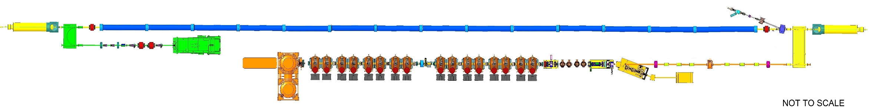
Producing ‘Flat’ Proton Bunches
See A. Fedotov’s talk in SC2
RF diagnostics line with Deflecting cavity
180°Dipole
(U-turn)
LEReC
Cooling Solenoids
180° Dipole
Spectrometer
Mu-metal shielding
Quad
cooling
RF diagnostic
hadron
hadron
hadron
e⁻
HSR
e⁻
HSR
e⁻
extraction
transport
IR2 layout
(all within the
existing RHIC
Tunnel)
Injector test
injection
SC Quad
PM
Cathode transport
PM
PM
Solenoids
Laser
197 MHz
130 kW Beam Dump
Extraction line
900 kW Beam Dump
4x 591 MHz
NCRF correction Cavities
DC Gun
400kV
Injector/linac
Test line
24MHz
RF cavity
16x 197 MHz
NCRF LINAC
Not to scale

Slide 30
Electron Beam Polarization

Slide 31
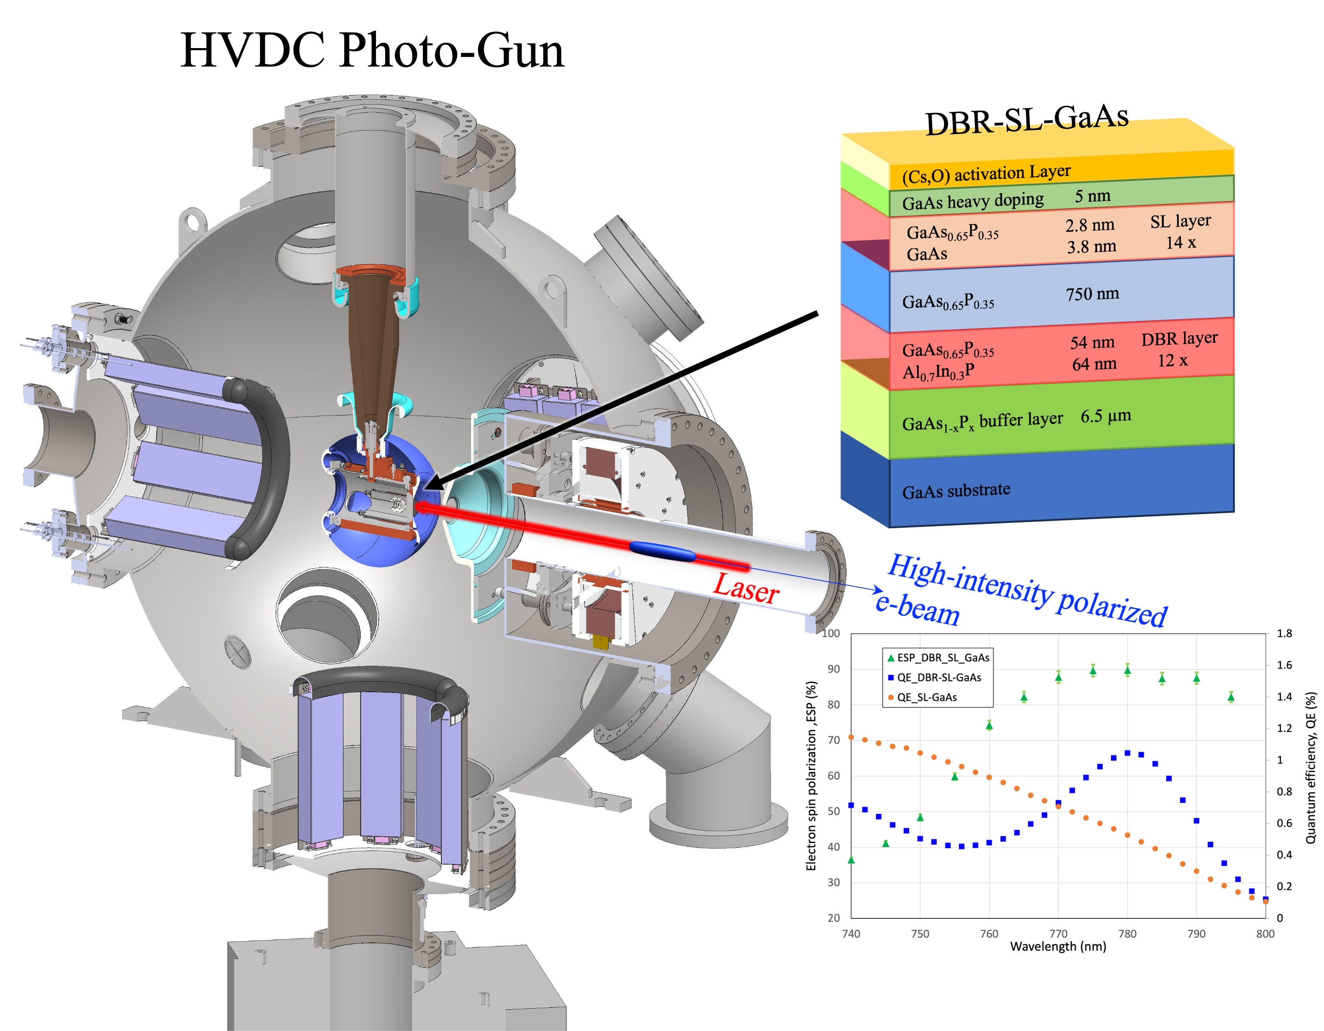
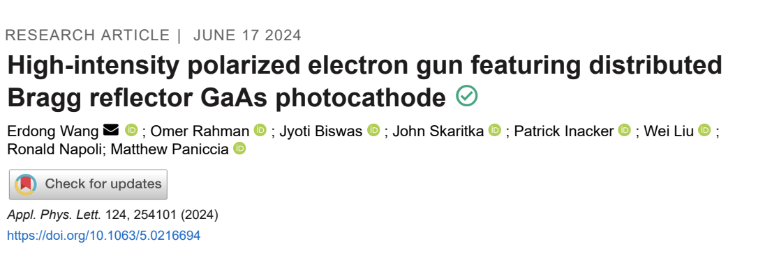
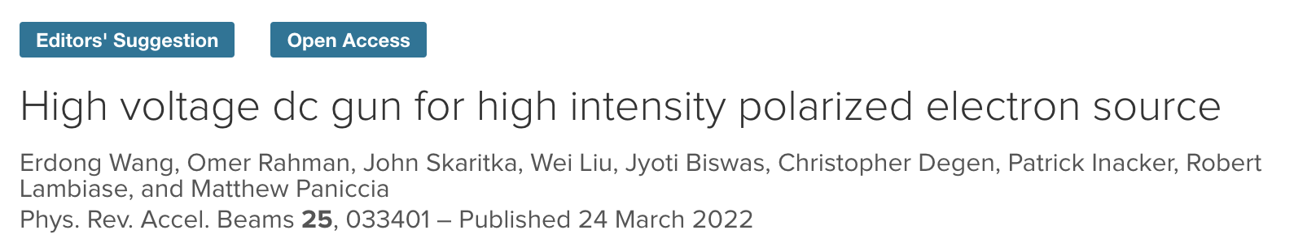
High Intensity Polarized HVDC Gun
Charge 2
High intensity polarized HVDC gun
  R&D achievements
  Plan

Slide 32
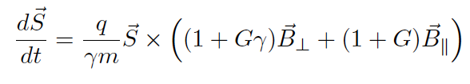
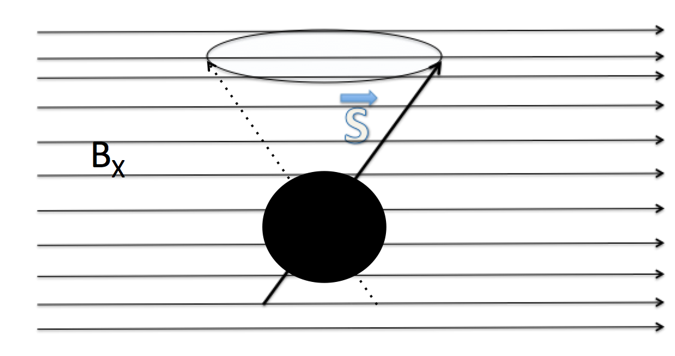
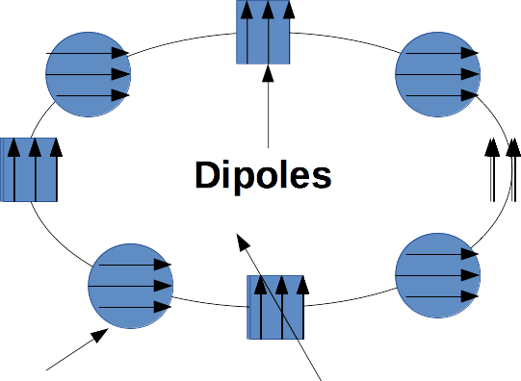


Spin Resonances
G = 0.00115965…
the electron anomalous
dipole moment
Imperfection resonances occur every ~440 MeV

Slide 33
Electron Injector Functions
The EIC design calls for an on-axis swap-out injection of polarized electron bunches into the ESR
  All ESR bunches to be exchanged frequently for 70% average polarization
  Polarized electron source already exists, 85% polarization, ~11 nC bunch charge & long cathode lifetimes.
  Rapid Cycling Synchrotron (1 Hz): special lattice & beam optics suppress depolarizing resonances.
  Frequent swap-out injection of bunches with high initial polarization of 85%
The Electron Injector functions
  Provide 7 nC (ultimately 28-nC) in a single bunch per 1 second
    filling 1160 ESR bunches in 20 minutes (one bunch per second)
  Accelerate up to 10 (18) GeV with a 1-Hz cycle rat
  Preserve the initial polarization during acceleration (~85% min).
  Prepare bunch emittances to match that of the ESR, before bunch transfer
Typically, this would require an extra ring (e.g., LEP, APS, ALS-U, etc.).

Slide 34

Electron polarization loss in the ESR
Frequent injection of bunches with high initial polarization of 85%
Initial polarization decays towards P∞
At 18 GeV, every bunch is replaced (on average) after 2.2 min with RCS cycling rate of 1Hz
B P
B P
Refilled every 3.2 minutes
Refilled every 1.2 minutes
Re-injection
P_{av}=80%
P∞= 30%
(conservative)
P_{av}=80%
Re-injections

Slide 35

Electron Injector
750 MeV linac @ 3 GHz Copper RF
28 x 1 nC single bunch injection
0.75 to 18 GeV at 1 Hz
at 30 Hz
ESR
RCS
1.4 km circ.
In RHIC tunnel
Swap out
Upgrade path
  Add RCS rf cavities: one (at 10 GeV) to ~8 (at 18 GeV)
BAR
28 nC/bunch
accumulator
ring
f_{RF} = 591 MHz
RF
RF
APS PAR ring
30 m long

Slide 36
EIC Electron Storage Ring
Electron Storage Ring (ESR) consists of six FODO-cell arcs, and six straight sections (IRs)
Straight sections are used for:
  Detectors (IR6 and IR8)
  RF cavities (IR10)
  Injection and cross-over with HSR (IR12)
  Instrumentation (IR2)
  Cross-over with HSR (IR4)
Replace figure
Replace figure
See talk by C. Montag, SC-2

Slide 37


Emittance Control in the ESR
EIC needs nearly constant (20 to 24 nm) emittance from 5 to 18 GeV for optimum luminosity, but equilibrium emittance in an electron storage ring depends on beam energy:
Betatron phase advance μ per FODO cell is the “knob” to adjust the emittance
60 degrees at 10 GeV and 90 degrees at 18 GeV yield 20 nm at 10 GeV, 24 nm at 18 GeV
“Super-bends” (reverse bends) for emittance generation below 10 GeV – pole width accommodates the ~20 mm orbit variation
Rotating coil field measurements to be taken along different paths to reflect these orbit changes
Feed-down due to off-center orbits taken into account in dynamic aperture tracking
CD-3B dipole magnet design meets these requirements

Slide 38


Present EIC Concept (2025)
Ultimate EIC Performance Parameters:
High Luminosity: L= 10³³ – 10³⁴cm⁻²sec⁻¹
Highly Polarized Beams: 70%
Large Center of Mass Energy Range: Ecm = 28 – 140 GeV
Large Ion Species Range: protons – Uranium
Large Detector Forward Acceptance and Low-Background Conditions
Possibility to Implement a Second Interaction Region (IR)
Accelerator Status in a glance:
Polarized ion/proton source
Ion injection and initial acceleration systems – Linac (200 MeV), Booster (1.5 GeV), AGS (25 GeV)
Hadron Storage Ring (40-275 GeV) – HSR
Electron Pre-Injector (750 MeV linac) – EPI
Electron Rapid Cycling Synchrotron (0.75 GeV – top energy) – RCS
Electron Storage Ring (5 GeV – 18 GeV) – ESR
Interaction Region(s) – IR
Hadron Injection Cooling System
38

Slide 39

EIC Project-Critical Decisions and Plans
2019
2021
CD-2 and CD-3 in Preparation
CD-4 EF = 2034
CD-3A, Long-Lead Procurement, approved March 2024. Excellent use of IRA funding.
CD-3B, Long-Lead Procurement, approval planned for March 2025.

Slide 40
Proposed EIC Performance Goals
10³¹
10³²
10³³
MNS range
10³⁴
EIC Luminosity (e, p)
EIC project
Early Science Program
Upgrades and improvements
We are proposing to focus on delivering EIC performance, which meets the MNS for the range of Center of Mass energies from 40 GeV – 100 GeV and peak luminosity of 10³³ cm⁻²s⁻¹ or above. Ultimate EIC performance would leverage upgrades and improvements.

Slide 41

EIC Early Science Program Reach
41

Slide 42



Strong Support from Partners & Collaborators
New York State committed $100M toward construction of EIC buildings and infrastructure.
EIC Accelerator Collaboration kicked off at the International Particle Accelerator Conference with over 150 participants expressing interest in contributing to the global EIC effort.
UK announced £58 million ($75M) for the EIC.
EIC Resource Review Board Meetings in Rome in May 2024 and at BNL in Oct. 2024. Strong participation from Canada, Czech Republic, France, India, Israel, Italy, Japan, Poland, South Korea, United Kingdom, and Taiwan. Next meeting to be held in Prague in June 2025.
In-kind contribution goals represent ~30% of the Detector and ~5% of the Accelerator
42
42
42

Slide 43
Summary
EIC is a unique, high-energy, high-luminosity, polarized beam collider that will be one of the most challenging and exciting accelerator complexes ever built – the only new collider in the next decades.
All EIC design elements are progressing well!
Some project scope is well developed, designs are mature, ready to be executed as Long-lead procurements (CD3A, CD3B)
We made several project design decisions to increase the design maturity and decrease risks.
  There is no change to the current preliminary performance parametrs and no change to the EIC cost objective.
We understand what we need to build to deliver EIC!

Slide 44
Extra slides

Slide 45

CeC-X Experiment(off project) Update
Kicker
4-cell PCA
Modulator
Observed high noise in the initial bunch in Run 19, fail to observe CeC signal.
Observed conventional e-cooling in Run 21, but CeC cooling was washed out by large timing jitter
(15 ps, RMS) of the seed laser and resulting 5x10⁻⁴ RMS e-beam energy jitter.
Observed PCA-amplified imprint of ion beam in the electron beam radiation.
In Run 23, the beam test was not finished due to early RHIC operation termination.
Lessons learned from CeC-X experiment benefits the EIC cooler design, e.g.
  Studied the beam noise requirements and simulate noise electron beam in the accelerator design.
  Mode-lock laser is selected for low jitter.
  A uniform current and uniform energy spread electron beam is important to get high cooling rate.
  Our design has addressed this issue.
  SPACE code is used to benchmark the hybrid model code.
  Emittance growth due to focusing from ions. Optimized the electron beam size to reduce this effect.
  Evaluating possibility of using PCA as SHC amplifier.

Slide 46
Polarized Beams
Discriminating against systematic errors: polarized bunches with spin up & down, stored simultaneously
Hadrons:
RHIC: successful polarized program with Siberian snakes & spin rotators based on helical dipoles
Electrons:
  Sokolov-Ternov self-polarization is too slow, produces only polarization anti-parallel to main dipole field
➔ Polarized electron bunches produced at the GaAs cathode & accelerated and injected at collision
energy into electron storage ring
Sokolov-Ternov works against spin-down polarization, spin diffusion reduces polarization
➔All bunches be exchanged frequently for 70% average polarization
Polarized source already exists, 91% polarization, 11 nC bunch charge & long cathode lifetimes
Rapid cycling synchrotron (1 Hz): special lattice & beam optics suppress depolarizing resonances
Frequent injection of bunches with high initial polarization of 85%
Spin rotators: 8 strong solenoids around IR ➔ helical electron spins

