Slide 1
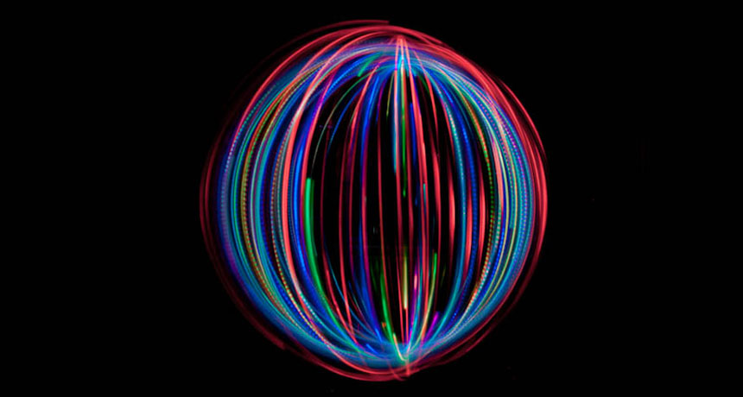
Spin Structure of the Nucleon
Renee Fatemi
University of Kentucky
March 10th, 2025
Center for Frontiers in Nuclear Science Special Conference on Polarized Sources and Beams at the EIC

Slide 2
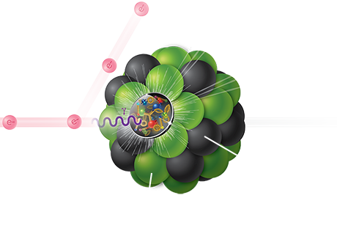

How do we “see” quarks and gluons?
At the EIC we will use matter, electrons, to probe inside nucleons and nuclei.
Resolution of matter microscope:
$Q^{2}=−(p_{e}−$ $p_{e}$’)²
Momentum Fraction of struck quark:
$$x= \frac{Q^{2}}{2p_{p}{·p}_{γ}}$$

Slide 3

When you close your eyes … what proton do you see?

Slide 4
Credits
This work was a collaborative effort of Rolf Ent (Physicist, Jefferson Lab) and Richard Milner (Physicist, MIT). Proton animations by James LaPlante (Animator, Sputnik Animation). Edited by Alexander Higginbottom (MIT Video Productions). Film consultants Christopher Boebel and Joe McMaster (Film Producers, MIT).

Slide 5
Now add in spin degrees of freedom….

Slide 6

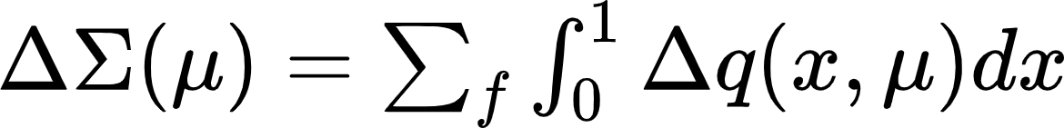
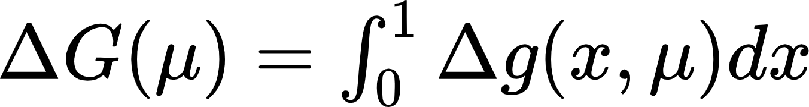
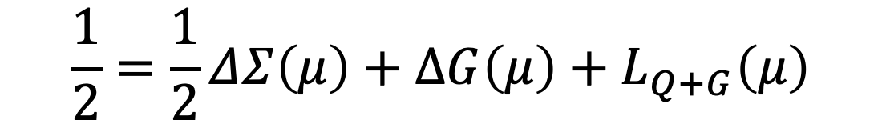
Spin Sum Rule
$$\frac{1}{2}=\frac{1}{2}ΔΣ\left(μ\right)+∆G\left(μ\right)+L_{Q+G}\left(μ\right)$$
QUARK Helicity
All distributions are defined at renormalization scale μ ~ Q² setting the effective resolution at which the proton is probed.
GLUON Helicity
QUARK+GLUON Angular Momentum

Slide 7
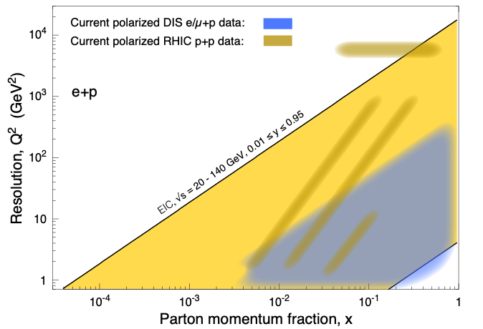
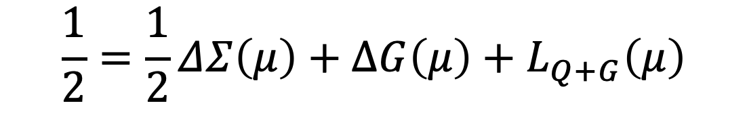
Spin Sum Rule
$$\frac{1}{2}=\frac{1}{2}ΔΣ\left(μ\right)+∆G\left(μ\right)+L_{Q+G}\left(μ\right)$$

Slide 8
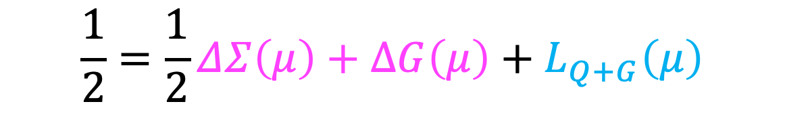
$$\frac{1}{2}=\frac{1}{2}ΔΣ\left(μ\right)+∆G\left(μ\right)+L_{Q+G}\left(μ\right)$$
Helicity Distributions
Quark Sum and Gluon
Flavor separated quarks
Sea quark distributions
Bjorken Sum Rule
Orbital Angular Momentum
Sum Rule constraints
Generalized Parton Distribution Functions
Transverse Momentum Distributions

Slide 9
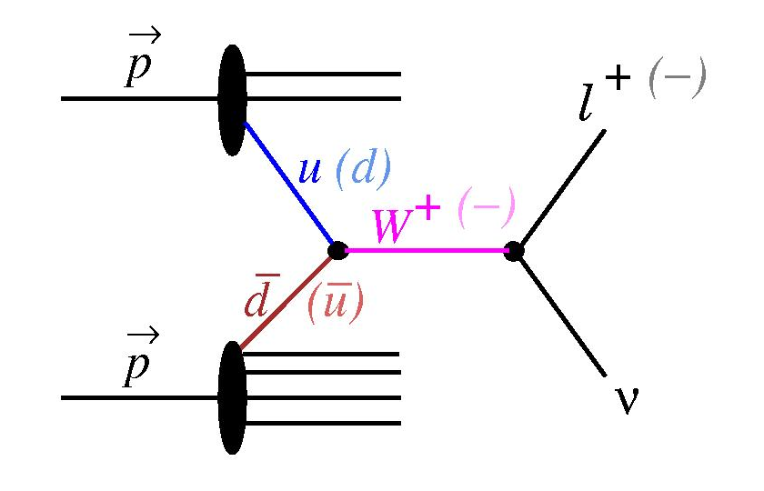
Quark and Gluon HELICITY
Four decades of asymmetry measurements in polarized lepton-proton and proton-proton scattering experiments has produced a wealth of data that is sensitive to quark and gluon helicity distributions.

Slide 10
Quark and Gluon HELICITY
Global QCD Analysis of inclusive DIS + SIDIS and pp data allows for extraction of state-of-the art helicity PDFs at NLO and NNLO.
DSSV
PRL 101 (2008) 072001
PRD 80 (2009) 034030
PRL 113 (2014) 012001
PRD 100 (2019) 114027
JAM
PRD 93 (2016) 074005
PRL 119 (2017) 132001
PRD 104 (2021) L031501
NNPDF ^{*only inclusive}
NPB 874 (2013) 36
NPB 887 (2014) 276
arXiv : 1510.04248
arXiv : 1702.05077

Slide 11
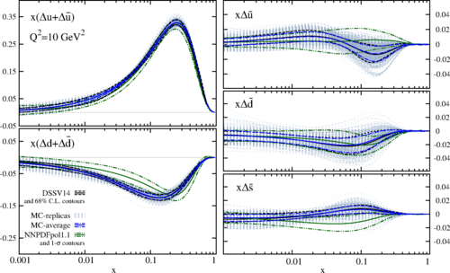
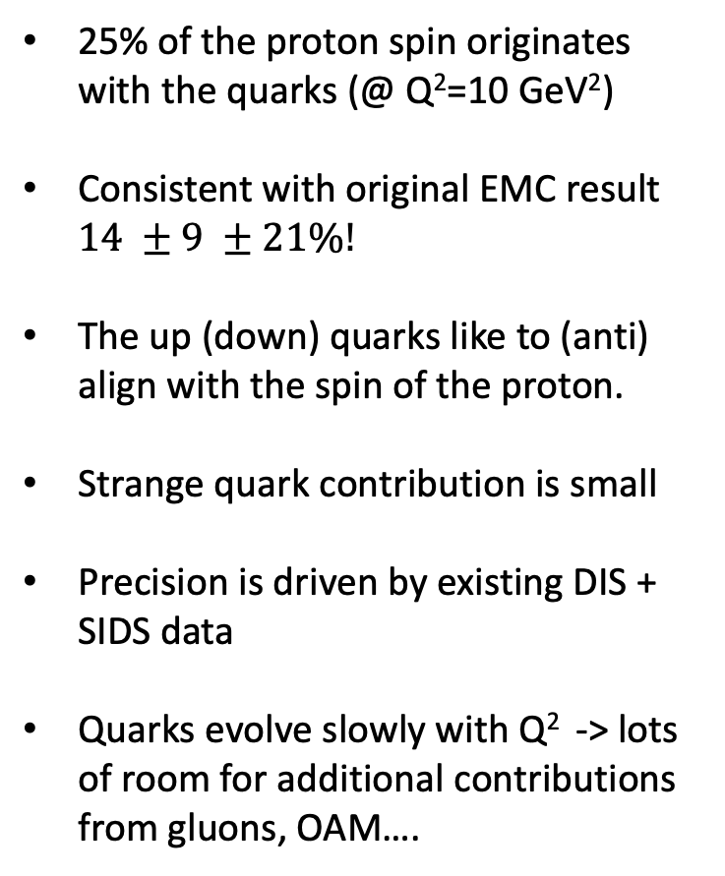
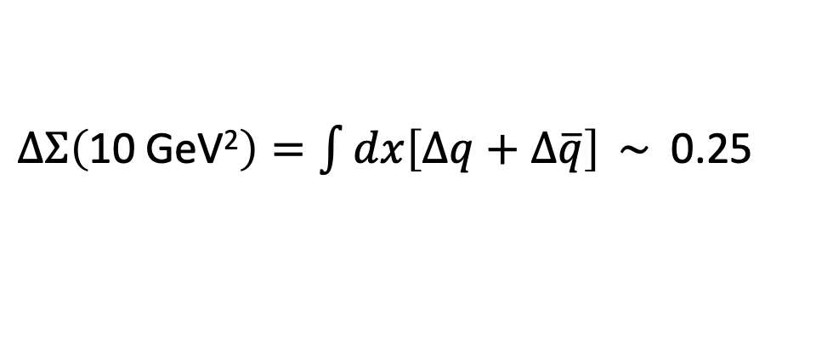
Quark and Gluon HELICITY
25% of the proton spin originates with the quarks (@ Q²=10 GeV²)
Consistent with original EMC result $14 ±9 ±21\%!$
The up (down) quarks like to (anti) align with the spin of the proton.
Strange quark contribution is small
Precision is driven by existing DIS + SIDS data
Quarks evolve slowly with Q² -> lots of room for additional contributions from gluons, OAM….
$∆Σ\left(\text{10 }\text{GeV}\text{2}\right)=\int{dx\left[∆q+∆\overline{q}\right]} \sim$ 0.25

Slide 12
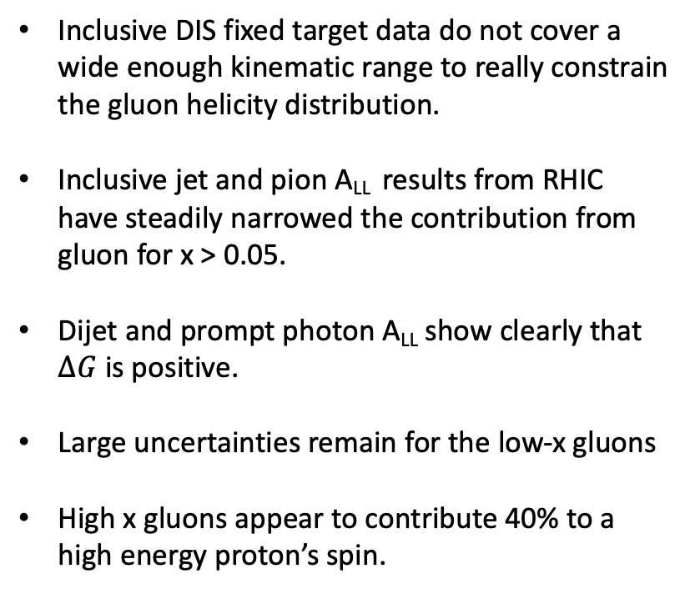
Quark and Gluon HELICITY
Inclusive DIS fixed target data do not cover a wide enough kinematic range to really constrain the gluon helicity distribution.
Inclusive jet and pion A_{LL} results from RHIC have steadily narrowed the contribution from gluon for x > 0.05.
Dijet and prompt photon A_{LL} show clearly that $∆G$ is positive.
Large uncertainties remain for the low-x gluons
High x gluons appear to contribute 40% to a high energy proton’s spin.

Slide 13
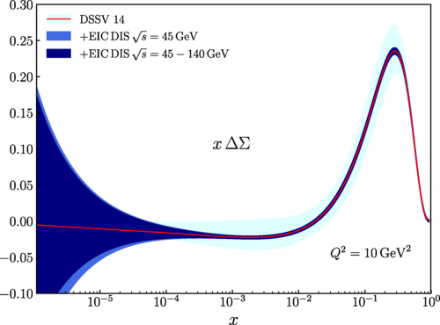
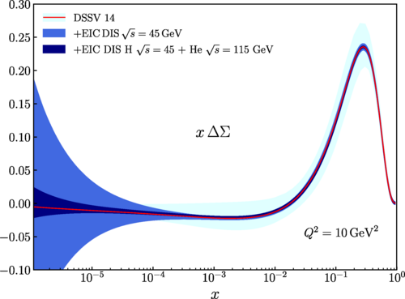

EIC constraints on $∆Σ$
PRD 102 (2020) 094018
Inclusive e+p data only!
Inclusive data e+p and e+He data

Slide 14
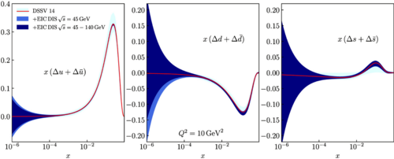
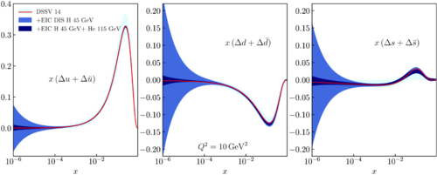
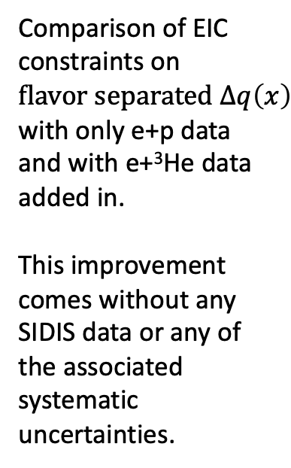
Quark and Gluon HELICITY
Comparison of EIC constraints on $flavor separated ∆q\left(x\right)$ with only e+p data and with e+³He data added in.
This improvement comes without any SIDIS data or any of the associated systematic uncertainties.
PRD 102 (2020) 094018

Slide 15
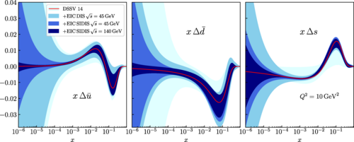
Quark and Gluon HELICITY
PRD 102 (2020) 094018
EIC constraints on $∆q\left(x\right)$ from both Inclusive and SIDIS data.

Slide 16
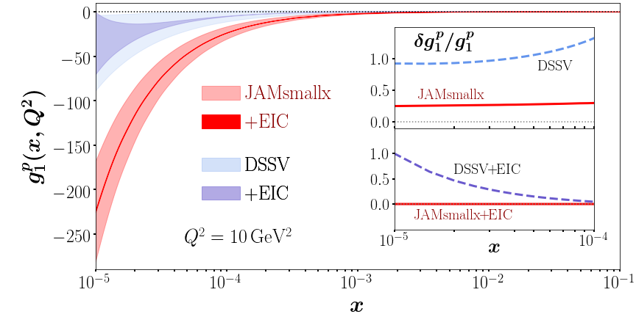

Quark and Gluon HELICITY
EIC constraints on $∆g(x)$
Curves x < 10⁻⁴ are constrained by evolution equations. DSSV and JAMsmallx use Q² and x evolution respectively.
Kinematic limit of ePIC
PRD 102 (2020) 094018
PRD 104 (2021) L031501

Slide 17
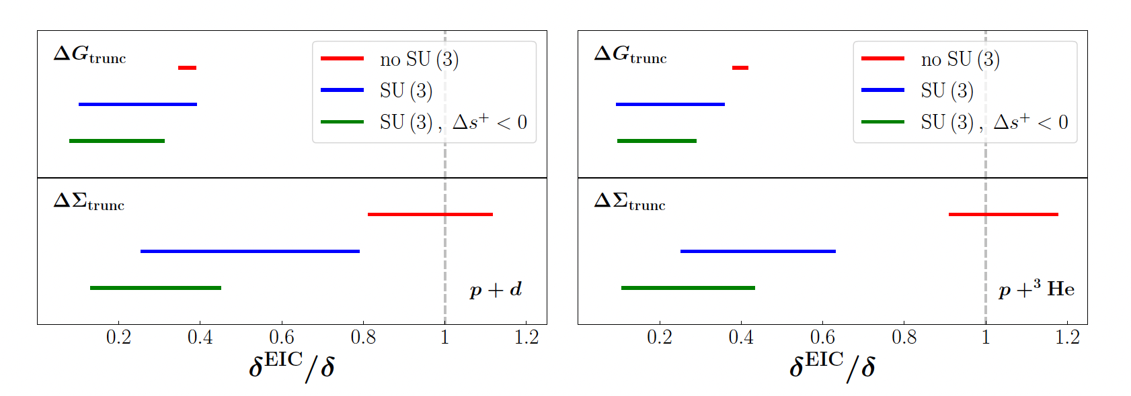
Quark and Gluon HELICITY
JAM Collaboration
Phys Rev D. 111, 05201 (2024)
Proton + deuteron
Proton + ³He
Ratio of the uncertainties on the truncated (x_{min} = 0.0001) quark singlet and gluon moments with and without EIC data as evaluated by JAM collaboration. The width of the lines correspond to uncertainty on extrapolation to lower x.

Slide 18
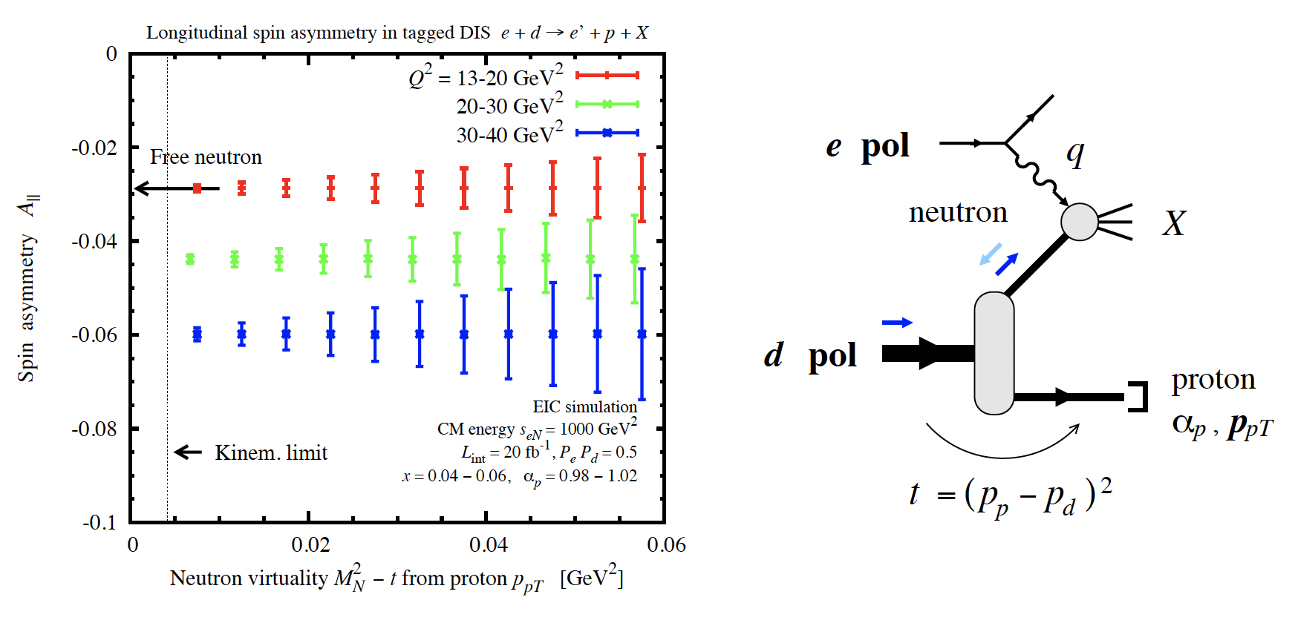
Quark and Gluon HELICITY
Analysis of ³He data relies on effective neutron polarizations inferred from non-relativistic nuclear structure.
Nuclear modifications arise from Δ isobars in the ³He nucleus for x > 0.1 and from spin-dependent nuclear anti-shadowing and shadowing at x < 0.1.
If the proton is tagged and the asymmetry plotted as a function of the neutron virtuality, then the free neutron spin asymmetry can be extracted in the limit of virtuality ~ 0.
Phys Rev D. 111, 05201 (2024)

Slide 19
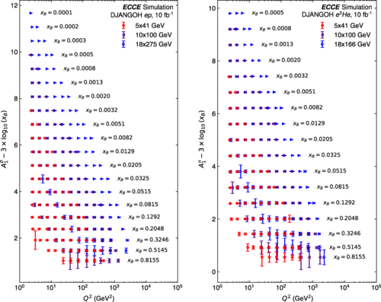
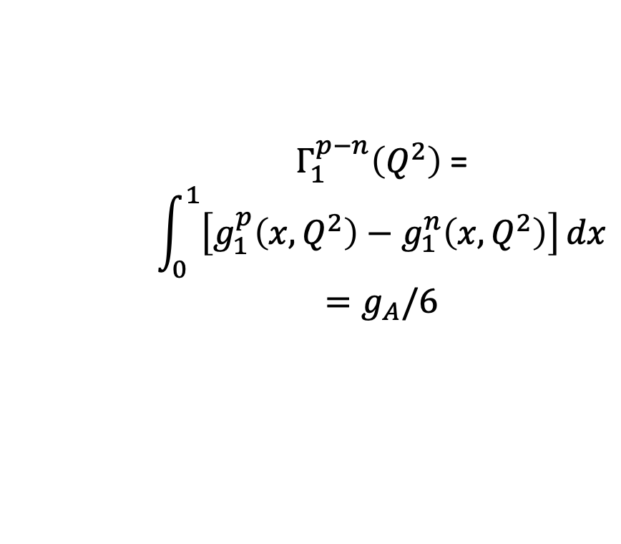
Quark and Gluon HELICITY
Phys Rev D. 110, 074004 (2024)
Highly polarized proton and ³He beams (~70%), spanning a range of center-of-mass energies, allow for a precision measurement of the Bjorken Integral:
$Γ_{1}^{p−n}\left(Q^{2}\right)$ =
$$\int_{0}^{1}{\left[g_{1}^{p}\left(x,Q^{2}\right)−g_{1}^{n}\left(x,Q^{2}\right)\right]}dx$$
$${=g}_{A}/6$$
In the limit of Q² → ∞ the integral is equal to the axial vector coupling constant

Slide 20
Quark and Gluon HELICITY
Requires:
Measurement of double spin asymmetries where hadron spin is longitudinal and transverse to momentum. Electron spin is always longitudinal.
Double tagging, i.e. both spectator protons from ³He are detected using far forward tracking and roman pot detectors spanning 4 < η < 6.
Low x contribution to integral determined by subtracting simulated (aka measured) portion from calculation of total sum rule (next page).
Phys Rev D. 110, 074004 (2024)

Slide 21
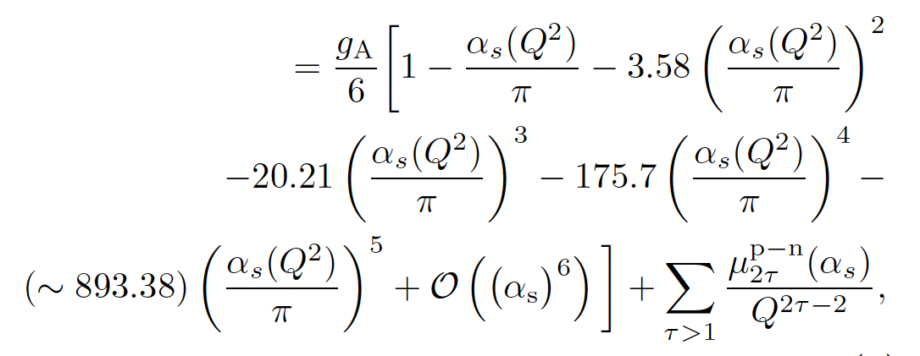
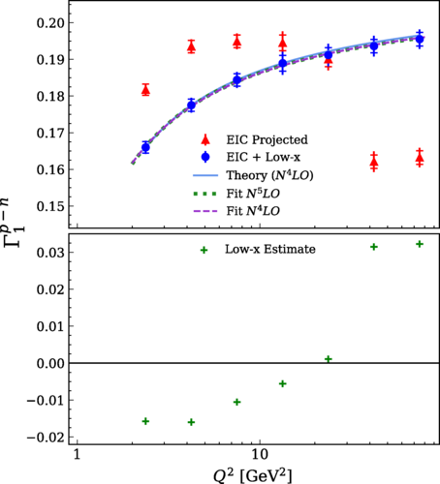
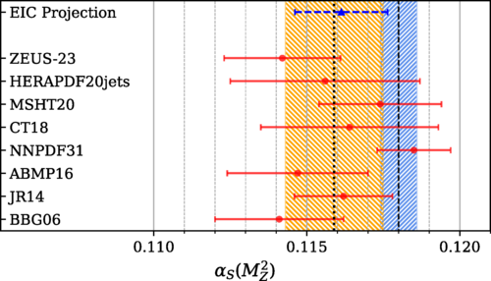

Exploit the Q² evolution of BSR to constrain ⍺_{s} !
Phys Rev D. 110, 074004 (2024)
$Γ_{1}^{p−n}\left(Q^{2}\right)$

Slide 22
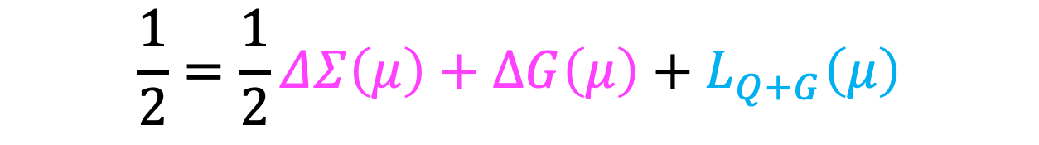
Orbital Angular Momentum
$$\frac{1}{2}=\frac{1}{2}ΔΣ\left(μ\right)+∆G\left(μ\right)+L_{Q+G}\left(μ\right)$$

Slide 23
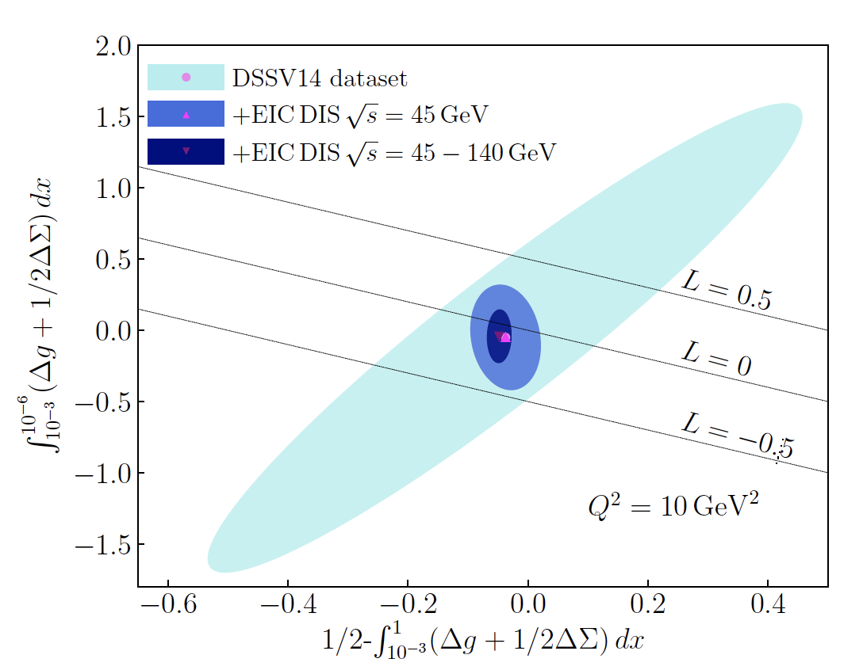
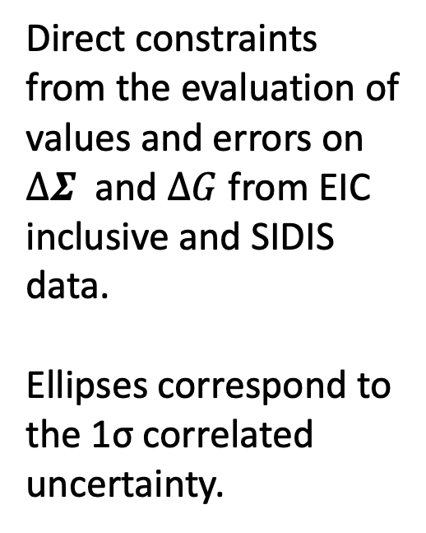
Orbital Angular Momentum
Direct constraints from the evaluation of values and errors on $∆Σ$ and $∆G$ from EIC inclusive and SIDIS data.
Ellipses correspond to the 1σ correlated uncertainty.

Slide 24
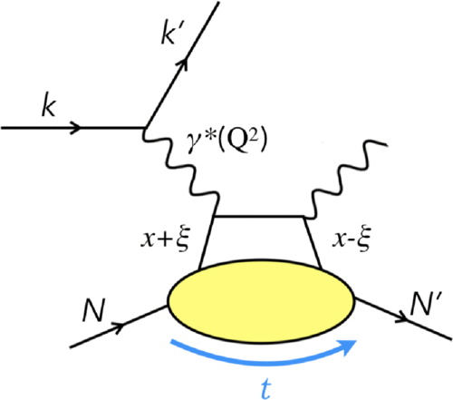
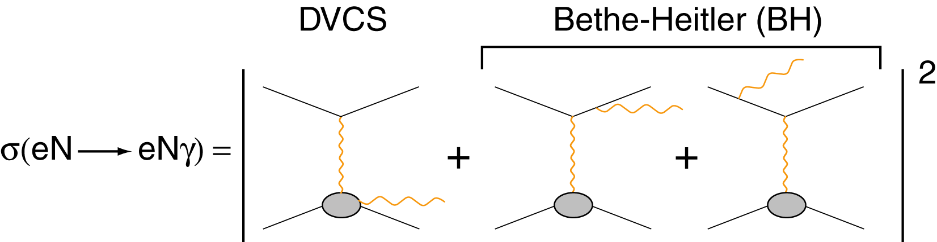
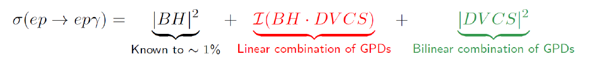
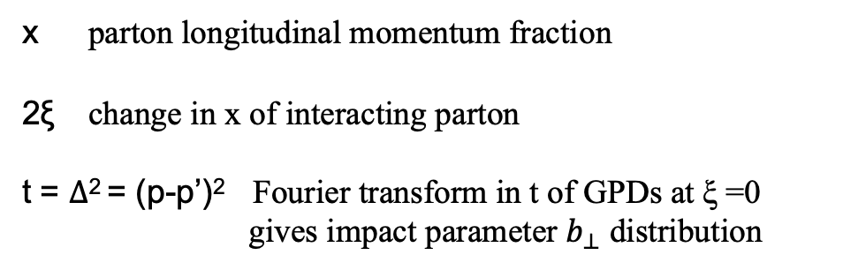
Orbital Angular Momentum
… Also accessible via Deeply Virtual Compton Scattering
x parton longitudinal momentum fraction
2ξ change in x of interacting parton
t = $∆$² = (p-p’)² Fourier transform in t of GPDs at ξ =0 gives impact parameter $b_{⊥}$ distribution
~ ~
H, E, H, E (x,ξ,t)
Notes:
BH is exactly calculable from QED from nucleon form factors

Slide 25
Orbital Angular Momentum
3D QUARK NUMBER DENSITY & HELICITY
~ ~
H, E, H, E (x,ξ,t)
M. Burkardt, PRD 62, 71503 (2000)
QUARK ANGULAR MOMENTUM : Ji Sum Rule
X. Ji, Phy.Rev.Lett.78 (1997)

Slide 26
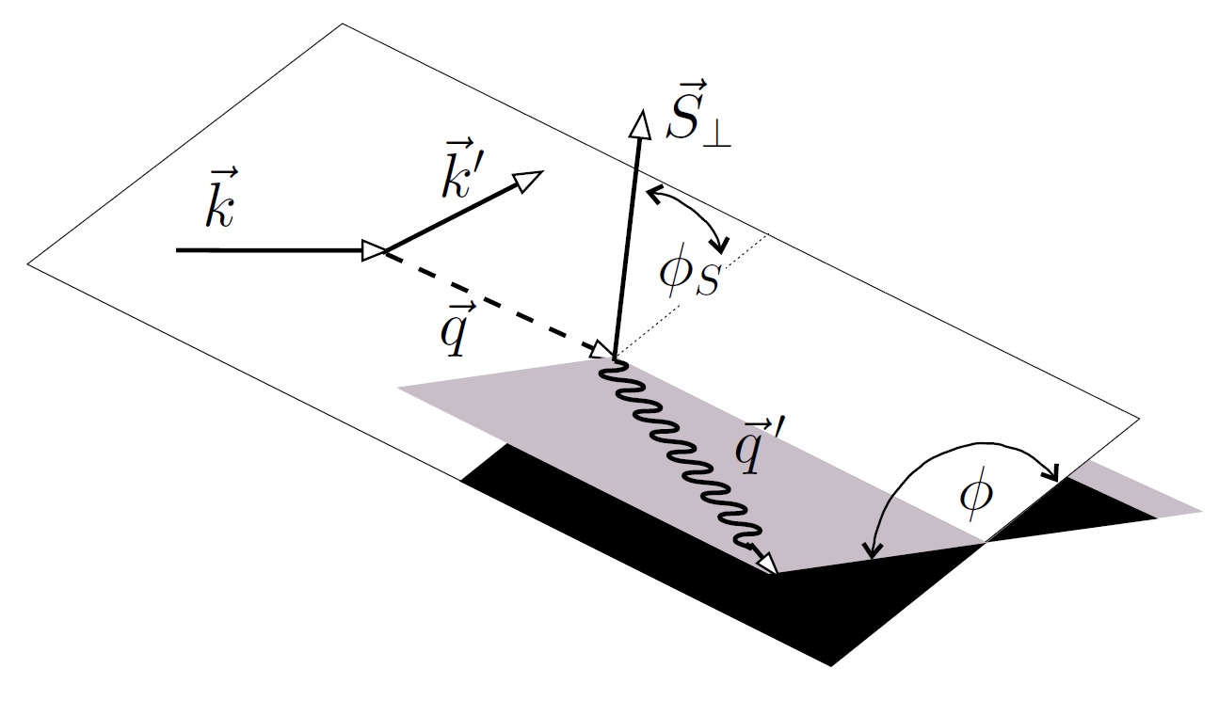
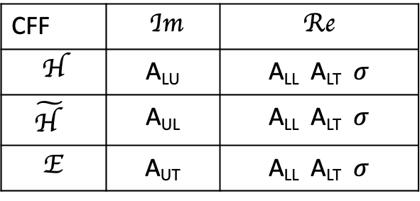
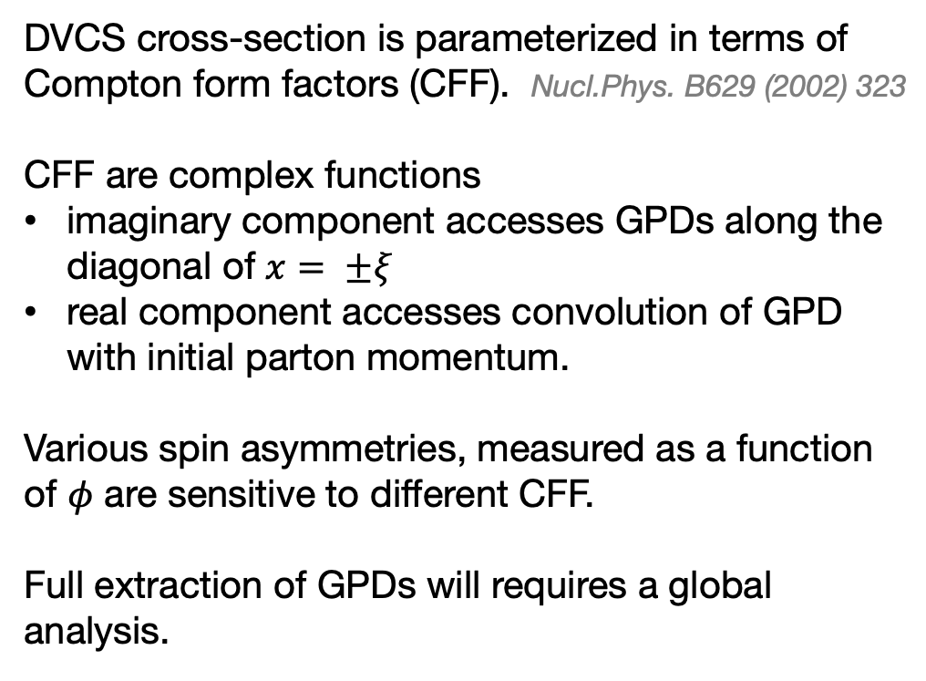
GPD Extraction
DVCS cross-section is parameterized in terms of Compton form factors (CFF). Nucl.Phys. B629 (2002) 323
CFF are complex functions
imaginary component accesses GPDs along the diagonal of $x= ±ξ$
real component accesses convolution of GPD with initial parton momentum.
Various spin asymmetries, measured as a function of $φ$ are sensitive to different CFF.
Full extraction of GPDs will requires a global analysis.
CFF | Im | Re
H | A_{LU} | A_{LL} A_{LT} $σ$
$$\tilde{\text{H} }$$ | A_{UL} | A_{LL} A_{LT} $σ$
E | A_{UT} | A_{LL} A_{LT} $σ$

Slide 27
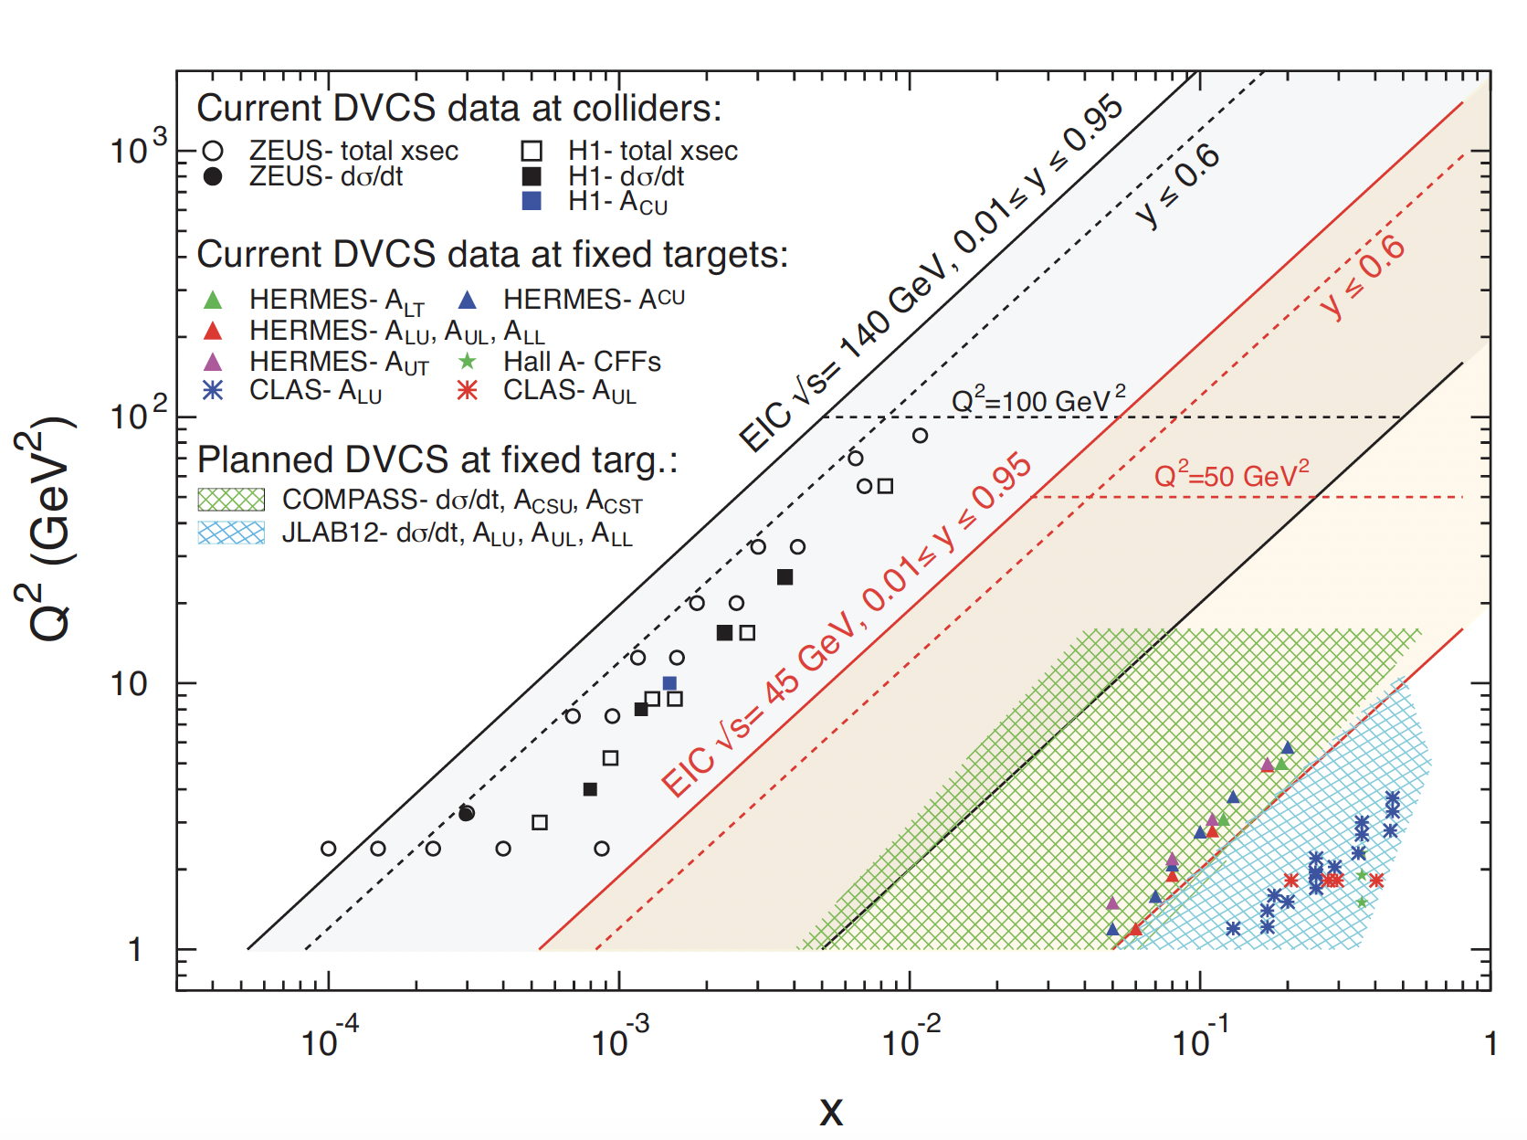
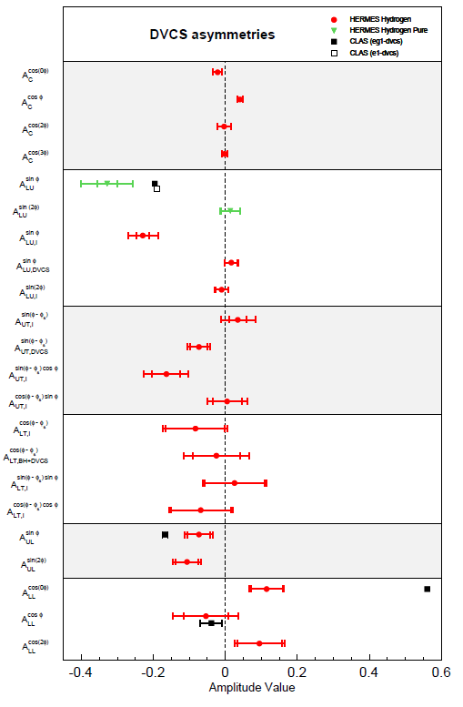
Current and Future DVCS Experiments
JLAB high-x program critical for valence region!
from Silvia Niccolai, SPIN 2023

Slide 28
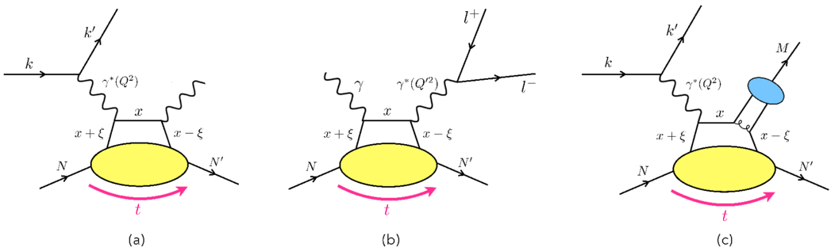
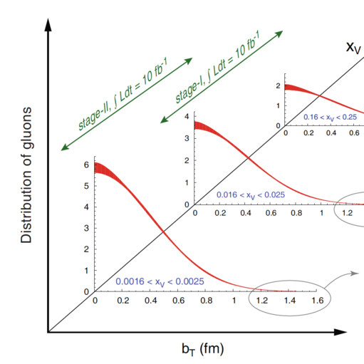
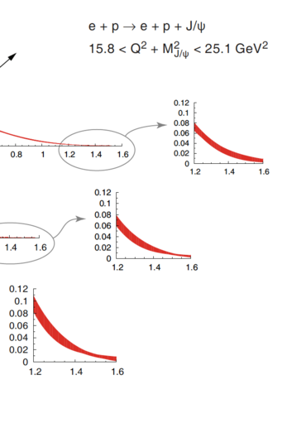
GPDs at the EIC
Orbital Angular Momentum
Will access a unique kinematic space that is sensitive to gluons and sea quarks.
GPD program is one of the most experimentally demanding at the EIC.
Requires multi-dimensional binning over broad range of center-of-mass energies.
Requires precision calorimetry to reconstruct scattered electron and photon.
Requires careful design of the interaction region to allow for reconstruction of protons scattered at small forward angles.
Notes:
Projected EIC uncertainties for the gluon IPD obtained from a Fourier transform of the differential cross-section j/Psi production for 10 fb-1

Slide 29
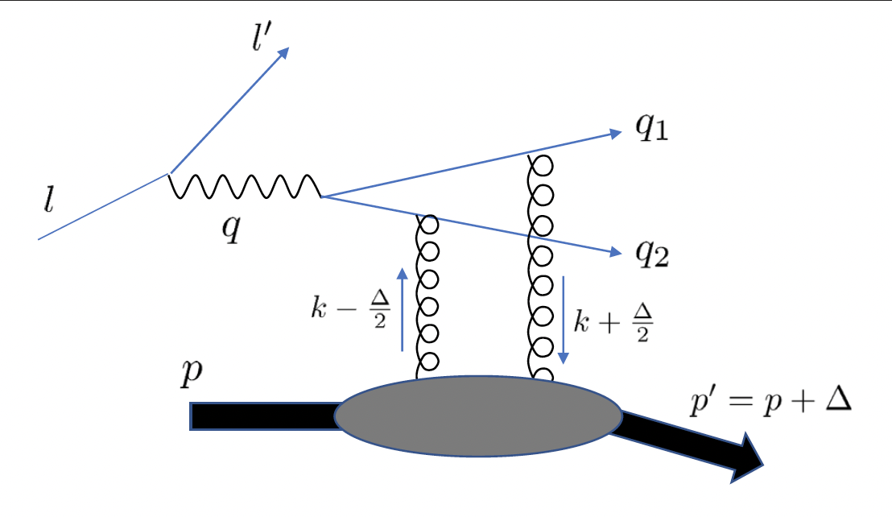
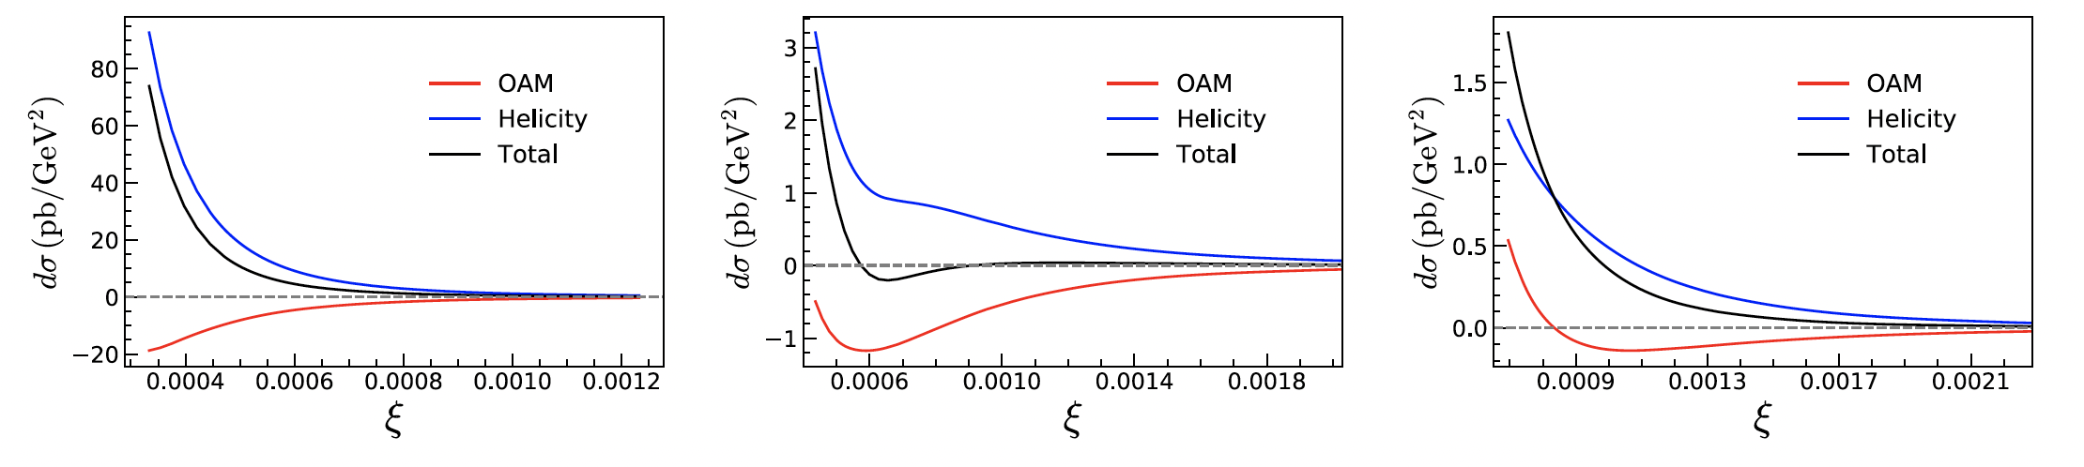
Exclusive Dijet Double Spin Asymmetry
Requires longitudinally polarized electron and proton beams
Azimuthal angle of scattered electron must be measured
Dijets emerge in backwards region (-2 < η < -1)
DSA is sensitive to GPDs that encapsulate gluon OAM and helicity information.
Precisely mapping out gluon helicity GPD will allow for extraction of gluon OAM component.
Phys. Rev. Lett. 128, 182002 (20222)
Q² = 2.7
Q² = 4.8
Q² = 10

Slide 30
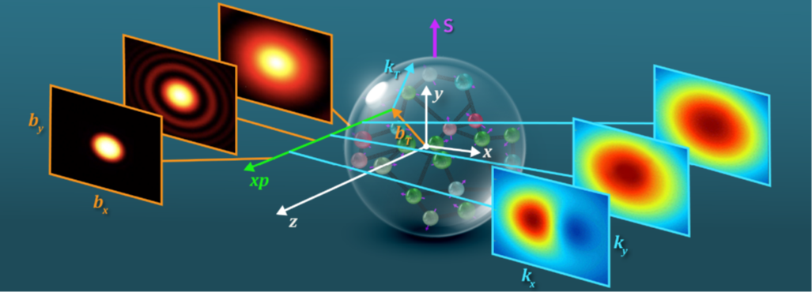
3D Imaging
GPD
TMD
2D in parameter space +1 in momentum space
Collinear factorization
Gives access to parton helicity and OAM
Multiple channels, including Deeply Virtual Meson Production are necessary for full reconstruction.
3D in momentum space
Non-trivial factorization
Origin of spin-orbit correlations is orbital angular momentum.

Slide 31
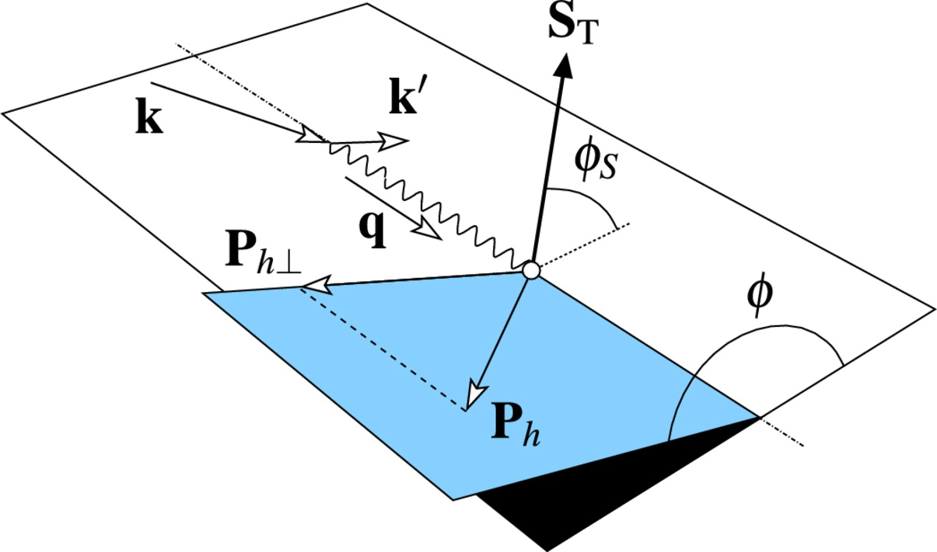
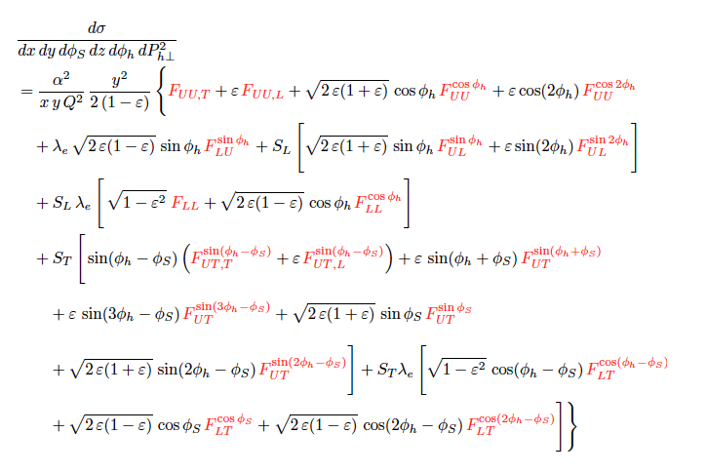


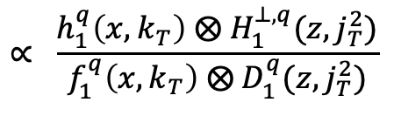
TMDs in SIDIS
A_{COLLINS}
$$∝ \frac{h_{1}^{q}\left(x,k_{T}\right) ⨂{ H}_{1}^{⊥,q}(z,j_{T}^{2})}{f_{1 }^{q}\left(x,k_{T}\right) ⨂{ D}_{1}^{q}(z,j_{T}^{2})}$$
Probability for quark to be transversely polarized inside a proton with transverse spin.
$$h_{1}^{q}\left(x,k_{T}\right)$$
Correlations between quark transverse spin and azimuthal modulations in the fragmentation.
$${ H}_{1}^{⊥,q}(z,j_{T}^{2})$$

Slide 32


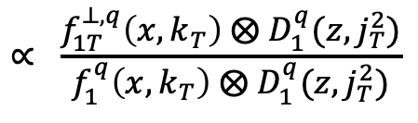
TMDs in SIDIS
$$∝ \frac{f_{1T}^{⊥,q}\left(x,k_{T}\right) ⨂{ D}_{1}^{q}(z,j_{T}^{2})}{f_{1 }^{q}\left(x,k_{T}\right) ⨂{ D}_{1}^{q}(z,j_{T}^{2})}$$
A_{SIVERS}
correlation between the quark k_{T} and proton momentum and transverse spin.
$$f_{1T}^{⊥,q}\left(x,k_{T}\right)$$
Probability for a quark to fragment into a hadron with z and j_{T}
$${ D}_{1}^{q}(z,j_{T}^{2})$$

Slide 33
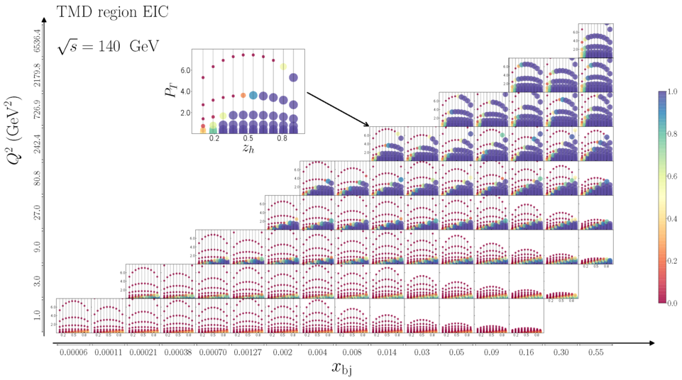

Future TMD measurements
Low-x at the EIC
High-x at the JLAB 12 GeV
Notes:
TMD factorization typically requires delta < 0.25 pT/zQ.

Slide 34
Take Home Messages
The advent of highly polarized beams and targets, nearly four decades ago, opened a frontier in experimental hadronic physics and transformed our understanding of nucleon spin structure and the theory of Quantum Chromodynamics.
As we embark on the EIC era it is imperative that we pursue highly polarized ²H and ³He beams in addition to polarized proton beams. ``Neutron” beams :
  Provide significant increase in precision in the determination of the quark helicity PDFs for x < 10⁻³
  Provide leverage to reduce uncertainties on the flavor separated distributions, at a level similar to SIDIS, but without the systematic errors associated with fragmentation functions.
  Allow for precision measurements of the Bjorken Integral, which allows in turn, for the first time, a competitive extraction of the strong coupling constant.
It is critical to install detectors, along the beamline, that can detect spectator protons, allowing for a clean extraction of the neutron signal.
The EIC will measure a suite of channels that will allow us to evaluate the total orbital angular momentum of the nucleon. These channels range from DVCS and DVMP to exclusive dijet production.

Slide 35

Postcard credit : CERN
Thank you!

Slide 36


The plot that launched the “spin-crisis”
The Ellis-Jaffe Sum Rule predicts a value for the integral of g₁(x) over all x assuming:
No gluon contribution to the spin of the proton
No strange sea contribution to spin of the proton.
Conclusion was that quarks carry very little of the spin of the proton -> $14 ±9 ±21\%!$
This generated a lot of discussion in the high energy physics community.

Slide 37




First DVCS Measurements
… published back-to-back in PRL 87 (2001)
~
Beam Spin Asymmetries – polarized beam + unpolarized target – sensitive to
H, E, H

Slide 38





Global TMD Analysis
PRD 93 014009 (2015)
Requires the development of methodology to handle differences in hard scale Q².
Unlike collinear observables, evolution contains a non-perturbative component that cannot be calculated from first principles.
PRD 106 (2022) 034014
PRD 102 054002 (2020)

