Slide 1
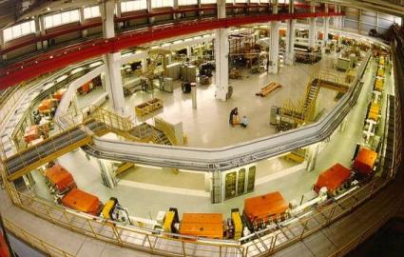

Polarized Deuteron Sources
Polarized Ion Sources and Beams at EIC,
Community Wide Meeting, Stony Brook, March 10-12, 2025
March 10, 2025 | FrANK Rathmann (for Ralf Gebel)

Slide 2
Outline
Review of Polarized Ion Sources
Some Historical Sources and the State-of-the-Art
(from literature)
Requirements for Precision Experiments
(see also V. Hejny & J. Slim‘s talks)
Tools @ COSY
Conclusion

Slide 3
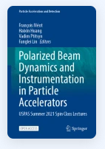
Sources of Polarized Ions
Description of first polarized proton sources:
INTERNATIONAL SYMPOSIUM ON
POLARIZATION PHENOMENA OF NUCLEONS, Basel, July 1960
Review of early work:
SOURCES OF POLARIZED IONS BY W. HAEBERLI
ANNUAL REVIEW OF NUCLEAR SCIENCE, Vol. 17, 1967
Review of recent techniques and state-of-the-art sources:
Zelenski, A. (2023). Polarized Ion Sources.
Polarized Beam Dynamics and Instrumentation in Particle Accelerators. Springer, Cham.
https://doi.org/10.1007/978-3-031-16715-7_10 https://rdcu.be/ecH5M

Slide 4
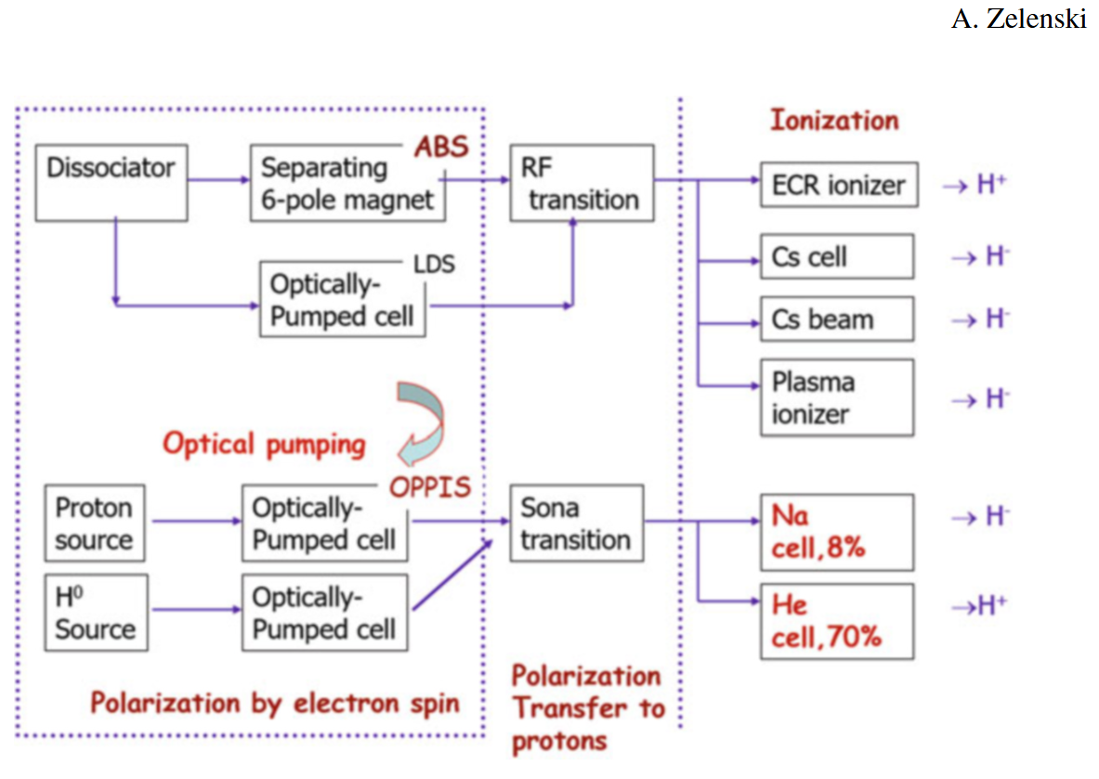
Polarization Techniques
Three-step process:
  Spin Filtering or
  Optical pumping
  Polarization Transfer
  Ionization
Examples:
  (First Sources)
  CIPIOS / INR / HIAF
  NICA
  COSY

Slide 5
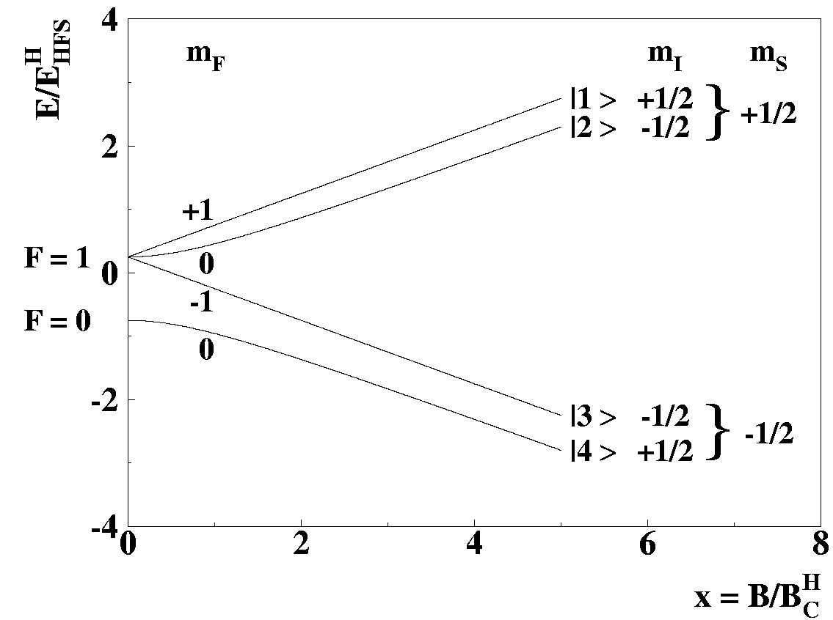
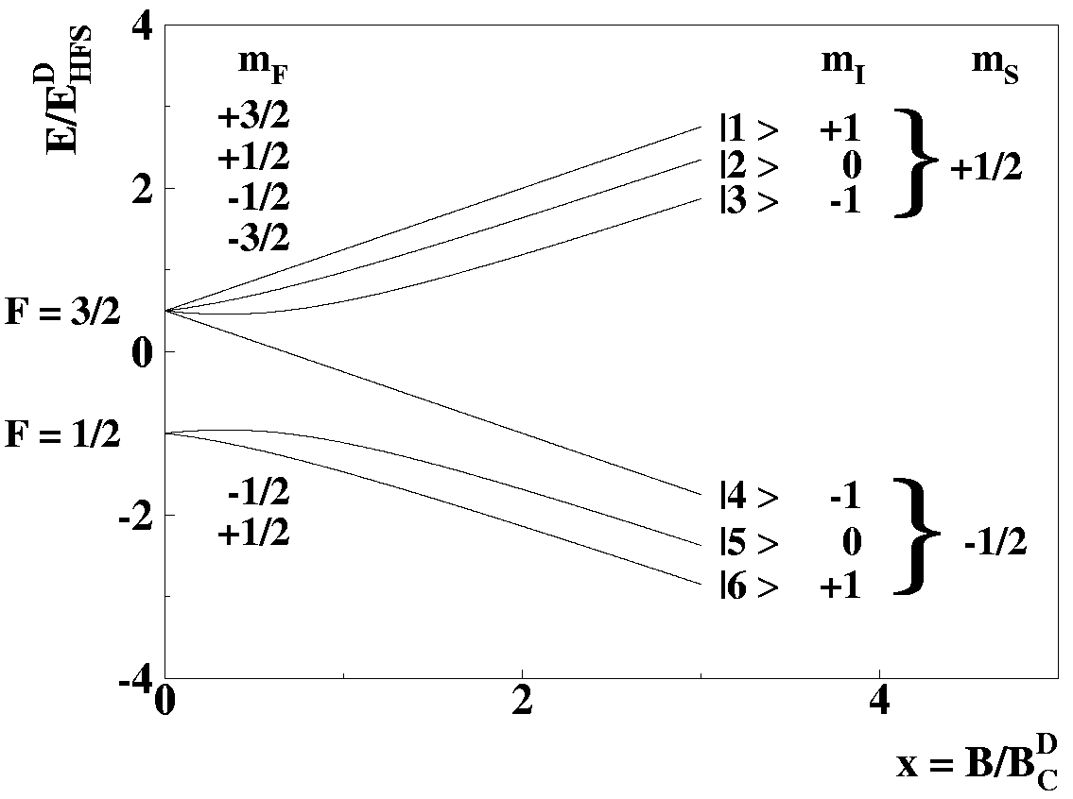
Basics: Select your Spin State…
Hydrogen
Deuterium
B_{c} = 507 G
B_{c} = 117 G

Slide 6
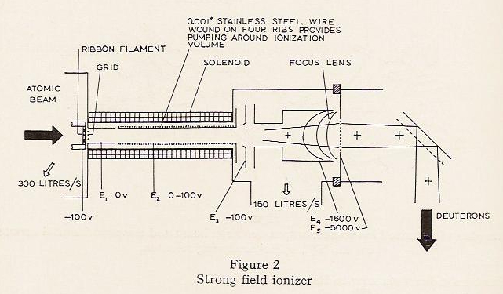
First polarized protons / deuteron sources
Ionization by electron bombardment (NIM 25 (1963) 67-76)
Improvement by strong field ionizers (e.g. Glavish NIM 65 (1968) 1-7)
with confinement of electrons in a solenoid: from 0.2 µA to ~ 0.5 µA p P = 90 %

Slide 7
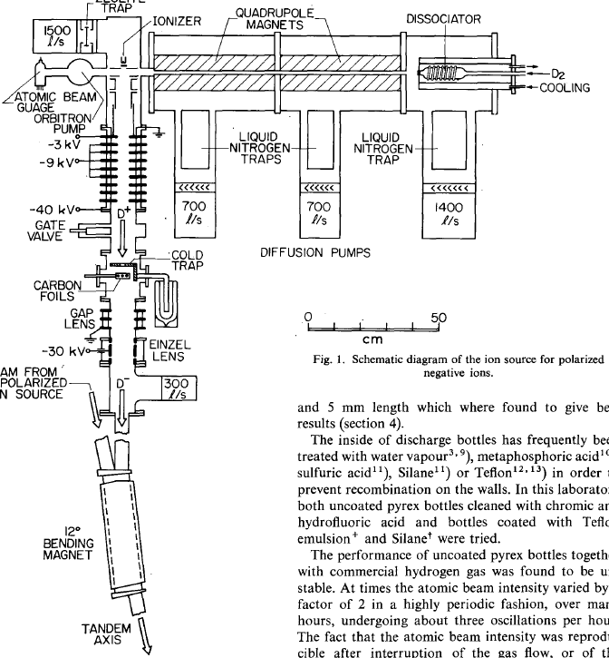
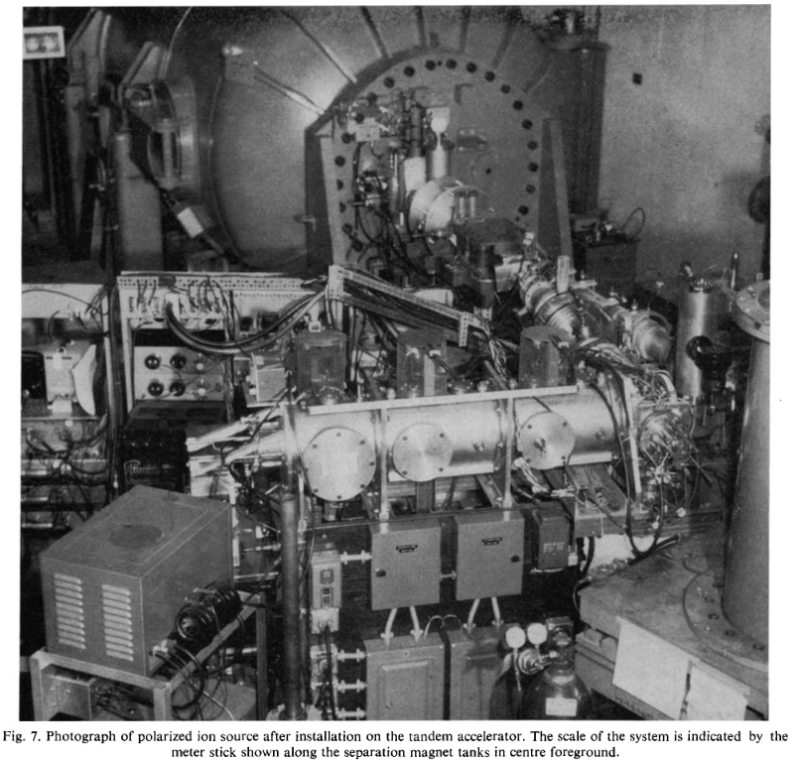
Negative polarized deuterons
First source of negative polarized D (1964)
Gruebler, Schwandt, Yule, Haeberli
NIM 41 (1965) 245-254)
H⁰ beam 0.4x10¹⁶ /s
H⁺ beam 0.15 mA = 10¹² /s
H⁻ beam 0.15 nA =10⁸ /s
P = 0.47 (weak field)
Ionizer: 0.2A electrons, 250 eV
Ionizer efficiency 0.25x10⁻⁴

Slide 8
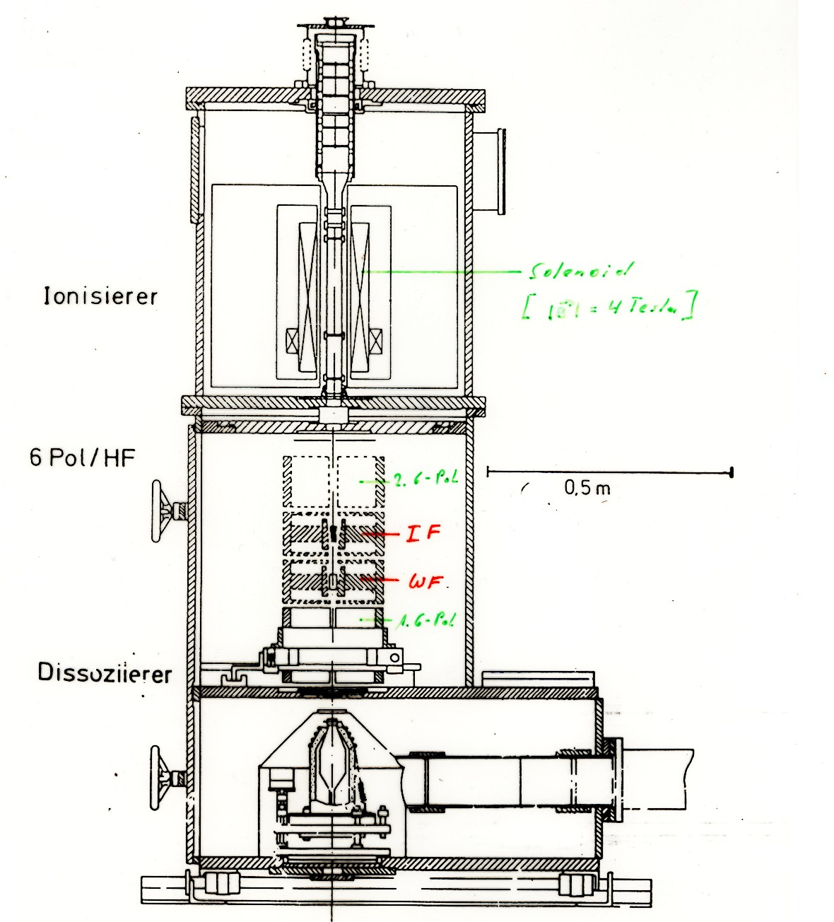
From µA to mA intensities (Bonn 1982 - 1988)
System with 8 electrostatic electrodes,
magnetic and electrostatic mirror.
Penning
Ionizer
Solenoid
(<4 Tesla)
Strongly coupled system with hysteresis
Large potential depression
Noisy
2nd 6-Pole
System with compressor (2nd) 6-pole magnet
and tapered (1st) 6-pole magnet.
Transitions suffer from the stray-field of the solenoid
1.8 m
IF
6-Poles &
Transitions
WF
Beam handling matched to cooled nozzle
Polarization suboptimal
1st 6-Pole
Nozzle cooled to 77K
Dissociator

Slide 9
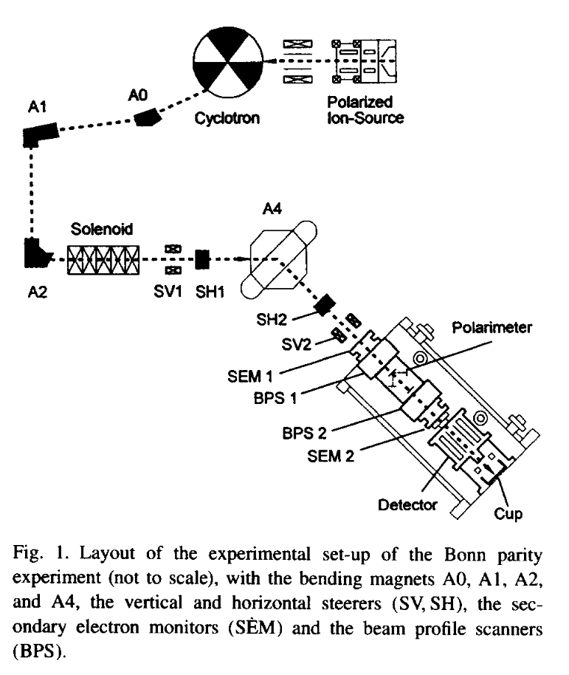
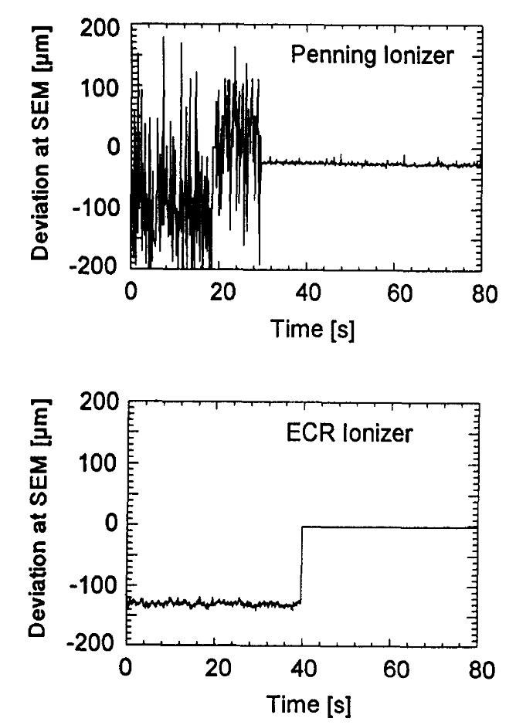
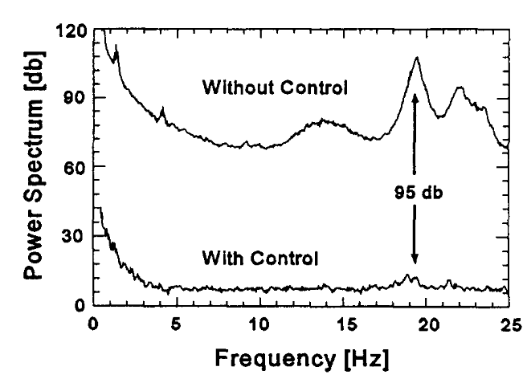
Precision of beam control: Penning vs. ECR
Eversheim et al.
NIM A 371 (1996) 345-350
Lesson learned: Source quality is mandatory.

Slide 10
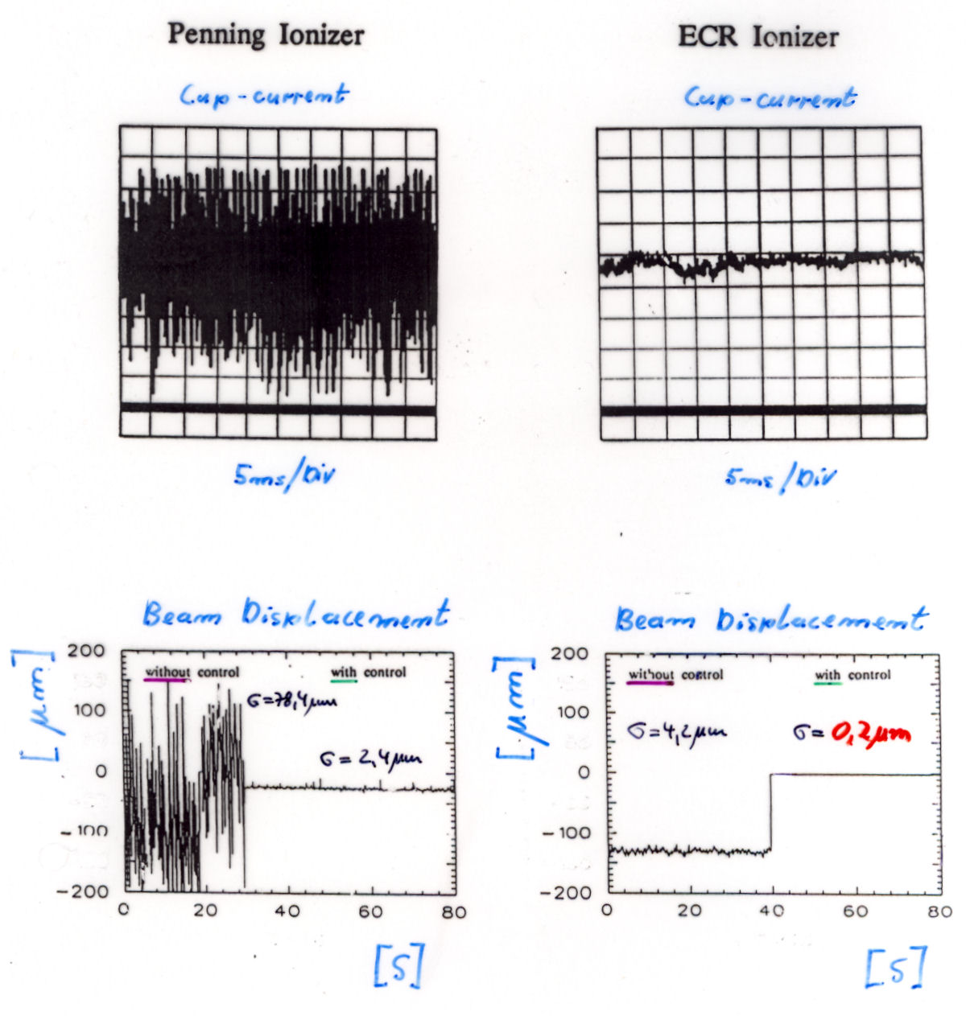
From µA to mA intensities: Quality is mandatory
Penning ionizer
ECR Ionizer

Slide 11
Exceeding (pulsed) 5 mA intensity
A method based on a proposal from 1968 (NIM 63, page 335):
The process H⁰ ↑ D⁻ → H⁻ + D⁰ ↑ is a resonant charge transfer process. The cross section increases with decreasing relative velocity and reaches:
At INR Moscow 5 mA with 95% polarization
σ = 22x10⁻¹⁶cm² at 2 keV -> 100x10⁻¹⁶cm² at 10eV

Slide 12
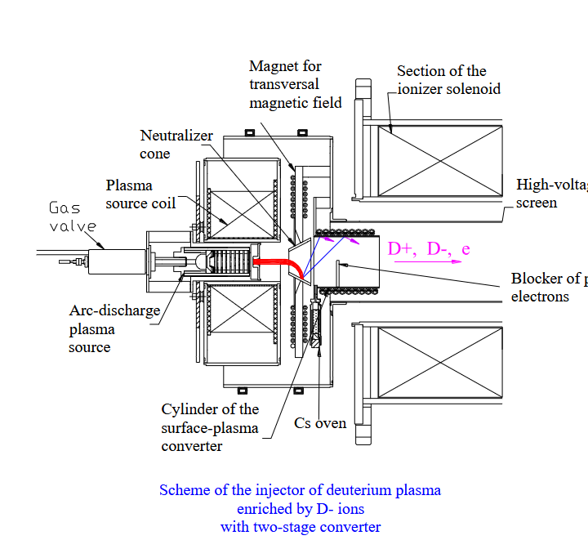
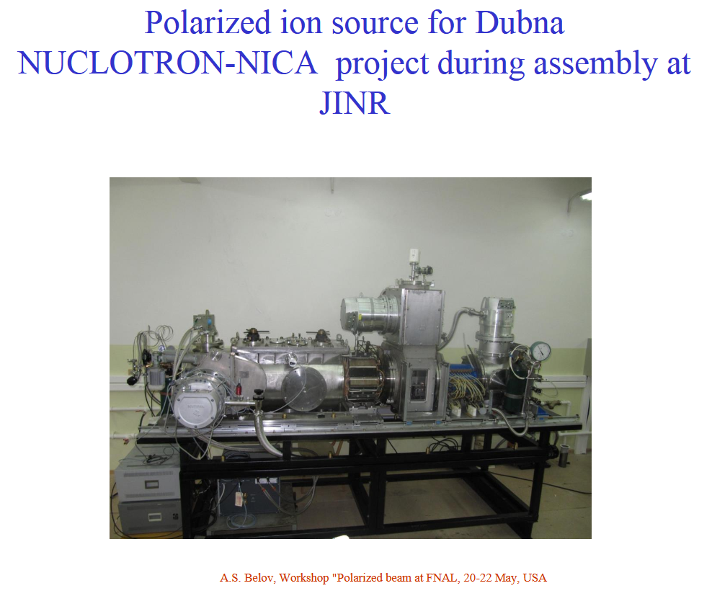
INR-RAS: Unique plasma injector of deuterium plasma enriched by D- ions (A. Belov et al.)

Slide 13
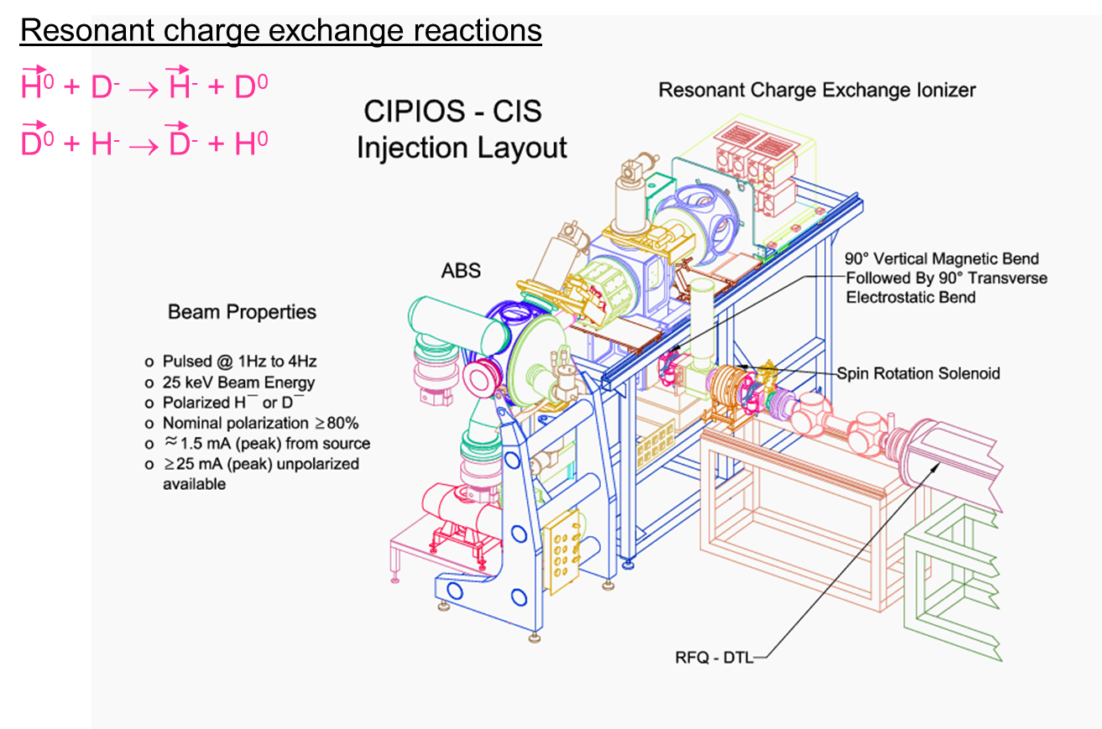
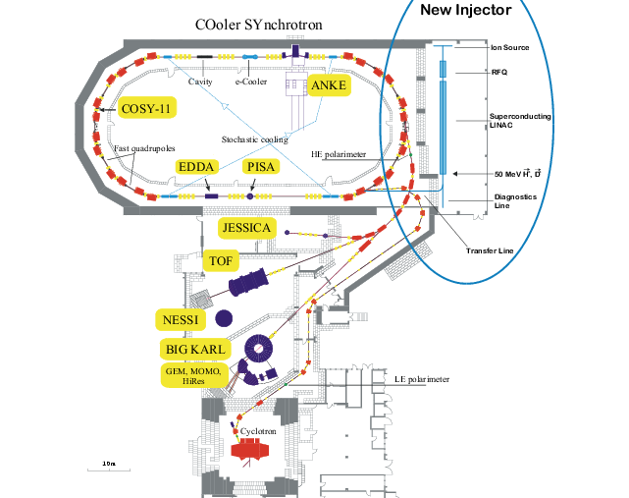
CIPIOS: THE source for COSY‘s scLinac (2002)
V.P. Derenchuk et al., Workshop on Polarized Sources and Targets, Erlangen 1999

Slide 14
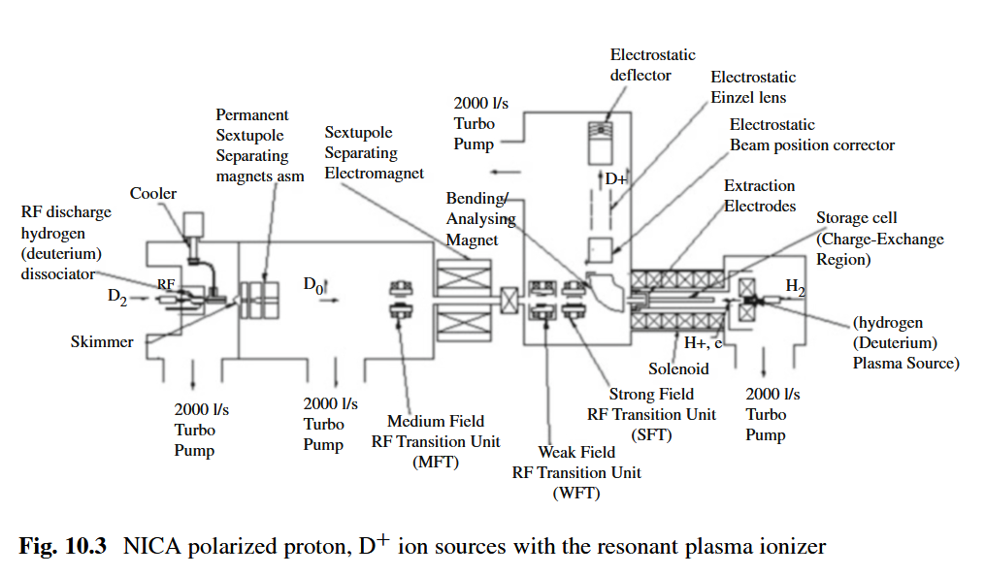
NICA polarized Deuteron ion source
A S Belov et al 2017 J. Phys.: Conf. Ser. 938 012017
DOI 10.1088/1742-6596/938/1/012017

Slide 15
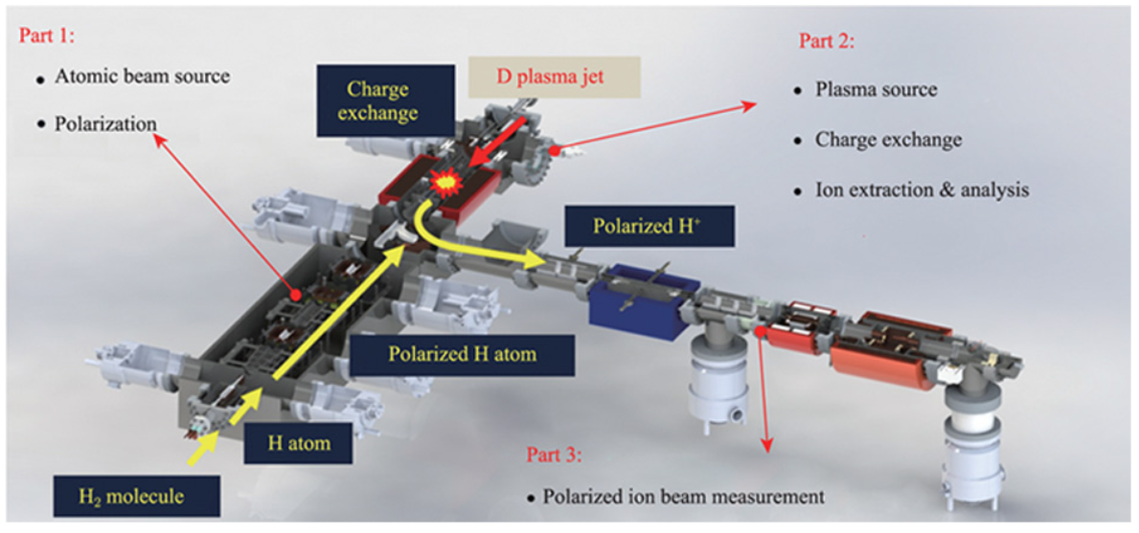
IMP polarized ion source for HIAF (EicC)

Slide 16
Electron transfer from atoms or ions
NIM 62 (1968) 355-357
W. Haeberli (1968): transfer an electron from Cs to H⁰
H⁰↑+Cs⁰ (30keV) -> H⁻↑+ Cs⁺ (σ= 4x10⁻¹⁶ cm²)
B
Cs
H⁰
Cs
Cs⁺ (30 keV)
First test (Wisconsin): 1 μA H⁻ - high polarization (90%).
COSY/Jülich: up to 50 μA H⁻ (*1993/ D⁻2003– 2023)

Slide 17
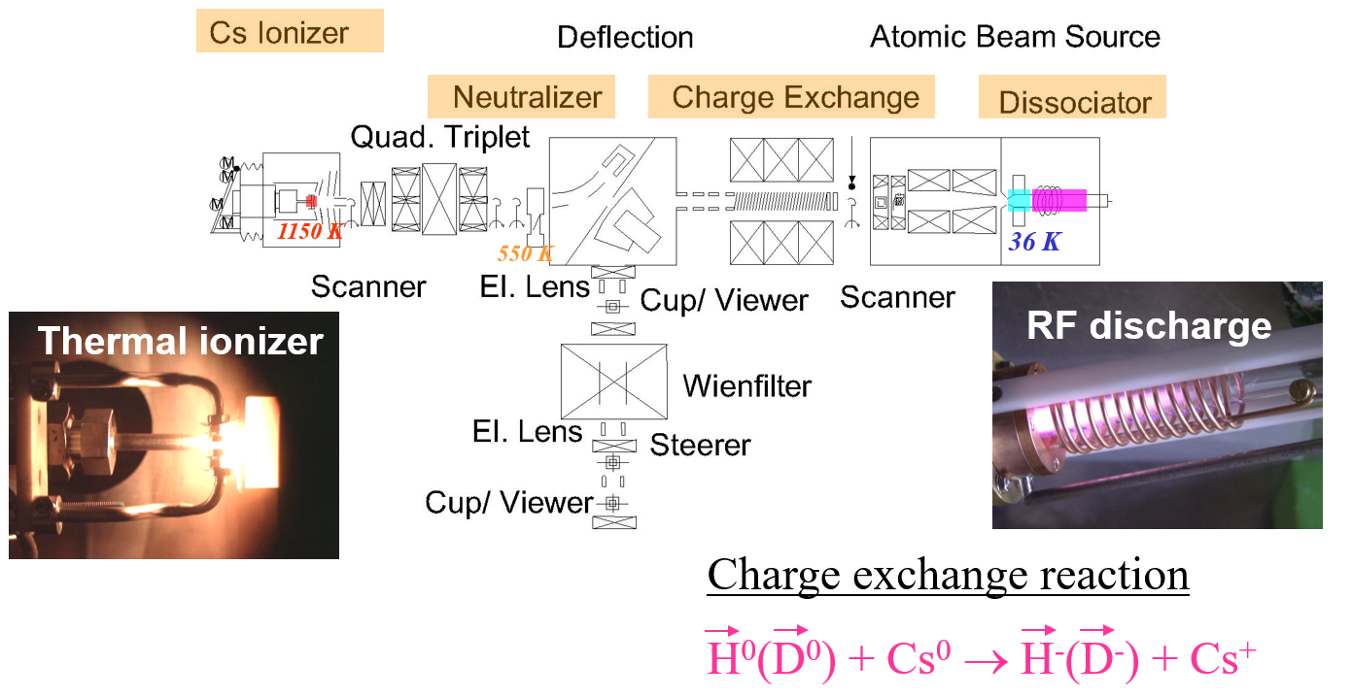
COSY/Jülich: polarized H⁻/D⁻ source

Slide 18
Review – Hands-on experience
Source Experience
  1986 - 1989 Atomic beam source with Penning ionizer (Bonn)
  1989 - 1995 Atomic beam source with ECR ionizer (PSI, ETH, Bonn)
  1993 - 2023 Atomic beam source with colliding beams ionizer (COSY/Jülich)
  1995 - OPPIS (@TRIUMF); SABPIS (Cologne), Lambshift (FZJ), LASER-based …
  2001 - 2003 CIPIOS Atomic beam source with plasma ionizer (IUCF)
  (+ unpolarized …)
Two favorites:
  BNL’s OPPIS (p) @ BNL and
  IUCF’s CIPIOS (p & d), selected (for COSY’s scLinac), NICA & HIAF

Slide 19
Spin Manipulation Tools @ COSY
Polarimeter (JEPO, EDDA, LSP, LEP, BRP)
Wienfilter (DC classical ExB)
Solenoids (nc)
Siberian snake (sc, “fast” ramping)
AC dipoles and solenoids
Fast kickers/correctors
Fast Q-Jump quadrupoles
KO exciter and spill optimization by feedback
Orbit control with precision and feedback
Dynamic Tune and Chromaticity Control
AI applications: intensity, orbit,…

Slide 20
Sophisticated DAQ and Beam control
Fast set-point and process value monitoring (archive!)
Appropriate accelerator model and simulation
Visualization (fast and “good enough”)
Beam control
  Intensity and availability
  Orbit control
  Momentum distribution (cooling, bunching, shaping, extraction, …)
  Polarization handling (preservation, coherence, flip, spin tune lock, …)
  Application of AI

Slide 21
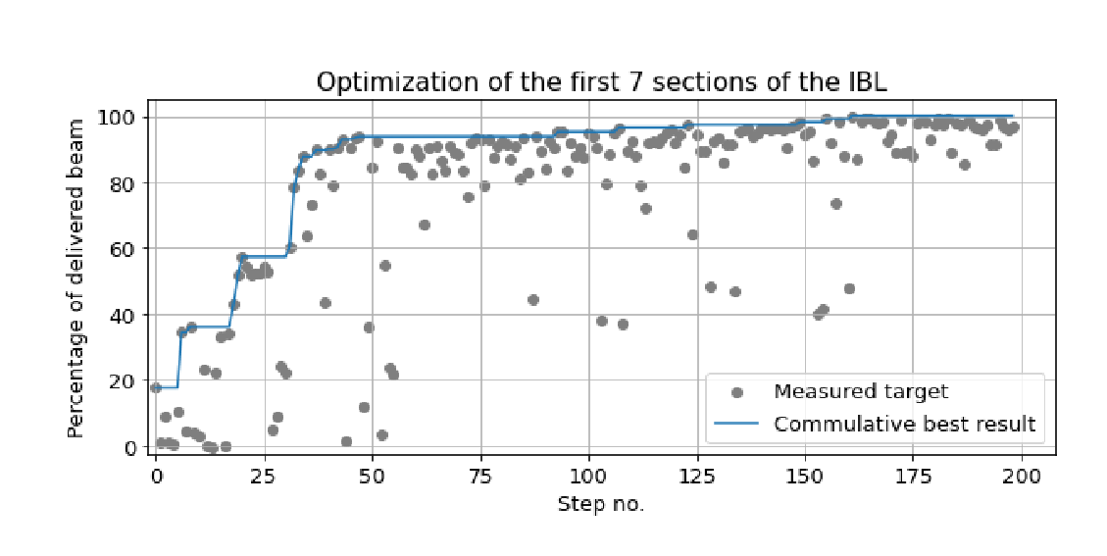
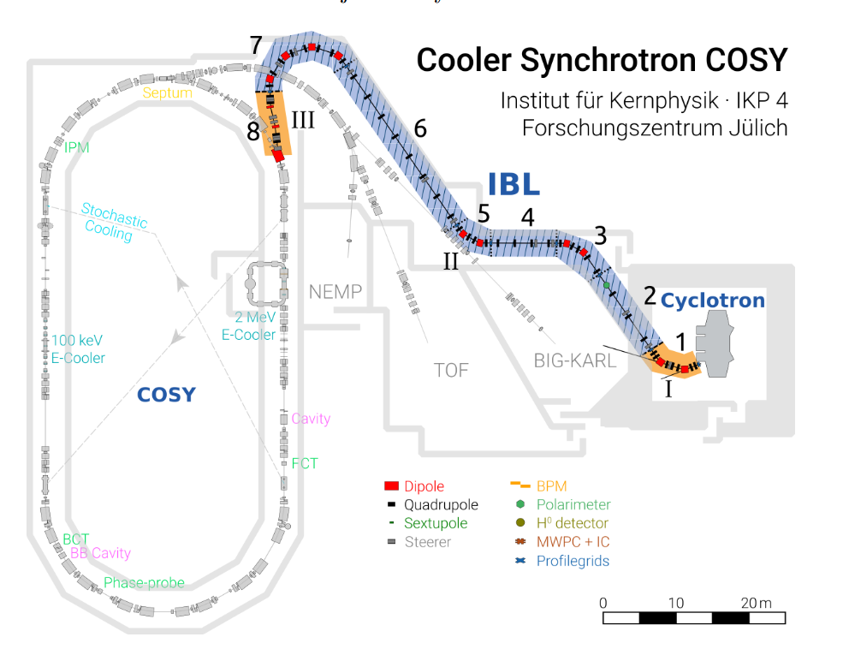
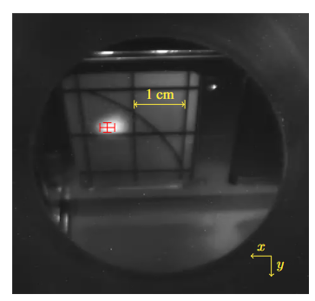
Application of machine learning - 2023
COSY (2023): Awal: AI for intensity and beam localization

Slide 22
Conclusion
Select your state-of-the-art source model: PI w/o storage cell)
Combine it with excellent diagnostics and control/feedback systems
Apply AI methods (Simulation, digital twins, …)
Continuous improvement is mandatory

