Slide 1
What should be learned for the EIC from accelerating polarized protons in the AGS
Thomas Roser
Polarized Ion Sources and Beams at EIC
March 11, 2025

Slide 2
History of accelerating polarized protons in the AGS without partial Siberian snakes
Effort started after demise of Isabelle, 1983 – 1988
Team to work on polarized proton acceleration in the AGS: Alan Krisch, Larry Ratner, Kent Terwilliger, Fatah Khiari, TR (Univ. of Michigan); Leif Ahrens, Woody Glenn (BNL) (Fatah and I are the sole survivors of this group)
Without partial Siberian snakes 45 intrinsic and imperfection depolarizing spin resonances had to be crossed using 95 correction magnets and 10 fast pulsed quadrupoles to reach a kinetic energy of 22 GeV with a polarization of 42%.
This was reached only after a very lengthy tuning process (weeks!) and without operational stability, primarily due to the changing orbit errors during the acceleration ramp that had to be recorrected frequently. For each resonance, the orbit had to be corrected based on lengthy beam polarization measurements.
Summary paper of this effort: ‘Acceleration of polarized protons to 22 GeV/c and the measurement of spin-spin effects in p↑ + p↑ -> p + p’, F.Z. Khiari et al, Phys. Rev. D 39 (45) 1989

Slide 3
Relevance for polarized electron injector of the EIC
The EIC RCS electron injector covers a very similar energy and spin precession frequency range as the AGS with a similar number of depolarizing spin resonances:
Energy between imperfection resonances: 523 MeV (protons), 441 MeV (electrons)
Spin precession in 1 Tm transverse field: 573 mrad (protons), 680 mrad (electrons)
The acceleration of polarized electrons in the EIC RCS would therefore be very similar to the first attempt of accelerating polarized protons in the AGS with the same difficulties and operational instabilities.
The RCS design is taking on substantial technical and operational risks when there are proven designs, such as the linac-based SLC and CEBAF, that have operated successfully for decades with high electron polarization. The cost of a linac-based injector is likely similar or even lower than an RCS-based injector.

Slide 4
Spin Dynamics in Rings
Precession Equation in Laboratory Frame: (Thomas [1927], Bargmann, Michel, Telegdi [1959])
dS/dt = - (e/γm) [(1+Gγ)B⊥ + (1+G) B_{II} ] × S (G=(g-2)/2 : anomalous gyromagnetic ratio)
Lorentz Force equation:
dv/dt = - (e/γm) [ B⊥ ] × v
For pure vertical field: Spin rotates Gγ times faster than motion, spin tune ν_{sp} = Gγ
For spin manipulation: At low energy, use longitudinal fields
At high energy, use transverse fields

Slide 5
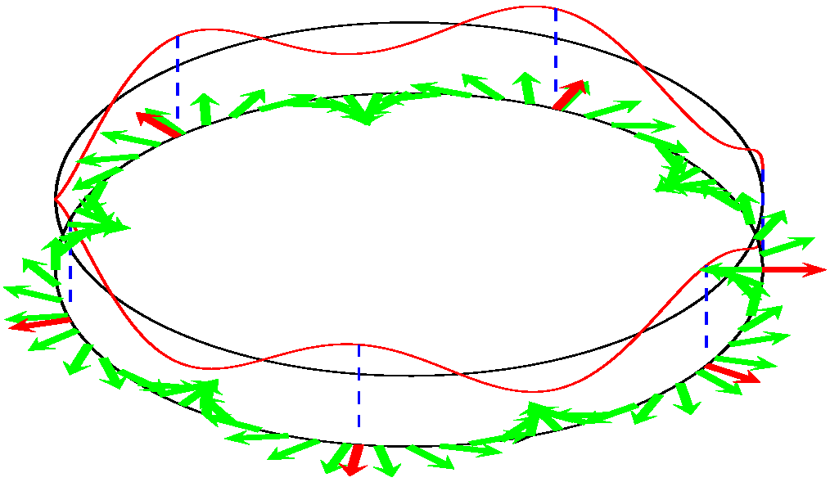
Depolarizing Spin Resonances
Depolarizing resonance condition:
  Number of spin rotations per turn = Number of spin kicks away from stable direction per turn
  Spin resonance strength ε = Number of full spin rotations due to resonance per turn
Imperfection resonance (magnet errors and misalignments):
ν_{sp} = n
Intrinsic resonance (Vertical focusing fields):
ν_{sp} = Pn± ν_{y} P: Superperiodicity [AGS: 12]
ν_{y} : Betatron tune [AGS: 8.75]
Weak resonances: some depolarization
Strong resonances: partial or complete spin flip
Illustration by W.W. MacKay

Slide 6
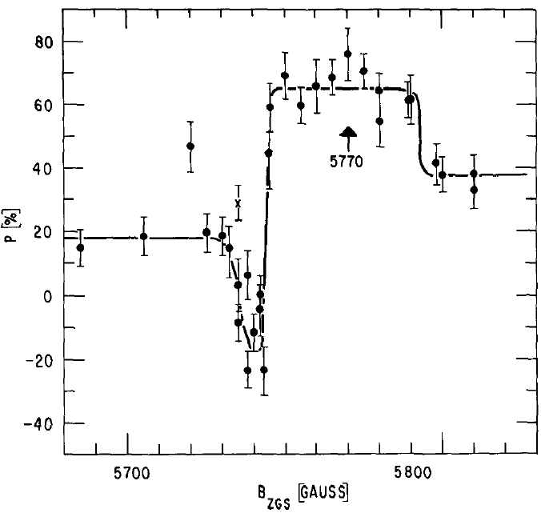
Polarized Proton Accelerations at the ANL ZGS
ZGS (up to 70% at 12 GeV/c):
Weak resonances (ε_{max} ~ 0.002)
Timing of betatron tune jump using polarization measurement

Slide 7
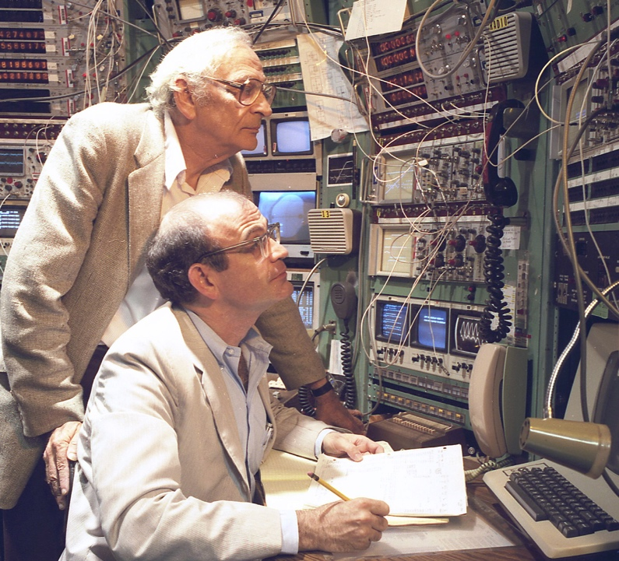
First Effort to Accelerate Polarized Protons in AGS
In the 1980s, Alan Krisch and Larry Ratner led the first effort to polarize the AGS by correcting the 45 imperfection and intrinsic depolarizing resonances. This was a truly heroic effort!
The first BNL polarized proton source was an atomic beam source, based on the Haeberli design.
1/95 correction dipole; 1/10 pulsed quadrupole; main field

Slide 8
First Effort to Accelerate Polarized Protons in AGS (cont’d)
AGS (up to 42% at 22 GeV/c): strong resonances (ε_{max} ~ 0.03)
Resonance strength predictions for 10 pi mm mrad emittance and
magnet errors of +- 0.1 mm:

Slide 9
Tuning for polarization in the AGS
Timing of betatron tune jump and adjusting dipole correction strength using polarization measurements, each taking 5 - 30 minutes! Total tuning effort took weeks.
Note: simply correcting the orbit could not remove depolarization. More about this later.
Setting up polarized proton acceleration to 22 GeV required:
  6 pulsed quadrupole timing scans
  2 × 35 harmonic corrector scans (sin + cos)

Slide 10
Measured imperfection resonances in the AGS
Required correction dipole current for maximum
polarization (128 – 10 A):
AGS: tune = 9; super periodicity: 12
“Beat resonances”: High sensitivity to errors (and correctors)
around harmonic = 9, 12 + 9, 36 – 9, 60 – 9:
Strong resonances cause high polarization loss but are easy to correct;
Weak resonances cause little polarization loss but are harder to correct

Slide 11
AGS polarimeters
Internal polarimeter: Scattering from Nylon (fishing) line,
measurement took about 5 minutes
External polarimeter: elastic scattering from liquid hydrogen target,
double arm spectrometer, measurement took about 30 minutes

Slide 12
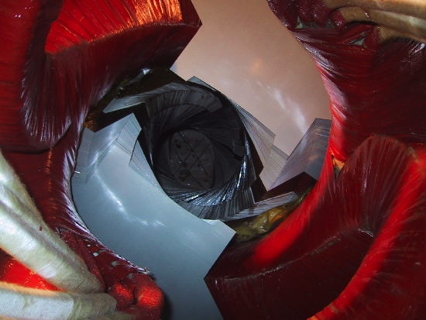
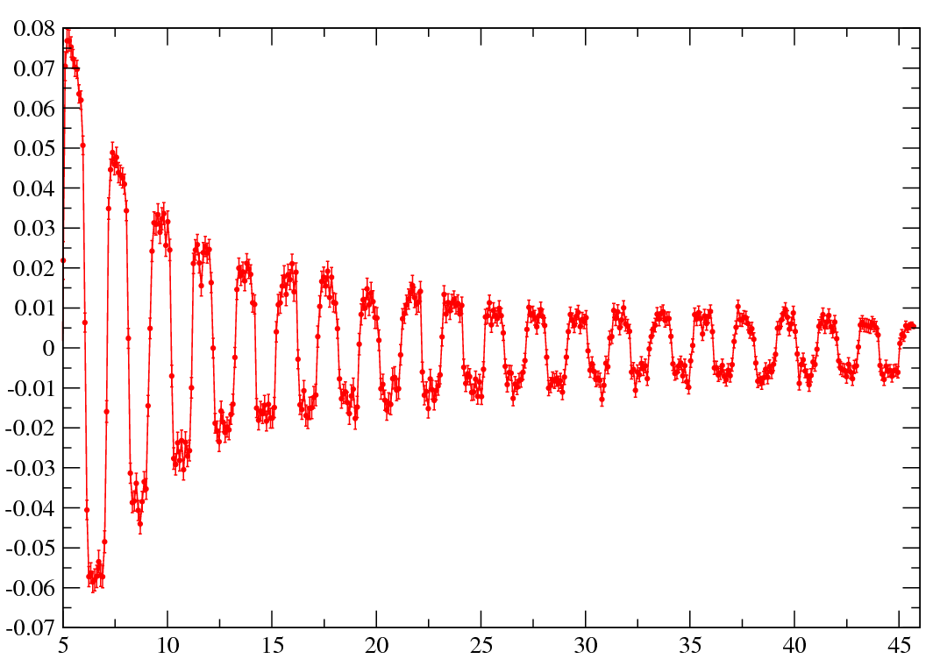
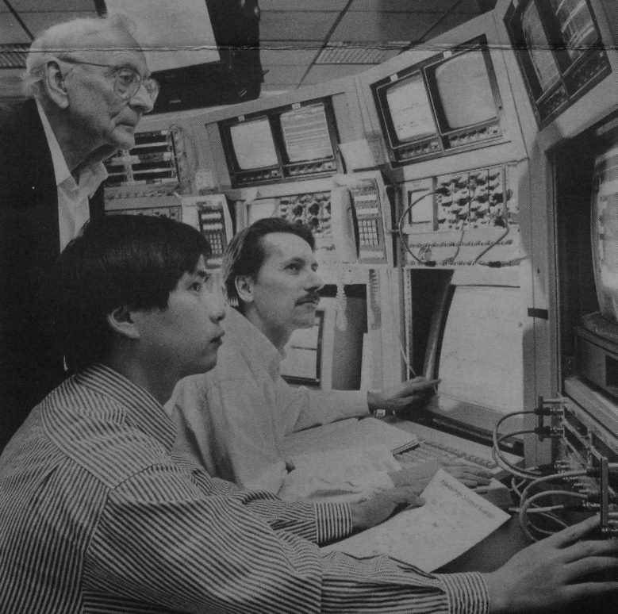
Polarized protons acceleration with partial Siberian snakes
Two partial Siberian snakes using variable-pitch helical dipoles
eliminate depolarization from all imperfection resonances. This was my main motivation for proposing to use partial Siberian snakes.
Intrinsic resonances are overcome with vertical betatron tune at 8.98!
Polarimeter asymmetry
Larry Ratner, Haixin Huang and TR in AGS MCR.
Gγ

Slide 13
Accelerating polarized beams in an RCS w/o Siberian snakes
Imperfection spin resonances are driven by vertical deflections in quadrupoles, vertical correctors, and rolled dipoles.
Even after fully correcting the orbit to go through the center of the position monitors (BPM) there can still be vertical deflections. Spin is uniquely sensitive to such “hidden” misalignments.
  The quadrupole/BPM/corrector package is
  vertically misaligned:
  The BPM is misaligned wrt to the quadrupole:
In an RCS these situations can change throughout the cycle due to changing eddy current effects and from year-to-year due to settling of the ground.
If there is depolarization it will have to be corrected with harmonic corrections and polarization measurements at every Ggamma = n energy, just as in the AGS.
Quad
Corrector
BPM
Quad
Corrector
BPM

Slide 14
Lessons from accelerating polarized protons in the AGS without partial snakes
Tuning a synchrotron using polarization measurements is impractical: it takes too long, and retuning takes just as long since the polarization loss cannot be located during the acceleration cycle.
For polarized proton acceleration: use partial or full Siberian snakes. Work with enough snakes that tuning with polarization measurements is never necessary. (RHIC should have had 6 snakes per ring.)
For polarized electron acceleration use linear accelerators as at SLC and CEBAF (snakes are not feasible).
Comment on the EIC RCS injector design:
Making the tune and super-periodicity higher than the maximum Ggamma is a very clever idea. It eliminates the strong intrinsic and imperfection spin resonances. However, the required very strong focusing makes all the imperfection spin resonances stronger. The effects of all the weak imperfection resonances remain, and this makes the design sensitive to misalignments and magnet errors, some of them cannot be corrected with orbit corrections.

Slide 15
Back-up slides

Slide 16
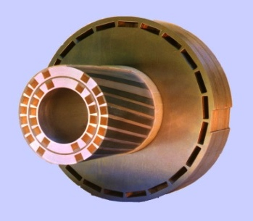
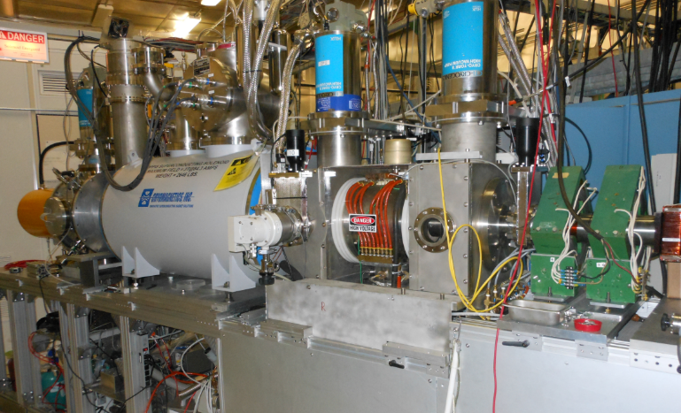

RHIC – First Polarized Hadron Collider
Two full Siberian snakes per ring preserve proton polarization to 255 GeV
Spin direction control at detectors with spin rotators
Minimally invasive polarimeters; also measure polarization profiles
Absolute polarimeter using world’s most intense polarized H jet
Absolute Polarimeter (H↑ jet)
pC Polarimeters
Spin flipper
Siberian Snakes
Siberian Snakes
(s)PHENIX
STAR
Spin Rotators
(longitudinal polarization)
Spin Rotators (long. pol.)
LINAC
5.9% Helical Partial
Siberian Snake
BOOSTER
Pol. H⁻ Source
AGS
200 MeV Polarimeter
pC Polarimeter
10-25% Helical Partial Siberian Snake

