Slide 1
Polarization and Intensity Optimization in the Hadron injector chain for EIC
V. Schoefer for the C-AD team
(with many donated slides)
Polarized Sources and Beams at EIC
Center of Frontiers in Nuclear Science, Sony Brook University
3/11/2025

Slide 2
Overview
RHIC physics operation will end in December 2025, followed by ~10 years of EIC construction
Two months of operation of the hadron injectors per year (on average) to be used largely for
commissioning of polarized ³He (see Kiel Hock’s talk)
Development of new techniques/configurations to improve existing beams – like polarized protons
What are the challenges to work on?
Facility overview
Present state of performance for polarized proton operation – RHIC Run 24
Intensity dependence of emittance in the injectors
Space charge and its mitigation
Depolarizing resonances in the AGS
Horizontal resonances
Survey/alignment effort
Instrumentation and operation improvements

Slide 3
RHIC Polarized Beam Complex
 | Max Energy [GeV] | Pol. At Max Energy [%] | Polarimeter
Source+Linac | 1.1 | 82-84
Booster | 2.5 | ~80-84
AGS | 23.8 | 67-70 | p-Carbon
RHIC | 255 | 55-60 | Jet, full store avg*
2 Siberian Snakes/ring
Spin flipper
Absolute Polarimeter (H jet)
RHIC pC Polarimeters
PHENIX
* Includes both ramp loss and store decay
STAR
Spin Rotators
(longitudinal polarization)
Spin Rotators
(longitudinal polarization)
LINAC
BOOSTER
Pol. H⁻ Source
Helical Partial
Siberian Snake
 | Relative Ramp Polarization Loss (Run 17, full run avg)
AGS | 17 %
RHIC | 8 %
200 MeV Polarimeter
AGS
AGS Polarimeter
Strong AGS Snake

Slide 4
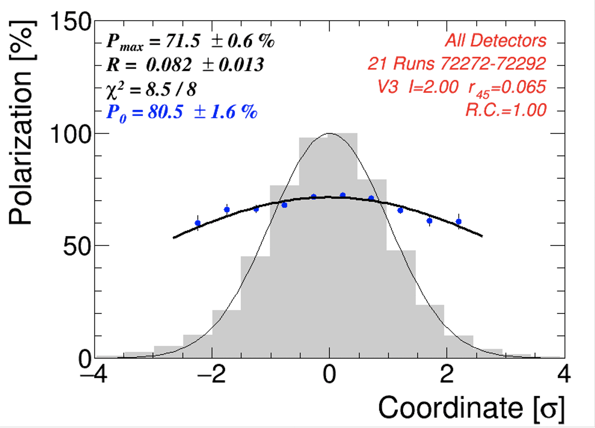
Depolarizing resonances
Most remaining depolarization between the source and RHIC is from intrinsic resonances
High amplitude particles sample higher focusing fields in quads
More depolarization at higher betatron amplitude (i.e. with higher emittance)
Polarization profile
Polarization
Polarization transmission through single intrinsic resonance (gaussian beam, emittance I):
Intensity profile
P_{f,}P_{i} = final, initial polarization
I = rms transverse emittance
I₀ = reference emittance
$ε\left(I_{o}\right)$ = resonance strength at ref emittance
α = resonance crossing rate
Transverse position
Improve polarization with:
Faster crossing rate
Lower resonance strength
Smaller emittance
$\frac{P_{f}}{P_{i}}=\frac{1−\frac{π}{α}\frac{I}{I_{o}}{|ε\left(I_{o}\right)|}^{2}}{1+\frac{π}{α}\frac{I}{I_{o}}{|ε\left(I_{o}\right)|}^{2}} ≈$1- $\frac{2π}{α}{|ε\left(I_{o}\right)|}^{2}\frac{I}{I_{o}}$

Slide 5
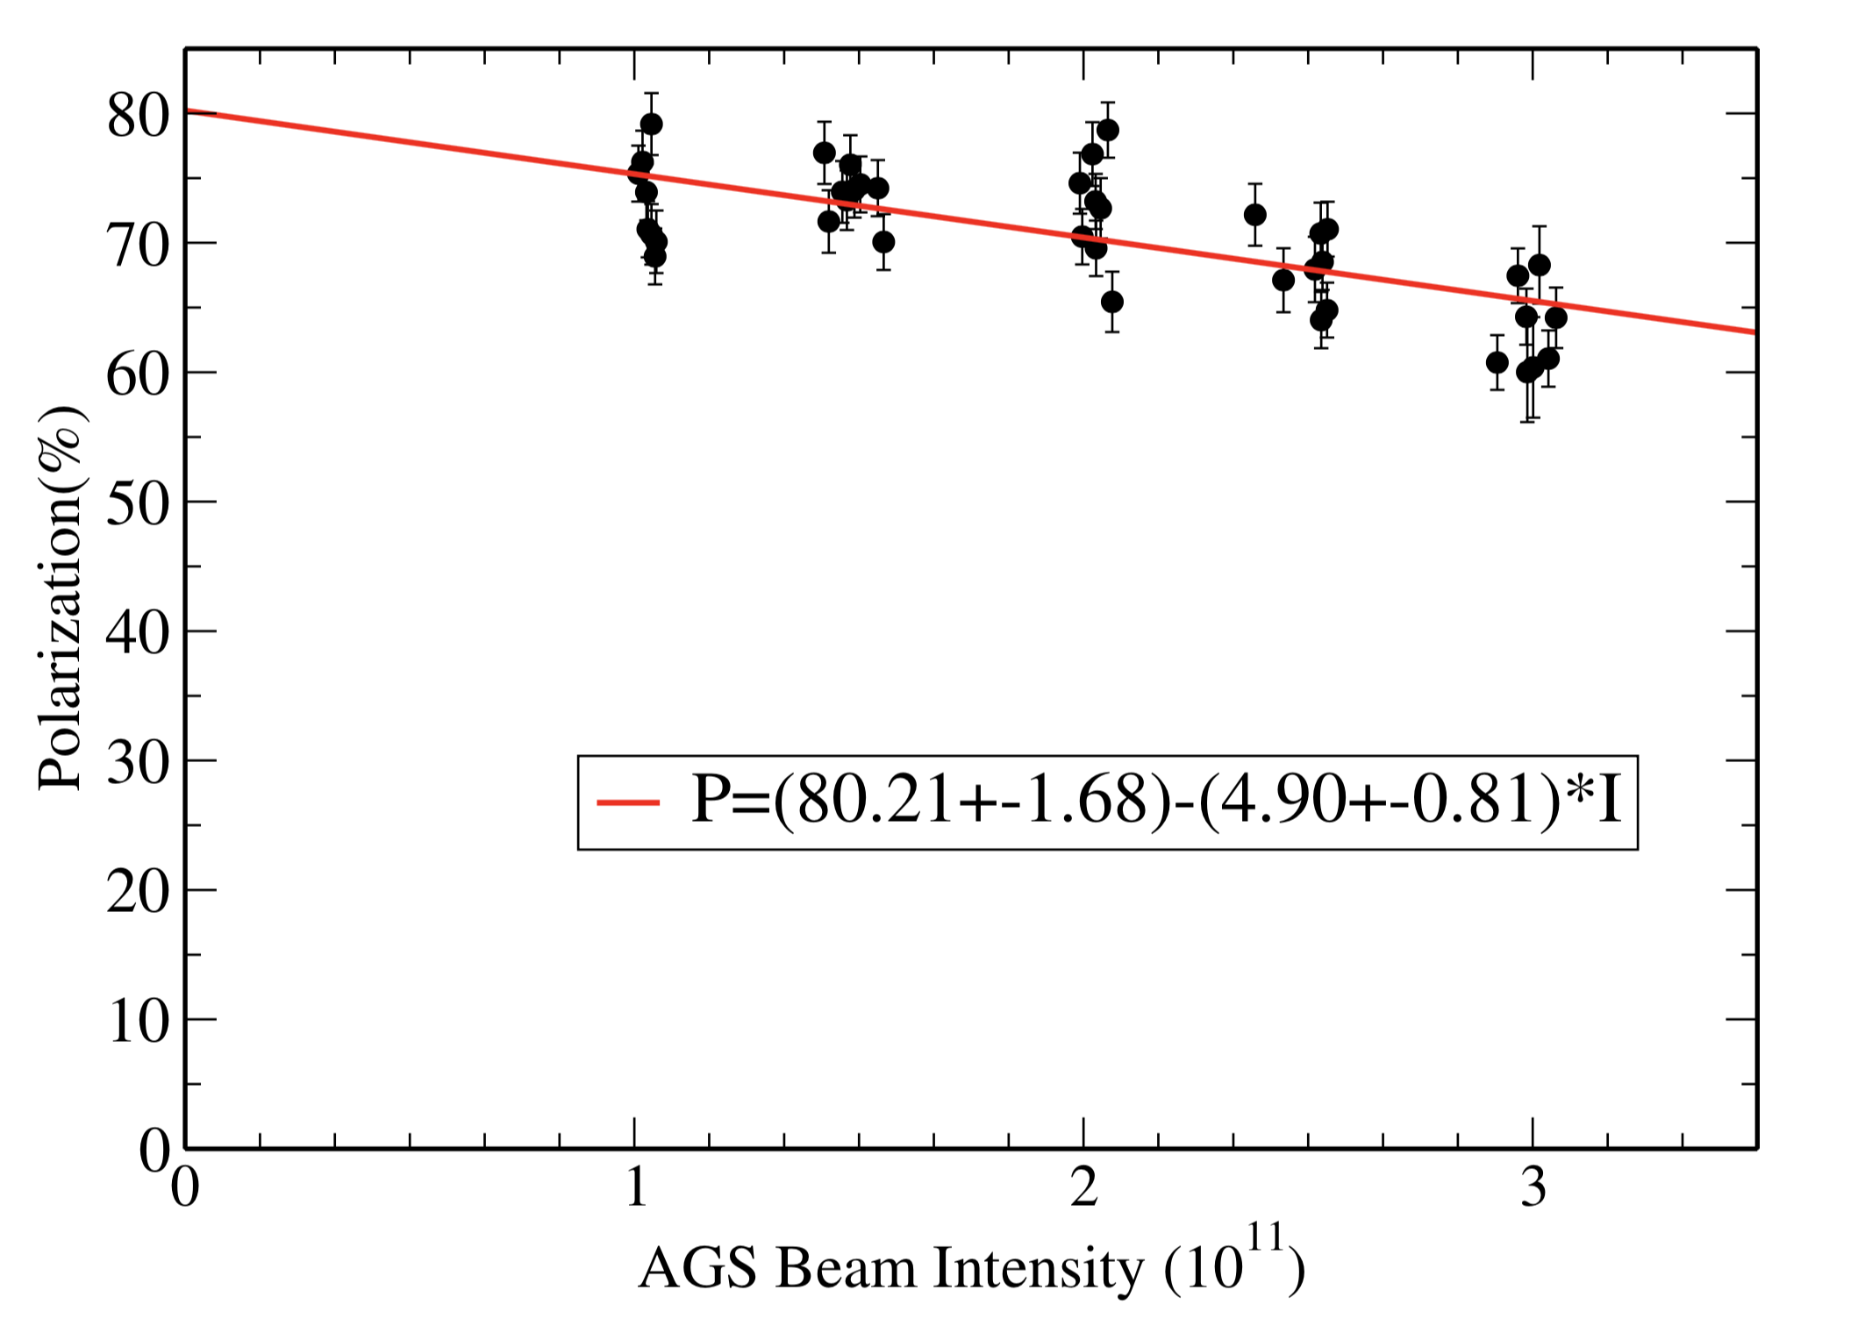
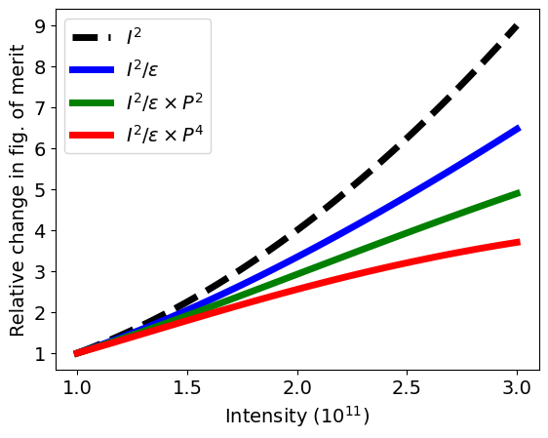
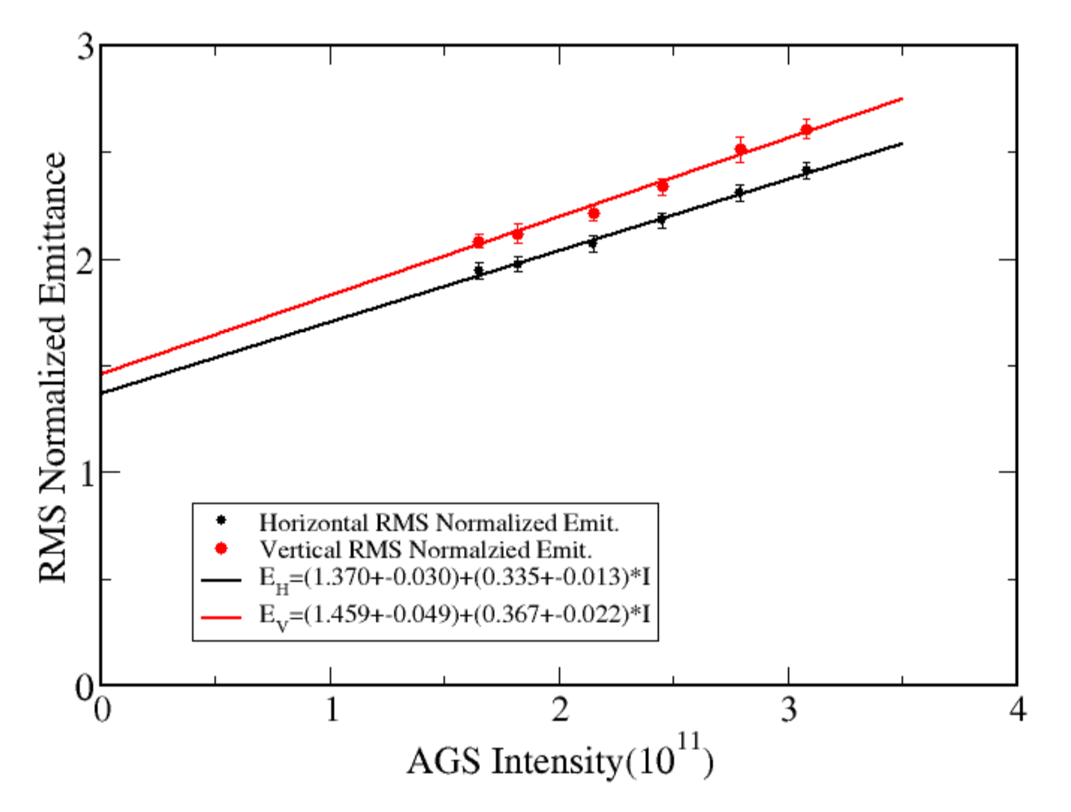
Polarized collider performance
AGS extraction
Collider luminosity, $ℒ$
Pol vs Intensity
$$ℒ∝\frac{N^{2}}{ε}$$
N = intensity/ bunch
$ε$ = tran. emittance
Polarized beam collider FOM
Polarized collider figure of merit (for polarization P):
$$ℒ P^{2}$$
$$ℒ P^{4}$$
single spin
FOM =
double spin
Emittance vs Intensity
(For RHIC where P_{beam1} = P_{beam2})
EIC Hadron P² dependence on hadron P
Since both emittance and polarization degrade with intensity figure of merit decreases rapidly
FOM dependence on intensity closer to linear in N than quadratic.
Impact of intensity increase on FOM given emittance and polarization dependence at AGS extraction

Slide 6
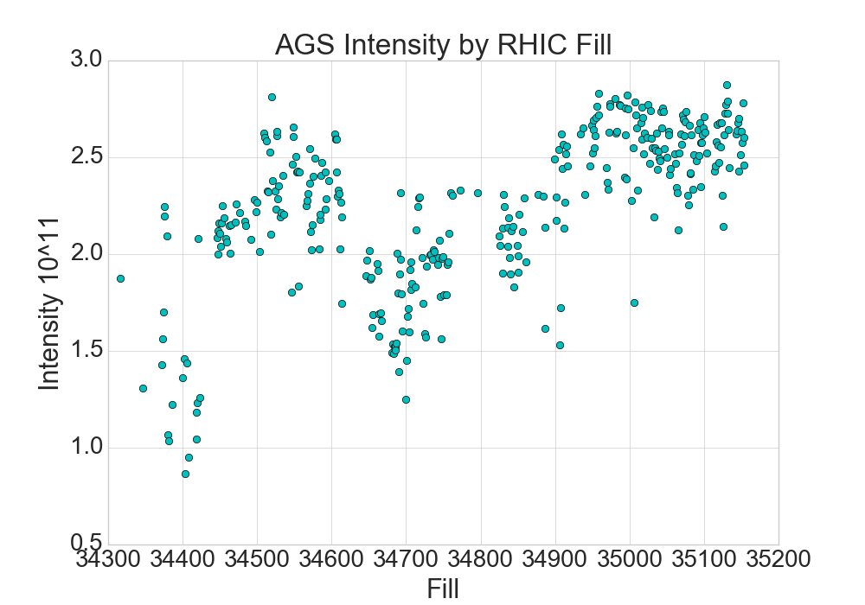
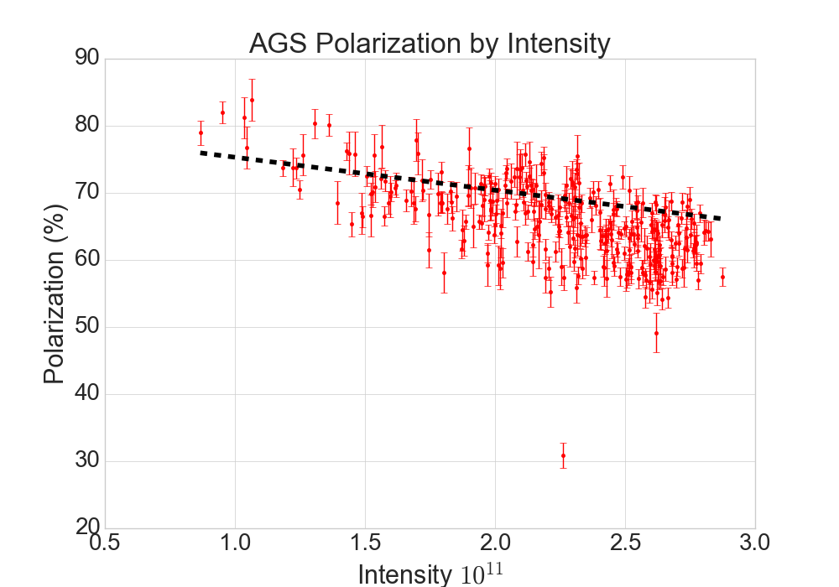
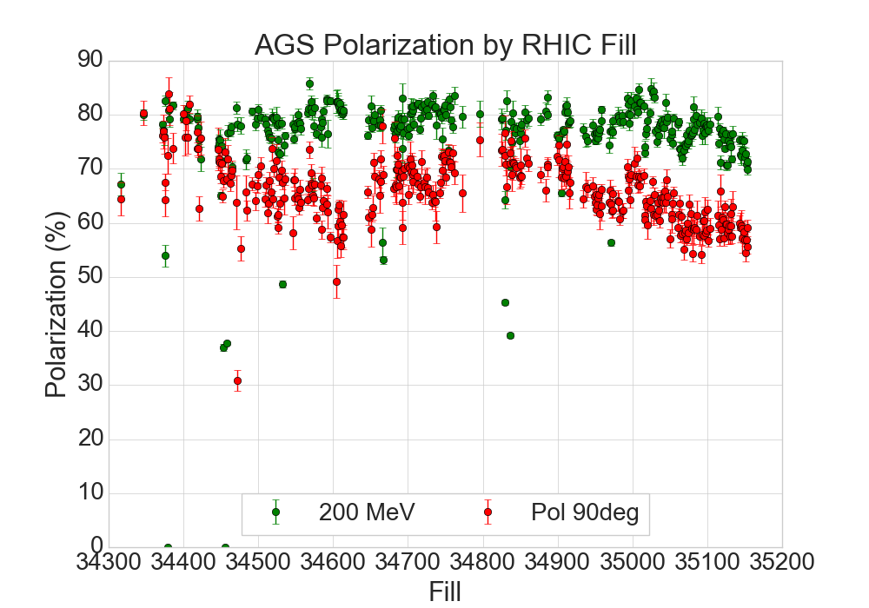
Run 24 Polarization Performance
EIC target region
Dashed line is previously established good operation
Each point is one RHIC physics fill
AGS proton requirement from EIC:
3x10¹¹/protons per pulse
Enough polarization to get to 70% at EIC top energy
i.e. 70%/(HSR pol efficiency)

Slide 7
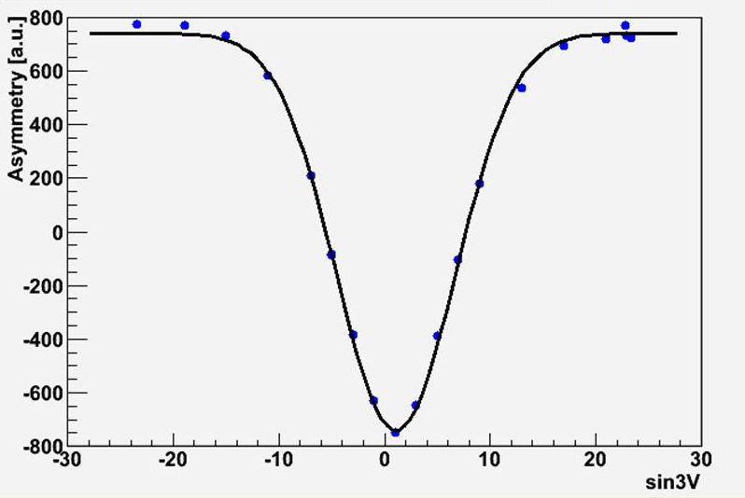
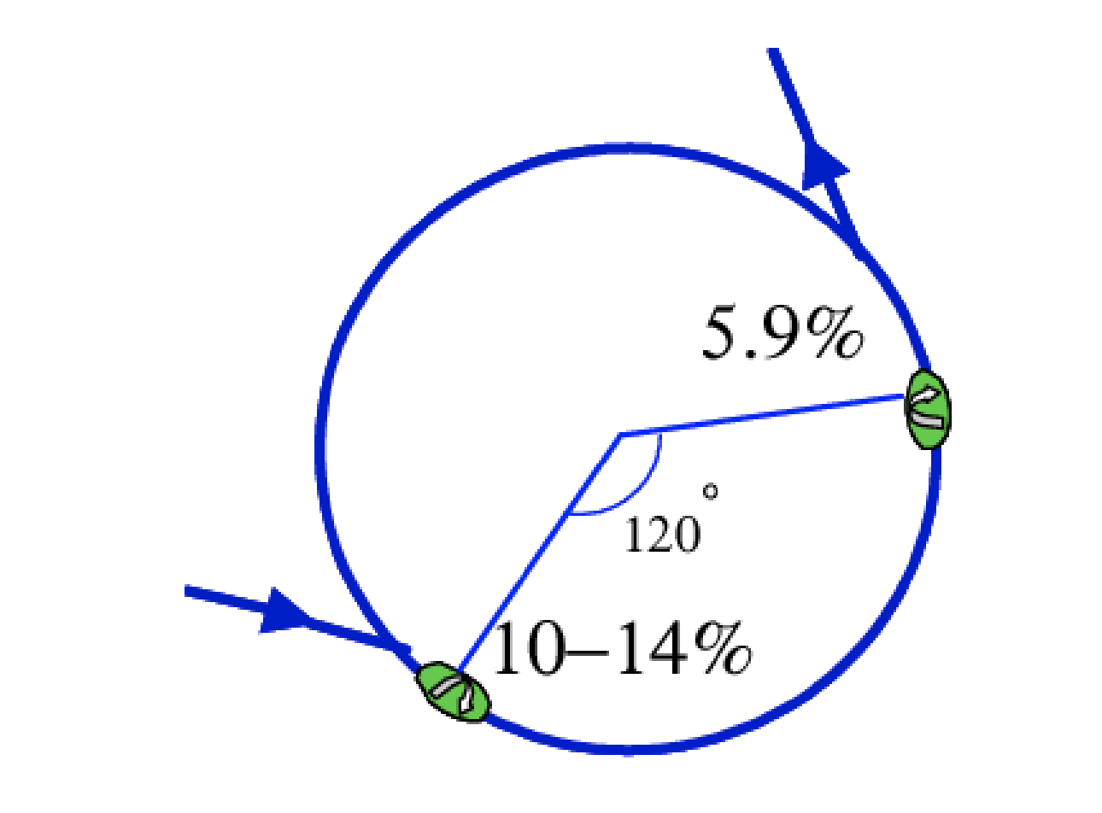
Depolarizing mechanisms in the injectors
Booster harmonic correction
Booster
Two imperfection (orbit based) depolarization resonances (GƔ=3,4)
Handled with closed orbit changes
>99% transmission of polarization
Booster challenge primarily preservation of beam brightness– high intensity and low emittances
Asymmetry (AGS injection)
Current in harmonic function
AGS
Two partial helical dipoles: remove imperfection resonances, can avoid intrinsics
2 strong vertical intrinsic resonance remain important (GƔ ~ 9,45)
82 weak horizontal resonances
15-20% relative polarization loss
AGS work focuses on BOTH the beam brightness and depolarization resonance mitigation directly
AGS Snake configuration
Extraction
Injection

Slide 8
Intensity, emittance and space charge

Slide 9
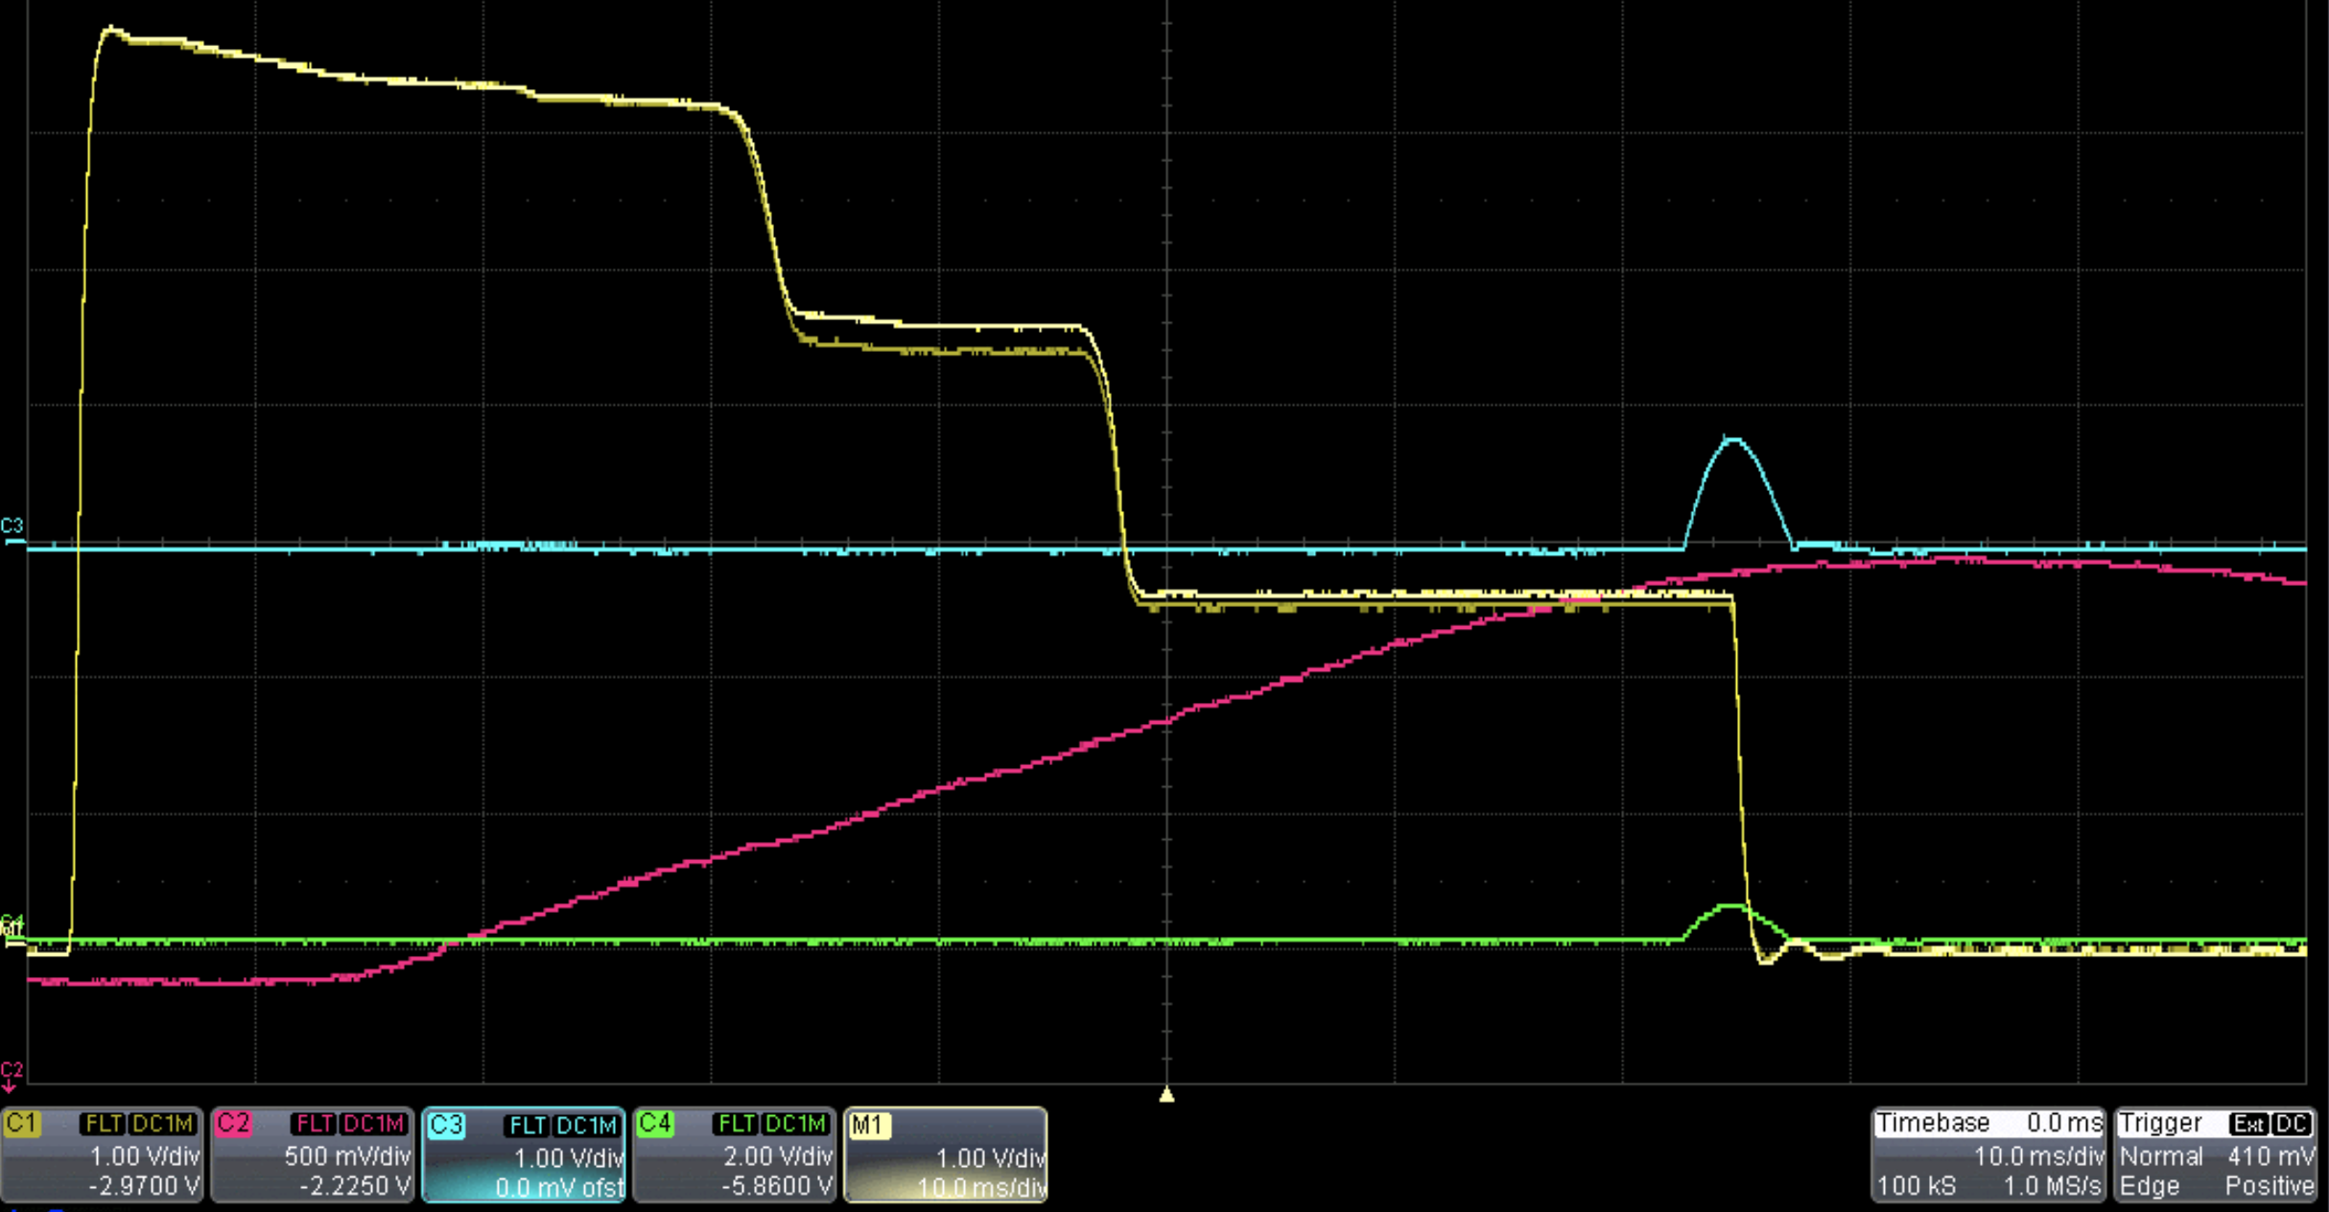
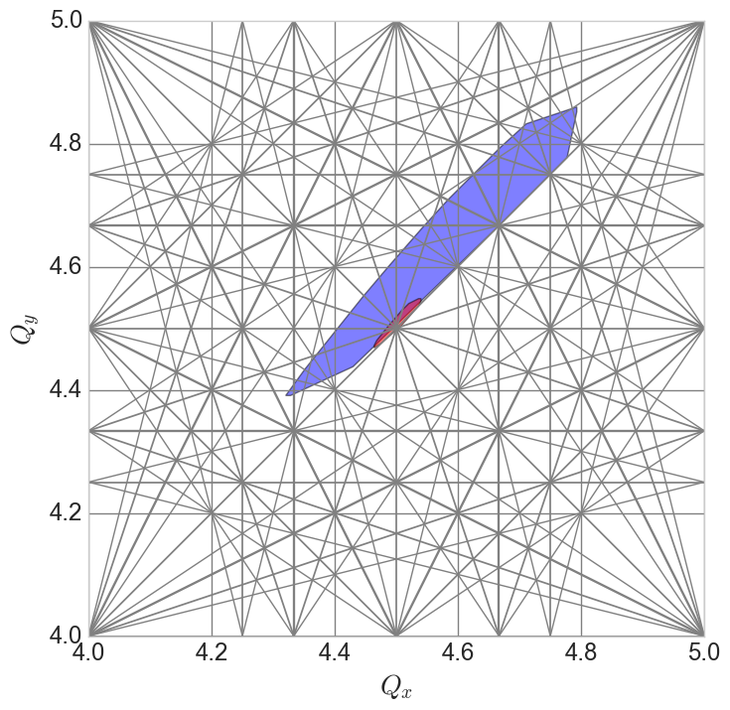
Proton Acceleration in Booster
Booster cycle
H- Linac delivers up to 1x10¹² in 300 us pulse
Adiabatic RF capture (h=1,2)
Acceleration ~70 ms
Transverse scrapes
Orbit bumps against apertures
Reduce intensity and emittance to RHIC requirements
Generally more vertical scraping than horizontal (strong intrinsic resonances are vertical)
Intensity
Hor scrape
Ver scrape
injection
Capture
Extraction
Main Magnet
Capture/Early acc
 | Energy (Kin. GeV) | Intensity (10¹¹)
Injection | 0.2 | 6-8
Extraction | 1.416 | 2.5-3.0
Injection

Slide 10
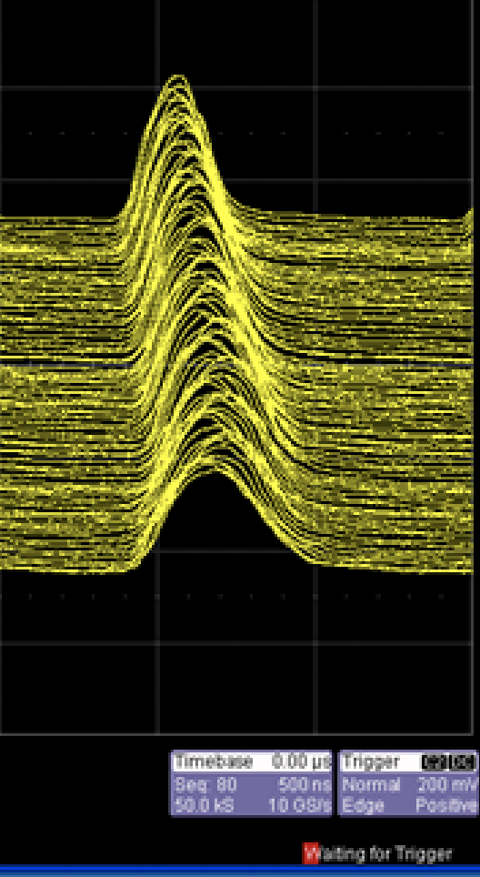
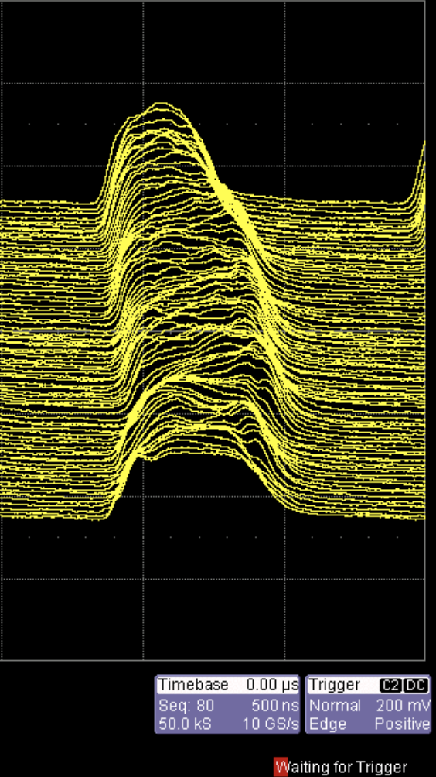
Intensity, emittance and space charge
Space charge tune shifts:
Booster capture: dQ_{sc} = -0.4, -0.4
AGS Injection: dQ_{sc,x,y} = -0.11, -0.23
Space charge effects reduced by:
Dual harmonic bunch lengthening at injection in Booster, AGS (since 2018 at least)
Longitudinal splitting for transfer to AGS to lower peak current, merge at top (developed in Run 24)
Merge is slow, costs +20-25% increase in longitudinal emittance
Split/merge scheme: Add a longitudinal split in Booster and merge in AGS at extraction energy
Booster
AGS
Extract to RHIC
Extract to AGS
Bunch Merge
Dual harmonic RF
Bunch Split
Dual harmonic RF
RF h=1
RF h=1,2
Split
Merge

Slide 11
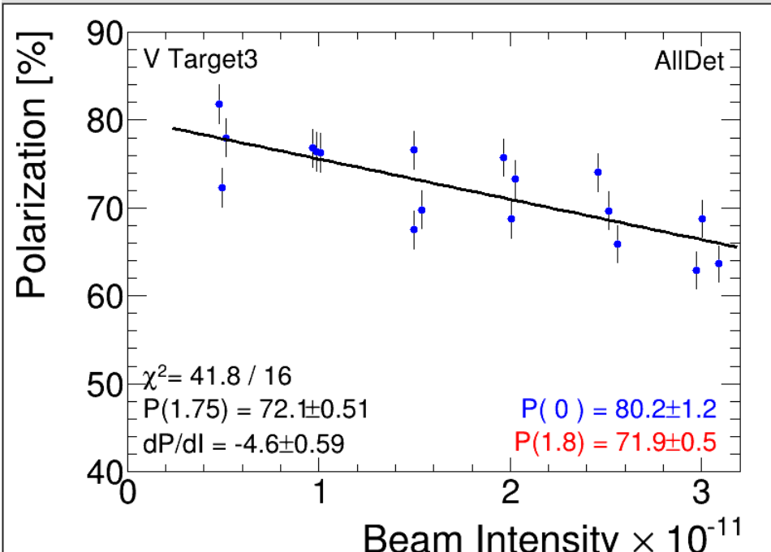
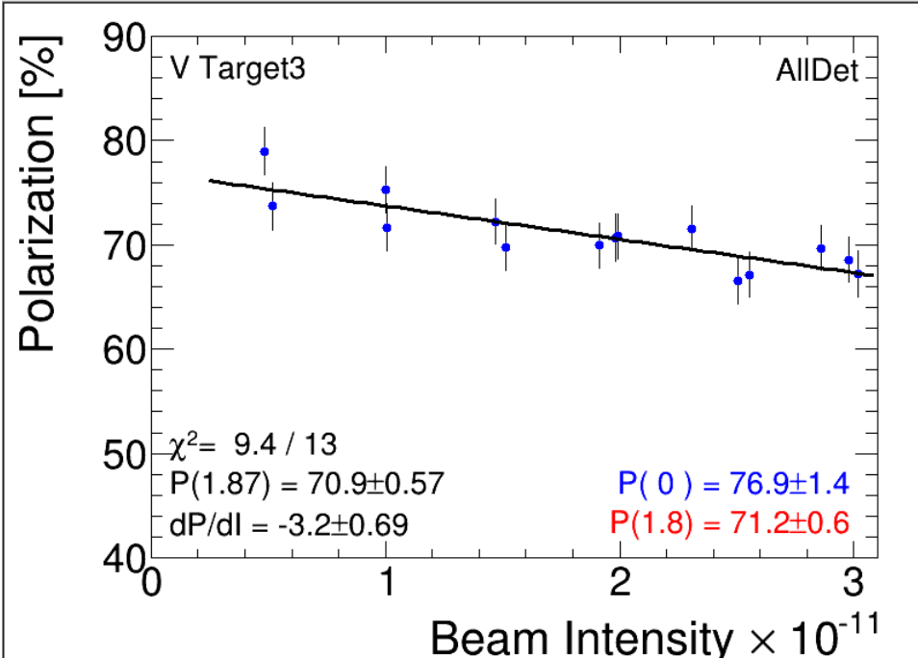
Split/merge setup
Nominal user (single bunch)
Split/merge
Aimed at reducing space charge at AGS injection
Value @ 3x10¹¹ | Single bunch | Split/ merge
Pol (%) | 66.4 | 67.3
Emit hor | 3.1 | 2.6
Emit vert | 3.2 | 2.7
(emit is rms, norm, urad)
Slope dP/dI is less steep
Emittance is 15% smaller
Total polarization is only slightly changed
Seem associated with the P(0) offset: normally associated with Booster or source
Long emit is ~1.2 eVs (+20% from nominal)

Slide 12
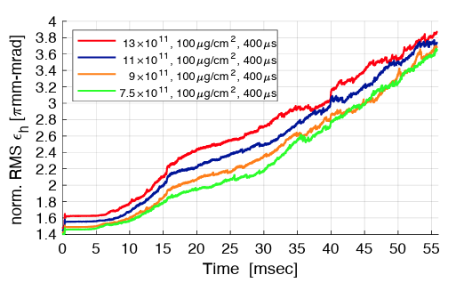
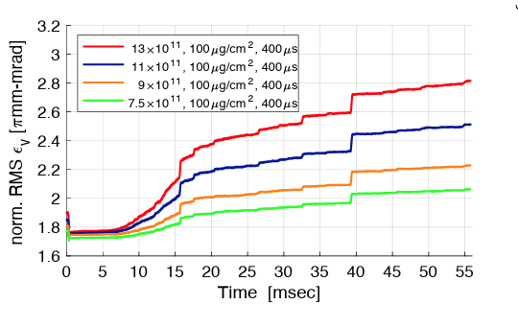
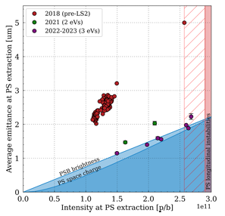
Intensity, emittance and space charge: Simulation
If peak current is minimized, must identify/reduce driving terms
Simulation
Some work from pre-Run 24, needs:
Beam experiments to validate
Identification of sources of emittance growth (resonant stopbands etc)
No simulations of beam with space charge in the AGS recently: complicated by snakes
No impedance model for any injector machine
Recent efforts at other facilities (state-of-the-art tools/approaches)
LHC Injector Upgrade Project
Rumolo, et al, High Brightness 2023, Geneva
Identification of limits, sources of growth
FAIR space charge studies
Oeftiger et al, Simulation study of the space charge limit in heavy-ion synchrotrons, PRAB 25, 054402
utility of faster ‘frozen space charge’ models
Booster space charge simulations
LHC Inj. Upgrade
FAIR studies

Slide 13
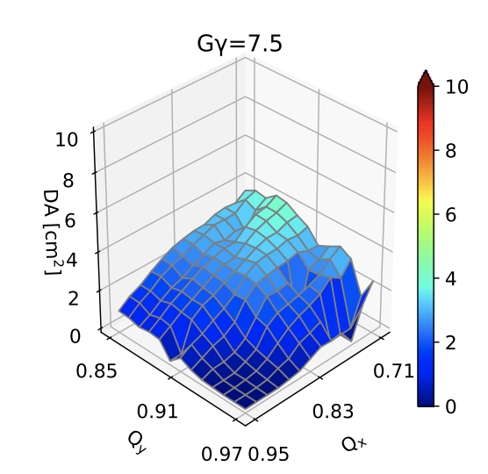
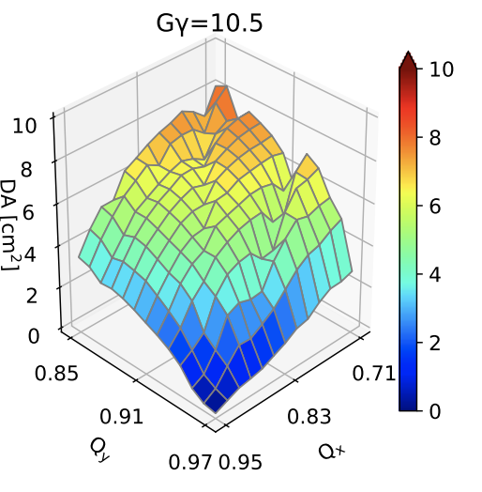
Intensity, emittance and space charge: Increased BtA transfer energy
Proposed upgrade of ³He Booster-to-AGS transfer from |GƔ|=7.5 → 10.5
Motivated by simulations showing difficult intensity and polarization transmission in ³He low energy interval
Would require upgrades of:
Booster main magnet power supply
Multiple pulsed power injection/extraction supplies
Possibly upgrades of kicker/septum magnets (TBD)
Significant expense
For protons, this would enable increase transfer energy from GƔ = 4.5→7.5
Reduce space charge tune shifts by factor 0.35
E.g 3x10¹¹ bunch would have dQ_{sc} of 1x10¹¹ at present energy
Adds 3 imperfection (orbit) and 2 intrinsic resonances (handled via AC dipole) to the Booster
Helion dynamic aperture by GƔ

Slide 14
Polarization and resonance correction

Slide 15
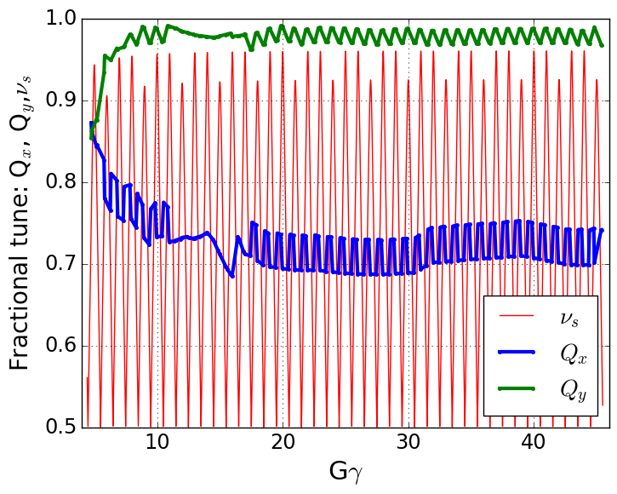
Depolarizing resonances in AGS
Polarization is preserved in the AGS with two partial helical dipole snakes (10% and 6% rotation)
Provides spin tune ‘gap’ where imperfection and vertical intrinsic resonance condition are never met
ν_{s} ≠ N (full spin flips)
ν_{s} ≠ N +/- Q_{y}
Horizontal resonance condition still met
ν_{s} = N +/- Q_{x}
Horizontal resonance are weak, but many (82 crossings)
Currently handled with fast tune jump
ΔQ_{x} = 0.04, 100 μs
Spin tune gap
Hor resonance crossings
Tune
jump
(pause tune jump near transition)
Extraction
Injection

Slide 16
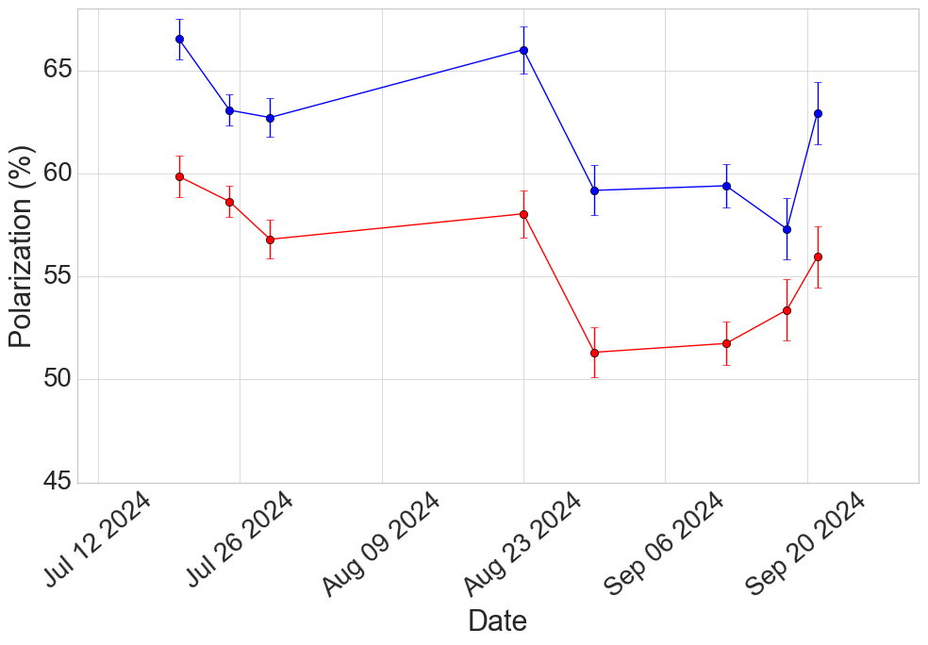
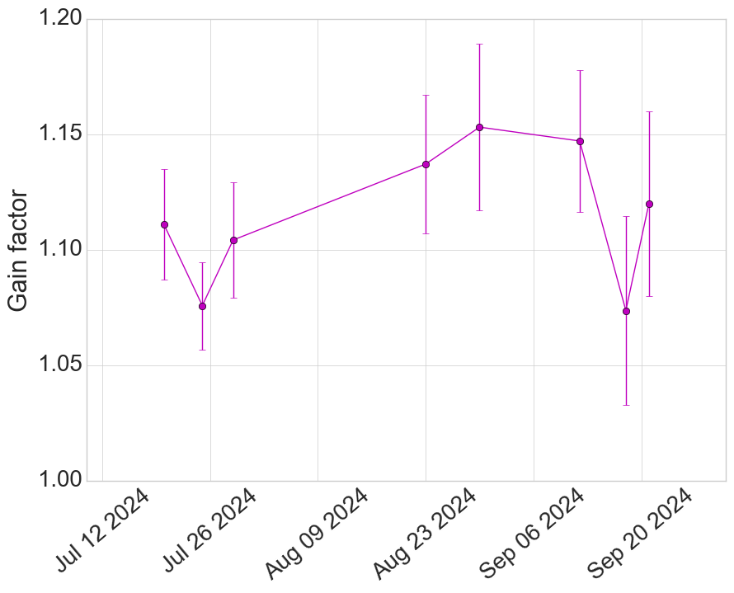
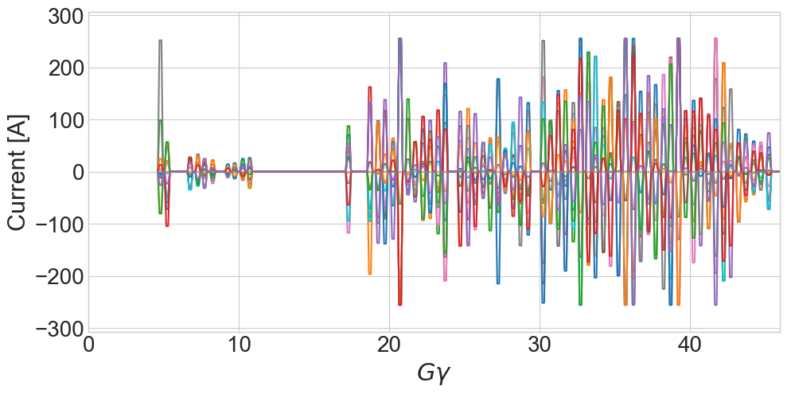
Horizontal resonance correction
Skew quads installed to correct horizontal resonance terms
Commissioning in Run 24
Tune jump: 8-10% improvement over baseline
Skew quads: 12-15% improvement over baseline
Skew quad approach requires accurate optical model knowledge
Measured effect of low energy resonances 2-5% below expectation
Could improve with improved optical modeling
Intensity dependence of polarization not significantly changed by skew quad approach
system still needs commissioning, but early indication is that vertical resonances still an important problem
Polarization comparison
Intentionally omit
Near transition
Skew quads ON
Skew quads OFF
Each trace= 1 skew quad
Orbit iterations
Add pulses
Skew quad currents
Polarization ratio
Skew Quads ON/OFF

Slide 17
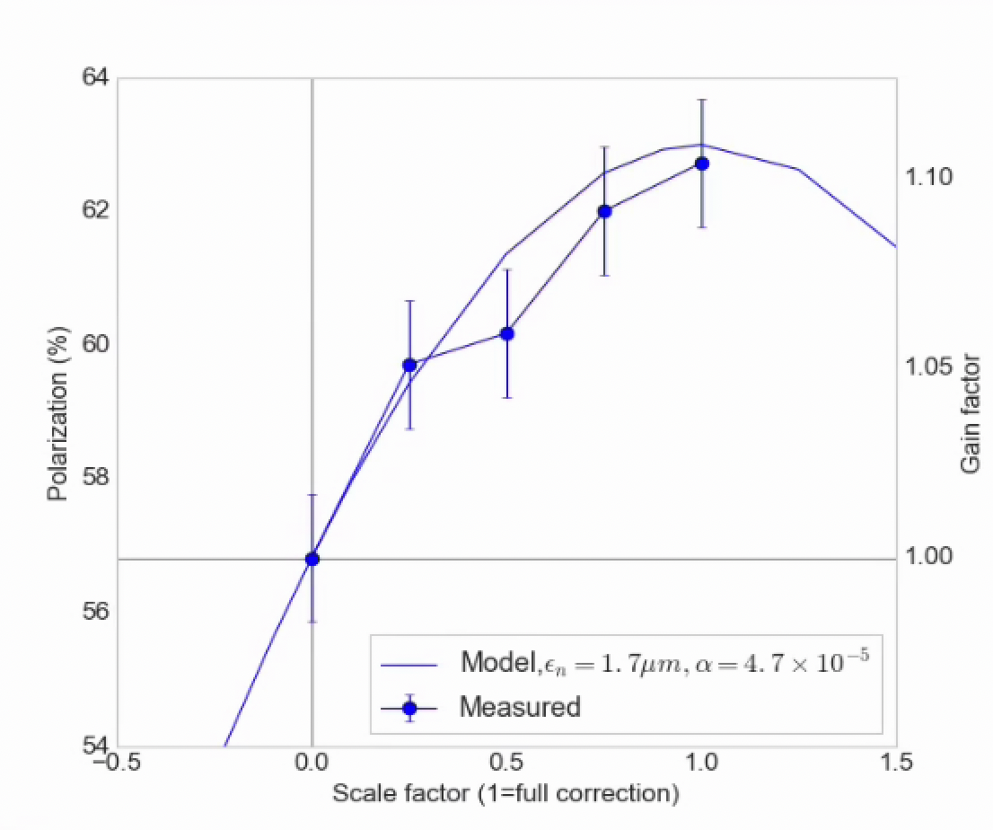
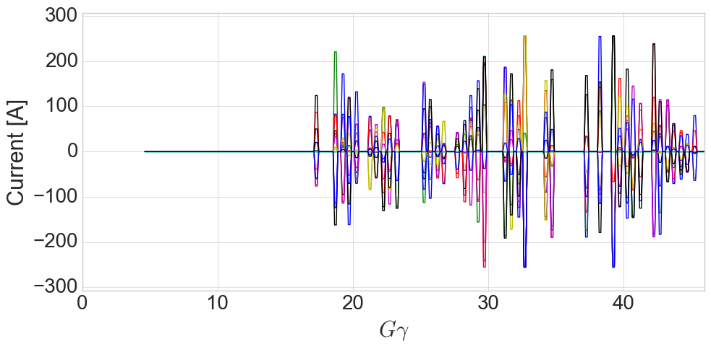
Ramp implementation and Polarization
Early attempts:
High energy pulses only (avoids difficult low energy optics)
Omitting several pulses with too large orbit excursions
Within statistical error of model in terms of gain factor over uncorrected polarization
Correcting only resonance above transition
Skew quad current
Each trace= 1 skew quad

Slide 18
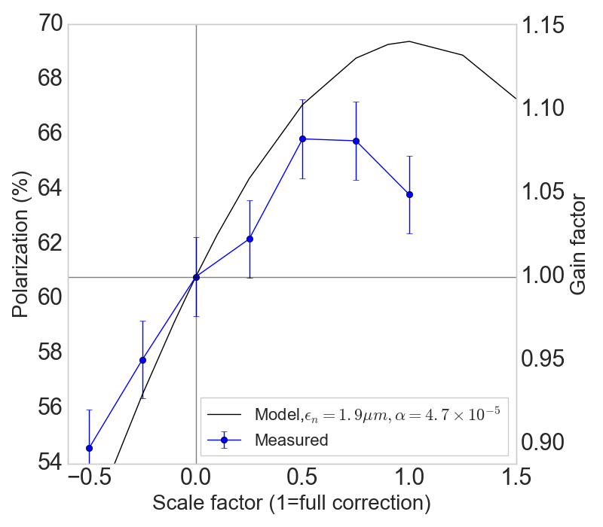
Low energy resonance correction
Benefit from low energy pulses (GƔ < 15) expected to be ~3-4%
Measured benefit ~1%
In some cases negative, less reliable correction
Not totally understood – possible culprits:
Model error is highest at low energy (snakes, orbit feed-down)
Q_{x} closer to Q_{y}: residual coupling from errors will change the drive term addressed by the skew quads
Near GƔ = 9 =0+Q_{y}, very small correction strengths required (easy to provoke extra resonance terms from coupling)
Correcting scaling, full cycle
Orb correction also enables broader scans
Skew quad currents
Intentionally omit
Near transition
Each trace= 1 skew quad

Slide 19
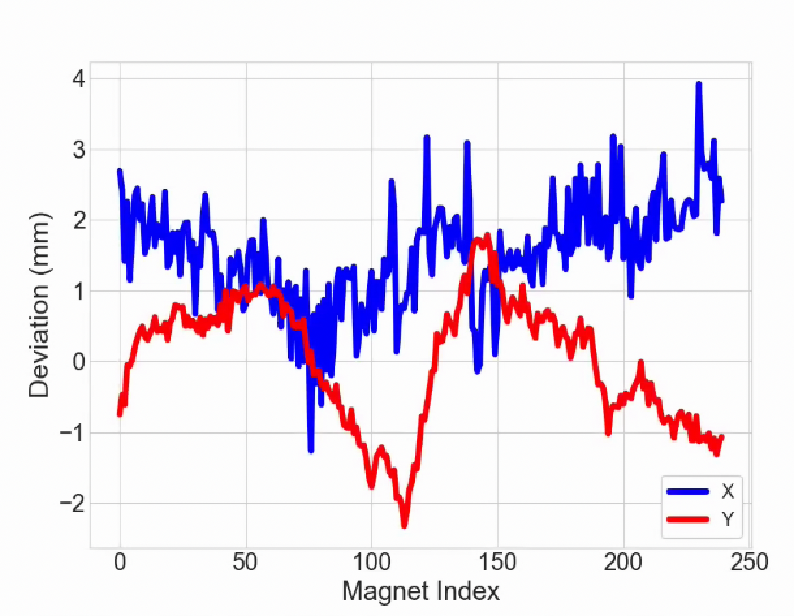
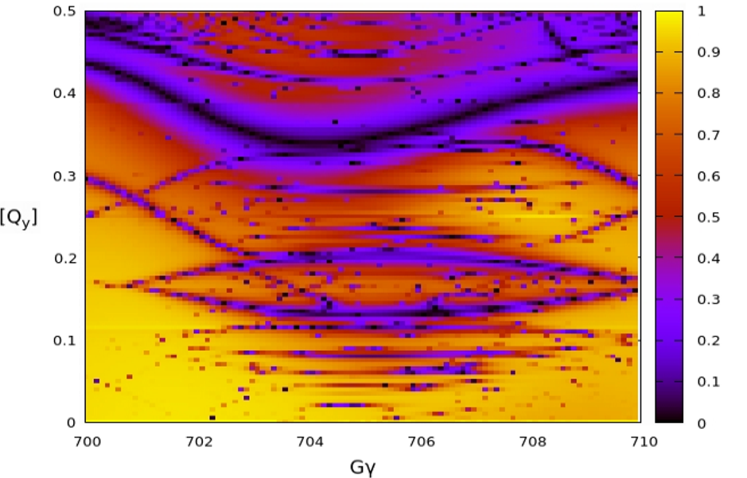
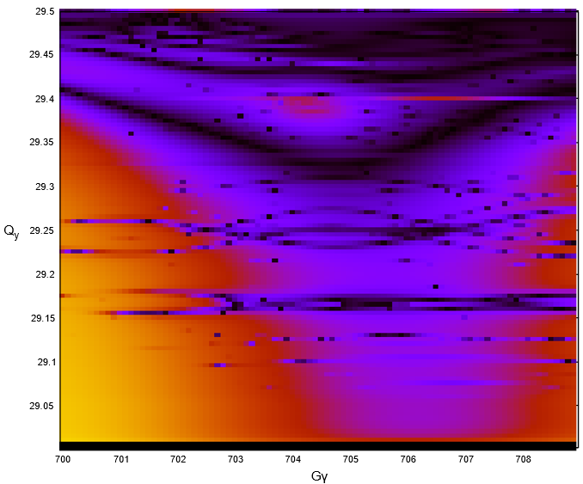
Remaining depolarization: where does it go? Misalignments?
AGS Main magnet misalignments
Resonance associated with vertical motion probably still important
AGS Magnet survey/realignment effort
all 240 AGS main magnets are combined function (dipole + quadrupole)
No global realignment since the 90’s (smaller targeted effort in 2012)
Needs simulation assessment of impact on depolarizing resonances (ongoing)
Also puts orbit closer to reach of existing (or moderately upgraded) correction magnets
EIC HSR Lattice optimized to reduce resonance lines (³He)
Could use tools from EIC/HSR efforts
Resonance “portraits” have been useful in optimizing lattice design for HSR
Could be used to study impact of machine error on resonance structure
Q_{y}
(HSR modeling by Eiad Hamwi)

Slide 20
Instrumentation and Operations

Slide 21
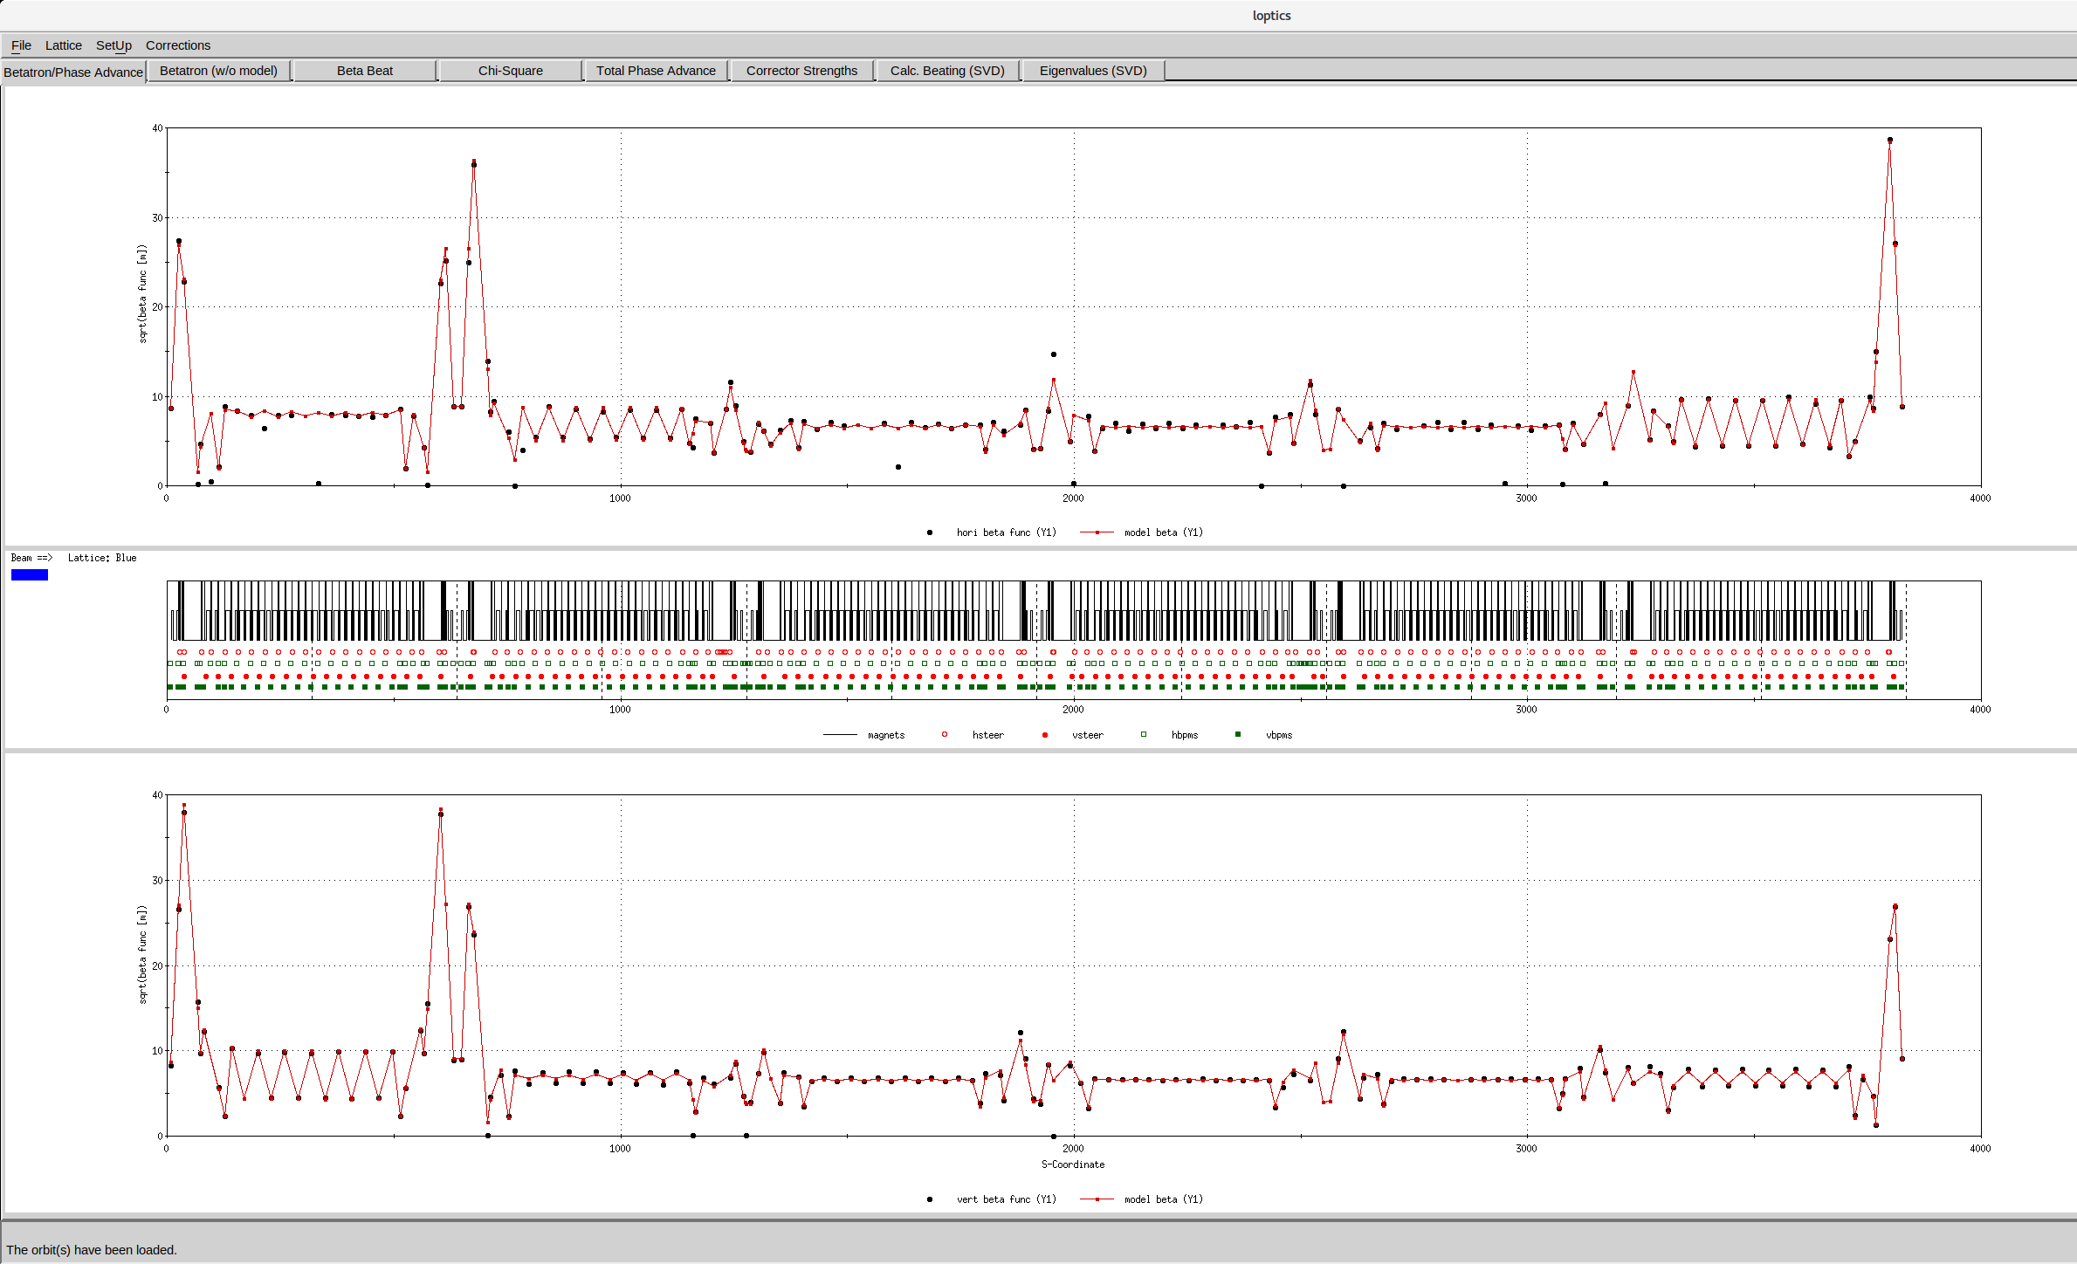
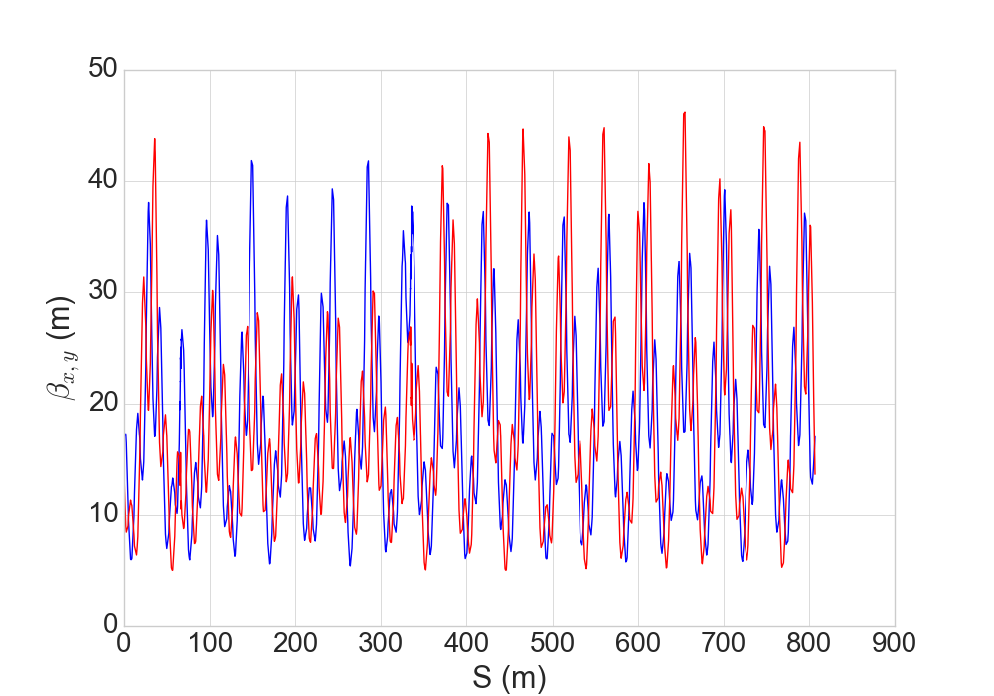
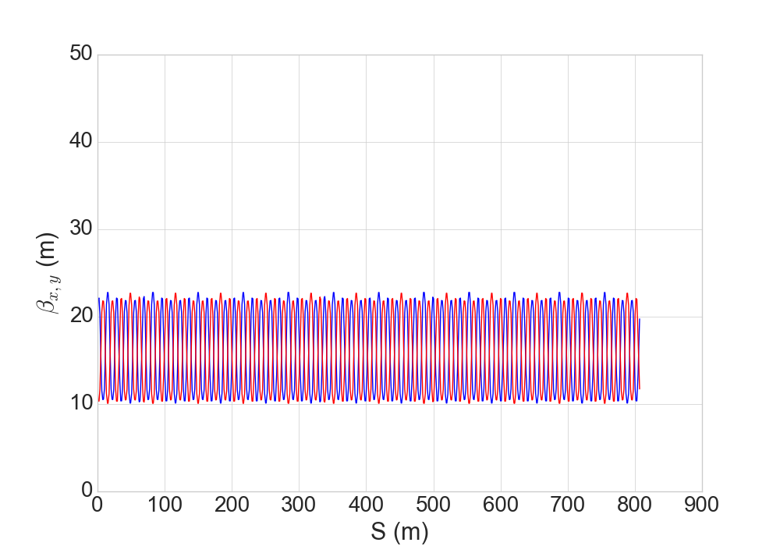
Instrumentation and potential upgrades: BPMs
RHIC Optics from TBT BPMs
Injector Beam position monitor (BPM) upgrades to full turn-by-turn
Booster ~48/plane closed orbit
AGS ~72/plane closed orbit
Currently only 1 TBT BPM instrumented in each machine
Full TBT allows much faster, more precise optics determination
Measurement effectively instant vs ~5 hours of acquisition (plus lengthy analysis)
Installation/commissioning in next ~2 years
Potential benefits
Skew quad resonance approach heavily model based 2-5% further improvement possible if early ramp optics corrected
Better understanding of residual depolarization in non-ideal conditions (optical error, misalignment)
Understand large optics changes in early acceleration → required for understanding early emittance evolution
β_{x}
β_{y}
AGS optics (model)
Injection
Extraction

Slide 22
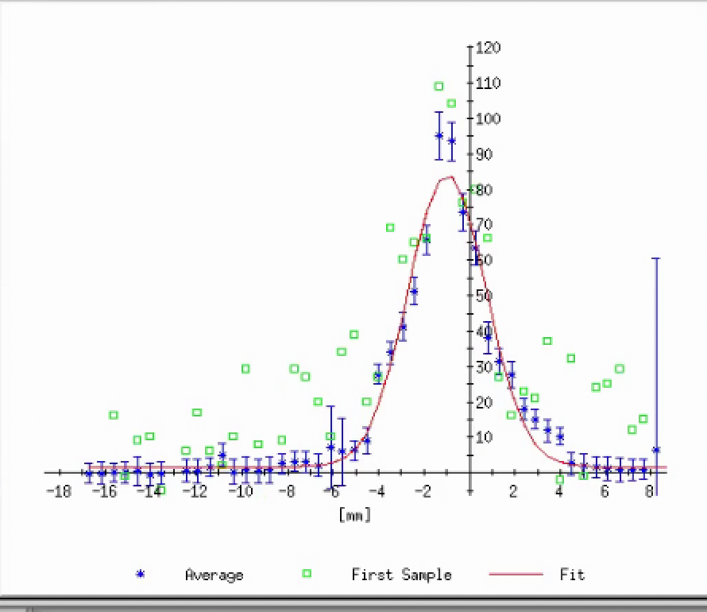
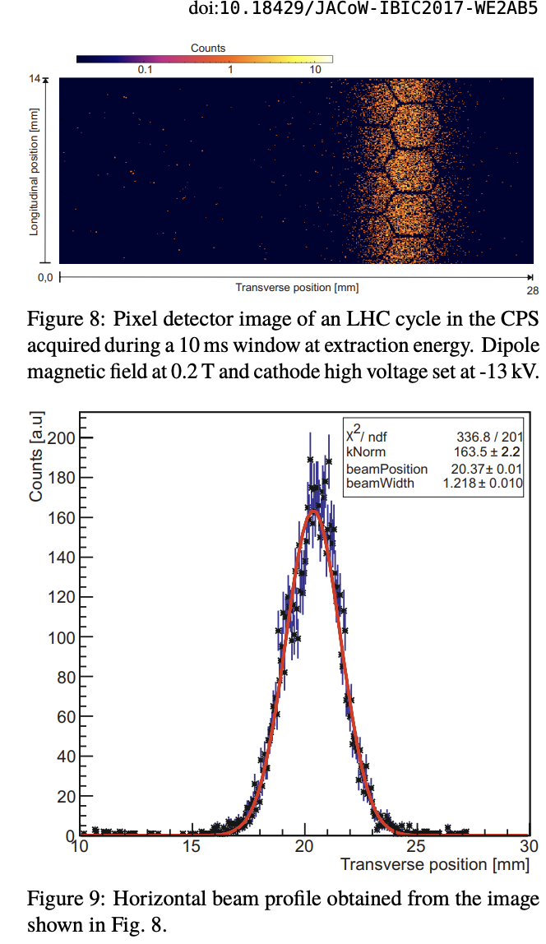
Instrumentation and potential upgrades: Emittance
Booster ring: no device
Possible use of scraping as destructive profile measurement*
Would be better with a dedicated scraper, instead of orbit
AGS ring: two ionization profile monitor devices per a plane
Ion collection: dominated by intensity dependent systematic (decades old problem)
E-collecting: multi-channel gain vs. position variation, depletion with time
Are these optimal design for our purposes?
PIXEL detector based upgrade: see CERN PS experience
AGS Hor eIPM
* Russo et al, Transverse Emittance Reconstruction Along the Cycle of the CERN Antiproton Accelerator, High Brightness Hadron Beams, HB2023, Geneva, Switzerland
CERN PS Pixel IPM (IBIC’17)

Slide 23
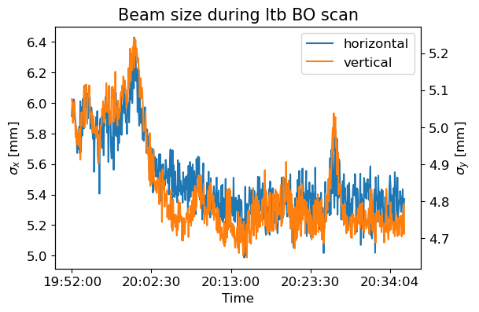
Optimization with ML: LtB Injection example
Multi-year effort with Cornell, RPI, JLab, FNAL
ML-based effort at online optimization and model calibration, aimed at polarization optimization
Linac-to-Booster optimization
Minimal model inputs
Likely to help better maintain previously achieved optimum
Beam sigma (BtA)
Not an explicit objective, consequence of improving scrape efficiency
$$ℒ \sim \frac{N^{2}}{β^{∗}ε} \sim \frac{N^{2}}{beam size}$$
Intensity Booster extraction
Slide from Lucy Lin

Slide 24
Overview of effort
Intensity and Emittance
Polarization and Resonance
Instrumentation and Operation
Space charge study and modeling at injection Booster/AGS
Identify primary drivers of growth
Impedance accounting
Fully spec the increased BtA transfer energy
Further reduction of peak current?
Improve hor resonance correction with modeling (ORM, TBT)
Resonance structure from measured misalignment and optical error
Turn-by-turn BPMs for improved optical studies
Emittance measurements toward full Linac-to-collider emittance story
Machine learning aimed at operational optimizations and calibrations

Slide 25
Summary
20+ years of RHIC polarized operation (~40 in the injectors!)
Injectors probably well “tuned” in present configuration
Further improvement needs insight into basic mechanisms of
Intensity dependent emittance growth (space charge)
Depolarizing resonance structure
New tools available and in use in design of EIC (and other facilities)
Well-suited to our current challenges
Mostly a question of person-power

Slide 26
Backups

Slide 27
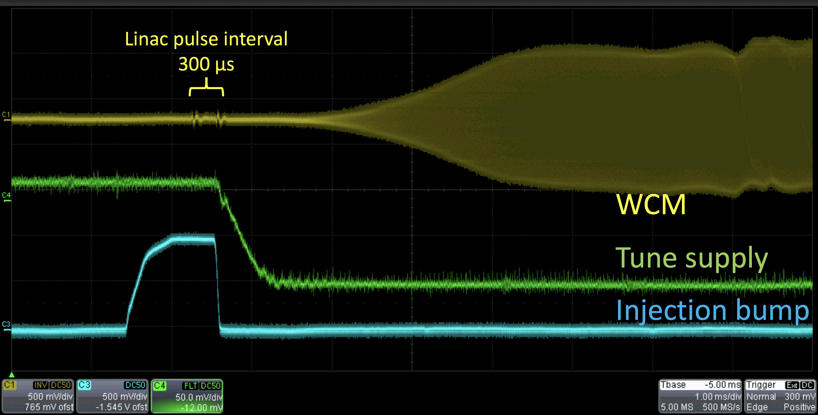
Injection of H⁻ into Booster
Booster Injection
Injection of coasting beam with tunes near and just above ½
Coasting beam has small space charge
Half-integer tune + half integer stopband correction quads minimize beta at stripping foil location
Minimizes scattering due to foil
Tunes pulled up away from half before bunching
Max space charge tune shift dQ_{sc} = -0.4
Injection tune: empirical tradeoff between injection foil scattering and proximity to half integer
Capture/Early acc
Injection

Slide 28
Ramp implementation and Polarization
Early attempts:
High energy pulses only (avoids difficult low energy optics)
Omitting several pulses with too large orbit excursions
Within statistical error of model in terms of gain factor over uncorrected polarization
Correcting only resonance above transition
Skew quad current
Each trace= 1 skew quad

Slide 29
Low energy resonance correction
Benefit from low energy pulses (GƔ < 15) expected to be ~3-4%
Measured benefit ~1%
In some cases negative, less reliable correction
Not totally understood – possible culprits:
Model error is highest at low energy (snakes, orbit feed-down)
Q_{x} closer to Q_{y}: residual coupling from errors will change the drive term addressed by the skew quads
Near GƔ = 9 =0+Q_{y}, very small correction strengths required (easy to provoke extra resonance terms from coupling)
Correcting scaling, full cycle
Orb correction also enables broader scans
Skew quad currents
Intentionally omit
Near transition
Each trace= 1 skew quad

Slide 30
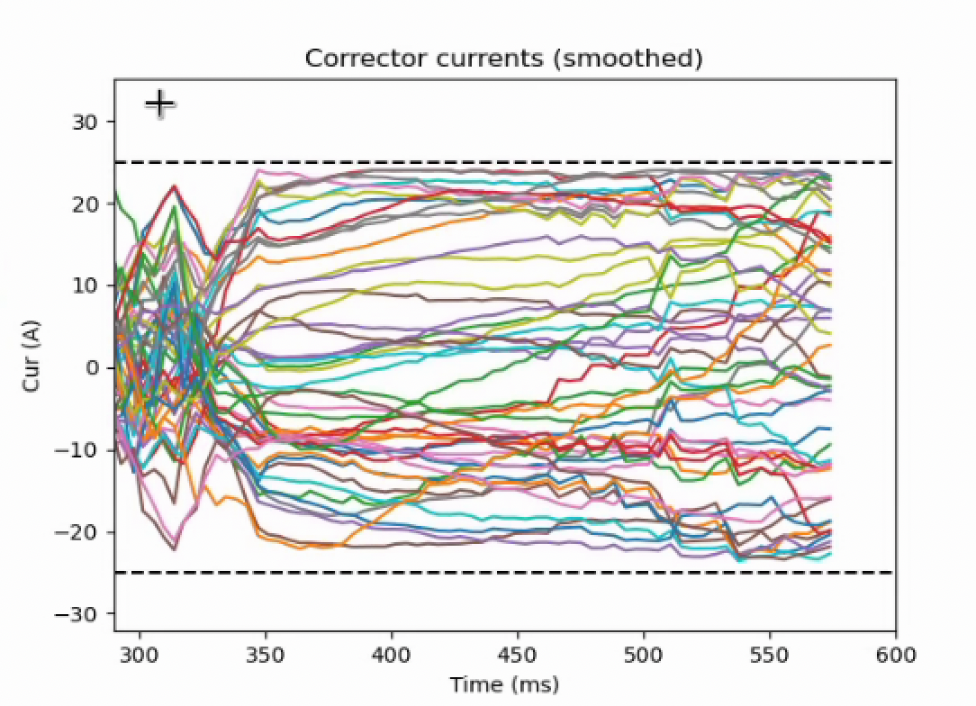
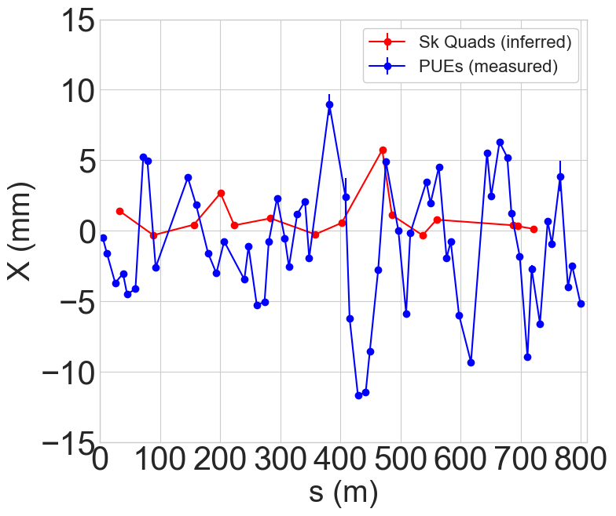
AGS Orbits
AGS Hor Orbit Corrector Currents
Skew quad effort motivated a horizontal orbit correction to center in magnets
Still 1 cm excursions after correction, limited by corrector strength and size of underlying misalignment
Misalignment affects extend to optics
Considerable feed-down from sextupoles (dQ~10⁻²)
+/- 25 A
limit
After correction
G20
Full alignment not possible until after RHIC operation for Run 25.
C20

Slide 31
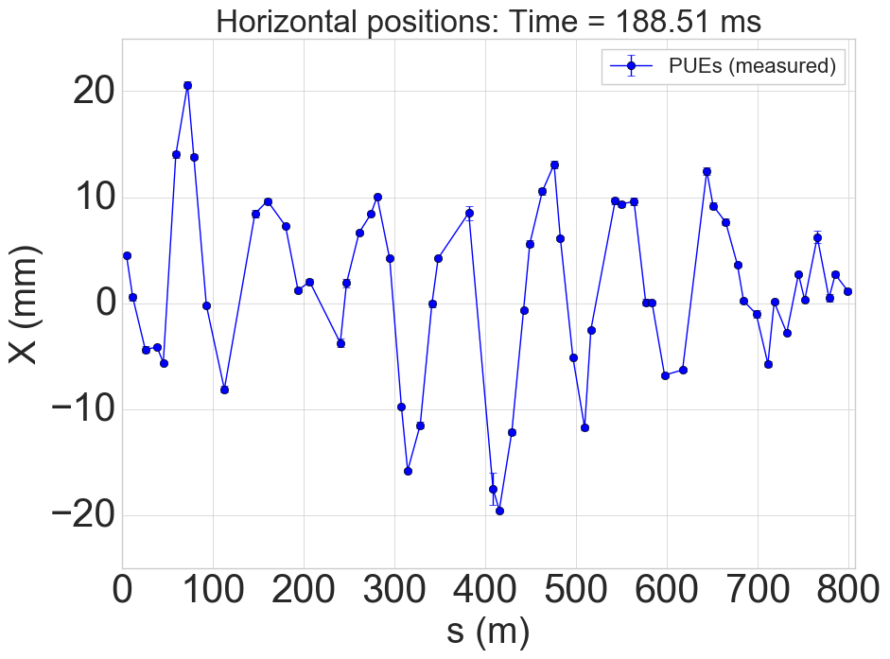
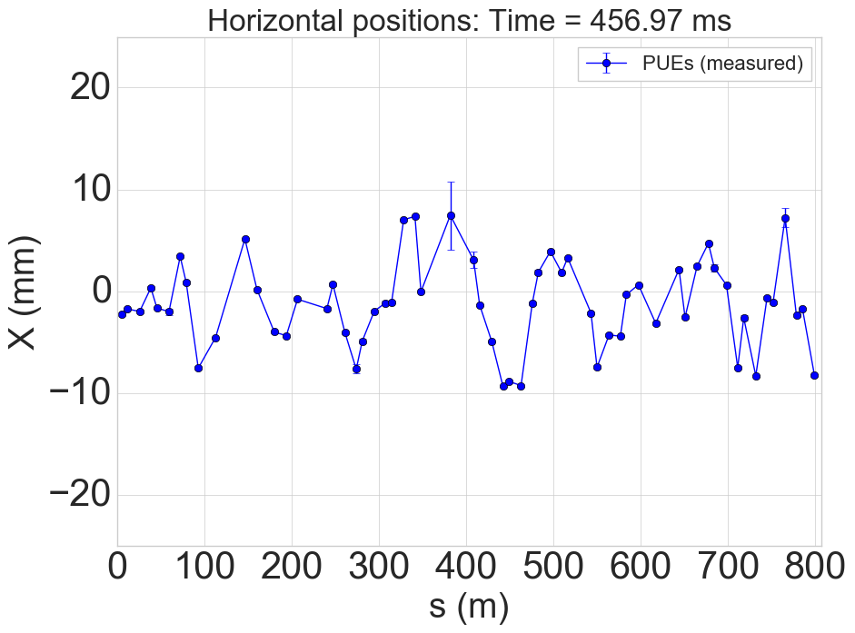
Orbit effects during acceleration
Large horizontal orbit excursions in AGS
High vertical tune (8.985 – 8.991)
Horizontal off-centering in skew quads leads to large vertical orbit changes and beam loss.
Low energy: excursions driven by requirements for helical dipoles
High energy: excursions driven by misalignments
Sample horizontal orbits (at BPMs)
Low energy
High energy
31
31

Slide 32
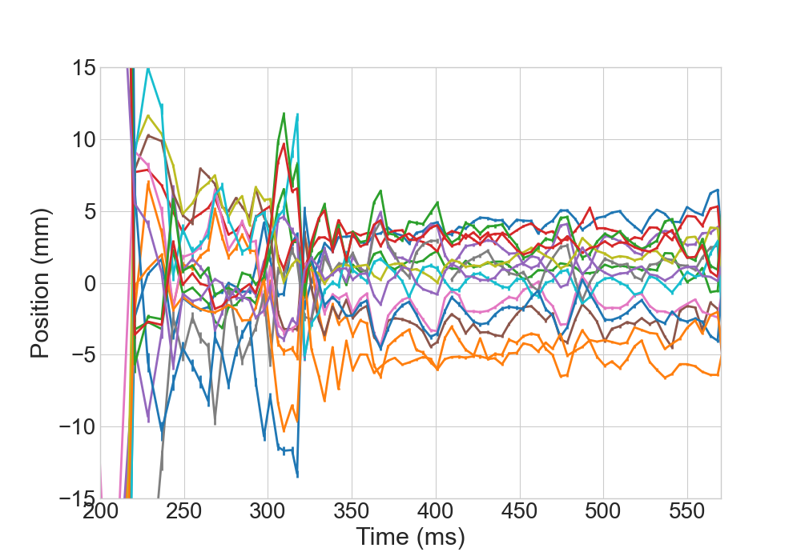
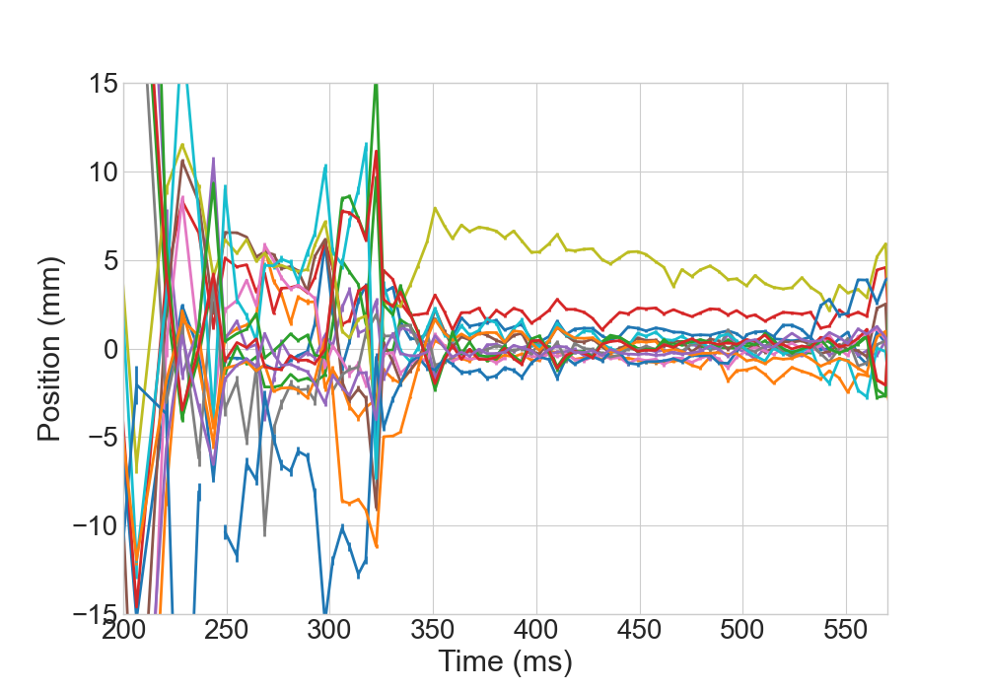
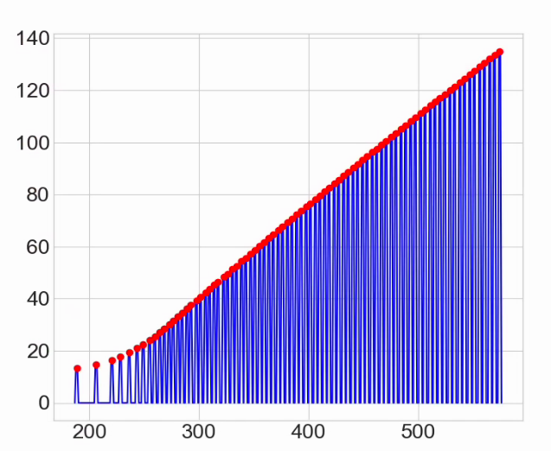
Horizontal position at skew quad
Beam-based centering
No BPMs at skew quadrupole locations
Beam-based orbit offsets measured and corrected
Skew quads pulsed individually, infer offset from vertical orbit change + model
Orbits at low energy (below transition GƔ ~ 15) not corrected
Model infrastructure needs to be developed to correct orbit including design orbit specification with backleg windings, injection and snake related manipulations
Before correction
After correction
Sk. Quad current function for orbit measurement
Scales with rigidity
Current (A)
GƔ ~ 15
32
32
Time in cycle (ms)

Slide 33
AGS Vertical Polarization Profile Comparisons
The vertical polarization profile is developed between Gγ=13.5 and 31.5, across 12+, 36- and transition.
(Simulation by Yann)
JQ on
preliminary
JQ off

