Slide 1
Update on BeAGLE Simulations
Mark Ddamulira
Department of Physics
Michigan State University
October 2, 2024

Slide 2
Outline
Recap
Decoupling photons and neutrons
Exploring neutrinos
Summary

Slide 3
Decoupling the photons
Stages of the e-A interaction
Hard scattering/collision
Intranuclear cascade
Evaporation/Fission
The NOBAM particle origin flag tags particles by stage from which they originate
Notes:
Neutrons are produced more transverse to the beam line

Slide 4
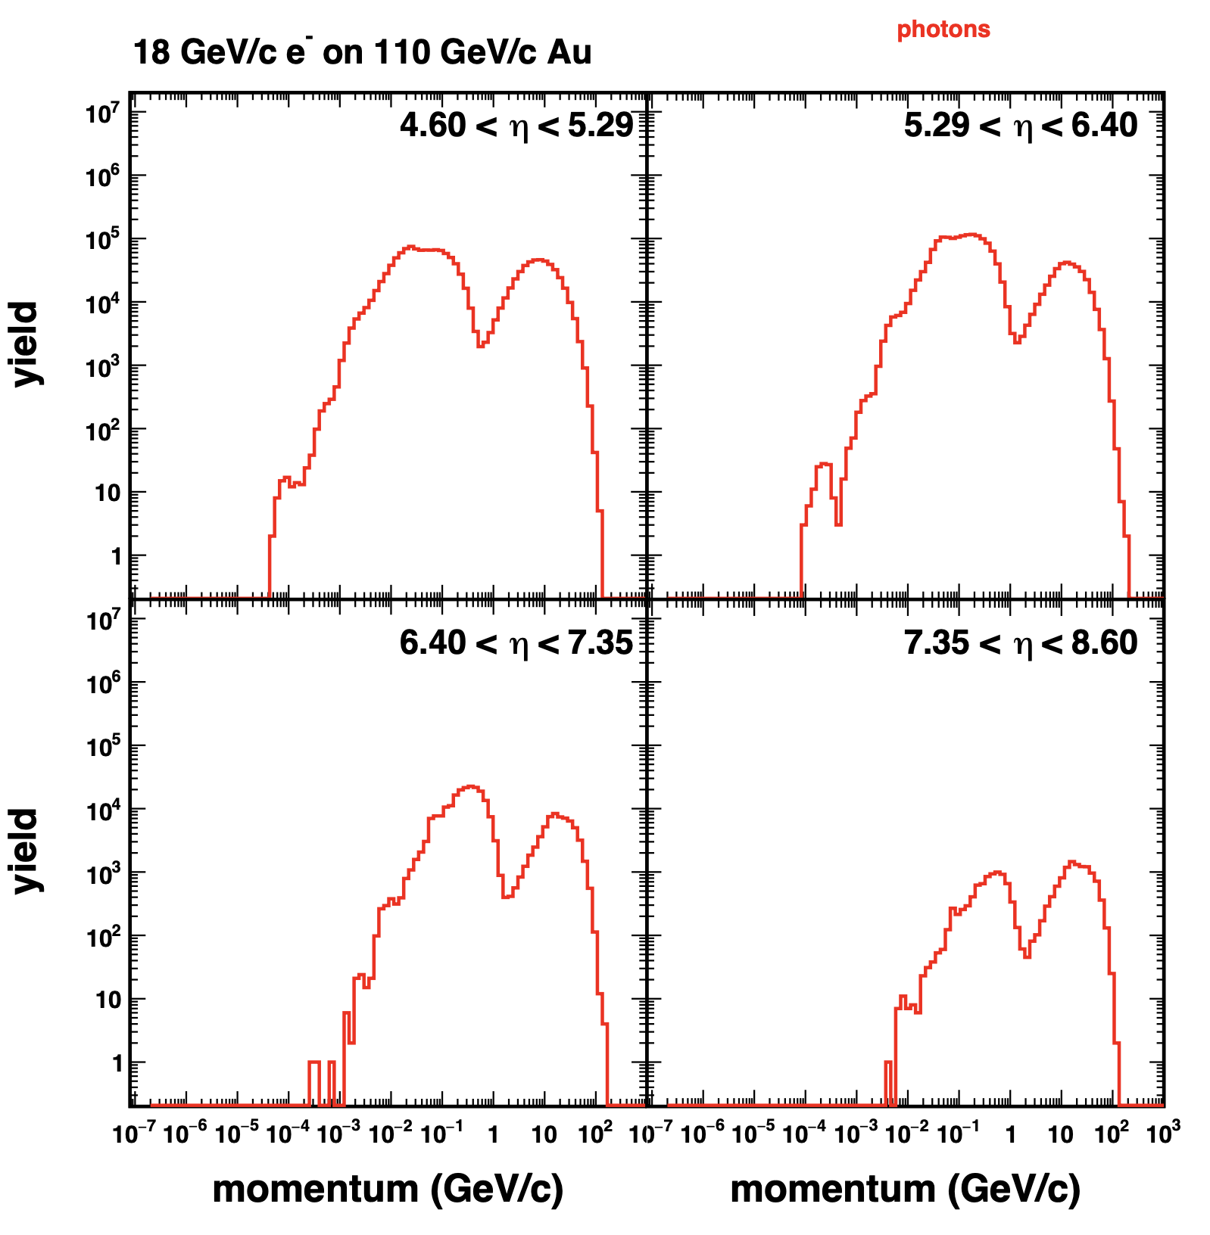
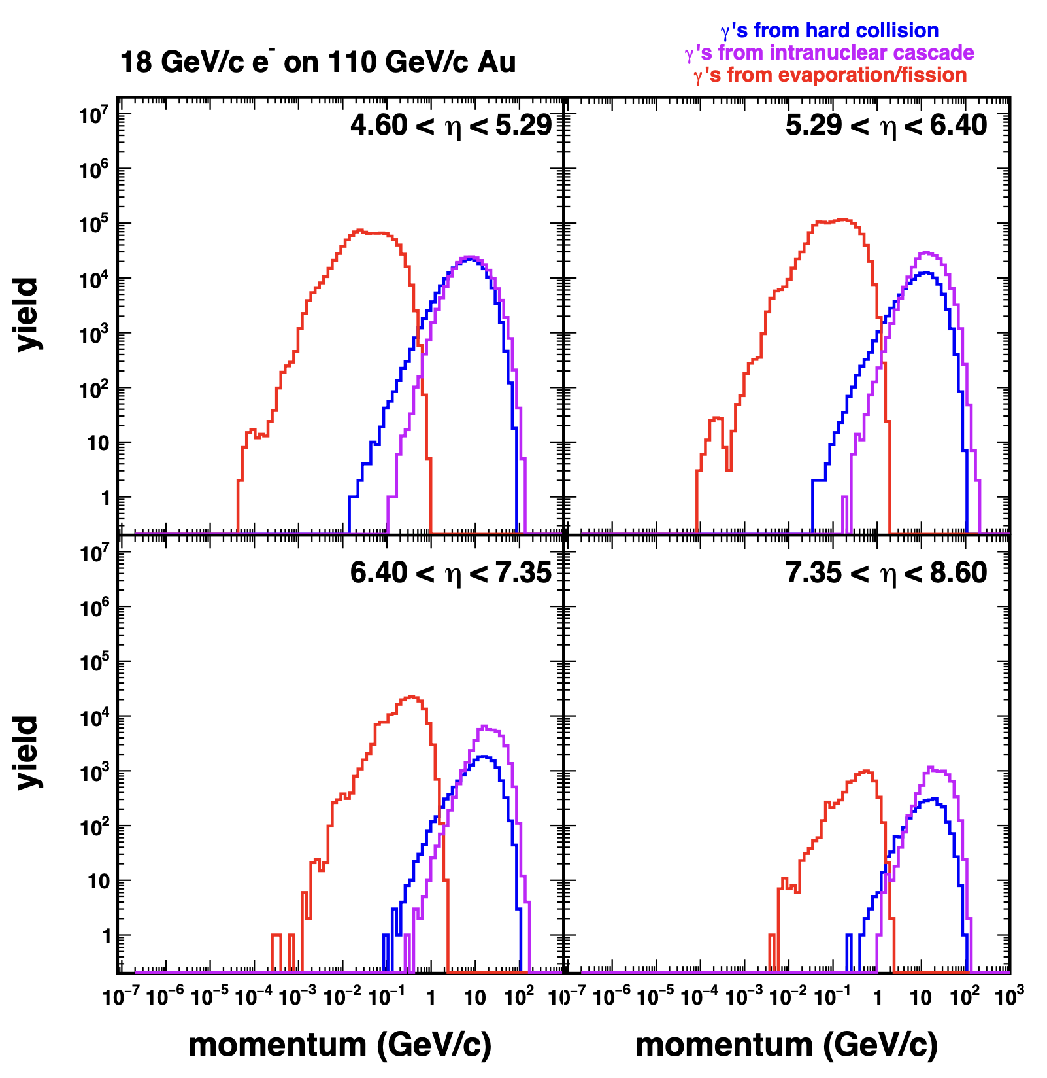
Photons; Far forward

Slide 5
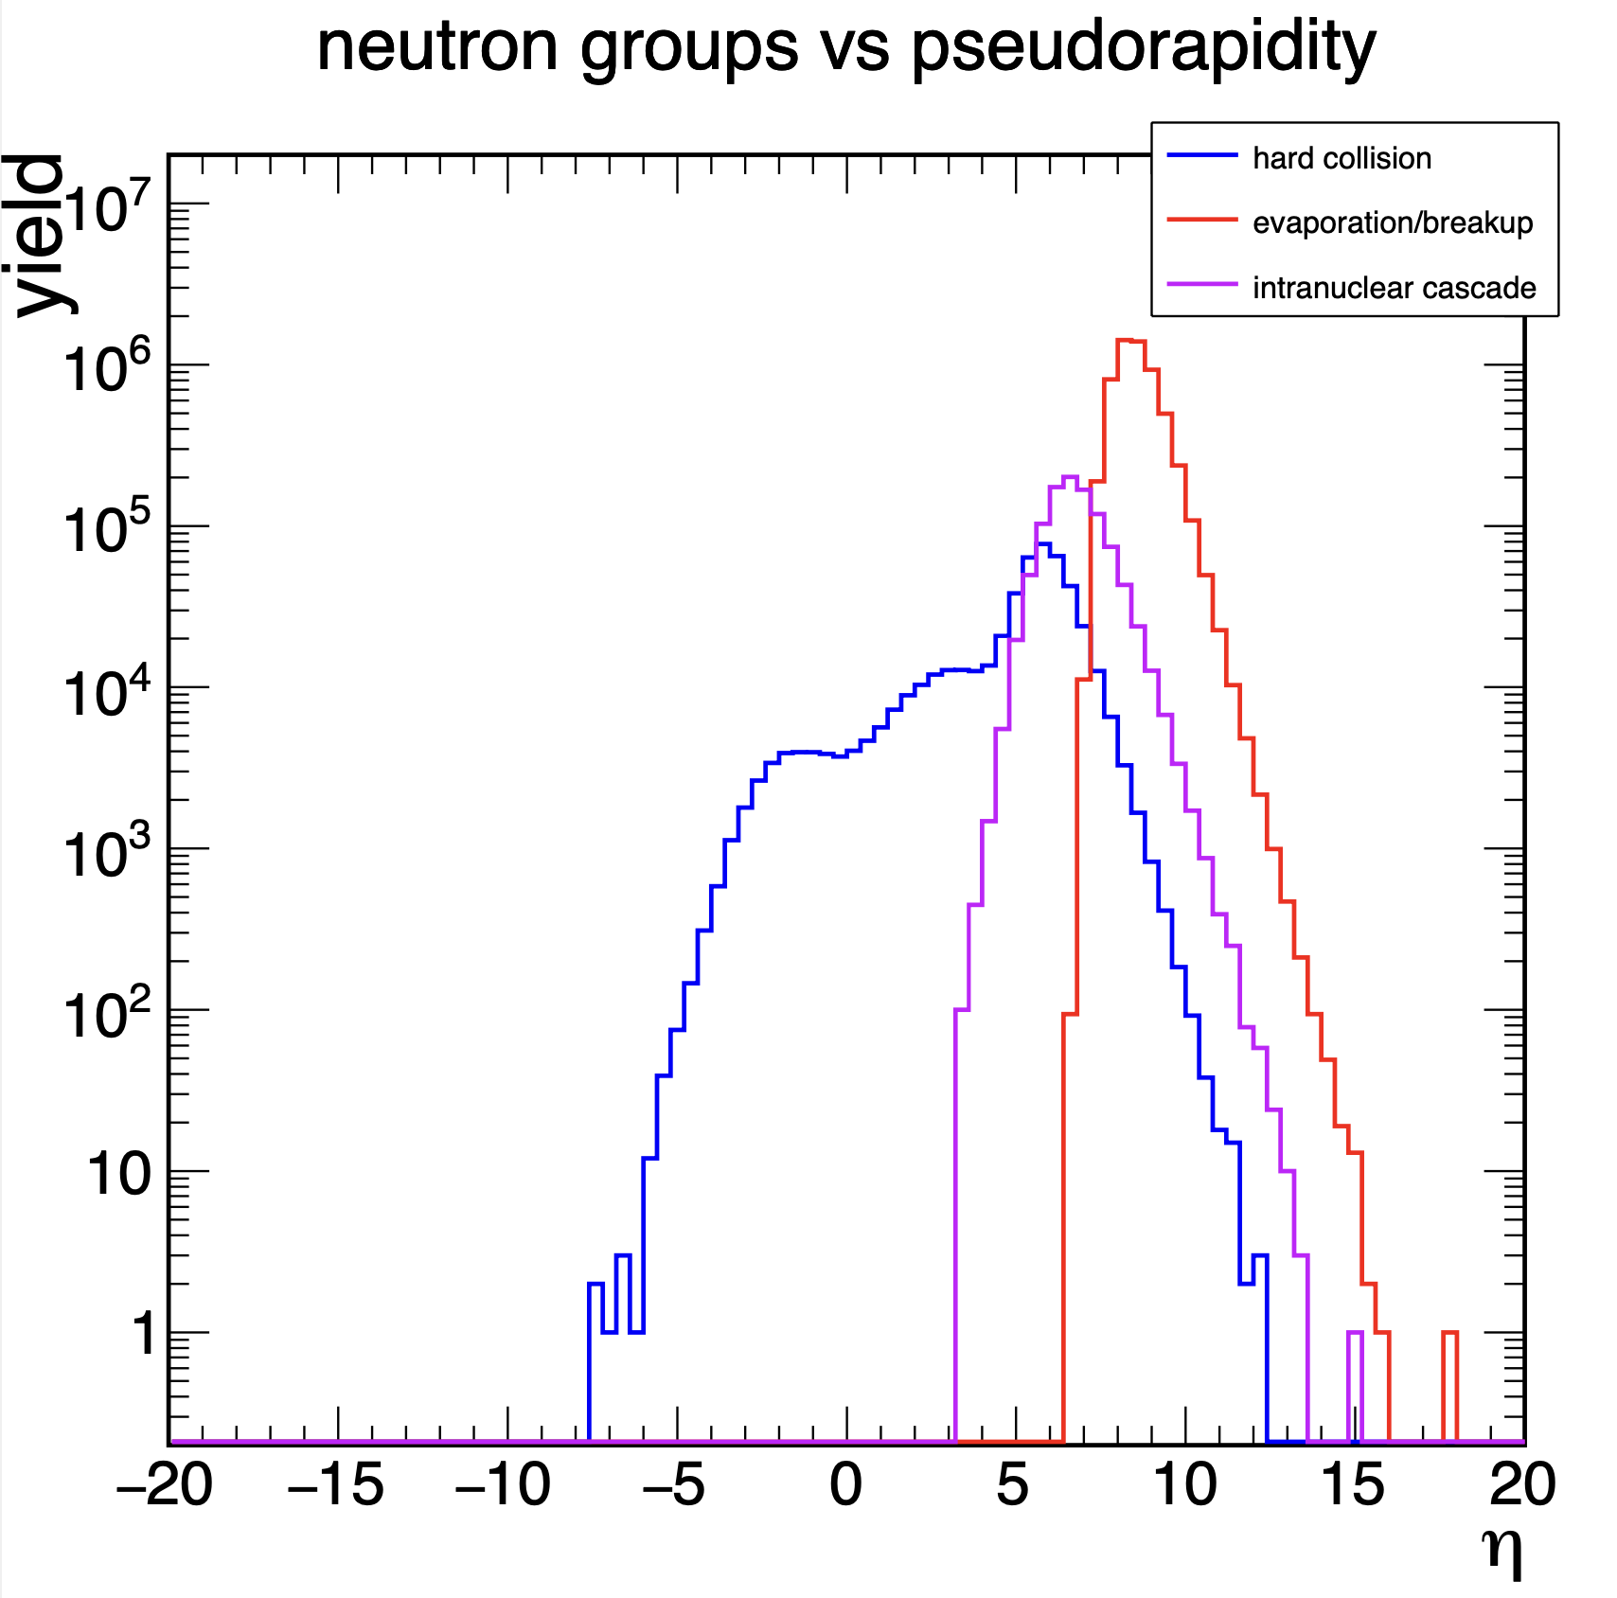
Neutron production
Momentum distributions
Pseudorapidity distributions

Slide 6
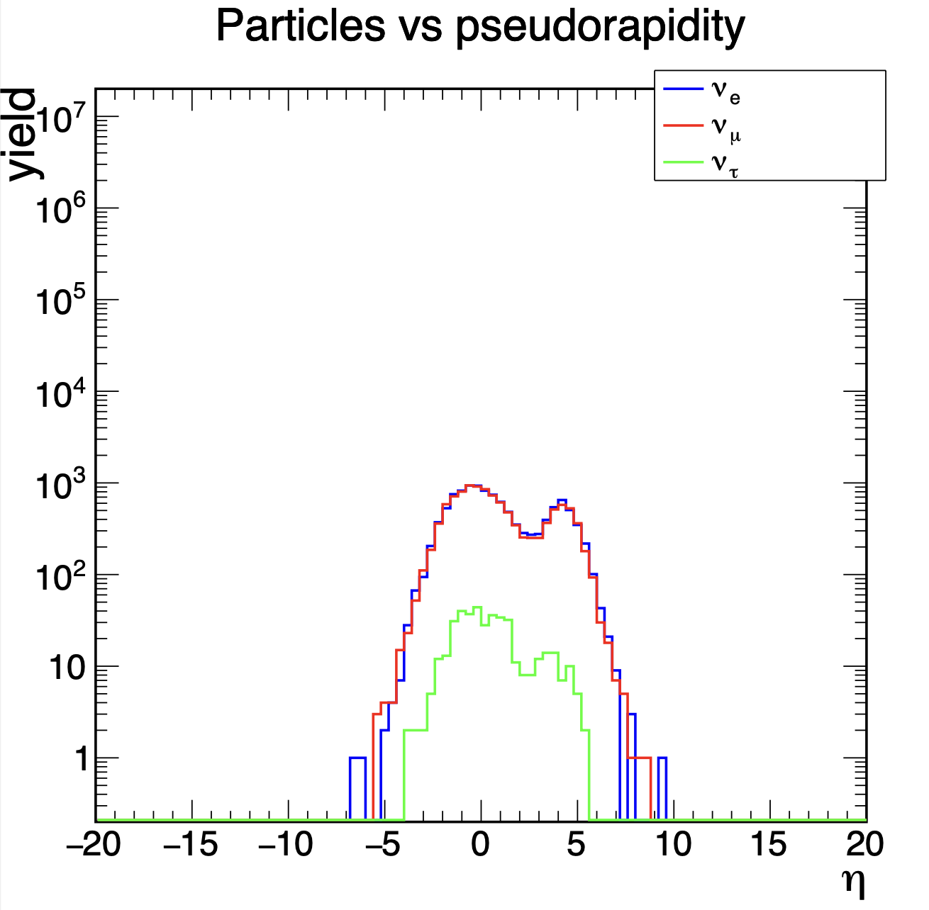
Neutrino production
Momentum distributions
Pseudorapidity distributions

Slide 7
Summary
The NOBAM origin flag is useful for decoupling particles by stage of e-A interaction from which they originate
All neutrino flavors are produced in e-A collisions
We only see neutrinos produced from hard scattering based on current statistics
Neutrons from hard scattering are preferentially produced in regions transverse to the beam axis
Neutrons from the intranuclear cascade and evaporation/breakup are produced in regions close to the beam axis (far forward)
Future works:
Reestablishing access to SDCC account
Similar studies for 𝜋⁰ and K⁰_{L} and anti neutrinos
Looking at invariant mass reconstruction for 𝜋⁰

