Slide 1


Polarimetry
Oleg Eyser
Brookhaven National Laboratory
CFNS-SURGE Summer Workshop on Physics of the Electron-Ion Collider
June 2025

Slide 2
Outline
I. Polarized Particle beams
II. Proton Polarimetry
III. Electron Polarimetry
What is polarization?
Why do we need to measure it?

Slide 3
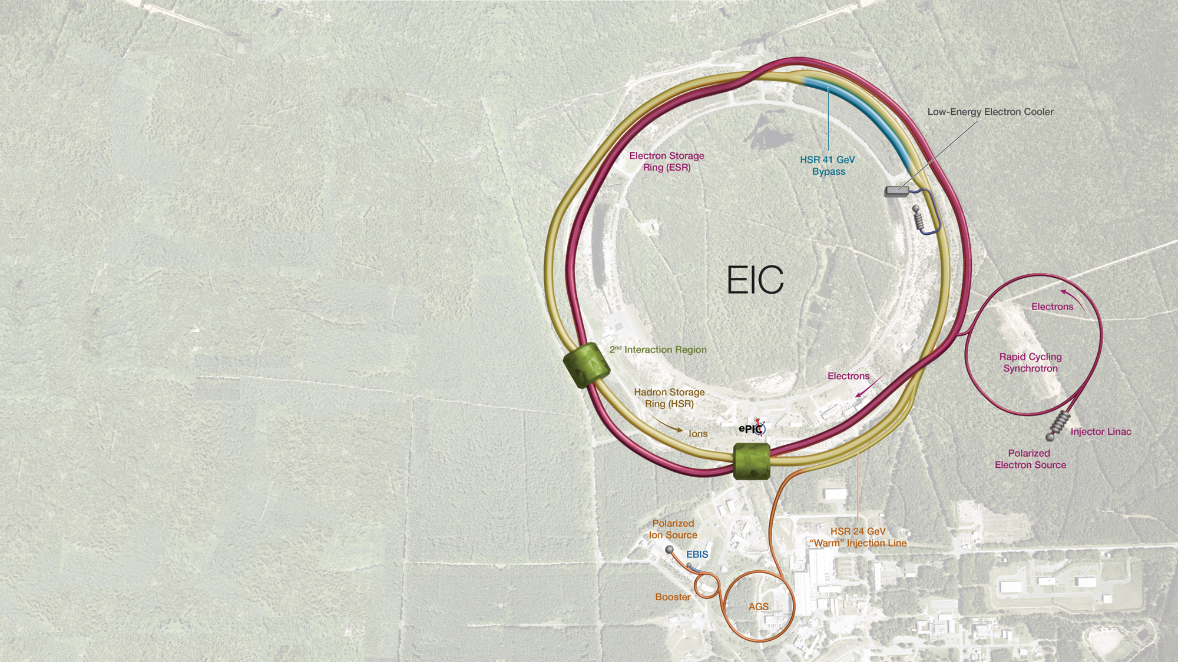

The Electron-Ion Collider
Electrons: $5−18 \text{GeV}$
Protons: $41−275 \text{GeV}$
Ion beams: protons, ${}_{}^{3}{\text{He}}$, Ag, $\text{Au}$, $\text{Pb}$, $\text{U}$
Variable center-of-mass energy:
$$\sqrt{s}=20−140 \text{GeV}$$
High luminosity:
$$L={10}^{33}−{10}^{34} {\text{c}\text{m}}^{−1}{\text{s}}^{−1}$$
Polarized electron and proton beams:
$$P≈70\%$$

Slide 4

What is Polarization?
Merriam-Webster
Noun, po·​lar·​i·​za·​tion ˌpō-lə-rə-ˈzā-shən
the action of polarizing or state of being or becoming polarized: such as
  the action or process of affecting radiation and especially light so that the vibrations of the wave assume a definite form
  the state of radiation affected by this process
  an increase in the resistance of an electrolytic cell often caused by the deposition of gas on one or both electrodes
  MAGNETIZATION
    an instance of magnetizing or the state of being magnetized
    also: the degree to which a body is magnetized
division into two sharply distinct opposites
  especially: a state in which the opinions, beliefs,
  or interests of a group or society no longer range
  along a continuum but become concentrated at
  opposing extremes
Polarization is the average alignment of the magnetic moment of an ensemble of particles with respect to an external magnetic field.
For $s=\frac{1}{2}ℏ$:
$$P=\frac{n^{+}−n^{−}}{n+n^{−}}$$

Slide 5



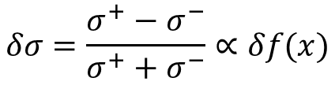
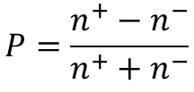
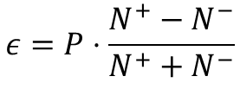
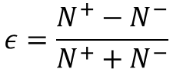
The Figure of Merit
$$δσ=\frac{σ^{+}−σ^{−}}{σ^{+}+σ^{−}}∝δf(x)$$
Physics observable of interest depends on the spin alignment
$$ε=\frac{N^{+}−N^{−}}{N^{+}+N^{−}}$$
If the measurement is done with pure spin alignment
$$ε=P⋅\frac{N^{+}−N^{−}}{N^{+}+N^{−}}$$
With polarization
$$P=\frac{n^{+}−n^{−}}{n^{+}+n^{−}}$$
Uncertainty of physics observable
$$Δ_{f}=Δ_{E}P$$
Statistical uncertainty of measurement $Δ_{S}=\sqrt{N}$
Figure of merit: $FOM=NP^{2}$

Slide 6
Polarized High Energy Particle Beams

Slide 7
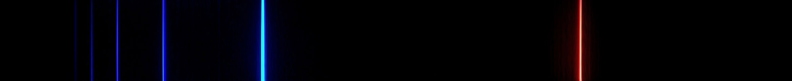
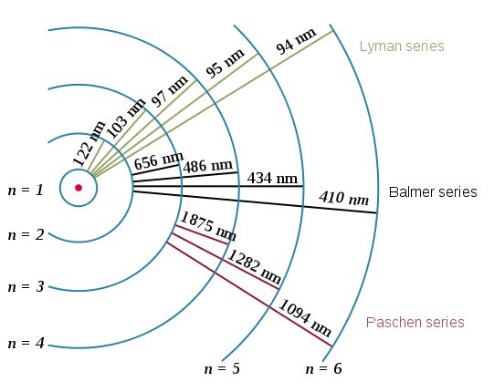







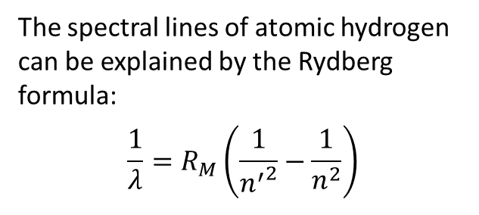

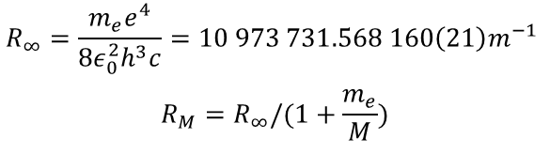
The Bohr Model of Hydrogen Atoms
The spectral lines of atomic hydrogen can be explained by the Rydberg formula:
$$\frac{1}{λ}=R_{M}\left(\frac{1}{{n^{′}}^{2}}−\frac{1}{n^{2}}\right)$$
$$n=5$$
$$−0.85 \text{MeV}$$
$$n=4$$
$$n=3$$
$$−1.51 \text{MeV}$$
$$n=2$$
$$−3.40 \text{MeV}$$
$$R_{∞}=\frac{m_{e}e^{4}}{8ε_{0}^{2}h^{3}c}=10 973 731.568 160\left(21\right)m^{−1}$$
$$R_{M}=R_{∞}/(1+\frac{m_{e}}{M})$$
$$n=1$$
$$−13.6 \text{MeV}$$

Slide 8

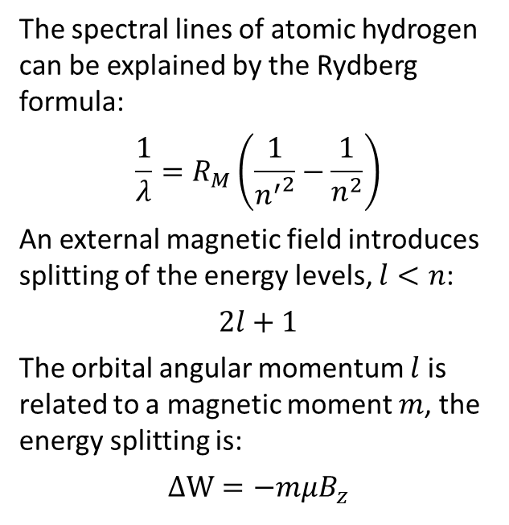




Space Quantization
$$B_{z}$$
$$n=1, l=1$$
The spectral lines of atomic hydrogen can be explained by the Rydberg formula:
$$\frac{1}{λ}=R_{M}\left(\frac{1}{{n^{′}}^{2}}−\frac{1}{n^{2}}\right)$$
An external magnetic field introduces splitting of the energy levels, $l<n$:
$$2l+1$$
The orbital angular momentum $l$ is related to a magnetic moment $m$, the energy splitting is:
$$ΔW=−mμB_{z}$$
$$n=5$$
$$−0.85 \text{MeV}$$
$$n=4$$
$$l_{z}=+1$$
$$n=3$$
$$−1.51 \text{MeV}$$
$$n=2$$
$$−3.40 \text{MeV}$$
$$l_{z}=0$$
$$n=1$$
$$−13.6 \text{MeV}$$
$$l_{z}=−1$$

Slide 9


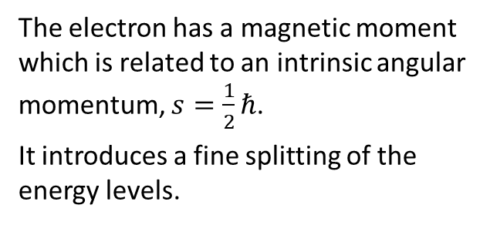







Space Quantization
$$B_{z}$$
$$s=1/2$$
The electron has a magnetic moment which is related to an intrinsic angular momentum, $s=\frac{1}{2}ℏ$.
It introduces a fine splitting of the energy levels.
$s_{z}=+1$/2
$$W$$
$$n=1$$
$$l=0$$
$$m_{l}=−1/2$$
$$−13.6 \text{MeV}$$
$$ΔW=\frac{e}{2m}ℏB$$
$$s_{z}=−1/2$$
$$m_{l}=+1/2$$

Slide 10
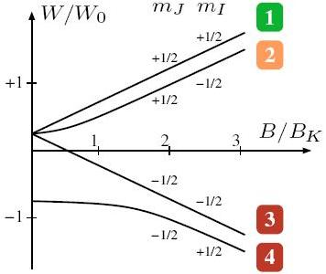
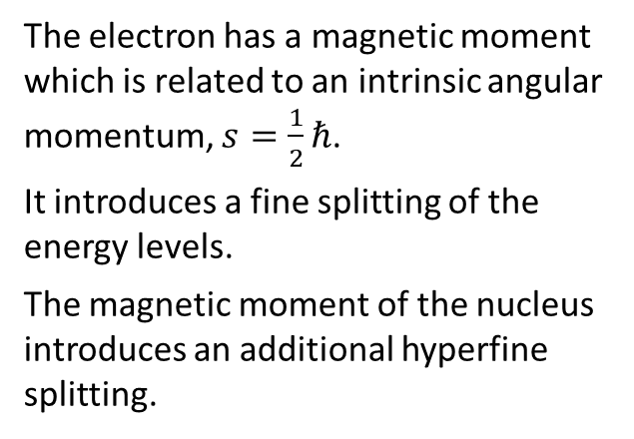
Space Quantization
$$B_{z}$$
$$s=1/2$$
The electron has a magnetic moment which is related to an intrinsic angular momentum, $s=\frac{1}{2}ℏ$.
It introduces a fine splitting of the energy levels.
The magnetic moment of the nucleus introduces an additional hyperfine splitting.
$s_{z}=+1$/2
$$s_{z}=−1/2$$
https://demonstrations.wolfram.com/BreitRabiDiagram/

Slide 11
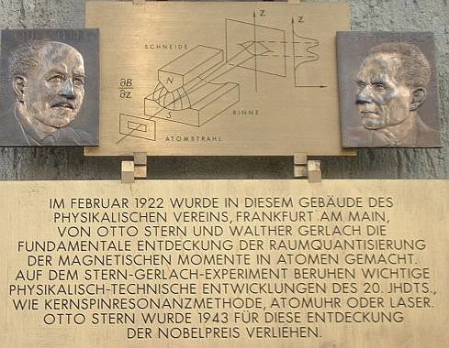
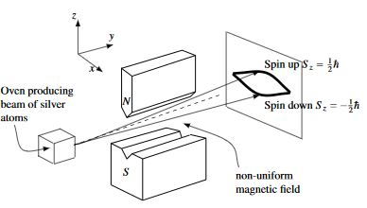
Spin Polarized Protons
Stern-Gerlach (1922) demonstrated that the electron spin is quantized.

Slide 12



Spin Polarized Protons
Stern-Gerlach (1922) demonstrated that the electron spin is quantized.
Use a similar setup as a filter to produce polarized protons.
The magnetic moment of the nucleus is much smaller than that of the electron.
$$ΔE=ℏν$$
$$\frac{dB}{dz}$$
$$\frac{dB}{dz}$$

Slide 13
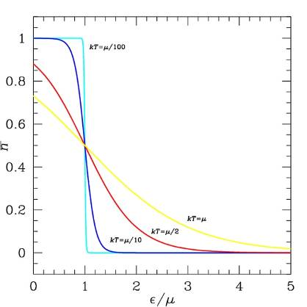
Spin Polarized Protons
Stern-Gerlach (1922) demonstrated that the electron spin is quantized.
Use a similar setup as a filter to produce polarized protons.
The magnetic moment of the nucleus is much smaller than that of the electron.
There is a limit to the polarization (temperature, magnetic field, power of rf unit).

Slide 14

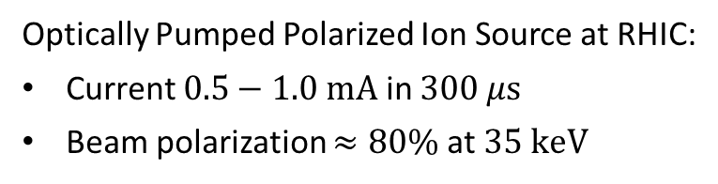




An Advanced Polarized Proton Source
A. Zelenski et al., J. Phys. Conf. Ser. 295 (2011) 012147
High brightness proton source
Focusing solenoid
Pulsed hydrogen neutralization cell
Superconducting solenoid 30 kG
Pulsed He-ionized cell
Optically pumped Rb cell
Sona shield
Sodium-jet ionizer
$$H^{+}$$
$$10 \text{keV}$$
$$H^{0}$$
$$10 \text{keV}$$
$$H^{0↑}$$
$$3 \text{keV}$$
$$H^{+↑}$$
$$3 \text{keV}$$
$$H^{+↑}$$
$$35 \text{keV}$$
Optically Pumped Polarized Ion Source at RHIC:
Current $0.5−1.0 \text{mA}$ in $300 μ\text{s}$
Beam polarization $≈80\%$ at $35 \text{keV}$
One proton bunch in RHIC

Slide 15
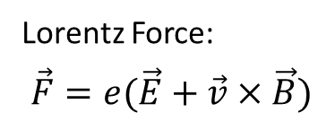
Particle Beam Optics
Lorentz Force:
$$\vec{F}=e(\vec{E}+\vec{v}×\vec{B})$$
We need to keep the particles on a circle.
There is a closed orbit.
Beam has a size and momentum spread.
Particles oscillate around the closed orbit (betatron oscillation).
acceleration
dipole magnets
F0D0 lattice and orbit envelope
injection
experiment
other magnets
Quadrupole magnets focus in one direction only.
Liouville’s theorem: The phase ellipse and the emittance of the beam are invariant.

Slide 16

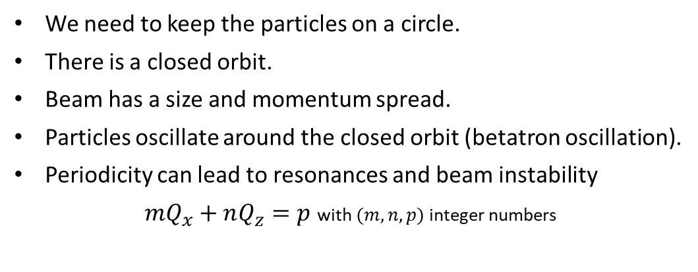





Particle Beam Optics
Lorentz Force:
$$\vec{F}=e(\vec{E}+\vec{v}×\vec{B})$$
We need to keep the particles on a circle.
There is a closed orbit.
Beam has a size and momentum spread.
Particles oscillate around the closed orbit (betatron oscillation).
Periodicity can lead to resonances and beam instability
$mQ_{x}+nQ_{z}=p$ with $(m,n,p)$ integer numbers
acceleration
dipole magnets
Optical resonances up to 3rd order
injection
experiment
particle trajectory
$$m+1$$
orbit
other magnets
possible
distortion
$$Q_{z}$$
working point
$$m$$
$$n$$
$$Q_{x}$$
$$n+1$$

Slide 17
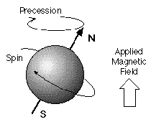
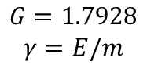
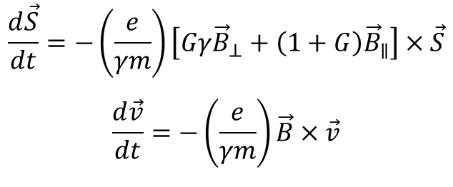
Particle Beam Optics
Lorentz Force:
$$\vec{F}=e(\vec{E}+\vec{v}×\vec{B})$$
We need to keep the particles on a circle.
There is a closed orbit.
Beam has a size and momentum spread.
Particles oscillate around the closed orbit (betatron oscillation).
Periodicity can lead to resonances and beam instability.
The magnetic moment of particles precesses in magnetic fields.
acceleration
dipole magnets
injection
experiment
$$\frac{d\vec{S}}{dt}=−\left(\frac{e}{γm}\right)\left[Gγ{\vec{B}}_{⊥}+\left(1+G\right){\vec{B}}_{∥}\right]×\vec{S}$$
$$\frac{d\vec{v}}{dt}=−\left(\frac{e}{γm}\right)\vec{B}×\vec{v}$$
other magnets
$$G=1.7928$$
$$γ=E/m$$

Slide 18
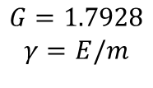
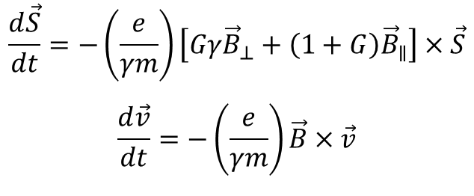
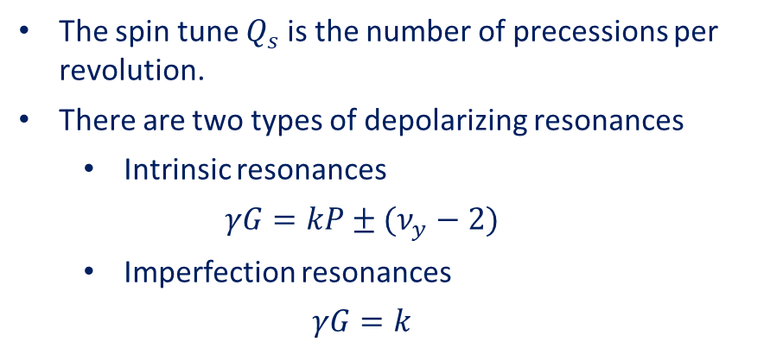
Depolarizing Resonances
Thomas-BMT equation:
$$\frac{d\vec{S}}{dt}=−\left(\frac{e}{γm}\right)\left[Gγ{\vec{B}}_{⊥}+\left(1+G\right){\vec{B}}_{∥}\right]×\vec{S}$$
$$\frac{d\vec{v}}{dt}=−\left(\frac{e}{γm}\right)\vec{B}×\vec{v}$$
L.H. Thomas “The kinematics of an electron with an axis.” The London, Edinburgh, and Dublin Philosophical Magazine and Journal of Science 3.13 (1927)
V. Bargmann, L. Michel, and V.L. Telegdi “Precession of the polarization of particles moving in a homogeneous electromagnetic field.” Physical Review Letters 2.10 (1959)
$$G=1.7928$$
$$γ=E/m$$
The spin tune $Q_{s}$ is the number of precessions per revolution.
There are two types of depolarizing resonances
  Intrinsic resonances
  $$γG=kP±(ν_{y}−2)$$
  Imperfection resonances
  $$γG=k$$
The resonance strength depends on the local orbit distortion, magnetic field, and crossing speed.
The number of resonances grows linearly with the top energy.

Slide 19
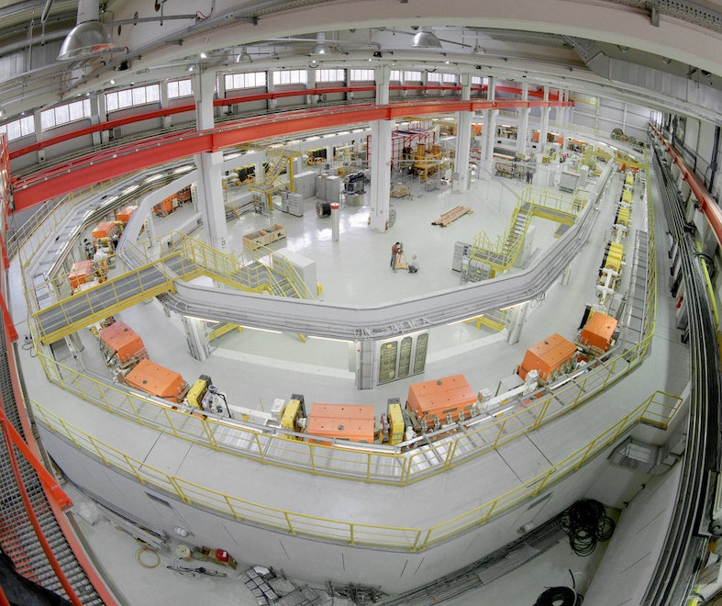
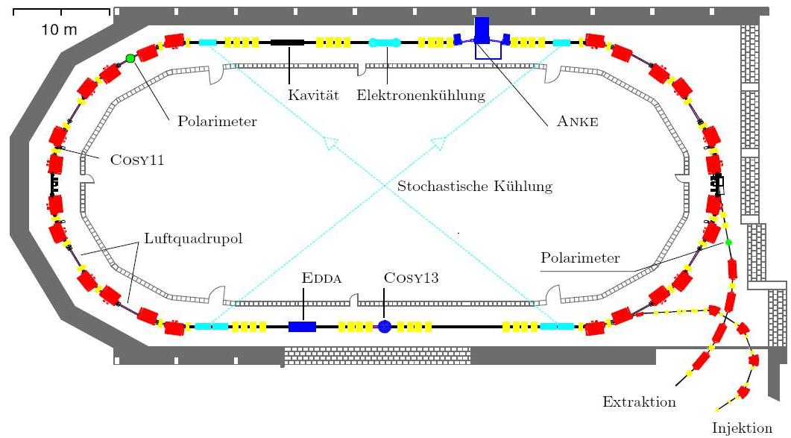
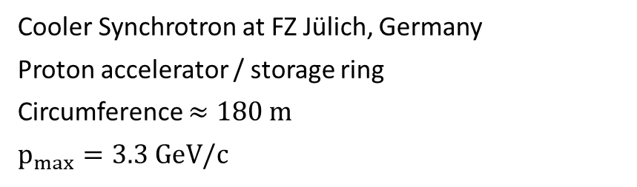
Example: COSY
Cooler Synchrotron at FZ Jülich, Germany
Proton accelerator / storage ring
Circumference $≈180 \text{m}$
$$p_{max}=3.3 \text{Ge}\text{V}\text{/}\text{c}$$
air quadrupole

Slide 20
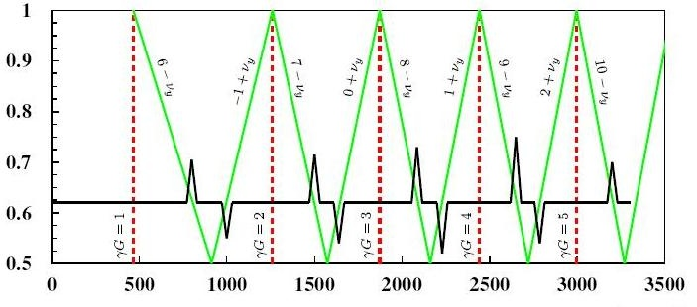
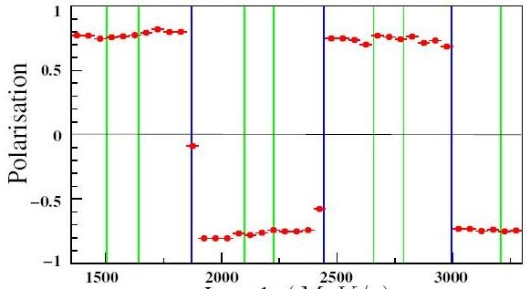

Example: COSY
Intrinsic resonances
Imperfection resonances
Cooler Synchrotron at FZ Jülich, Germany
Proton accelerator / storage ring
Circumference $≈180 \text{m}$
$$p_{max}=3.3 \text{Ge}\text{V}\text{/}\text{c}$$
Working point $q_{y}$
Momentum (MeV/c)
air quadrupole
Polarization
Momentum (MeV/c)

Slide 21
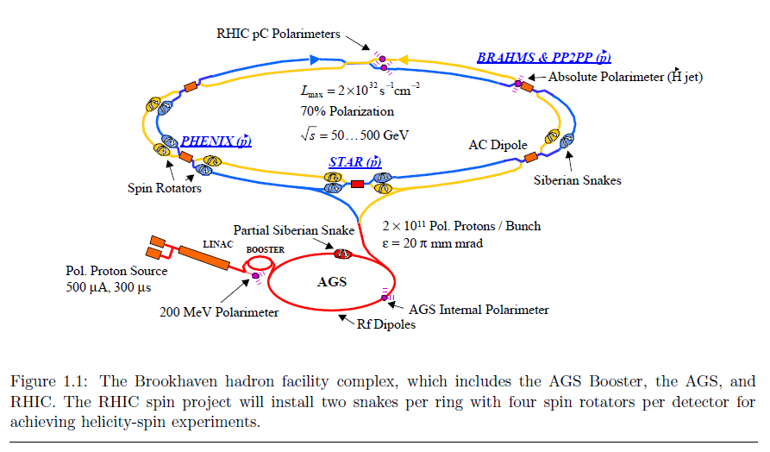
The Relativistic Heavy Ion Collider
“Configuration Manual Polarized Proton Collider at RHIC.” I. Alekseev et al. NIM A (2004)
250 GeV
25 GeV
200 MeV
35 keV

Slide 22
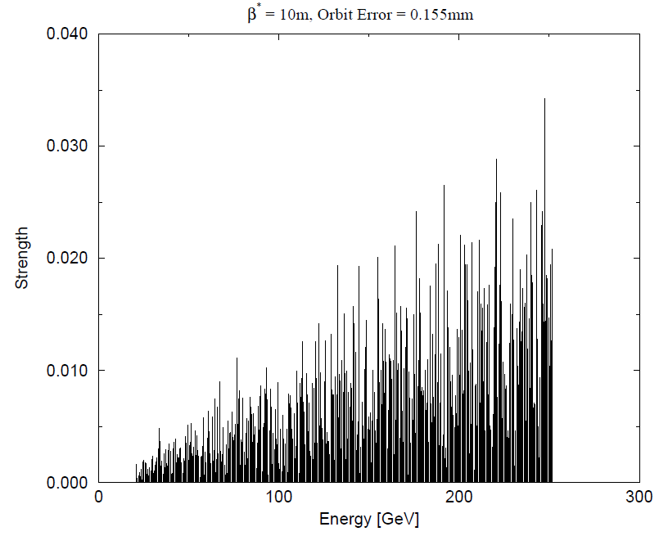
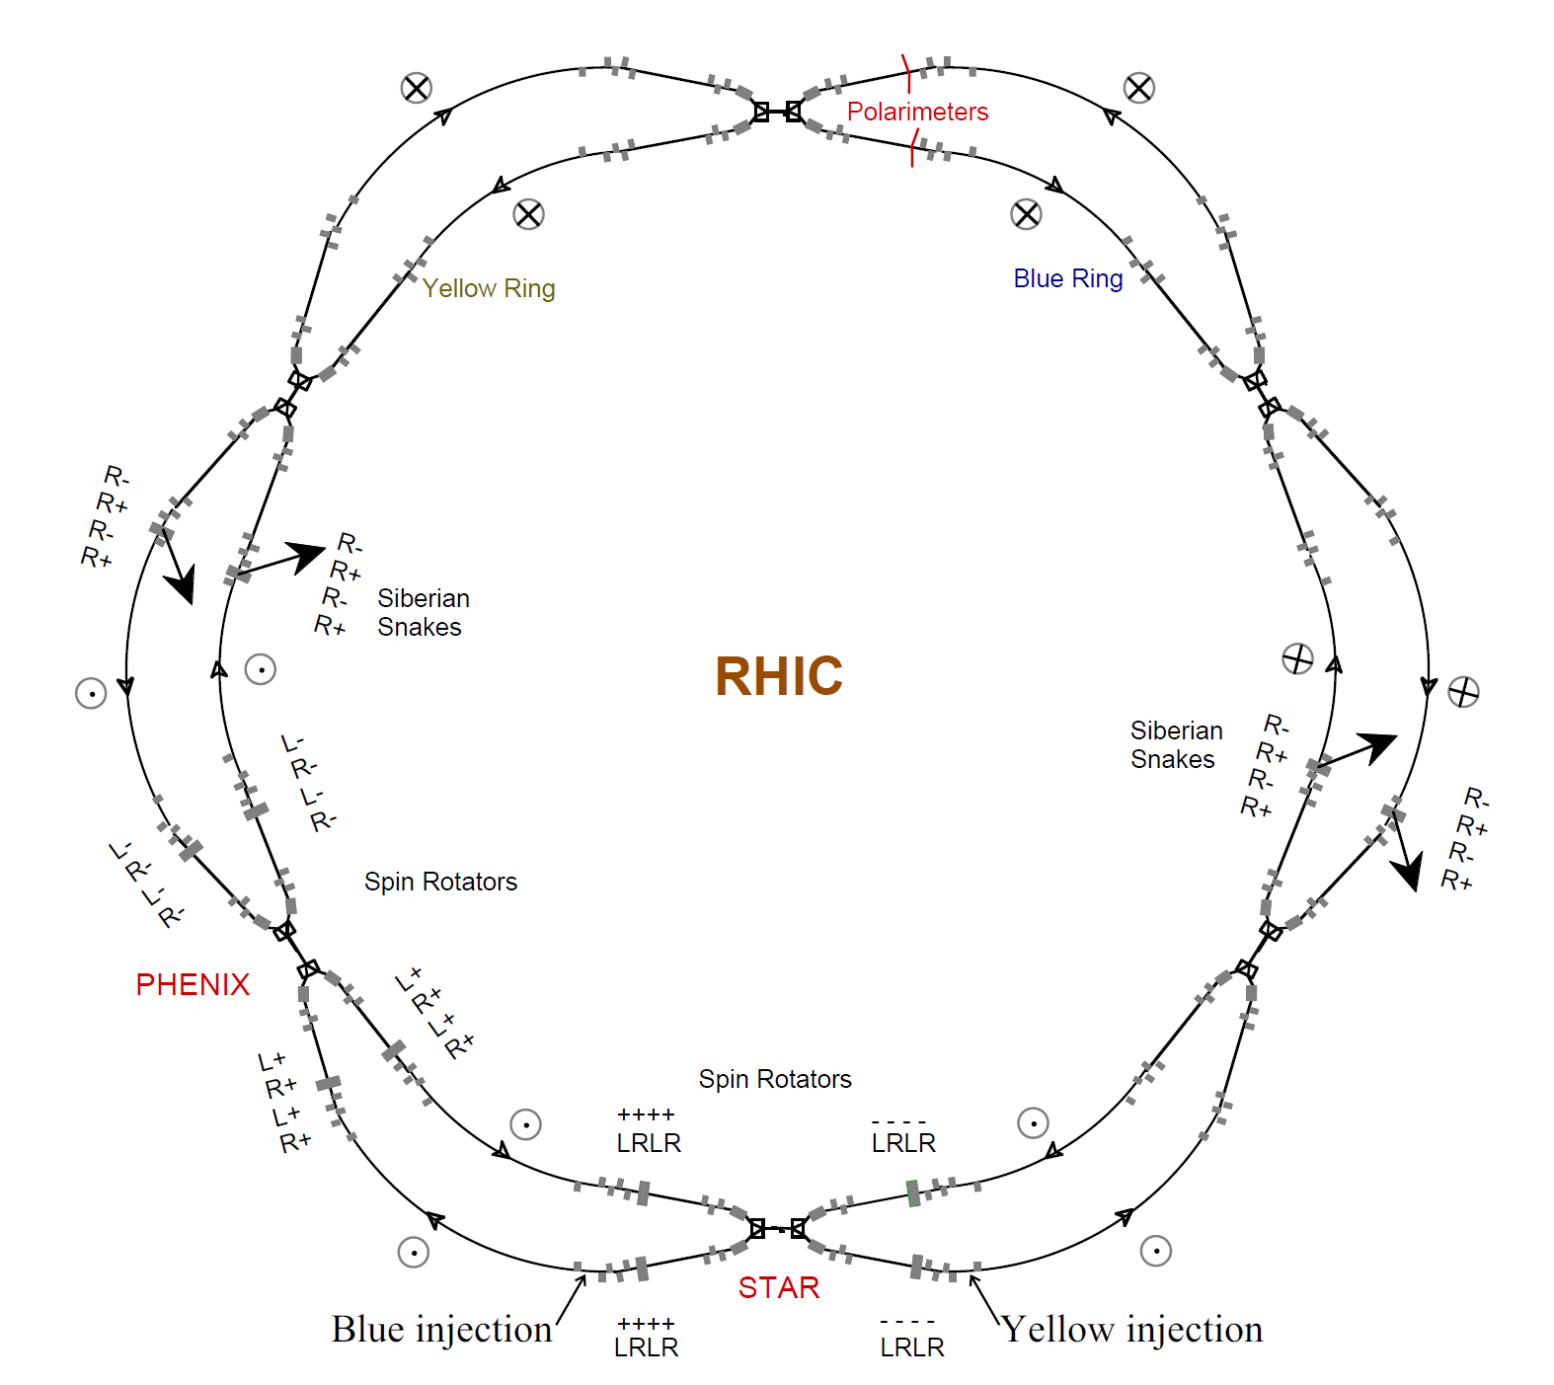
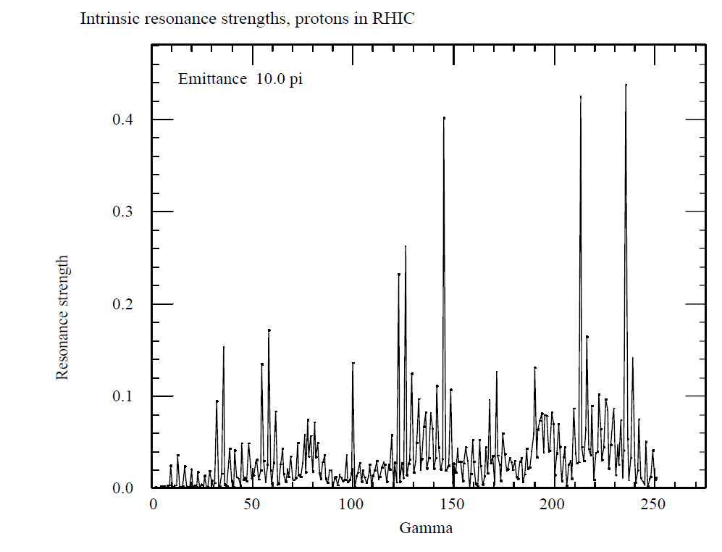

Spin Resonances in RHIC
Imperfection resonances
  $ν_{spin}=γG=n$
  integer $n$
Intrinsic resonances
  $ν_{spin}=γG=kP+ν_{y}$
  integer $k$
  superiodicity P
  vertical betatron tune $ν_{y}$

Slide 23
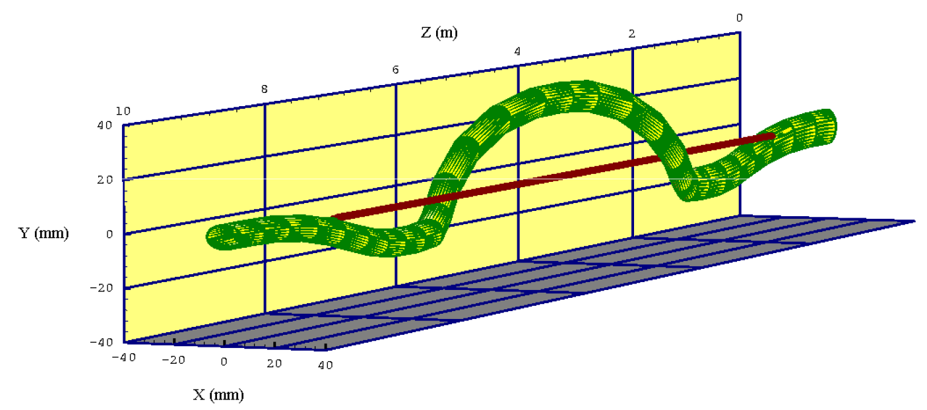
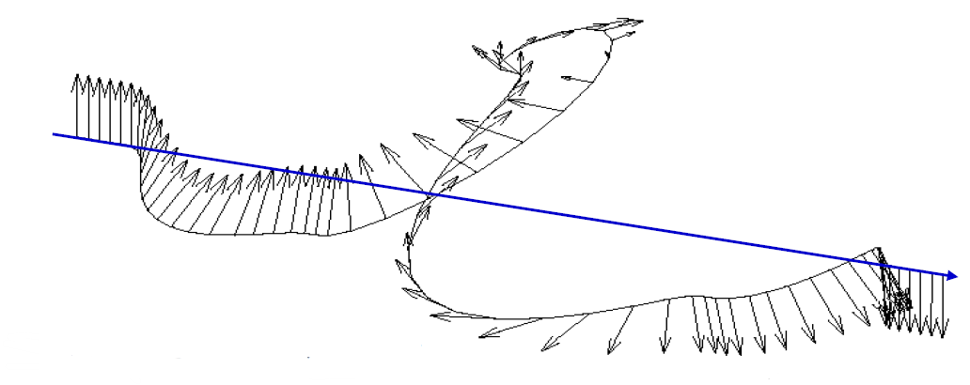
Resonance Mitigation
Deliberately advance the spin precession to avoid resonance conditions
Group of dipole magnets with alternating horizontal and vertical field directions which rotates the spin vector by 180°
Siberian Snakes: Ya. S. Derbenev, A.M. Kondratenko “Polarization kinematics of particles in storage rings.” Sov. Phys. JETP 37 (1973)
Strong AGS Snake

Slide 24
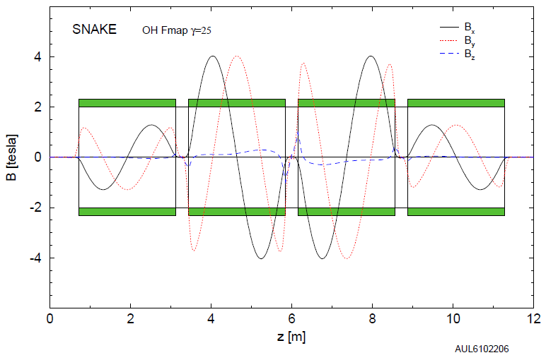
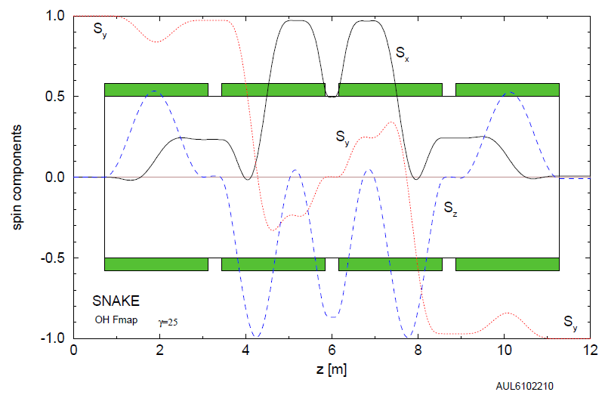
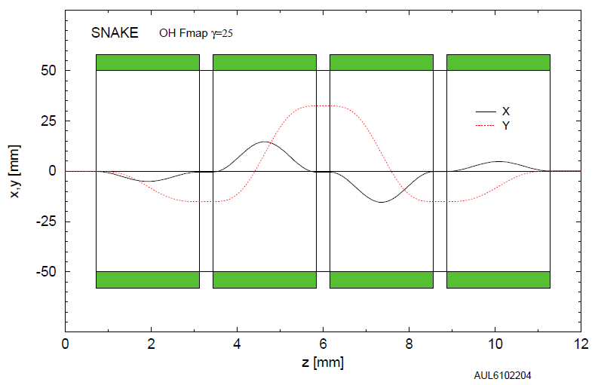
Spin Motion through Siberian Snake

Slide 25
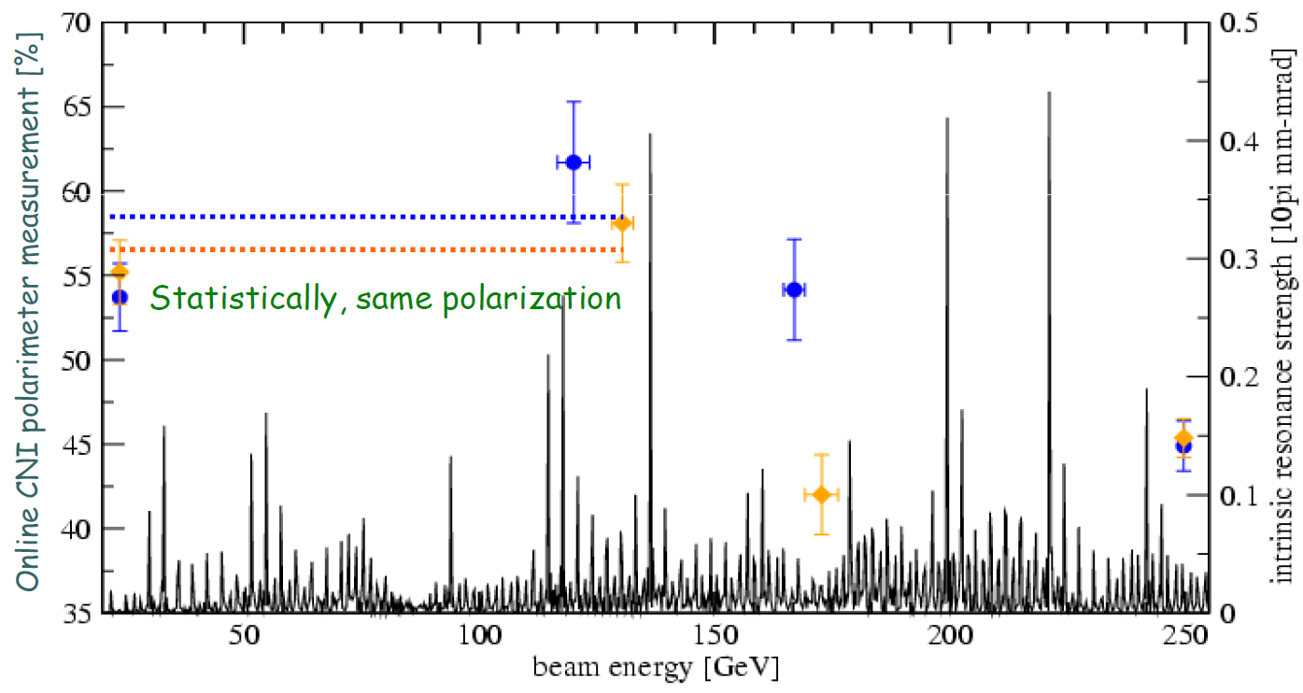
RHIC Proton Polarization
During the first 250 GeV beam operation in 2009

Slide 26
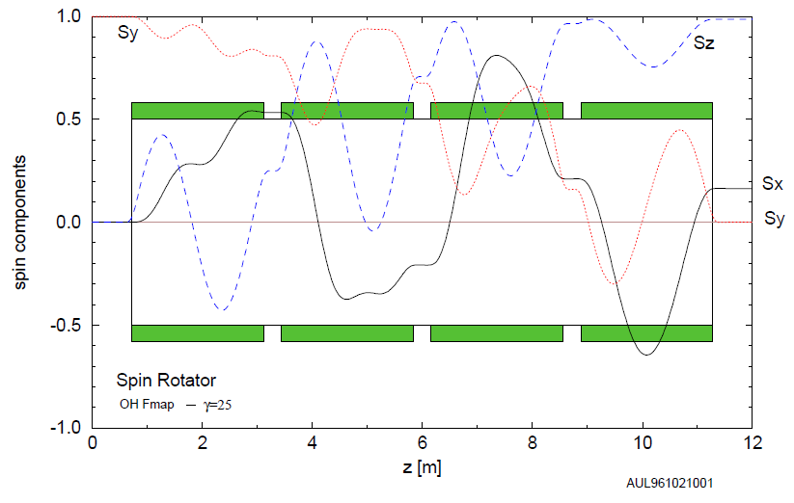
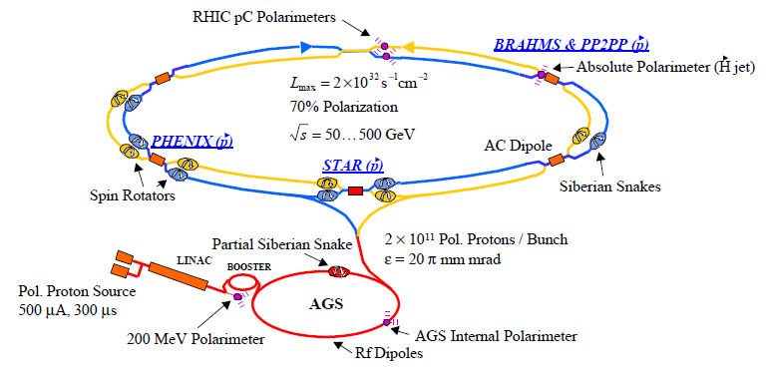




Spin Motion through a Spin Rotator
$$\vec{S}$$
$$\vec{S}$$
The stable spin direction in a circular accelerator is vertical.
Experiments also require longitudinal polarization.
Spin rotators before and after each experiment.
Transverse polarization remnant can cause systematic uncertainties in physics observables.
$$\vec{p}$$
$$\vec{p}$$

Slide 27
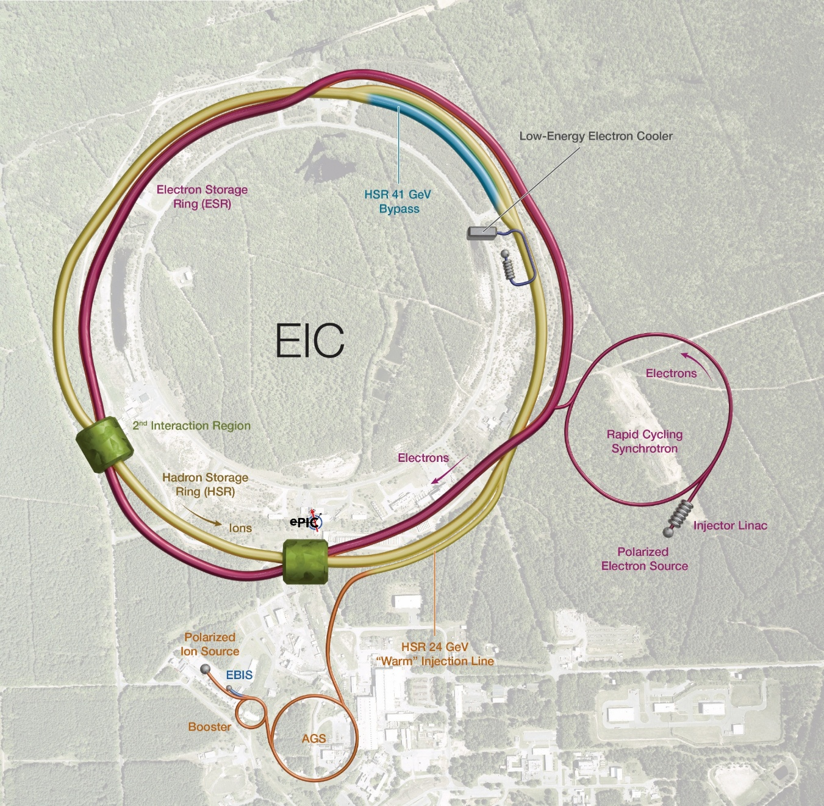
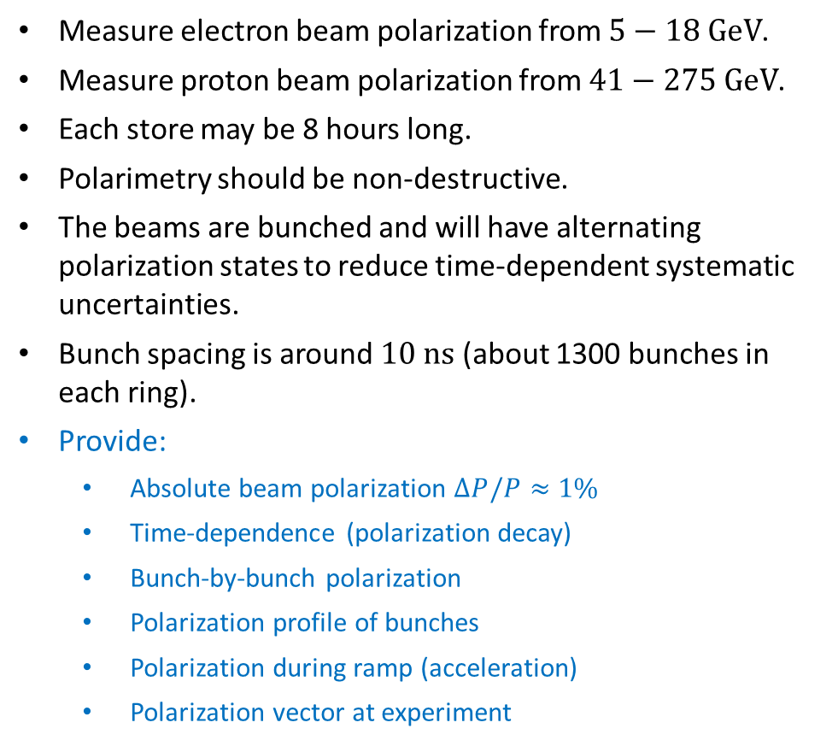
Recap: Requirements for Polarimetry
Measure electron beam polarization from $5−18 \text{GeV}$.
Measure proton beam polarization from $41−275 \text{Ge}\text{V}$.
Each store may be 8 hours long.
Polarimetry should be non-destructive.
The beams are bunched and will have alternating polarization states to reduce time-dependent systematic uncertainties.
Bunch spacing is around $10 \text{ns}$ (about 1300 bunches in each ring).
Provide:
  Absolute beam polarization $ΔP/P≈1\%$
  Time-dependence (polarization decay)
  Bunch-by-bunch polarization
  Polarization profile of bunches
  Polarization during ramp (acceleration)
  Polarization vector at experiment

Slide 28
Polarimetry of High Energy Hadron Beams

Slide 30
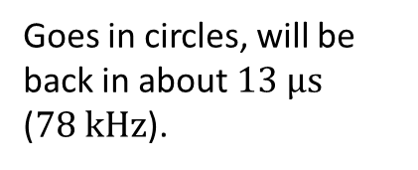
Particle Bunches
A bunch of particles in vacuum travelling at almost the speed of light
Goes in circles, will be back in about $13 μ\text{s}$ ($78 \text{kHz}$).
?

Slide 31
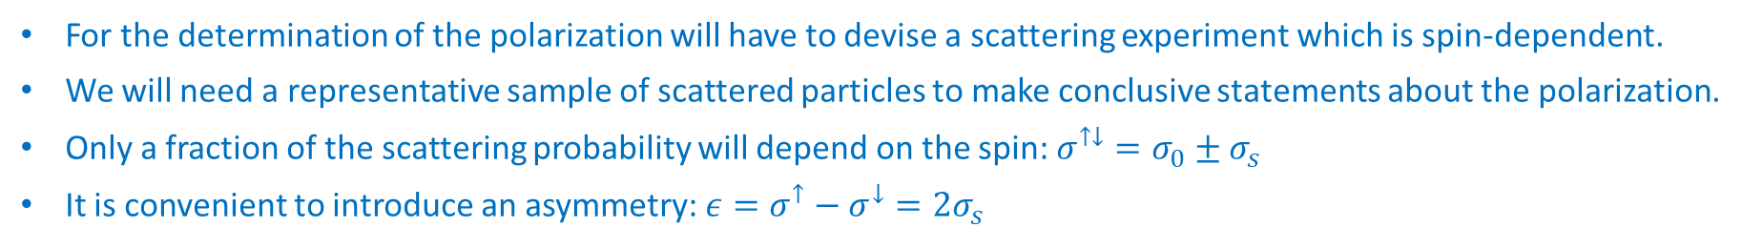
Polarization Measurement
A bunch of particles in vacuum travelling at almost the speed of light
Goes in circles, will be back in about $13 μ\text{s}$ ($78 \text{kHz}$).
?
For the determination of the polarization will have to devise a scattering experiment which is spin-dependent.
We will need a representative sample of scattered particles to make conclusive statements about the polarization.
Only a fraction of the scattering probability will depend on the spin: $σ^{↑↓}=σ_{0}±σ_{s}$
It is convenient to introduce an asymmetry: $ε=σ^{↑}−σ^{↓}=2σ_{s}$

Slide 32


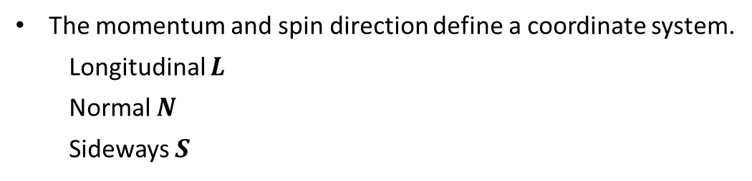




The Right Frame
The momentum and spin direction define a coordinate system.
  Longitudinal $L$
  Normal $N$
  Sideways $S$
$$S=N×L$$
$$ε=A_{N}∙P=\frac{N_{L}−N_{R}}{N_{L}+N_{R}}$$
left
$$s_{z}=N$$
right
refers to the projectile
$$p=L$$
Analyzing power $A_{N}$
Polarization $P=\frac{n^{↑}−n^{↓}}{n^{↑}+n^{↓}}$
(proton)

Slide 33







Polarized Observables
Elastic scattering obeys parity conservation and time invariance.
The collision is symmetric (in the center-of-mass frame), recoil and ejectile are indistinguishable.
$$ρ_{f}=Mρ_{i}M^{∗}$$
$$ρ=\sum_{n}{p_{n}}|\left.n\right\rangle \left\langle n\right.|$$
$$M=\sum_{i,f}{a_{f,i}σ_{i}⨂σ_{f}}$$
$$ρ_{i}=ρ_{beam}⊗ρ_{target}$$
left
$$\frac{dσ}{dΩ}=Tr\left(ρ_{f}\right)=\sum_{n}{p_{n}}{\left|\left\langle n | M | n\right\rangle \right|}^{2}$$
$$s_{z}=N$$
right
$$\frac{dσ}{dΩ}=a_{0000}+\sum_{n}{P_{n}a_{00n0}}+\sum_{m}{Q_{m}a_{000m} }+\sum_{m,n}{P_{n}Q_{m}a_{00nm}}+…$$
$$p=L$$
(proton)
$$\frac{dσ}{dΩ}={\frac{dσ}{dΩ}}_{0}(1+\sum_{n}{P_{n}A_{00n0}}+\sum_{m}{Q_{m}A_{000m} }+\sum_{m,n}{P_{n}Q_{m}A_{00nm}}+…)$$
(proton)
→ 4⁴=256 possible Observables (25 independent parameters)

Slide 34



Polarized Observables
Elastic scattering obeys parity conservation and time invariance.
The collision is symmetric (in the center-of-mass frame), recoil and ejectile are indistinguishable.
$$\frac{dσ}{dΩ}={\frac{dσ}{dΩ}}_{0}(1+P_{beam}A_{00N0}+P_{target}A_{000N})$$
ejectile, recoil, projectile, target
left
For elastic scattering:
$$A_{00N0}=A_{000N}$$
$$s_{z}=N$$
right
$$p=L$$
(proton)
$$P_{Beam}=\frac{ε_{Beam}}{ε_{Target}}P_{Target}$$
(proton)

Slide 35




Transverse Single-Spin Asymmetries
Transformation of $S=N×L$ into the laboratory frame
$$\frac{dσ}{dΩ}={\frac{dσ}{dΩ}}_{0}(1+P⋅A_{N}⋅\cos{φ})$$
detector
y
$$P_{N}=−P_{x}\sin{φ}+P_{y}\cos{φ}$$
$$P_{S}=P_{x}\cos{φ}+P_{y}\sin{φ}$$
$$P_{L}=P_{z}$$
ϕ
detector
x
z
left
scattering plane
$$s_{z}=N$$
right
$$p=L$$
$$N=\int{\frac{dσ}{dΩ}ℒ_{P}\left(t\right)e\left(dΩ,t\right)dΩdt}$$
(proton)
What are possible sources of systematic uncertainties?
And how can you avoid them?
(proton)

Slide 36




Elastic $p+p$ Scattering
Example: EDDA @ COSY
Kinematic correlation in elastic scattering
$$φ_{1}−φ_{2}=π$$
$$\tan{θ_{1}⋅\tan{θ_{2}}=1/γ_{cm}^{2}}$$
EDDA detector
  Scintillator hodoscope specifically designed for elastic $p+p$ scattering

Slide 37


Elastic $p+p$ Scattering
Example: EDDA @ COSY
Atomic hydrogen target
  Selection of hyperfine state 1 (of 4)
  Magnetic holding field $B_{x,y,z}≈10 \text{G}$
  Rabi unit for polarization measurement
  Target polarization $Q≈70\%$

Slide 38





Elastic Scattering at RHIC energies
The beam energy is $100−250 \text{GeV}$.
A significant analyzing power exists in the Coulomb-Nuclear Interference region.
$$φ\left(s,t\right)=\left\langle λ_{C}λ_{D}\left|φ\right|λ_{A}λ_{B}\right\rangle$$
$$φ_{1}\left(s,t\right)=\left\langle +\frac{1}{2}+\frac{1}{2}\left|φ\right|+\frac{1}{2}+\frac{1}{2}\right\rangle$$
$$φ_{2}\left(s,t\right)=\left\langle +\frac{1}{2}+\frac{1}{2}\left|φ\right|−\frac{1}{2}−\frac{1}{2}\right\rangle$$
$$φ_{3}\left(s,t\right)=\left\langle +\frac{1}{2}−\frac{1}{2}\left|φ\right|+\frac{1}{2}−\frac{1}{2}\right\rangle$$
$$φ_{4}\left(s,t\right)=\left\langle +\frac{1}{2}−\frac{1}{2}\left|φ\right|−\frac{1}{2}+\frac{1}{2}\right\rangle$$
$$φ_{5}\left(s,t\right)=\left\langle +\frac{1}{2}+\frac{1}{2}\left|φ\right|+\frac{1}{2}−\frac{1}{2}\right\rangle$$
A. Poblaguev et al., Phys. Rev. D 79, 094014 (2009)
$$A_{N}\frac{ds}{dt}=−\frac{4π}{s^{2}}\text{Im}\left[φ_{5}^{em∗}\left(s,t\right)φ_{+}^{had}\left(s,t\right)+φ_{5}^{had∗}\left(s,t\right)φ_{+}^{em}(s,t)\right]$$
no-flip amplitude: $φ_{+}\left(s,t\right)=\frac{1}{2}\left[φ_{1}\left(s,t\right)\text{+}φ_{3}\left(s,t\right)\right]$

Slide 39



Elastic Scattering at RHIC energies
The beam momentum is $100−250 \text{GeV}$.
A significant analyzing power exists in the Coulomb-Nuclear Interference region.
Recoil comes out almost perpendicular to the beam direction.
A. Poblaguev et al., Phys. Rev. D 79, 094014 (2009)
Recoil angle $({90}^{∘}−θ)$
Kinetic energy of the recoil proton

Slide 40



An Absolute Polarimeter at RHIC
$H_{2}$ source
Dissociator
RF unit
Holding field
Detectors
beam

Slide 41



An Absolute Polarimeter at RHIC
Polarized atomic hydrogen jet target (HJET)
Set of eight Hamamatsu $Si$ strip detectors
12 vertical strips
  $3.75 \text{mm}$ pitch
  $500 \text{μ}\text{m}$ thick
Uniform dead layer $≈1.5 \text{μ}\text{m}$
left
scattering plane
$$s_{z}=N$$
right
$$p=L$$
(proton)
≈ 0.7 cm
INNER
OUTER
(proton)
target
scattered proton
proton beam
100/250 GeV
75 cm
≈10 cm
Si strip detectors

Slide 42





Proton Recoil Measurement
Expected elastic signal
Simple toy simulation with bunch length $3 \text{ns}$
Non-relativistic: $T_{kin}=\frac{1}{2}mv^{2}$
Time of flight is used for particle identification
Real measurement
Already includes some basic cuts (low $E$, low $t$)

Slide 43


Proton Recoil Measurement
Time of flight is used for particle identification
Recoil angle is used for kinematic correlation in elastic scattering

Slide 44




Absolute Beam Polarization
detector
beam
$$ε=A_{N}∙P$$
$$P_{Beam}=\frac{ε_{Beam}}{ε_{Target}}P_{Target}$$
detector
beam
❶
Polarization independent background
$ε=\frac{N^{↑}−N^{↓}}{N^{↑}+N^{↓}+2∙N_{bg}}$ ⇒ $\frac{ε_{B}}{ε_{T}}=\frac{N_{B}^{↑}−N_{B}^{↓}}{N_{T}^{↑}−N_{T}^{↓}}$
❷
Polarization dependent background
$$ε=\frac{ε_{inc}−r∙ε_{bg}}{1−r}$$
background fraction $r=N_{bg}/N$
Background
Inclusive
SIGNAL
Background
SIGNAL
Inclusive

Slide 45

RHIC Overview
Hydrogen Jet
Polarimeter
Carbon Polarimeters
$120$ bunches ($106 \text{ns}$ spacing)
${10}^{11}$ protons per bunch
Store $≈8$ hours
Polarimeters at IP12
  Absolute polarimeter
  Fast polarimeters
Siberian
Snakes
Siberian
Snakes
(s)PHENIX
STAR
RHICf
Spin
Rotators
Polarized
Source
Spin
Rotators
Tune Jump
Quads
Booster
Helical Partial
Snake
LINAC
AGS
200 MeV Polarimeter
Strong
Snake
AGS pC
Polarimeter

Slide 46


RHIC Operations
Beam intensities from a typical RHIC store
(Fill 33214, 2022)
Collision rate at STAR
Collision rate dynamically adjusted for STAR through $β^{∗}$ (see page 15, Beam Optics)

Slide 47




RHIC Polarimeters
beam
From our list of requirements:
Time-dependence (polarization decay)
Bunch-by-bunch polarization
Transverse polarization profile of bunches
Has to be non-destructive!
Carbon polarimeters
Fast measurement
$δP/P≈4\%$
Beam polarization profile
Bunch-by-bunch
Polarization decay (time dependence)
normalization
Hydrogen jet polarimeter
Polarized target
Continuous operation
$δP/P≈5−6\%$ per 8 hours of operation

Slide 48






Fiber Target Polarimeters
Ultra-thin ribbon targets:
$$≈10 μ\text{m} x 100 \text{nm}$$
Target holder inside the beam pipe
Measure Carbon recoil (not protons)

Slide 49



Polarization Decay
injection
Polarization losses during the store are correlated to
acceleration
emittance
profile
normalization with HJET
Polarization P (%)
$$P=P_{0}+\frac{dP}{dt}t$$
$$P_{jet}=\frac{\int{dxdyP\left(t\right)I_{B}\left(t\right)}}{\int{dxdyI_{B}\left(t\right)}}$$

Slide 50

Polarization Decay
injection
Polarization losses during the store are correlated to
acceleration
emittance
profile
Polarization P (%)
$$P=P_{0}+\frac{dP}{dt}t$$
$$P_{coll}=\frac{\int{dxdyP\left(t\right)I_{B}\left(t\right)I_{Y}(t)}}{\int{dxdyI_{B}\left(t\right)I_{Y}(t)}}$$
$$P_{jet}=\frac{\int{dxdyP\left(t\right)I_{B}\left(t\right)}}{\int{dxdyI_{B}\left(t\right)}}$$
Important for experiments:
Luminosity changes throughout each store

Slide 51







Polarization Profile
injection
Polarization losses during the store are correlated to
acceleration
emittance
profile
Polarization P (%)
$$P=P_{0}+\frac{dP}{dt}t$$
$$R=R_{0}+\frac{dR}{dt}t$$
$$P_{coll}=\frac{\int{dxdyP\left(x,y\right)I_{B}\left(x,y\right)I_{Y}(x,y)}}{\int{dxdyI_{B}\left(x,y\right)I_{Y}(x,y)}}$$
For Gaussian profiles
$$I=I_{peak}∙e^{−i{\overset{⃑}{r}}^{2}/σ_{I}^{2}}$$
$$P=P_{peak}∙e^{−i{\overset{⃑}{r}}^{2}/σ_{P}^{2}}$$
$$P_{jet}=\frac{\int{dxdyP\left(x,y\right)I_{B}\left(x,y\right)}}{\int{dxdyI_{B}\left(x,y\right)}}$$
Profile R
Profile parameter $R=\frac{σ_{I}^{2}}{σ_{P}^{2}}$
$$P_{sweep}=\frac{\int{dyP\left(y\right)I_{B}\left(y\right)}}{\int{dyI_{B}\left(y\right)}}$$

Slide 52






Limitations of the Measurement
Recoil particles have very low energy.
  significant impact of the inactive detector parts (dead layer $ΔE$), especially for the Carbon measurement
  Calibration with $α$-sources
  $${}_{}^{148}{Gd}(E_{α}=3.183 \text{MeV})$$
  $${}_{}^{243}{Am}(E_{α}=5.486 \text{MeV})$$
Small angle scattering of recoil inside the target dilutes the kinematic correlation for elastic scattering.
  Background dilutes the measured asymmetry (increases statistical uncertainty), but normalized with HJET
  $A_{N}$ drops above 1 MeV
$$c∙A=E_{meas}=E_{kin}−∆E$$
Dead layer
$$z≈0.25−0.5 μ\text{m}$$

Slide 53





Fiber Targets and High Energy Beams
High energy, high intensity proton beams provide an extreme environment
  Energy loss of beam in the target
Target is electrostatically attracted to the beam
  Mechanical stress on target
  Material in beam is hard to control
Induced charge from wake field on target ends
  Change to insulated ladder construction
Targets have a limited lifetime
Simulation by J. Kewisch, BNL

Slide 54







Local Polarimetry at RHIC
Local polarimetry is primarily for confirming the direction of the polarization vector at the experiment.
  Observe suppression of asymmetry or change of direction
  Very forward going production of neutrons in $p+p$ collisions
  First established at RHIC-IP12, standard method for RHIC experiments
$$x_{F}=2p_{z}/\sqrt{s}$$
Physical Review D 88 (2013) 032006

Slide 55




Potential for Future Applications
Nuclear dependence of very forward going neutrons
  Very large asymmetry (with opposite sign)
  Select low multiplicity with beam-beam counters
  Ultra-peripheral collision extension to $π/a_{1}$ model
  Photon flux from STARlight
  Klein et al., Comput. Phys. Comm. 212 (2017) 258
  $γ+p^{↑}→n+π^{+}$ from MAID
  Drechsel et al., Eur. Phys. J. A 34 (2007) 69
$$p^{↑}+p$$
$$p^{↑}+Al$$
$$p^{↑}+Au$$
Phys. Rev. Lett 120 (2018) 022001
Phys. Rev. C 95 (2017) 044908

Slide 56




From RHIC to EIC
Data
Simulation
120 bunches $→$ 1320 bunches
Bunch spacing 106 ns $→$ 9.6 ns
Bunch length $3.5 \text{ns}→ 0.3 \text{ns}$
Bunch length
Detector resolution
Punch through region

Slide 57


From RHIC to EIC
Loss of increased asymmetry at lower energies, $A_{N}(−t)$
Reduced bunch spacing requires much better understanding of background
  Polarized or unpolarized
  Better: reject/suppress background
  Second detector layer to veto high energy particles
Veto punch through particles

Slide 58








Polarized Light Ion Beams
threshold for $pp→ppπ$
Polarized $d$ and ${}_{}^{3}{He}$ beams are not part of the EIC baseline design.
Absolute polarization will (likely) require a polarized ${}_{}^{3}{He}$ target.
  Elastic scattering is necessary for the sign-flip of the analyzing power
  $$A_{00N0}=−A_{000N}$$
  Breakup energy is only $5.5 \text{MeV}$: problematic if beam breaks up $h→pd$
  Tag/veto breakup products downstream of the polarimeter
$$p:e/m=1$$
$$\int{B\text{d}l}$$
$$h:e/m=2/3$$
$$d:e/m=1/2$$
$$h$$
target
$$n:e/m=0$$
strong dipole magnet
drift space
calorimeter

Slide 59


Summary: Hadron Polarimetry for EIC
Proton beam energies: $41−275 \text{Ge}\text{V}$
Combination of devices for
  Non-destructive
  Absolute polarization
  Fast measurements during store
  Bunch profile
  Local polarimetry at experiment
Potential for future polarized light ion beams
  Location allows for upgrades to the polarimeter setup

Slide 60
Polarimetry of High Energy Electron Beams

Slide 61

Recap: Requirements for Polarimetry
Electron beam polarization has to be measured between $5−18 \text{GeV}$.
Proton beam polarization has to be measured between $41−275 \text{Ge}\text{V}$.
Each store may be 8 hours long.
The beams are bunched and will have alternating polarization states to reduce time-dependent systematic uncertainties.
Bunch spacing is around $10 \text{ns}$ (about 1300 bunches in each ring).
Provide:
  Absolute beam polarization $ΔP/P≈1\%$
  Time-dependence (polarization decay)
  Bunch-by-bunch polarization
  Polarization profile of bunches
  Polarization during ramp (acceleration)
  Polarization vector at experiment

Slide 62




Synchrotron Radiation
Acceleration of electrical charge emits an electromagnetic wave.
Relativistic boost $γ$ in the laboratory frame turns the radiation in the direction of the charged particle.
Emitted power: $P_{γ}=\frac{q^{2}}{6πε_{0}c^{3}}\frac{β^{4}γ^{4}}{ρ^{2}}$ (Larmor formula)
The radiated power is $P∝E^{4}/ρ$
W. Eberhard “Synchrotron radiation: A continuing revolution in X-ray science” Journal of Electron Spectroscopy and Related Phenomena 200 (2015)
K. Wille “Physik der Teilchenbeschleuniger und Synchrotronstrahlungsquellen” Teubner (1996)

Slide 63







Synchrotron Radiation
synchrotron fan
The emission of synchrotron radiation leads to a self-polarizing of the beam (Sokolov-Ternov effect).
$$ξ\left(t\right)=A(1−e^{−t/τ})$$
$$τ=A\frac{4πε_{0}ℏ^{2}}{mce^{2}}{\left(\frac{mc^{2}}{E}\right)}^{2}{\left(\frac{B_{c}}{B}\right)}^{3}$$
After long enough time, the polarization limit should be reached: $A=92.4\%$ (actually much smaller due to spin diffusion).
But: the beam is bunched with alternating polarization directions.
Polarized bunches need to be replaced every few minutes in order to ensure $|\left\langle P^{↑}\right\rangle |=|\left\langle P^{↓}\right\rangle |$
$$\vec{B}$$
$$e^{−}$$
$$E$$
$$\vec{B}↑↓\vec{S}$$
$$\vec{B}↑↑\vec{S}$$

Slide 64






Electrons Are Not Hadrons
The electron in deep-inelastic scattering is probing the nucleon.
Interactions with the electron are through electromagnetic force.
  Use electromagnetic field or photon to determine electron polarization
Mott Scattering
Møller Scattering
Compton Scattering
Polarized Electron Source
(R&D Prototype)
$$U(r)$$
$$r$$

Slide 65





Mott Scattering
Spin-orbit coupling of the electron passing through the electromagnetic field of a nucleus
Electron experiences a magnetic field $\vec{B}∝\frac{∂U(r)}{∂r}\vec{r}×\vec{p}$
$V_{SO}=\vec{μ} ∙\vec{B}$ changes the scattering probability to the left and right:
  Sherman function $S(θ)$
  $A=PS(θ)$
  $S(θ)$ depends on $β=v/c$
$$\vec{S}$$
$$\vec{p}$$
$$θ$$
electron beam
$Au$ target
Asymmetries strongly energy dependent
  Transverse polarization
  Large asymmetries in backward direction
  Useful for electron sources (keV to MeV)
  Multiple scattering in target (systematics)
  Heavy nuclei, destructive measurement
Nucl. Inst. & Meth. A 488 (2021) 37-42

Slide 66





Møller Scattering
$t$-channel
$u$-channel
Electron-electron scattering
  Can be calculated in QED at tree level
  Typically use electrons in fixed target
  double-spin asymmetry:
  magnetized ferromagnetic foils
High energy limit of the analyzing power
$$s={\left(p_{1}+p_{2} \right)}^{2}={\left(p_{3}+p_{4} \right)}^{2}$$
$$t={\left(p_{1}−p_{3} \right)}^{2}={\left(p_{4}−p_{2} \right)}^{2}$$
$$u={\left(p_{1}−p_{4} \right)}^{2}={\left(p_{3}−p_{2} \right)}^{2}$$
Nucl. Inst. & Meth. A 294 (2990) 541

Slide 67



Møller Scattering
Electron-electron scattering
  Can be calculated in QED at tree level
  Typically use electrons in fixed target
  double-spin asymmetry:
  magnetized ferromagnetic foils
High energy limit of the analyzing power
Maximum asymmetry at ${90}^{°}$ in cms
  Symmetric electron pair in lab frame: same energy, opposite angle
  Target polarization can be changed by magnetic fields:
  “easy” magnetization $→$ significant systematic uncertainty of polarization
  Effective analyzing power for $Fe$ is only 2/26
  Work horse for fixed target experiments
Nucl. Inst. & Meth. A 294 (1990) 541

Slide 68












Compton Scattering
Cross section can be calculated at tree level in QED
Target at rest
$$λ^{′}−λ=\frac{h}{m_{e}c}(1−\cos{θ})$$
The cross section depends on the electron spin and photon helicity
$$\frac{dσ}{dy}=\frac{2σ_{0}}{x}\left[\frac{1}{1−y}+1−y−4r\left(1−r\right)+Pλrx(1−2r)(2−y)\right]$$
$$y=1−\frac{E}{E_{0}}=\frac{ω}{E}$$
Electron/photon helicities
$$θ_{γ}=\frac{m}{E_{0}}\sqrt{\frac{x}{y}−(x+1)}$$
$$ω_{max}=E_{0}\frac{x}{1+x}$$
$$x=\frac{4E_{0}ω_{0}}{m^{2}}\cos^{2}{{(θ}_{0}/2)}≈\frac{4E_{0}ω_{0}}{m^{2}}$$
$$r=\frac{y}{x(1−y)}$$
$$E_{min}=E_{0}\frac{1}{1+x}$$
$$θ_{e}=\frac{y}{1−y}θ_{γ}$$
$$σ_{0}=πr_{0}^{2}=0.2495 \text{barn}$$

Slide 69



Polarized Compton Scattering at High Energies
Example: International Linear Collider
  Electron beam $250/400 \text{Ge}\text{V}$
V. Gharibyan, K. Meinert, P. Schüler.
“The TESLA Compton Polarimeter” LC-DET 2001-047

Slide 70





Transverse Electron Polarization
Transverse electron polarization introduces an additional up/down asymmetry
$$A_{T}=\frac{2πr_{0}^{2}a}{dσ/dρ}\cos{φ\left[\frac{ρ\left(1−a\right)\sqrt{4aρ\left(1−ρ\right)}}{1−ρ\left(1−a\right))}\right]}$$
$$a={\left(1+\frac{4γE_{laser}}{m_{e}}\right)}^{−1}$$
$$ρ=ω/ω_{max}$$
Early results from HERA (DESY)
$$E_{e}=20 \text{GeV}$$
$$ω=2.33 \text{eV}$$
D. Barber et al. NIM A 329 (1993) 79

Slide 71




Components for Compton Measurements
Laser
Photon detector
Dipole
$$γ$$
Electron beam
Scattered electrons
Electron
detector

Slide 72


Compton Polarimeters
JLAB
SLAC
Electron measurement seems easier to extract
Dipole magnets (chicane) are less problematic in linear accelerator
Every magnet creates synchrotron radiation
K. Aulenbacher, E. Chudakov, D. Gaskell, J. Grames, and K. D. Paschke,
“Precision electron beam polarimetry for next generation nuclear physics experiments,”
Int. J. Mod. Phys. E, vol. 27, no. 07, p. 1830004, 2018.

Slide 73




ILC Design
International Linear Collider will use longitudinally polarized electron beams
  $\sqrt{s}=500 \text{GeV}$
  Beam-beam interaction will significantly affect the polarization: measure before and after
  High rate for fast measurement, $O\left({10}^{3}\right)$ events per bunch
Cerenkov detector
  Position translates into energy
  Multi-electron measurement with simple counting
Based on SLD design

Slide 74

JLAB Hall C Compton Electron Detector
Solid state detector on a movable arm
  Similar to Roman Pot detector
  Can get very close to the beam
Silicon or diamond strips
  Fine segmentation ($≈200$ strips with small pitch)
Zero crossing of asymmetry (calibration/alignment)

Slide 75
LASER Requirements for the EIC
Analyzing power depends on the photon energy.
Components:
  Gain-switched seed laser (1064 nm)
  Fiber amplifier
  Frequency doubling system (532 nm)
  Laser polarization setup and diagnostics
The laser power needs to match the beam intensity to meet the statistical demand.
Pulsed laser at RF frequency of electron beam (25 and 100 MHz)
  Average power = 10-20 W
  Narrow bunch-width (10-15 ps)
Laser power scaled from JLAB experiments

Slide 76


Compton Asymmetries at the EIC
Longitudinal electron polarization
Transverse electron polarization
Moderate energy resolution needed
Vertical segmentation is vital

Slide 77


The EIC Compton Polarimeter
Crab Cavity
Photon
detector
Electron
detector
Weak dipoles
θ_{B}=1.5 mr
IP6
Bijan Bhandari 09.12.2024
Laser IP

Slide 78



Compton Detectors
Separate the signal from primary beam
Avoid synchrotron background
Use a combination of tracking with calorimetry
Tungsten converter
Diamond strips (0.1 mm pitch)
Energy deposited in each strip of diamond detector
Simulated 10 laser pulses → 10,000 backscattered photons per pules

Slide 79
Summary

Slide 80



A Polarized Electron-Ion Collider
The EIC will be the first dedicated polarized electron-ion collider.
Polarimetry is an integral part of the collider design to meet the demands of the physics goals.
IR-6
Local polarimetry
Inside spin rotators
Fiber target for hadron polarization orientation
Compton backscattering for electron polarization (ESR)
RCS
Compton backscattering for electron polarization
IR-4
Hadron polarimetry
HJET for absolute polarization
Fiber target for polarization lifetime and bunch profile
IR-6
C fiber target to ensure $P_{x,y}=0$
$$10 \text{ns}$$
transverse
longitudinal

