Slide 1


Polarimetry
Oleg Eyser
Brookhaven National Laboratory
CFNS-SURGE Summer Workshop on Physics of the Electron-Ion Collider
June 2025

Slide 2
Outline
I. Polarized Particle beams
II. Proton Polarimetry
III. Electron Polarimetry
What is polarization?
Why do we need to measure it?

Slide 3
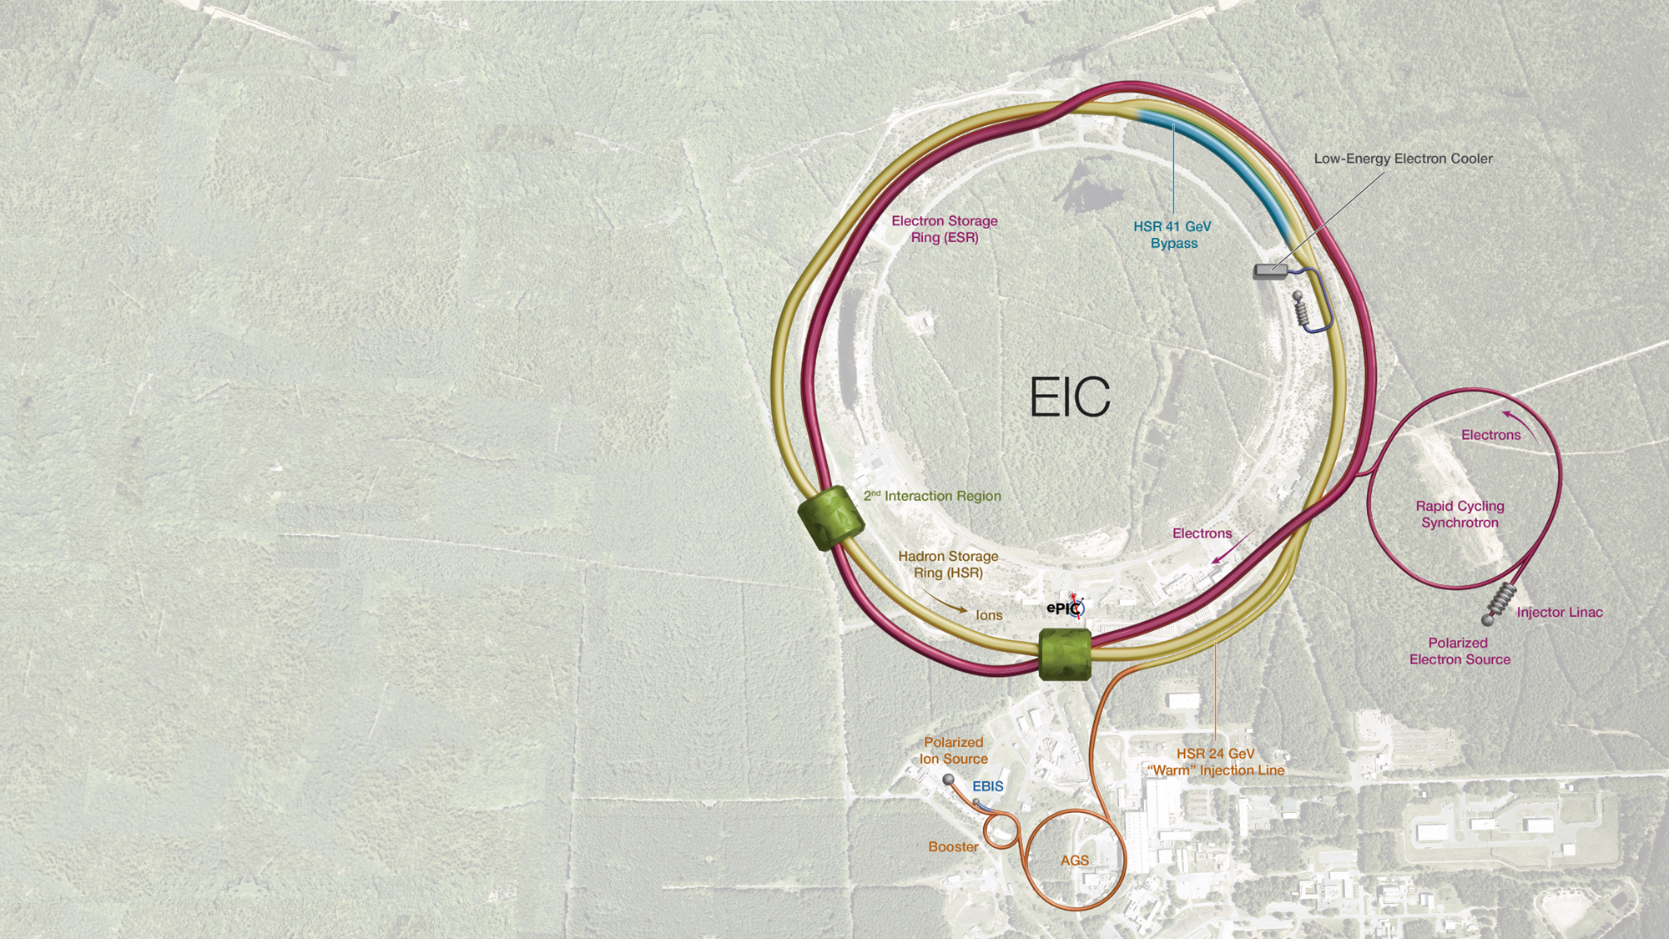

The Electron-Ion Collider
Electrons: $5−18 \text{GeV}$
Protons: $41−275 \text{GeV}$
Ion beams: protons, ${}_{}^{3}{\text{He}}$, Ag, $\text{Au}$, $\text{Pb}$, $\text{U}$
Variable center-of-mass energy:
$$\sqrt{s}=20−140 \text{GeV}$$
High luminosity:
$$L={10}^{33}−{10}^{34} {\text{c}\text{m}}^{−1}{\text{s}}^{−1}$$
Polarized electron and proton beams:
$$P≈70\%$$

Slide 4

What is Polarization?
Merriam-Webster
Noun, po·​lar·​i·​za·​tion ˌpō-lə-rə-ˈzā-shən
the action of polarizing or state of being or becoming polarized: such as
  the action or process of affecting radiation and especially light so that the vibrations of the wave assume a definite form
  the state of radiation affected by this process
  an increase in the resistance of an electrolytic cell often caused by the deposition of gas on one or both electrodes
  MAGNETIZATION
    an instance of magnetizing or the state of being magnetized
    also: the degree to which a body is magnetized
division into two sharply distinct opposites
  especially: a state in which the opinions, beliefs,
  or interests of a group or society no longer range
  along a continuum but become concentrated at
  opposing extremes
Polarization is the average alignment of the magnetic moment of an ensemble of particles with respect to an external magnetic field.
For $s=\frac{1}{2}ℏ$:
$$P=\frac{n^{+}−n^{−}}{n+n^{−}}$$

Slide 5



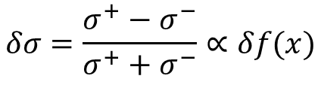
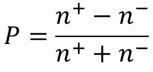
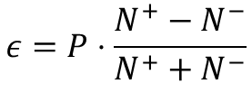
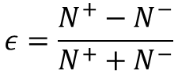
The Figure of Merit
$$δσ=\frac{σ^{+}−σ^{−}}{σ^{+}+σ^{−}}∝δf(x)$$
Physics observable of interest depends on the spin alignment
$$ε=\frac{N^{+}−N^{−}}{N^{+}+N^{−}}$$
If the measurement is done with pure spin alignment
$$ε=P⋅\frac{N^{+}−N^{−}}{N^{+}+N^{−}}$$
With polarization
$$P=\frac{n^{+}−n^{−}}{n^{+}+n^{−}}$$
Uncertainty of physics observable
$$Δ_{f}=Δ_{E}P$$
Statistical uncertainty of measurement $Δ_{S}=\sqrt{N}$
Figure of merit: $FOM=NP^{2}$

Slide 6
Polarized High Energy Particle Beams

Slide 7
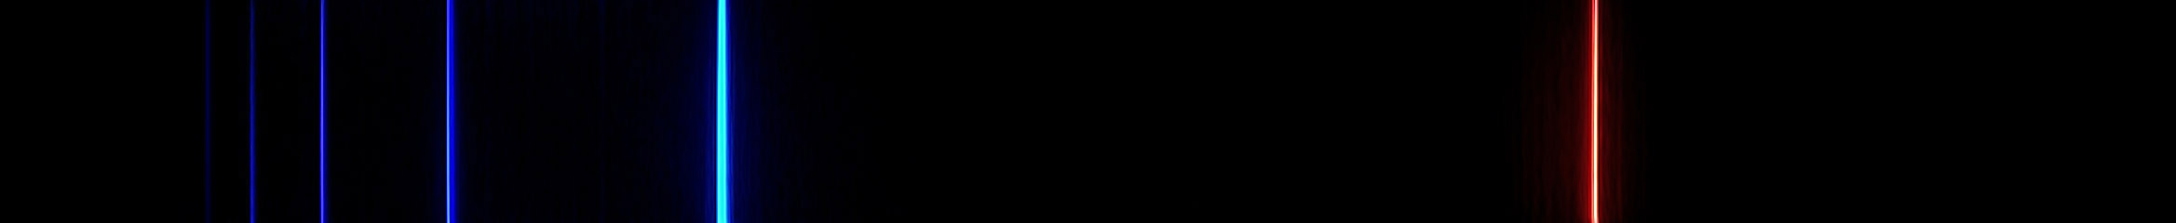
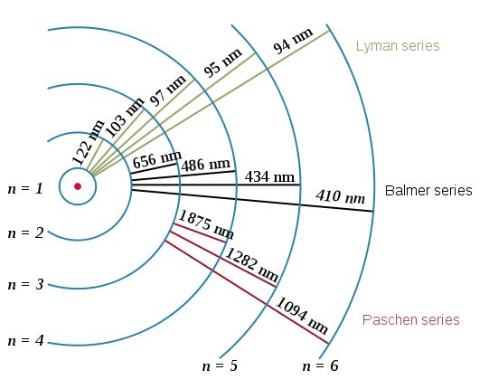







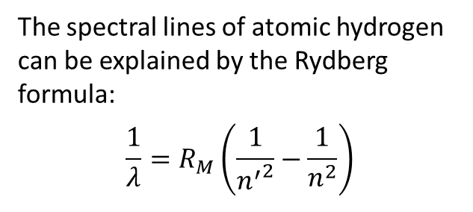

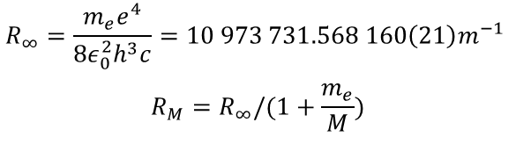
The Bohr Model of Hydrogen Atoms
The spectral lines of atomic hydrogen can be explained by the Rydberg formula:
$$\frac{1}{λ}=R_{M}\left(\frac{1}{{n^{′}}^{2}}−\frac{1}{n^{2}}\right)$$
$$n=5$$
$$−0.85 \text{MeV}$$
$$n=4$$
$$n=3$$
$$−1.51 \text{MeV}$$
$$n=2$$
$$−3.40 \text{MeV}$$
$$R_{∞}=\frac{m_{e}e^{4}}{8ε_{0}^{2}h^{3}c}=10 973 731.568 160\left(21\right)m^{−1}$$
$$R_{M}=R_{∞}/(1+\frac{m_{e}}{M})$$
$$n=1$$
$$−13.6 \text{MeV}$$

Slide 8

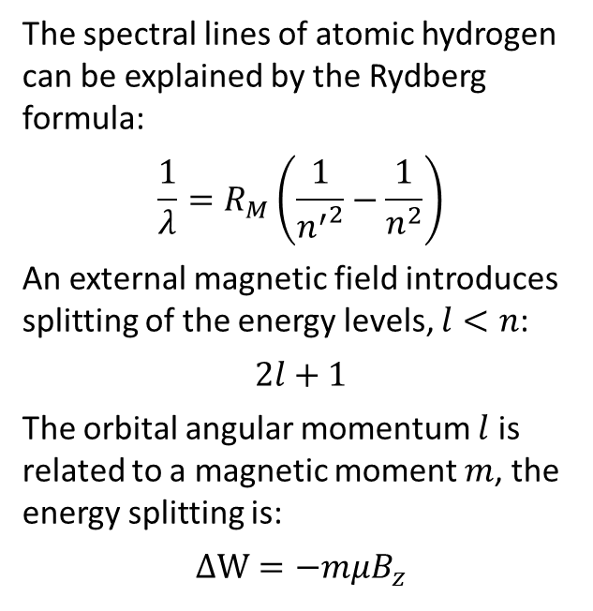




Space Quantization
$$B_{z}$$
$$n=1, l=1$$
The spectral lines of atomic hydrogen can be explained by the Rydberg formula:
$$\frac{1}{λ}=R_{M}\left(\frac{1}{{n^{′}}^{2}}−\frac{1}{n^{2}}\right)$$
An external magnetic field introduces splitting of the energy levels, $l<n$:
$$2l+1$$
The orbital angular momentum $l$ is related to a magnetic moment $m$, the energy splitting is:
$$ΔW=−mμB_{z}$$
$$n=5$$
$$−0.85 \text{MeV}$$
$$n=4$$
$$l_{z}=+1$$
$$n=3$$
$$−1.51 \text{MeV}$$
$$n=2$$
$$−3.40 \text{MeV}$$
$$l_{z}=0$$
$$n=1$$
$$−13.6 \text{MeV}$$
$$l_{z}=−1$$

Slide 9


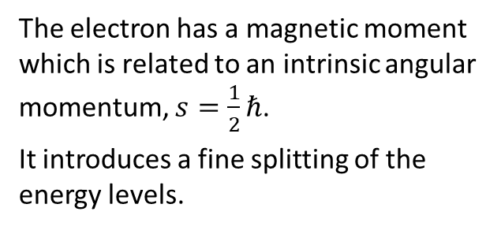







Space Quantization
$$B_{z}$$
$$s=1/2$$
The electron has a magnetic moment which is related to an intrinsic angular momentum, $s=\frac{1}{2}ℏ$.
It introduces a fine splitting of the energy levels.
$s_{z}=+1$/2
$$W$$
$$n=1$$
$$l=0$$
$$m_{l}=−1/2$$
$$−13.6 \text{MeV}$$
$$ΔW=\frac{e}{2m}ℏB$$
$$s_{z}=−1/2$$
$$m_{l}=+1/2$$

Slide 10
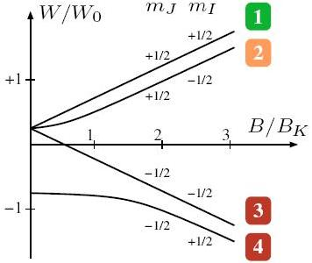
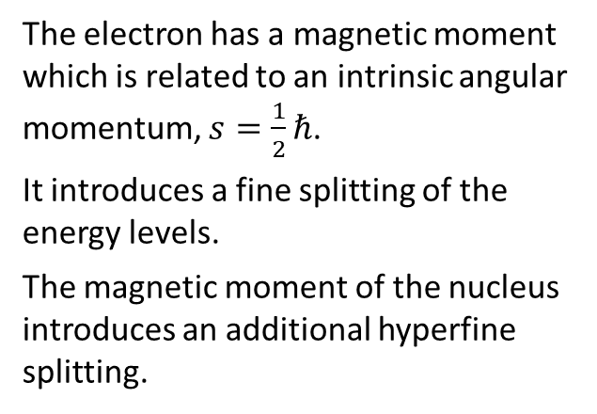
Space Quantization
$$B_{z}$$
$$s=1/2$$
The electron has a magnetic moment which is related to an intrinsic angular momentum, $s=\frac{1}{2}ℏ$.
It introduces a fine splitting of the energy levels.
The magnetic moment of the nucleus introduces an additional hyperfine splitting.
$s_{z}=+1$/2
$$s_{z}=−1/2$$
https://demonstrations.wolfram.com/BreitRabiDiagram/

Slide 11
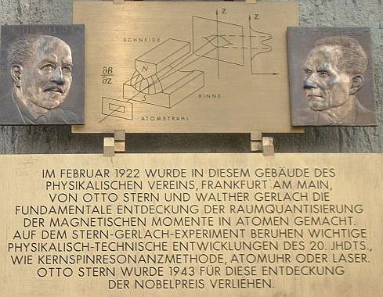
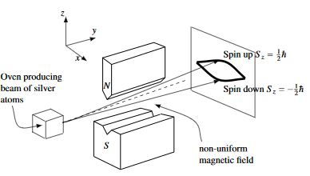
Spin Polarized Protons
Stern-Gerlach (1922) demonstrated that the electron spin is quantized.

Slide 12



Spin Polarized Protons
Stern-Gerlach (1922) demonstrated that the electron spin is quantized.
Use a similar setup as a filter to produce polarized protons.
The magnetic moment of the nucleus is much smaller than that of the electron.
$$ΔE=ℏν$$
$$\frac{dB}{dz}$$
$$\frac{dB}{dz}$$

Slide 13
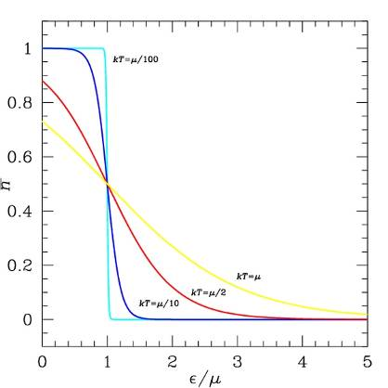
Spin Polarized Protons
Stern-Gerlach (1922) demonstrated that the electron spin is quantized.
Use a similar setup as a filter to produce polarized protons.
The magnetic moment of the nucleus is much smaller than that of the electron.
There is a limit to the polarization (temperature, magnetic field, power of rf unit).

Slide 14

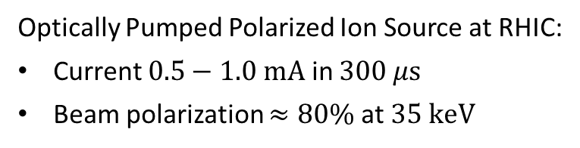




An Advanced Polarized Proton Source
A. Zelenski et al., J. Phys. Conf. Ser. 295 (2011) 012147
High brightness proton source
Focusing solenoid
Pulsed hydrogen neutralization cell
Superconducting solenoid 30 kG
Pulsed He-ionized cell
Optically pumped Rb cell
Sona shield
Sodium-jet ionizer
$$H^{+}$$
$$10 \text{keV}$$
$$H^{0}$$
$$10 \text{keV}$$
$$H^{0↑}$$
$$3 \text{keV}$$
$$H^{+↑}$$
$$3 \text{keV}$$
$$H^{+↑}$$
$$35 \text{keV}$$
Optically Pumped Polarized Ion Source at RHIC:
Current $0.5−1.0 \text{mA}$ in $300 μ\text{s}$
Beam polarization $≈80\%$ at $35 \text{keV}$
One proton bunch in RHIC

Slide 15
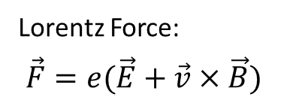
Particle Beam Optics
Lorentz Force:
$$\vec{F}=e(\vec{E}+\vec{v}×\vec{B})$$
We need to keep the particles on a circle.
There is a closed orbit.
Beam has a size and momentum spread.
Particles oscillate around the closed orbit (betatron oscillation).
acceleration
dipole magnets
F0D0 lattice and orbit envelope
injection
experiment
other magnets
Quadrupole magnets focus in one direction only.
Liouville’s theorem: The phase ellipse and the emittance of the beam are invariant.

Slide 16

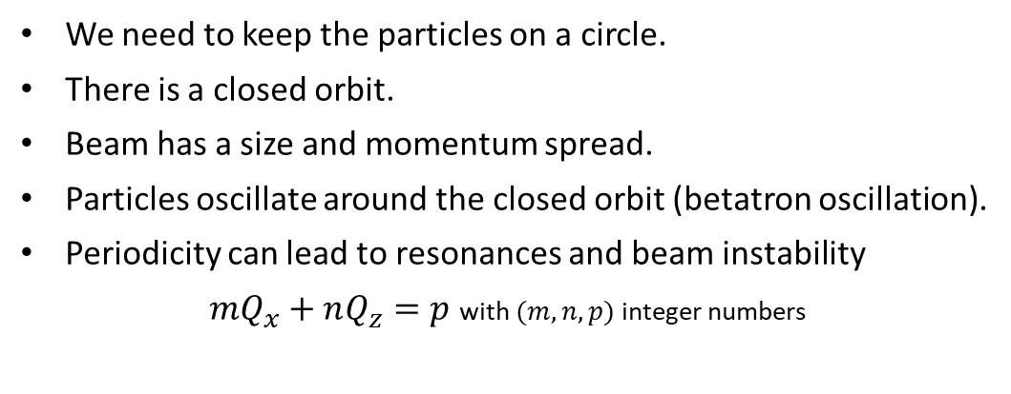





Particle Beam Optics
Lorentz Force:
$$\vec{F}=e(\vec{E}+\vec{v}×\vec{B})$$
We need to keep the particles on a circle.
There is a closed orbit.
Beam has a size and momentum spread.
Particles oscillate around the closed orbit (betatron oscillation).
Periodicity can lead to resonances and beam instability
$mQ_{x}+nQ_{z}=p$ with $(m,n,p)$ integer numbers
acceleration
dipole magnets
Optical resonances up to 3rd order
injection
experiment
particle trajectory
$$m+1$$
orbit
other magnets
possible
distortion
$$Q_{z}$$
working point
$$m$$
$$n$$
$$Q_{x}$$
$$n+1$$

Slide 17
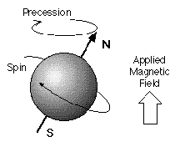
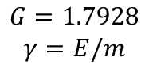
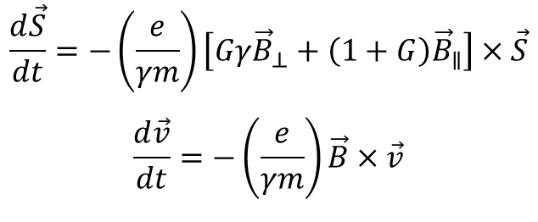
Particle Beam Optics
Lorentz Force:
$$\vec{F}=e(\vec{E}+\vec{v}×\vec{B})$$
We need to keep the particles on a circle.
There is a closed orbit.
Beam has a size and momentum spread.
Particles oscillate around the closed orbit (betatron oscillation).
Periodicity can lead to resonances and beam instability.
The magnetic moment of particles precesses in magnetic fields.
acceleration
dipole magnets
injection
experiment
$$\frac{d\vec{S}}{dt}=−\left(\frac{e}{γm}\right)\left[Gγ{\vec{B}}_{⊥}+\left(1+G\right){\vec{B}}_{∥}\right]×\vec{S}$$
$$\frac{d\vec{v}}{dt}=−\left(\frac{e}{γm}\right)\vec{B}×\vec{v}$$
other magnets
$$G=1.7928$$
$$γ=E/m$$

Slide 18
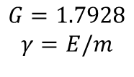
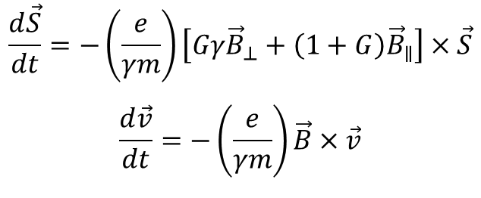
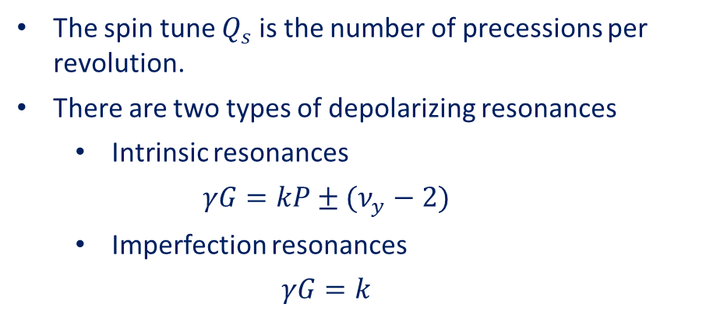
Depolarizing Resonances
Thomas-BMT equation:
$$\frac{d\vec{S}}{dt}=−\left(\frac{e}{γm}\right)\left[Gγ{\vec{B}}_{⊥}+\left(1+G\right){\vec{B}}_{∥}\right]×\vec{S}$$
$$\frac{d\vec{v}}{dt}=−\left(\frac{e}{γm}\right)\vec{B}×\vec{v}$$
L.H. Thomas “The kinematics of an electron with an axis.” The London, Edinburgh, and Dublin Philosophical Magazine and Journal of Science 3.13 (1927)
V. Bargmann, L. Michel, and V.L. Telegdi “Precession of the polarization of particles moving in a homogeneous electromagnetic field.” Physical Review Letters 2.10 (1959)
$$G=1.7928$$
$$γ=E/m$$
The spin tune $Q_{s}$ is the number of precessions per revolution.
There are two types of depolarizing resonances
  Intrinsic resonances
  $$γG=kP±(ν_{y}−2)$$
  Imperfection resonances
  $$γG=k$$
The resonance strength depends on the local orbit distortion, magnetic field, and crossing speed.
The number of resonances grows linearly with the top energy.

Slide 19
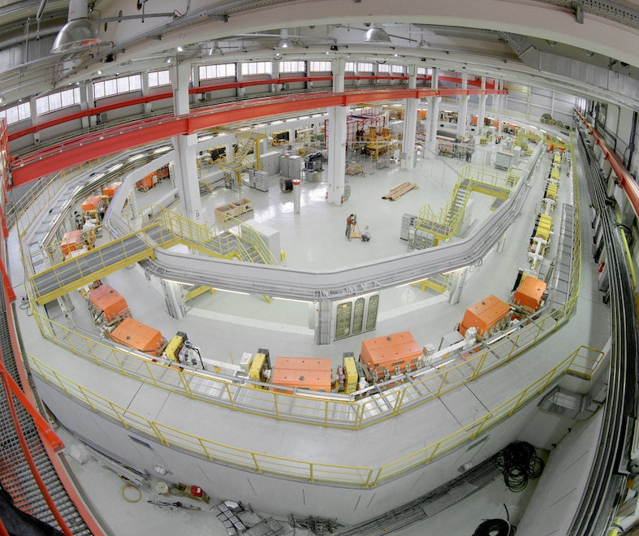
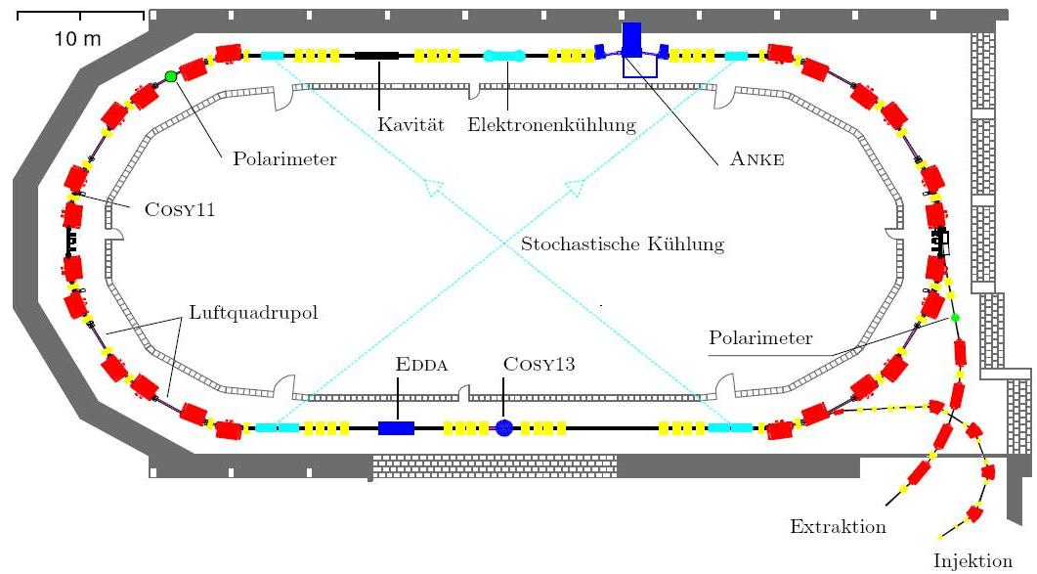
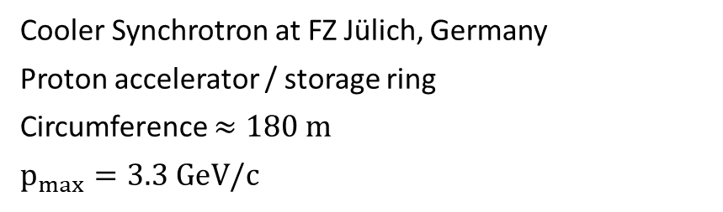
Example: COSY
Cooler Synchrotron at FZ Jülich, Germany
Proton accelerator / storage ring
Circumference $≈180 \text{m}$
$$p_{max}=3.3 \text{Ge}\text{V}\text{/}\text{c}$$
air quadrupole

Slide 20
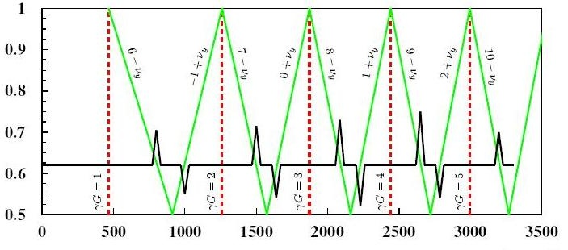
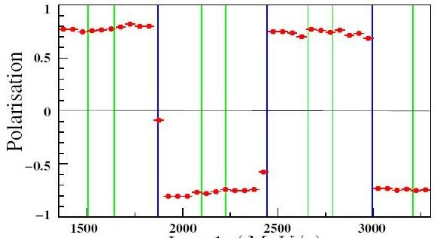

Example: COSY
Intrinsic resonances
Imperfection resonances
Cooler Synchrotron at FZ Jülich, Germany
Proton accelerator / storage ring
Circumference $≈180 \text{m}$
$$p_{max}=3.3 \text{Ge}\text{V}\text{/}\text{c}$$
Working point $q_{y}$
Momentum (MeV/c)
air quadrupole
Polarization
Momentum (MeV/c)

Slide 21
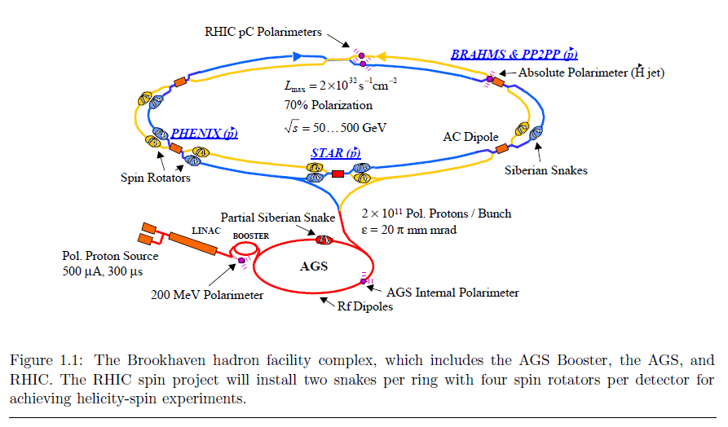
The Relativistic Heavy Ion Collider
“Configuration Manual Polarized Proton Collider at RHIC.” I. Alekseev et al. NIM A (2004)
250 GeV
25 GeV
200 MeV
35 keV

Slide 22
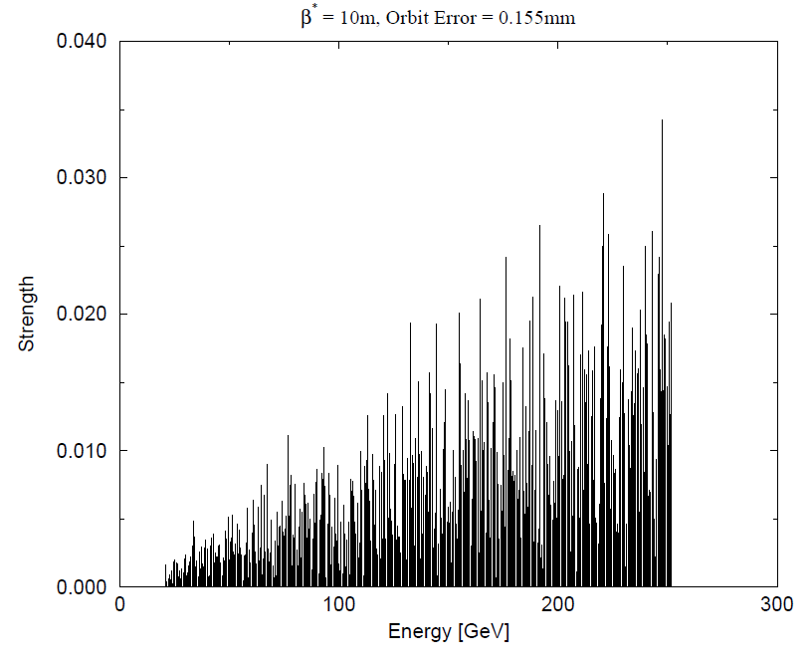
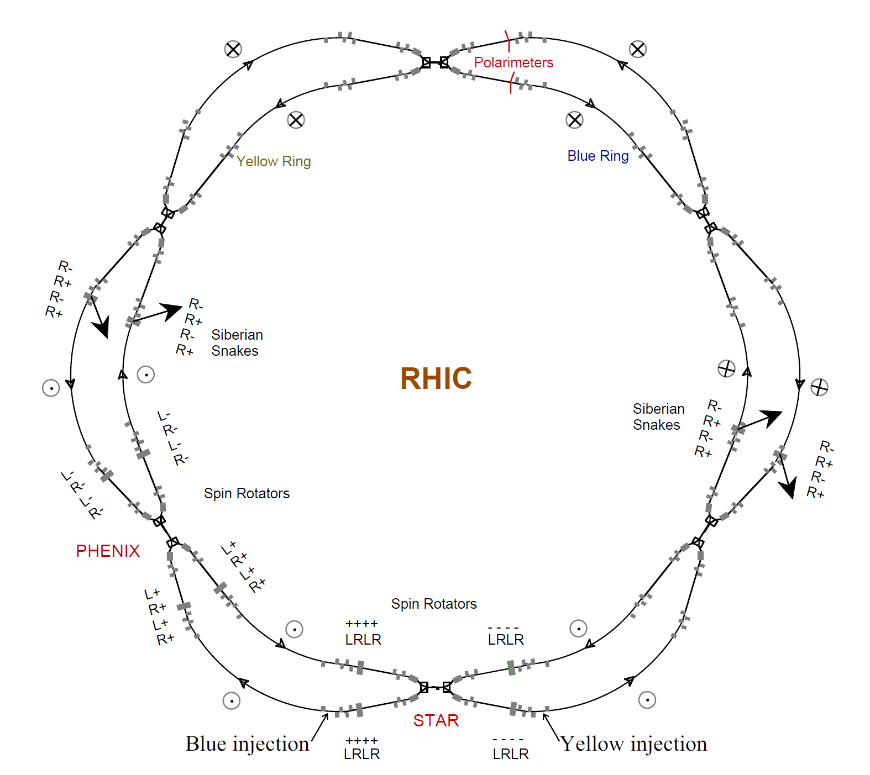
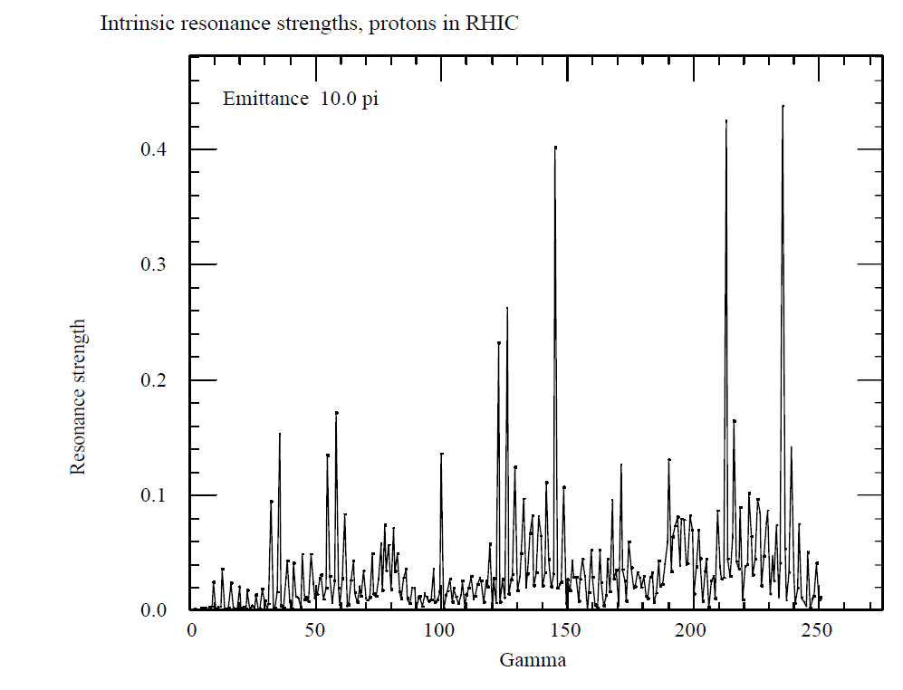

Spin Resonances in RHIC
Imperfection resonances
  $ν_{spin}=γG=n$
  integer $n$
Intrinsic resonances
  $ν_{spin}=γG=kP+ν_{y}$
  integer $k$
  superiodicity P
  vertical betatron tune $ν_{y}$

Slide 23
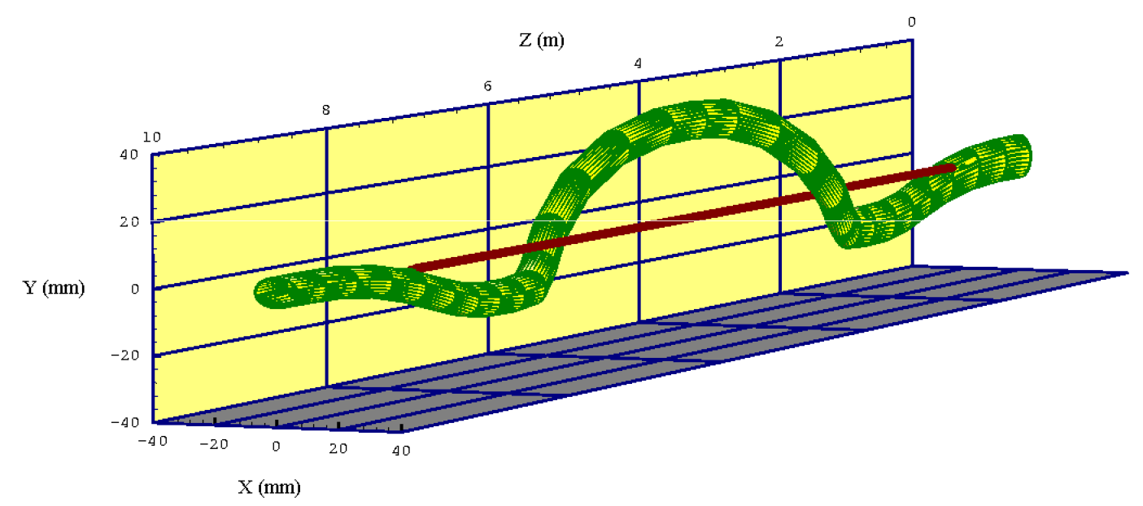
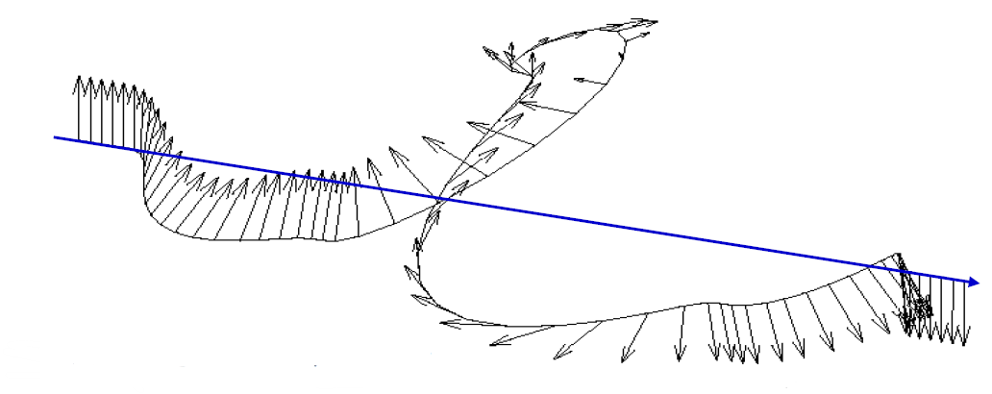
Resonance Mitigation
Deliberately advance the spin precession to avoid resonance conditions
Group of dipole magnets with alternating horizontal and vertical field directions which rotates the spin vector by 180°
Siberian Snakes: Ya. S. Derbenev, A.M. Kondratenko “Polarization kinematics of particles in storage rings.” Sov. Phys. JETP 37 (1973)
Strong AGS Snake

Slide 24
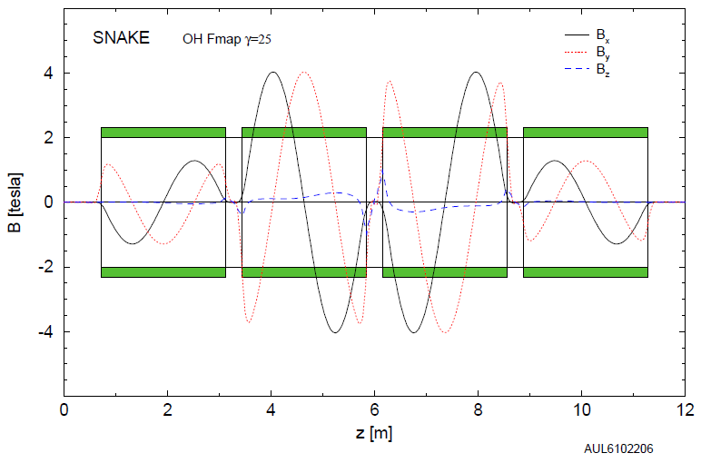
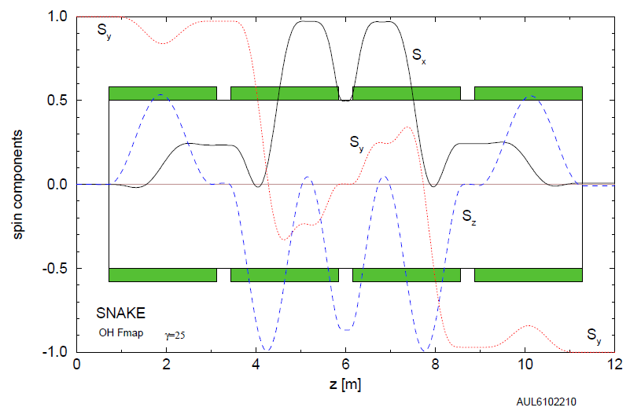
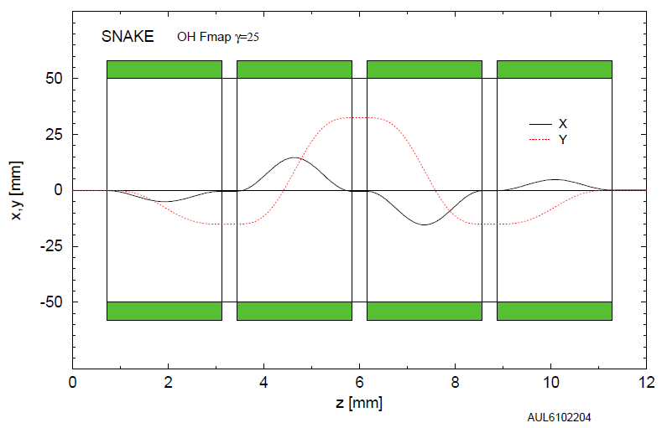
Spin Motion through Siberian Snake

Slide 25
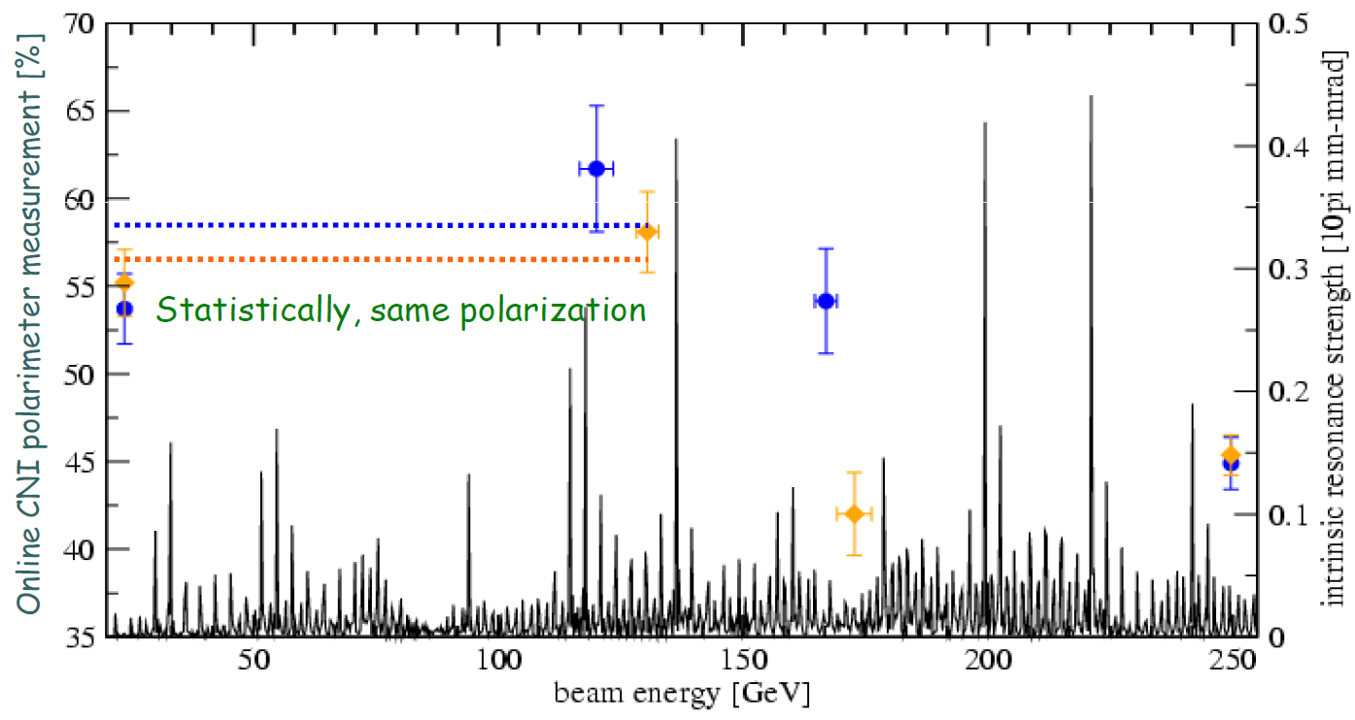
RHIC Proton Polarization
During the first 250 GeV beam operation in 2009

Slide 26
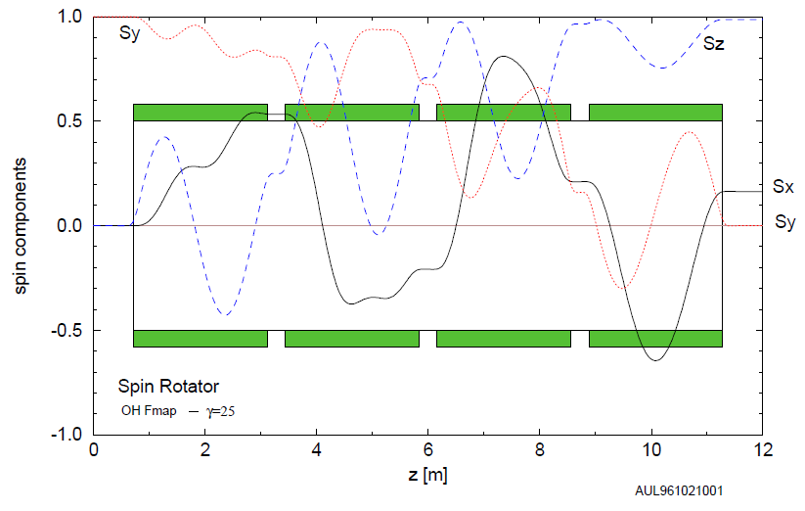
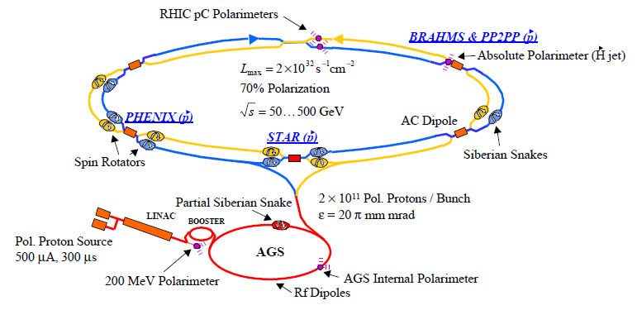




Spin Motion through a Spin Rotator
$$\vec{S}$$
$$\vec{S}$$
The stable spin direction in a circular accelerator is vertical.
Experiments also require longitudinal polarization.
Spin rotators before and after each experiment.
Transverse polarization remnant can cause systematic uncertainties in physics observables.
$$\vec{p}$$
$$\vec{p}$$

Slide 27
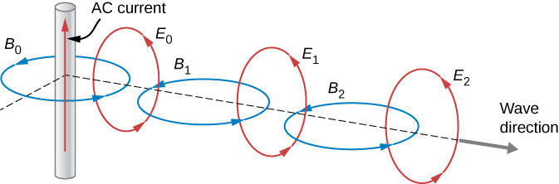
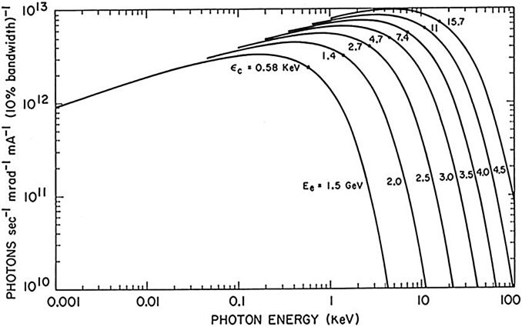
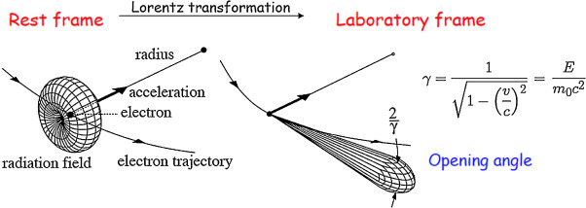
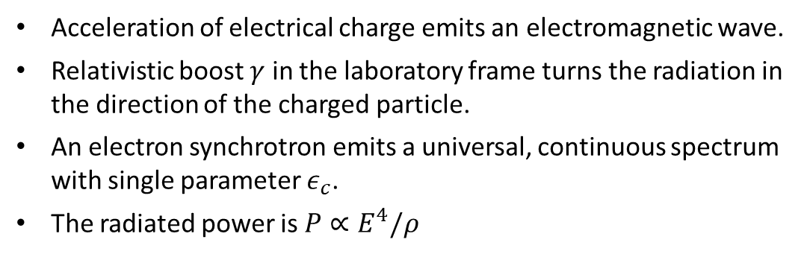
Synchrotron Radiation
Acceleration of electrical charge emits an electromagnetic wave.
Relativistic boost $γ$ in the laboratory frame turns the radiation in the direction of the charged particle.
An electron synchrotron emits a universal, continuous spectrum with single parameter $ε_{c}$.
The radiated power is $P∝E^{4}/ρ$
W. Eberhard “Synchrotron radiation: A continuing revolution in X-ray science” Journal of Electron Spectroscopy and Related Phenomena 200 (2015)
K. Wille “Physik der Teilchenbeschleuniger und Synchrotronstrahlungsquellen” Teubner (1996)

Slide 28


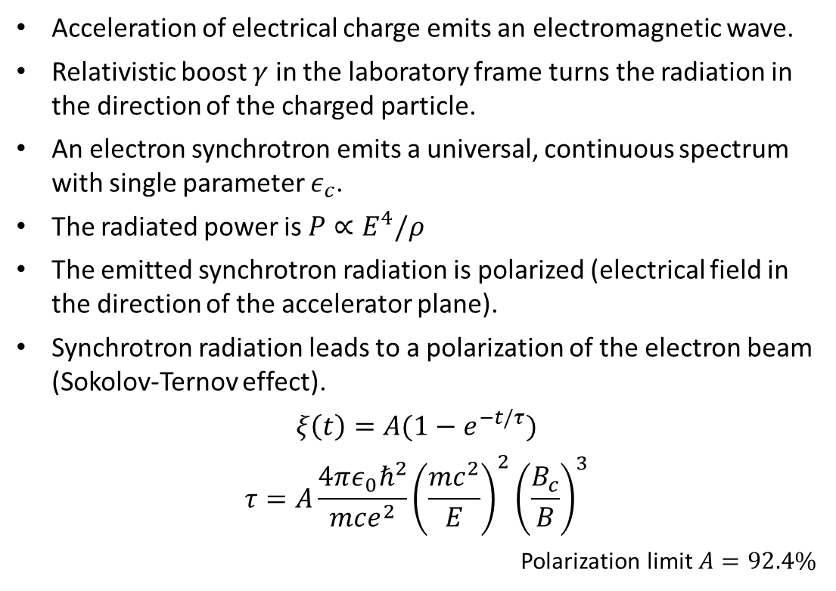



Synchrotron Radiation
synchrotron fan
Acceleration of electrical charge emits an electromagnetic wave.
Relativistic boost $γ$ in the laboratory frame turns the radiation in the direction of the charged particle.
An electron synchrotron emits a universal, continuous spectrum with single parameter $ε_{c}$.
The radiated power is $P∝E^{4}/ρ$
The emitted synchrotron radiation is polarized (electrical field in the direction of the accelerator plane).
Synchrotron radiation leads to a polarization of the electron beam (Sokolov-Ternov effect).
$$ξ\left(t\right)=A(1−e^{−t/τ})$$
$$τ=A\frac{4πε_{0}ℏ^{2}}{mce^{2}}{\left(\frac{mc^{2}}{E}\right)}^{2}{\left(\frac{B_{c}}{B}\right)}^{3}$$
Polarization limit $A=92.4\%$
$$\vec{B}$$
$$e^{−}$$
$$E$$
$$\vec{B}↑↑\vec{S}$$
$$\vec{B}↑↓\vec{S}$$
W. Eberhard “Synchrotron radiation: A continuing revolution in X-ray science” Journal of Electron Spectroscopy and Related Phenomena 200 (2015)
K. Wille “Physik der Teilchenbeschleuniger und Synchrotronstrahlungsquellen” Teubner (1996)

Slide 29


Recap: Requirements for Polarimetry
Electron beam polarization has to be measured between $5−18 \text{GeV}$.
Proton beam polarization has to be measured between $41−275 \text{Ge}\text{V}$.
Each store may be 8 hours long.
The beams are bunched and will have alternating polarization states to reduce time-dependent systematic uncertainties.
Bunch spacing is around $10 \text{ns}$ (about 1300 bunches in each ring).
Provide:
  Absolute beam polarization $ΔP/P≈1\%$
  Time-dependence (polarization decay)
  Bunch-by-bunch polarization
  Polarization profile of bunches
  Polarization during ramp (acceleration)
  Polarization vector at experiment

Slide 30
Polarimetry of High Energy Hadron Beams

Slide 32

Particle Bunches
A bunch of particles in vacuum travelling at almost the speed of light
Goes in circles, will be back in about $13 μ\text{s}$ ($78 \text{kHz}$).
?

Slide 33

Polarization Measurement
A bunch of particles in vacuum travelling at almost the speed of light
Goes in circles, will be back in about $13 μ\text{s}$ ($78 \text{kHz}$).
?
For the determination of the polarization will have to devise a scattering experiment which is spin-dependent.
We will need a representative sample of scattered particles to make conclusive statements about the polarization.
Only a fraction of the scattering probability will depend on the spin: $σ^{↑↓}=σ_{0}±σ_{s}$
It is convenient to introduce an asymmetry: $ε=σ^{↑}−σ^{↓}=2σ_{s}$

Slide 34







The Right Frame
The momentum and spin direction define a coordinate system.
  Longitudinal $L$
  Normal $N$
  Sideways $S$
$$S=N×L$$
$$ε=A_{N}∙P=\frac{N_{L}−N_{R}}{N_{L}+N_{R}}$$
left
$$s_{z}=N$$
right
refers to the projectile
$$p=L$$
Analyzing power $A_{N}$
Polarization $P=\frac{n^{↑}−n^{↓}}{n^{↑}+n^{↓}}$
(proton)

Slide 35







Polarized Observables
Elastic scattering obeys parity conservation and time invariance.
The collision is symmetric (in the center-of-mass frame), recoil and ejectile are indistinguishable.
$$ρ_{f}=Mρ_{i}M^{∗}$$
$$ρ=\sum_{n}{p_{n}}|\left.n\right\rangle \left\langle n\right.|$$
$$M=\sum_{i,f}{a_{f,i}σ_{i}⨂σ_{f}}$$
$$ρ_{i}=ρ_{beam}⊗ρ_{target}$$
left
$$\frac{dσ}{dΩ}=Tr\left(ρ_{f}\right)=\sum_{n}{p_{n}}{\left|\left\langle n | M | n\right\rangle \right|}^{2}$$
$$s_{z}=N$$
right
$$\frac{dσ}{dΩ}=a_{0000}+\sum_{n}{P_{n}a_{00n0}}+\sum_{m}{Q_{m}a_{000m} }+\sum_{m,n}{P_{n}Q_{m}a_{00nm}}+…$$
$$p=L$$
(proton)
$$\frac{dσ}{dΩ}={\frac{dσ}{dΩ}}_{0}(1+\sum_{n}{P_{n}A_{00n0}}+\sum_{m}{Q_{m}A_{000m} }+\sum_{m,n}{P_{n}Q_{m}A_{00nm}}+…)$$
(proton)
→ 4⁴=256 possible Observables (25 independent parameters)

Slide 36



Polarized Observables
Elastic scattering obeys parity conservation and time invariance.
The collision is symmetric (in the center-of-mass frame), recoil and ejectile are indistinguishable.
$$\frac{dσ}{dΩ}={\frac{dσ}{dΩ}}_{0}(1+P_{beam}A_{00N0}+P_{target}A_{000N})$$
ejectile, recoil, projectile, target
left
For elastic scattering:
$$A_{00N0}=−A_{000N}$$
$$s_{z}=N$$
right
$$p=L$$
(proton)
$$P_{Beam}=−\frac{ε_{Beam}}{ε_{Target}}P_{Target}$$
(proton)

Slide 37




Transverse Single-Spin Asymmetries
Transformation of $S=N×L$ into the laboratory frame
$$\frac{dσ}{dΩ}={\frac{dσ}{dΩ}}_{0}(1+P⋅A_{N}⋅\cos{φ})$$
detector
y
$$P_{N}=−P_{x}\sin{φ}+P_{y}\cos{φ}$$
$$P_{S}=P_{x}\cos{φ}+P_{y}\sin{φ}$$
$$P_{L}=P_{z}$$
ϕ
detector
x
z
left
scattering plane
$$s_{z}=N$$
right
$$p=L$$
$$N=\int{\frac{dσ}{dΩ}ℒ_{P}\left(t\right)e\left(dΩ,t\right)dΩdt}$$
(proton)
What are possible sources of systematic uncertainties?
And how can you avoid them?
(proton)

Slide 38




Elastic $p+p$ Scattering
Example: EDDA @ COSY
Kinematic correlation in elastic scattering
$$φ_{1}−φ_{2}=π$$
$$\tan{θ_{1}⋅\tan{θ_{2}}=1/γ_{cm}^{2}}$$
EDDA detector
  Scintillator hodoscope specifically designed for elastic $p+p$ scattering

Slide 39


Elastic $p+p$ Scattering
Example: EDDA @ COSY
Atomic hydrogen target
  Selection of hyperfine state 1 (of 4)
  Magnetic holding field $B_{x,y,z}≈10 \text{G}$
  Rabi unit for polarization measurement
  Target polarization $Q≈70\%$

Slide 40





Elastic Scattering at RHIC energies
The beam energy is $100−250 \text{GeV}$.
A significant analyzing power exists in the Coulomb-Nuclear Interference region.
$$φ\left(s,t\right)=\left\langle λ_{C}λ_{D}\left|φ\right|λ_{A}λ_{B}\right\rangle$$
$$φ_{1}\left(s,t\right)=\left\langle +\frac{1}{2}+\frac{1}{2}\left|φ\right|+\frac{1}{2}+\frac{1}{2}\right\rangle$$
$$φ_{2}\left(s,t\right)=\left\langle +\frac{1}{2}+\frac{1}{2}\left|φ\right|−\frac{1}{2}−\frac{1}{2}\right\rangle$$
$$φ_{3}\left(s,t\right)=\left\langle +\frac{1}{2}−\frac{1}{2}\left|φ\right|+\frac{1}{2}−\frac{1}{2}\right\rangle$$
$$φ_{4}\left(s,t\right)=\left\langle +\frac{1}{2}−\frac{1}{2}\left|φ\right|−\frac{1}{2}+\frac{1}{2}\right\rangle$$
$$φ_{5}\left(s,t\right)=\left\langle +\frac{1}{2}+\frac{1}{2}\left|φ\right|+\frac{1}{2}−\frac{1}{2}\right\rangle$$
A. Poblaguev et al., Phys. Rev. D 79, 094014 (2009)
$$A_{N}\frac{ds}{dt}=−\frac{4π}{s^{2}}\text{Im}\left[φ_{5}^{em∗}\left(s,t\right)φ_{+}^{had}\left(s,t\right)+φ_{5}^{had∗}\left(s,t\right)φ_{+}^{em}(s,t)\right]$$
no-flip amplitude: $φ_{+}\left(s,t\right)=\frac{1}{2}\left[φ_{1}\left(s,t\right)\text{+}φ_{3}\left(s,t\right)\right]$

Slide 41



Elastic Scattering at RHIC energies
The beam momentum is $100−250 \text{GeV}$.
A significant analyzing power exists in the Coulomb-Nuclear Interference region.
Recoil comes out almost perpendicular to the beam direction.
A. Poblaguev et al., Phys. Rev. D 79, 094014 (2009)
Recoil angle $({90}^{∘}−θ)$
Kinetic energy of the recoil proton

Slide 42



An Absolute Polarimeter at RHIC
$H_{2}$ source
Dissociator
RF unit
Holding field
Detectors
beam

Slide 43



An Absolute Polarimeter at RHIC
Polarized atomic hydrogen jet target (HJET)
Set of eight Hamamatsu $Si$ strip detectors
12 vertical strips
  $3.75 \text{mm}$ pitch
  $500 \text{μ}\text{m}$ thick
Uniform dead layer $≈1.5 \text{μ}\text{m}$
left
scattering plane
$$s_{z}=N$$
right
$$p=L$$
(proton)
≈ 0.7 cm
INNER
OUTER
(proton)
target
scattered proton
proton beam
100/250 GeV
75 cm
≈10 cm
Si strip detectors

Slide 44





Proton Recoil Measurement
Expected elastic signal
Simple toy simulation with bunch length $3 \text{ns}$
Non-relativistic: $T_{kin}=\frac{1}{2}mv^{2}$
Time of flight is used for particle identification
Real measurement
Already includes some basic cuts (low $E$, low $t$)

Slide 45


Proton Recoil Measurement
Time of flight is used for particle identification
Recoil angle is used for kinematic correlation in elastic scattering

Slide 46




Absolute Beam Polarization
detector
beam
$$ε=A_{N}∙P$$
$$P_{Beam}=\frac{ε_{Beam}}{ε_{Target}}P_{Target}$$
detector
beam
❶
Polarization independent background
$ε=\frac{N^{↑}−N^{↓}}{N^{↑}+N^{↓}+2∙N_{bg}}$ ⇒ $\frac{ε_{B}}{ε_{T}}=\frac{N_{B}^{↑}−N_{B}^{↓}}{N_{T}^{↑}−N_{T}^{↓}}$
❷
Polarization dependent background
$$ε=\frac{ε_{inc}−r∙ε_{bg}}{1−r}$$
background fraction $r=N_{bg}/N$
Background
Inclusive
SIGNAL
Background
SIGNAL
Inclusive

Slide 47



A Suite of Polarimeters
beam
From our list of requirements:
Time-dependence (polarization decay)
Bunch-by-bunch polarization
Transverse polarization profile of bunches
Also has to be non-destructive!
Carbon polarimeters
Fast measurement
$$δP/P≈4\%$$
Beam polarization profile
Bunch-by-bunch
Polarization decay (time dependence)
Hydrogen jet polarimeter
Polarized target
Continuous operation
$δP/P≈5−6\%$ per 8 hours of operation
normalization

Slide 48






Fiber Target Polarimeters
Ultra-thin ribbon targets:
$$≈10 μ\text{m} x 100 \text{nm}$$
Target holder inside the beam pipe

Slide 49



Polarization Decay
injection
Polarization losses during the store are correlated to
acceleration
emittance
profile
normalization with HJET
Polarization P (%)
$$P=P_{0}+\frac{dP}{dt}t$$
$$P_{jet}=\frac{\int{dxdyP\left(t\right)I_{B}\left(t\right)}}{\int{dxdyI_{B}\left(t\right)}}$$

Slide 50

Polarization Decay
injection
Polarization losses during the store are correlated to
acceleration
emittance
profile
Polarization P (%)
$$P=P_{0}+\frac{dP}{dt}t$$
$$P_{coll}=\frac{\int{dxdyP\left(t\right)I_{B}\left(t\right)I_{Y}(t)}}{\int{dxdyI_{B}\left(t\right)I_{Y}(t)}}$$
$$P_{jet}=\frac{\int{dxdyP\left(t\right)I_{B}\left(t\right)}}{\int{dxdyI_{B}\left(t\right)}}$$
Important for experiments:
Luminosity changes throughout each store

Slide 51







Polarization Profile
injection
Polarization losses during the store are correlated to
acceleration
emittance
profile
Polarization P (%)
$$P=P_{0}+\frac{dP}{dt}t$$
$$R=R_{0}+\frac{dR}{dt}t$$
$$P_{coll}=\frac{\int{dxdyP\left(x,y\right)I_{B}\left(x,y\right)I_{Y}(x,y)}}{\int{dxdyI_{B}\left(x,y\right)I_{Y}(x,y)}}$$
For Gaussian profiles
$$I=I_{peak}∙e^{−i{\overset{⃑}{r}}^{2}/σ_{I}^{2}}$$
$$P=P_{peak}∙e^{−i{\overset{⃑}{r}}^{2}/σ_{P}^{2}}$$
$$P_{jet}=\frac{\int{dxdyP\left(x,y\right)I_{B}\left(x,y\right)}}{\int{dxdyI_{B}\left(x,y\right)}}$$
Profile R
Profile parameter $R=\frac{σ_{I}^{2}}{σ_{P}^{2}}$
$$P_{sweep}=\frac{\int{dyP\left(y\right)I_{B}\left(y\right)}}{\int{dyI_{B}\left(y\right)}}$$

Slide 52






Limitations of the Measurement
Recoil particles have very low energy.
  significant impact of the inactive detector parts (dead layer $ΔE$), especially for the Carbon measurement
  Calibration with $α$-sources
  $${}_{}^{148}{Gd}(E_{α}=3.183 \text{MeV})$$
  $${}_{}^{243}{Am}(E_{α}=5.486 \text{MeV})$$
Small angle scattering of recoil inside the target dilutes the kinematic correlation for elastic scattering.
  Background dilutes the measured asymmetry (increases statistical uncertainty), but normalized with HJET
  $A_{N}$ drops above 1 MeV
$$c∙A=E_{meas}=E_{kin}−∆E$$
Dead layer
$$z≈0.25−0.5 μ\text{m}$$

Slide 53





Fiber Targets and High Energy Beams
High energy, high intensity proton beams provide an extreme environment
  Energy loss of beam in the target
Target is electrostatically attracted to the beam
  Mechanical stress on target
  Material in beam is hard to control
Induced charge from wake field on target ends
  Change to insulated ladder construction
Targets have a limited lifetime
Simulation by J. Kewisch, BNL

Slide 54







Local Polarimetry at RHIC
Local polarimetry is primarily for confirming the direction of the polarization vector at the experiment.
  Observe suppression of asymmetry or change of direction
  Very forward going production of neutrons in $p+p$ collisions
  First established at RHIC-IP12, standard method for RHIC experiments
$$x_{F}=2p_{z}/\sqrt{s}$$
Physical Review D 88 (2013) 032006

Slide 55




Potential for Future Applications
Nuclear dependence of very forward going neutrons
  Very large asymmetry (with opposite sign)
  Select low multiplicity with beam-beam counters
  Ultra-peripheral collision extension to $π/a_{1}$ model
  Photon flux from STARlight
  Klein et al., Comput. Phys. Comm. 212 (2017) 258
  $γ+p^{↑}→n+π^{+}$ from MAID
  Drechsel et al., Eur. Phys. J. A 34 (2007) 69
$$p^{↑}+p$$
$$p^{↑}+Al$$
$$p^{↑}+Au$$
Phys. Rev. Lett 120 (2018) 022001
Phys. Rev. C 95 (2017) 044908

Slide 56




From RHIC to EIC
Data
Simulation
120 bunches $→$ 1320 bunches
Bunch spacing 106 ns $→$ 9.6 ns
Bunch length $3.5 \text{ns}→ 0.3 \text{ns}$
Bunch length
Detector resolution
Punch through region

Slide 57


From RHIC to EIC
Loss of increased asymmetry at lower energies, $A_{N}(−t)$
Reduced bunch spacing requires much better understanding of background
  Polarized or unpolarized
  Better: reject/suppress background
  Second detector layer to veto high energy particles
Veto punch through particles

Slide 58








Polarized Light Ion Beams
threshold for $pp→ppπ$
Polarized $d$ and ${}_{}^{3}{He}$ beams are not part of the EIC baseline design.
Absolute polarization will (likely) require a polarized ${}_{}^{3}{He}$ target.
  Elastic scattering is necessary for the sign-flip of the analyzing power
  $$A_{00N0}=−A_{000N}$$
  Breakup energy is only $5.5 \text{MeV}$: problematic if beam breaks up $h→pd$
  Tag/veto breakup products downstream of the polarimeter
$$p:e/m=1$$
$$\int{B\text{d}l}$$
$$h:e/m=2/3$$
$$d:e/m=1/2$$
$$h$$
target
$$n:e/m=0$$
strong dipole magnet
drift space
calorimeter

Slide 59

Recap: Hadron Polarimetry
Proton beam energies: $41−275 \text{Ge}\text{V}$
Combination of devices for
  Non-destructive
  Absolute polarization
  Fast measurements during store
  Bunch profile
  Local polarimetry at experiment
Potential for future polarized light ion beams
  Location allows for upgrades to the polarimeter setup

