Slide 1
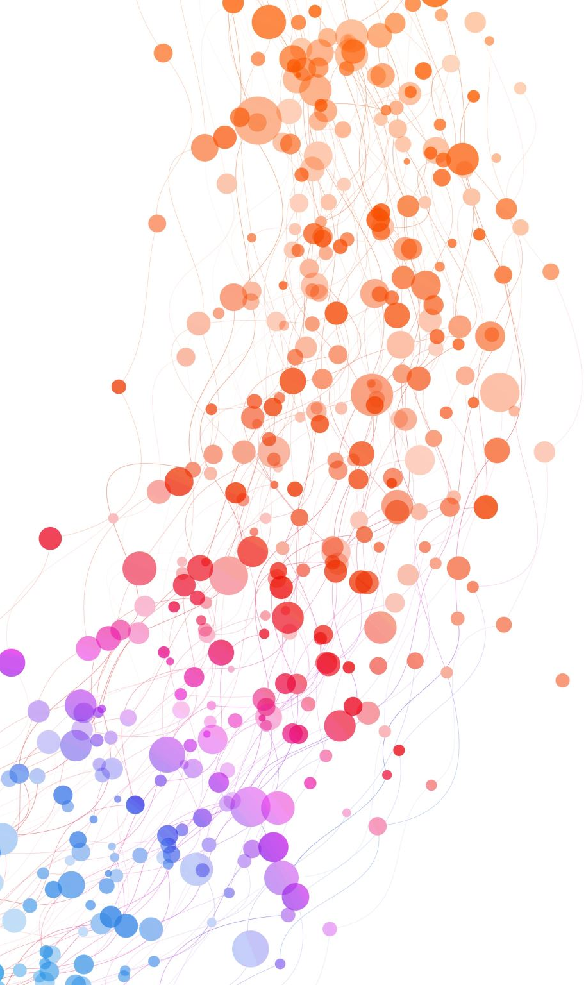
QCD at Small x and Saturation
Yuri Kovchegov
The Ohio State University

Slide 2
Lecture plan
General concepts of saturation physics
DIS: a brief reminder.
Classical small-x physics:
  DIS in the dipole picture, light-cone perturbation theory, light-cone wave functions
  Glauber-Gribov-Mueller formula
  Black disk limit, parton saturation, saturation scale
  McLerran-Venugopalan model, saturation scale for a nucleus
Nonlinear small-x evolution:
  Non-linear BK and JIMWLK evolution equations
  Solution of BK and JIMWLK equations, unitarity,
  energy dependence of the saturation scale, geometric scaling
Saturation physics at the future EIC

Slide 3
General Concepts
Big goal: understand QCD at high energies.
What is the high-energy asymptotic behavior of QCD?

Slide 4
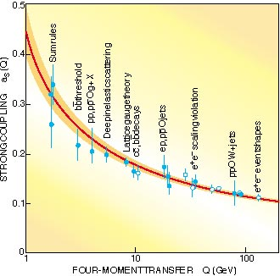
Running of QCD Coupling Constant
QCD coupling constant changes with the momentum scale involved in the interaction
Asymptotic Freedom!
Gross and Wilczek,
Politzer, ca ‘73
Physics Nobel Prize 2004!
For short distances x < 0.2 fm, or, equivalently, large momenta k > 1 GeV
the QCD coupling is small, and interactions are weak.

Slide 5
What sets the scale of running QCD coupling in high energy collisions?
“Optimist”:
Pessimist: we simply can not
tackle high energy scattering in QCD.
pQCD: only study high-p_{T} particles such that
But: what about total cross section? bulk of particles?

Slide 6
What sets the scale of running QCD coupling in high energy collisions?
Saturation physics is based on the existence of a large internal momentum scale Q_{S} which grows with both energy s and nuclear atomic number A
such that
and we can calculate total cross sections, particle spectra and multiplicities, etc, from first principles.

Slide 7
The main principle
Saturation physics is based on the existence of a large internal transverse momentum scale Q_{S} which grows with both decreasing Bjorken x and with increasing nuclear atomic number A
such that
and we can use perturbation theory to calculate total cross sections, particle spectra and multiplicities, correlations, etc, from first principles.

Slide 8
Quasi-classical approximation

Slide 9
A. Glauber-Mueller Rescatterings

Slide 10
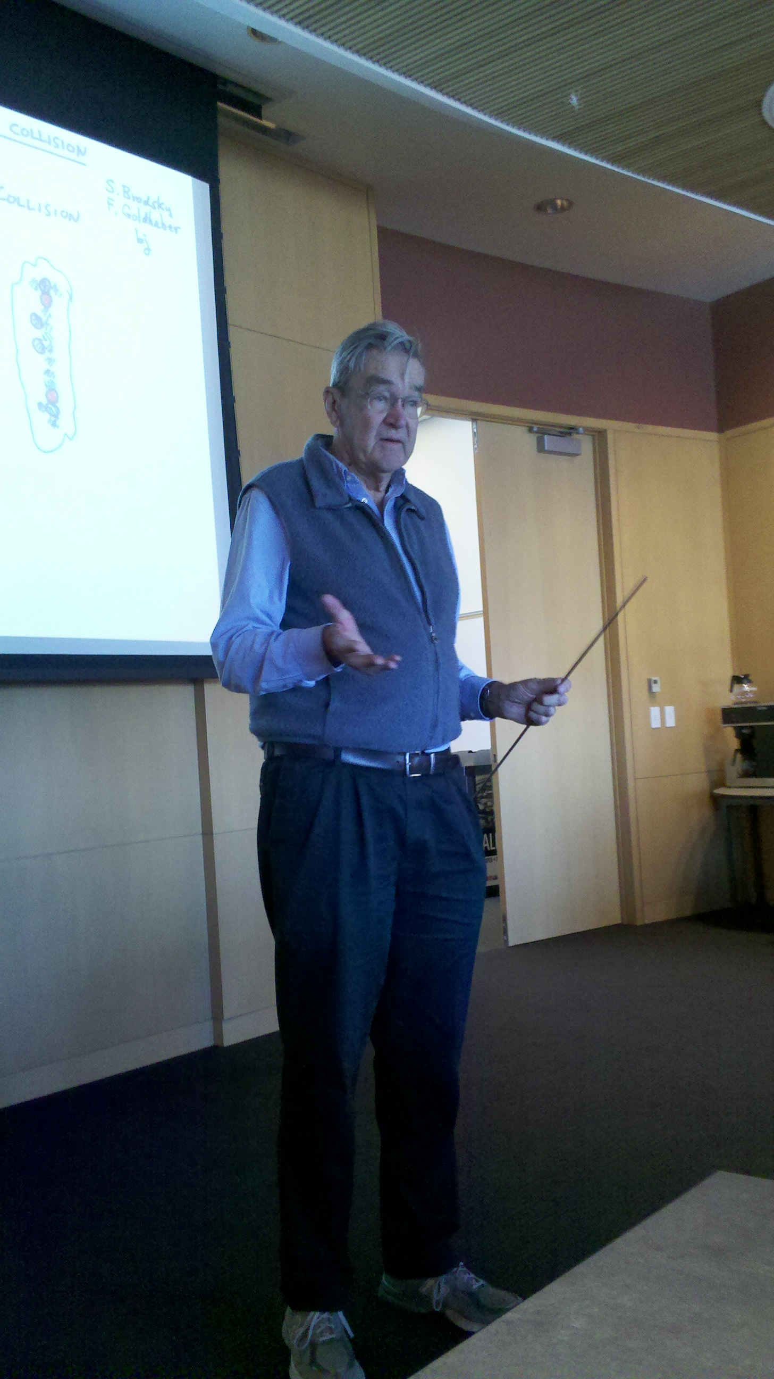
Kinematics of DIS
Photon carries 4-momentum , its virtuality is
Photon hits a quark in the proton carrying momentum
with p being the proton’s momentum. Parameter is
the Bjorken x variable.

Slide 11
Physical Meaning of Q
Uncertainty principle teaches us
that
which means that the photon
probes the proton at the
distances of the order (ħ=1)
Large Momentum Q = Short Distances Probed

Slide 12
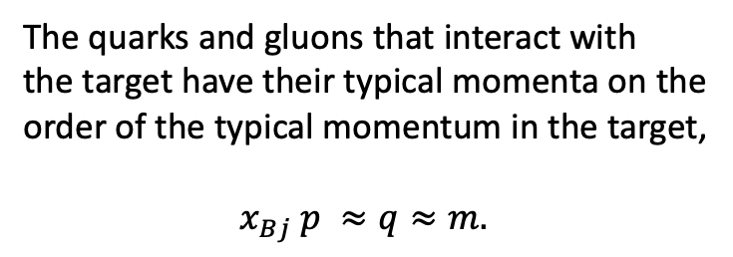


Physical Meaning of Bjorken x
The quarks and gluons that interact with
the target have their typical momenta on the
order of the typical momentum in the target,
${ x}_{Bj} p ≈q≈m.$
$$p$$
proton
$$x_{Bj} p$$
Then the energy of the collision
target
at rest
High Energy = Small x

Slide 13
Gluons at Small x
There is a large number of small-x gluons (and quarks) in a proton:
G(x, Q²) , q(x, Q²) = gluon and quark number densities (q=u,d, or S for sea).

Slide 14
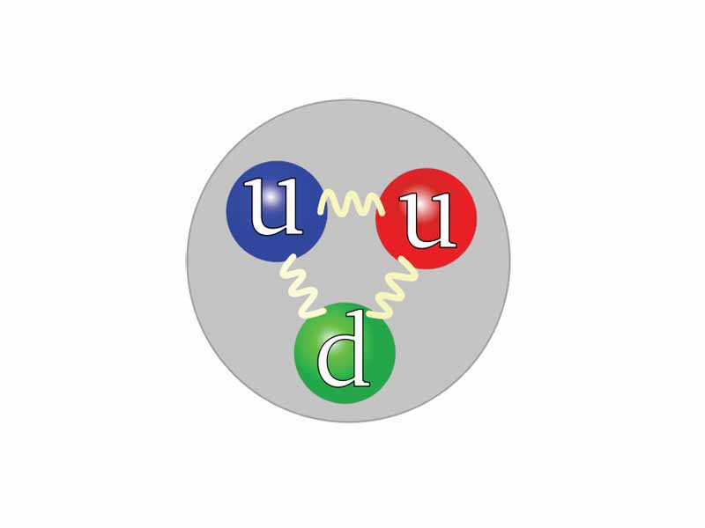
Gluons and Quarks in the Proton
There is a huge number of quarks, anti-quarks
and gluons at small-x !
How do we reconcile this result with the picture of the proton made up of three valence quarks?
Qualitatively we understand that these extra quarks and gluons are emitted by the original three valence quarks in the proton.

Slide 15
Dipole picture of DIS
x⁻
x⁺
Large q⁻ → large x⁻ separation
aka the “shock wave”

Slide 16
Dipole picture of DIS
At small x, the dominant contribution to DIS structure functions does not
come from the handbag diagram.
Instead, the dominant terms comes from the dipole picture of DIS, where the virtual photon splits into a quark-antiquark pair, which then interacts with the target.

Slide 17
Dipole Amplitude
The total DIS cross section is expressed in terms of the (Im part of the) forward quark dipole amplitude N:
b is the Fourier conjugate to q
with t = - q², making the dipole
amplitude N similar to the GPDs
at zero skewness.
Gribov, 1970; Bjorken and Kogut, 1973;
Frankfurt, Strikman 1988; Mueller 1990;
Nikolaev and Zakharov 1991
with rapidity Y=ln(1/x)

Slide 18
DIS in the Classical Approximation
The DIS process in the rest frame of the target nucleus is shown below.
with rapidity Y=ln(1/x)

Slide 19
Dipole Amplitude
The quark dipole amplitude is defined by
Here we use the Wilson lines along the light-cone direction
In the classical Glauber-Mueller/McLerran-Venugopalan approach the dipole amplitude resums multiple rescatterings:

Slide 20
Quasi-classical dipole amplitude
A.H. Mueller, ‘90
Lowest-order interaction with each nucleon – two gluon exchange – lead to the
following resummation parameter:

Slide 21
Quasi-classical dipole amplitude
To resum multiple rescatterings, note that the nucleons are independent
of each other and rescatterings on the nucleons are also independent.
One then writes an equation (Mueller ‘90)
Each scattering!

Slide 22
DIS in the Classical Approximation
The dipole-nucleus amplitude in
the classical approximation is
A.H. Mueller, ‘90
Black disk
limit,
Color
transparency
1/Q_{S}

Slide 23
Black Disk Limit
Start with basic scattering theory: the final and initial states are related by the S-matrix operator,
Write it as
The total cross section is
where the forward matrix element of the S-matrix operator is
and we have used unitarity of the S-matrix

Slide 24
Black Disk Limit
Now, since
the elastic cross section is
The inelastic cross section can be found via
In the end, for scattering with impact parameter b we write

Slide 25
Unitarity Limit
Unitarity implies that
Therefore
leading to the unitarity bound on the total cross section
Notice that when S=-1 the inelastic cross section is zero and
This limit is realized in low-energy scattering!

Slide 26
Black Disk Limit
At high energy inelastic processes dominate over elastic. Imposing
we get
The bound on the total cross section is (aka the black disk limit)
The inelastic and elastic cross sections at the black disk limit are

Slide 27
Notation
At high energies
Define the dipole amplitude N as the imaginary part of the dipole T-matrix (S=1+iT), such that
The cross sections are
We see that N=1 is the black disk limit. Hence as we saw above.

Slide 28
DIS in the Classical Approximation
The dipole-nucleus amplitude in
the classical approximation is
A.H. Mueller, ‘90
Black disk
limit,
Color
transparency
1/Q_{S}

Slide 29
B. McLerran-Venugopalan Model

Slide 30
Gluons at Small-x
There is a large number of small-x gluons (and quarks) in a proton:
G(x, Q²) , q(x, Q²) = gluon and quark number densities (q=u,d, or S for sea).

Slide 31
McLerran-Venugopalan Model
The wave function of a single nucleus has many small-x quarks and gluons in it.
In the transverse plane the nucleus is densely packed with gluons and quarks.
Large occupation number ⇨ Classical Field

Slide 32
McLerran-Venugopalan Model
Get A^{1/3} density
enhancement
Large gluon density gives a large momentum scale Q_{s} (the saturation scale): Q_{s}² ~ # gluons per unit transverse area ~ A^{1/3} (nuclear oomph).
For Q_{s} >> Λ_{QCD}, get a theory at weak coupling
and the leading gluon field is classical.

Slide 33
Color Charge Density
Small-x gluon “sees” the whole nucleus coherently
in the longitudinal direction! It “sees” many color charges
which form a net effective color charge Q = g (# charges)^{1/2}, such that Q² = g² #charges (random walk).
Define color charge density
such that for a large nucleus (A>>1)
Nuclear small-x wave function is perturbative!
McLerran
Venugopalan
`93-`94

Slide 34
Saturation Scale
To argue that let us consider an example of a
particle scattering on a nucleus. As it travels through the nucleus it
bumps into nucleons. Along a straight line trajectory it encounters
~ R ~ A^{1/3} nucleons, with R the nuclear radius and A the atomic
number of the nucleus.
The particle receives ~ A^{1/3}
random kicks. Its momentum
gets broadened by
Saturation scale, as a feature of a collective field
of the whole nucleus also scales ~ A^{1/3}.

Slide 35
McLerran-Venugopalan Model
To find the classical gluon field A_{μ} of the nucleus one has to solve the non-linear analogue of Maxwell equations – the Yang-Mills equations, with the nucleus as a source of the color charge:
Yu. K. ’96; J. Jalilian-Marian et al, ‘96

Slide 36
Classical Field of a Nucleus
Here’s one of the diagrams showing the non-Abelian
gluon field of a large nucleus.
The resummation parameter is α_{S}² A^{1/3} , corresponding to
two gluons per nucleon approximation.

Slide 37
Unpolarized WW Gluon TMD
One can calculate the unpolarized gluon TMD with, say, the forward-pointing (SIDIS) Wilson line staple
In A⁺=0 gauge one can choose a sub-gauge eliminating the Wilson line staple (making it 1), and, since , one obtains
Since the classical (Weizsacker-Williams) A^{i} field is known exactly from solving the Yang-Mills equations, one can directly calculate the gluon TMD in the classical limit.
This is the WW gluon TMD.

Slide 38
Classical Gluon Field of a Nucleus
Using the obtained classical
gluon field one can construct
corresponding gluon distribution
function (gluon WW TMD):
with the field in the A⁺=0 gauge
J. Jalilian-Marian et al, ’97; Yu. K. and A. Mueller, ‘98
Q_{S}=μ is the saturation scale
Note that φ~<A_{μ} A_{μ}>~1/α such that A_{μ}~1/g, which is what
one would expect for a classical field.

Slide 39
In the UV limit of k→∞,
x_{T} is small and one obtains
which is the usual LO result.
In the IR limit of small k_{T},
x_{T} is large and we get
SATURATION !
Divergence is regularized.

Slide 40
Classical Gluon Distribution
A good object to plot is
the classical gluon TMD
distribution multiplied by
the phase space k_{T}:
Most gluons in the nuclear wave function have transverse
momentum of the order of k_{T} ~ Q_{S} and
We have a small coupling description of the whole wave
function in the classical approximation.

Slide 41
Summary
We applied the quasi-classical small-x approach to DIS in the dipole picture, obtaining Glauber-Mueller formula for multiple rescatterings of a dipole in a nucleus.
We saw that onset of saturation ensures that unitarity (the black disk limit) is not violated. Saturation is a consequence of unitarity!
We have reviewed the McLerran-Venugopalan model for the small-x wave function of a large nucleus.
We saw the onset of gluon saturation and the appearance of a large transverse momentum scale – the saturation scale:

Slide 42
Summary of the last time
We discussed dipole picture of DIS:
We calculated multiple-rescattering of the
dipole on a nucleus:
We discussed the MV model, in which the
gluon field of the proton/nucleus is
classical, such that you can calculate the
WW gluon TMD directly:

Slide 43
Small-x evolution equations

Slide 44
Small-x Evolution
Energy dependence comes in through the long-lived s-channel gluon corrections (higher Fock states):
These extra gluons bring in powers of α_{S} ln s, such that when α_{S} << 1 and ln s >>1 this parameter is α_{S} ln s ~ 1 (leading logarithmic approximation, LLA).

Slide 45
Small-x Evolution: Large N_{c} Limit
How do we resum this cascade of gluons?
The simplification comes from the large-Nc limit, where each gluon becomes a quark-antiquark pair:
Gluon cascade becomes a dipole cascade (each color outlines a dipole):

Slide 46

Mueller’s Dipole Model
To include the quantum evolution in a dipole amplitude one
Can use the approach developed by A. H. Mueller in ’93-’94.
The goal is to resum leading logs of energy, α log s, just like
for the BFKL equation.
Emission of a small-x
gluon taken in the
large-N_{C} limit would
split the original color
dipole in two:

Slide 47
Notation (Large-N_{C})
Real emissions in the
amplitude squared
(dashed line – all
Glauber-Mueller exchanges
at light-cone time =0)
Virtual corrections in the amplitude
(wave function)

Slide 48
Nonlinear Evolution
To sum up the gluon cascade at large-N_{C} we write the following equation
for the dipole S-matrix:
dashed line =
all interactions
with the target
Remembering that S=1 + i T = 1 - N where N = Im(T) we can rewrite this equation in terms of
the dipole scattering amplitude N.

Slide 49
Nonlinear evolution at large N_{c}
As N=1-S we write
dashed line =
all interactions
with the target
BFKL
Balitsky ‘96, Yu.K. ’99; beyond large N_{c}, JIMWLK evolution, 0.1% correction for the dipole amplitude

Slide 50
Re-summing gluon cascade
At large N_{c} the gluon cascade turns into a dipole cascade. We are resumming the dipole cascade, with each dipole interacting with the target independently:

Slide 51
Resummation parameter
BK equation resums powers of
The Glauber-Mueller/McLerran-Venugopalan initial conditions resum powers of
Beyond the large-N_{c} limit: use the JIMWLK functional evolution equation (Iancu, Jalilian-Marian, Kovner, Leonidov, McLerran and Weigert, 1997-2002)

Slide 52
JIMWLK: derivation outline
A.H. Mueller, 2001
Start by introducing a weight functional, W_{Y}[α]. Here α=Α⁺ is the gluon field of the target proton or nucleus.
The functional is used to generate expectation values of gluon-field dependent operators in the target state:
Imagine that we know small-x evolution for some operator O:
On the other hand, we can differentiate the first equation above,
Comparing the last two equations and integrating by parts in the second to last equation, we will arrive at and equation for the weight functional W_{Y}[α].

Slide 53
JIMWLK: derivation outline
As a test operator, take a pair of Wilson lines (not a dipole!):
Construct the evolution of this operator by summing the following familiar diagrams:
real
virtual

Slide 54
The JIMWLK Equation
In the end one arrive at the JIMWLK evolution equation (Jalilian-Marian—Iancu–McLerran—Weigert—Leonidov—Kovner, 1997-2002):
with
Here U is the adjoint Wilson line on a light cone,

Slide 55
The JIMWLK Equation
JIMWLK equation can be used to construct any-N_{C} small-x evolution of any operator made of infinite light-cone Wilson lines (in any representation), such as color-dipole, color-quadrupole, etc., and other operators.
Since
JIMWLK evolution can be re-written in terms of the color density ρ in the kernel.
JIMWLK approach sums up powers of and

Slide 56
Solving JIMWLK
The JIMWLK equation was solved on the lattice by K. Rummukainen and H. Weigert ’04 (and others since).
For the dipole amplitude N(x₀,x₁, Y), the relative corrections to the large-N_{C} limit BK equation are < 0.001 ! Not the naïve 1/N_{C}² ~ 0.1 ! (For realistic rapidities/energies.)
The reason for that is dynamical and is largely due to saturation effects suppressing the bulk of the potential 1/N_{C}² corrections (Yu.K., J. Kuokkanen, K. Rummukainen, H. Weigert, ‘08).
There are other objects at small x, quadrupoles, double-trace operators, etc. Some (linear combinations) of them are subleading-N_{c}, and one has to use JIMWLK to describe their evolution.

Slide 57
Solution of the nonlinear equation

Slide 58
Solution of BK equation
numerical solution
by J. Albacete ‘03
We conclude that
Energy increases → Q_{s} increases
moving further away from Λ_{QCD}
BK solution preserves the black disk limit, N<1 always
(unlike the linear BFKL equation)

Slide 59
Saturation scale
numerical solution by J. Albacete (ca. 2006)

Slide 60
BK Solution
Preserves the black disk limit, N<1 always.
Avoids the IR problem of BFKL
evolution due to the saturation
scale screening the IR:
Golec-Biernat, Motyka, Stasto ‘02

Slide 61



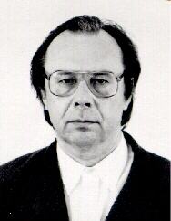
The BFKL Equation
The Balitsky, Fadin, Kuraev, Lipatov (BFKL) equation was derived in 1977-78.
One starts with a two-gluon exchange diagram (left) and “dresses” it
by radiative corrections.
The leading high-energy contribution can be drawn as a ladder
diagram, with the t-channel gluons being the special “reggeized”
gluons and the thick dots representing effective Lipatov vertices.
The BFKL equation.
K_{BFKL} is an integral kernel.

Slide 62
BFKL Equation
In the conventional Feynman-diagram picture the BFKL equation can be represented by the ladder
graph shown here. Each rung of the ladder brings in a power of α ln s.
The resulting dipole amplitude grows as a power of energy
violating Froissart unitarity bound

Slide 63
GLR-MQ Equation
Gribov, Levin and Ryskin (‘81)
proposed summing up “fan” diagrams:
Mueller and Qiu (’85) summed
“fan” diagrams for large Q².
The GLR-MQ equation reads:
GLR-MQ equation has the same principle of recombination as BK and JIMWLK. GLR-MQ equation was thought about as the first nonlinear correction to the linear BFKL evolution. An AGL (Ayala, Gay Ducati, Levin ‘96) equation was suggested to resum higher-order nonlinear corrections.
BK/JIMWLK derivation showed that for the dipole amplitude N (!) there are no more terms in the large-N_{C} limit and obtained the correct kernel for the non-linear term (compared to GLR suggestion).

Slide 64
Energy Dependence of the Saturation Scale
Single BFKL ladder gives scattering
amplitude of the order
Nonlinear saturation effects become
important when N ~ N² ⇨ N ~ 1. This
happens at
Saturation scale grows with energy!
Typical partons in the wave function have k_{T} ~ Q_{S}, so that their
characteristic size is of the order r ~ 1/k_{T} ~ 1/Q_{S}.
Typical parton size decreases with energy!

Slide 65
Saturation scale
numerical solution by J. Albacete

Slide 66
High Density of Gluons
High number of gluons populates the transverse extent of the proton or nucleus, leading to a very dense saturated wave function known as the Color Glass Condensate (CGC):

Slide 67
Map of High Energy QCD
energy
size of gluons

Slide 68
Map of High Energy QCD
Saturation Scale
grows with energy
energy
BFKL, DGLAP – linear equations
BK/JIMWLK – nonlinear
size of gluons

Slide 69
Map of High Energy QCD
Saturation Scale
grows with energy and atomic number A for a nucleus
BFKL, DGLAP – linear equations
BK/JIMWLK – nonlinear

Slide 70
Geometric Scaling
One of the predictions of the JIMWLK/BK evolution equations is geometric scaling:
DIS cross section should be a function of one parameter:
(Levin, Tuchin ’99; Iancu, Itakura, McLerran ’02)

Slide 71
Geometric Scaling
numerical solution by J. Albacete

Slide 72
Geometric Scaling in DIS
Geometric scaling was found in DIS data by Stasto, Golec-Biernat, Kwiecinski in `00.
Here they plot the total DIS cross section, which is a function of 2 variables, Q² and x, as a function of just one variable:

Slide 73
Map of High Energy QCD
k_{geom} ~ Q_{S}² / Q_{S0}
Q_{S}
Q_{S}

Slide 74
Saturation Scale
To summarize, saturation scale is an increasing function of both energy (1/x) and A:
Gold nucleus provides an enhancement
by 197^{1/3}, which is equivalent to doing
scattering on a proton at 197 times
smaller x / higher s!

Slide 75
References
E.Iancu, R.Venugopalan, hep-ph/0303204.
H.Weigert, hep-ph/0501087
J.Jalilian-Marian, Yu.K., hep-ph/0505052
F. Gelis et al, arXiv:1002.0333 [hep-ph]
J.L. Albacete, C. Marquet, arXiv:1401.4866 [hep-ph]
A. Morreale, F. Salazar, arXiv:2108.08254 [hep-ph]
and…

Slide 76
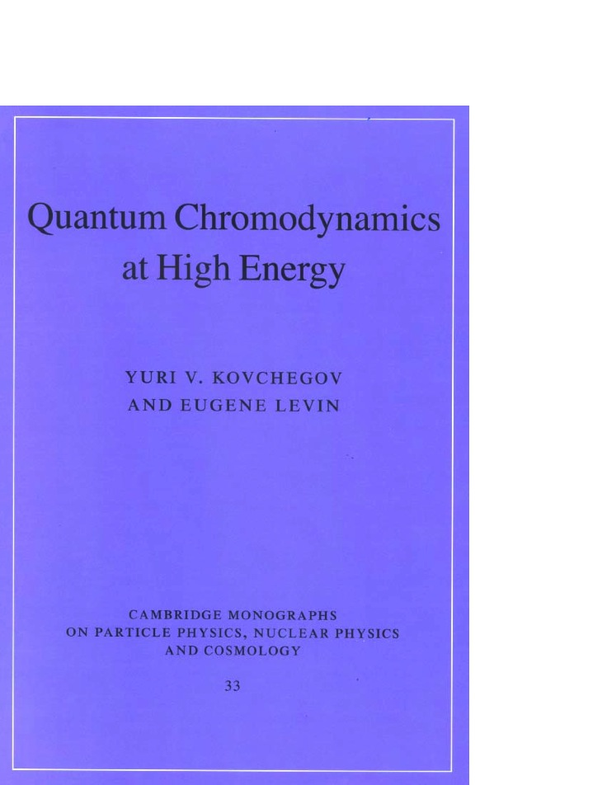
References
Published in September 2012
by Cambridge U Press

Slide 77
Saturation Physics at EIC

Slide 78
Can Saturation be Discovered at EIC?
EIC will have an unprecedented small-x reach for DIS on large nuclear targets,
enabling decisive tests of saturation and non-linear evolution:
Plots from the EIC White Paper, ’12, ’14 (2nd ed).

Slide 79
EIC Literature
+ EIC Yellow Report, 2021

Slide 80

Electron-Ion Collider (EIC) White Paper
EIC WP was finished in late 2012 + 2nd edition in 2014
A several-year effort by a 19-member committee + 58 co-authors
arXiv:1212.1701 [nucl-ex]
We will follow the physics discussion and use the plots from this WP.

Slide 81
(i) Nuclear Structure Functions

Slide 82
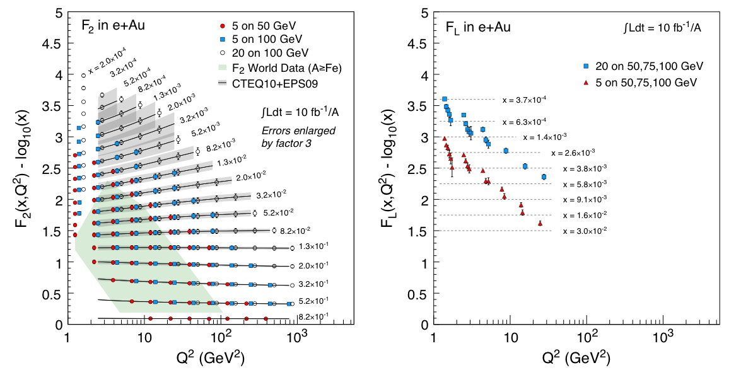
Structure Functions at EIC
Nuclear structure functions F₂ and F_{L} (parts of $σ^{e+A}$ cross section) which will be measured at EIC (values = EPS09+PYTHIA). Shaded area = (x, Q²) range of the world e+A data.

Slide 83
Nuclear Shadowing
Saturation effects may explain nuclear shadowing: reduction of the number of gluons per nucleon with decreasing x and/or increasing A:
But: as DGLAP does not predict the x- and A-dependences, it needs to be constrained by the data.
Note that including heavy flavors (charm) for F₂ and F_{L} should help distinguish between the saturation versus non-saturation predictions.

Slide 84
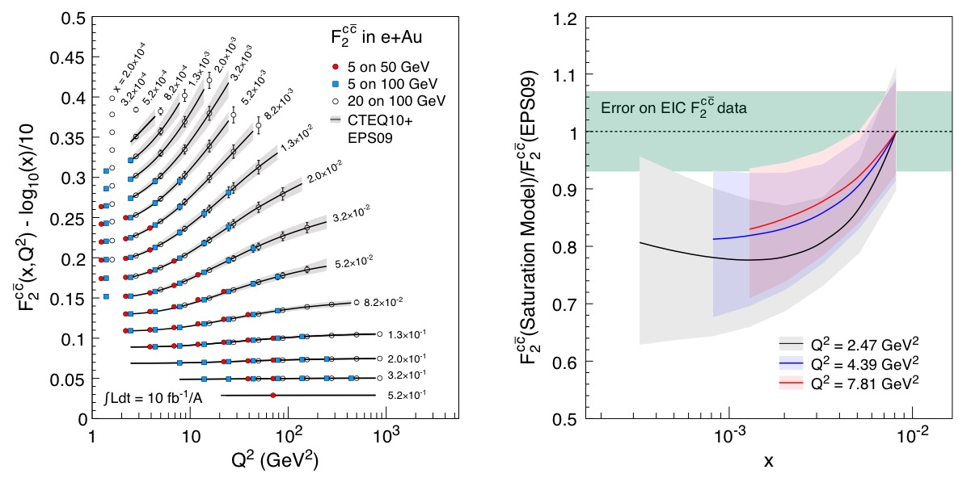
Nuclear Shadowing for Charm
may help distinguish saturation vs DGLAP-based prediction

Slide 85
(ii) Di-Hadron Correlations

Slide 86
De-correlation
Small-x evolution ↔ multiple emissions
Multiple emissions → de-correlation.
~Q_{S}
P_{T, trig}
P_{T, trig} - P _{T, assoc} ~ Q_{S}
P_{T, assoc}
B2B jets may get de-correlated in p_{T} with the spread of the order of Q_{S}

Slide 87
Di-hadron Correlations
Depletion of di-hadron correlations is predicted for e+A as compared to e+p.
(Dominguez et al ‘11; Zheng et al ‘14). This is a signal of saturation.

Slide 88
(iii) Diffraction

Slide 89
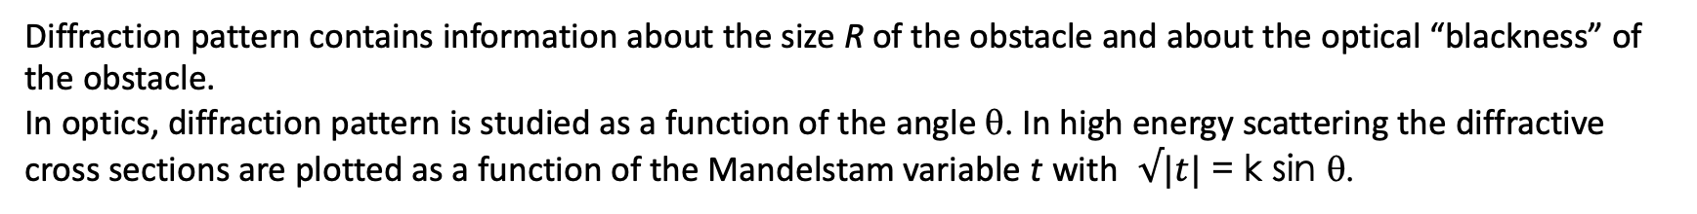
Diffraction in optics
Diffraction pattern contains information about the size R of the obstacle and about the optical “blackness” of the obstacle.
In optics, diffraction pattern is studied as a function of the angle θ. In high energy scattering the diffractive cross sections are plotted as a function of the Mandelstam variable t with $√|t|$ = k sin θ.

Slide 90
Optical Analogy
Diffraction in high energy scattering is not very different from diffraction in optics:
both have diffractive maxima and minima:
Coherent: target stays intact;
Incoherent: target nucleus breaks up, but nucleons are intact.

Slide 91
Diffraction terminology
W² = cms energy squared
for the photon+proton/nucleus
system

Slide 92
Quasi-elastic DIS
Consider the case when nothing but the quark-antiquark pair, i.e., two jets, are produced:
The quasi-elastic cross section is then proportional to the square of the dipole amplitude N:
Buchmuller et al ‘97, McLerran and Yu.K. ‘99

Slide 93
Diffraction on a black disk
For low Q² (large dipole sizes) the black disk limit is reached with N=1
Diffraction (elastic scattering) becomes a half of the total cross section
Large fraction of diffractive events in DIS is a signature of reaching the black disk limit!
HERA: ~15% (unexpected!) ; EIC: ~25% expected from saturation

Slide 94
Diffractive over total cross sections
Here’s an EIC measurement which may distinguish saturation from non-saturation approaches (from the 2012 EIC White Paper), using diffractive to total double ratio:
sat = Kowalski et al ‘08, plots generated by Marquet
no-sat = Leading Twist Shadowing (LTS), Kopeliovich, Tarasov, ‘02; Frankfurt, Guzey, Strikman ‘04, plots by Guzey

Slide 95
Exclusive Vector Meson Production
An important diffractive process which can be measured at EIC is exclusive vector meson production (cf. UPCs):

Slide 96
Exclusive VM Production:
Probe of Spatial Gluon Distribution
Differential exclusive VM production cross section is
the T-matrix is related to the dipole amplitude N:
Can study t-dependence of the dσ/dt and look at different mesons to find the dipole amplitude N(x,b,Y) (Munier, Stasto, Mueller ’01).
Learn about the gluon distribution in space. This is similar to GPDs.
Brodsky et al ‘94, Ryskin ‘93

Slide 97
Exclusive VM Production as a Probe of Saturation
Plots by T. Toll and T. Ullrich using the Sartre event generator
(b-Sat (=GBW+b-dep+DGLAP) + WS + MC, from the 2012 EIC White Paper).
J/psi is smaller, less sensitive to saturation effects
Phi meson is larger, more sensitive to saturation effects

Slide 98
Summary
We have constructed nuclear/hadronic wave function in the quasi-classical approximation (MV model) and studied DIS in the same approximation.
We included small-x evolution corrections into the DIS process, obtaining nonlinear BK/JIMWLK evolution equations.
Nonlinear evolution restores unitarity at high energies, which was violated by the BFKL equation.
We found the saturation scale which is large at small x and for large nuclei,
justifying the whole procedure.
Saturation/CGC physics predicts geometric scaling observed experimentally at HERA.
We hope to discover saturation physics at the EIC.

