Slide 1


News from Quark Matter 2025 Conference
Tongzhou Guo
May.2 2025

Slide 2
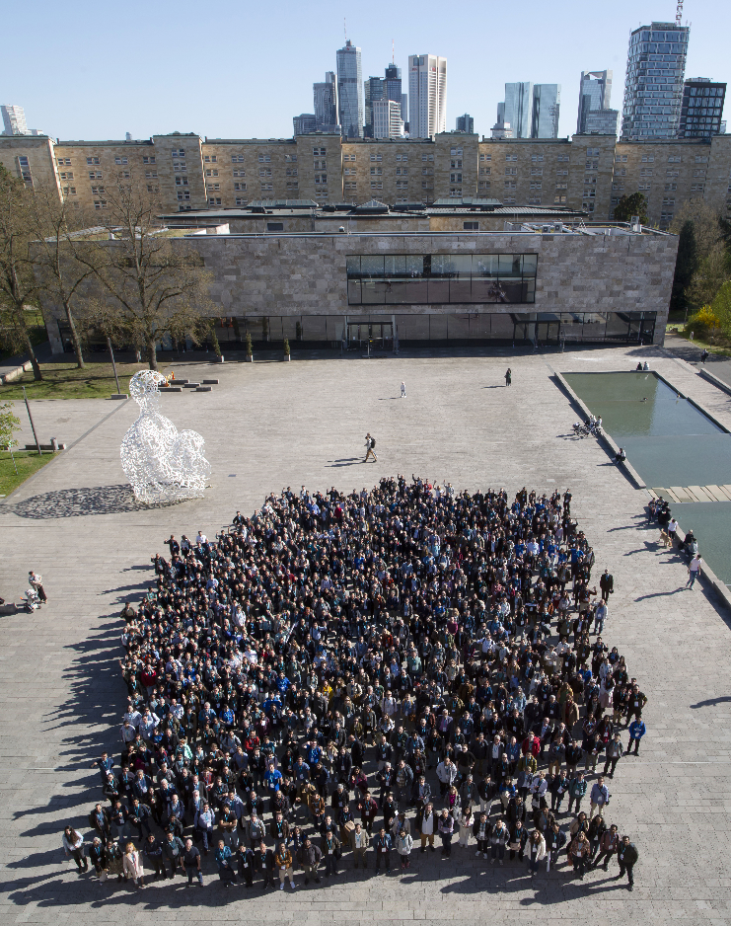
Overview
1015 registered participants and 1044 submitted abstracts.
40 plenary talks, 200 parallel talks, 540 posters.
Hosted by Goethe University Frankfurt am Main.

Slide 3
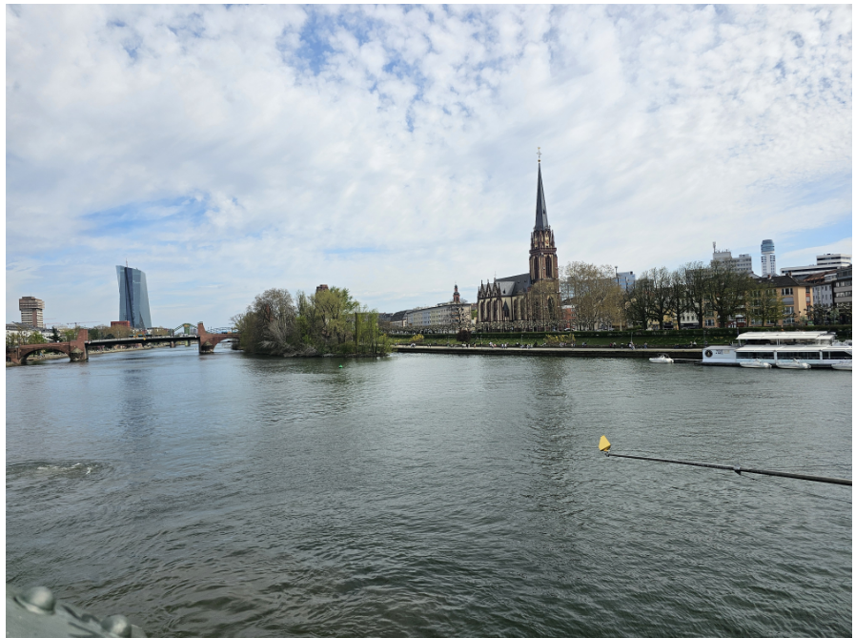
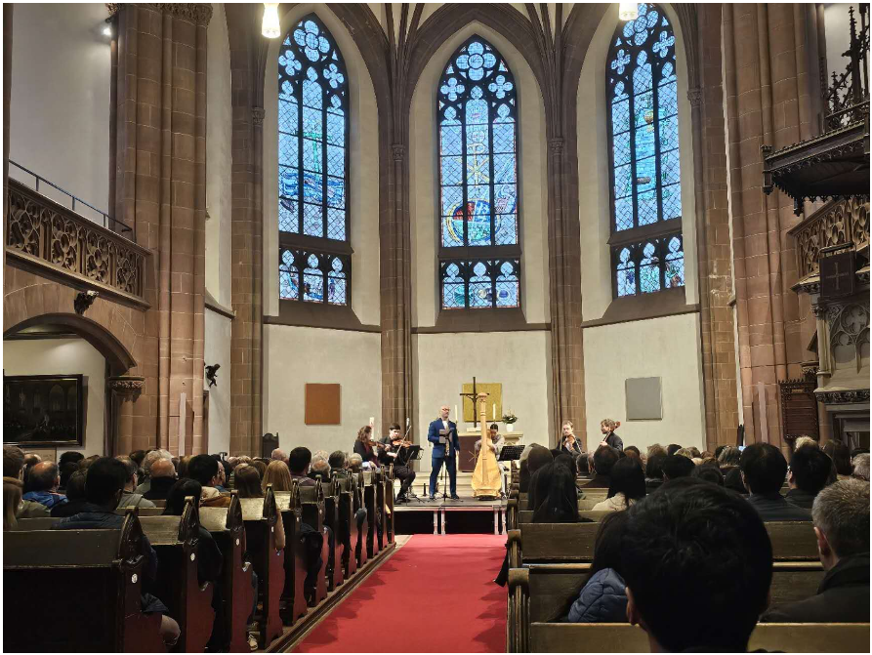
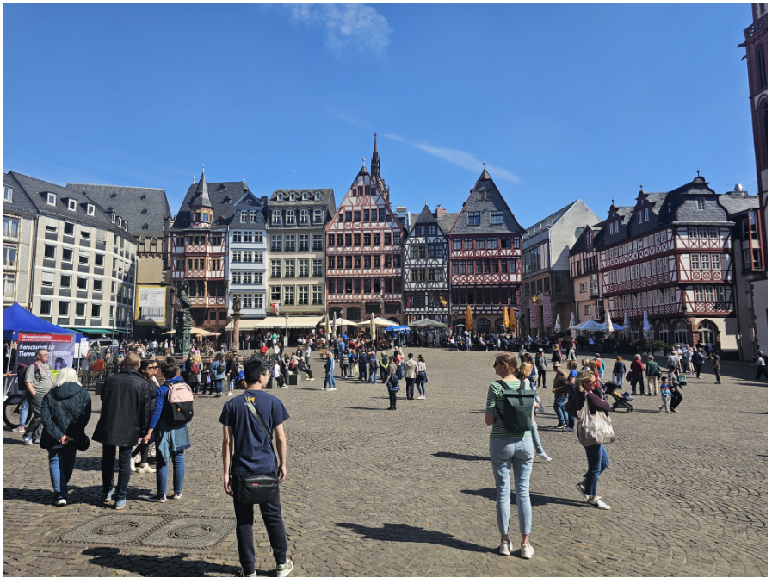
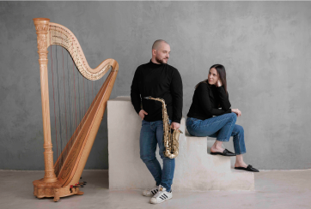
Beyond physics ...
Johann Wolfgang von Goethe, the most famous son of Frankfurt.
A novel combination: saxophone, harp and string quartet, concert by organizer.
Beautiful River Main and Romerberg.

Slide 4
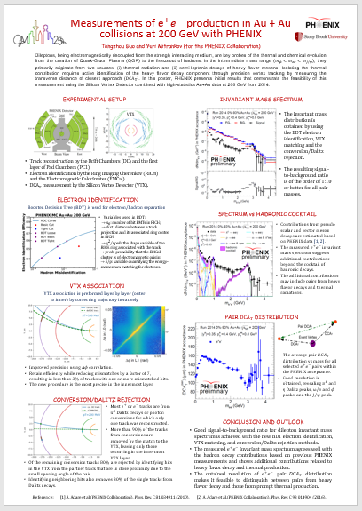
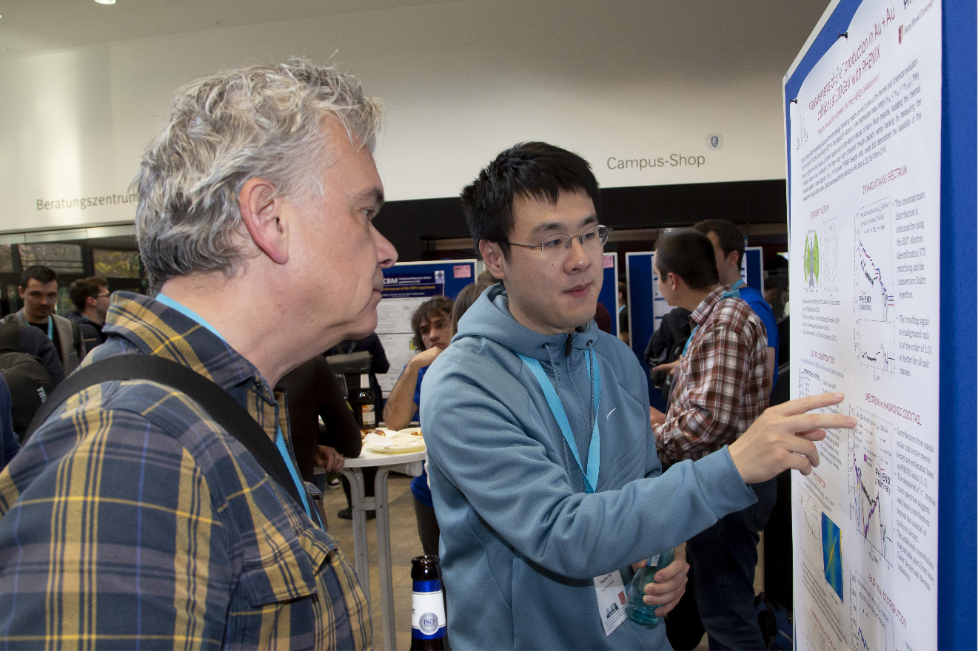
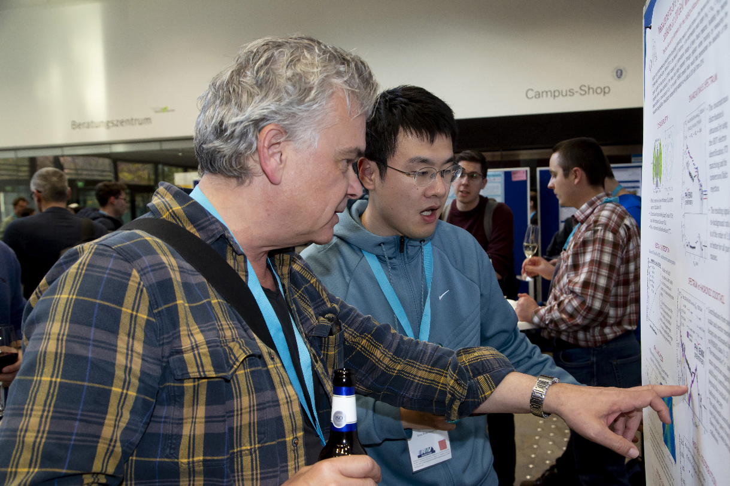
On myself

Slide 5
Subjects
Small systems
->Exploring the origin of collective phenomena in small collision systems with ALICE at the LHC.
->Latest anisotropic flow measurements in Pb–Pb collisions with ALICE: New insights into QGP properties.
Electromagnetic probes
->A brief summary of multiple talks & posters.
Jets
->Some fragments that impressed me.
->Zhuoheng has a more complete summary.
Theories & Models
->Maybe I’m not the suitable target for several theory & model talks.
Disclaimer: talks were selected by my personal tastes, not comprehensive, not necessary; I might also misunderstand some parts for some talks.

Slide 6
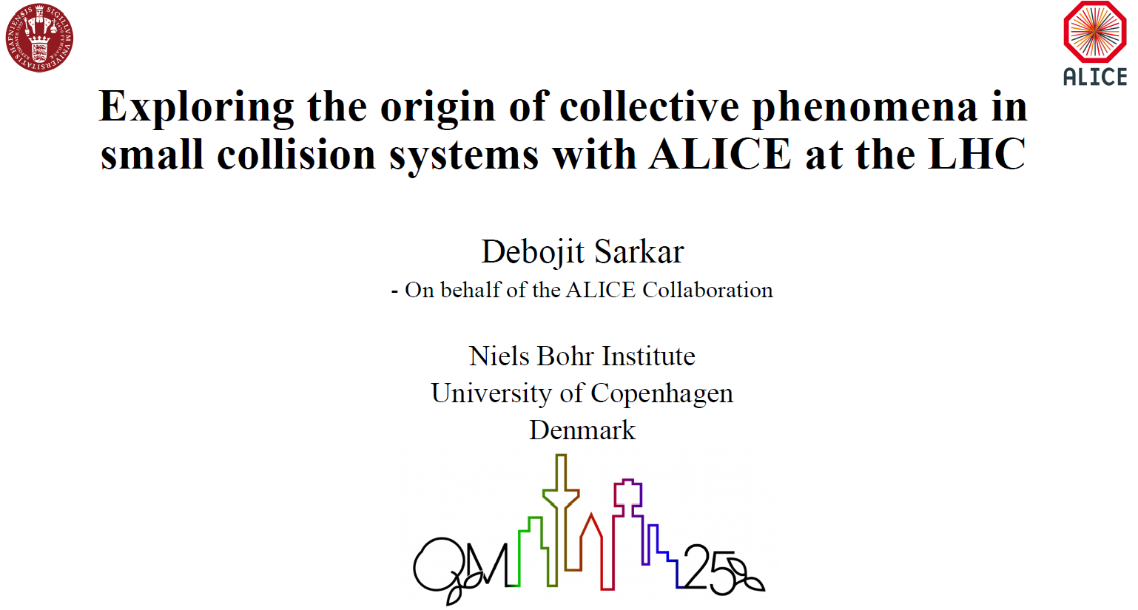
https://indico.cern.ch/event/1334113/contributions/6350958/

Slide 7
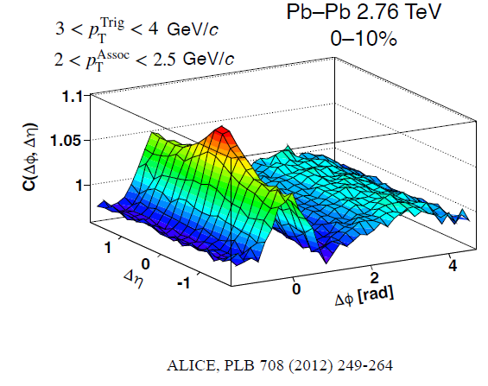
Basic concepts
Two‐particle correlation function C(Δη, ΔΦ)
At its heart, 𝐶(Δ𝜂,ΔΦ) measures how likely you are to find a pair of particles separated by Δη in pseudorapidity and ΔΦ in azimuth, above what you’d expect just from random combinatorics and detector acceptance.
-> Near‐side “jet peak” at (Δη≈0, ΔΦ≈0) from particles fragmenting out of the same high‑𝑝𝑇​ parton.
-> Away‐side ridge at (Δη≈0, ΔΦ≈π) from back‑to‑back jets.
-> Long‐range “ridge” at large Δη but small ΔΦ, a hallmark of collective flow in A–A collisions.
People usually construct two‐particle correlation function by C(Δη,ΔΦ)≡ S(Δη,ΔΦ)/B(Δη,ΔΦ)​
-> S stands for “same-event”, and B stands for “mixed-event as background”.
->

Slide 8


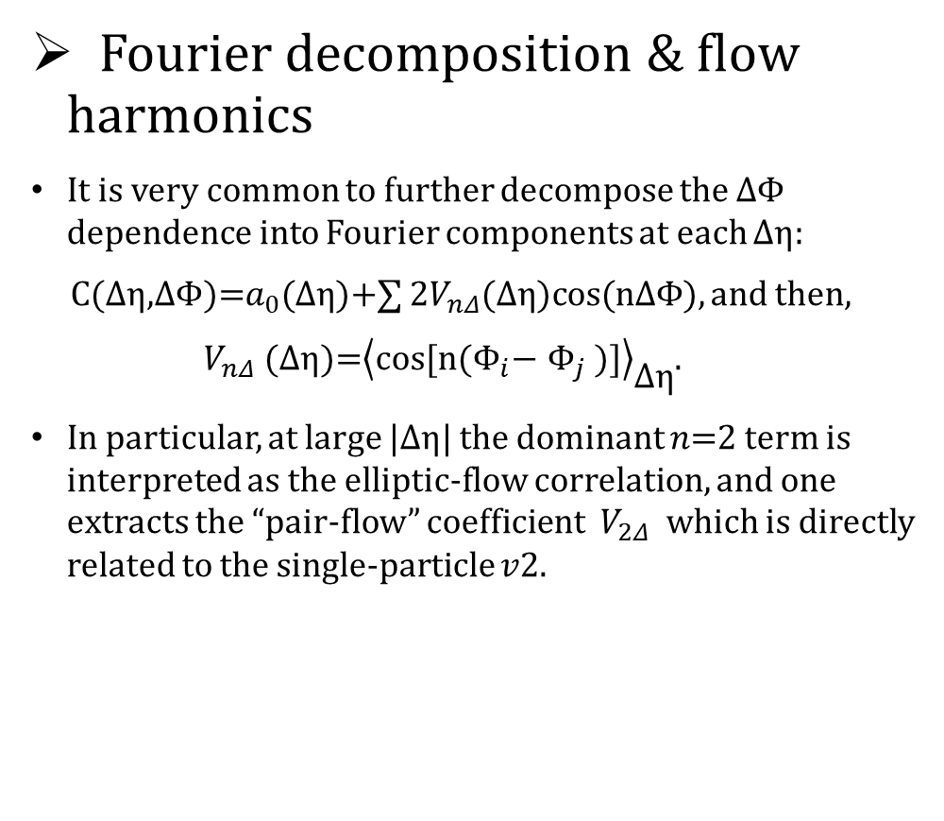
Basic concepts
Fourier decomposition & flow harmonics
It is very common to further decompose the ΔΦ dependence into Fourier components at each Δη:
C(Δη,ΔΦ)=$a_{0}$(Δη)+∑ 2$V_{nΔ}$(Δη)cos(nΔΦ), and then,
$V_{nΔ}$(Δη)=${\left\langle \text{cos}\text{[}\text{n}\text{(}Φ_{i}\text{−} Φ_{j}\text{ )]}\right\rangle }_{\text{Δη}}$.
In particular, at large |Δη| the dominant 𝑛=2 term is interpreted as the elliptic‐flow correlation, and one extracts the “pair‐flow” coefficient ​ $V_{2Δ}$ which is directly related to the single‐particle 𝑣2.

Slide 9
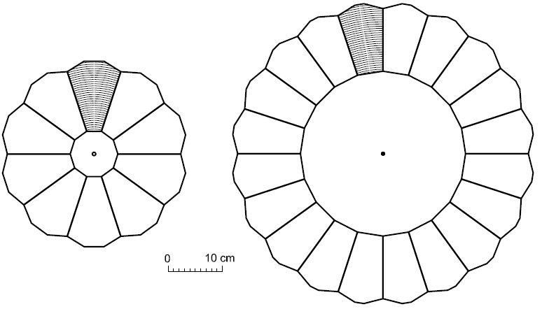
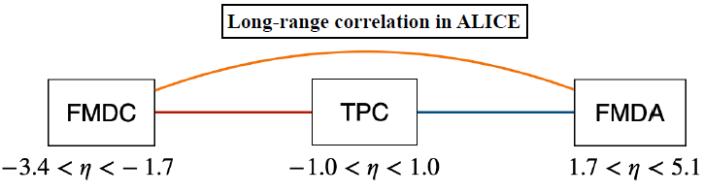
Experimental Setup
The ALICE Forward Multiplicity Detector (FMD)
The FMD is a silicon strip detector of modest segmentation. It is made of 5 rings placed around the beam pipe.
The rings consists of 10 or hexagonal silicon sensors cut out of 300 μm thick silicon wafers.
Each sensor is azimuthal segmented into 2 sectors, and each sector is segmented into strips at constant radii.
The segmentation gives a total of 51,200 read-out channels (or strips).
https://doi.org/10.48550/arXiv.0712.1117

Slide 10
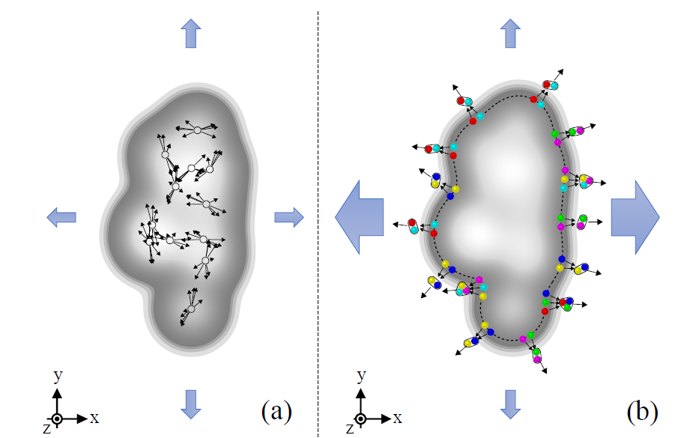
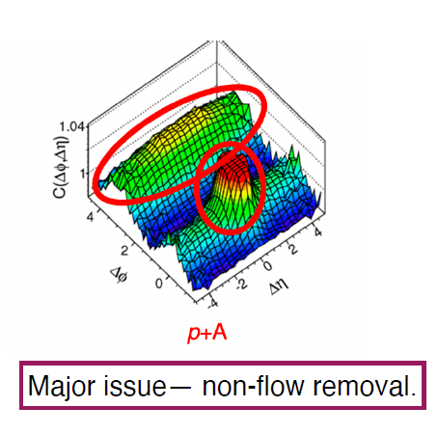
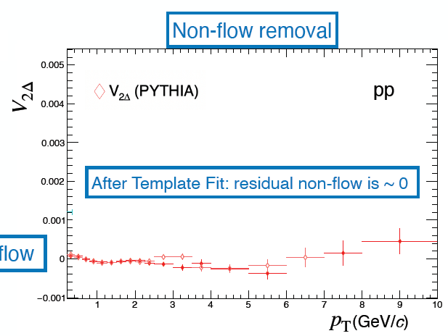
Non-flow
A little unclear to me: non-flow removal
Non‑flow includes azimuthal correlations that do not arise from the collective response of all particles to the event’s symmetry plane, but rather from a handful of localized processes.
Main sources of non‑flow:
-> Resonance decays (for example, ρ meson decaying to two pions produces a tight Δη–ΔΦ correlation between its daughters).
-> Jet fragmentation and di‑jet recoil, where particles from the same parton shower remain clustered in azimuth.
Usual strategies to suppress non‑flow:
-> Pseudorapidity gaps (∣Δη∣ cuts).
-> Multi‑particle cumulants.
arXiv:2411.09323v1
https://indico.cern.ch/event/1334113/contributions/6350958/

Slide 11
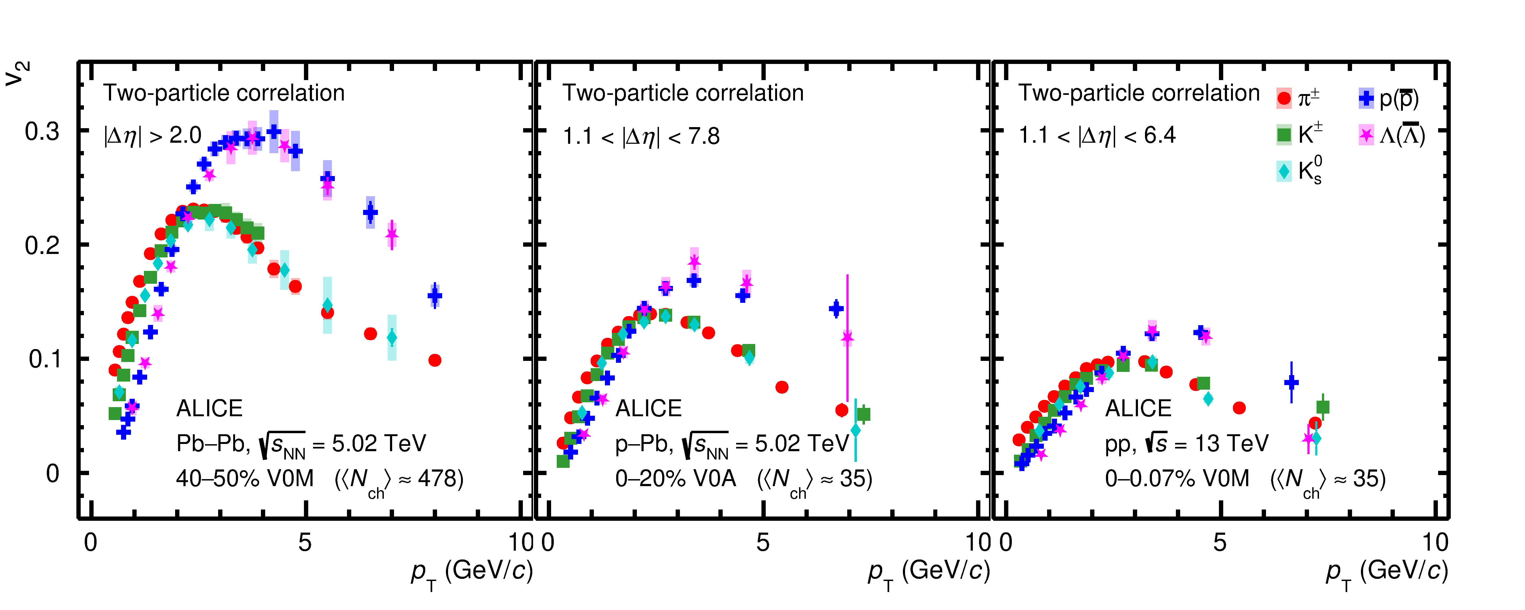
Results
A clear similarity in the characteristic features of v2 among the three collision systems.
For the low pT region (< 2.0 GeV), a clear mass ordering of the v2 coefficients is observed, providing significant evidence of radial flow in small collision systems.
Beyond pT > 2.5 GeV, the v2 coefficients of baryons are consistent within 1σ up to 10 GeV in Pb–Pb and p–Pb collisions and up to 6 GeV in pp.
A distinctive baryon-meson v2 grouping (within 1σ) and splitting between them with high significance (∼ 5σ) was shown at intermediate pT in both p–Pb and pp collisions at the LHC, similar to that observed in heavy-ion collisions.
https://indico.cern.ch/event/1334113/contributions/6350958/
arXiv:2411.09323v1

Slide 12
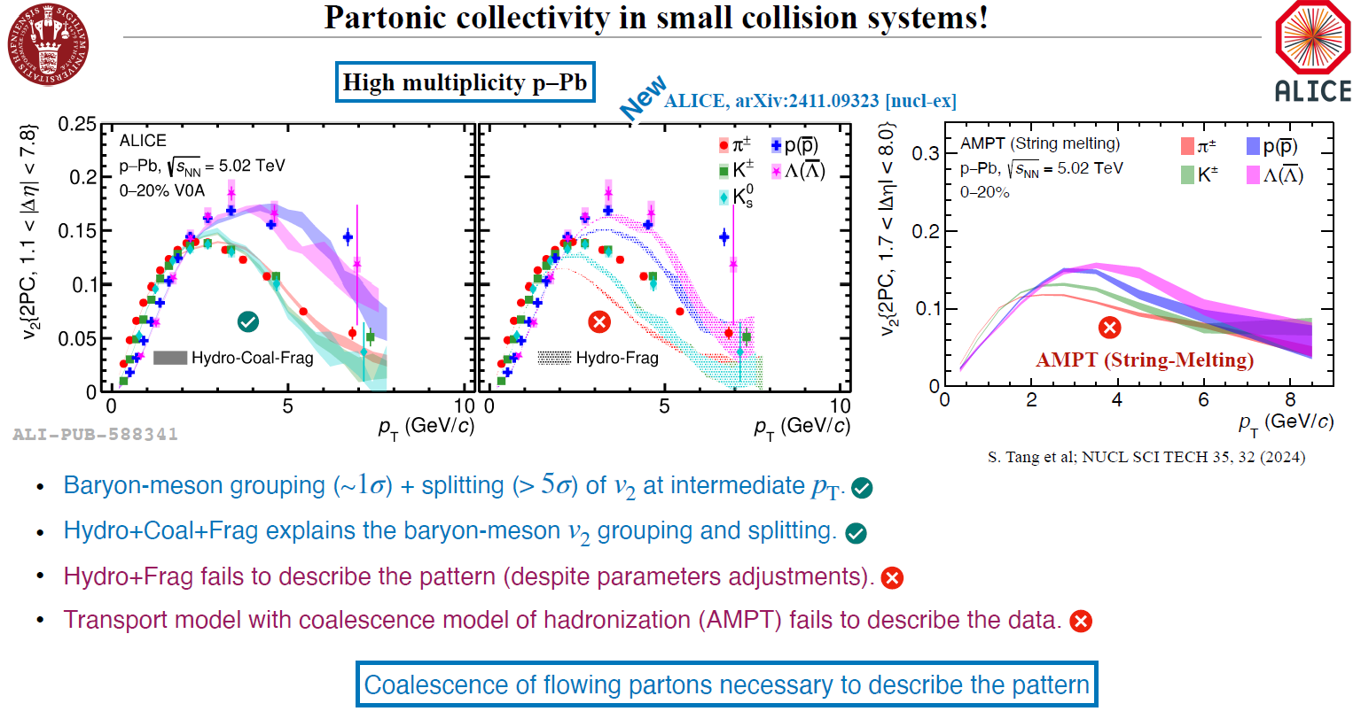
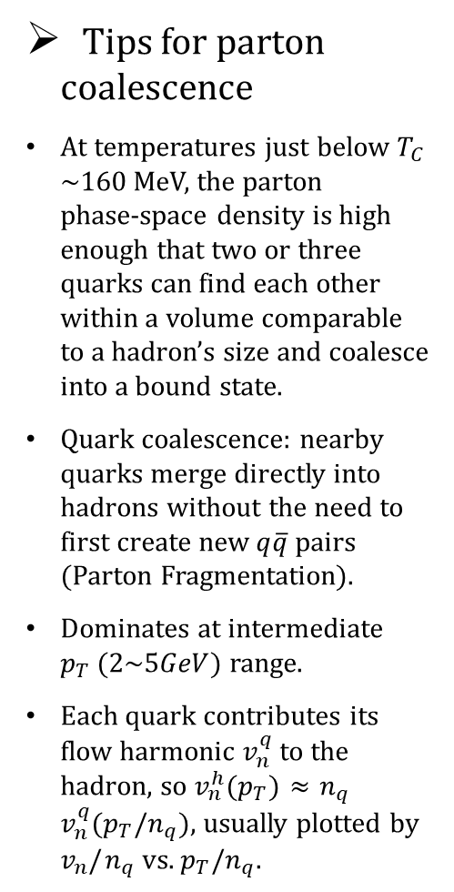
Results
Tips for parton coalescence
At temperatures just below $T_{C}$​ ∼160 MeV, the parton phase‐space density is high enough that two or three quarks can find each other within a volume comparable to a hadron’s size and coalesce into a bound state.
Quark coalescence: nearby quarks merge directly into hadrons without the need to first create new $q\overline{q}$ pairs (Parton Fragmentation).
Dominates at intermediate $p_{T} (2\sim 5GeV)$ range.
Each quark contributes its flow harmonic $v_{n}^{q}$ to the hadron, so $v_{n}^{h}$($p_{T}$) ≈ $n_{q}$ $v_{n}^{q}$($p_{T}$/$n_{q}$), usually plotted by $v_{n}/$ $n_{q}$ vs. $p_{T}$/$n_{q}$.

Slide 13
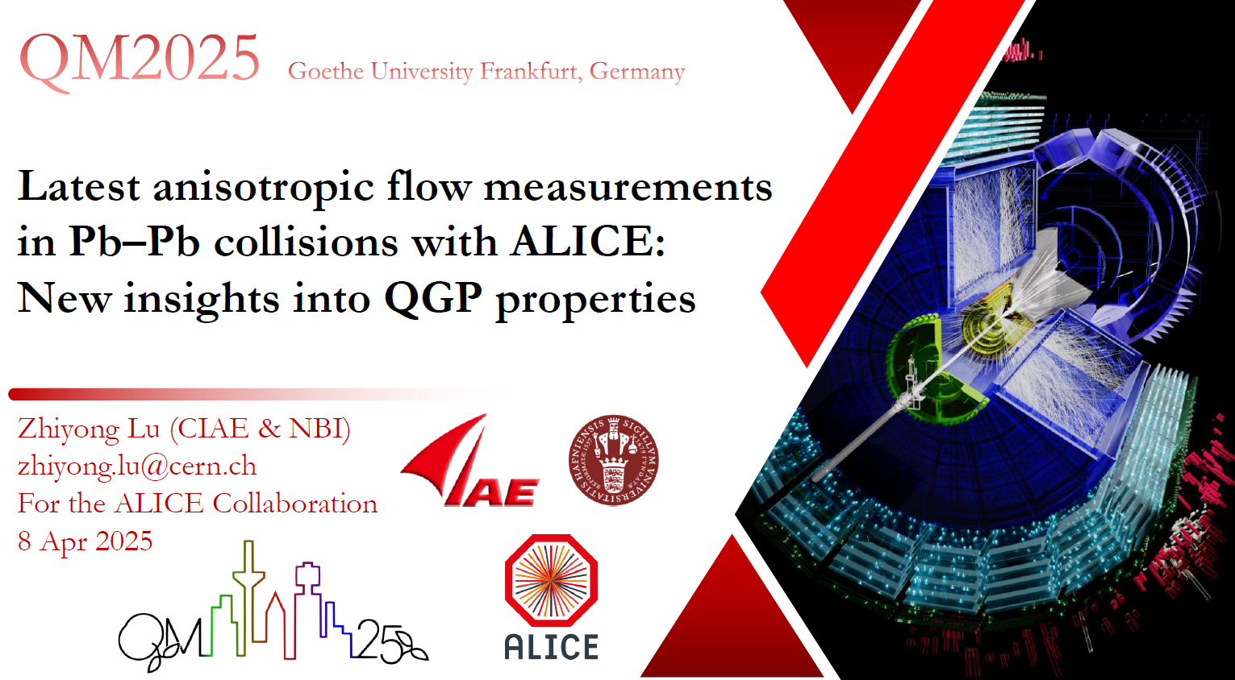
https://indico.cern.ch/event/1334113/contributions/6350969/

Slide 14
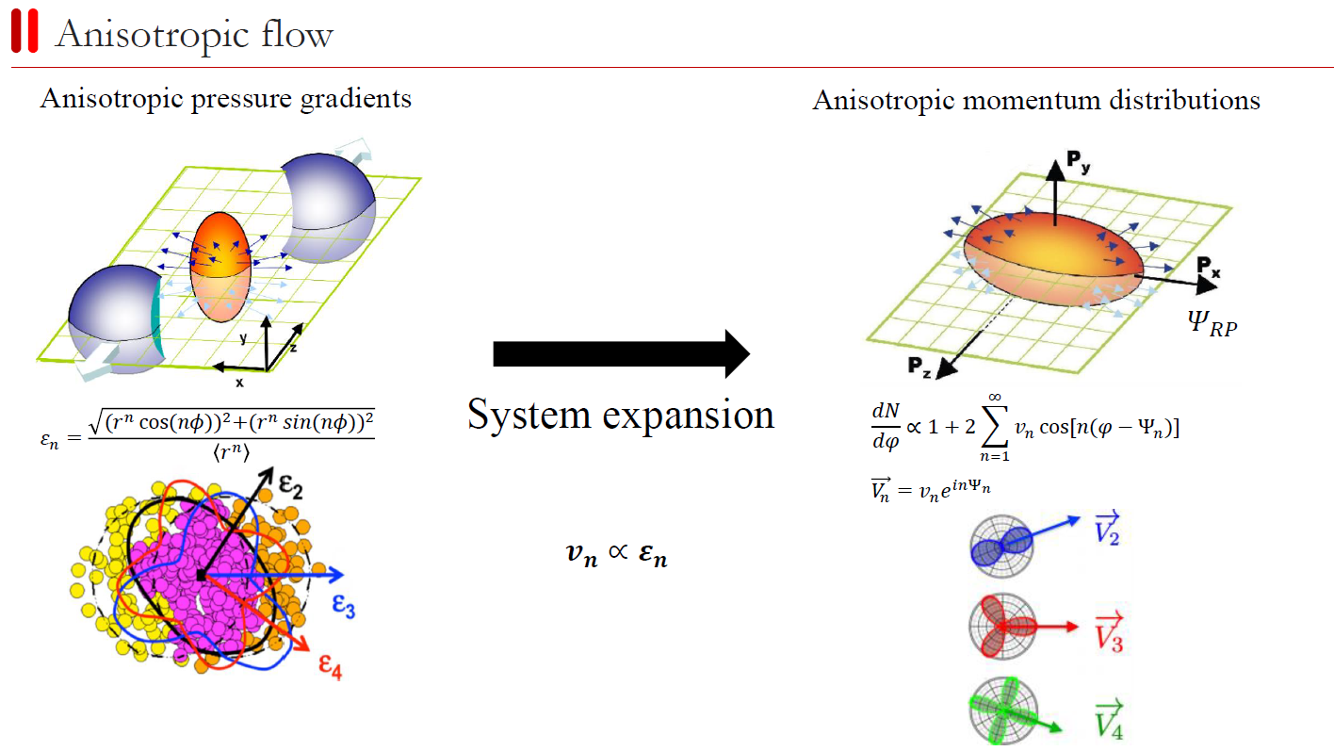

Slide 15
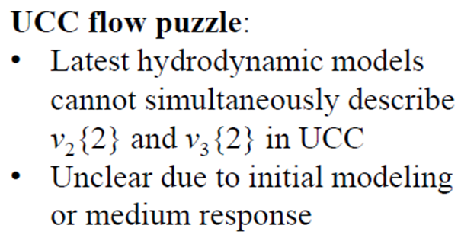
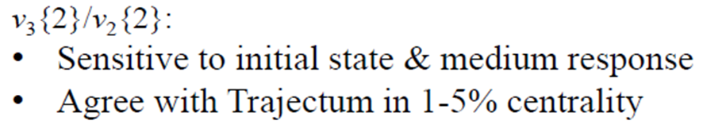
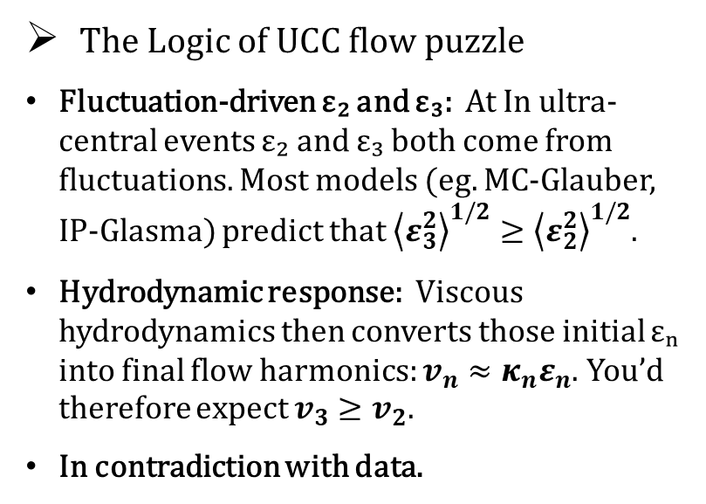
The Logic of UCC flow puzzle
Fluctuation-driven ε₂ and ε₃: At In ultra-central events ε₂ and ε₃ both come from fluctuations. Most models (eg. MC-Glauber, IP-Glasma) predict that ${\left\langle ε_{3}^{2}\right\rangle }^{1/2}≥{\left\langle ε_{2}^{2}\right\rangle }^{1/2}$.
Hydrodynamic response: Viscous hydrodynamics then converts those initial εₙ into final flow harmonics: $v_{n}≈κ_{n}ε_{n}$. You’d therefore expect $v_{3}$ $≥$ $v_{2}.$
In contradiction with data.

Slide 16
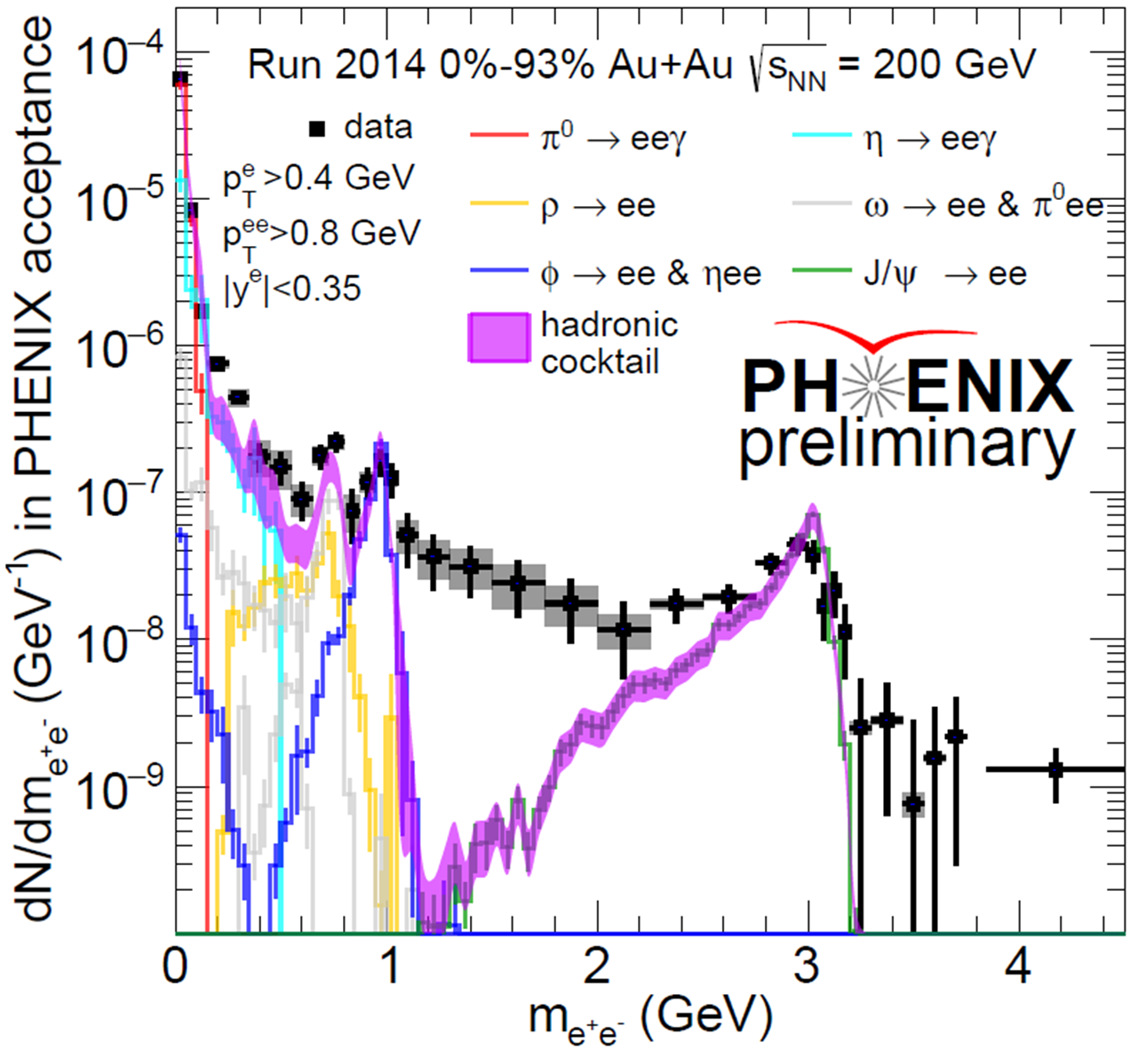
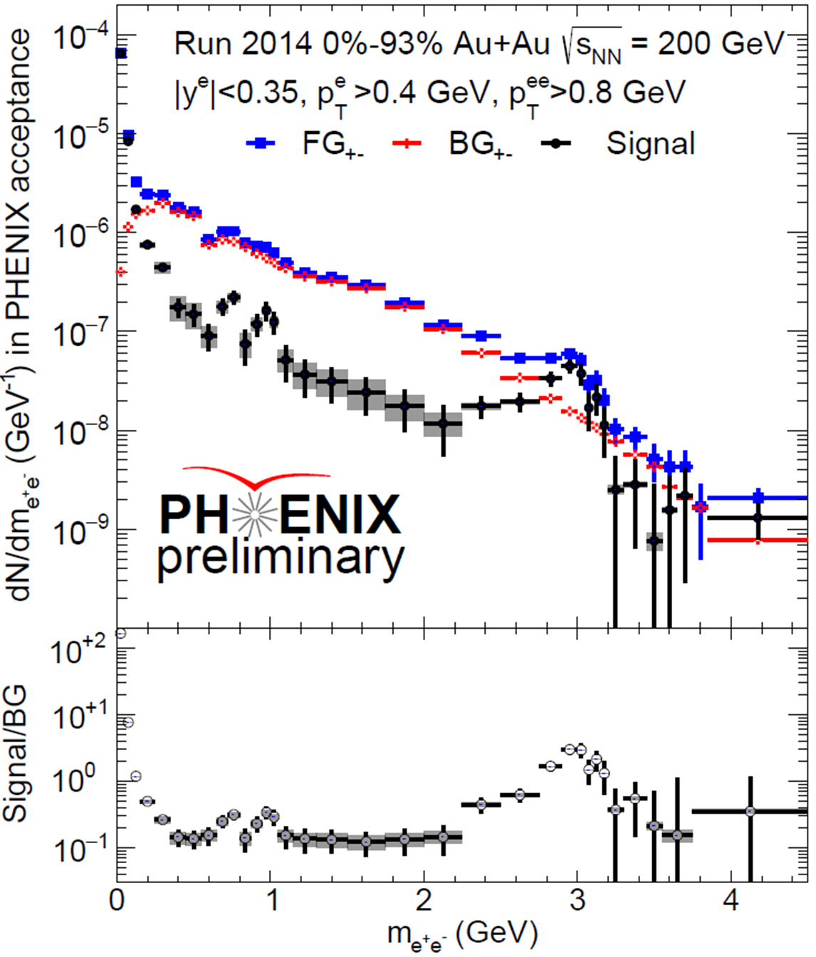
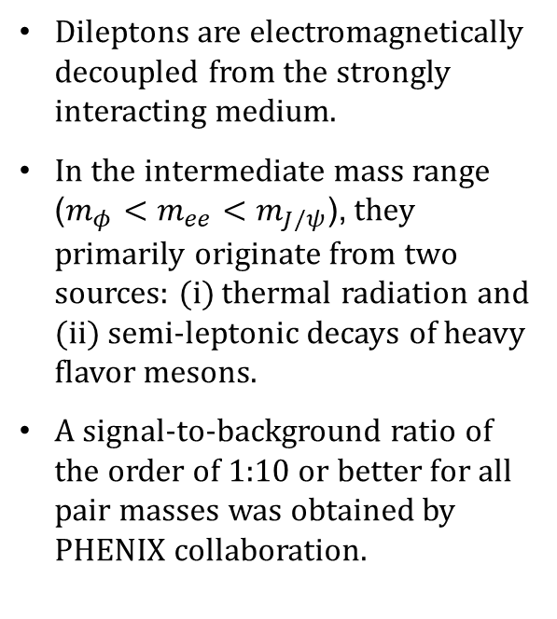
Electromagnetic probes: dileptons
Dileptons are electromagnetically decoupled from the strongly interacting medium.
In the intermediate mass range ($m_{φ}<m_{ee}<m_{J/ψ}$), they primarily originate from two sources: (i) thermal radiation and (ii) semi-leptonic decays of heavy flavor mesons.
A signal-to-background ratio of the order of 1:10 or better for all pair masses was obtained by PHENIX collaboration.

Slide 17
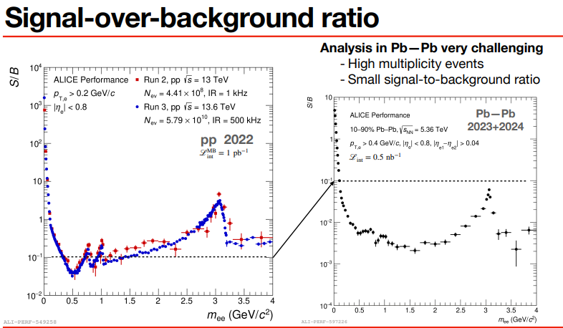
Electromagnetic probes: dileptons
https://indico.cern.ch/event/1334113/contributions/6350995/

Slide 18
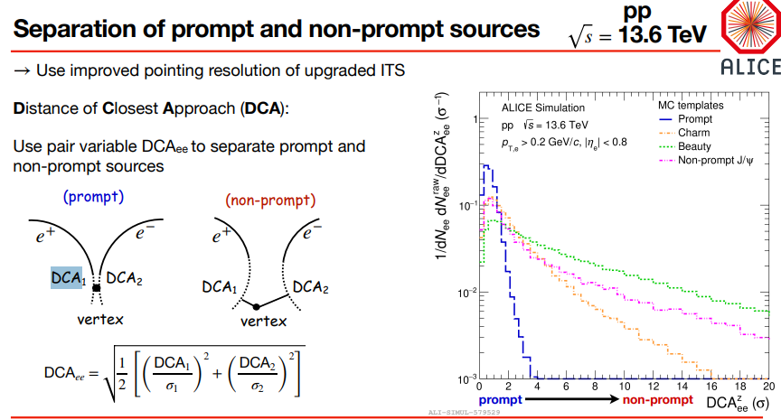

Electromagnetic probes: dileptons
Here, σ ~ 10 $μm.$

Slide 19
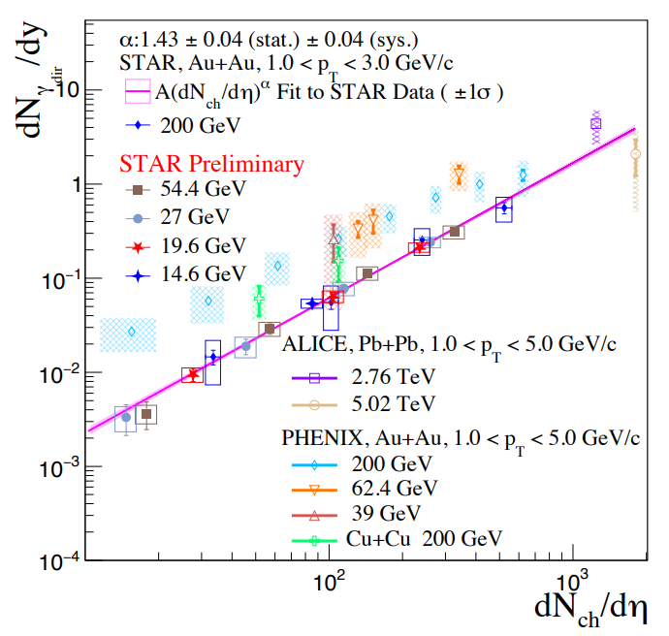
Electromagnetic probes: direct photon
Multiple talks from STAR, for example https://indico.cern.ch/event/1334113/contributions/6369558/

Slide 20
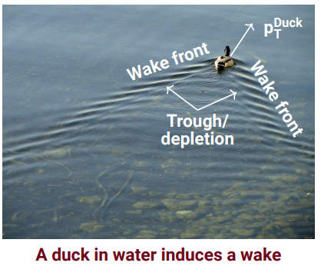
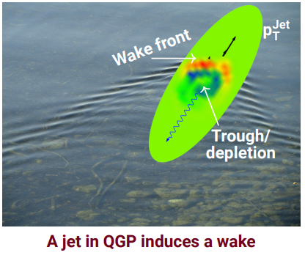

Jets / medium response
https://indico.cern.ch/event/1334113/contributions/6209732/
https://indico.cern.ch/event/1334113/contributions/6289789/

