Slide 1
Overview of the AGS capabilities for fixed target experiments
Vincent Schoefer
Brookhaven National Laboratory, Collider-Accelerator Dept
Center for Frontiers in Nuclear Science
New Horizons with Fixed-Target Proton-Nucleus Experiments at Intermediate Energies
Jul 10 – 11, 2025, Stony Brook University

Slide 2
Outline
Overview of Brookhaven Lab Collider/Accelerator complex
  Aiming for breadth, rather than depth
Sources and species
Beam parameters
  heavy ions
  polarized protons
Scheduling

Slide 3
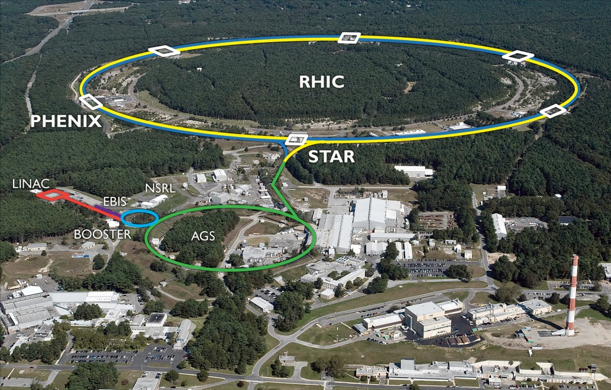
BNL RHIC Accelerator Complex
Multi-stage accelerator complex
Four beam sources (and their early acceleration stages)
Three synchrotron ring acceleration stages: Booster, AGS and RHIC rings
Currently serving three main programs:
RHIC colliding beam physics (full complex)
NASA Space Radiation Laboratory (sources + Booster)
  Fixed target off of Booster
Brookhaven Lab Isotope Production (high intensity proton source + Linac)
Tandem van de Graaff
3

Slide 4
BNL RHIC Accelerator Complex
Accelerator Rings
 | Circumference [m]
Booster | 201
AGS | 807
RHIC | 3833
Typical Top Energies [Total, GeV/N]
 | Au | Pol. Protons
Linac (H⁻) | -- | 1.1
Booster | 1 | 2.3
AGS | 10 | 23.8
RHIC | 100 | 255
Tandem van de Graaff
Heavy Ions | Protons
E-beam Ion Source (EBIS) | OPPIS (polarized)
Tandem Van de Graaf | High-intensity H⁻ (unpolarized)
4

Slide 5
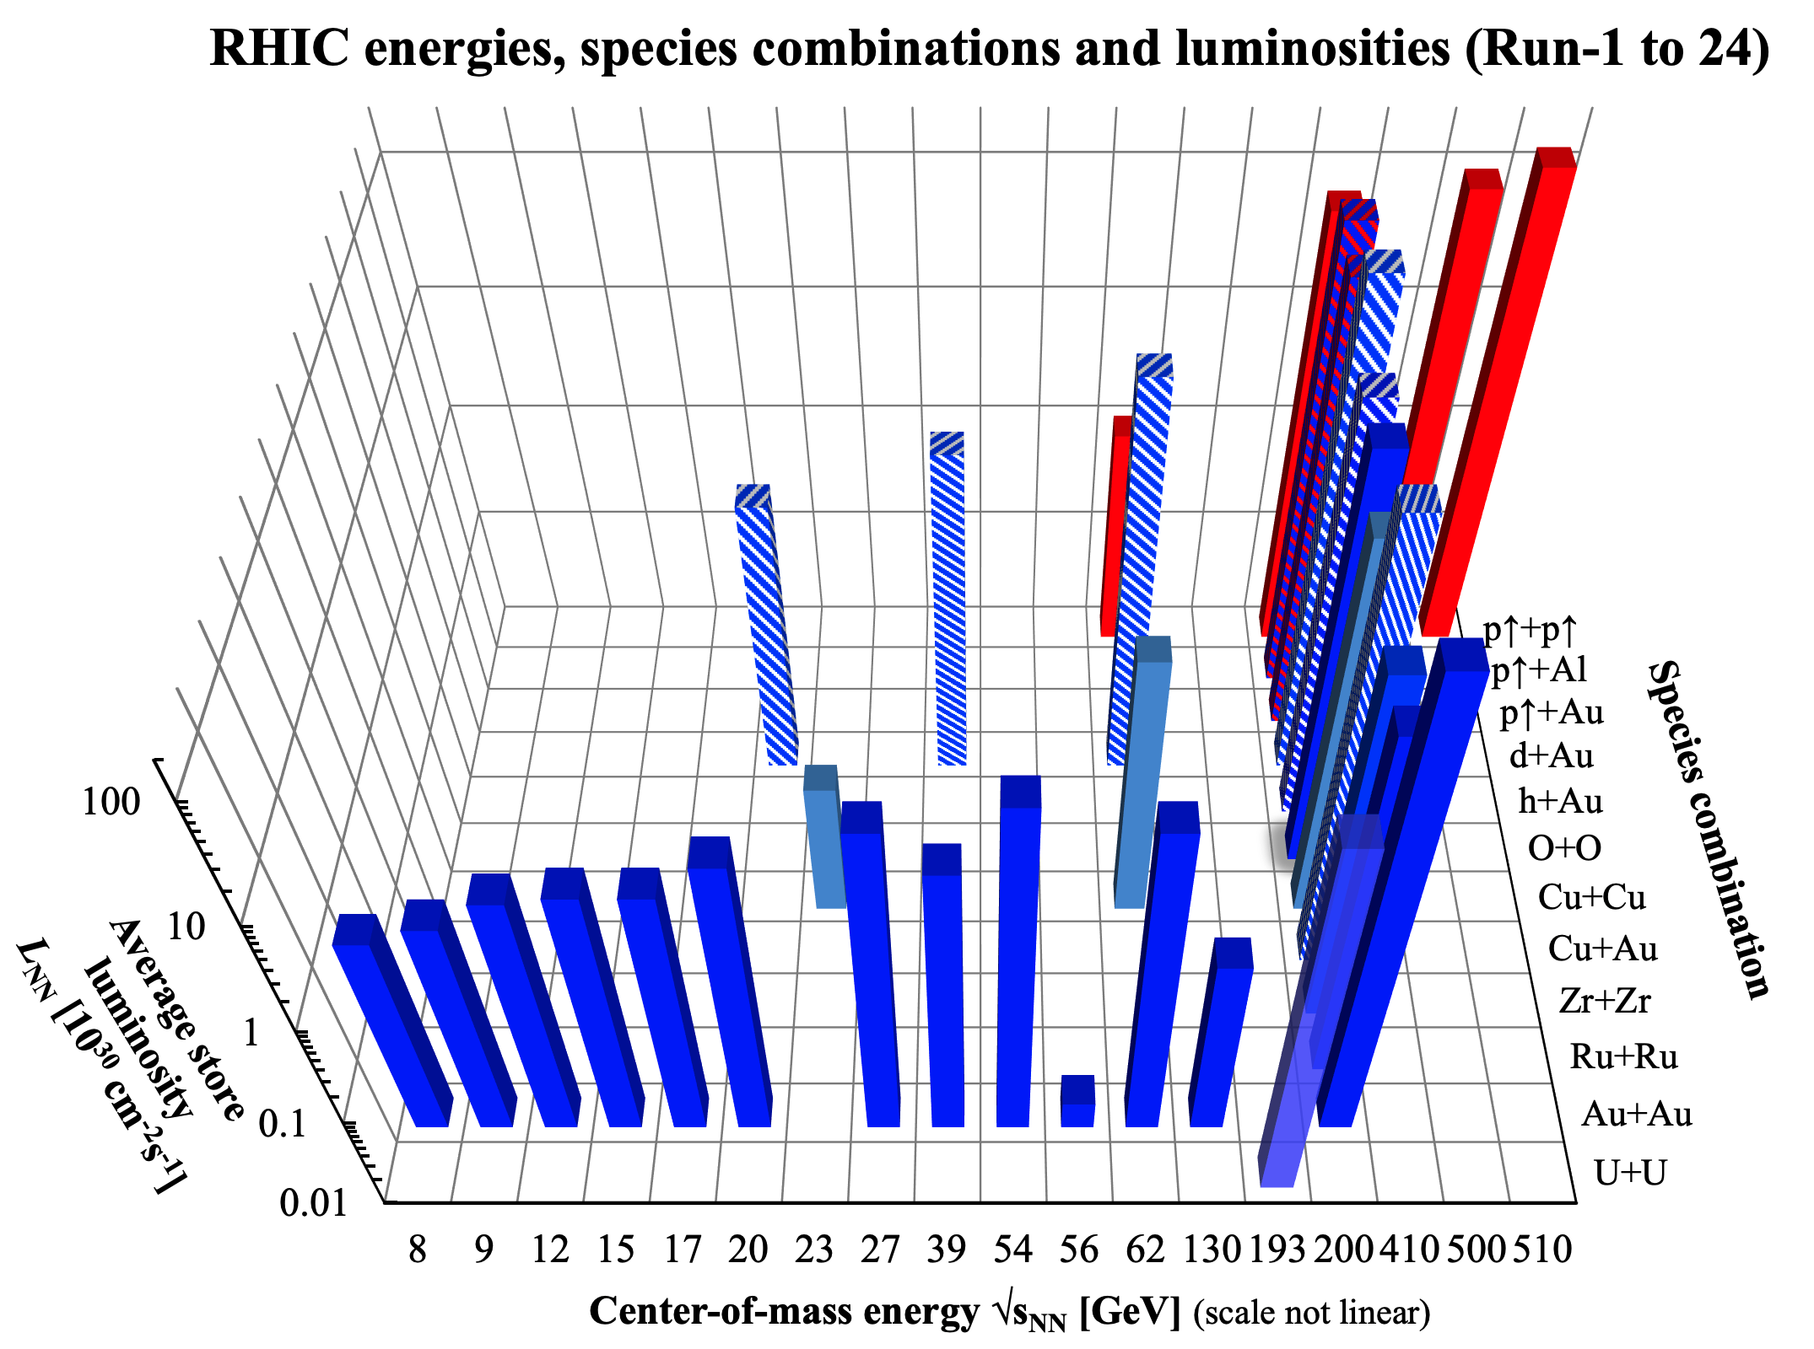
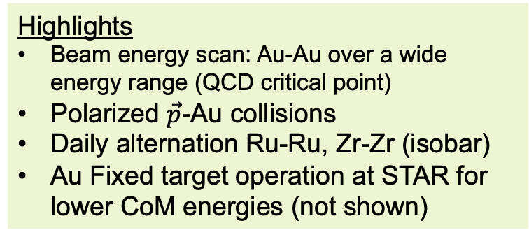
Polarized protons
Heavy ions
Asymmetric
Highlights
Beam energy scan: Au-Au over a wide energy range (QCD critical point)
Polarized $\vec{p}$-Au collisions
Daily alternation Ru-Ru, Zr-Zr (isobar)
Au Fixed target operation at STAR for lower CoM energies (not shown)
Additional species in Booster for
NASA Space Radiation Laboratory
C,Ne,Si,Cl,Ar,Ti,Fe,Kr,Nb,Ag,Xe,Tb,Ta,W,Bi,Th
Beam Energy Scan

Slide 6
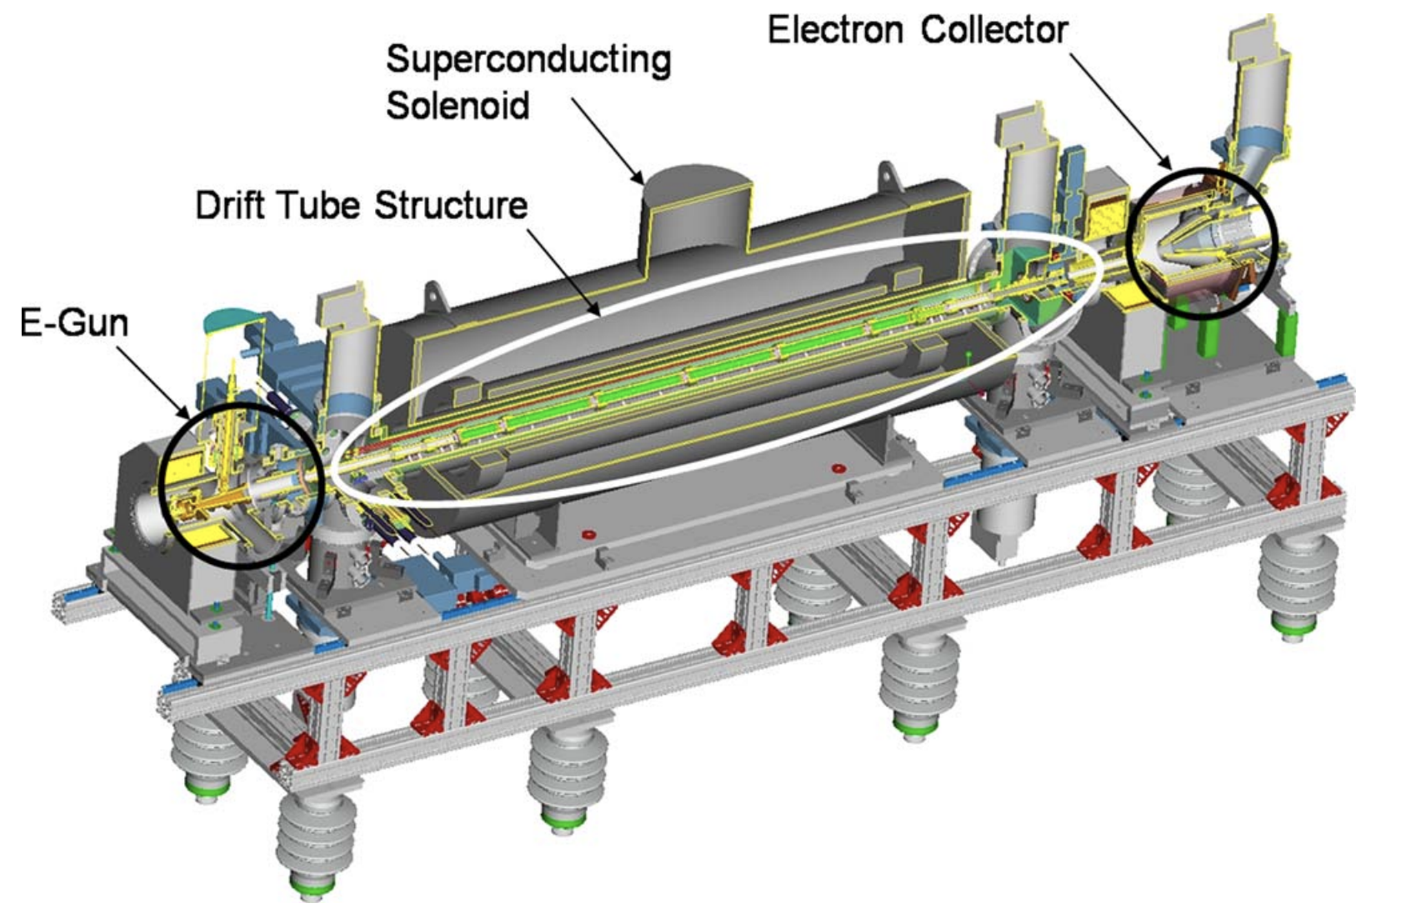
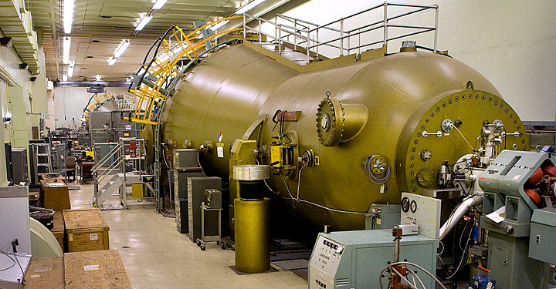
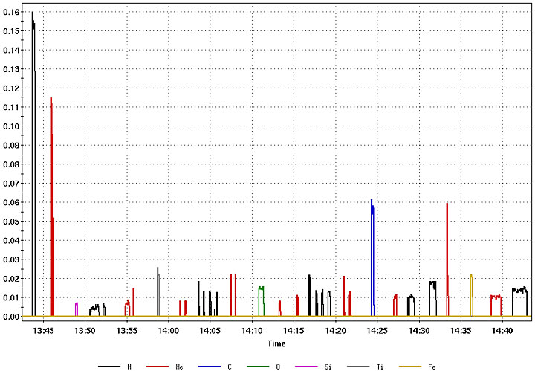
Ion Sources
Electron Beam Ion Source
Primary source for NSRL ions
Large array of ions possible
Different species can be delivered to Booster with a few seconds of each other
Swiching Booster setups to NSRL of order 2-3 minutes.
Galactic Cosmic Ray simulator program doses fixed targets at NSRL with an array of ions ~20 species energy switches in ~1 hour
Similar AGS switches would take similar time
Future source of polarized ³He.
Tandem van de Graaf
Not capable of fast switches. Usually used as a backup to EBIS
Or for a few difficult species combinations (e.g. He and high intensity Au)
Tandem van de Graaf
Electron Beam Ion Source
Galactic cosmic ray simulator run
Dose fraction
Each pulse different species and/or energy delivered to NSRL
~ 1 hr
Plot from NSRL user guide

Slide 7
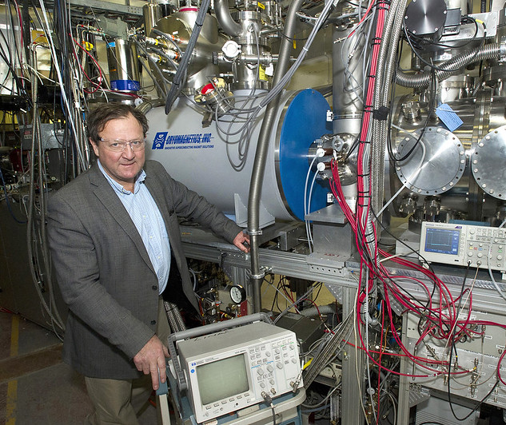
Proton sources
Optically pumped polarized ion source
  Produces pulses of H⁻ up to 10¹² particles particle per pulse
  Accelerated to 200 Mev via Linac
  Polarization 80-83% at 200 MeV
  Delivered to Booster via strip injection (H⁻ → proton)
High intensity Unpolarized source
  1.5 x 10¹⁴ protons per pulse
  Typical only for BLIP
  Used (at low intensity) as unpolarized backup for OPPIS

Slide 8
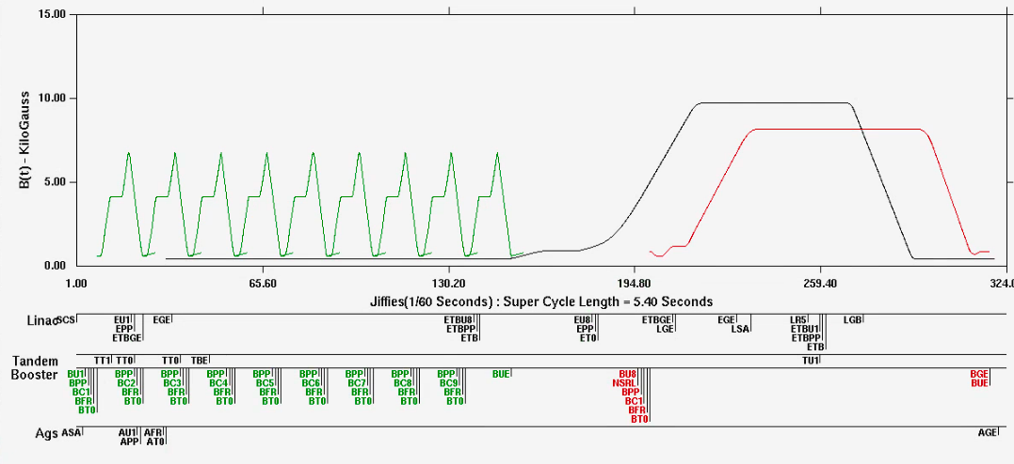
Anatomy of an Injector “Supercycle”
AGS main magnet
Booster main magnet cycles
Booster NSRL cycle
Repeat period of the AGS complex is called the “supercycle”: orchestrates all Booster and AGS beam transfers
Typical length is 4-6 seconds: accommodates many Booster pulses for high intensity RHIC operation and an NSRL cycle
Shorter supercycle is atypical, but possible (down to 3 seconds)

Slide 9
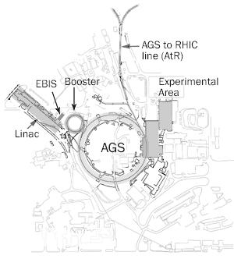
Possibilities for extraction and target location
AGS-to-RHIC (AtR) transfer line
Space available after AtR line bends toward RHIC
Tunnel space immediately after the split – would require minimal additional transport magnets
100 m+ space available extending into a stub tunnel
  Would require: beam pipe and magnets, review, refurbishing of access controls
AtR “Z” line
Bldg 912
Experimental Floor
Experimental Floor (Bldg 912)
Former location of AGS fixed target physics program
Requires installation of extraction magnets in AGS and refurbishment of transfer lines (see K. Brown’s talk)

Slide 10
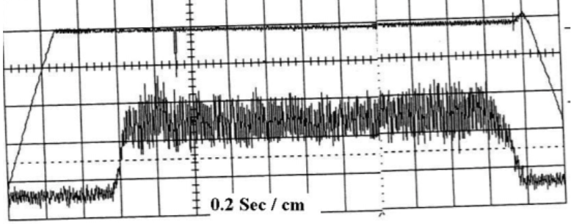
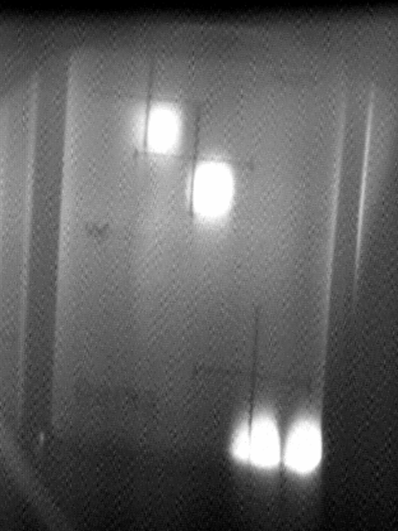
Extraction to Bldg 912 experimental floor
1. Fast beams (single bunches)
  To 912 (A,B,C, or D lines) via G10 kick into
  F5 and F10 Septa (requires correct horizontal tune)
2. Slow extracted beams (1 – 2 seconds long)
To 912 via F5 and F10 septa
3. Slow extracted modes
Debunched beam slow extraction
Micro-bunched beam slow extraction
We do not have the ability to extract full turn. This would require a new kicker magnet.
More details on this configuration in Kevin’s talk.
Slow extracted high intensity protons 2 second spill (2001)
U line
Booster
AGS
B
D
C
H10
Septum
A
Bldg 912
Single bunch
Kicker, G10
F10
Septum
Slow extracted high intensity protons split into 4 beams (2001)
F5
Septum
F7 Bump

Slide 11
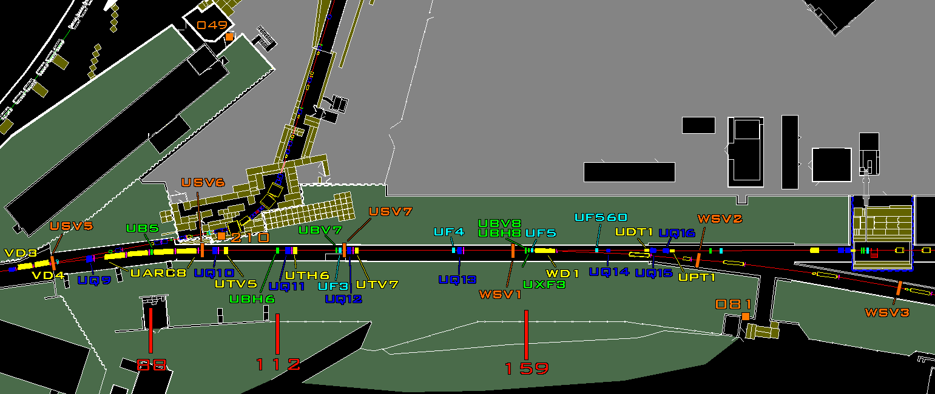
Target location possibility: AtR geography
Downstream of AtR bend “WD1”: ~40 m of space to Z-line security gate
AtR vacuum pipe section could be removed for installation
Farther down Z-line: target area and blockhouse (semi-mothballed)
AGS Ring
To g-2
Target location
40 m
To Z line
To RHIC
Acess gate

Slide 12
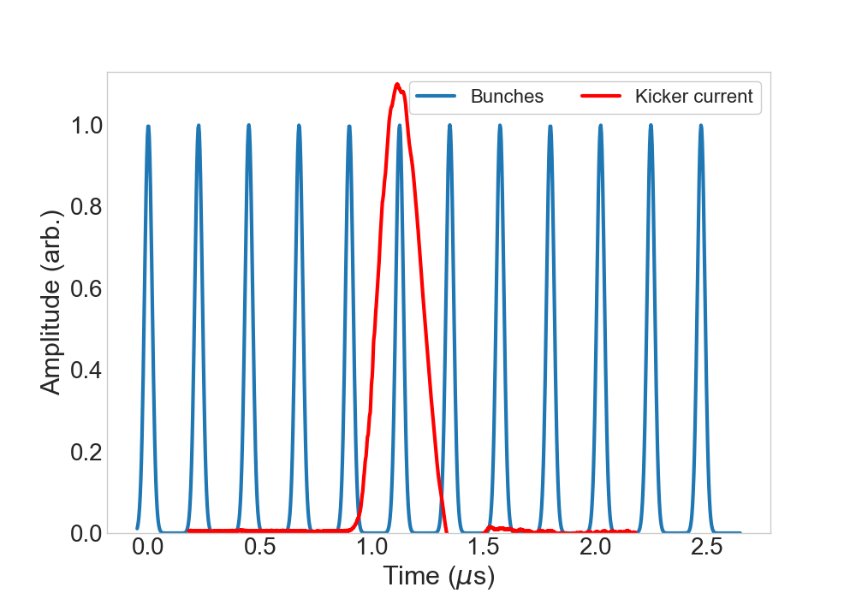
Target location possibility: AtR time structure
For AtR location: only considering FAST extracted beam
short, individual pulses extracted instantly, similar to RHIC
(up to) 12 bunches circulating at AGS extraction
Gaussian current profile 20-100 ns at base
Extracted one at a time with a minimum spacing of 33 ms
i.e. experiment would see one gaussian pulse every 33 ms
Number of bunches per cycle and per bunch intensity constrained by operating requirements
  For ions in particular, more bunches per cycle requires lower intensity per bunch
1 AGS revolution

Slide 13
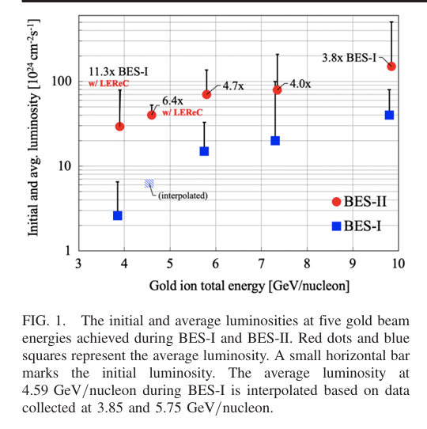
Beam energy limits of AGS
Top extracted energy limited by magnet strengths
AGS main magnet
AtR magnets
Pulsed power kickers
AGS and AtR magnets rated up to rigidity of 100 T-m
  Have not run above 80 T-m in ~20 years (23 GeV protons)
  Likely practically limited by the pulsed power
Lower end is limited by the beam size (gamma dependent) and limited extraction channel aperture
Lowest used in operation 3.85 GeV/N Au (gamma ~ 4)
Attempted 2.5 GeV/N Au, very lossy, difficult for extended high intensity operation
Small gap around gamma ~8.5 to avoid extracting to close to transition energy (unstable extractions)
*Special considerations for polarized beams (see later slides)
Beam Energy Scan Lumi

Slide 14
Intensity range of AGS
AGS intensity in recent years driven entirely by RHIC needs: higher per bunch intensity, polarization, not a lot of concern for high bunch number per cycle
(unpolarized) Proton intensity and number of bunches per cycle not pushed since g-2 (~2002)
12 bunches/cycle, 6x10¹²/bunch
This would require (re) development
Intensity of new species in AGS generally needs to be studied: main limitations are initial source production intensity and stripping foil efficiency
(many of the species on the NSRL Booster list have not been stripped/injected into AGS)
Species | “Routine” highest intensity/bunch | Bunches/AGS cycle
Pol.Protons | 3x10¹¹ | 1
Gold | 3x10⁹ | 2
Cu | 4x10⁹ | 2
Al | 1x10¹⁰ | 2
Per bunch intensities achievable with ‘normal’ efforts (i.e. for a RHIC run)

Slide 15
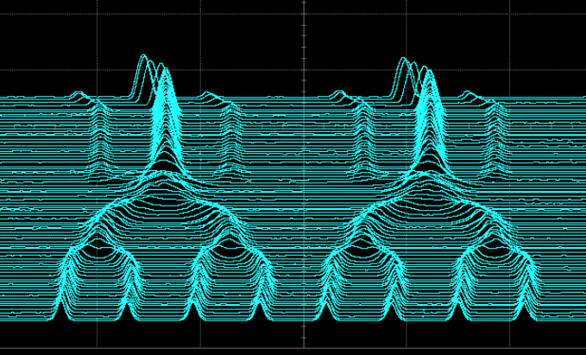
What about the low end of intensity?
AGS Bunch Merges
Extreme low intensities generally limited by:
Operational difficulties in maintaining performance
  Can be coped with by tuning with more beam and then turning it down
Injector RF relies on feedback control
  do not have enough signal
Possibilities
  NSRL routinely runs with ‘invisibly’ low intensity
    Open loop RF reliable enough for their purposes
    Has not been done in AGS
  Could run with a high intensity unextracted ‘pilot’ and low intensity production bunches
  Low intensity bunches could be generated from high intensity bunches by partial merging
RHIC bunch
Baby bunch
Time
Merge: RF gymnastic normally used to combine many smaller Booster bunches into high intensity bunches for RHIC
A partial merge generates almost arbitrarily small ‘baby’ bunches (normally a problem), here maybe useful

Slide 16
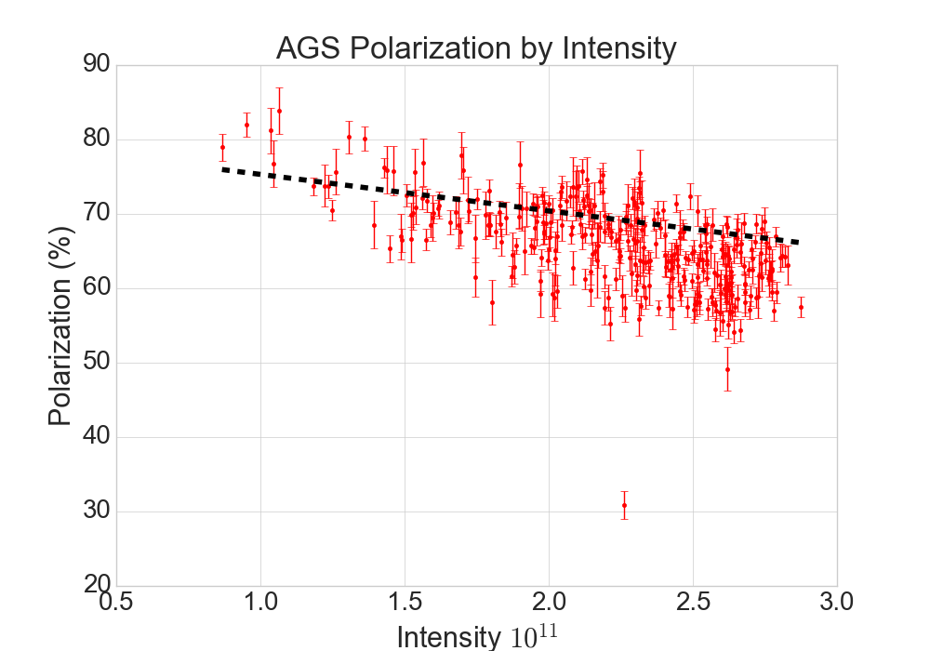
Polarization considerations
Proton polarization at AGS extracton is 65-70% at about 2.5x10¹¹ for a well-optimized injector chain
Intensity dependence: 4-5% point drop per 1x10¹¹ increase in intensity
Currently limited to 1 full intensity bunch per cycle Early development of 2 full intensity bunches/cycle in Run 24.
Spin direction and resonance structure in AGS are energy dependent
Limits extraction energy to discrete values: generally Gɣ= N + ½, integer N
Other spin orientations would require exploratory development effort
Dashed line is previously established good operation
Deviation gives idea of reproducibility of ‘best state’

Slide 17
Scheduling
RHIC operations to end some time between Dec 2025 and Apr 2026
  RHIC equipement removal to commence immediately to being ~10 year construction effort for the Electron-Ion Collider
BLIP, NSRL operation to continue in the intervening years
  Requires only sources and Booster in stretches of several weeks to a few months throughout the year
AGS to be operated for (on average) two months a year for development
  Exact distribution of time not at all settled, funding contingent (longer, less frequent blocks better?)
  Development time planned mostly for polarized species
    Principally: development of polarized ³He. Dominates the time, requires new equipment in Booster and challenging AGS setup. Only the second polarized species in AGS.
    Commissioning new systems: Polarization resonance correction schemes, TBT BPMs, upgraded tune meter
  Other AGS efforts, like test beam, not currently allotted (that’s why we’re here…)

Slide 18
Summary
The BNL injector complex has delivered a wide range of species and beam parameters energies to its physics programs at BLIP, NSRL and RHIC
A Test Beam Facility in the AtR and/or the Experimental Floor would make use of current capabilities, restore some long-unused ones and maybe give us some ideas for new ones
Thanks for your attention!

Slide 19
Extras

Slide 20
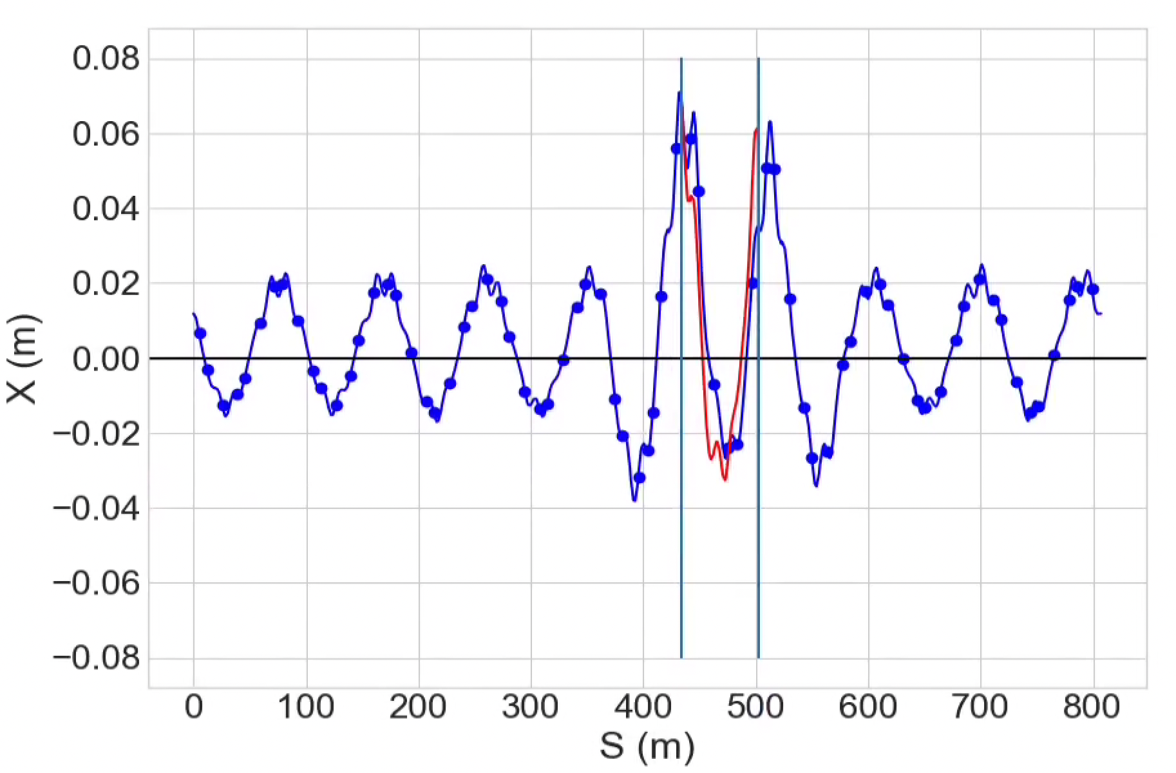
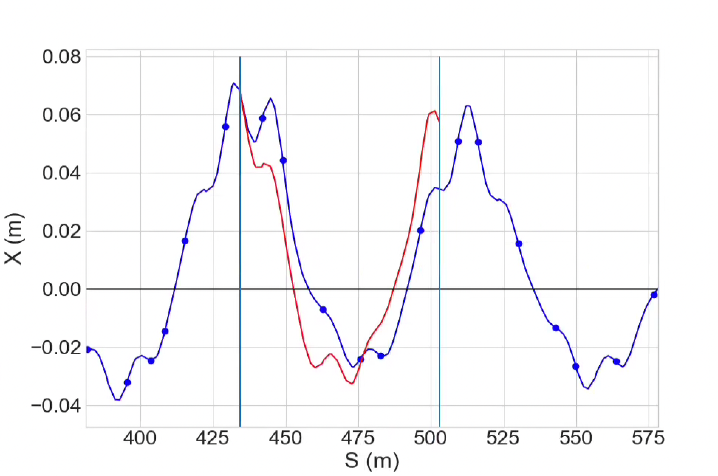
AGS Orbit at Extraction
Extracted beam
Circulating beam
G10 kicker
H10 septum

