Slide 1
Extraction and transport from AGS for fixed target experiments
Kevin Brown
Brookhaven National Lab
10 July 2025
Advancing Nuclear Physics:
New Horizons with Fixed-Target Proton-Nucleus Experiments at Intermediate Energies

Slide 2
Outline
Overview of AGS Extraction systems
Slow Extracted Beams
Fast Extracted Beams
Applications and Requirements
Electronics testing for Space Radiation Environment
Detector Test beams
Proton radiography
Nuclear physics
Beam transport options
Slow extraction to Bldg. 912
Beam Quality and methods to improve duty factor

Slide 3
Overview of AGS Extraction systems

Slide 4
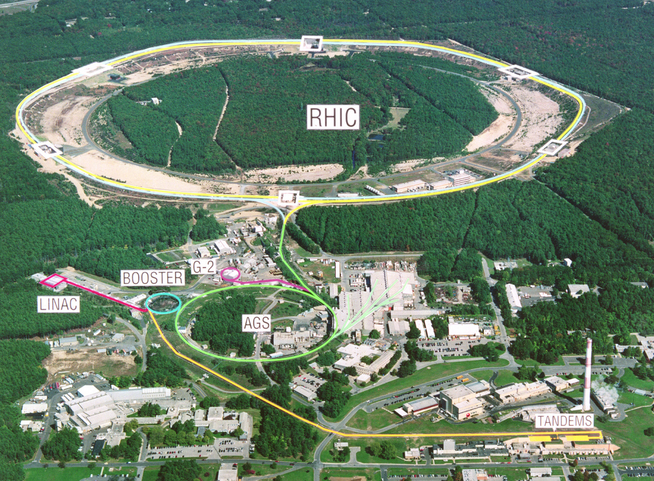
An old image but shows 3 things.
Fixed target Area (912)
  Slow extracted beams
  Single bunch fast beam
  Micro & mini-bunched SX
G-2 with fast single bunch
  12 bunches, 33msec apart
AtR, with fast single bunch
Old Fixed Target Area

Slide 5
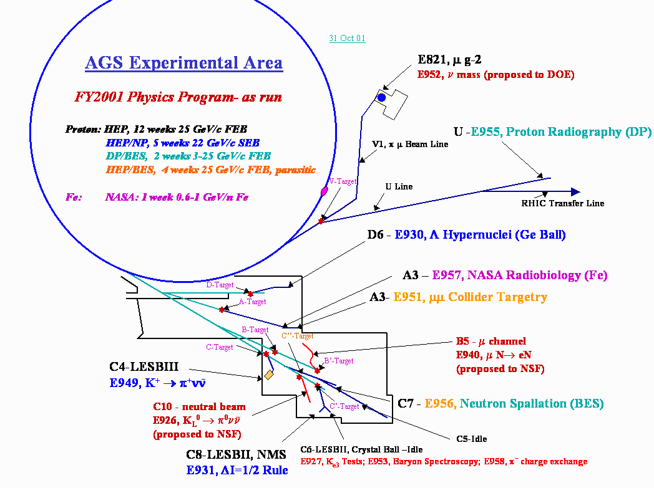
We used to handle a large variety of experiments.
After 2002
all HEP experiments ended
NP experiments ended with RHIC startup
NASA moved to new facility off the AGS Booster
G-2 finished
Radiography ran 1 year

Slide 6
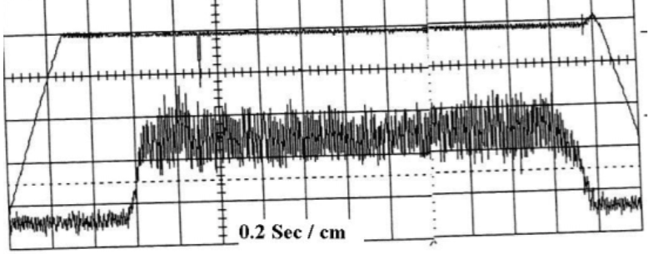
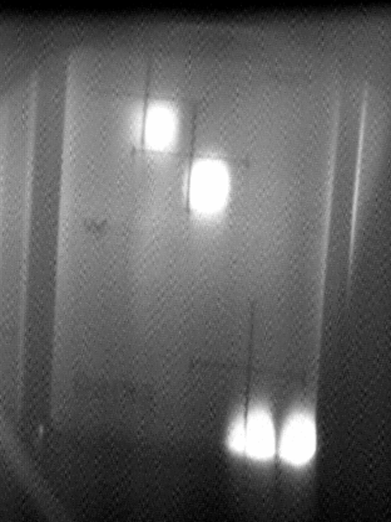
Slow extracted high intensity protons 2 second spill (2001)
As Vincent already showed
Ways to extract beam from the AGS
1. Fast beams (single bunches)
  To Uline via G10 kick into H10 Septum
  OR
  To 912 (A,B,C, or D) via G10 kick into
  F5 and F10 Septa (requires correct horizontal tune)
2. Slow extracted beams (1 – 2 seconds long)
To 912 via F5 and F10 septa
3. Slow extracted modes
Bunched beam slow extraction
Micro-bunched beam slow extraction
We do not have the ability to extract full turn. This would require a new kicker magnet.
U line
Booster
AGS
B
D
C
H10
Septum
A
Bldg 912
Single bunch
Kicker, G10
F10
Septum
Slow extracted high intensity protons split into 4 beams (2001)
F5
Septum
F7 Bump

Slide 7
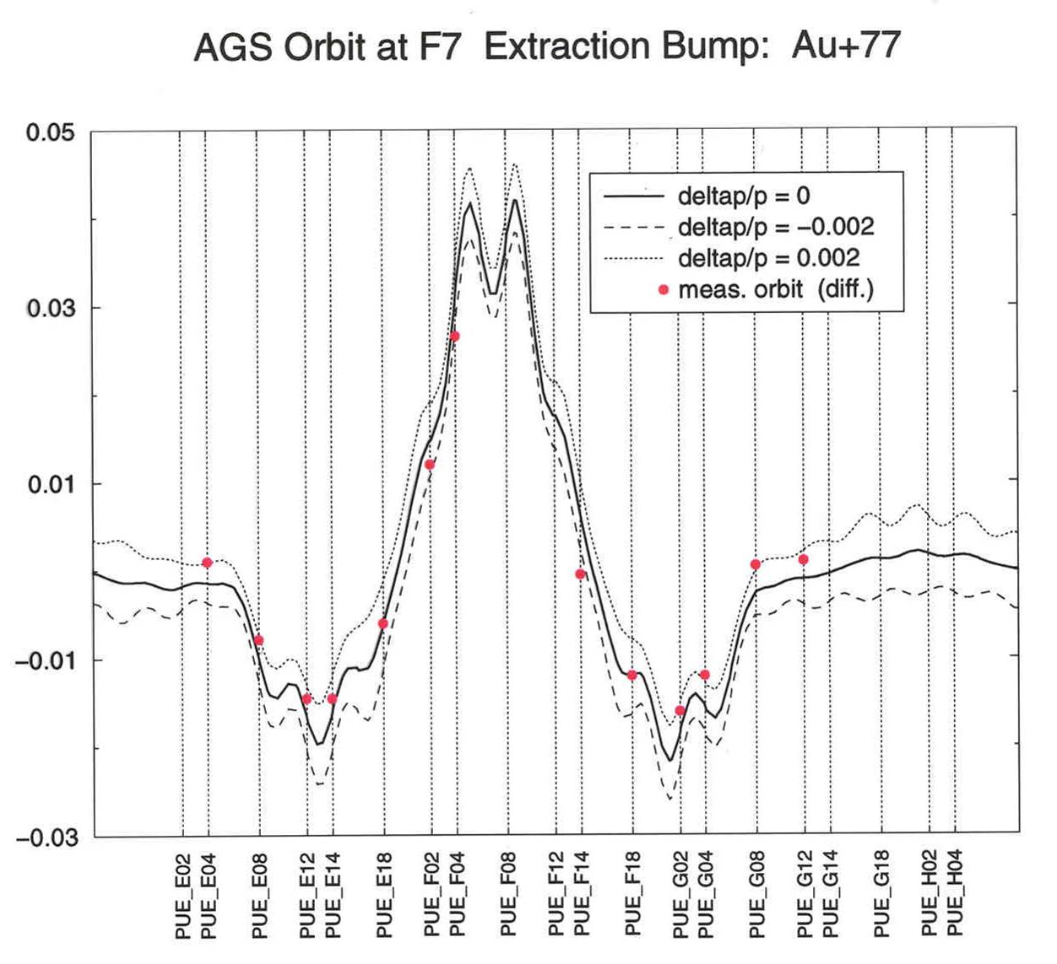
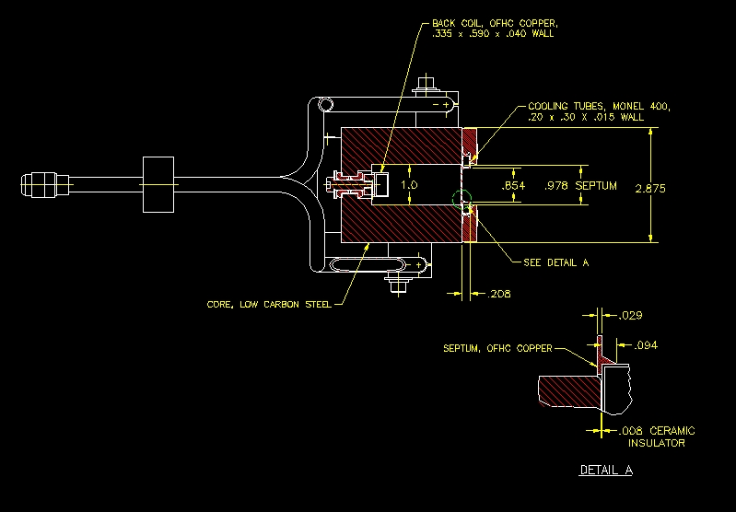
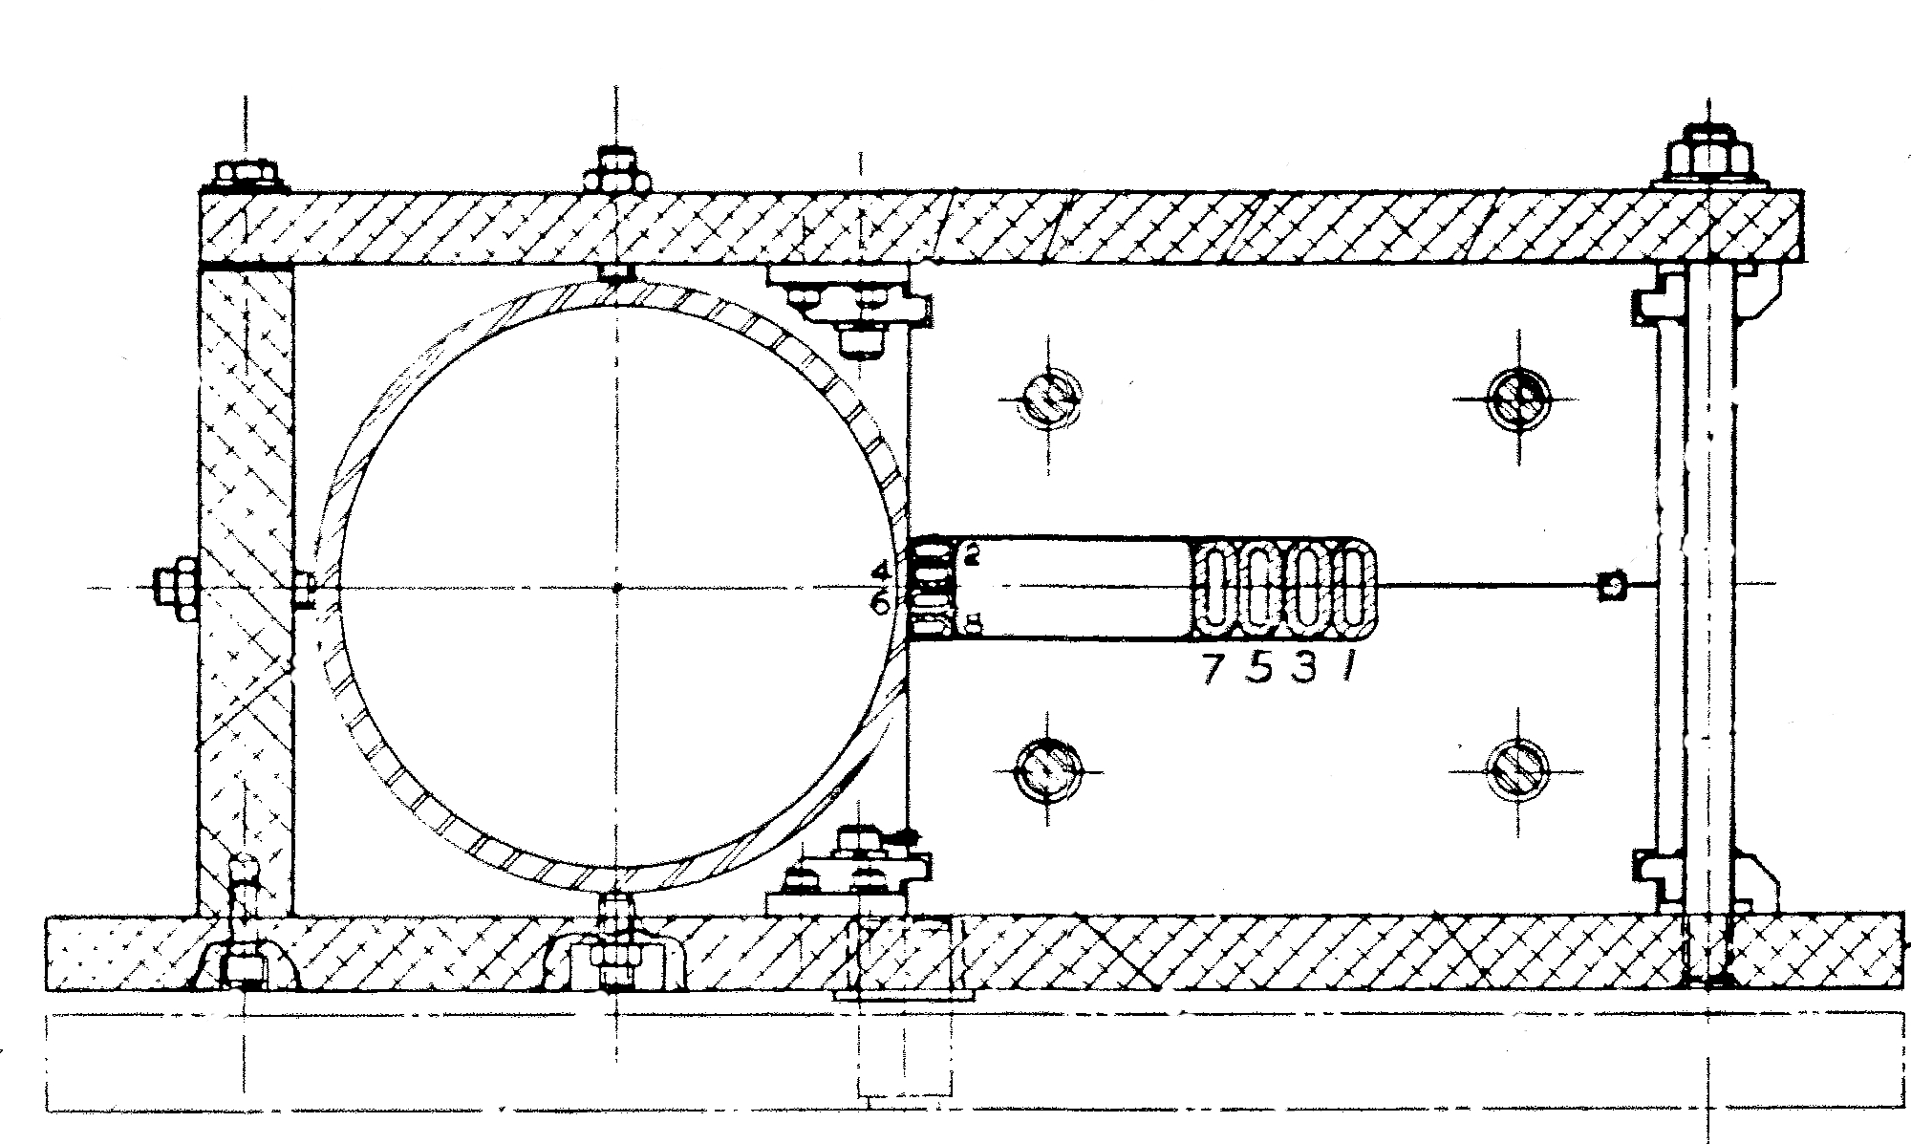
Overview of AGS Slow Extraction
Thin Septum
0.76 mm, 1.5 kG
Thick Septum
13.5 mm, 9.5 kG

Slide 8
AGS Performance History
PROTON BEAM FY94 FY95 FY96 FY97 FY98/99 FY2000
SEB FEB (g-2) SEB FEB (g-2) FEB (g-2)
Beam Energy 24 GeV 24 GeV 24 GeV 24 GeV 24 GeV 24 GeV 24 GeV 24 GeV
Peak Beam Intensity 40 x 10¹² ppp 63 x 10¹² ppp 62 x 10¹² ppp 62 x 10¹² ppp 46 x 10¹² ppp 72 x 10¹² ppp 58 x 10¹² ppp 61 x 10¹² ppp
Total protons accelerated 0.3 x 10²⁰ 1.1 x 10²⁰ 0.9 x 10²⁰ 0.4 x 10²⁰ 0.1 x 10²⁰ 0.9 x 10²⁰ 0.4x 10²⁰ 0.5x 10²⁰
Spill Length/Cycle Time 1.0 sec/3.8 sec 1.6 sec/3.6 sec 1.6 sec/3.6 sec 1.6 sec/3.6 sec 2.8 sec/5.1 sec
-> Duty Cycle 26% 44% 44% 44% 55%
Spill Structure Modulation
(peak-average) /average 50% 20% 20% 20% 20%
Average Availability
/Best Week ~83% 82%/ 93% 76% / 92% 71% / 79% 58 % / 67 % 71% / 88% 55 % / 83 % 74 % / 87 %
HEAVY ION BEAM Au Au Au Au Fe (NASA) Au Fe (NASA)
Beam Energy /nucleon 11 GeV 11 GeV 11 / 4 / 2 GeV 11 / 8 / 6 GeV 1.0 / 0.6 GeV 11 GeV 1.0 / 0.6 GeV
Peak Beam Intensity 2 x 10⁸ Au/p 2 x 10⁸ Au/p 4 x 10⁸ Au/p 17 x 10⁸ Au/p 20 x 10⁸ Fe/p 9 x 10⁸ Au/bunch 36 x 10⁸ Fe/p
Spill Length/Cycle Time 1.0 sec/3.8 sec 1.0 sec/3.8 sec 1.4 sec/3.6 sec 1.5 sec/4.0 sec 1.2 sec/3.0 sec
-> Duty Cycle 26% 26% 39% 38% 40 %
Spill Structure Modulation
(peak-average) /average 50% 20% <20% <20% <20%
Average Availability ~85% 90% 80% 82 % 96 % 81 % 90 %

Slide 9
Applications and Requirements

Slide 10
Various Users are looking for beam
Electronics testing to replicate space radiation effects
  NASA, MDA, SpaceX, Blue Origin, ESA, etc.
  Need low energies = 100 MeV/n to 2 GeV/n
  Need many different ions (protons to Bismuth)
  Large uniform beams + smooth, long spills
Detector test beams (big demand, no supply for next few years)
Imaging dense materials (radiography – HE protons, no supply)
NP experiments

Slide 11
Historically, NP requirements
Slow extracted beams mostly with Au
  Energy scans
  Specialized targets
  Well focused (point sources) on target
All standard experimental support services
  Riggers, electricians, etc.
  Engineering support for detector installation
  Physics support to liaison with accelerator department
  Communications (network for data links, etc.)
  Counting houses with A/C

Slide 12
Beam transport options

Slide 13
Status
Slow extraction from AGS has been disabled, to re-enable we need
New thin and thick septa magnets and power supplies
F7 bump reinstalled with new cables and new PS
4 sextupole magnets reinstalled and new PS
New active filter (to reduce spill ripple)
New vacuum pipe from F10 to F12, for extraction channel
Refurbished magnets in 912
Refurbished and possibly new PSs for magnets
New vacuum systems
New instrumentation

Slide 14
Building 912 today
Most of the old switchyard is still in place.
But,
Not operated in 25 years.
All formed experiments and detectors have been removed.
Some magnets have been removed, to repurpose and use for other applications.
Electrical infrastructure does not meet code – needs upgrading before running.
EEBA no longer available!

Slide 15
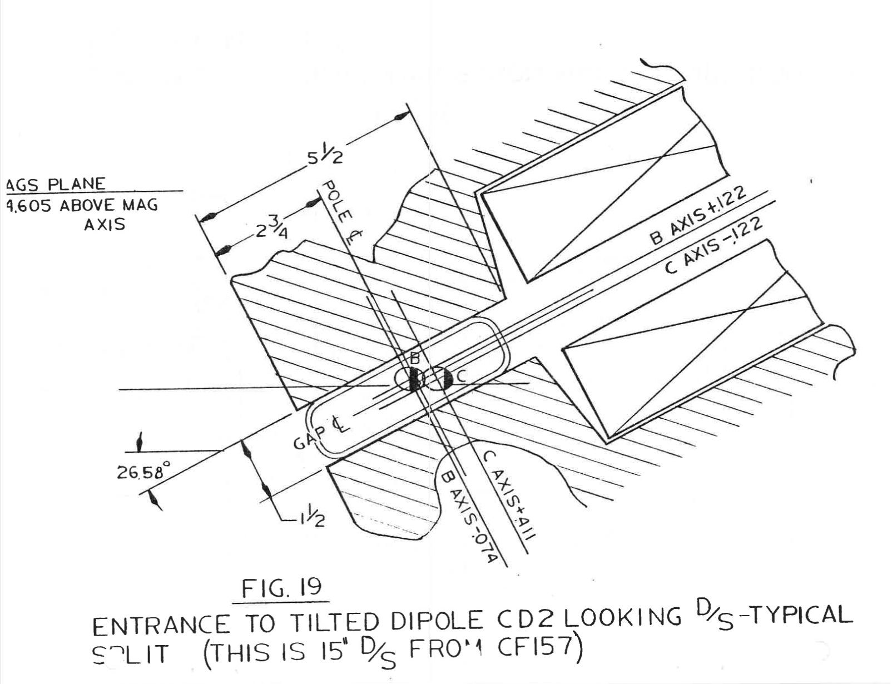
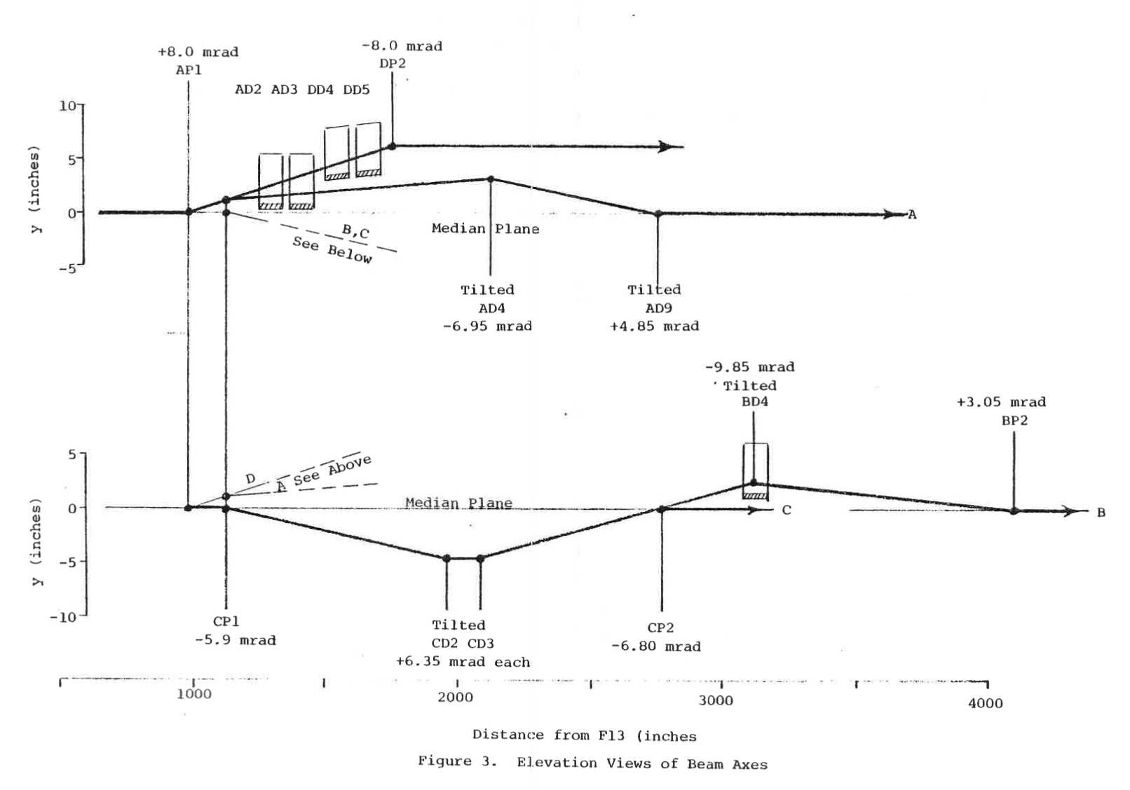
Features of old Switchyard
Beams were split to four primary targets
    Requires 3 electrostatic splitters and 3 movable Lambertson magnets
    Features complicated vertical trajectories for each beam line

Slide 16
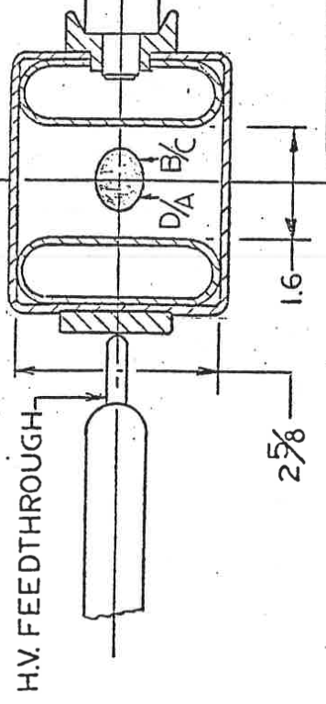
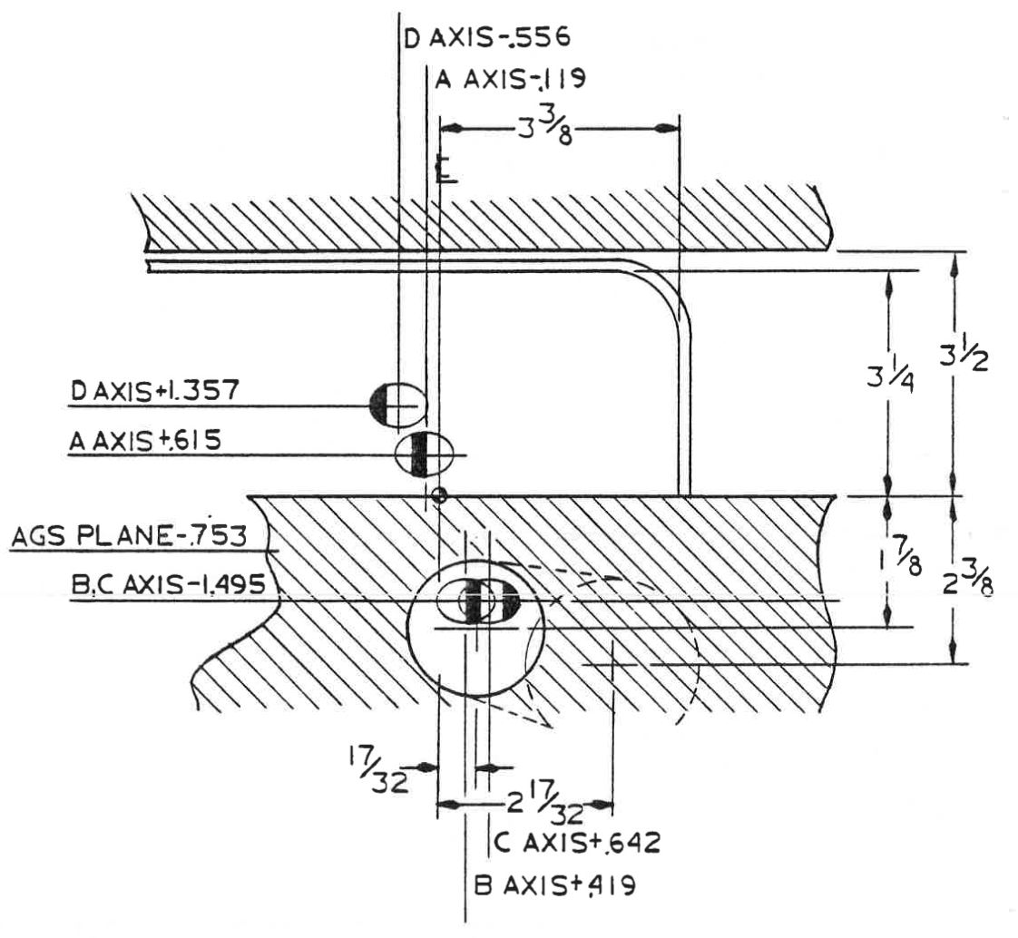
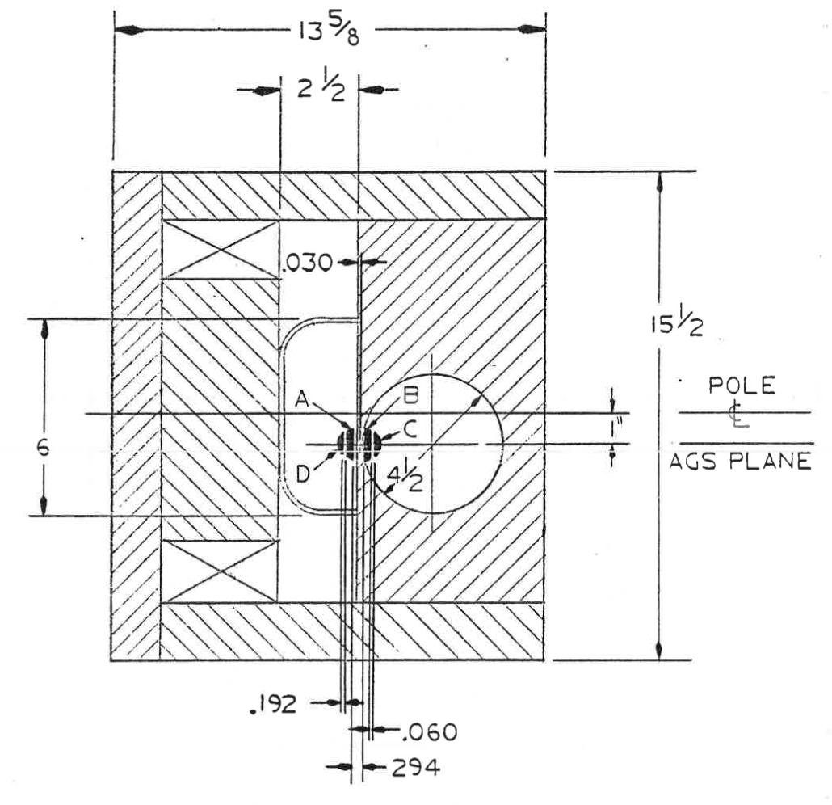
Options
We could do split beams again, but we would simplify the design.
How many beamlines are needed?
We would look into horizontally splitting, rather than vertical
Handling momentum dispersion will be an issue. Would want to design achromatic tune and split where D=D’=0.
We could eliminate splitters and use a switching magnet
If each beamline has a different purpose this is the best option
Can NP experiments share a single target?
Thick Lambertson
Electrostatic splitter
Thin Lambertson

Slide 17
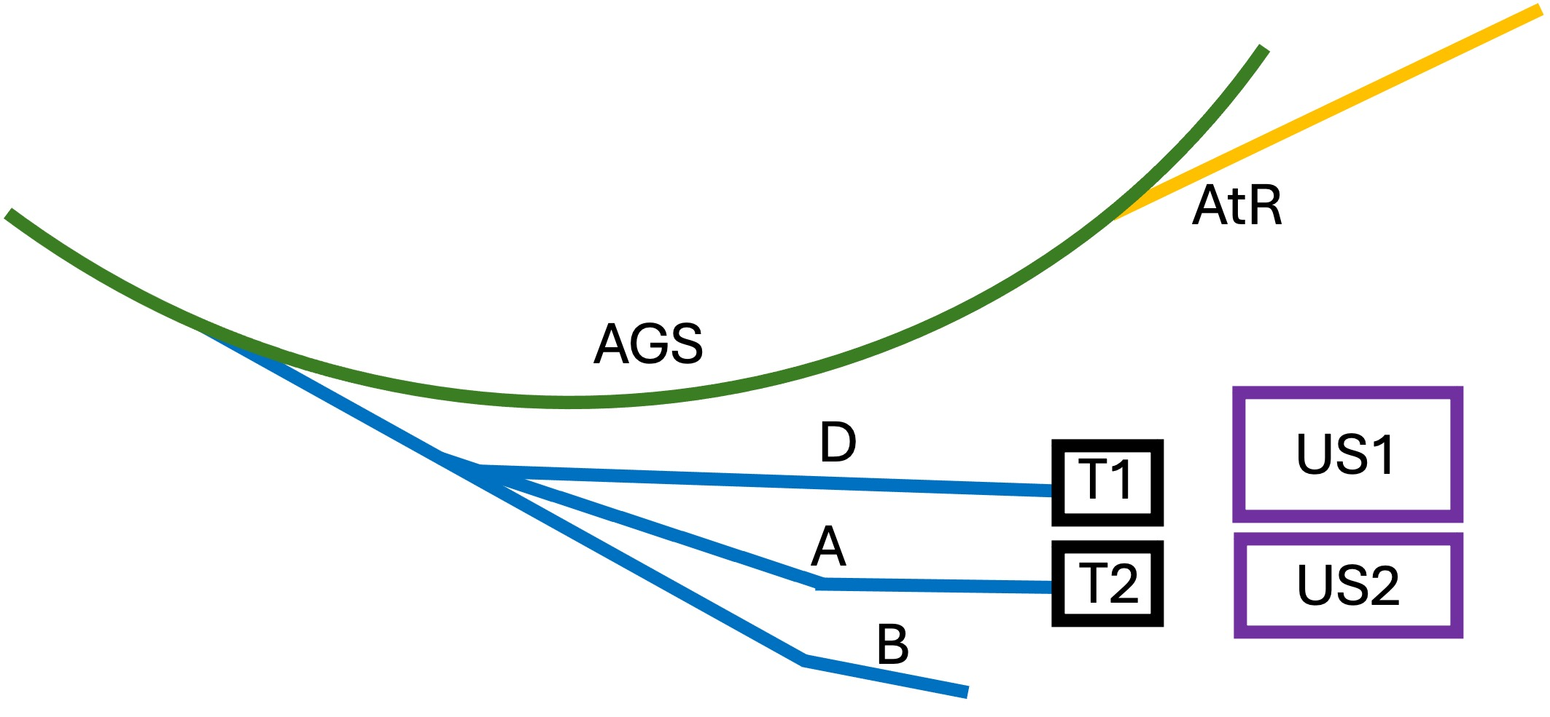
For Example: 3 different Users
US1 might be electronics testers
Best use of Dline is for low energies
Designed to give large uniform beams created using octupole magnets
US2 may be anything
Designed to give large uniform beams but by rastering a small beam.
Could deliver small beams on a target.
Switching magnet
Test Beam or NP Experiment

Slide 18
Beam Quality and methods to improve duty factor

Slide 19
Main beam quality issues to consider
Spill quality
  Historically it was usually around 30-40% modulated
  Modulation comes from tune ripple in the AGS (ripple on power supplies modulate the tune during extraction)
  Active filter (on AGS Main magnet PS) helps
  Additionally, could add high frequency quadrupole and modulate to remove the ripple structure (have such system Booster, R&D project)
Beam size and shape
  We can make small Gaussian shaped beams (~ a few mm diameter)
  We can make various size uniform beams. But using octupoles to do this gets harder with high energy beams. Rastering is a better approach.
Beam Motion on target
  Historically a challenge in the switchyard. No dispersion control.
  Two ways to fix it: ramp dipoles with spill or design achromatic tune.

Slide 20
Samples of Spills
2.2 Seconds
CNAO, MedAustron, Italy
AGS 2001 high intensity protons
CERN SPS
Air core quad feed forward
JPARC has some unique problems, due to operation with zero chromaticity.

Slide 21
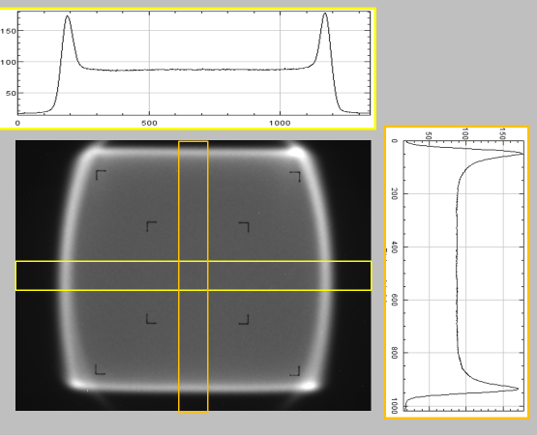
Beam distribution
Uniform Beams at NSRL (NASA beamline of the AGS Booster)
Typical beam profile, captured on the Digital Beam Imager (DBI), and analyzed using ImageJ. This is an image formed from one full spill.
The projections show the beam spatial distribution to be within a few % of the mean in the area between the outer “ears”.
20 cm

Slide 22
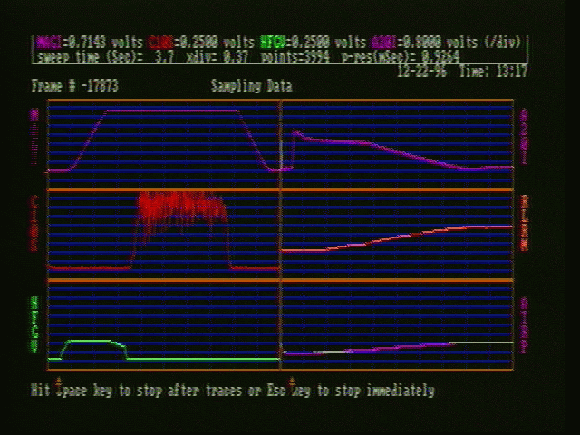
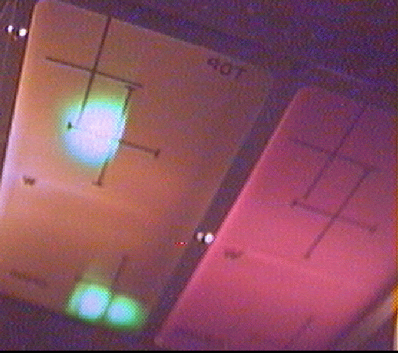
Images from Heavy Ion running in 1997, 11.68 GeV/n Au
Species | Year/Run | Frequency {MHz} | Harmonic | Momentum {GeV/c/n}
Au | FY97 10.6GeV | 4.443350 +/- 20Hz | 12 | 11.71
Au | FY97 8GeV | 4.43296 +/- 50Hz | 12 | 8.859
Au | FY97 6GeV | 4.41680 +/- 50Hz | 12 | 6.841
Fe | FY97 1GeV | 3.9585 +/- 100Hz | 12 | 1.80
Fe | FY97 0.6GeV | 3.539215 +/- 100Hz | 12 | 1.215
Au | FY96 10.6GeV | 2.96224 +/- 20Hz | 8 | 11.69
Au | FY96 4GeV | 2.918984 +/- 50Hz | 8 | 4.883
Au | FY96 2GeV | 2.8180 +/- 50Hz | 8 | 2.783

Slide 23
Questions?

