Slide 1
Heavy Ion experiments at AGS
From 1986 to 1990s
Y. Akiba
2025/7/11
CFNS workshop

Slide 2
Disclaimer
I am asked to review the AGS heavy ion experiments in 1980’s and 1990s
I participated in E802, one of the first generation AGS heavy ion experiment, and continue to work in E859 and E866.
However, it is a long time ago.
It is a challenge to prepare a comprehensive review of the AGS experiments.
So this is a rather limited review of the AGS HI experiment

Slide 3
Time line
Birth of the concept of RHIC
1984 Start of construction of the first generation HI experiments
(E802, E810, and E814)
1986 First heavy ion beam (¹⁶O) from the AGS. Pre-E802 and pre-E814
First ²⁸Si beam from the AGS and first run of E802, E810, E814
Quark Matter 87. First results from AGS and SPS HIP Exp.
1990 E859 upgrade of E802 with high level trigger
1994 E866 upgrade of E802 with 2nd spectrometer
First Au beam from the AGS

Slide 4
AGS HI experiments
1986 First HI beam from AGS. ¹⁶O at 14.6 GeV/c
1987 to 1993 ²⁸Si beam at 14.6 GeV/c per nucleon
1994- Au beam at 11.6 GeV/c per nucleon
E802/859/866/917 Particle production with centrality
E810 multi-particle spectrometer
E814/864/877 Forward measurement
（E864:strangelet search)
E895 (EOS) flow measurement
(E896 H-Dibaryon search)

Slide 5
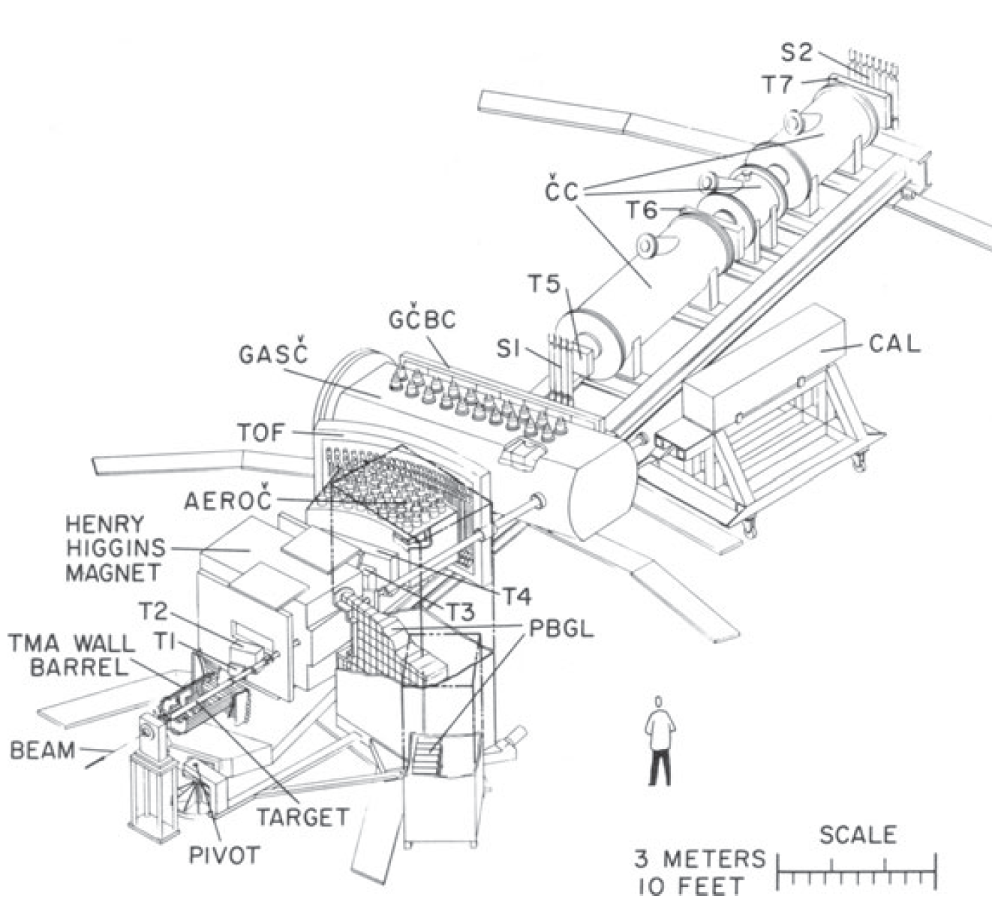
E802 (1987-1990), E859(1990-1993)
E802 is the one of the first heavy ion experiment at the AGS
It consists of a single arm spectrometer with hadron PID detectors (TOF, Gas cerenkovs) and global (TMA, PbGl wall, ZCAL, and BBC)
Study hadron production with Si+A collisions
E859 is upgrade of E802 with higher level trigger
E802/E859 produced many interesting results, including observation of kaon enhancement.

Slide 6
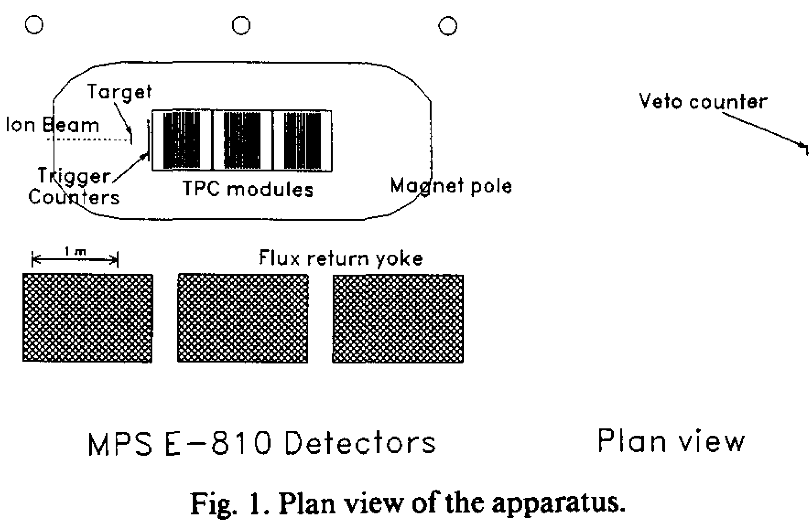
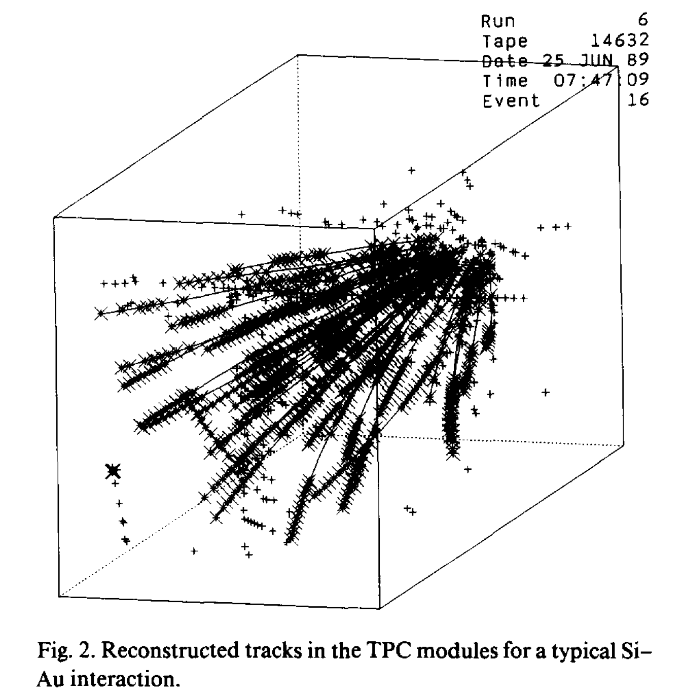
E810
E810 is a large solid-angle multiparticle spectrometer based on TPCs
Beam rate was limited to <5000 Si ions/s to limit the ionization in TPC
DAQ rate is low. I think it was O(1)Hz or even less.

Slide 7
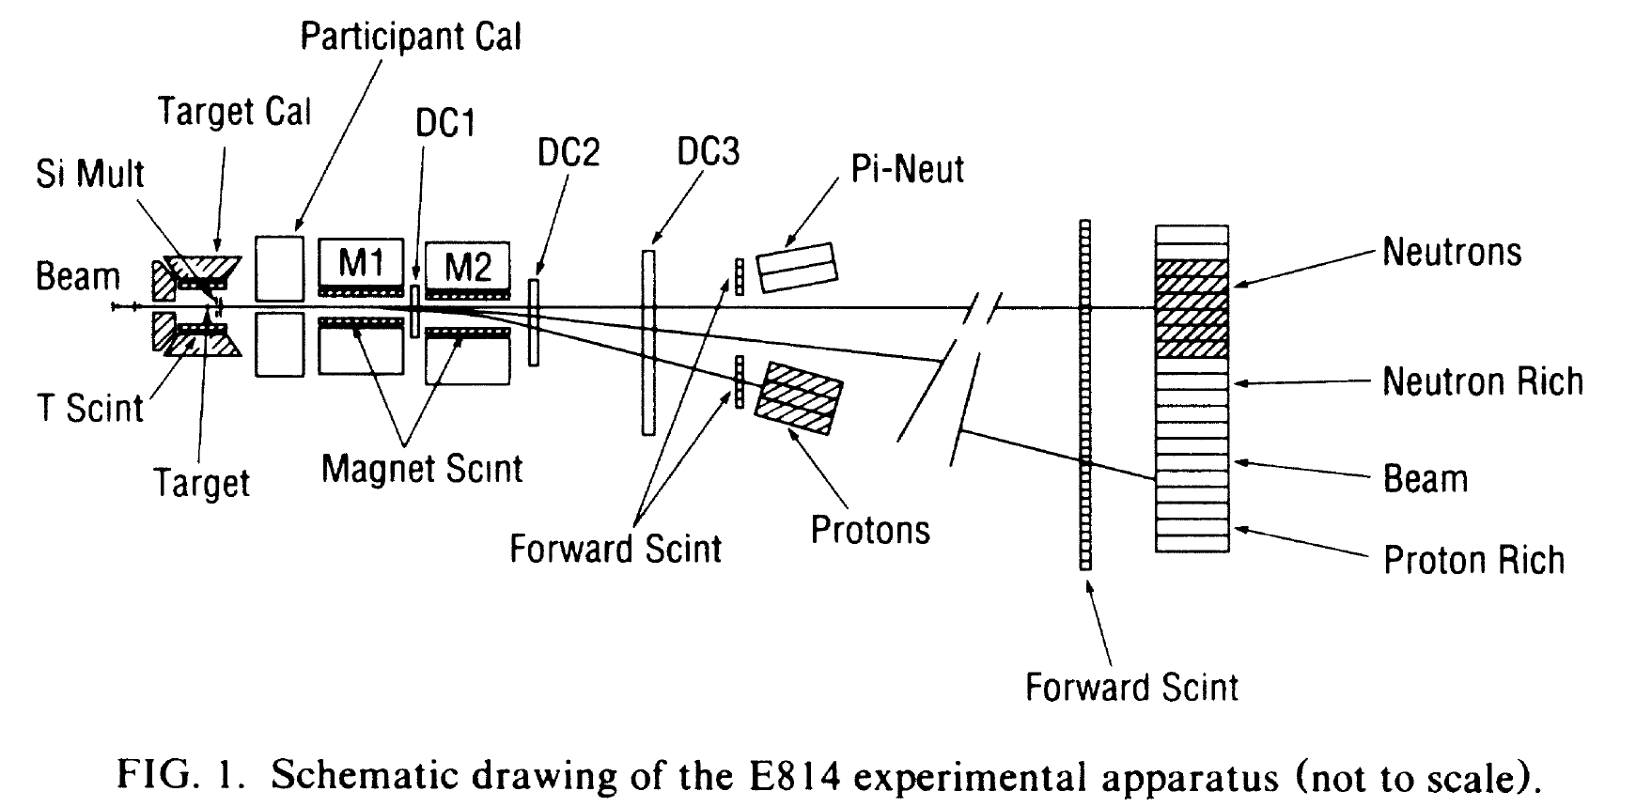
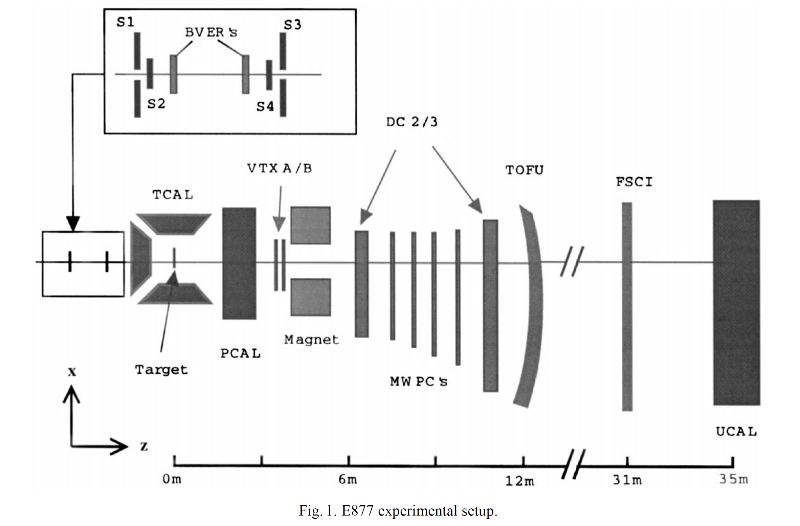
E814 (Si+A) and E877 (Au+A)
E814 studied energy flow and forward particles
E877 is the upgrade of E814 for Au+A collisions

Slide 8
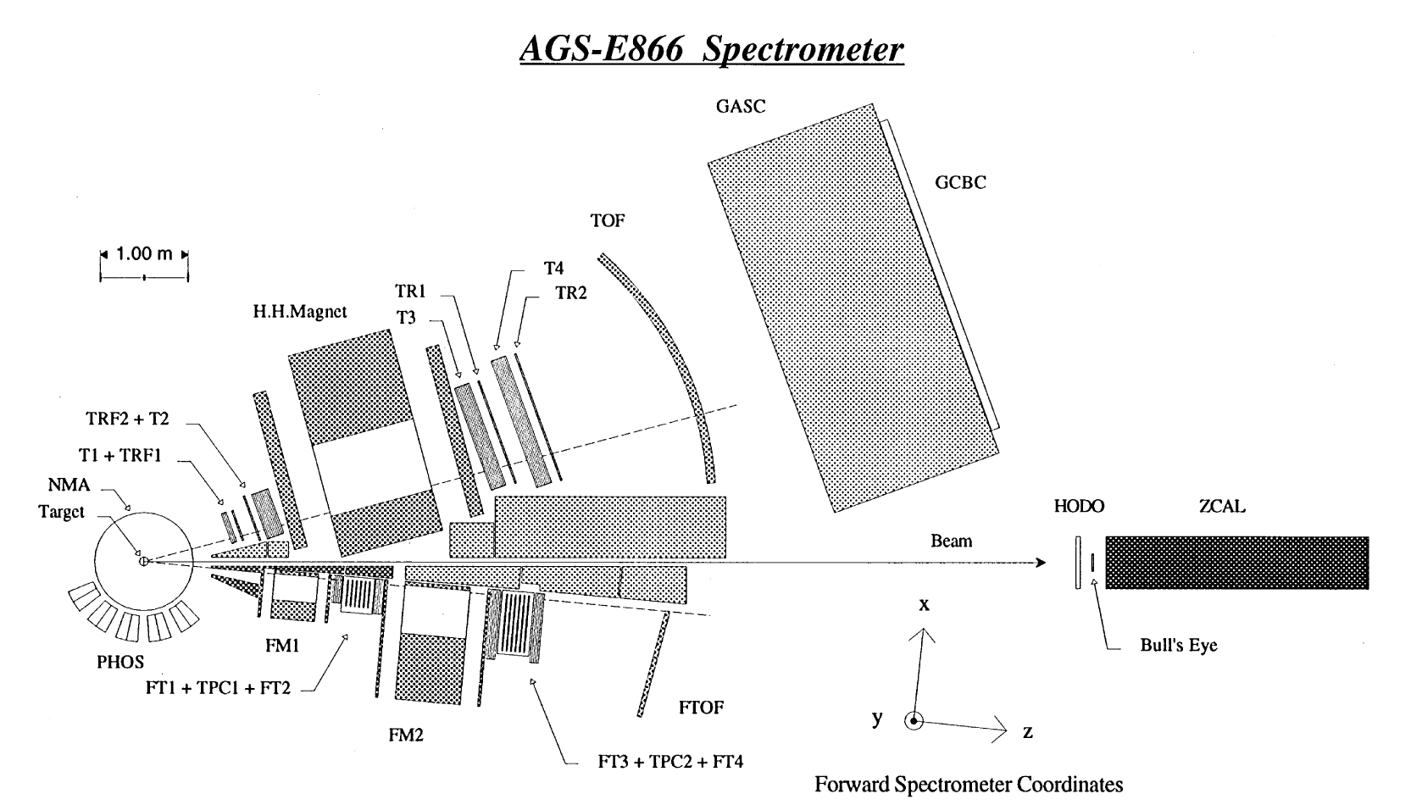
E866: Au+Au collisions at the AGS
E866 is an upgrade of E802 with the 2nd spectrometer (Forward Spectrometer) to cover mid-rapidity of produced protons
E866 studied PID hadron production in Au+Au collisions

Slide 9
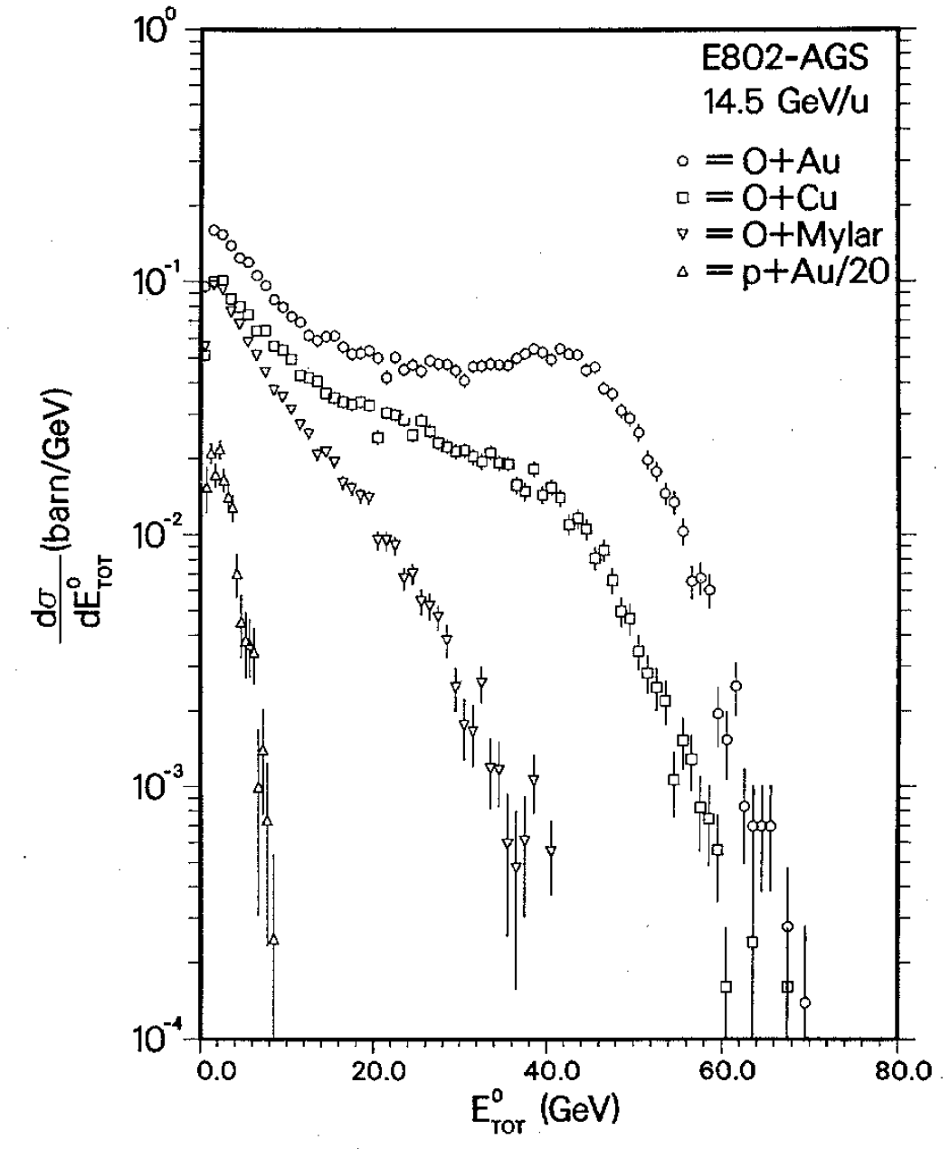
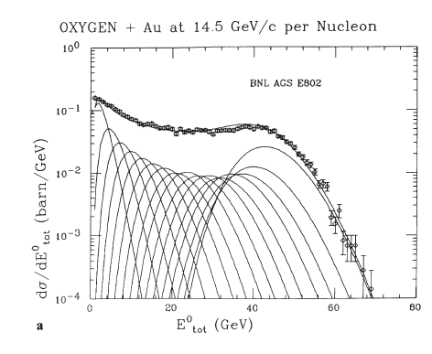
1986: pre-E802 and the first E_{T} measurement
PLB197, 285 (1987)
In November 1986, the AGS has its first heavy ion beam: ¹⁶O at 14.5 A GeV.
E802 detector was not ready, and a small pre-E802 experiment was set up to take data. I was one of the proposers
The pre-E802 measured ET flow in O+A collisions with an array of 96 PbGL blocks
ET distribution is well reproduced by convolution of ET distribution of p+Au collisions with a geometrical model (Wounded participant nucleon model)
This became the first publication of E802 and the AGS heavy ion program
In RHIC era, this kind of measurement is used to estimate Npart and Ncoll
Figure of QM87 proceeding
Convolution of ET distribution
of 1 to 16 beam participants

Slide 10
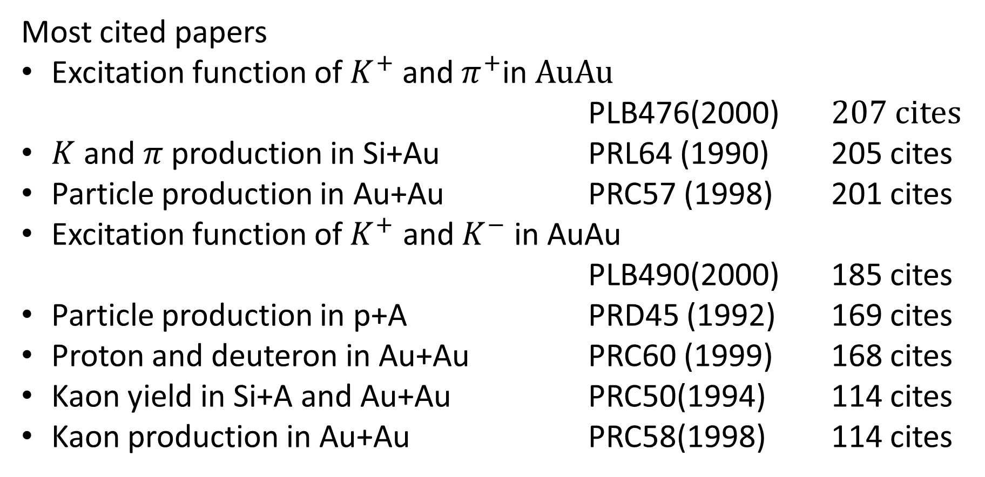
Main results from E802/859/866/917
Most cited papers
Excitation function of $K^{+}$ and $π^{+}$in AuAu
PLB476(2000) 207 cites
$K$ and $π$ production in Si+Au PRL64 (1990) 205 cites
Particle production in Au+Au PRC57 (1998) 201 cites
Excitation function of $K^{+}$ and $K^{−}$ in AuAu
PLB490(2000) 185 cites
Particle production in p+A PRD45 (1992) 169 cites
Proton and deuteron in Au+Au PRC60 (1999) 168 cites
Kaon yield in Si+A and Au+Au PRC50(1994) 114 cites
Kaon production in Au+Au PRC58(1998) 114 cites

Slide 11
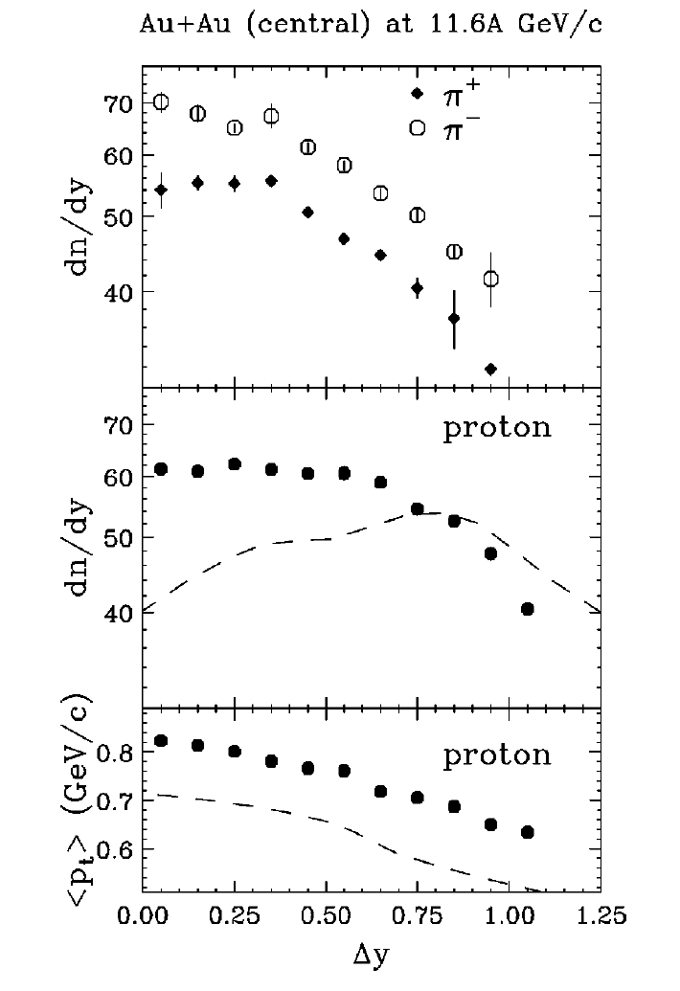
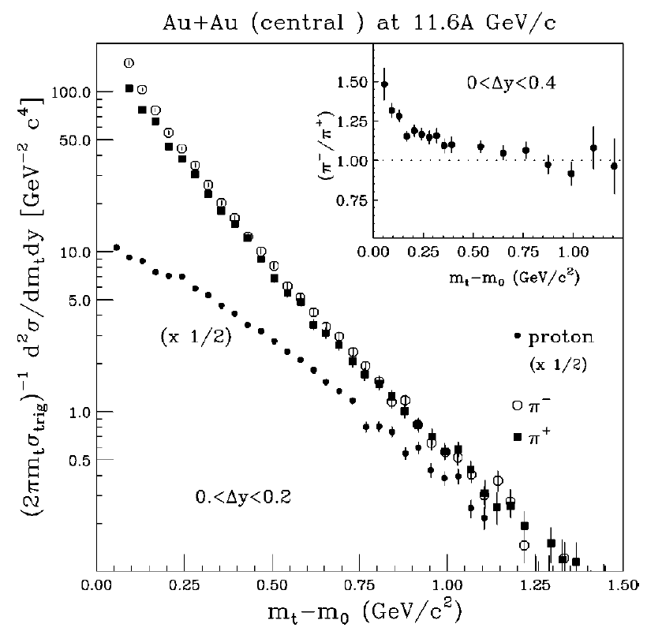
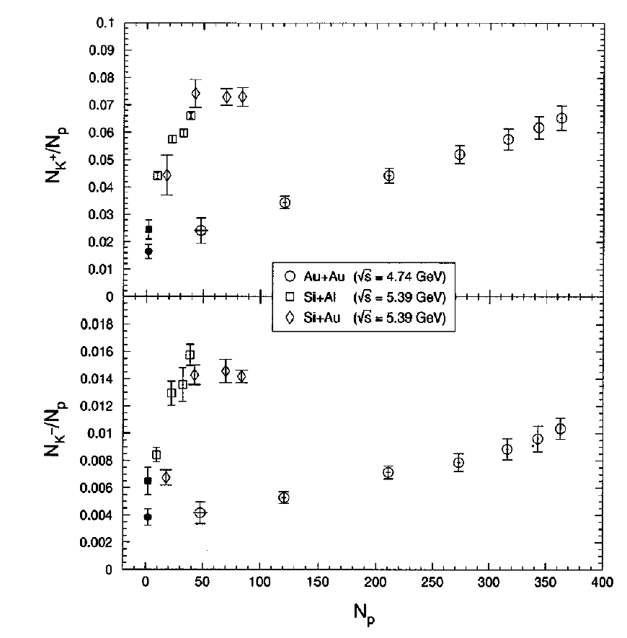
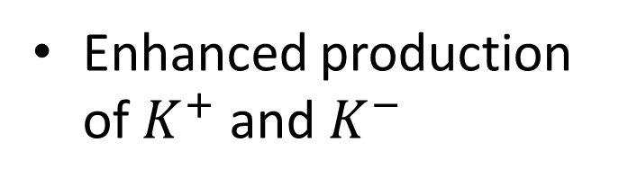
Main results of E866
Radial flow of proton
Stopping of baryon
Formation of high baryon density
Enhanced production of $K^{+}$ and $K^{−}$

Slide 12
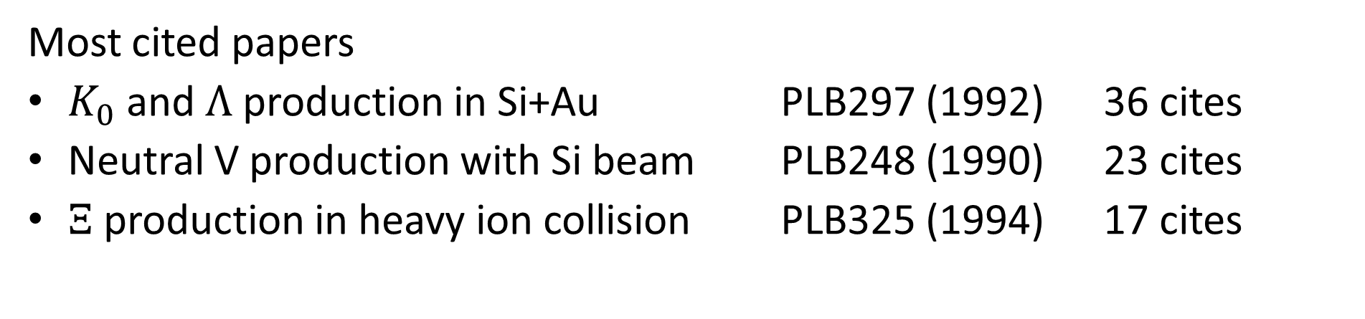
Main results from E810
Most cited papers
$K_{0}$ and $Λ$ production in Si+Au PLB297 (1992) 36 cites
Neutral V production with Si beam PLB248 (1990) 23 cites
$Ξ$ production in heavy ion collision PLB325 (1994) 17 cites

Slide 13
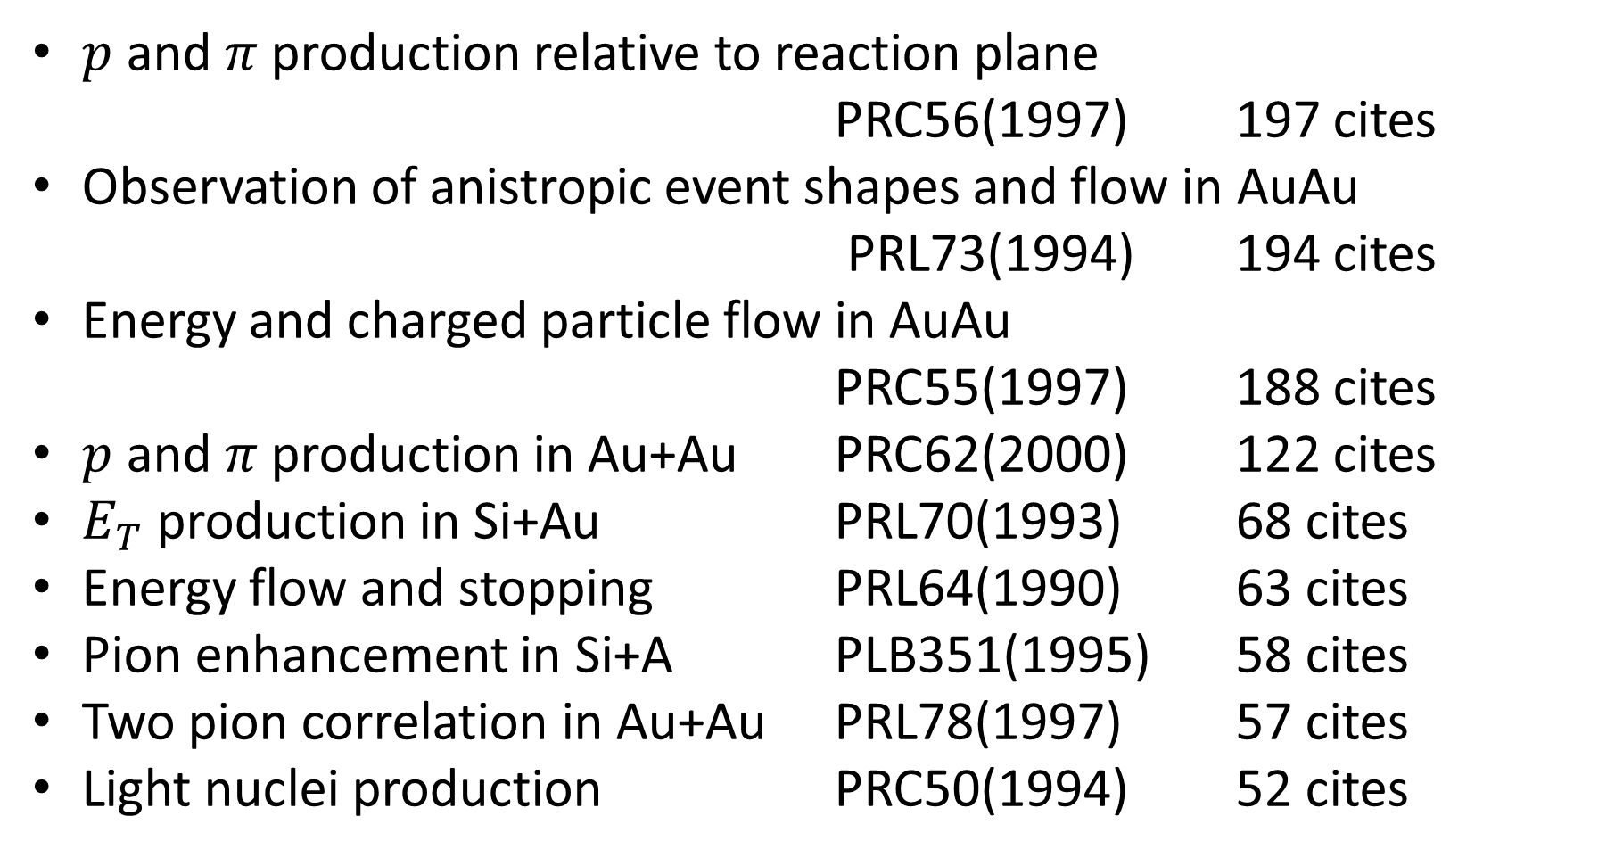
Main results from E814/E877
$p$ and $π$ production relative to reaction plane
PRC56(1997) 197 cites
Observation of anistropic event shapes and flow in AuAu
PRL73(1994) 194 cites
Energy and charged particle flow in AuAu
PRC55(1997) 188 cites
$p$ and $π$ production in Au+Au PRC62(2000) 122 cites
$E_{T}$ production in Si+Au PRL70(1993) 68 cites
Energy flow and stopping PRL64(1990) 63 cites
Pion enhancement in Si+A PLB351(1995) 58 cites
Two pion correlation in Au+Au PRL78(1997) 57 cites
Light nuclei production PRC50(1994) 52 cites

Slide 14
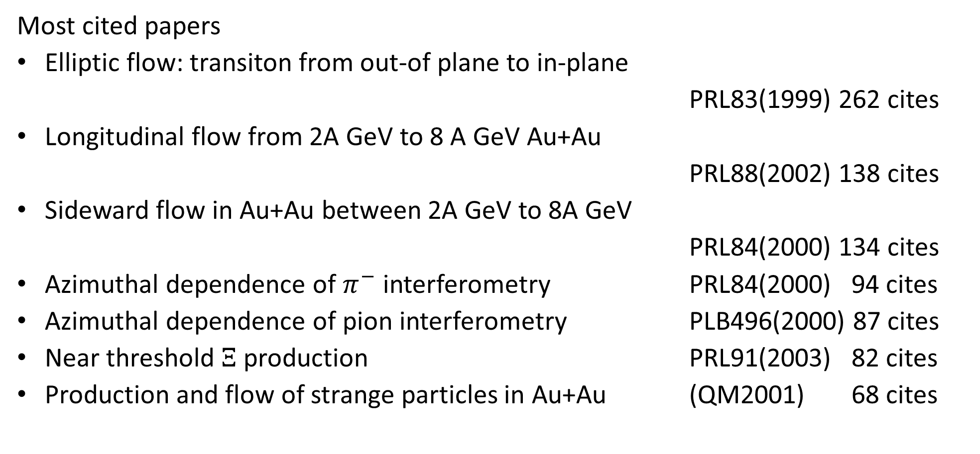
Main results from E895 (EOS)
Most cited papers
Elliptic flow: transiton from out-of plane to in-plane
PRL83(1999) 262 cites
Longitudinal flow from 2A GeV to 8 A GeV Au+Au
PRL88(2002) 138 cites
Sideward flow in Au+Au between 2A GeV to 8A GeV
PRL84(2000) 134 cites
Azimuthal dependence of $π^{−}$ interferometry PRL84(2000) 94 cites
Azimuthal dependence of pion interferometry PLB496(2000) 87 cites
Near threshold $Ξ$ production PRL91(2003) 82 cites
Production and flow of strange particles in Au+Au (QM2001) 68 cites

Slide 15
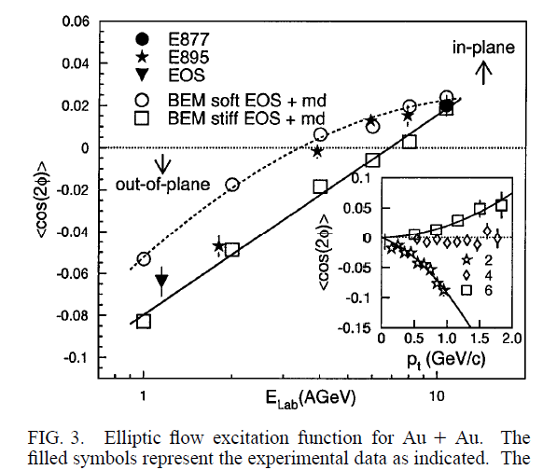
Main results of E895
PRL83, 1295(1999) from E895 is the most cited paper from all of AGS HI experiment
This is due to the interest to the elliptic flow after the start of RHIC and discovery of strong elliptic flow at RHIC
The data show that the sign of the elliptic flow changes at about Elab=4 GeV

Slide 16
Some remark
Many results were obtained from the AGS HI experiments. These results includes
  Strangeness enhancement / chemical equilibrium
  High baryon density
  Radial flow
  Directed flow and elliptic flow
New experiment requires a lot of effort (money and person power) . Easily obtainable results were already obtained
If you want to do a new heavy ion experiment at the AGS energy, you need to promise a new and very significant results that justify the cost and the effort

