Slide 1
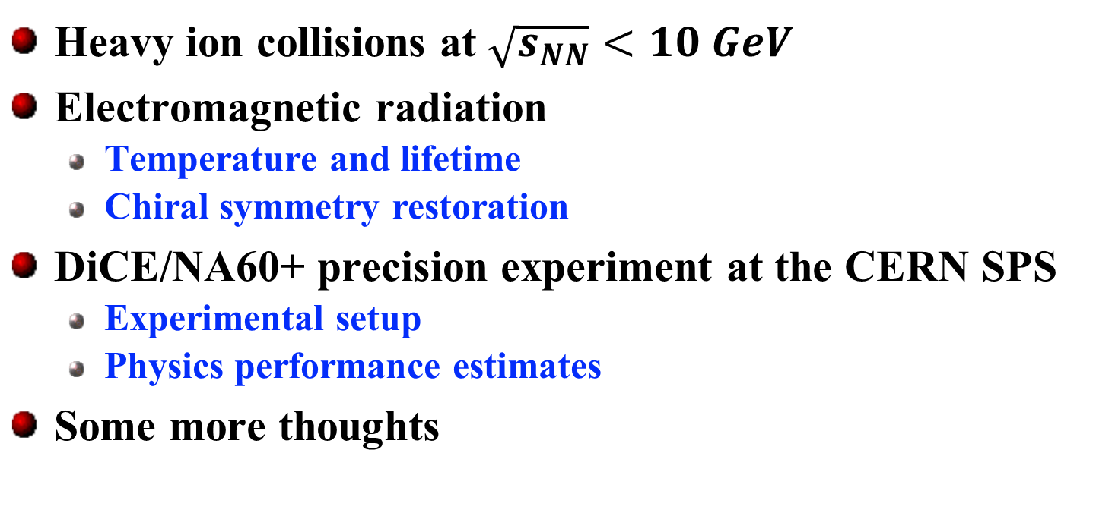
Electromagnetic Probes and DiCE/NA60+
New Horizons with Fixed-Target Proton-Nucleus Experiments
Axel Drees, CFNS Workshop, July 2024, Stony Brook
Heavy ion collisions at $\sqrt{s_{NN}}<10 GeV$
Electromagnetic radiation
  Temperature and lifetime
  Chiral symmetry restoration
DiCE/NA60+ precision experiment at the CERN SPS
  Experimental setup
  Physics performance estimates
Some more thoughts
Dilepton and Charm Experiment

Slide 2
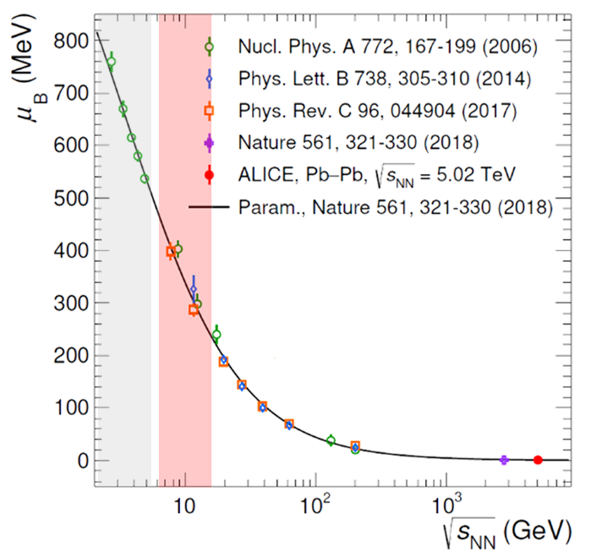
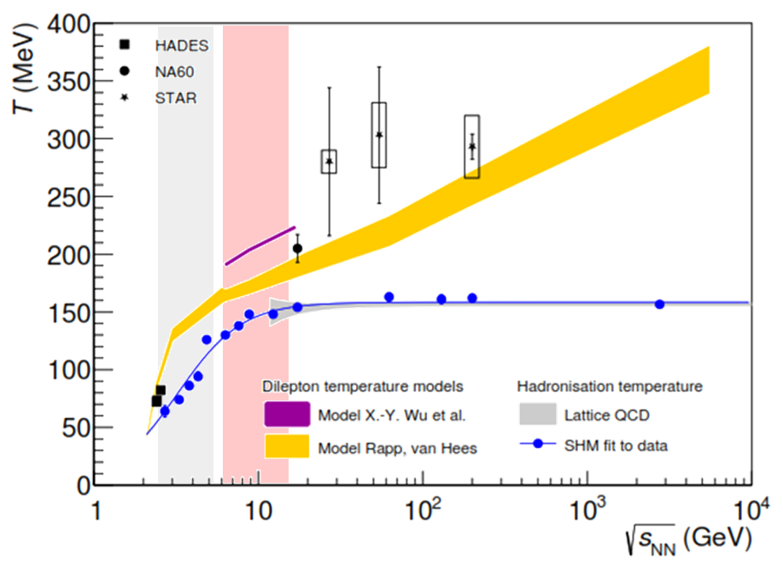


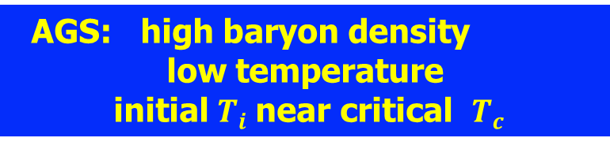
Characterizing Initial Conditions of Heavy Ion Collisions
Thermal Model Analyses
ALICE: Phys. Rev. Lett. 113 (2024) 092301
NA60+/DiCE proposal: CERN-SPSC-2025-023 ; SPSC-P-373
$$T_{i}$$
$$T_{C} \sim 156 MeV$$
SIS 100
AGS
SPS
RHIC BES
AGS Fixed Target Mode: $2.5<\sqrt{s_{NN}}<$ 5 GeV
AGS: high baryon density
low temperature
initial $T_{i}$near critical $T_{c}$

Slide 3
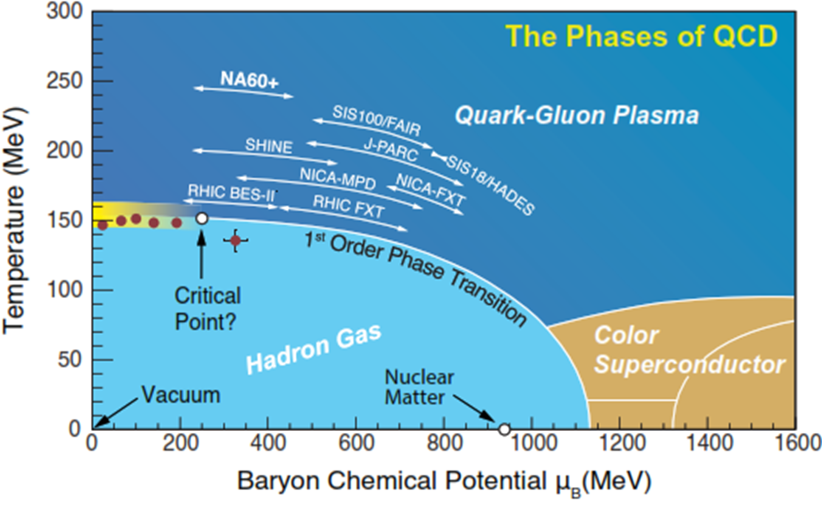
Phase Diagram of Nuclear Matter
Adapted from T. Ullrich
SPS
RHIC BES I/II
SIS 100
AGS
BES-II fix T
SIS 18

Slide 4
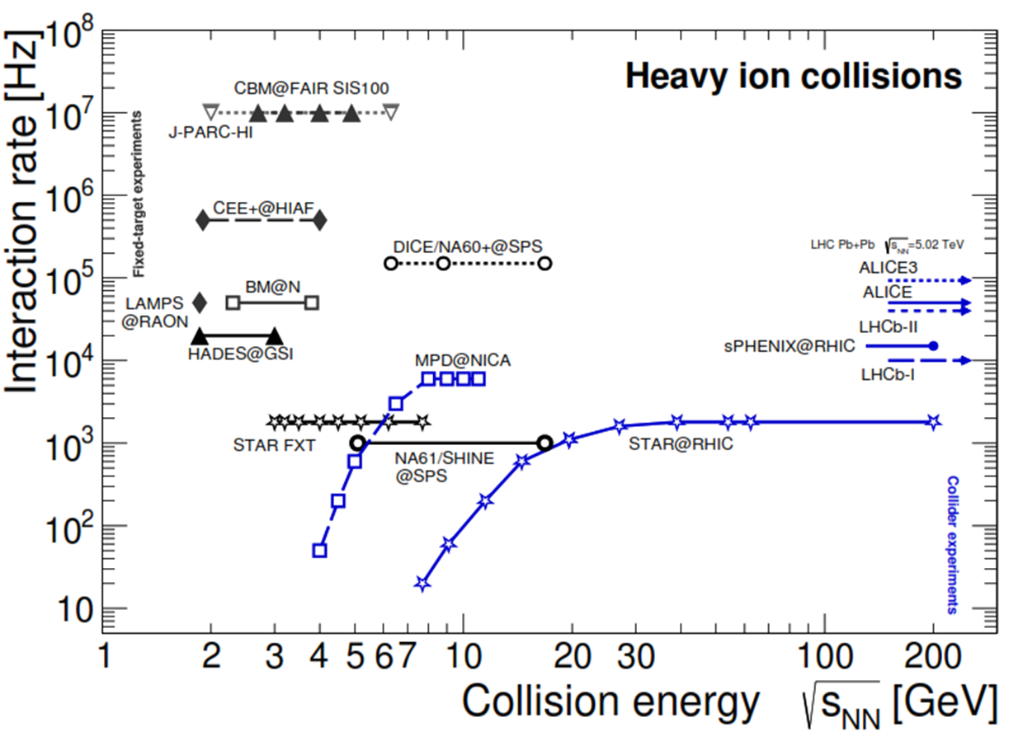
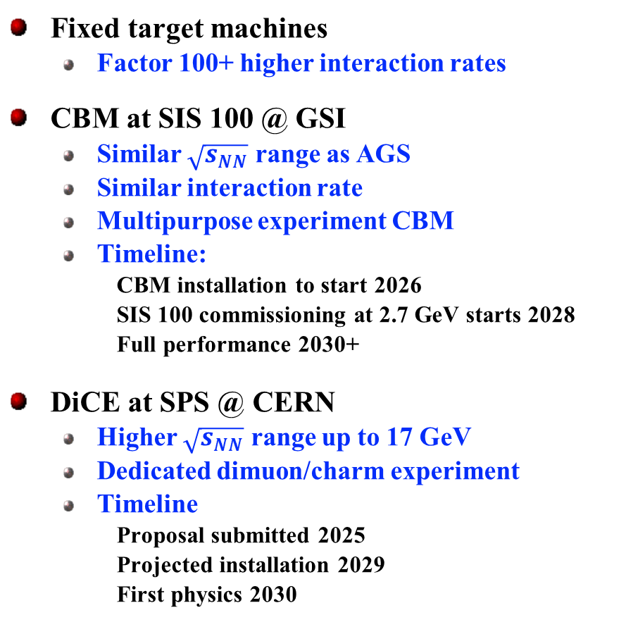
Experimental Landscape for High $μ_{B}$Facilities
Adapted from T. Galatyuk NPA (2019) 982
Fixed target machines
  Factor 100+ higher interaction rates
CBM at SIS 100 @ GSI
  Similar $\sqrt{s_{NN}}$ range as AGS
  Similar interaction rate
  Multipurpose experiment CBM
  Timeline:
    CBM installation to start 2026
    SIS 100 commissioning at 2.7 GeV starts 2028
    Full performance 2030+
DiCE at SPS @ CERN
  Higher $\sqrt{s_{NN}}$ range up to 17 GeV
  Dedicated dimuon/charm experiment
  Timeline
    Proposal submitted 2025
    Projected installation 2029
    First physics 2030
AGS
New Generation HI Experiments @AGS:
complementary to CBM
and/or aggressive timeline

Slide 5
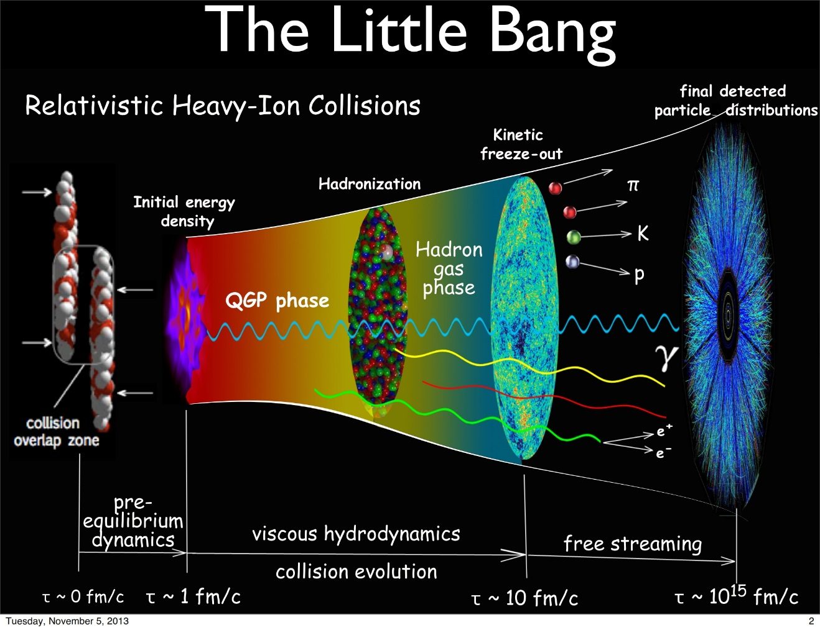


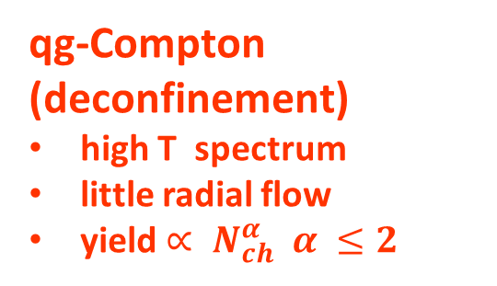
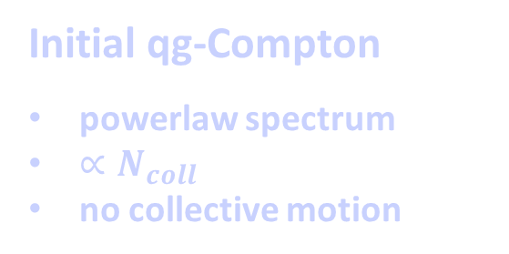
Electromagnetic Radiation in A+A Collisions:
160-110 MeV
110 MeV
Hubble Expansion: T=300-160 MeV
qg-Compton (deconfinement)
high T spectrum
little radial flow
yield $∝ N_{ch}^{α} α ≤2$
Confinement
Chiral symmetry breaking
Initial qg-Compton
powerlaw spectrum
$∝N_{coll}$
no collective motion
πρ Scattering
Low T spectrum
Large flow/ blue shift
yield $∝ N_{ch}^{α} α>1$
Hadron Decays
yield $∝ N_{ch}^{}$
Spectra derived from parent particles
<

Slide 6
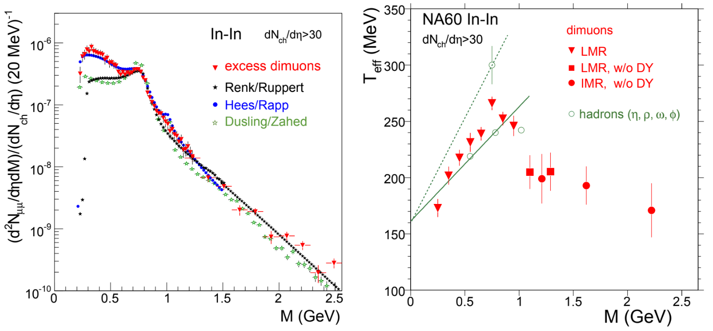

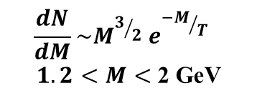


Temperature Measurement
NA60 dimuon mass and p_{T} spectra
NA60: Euro. Phys. J. C61 (2009) 711
NA60: Euro. Phys. J. C59 (2009) 607
$$T=205±12 MeV$$
$$T_{eff} \sim 200 MeV$$
$$\frac{dN}{dM}\sim {M^{3/2} e}^{{−M}/{T_{}}}$$
$1.2<M<$ 2 GeV
$$\frac{1}{p_{T}}\frac{dN}{dp_{T}}\sim e^{{−m_{T}}/{T_{eff}}}$$
Model independent determination
Initial Temperature T_{i}>200 MeV > T_{C}

Slide 7
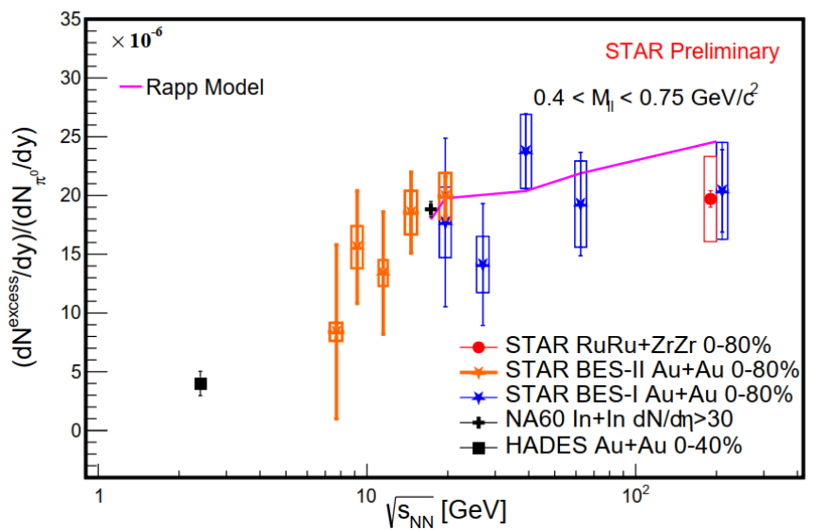
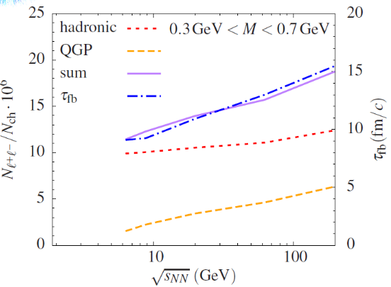

Lifetime Measurement
Chronometer of fireball: normalized integrated yield ${N_{γ∗} }/{N_{ch}}$ sensitive to lifetime
Rapp & vHees Euro.Phys.J. A52 (2016) 257
STAR: QM2025
Model dependent determination
Fireball lifetime $τ_{fb}\sim 10 to 15 fm/c$

Slide 8
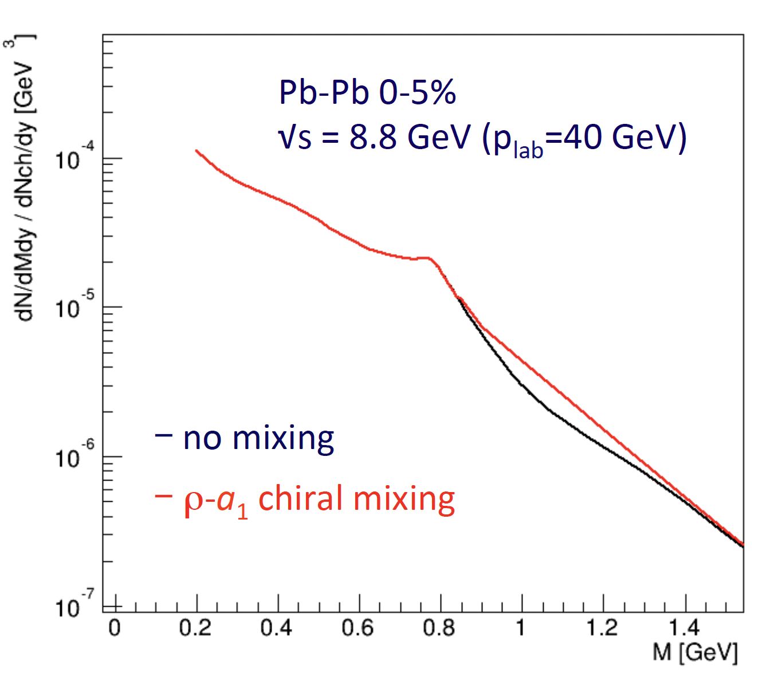
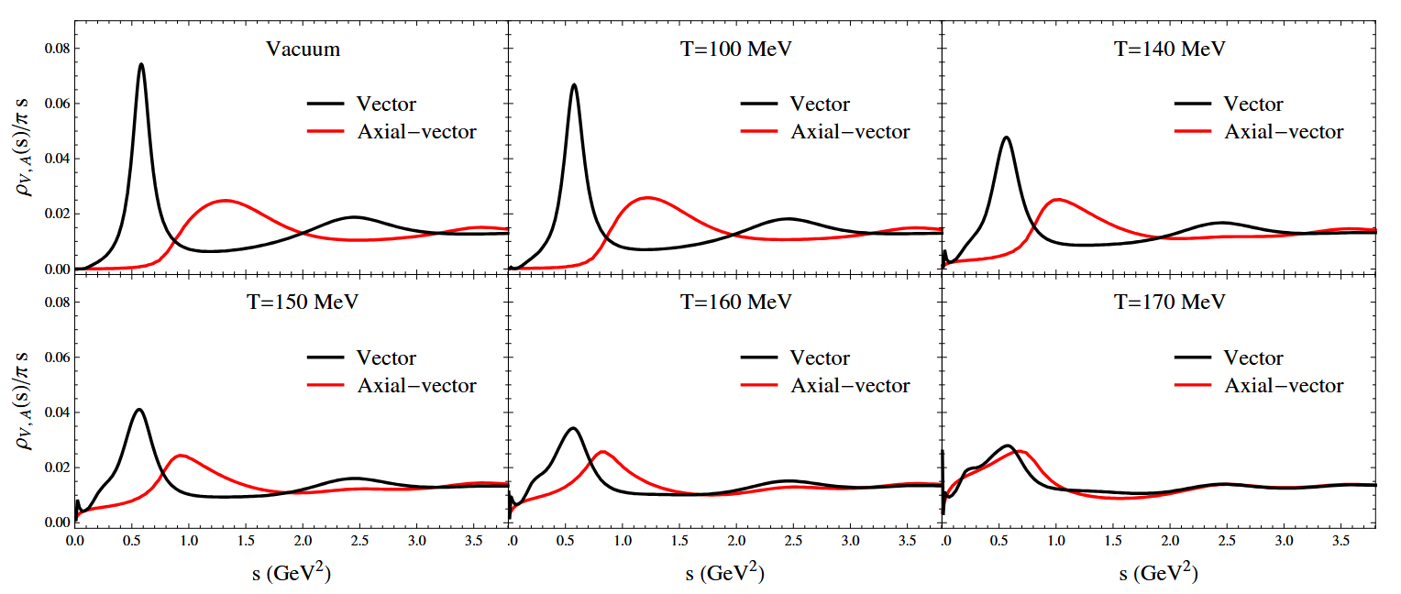
Spectral Functions and Chiral Symmetry Restoration
Spectral function in nuclear matter sensitive to chiral symmetry restoration
DiCE/NA60+ proposal
Rapp & vHees Euro.Phys.J. A52 (2016) 257
ρ
a₁
ρ−a₁ chiral mixing
Chiral symmetry will lead to
ρ and a₁ degeneracy

Slide 9
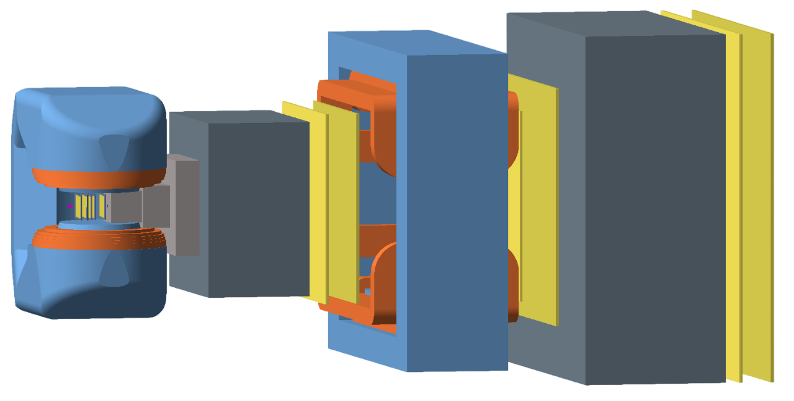

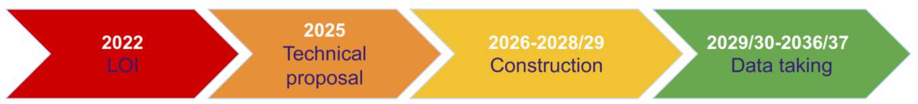

The DiCE/NA60+ Experiment
Dilepton and Charm Experiment
Proposal 5-23-2025
CERN-SPSC-2025-023; SPSC-P-373

Slide 10
The DiCE/NA60+ Experiment
Dimuon Spectrometer:
muon dipole magnet
vertex dipole magnet
muon wall
target
Pb or proton beam
hadron absorber
vertex
telescope
muon tracking chambers
Vertex Spectrometer
tracking, momentum, displaced vertex
Muon spectrometer
muon ID, tracking, matching in space
and momentum

Slide 11
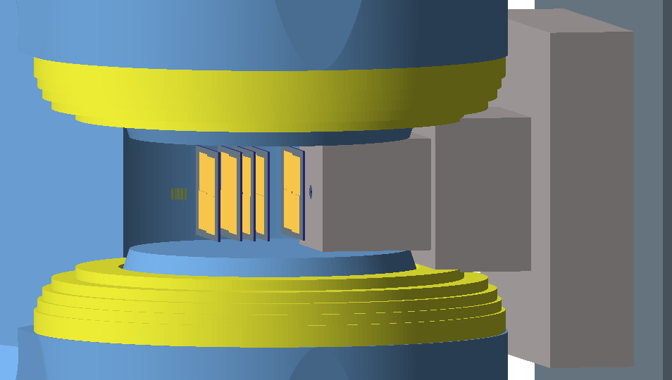
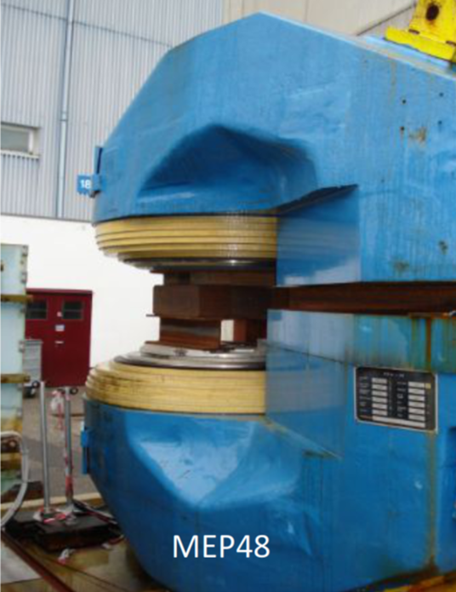
Vertex Spectrometer
1.5 T dipole magnet
1.5 T
dipole magnet
10⁶ Pb/s or 5x10⁷ p/s
vertex telescope:
5 layers of large area MAPS pixel sensors
placed at 7 < z < 38 cm from the closest target
segmented target:
Pb beam: 5 x 1.5mm Pb targets (15% interaction length)
p-beam: 3 mm Pb + 5 mm Cu + 12 mm Be

Slide 12
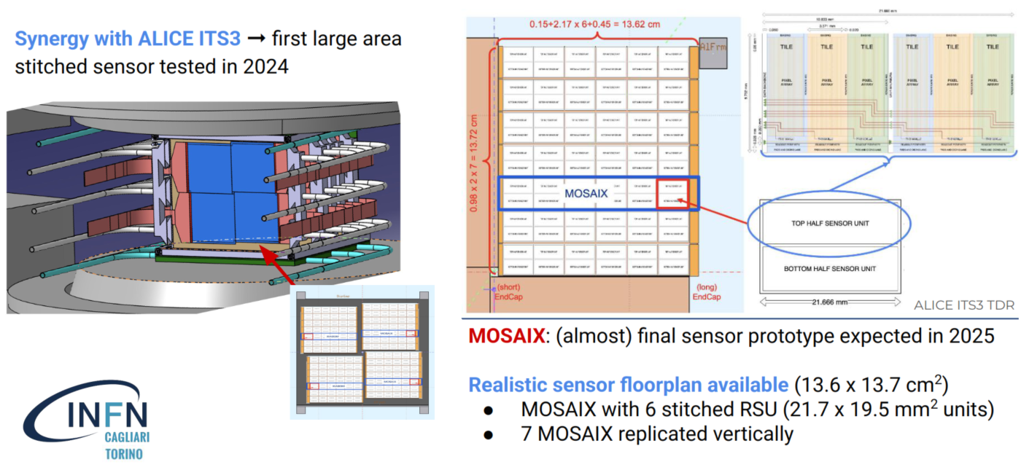
Vertex Telescope
Notes:
Monolithic CMOS sensors, developed for ALICE upgrade ITS3,

Slide 13
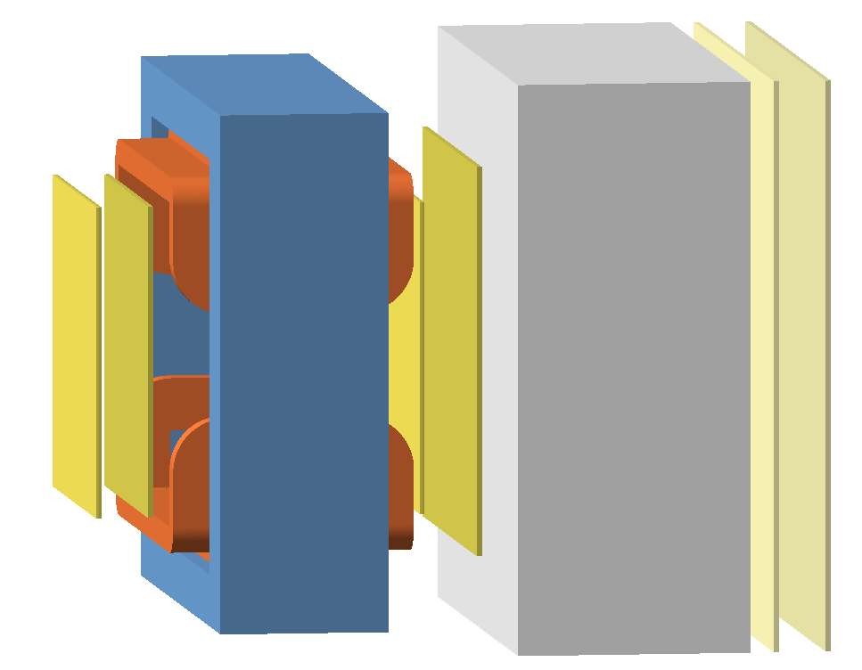
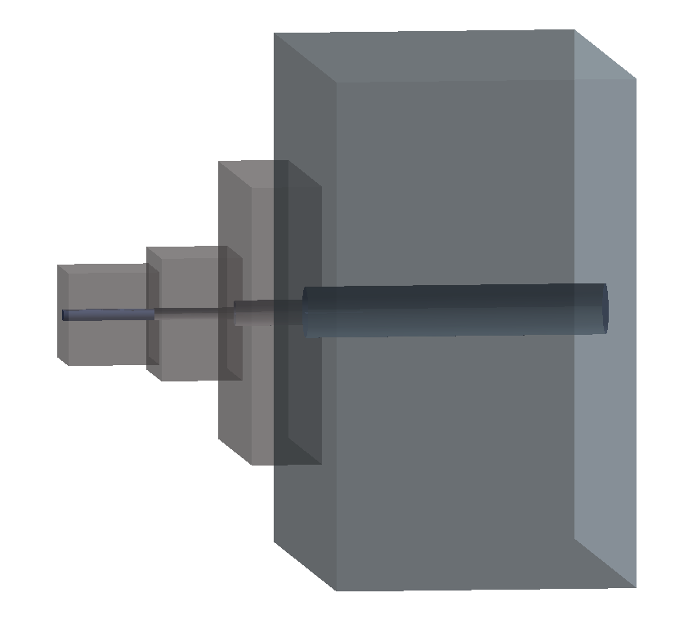
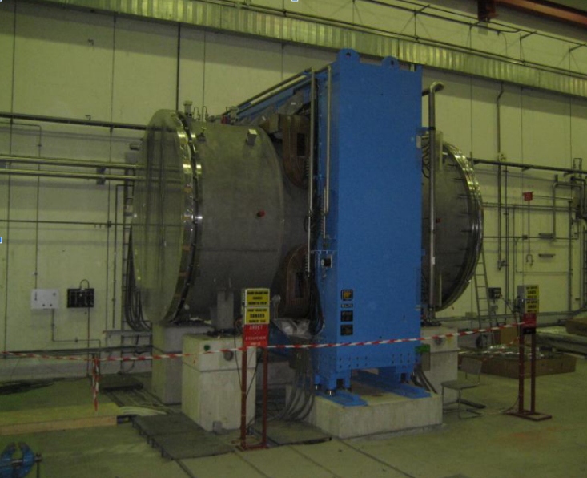
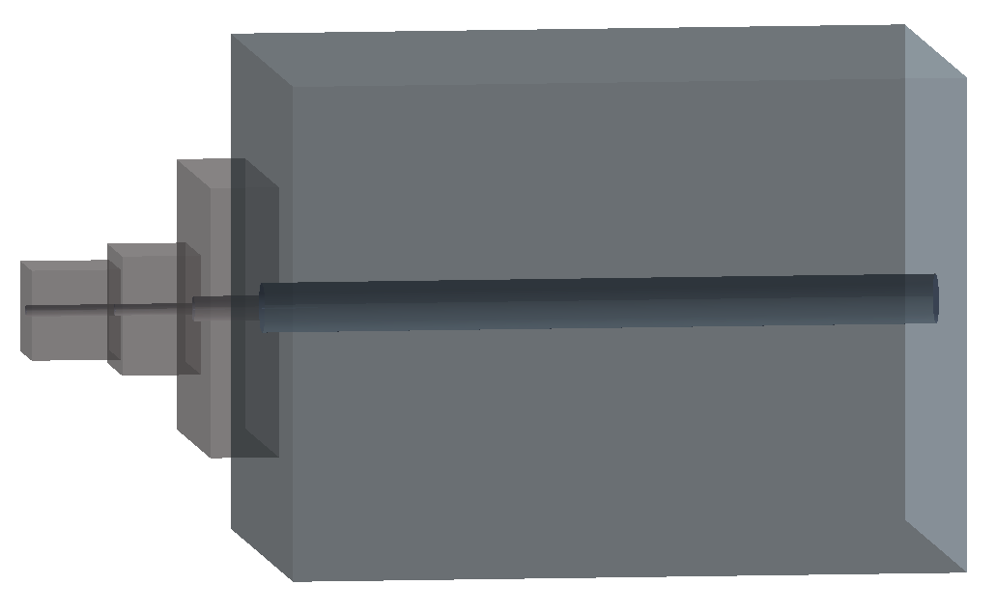
Muon Spectrometer
Low energy setup:
short hadron absorber BeO+C
MNP33 dipole magnet speciﬁcs:
Large acceptance
Iron yoke: 2.40 m x 3.20 m
Integrated ﬁeld: 0.864 T m
High energy setup:
long hadron absorber BeO+C

Slide 14
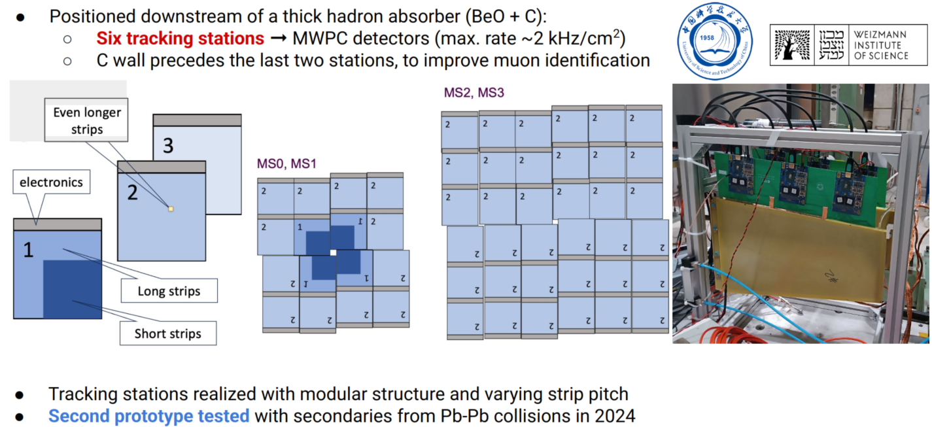
Muon Tracking Chambers

Slide 15
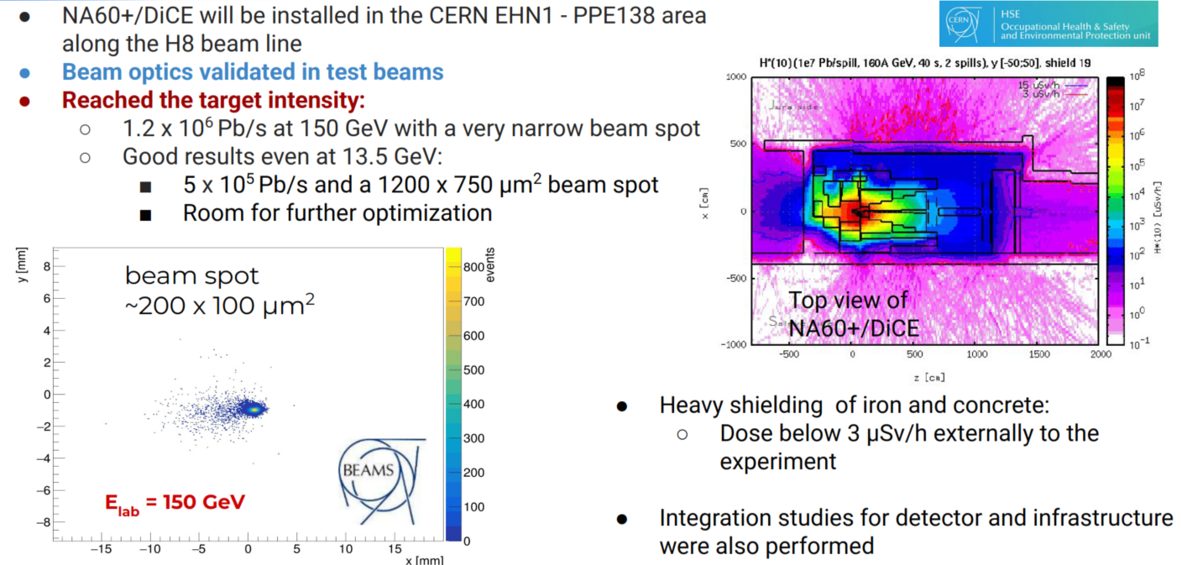
Muon Tracking Chambers

Slide 16
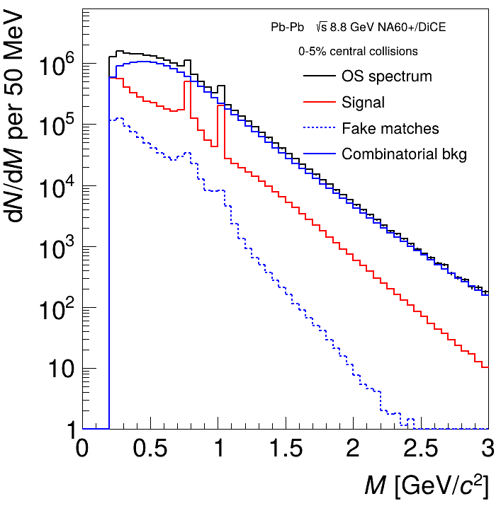
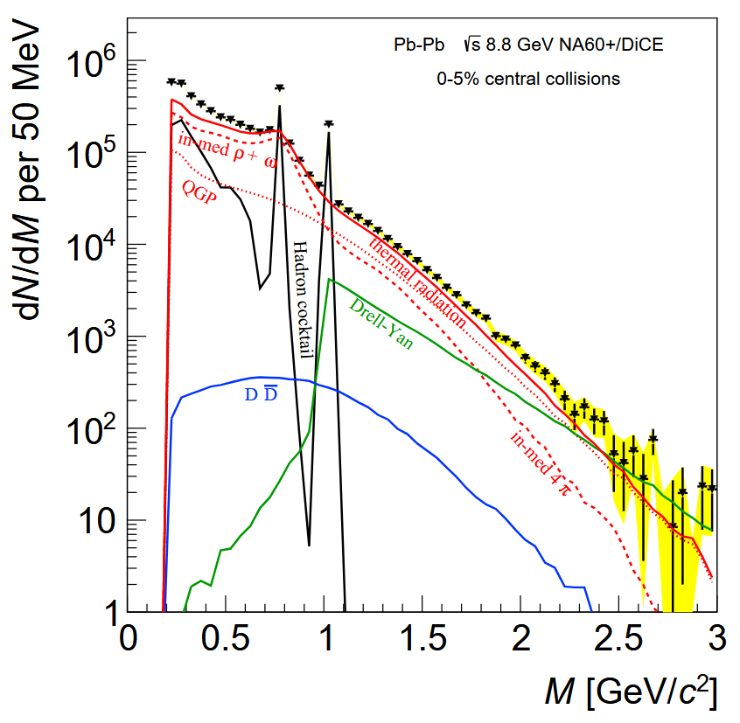
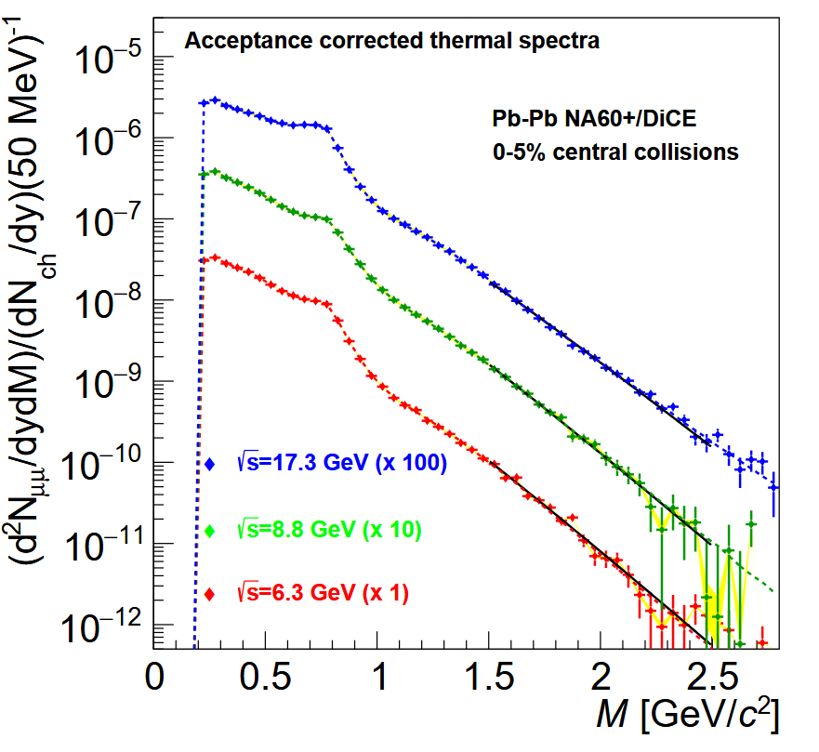

Thermal Radiation Performance Studies
Pb-Pb at $\sqrt{s_{NN}}=6.3,8.8,17.3 GeV$for 2, 1, 1 month data taking
DiCE/NA60+ proposal
Raw data Signal vs cocktail Acceptance corrected thermal spectra
$$σ_{ω}\sim 7MeV$$
S/B ~ 1/10
Acceptance corrected thermal spectrum
0.2 < M < 2.5 GeV
with unprecedented accuracy!

Slide 17
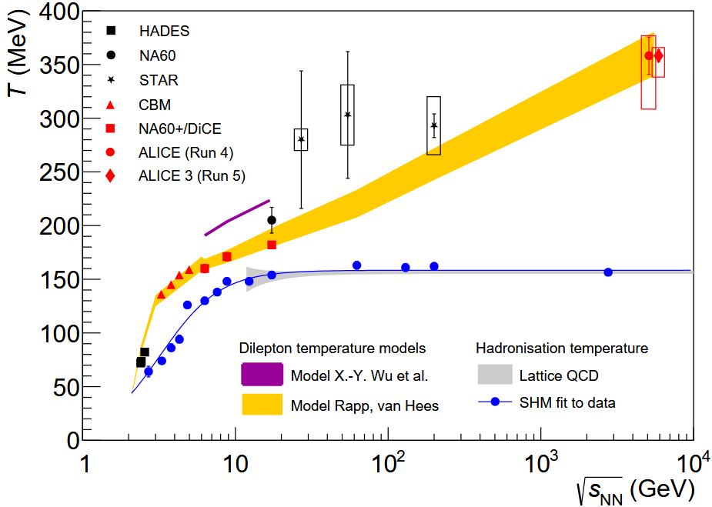
Thermal Radiation Performance Studies
Pb-Pb at $\sqrt{s_{NN}}=6.3,8.8,17.3 GeV$for 2, 1, 1 month data taking
DiCE/NA60+ proposal
DiCE/NA60+ & CBM
Precision characterization
system temperatures
in phase transition region!

Slide 18
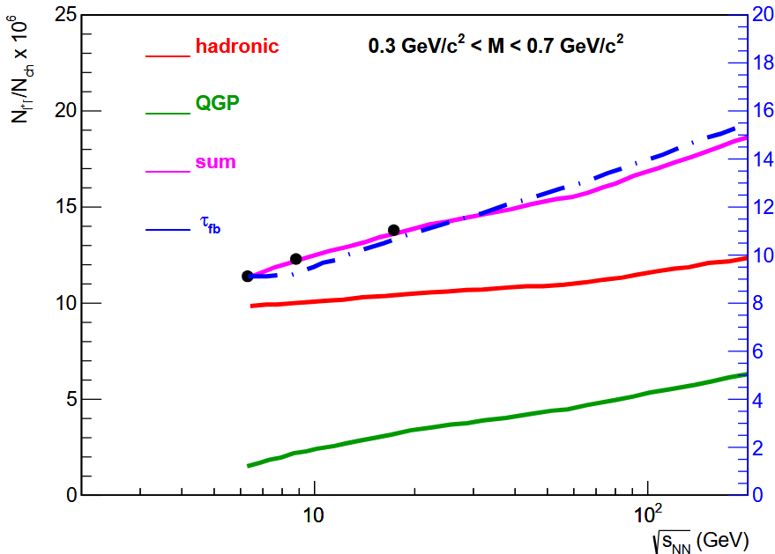
Thermal Radiation Performance Studies
Pb-Pb at $\sqrt{s_{NN}}=6.3,8.8,17.3 GeV$for 2, 1, 1 month data taking
DiCE/NA60+ proposal
DiCE/NA60+ precision
lifetime measurement!

Slide 19
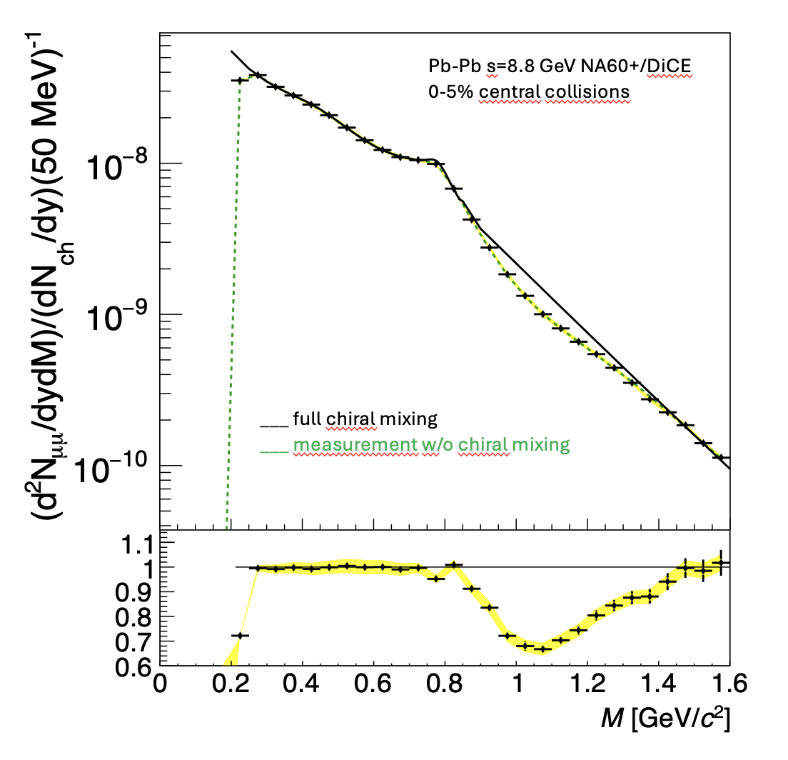
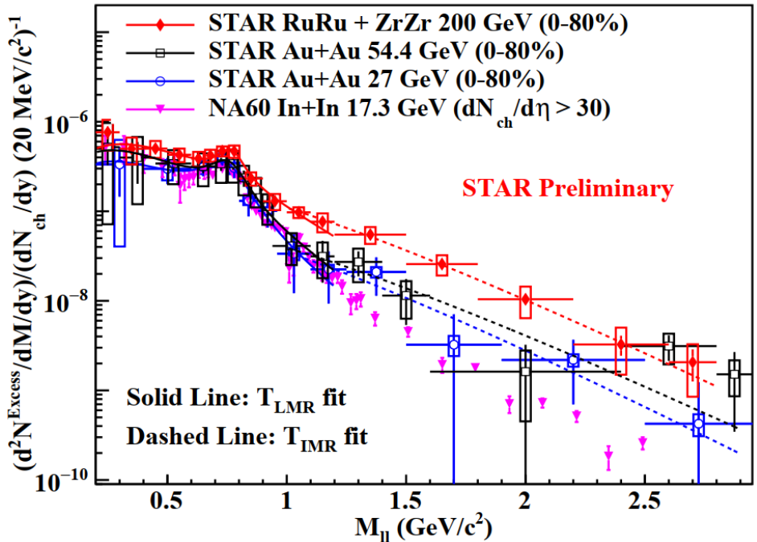
Thermal Radiation Performance Studies
Pb-Pb at $\sqrt{s_{NN}}=6.3,8.8,17.3 GeV$for 2, 1, 1 month data taking
DiCE/NA60+ proposal
10x NA60 Statistics
Statistical precision will allow DiCE/NA60+ to detect
chiral symmetry restoration!

Slide 20
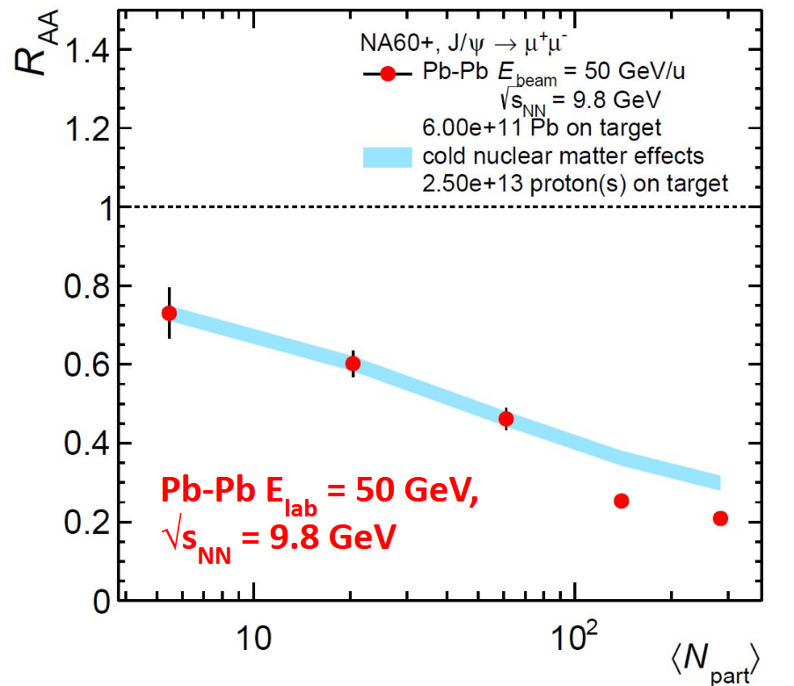
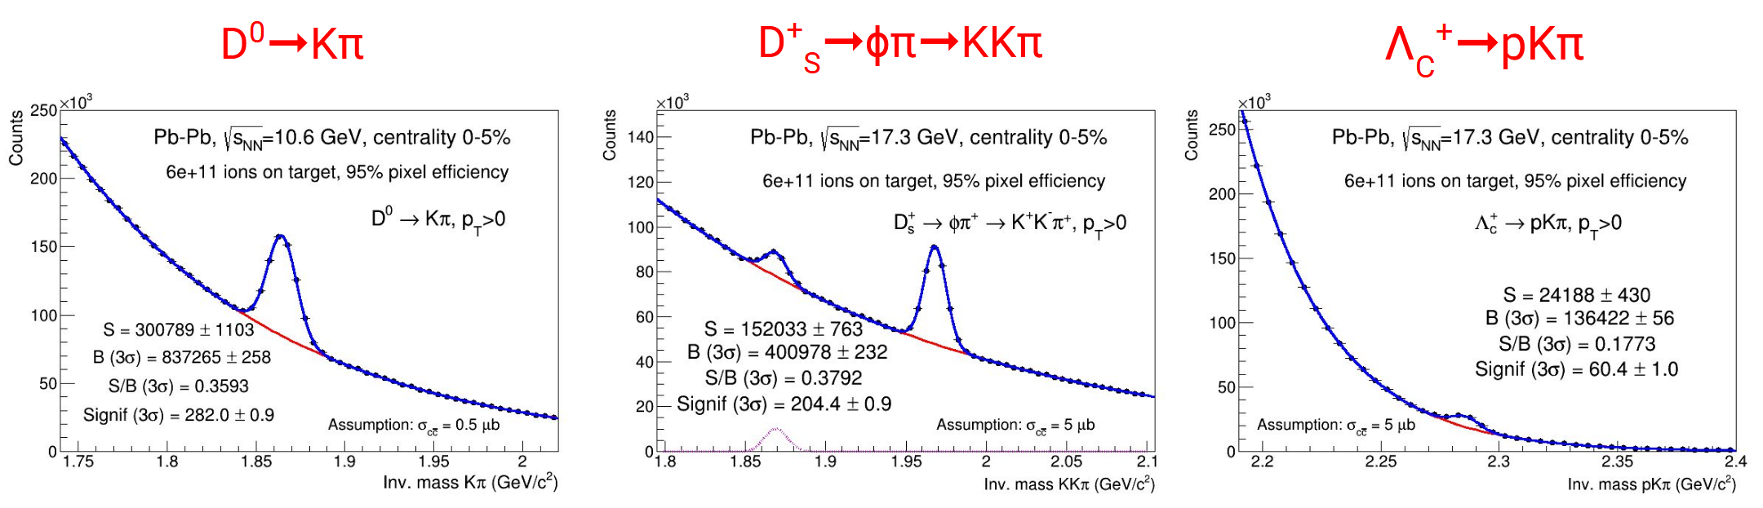

Charmonium and Open Heavy Flavor Performance Studies
Pb-Pb at $\sqrt{s_{NN}}=9.8,10.6, 17.3 GeV$for 1 month data taking each
DiCE/NA60+ proposal
$$J/ψ$$
Dice/NA60+
Precision charm measurements

Slide 21

Heavy Ion Physics at the AGS
Initial system near $critical temperature T_{i} \sim { T}_{c}$
  Initial partonic state
  Immediate hadronization
Competitive environment with state-of-the-art experiments
  @FAIR CBM multipurpose and dilepton detector
  @SPS DiCE dimuon & charm & some hadronic observables
Ideally suited to study hadronization?
AGS
AGS
Absence of photon measurements!
Possible opportunity:
low p_{T} direct photons
from hadronization

Slide 22
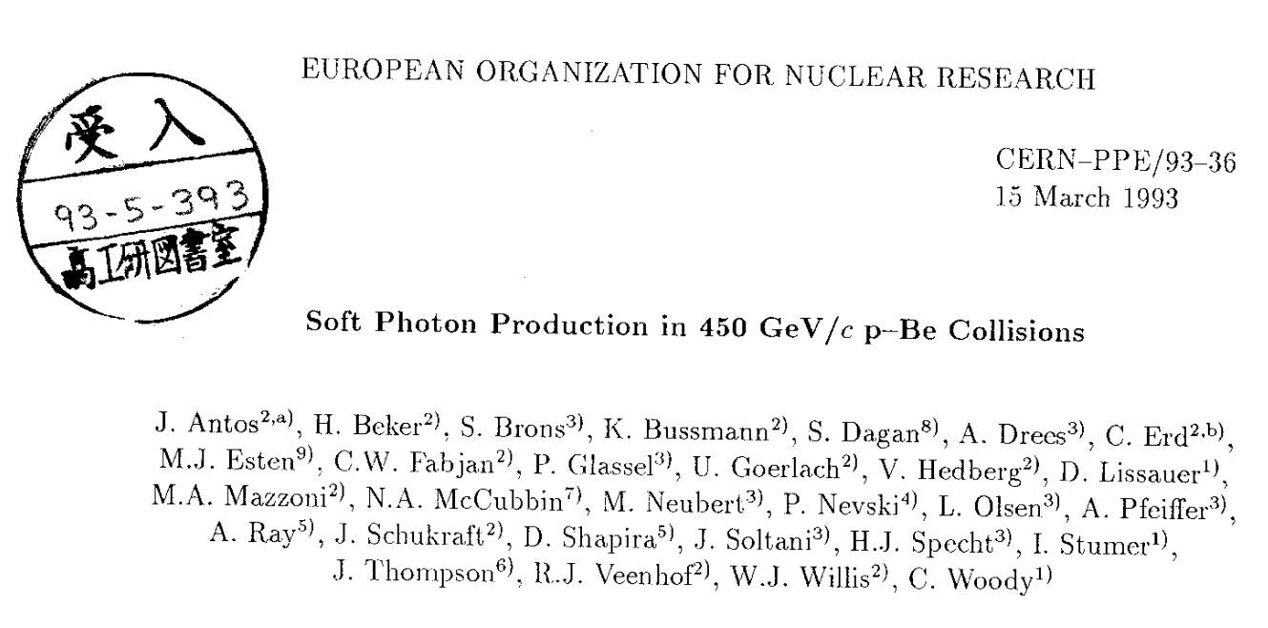
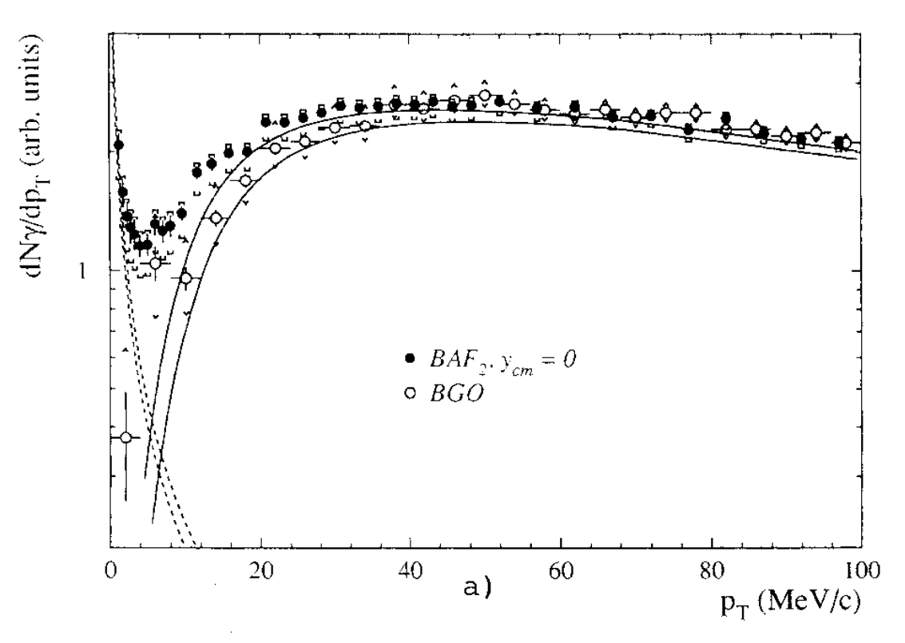
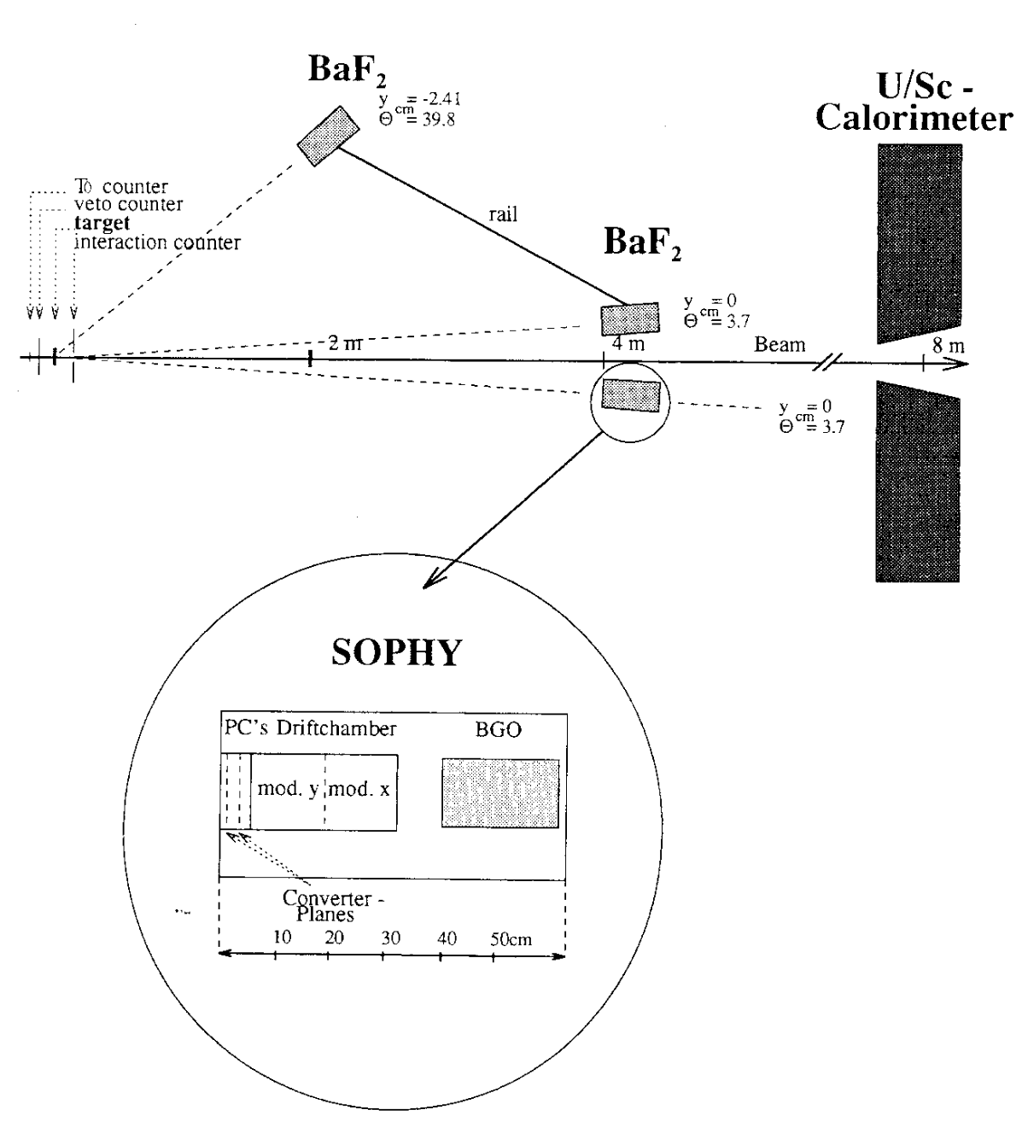
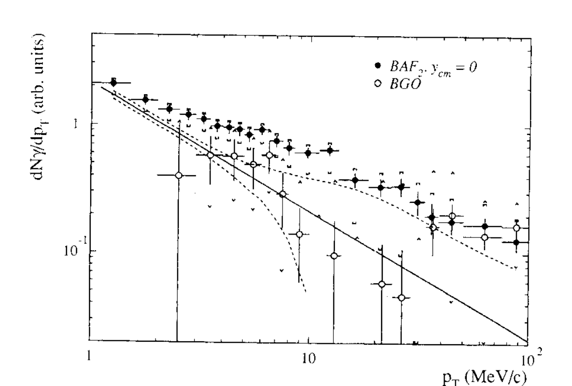
Low p_{T} Direct Photons in Fixed Target Experiments
HELIOS subgroup Specht/Willis Z.Phys.C59 (1993) 547
Inclusive Photons
hadron decays
Direct Photons:
bremsstrahlung signal
(consistent with Low’s Theorem)
+
possible enhancement
(hadronization?)
bremsstrahlung
Direct Photons
bremsstrahlung

