Slide 1
BeAGLE analysis: Excitation Energy Distribution dependence on Formation Time Parameter Variation
Isaiah Richardson
5/28/2025
Facility for Rare Isotope Beams, Michigan State University, East Lansing, MI 48824 USA
2025

Slide 2
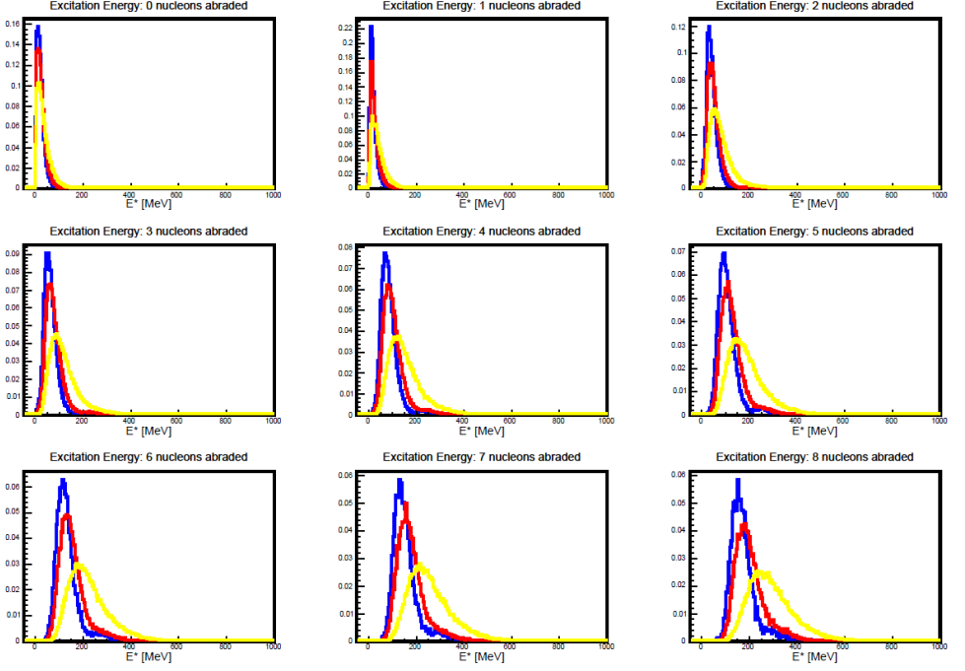
Results observed with our data (Barak and I)
Barak Previous analysis showed
  The yellow curve (2 fm/c) has a larger mode and median than red curve (10 fm/c) as dA increases
  The blue curve (20 fm/c) has a smaller mode and median than red curve (10 fm/c) as dA increases
My data shows the same trend
  Color tables show that 20 fm/c has lower mode while 2 fm/c has much larger mode which agrees with Baraks previous work (see Slides 3, 5, 7,16, 18, 19)
  My analysis differs for ²³⁸U and ⁷⁸Kr because typically the red or blue lognormal is shorter in amplitude than yellow lognormal (See slides 9, 11, 13, 15, 21, 23, 25, 27)

Slide 3
²³⁸U color table comparison – Original vs New for 𝜏₀ = 10
²³⁸U - Original
Noticed ²³⁸U (Original) and ²³⁸U 𝜏=10 Mode/dA is quite different
  E* is generally higher in the new 𝜏 = 10 by about 3 MeV on average.
  I was expecting these two to be the same because the original analysis was 𝜏=10
I also observed a shift between the Original data set and 𝜏 = 10 for ²³⁸U but not for ⁷⁸Kr
  BeAGLE version for original data was before v.1.01.03
    Fermi motion and binding energy changes
²³⁸U - 𝜏₀ =10

Slide 4
²³⁸U Sum comparison – Original vs New - 𝜏₀ = 10
²³⁸U - Original
Sum of Counts for each prefragment was observed between the Original and 𝜏 =10 to be nearly the same
  The sum can’t be the reason why the E* is so different
  Total Sum Original: 9,998,941
  Total Sum 𝜏 = 10: 9,999,094
  (about 10 million events sent)
²³⁸U - 𝜏 =10

Slide 5
²³⁸U for 𝜏₀ = 2: Color table
A overall higher E* was observed for this data set
More nuclei were produced overall
  Less formation time gives more prefragments produced

Slide 6
²³⁸U for 𝜏₀ = 2: Sum table
Total Sum in the color table for 𝜏 = 2: 997,134 (1 million events were sent)

Slide 7
²³⁸U for 𝜏₀ = 20 : Color table and Sum Table
A overall lower E* was observed for this data set
Less nuclei were produced
  More formation time gives less prefragments produced
Total Sum in the color table for 𝜏₀ = 20: 997,134 (1 million events were sent) *Double check number*

Slide 8
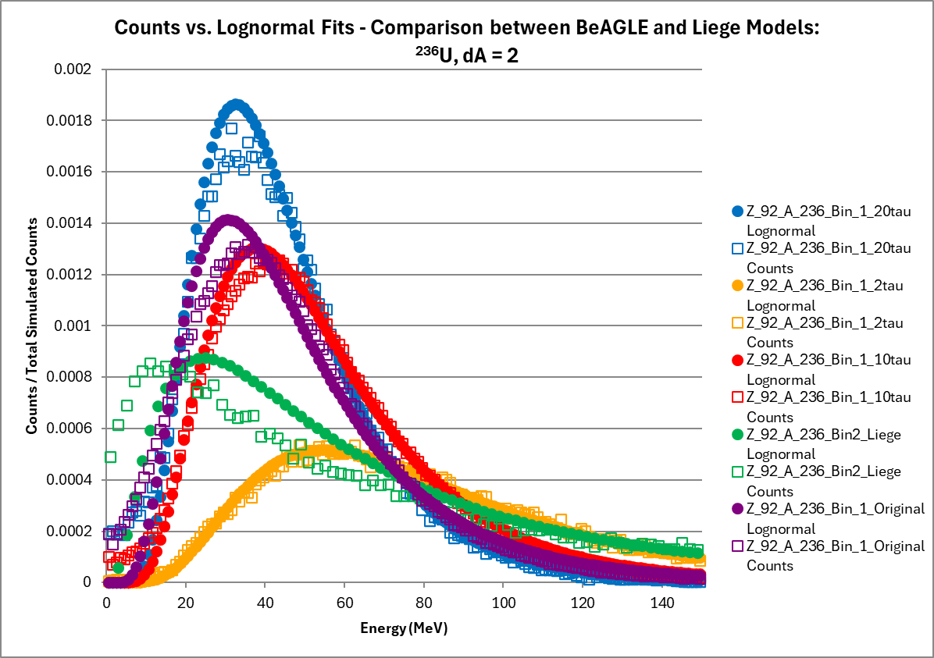
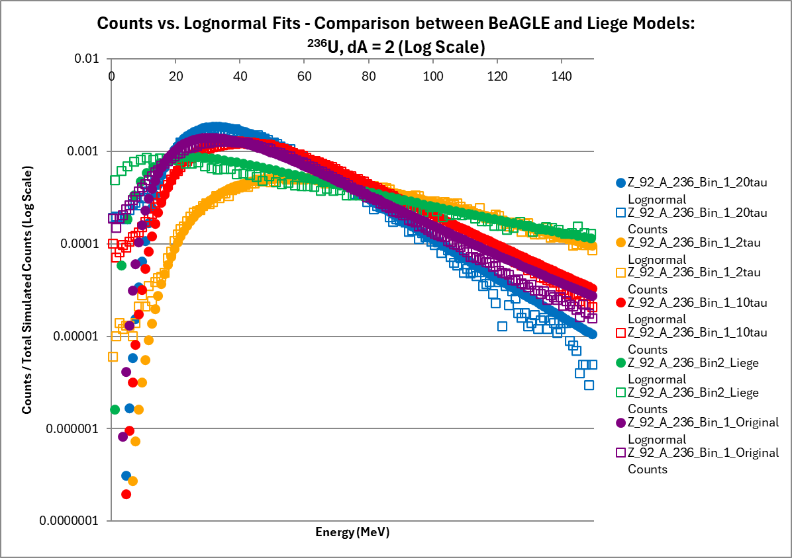
Example for ²³⁸U using All Models : ²³⁶U - dA=2, dZ=0, dN=2
We see the slight difference between the Original (Purple) and new 𝜏₀ = 10 (Red)
This helps explain behavior between BeAGLE and Liège Mode and Median (Slides 28, 29)
  The Mode for the Liège data (Green) matches closer to 𝜏₀ = 20
  The Median for the Liège Data (Green) matches closer to 𝜏₀ = 2 (my note check better E* dist. Liege)

Slide 9
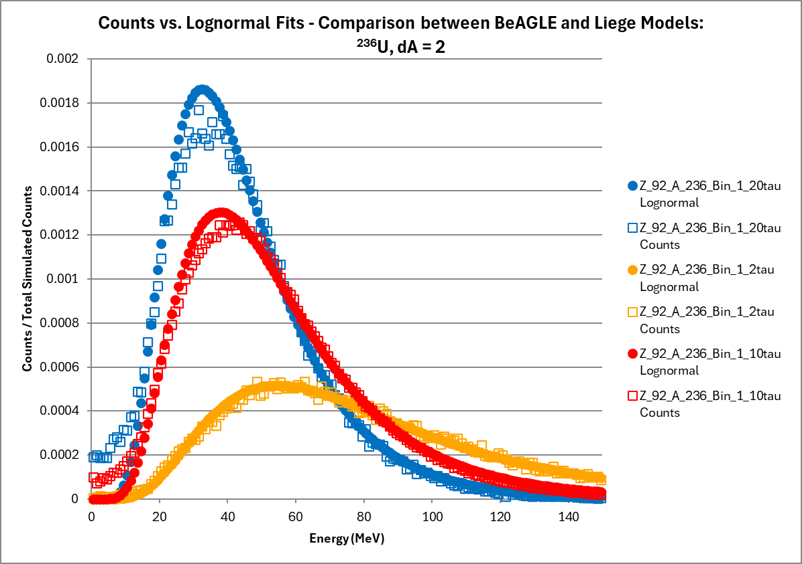
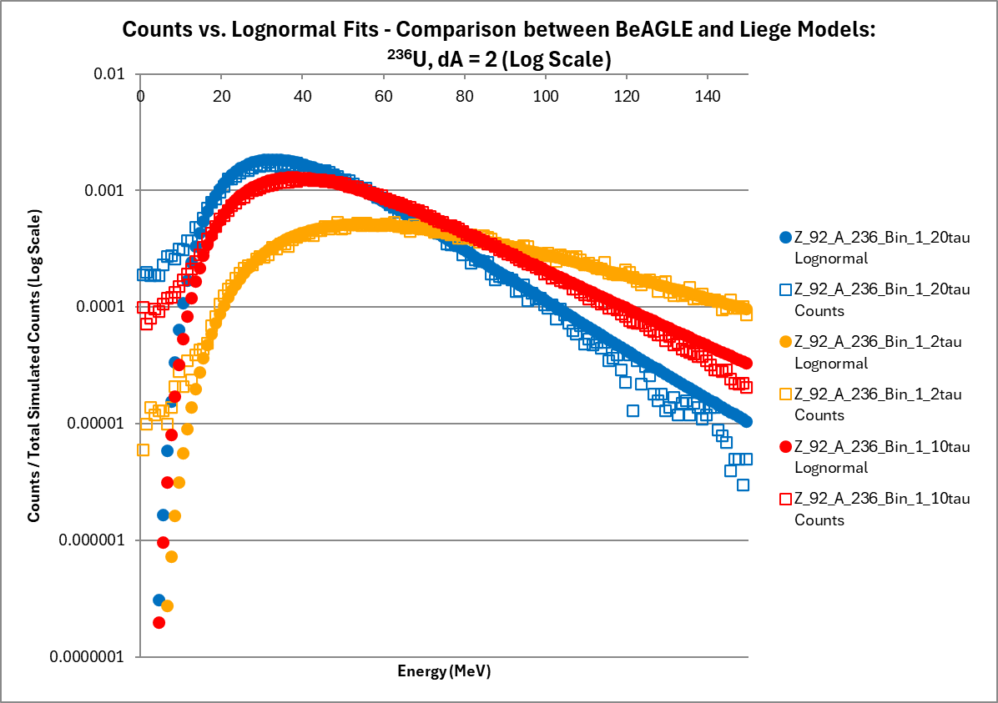
Example for ²³⁸U using 𝜏₀ only: ²³⁶U - dA=2, dZ=0, dN=2
We see the similar trend to Barak’s original data (slide 2)
  𝜏₀ =2 has the higher mode and median and 𝜏₀ = 20 has the lower median and mode
  Amplitudes with normalized axes follow trend of Slide 2
Less right tail peak demonstrated for 𝜏₀ =2 than 𝜏₀ =10 and 𝜏₀ =20

Slide 10
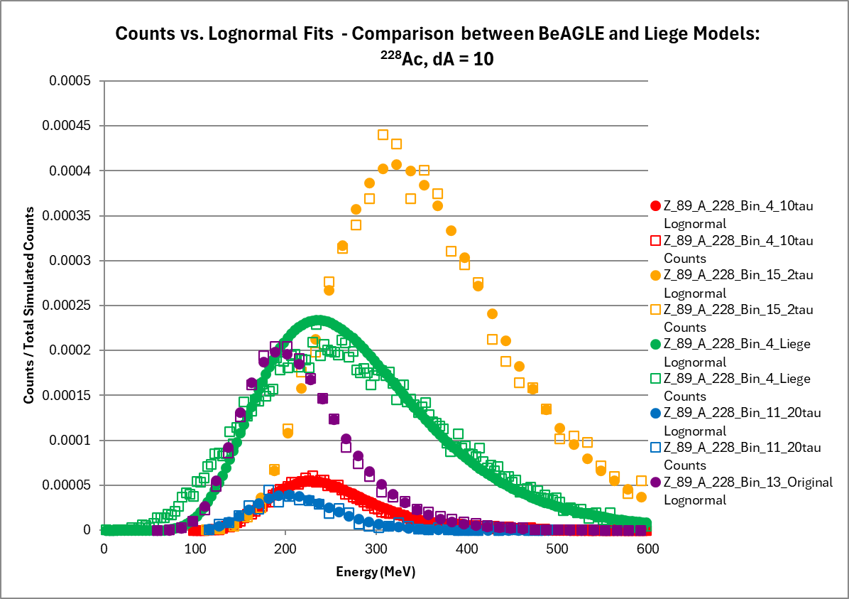
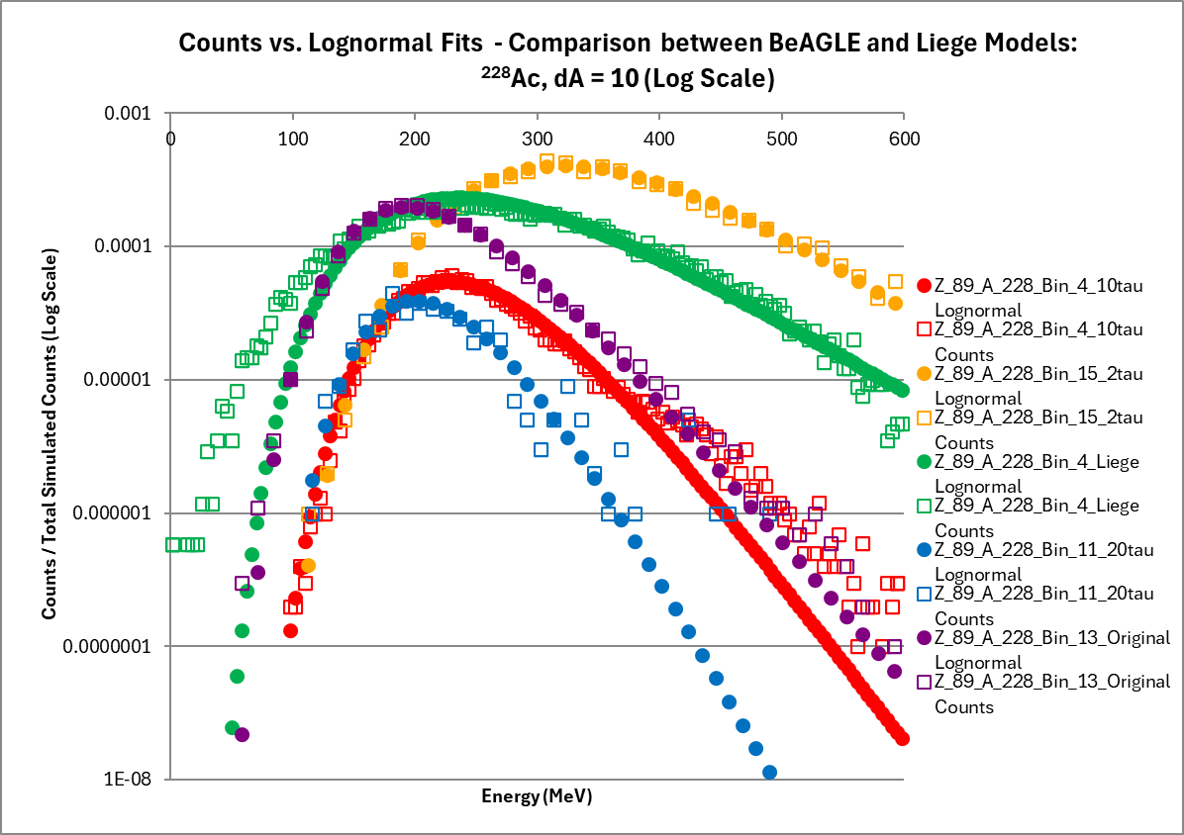
Example for ²³⁸U using All Models: ²²⁸Ac - dA = 10, dZ=3, dN=7
We see the large difference between the Original (Purple) and new 𝜏₀ = 10 (Red)
This helps explain behavior between BeAGLE and Liège Mode and Median (Slides 28, 29)
  The Mode for the Liège data (Green) matches closer to 𝜏₀ = 20
  The Median for the Liège Data (Green) matches closer to 𝜏₀ = 2

Slide 11
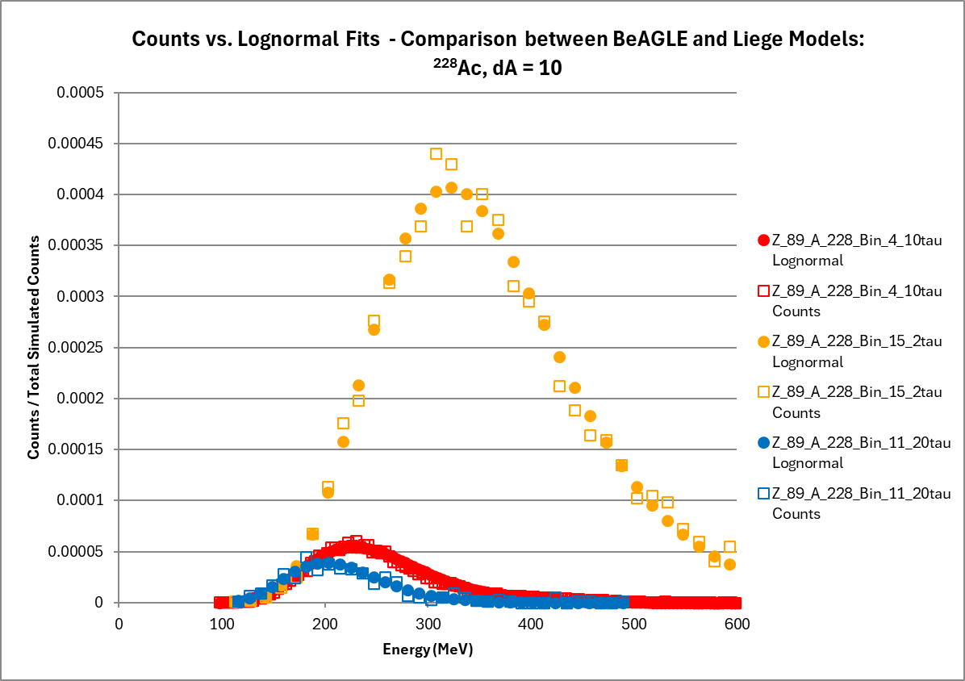
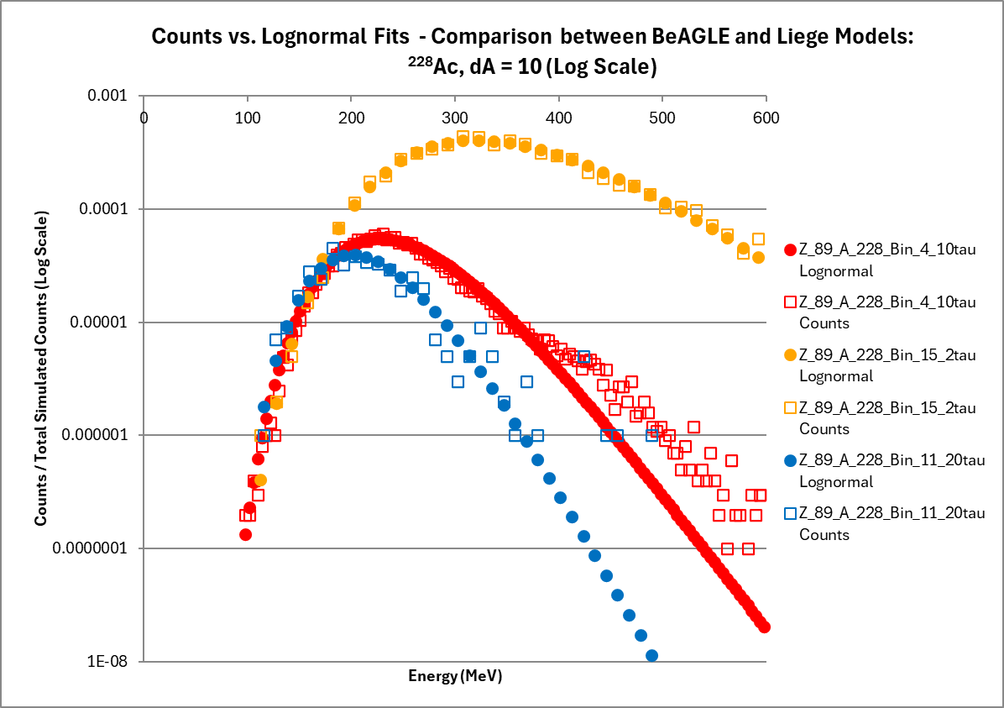
Example for ²³⁸U using 𝜏 only : ²²⁸Ac - dA = 10, dZ=3, dN=7
We see the similar trend to Barak’s original data (slide 2)
  𝜏₀ =2 has the higher mode and median and 𝜏₀ = 20 has the lower median and mode
Yellow lognormal amplitude is much bigger than red and so is the blue curve
Less right tail peak demonstrated for 𝜏₀ =2 than 𝜏₀ =10 and 𝜏₀ =20

Slide 12
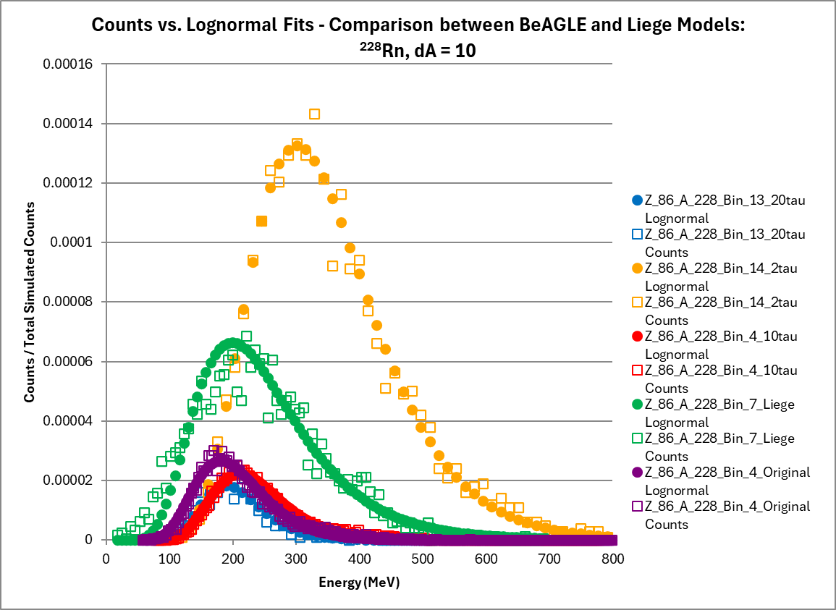
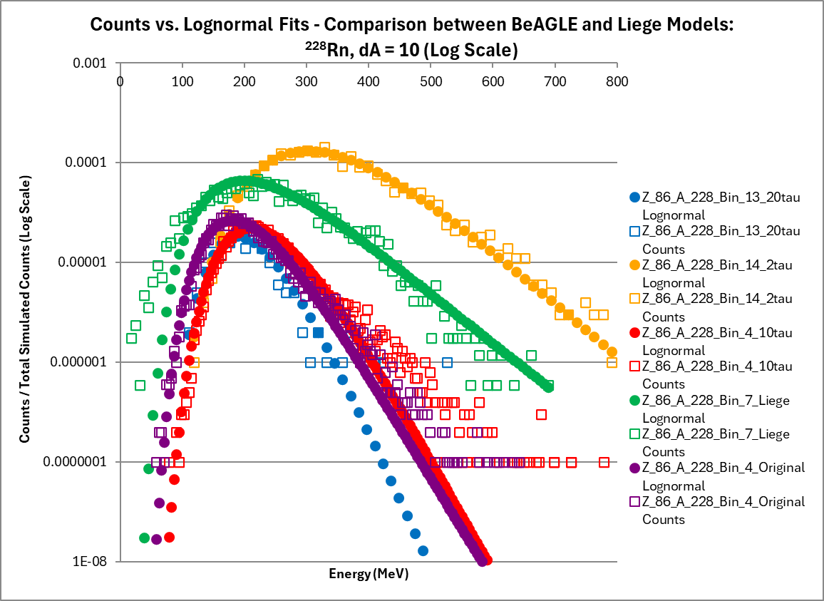
Example for ²³⁸U using All Models : ²²⁸Rn - dA = 10, dZ=6, dN = 4
We see the large difference between the Original (Purple) and new 𝜏₀ = 10 (Red)
This helps explain behavior between BeAGLE and Liège Mode and Median (Slides 28, 29)
  The Mode for the Liège data (Green) matches closer to 𝜏₀ = 20
  The Median for the Liège Data (Green) matches closer to 𝜏₀ = 2

Slide 13
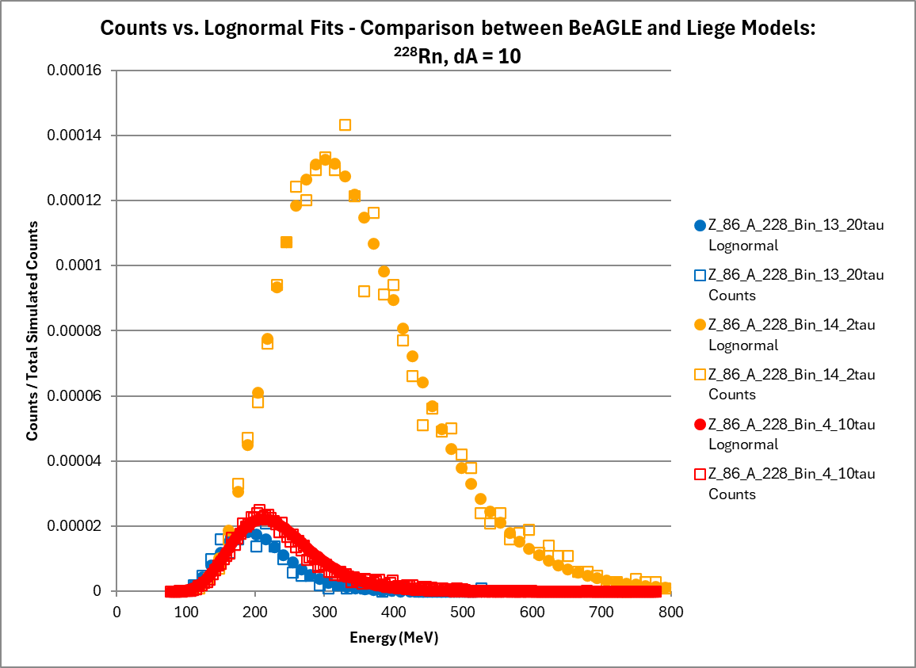
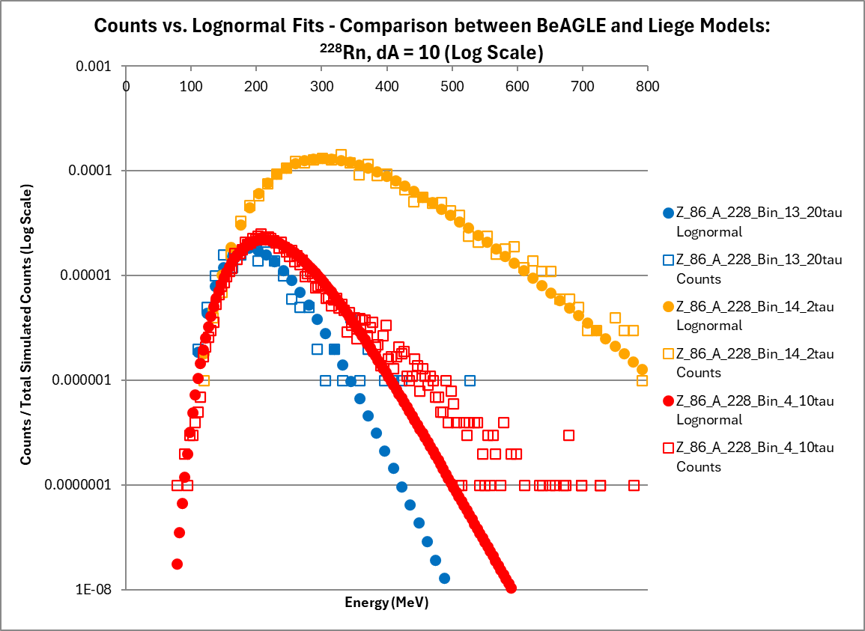
Example for ²³⁸U using 𝜏₀ only: ²²⁸Rn - dA = 10, dZ=6, dN = 4
We see the similar trend to Barak’s original data (slide 2)
  𝜏=2 has the higher mode and median and 𝜏₀ = 20 has the lower median and mode
Yellow lognormal amplitude is much bigger than red and so is the blue curve
Less right tail peak demonstrated for 𝜏₀ =2 than 𝜏₀ =10 and 𝜏₀ =20

Slide 14
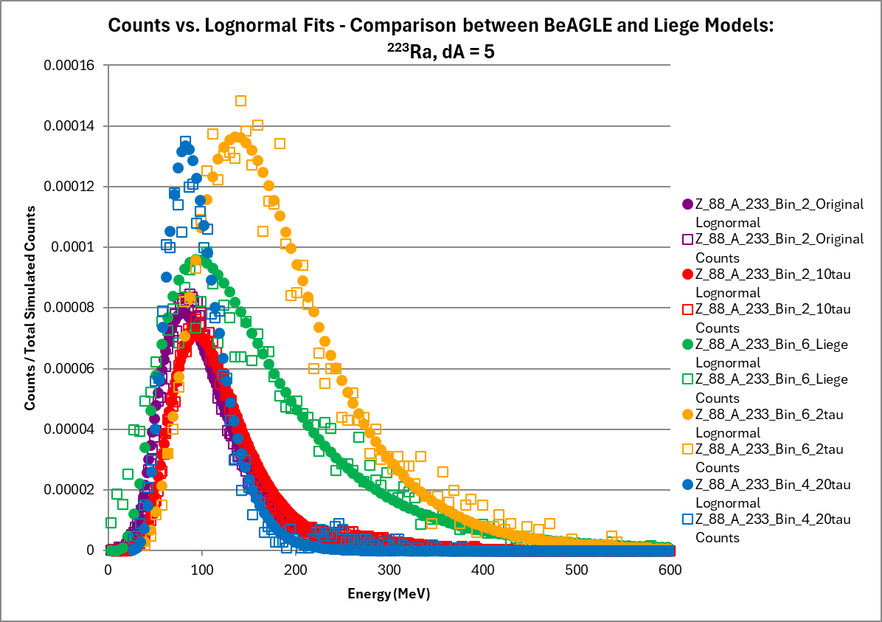
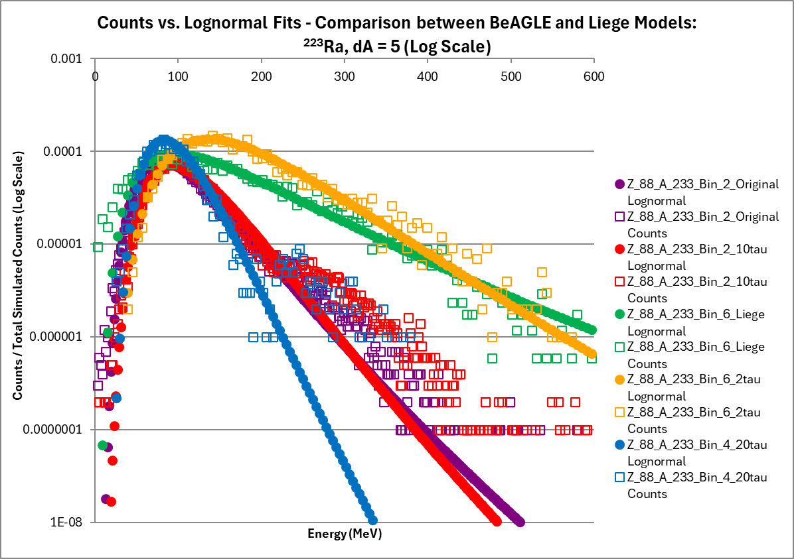
Example for ²³⁸U using All Models: ²³³Ra - dA = 5, dZ=4, dN = 1
We see the difference between the Original (Purple) and new 𝜏₀ = 10 (Red)
This helps explain behavior between BeAGLE and Liège Mode and Median (Slides 28, 29)
  The Mode for the Liège data (Green) matches closer to 𝜏₀ = 20
  The Median for the Liège Data (Green) matches closer to 𝜏₀ = 2
Less right tail peak demonstrated for 𝜏₀ =2 than 𝜏₀ =10 and 𝜏₀ =20

Slide 15
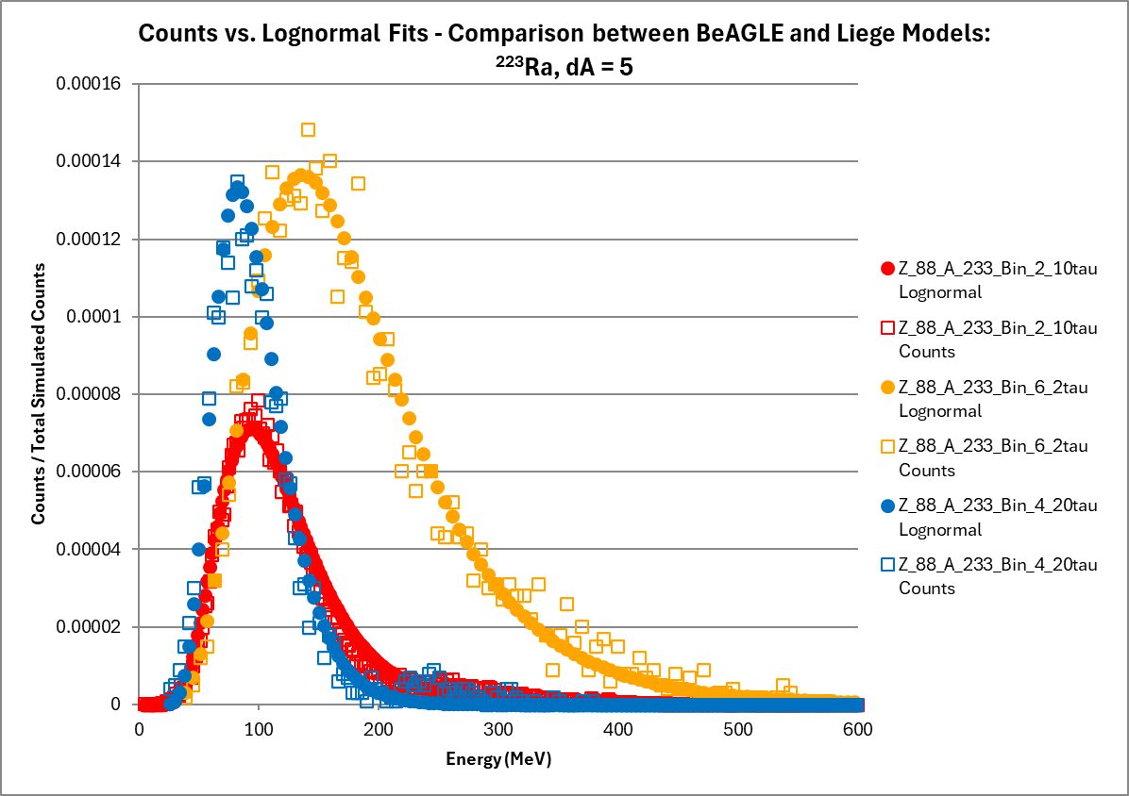
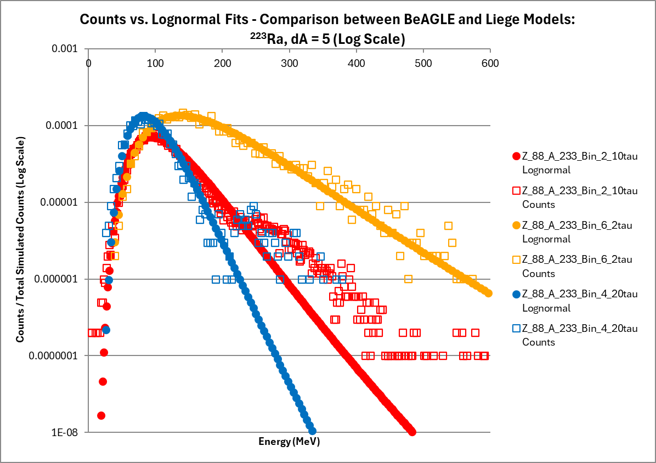
Example for ²³⁸U using 𝜏₀ only: ²³³Ra - dA = 5, dZ=4, dN = 1
We see the similar trend to Barak’s original data (slide 2)
  𝜏 = 2 has the higher mode and median and 𝜏₀ = 20 has the lower median and mode
Less right tail peak demonstrated for 𝜏₀ =2 than 𝜏₀ =10 and 𝜏₀ =20

Slide 16
⁷⁸Kr color table comparison – Original vs New - 𝜏₀ = 10
Noticed ⁷⁸Kr and ⁷⁸Kr 𝜏₀ = 10 Mode/dA are nearly identical
  E* is about the same for the new 𝜏₀ = 10 the differences are most likely statistical
  This is the result I was expecting when I started the analysis because the Original analysis was done at 𝜏₀ = 10
⁷⁸Kr - Original
⁷⁸Kr - 𝜏 =10

Slide 17
⁷⁸Kr sum comparison – Original vs New - 𝜏₀ = 10
Noticed ⁷⁸Kr and ⁷⁸Kr 𝜏₀ = 10 sum are nearly identical
  This is the result I was expecting when I started the analysis because the Original analysis was done at 𝜏₀ = 10
  Total sum for Original: 988,637
  Total sum for 𝜏₀ = 10: 999,585
⁷⁸Kr - Original
⁷⁸Kr - 𝜏 =10

Slide 18
⁷⁸Kr for 𝜏₀ = 2: Color table and Sum Table
A overall higher E* was observed for this data set
More nuclei were produced
  Less formation time gives more prefragments produced
Same effect as the ²³⁸U set
Total Sum for 𝜏₀ = 2: 998,924

Slide 19
⁷⁸Kr for 𝜏₀ = 20: Color table and Sum Table
A overall lower E* was observed for this data set
Less nuclei were produced
  More formation time gives less prefragments produced
Same effect as the ²³⁸U set
This data set is not too much different from the 𝜏₀ = 10 data set
Total sum for 𝜏₀ = 20: 999,752

Slide 20
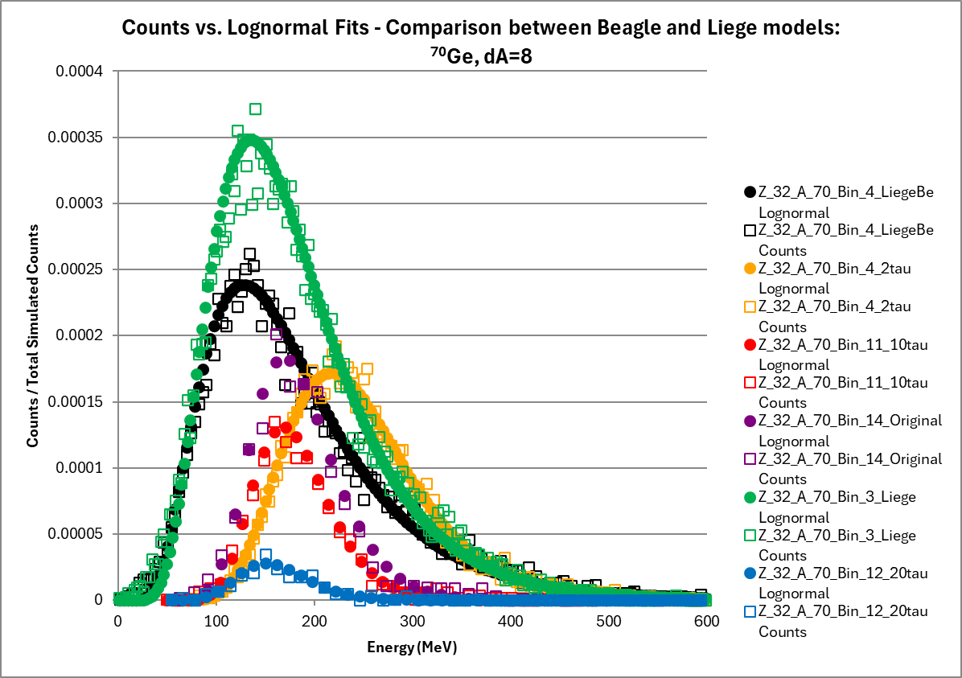
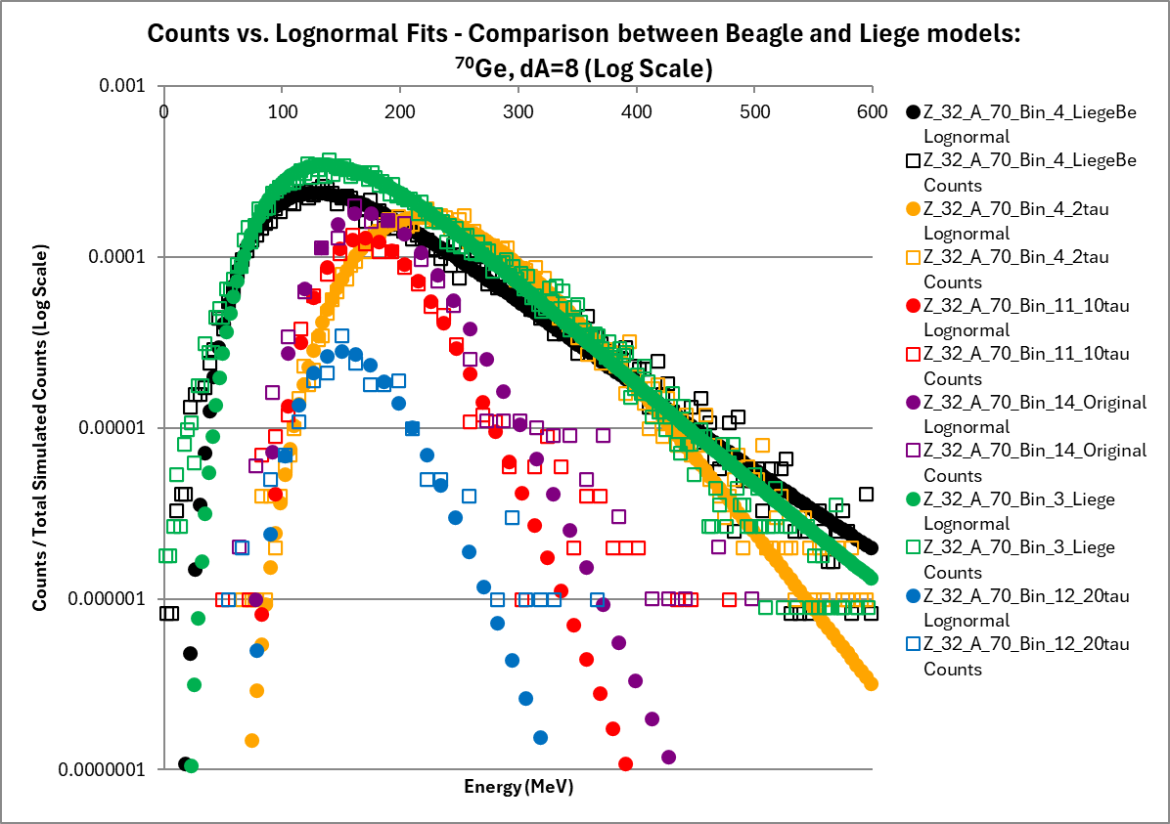
Example for ⁷⁸Kr using All Models : ⁷⁰Ge - dA=8, dZ=4, dN=4
We see the similarity between the Original (Purple) and new 𝜏₀ = 10 (Red) in contrast to ²³⁸U
This helps explain behavior between BeAGLE and Liège Mode and Median (Slides 28, 29)
  The Mode for the Liège data (Green) matches closer to 𝜏₀ = 20
  The Median for the Liège Data (Green) matches closer to 𝜏₀ = 2

Slide 21
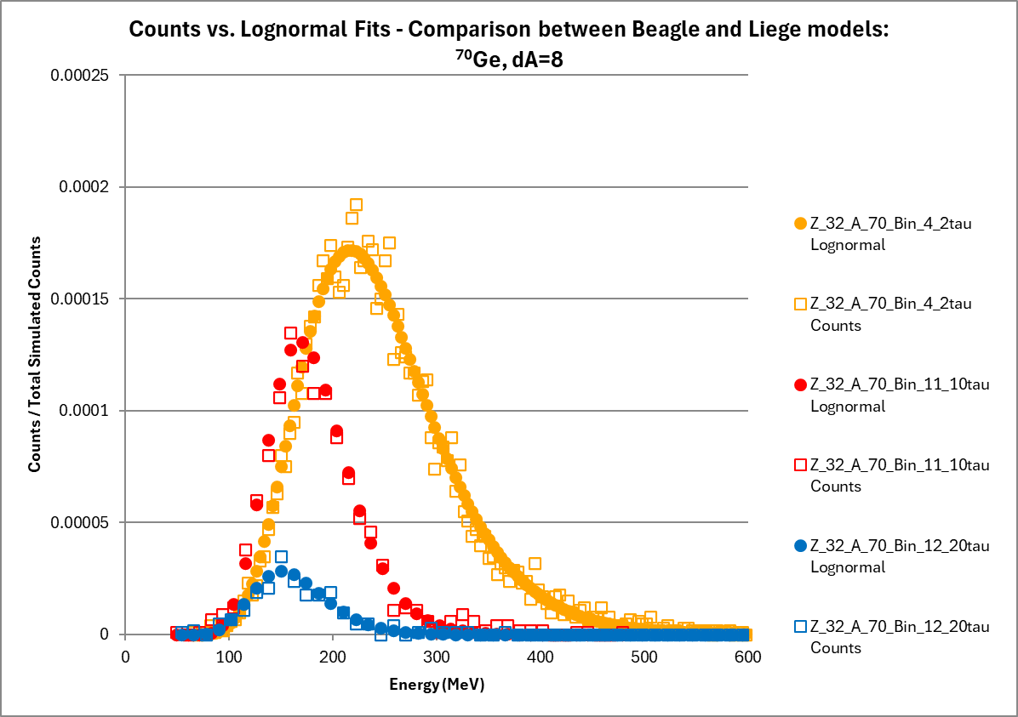
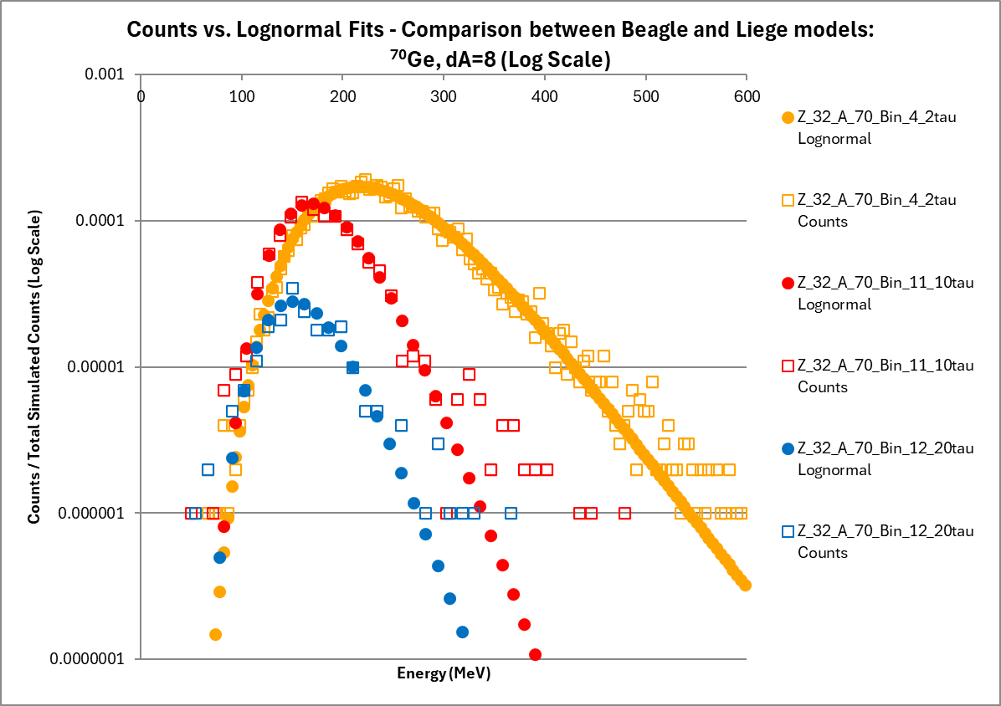
Example for ⁷⁸Kr using 𝜏 only: ⁷⁰Ge - dA=8, dZ=4, dN=4
We see the similar trend to Barak’s original data (slide 2)
  𝜏₀ =2 has the higher mode and median and 𝜏₀ = 20 has the lower median and mode
Less right tail peak demonstrated for 𝜏₀ =2 than 𝜏₀ =10 and 𝜏₀ =20

Slide 22
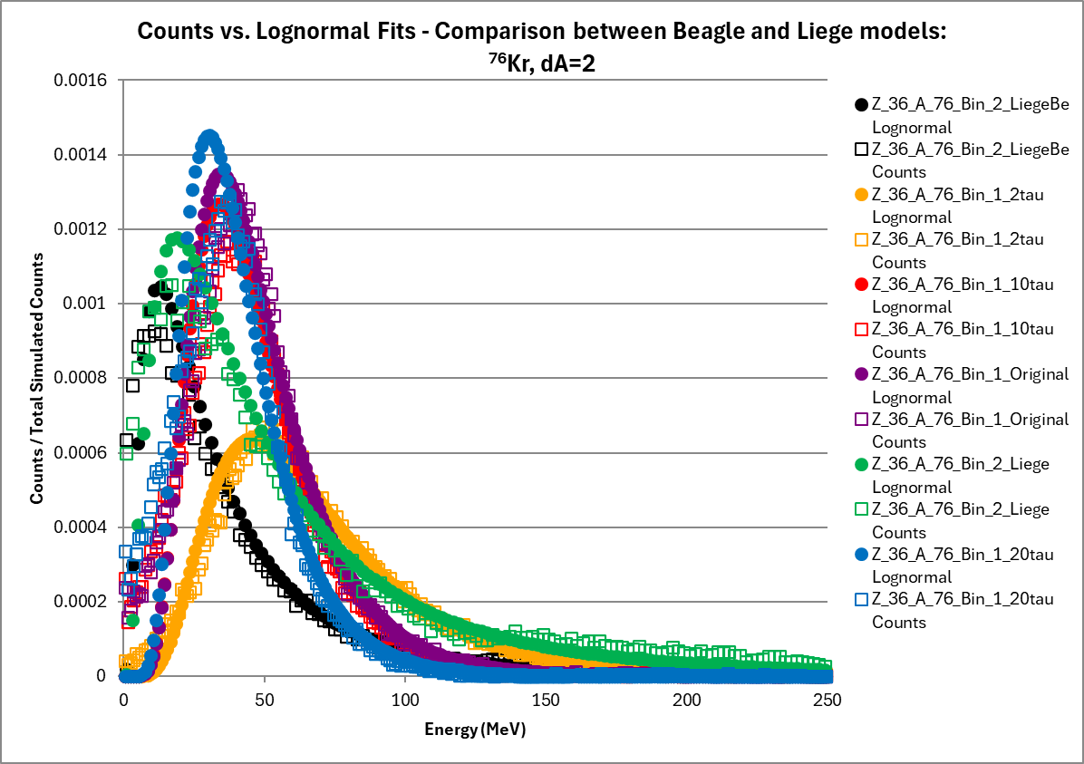
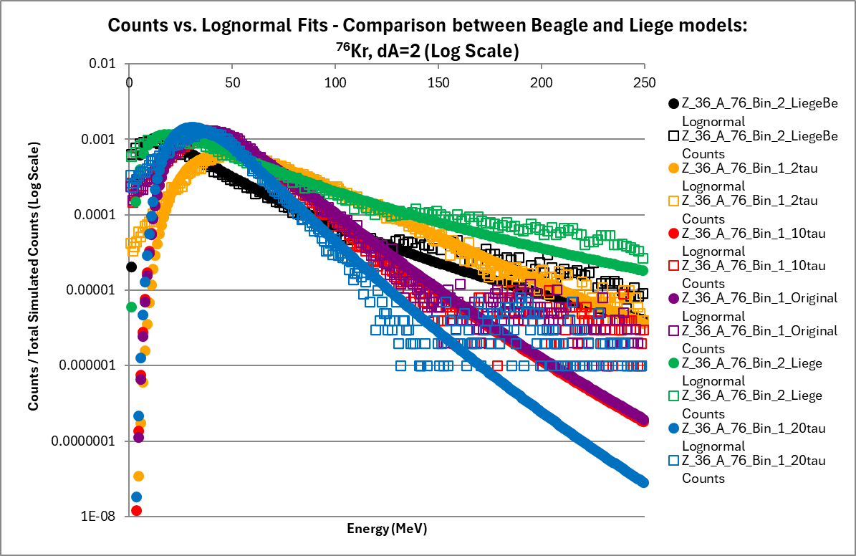
Example for ⁷⁸Kr using All Models : ⁷⁶Kr - dA=2, dZ=0, dN=2
We see the similarity between the Original (Purple) and new 𝜏 = 10 (Red) in contrast to ²³⁸U
  In this distribution they are nearly identical
This helps explain behavior between BeAGLE and Liège Mode and Median (Slides 28, 29)
  The Mode for the Liège data (Green) matches closer to 𝜏₀ = 20
  The Median for the Liège Data (Green) matches closer to 𝜏₀ = 2
Less right tail peak demonstrated for 𝜏₀ =2 than 𝜏₀ =10 and 𝜏₀ =20

Slide 23
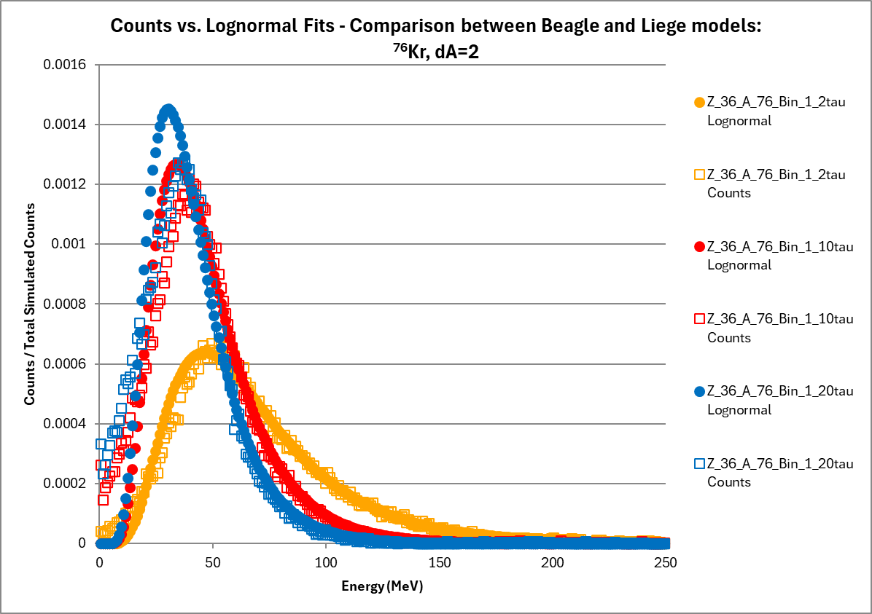
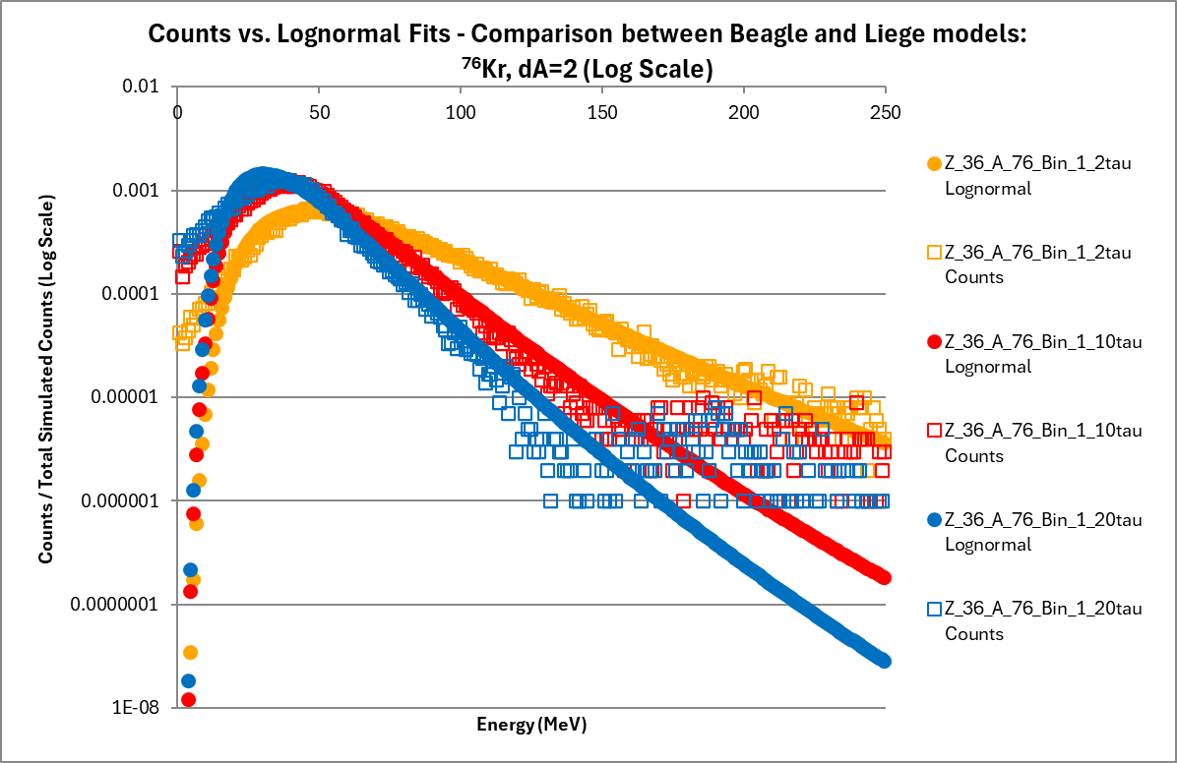
Example for ⁷⁸Kr using 𝜏₀ only: ⁷⁶Kr - dA=2, dZ=0, dN=2
We see the similar trend to Barak’s original data (slide 2)
  𝜏₀ =2 has the higher mode and median and 𝜏₀ = 20 has the lower median and mode
Less right tail peak demonstrated for 𝜏₀ =2 than 𝜏₀ =10 and 𝜏₀ =20

Slide 24
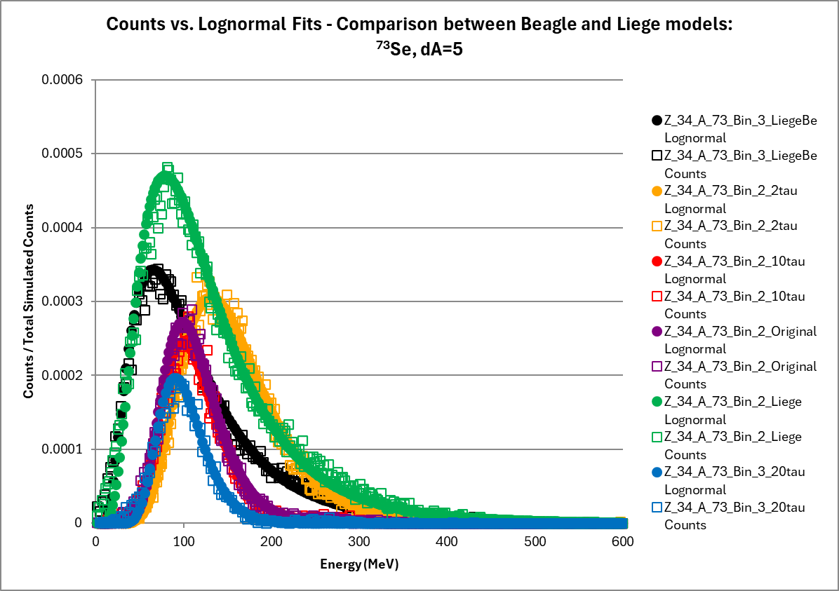
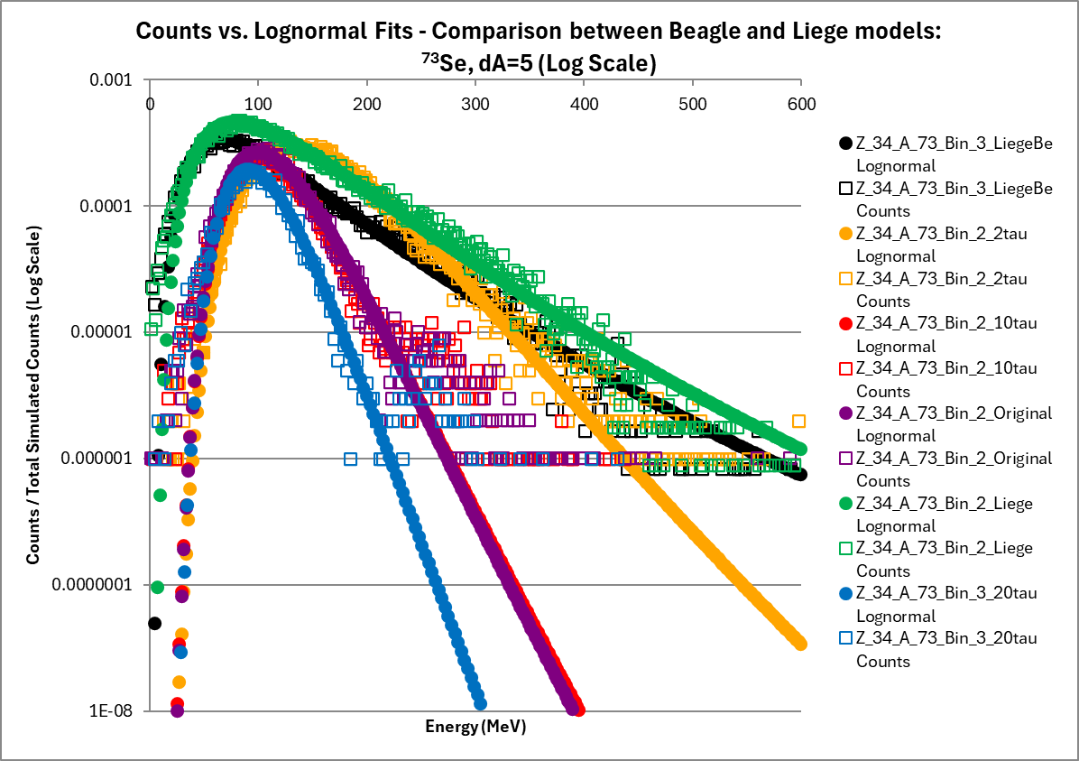
Example for ⁷⁸Kr using All Models : ⁷³Se - dA=5, dZ=2, dN=3
We see the similarity between the Original (Purple) and new 𝜏 = 10 (Red) in contrast to ²³⁸U
  In this distribution they are nearly identical
This helps explain behavior between BeAGLE and Liège Mode and Median (Slides 28, 29)
  The Mode for the Liège data (Green) matches closer to 𝜏₀ = 20
  The Median for the Liège Data (Green) matches closer to 𝜏₀ = 2
Less right tail peak demonstrated for 𝜏₀ =2 than 𝜏₀ =10 and 𝜏₀ =20

Slide 25
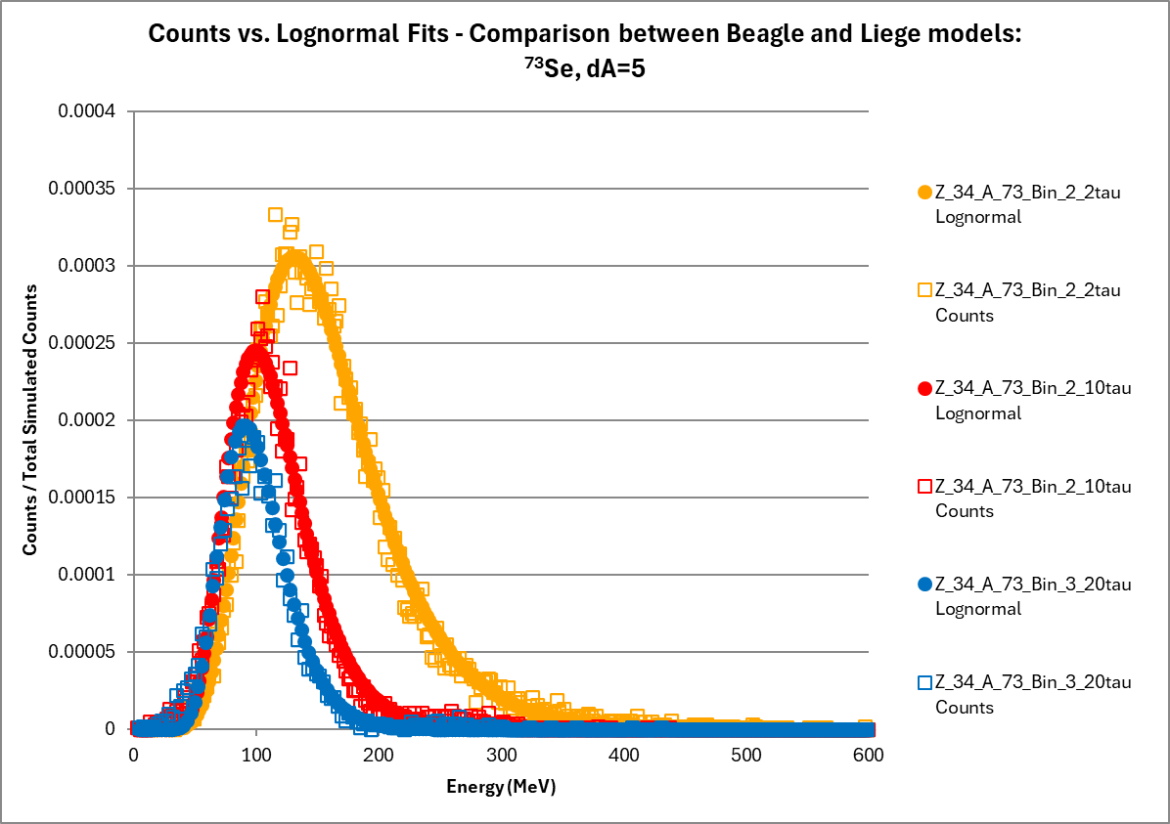
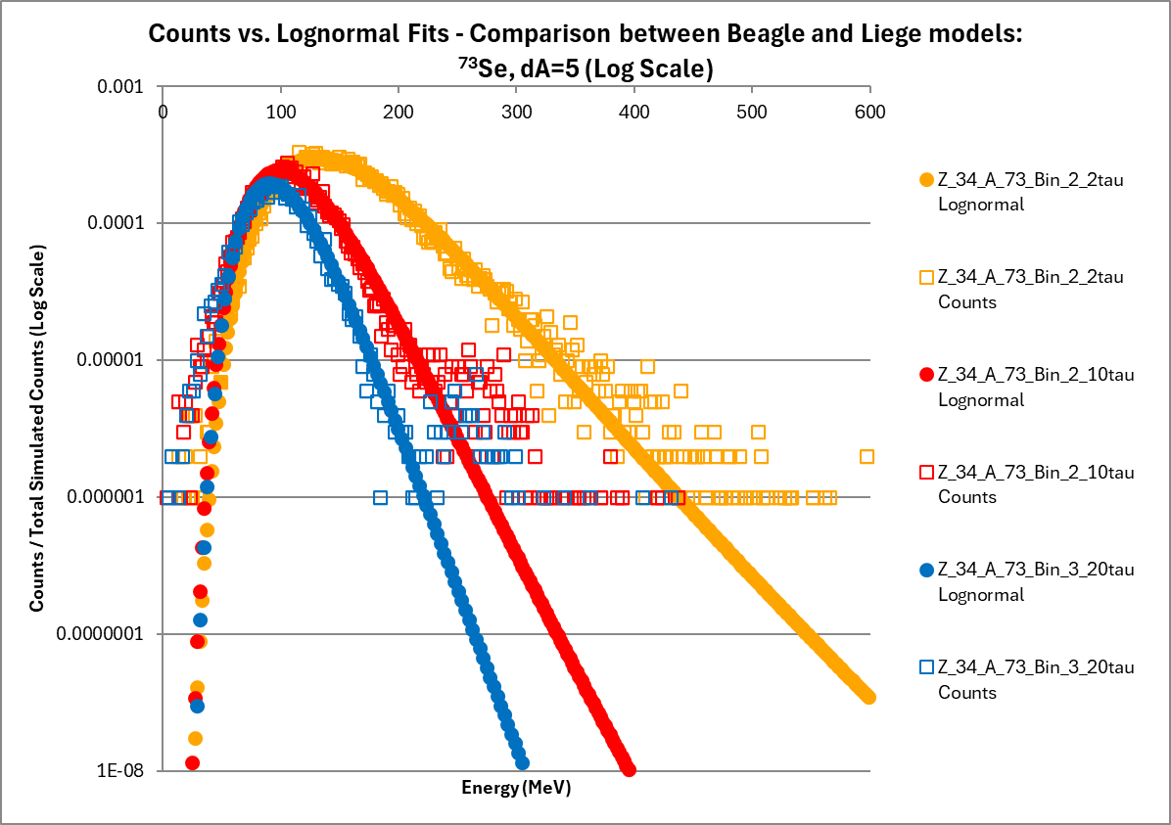
Example for ⁷⁸Kr using 𝜏₀ only: ⁷³Se - dA=5, dZ=2, dN=3
We see the similar trend to Barak’s original data (slide 2)
  𝜏₀ =2 has the higher mode and median and 𝜏₀ = 20 has the lower median and mode
Less right tail peak demonstrated for 𝜏₀ =2 than 𝜏₀ =10 and 𝜏₀ =20

Slide 26
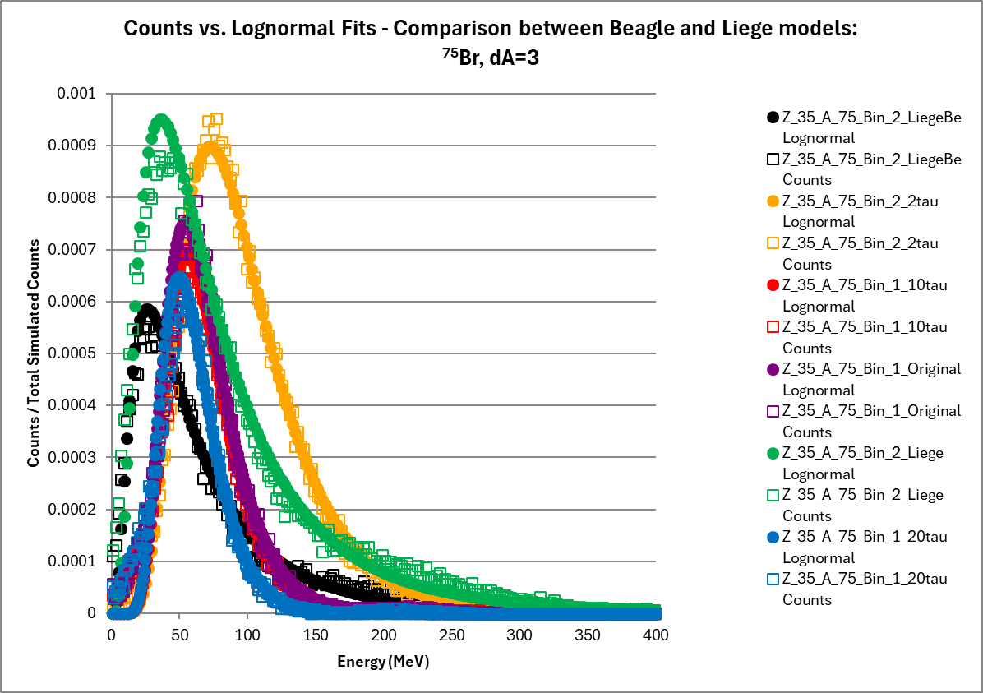
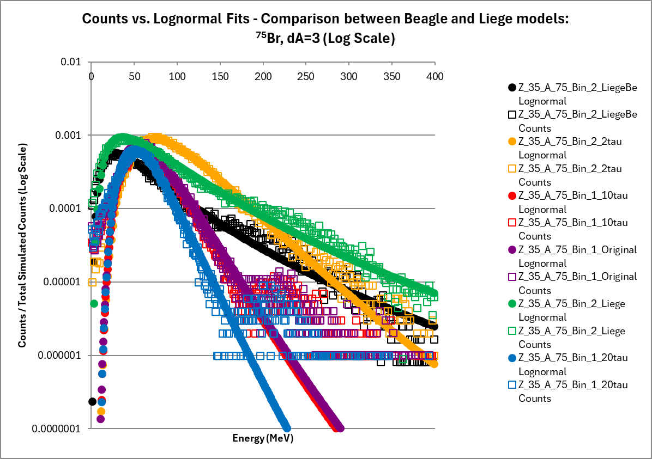
Example for ⁷⁸Kr using All Models : ⁷⁵Br - dA=3, dZ=1, dN=2
We see the similarity between the Original (Purple) and new 𝜏₀ = 10 (Red) in contrast to ²³⁸U
  In this distribution they are nearly identical
This helps explain behavior between BeAGLE and Liège Mode and Median (Slides 28, 29)
  The Mode for the Liège data (Green) matches closer to 𝜏₀ = 20
  The Median for the Liège Data (Green) matches closer to 𝜏₀ = 2
Less right tail peak demonstrated for 𝜏₀ =2 than 𝜏₀ =10 and 𝜏₀ =20

Slide 27
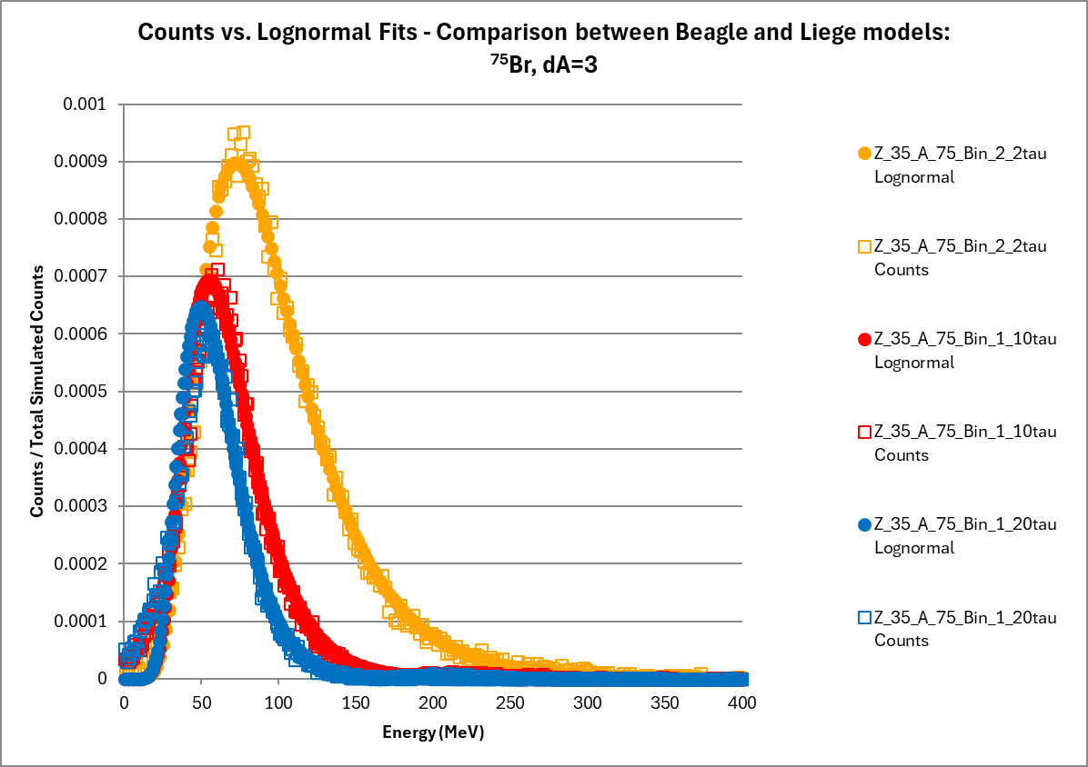
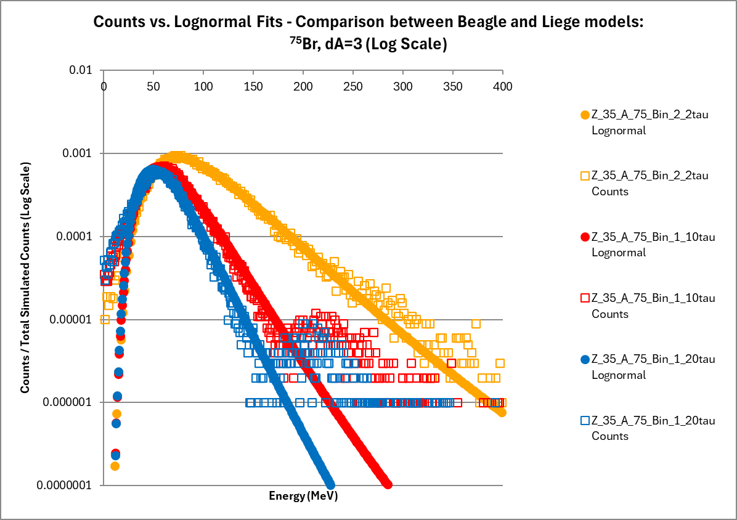
Example for ⁷⁸Kr using 𝜏₀ only: ⁷⁵Br - dA=3, dZ=1, dN=2
We see the similar trend to Barak’s original data (slide 2)
  𝜏₀ =2 has the higher mode and median and 𝜏₀ = 20 has the lower median and mode
Less right tail peak demonstrated for 𝜏₀ =2 than 𝜏₀ =10 and 𝜏₀ =20

Slide 28
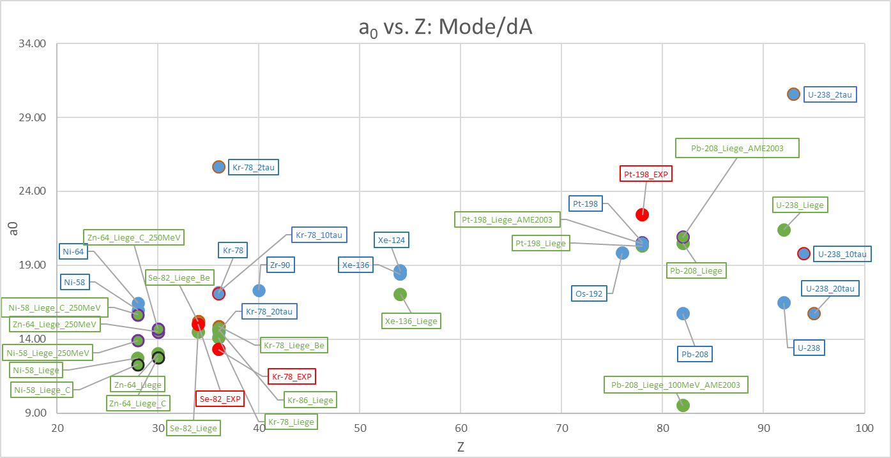
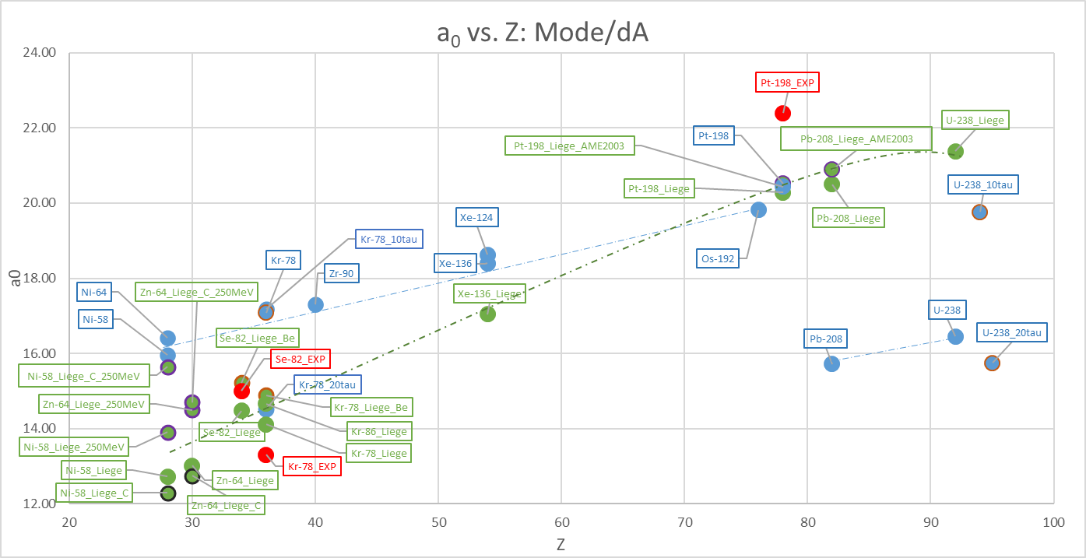
Mode/dA Global Trend
This plot is the a₀ parameter from the linear E* model a₀ + a₁*dZ + a₂*dN to the color tables (Slides 3, 5, 7, 16, 18, 19)
The blue points are BeAGLE data
  The blue points with a red border is the new 𝜏₀ = 2, 10, 20 data sets
The Green points are the Liège Model
  Red Border: 250 MeV beam, Brown border: Be target, Black Border: C target
I observed the 𝜏₀ = 10 data set to match closer to the Liège results I obtained before
I also observed a shift between the Original data set and 𝜏₀ = 10 for ²³⁸U but not for ⁷⁸Kr
  BeAGLE version for original data was before v.1.01.03
    Fermi motion and binding energy changes

Slide 29
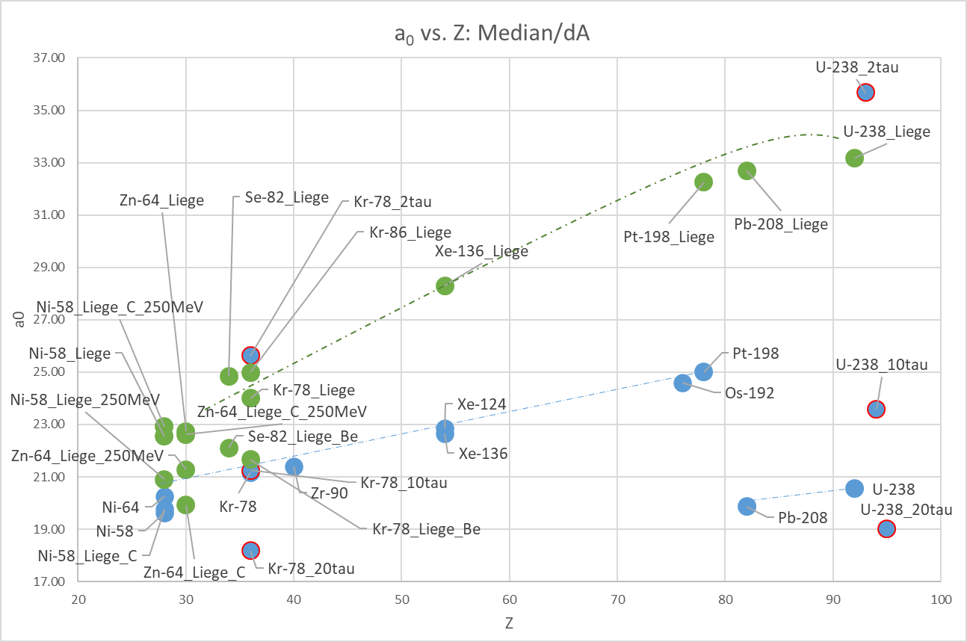
Median/dA Global Trend
This plot is the a₀ parameter from the linear E* model a₀ + a₁*dZ + a₂*dN to the color tables (Slides 3, 5, 7, 16, 18, 19)
The blue points are BeAGLE data
  The blue points with a red border is the new 𝜏₀ = 2, 10, 20 data sets
The Green points are the Liège Model
I observed the 𝜏₀ = 2 data set to match closer to the Liège results I obtained before

Slide 30
Conclusion
The distributions of BeAGLE and Liège differ
  Lognormal does not fit to Liège as well as BeAGLE for some prefragments
    This seems more the case for ²³⁸U than ⁷⁸Kr
    However, Lognormal is is a good model for Liège for most Prefragments beyond 100 MeV
I did not fully reproduce the behavior of Baraks original analysis
  The mode and median behavior is properly reproduced
    𝜏₀ = 2 (blue) distribution always proceeds 𝜏₀ = 10 while 𝜏₀ = 20 is larger than 𝜏₀ = 10
  The relative amplitudes of the different 𝜏 data sets differed depending on the prefragment
    Possibly due to statistics or prefragment selection
  The Original analysis I did and the new 𝜏₀ = 10 data set do not match for ²³⁸U but does for ⁷⁸Kr
    If this is consistent then the 𝜏₀ = 10 would be the best parameter to match the Mode of Liège
    We are normally more interested about the Mode of the distribution rather than the Median for systematics
The formation time parameter affects the E* distribution
  The lower the formation time parameter, the more nuclei are produced from the reaction, E* is larger
  The higher the formation time parameter, the less nuclei are produced from the reaction, E* is smaller
Next Steps
  Perhaps Deeper Analysis is needed to see overall trends of Lognormal Distribution
  Why does Lognormal not fit to Liège data as well as BeAGLE for some prefragments
  Perhaps using Different beam energies
    18 GeV e- on 110 GeV A is what we have

