Slide 1
Fixed Target Options and Parameters at the AGS
Kevin Brown
Collider-Accelerator Department, Brookhaven National Lab.
September 30, 2025 Exploring a Fixed-Target Program at the EIC

Slide 2
Outline
Overview of AGS Extraction systems
Replicating the Space Environment in the lab
Beam Transport Options
Beam Quality and methods to improve duty factor
Options for NP fixed target experiments
Summary

Slide 3
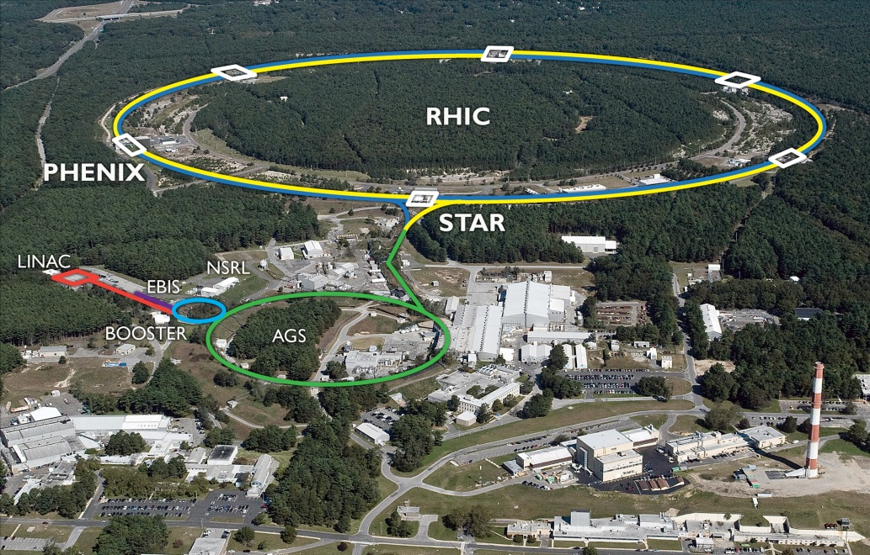
BNL RHIC Accelerator Complex
Accelerator Rings
 | Circumference [m]
Booster | 201
AGS | 807
RHIC | 3833
Typical Top Energies [GeV/N]
 | Au | Pol. Protons
Linac (H⁻) | -- | 0.2
Booster | 1 | 2
AGS | 10 | 24
RHIC | 100 | 255
Tandem van de Graaff
Note:
Tandem and EBIS can supply protons, as well.
Heavy Ions | Protons
E-beam Ion Source (EBIS) | OPPIS (polarized)
Tandem Van de Graaf | High-intensity H⁻ (unpolarized)
3

Slide 4
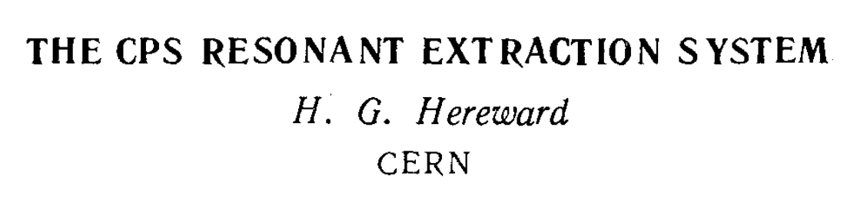
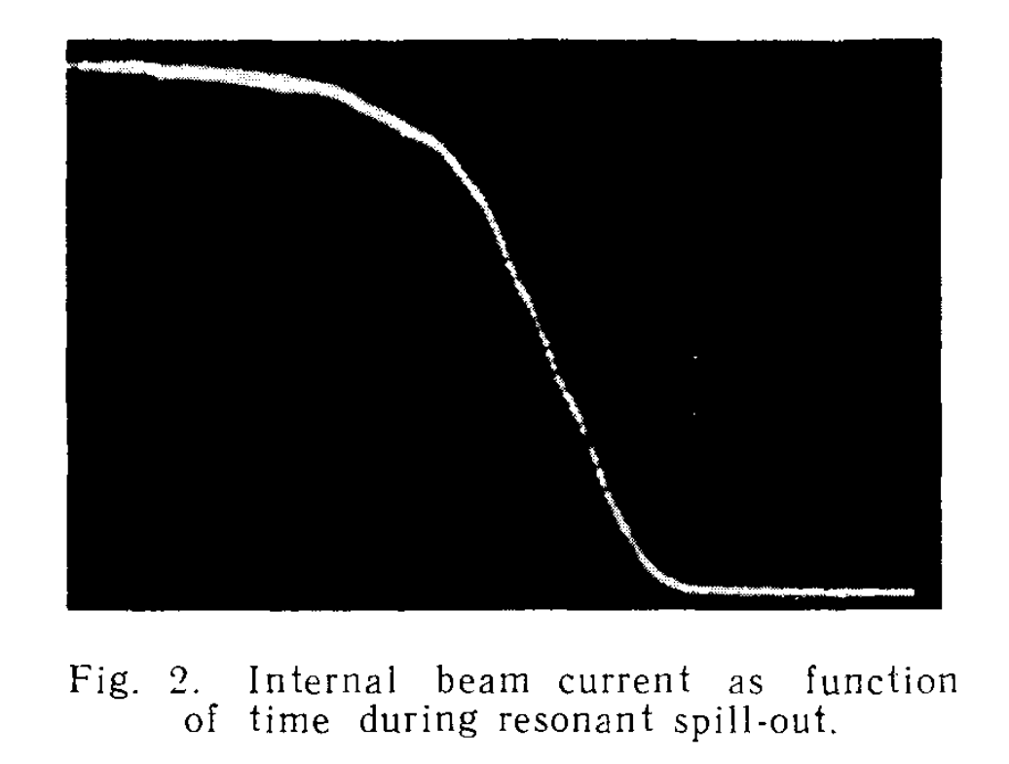
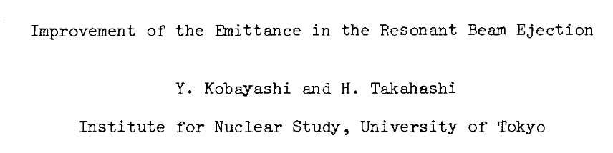
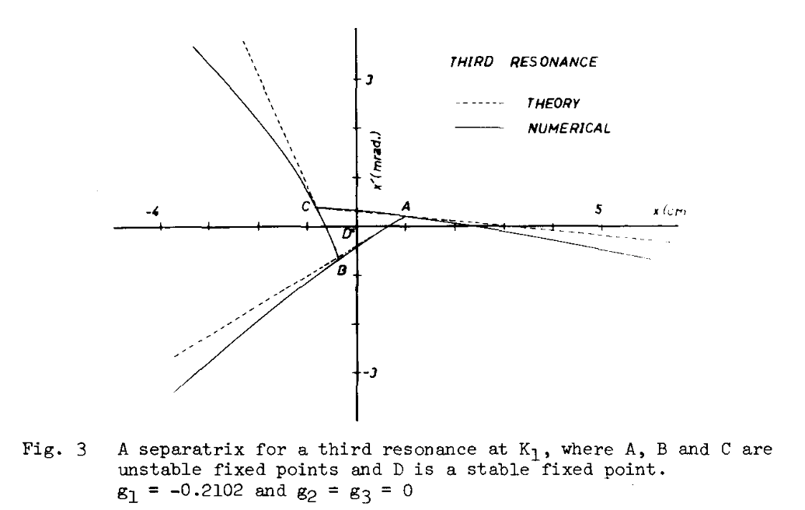

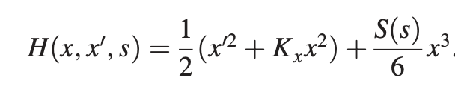
Slow Extraction at the AGS
1963 (work started in 1961)
March 1968: first SE for HEP, 3Q_{H}=26
  Simple system with no ES septum
1972: 200 MeV LINAC (previous was 50 MeV), H+ injection to AGS
1979: first ES septum installed
1979: new multi-hall switchyard (3 lines)
1980’s: pre-Booster era, H- injection to AGS
  Intensities 1.0 – 1.6 x 10¹³ protons/pulse
  Extraction momentum 25-29 GeV/c
  Spills 1 – 2 sec., repetition periods 2.4 - 4.0 sec.
  Extraction inefficiency 3 – 5 %
  Began doing heavy ion experiments (NPP)
1990’s: post-Booster era
  Intensities 5.0 – 7.6 x 10¹³ protons/pulse
  Extraction momentum 25.5 GeV/c (to improve uptime)
  Similar spills and rep periods, more optimization on duty factor
  Extraction inefficiency 2 – 3 %
  Problem! Higher losses in switchyard beam transport
2002: program ends. RHIC era.
1967
The Kobayashi Hamiltonian

Slide 5
Replicating the Space Environment in the lab

Slide 6
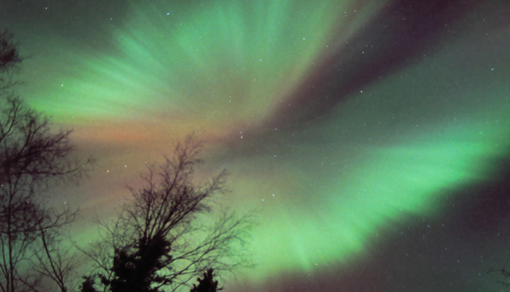
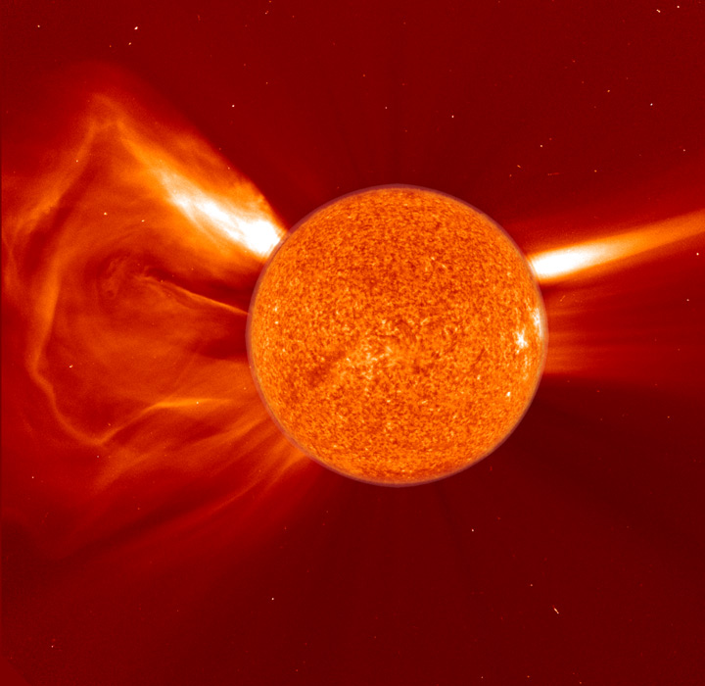
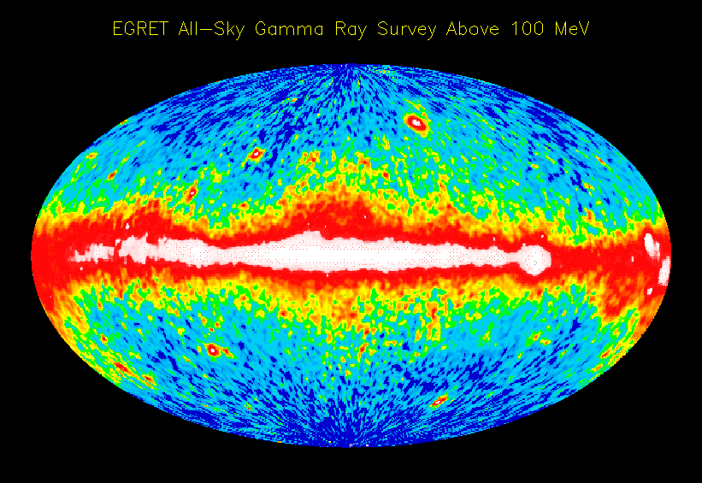
Coronal Mass
Ejections
SPACE WEATHER
SPE: Solar Particle Events = Coronal Mass Ejections
GCR: Galactic Cosmic Rays
= particles from outside the solar system
Galactic Cosmic Rays
SOHO (ESA & NASA)
Space is filled with charged ionizing radiation.
EGRET Team

Slide 7
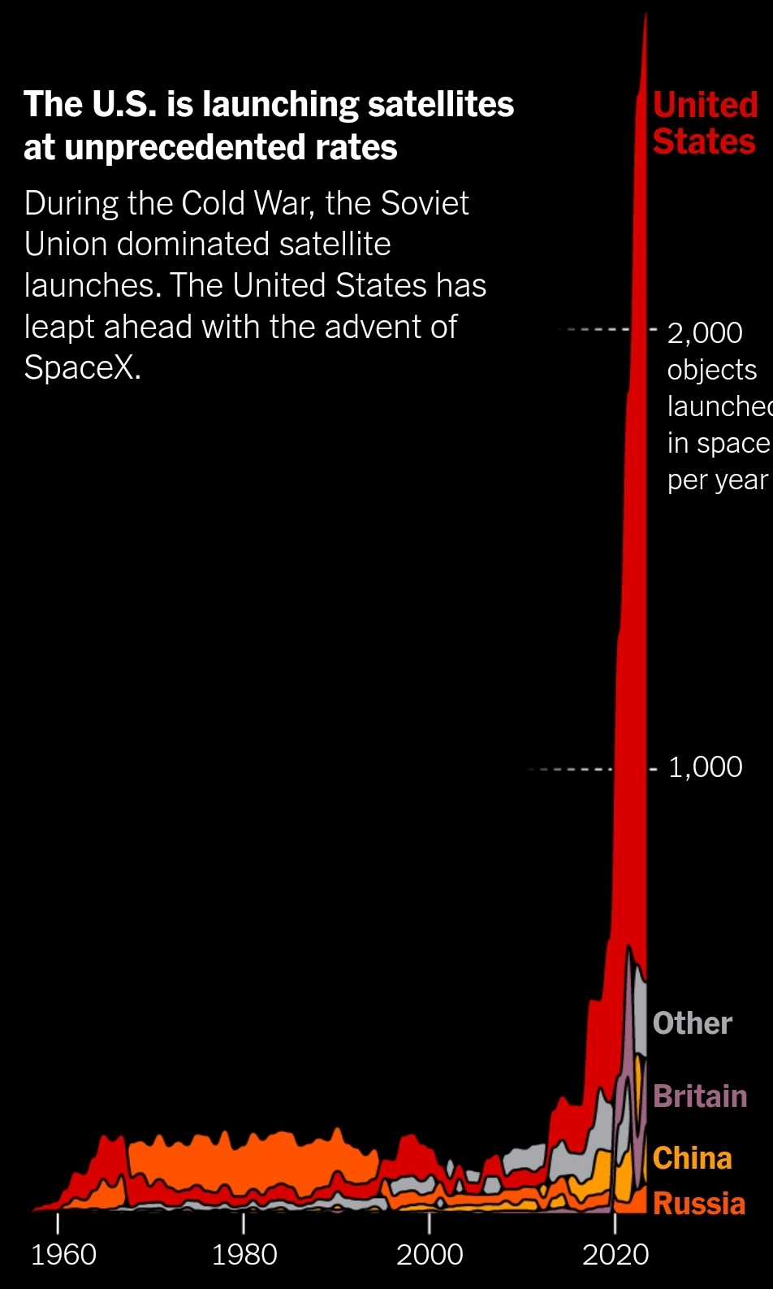
Why is it important?
Things we put in space encounter two types of radiation effects
Continuous bombardment from high energy particles is called cumulative dose and can lead to equipment failures
Single event effects are a single particle hitting a sensitive part, such as a cell in computer memory or even the microprocessor
As we see in current events, there is a new space race taking place and we will soon see people going to the moon and beyond.

Slide 8
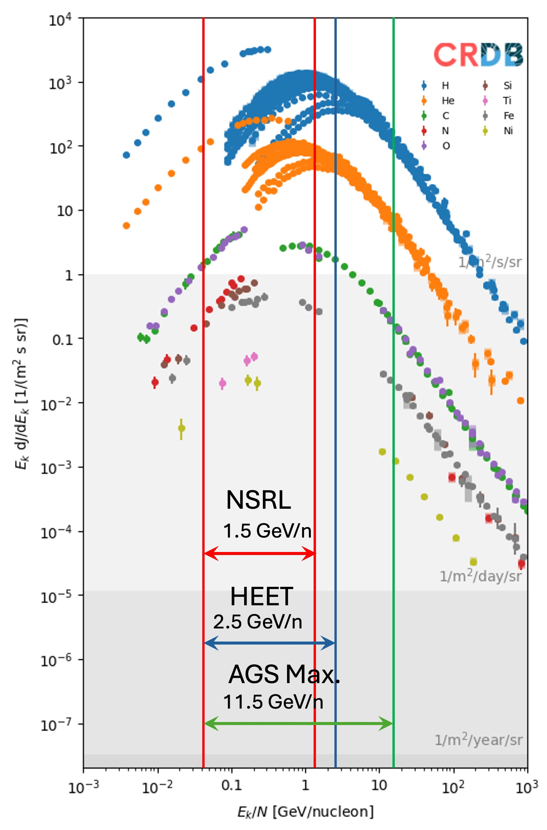
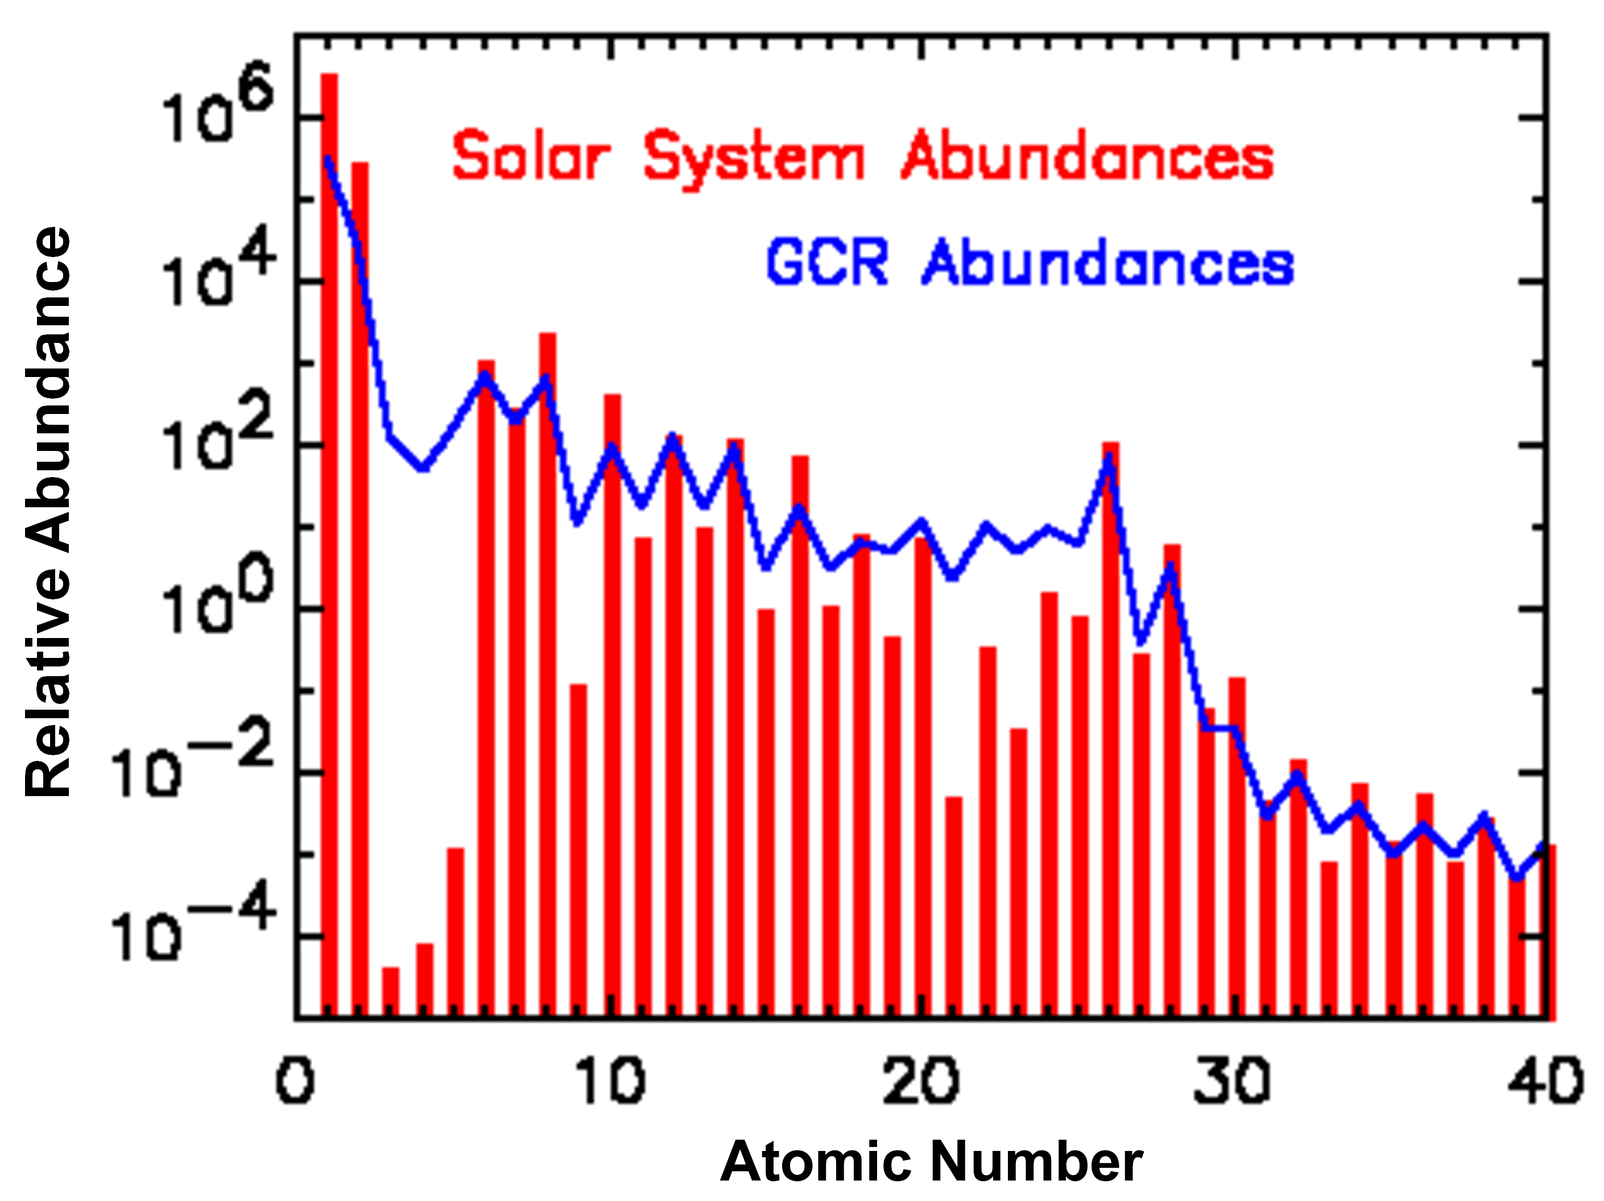
GCR is Composed of all naturally occurring elements
  90% hydrogen
  9% helium
  1% heavier ions
Generally similar to solar abundances but secondary products due to interstellar GCR fragmentation smooths out abundances
Iron
https://imagine.gsfc.nasa.gov/

Slide 9
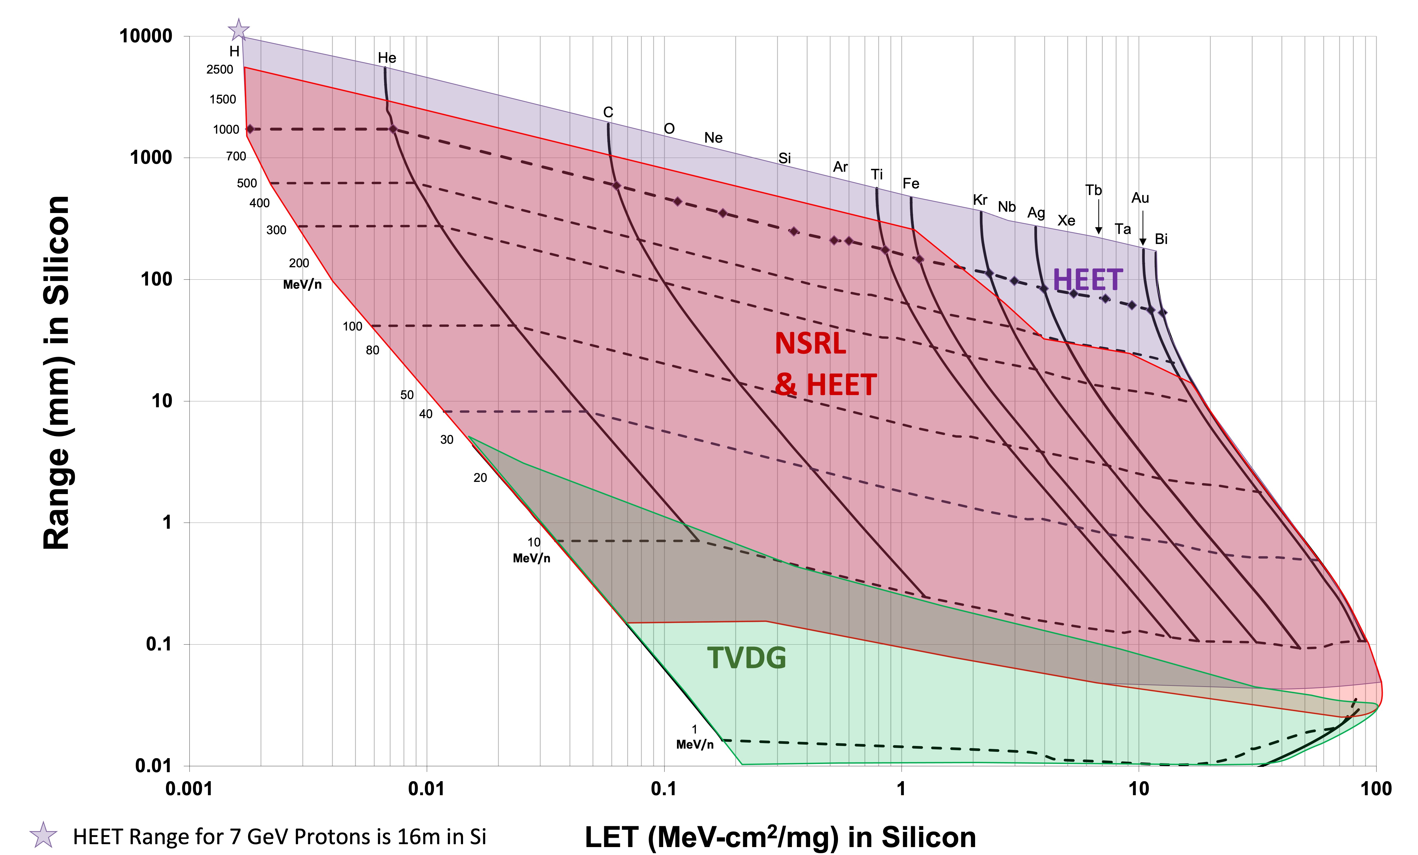
Range vs LET

Slide 10
Overview of AGS Extraction systems

Slide 11
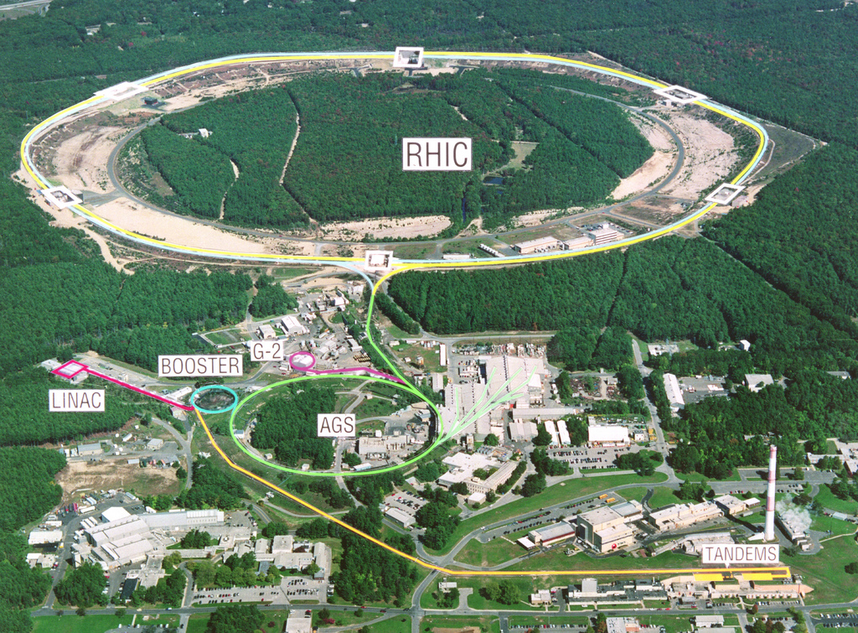
An old image but shows 3 things.
Fixed target Area (912)
  Slow extracted beams
  Single bunch fast beam
  Micro & mini-bunched SX
G-2 with fast single bunch
  12 bunches, 33msec apart
AtR, with fast single bunch to RHIC
Old Fixed Target Area

Slide 12
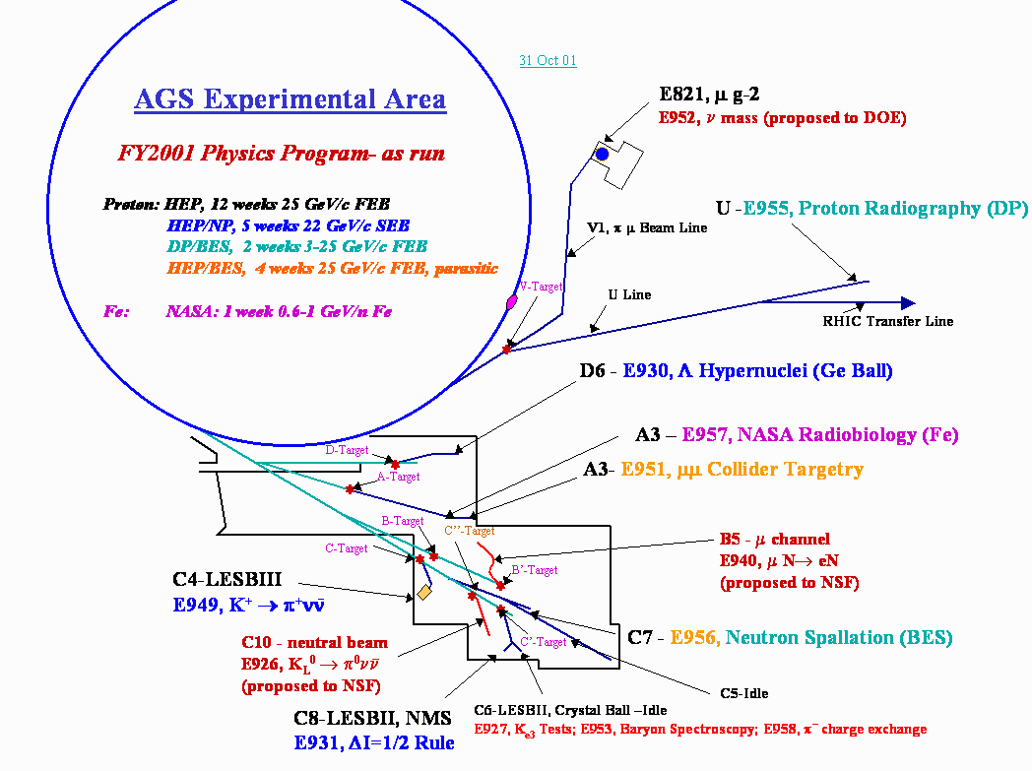
We used to handle a large variety of experiments.
After 2002
all HEP experiments ended
NP experiments ended with RHIC startup
NASA moved to new facility off the AGS Booster
G-2 finished
Radiography ran 1 year

Slide 13
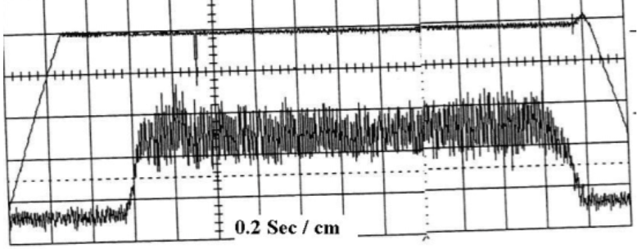
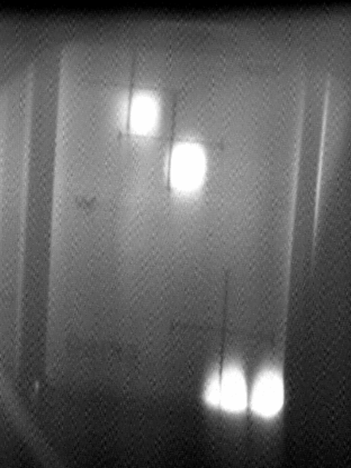
Slow extracted high intensity protons 2 second spill (2001)
Ways to extract beam from the AGS
1. Fast beams (single bunches)
  To Uline via G10 kick into H10 Septum
  OR
  To 912 (A,B,C, or D) via G10 kick into
  F5 and F10 Septa (requires correct horizontal tune)
2. Slow extracted beams (1 – 2 seconds long)
To 912 via F5 and F10 septa
3. Slow extracted modes
Bunched beam slow extraction
Micro-bunched beam slow extraction
We do not have the ability to extract full turn. This would require a new kicker magnet.
U line
Booster
AGS
B
D
C
H10
Septum
A
Bldg 912
Single bunch
Kicker, G10
F10
Septum
Slow extracted high intensity protons split into 4 beams (2001)
F5
Septum
F7 Bump

Slide 14
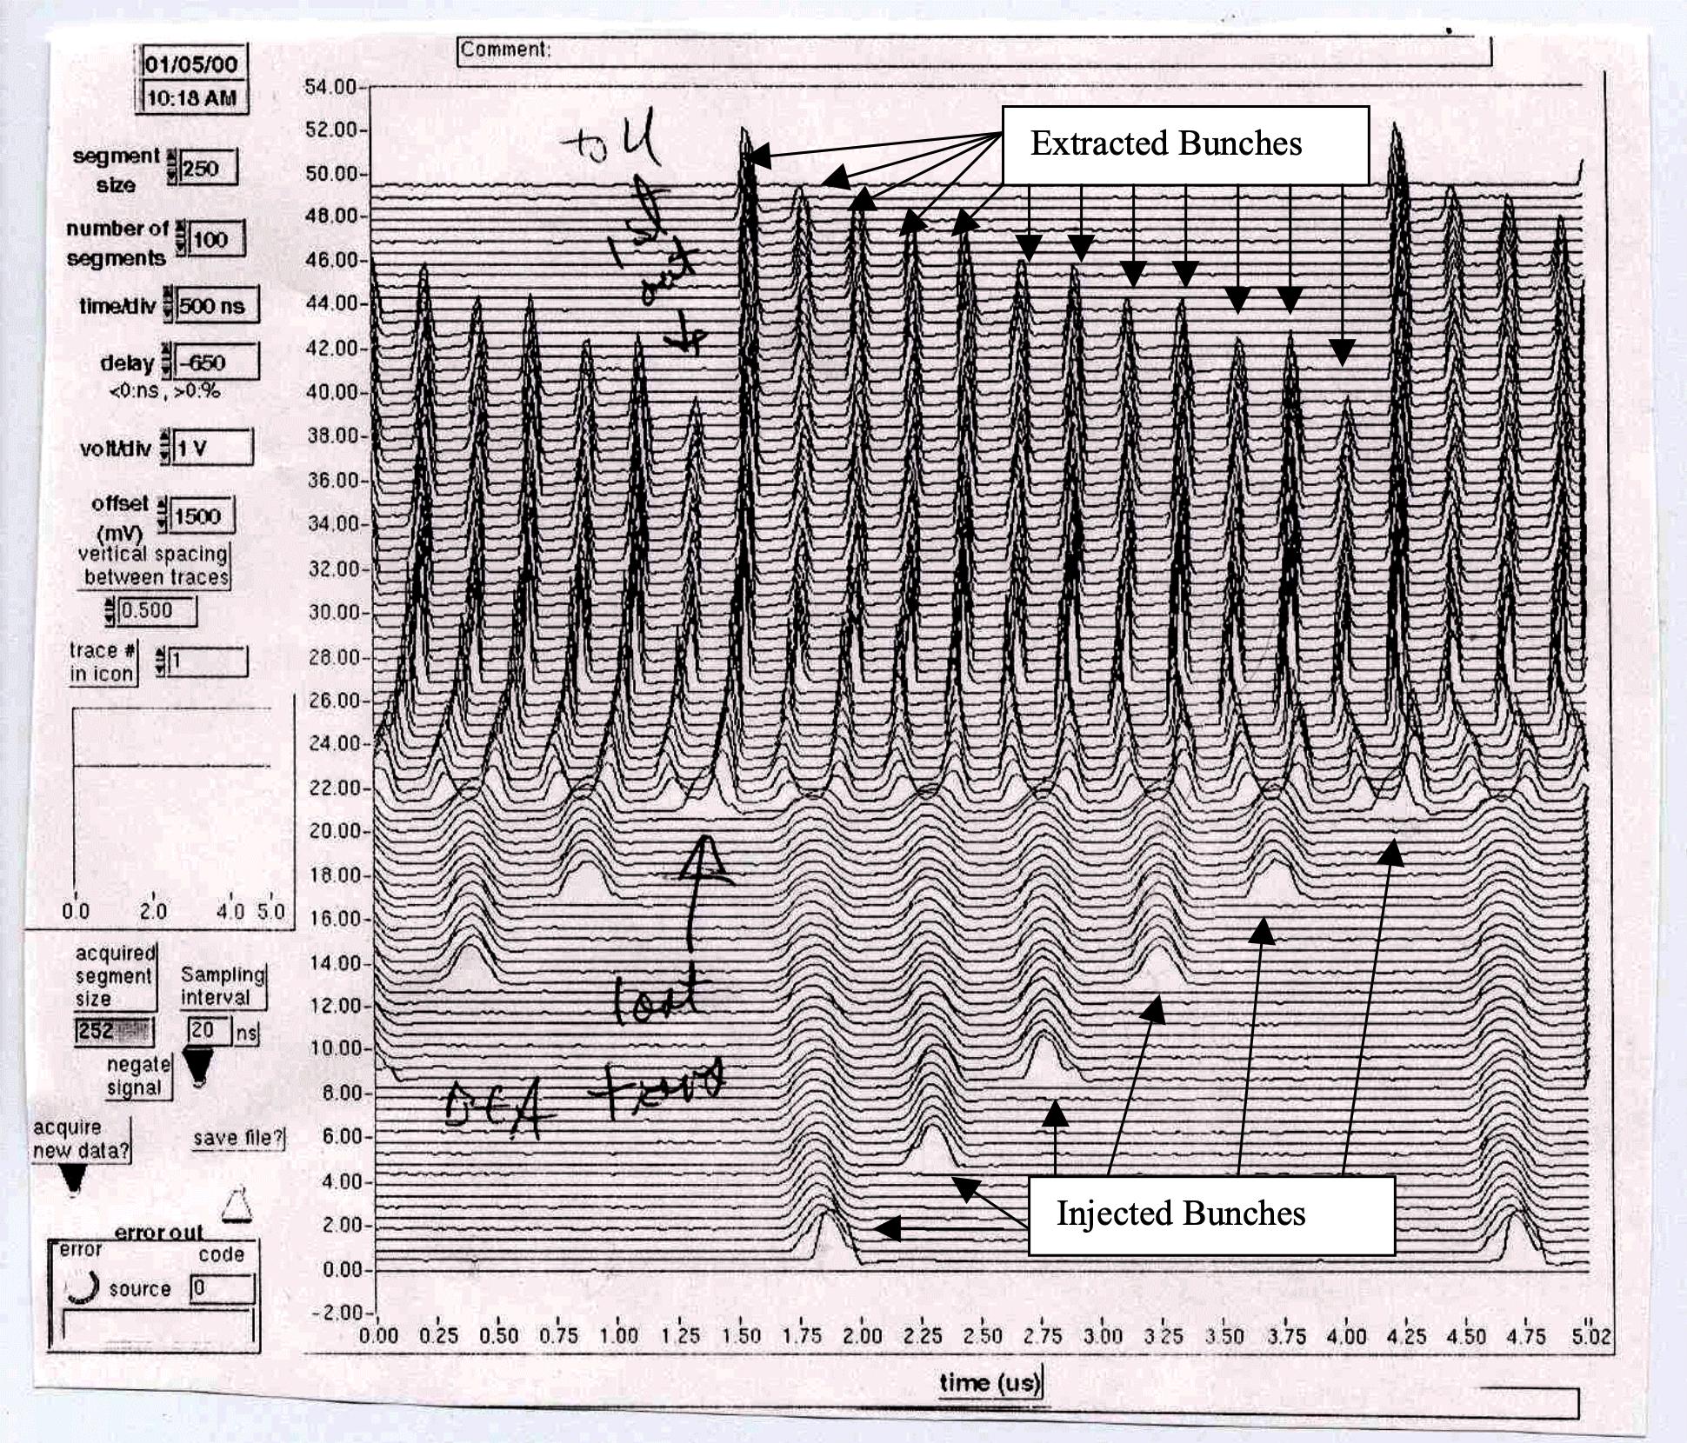
A little on Fast Extracted Beams
For G-2, p=24 GeV/c protons
we ran ~6x10¹² p / bunch
Bunches were about ~80 nsec long (at the baseline)
Single Bunches extracted at 30 Hz
Au ions can be extracted in a similar way, but for RHIC they are transferred on demand, cogged for bucket-to-bucket transfer.

Slide 15
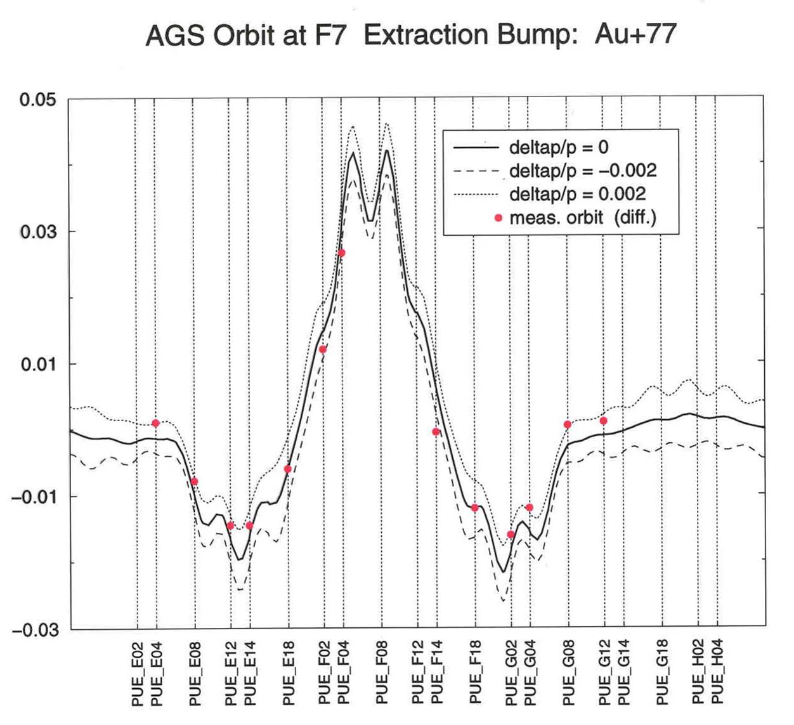
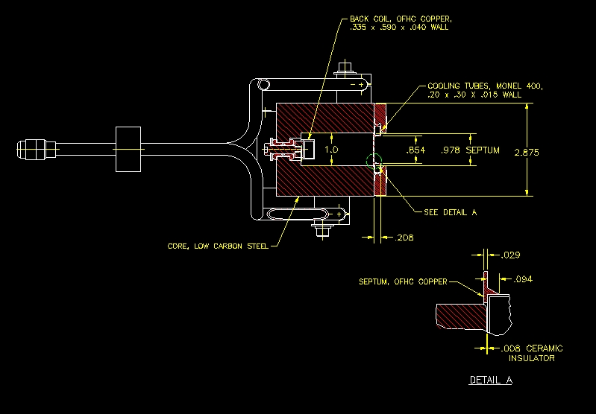
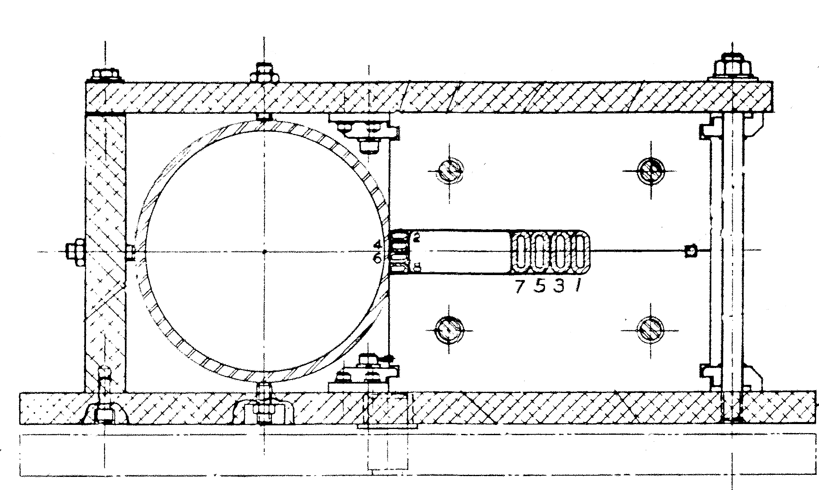
Overview of AGS Slow Extraction
Thin Septum
0.76 mm, 1.5 kG
Thick Septum
13.5 mm, 9.5 kG

Slide 16
AGS Performance History
PROTON BEAM FY94 FY95 FY96 FY97 FY98/99 FY2000
SEB FEB (g-2) SEB FEB (g-2) FEB (g-2)
Beam Energy 24 GeV 24 GeV 24 GeV 24 GeV 24 GeV 24 GeV 24 GeV 24 GeV
Peak Beam Intensity 40 x 10¹² ppp 63 x 10¹² ppp 62 x 10¹² ppp 62 x 10¹² ppp 46 x 10¹² ppp 72 x 10¹² ppp 58 x 10¹² ppp 61 x 10¹² ppp
Total protons accelerated 0.3 x 10²⁰ 1.1 x 10²⁰ 0.9 x 10²⁰ 0.4 x 10²⁰ 0.1 x 10²⁰ 0.9 x 10²⁰ 0.4x 10²⁰ 0.5x 10²⁰
Spill Length/Cycle Time 1.0 sec/3.8 sec 1.6 sec/3.6 sec 1.6 sec/3.6 sec 1.6 sec/3.6 sec 2.8 sec/5.1 sec
-> Duty Cycle 26% 44% 44% 44% 55%
Spill Structure Modulation
(peak-average) /average 50% 20% 20% 20% 20%
Average Availability
/Best Week ~83% 82%/ 93% 76% / 92% 71% / 79% 58 % / 67 % 71% / 88% 55 % / 83 % 74 % / 87 %
HEAVY ION BEAM Au Au Au Au Fe (NASA) Au Fe (NASA)
Beam Energy /nucleon 11 GeV 11 GeV 11 / 4 / 2 GeV 11 / 8 / 6 GeV 1.0 / 0.6 GeV 11 GeV 1.0 / 0.6 GeV
Peak Beam Intensity 2 x 10⁸ Au/p 2 x 10⁸ Au/p 4 x 10⁸ Au/p 17 x 10⁸ Au/p 20 x 10⁸ Fe/p 9 x 10⁸ Au/bunch 36 x 10⁸ Fe/p
Spill Length/Cycle Time 1.0 sec/3.8 sec 1.0 sec/3.8 sec 1.4 sec/3.6 sec 1.5 sec/4.0 sec 1.2 sec/3.0 sec
-> Duty Cycle 26% 26% 39% 38% 40 %
Spill Structure Modulation
(peak-average) /average 50% 20% <20% <20% <20%
Average Availability ~85% 90% 80% 82 % 96 % 81 % 90 %

Slide 17
Intensity range of AGS (today)
AGS intensity in recent years driven entirely by RHIC needs; higher per bunch intensity, polarization, not a lot of concern for high bunch number per cycle
(unpolarized) Proton intensity and number of bunches per cycle not pushed since g-2 (~2002)
12 bunches/cycle, 6x10¹²/bunch
This would require (re) development
Intensity of new species in AGS generally needs to be studied: main limitations are initial source production intensity and stripping foil efficiency
(many of the species on the NSRL Booster list have not been stripped/injected into AGS)
Species | “Routine” highest intensity/bunch | Bunches/AGS cycle
Pol.Protons | 3x10¹¹ | 1
Gold | 3x10⁹ | 2
Cu | 4x10⁹ | 2
Al | 1x10¹⁰ | 2
Per bunch intensities achievable with ‘normal’ efforts (i.e. for a RHIC run)

Slide 18
Beam transport options

Slide 19
Status
Slow extraction from AGS has been disabled, to re-enable we need
New thin and thick septa (have one still) magnets and power supplies
F7 bump reinstalled with new cables and new PS
4 sextupole magnets powered with new PS
New active filter (to reduce spill ripple)
New vacuum pipe from F10 to F12, for extraction channel (have old one)
Refurbished magnets in 912
Refurbished and some new PSs for magnets
New vacuum systems
New instrumentation
Getting all this back in place and operating will take ~3 years

Slide 20
Building 912 today
Most of the old switchyard is still in place.
But,
Not operated in 25 years.
All formed experiments and detectors have been removed.
Some magnets have been removed, to repurpose and use for other applications.
Electrical infrastructure does not meet code – needs upgrading before running.
70,000 ft²
floorspace
EEBA no longer available!

Slide 21
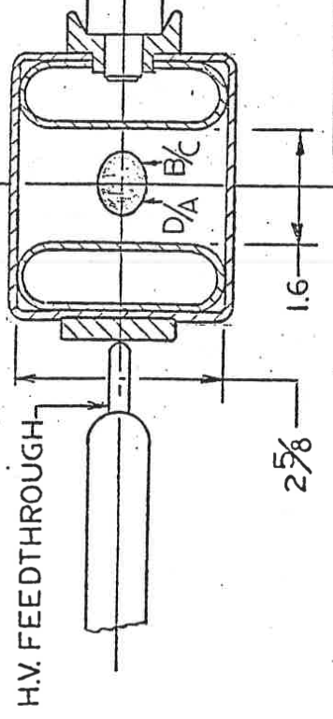
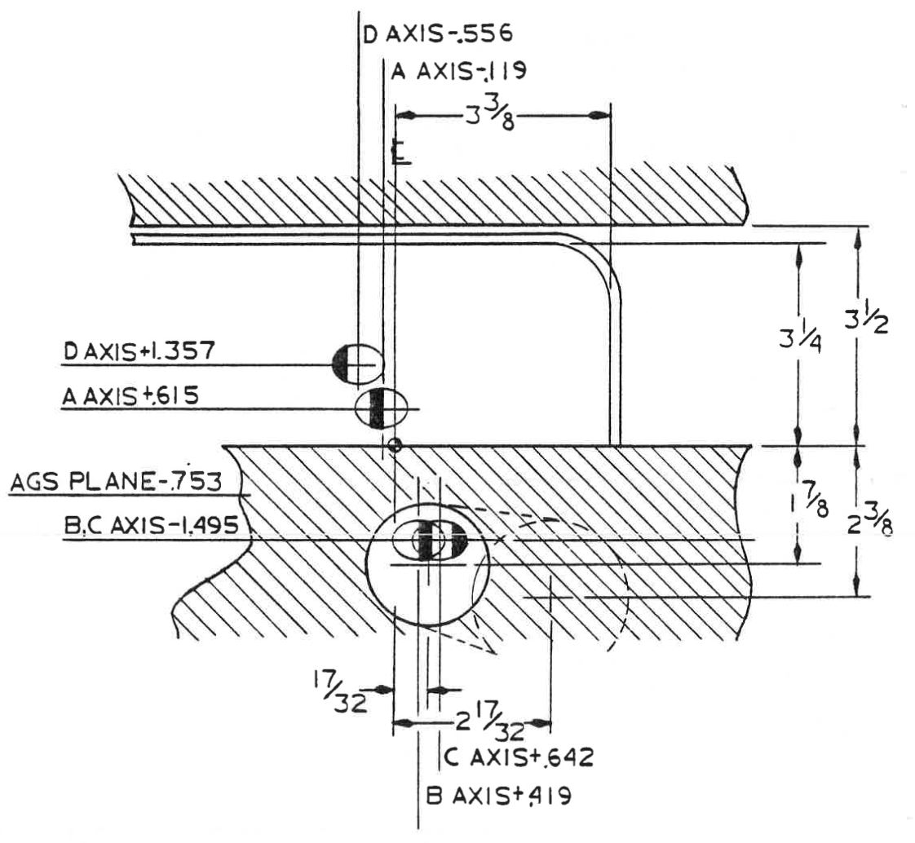
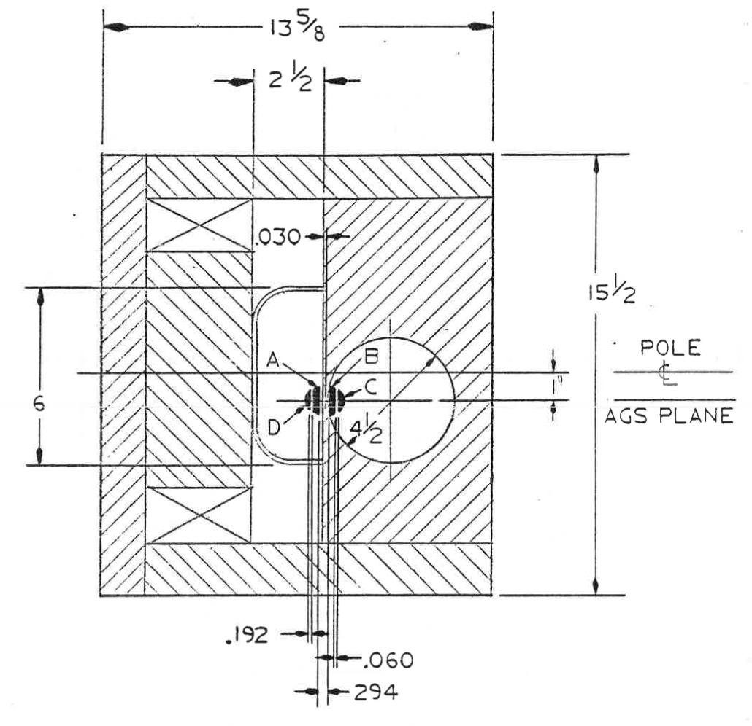
Options
We could do split beams again, but we could simplify the design.
How many beamlines are needed?
We could look into horizontally splitting, rather than vertical
Handling momentum dispersion will be an issue. Would want to design achromatic tune and split where D=D’=0 (oddly enough, this is simpler).
We could eliminate splitters and use a switching magnet
If each beamline has a different purpose this is the best option
Can NP experiments share a single target?
Thick Lambertson
Electrostatic splitter
Thin Lambertson

Slide 22
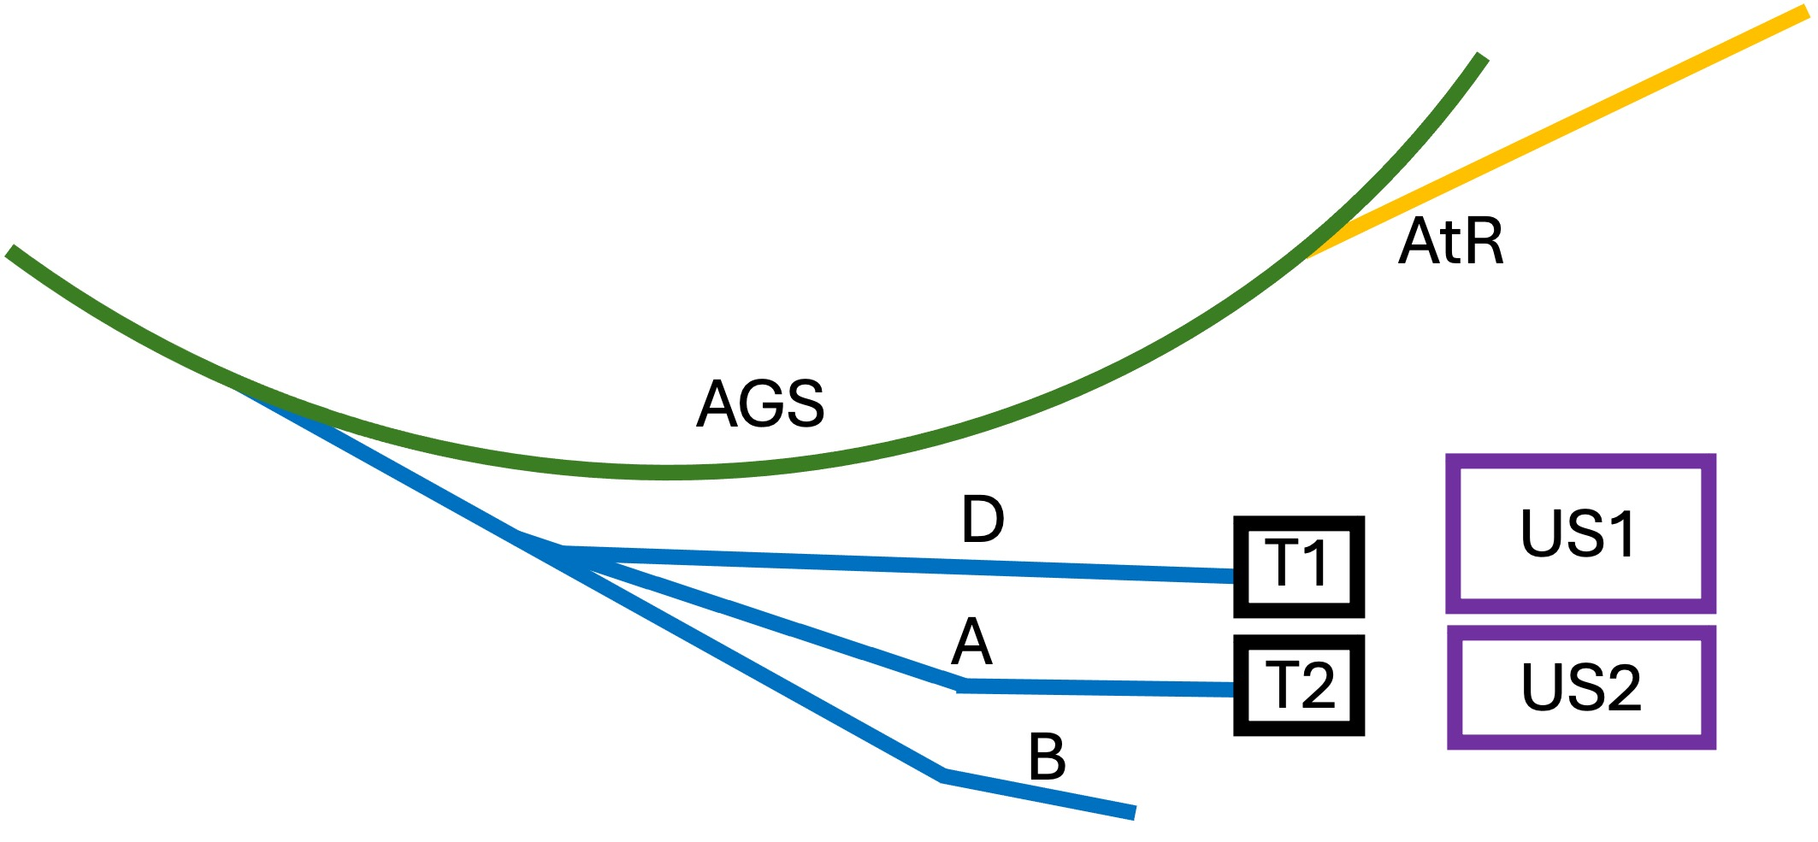
For Example: 3 different Users
US1 might be electronics testers
Best use of Dline is for low energies
Designed to give large uniform beams created using octupole magnets
US2 may be anything
Designed to give large uniform beams but by rastering a small beam.
Could deliver small beams on a target.
Switching magnet
Test Beam or NP Experiment

Slide 23
Beam Quality and methods to improve duty factor

Slide 24
Main beam quality issues to consider
Spill quality
  Historically it was around 30-40% modulated
  Modulation comes from tune ripple in the AGS (ripple on power supplies modulate the betatron tune during extraction)
  Active filter (on AGS Main magnet PS) helps
  Additionally, adding a high frequency quadrupole and modulate will remove the ripple structure (have such system Booster, R&D project)
Beam size and shape
  small Gaussian shaped beams (~ a few mm diameter)
  Making very small beams increases the angular divergence – so a careful analysis of the beam parameters is needed to inform the optics design
Beam Motion on target
  Historically a challenge in the switchyard. No dispersion control.
  Two ways to fix it: ramp dipoles with spill or design achromatic tune.

Slide 25
Samples of Spills
2.2 Seconds
CNAO, MedAustron, Italy
AGS 2001 high intensity protons
CERN SPS
Air core quad feed forward
JPARC has some unique problems, due to operation with zero chromaticity.

Slide 26
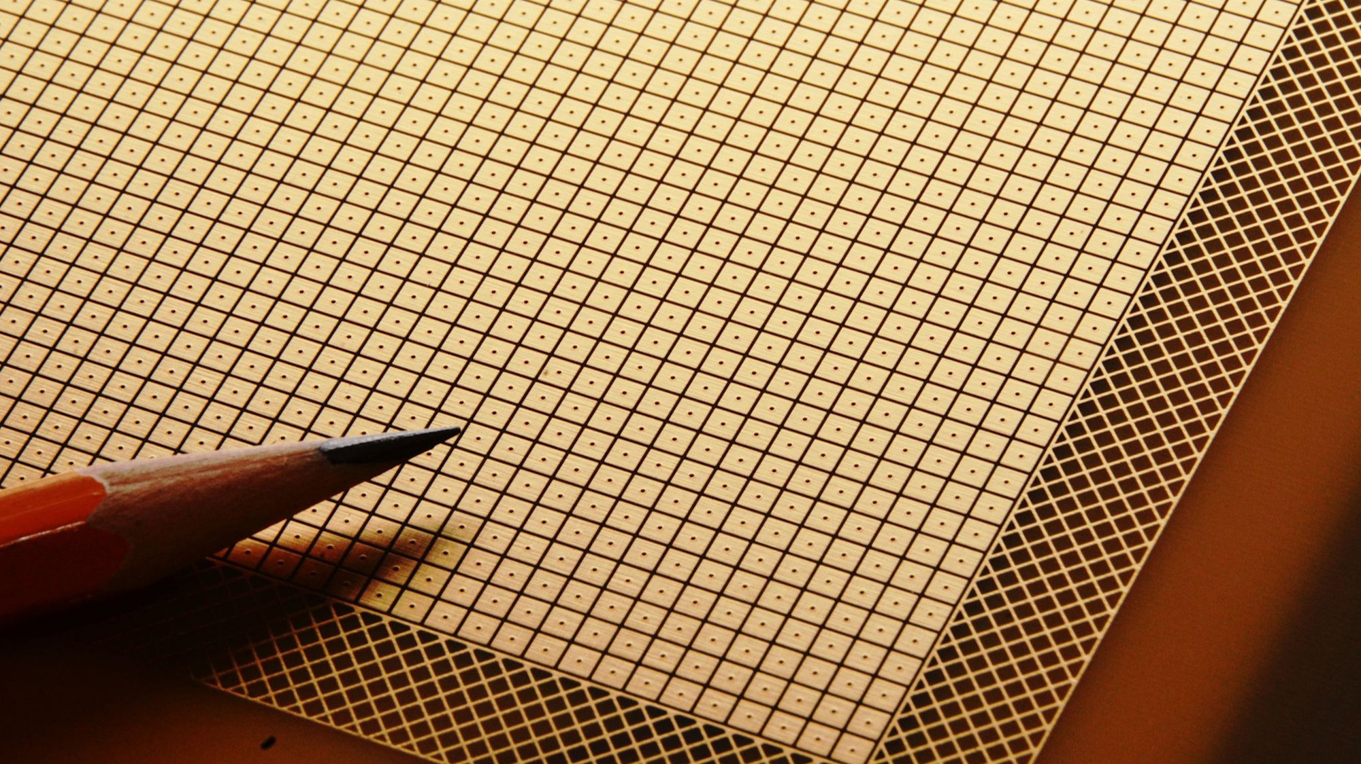
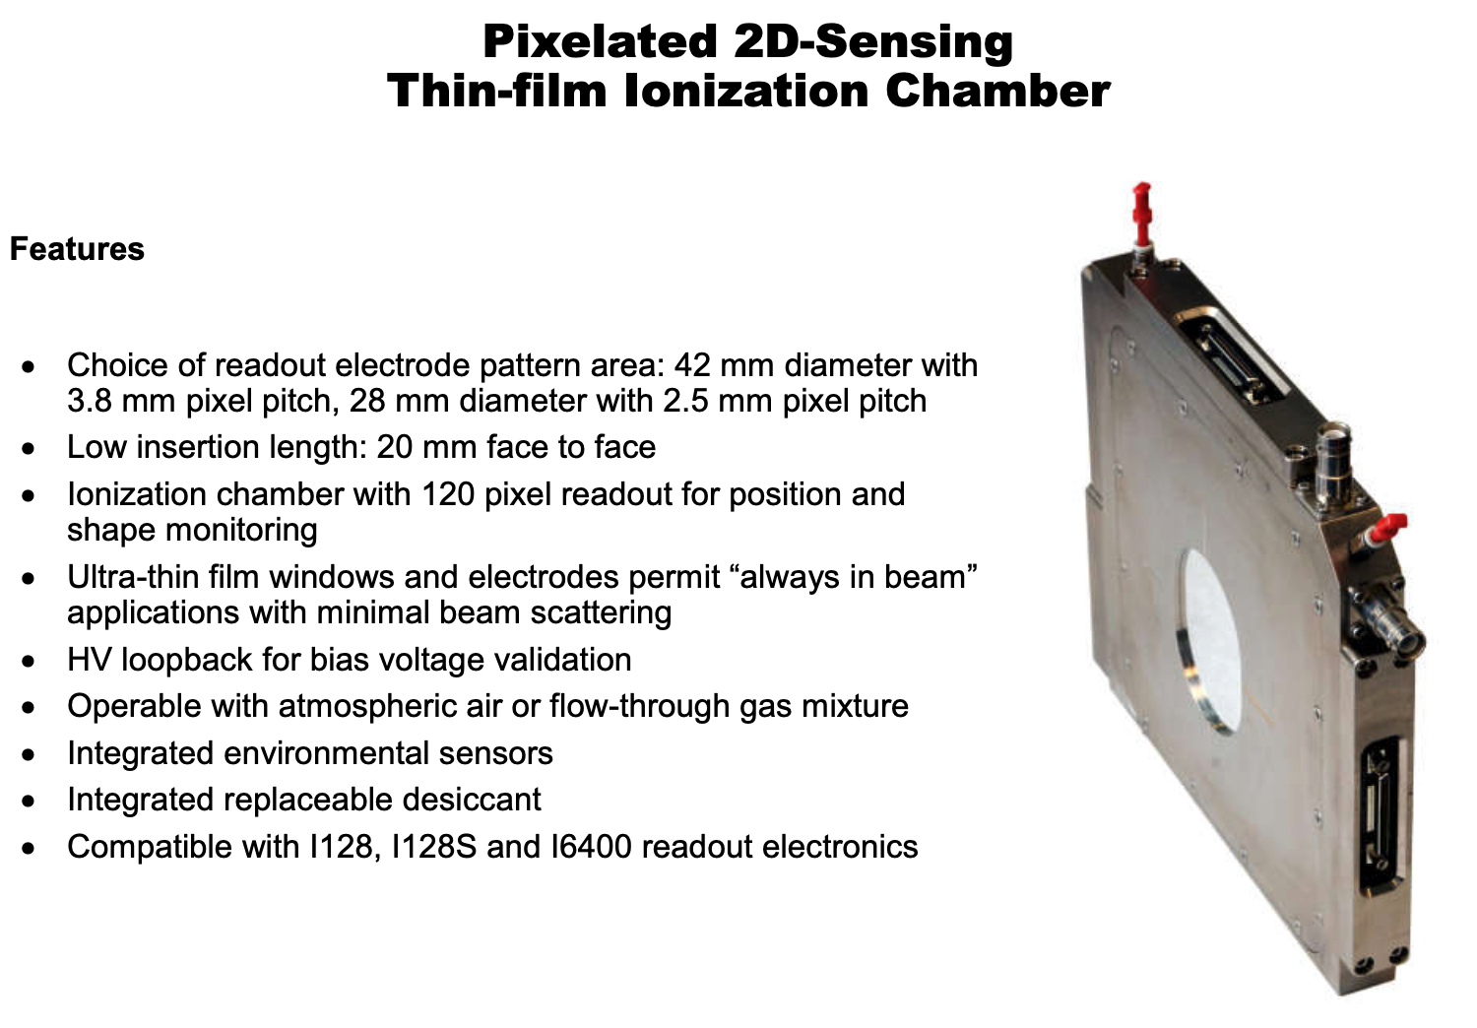
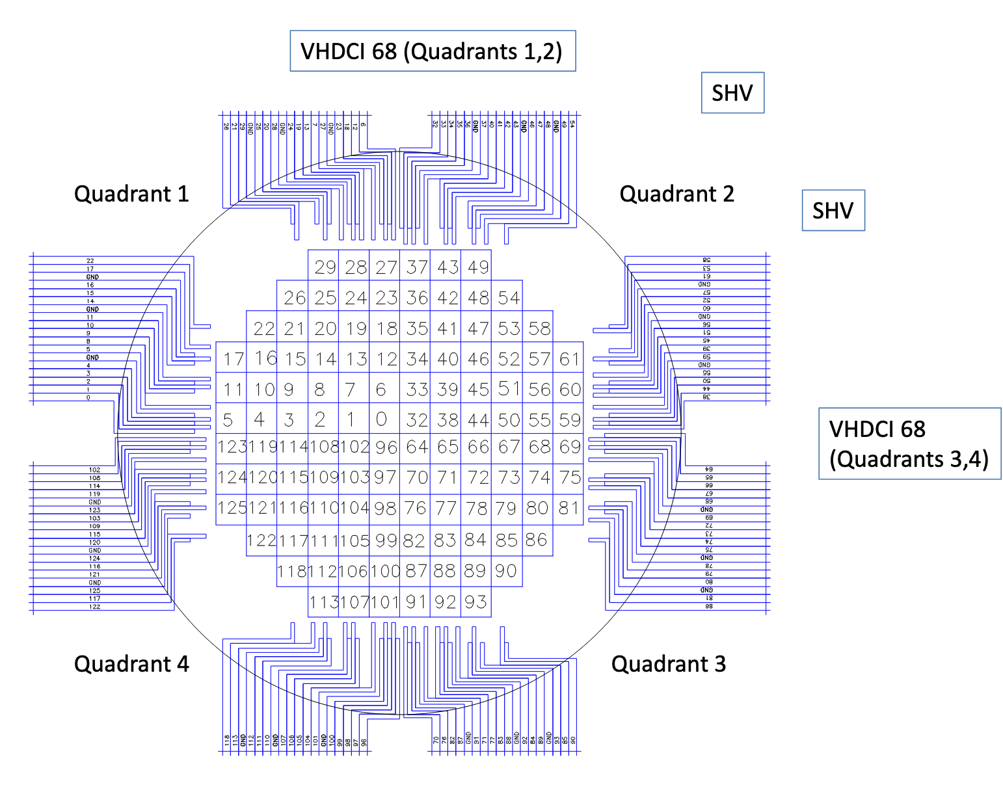
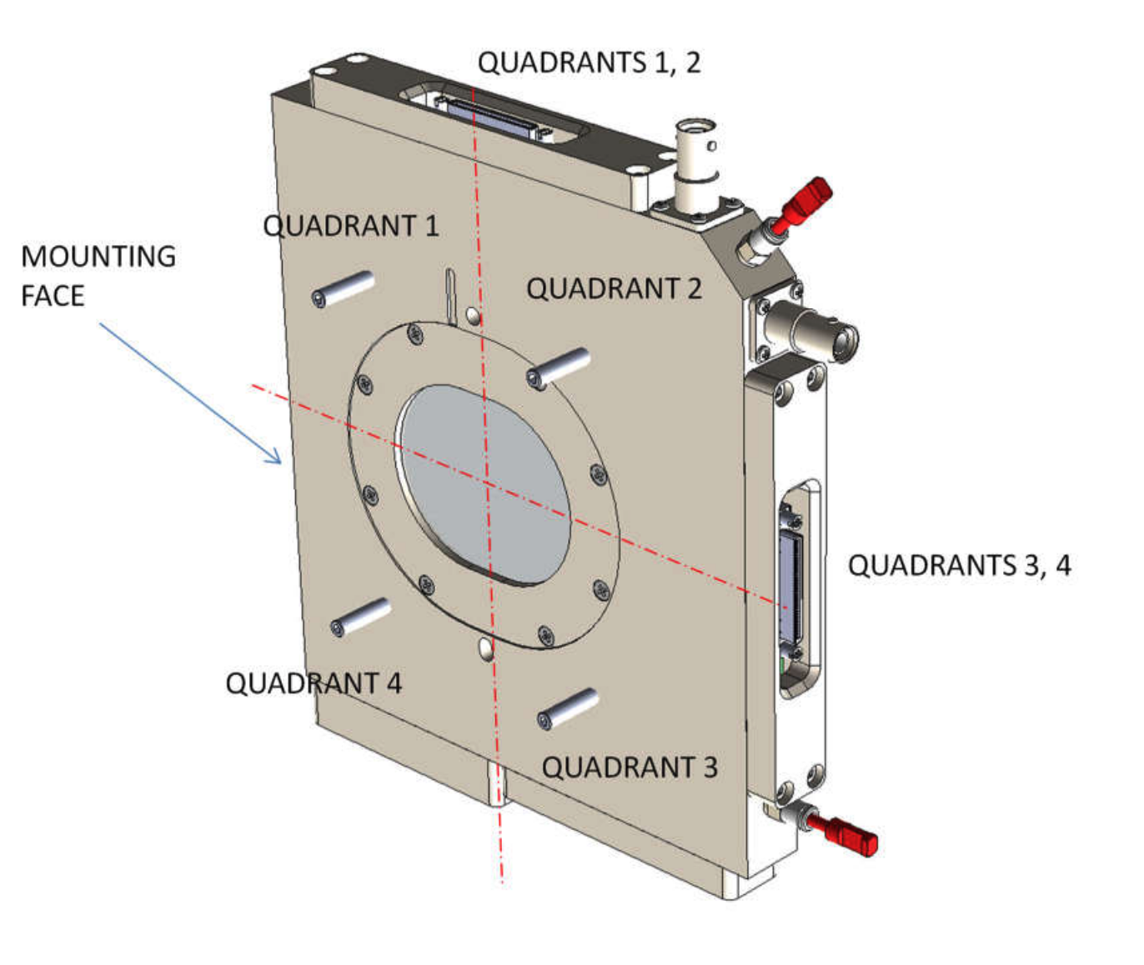
Beamline instrumentation: commercial ion chambers
Pyramid Technical Consultants make a wide array of devices.
We have a large 25x25 cm unit with pretty big pixels in a 16x16 array.
We have plans for a 16x16 cm unit with 1 cm pixels. We hope to end
up with a wide range of both thin and thick detectors fairly soon,
but with 16x16 pixels in all cases.
https://ptcusa.com/

Slide 27
Options for NP fixed target experiments

Slide 28
What’s available?
Ions’?
NSRL has used
C, Ne, Si, Cl, Ar, Ti, Fe, Kr, Nb, Ag, Xe, Tb, Ta, Au, W, Bi, Th
RHIC has used
  d, Al, O, Cu, Zr, Ru, Au, U
Old SEB => mostly Au at 11 GeV/n/c
Energies?
AGS can run as high as Bρ = 100 Tm (roughly 28 GeV/c protons or 10.8 GeV/n Au)
Lower energies are possible, but beam size gets bigger. However, we might get down to ~10 Tm, or ~1.2 GeV/n for Au. Beam will be x3 larger, so likely higher losses.
d => 14 GeV/n and He3 => 19 GeV/n (fully stripped in AGS)

Slide 29
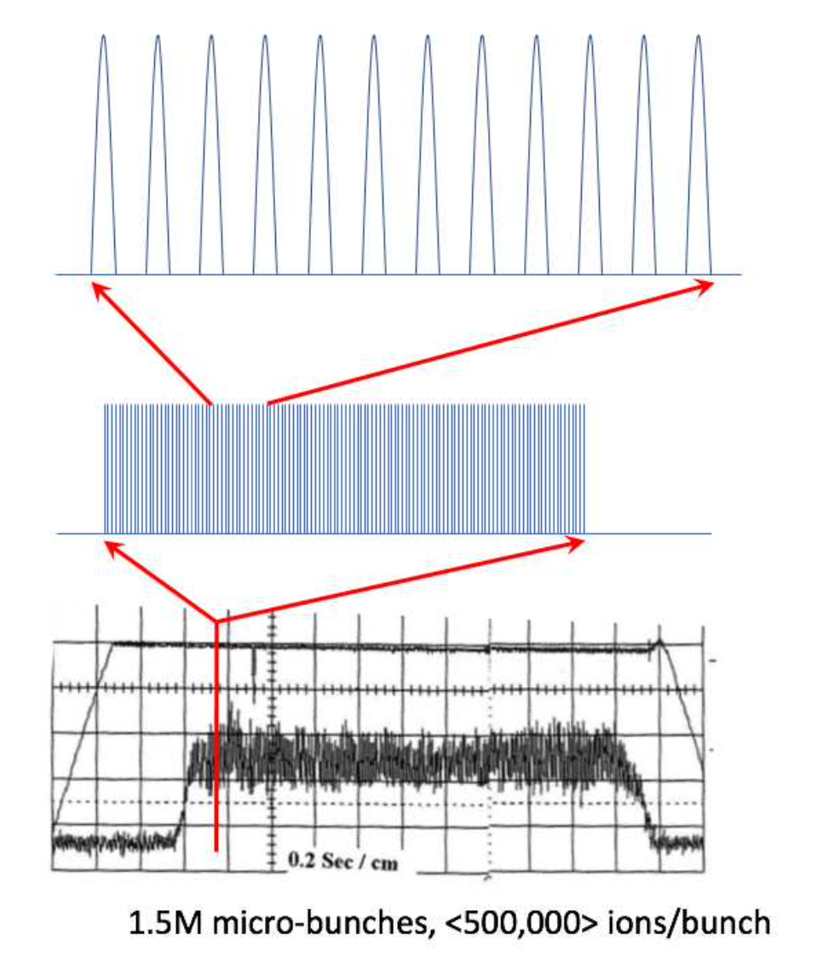
Operation Modes to Switchyard
Once Extraction to switchyard is re-established
Slow extraction from the AGS with 2- to 4-second-long spills
  Options:
  Completely debunched, smooth constant flux
  bunched beam SX, to get 0.2 - 2.5 μsec bunch spacings – simulate collider beams
  Possible microbunched beam, but will require high freq RF
  (e.g., <1 nsec bunches w/ 10 – 40 nsec spacing)
Fast Extracted single bunches (like G-2, but to the switchyard beamlines)

Slide 30
Scheduling
RHIC operations to end some time between Dec 2025 and Apr 2026
  RHIC equipment removal to commence immediately to begin ~10 year construction effort for the Electron-Ion Collider
BLIP, NSRL operation to continue in the intervening years
  Requires only sources and Booster in stretches of several weeks to a few months throughout the year
AGS to be operated for (on average) two months a year for development
  Exact distribution of time not at all settled, funding contingent (longer, less frequent blocks better?)
  Development time planned mostly for polarized species
    Principally: development of polarized ³He. Dominates the time, requires new equipment in Booster and challenging AGS setup. Only the second polarized species in AGS.
    Commissioning new systems: Polarization resonance correction schemes, TBT BPMs, upgraded tune meter
  Other AGS efforts, like test beams, not currently allotted

Slide 31
Summary
We have a long history of delivering many kinds of beams to experiments from the AGS.
Slow extraction from the AGS is currently disabled. Will require $10’s of millions to resurrect beam in building 912.
We have many questions, but much depends on experimental requirements and how well AGS capabilities can match those requirements.
If we started today, it would take a few years to have beam.

Slide 32
Questions (from me)
We assume interest is in polarized beams, d, and He3 ions.
Does community want K.E. = 10.8 GeV/n Au beams?
Can a cheap new detector be built from old STAR/sPHENIX parts?
What kind of targets are needed? Polarized? Jets? Solid?
How long to get a detector installed?
Please note: assume a schedule of 3 years to get beam in 912.

