Slide 1
The Potential of EIC Machines for Fixed Target Experiments
Chuyu Liu
Collider-Accelerator Department, BNL
Exploring a Fixed-Target Program at the EIC workshop, Stony Brook University, USA, Sep 29-30, 2025

Slide 2
Outline
RHIC Facility Overview
RHIC STAR FXT Experience
Electron-Ion Collider (EIC) Overview
Hadron Beam Parameters
Electron Beam Parameters
Summary

Slide 3
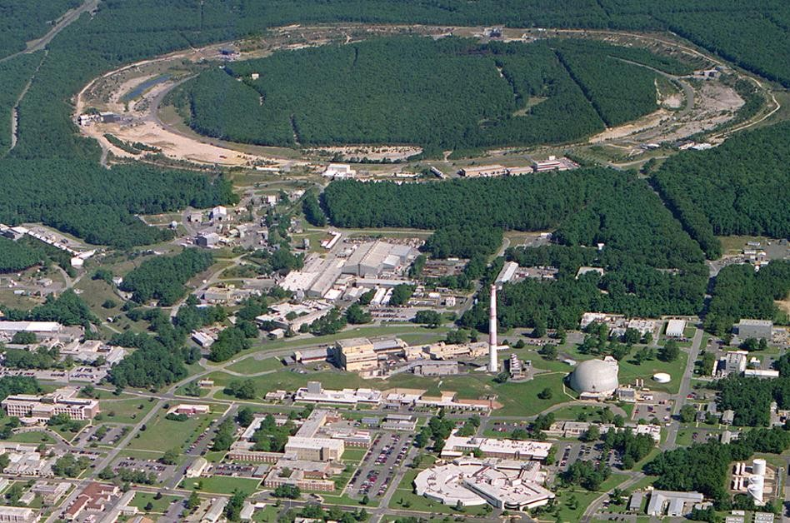
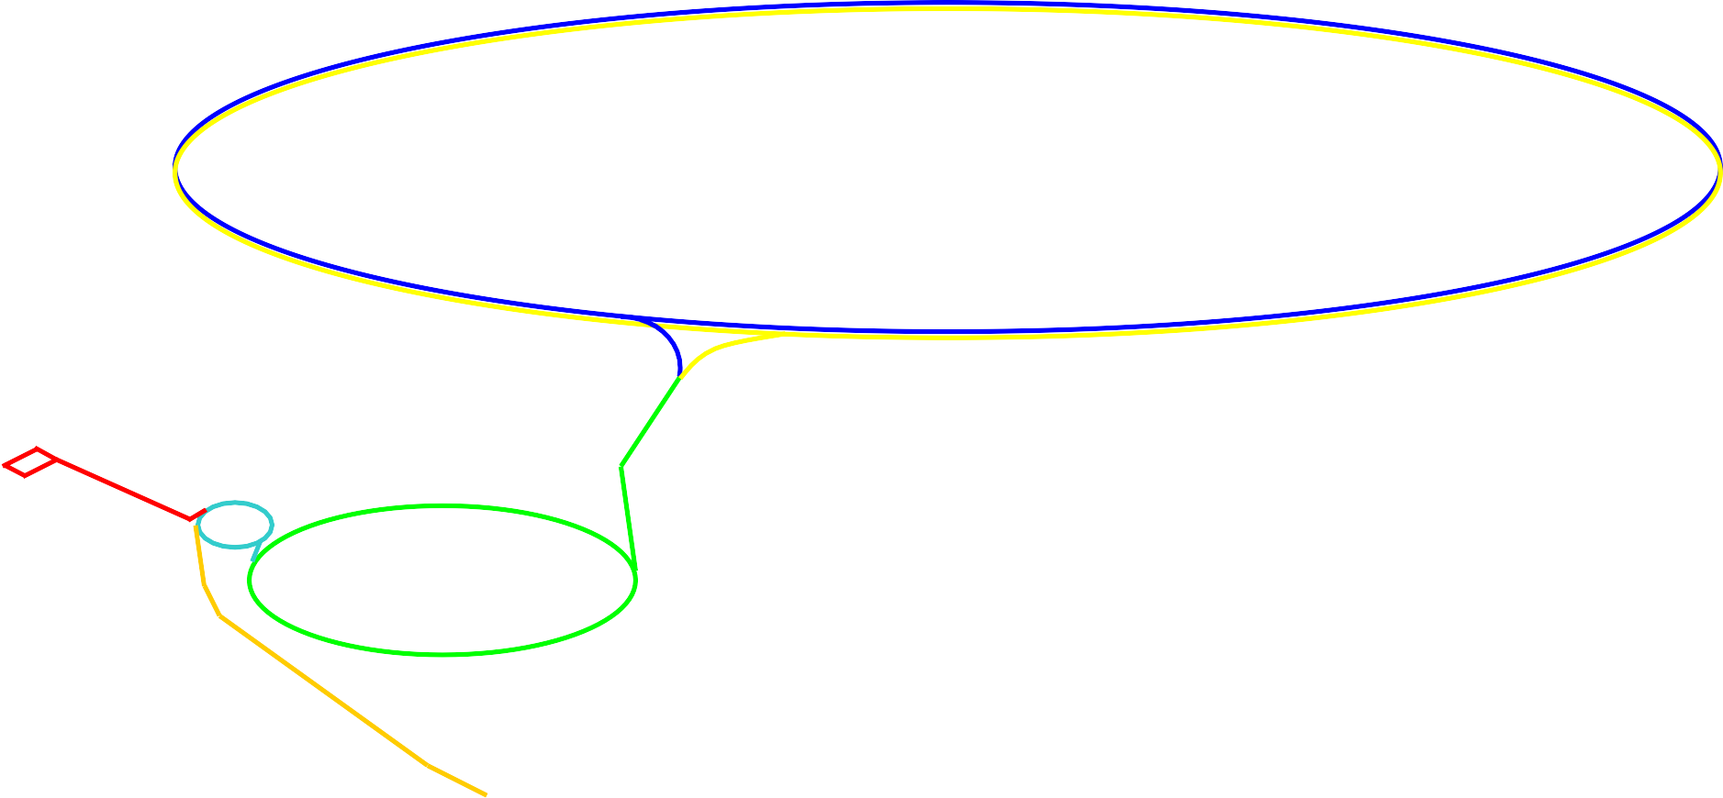

Aerial view of the RHIC facility
12:00 o’clock
RHIC
10:00 o’clock
2:00 o’clock
8:00 o’clock
6:00 o’clock
4:00 o’clock
LINAC
NSRL
^{EBIS}Booster
AGS
Tandem
Notes:
Several decades following Rutherford's landmark experiment, our understanding solidified, revealing that atoms are composed of nucleons and electrons. Furthermore, the discovery of quarks and gluons as the constituents of nucleons further expanded our knowledge. However, physicists sought to generate an abundant supply of quarks and gluons to comprehensively study their properties and interactions.

Slide 4
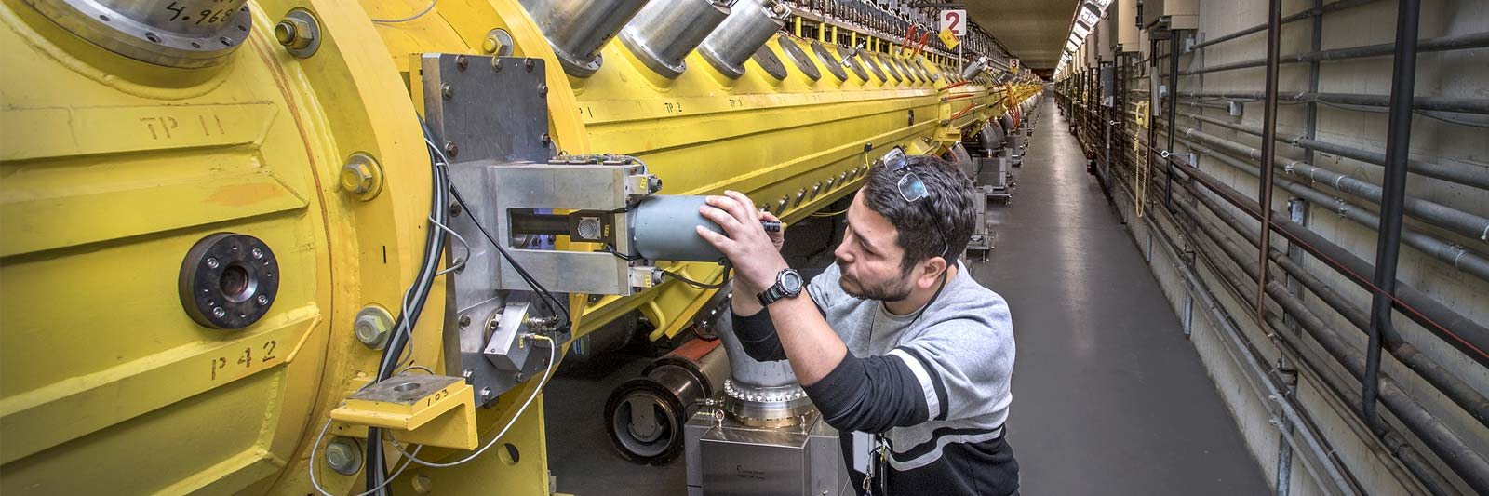
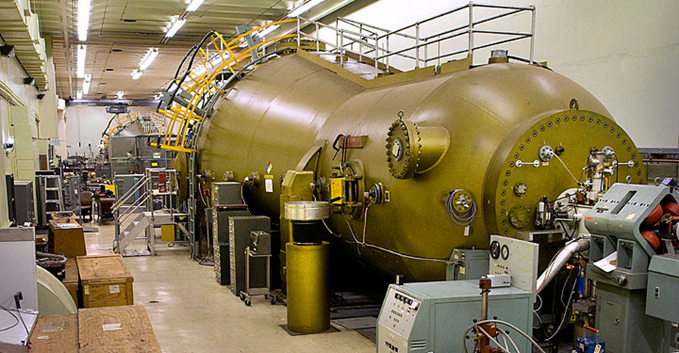
Hadron Preinjector at BNL
Linac (1970) EBIS injector (2010) Tandem (1970)
Ion: H⁻, H^{-^} H-U H-U
E: 10 -200 MeV 2 MeV/u 14 MV(1+q)
I_{ave} : 200uA, ~150 nA ~10 μA
RR: 10 Hz 5 Hz dc/pulsed
User: BLIP, NSRL, NSRL, RHIC SEU, NSRL
RHIC RHIC,
Can serve all users simultaneously
Courtesy of Deepak Raparia

Slide 5
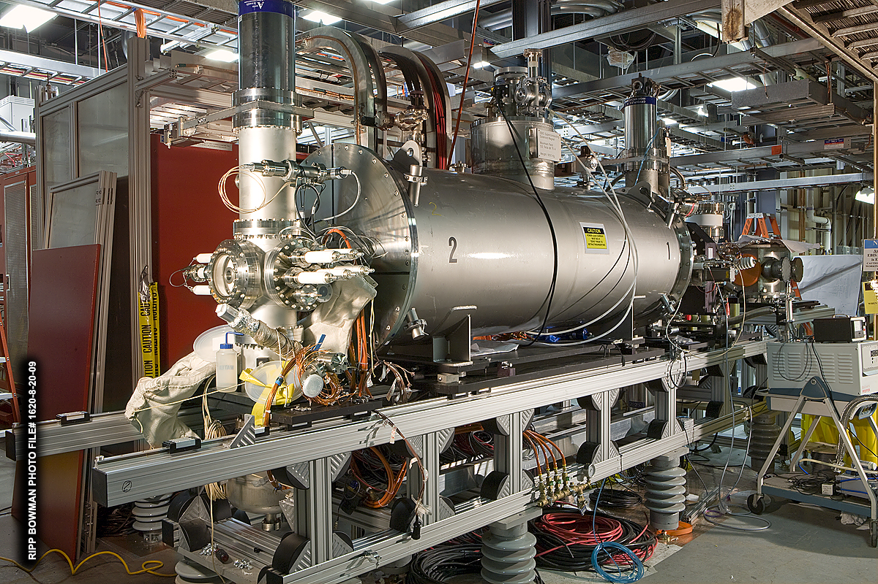
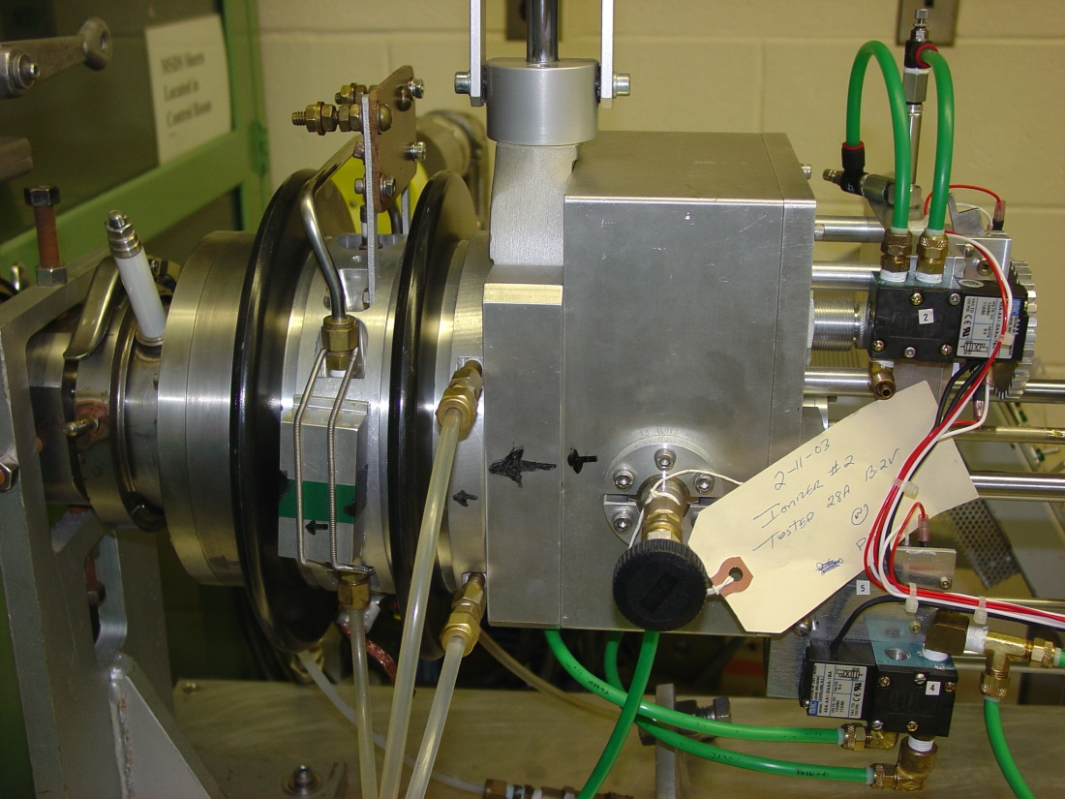
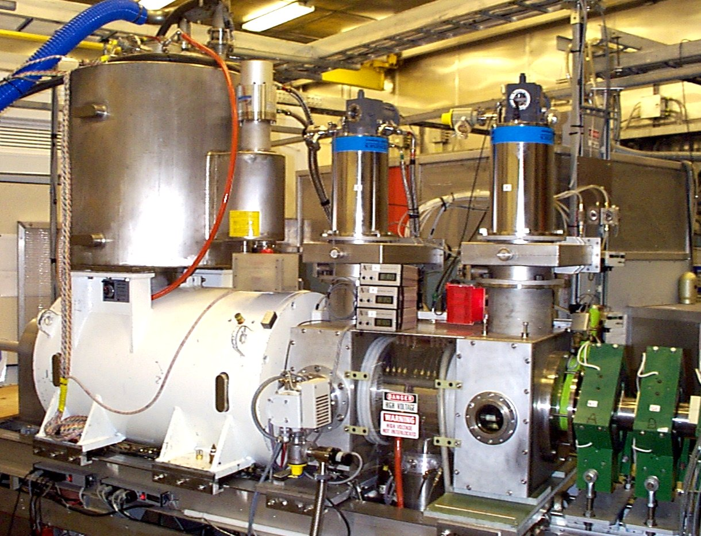
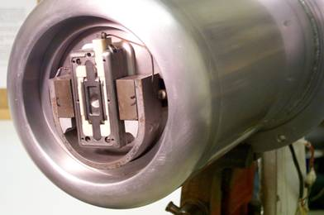
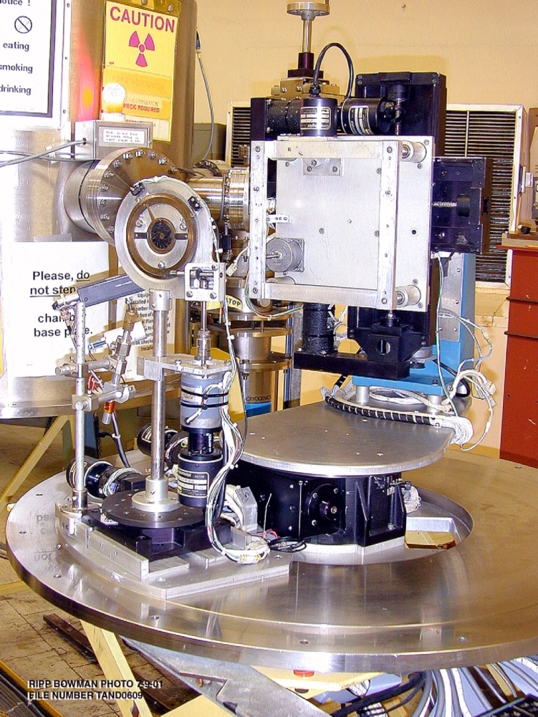
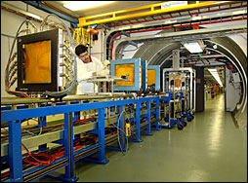
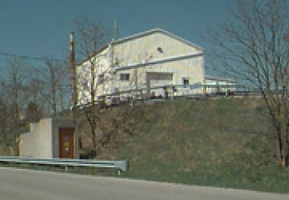
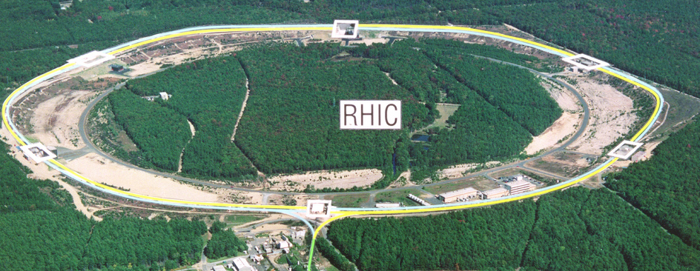
Cs sputter (Tandem)
OPPIS (Linac)
Magnetron (Linac)
EBIS (Heavy Ion Linac)
H-Au
H-
H- U,
H-
Relativistic Heavy Ion Collider
Brookhaven Linac Isotope Producer
NASA Space Radiation Lab
Single Event Upset
Ion Sources at Pre-Injector
Courtesy of Deepak Raparia

Slide 6
BNL LINAC Beam Parameters
RHIC Program
Energy: 200 MeV ,
Intensity: ~400 μA ,
Pulse length: 300 μs
Pol: 85%
goals: max. pol. & min. emit.
BLIP Program
Energy: 66–200 MeV
Pulse length :~600 μs
Intensity 60 mA
Goals: uniform beam & min. losses.
NSRL Program:
Energy : 200 MeV
Intensity: ~350 μA ,
Pulse length: 300 μs
Goal: schedule
Can be serve all programs simultaneously
Frequency 201.25 MHz
Injection Energy 0.750 MeV
Final Energy 10-200 MeV
Peak Current ~60 mA/ ~ .5 mA P^
Pulse Length 600 μs
Repetition Rate 6.67 Hz
Number of cavities 9
Length 144.8 m
Total Peak RF Power 22 MW
Courtesy of Deepak Raparia

Slide 7
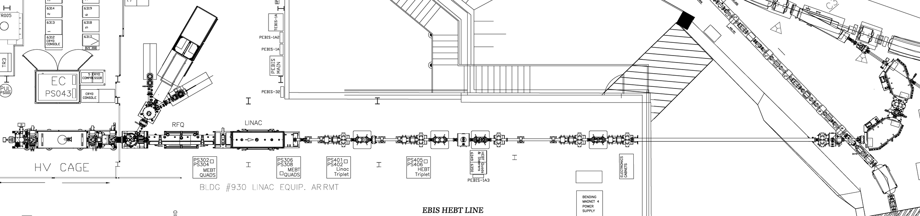
EBIS Preinjector (2 MeV/u)
BOOSTER
BIG BEND
EBIS
RFQ
IH LINAC
BEAM TRANSPORT LINE
LION
Ions | H - U
Q / m | ≥1/6
Current | > 1.5 emA (20 μs)
Pulse length | 10-40 μs
Rep rate | 5 Hz
Output energy | 2 MeV / u
Time to switch species | 1 second
HCIS1
HCIS2
EBIS
TOF
RFQ
IH LINAC
Courtesy of Deepak Raparia

Slide 8
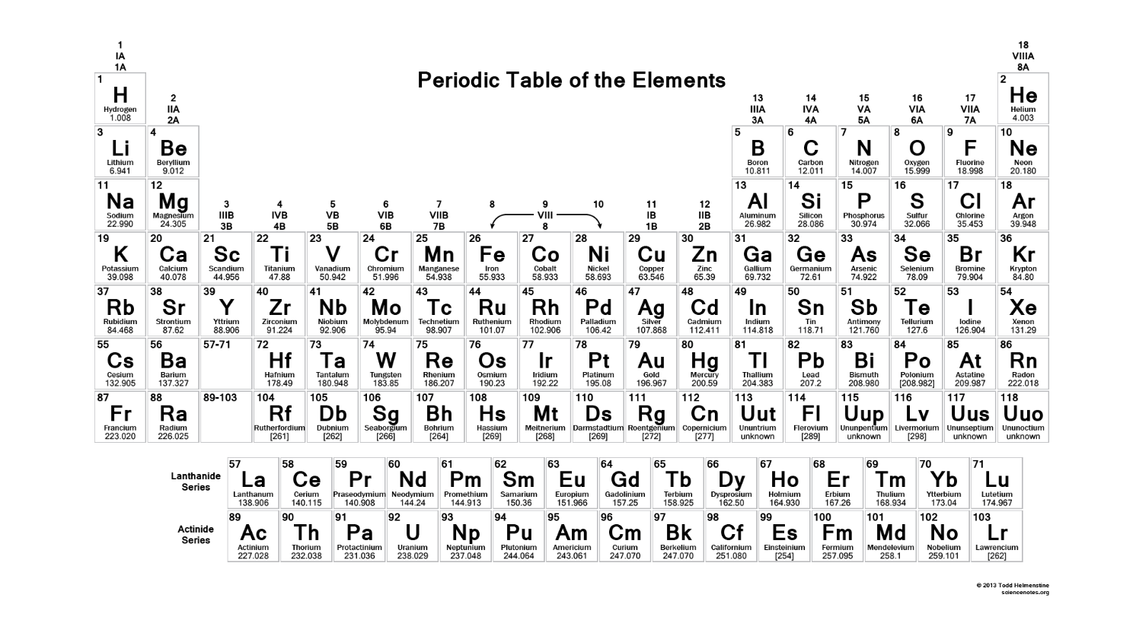
EBIS beams run to date
³He⁺² : will be installing 3He Gas cell
summer 2026,
Capable of 2.5E11/pulse
polarization ~65% at 6 MeV
Goal: 85%
H, H₂⁺, D, ³He²⁺, ⁴He^{1+,2+}, Li³⁺, C^{5+,6+}, O⁷⁺, Ne⁵⁺, Al⁵⁺, Si^{11+,12+}, Ar¹¹⁺, Ca¹⁴⁺, Ti¹⁸⁺, Fe^{20+,24+}, Cu¹¹⁺, Kr¹⁸⁺, ⁹⁰Zr¹⁵⁺, ⁹⁶Zr¹⁶⁺, Nb⁺¹⁶,Ag⁺²⁹ Xe²⁷⁺, Ta³⁸⁺, ¹⁸⁴W³¹⁺, Au³²⁺, Pb³⁴⁺, Bi⁺³⁹, ²³²Th³⁹⁺, U³⁹⁺
^{Red: RHIC. Blue: NSRL}
1 second switching between species (2, or more), alternating
<30 second switching among almost any 10, if loaded into external sources
Courtesy of Deepak Raparia

Slide 9
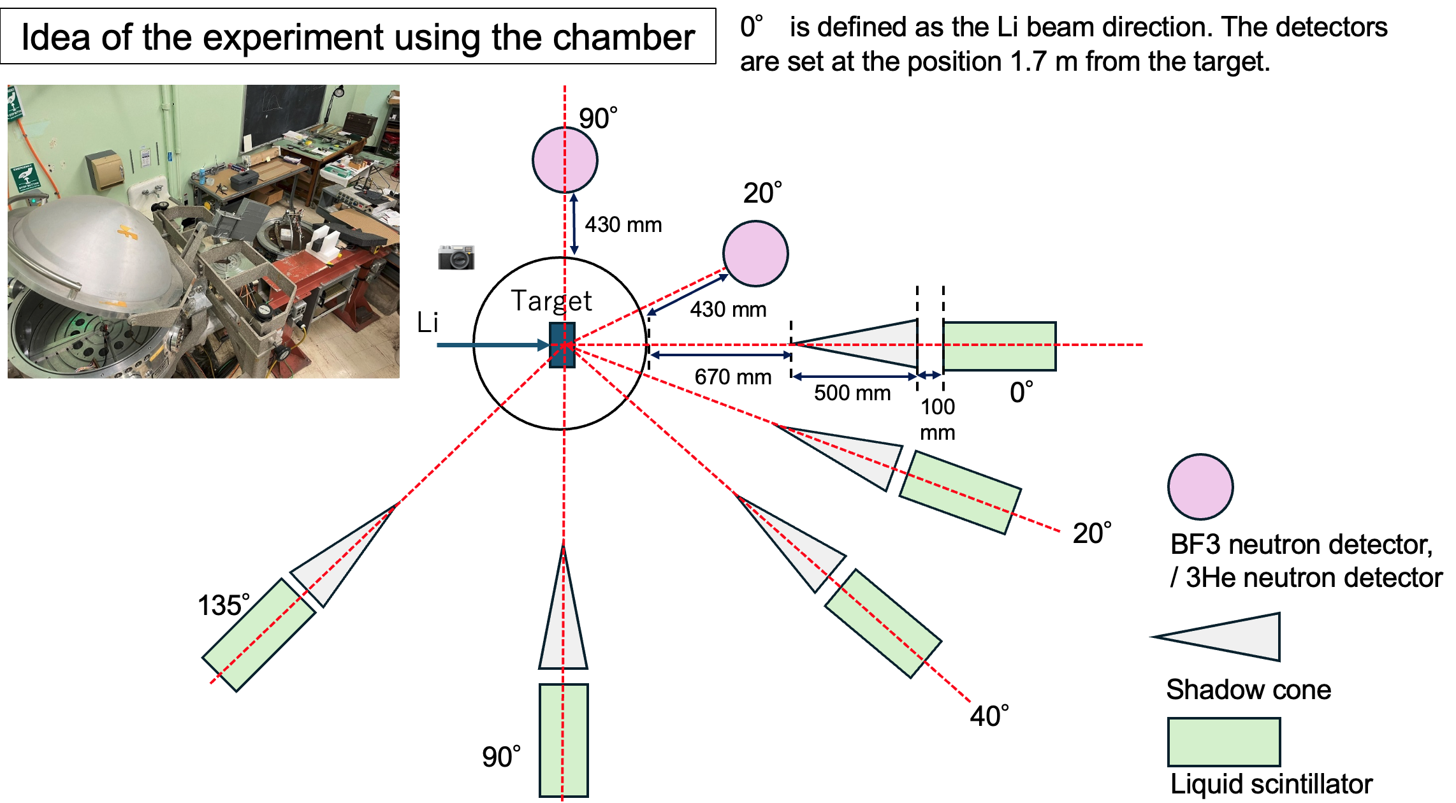
Tandem Van de Graff Facility
ION: H-U
E: 14MV(1+Q)
I (Ave): ~ 10uA
RR. : Dc/Pulse
Two 15 MV
Neutron production experiment at Tandem
Masahiro, Toshiro, Madhawa, Antonino, Takeshi, Shunsuke, Dannie,
Benedikt (Germany), Phillip (Germany)
Radiation Effects testing and Calibration
Sigle Event Upset Test facility
Ion irradiation/implantation
Radiobiology Research Facility
Also, backup for EBIS
Very high directivity was confirmed using Shadow Cone technique
Courtesy of Deepak Raparia

Slide 10
RHIC STAR Halo-on-Target FXT Experiment Experience

Slide 11
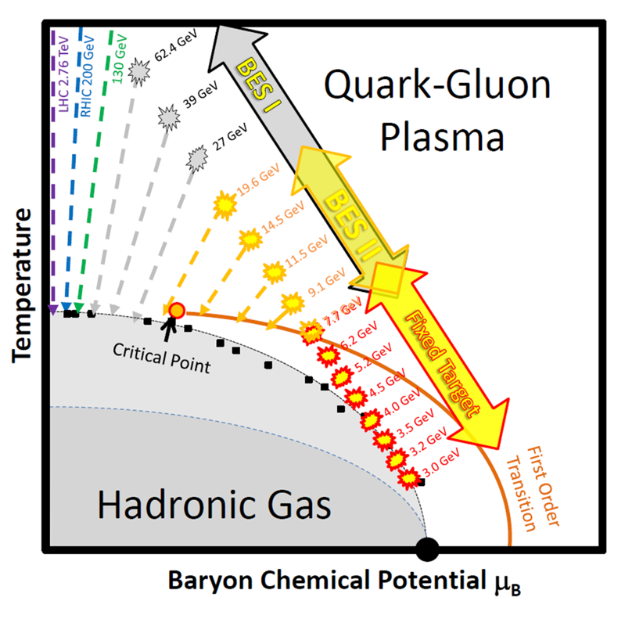
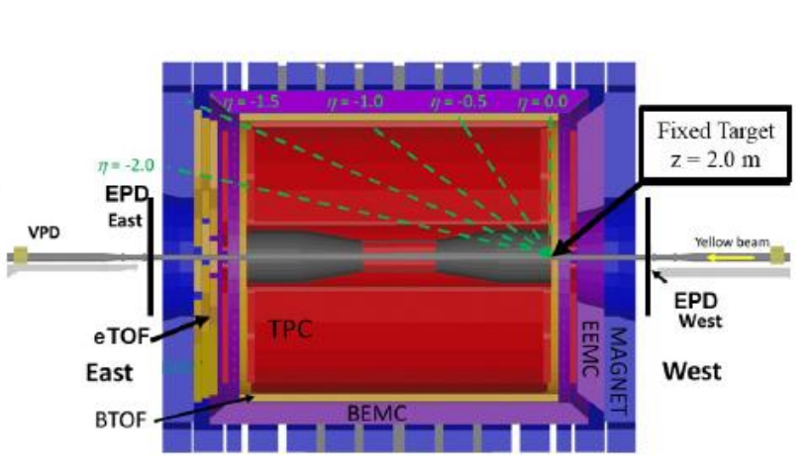
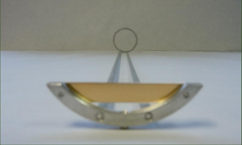
STAR FXT setup
The beam energy scan I (BES-I) was completed during 2007-2014. However, the transition between QGP and hadronic gas has not been understood yet. The BES-I program offered limited statistics because the RHIC luminosity decreases steeply at lower energies. Therefore, the beam energy Scan II (BES-II) was performed with the luminosity improved by a factor of ∼ 4 at multiple beam energies (3.85, 4.55, 5.75, 7.3 and 9.8 GeV/nucleon). In addition, FXT experiments were carried out to extend the energy reach out of the nominal beam energy range.
Au target

Slide 12
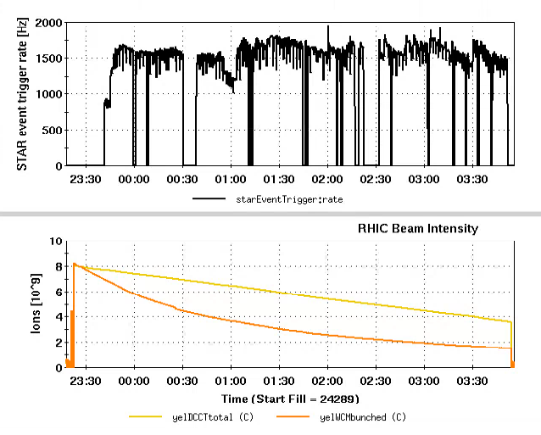
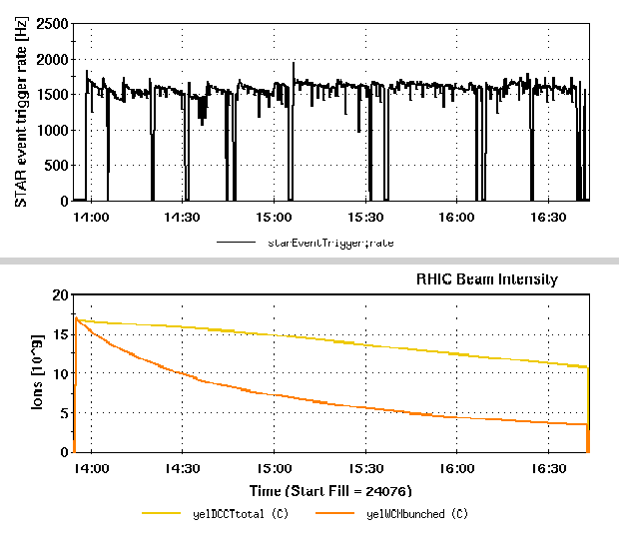
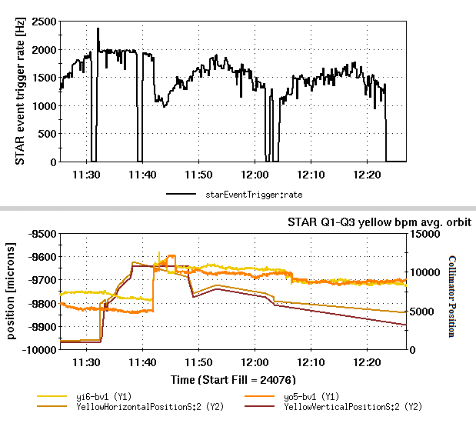
FXT Operations in 2019
rate
4.59 GeV/nucleon
7.3 GeV/nucleon
31.2 GeV/nucleon

Slide 13
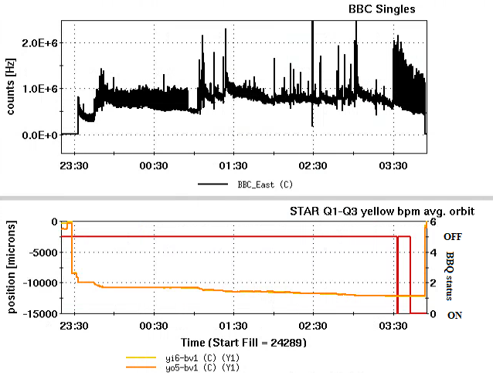
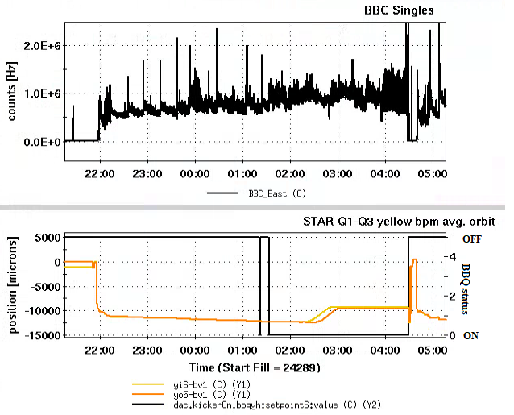
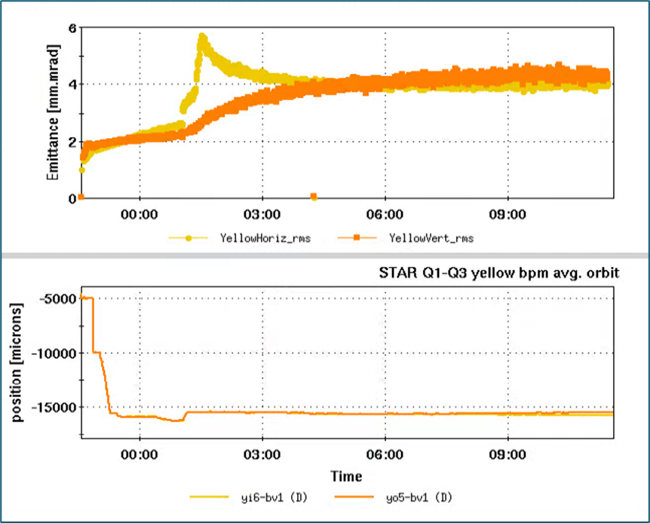
FXT Operations in 2019 (cant.)
Tune meter kicker was turned on towards the end of the 4.59 GeV/nucleon store to replenish beam halo therefore maintain the rates
For the later half of the 7.3 GeV/nucleon store, the tune meter kicker was on to sustain the rate.
The event rate at 31.2 GeV/nucleon was extremely sensitive to the beam position once the beam halo is scraping on the target. It was found that the BBQ kickers were not strong enough to blow up beam emittance in a reasonable amount of time. A desirable event rate was only achieved when the horizontal emittance was diluted by instability with a close to zero chromaticity.

Slide 14
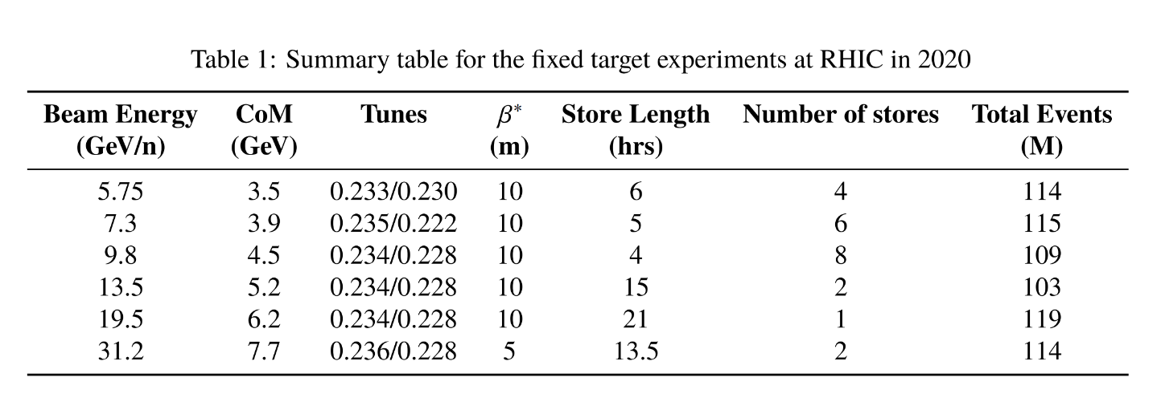
FXT Operations in 2020

Slide 15
Summary table for FXT during BES-II
Beam Total Energy (GeV/u) | 3.85 | 4.59 | 5.75 | 7.3 | 9.8 | 13.5 | 19.5 | 26.5 | 31.2 | 44.5 | 70 | 100
Species | Au | Au | Au | Au | Au | Au | Au | Au | Au | Au | Au | Au
# of Bunches | 12 | 12 | 12 | 12 | 12 | 12 | 12 | 12 | 12 | 12 | 12 | 12
Ions/bunch | 1.7E9 | 0.65E9 | 1.0E9 | 1.0E9 | 1.25E9 | 1.0E9 | 1.0E9 | 0.2E9 | 1.5E9 | 1.5E9 | 1.5E9 | 1.3E9
β* (m) | 10 | 10 | 10 | 10 | 10 | 10 | 10 | 5 | 5 | 5 | 5 | 5
Rms emit. (mm*mrad) | 1.1 | 1.25 | 2 | 1.4 | 2.0 | 2.4 | 1.5 | 1.5 | 3 | NA | NA | 15
Rate control | Orbit control, controlled emittance blow-up with BBQ | Orbit control, controlled emittance blow-up with BBQ at the end of store​ | Orbit control | Orbit control | Orbit control | Orbit control | Orbit control | Orbit control, parallel to CeC | Orbit control with 50 um step, emit increase with small chrom during acceleration​ | Orbit control | Orbit control | 17 mm orbit bump, injection mismatch, emit increase with small chrom, controlled emittance blow-up with BBQ

Slide 16
Reasons that we liked FXT
Easy to establish beam conditions required for FXT experiment.
Substantial luminosity can be achieved for Halo-on-Target with very little beam intensity (1E9 ions) in the machine.
FXT does not care much deteriorating beam conditions which are unfavorable for colliding beam
Rate can be maintained with decreasing beam intensity by measures mentioned in previous slides
Increasing beam size makes rate more controllable
The typically detrimental effects, such as intra-beam scattering and space charge, can actually aid in populating the beam halo.
Background was not difficult to manage with collimators.

Slide 17
Electron-Ion Collider Overview

Slide 18
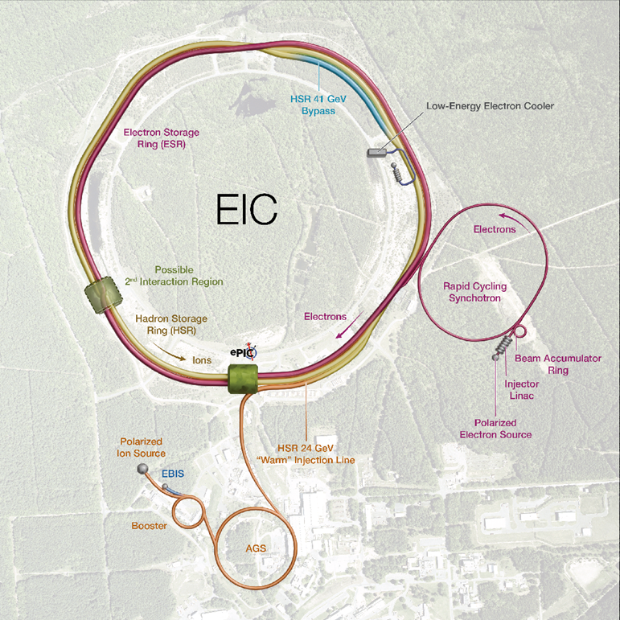
Electron-Ion Collider
Hadron Storage Ring (HSR) 10-275 GeV
Superconducting magnets (existing)
1160 bunches, 1A beam current (3x RHIC)
Flat beam (11:1 ratio)
Beam cooling
Electron Storage Ring (ESR) 5–18 GeV
large beam current, 2.5 A ➔ 9 MW S.R. power
S.C. RF cavities
Need to inject polarized bunches
Electron Rapid Cycling Synchrotron (RCS) 750 MeV- 18GeV
1 Hz
Spin transparent due to high periodicity
Electron Injector
Warm Linac, 30 Hz
Beam Accumulation Ring, 1 Hz

Slide 19
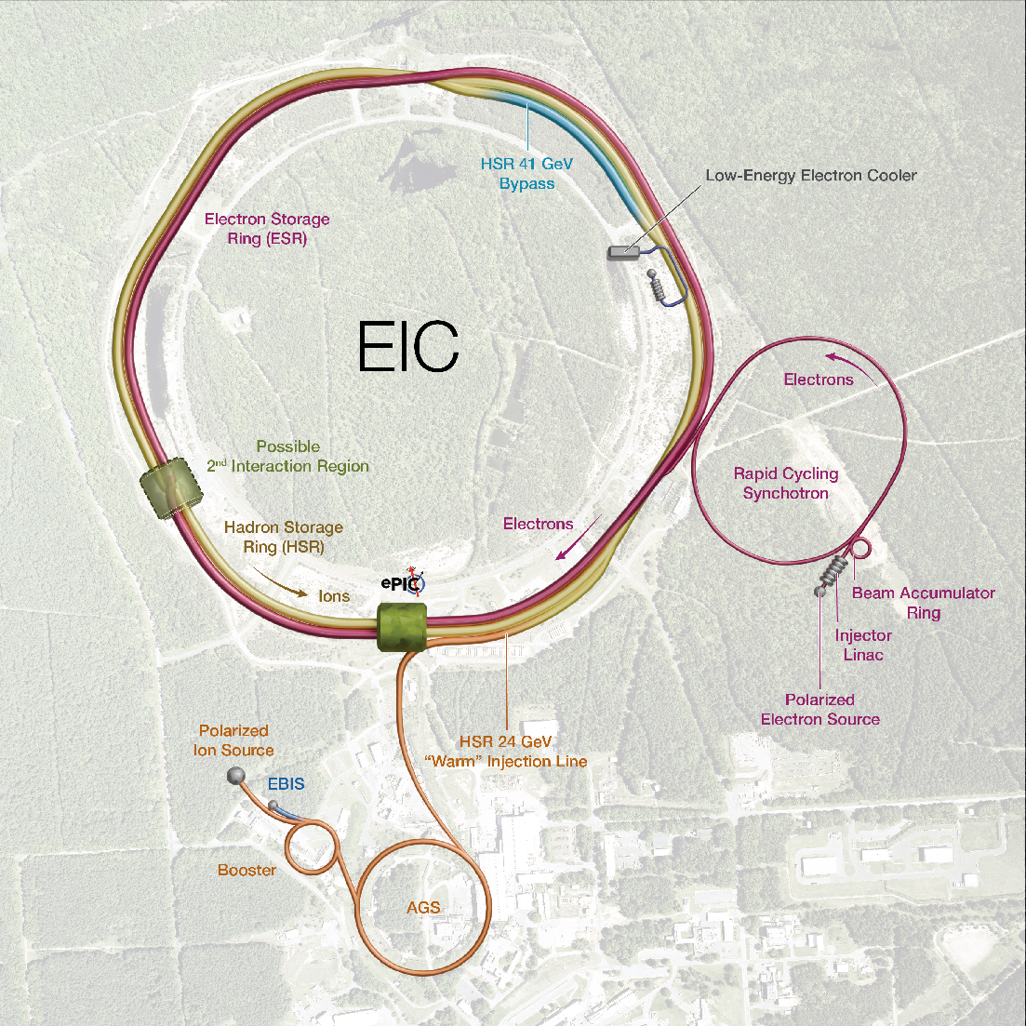
HSR Machine
Design is based on the existing RHIC Complex in BNL.
HSR will be composed of Yellow ring only and new IR6.
HSR warm injection line bring beams from AGS to HSR IR4, where the septum and injection kickers are located.
Low Energy Cooler is located at IR2.
41 GeV bypass will be added between IR12 and IR2.

Slide 20
HSR Machine (cont'd)
Several upgrades must be realized in order to satisfy advanced requirements for EIC hadron beams, higher energy, higher current, high polarization, more bunches...
Hadron beams include:
Polarized protons
Polarized 3He ions
Unpolarized ion species up to Uranium
Number of bunches and bunch pattern (at injection) can be flexible for FXT operation.
At injection, a fully configurable bunch-by-bunch spin pattern is available, for experiments.
105 ns
RHIC:111 bunches all times
40ns
HSR: 290 bunches at injection
10ns
HSR: 1160 bunches at store

Slide 21
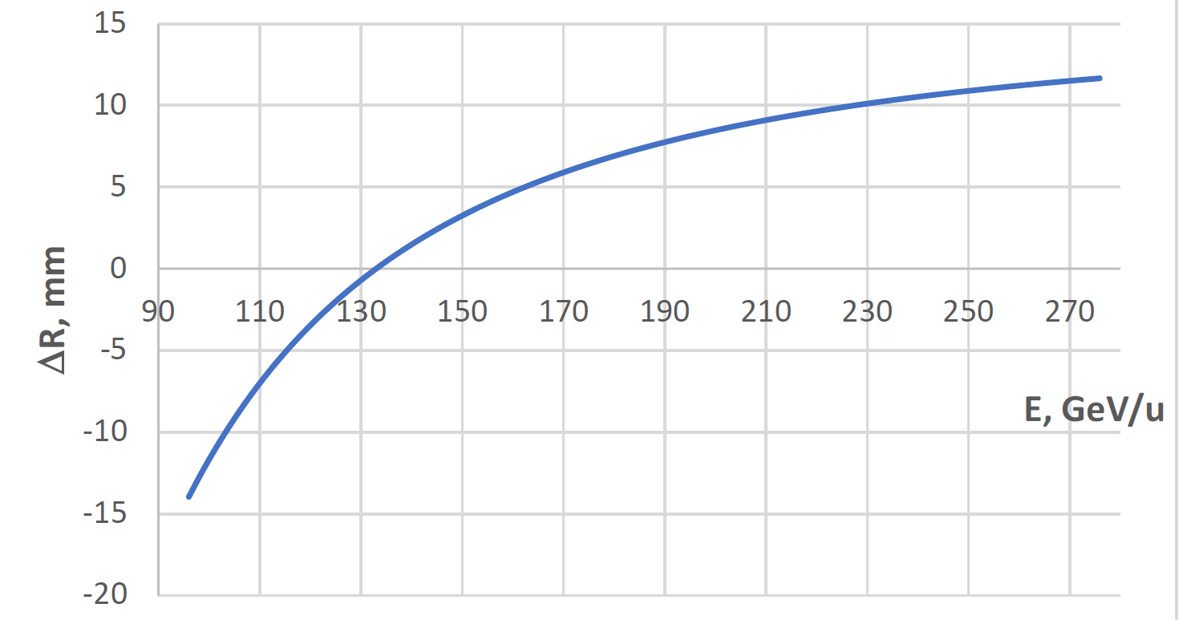

Beam Energy and Average Orbit Radius in the HSR
20 mm
130 GeV
100 GeV
store
275 GeV
70 mm $∅$ beam pipe
Since the electron revolution frequency is fixed, the hadron orbit must be adjusted with energy to keep the collisions in sync.
Courtesy of V. Ptitsyn

Slide 22
Energy and average orbit radius for different ion species at HSR maximum beam rigidity (917 T*m)
d
3He
p
Zr
Au
U
Ru
Cu

Slide 23
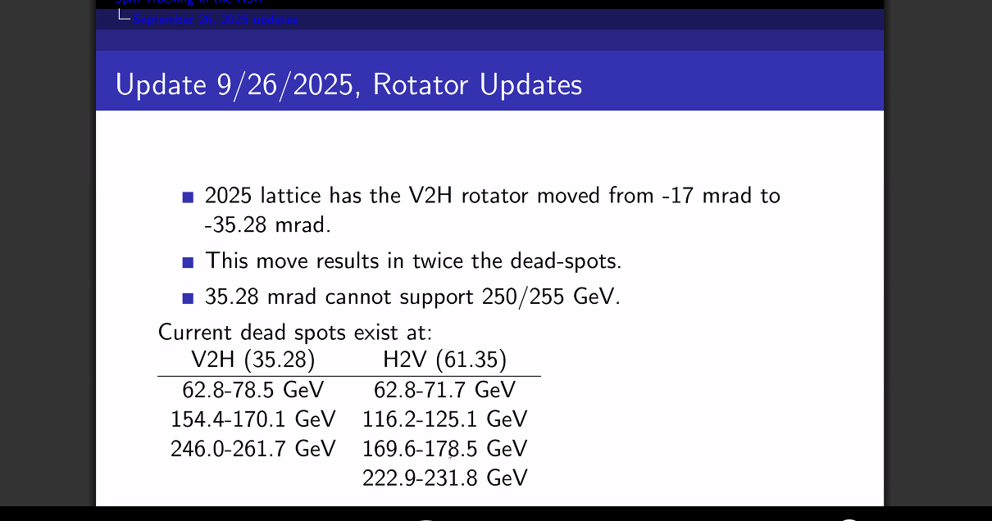
Energy gaps for longitudinal spin
Courtesy of K. Hock

Slide 24
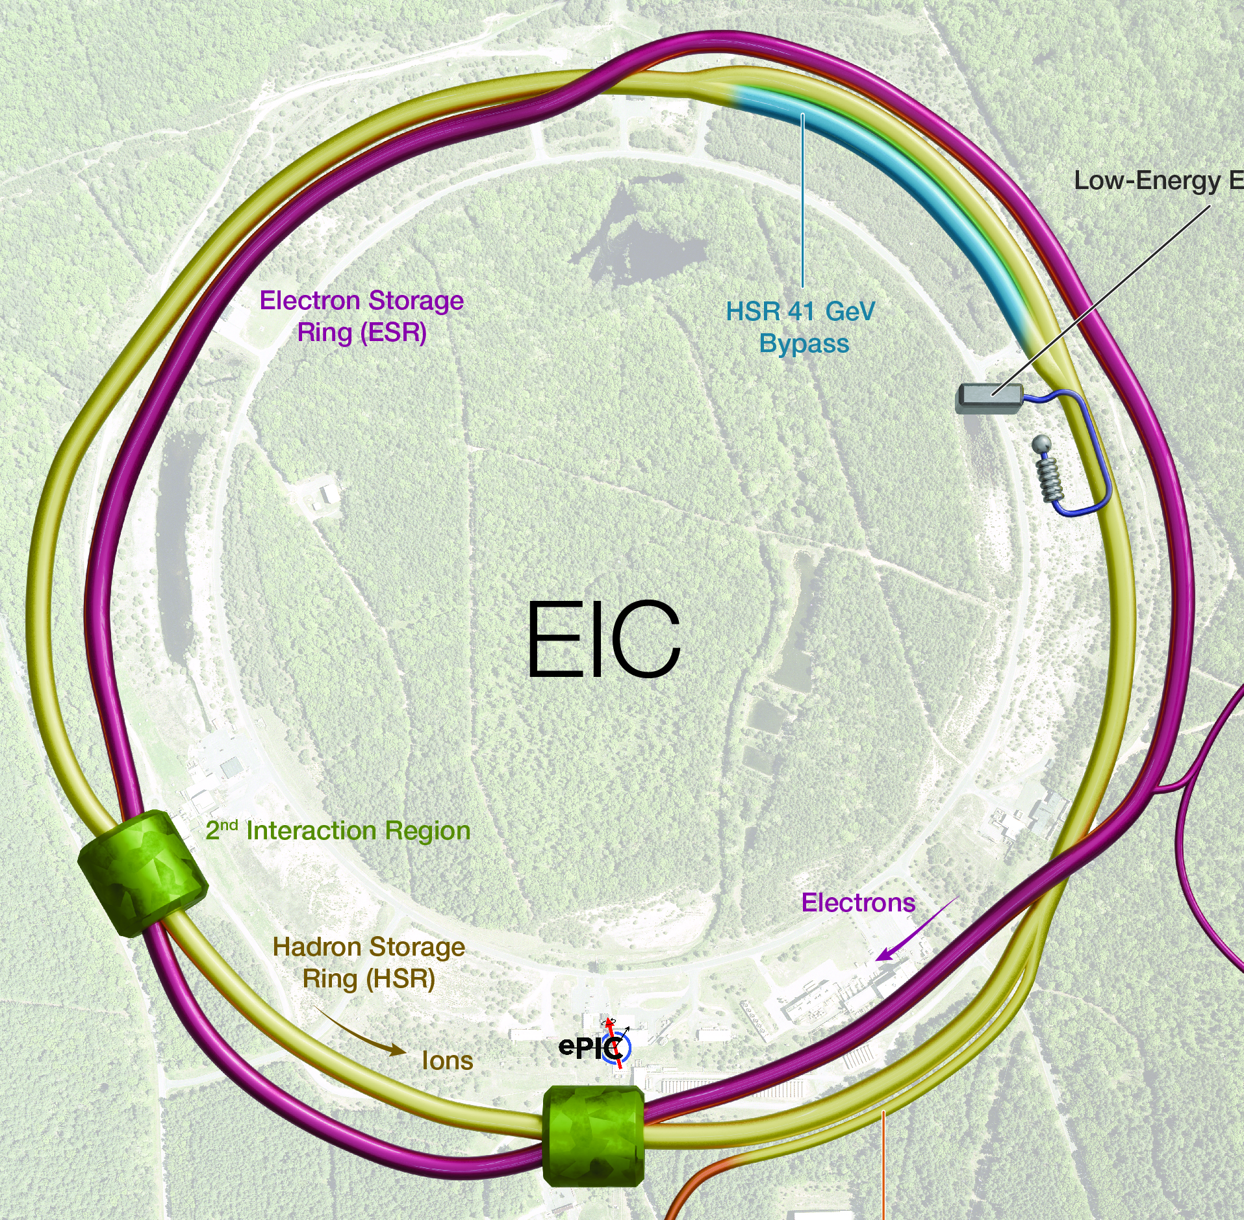
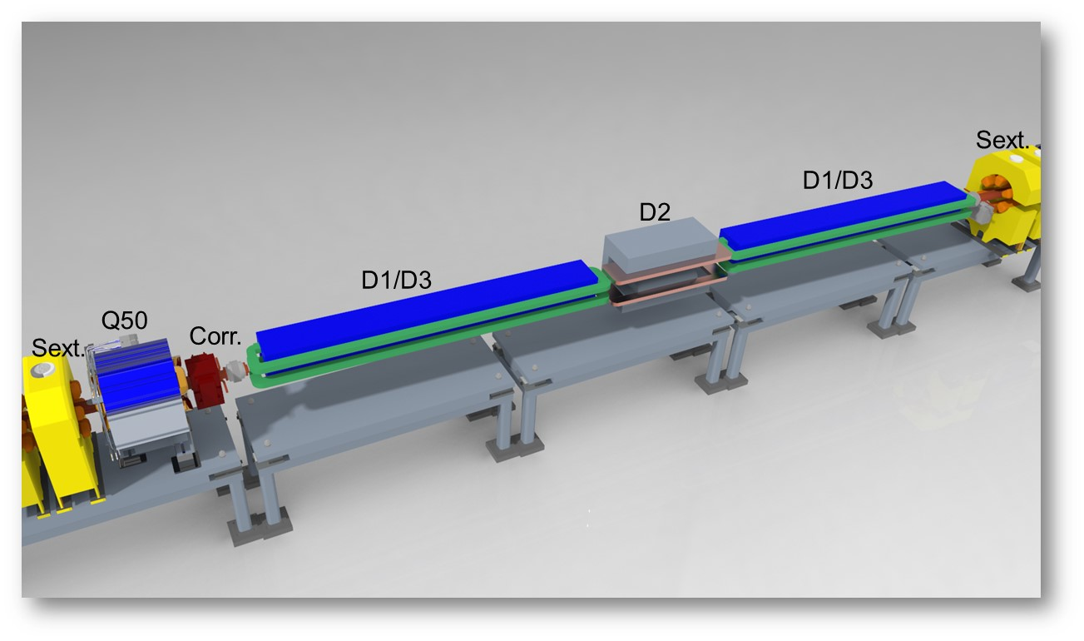
EIC Electron Storage Ring
Electron Storage Ring (ESR) consists of six FODO-cell arcs, and six straight sections (IRs)
High-intensity (28 nC), short (7 mm) bunches
Swap-out injection
Circulating beam current ~2.5 A and the synchrotron
radiation power of ~10MW
HSR
EIC needs nearly constant (20 to 24 nm) emittance from
5 to 18 GeV for optimum luminosity, but equilibrium
emittance in an electron storage ring depends on beam energy.
‘Super bends’ (reverse bends) for emittance control below 10 GeV. Optimized for 5 GeV, compatible with 3 GeV. It reduces damping time therefore allowing for larger beam-beam.
Courtesy of C. Montag

Slide 25
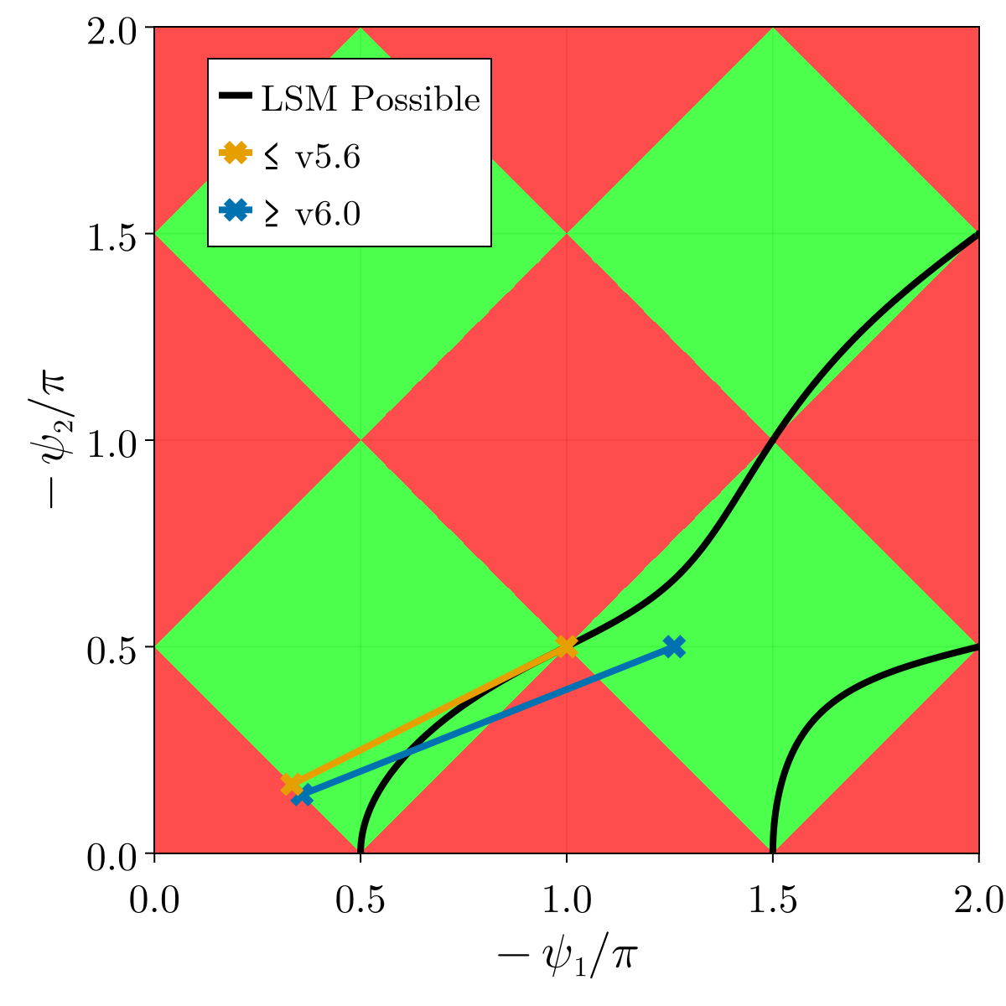
Longitudinal spin energy gap
The psis correspond to the bend module spin precession, and the phis the solenoid modules. In a bend psi= -theta*a*gamma, where theta is the bend angle. So for some psi_2/psi_1 = theta_2/theta_1 the geometry is fixed.
The energy exclusion range is 11.7275 - 15.2024 GeV
Courtesy of M. Signorelli

Slide 26
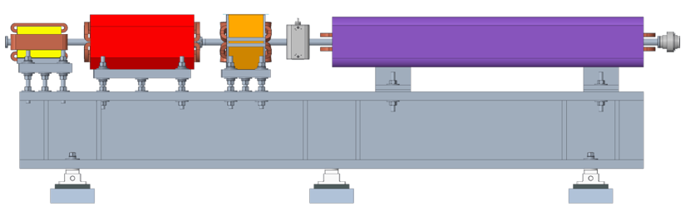
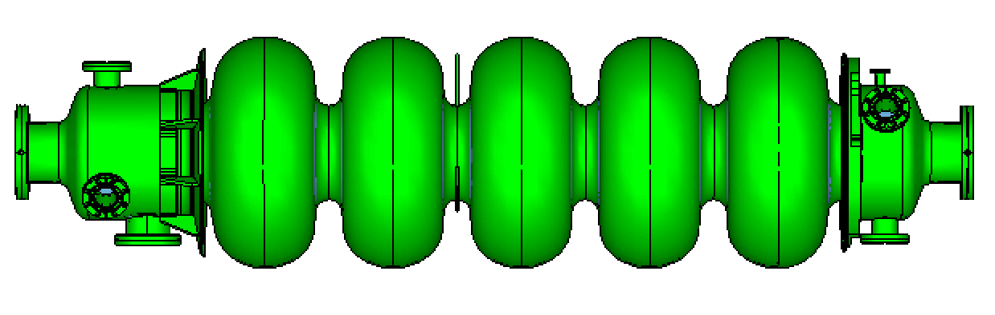
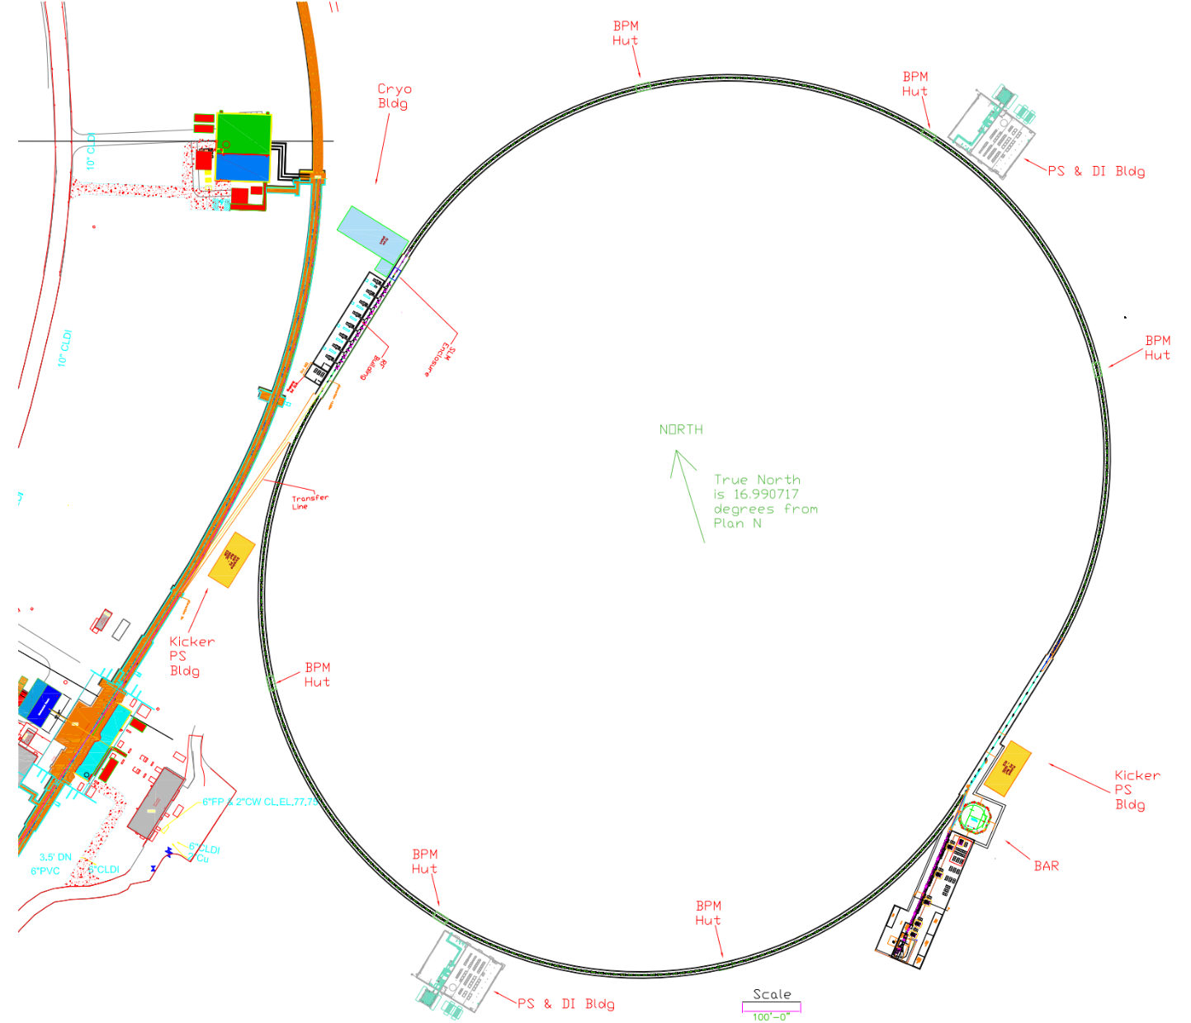
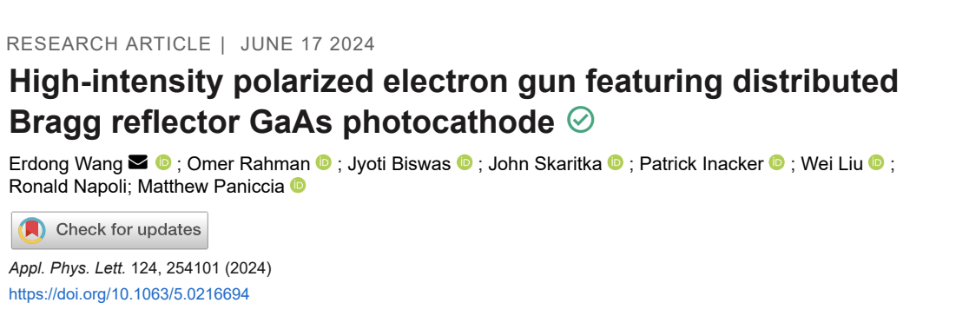
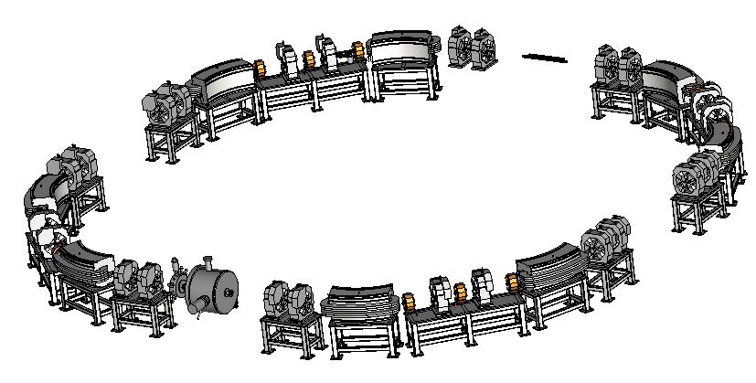
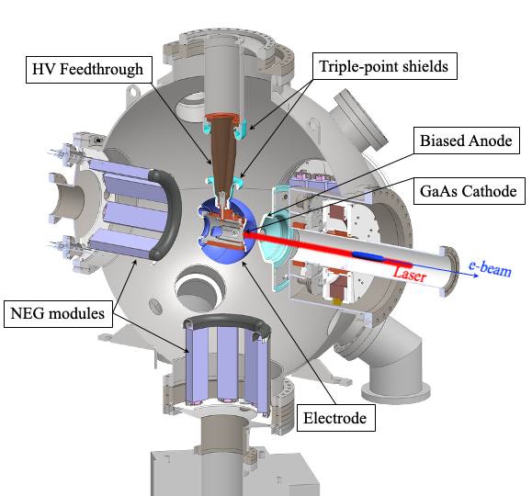
Electron Injector
Concept modeled after the ANL APS-U injector
Function: Deliver electron bunches of up to 28 nC at a 1 Hz repetition rate for injection into the ESR at various energies of 5 – 18 GeV.
RCS magnet assembly
Vacuum chamber: stainless steel, copper coated (50 um)
RCS SRF Cavity, 591 MHz
RCS
750 MeV – 18 GeV
28 nC, 1 Hz
85% polarization
1.4 km
Beam Accumulator Ring
750 MeV, 40 m
Polarized Electron Gun
1-nC, 30 Hz
S-band linac, 750 MeV, 30 Hz, 1 nC single bunch
Courtesy of Q. Wu

Slide 27
EIC beam parameters
EIC beam parameter table for one of the collider operation modes
Table 1.1b | Main collision related parameters for electron-proton collisions in the High Divergence operation mode, at the EIC Full Capability.
 | Parameter |  | Units | p+ | e- | p+ | e- | p+ | e- | p+ | e- | p+ | e-
 | Energy |  | GeV | 275 | 18 | 275 | 10 | 100 | 10 | 100 | 5 | 41 | 5
 | Gamma |  | - | 294 | 35226 | 294 | 19570 | 108 | 19570 | 108 | 9786 | 45 | 9786
 | CM energy |  | GeV | 140.70 |  | 104.90 |  | 63.20 |  | 44.70 |  | 28.60
 | Bunch intensity |  | (10¹⁰)\(nC) | 19.1\30.6 | 6.2\9.9 | 6.9\11.1 | 17.2\27.6 | 6.9\11.1 | 17.2\27.6 | 4.8\7.7 | 17.2\27.6 | 2.6\4.2 | 13.3\21.3
 | Number of bunches |  | - | 290.00 |  | 1160.00 |  | 1160.00 |  | 1160.00 |  | 1160.00
 | Average beam current |  | A | 0.69 | 0.23 | 1.00 | 2.50 | 1.00 | 2.50 | 0.69 | 2.50 | 0.38 | 1.93
 | Normalized emittance | H | μm rms | 5.2 | 845 | 3.3 | 391 | 3.2 | 391 | 2.7 | 196 | 1.9 | 196
 |  | V |  | 0.47 | 71 | 0.3 | 26 | 0.29 | 26 | 0.25 | 18 | 0.45 | 34
 | Unnormalised emittance | H | nm rms | 18 | 24.0 | 11.3 | 20 | 30 | 20 | 26 | 20 | 44 | 20
 |  | V |  | 1.6 | 2.0 | 1.0 | 1.3 | 2.7 | 1.3 | 2.3 | 1.8 | 10 | 3.5
 | Beta | H | cm | 80 | 59 | 80 | 45 | 63 | 96 | 61 | 78 | 90 | 196
 |  | V |  | 7.1 | 5.7 | 7.2 | 5.6 | 5.7 | 12 | 5.5 | 7.1 | 7.1 | 21
 | IP RMS beam size | H | μm | 119 |  | 9.5 |  | 138 |  | 125 |  | 198
 |  | V |  | 11 |  | 8.5 |  | 12 |  | 11 |  | 27
 | Kx |  | - | 11.10 |  | 11.10 |  | 11.10 |  | 11.10 |  | 7.30
 | Divergence | H | μrad rms | 150 | 202 | 119 | 211 | 220 | 145 | 206 | 160 | 220 | 101
 |  | V |  | 150 | 187 | 119 | 252 | 220 | 105 | 206 | 160 | 380 | 129
 | BB parameter | H | 10³ | 3 | 93 | 12 | 72 | 12 | 72 | 14 | 100 | 15 | 53
 |  | V |  | 3 | 100 | 12 | 100 | 12 | 100 | 14 | 100 | 9 | 42
 | Longitudinal emittance |  | 10⁻³eV·s rms | 36 | - | 36 | - | 21 | - | 21 | - | 11 | 53\42
 | 90% longitudnal bunch area |  | eV.s | 0.216 | - | 0.216 | - | 0.126 | - | 0.126 | - | 0.066 | 0.32\0.25
 | Bunch length |  | cm rms | 6.0 | 0.9 | 6.0 | 0.7 | 7.0 | 0.7 | 7.0 | 0.7 | 7.5 | 0.7
 | Relative momentum spread σ_{p}/p |  | 10⁻⁴ rms | 6.8 | 10.9 | 6.8 | 5.8 | 9.7 | 5.8 | 9.7 | 6.8 | 10.3 | 6.8
 | Maximum space charge |  | - | 0.0 | Neg | 0.0 | Neg | 0.0 | Neg | 0.0 | Neg | 0.1 | Neg
 | Piwinski angle |  | rad | 6.3 | 2.1 | 7.9 | 2.4 | 6.3 | 1.8 | 7.0 | 2.0 | 4.2 | 1.1
 | Longitudinal IBS time |  | hrs | 2.0 | - | 2.9 | - | 2.5 | - | 3.1 | - | 3.8 | -
 | Transverse IBS time | H | hrs | 2 | - | 2 | - | 2.0 | - | 2.0 | - | 3.4 | -
 |  | V |  | Lrg. | - | Lrg. | - | 4.0 | - | 4.0 | - | 2.1 | -
 | Hourglass factor H |  | - | 0.91 |  | 0.94 |  | 0.90 |  | 0.88 |  | 0.93
 | Luminosity |  | 10³³cm⁻²s⁻¹ | 1.54 |  | 10.00 |  | 4.48 |  | 3.68 |  | 0.44
 | H=Horizontal, V=Vertical, Lrg= Large enough to not require cooling, negl= Negligible.
Hadron beam and electron beam operate at a few discrete energies in collider mode, while it is not a constraint for FXT.
The bunch charge and beam currents are constrained by injector capability, beam-beam and synchrotron radiation in the collider. The assumption is that FXT would not need higher current than that in colliding mode.
Emittance, beta star and beam size at IP are designed to have 11:1 aspect ratio in collider mode, which is no longer true in FXT mode.

Slide 28
HSR beam parameters for FXT experiment
Parameters | Value | Notes
Beam species | Polarized p, He, unpolarized species up to U | Use Au as a representative for the rest of beam parameters
Beam Energy | 3.85 to 110 GeV/nucleon | The updated IR6 might be aperture bottleneck for energies below 9.8 GeV. Near transition energy is not available.
Beam Rigidity | 31 to 916 T-m
No. Bunches | 12 to 1160 | Bunch split or not?
Average current | Up to 1 A | Lower if below injection
Normalized emittance | H: ~ 2 um, V: 0.25 to 2 um | One can always blowup emittance, except for low energies when aperture is limited.
Bunch length | 6 cm | Longer is better for lifetime
Beta star | H: 80 cm to 10 m, V: 7.1 cm to 90 cm | Preference?
Crab cavity | No need
Radial shift | No need
Low energy bypass | No need

Slide 29
ESR beam parameters for FXT experiment
Parameters | Value | Notes
Beam species | e
Beam Energy | 3 – 18 GeV | Any energy in the range, energy below 5 GeV, 11.7-15.2 GeV w/o longitudinal polarization
Spin direction | Longitudinal, vertical
No. Bunches | 1 to 1160 | Bunch split or not?
Average current | Up to 2.5 A | 0.2 A @18 GeV
Normalized emittance | H: 196 – 845 um V: 18 – 70 um | Emittance is tunable with super-bend and external excitation, vertical orbit bumps (bagels technique)
Bunch length | 0.7 cm | Longer is better for lifetime
Beta star | H: 103 to 306 cm, V: 9.2 to 30 cm
Crab cavity | No need

Slide 30
Summary
The operational conditions for fixed-target (FXT) experiments at the EIC are generally less demanding, as they do not require crab cavities, radial shifts, or beam-beam collisions.
The relevant beam parameters for the HSR and ESR in FXT mode are summarized. Detailed beam requirements will need to be revisited once the target specifications are further defined.
The hadron beam exhibits a well-defined Gaussian-like transverse distribution with a gradually evolving halo primarily driven by physical processes such as intra-beam scattering. In contrast, the electron beam develops a rapidly replenished halo due to quantum excitation effects.
Although both beams can be delivered over a wide range of energies, certain gaps exist where longitudinal polarization cannot be achieved.
Extraction of RCS beam for FXT experiment is possible in principle however costly. In addition, operation of EIC at 18 GeV would require non-stop operation of the RCS (1Hz).

Slide 31
Additional slides

Slide 32
Energy and average orbit radius for different ion species at RHIC maximum beam rigidity (833 T*m)
3He
p
Zr
d
Au
U
Ru
Cu

Slide 33
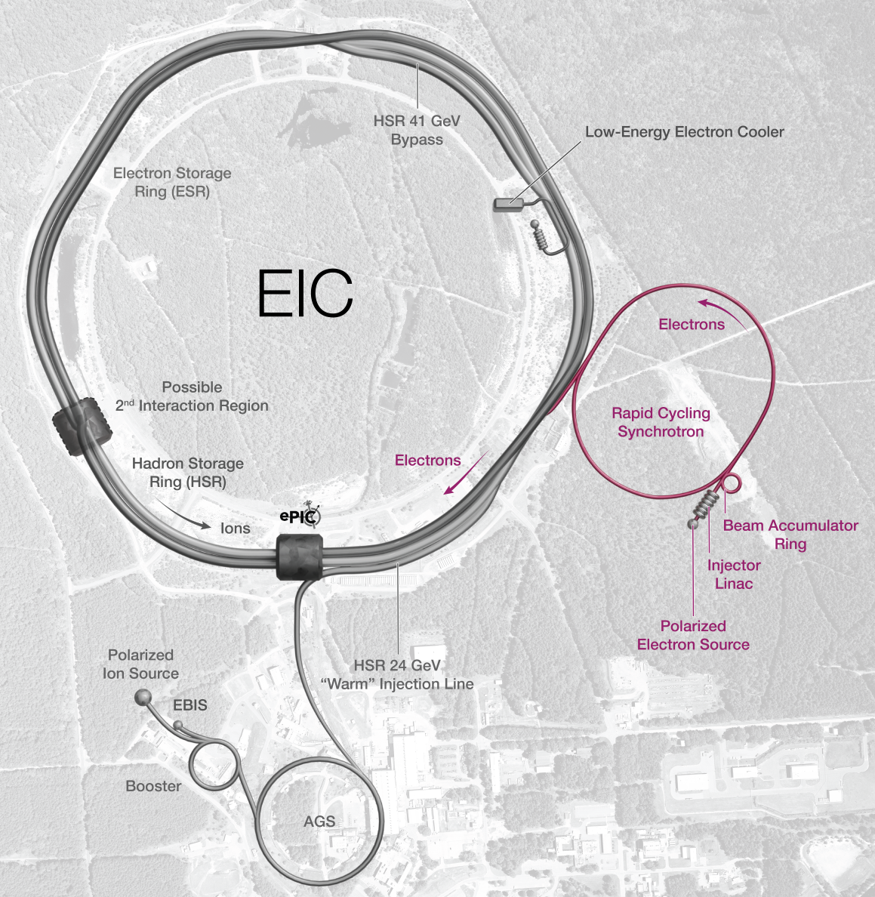
Subproject EIN Scope Defined
The Electron Injectors Subproject includes the following systems:
Pre-Injector
Beam Accumulator Ring
Rapid Cycling Synchrotron
Electron Storage Ring injection and swap-out systems
Infrastructure and utilities limited to the local systems, services, and connections required specifically for the systems listed above.
Design of the above accelerator systems to support the full operational requirements of the EIC electron beam, including up to 11 nC at 18 GeV and 28 nC at 10 GeV.
Design of supporting infrastructure and utilities necessary to enable the start of the EIC physics program.
Installation and hardware commissioning of the above systems, once integrated with other subprojects, are essential for starting the physics program.

Slide 34
Proposal for EIC Science Program in the First Years
Year - 1
Year - 2
Year - 3
Year - 4
Year - 5
Start EIC Science
New Capability:
Commission electron polarization in parallel
Collider:
10 GeV electrons on 115 GeV/u heavy ion beams (Ag or Nb)
+Long. electron polarization
New Capability:
Commission proton polarization in parallel
Collider (base goal):
10 GeV long. polarized electrons on 130 GeV/u Deuterium
Collider (stretch goal):
Last weeks: 10 GeV long. polarized electrons and 130 GeV polarized protons
+Long. electron polarization
+ Proton polarization
New Capability:
Commission hadron spin rotators
Collider (base goal):
10 GeV long. polarized electrons on 130 GeV transverse-polarized protons
Collider (stretch goal):
Last weeks switch to longitudinal proton polarization
+ Long. electron polarization
+ Proton polarization
+ Hadron spin rotators
New Capability:
Commission hadron accelerator to operate with off-center orbits
Collider (base goal):
10 GeV long. polarized electrons on 100 GeV Au
Collider (stretch goal):
10 GeV long. polarized electrons on 250 GeV transverse and longitudinal polarized protons
+ Long. electron polarization
+ Proton polarization
+ Hadron spin rotators
+ Hadron beams with off-center orbits
Collider (base goal):
10 GeV long. polarized electrons on 100 GeV Au
Collider (stretch goal):
10 GeV long. polarized electrons on 166 GeV transverse and longitudinal polarized He-3
Time to construct the ELR subproject

Slide 35
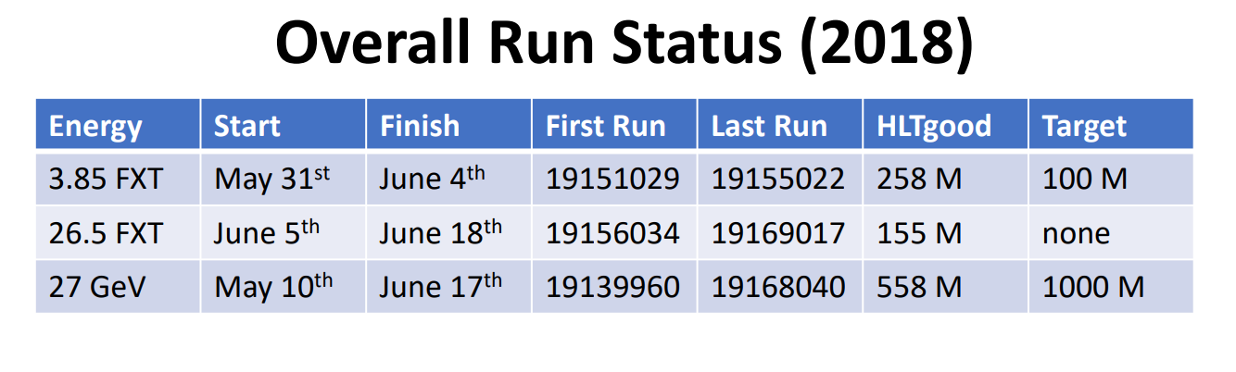
Summary tables provided by D. Cebra

Slide 36
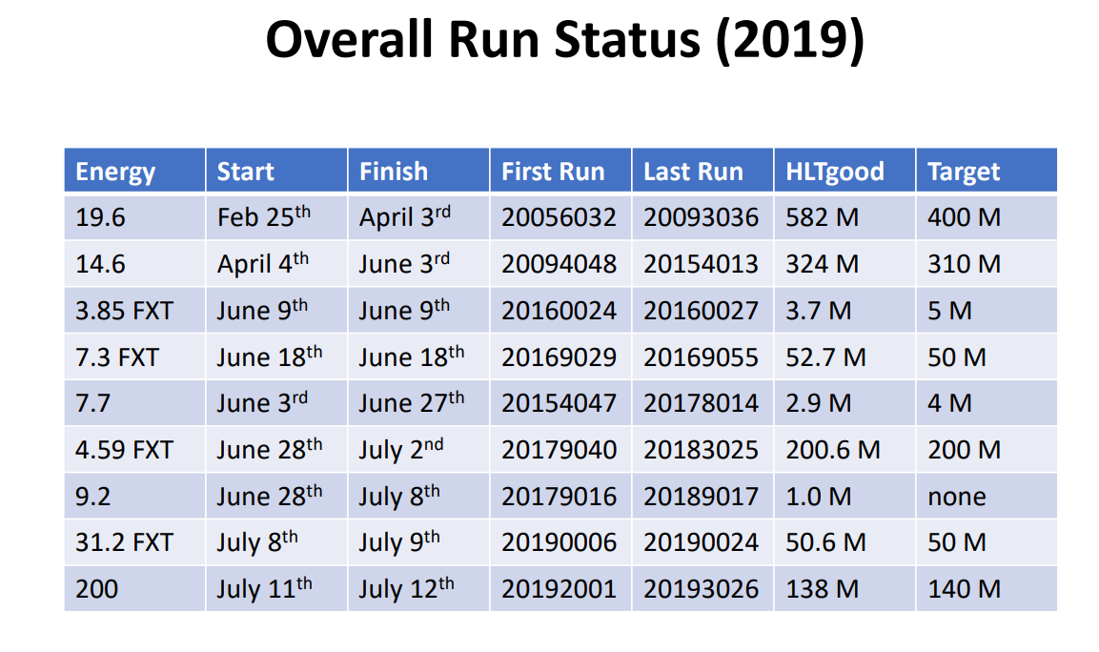

Slide 37
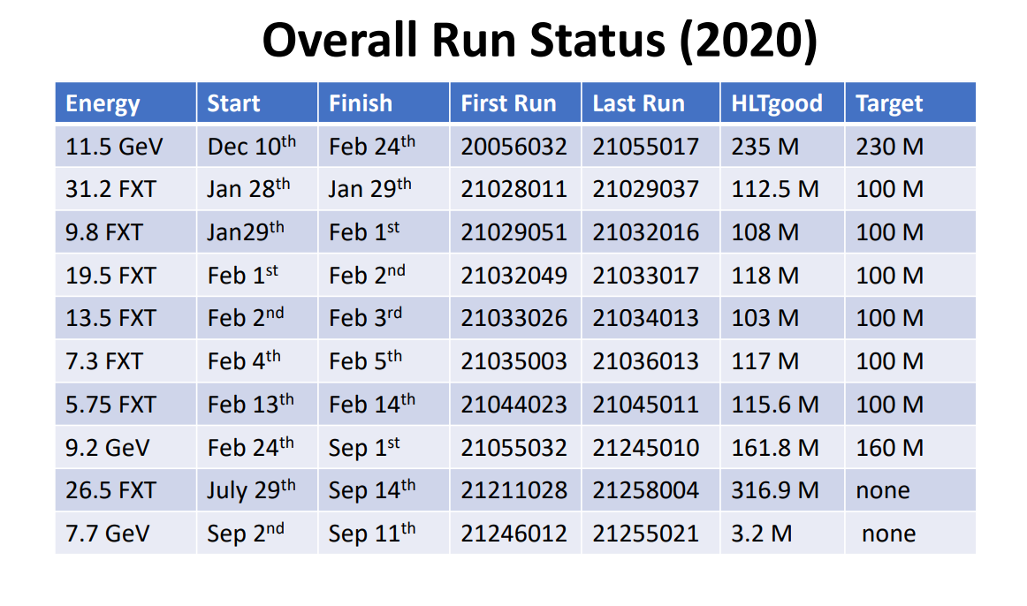

Slide 38
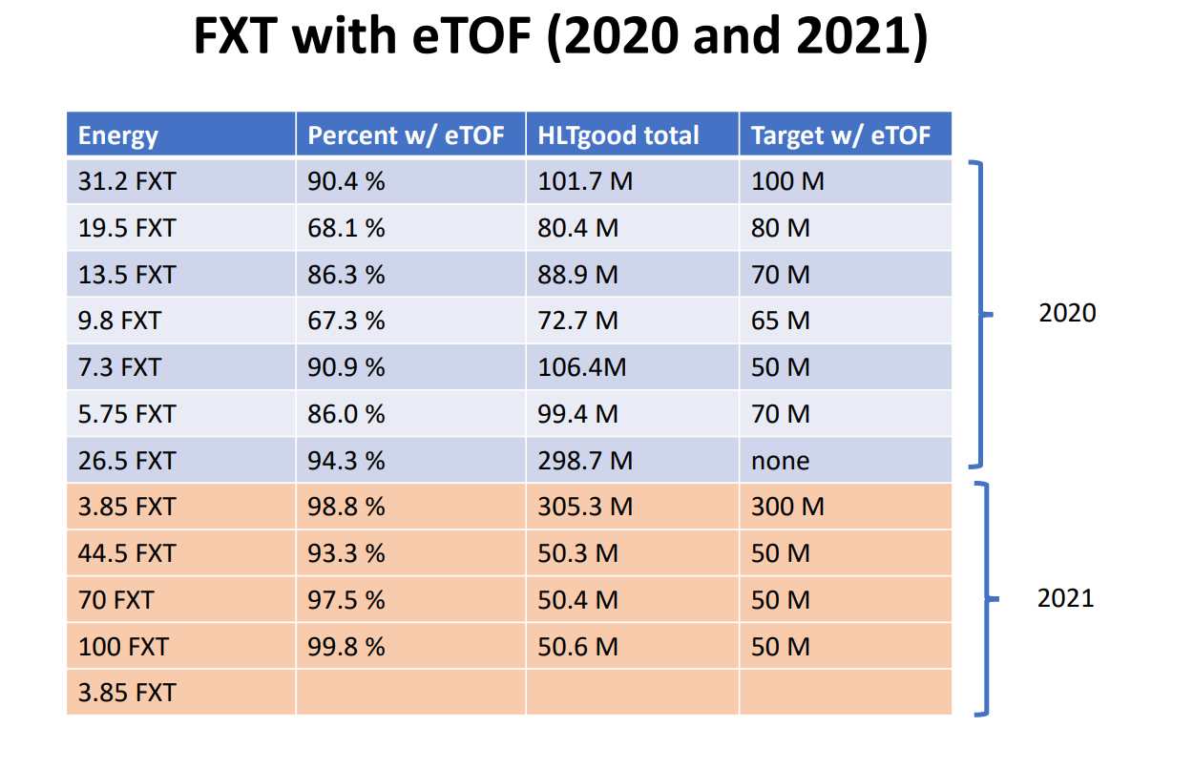

Slide 39
