Slide 1


A Precise Determination of Collins-Soper Kernel from Lattice QCD
Jin-Xin Tan
Shanghai Jiao Tong University
Oct. 9 @LaMET 2025
In collaboration with:
Hang Liu, Zhi-Chao Gong, Qi-An Zhang, Wei Wang et.al
Notes:
Hello everyone. I’m Jinxin Tan from Shanghai Jiao Tong University. It’s my honor to be here at LaMET 2025 and to share my work with you. The topic of my talk today is “A Precise Determination of Collins–Soper Kernel from Lattice QCD.” There are my collaborators.
1

Slide 2
Outline
2
Motivation
Lattice QCD calculation of Collins-Soper Kernel
Quasi-TMD Wave Function
Collins-Soper Kernel
Summary and Outlook
Notes:
In the following, I will present our work from these three parts
2

Slide 3
Outline
3
Motivation
Lattice QCD calculation of Collins-Soper Kernel
Quasi-TMD Wave Function
Collins-Soper Kernel
Summary and Outlook
Notes:
So let us start with the motivation for this study.
3

Slide 4
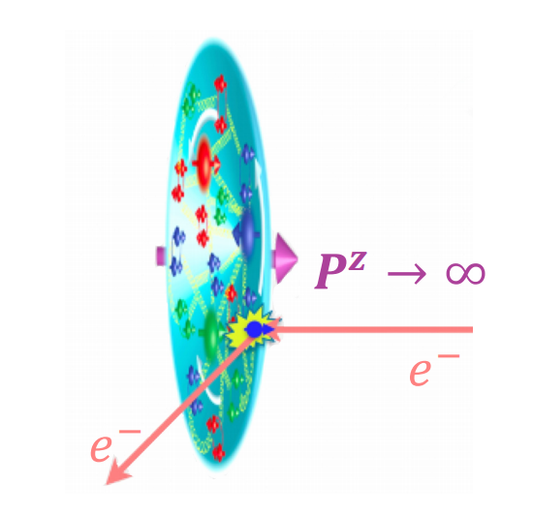
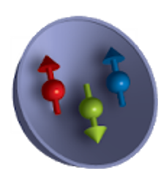

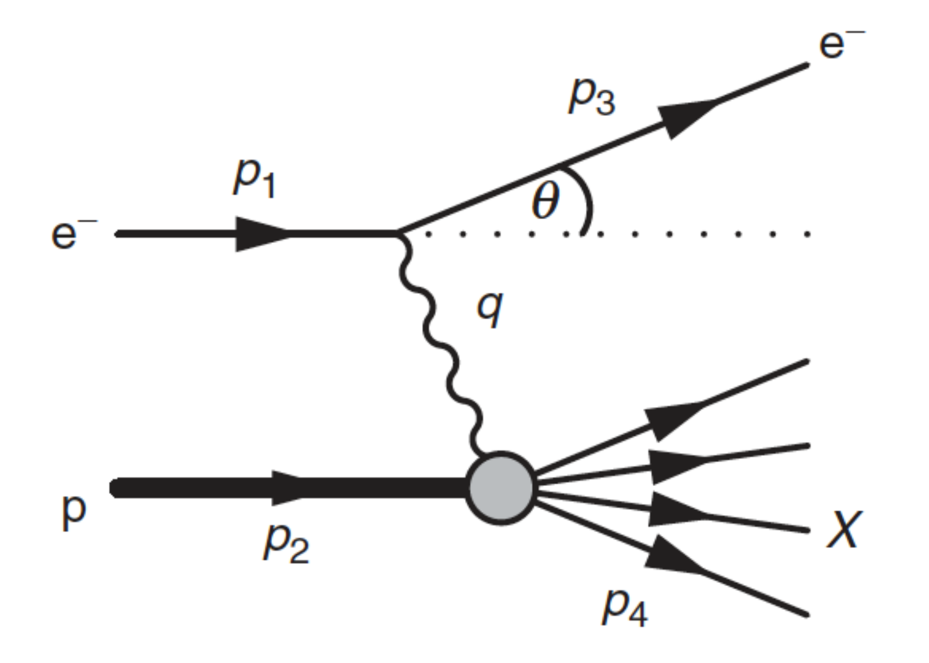
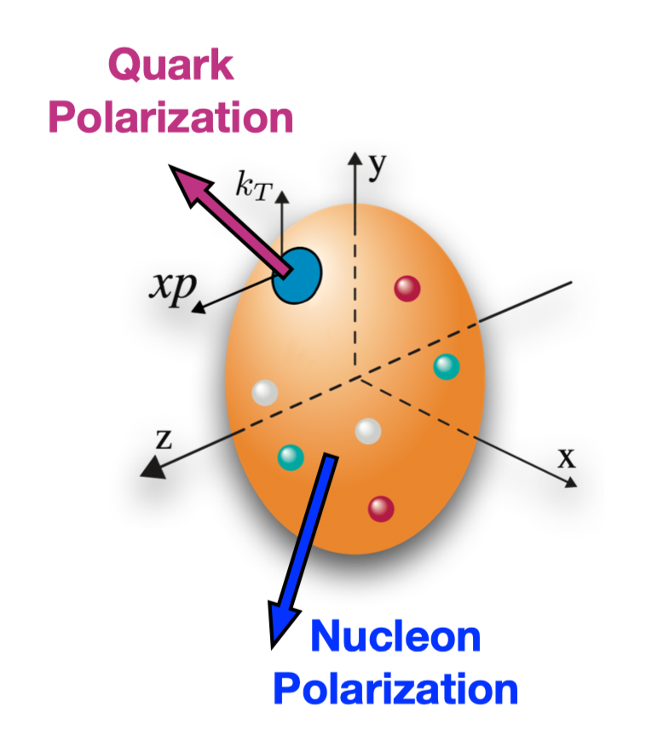



Exploration of Nucleon Structure
4
Gell-Mann
quark model
Feynman
parton model
JLab
COMPASS
JAM
EIC
EicC
......
0D: spin and mass
1D: PDF
3D: TMDs
Higgs
mechanism
Deep inelastic
scattering
TMDPDF
Notes:
Our understanding of nucleon structure has gradually improved, moving from low-dimension to higher-dimension information. At the zero-dimension, we focused on overall properties of the nucleon, like its mass and spin. With DIS experiments, the focus shifted to the one-dimension structure. From Feynman’s parton model ,we learned about the longitudinal momentum distributions of quarks, called PDFs. To get a fuller picture of the nucleon, we need to study its three-dimension structure. Today, many experiments, like SIDIS and Drell–Yan processes, study transverse-momentum-dependent distributions (TMDs), which are also a major focus of theoretical work.
4

Slide 5
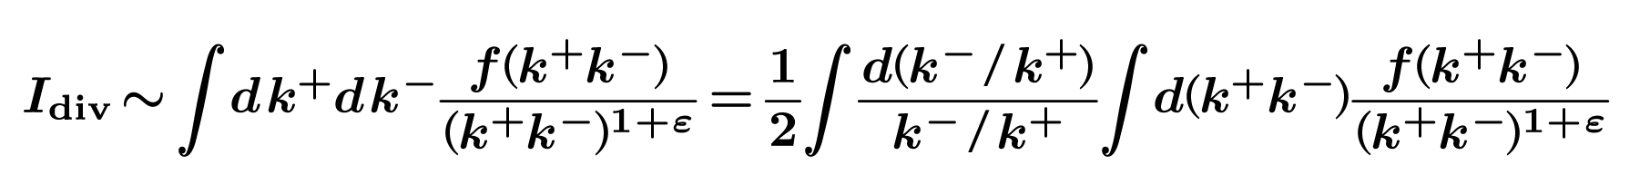
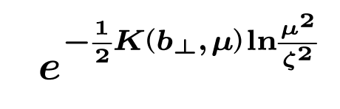
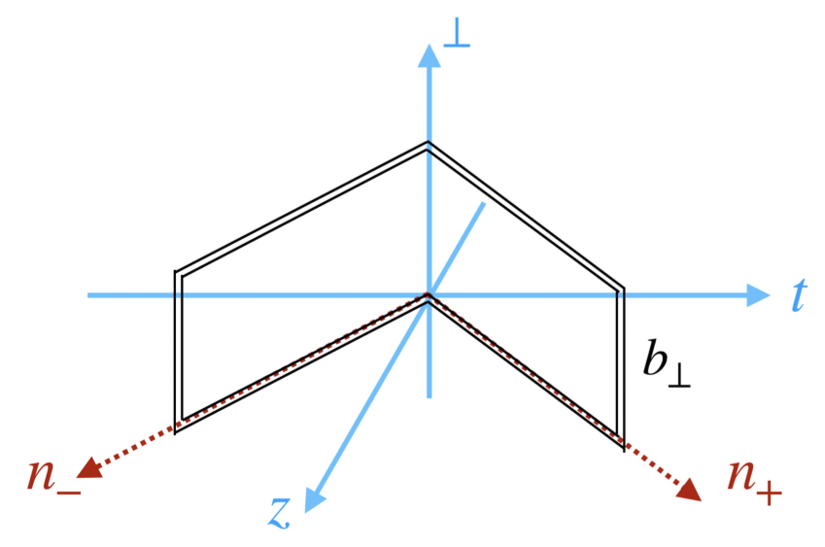

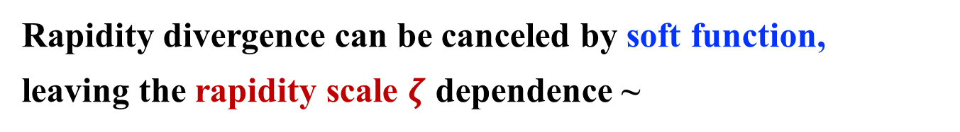







Theoretical Complexity of TMDPDF -- Rapidity Divergence
5
Rapidity divergence from gluons radiation collinear to lightlike gauge link:
$$t$$
$$n_{−}$$
$$y_{k}=\frac{1}{2}\ln{\frac{k^{+}}{k^{−}}}$$
$y_{k}→±∞$: rapidity divergence
$$z$$
$$⊥$$
$$P$$
Rapidity divergence can be canceled by soft function,
leaving the rapidity scale $ζ$ dependence ~
$$P$$
Ji et al., PRD 71, 034005(2005);
Collins, Vol. 32(Cambridge University Press, 2011).
Notes:
So let’s take a look at one of main theoretical challenges of TMDs — the rapidity divergence.
In TMDPDF factorization, when the gluon is moving along the lightlike direction — that is, along the gauge link — it will introduce the rapidity divergence. We can see, the loop integral contains terms like this one, and it will diverge when the gluon rapidity goes to Infinity.
This rapidity divergence can be canceled by the soft function, which is defined using lightlike gauge links of the same shape as those appearing in the TMDPDF.
Then it will leave the rapidity scale dependence in this form. And this K is called CS kernel.
5

Slide 6
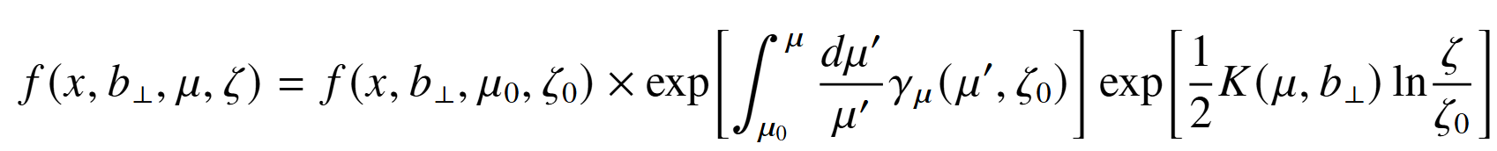
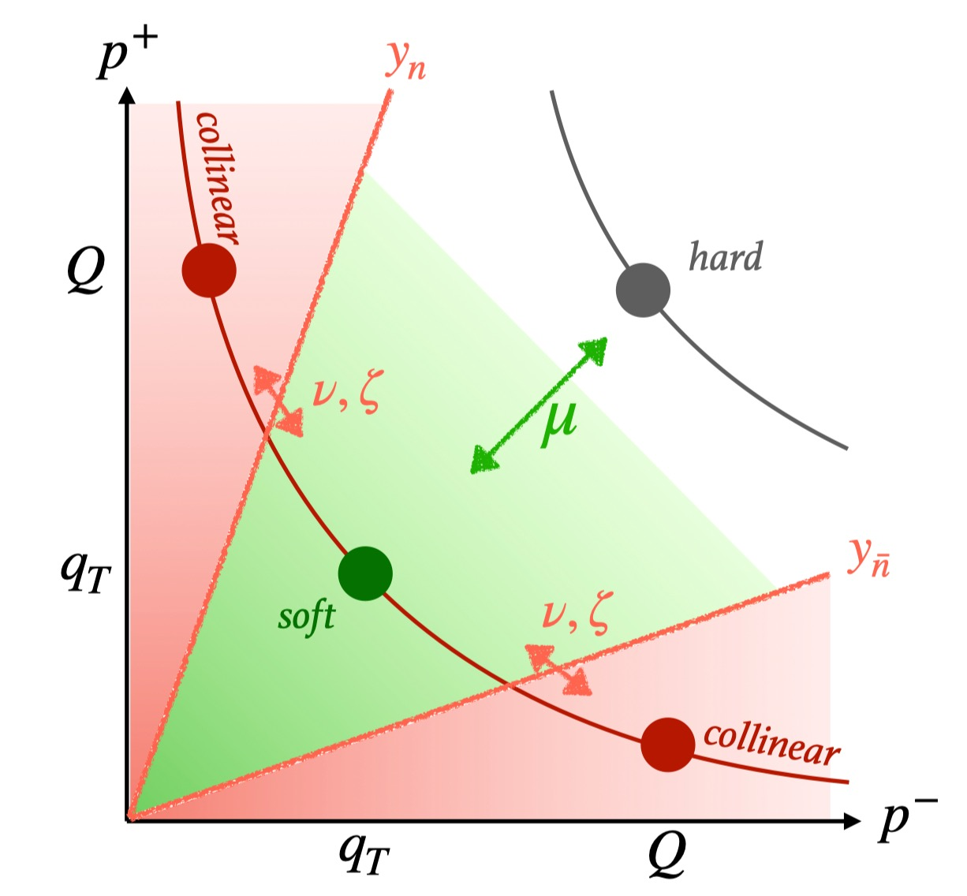
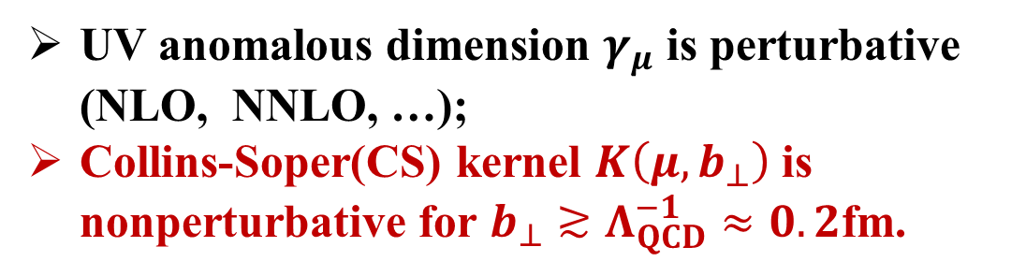
Collins-Soper Kernel -- Describe Rapidity Evaluation of TMDs
6
Evolution of TMDs:
UV anomalous dimension
Rapidity anomalous dimension
(Collins-Soper kernel)
UV anomalous dimension $γ_{μ}$ is perturbative (NLO, NNLO, …);
Collins-Soper(CS) kernel $K\left(μ,b_{⊥}\right)$ is nonperturbative for $b_{⊥}≳Λ_{QCD}^{−1}≈0.2$fm.
Ji et al., PRD 71, 034005(2005);
Collins, Vol. 32(Cambridge University Press, 2011).
Notes:
So, in the evolution of TMDs, UV anomalous dimension controls the UV evolution , and it helps to controls renormalization in the UV regions. While rapidity evolution is described by the Collins–Soper kernel, and it complements the dynamics between the soft and collinear regions, as the red line in the figure . we know that UV anomalous dimension can be given by perturbative theory. However, Collins-Soper kernel is nonperturbative when b is large , which means it is hard to calculate.
6

Slide 7
CS Kernel -- An Essential Component for Lattice Calculations of TMDs
7
LaMET framework:
Ji, PRL 110, 262002 (2013); Ji, Sci.China 57 (2014)
Matching kernel
$${\tilde{f}}_{Γ}(x,b_{⊥},μ,ζ^{z})S_{I}^{\frac{1}{2}}(b_{⊥},μ)=H_{Γ}(ζ^{z},μ)\exp\left[\frac{1}{2}K(b_{⊥},μ)\ln{\frac{ζ^{z}−iε}{ζ}}\right]f(x,b_{⊥},μ,ζ)+𝓞(\frac{Λ_{\text{QCD}}^{2}}{ζ^{z}},\frac{M^{2}}{(P^{z})^{2}},\frac{1}{b_{⊥}^{2}ζ^{z}})$$
Quasi TMDs
Intrinsic soft function
Collins-Soper kernel
Light-cone TMDs
Collins-Soper kernel
Lattice QCD
Physical distribution
…
…
Ji et al., PLB811(2020);
Ebert et al., JHEP 09 (2019);
Ebert et al., JHEP04(2022);
Notes:
On the lattice, a very important method for calculating TMDPDFs is LaMET. We can calculate quasi-TMDs on the lattice by constructing equal-time correlation functions. When the momentum is large enough, we can use the factorization formula to match the lattice-calculable quasi- TMDs to the physical distribution . And one key section in this matching is the CS kernel.
7

Slide 8
Outline
8
Motivation
Lattice QCD calculation of Collins-Soper Kernel
Quasi-TMD Wave Function
Collins-Soper Kernel
Summary and Outlook
Notes:
So how can we extract the Collins-Soper Kernel from lattice? We first need to know its base— the quasi-TMD wave function.
8

Slide 9
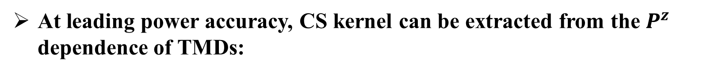
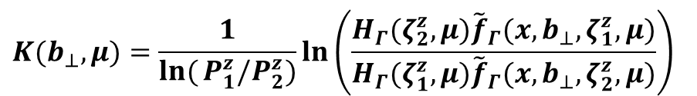
From quasi TMDs to Collins-Soper kernel
9
At leading power accuracy, CS kernel can be extracted from the $P^{z}$ dependence of TMDs:
Matching kernel
$${\tilde{f}}_{Γ}(x,b_{⊥},μ,ζ^{z})S_{I}^{\frac{1}{2}}(b_{⊥},μ)=H_{Γ}(ζ^{z},μ)\exp\left[\frac{1}{2}K(b_{⊥},μ)\ln{\frac{ζ^{z}−iε}{ζ}}\right]f(x,b_{⊥},μ,ζ)+𝓞(\frac{Λ_{\text{QCD}}^{2}}{ζ^{z}},\frac{M^{2}}{(P^{z})^{2}},\frac{1}{b_{⊥}^{2}ζ^{z}})$$
Quasi TMDs
Intrinsic soft function
Collins-Soper kernel
Light-cone TMDs
Taking ratio, $S_{I}$ and $f$cancelled each other, then
$$K(b_{⊥},μ)=\frac{1}{\ln{(}P_{1}^{z}/P_{2}^{z})}\ln\left(\frac{H_{Γ}(ζ_{2}^{z},μ){\tilde{f}}_{Γ}(x,b_{⊥},ζ_{1}^{z},μ)}{H_{Γ}(ζ_{1}^{z},μ){\tilde{f}}_{Γ}(x,b_{⊥},ζ_{2}^{z},μ)}\right)$$
${\tilde{f}}_{Γ}$ could be either unsubtracted quasi TMD wave function or quasi TMDPDF.
Ji, PRL 110, 262002 (2013);
Ji, Sci.China 57 (2014)
Notes:
From the TMD factorization in LaMET, if we take ratios at different momenta cases, that the intrinsic soft function and the light-cone TMD cancel out. This leaves only the CS kernel we want, the perturbative matching kernel, and the quasi-TMDs we can calculate on the lattice. Since this formula works for both TMDPDFs and TMDWFs.
9

Slide 10
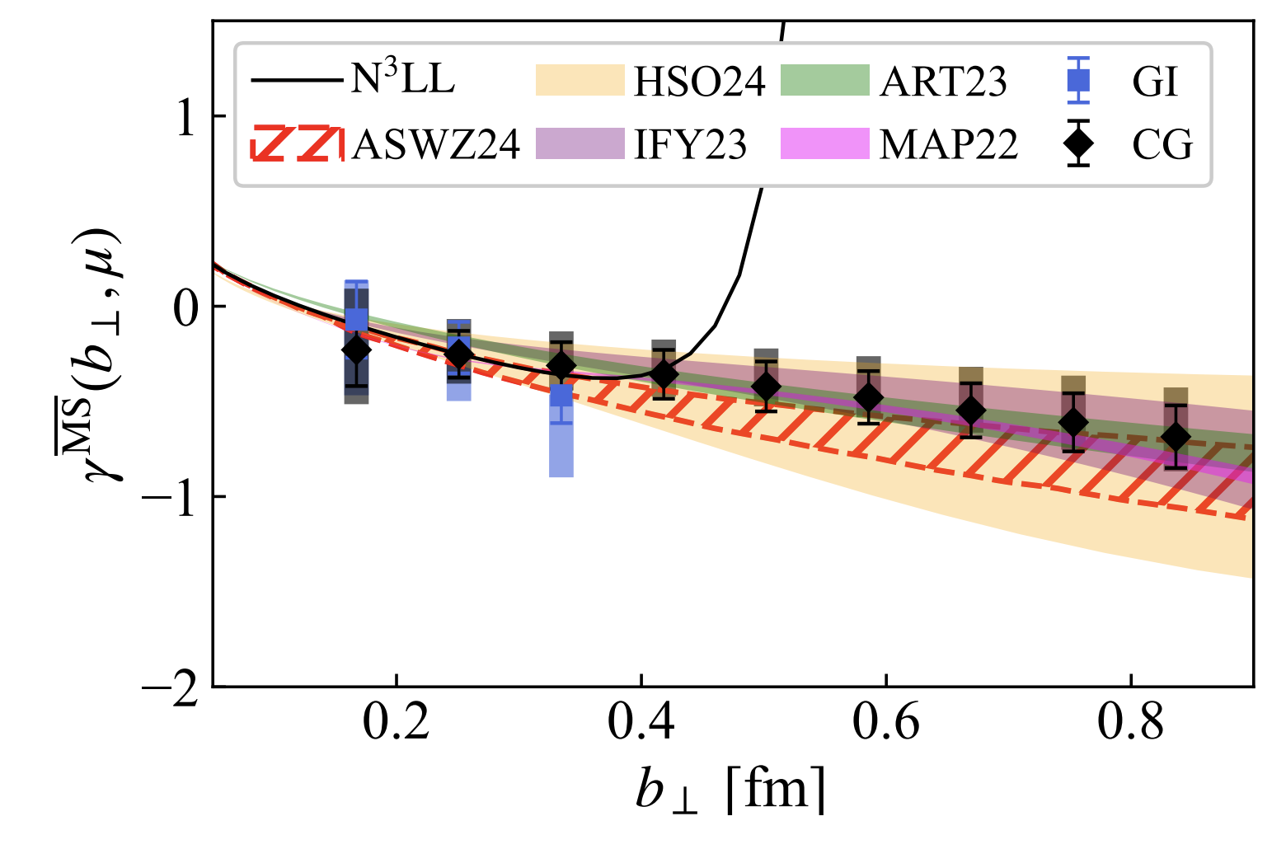
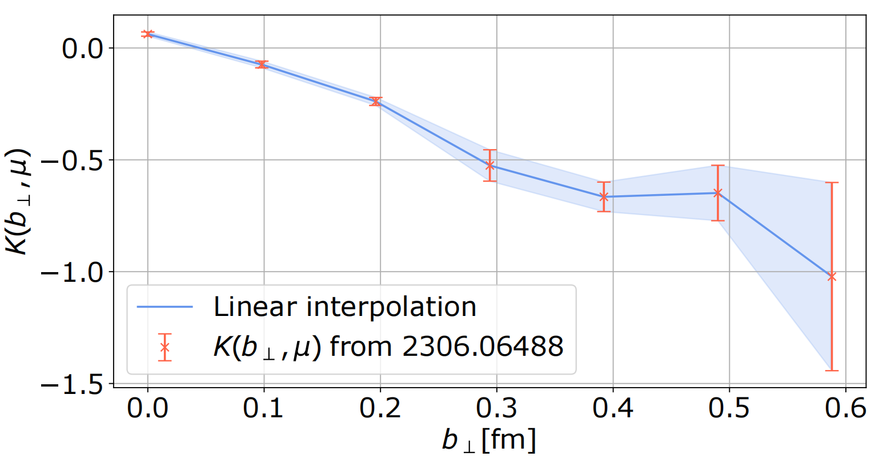
From quasi TMDs to Collins-Soper kernel
10
At leading power accuracy, CS kernel can be extracted from the $P^{z}$ dependence of TMDs:
Bollweg et al.,PLB852, 138617 (2024);
Walter, et al.(LPC),PRD.111.094507(2024).
Matching kernel
$${\tilde{f}}_{Γ}(x,b_{⊥},μ,ζ^{z})S_{I}^{\frac{1}{2}}(b_{⊥},μ)=H_{Γ}(ζ^{z},μ)\exp\left[\frac{1}{2}K(b_{⊥},μ)\ln{\frac{ζ^{z}−iε}{ζ}}\right]f(x,b_{⊥},μ,ζ)+𝓞(\frac{Λ_{\text{QCD}}^{2}}{ζ^{z}},\frac{M^{2}}{(P^{z})^{2}},\frac{1}{b_{⊥}^{2}ζ^{z}})$$
From quasi TMDPDF
Quasi TMDs
Intrinsic soft function
Collins-Soper kernel
Light-cone TMDs
Taking ratio, $S_{I}$ and $f$cancelled each other, then
From quasi TMDWF
$$K(b_{⊥},μ)=\frac{1}{\ln{(}P_{1}^{z}/P_{2}^{z})}\ln\left(\frac{H_{Γ}(ζ_{2}^{z},μ){\tilde{f}}_{Γ}(x,b_{⊥},ζ_{1}^{z},μ)}{H_{Γ}(ζ_{1}^{z},μ){\tilde{f}}_{Γ}(x,b_{⊥},ζ_{2}^{z},μ)}\right)$$
${\tilde{f}}_{Γ}$ could be either unsubtracted quasi TMD wave function or quasi TMDPDF.
For better signal, the CS kernel is extracted from the pion quasi-TMDWF.
Notes:
And given that quasi-TMDWFs always have a better signal-to-noise ratio on the lattice ,as these two figures show, we choose to extract the CS kernel from the pion quasi-TMDWF.
10

Slide 11

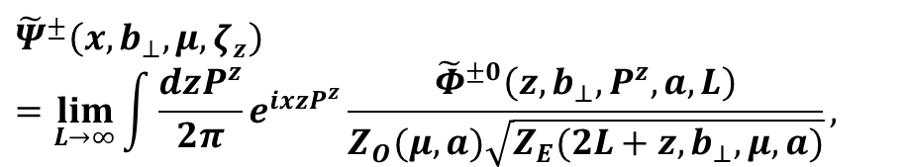






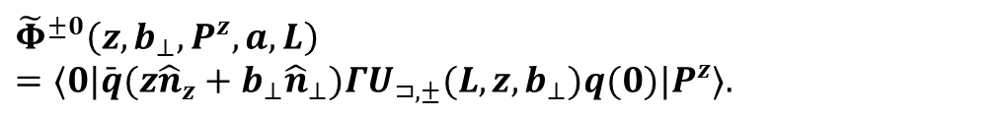

Quasi TMD Wave Function
11
The quasi-TMD wave functions can be defined as:
where the bare quasi-TMD wave function can be constructed as :
$$t$$
$$z$$
$$z+L$$
$$b_{⊥}$$
$${\tilde{Ψ}}^{±}\left(x,b_{⊥},μ,ζ_{z}\right)=\lim_{L→∞}{\int{\frac{dzP^{z}}{2π}}}e^{ixzP^{z}}\frac{{\tilde{Φ}}^{±0}\left(z,b_{⊥},P^{z},a,L\right)}{Z_{O}(μ,a)\sqrt{Z_{E}(2L+z,b_{⊥},μ,a)}},$$
$$q(0)$$
$$⊥$$
$$\overline{q}(\vec{z}+{\vec{b}}_{⊥})$$
$$P^{z}$$
$${\tilde{Φ}}^{±0}\left(z,b_{⊥},P^{z},a,L\right)=⟨0|\bar{q}(z{\hat{n}}_{z}+b_{⊥}{\hat{n}}_{⊥})ΓU_{⊐,±}(L,z,b_{⊥})q(0)|P^{z}⟩.$$
Chu et al.(LPC), PRD109(2024);
Chu et al.(LPC), PRD 106(2022);
Zhang et al., PRL125(2020).
Notes:
And the bare quasi-TMDWF is defined as a nonlocal matrix element, where the quark and antiquark are separated by a transverse distance $b$_perp and a longitudinal distance $z$. As shown in the figure on the right, they are connected by a Wilson line shaped like a staple.
To remove divergences, we first divide the bare matrix element by the square root of $Z_{E}$for a Wilson line with the same shape. It can cancel linear divergences from Wilson line self-energy. Then we divide by $Z_{O}$ to match the $\overset{‾}{\text{MS}}$scheme result and remove logarithmic divergence from the vertices connecting the Wilson line and light quark.
11

Slide 12
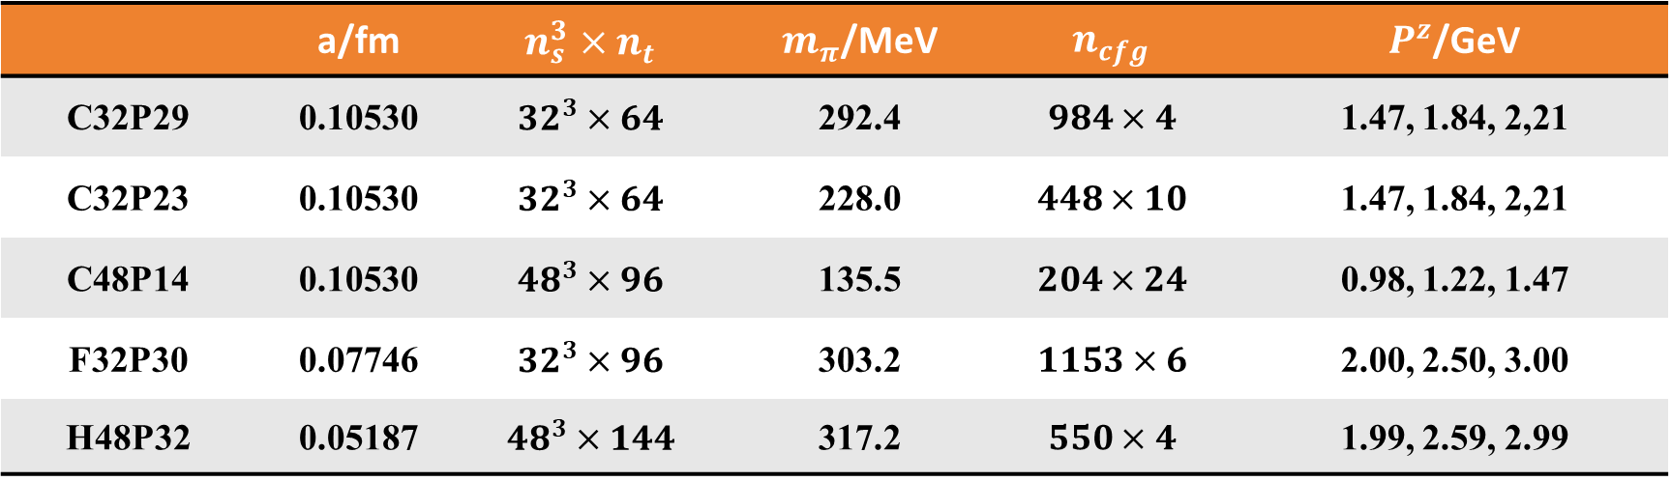
Lattice Setup
12
CLQCD lattice ensembles with multiple lattice spacings and physical pion masses;
Coulomb gauge fixed wall source propagators;
HYP smearing.
 | a/fm | $$n_{s}^{3}×n_{t}$$ | $m_{π}$/MeV | $$n_{cfg}$$ | $P^{z}$/GeV
C32P29 | 0.10530 | $${32}^{3}×64$$ | 292.4 | $$984×4$$ | 1.47, 1.84, 2,21
C32P23 | 0.10530 | $${32}^{3}×64$$ | 228.0 | $$448×10$$ | 1.47, 1.84, 2,21
C48P14 | 0.10530 | $${48}^{3}×96$$ | 135.5 | $$204×24$$ | 0.98, 1.22, 1.47
F32P30 | 0.07746 | $${32}^{3}×96$$ | 303.2 | $$1153×6$$ | 2.00, 2.50, 3.00
H48P32 | 0.05187 | $${48}^{3}×144$$ | 317.2 | $$550×4$$ | 1.99, 2.59, 2.99
Hu et al.(CLQCD), PRD 109 (2024); Hasenfratz et al., PRD 64, 034504(2001).
Notes:
In our lattice simulation, we have used five ensembles from CLQCD .They include three different lattice spacings and physical pion mass. The largest momentum reaches 3 GeV. Other detail parameters are listed in the table.
For the propagators, we used a Coulomb gauge-fixed wall source. When calculating Wilson loops and quasi-TMDWFs, we applied HYP smearing to the gauge fields to improve the signal-to-noise ratio.
12

Slide 13
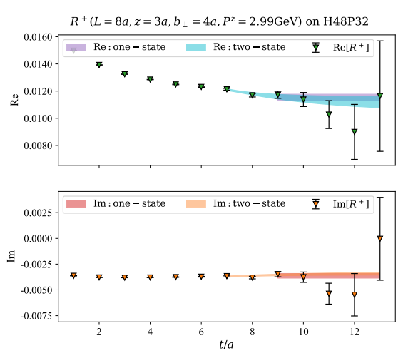
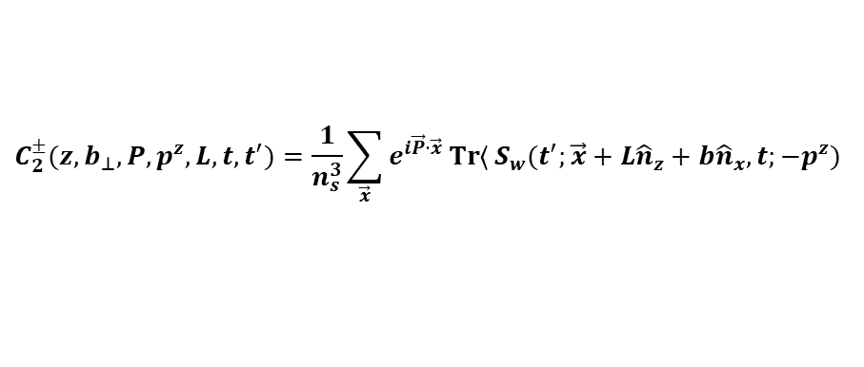

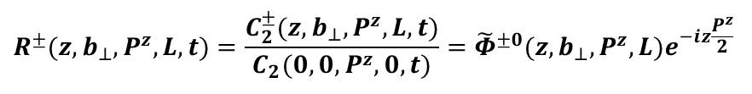
Extract Bare Quasi-TMDWF Matrix Elements
13
To determine the bare quasi-TMDWF, we construct the non-local two point correlation function :
The bare matrix elements can be extracted by one-/two-state fit:
$$C_{2}^{±}(z,b_{⊥},P,p^{z},L,t,t^{′})=\frac{1}{n_{s}^{3}}\sum_{\vec{x}}{e^{i\vec{P}⋅\vec{x}}}\operatorname{Tr}{⟨}S_{w}(t^{′};\vec{x}+L{\hat{n}}_{z}+b{\hat{n}}_{x},t;−p^{z})$$
$$×U_{⊐,±}(L,z,b_{⊥})Γ_{1}S_{w}(\vec{x}+L{\hat{n}}_{z}+z{\hat{n}}_{z},t;t^{′};p^{z})Γ_{2}⟩$$
$$R^{±}(z,b_{⊥},P^{z},L,t)=\frac{C_{2}^{±}(z,b_{⊥},P^{z},L,t)}{C_{2}(0,0,P^{z},0,t)}={\tilde{Φ}}^{±0}(z,b_{⊥},P^{z},L)e^{−iz\frac{P^{z}}{2}}$$
$$×\left[1+c_{1}(z,b_{⊥},P^{z},L)e^{−ΔEt}\right]$$
LPC, in preparation
Notes:
To calculate the bare quasi-TMDWF, we construct the nonlocal two-point correlation function. And it includes the same structure with the bare matrix element. By taking the ratio with a local one, we get its parameterization.
So the bare matrix elements can be extracted by one-state or two-state fits. One of the results are shown in the figure on the right. Both fits give consistent results within the errors.
13

Slide 14
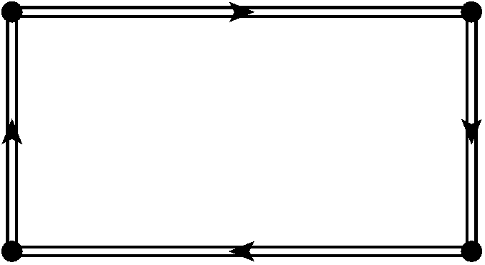
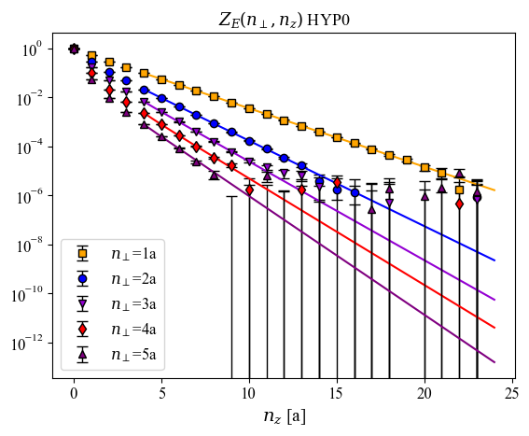
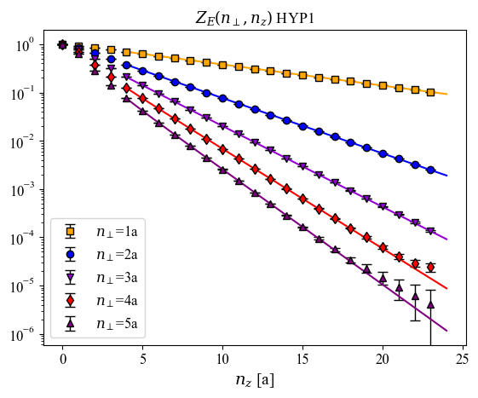



Wilson Loop Renormalization of Bare Quasi-TMDWFs
14
Wilson loop definition:
Ji et al., PRL120(11):112001, 2018.
$$z+2L$$
$$Z_{E}=$$
$$Z_{E}\left(2L+z,b_{⊥}\right)=\frac{1}{N_{c}}Tr⟨0|U_{⊥}\left(0;b_{⊥}{\hat{n}}_{⊥}\right)U_{z}\left(b_{⊥}{\hat{n}}_{⊥};\left(2L+z\right){\hat{n}}_{z}\right)|0⟩$$
$$b_{⊥}$$
Parameterization:
LPC, in preparation
Notes:
After extracting the bare matrix element, we need to do renormalization. So we calculated a Wilson loop which is formed by connecting two Wilson lines in different directions.
The figures below compare the lattice result of Wilson loop with different HYP smearing steps. As we can see, the HYP1 has a better signal and decays more slowly, which suggests that the HYP smearing affects the linear divergence behavior. On the other hand, we know the Wilson loop long-distance decay gives the static potential. So we can fit and extrapolate the Wilson loop using this formula.
14

Slide 15
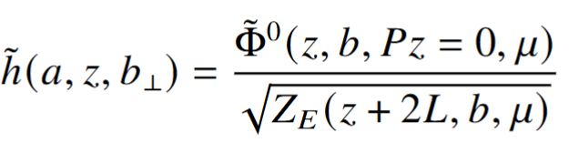
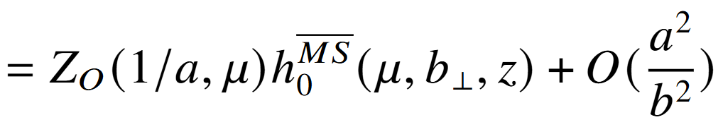
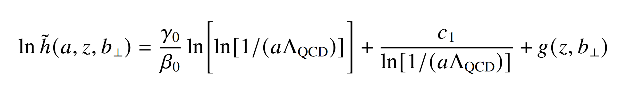
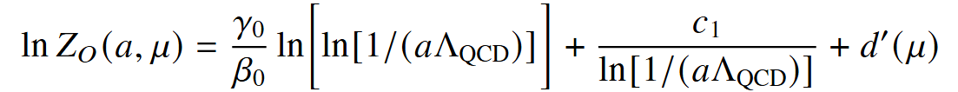
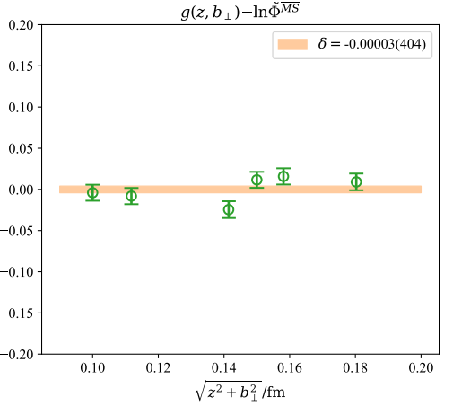
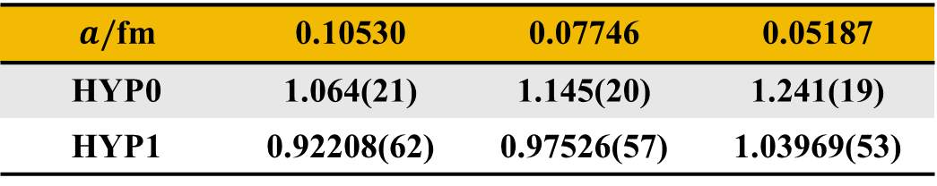

Self-Renormalization--a New Scheme to Extract $Z_{O}$
15
Subtracted matrix element
Renormalization condition:
Joint fit result：c₁=0.020
Parametrization:
✓
✓
$$d’\left(μ\right)=−\text{0.448}$$
LPC, in preparation
$a/$fm | 0.10530 | 0.07746 | 0.05187
HYP0 | 1.064(21) | 1.145(20) | 1.241(19)
HYP1 | 0.92208(62) | 0.97526(57) | 1.03969(53)
For more details, please see Hao-Yang and Mu-Hua’s talks.
Deng et al., JHEP 09 (2022); Huo et al. NPB 969(2021)
Notes:
Inspired by the self-renormalization, we determined the logarithmic divergence form. Moreover, it matches well with the MS scheme in the perturbative region, as shown in this figure. Finally, we obtained the renormalization factor ZO at different lattice spacings and HYP steps in this table. For more details, please see Hao-Yang and Mu-Hua’s talk
15

Slide 16
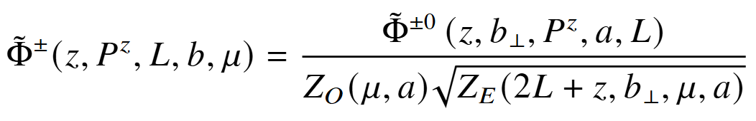
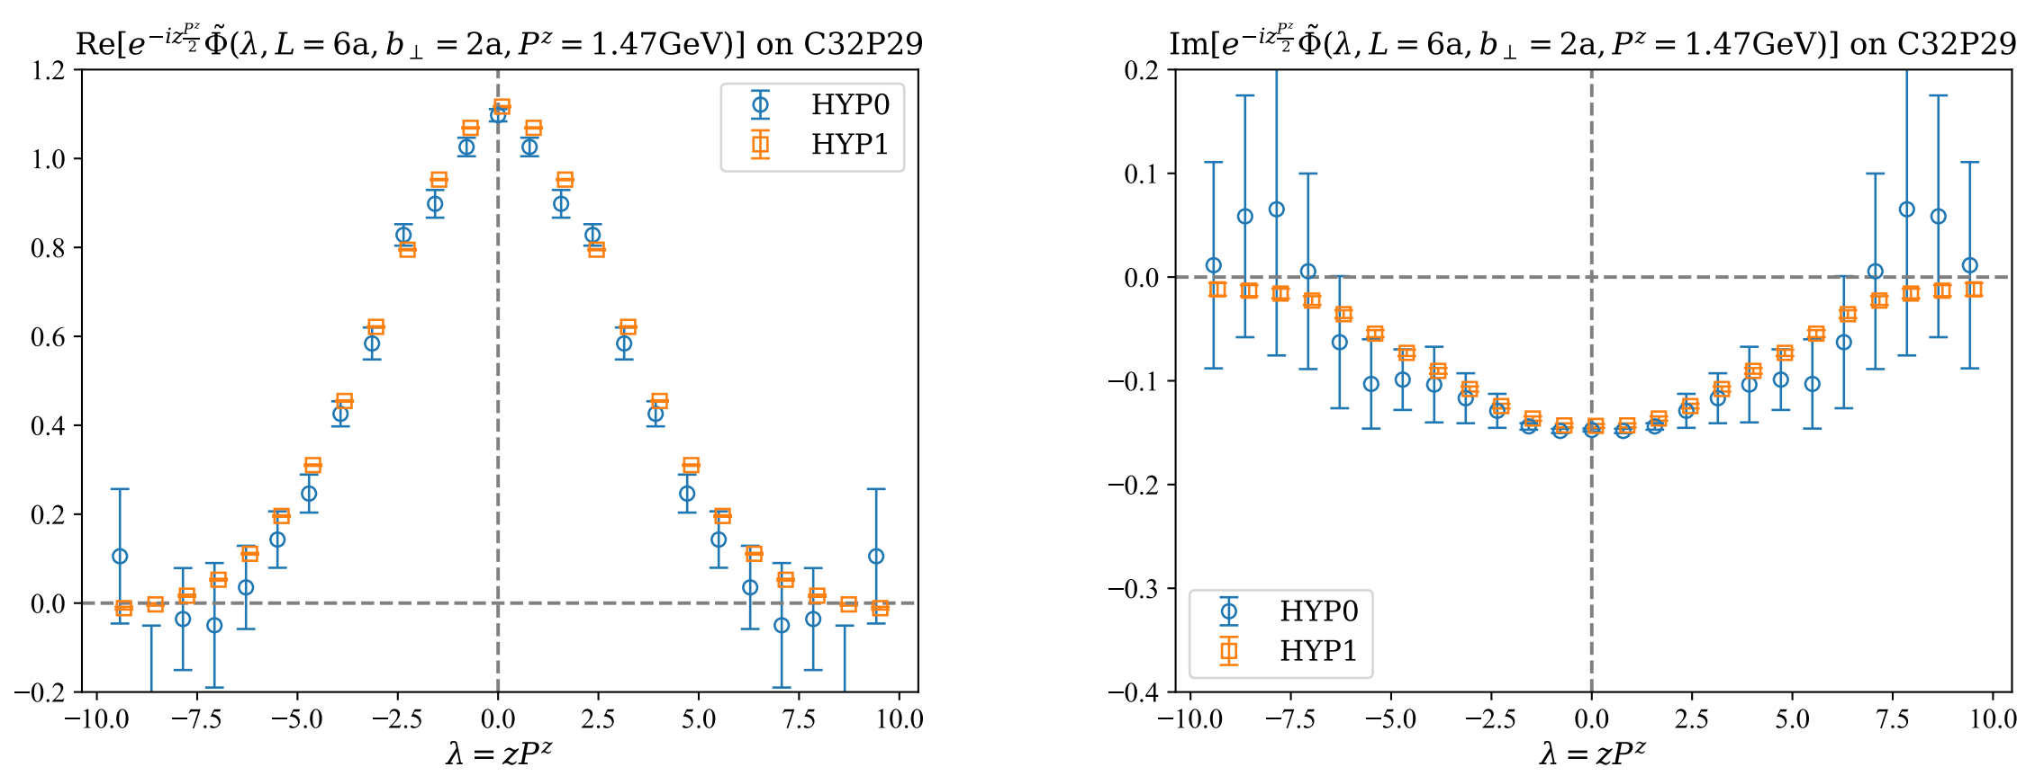
Result for Quasi-TMDWFs in Coordinate Space
16
Different HYP steps
LPC, in preparation
Notes:
So, when we have all three pieces of the quasi-TMDWF, we can plot its distribution in coordinate space. We first compare the result with different HYP steps. We can see that they are consistent with each other but HYP1 has the better signal.
16

Slide 17
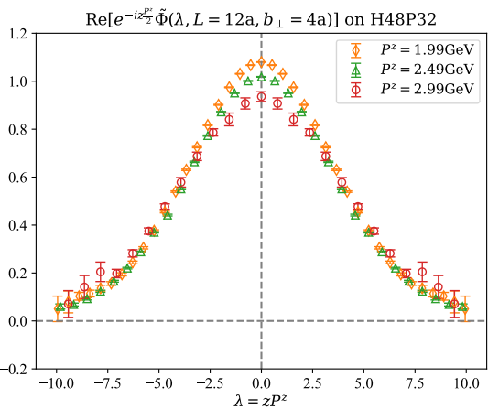
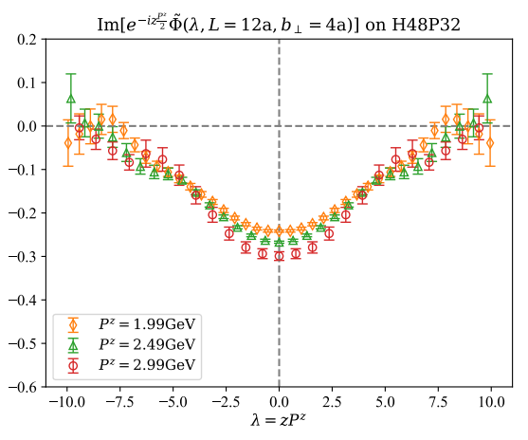

Result for Quasi-TMDWFs in Coordinate Space
17
Different $P^{z}$
LPC, in preparation
Notes:
Then, for each ensemble, we calculated results at three different momentums. They have similar behaviors.
17

Slide 18
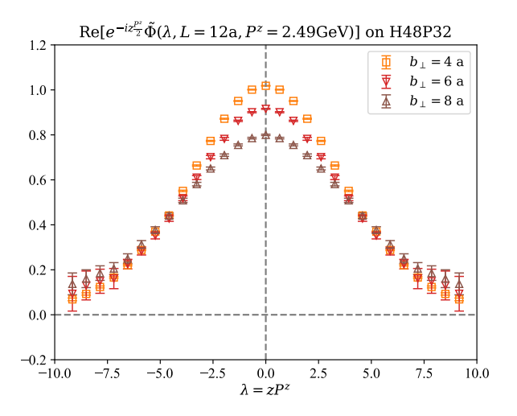
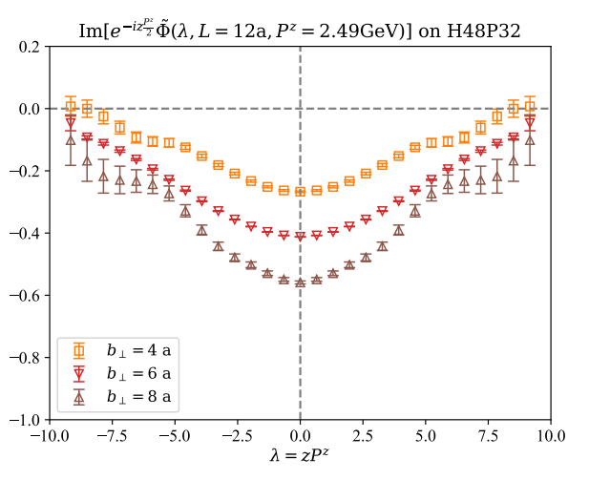

Result for Quasi-TMDWFs in Coordinate Space
18
Different $b_{⊥}$
LPC, in preparation
Notes:
We also compare the result with different b. As ( b ) increases, both the real and imaginary parts decrease.
18

Slide 19
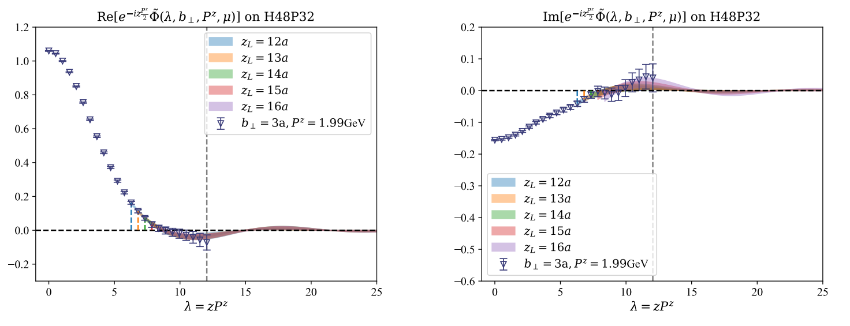

Extrapolation for Large $λ$
19
In large $λ$ area, a feasible form of asymptotic behavior can be written as:
LPC, in preparation
Notes:
To remove unphysical oscillations, the extrapolation of the quasi-TMDWF in the large-$λ$ region is necessary. in this region the wave function behavior can be written as this formula. Since this extrapolation will introduce systematic errors, we compared results with different starting points ZL. As shown in the figure, they are consistent within errors. Of course, their differences are also included in the systematic error and we will mention later.
19

Slide 20
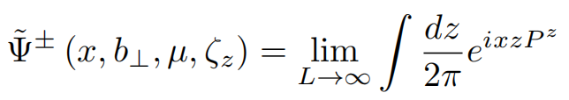
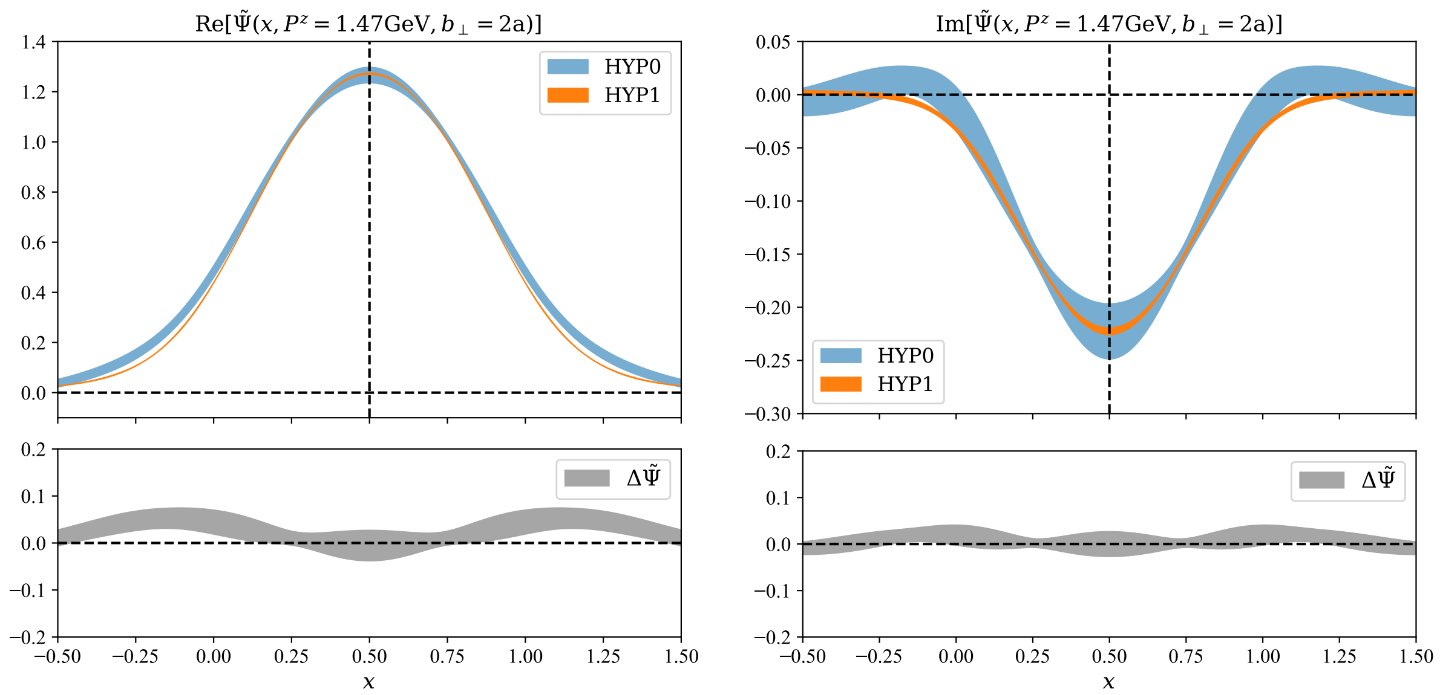
Result for Quasi-TMDWFs in Momentum Space
20
Different HYP steps
LPC, in preparation
Notes:
After the Fourier transformation, we obtain the quasi-TMDWF in momentum space. We compare the result with different HYP steps.
20

Slide 21
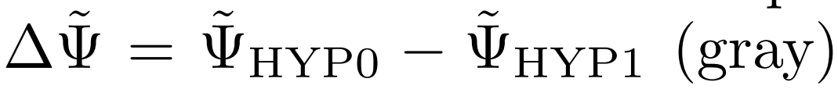
Result for Quasi-TMDWFs in Momentum Space
21
HYP smearing:
Better signal;
Same physics.
Different HYP steps
LPC, in preparation
Notes:
Besides, we compute their difference which is the delta psi labeled by the gray band. They are equal to 0 in physical region. So we confirmed that HYP smearing has Better signal and the Same physics. In the following work, we all use the quasi-TMDWF with HYP1
21

Slide 22
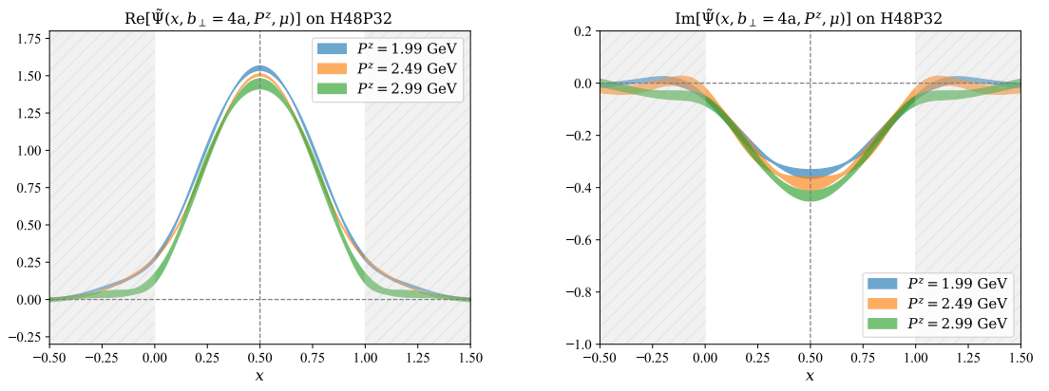

Result for Quasi-TMDWFs in Momentum Space
22
Different $P^{z}$
LPC, in preparation
Notes:
We also compare the result with different momentum Pz and tran sp b.
22

Slide 23
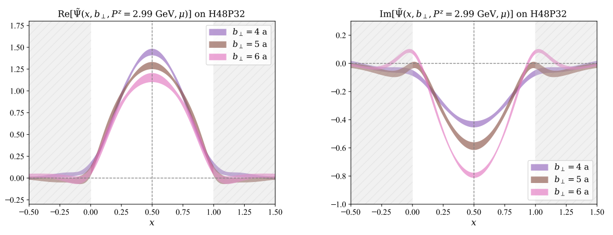
Result for Quasi-TMDWFs in Momentum Space
23
Different $b_{⊥}$
LPC, in preparation
Notes:
Their behaviors are similar with them in coordinate space.
23

Slide 24
Outline
24
Motivation
Lattice QCD calculation of Collins-Soper Kernel
Quasi-TMD Wave Function
Collins-Soper Kernel
Summary and Outlook
Notes:
From the quasi-tmdwf, finally we can extract CS kernel.
24

Slide 25
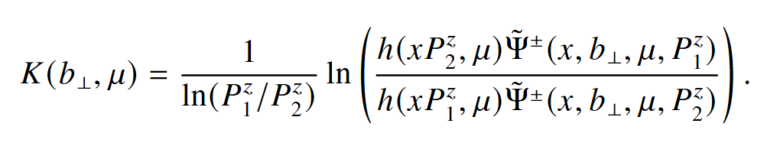
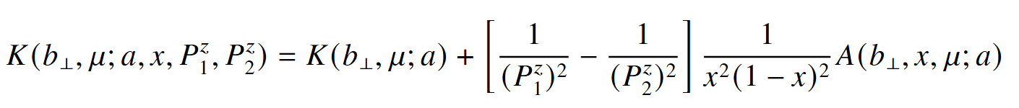
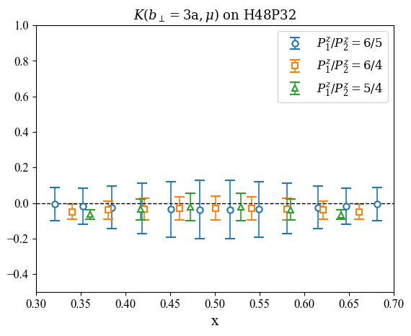
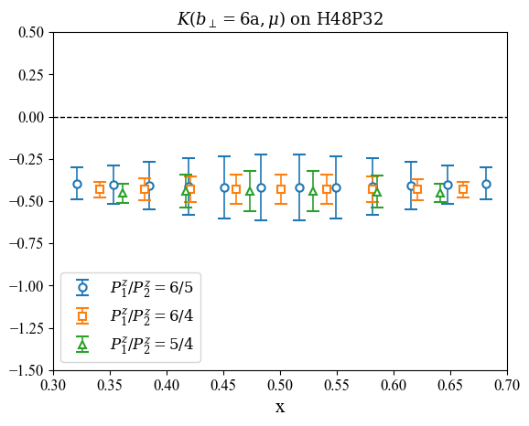
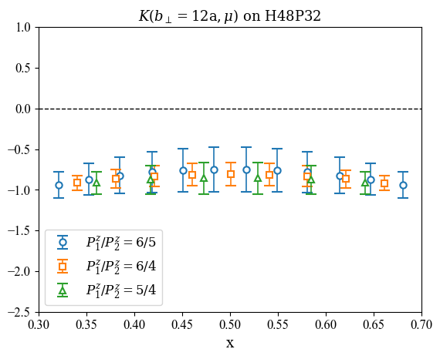
CS Kernel Extracted from Quasi-TMDWFs
25
quasi-TMDWFs
matching kernel
(For better visualization, we present a subset of points selected
from the 200 data points in each of the 3 cases.)
LPC, in preparation
Avkhadiev, et al., PRD 108, 114505 (2023).
Notes:
So, we can take the ratio at different momentum cases to calculate the CS kernel. In our work, we use the matching kernel from the paper below. The three figures shows the CS kernel with different b_perp. The three momentum combinations agree each other, but there is still some dependence on $x$ and $P_{z}$, which means the power correction is not cancel out.
25

Slide 26
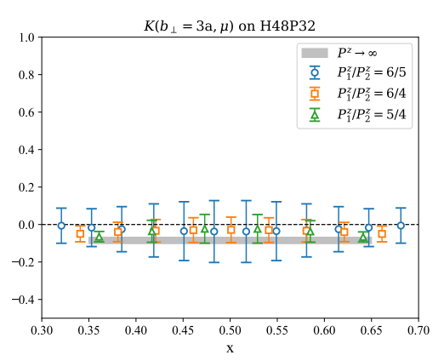
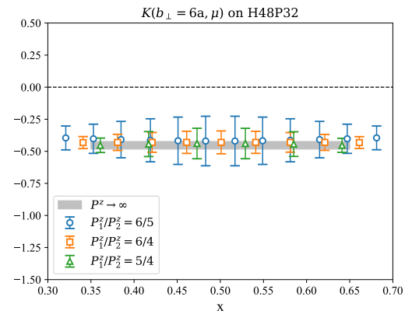

Large Momentum Limit Extrapolation
26
(For better visualization, we present a subset of points selected
from the 200 data points in each of the 3 cases.)
LPC, in preparation
Notes:
So to include this effect, we perform the large-momentum limit extrapolation above to remove the power correction . The gray band shows the extrapolation result.
26

Slide 27


Large Momentum Limit Extrapolation
27
... repeat for each $b_{⊥}$
and each ensemble ...
LPC, in preparation
Notes:
We can repeat this process for different $b_{⊥}$on each ensemble. This gives us the CS kernel at 5 lattice ensembles with different lattice spacings and pion masses . The results show very beautiful consistency.
27

Slide 28


Continuum Limit and Physical Mass Extrapolation
28
LPC, in preparation
Notes:
Up here, we can perform the continuum and physical mass extrapolations as this form. The colored error bars show the results at different lattice spacings, while the black error bars show the results at the physical point.
Overall, the CS kernel shows little dependence on the pion mass. At small $b_{⊥}$ , the three colored error bars differ a lot, which means discrete error is large.
28

Slide 29

The Systematic Uncertainty
29
We have considered four sources of systematic uncertainties:
1.the unphysical imaginary part, 2.the large-$λ$ extrapolation,
3.the large-momentum extrapolation, 4.the continuum and physical mass extrapolations.
Notes:
In our work, we have considered four sources of systematic error: 1.the unphysical imaginary part,2.the large-$λ$ extrapolation, 3.the large-momentum extrapolation,4.the continuum and physical mass extrapolations.
29

Slide 30



“Imaginary part” of the CS kernel
30
Systematic uncertainty from the imaginary part of the CS kernel:
Previous studies have shown that the imaginary part of the CS kernel primarily originates from the matching kernel.
$$σ_{\text{sys}}^{\text{Im}}=\sqrt{K(b_{⊥},μ)^{2}+\operatorname{Im}{[}K(b_{⊥},μ)^{2}]}−|K(b_{⊥},μ)|$$
The unphysical imaginary part will introduce large systematic error.
Chu et al. (LPC), PRD 106, 034509 (2022);
Notes:
We know that , as the TMD evolution kernel , the CS kernel is real . However, in our lattice calculation, we find that its Imaginary part is not completely canceled. In previous work, the imaginary part of the CS kernel was regarded as a systematic error. The paper also suggest that most of the imaginary part comes from the matching kernel. The quasi-TMDWF itself contribute a very small imaginary part. In the small-b region, The unphysical imaginary part will introduce large systematic error. So we need to cancel it.
30

Slide 31

“Imaginary part” of the CS kernel
31
The quasi-TMDWF factorization formula requires $xP^{z}b_{⊥}≫1,$ at small $b_{⊥}$region, remain the dependence on $b_{⊥}$when computing the matching kernel.
LPC, in preparation
Imaginary parts of the CS kernel are all very close to zero!
Avkhadiev, et al., PRD 108, 114505 (2023).
Notes:
We know the quasi-TMD factorization requires P is large. But considering the Pz and b range used in this work such conditions are not fully satisfied, especially at small b. This paper point out that at small $b_{⊥}$region, when computing the matching kernel, we can remain the dependence on $b_{⊥} .$ Using this kind of matching kernel , this figure shows that our imaginary part of CS kernel stays around zero for each ensemble, which is very exciting for us.
31

Slide 32



The Systematic Uncertainty
32
We have considered four sources of systematic uncertainties:
1.the unphysical imaginary part, 2.the large-$λ$ extrapolation,
3.the large-momentum extrapolation, 4.the continuum and physical mass extrapolations.
For these extrapolations(2, 3, 4), the difference of the result with different extrapolation schemes denotes the systematic error.
large-$λ$
extrapolation
large-$P^{z}$
extrapolation
a and $m_{π}$
extrapolation
MEs in coordinate space
MEs in momentum space
CS kernel at different
ensembles
Result
different scheme
different scheme
different scheme
result 4
…
result 3
…
…
result 2
Notes:
For these extrapolations(2, 3, 4), the difference of the result with different extrapolation schemes denotes the systematic error as this figure shows. We use different scheme at these steps, and compare their results with the original result to calculate systematic error.
32

Slide 33

The Systematic Uncertainty
33
We have considered four sources of systematic uncertainties:
1.the unphysical imaginary part, 2.the large-$λ$ extrapolation,
3.the large-momentum extrapolation, 4.the continuum and physical mass extrapolations.
Notes:
So the systematic error contributions from 4 sources is shown in this figure. The gray band present the total systematic error. You can see that the blue one , the imaginary part has already been significantly suppressed.
33

Slide 34


Final Result
34
Continuum limit;
Physical mass;
$b_{⊥}=1$fm.
Preliminary
Scimemi et al., JHEP 06, 137 (2020);
Moos et al., JHEP 05, 036 (2024);
Avkhadiev et al., PRL. 132, 231901 (2024);
Kang et al., arXiv:2410.21435;
Moos et al., arXiv:2503.11201.
Schlemmer et al., JHEP 08, 004 (2021);
Chu et al. (LPC), PRD 106, 034509 (2022);
Avkhadiev, et al., PRD 108, 114505 (2023).
Notes:
Finally we get the result of the cs kernel from lattice. In the left figure, we compare our work with other theoretical calculation, In the small-b region, our results agree with the perturbative calculation at 3-loop level. More importantly, as the transverse separation enters the nonperturbative region, our lattice results remain reliable. Without model, our determination of the CS kernel is up to one femtometer. We also compare our result with the phenomenology in the right figure. Our results show very good agreement with the global fit of SV19, which is the red band.
34

Slide 35

Review of CS Kernel Calculation
35
 | Pion mass | Renormalization | Fourier transform | Matching | x-plateau | Continuum | $b_{⊥}$ separation (*)
SWZ20 PRD 102, 014511 (2020) Quenched | 1.2 GeV | Yes | Yes | LO | Yes | No | 0.8fm
LPC20 PRL 125,192001 (2020) | 547 MeV | N/A | N/A | LO | N/A | No | 0.3fm
SVZES JHEP08 (2021), 2302.06502 | 422 MeV | N/A | N/A | NLO | N/A | No | 0.5fm
PKU/ETMC 21 PRL128, 062002 (2022) | 827 MeV | N/A | N/A | LO | N/A | No | 0.3fm
SWZ21 PRD 104,114502 (2022) | 580 MeV | Yes | Yes | NLO | Yes | No | 0.5fm
LPC22 PRD 106, 034509 (2022) | 670 MeV | Yes | Yes | NLO | Yes | No | 0.6fm
LPC23 JHEP 08,172 (2023) | 220 MeV | Yes | Yes | NLO | Yes | No | 0.6fm
ASWZ23 PRD108, 114505 (2023) | 148.8 MeV | Yes | Yes | uNNLL | Yes | No | 0.8fm
ASWZ24 PRL132, 231901 (2024) | 148.8 MeV | Yes | Yes | uNNLL | Yes | Model (0.15,0.12,0.09) fm | 0.9fm
LPC 25 (preliminary) | 135.5 MeV | Yes | Yes | uNLO | Yes | Yes | ~1.0fm
Table adapted/updated from Yong Zhao’s collection
(*) Only the results that deviate from 0 by more than 2σ are considered.
Notes:
So we updated this Table from Yong Zhao’s collection.
Starting from the work of SWZ20, the CS kernel was first extracted at a large pion mass and only at leading order. In the following years, studies have gradually lowered the pion mass and improved the precision of the matching kernel. The ASWZ23’s work introduced the b-unexpanded matching kernel, which helped to cancel the unphysical imaginary part of the CS kernel.
Compared with previous lattice studies, our work lowers the pion mass to the physical point and reaches the continuum limit without model dependence. Moreover, we have extended the transverse separation to about one femtometer, which means we are now able to describe the rapidity evolution at the nucleon scale.

Slide 36
Outline
36
Motivation
Lattice QCD calculation of Collins-Soper Kernel
Quasi-TMD Wave Function
Collins-Soper Kernel
Summary and Outlook
Notes:
36

Slide 37

Summary and Outlook
37
We present the lattice QCD calculation of CS kernel:
Systematic uncertainty have been carefully addressed;
Physical extrapolation include large momentum, continuum limit and physical mass;
The CS kernel has been extracted in the long-distance region ($b_{⊥}=1$fm).
In the future, we will:
Better control of uncertainties;
Polarized TMDPDFs calculation;
......
Thank you for your attention!
Notes:
37

Slide 38
36
Backup
Notes:
38

Slide 39

TMDPDFs: 3D tomography of the nucleon
39
TMDPDFs are indispensable and multifaceted.
Boussarie et al., TMD Handbook, 2304.03302
Notes:
这里最重要的一类研究对象就是 TMDPDF。它们不仅依赖纵向动量分数 x，还依赖于横向动量 kT，可以反映出夸克在核子横截面上的动量分布，从而给我们提供更完整的三维图像。在 leading twist下，我们通过对夸克相关张量的投影，可以系统地定义出 八种独立的TMDPDF，它们分别反映了不同极化状态下的动力学信息。
39

Slide 40


Phenomenological vs. Lattice at TMD Observables
40
Most recent global data fit-Tensor Charge
The tensor charge $δq$ is the first moment of the quark transversity distribution function $h_{1}(x)$:
$$δq=\int_{0}^{1}{dx[h_{1}^{q}(x)−h_{1}^{\overline{q}}(x)]}$$
There exists a noticeable difference between lattice QCD and phenomenological results obtained from global fits.
Zeng et al.,arXiv:2412.18324
High-precision calculations of TMDs on the lattice are urgently needed.
Notes:
但是近些年来，格点和唯象在一些TMD可观测量的研究结果上，出现了一些差异。例如对于张量荷的global fit，张量荷是夸克的transversity的一阶矩，从右图可以看到，格点和唯象上给出的delta u的结果出现明显差异，因此，我们格点上需要对这些TMD可观测量进行高精度的计算，需要排除如离散误差等因素造成的偏离。
40

Slide 41






TMDs on Lattice QCD
41
Large-momentum effective theory: connecting Euclidean lattice and physical observables
$$\frac{ξ^{−}}{\sqrt{2}}$$
Lorentz boost
EFT
$$−\frac{ξ^{−}}{\sqrt{2}}$$
Ji, PRL110(2013),
RMP93(2021), …
Achieved great success in the studies of TMDPDFs:
Proton transversity PDF, PRL131(2023)
Unpolarized nucleon TMDPDF, PRD109 (2024)
Boer-Mulders Function, arXiv:2502.11807
Notes:
41

Slide 42

Dispersion Relation
42
We use the following fitting formula to fit the dispersion relation of pion,
where the fit result is b1 = 1.0048 (90), b2 = -0.055 (16).
Notes:
42

Slide 43



L Dependence
43
The extraction of ${\tilde{Ψ}}^{±}(x,b_{⊥},μ,ζ_{z})$ requires L to be large enough. When L$≥$6a$≅$0.6fm, the matrix elements remain invariant.
Notes:
43

Slide 44


HYP smearing
44
N_conf = 500, fix timeslice = 4a, Pz=1.47GeV,
the noise-to-signal ratio of bare-TMDWF
N_conf = 500
HYP smearing significantly suppress the noise-to-signal ratio of bare-TMDWF
The noise-to-signal ratio of HYP smearing 1 times is lower than that of without HYP smearing.
Notes:
44

Slide 45


“Imaginary part” of the CS kernel
45
The quasi-TMDWF factorization formula requires $xP^{z}b_{⊥}≫1, \left(1−x\right)P^{z}b_{⊥}≫1,$ at small $b_{⊥}$region, remain the dependence on $b_{⊥}$when computing the matching kernel.
b-unexpanded matching kernel, PRD 108 (2023)
Notes:
However, we know the quasi-TMDWF factorization formula requires $xP^{z}b_{⊥}$is large, this paper shows that at small $b_{⊥}$region, we can remain the b_perp dependence in matching kernel. These figue shows with the b increase ,b unexpanded matching kernel approaches its NLO result.
45

Slide 46



Different Lorentz Structures
46
When $P^{z}$ = 1.47GeV
${{ Γ}_{src} = γ}^{t}γ_{5},{ γ}^{z}γ_{5},γ_{5}$ are consistent when the timeslice is large;
The signal-to-noise ratio of $γ^{t}γ_{5}, γ^{z}γ_{5}$ is greater than that of $γ_{5}$.
Notes:
46

Slide 47






Gauge Fixing Accuracy and Lorentz Structure
47
Left panel :
Right panel :We fix $Γ_{sink}=γ^{t}γ_{5} ,$
$the red: gauge fixing accuracy {10}^{−6}$
$the blue:$ $gauge fixing$ $accuracy$ ${10}^{−8}$
$the red:Γ_{src}=(γ^{t}γ_{5}+{i γ}^{z}γ_{5} )/2$
$the blue:Γ_{src}=γ_{5}$
Notes:
47

Slide 48

Self-Renormalization--a New Scheme to Extract $Z_{O}$
48
Subtracted matrix element
Renormalization condition:
Parametrization:
Deng et al., JHEP 09 (2022); Huo et al. NPB 969(2021)
Notes:
In our work, for the first time in the case of quasi-TMDWFs, we studied the logarithmic divergences in detail, inspired by self-renormalization.
After removing linear divergences, the zero-momentum matrix element can be factorized into a scale-dependent renormalization factor times the matrix element calculated in the $\overset{‾}{\text{MS}}$scheme.
This paper shows that the subtracted matrix element can be parameterized as shown below. The first two terms describe the logarithmic divergences. The g term describes the remaining part. The later terms are for matching to $\overset{‾}{\text{MS}}$, and $d^{′}$in $Z_{O}$ absorbs the scale dependence.
We first use all the zero-momentum lattice data to do the joint fit of $c_{1}$.
48

Slide 49



Self-Renormalization--a New Scheme to Extract $Z_{O}$
49
Subtracted matrix element
Renormalization condition:
Joint fit result：c₁=0.020
Parametrization:
Deng et al., JHEP 09 (2022); Huo et al. NPB 969(2021)
Notes:
We obtained the result for $c_{1}$and the fit shown below. Then we can fix the form of the logarithmic divergences. We also marked the data around the pion mass of 135 on the figure by blue errbars and found that the zero-momentum matrix element shows independence on the pion mass.
49

Slide 50


Self-Renormalization--a New Scheme to Extract $Z_{O}$
50
Subtracted matrix element
Renormalization condition:
Joint fit result：c₁=0.020
Parametrization:
✓
✓
$d’(μ)$= -0.448
$a/$fm | 0.10530 | 0.07746 | 0.05187
HYP0 | 1.064(21) | 1.145(20) | 1.241(19)
HYP1 | 0.92208(62) | 0.97526(57) | 1.03969(53)
Deng et al., JHEP 09 (2022); Huo et al. NPB 969(2021)
Notes:
We then adjusted $d^{′}$to match $g$ term with the $\overset{‾}{\text{MS}}$ result in the perturbative region. This lets us remove the $\overset{‾}{\text{MS}}$ part of $g$, fix the logarithmic divergence $c_{1}$, and define the scale dependence.
Finally, we obtained the renormalization factor $Z_{O}$for the three lattice spacings.
50

Slide 51








Quasi TMD Wave Function
51
$$t$$
$$z$$
$$z+L$$
$$b_{⊥}$$
$$⊥$$
$$P^{z}$$
Chu et al., PRD109(2024); Chu et al., PRD 106(2022);
Zhang et al., PRL125(2020);
Notes:
The bare quasi-TMDWF is defined as a nonlocal matrix element, where the quark and antiquark are separated by a transverse distance $b$_perp and a longitudinal distance $z$. As shown in the figure on the right, they are connected by a Wilson line shaped like a staple.
To remove divergences, we first divide the bare matrix element by the square root of $Z_{E}$for a Wilson line with the same shape. It can cancel linear divergences from Wilson line self-energy. Then we divide by $Z_{O}$to match the $\overset{‾}{\text{MS}}$scheme result and remove logarithmic divergence from the cusp.
51

