Slide 1


Slide 2
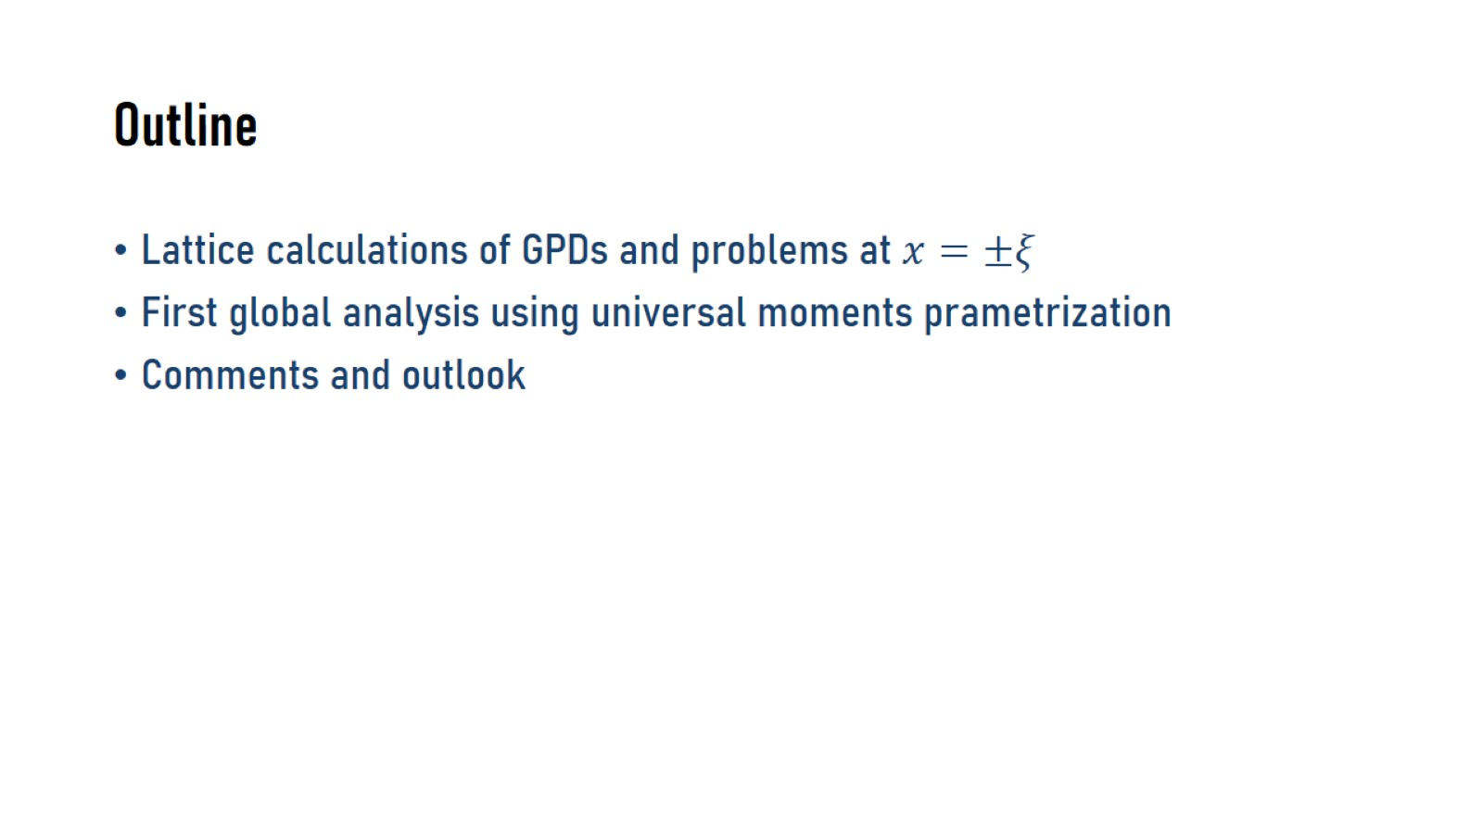
Outline

Slide 3
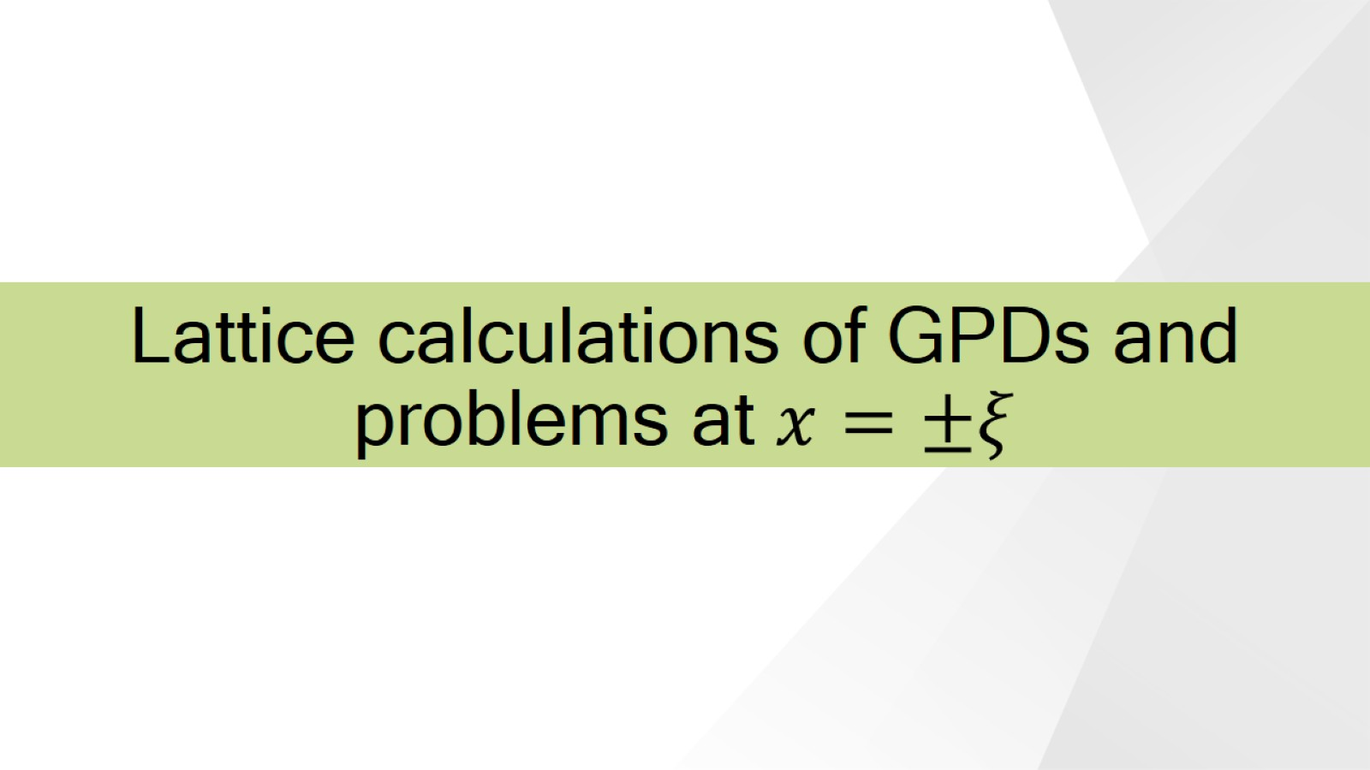
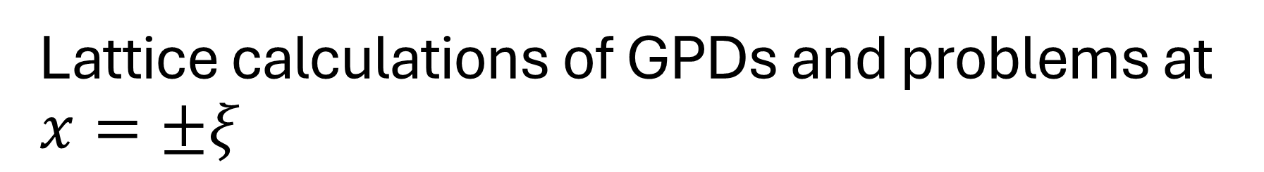
Lattice calculations of GPDs and problems at $x=±ξ$

Slide 4
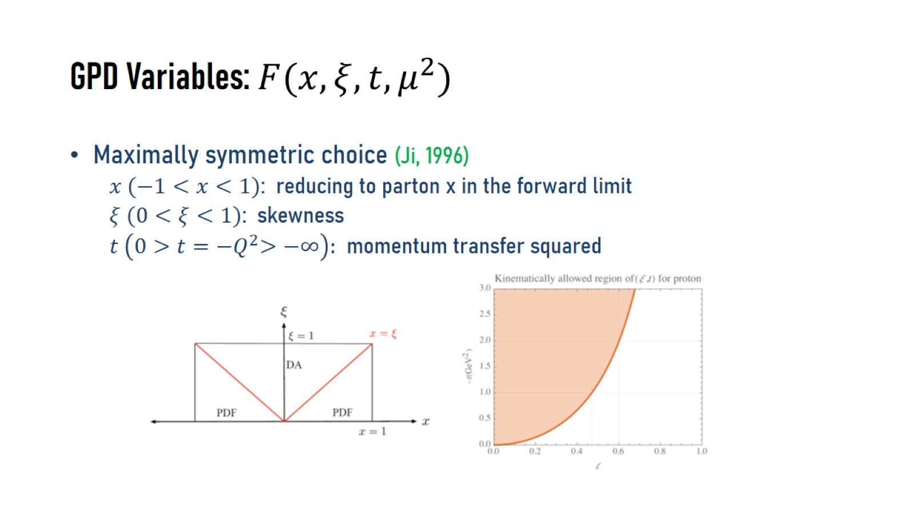

GPD Variables: $F(x, ξ, t, μ^{2})$

Slide 5
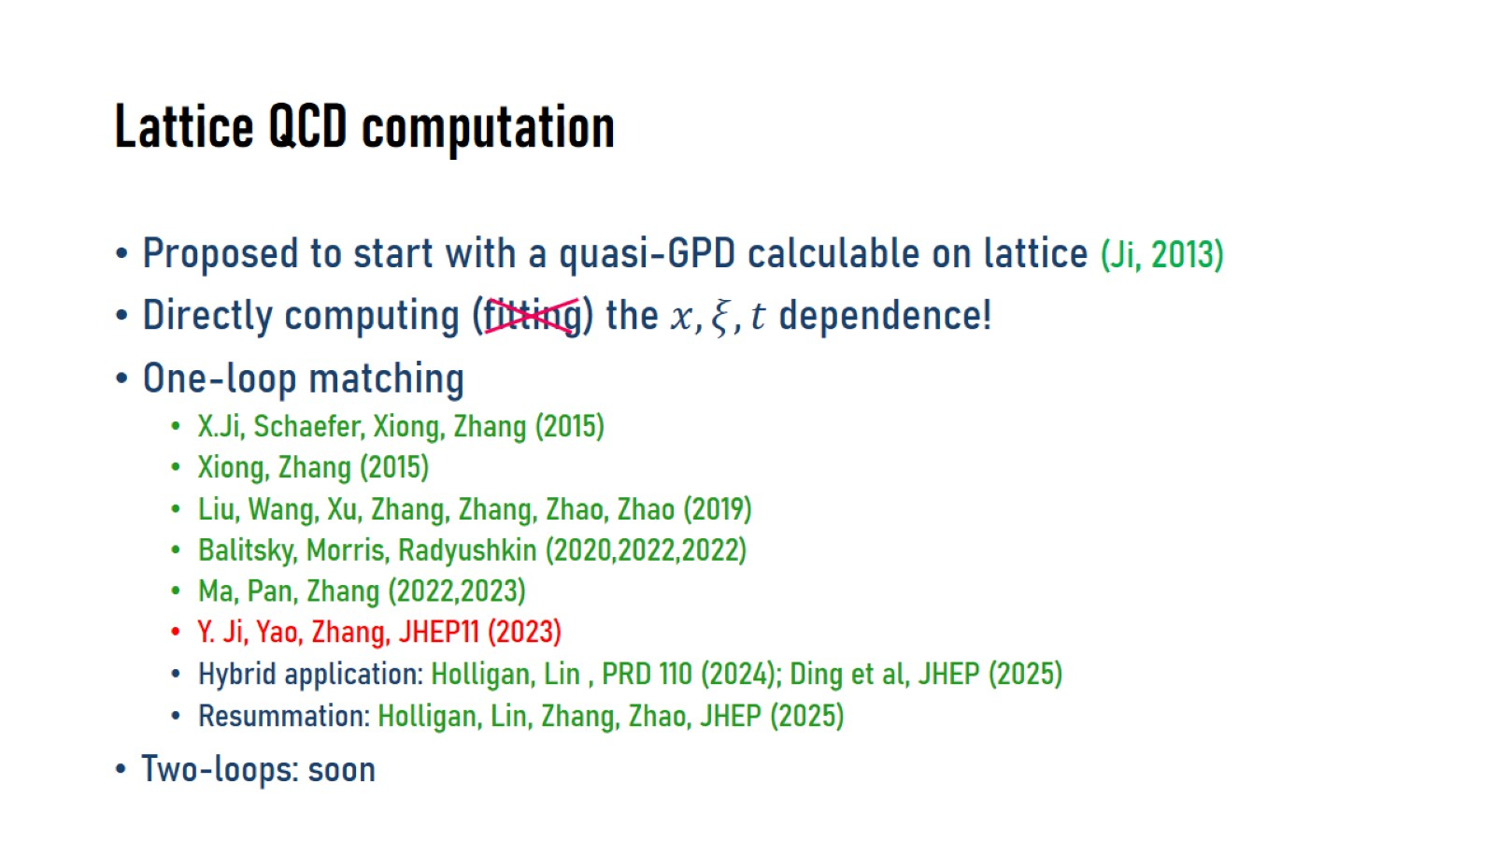
Lattice QCD computation

Slide 6
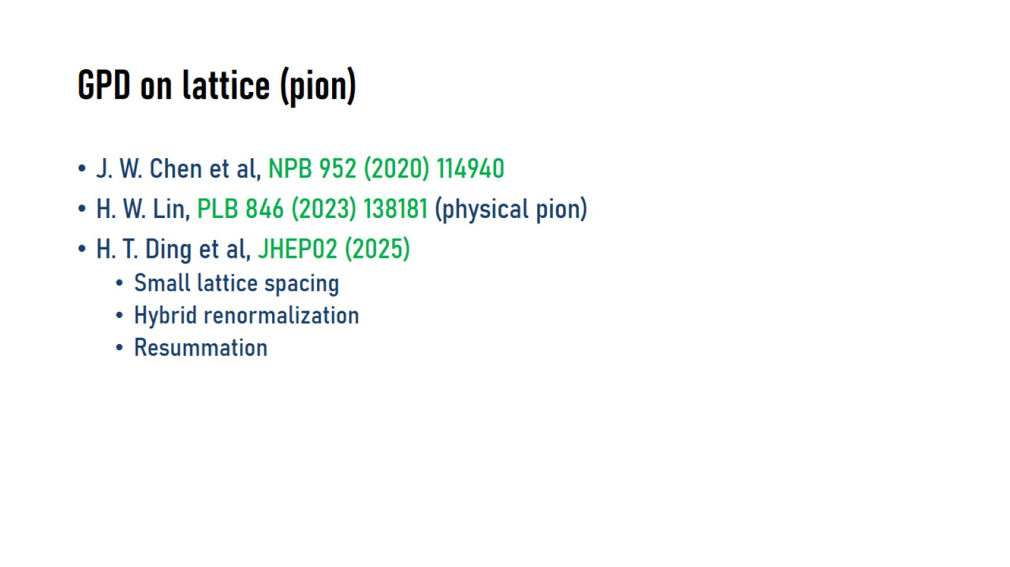
GPD on lattice (pion)

Slide 7
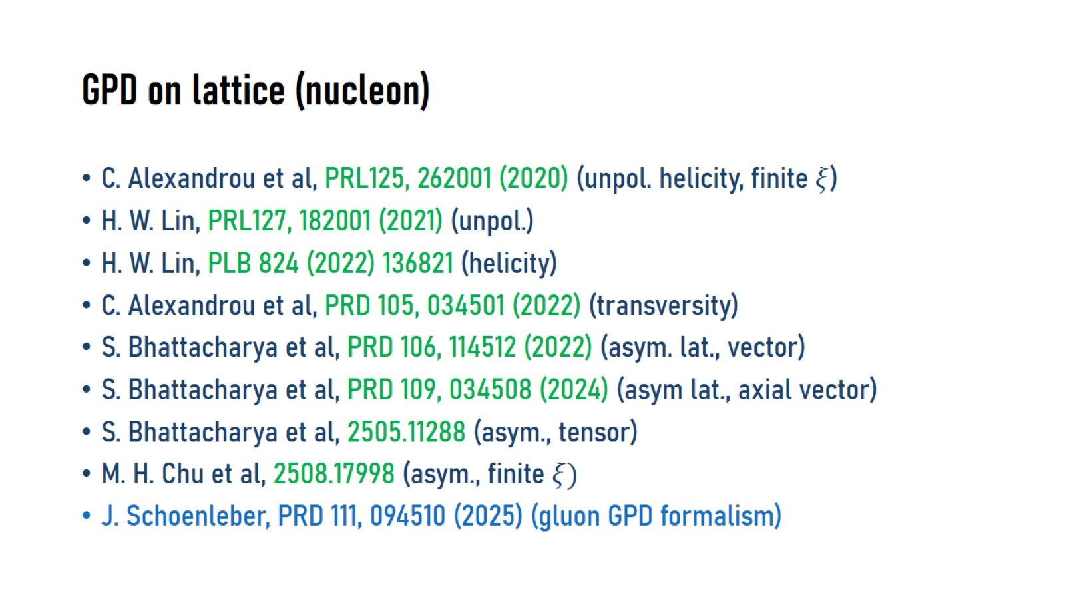
GPD on lattice (nucleon)

Slide 8
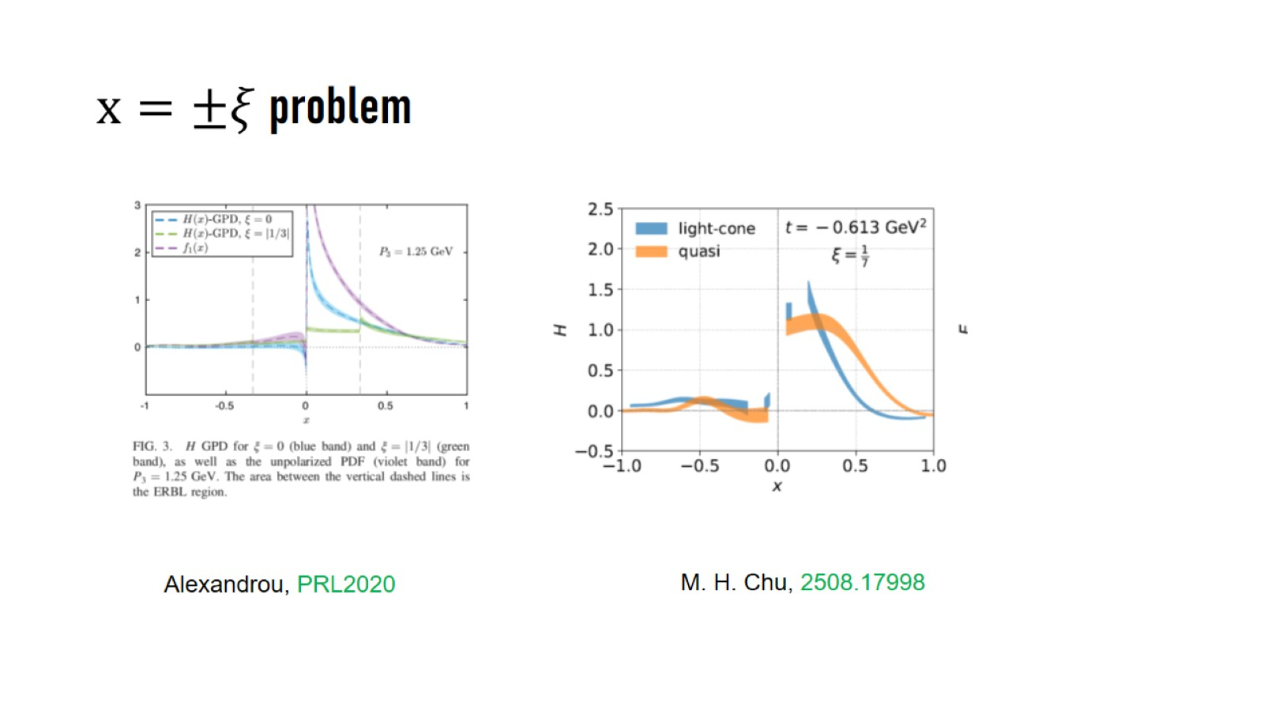
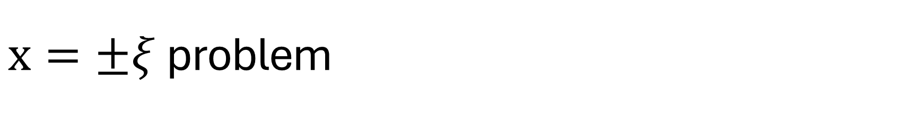
$x=±ξ$problem

Slide 9
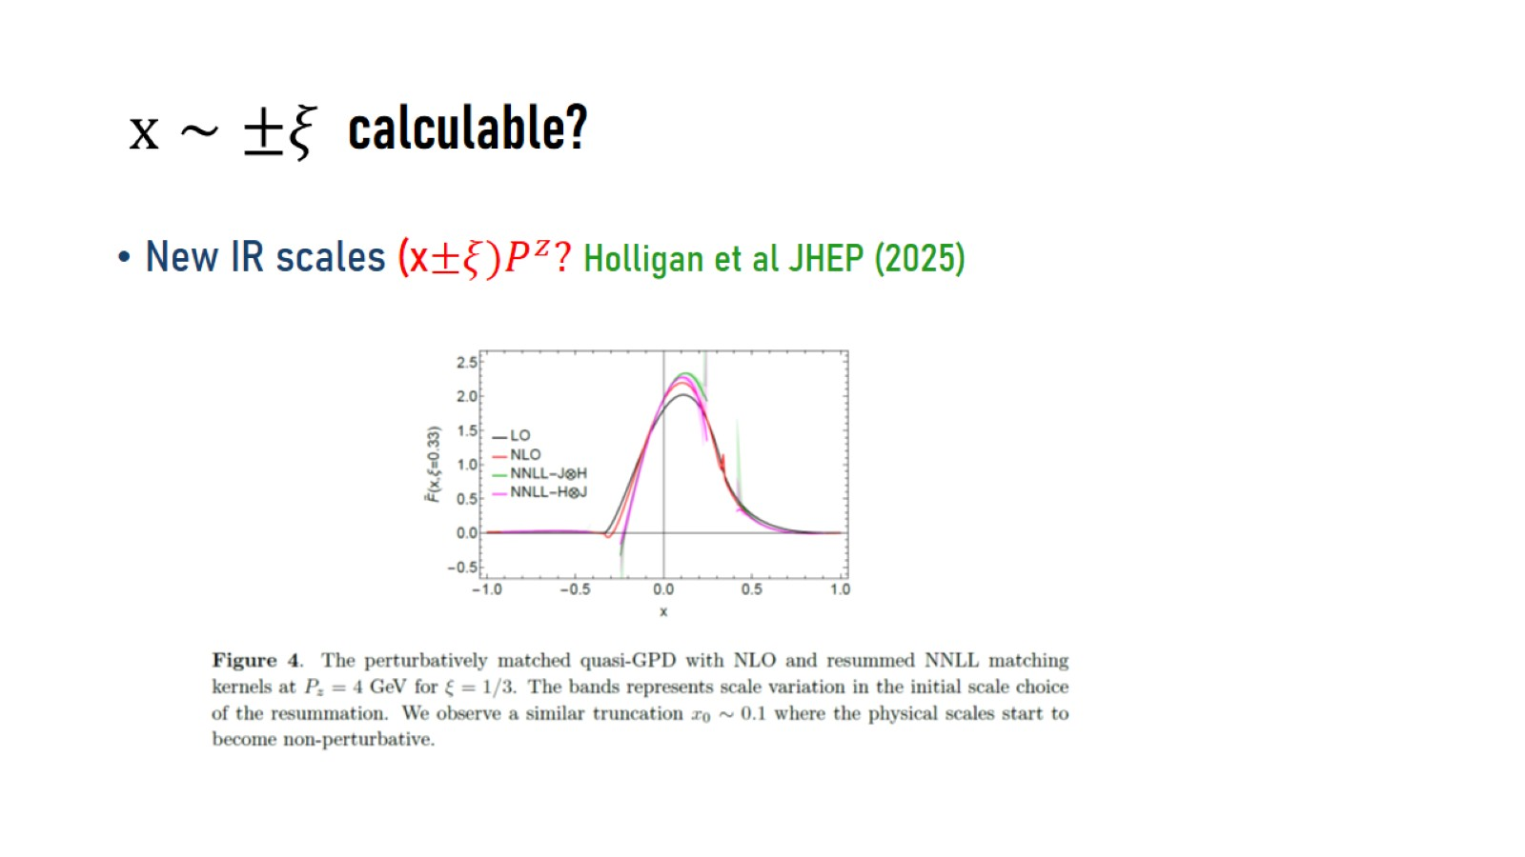
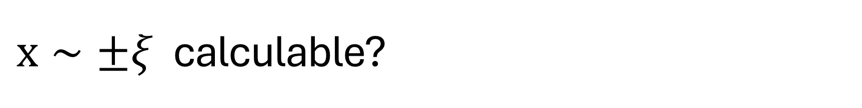
$x∼±ξ$ calculable?

Slide 10
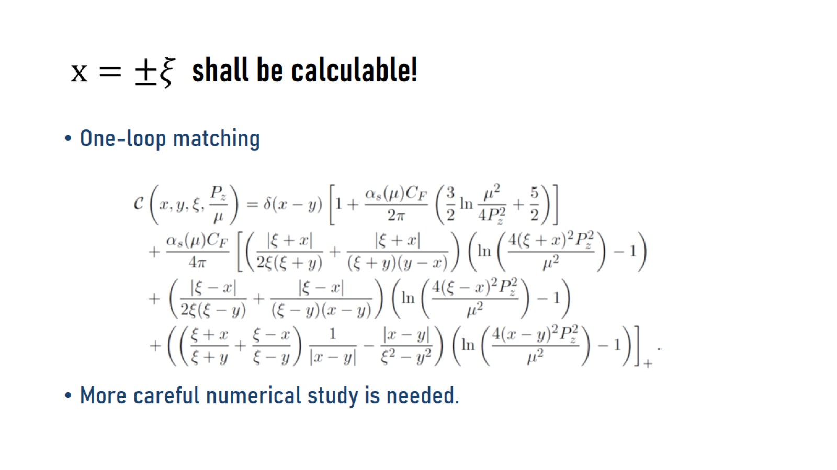
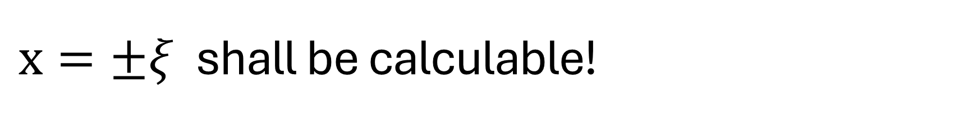
$x=±ξ$ shall be calculable!

Slide 11

First Global analysis of GPDs: GUMP1.0

Slide 12
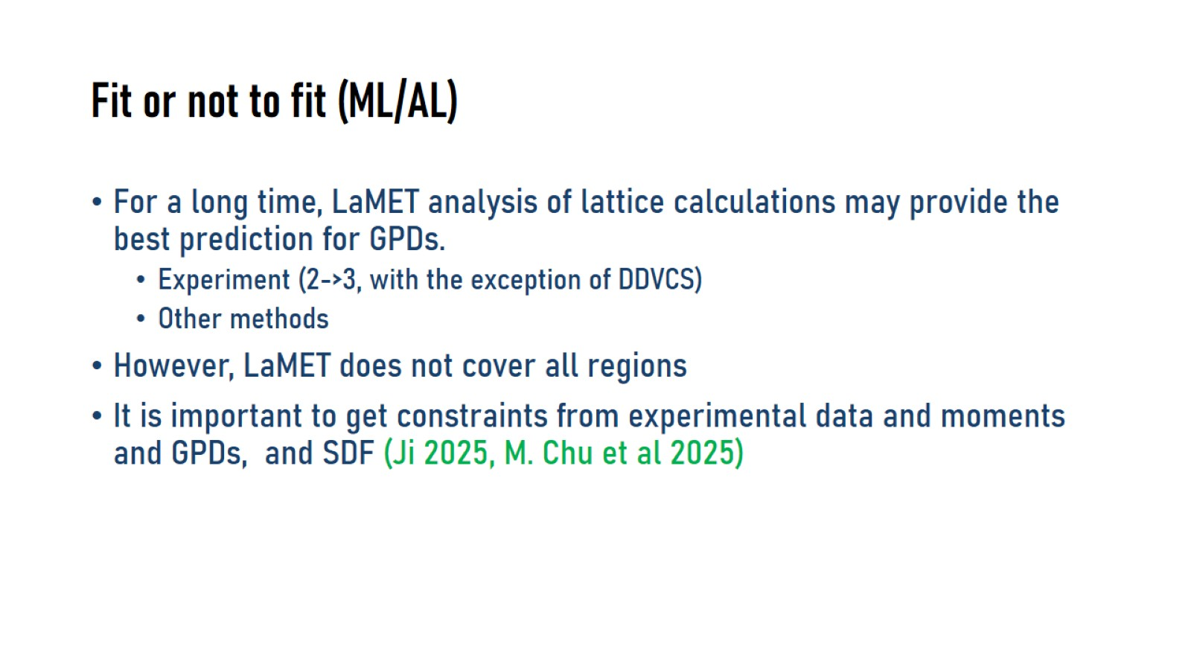
Fit or not to fit (ML/AL)

Slide 13
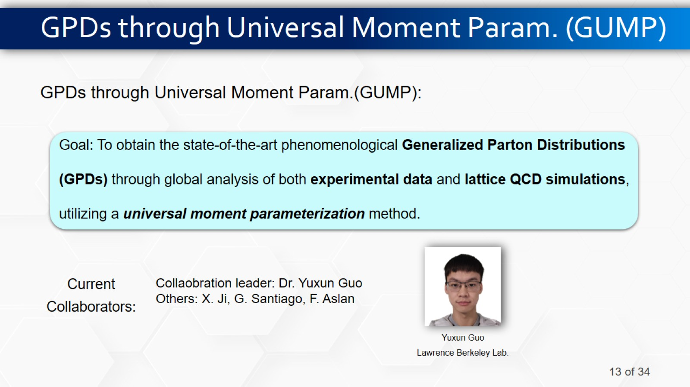
GPDs through Universal Moment Param. (GUMP)

Slide 14
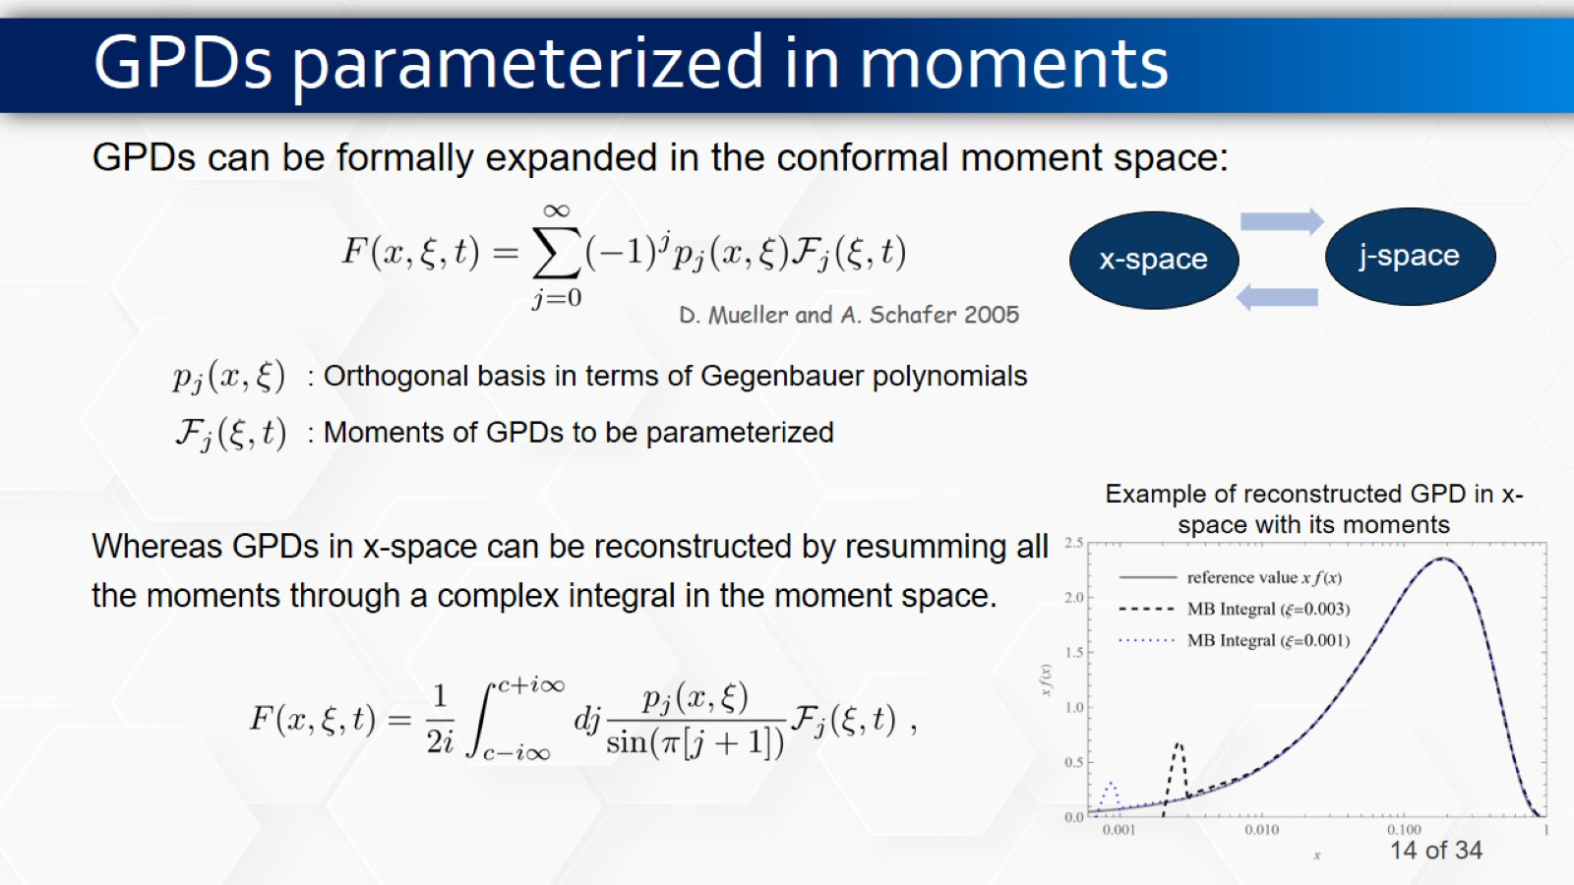
GPDs parameterized in moments

Slide 15
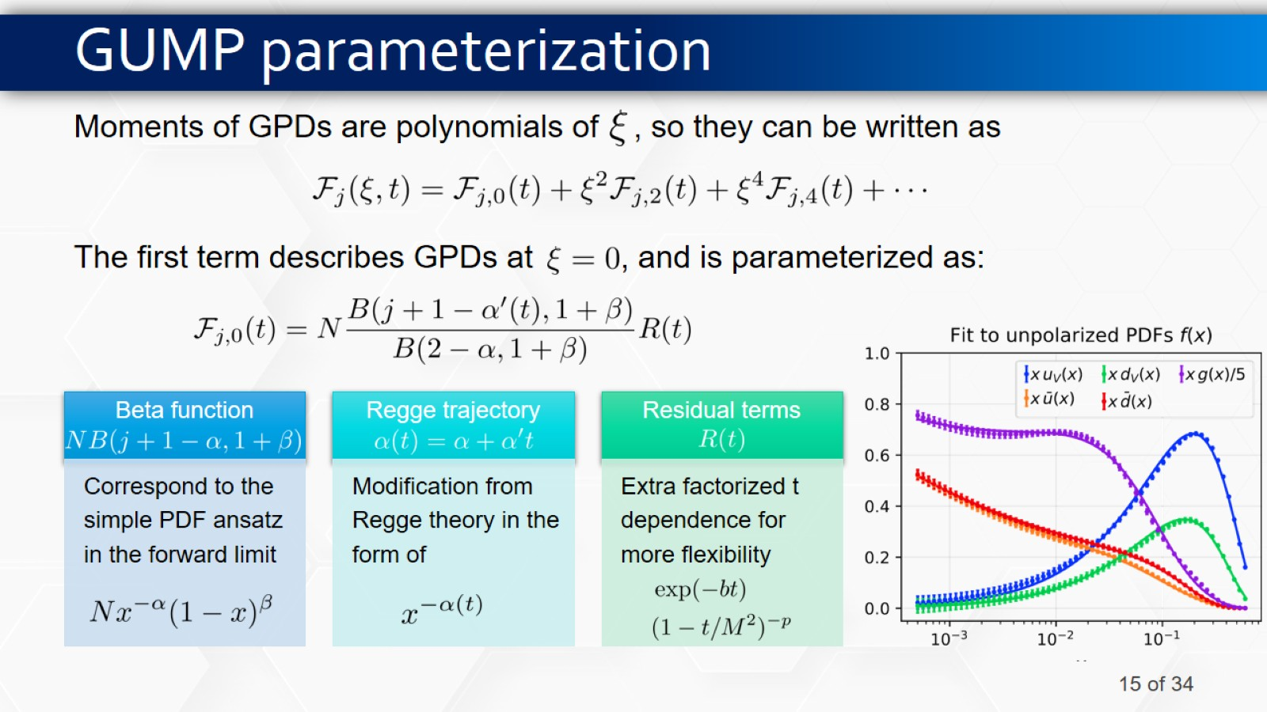
GUMP parameterization

Slide 16
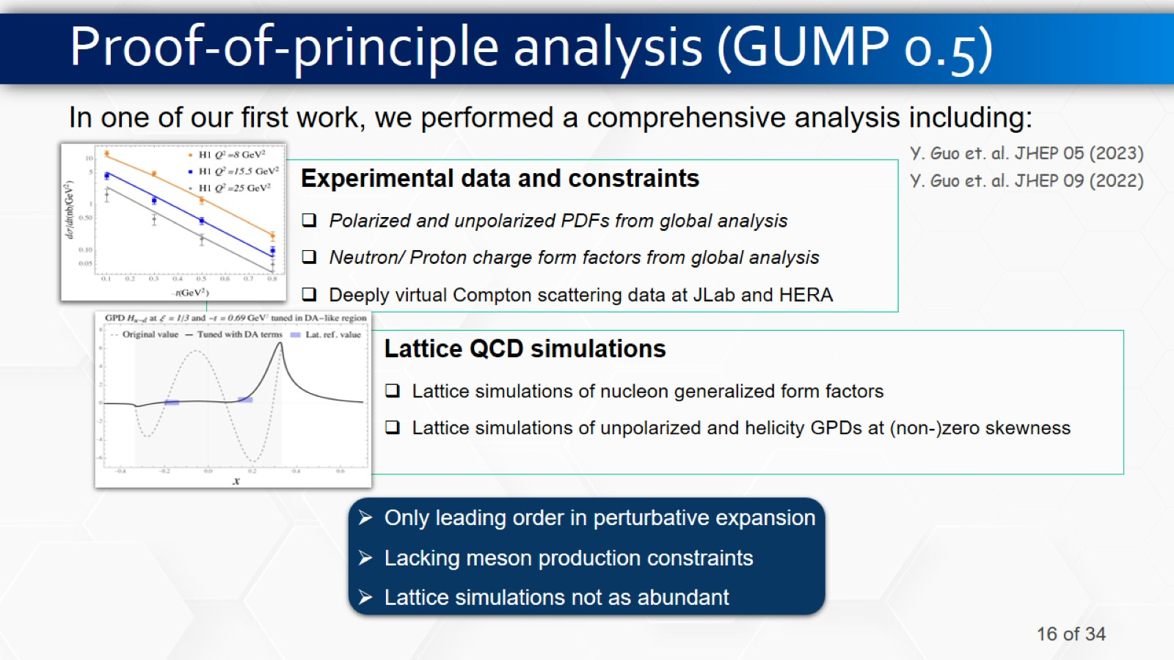
Proof-of-principle analysis (GUMP 0.5)

Slide 17
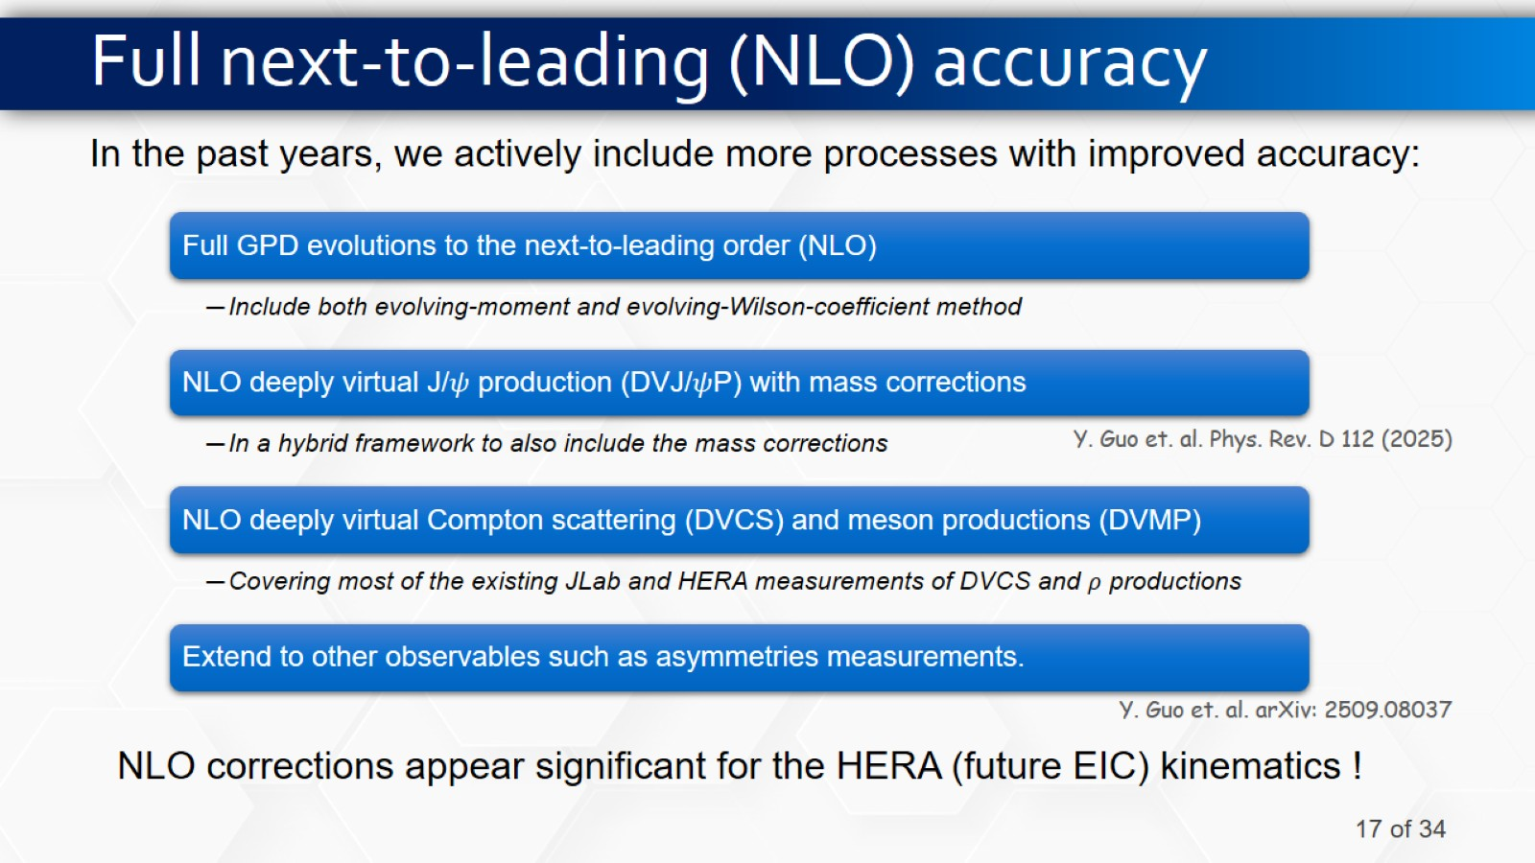
Full next-to-leading (NLO) accuracy

Slide 18
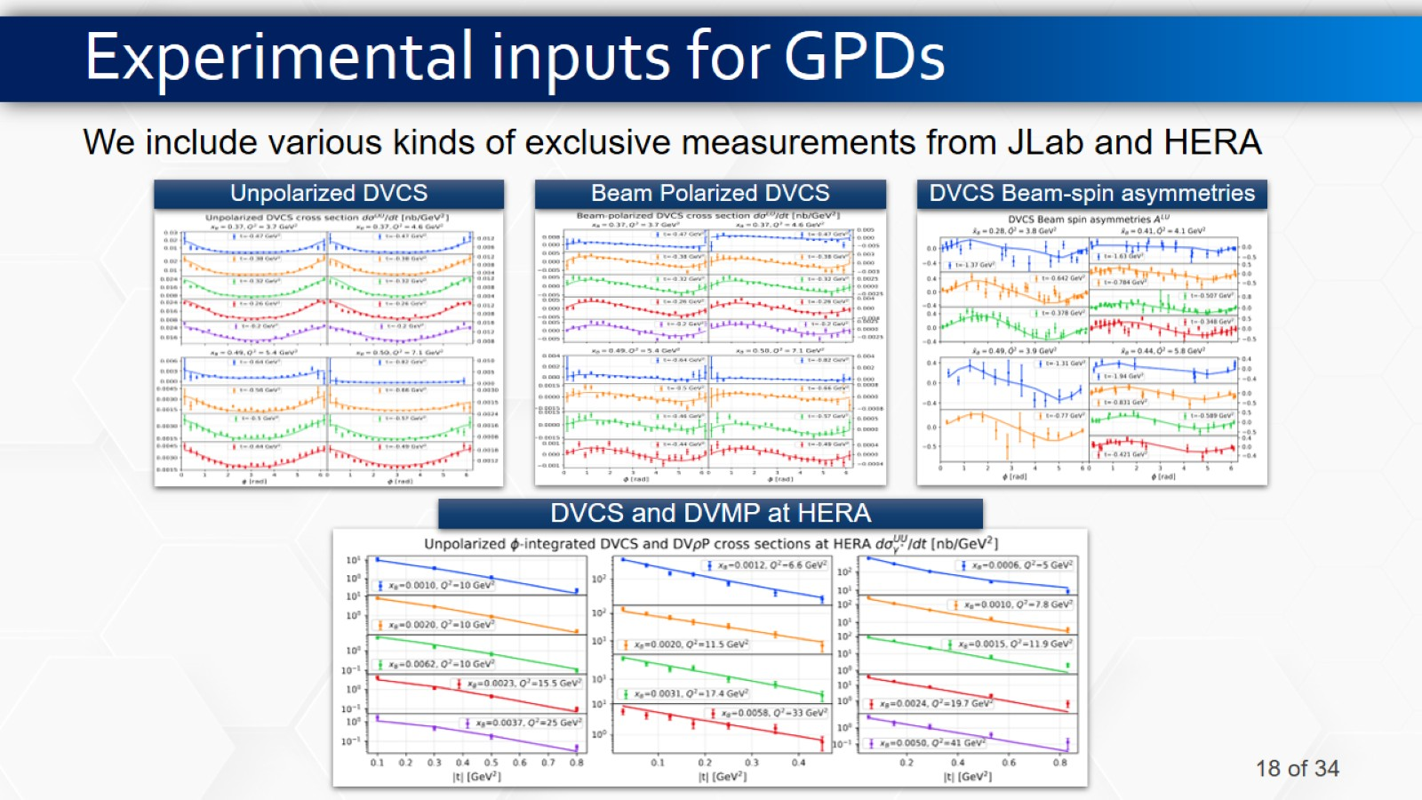
Experimental inputs for GPDs

Slide 19
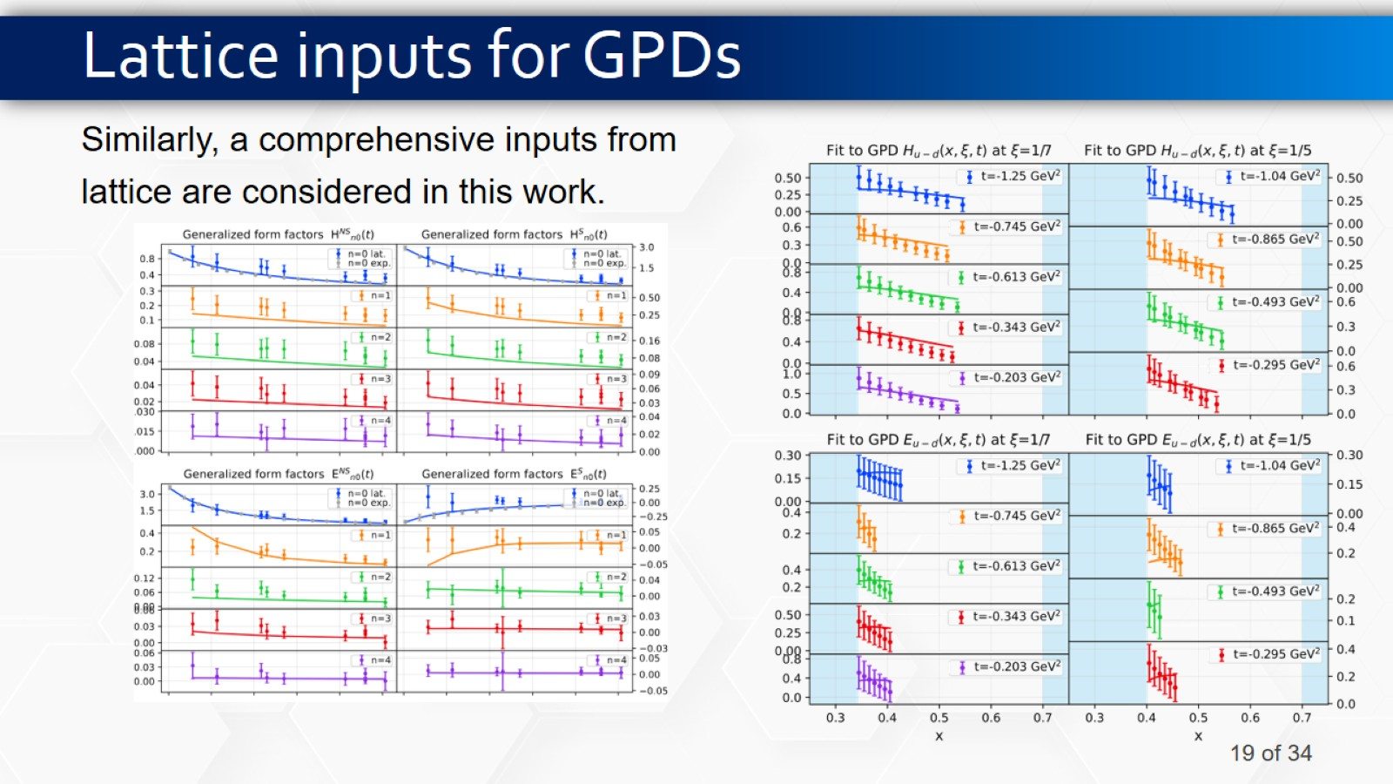
Lattice inputs for GPDs

Slide 20
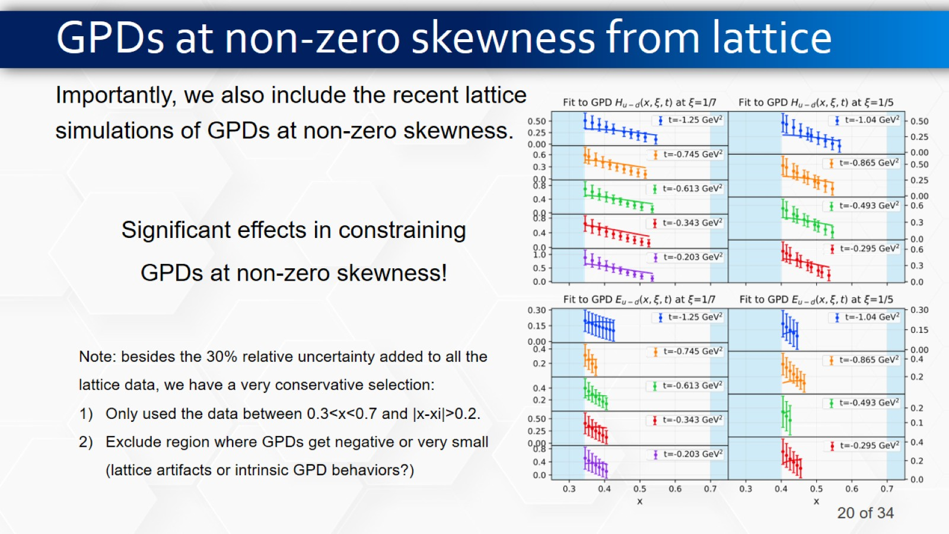
GPDs at non-zero skewness from lattice

Slide 21
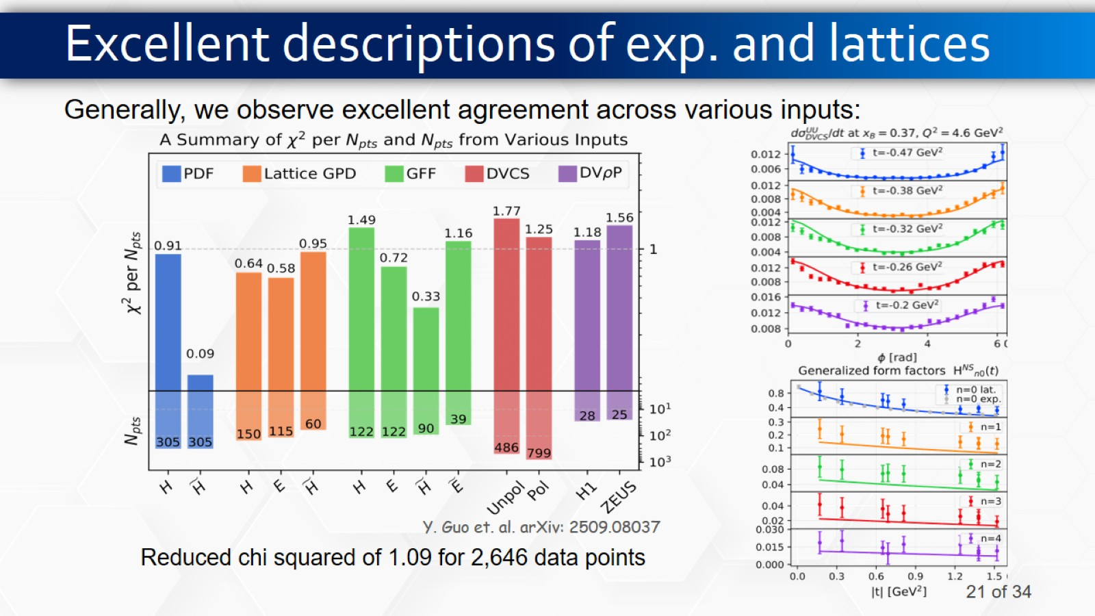
Excellent descriptions of exp. and lattices

Slide 22
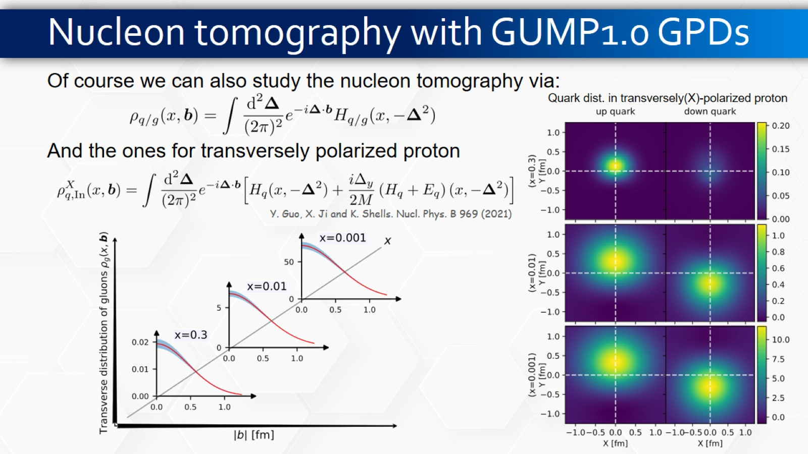
Nucleon tomography with GUMP1.0 GPDs

Slide 23
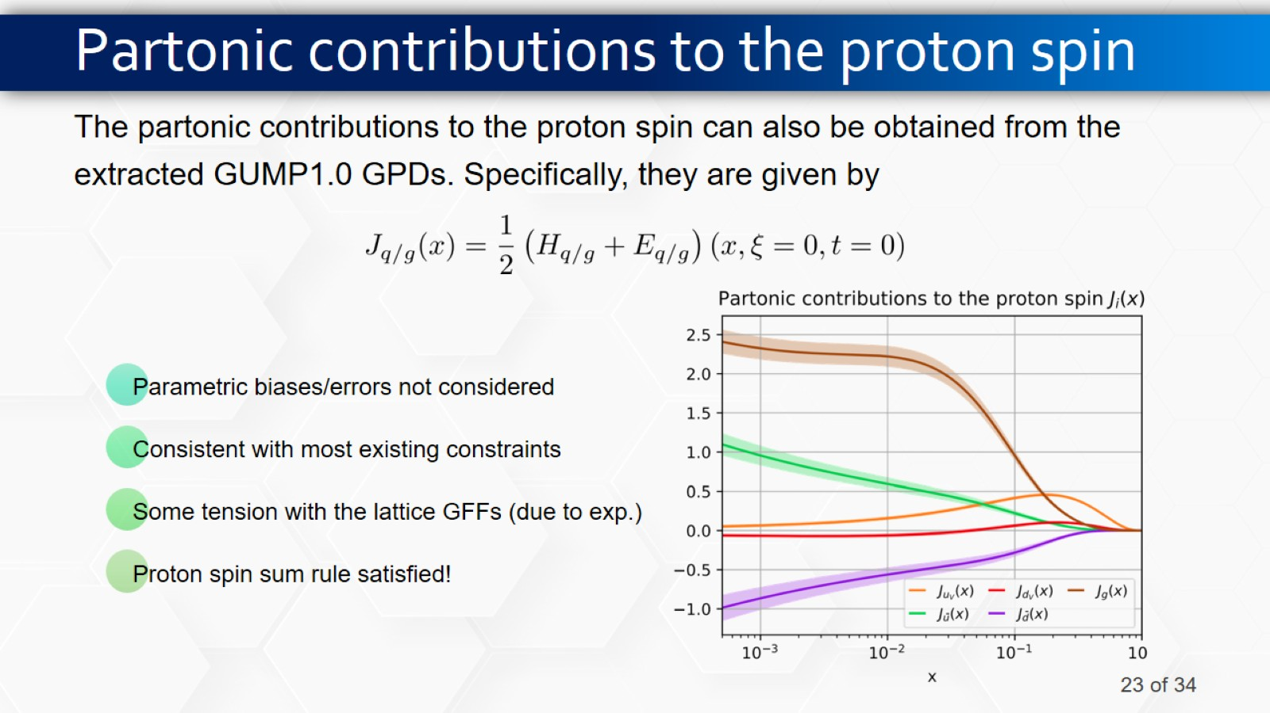
Partonic contributions to the proton spin

Slide 24
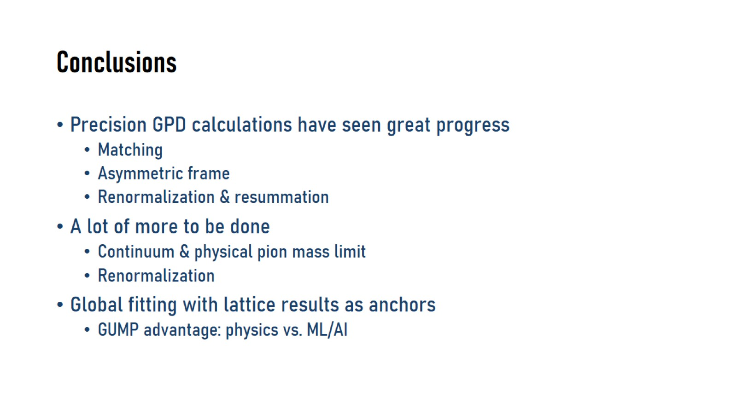
Conclusions

