Slide 1
Short distance asymptotics through OPE with condensates: several examples
Yizhuang Liu, UJ
LaMET 2025

Slide 2
Outline
Part I: Various examples of short distance asymptotics with operator condensates.

Slide 3
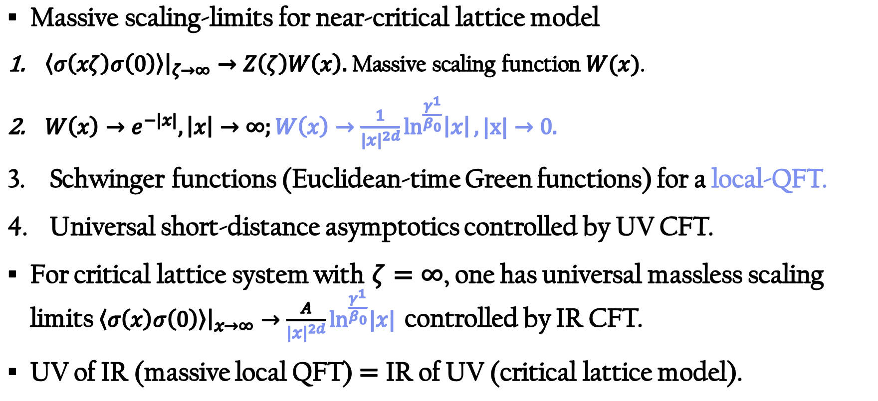
UV/IR fixed-point and local QFT
Massive scaling-limits for near-critical lattice model
$\left\langle σ\left(xζ\right)σ\left(0\right)\right\rangle {\left.​\right|}_{ζ→∞}→Z\left(ζ\right)W\left(x\right).$Massive scaling function $W(x)$.
$W\left(x\right)→e^{−|x|},\left|x\right|→∞;W\left(x\right)→\frac{1}{{\left|x\right|}^{2d}}\ln^{\frac{γ^{1}}{β_{0}}}\left|x\right|,|x|→0.$
Schwinger functions (Euclidean-time Green functions) for a local-QFT.
Universal short-distance asymptotics controlled by UV CFT.
For critical lattice system with $ζ=∞$, one has universal massless scaling limits $\left\langle σ\left(x\right)σ\left(0\right)\right\rangle {\left.​\right|}_{x→∞}→\frac{A}{{\left|x\right|}^{2d}}\ln^{\frac{γ^{1}}{β_{0}}}|x|{ }$controlled by IR CFT.
UV of IR (massive local QFT)$=$ IR of UV (critical lattice model).

Slide 4
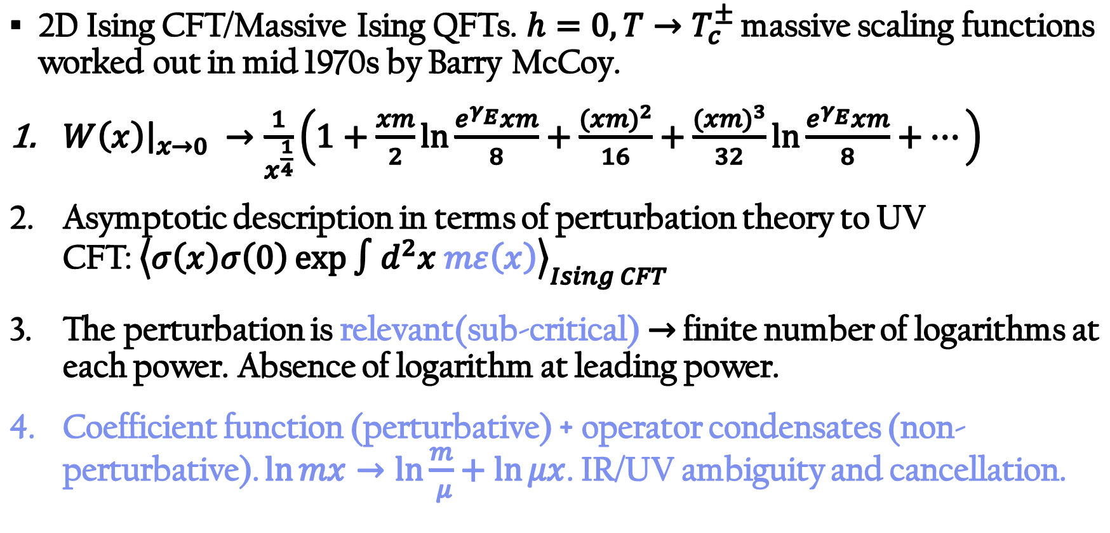
Condenstates in super-renormalizable QFT
2D Ising CFT/Massive Ising QFTs. $h=0,T→T_{c}^{±}$ massive scaling functions worked out in mid 1970s by Barry McCoy.
$W\left(x\right){\left.​\right|}_{x→0} →\frac{1}{x^{\frac{1}{4}}}\left(1+\frac{xm}{2}\ln{\frac{e^{γ_{E}}xm}{8}}+\frac{{(xm)}^{2}}{16}+\frac{({xm)}^{3}}{32}\ln{\frac{e^{γ_{E}}xm}{8}}+…\right)$
Asymptotic description in terms of perturbation theory to UV CFT:${\left\langle σ\left(x\right)σ\left(0\right)\exp{∫d^{2}x mε\left(x\right)}\right\rangle }_{Ising CFT}$.
The perturbation is relevant(sub-critical)$→$ finite number of logarithms at each power. Absence of logarithm at leading power.
Coefficient function (perturbative) + operator condensates (non-perturbative). $\ln{mx→\ln{\frac{m}{ μ}+\ln{μx}}}$. IR/UV ambiguity and cancellation.

Slide 5
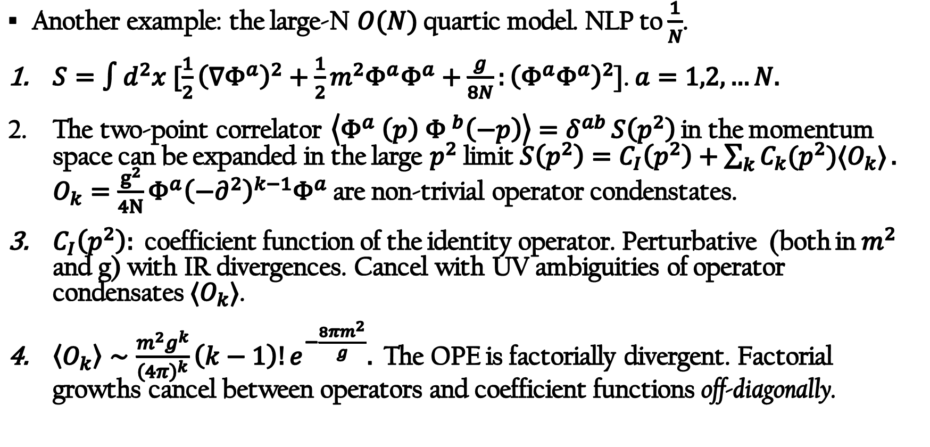
Short distance asymptotics of super-renormalizable QFT: divergence of OPE (Liu 2025)
Another example: the large-N $O(N)$ quartic model. NLP to $\frac{1}{N}$.
$S=∫d^{2}x [\frac{1}{2}{\left(∇Φ^{a}\right)}^{2}+\frac{1}{2}m^{2}Φ^{a}Φ^{a}+\frac{g}{8N}:{\left(Φ^{a}Φ^{a}\right)}^{2}$]. $a=1,2,…N.$
The two-point correlator $\left\langle Φ^{a}{ \left(p\right) Φ }^{b}\left(−p\right)\right\rangle =δ^{ab }S\left(p^{2}\right)$ in the momentum space can be expanded in the large $p^{2}$ limit$S\left(p^{2}\right)=C_{I}\left(p^{2}\right)+\sum_{k}{C_{k}(p^{2})⟨O_{k}⟩}.$ $O_{k}={\frac{g^{2}}{4N}Φ}^{a}{\left(−∂^{2}\right)}^{k−1}Φ^{a}$ are non-trivial operator condenstates.
$C_{I}\left(p^{2}\right):$ coefficient function of the identity operator. Perturbative (both in$m^{2}$ and g) with IR divergences. Cancel with UV ambiguities of operator condensates$⟨O_{k}⟩$.
$\left\langle O_{k}\right\rangle ∼\frac{m^{2}g^{k}}{{\left(4π\right)}^{k}}\left(k−1\right)!e^{−\frac{8πm^{2}}{g}}.$ The OPE is factorially divergent. Factorial growths cancel between operators and coefficient functions off-diagonally.

Slide 6
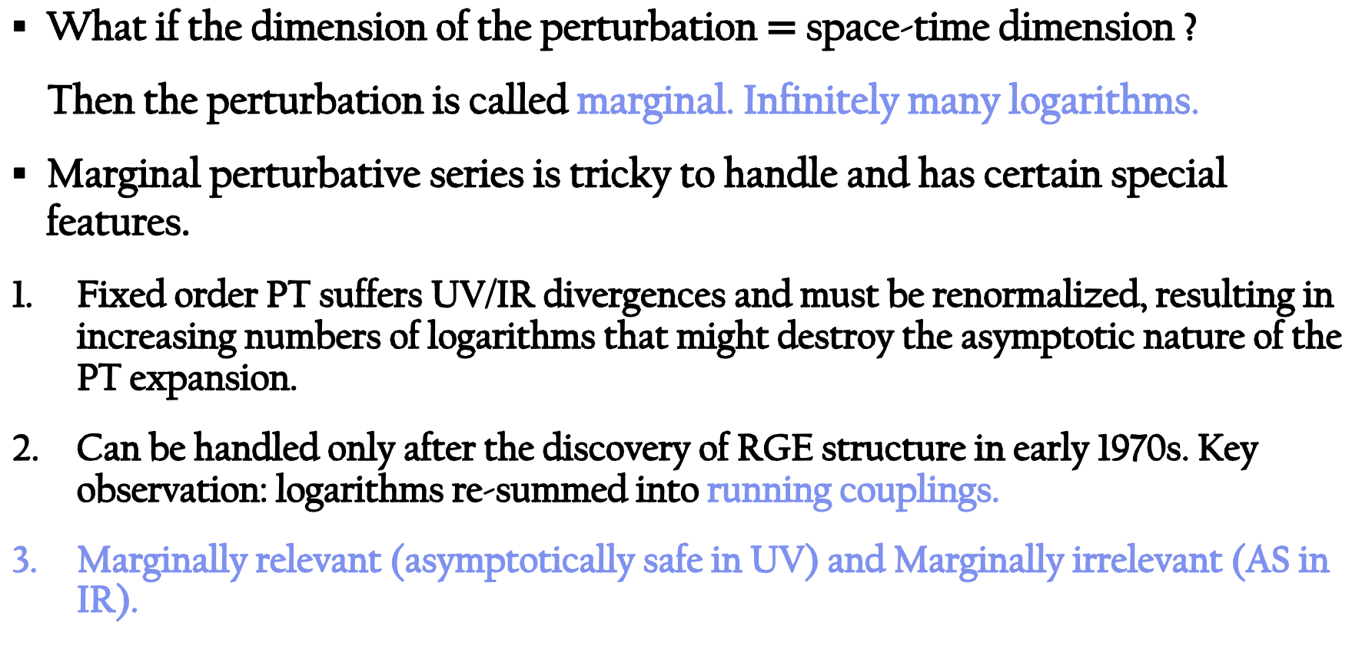
Marginal short distance asymptotics
What if the dimension of the perturbation $=$ space-time dimension ?
Then the perturbation is called marginal. Infinitely many logarithms.
Marginal perturbative series is tricky to handle and has certain special features.
Fixed order PT suffers UV/IR divergences and must be renormalized, resulting in increasing numbers of logarithms that might destroy the asymptotic nature of the PT expansion.
Can be handled only after the discovery of RGE structure in early 1970s. Key observation: logarithms re-summed into running couplings.
Marginally relevant (asymptotically safe in UV) and Marginally irrelevant (AS in IR).

Slide 7
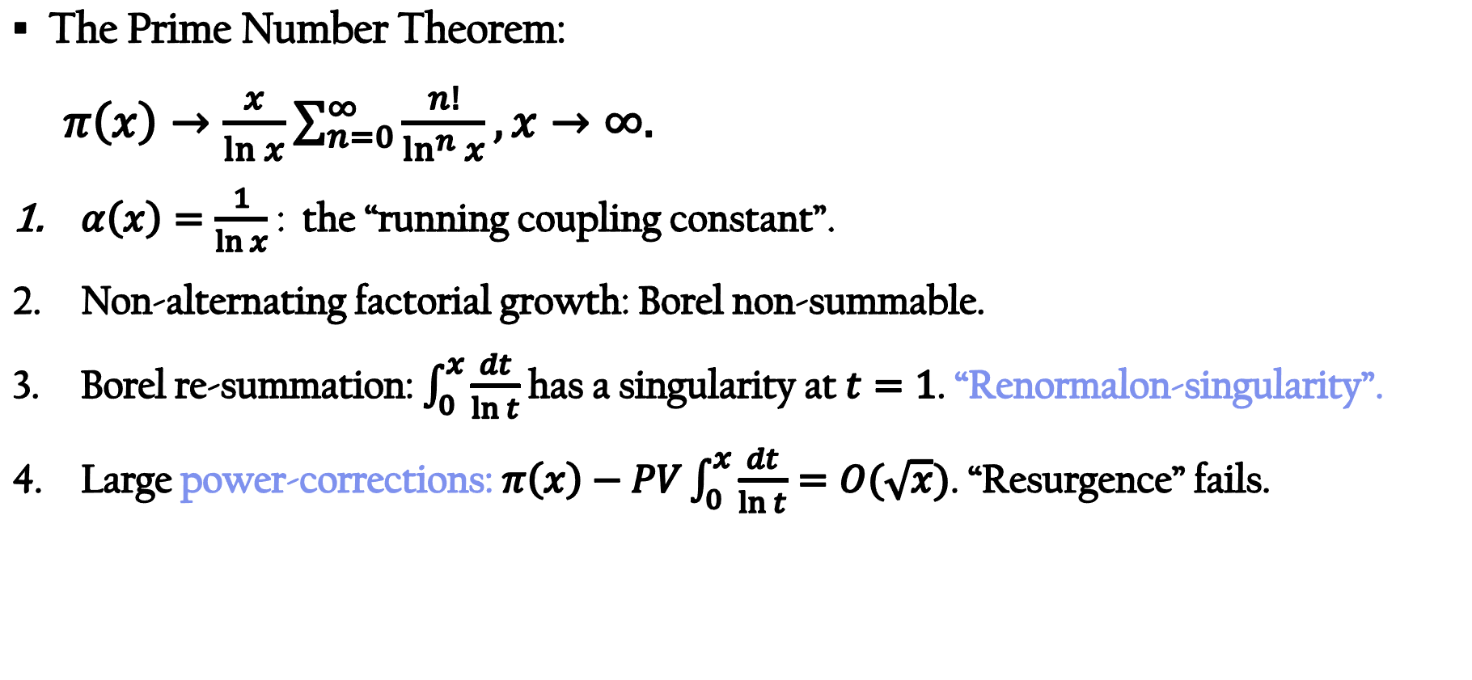
Marginal PT: A simple example
The Prime Number Theorem:
$π\left(x\right)→\frac{x}{\ln{x}}\sum_{n=0}^{∞}{\frac{n!}{\ln^{n}{x}}},x→∞.$
$α\left(x\right)=\frac{1}{\ln{x}}$ : the “running coupling constant”.
Non-alternating factorial growth: Borel non-summable.
Borel re-summation: $\int_{0}^{x}{\frac{dt}{\ln{t}}}$ has a singularity at $t=1$. “Renormalon-singularity”.
Large power-corrections: $π\left(x\right)−PV\int_{0}^{x}{\frac{dt}{\ln{t}}}=O(\sqrt{x})$. “Resurgence” fails.

Slide 8
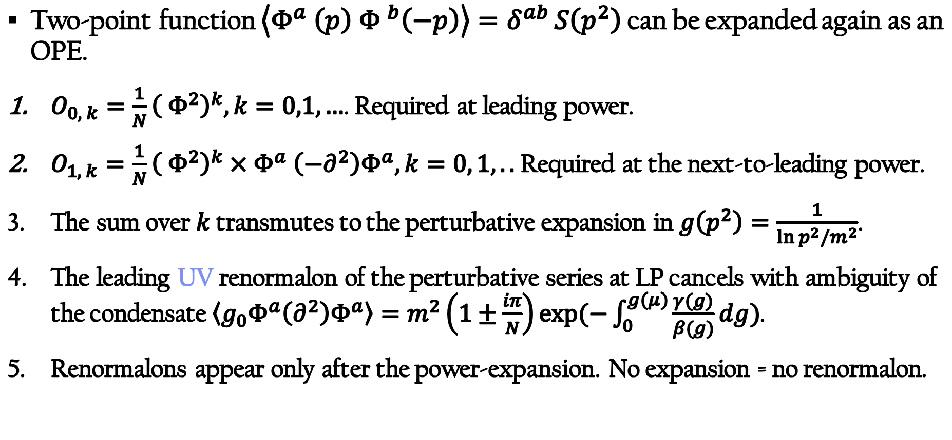
Marginal short distance limit: O(N) NLSM
Two-point function $\left\langle Φ^{a}{ \left(p\right) Φ }^{b}\left(−p\right)\right\rangle =δ^{ab }S\left(p^{2}\right)$ can be expanded again as an OPE.
$O_{0, k}=\frac{1}{N}{\left( Φ^{2}\right)}^{k}, k=0,1,…$. Required at leading power.
$O_{1, k}=$ $\frac{1}{N}{\left( Φ^{2}\right)}^{k}{×Φ}^{a}\left(−∂^{2}\right)Φ^{a}, k=0, 1,..$ Required at the next-to-leading power.
The sum over $k$ transmutes to the perturbative expansion in $g\left(p^{2}\right)=\frac{1}{\ln{p^{2}/m^{2}}}$.
The leading UV renormalon of the perturbative series at LP cancels with ambiguity of the condensate$\left\langle g_{0}Φ^{a}\left(∂^{2}\right)Φ^{a}\right\rangle =m^{2}\left(1±\frac{iπ}{N}\right)\exp{(−\int_{0}^{g(μ)}{\frac{γ(g)}{β(g)}dg})}$.
Renormalons appear only after the power-expansion. No expansion = no renormalon.

Slide 9
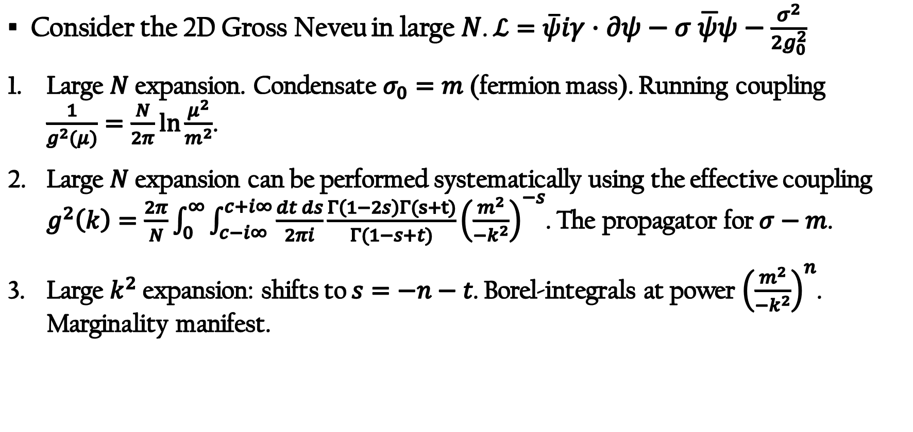
A space-like structure function in 2D Gross-Neveu
Consider the 2D Gross Neveu in large $N$. $ℒ=\overline{ψ}iγ⋅∂ψ−σ \overline{ψ}ψ−\frac{σ^{2}}{2g_{0}^{2}}$
Large $N$ expansion. Condensate $σ_{0}=m$ (fermion mass). Running coupling $\frac{1}{g^{2}(μ)}=\frac{N}{2π}\ln{\frac{μ^{2}}{m^{2}}}$.
Large $N$ expansion can be performed systematically using the effective coupling $g^{2}\left(k\right)=\frac{2π}{N}\int_{0}^{∞}{\int_{c−i∞ }^{c+i∞}{\frac{dt ds}{2πi}\frac{Γ\left(1−2s\right)Γ(s+t)}{Γ(1−s+t)}}}{\left(\frac{m^{2}}{−k^{2}}\right)}^{−s}$. The propagator for $σ−m$.
Large $k^{2}$ expansion: shifts to $s=−n−t$. Borel-integrals at power ${\left(\frac{m^{2}}{{−k}^{2}}\right)}^{n}$. Marginality manifest.

Slide 10
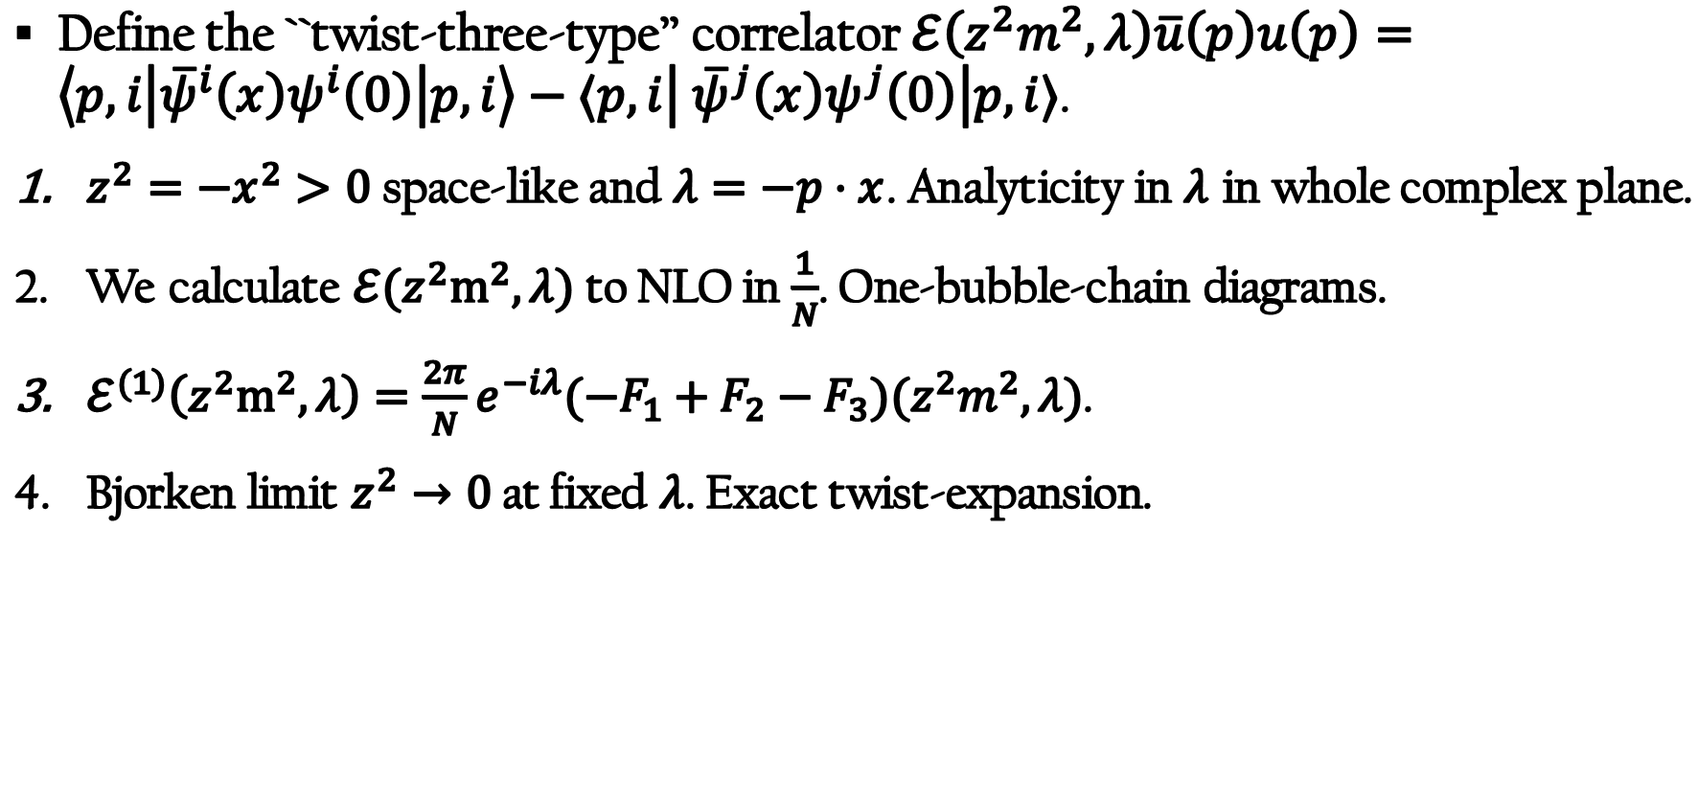
Space-like structure function
Define the ``twist-three-type’’ correlator $ℰ\left(z^{2}m^{2},λ\right)\overline{u}\left(p\right)u\left(p\right)=\left\langle p,i\left|{\overline{ψ}}^{i}\left(x\right)ψ^{i}\left(0\right)\right|p,i\right\rangle −⟨p,i\left| {\overline{ψ}}^{j}\left(x\right)ψ^{j}\left(0\right)\right|p,i⟩$.
$z^{2}=−x^{2}>0$ space-like and $λ=−p⋅x$. Analyticity in $λ$ in whole complex plane.
We calculate $ℰ(z^{2}m^{2},λ)$ to NLO in $\frac{1}{N}$. One-bubble-chain diagrams.
$ℰ^{(1)}\left(z^{2}m^{2},λ\right)=\frac{2π}{N}e^{−iλ}(−F_{1}+F_{2}−F_{3})(z^{2}m^{2},λ)$.
Bjorken limit $z^{2}→0$ at fixed $λ$. Exact twist-expansion.

Slide 11
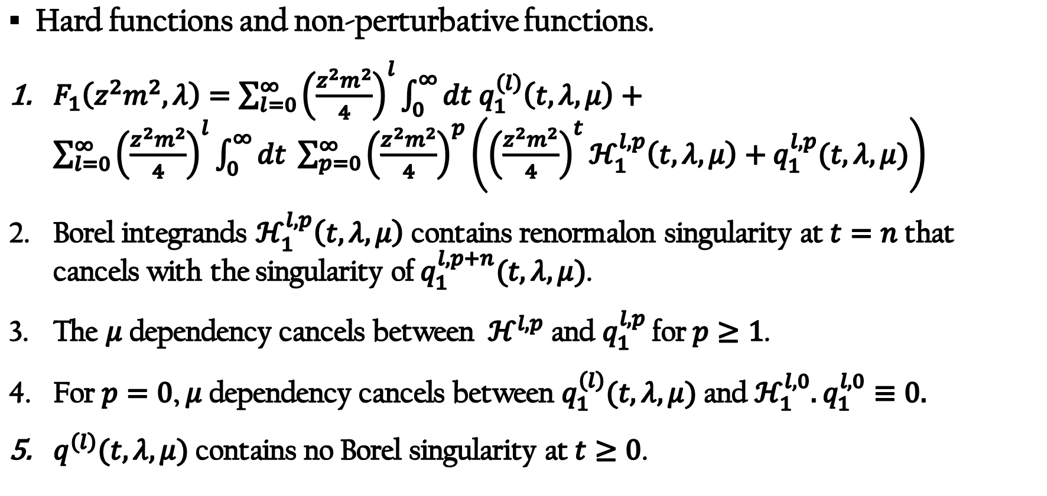
Twist-expansion.
Hard functions and non-perturbative functions.
$F_{1}\left(z^{2}m^{2},λ\right)=\sum_{l=0}^{∞}{{\left(\frac{z^{2}m^{2}}{4}\right)}^{l}}\int_{0}^{∞}{dt q_{1}^{\left(l\right)}\left(t,λ,μ\right)}+\sum_{l=0}^{∞}{{\left(\frac{z^{2}m^{2}}{4}\right)}^{l}{\int_{0}^{∞}{dt \sum_{p=0}^{∞}{\left(\frac{z^{2}m^{2}}{4}\right)}}}^{p}\left({\left(\frac{z^{2}m^{2}}{4}\right)}^{t}ℋ_{1}^{l,p}\left(t,λ,μ\right)+q_{1}^{l,p}(t,λ,μ)\right)}$
Borel integrands $ℋ_{1}^{l,p}\left(t,λ,μ\right)$ contains renormalon singularity at $t=n$ that cancels with the singularity of $q_{1}^{l,p+n}(t,λ,μ)$.
The $μ$ dependency cancels between $ℋ^{l,p}$ and $q_{1}^{l,p}$ for $p≥1$.
For $p=0$, $μ$ dependency cancels between $q_{1}^{\left(l\right)}(t,λ,μ)$ and $ℋ_{1}^{l,0}.$ $q_{1}^{l,0}≡0.$
$q^{\left(l\right)}(t,λ,μ)$ contains no Borel singularity at $t≥0$.

Slide 12
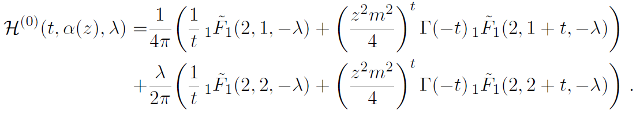
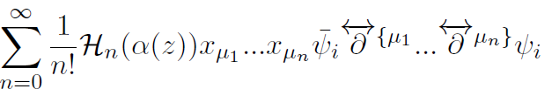

Operator content at LP
Operator content. There are four quark operator even at LP.
The ``Hard function’’ at LP reads
The first-line: explained by the operators
Second line: explained by the four-quark operators

Slide 13
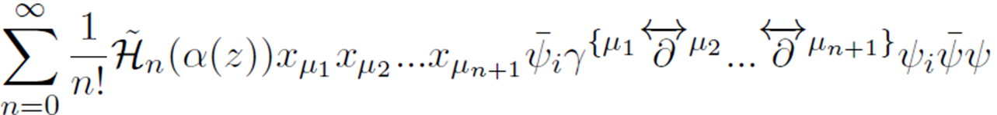
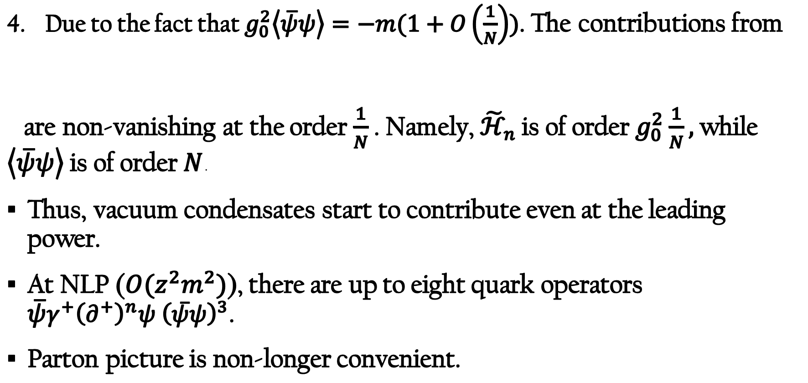
Operator content at LP : condensate contributes
Due to the fact that $g_{0}^{2}\left\langle \overline{ψ}ψ\right\rangle =−m(1+O\left(\frac{1}{N}\right))$. The contributions from
are non-vanishing at the order $\frac{1}{N}$ . Namely, ${\tilde{ℋ}}_{n}$ is of order $g_{0}^{2}\frac{1}{N},$while $\left\langle \overline{ψ}ψ\right\rangle$ is of order $N$.
Thus, vacuum condensates start to contribute even at the leading power.
At NLP ($O(z^{2}m^{2})$), there are up to eight quark operators $\overline{ψ}γ^{+}{\left(∂^{+}\right)}^{n}ψ {\left(\overline{ψ}ψ\right)}^{3}$.
Parton picture is non-longer convenient.

Slide 14
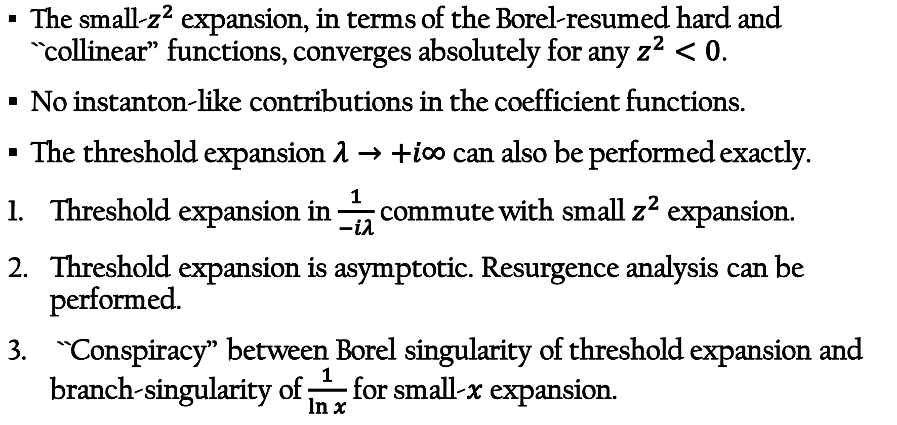
Twist-expansion and threshold expansion
The small-$z^{2}$ expansion, in terms of the Borel-resumed hard and ``collinear’’ functions, converges absolutely for any $z^{2}<0$.
No instanton-like contributions in the coefficient functions.
The threshold expansion $λ→+i∞$ can also be performed exactly.
Threshold expansion in $\frac{1}{−iλ}$ commute with small $z^{2}$ expansion.
Threshold expansion is asymptotic. Resurgence analysis can be performed.
``Conspiracy’’ between Borel singularity of threshold expansion and branch-singularity of $\frac{1}{\ln{x}}$ for small-$x$ expansion.

Slide 15
Conclusion
UV fixed points of local QFTs.
Operator condensates appear even in short distance expansion of super-renormalizable QFTs. UV/IR ambiguities cancellation.
Divergence of power-expansion in a super-renormalizable quartic model. The power of logarithms.
OPE in 2D large-N NLSM. Summation over infinitely many scaleless condensates. Ambiguity of the trace-anomaly condensate cancels with an UV renormalon.
Small-distance expansion of a twist-three type correlator in 2D large-N Gross-Neveu. Vacuum condensates contribute even at LP.

