Slide 1
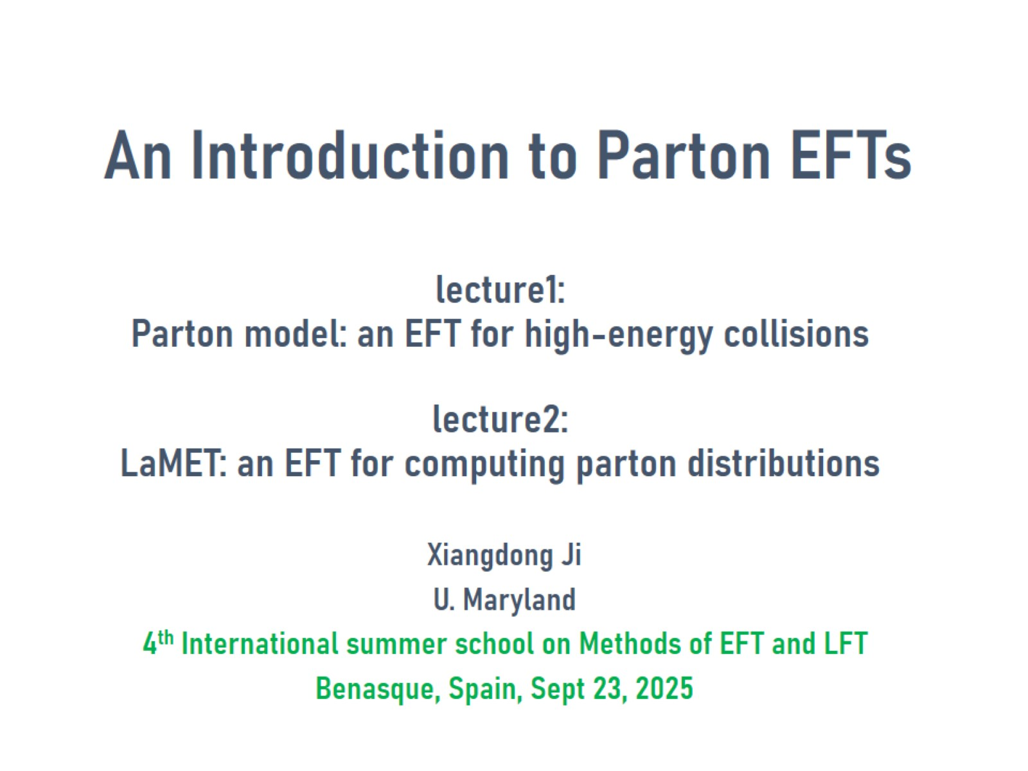
An Introduction to Parton EFTs lecture1: Parton model: an EFT for high-energy collisions lecture2: LaMET: an EFT for computing parton distributions

Slide 2
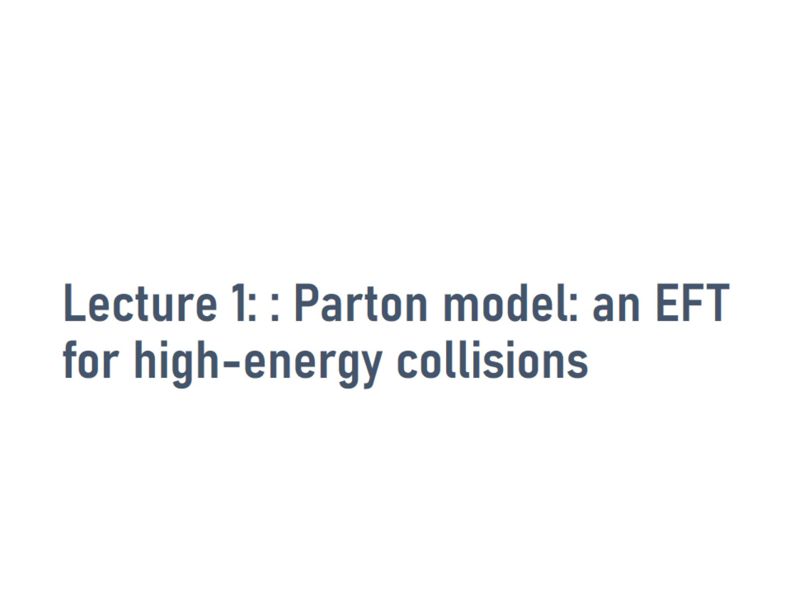
Lecture 1: : Parton model: an EFT for high-energy collisions

Slide 3
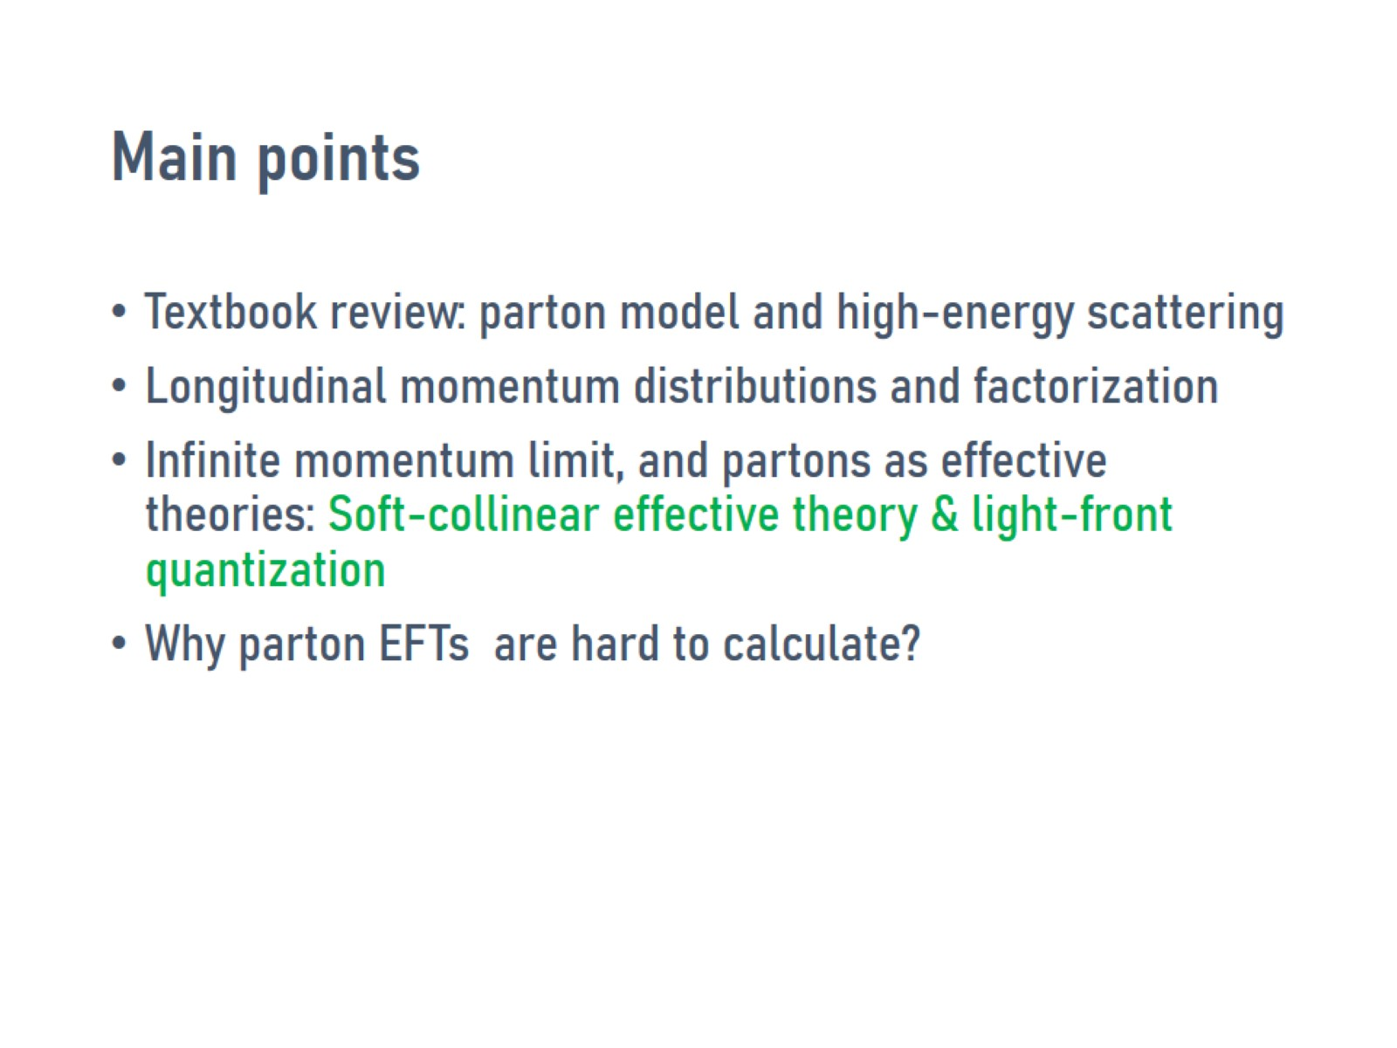
Main points

Slide 4
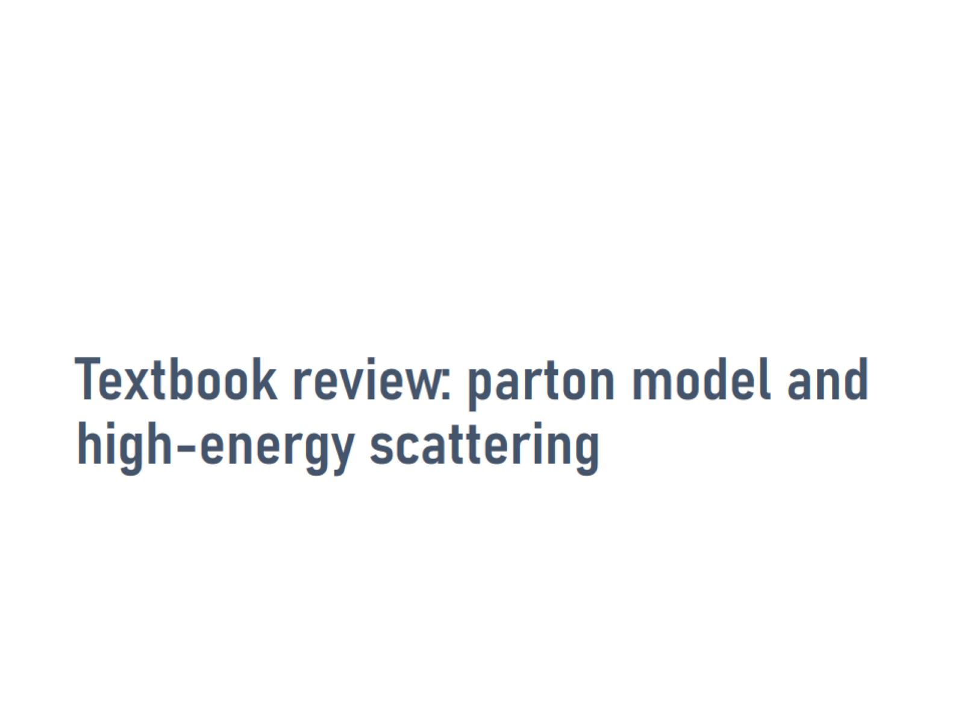
Textbook review: parton model and high-energy scattering

Slide 5
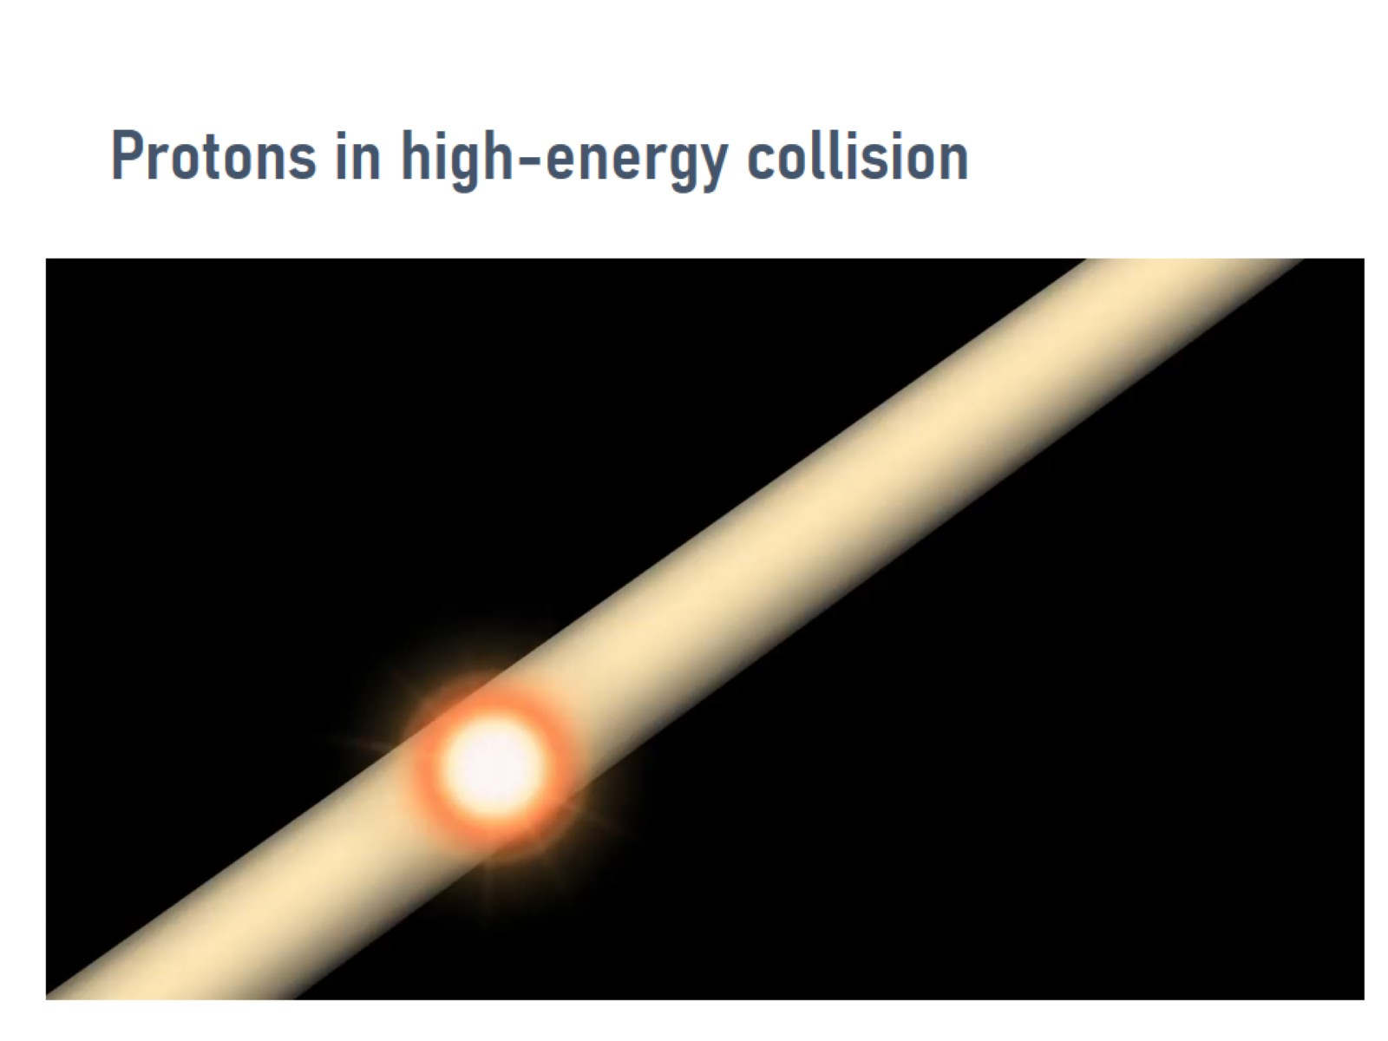
Protons in high-energy collision

Slide 6
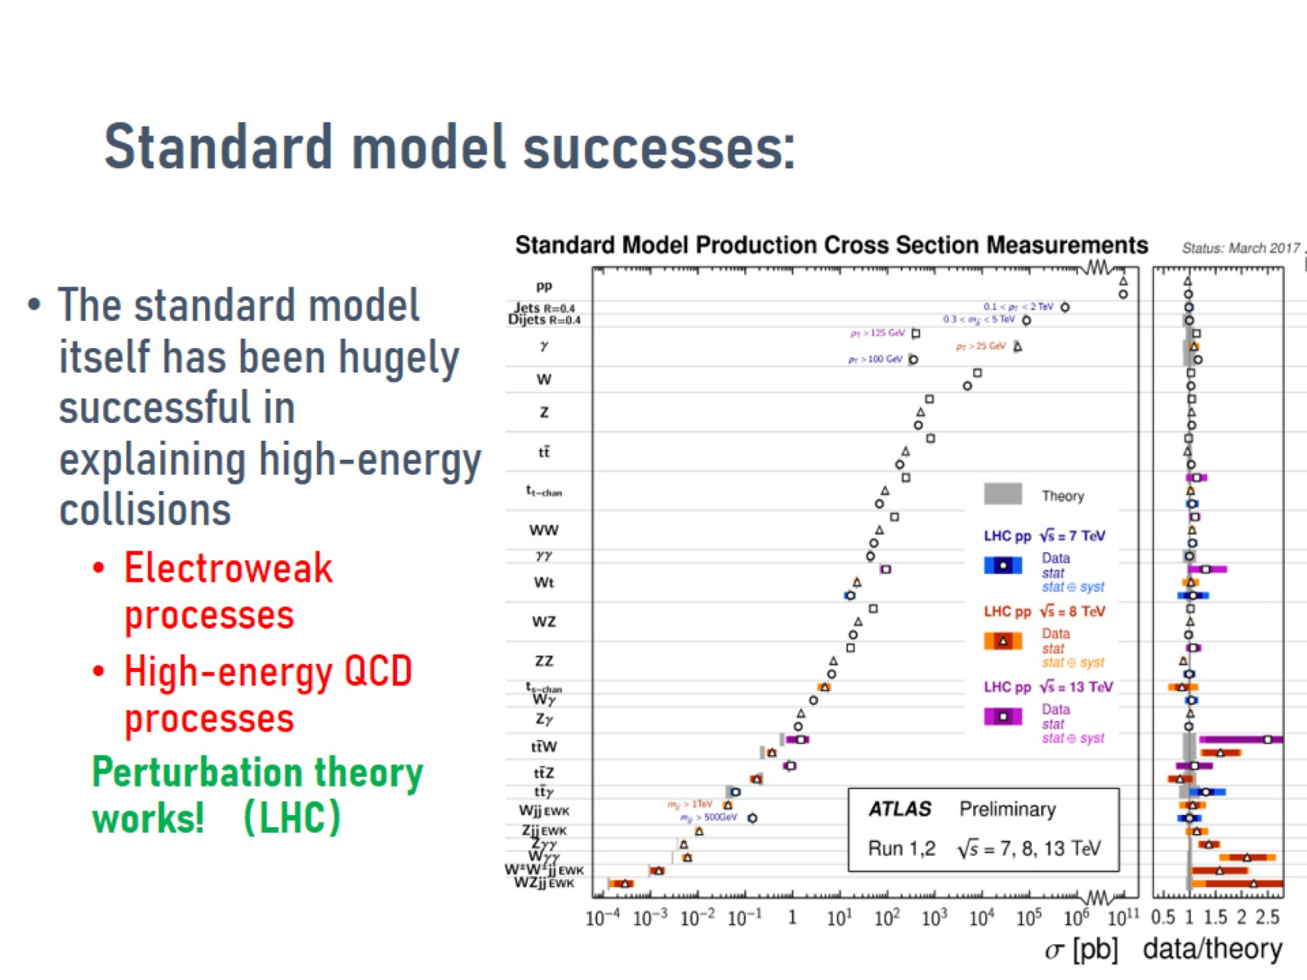
Standard model successes:

Slide 7
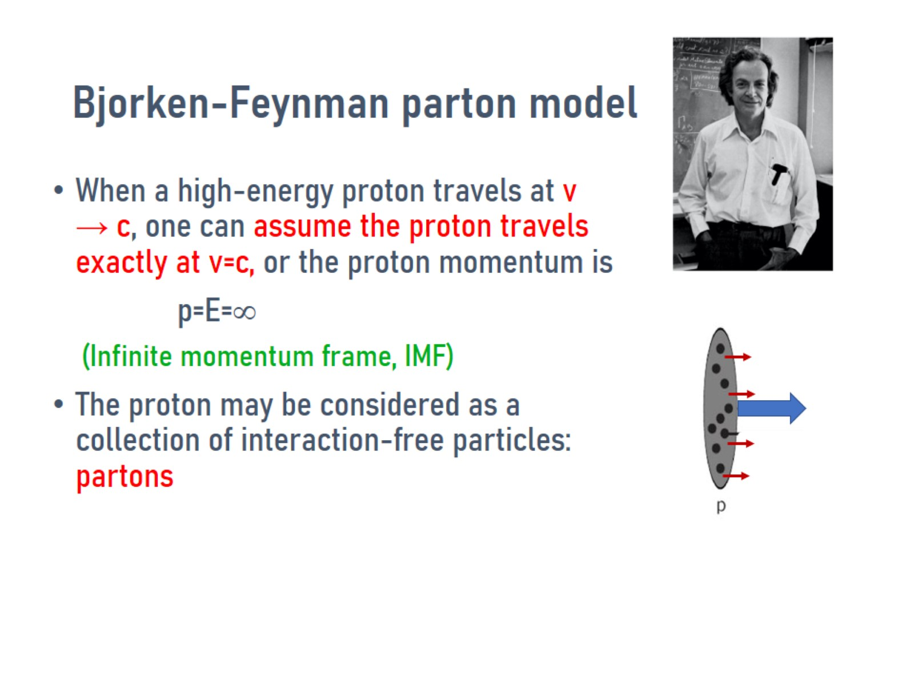
Bjorken-Feynman parton model

Slide 8
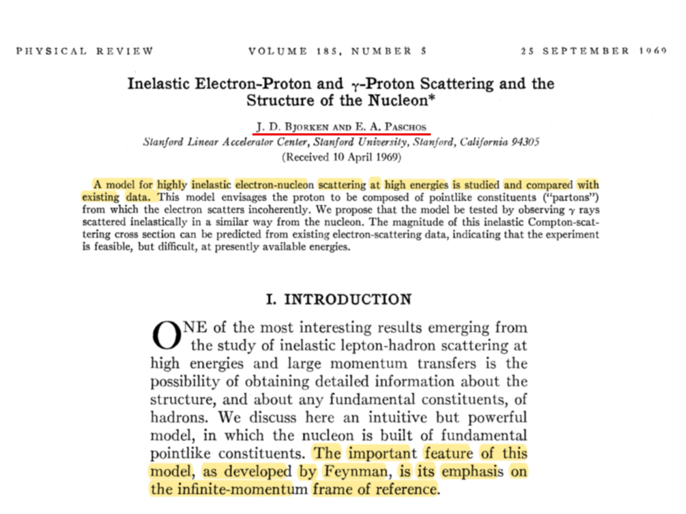

Slide 9
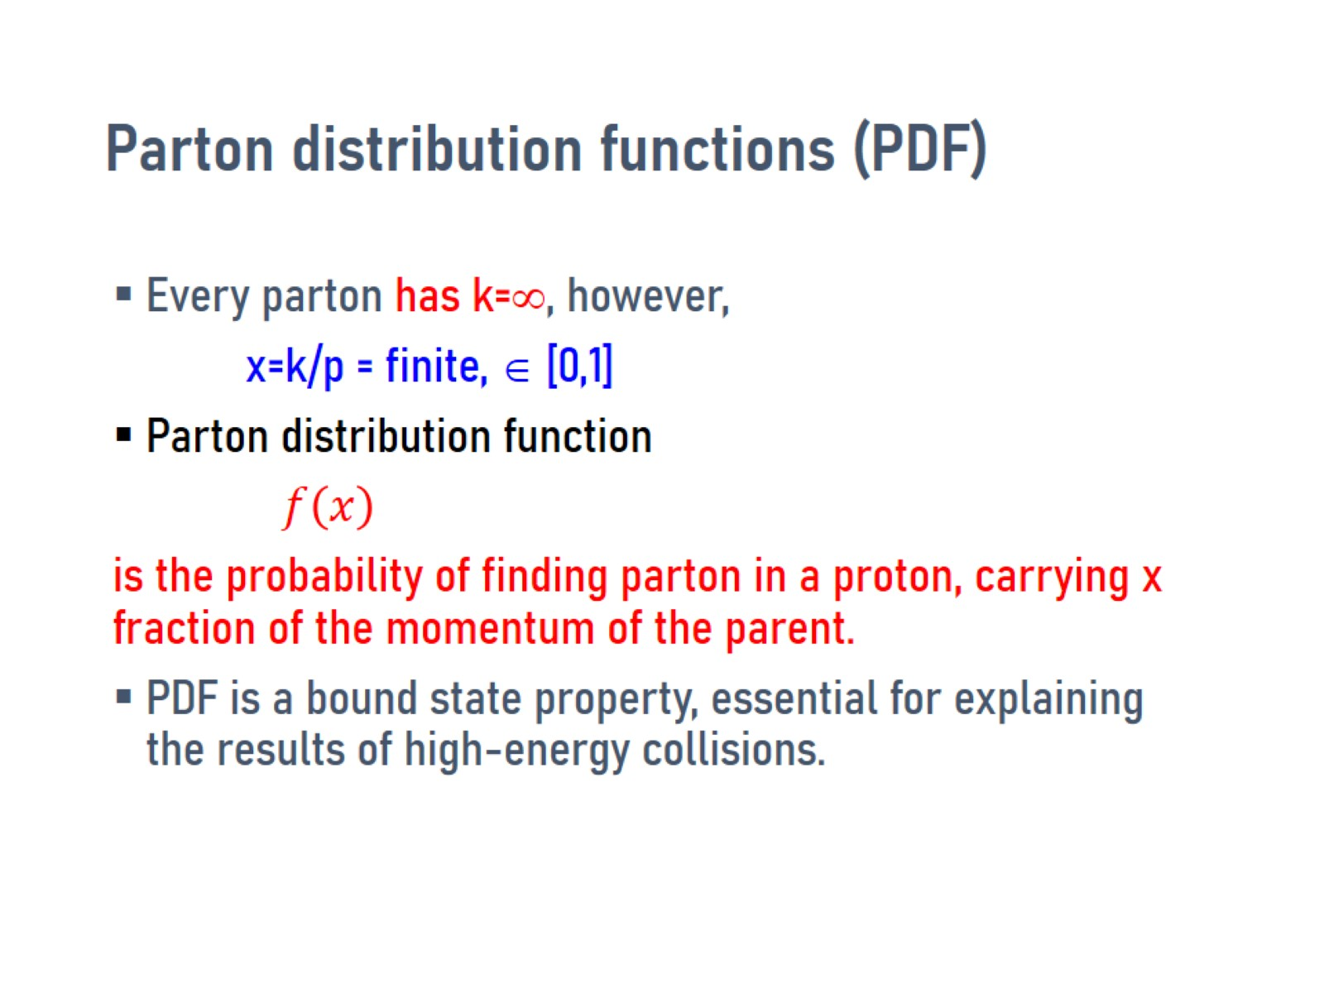
Parton distribution functions (PDF)

Slide 10
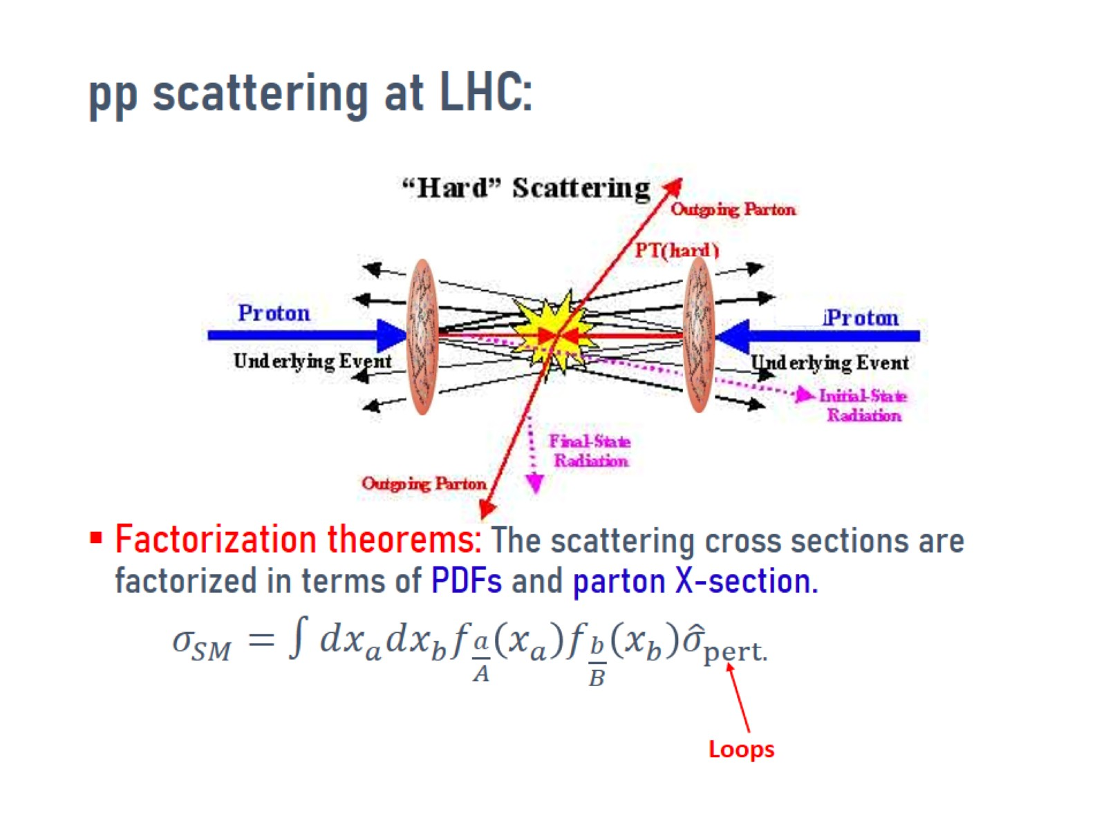
pp scattering at LHC:

Slide 11
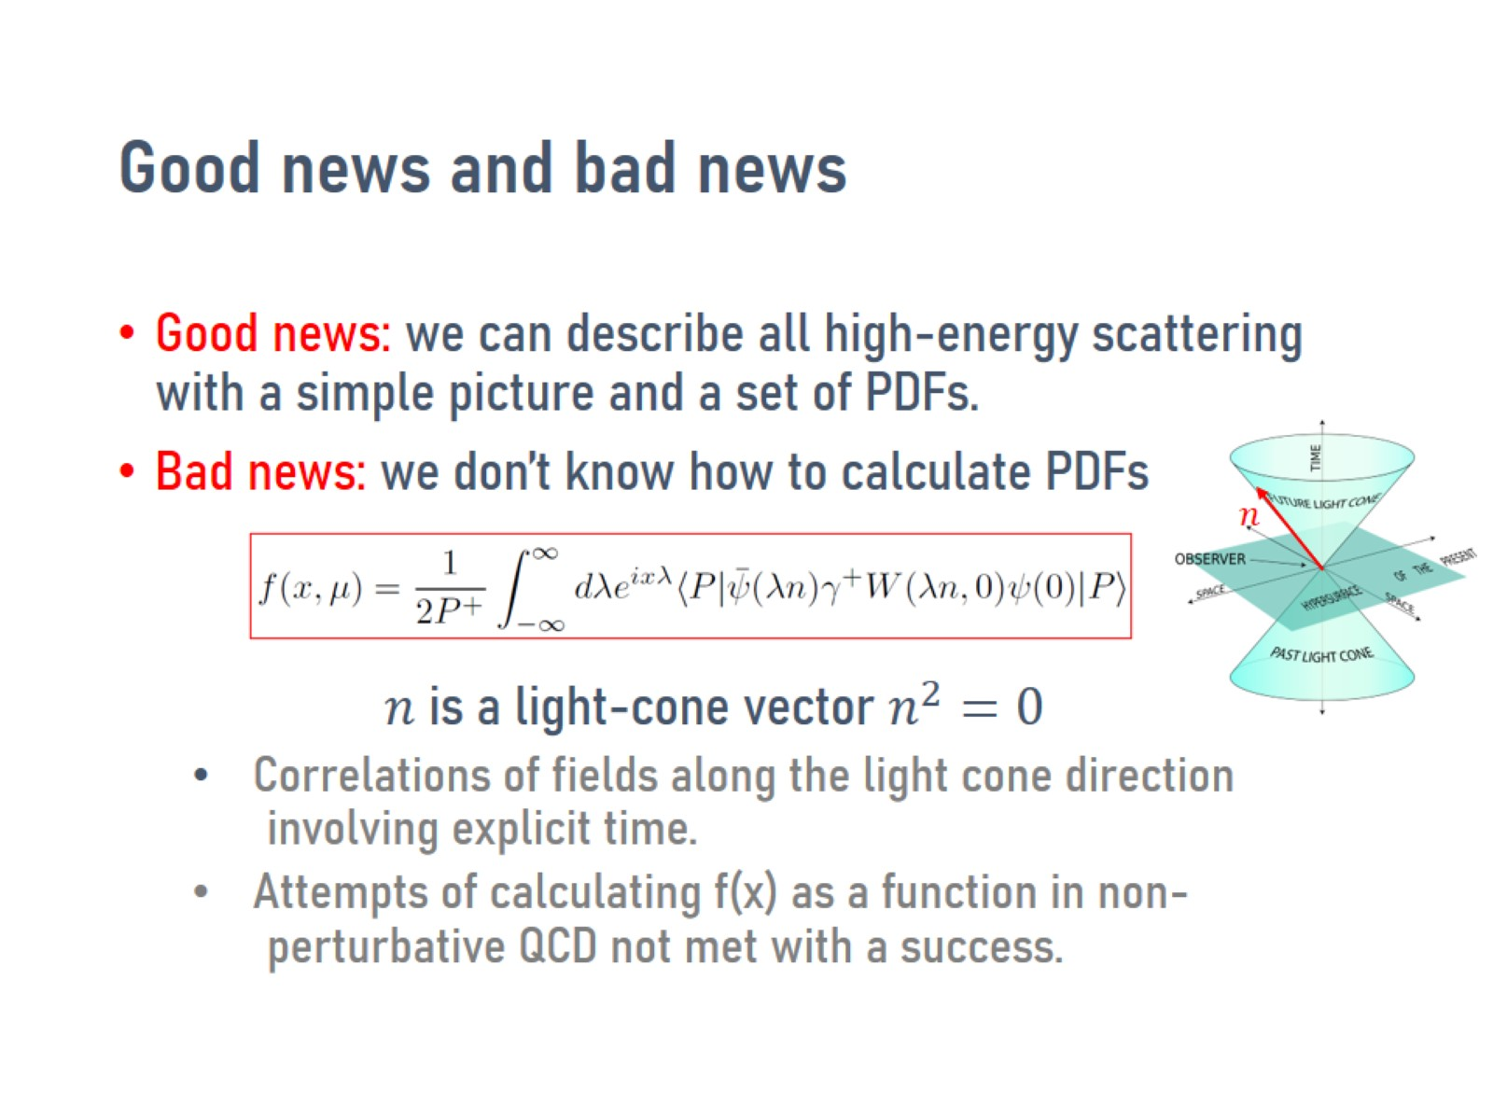
Good news and bad news

Slide 12
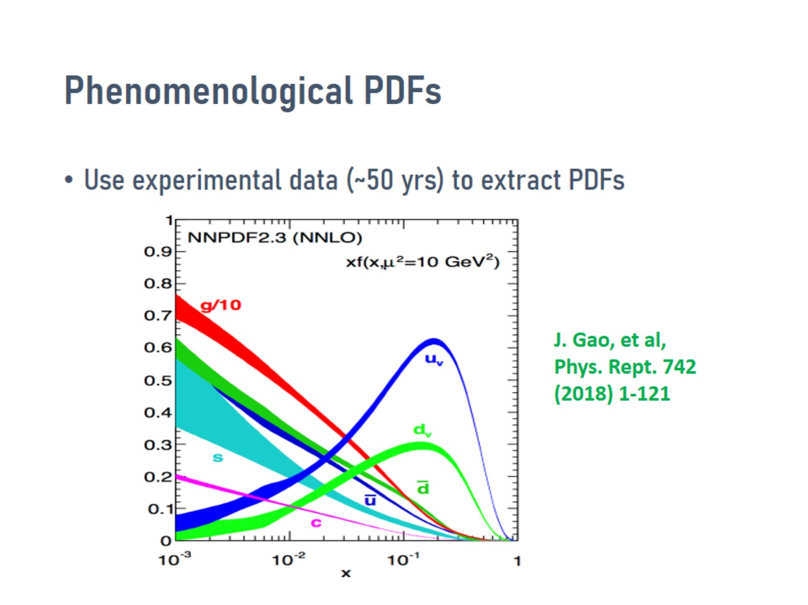
Phenomenological PDFs

Slide 13
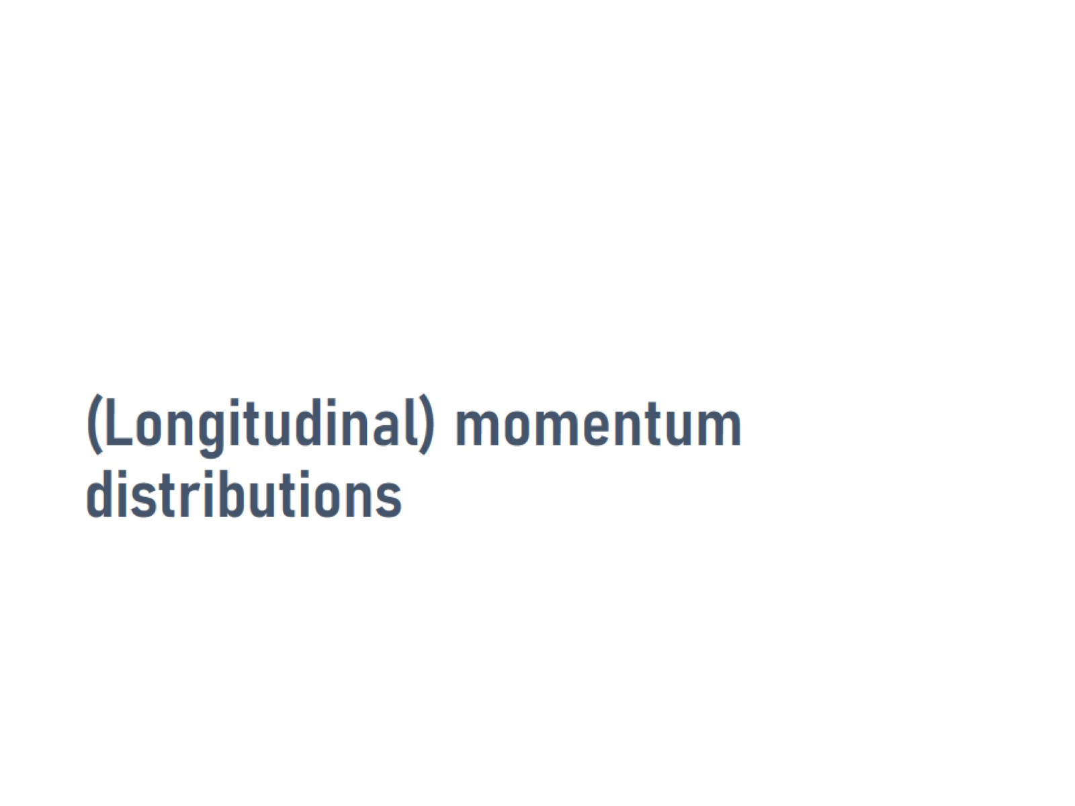
(Longitudinal) momentum distributions

Slide 14
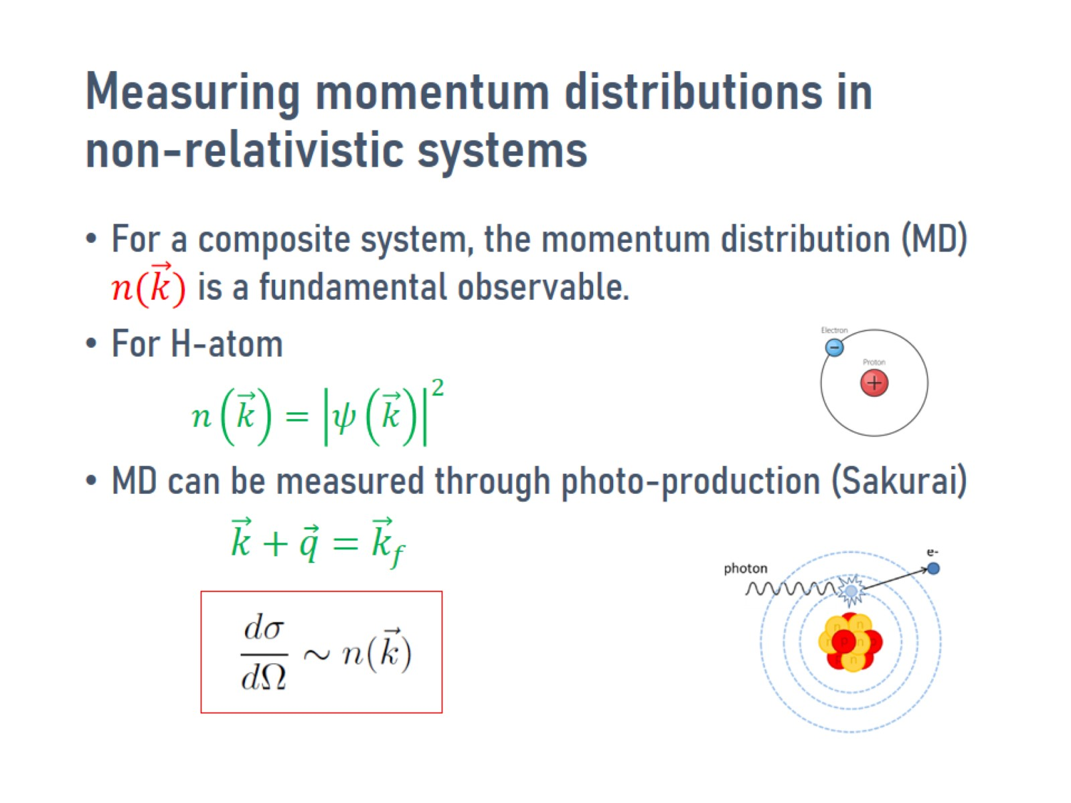
Measuring momentum distributions in non-relativistic systems

Slide 15
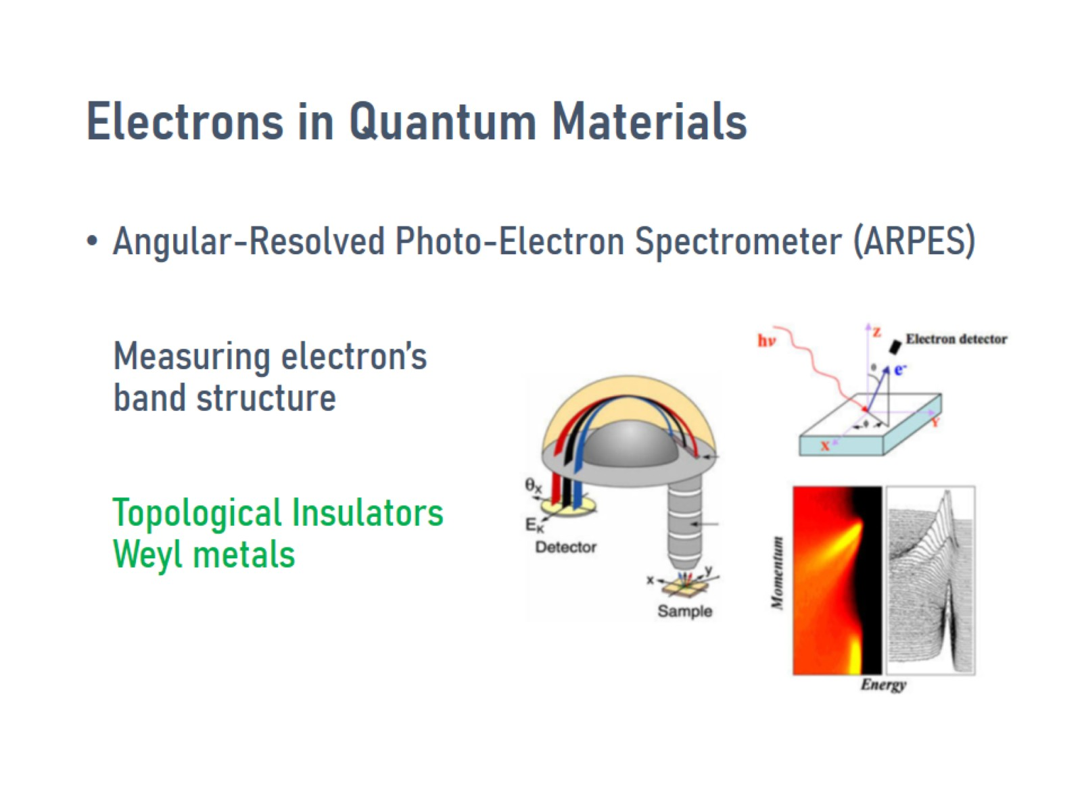
Electrons in Quantum Materials

Slide 16
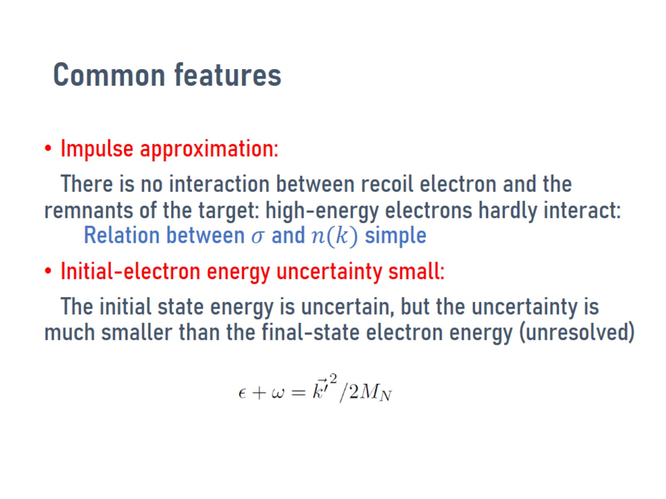
Common features

Slide 17
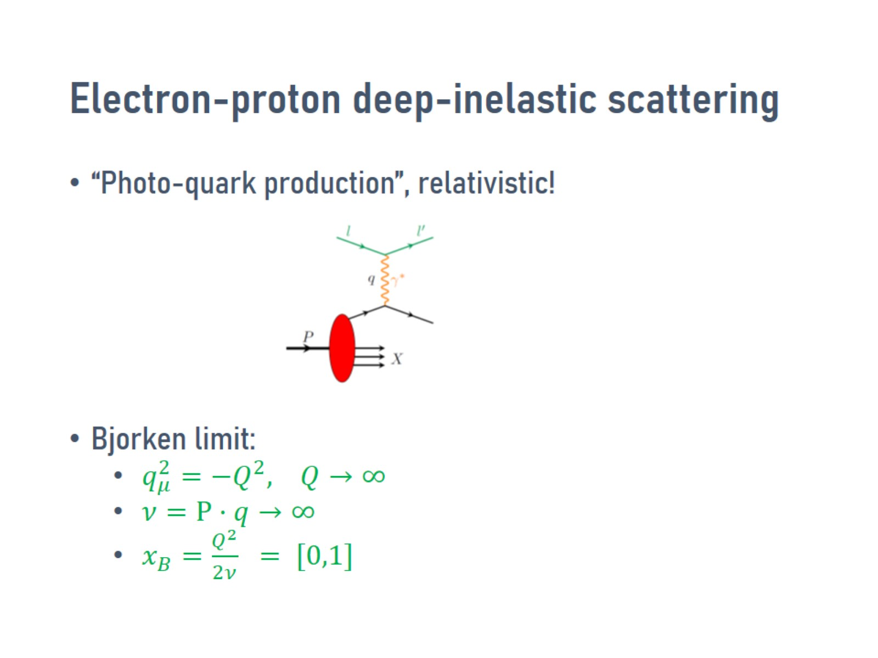
Electron-proton deep-inelastic scattering

Slide 18
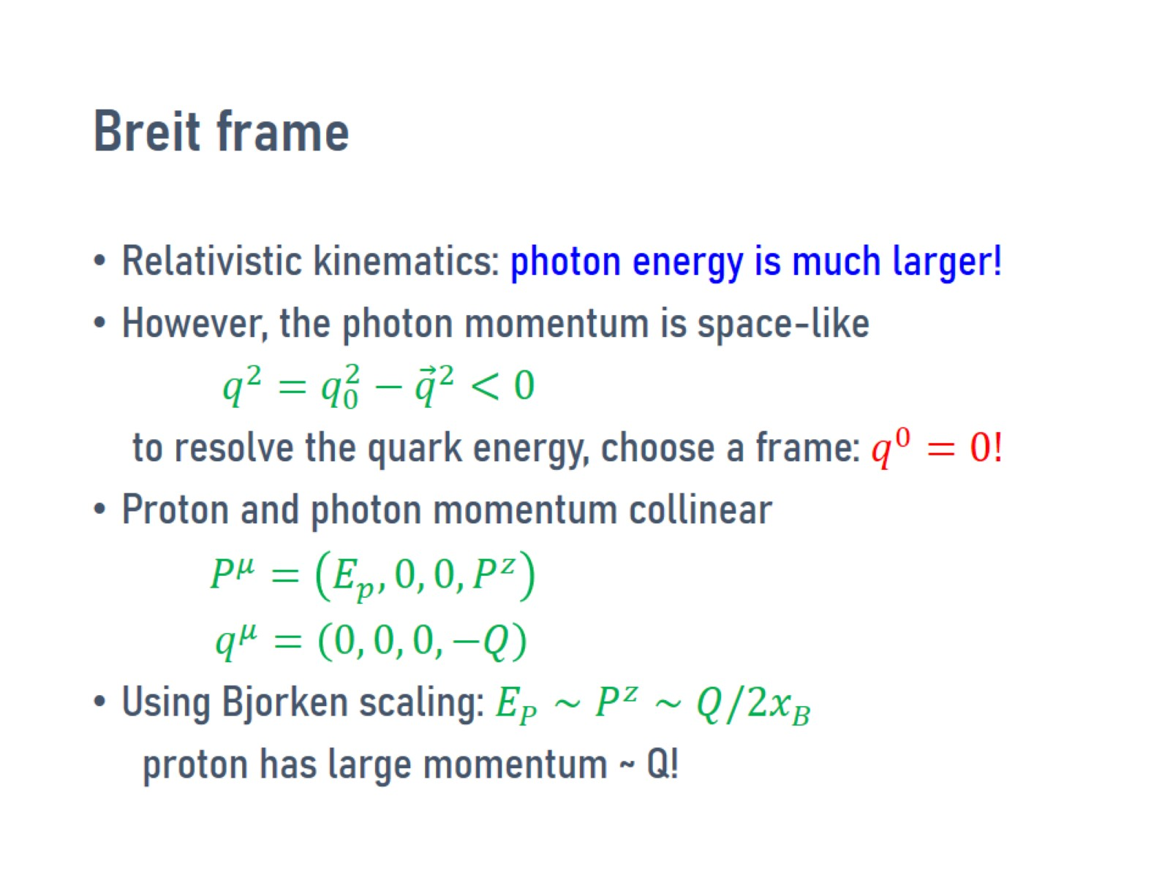
Breit frame

Slide 19
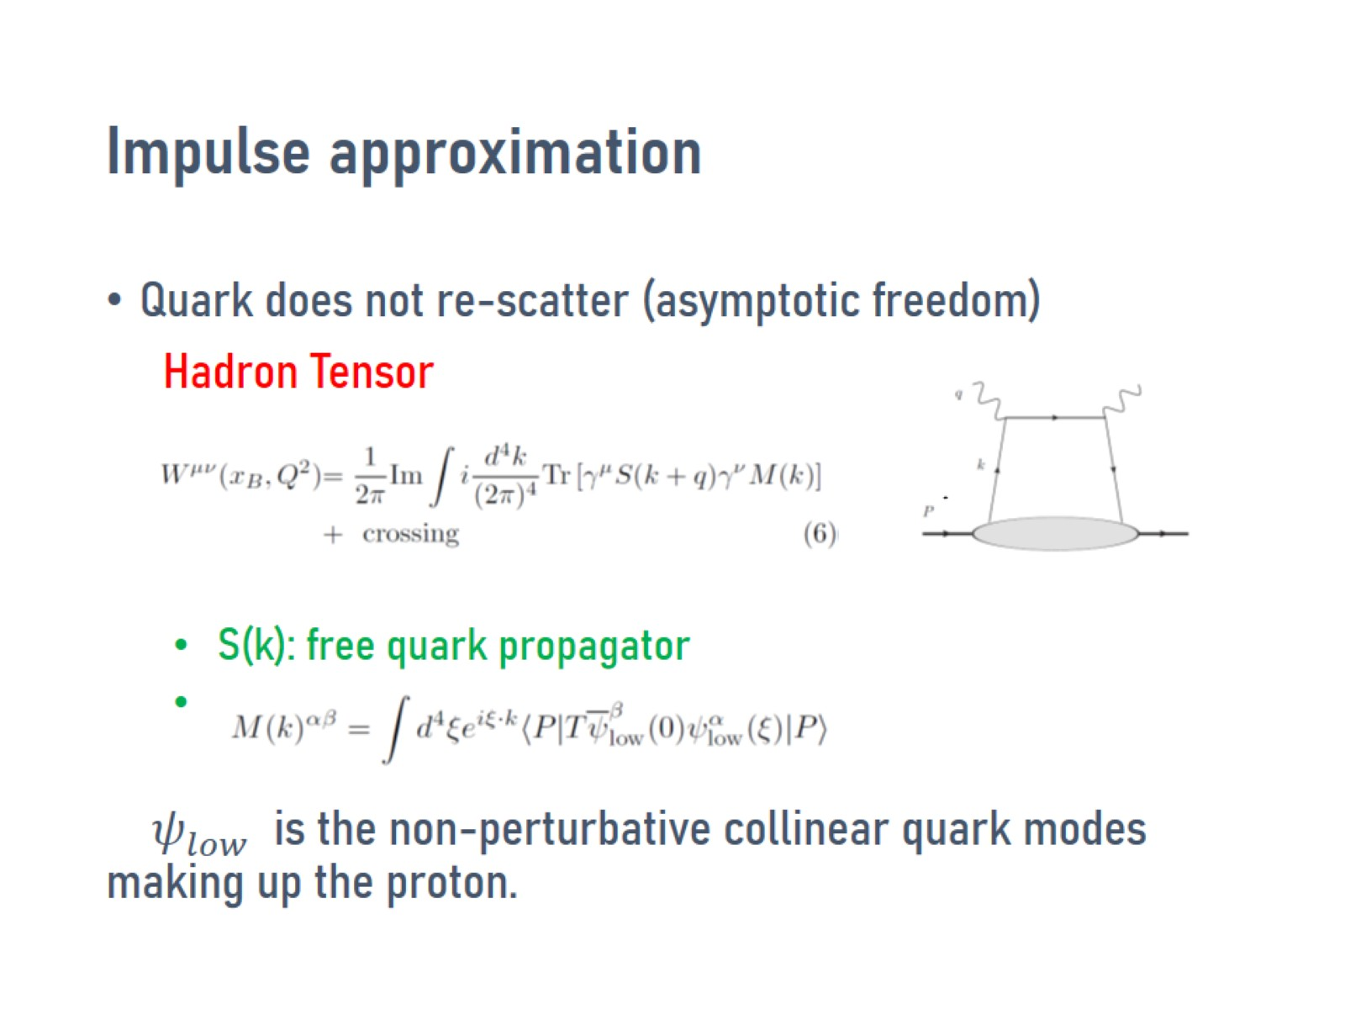
Impulse approximation

Slide 20
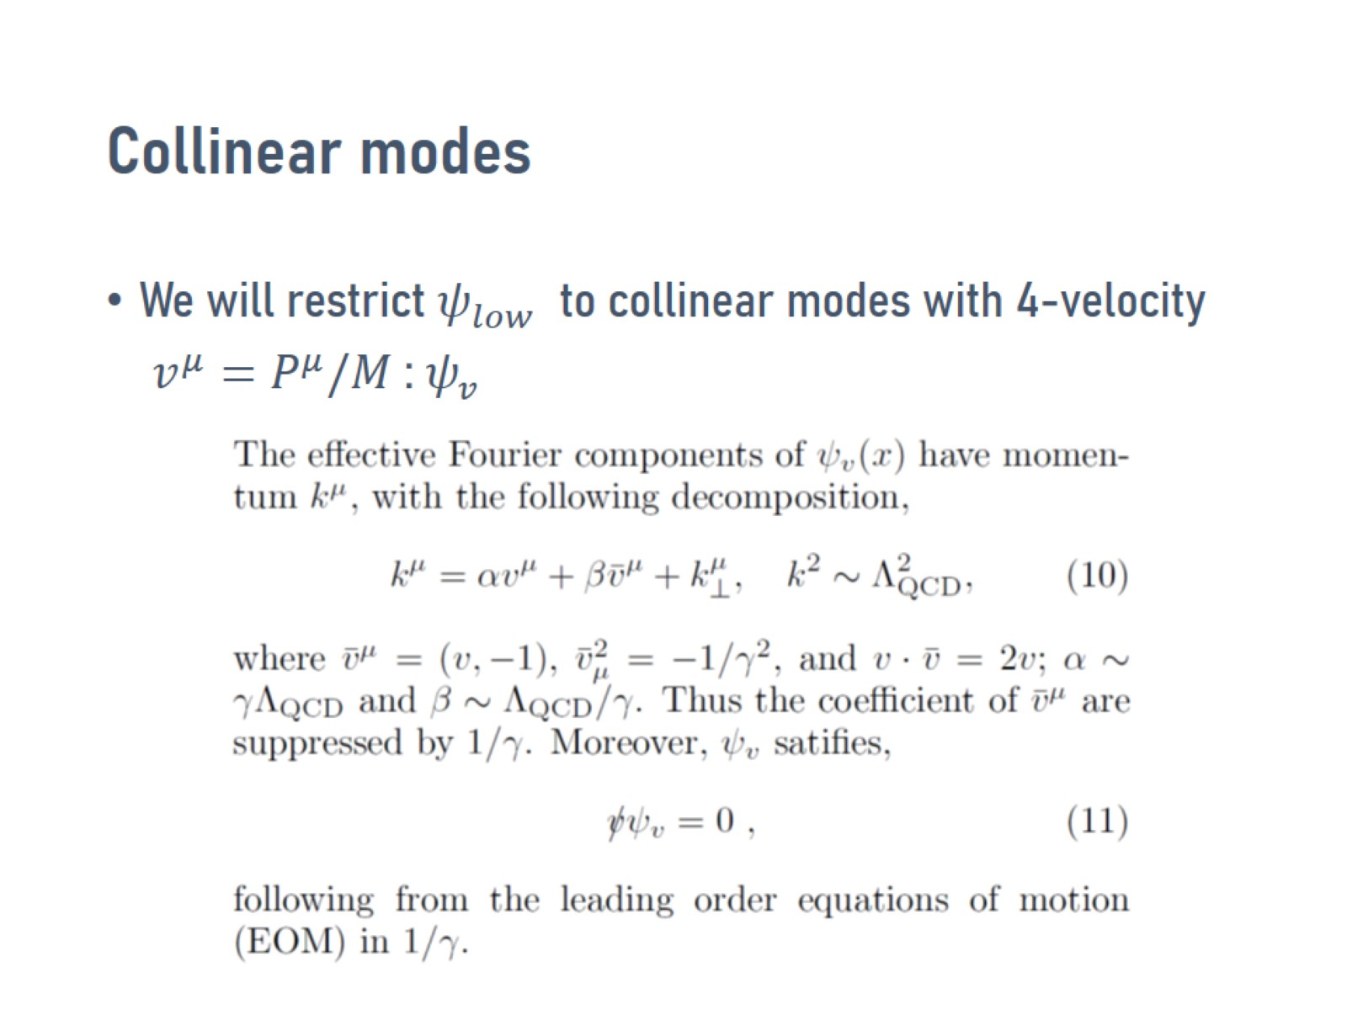
Collinear modes

Slide 21
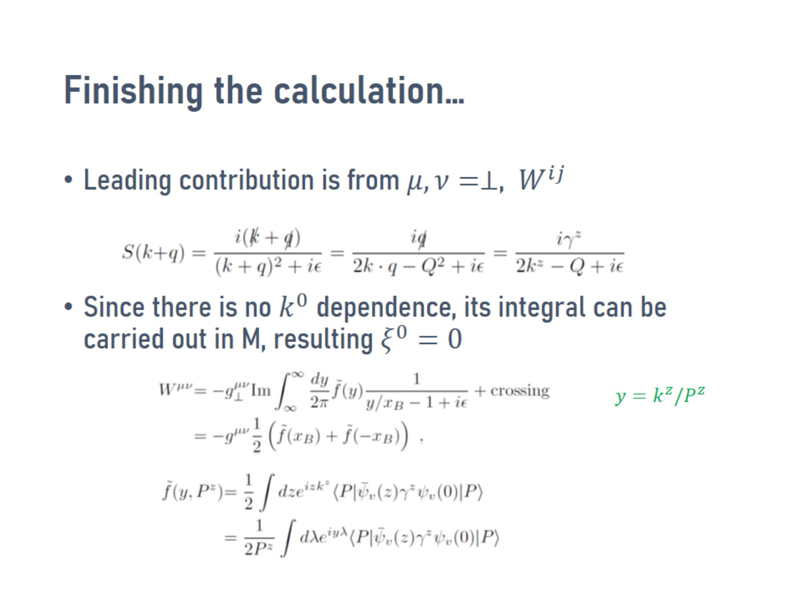
Finishing the calculation…

Slide 22
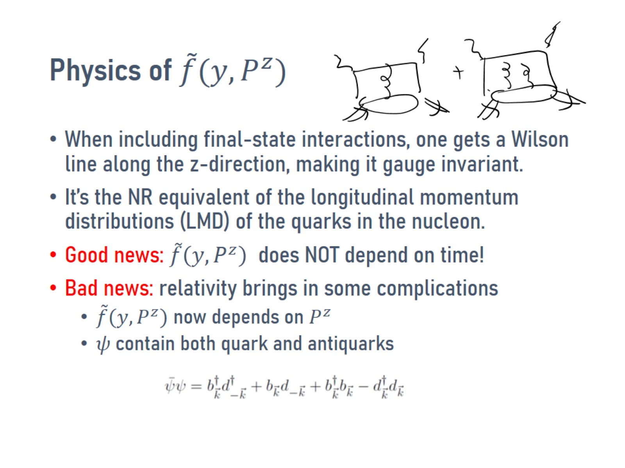

Physics of $\tilde{f}(y,P^{z})$

Slide 23
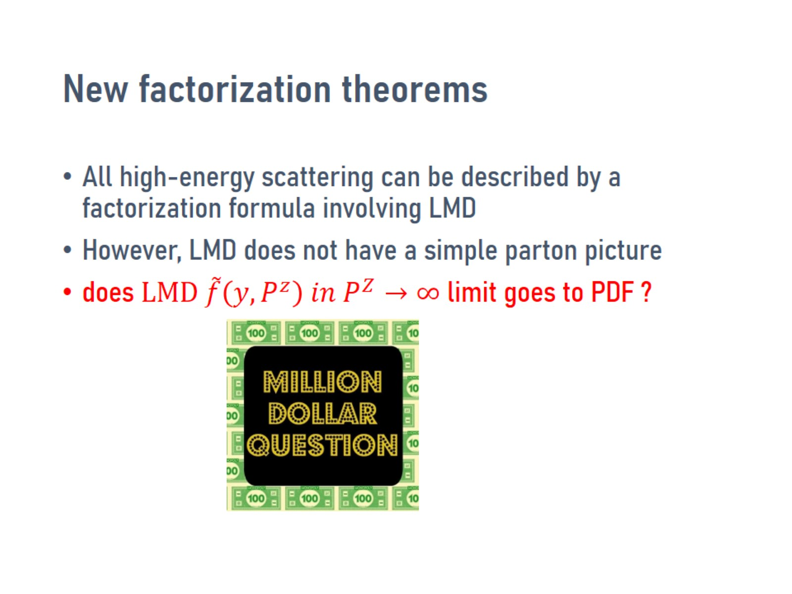
New factorization theorems

Slide 24
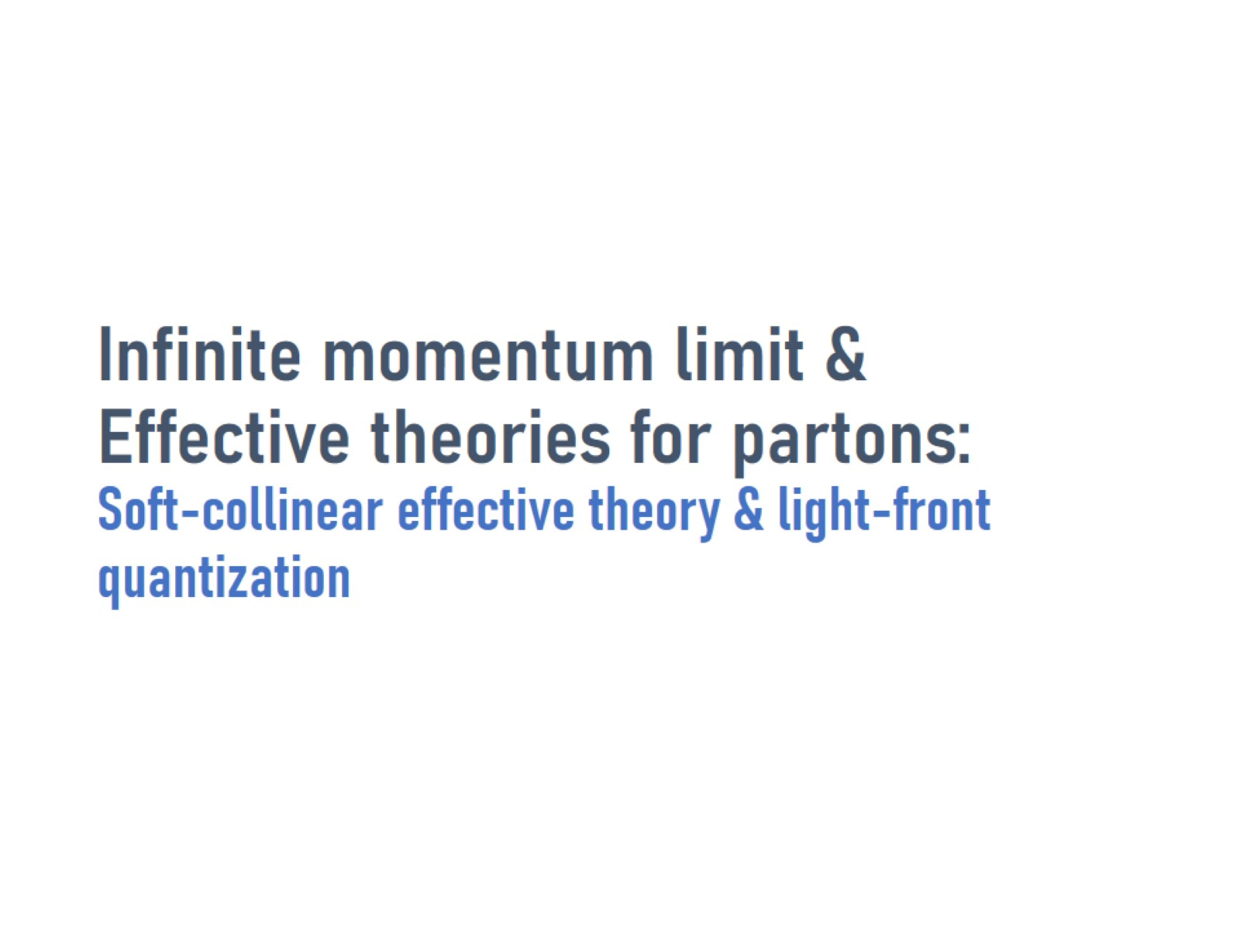
Infinite momentum limit & Effective theories for partons: Soft-collinear effective theory & light-front quantization

Slide 25
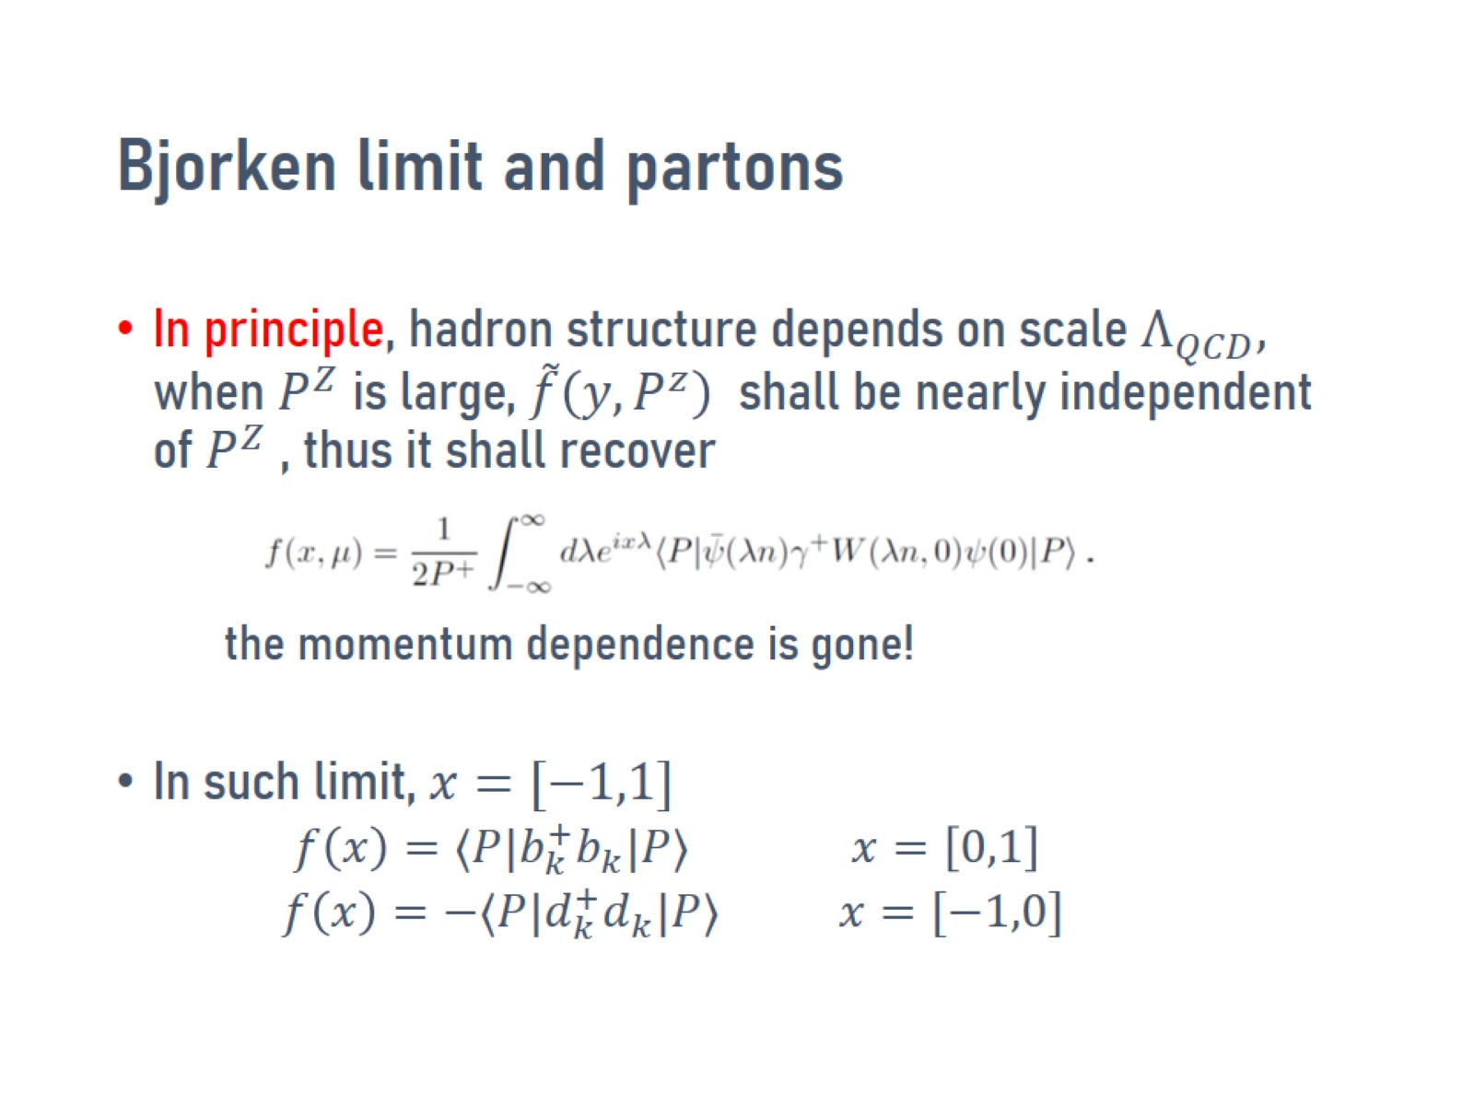
Bjorken limit and partons

Slide 26
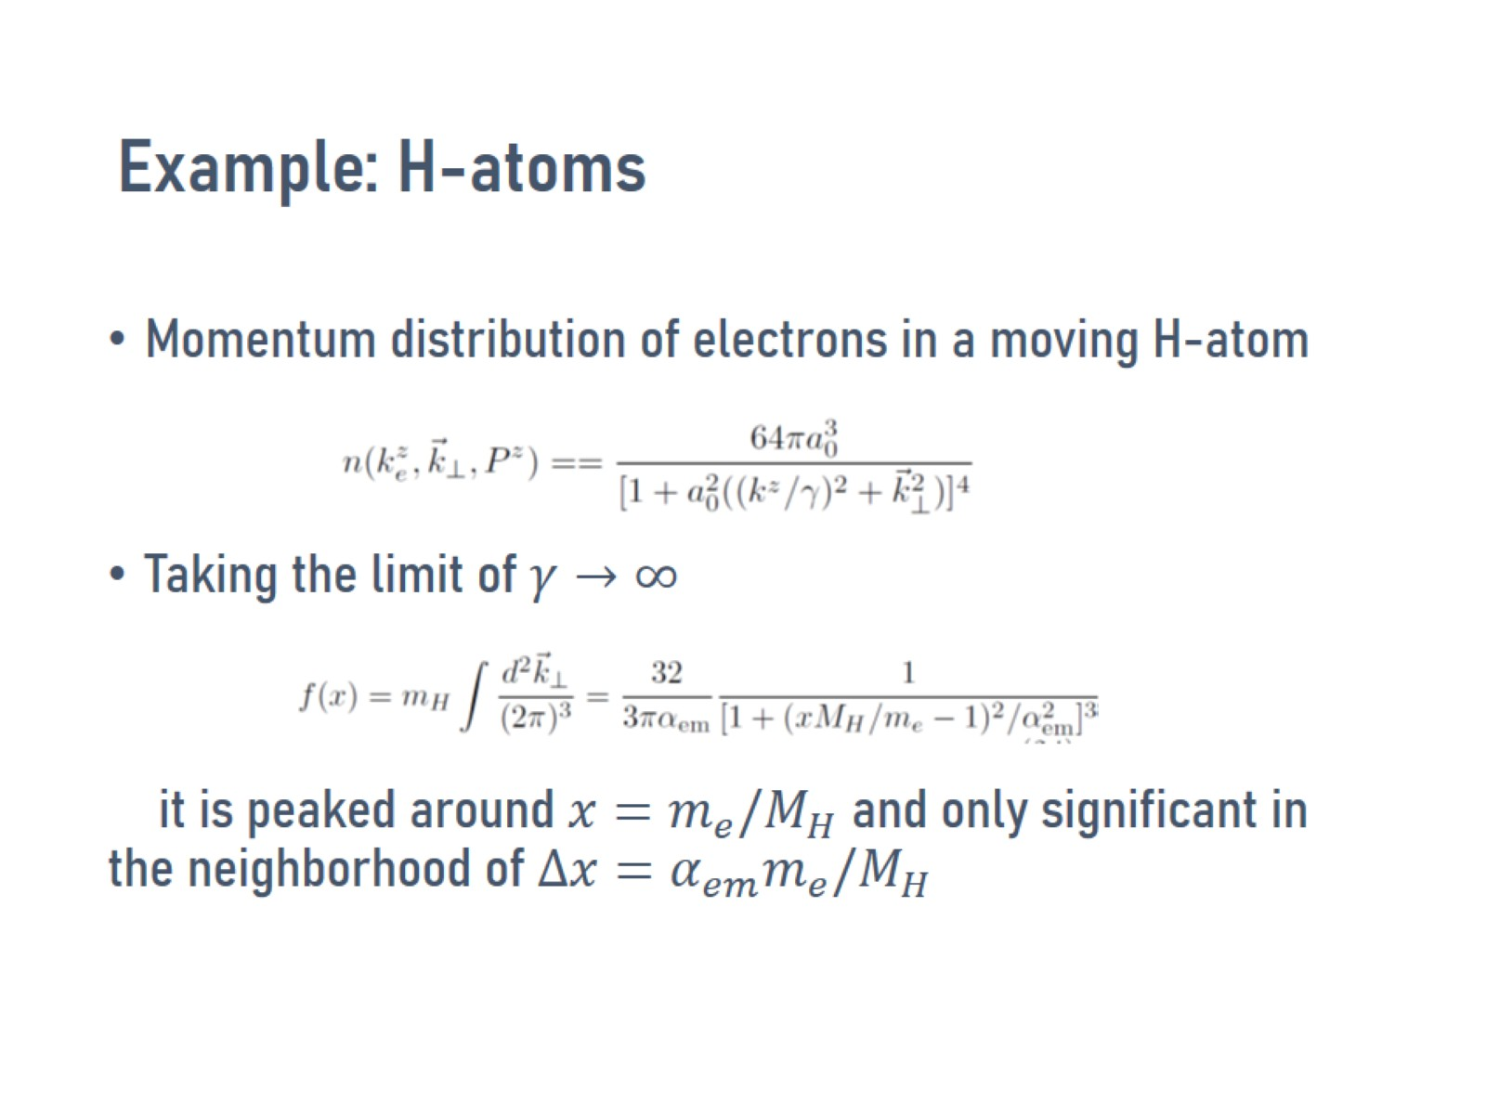
Example: H-atoms

Slide 27
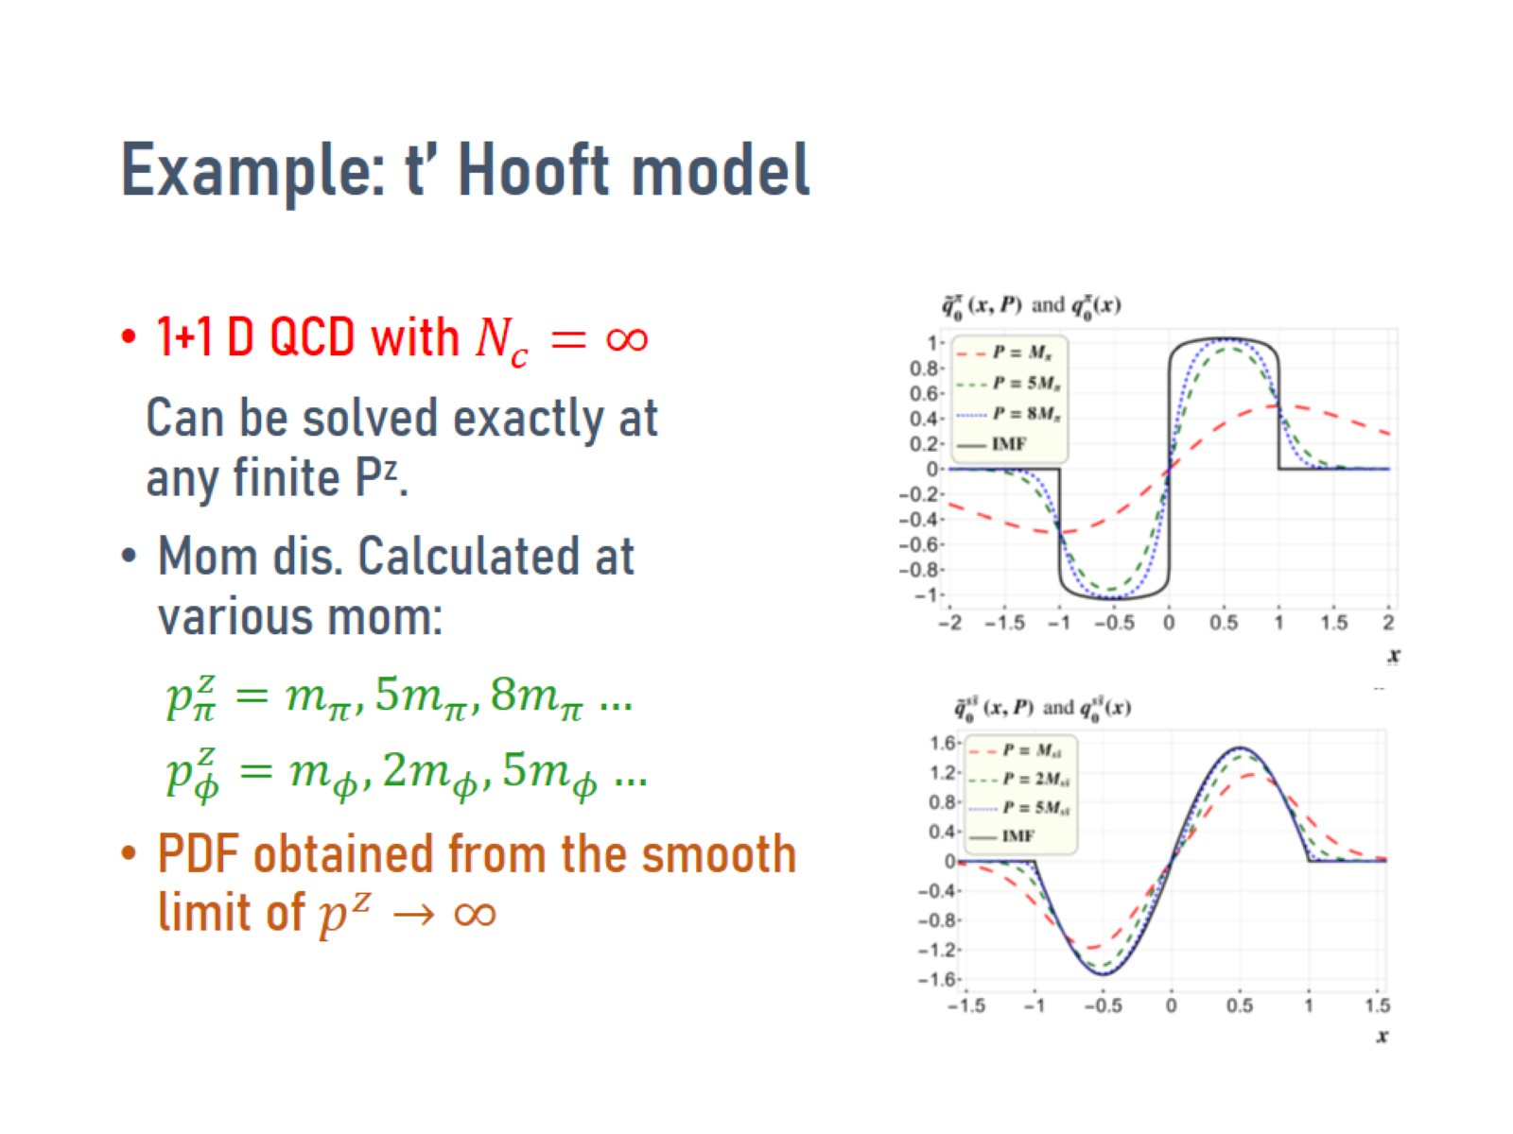
Example: t’ Hooft model

Slide 28
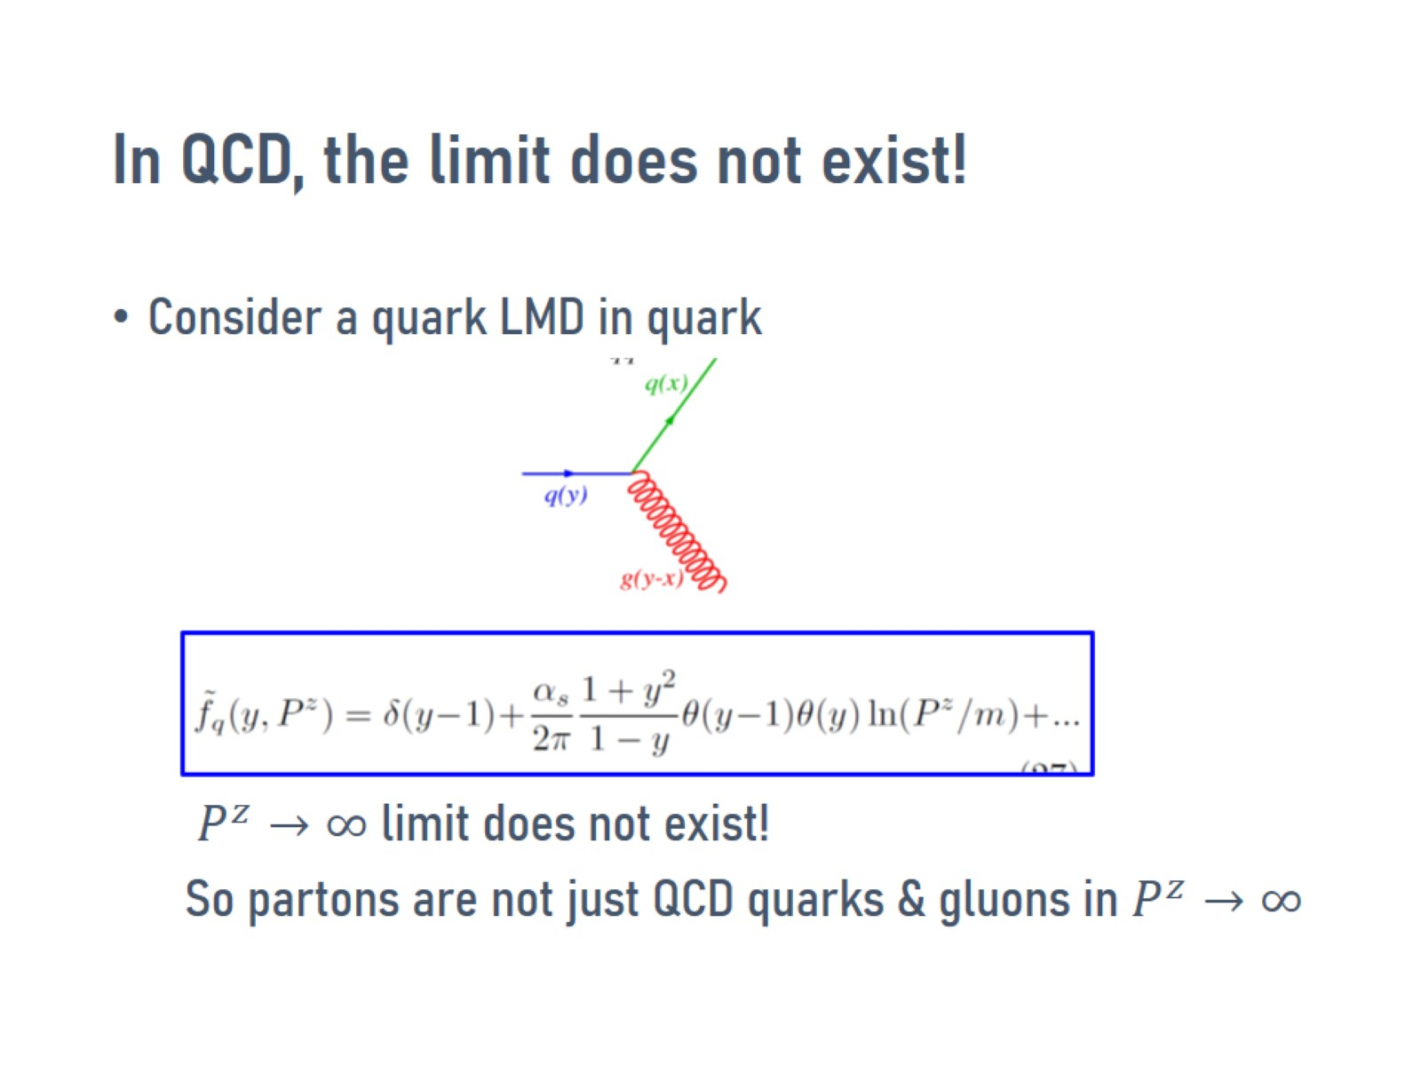
In QCD, the limit does not exist!

Slide 29
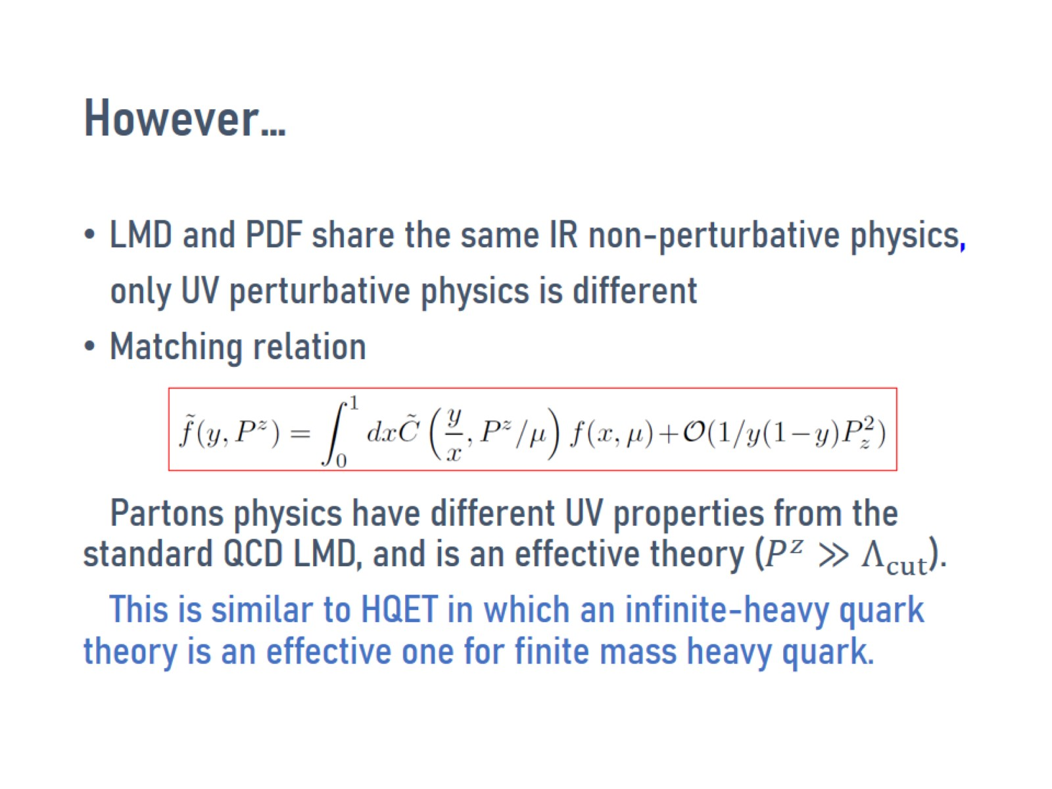
However…

Slide 30
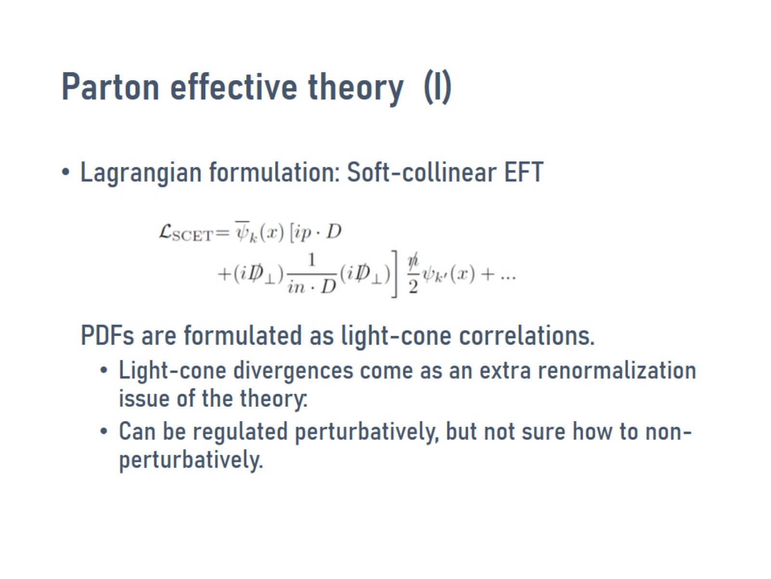
Parton effective theory (I)

Slide 31
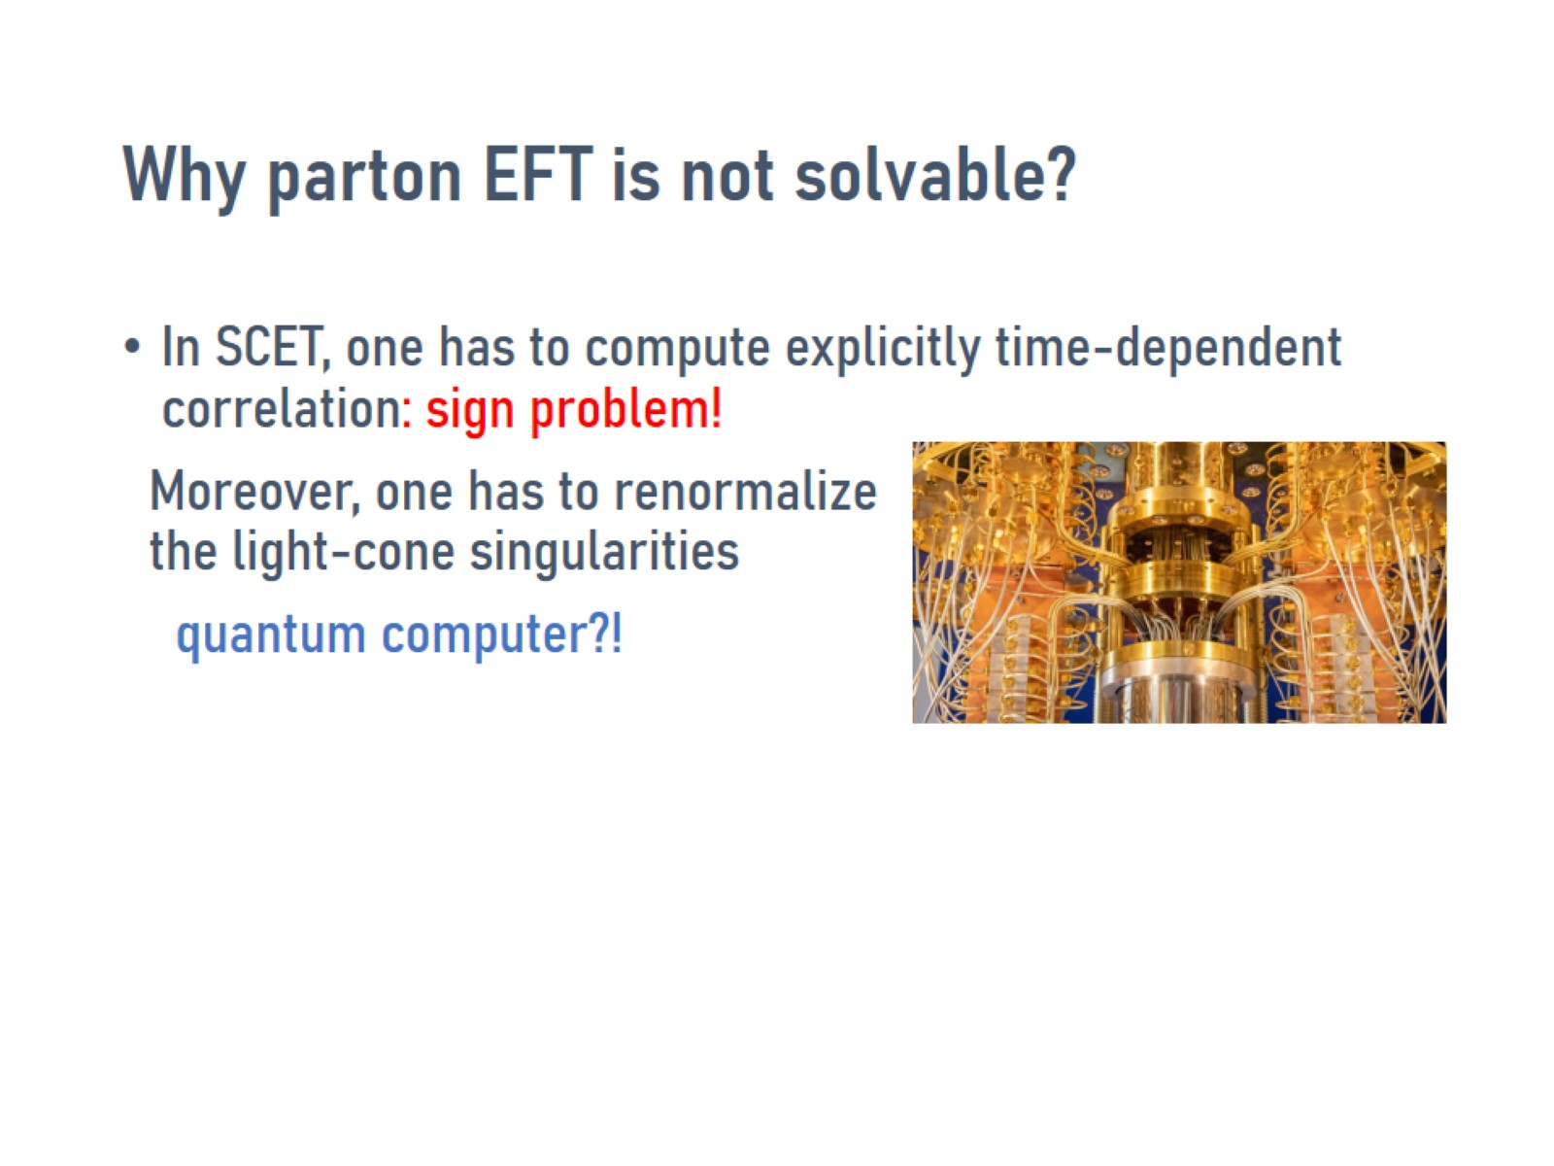
Why parton EFT is not solvable?

Slide 32
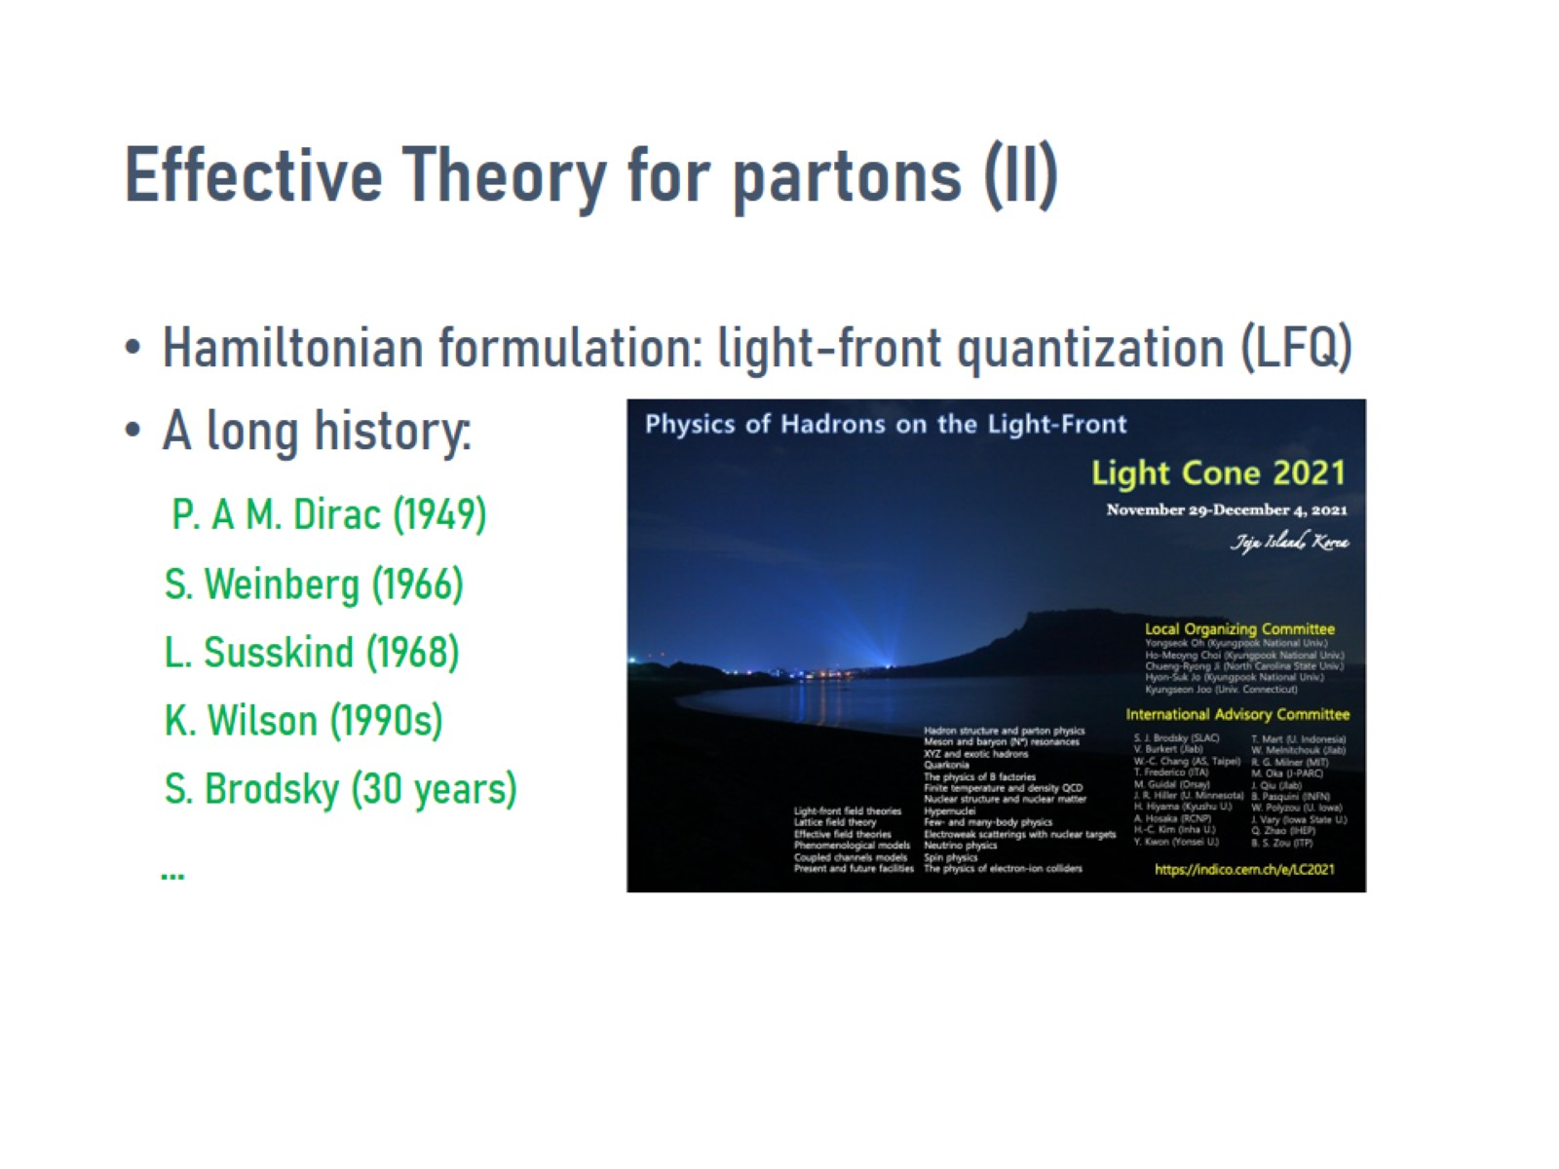
Effective Theory for partons (II)

Slide 33
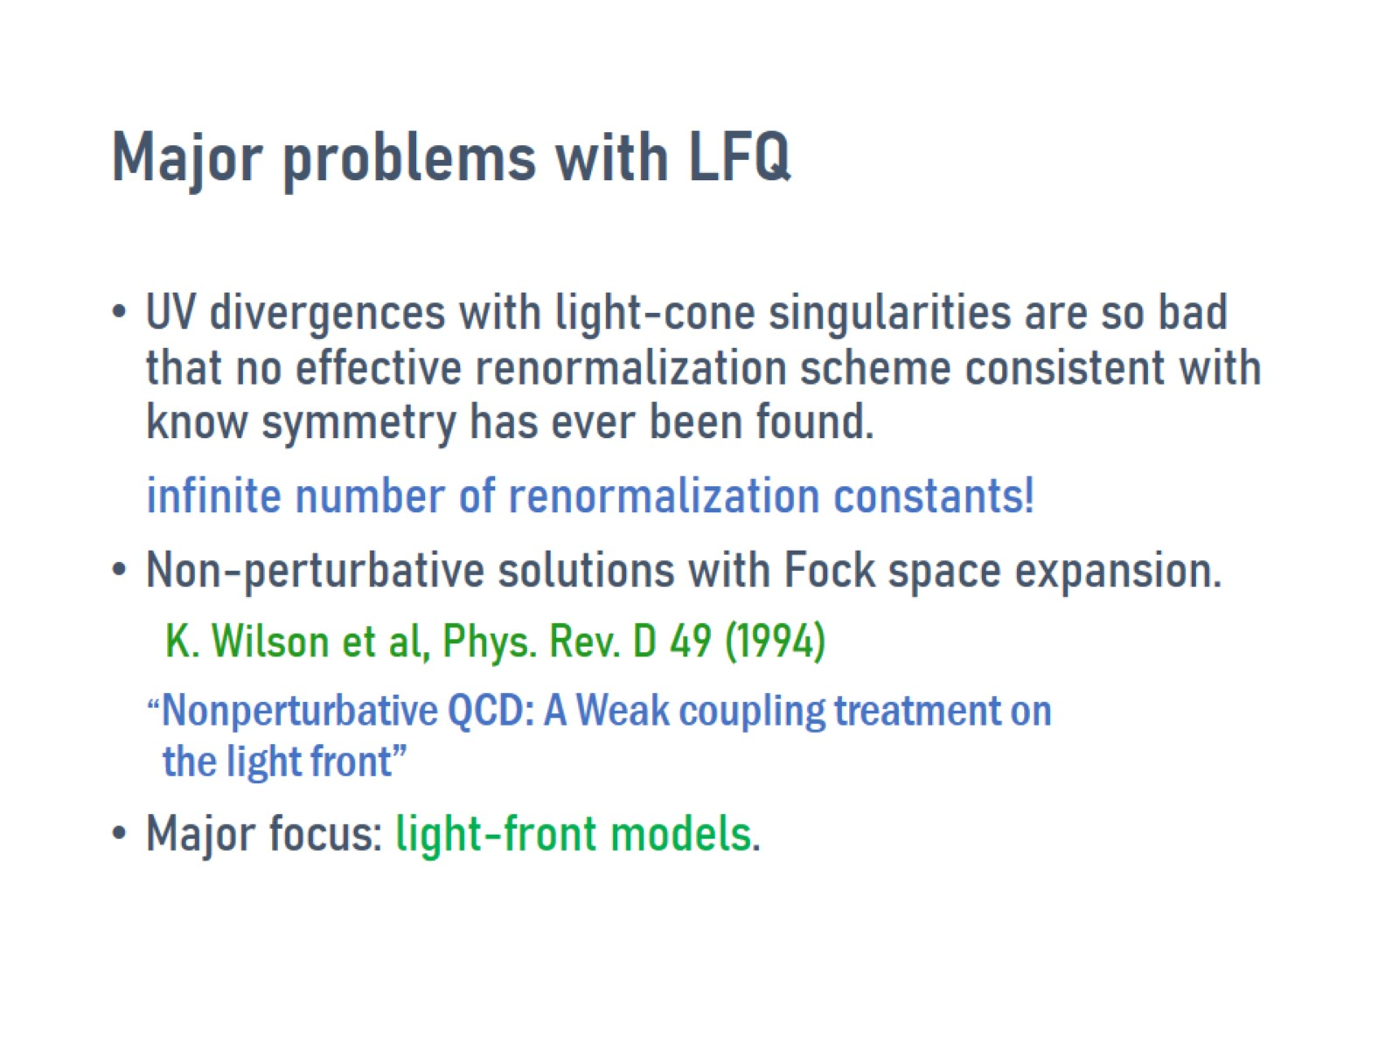
Major problems with LFQ

Slide 34


Slide 35
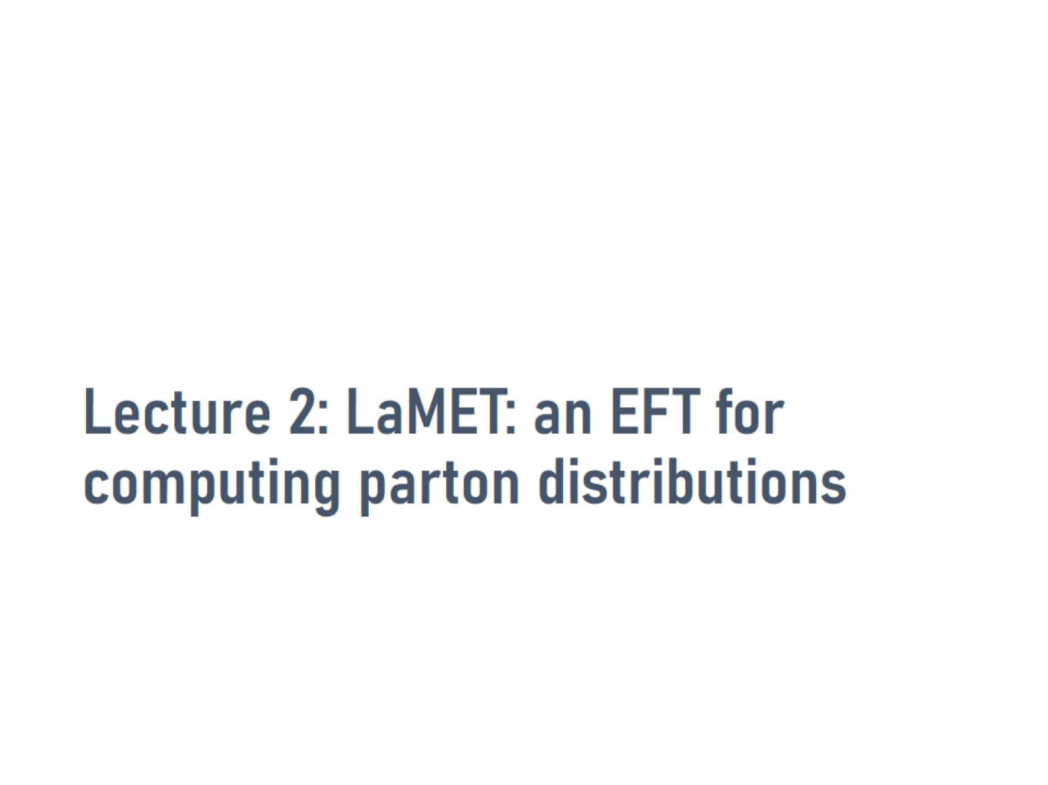
Lecture 2: LaMET: an EFT for computing parton distributions

Slide 36
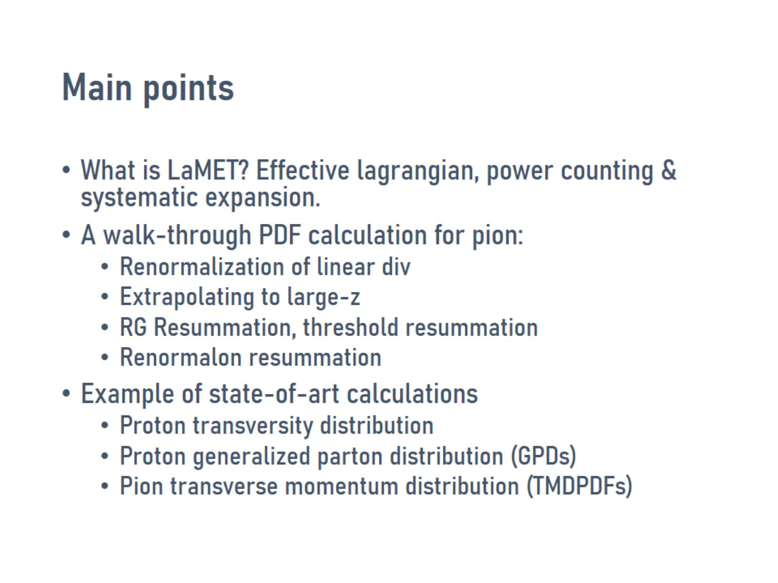
Main points

Slide 37
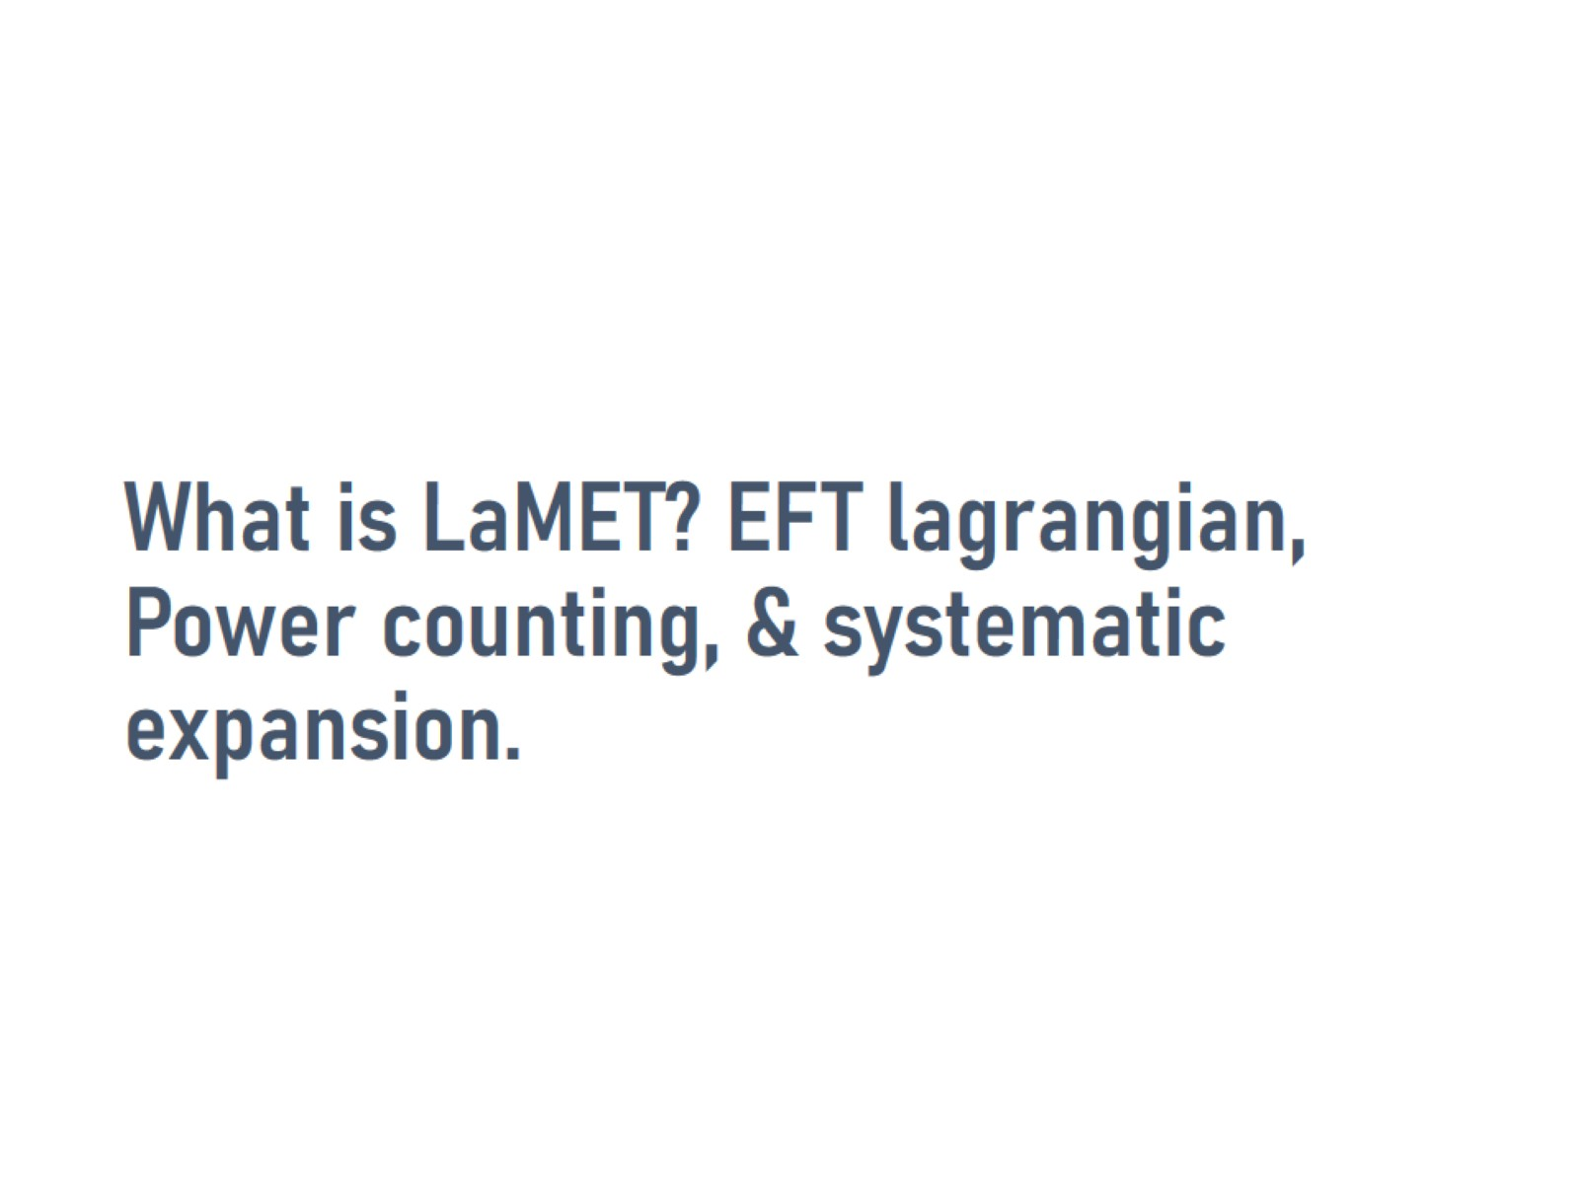
What is LaMET? EFT lagrangian, Power counting, & systematic expansion.

Slide 38
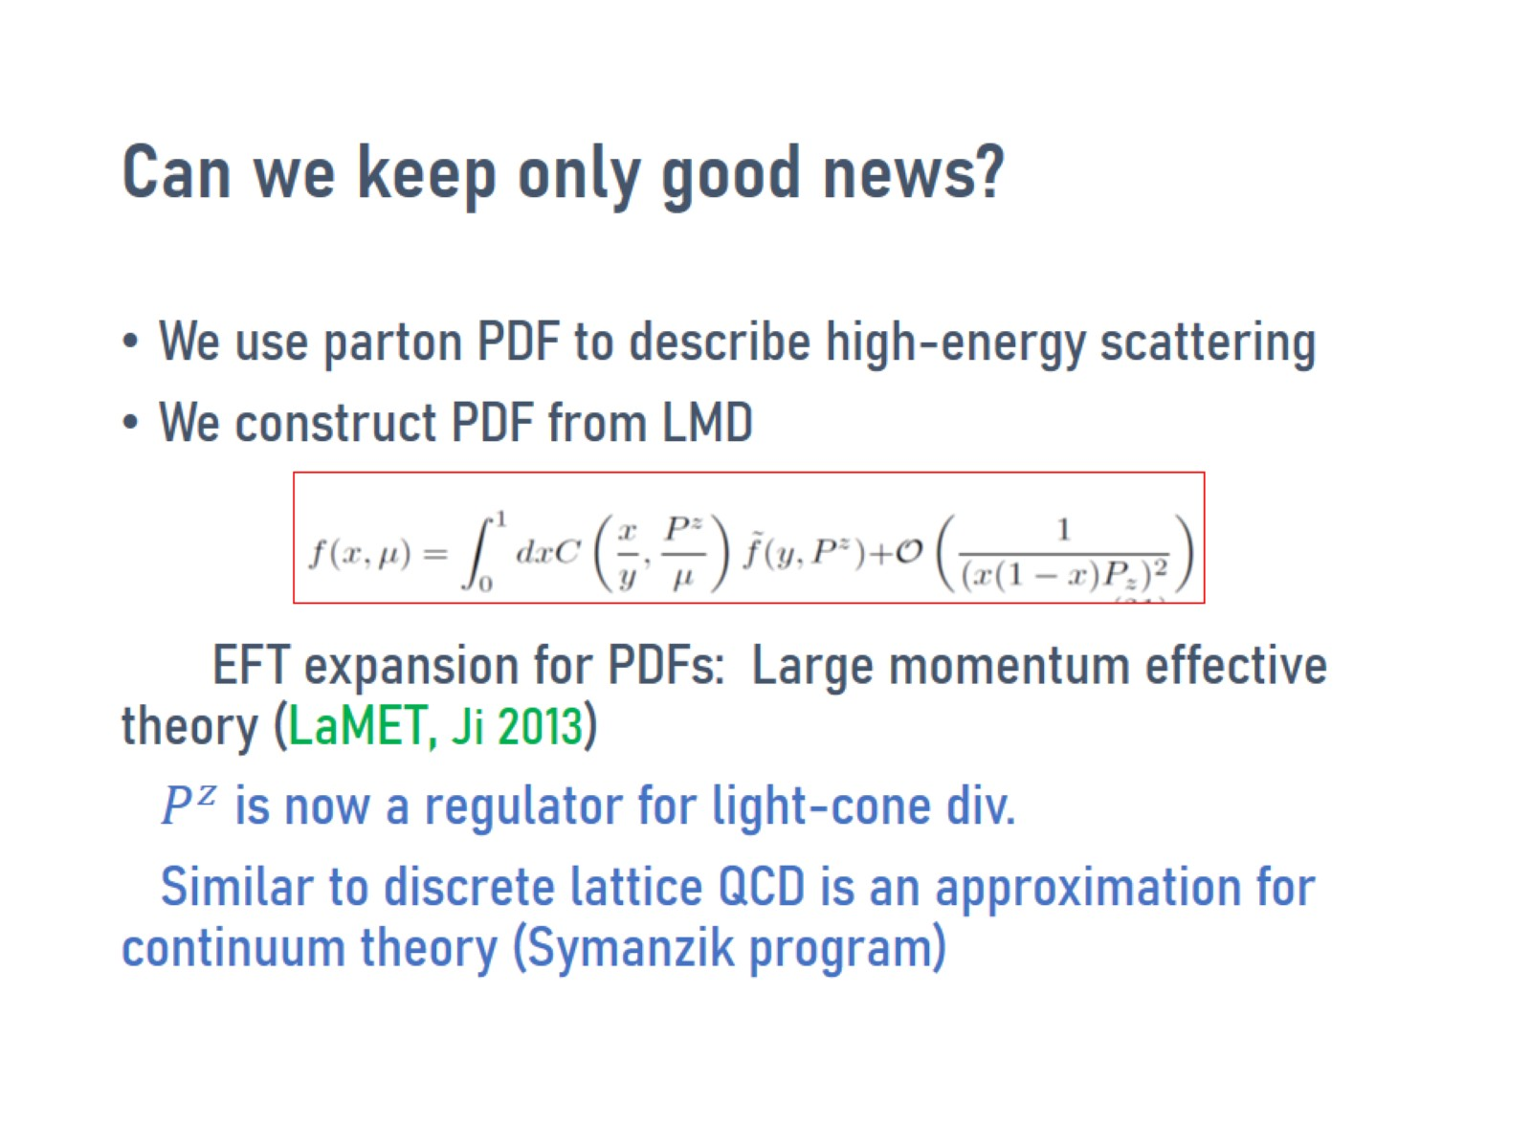
Can we keep only good news?

Slide 39
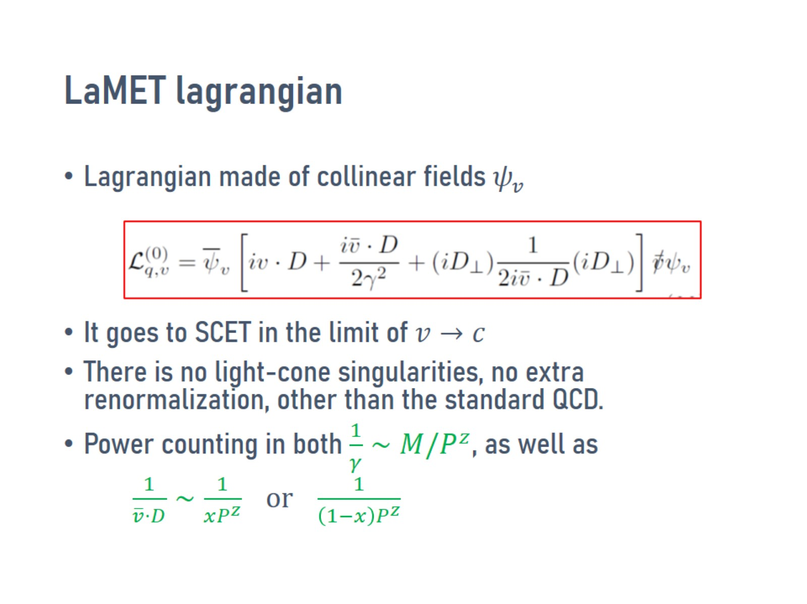
LaMET lagrangian

Slide 40
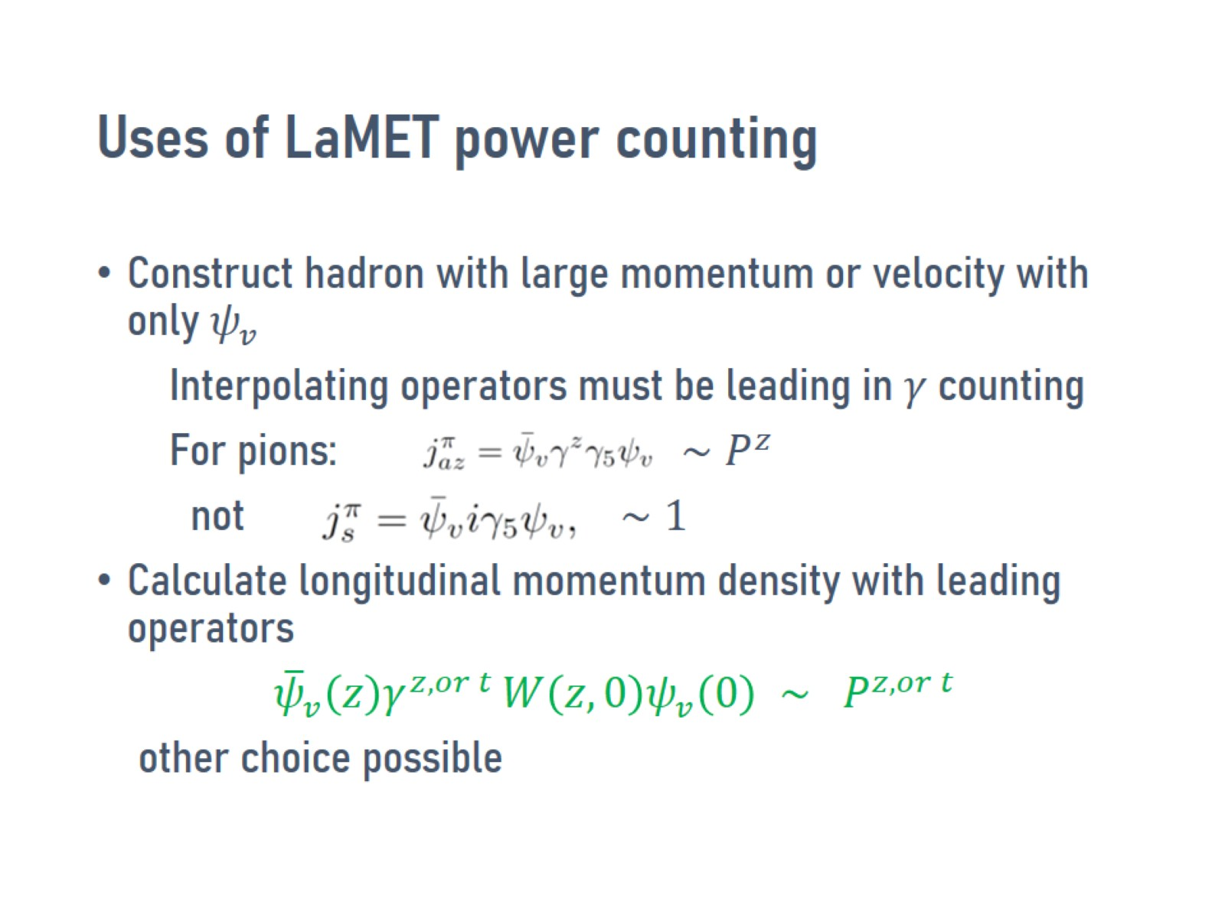
Uses of LaMET power counting

Slide 41
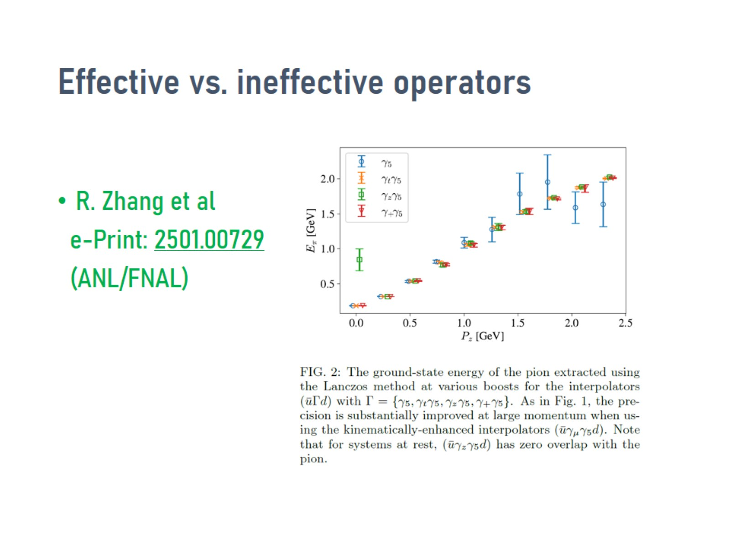
Effective vs. ineffective operators

Slide 42
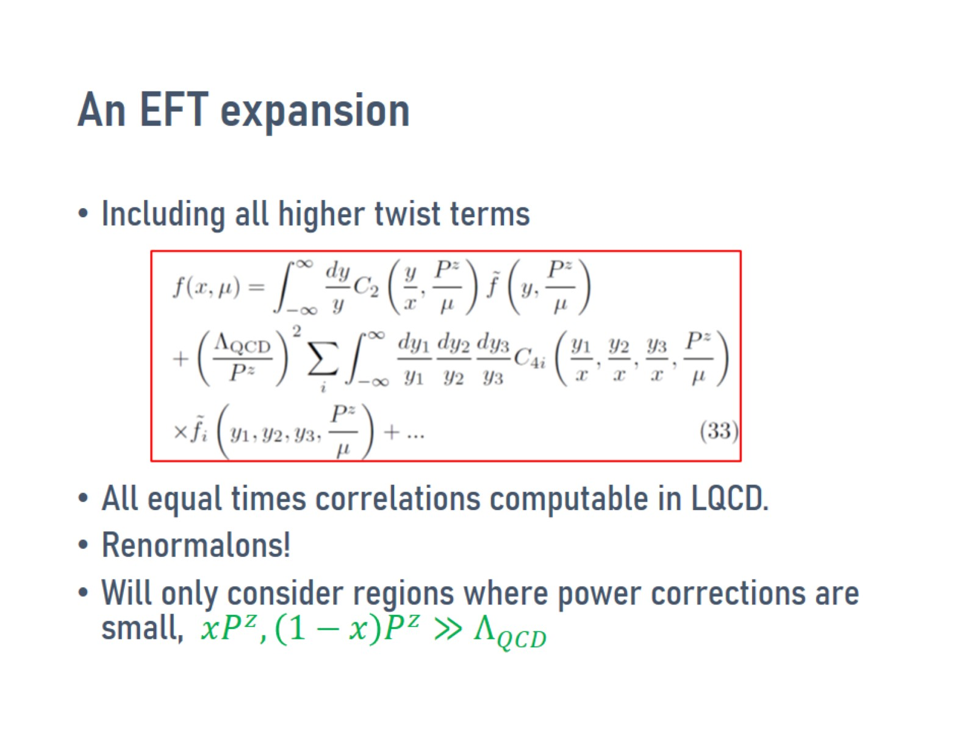
An EFT expansion

Slide 43
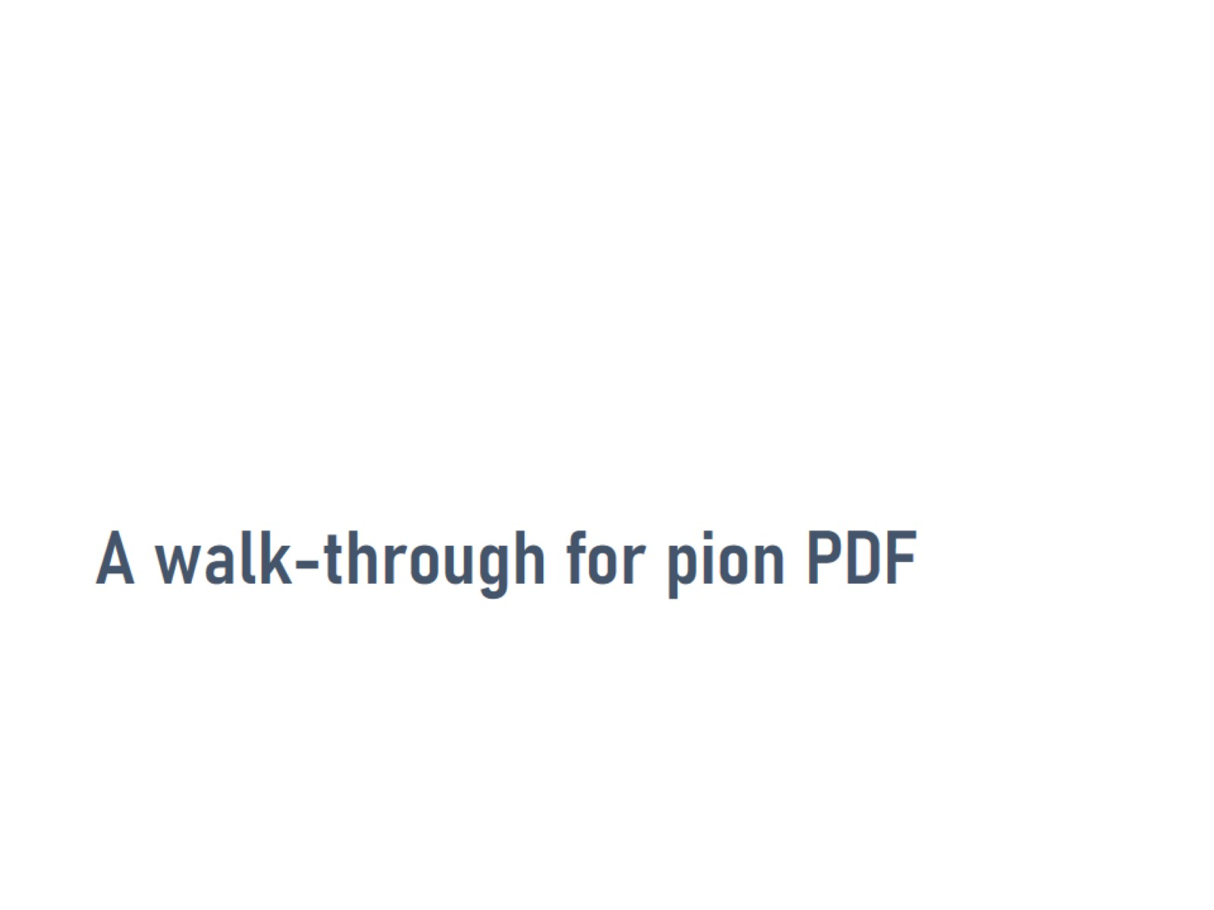
A walk-through for pion PDF

Slide 44
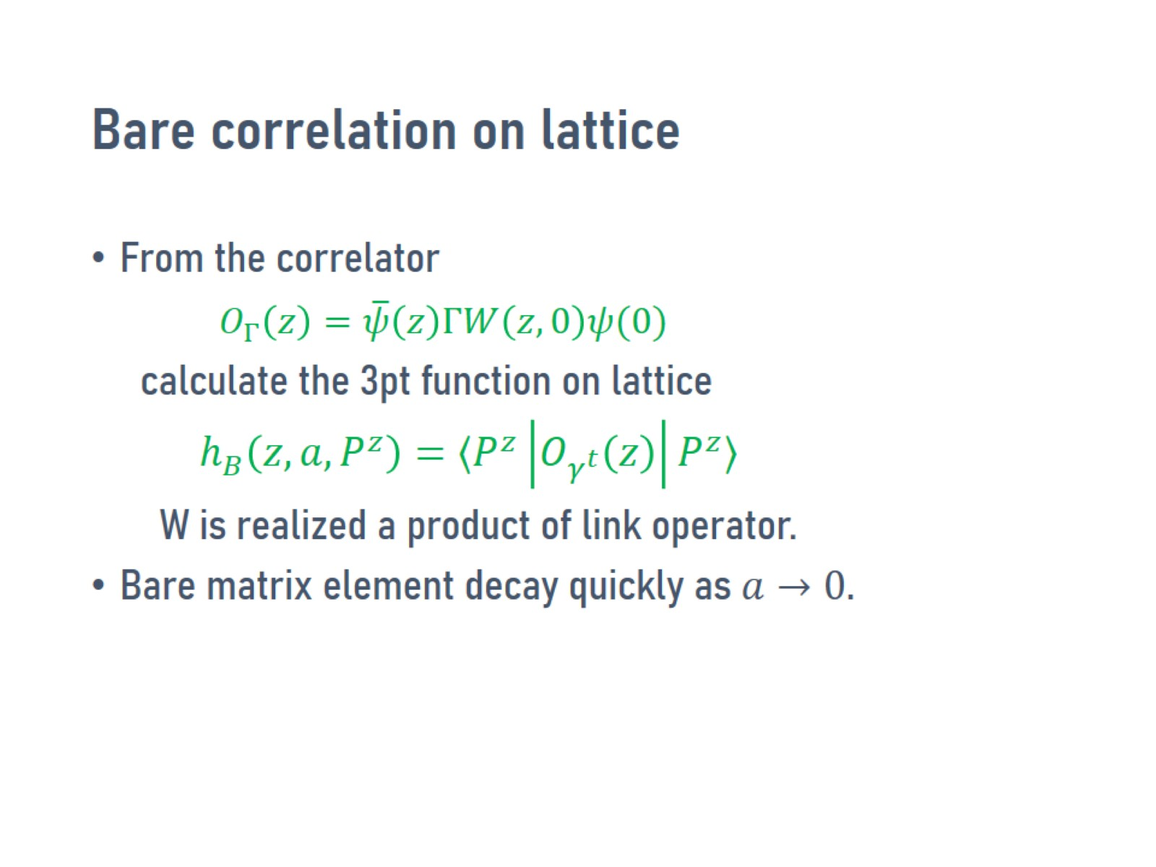
Bare correlation on lattice

Slide 45
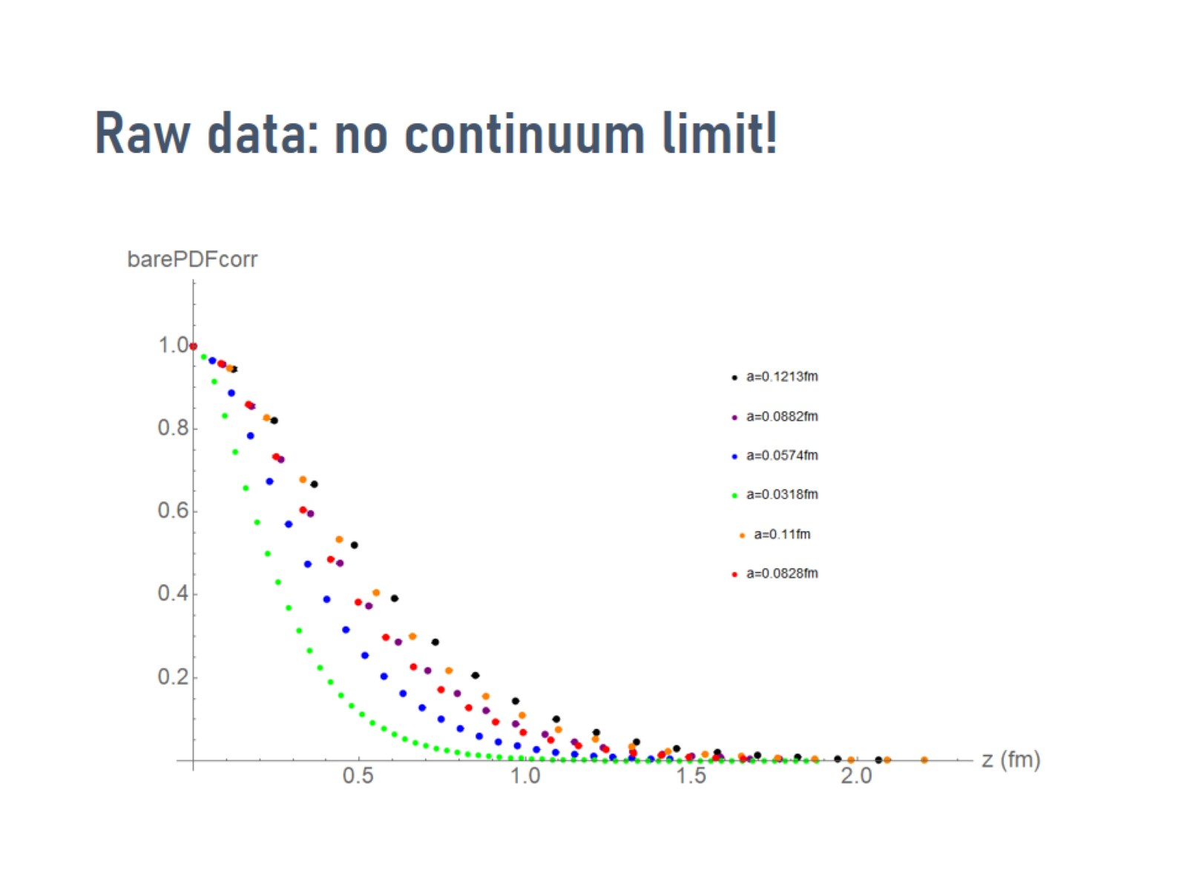
Raw data: no continuum limit!

Slide 46
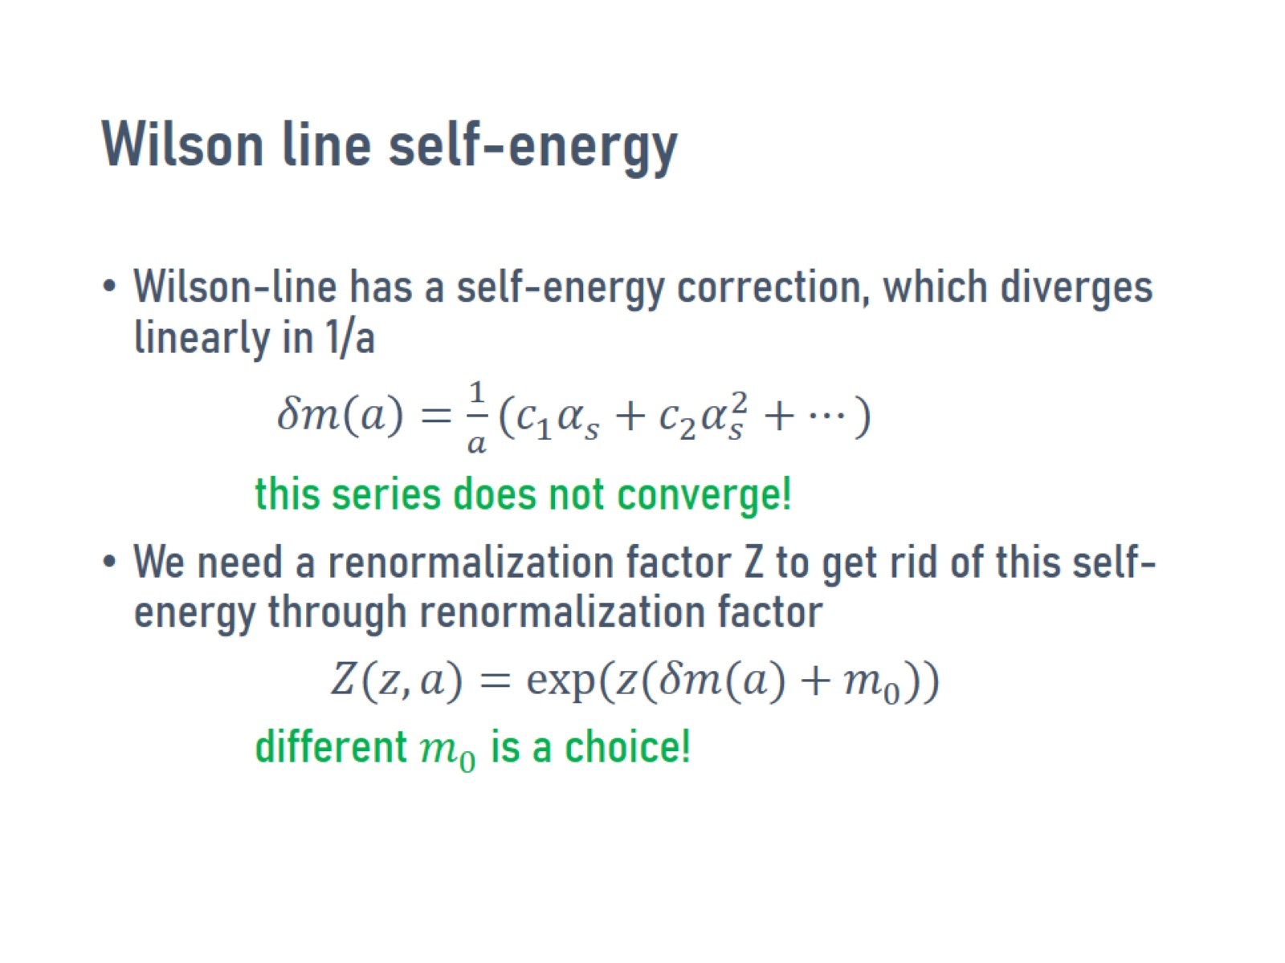
Wilson line self-energy

Slide 47
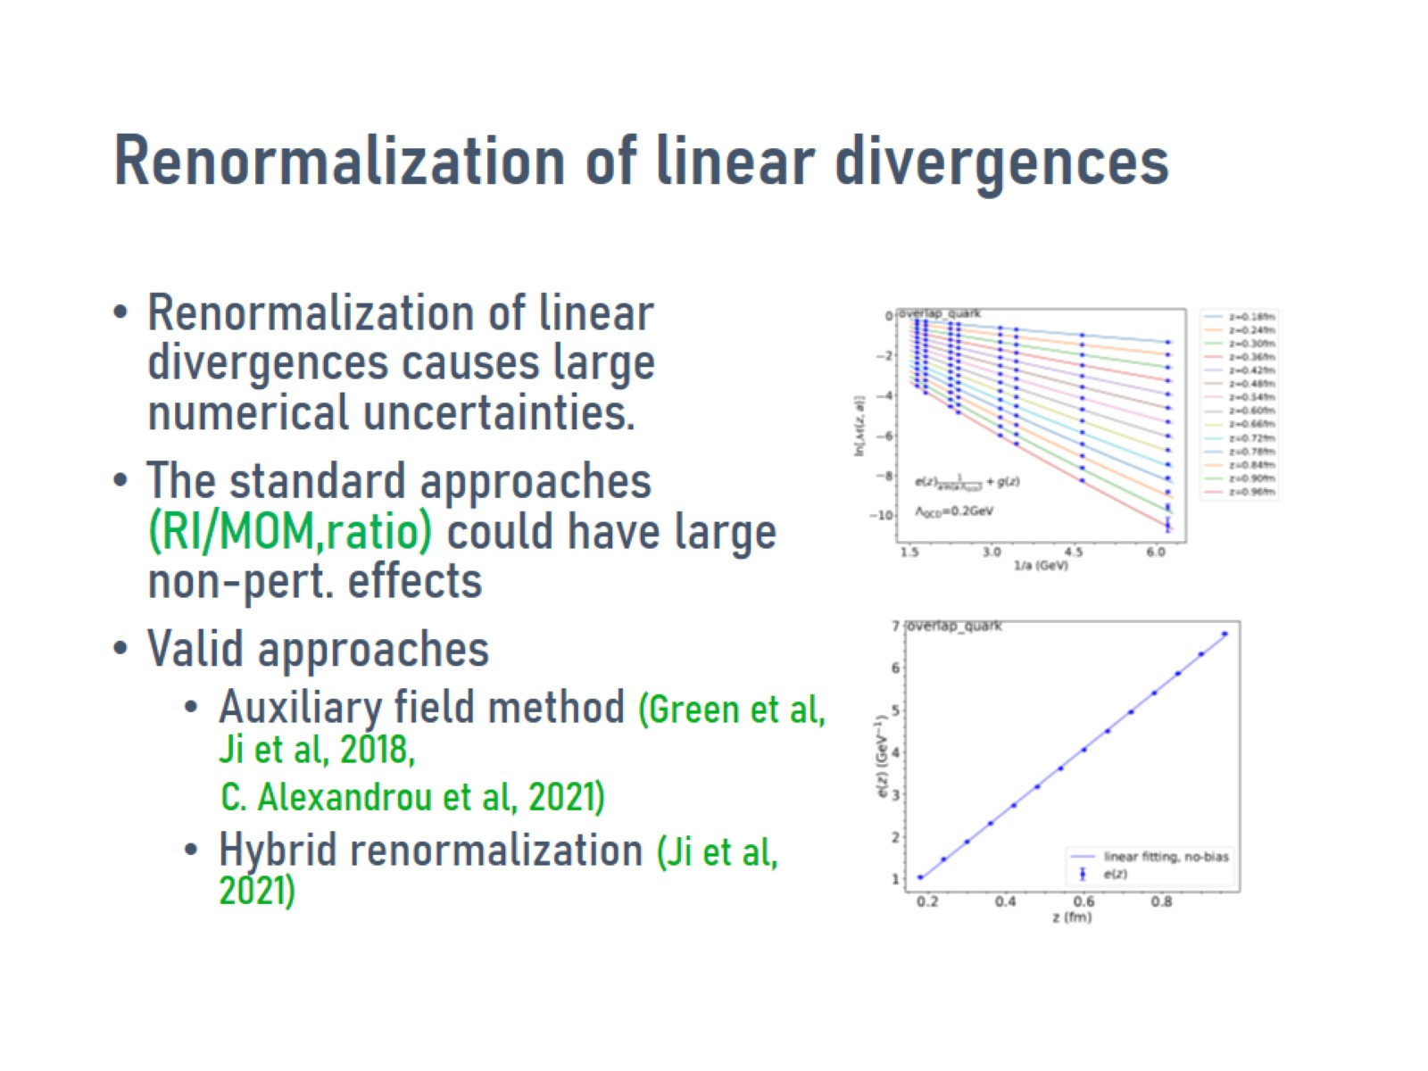
Renormalization of linear divergences

Slide 48
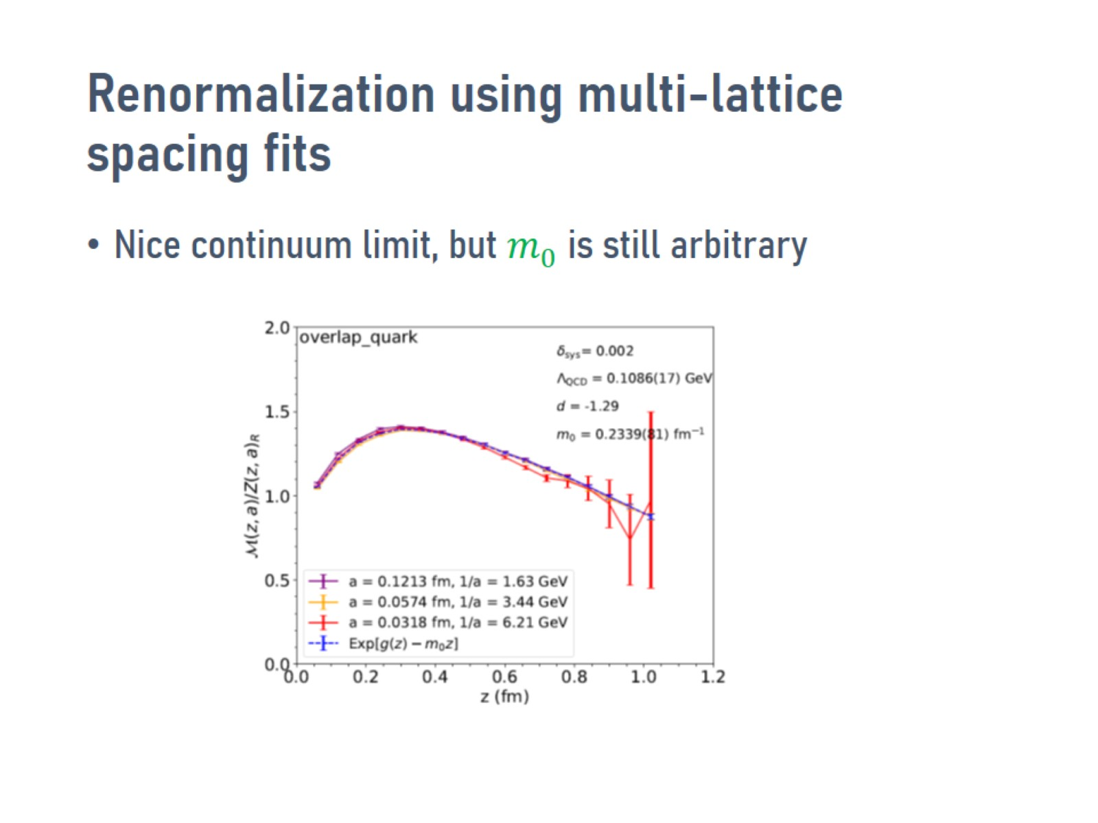
Renormalization using multi-lattice spacing fits

Slide 49
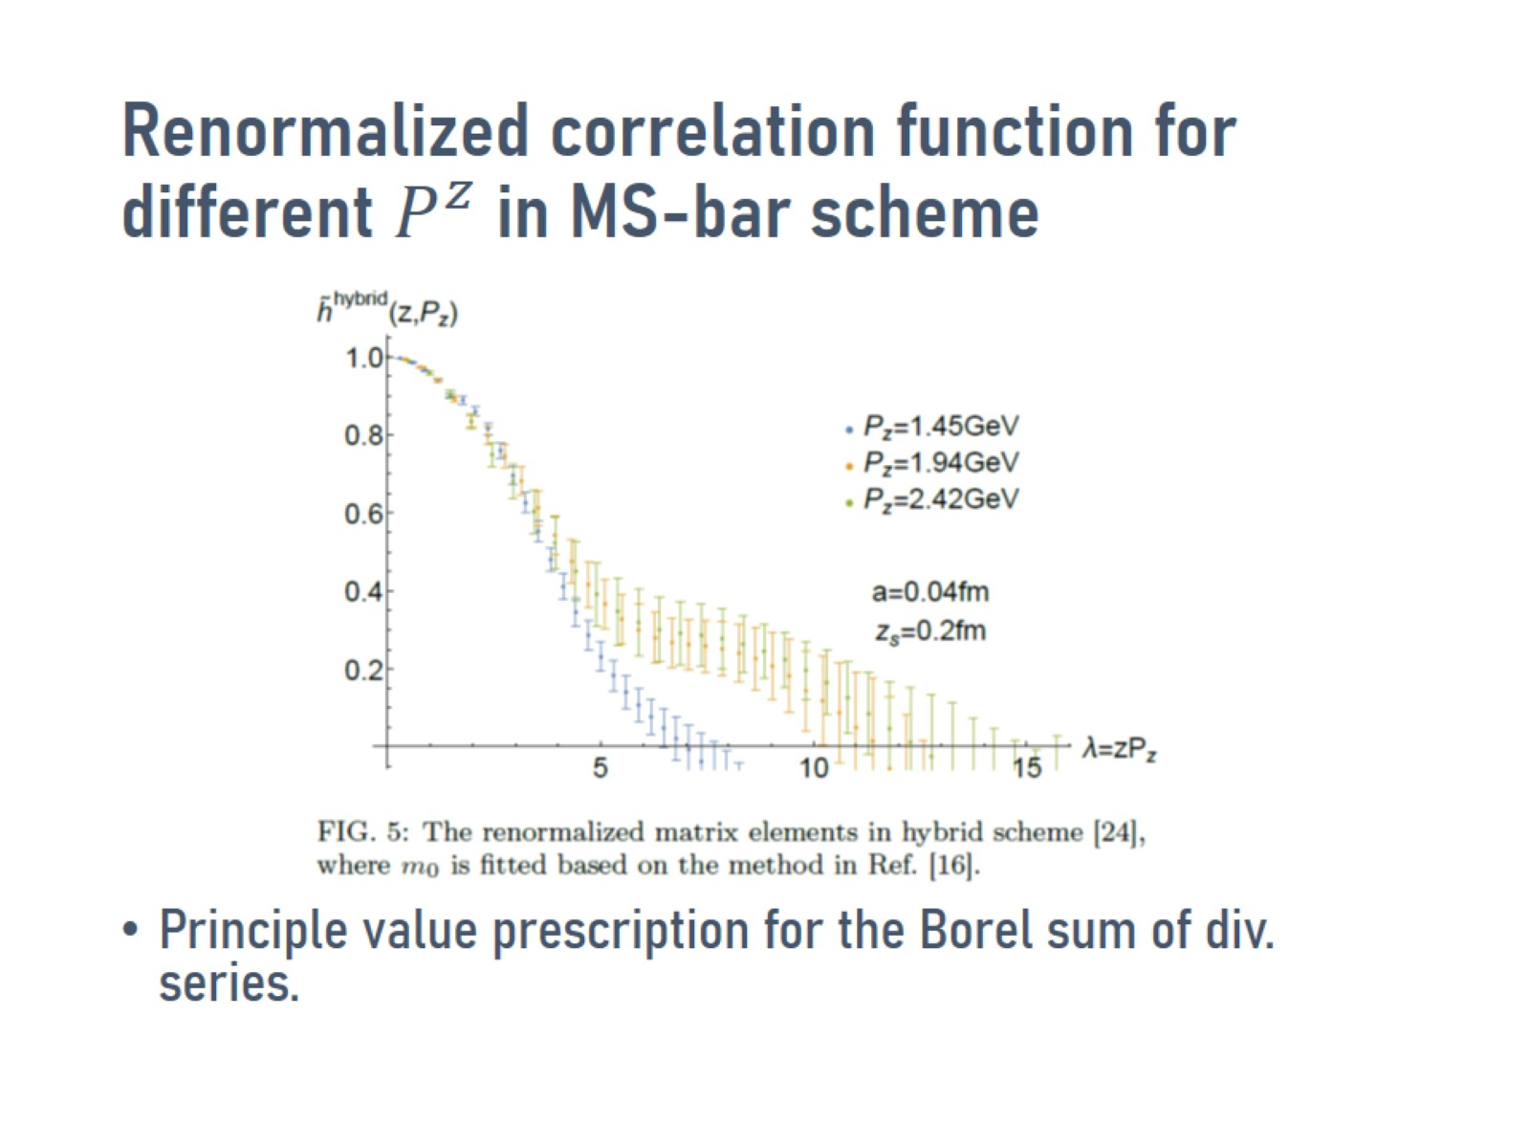

Renormalized correlation function for different $P^{z}$ in MS-bar scheme

Slide 50
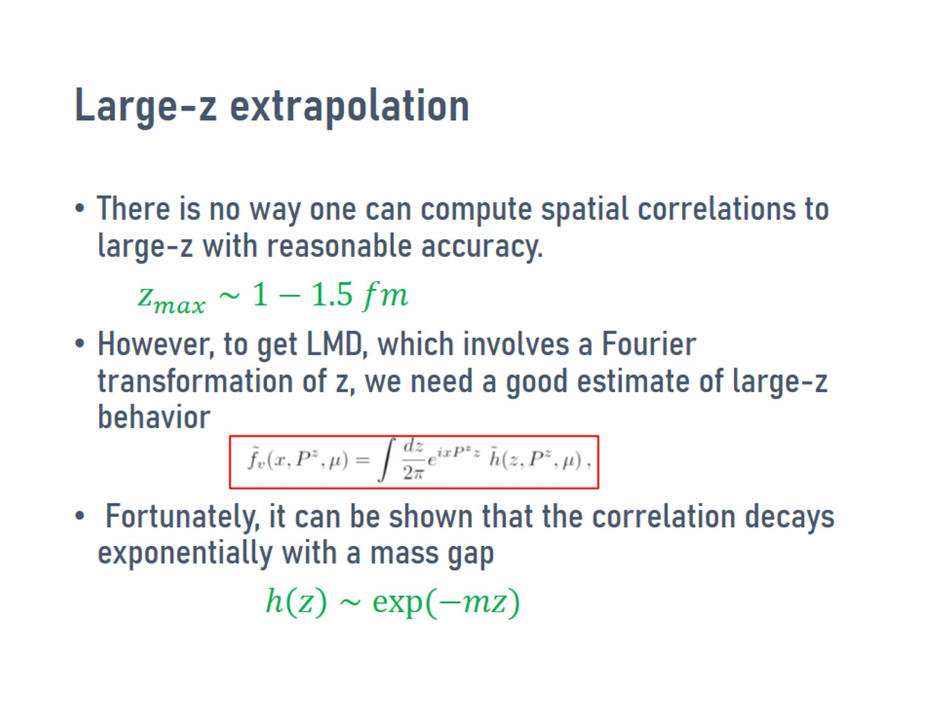
Large-z extrapolation

Slide 51
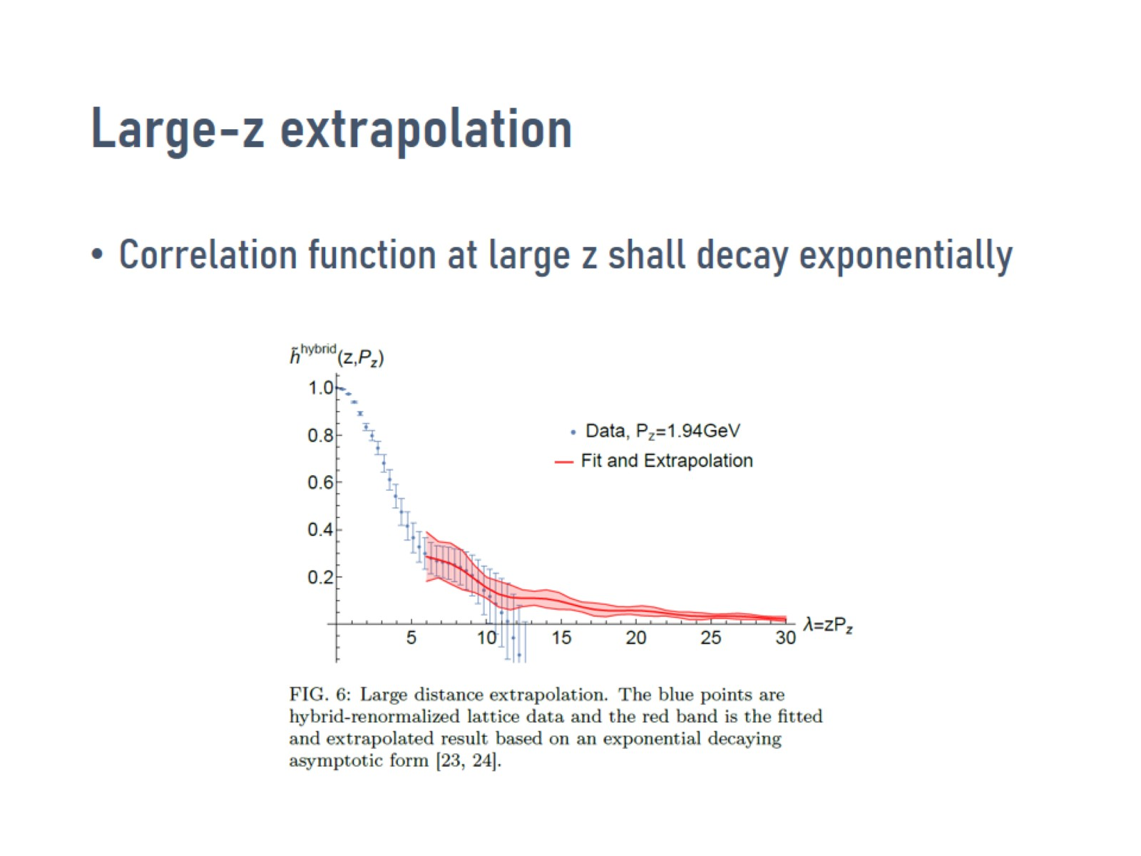
Large-z extrapolation

Slide 52

Leading order LaMET expansion coefficient

Slide 53

Leading order LaMET expansion for PDF

Slide 54

Leading-order lattice PDF vs exp fits X.Gao et al. PRL108 (2022), ANL/BNL collaboration

Slide 55

Resummation of the large logs

Slide 56

Leading renormalon resummation R. Zhang et al, Phys.Lett.B 844 (2023) 138081

Slide 57

Precisions in expansion Y. S. Su et al.

Slide 58

Examples of state-of-art calculations

Slide 59

Updated comparison with exp data

Slide 60

Quark transversity dis. in the proton F. Yao et al. Phys. Rev. Lett. 131,261901 (2023)

Slide 61

Generalized Parton Distributions

Slide 62

Pion GPDs: H.T.Ding et al, JHEP 02 (2025) 056

Slide 63

Quark transverse-plan distributions in the proton from lattice (H.W.Lin, PRL2021)

Slide 64

TMD PDFs

Slide 65

Mom. Dis. & TMDPDF (Ji, Liu, Liu, PLB2020, Ebert et al 2022)

Slide 66

Collins-Soper evolution kernel

Slide 67

Soft function

Slide 68

First proton TMD PDF results J. C. He et al (LPC), Phys. Rev. D 109 (2024) 11, 114513

Slide 69

First pion TMD PDF

Slide 70

Conclusions

Slide 71


