Slide 1
The STAR PHENIX Direct-Photon Discrepancy
Axel Drees, CFNS, 8/22/2025
Direct Photon Emission from AA collisions
PHENIX results
  Experimental techniques
  Direct photon spectra and flow
PHENIX – STAR Discrapancy
Notes:
Ok, so here is the outline of my talk:
I have a very short introductions
And then I will focus on the PHENIX results, and that is split into three parts
The experimental techniques used
The results spectra & flow – where possible compare to ALICE results.
And then give you a preview on dilepton results that will
At the end I will address the PHENIX – STAR – ALICE comparison

Slide 2
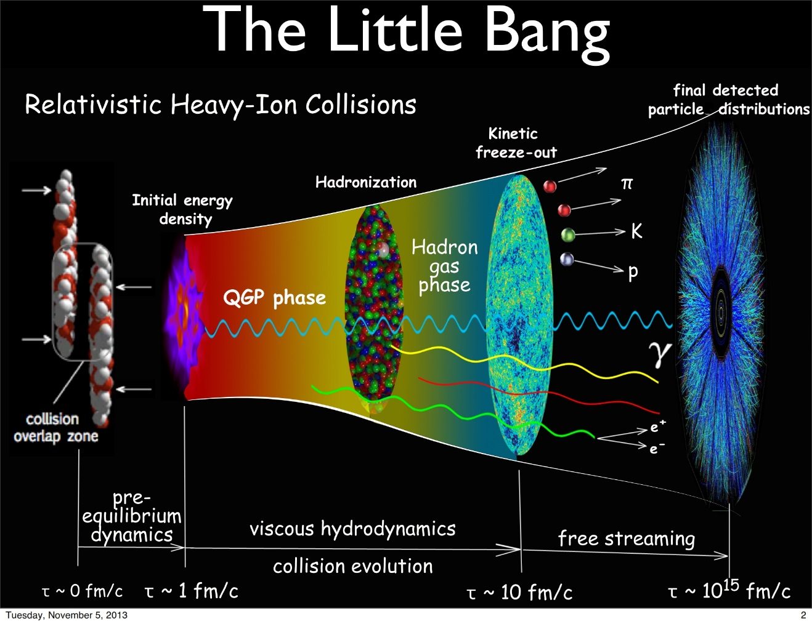


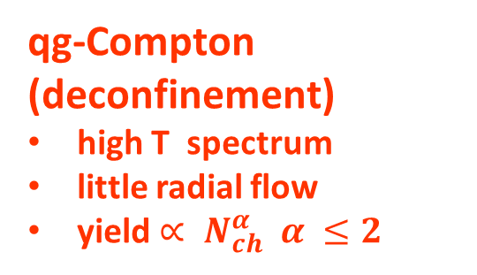
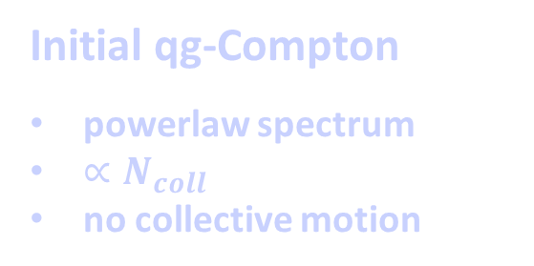
Electromagnetic Radiation in A+A Collisions:
160-110 MeV
110 MeV
Hubble Expansion: T=300-160 MeV
qg-Compton (deconfinement)
high T spectrum
little radial flow
yield $∝ N_{ch}^{α} α ≤2$
Confinement
Chiral symmetry breaking
Initial qg-Compton
powerlaw spectrum
$∝N_{coll}$
no collective motion
πρ Scattering
Low T spectrum
Large flow/ blue shift
yield $∝ N_{ch}^{α} α>1$
Hadron Decays
yield $∝ N_{ch}^{}$
Spectra derived from parent particles
<
Notes:
Photons are emitted during the entire duration of a heavy ion collision, and here I have adapted the sketch from Chun Shen to summarize in a big brush picture what properties we expect the photons to have that are emitted in a particular stage.
Hard scattering - hot and dense phase QGP/HG, temperature range 300 to 100 MeV – initially high temperature low blue shift – increasing radial expansion blue shift – drop of temperature, eventually decays of hadrons after freezeout
One important feature is that the contribution from each phase has a characteristic relation to the charged particle density that may help constrain sources and lifetime of fireball.

Slide 3
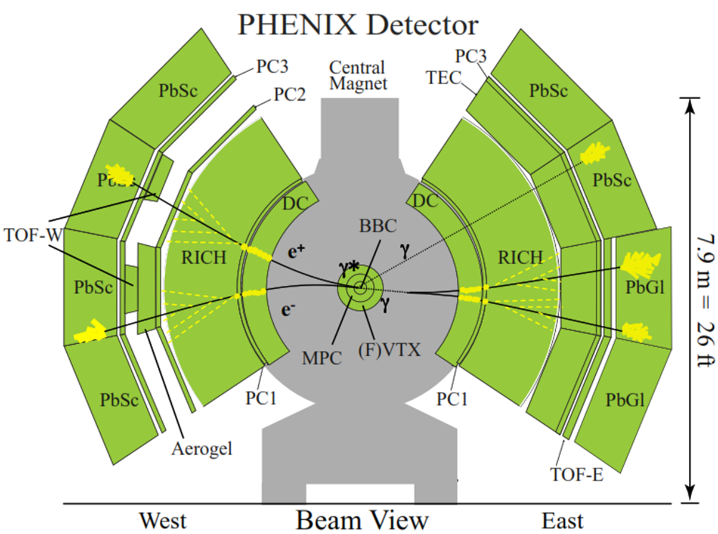
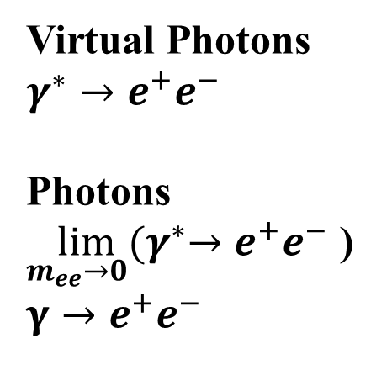
Photon Measurements with PHENIX
e⁺e⁻ identification
Photons,
neutral pion
γ, π⁰ → γ γ
E/p and RICH
final setup
Calorimeter
Virtual Photons
$$γ^{∗}→e^{+}e^{−}$$
Photons
$$\lim_{m_{ee}→0}{{(γ}^{∗}→e^{+}e^{−}\text{ ) }}$$
$$γ→e^{+}e^{−}$$
DC
PC1
magnetic field &
tracking detectors
Notes:
Photons are reasonably easy to measure, the difficulty is to extract the direct contributions from the order of magnitude larger decay photon yield.
In PHENIX we deploy 3 different methods to measure photons .. Cross section of central arm system
Direct measurement of energy in calorimeter
Or through e+e- pairs measured in the tracking system
Conversion in the detector material (mostly VTX)
Virtual photon or Internal conversions

Slide 4
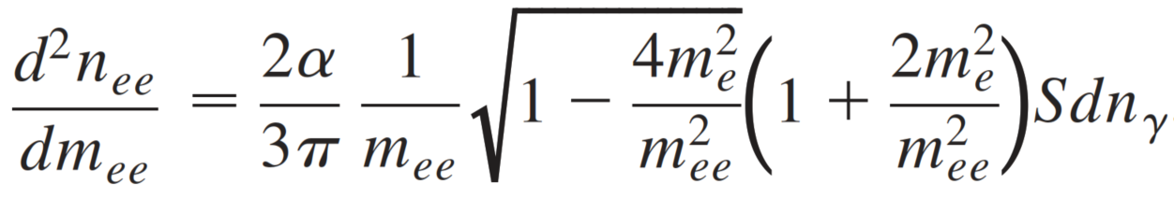
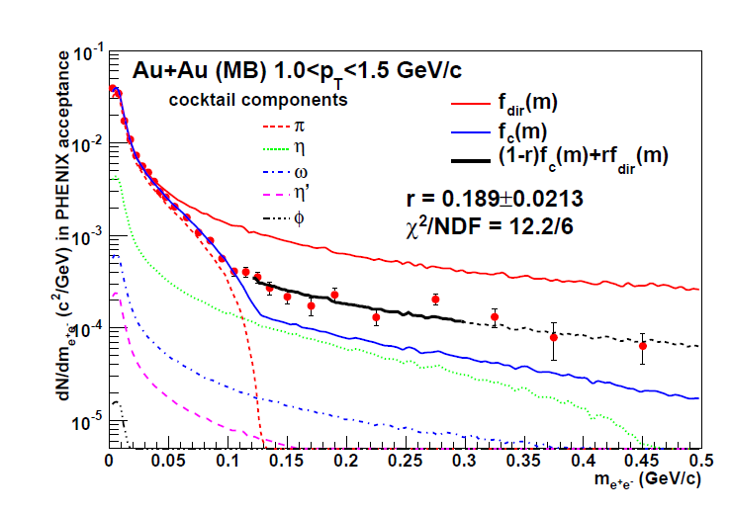

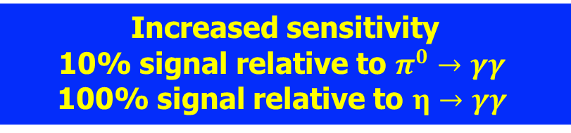
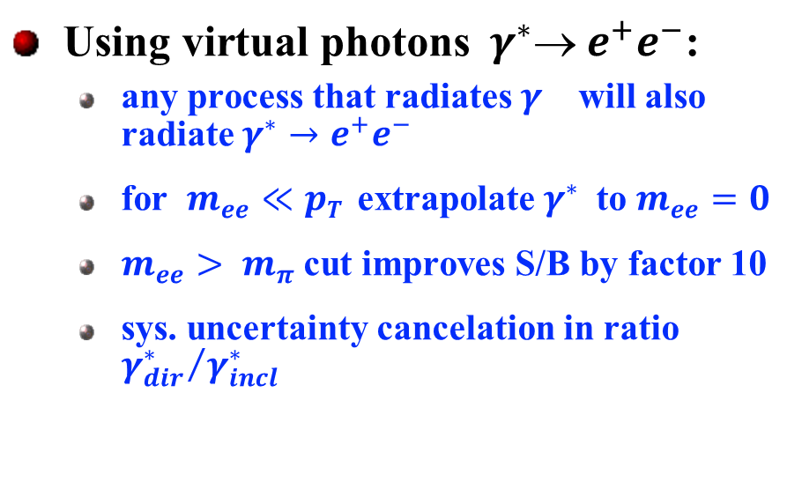
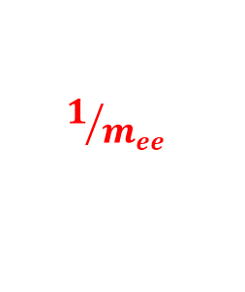
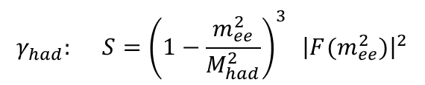
PHENIX low p_{T} Direct Virtual Photon Analyses
$$γ_{dir}: S \sim 1 for {m_{ee}≪p}_{T}$$
PhD – T. Dahms (2008)
$$γ_{had}: S={\left(1−\frac{m_{ee}^{2}}{M_{had}^{2}}\right)}^{3} {\left|F(m_{ee}^{2})\right|}^{2}$$
PHENIX: Phys. Rev. Lett. 104 (2010) 132301
Using virtual photons${ γ}^{∗} e^{+}e^{−}$:
  any process that radiates $γ^{}$ will also radiate $γ^{∗}→e^{+}e^{−}$
  for $m_{ee}≪pT$ extrapolate $γ^{∗}$to $m_{ee}=0$
  $m_{ee}> m_{π}$cut improves S/B by factor 10
  sys. uncertainty cancelation in ratio ${γ_{dir}^{∗}}/{γ_{incl}^{∗}}$
$$1/{m_{ee}}$$
Increased sensitivity
10% signal relative to $π^{0}→γγ$
100% signal relative to $η→γγ$
Direct γ* yield fitted in range 120 to 300 MeV
Insensitive to π⁰ yield
Notes:
I want to spend a few minutes to review how we extract the direct photon yields. And I start with the original measurement using virtual photon method published 15 years ago.
All processes that emit gamma also emit gamma* . For m<pt the yield can be extrapolated to m=0.
The mass distribution of virtual photons generally has a 1/m distribution, as shown here on the left. But for the decay photons the phase space is cut off by the parent mass which gives a distinct shape. And by going to mass > mpi one can remove the decay photons from pi0 decays, which increases the sensitivity by a factor of 10.
Finally by measuring the ratio dir/incl one can cancel many systematic uncertainties.

Slide 5
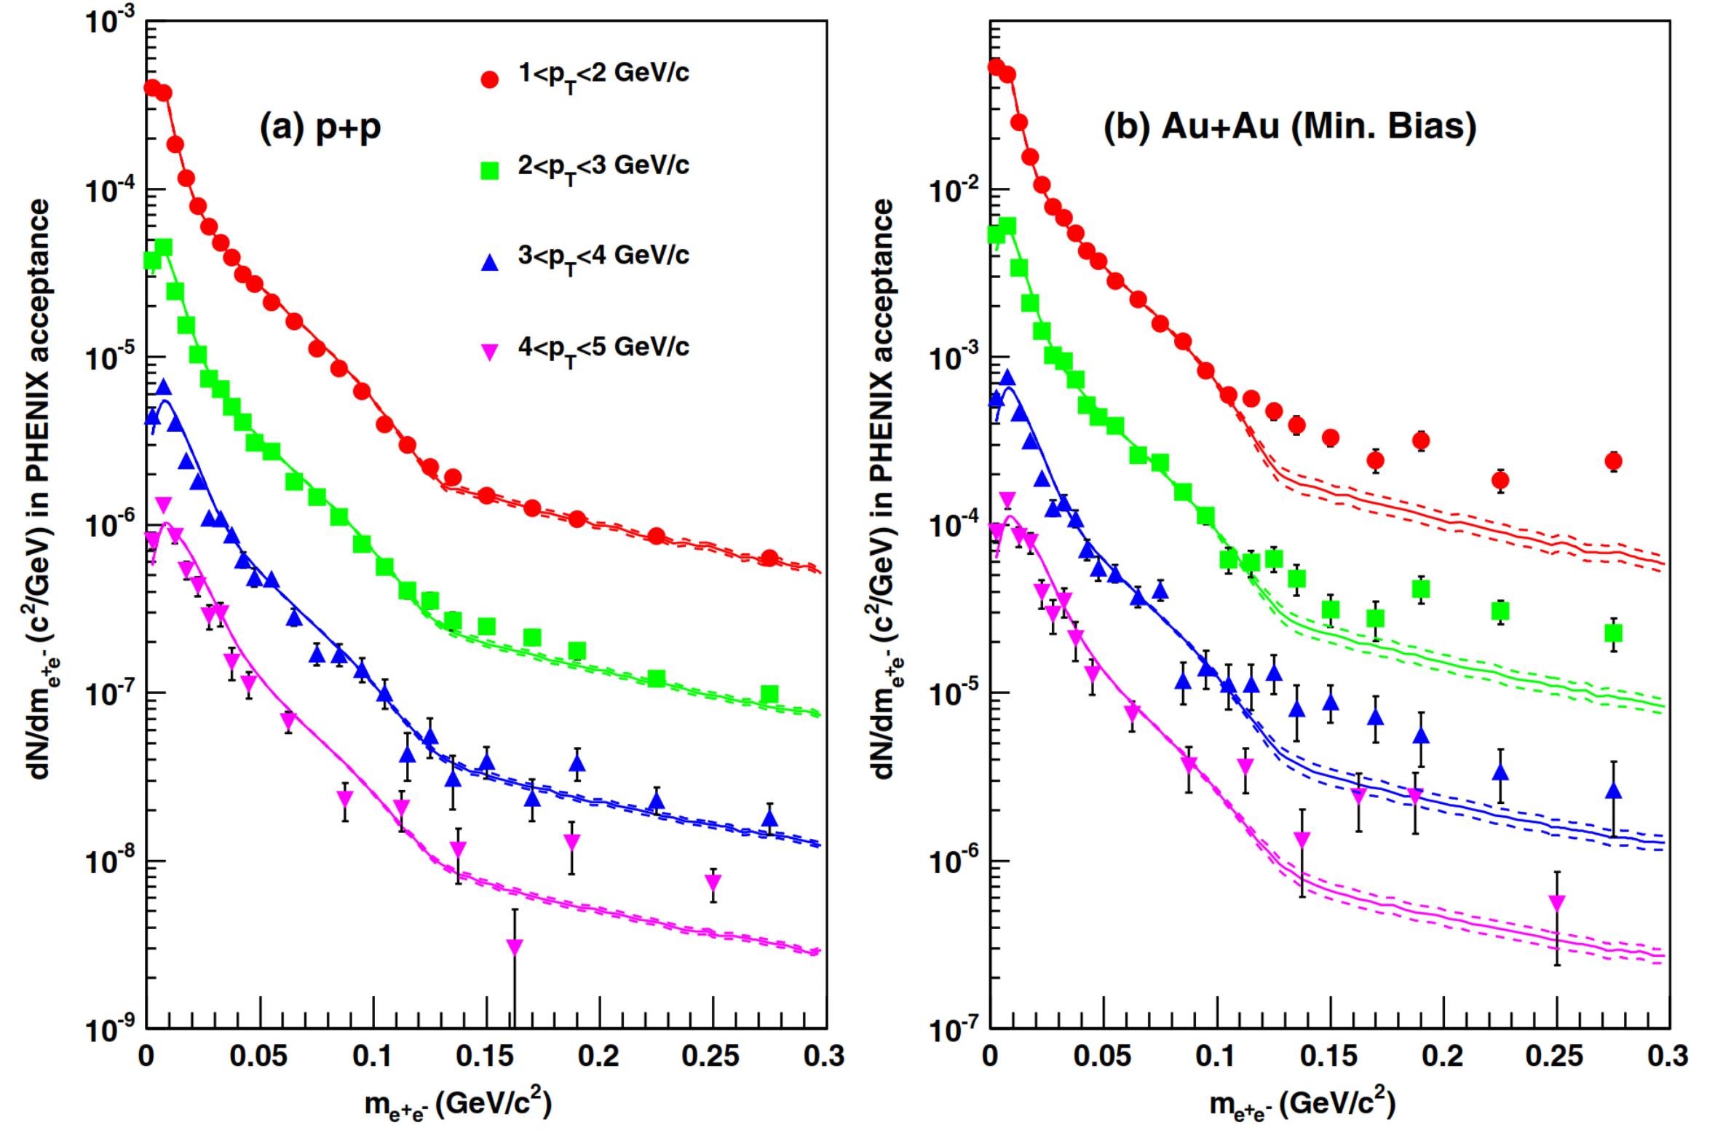
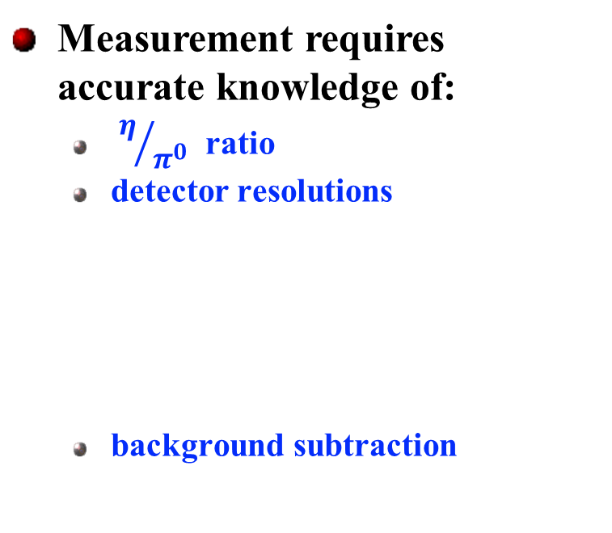
PHENIX Low p_{T} Direct Virtual Photon Analyses
PHENIX: Phys. Rev. Lett. 104 (2010) 132301
Measurement requires accurate knowledge of:
  $η/{π^{0}}$ ratio
  detector resolutions
  background subtraction
pp data confirm
understanding
S/B > 1/10
for p_{T} > 1 GeV
Min. bias AuAu
Notes:
An accurate measurement requires precise knowledge of
eta/pi0 ratio
Detector resolution (i.e. shape of mass distributions)
In PHENIX we have used pp collisions to assure ourselves that we control these inputs.
In AuAu one additional issue is the combinatorial background subtraction but that is reasonably small for pt>1 GeV.

Slide 6
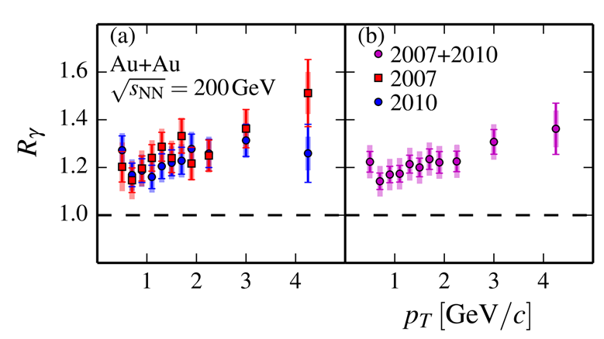
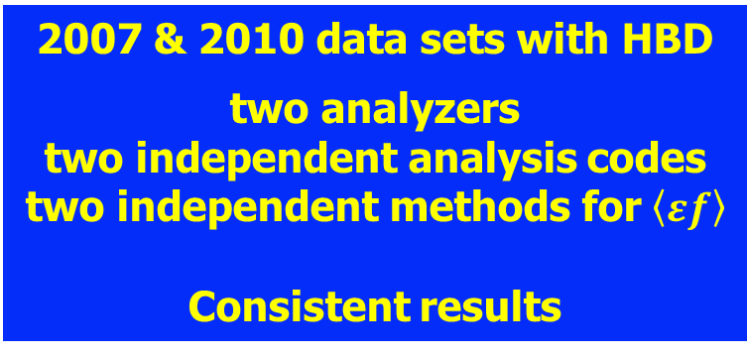
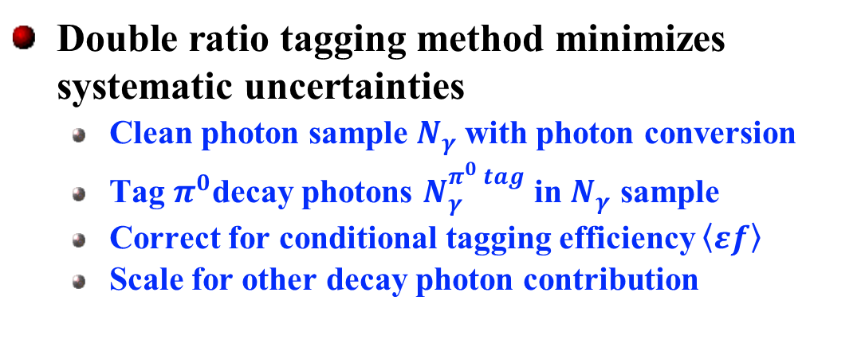
PHENIX Direct Photon $γ→e^{+}e^{−}$ (HBD) Measurements
Double ratio tagging method minimizes systematic uncertainties
  Clean photon sample $N_{γ}$with photon conversion
  Tag $π^{0}$decay photons $N_{γ}^{π^{0} tag}$ in $N_{γ}$ sample
  Correct for conditional tagging efficiency $\left\langle εf\right\rangle$
  Scale for other decay photon contribution
PhD - B. Bannier, R. Petti (2014/2013)
measured
raw yields
conditional
tagging efficiency
PHENIX: Phys. Rev. C 91 (2015) 064904
simulated based
on hadron data
2007 & 2010 data sets with HBD
two analyzers
two independent analysis codes
two independent methods for $\left\langle εf\right\rangle$
Consistent results
Notes:
Let me switch to real photons:
Photon conversions offer a nearly background free measurement of real photons, a fraction of these photons can be tagged with a photon measured in the calorimeter as pi0 decay photons. In the ratio of incl/tag all efficiencies and acceptance factor, including the conversion length, cancel, except for the conditional ef to tag a pi0 decay photon. Finaly one needs to account for the other hadron decay photons. That is done in this double ratio form assuring explicit cancelation of many systematic uncertainties.
We performed 2 simultaneous measurements from 2007/2010 data with the HBD that were published 2015: 2 data separate analyzers, 2 independent codes, 2 independent methods to determine ef. With consistent results.

Slide 7
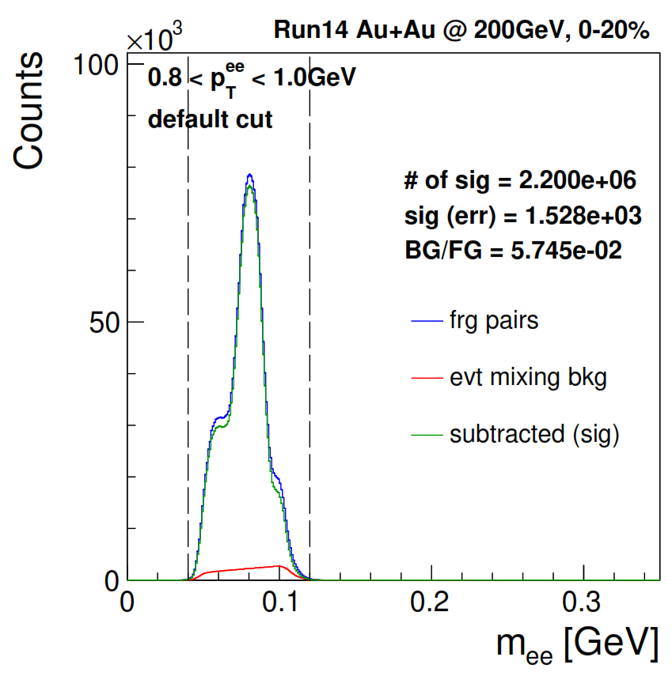
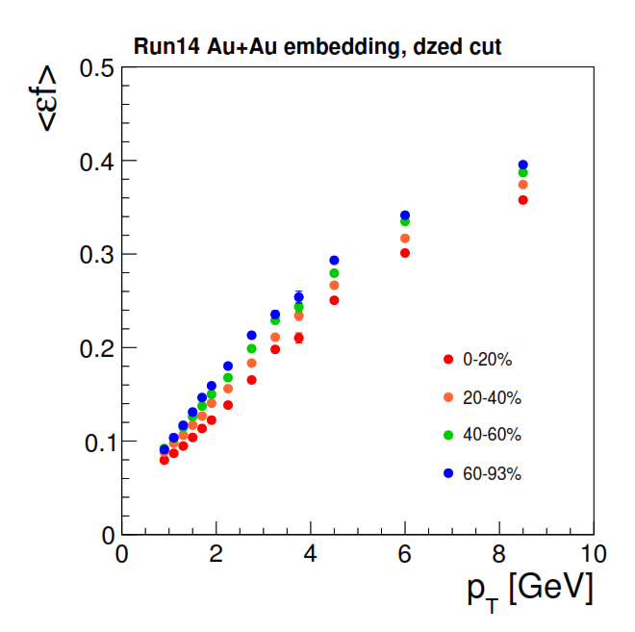
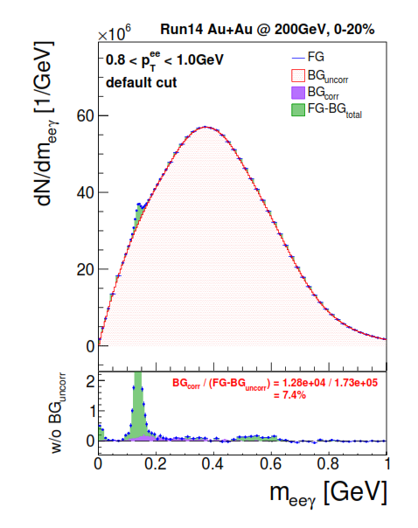



PHENIX Direct Photon $γ→e^{+}e^{−}$ (VTX) Measurements
PHENIX: Phys.Rev.C 109 (2024) 4, 044912
PhD – W.Fan (2019)
Full MC simulation
conditional
tagging efficiency
Closure test with full
high multiplicity
MC simulation
Key contributions
Energy cut
Acceptance
Detector material
measured
raw yields
$$N_{γ}^{}$$
$$N_{γ}^{π tag}$$
2014 high statistics data sets with VTX
independent analyzers
Different detector setup
Full MC closure test
consistent results
$η/π^{0}$ ratio
main contribution
Photons from
hadron decays
Notes:
Finally we performed a 3rd generation of measurements: real photon conversions in the VTX from the high statistics AuAu run in 2014. Published in 2024.
Completely different detector setup, new reconstruction code, and a new analyzer ..
This slide give much more details about each step of the analysis, I just want to point out that for this analysis a full MC closure test was performed showing that the absence of a signal leads to a null result.
Leads to yet another consistent result.

Slide 8
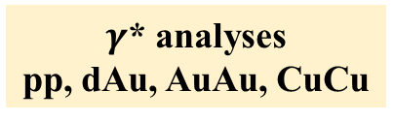
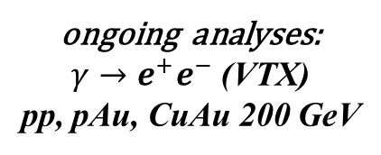
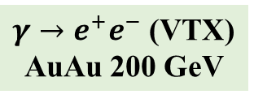
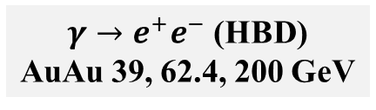
PHENIX Low p_{T} Direct Photon Analyses
$γ$* analyses
pp, dAu, AuAu, CuCu
$γ→e^{+}e^{−}$ (HBD)
AuAu 39, 62.4, 200 GeV
$γ→e^{+}e^{−}$ (VTX)
AuAu 200 GeV
ongoing analyses:
$γ→e^{+}e^{−}$ (VTX)
pp, pAu, CuAu 200 GeV
Multiple independent analyses with significant crosschecks
3 different methods, 11 theses, 10 publications
Notes:
Here is a full list of all analyses grouped in the three independent approaches I just outlined.

Slide 9
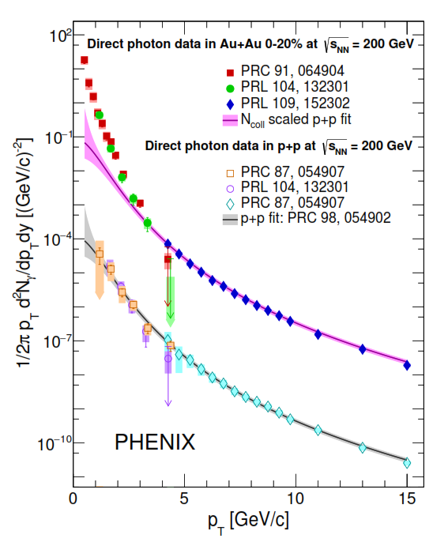
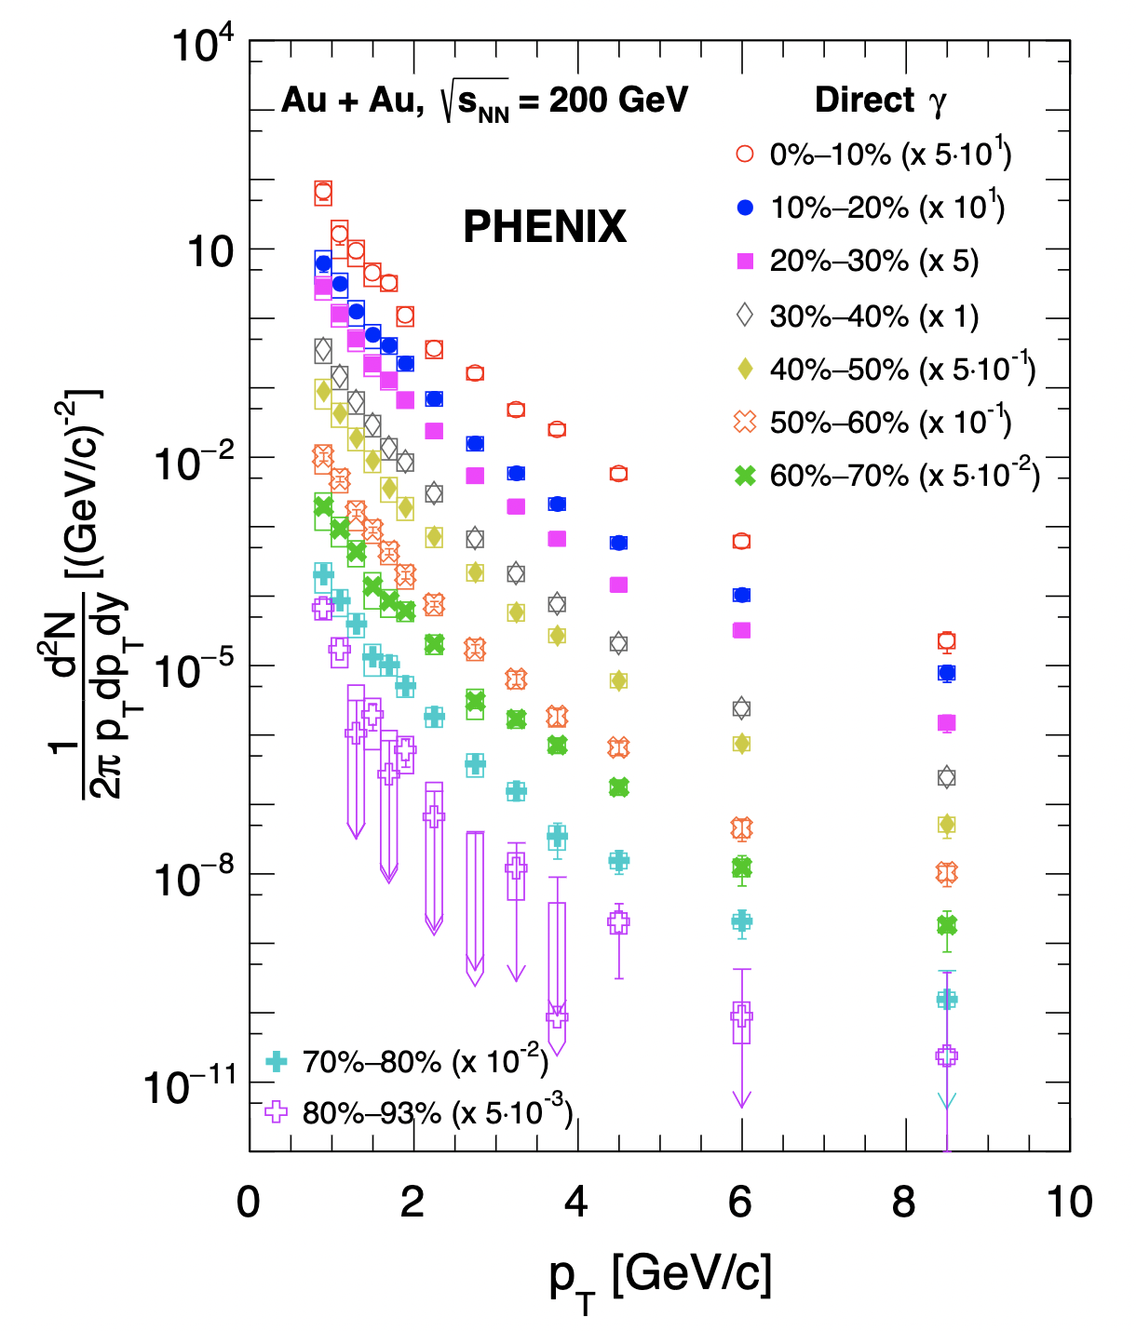
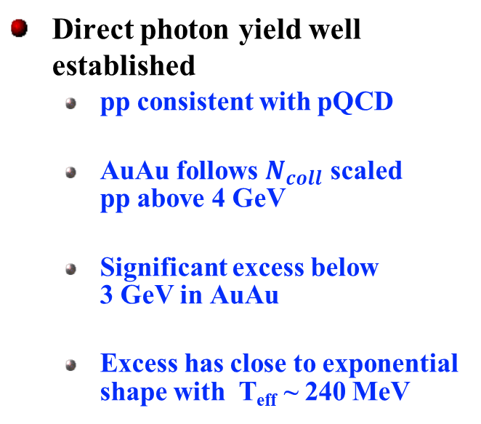
Direct Photons in p+p and Au+Au at √s_{NN}= 200 GeV
PHENIX: Phys. Rev. C 107 (2023) 2, 024914
PHENIX: Phys.Rev.C 109 (2024) 4, 044912
Direct photon yield well established
  pp consistent with pQCD
  AuAu follows $N_{coll}$ scaled pp above 4 GeV
  Significant excess below 3 GeV in AuAu
  Excess has close to exponential shape with T_{eff} ~ 240 MeV
High statistics Au+Au results reveal universal features
Notes:
With that we come to the results:
On the left hand side I show the momentum distribution of direct photons measured in pp (bottom) including a pQCD inspired fit, on the top are central 0-20% AuAu both at 200 GeV. Shown are results from multiple independent measurements. The pp data are consistent with pQCD calculations, when those are scaled up by the number of binary collisions AuAu is well described above 4 GeV, Below 3 GeV there is a significant excess, which resembles an exponential shape with an inverse slope of about 240 MeV. On the left is the most recently published results from the much larger 2014 data set. Results broken down into 10% bins in centrality.
In the following I will look at more details of the results.

Slide 10
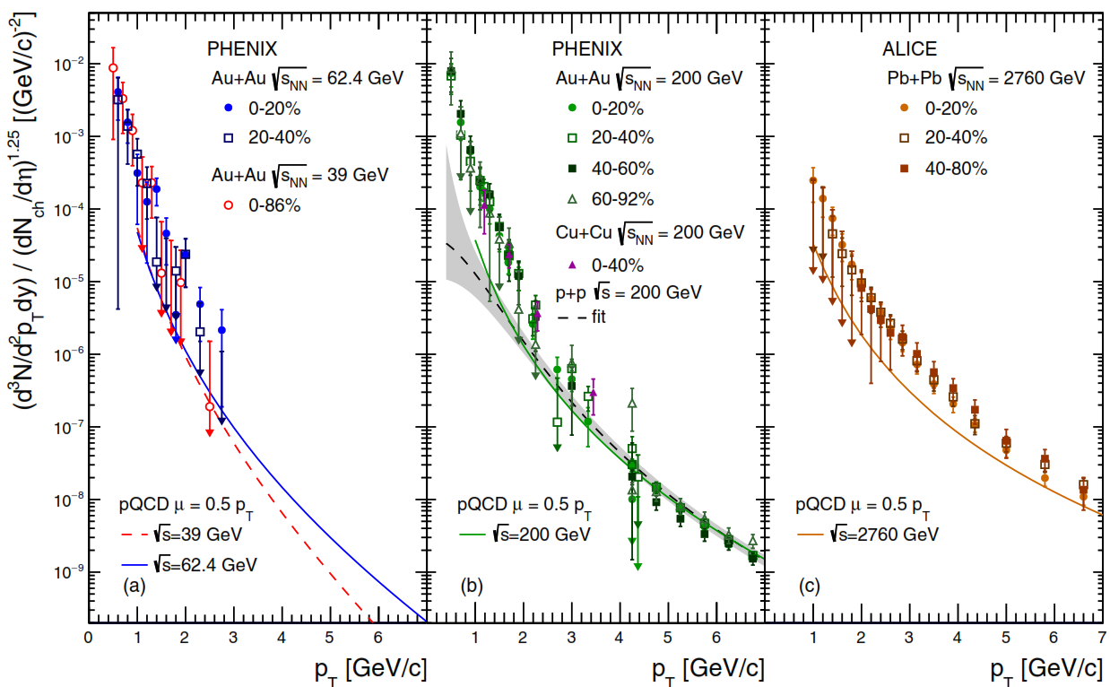
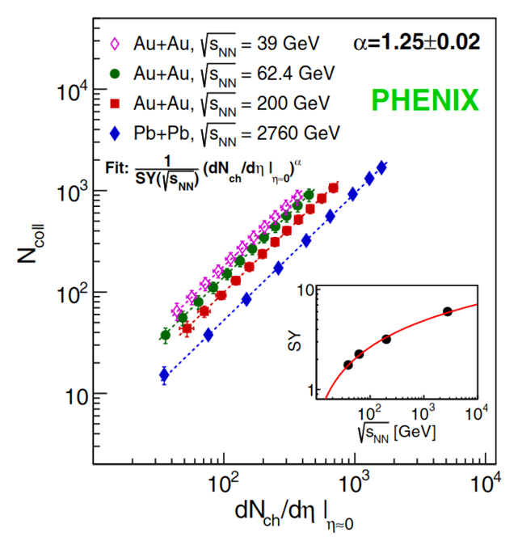
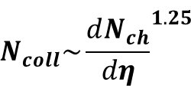
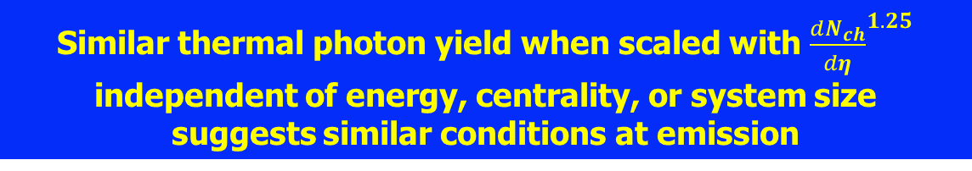
Low p_{T} “Thermal” Photon Region
PHENIX: Phys. Rev. C 107 (2023) 2, 024914
PHENIX: Phys. Rev. Lett. 123 (2019) 022301
$$N_{coll}\sim {\frac{dN_{ch}}{dη}}^{1.25}$$
Similar thermal photon yield when scaled with ${\frac{dN_{ch}}{dη}}^{1.25}$
independent of energy, centrality, or system size
suggests similar conditions at emission
Notes:
Ok lets turn back to low pt. This is a similar plot as before but focused on the low pt range and separated by sqrt(s).
First we will look at the integrated yield verses Nch, and then at inverse slopes.

Slide 11
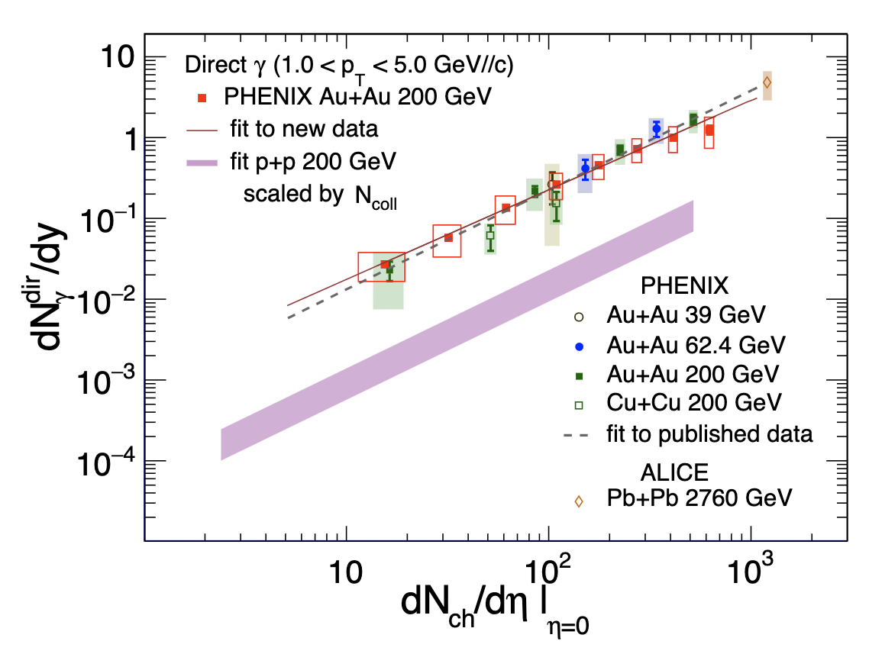
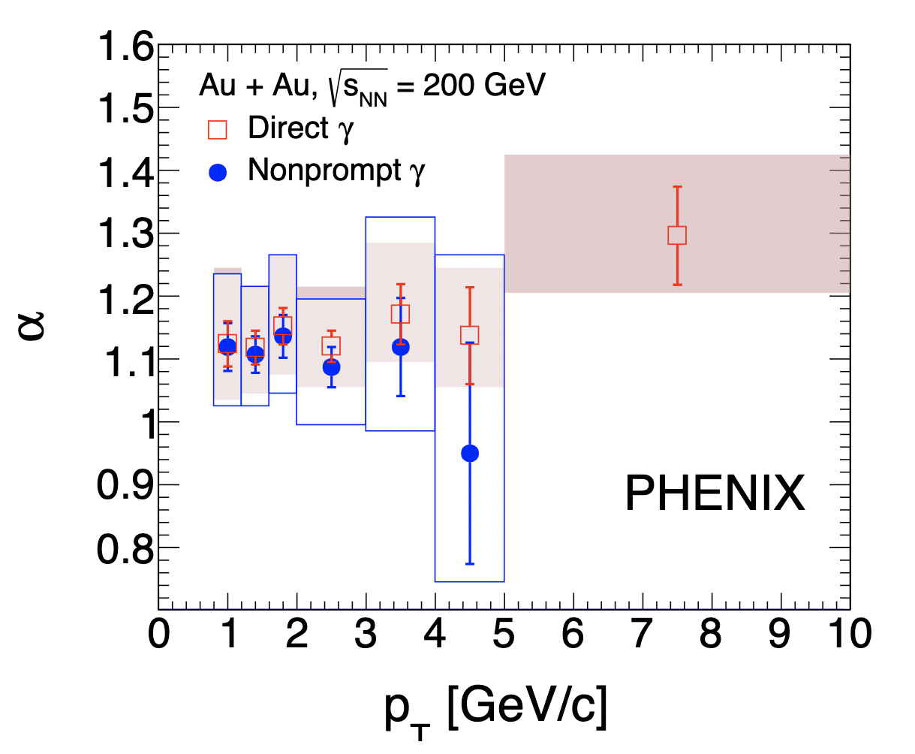


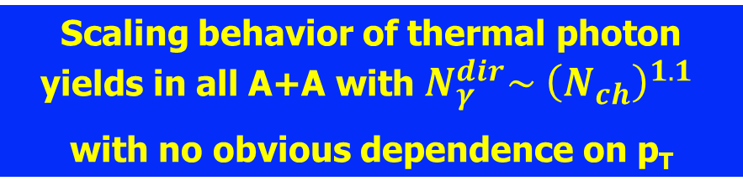
System Size and Energy Dependence of Direct Photon Yield
PHENIX: Phys. Rev. C 109 (2024) 4, 044912
PHENIX: Phys. Rev. C 107 (2023) 2, 024914
ALICE: Phys. Lett. B 754 (2016) 235-248
$$\frac{dN_{γ}}{dy} ∝(\frac{dN_{ch}}{dη})^{α}$$
$$α=1.11 ±0.02 \left(stat\right){}_{−0.08}^{+0.09}{(sys)}$$
Scaling behavior of thermal photon yields in all A+A with $N_{γ}^{dir}\sim {\left(N_{ch}\right)}^{1.1}$
with no obvious dependence on p_{T}
Notes:
The left hand side shows the yield 1-5 GeV vs Nch. All data sets follow the same trend, including PbPb data.
The dashed line corresponds to alpha 1.23, while the full line fits only the 2014 AuAu data and gives alpha = 1.1.
Furthermore, if the analysis is repeated in bins of pt one finds that alpha is essentially independent of pt.

Slide 12
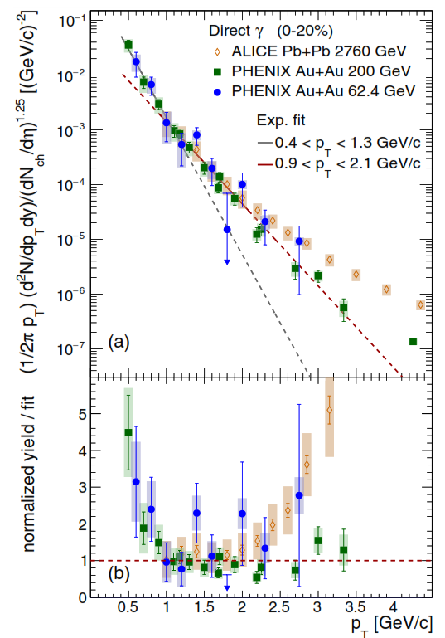
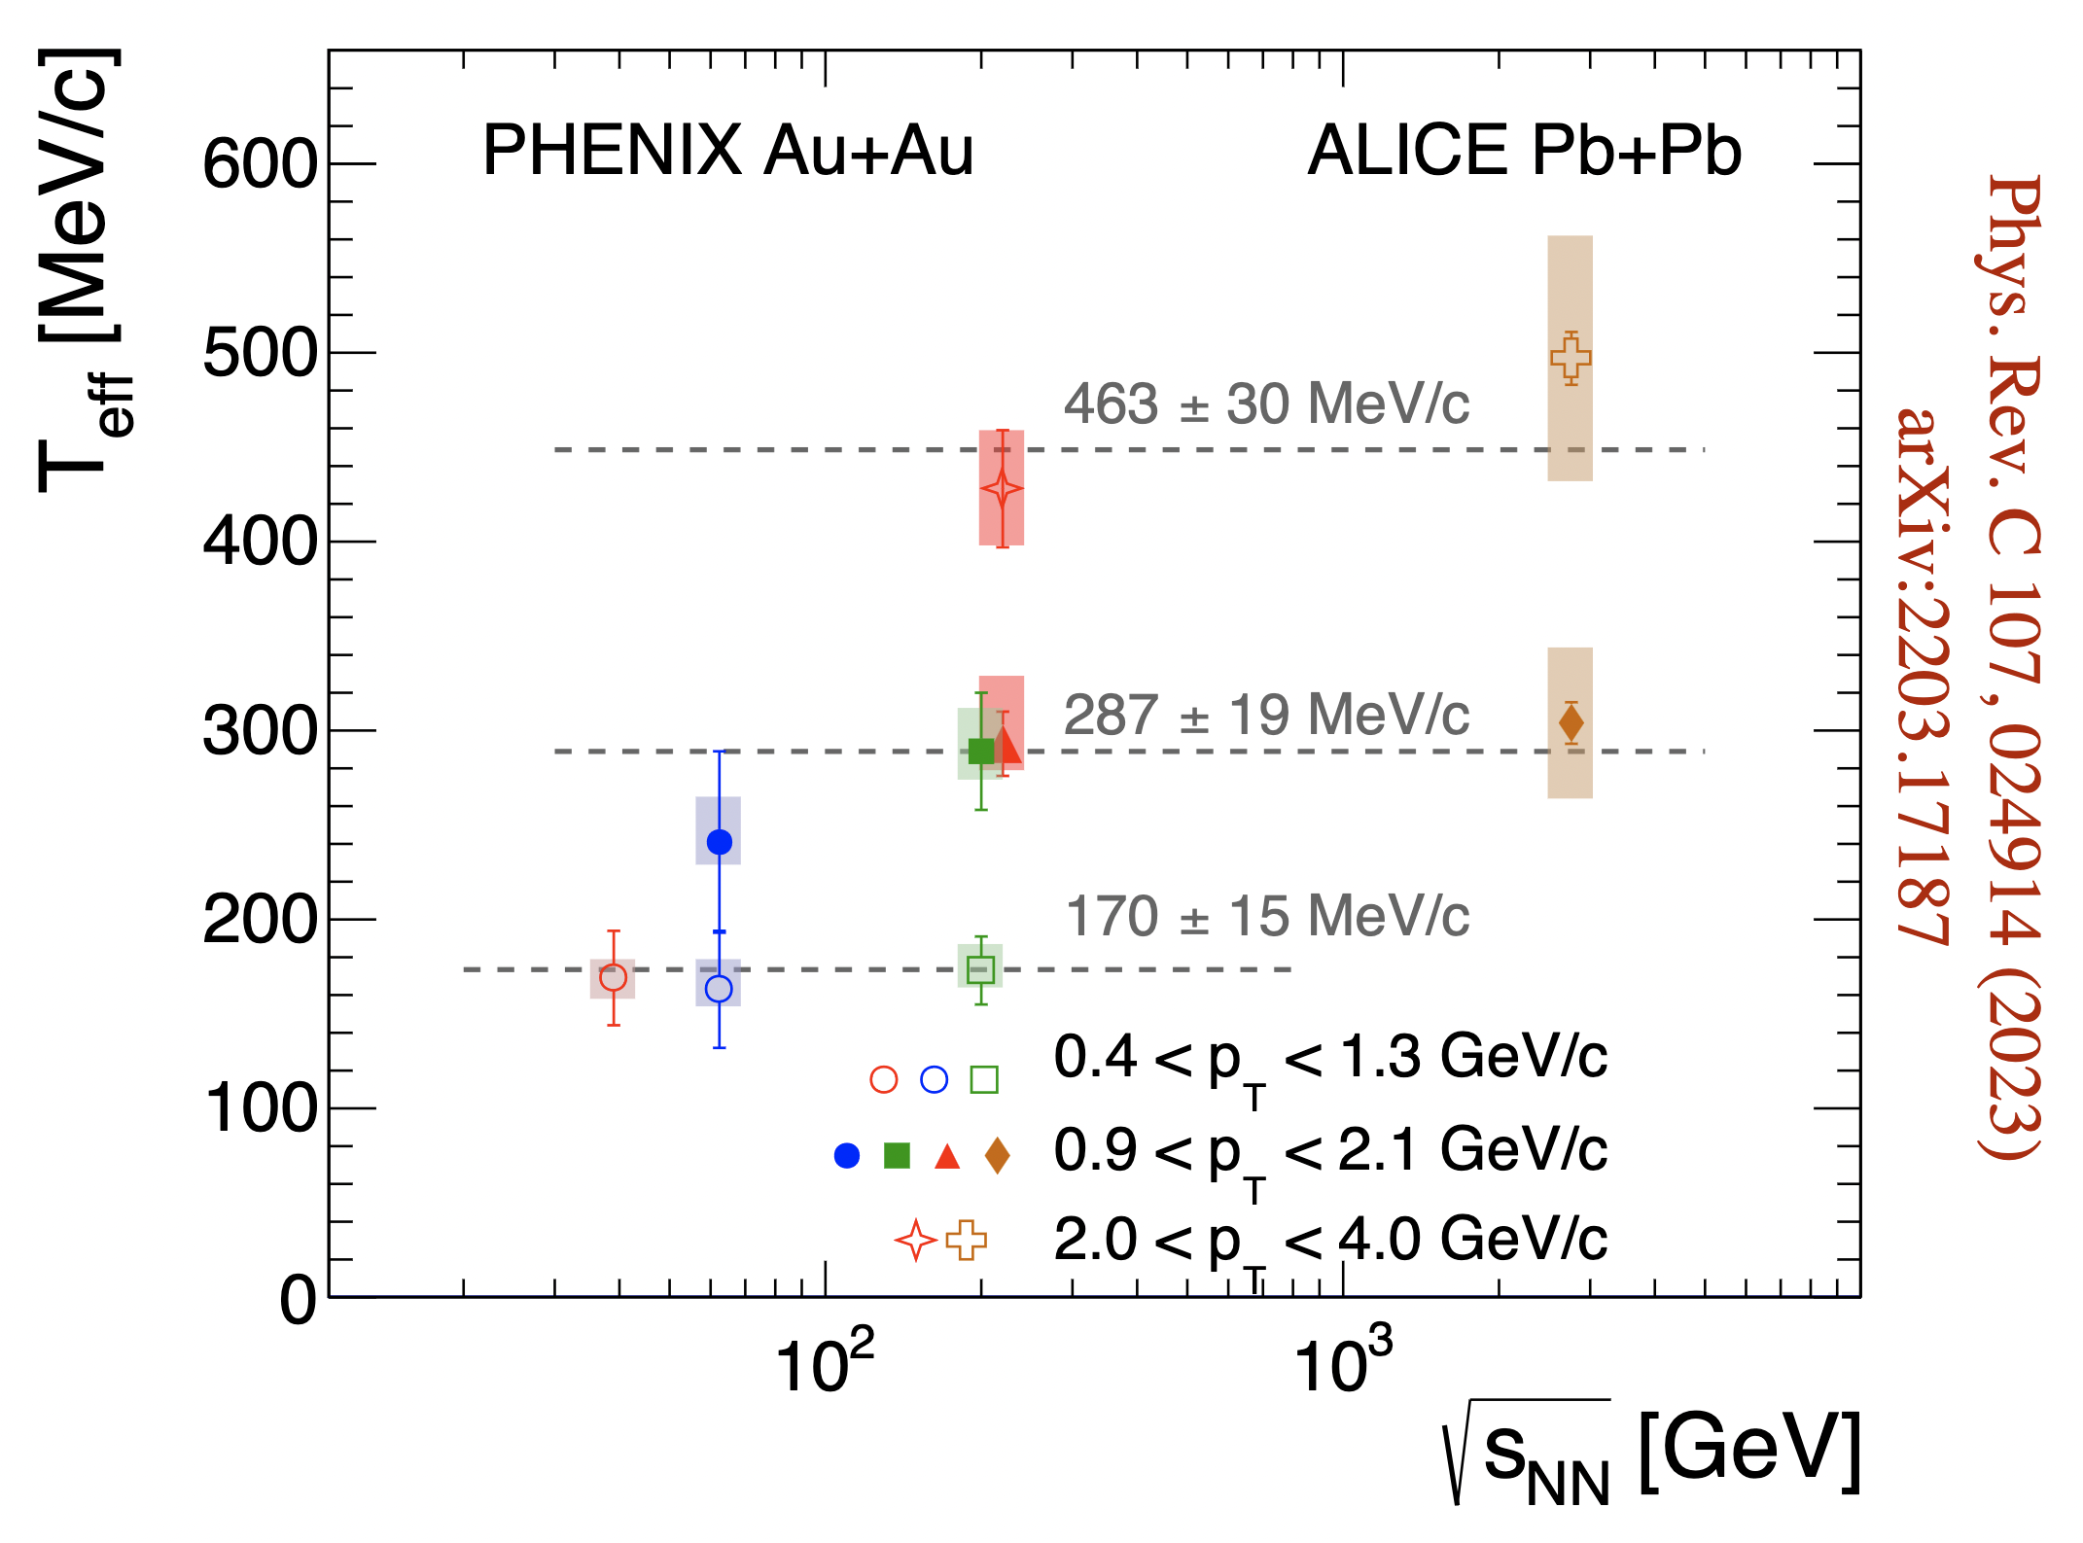
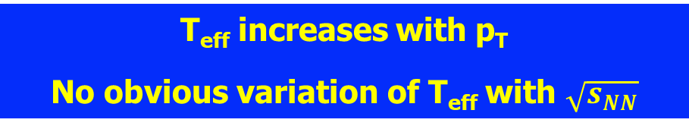
Energy Dependence of Spectral Shape
PHENIX: Phys. Rev. C 109 (2024) 4, 044912
PHENIX: Phys. Rev. C 107 (2023) 2, 024914
ALICE: Phys. Lett. B 754 (2016) 235-248
T_{eff} increases with p_{T}
No obvious variation of T_{eff} with $\sqrt{s_{NN}}$
Notes:
On left is another representation of the normalized spectra, overlaying results from central collisions for 62.4, 200, 2760 GeV in the region up to 5 GeV.
Below 2 GeV the spectra are very similar, but they are clearly not exponential, this is illustrated by two exponential fits to specific ranges, 0.4 < pt < 1.3 GeV and 0.9 < pt < 2.1 GeV. In the bottom panel the data are divided by the common fit in the 0.9 .. 2.1 GeV range. Over the fitted range the ratios for all data sets are consistent with unity indicating that they have the same Teff in this range.
More quantitative results are shown on the right, Teff fitted to each data set in 3 ranges vs sqrt(s). Lets first focus on 200 GeV: The inverse slope increases with pt from 170 MeV for the lowest bin 0.4-1.3 to 290 MeV to more than 400 MeV for the 2-4 GeV range. Fits in the same pt range for other sqrt_s reveal no obvious sqrt_s dependence. Shape of the spectra are very similar, most of the photon emission seems to happen under similar conditions.
Here the top range 2-4 GeV already includes a prompt photon contribution.

Slide 13
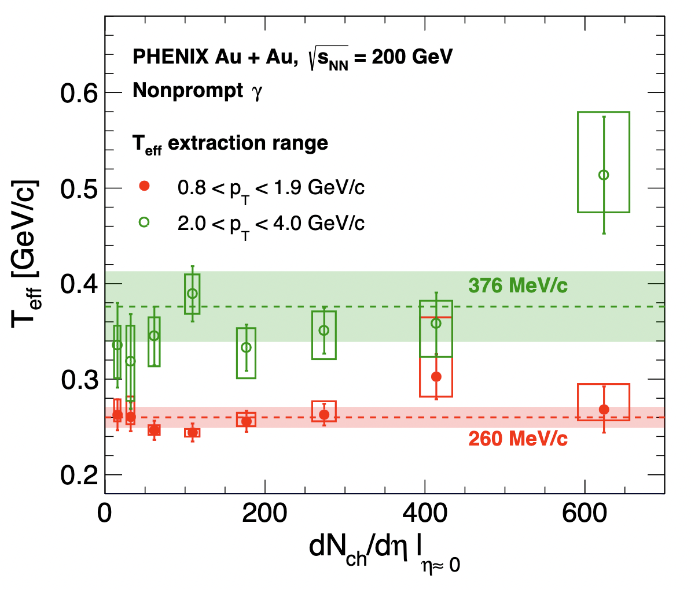
Centrality or System Size Dependence of Spectral Shape
PHENIX: Phys. Rev. C 109 (2024) 4, 044912
Nonprompt direct photons, i.e. photons from the fireball
  Teff increases with pt
  No obvious centrality dependence
T_{eff} ~ 260 MeV for 0.8 < p_{T} < 1.9 GeV
  Consistent with emission at chemical equilibrium + blue shift
T_{eff} ~ 370 MeV for 2.0 < p_{T} < 4.0 GeV
  Consistent with earlier emission, possible from pre-equilibrium phase
Data suggest bulk of emission near phase boundary
Indication of preequilibrium emission
Notes:
To explore this more we subtract the prompt component from the 2014 AuAu data and redo the fits.
Shown here are the results for two pt ranges for 10% centrality bins. All centralities give consistent results with no obvious centrality dependence.
For the range 0.8-1.9 GeV Teff is 260 MeV, effectively unchanged from before, which is consistent with emission near the phase boundary at chemical equilibration, plus radial flow.
For the range 2-4 GeV the slope is somewhat reduced to ~370 MeV, near or above what is expected for the initial temperature at RHIC. This suggest earlier emission, possibly from the preequilibrium phase.

Slide 14
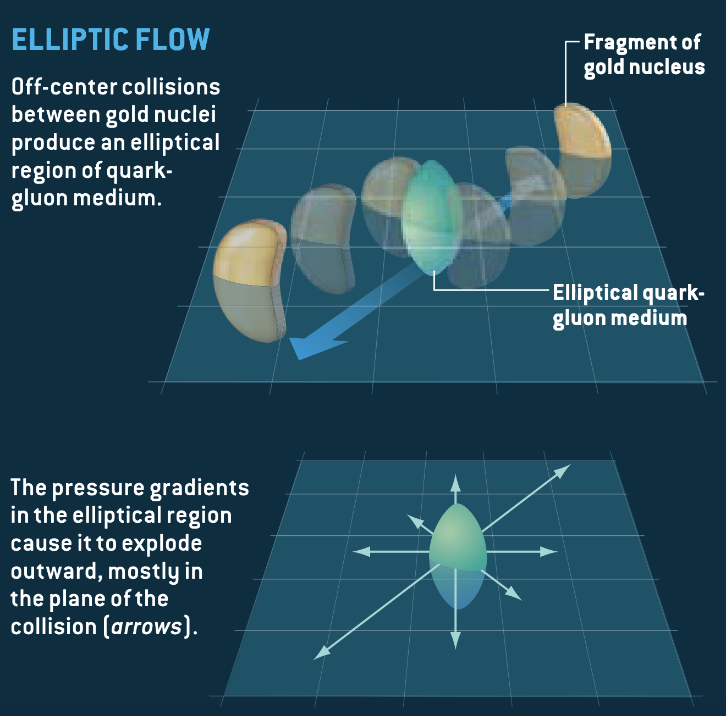
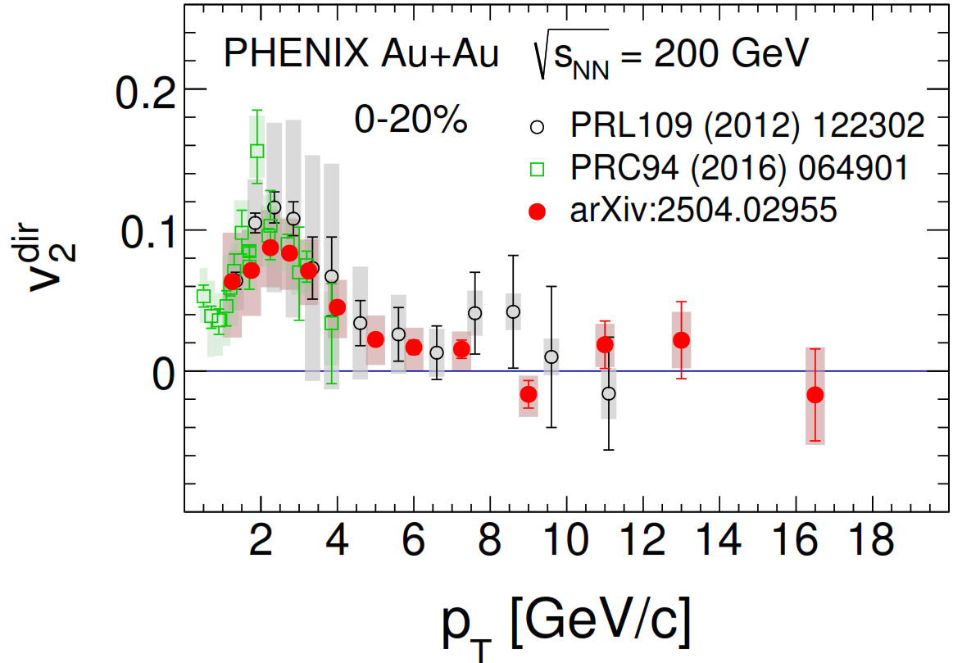
Azimuthal Anisotropy of Direct Photon Production
Fireball from collision rapidly expands
  Radial flow with anisotropy with respect to the reaction plane (elliptic flow)
Direct photons emitted from collectively expanding matter
  Anisotropic Doppler shift
PHENIX: arXiv:2504.02955
Notes:
The reaction volume explodes and cools rapidly, in transverse direction the expansion is anisotropic, and that anisotropy is imprinted in the momentum spectra of the produced particle .. Referred to as elliptic flow and characterized by v2. Photons are emitted from the exploding matter and thus blue shifted, with an azimuthal anisotropy.
That is what one finds experimentally, shown is here the v2 coefficient of direct photons as function of pt. The red points are our newest results, compared to other earlier results for 0-20% centrality. Results are consistent, v2 is positive, peaks around 2-3 GeV, and becomes zero at high pt where direct photon production is dominated by hard scattering.

Slide 15
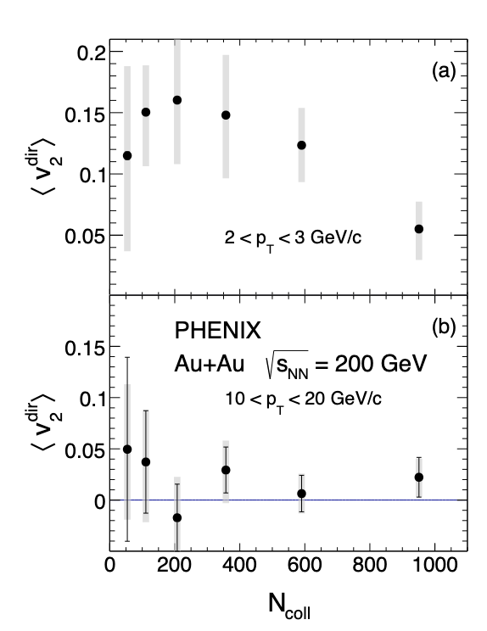
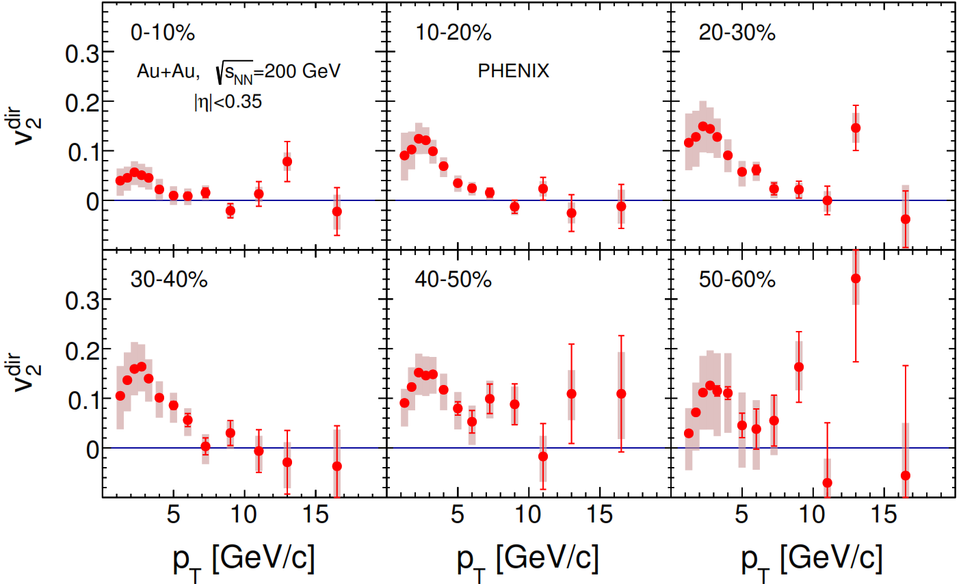
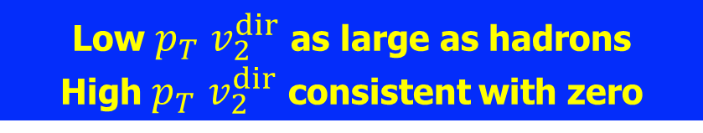
Direct Photon Azimuthal Anisotropy
PHENIX: arXiv:2504.02955
Low $p_{T}$ $v_{2}^{dir}$ as large as hadrons
High $p_{T}$ $v_{2}^{dir}$ consistent with zero
Notes:
We were able to measure the centrality dependence. There is a clear dependence at lower pt .. Similar to what is seen for hadrons, at high pt consistent with 0 and no obvious centrality dependence.

Slide 16
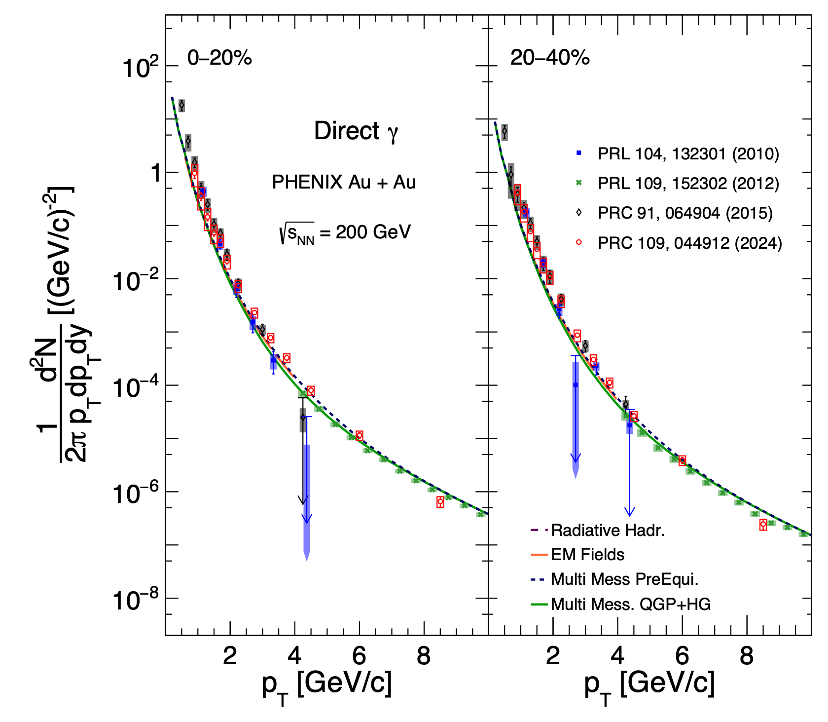
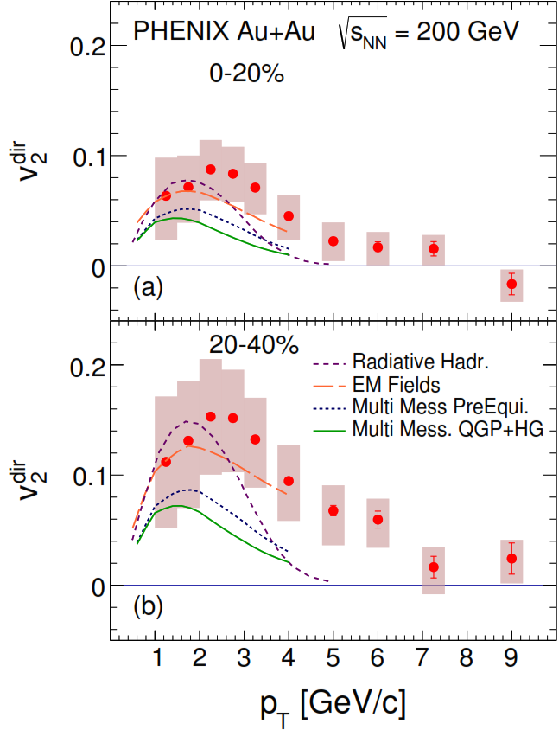
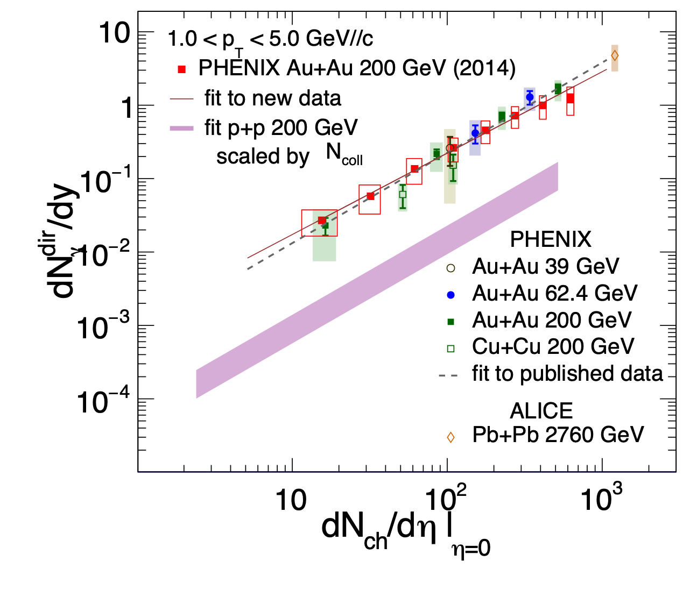
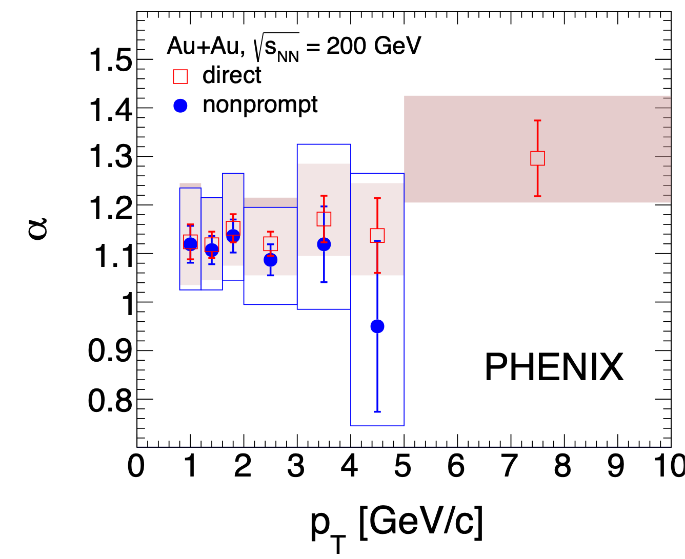
Comparison to Multi Messenger+ Model Calculations
PHENIX: Phys.Rev.C 109 (2024) 4, 044912
PHENIX: arXiv:2504.02955
PHENIX: Phys.Rev.C 109 (2024) 4, 044912
Model Calculations:
Gales et al. Phys. Rev. C 105 (2022) 014909
Sun et al. Nucl.Phys.Rev. 41 (2024) 558
Fujii et al. Acta Phys. Polon. Supp. 16 (2023) 1
Thermal Photon Puzzle:
Models qualitatively reproduce data
but fall short quantitatively
Notes:
With that I want to summarize to current results by comparing them to some recent model calculations.
This is of course an incomplete list that is chosen for illustrative purposes:
Green/blue is the multimessenger model HG/QGP w/wo preequilibrium, recent paper adding effect of magnetic fields red, another adding emission at hadronization purple.
On the left the models are compared to the spectra. Shapes are similar but generally the yields are lower than the data. In the middle is the v2, again the v2 falls short, though Bfield and emission at hadronization increases the v2. Finally on the left is the Nch dependence of the yield. It is not shown but the models predict an increasing alpha.
Overall the models reproduce the data qualitatively but fall short quantitatively.

Slide 17
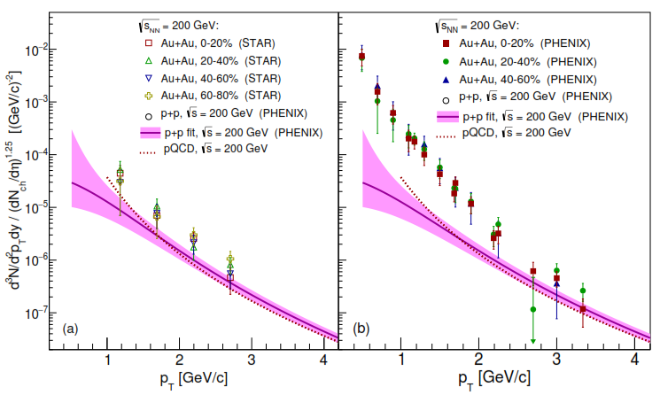
PHENIX – STAR Discrepancy
PHENIX γ→e⁺e⁻: Phys. Rev. C91 (2015) 064904
γ*: Phys. Rev. Lett. 104 (2010) 132301
STAR: Phys. Lett. B770 (2017) 451

Slide 18
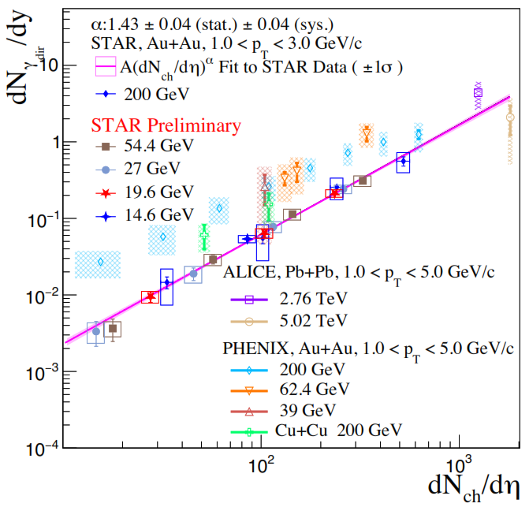


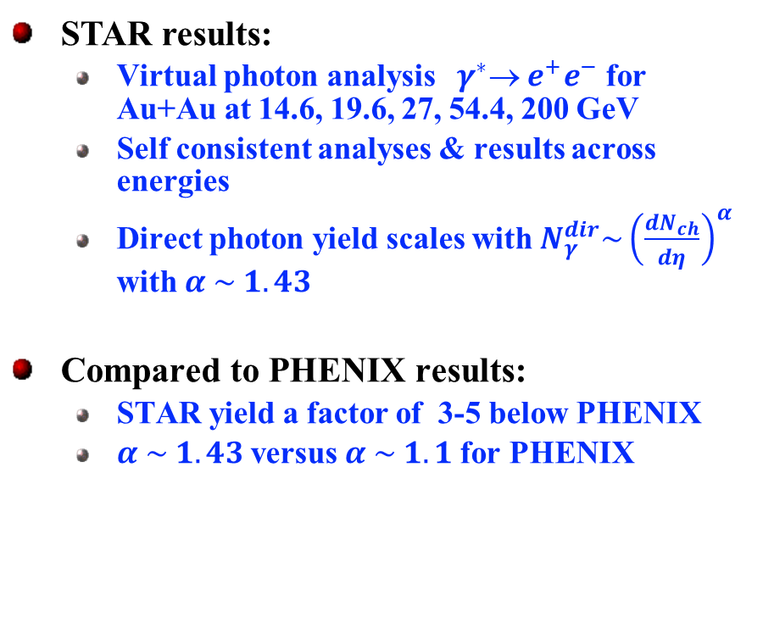
STAR vs PHENIX Discrepancy
STAR: QM2025
STAR results:
  Virtual photon analysis ${ γ}^{∗} e^{+}e^{−}$ for Au+Au at 14.6, 19.6, 27, 54.4, 200 GeV
  Self consistent analyses & results across energies
  Direct photon yield scales with $N_{γ}^{dir}\sim {\left(\frac{dN_{ch}}{dη}\right)}^{α}$ with $α \sim 1.43$
Compared to PHENIX results:
  STAR yield a factor of 3-5 below PHENIX
  $α \sim 1.43$versus $α \sim 1.1$for PHENIX
$$α=1.1$$
$$α=1.43$$
Differences need to be resolved!
Best option compare
Au-Au 200 GeV
virtual photon analyses

Slide 19


Direct Comparison on the Same Plot
Au+Au min. bias data
Same pt selection
All data is normalized
for m<30 MeV
STAR and PHENIX data agree well in
$π^{0} \& η$ Dalitz region
Cocktails do not agree
$η/{π^{0}}$ in STAR larger than in PHENIX

Slide 20

On the Same Plot
STAR and PHENIX data seem consistent for pt>2GeV!
There is a difference at lower pt

Slide 21

Next Steps
Collaborate with STAR
  Exchange AuAu virtual gamma data (not all in public domain or HEP data)
  Provide standalone software that reproduces experimental data
  Independently analyse data from both experiments with same cocktail
  Compare & discuss
On the PHENIX side
  Collect data in sharable form
  Develop standalone PHENIX simulator
  Create new cocktail based on today's knowledge
started

Slide 22




Reproducing Results with HELIOS & PHENIXSimulator
HELIOS is a new more modular decay generator that runs standalone in ROOT
HELIOS input tuned to reproduce
PHENIX: PRL 104 (2010) 132301
Same $π^{0}$ p_{T} distribution
m_{T} scaling
$η/{π^{0}}$ = 0.4
PHENIX Simulator
Ideal PHENIX acceptance
Resolution functions from AN 664
Cocktail and $R_{γ}$
Well reproduced

Slide 23


Fitting STAR Results with same Cocktail

Slide 24







Hadron Decay Cocktail: Input
$π^{0}$and $π^{±}$ input distribution
Universal $\frac{η}{π^{0}}$ ratio,
small correction for flow
Constrains on $\frac{ω}{π^{0}}$ ratio
PYTHIA
m_{T} scaling
REU Student
Konstantin Bauer, SBU 2023
Reasonably consistent
between STAR & PHENIX
Master Thesis Yuanjie Ren, SBU 2020
Phys.Rev.C104 (2021) 054902

Slide 25
Backup

Slide 26




Test of Universality of $η/π^{0}$Ratio
Fit all available data (with empirical fit B)
  Independent of $\sqrt{s}$ , particle multiplicity, and centrality
Universality of $η/π^{0}$

Slide 27


System Size and Energy Dependence of Spectral Shape
PHENIX: Phys. Rev. Lett. 123 (2019) 022301
Similar thermal photon yield when scaled with ${\frac{dN_{ch}}{dη}}^{1.25}$
independent of energy, centrality, or system size
suggests similar conditions at emission
Notes:
First a closer look at the system size and energy dependence:
All direct photon pt spectra here are normalized to Nch^1.25, which makes them surprisingly similar. Ill show on the next slide that the 1.25 is what is expected for hard scattering. But lets first look at the middle panel which shows various centrality selections of AuAu 200. and pp. At high pt they all fall on top of each other. Below 3 GeV the AuAu data deviate from the pp but all are similar.
On the left are AuAu data from 39 and 62.4 GeV shown together with pp data from the ISR and pQCD calculations. The AuAu data is strikingly similar to 200 GeV at low pt.
On the right-hand side are central collisions from different systems and energies, including the 2.56 TeV Pb-Pb data with a corresponding pQCD calculation. While the Pb-Pb data is distinctively different at high pt, at low pt data from all systems falls on top of each other.
The similarity suggest that photons are emitted under similar conditions.

