Slide 1
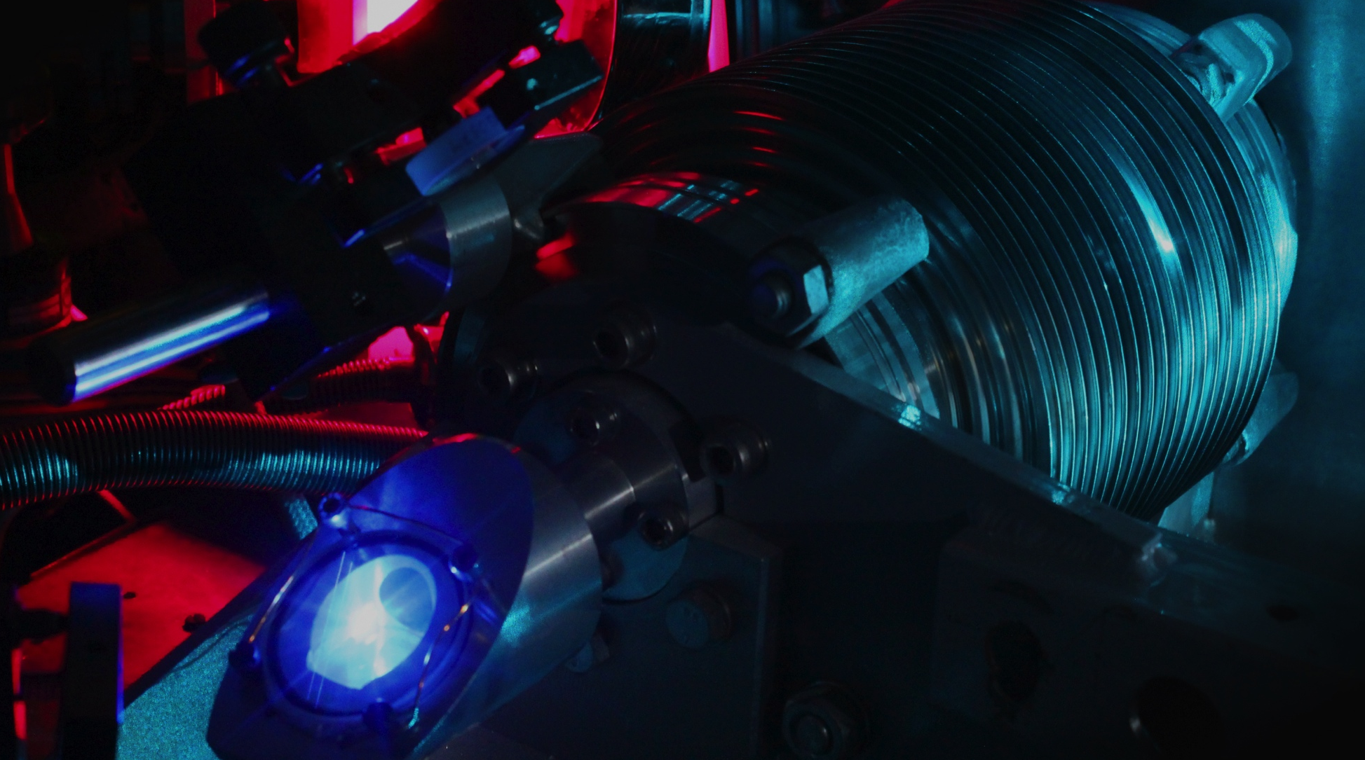

Nuclear charge radii from precision spectroscopy of atomic hydrogen
L. Maisenbacher*, V. Wirthl, A. Matveev, A. Grinin,
R. Pohl, T. W. Hänsch and Th. Udem
Max Planck Institute of Quantum Optics, Garching, Germany
*Now at: University of California, Berkeley, Berkeley, USA
Workshop on NREC 2026, April 13, 2026

Slide 2
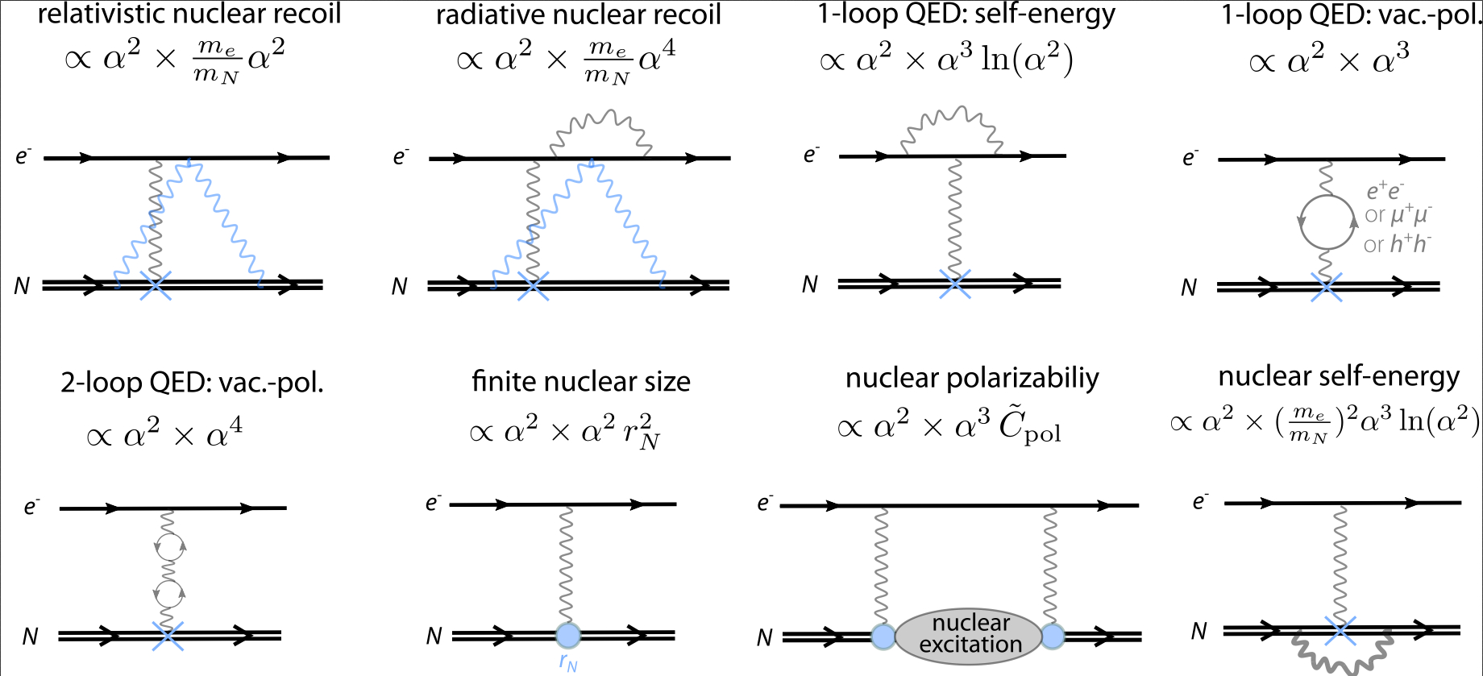
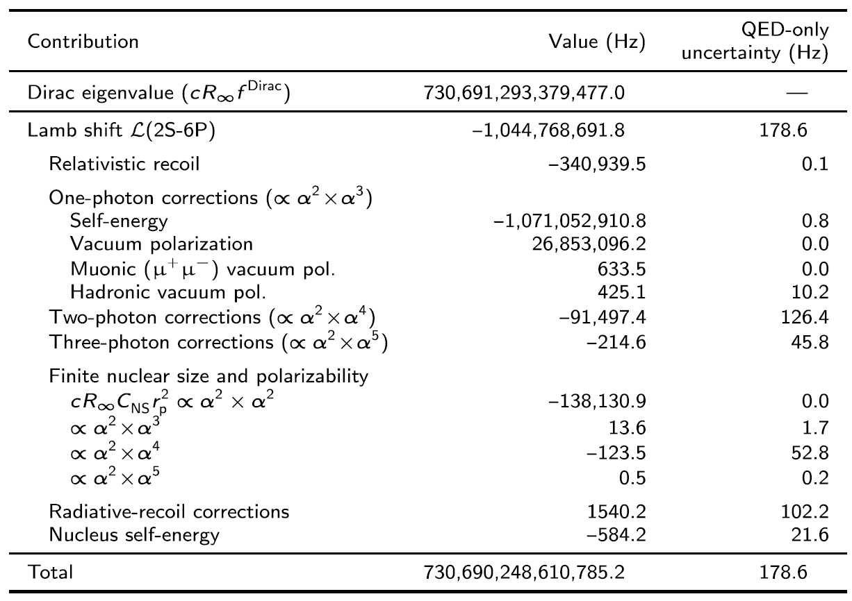









Hydrogen theory and the proton charge radius
$α$:
Fine-structure constant
$$\frac{m_{\text{p}}}{m_{\text{e}}}:$$
Proton-to-electron mass ratio (see next talks from Fabian Heiße and Soroosh Alighanbari)
~ ${10}^{−6}$ $E_{nlJ}$
~ ${10}^{−10}$ $E_{nlJ}$
$r_{\text{p}}$:
Proton charge radius
σ_{QED} ~ ${10}^{−13}$ $E_{nlJ}$
$R_{∞}$:
Rydberg constant
QED effects with point-like nucleus
Nuclear effects
Example: 2S-6P transition (Nature 650, 845–851 (2026))
In other words:
S-states (ℓ=0) wave functions penetrate proton (nonzero ∣ψ(0)∣²), and „see“ deviation from pure 1/r Coloumb potential
+ other terms
Uncertainty from exp. inputs: 138 Hz (r_{p} ), 3 Hz (1S-2S), 1.7 Hz (α), 0.1 mHz (m_{p}/m_{e})

Slide 3
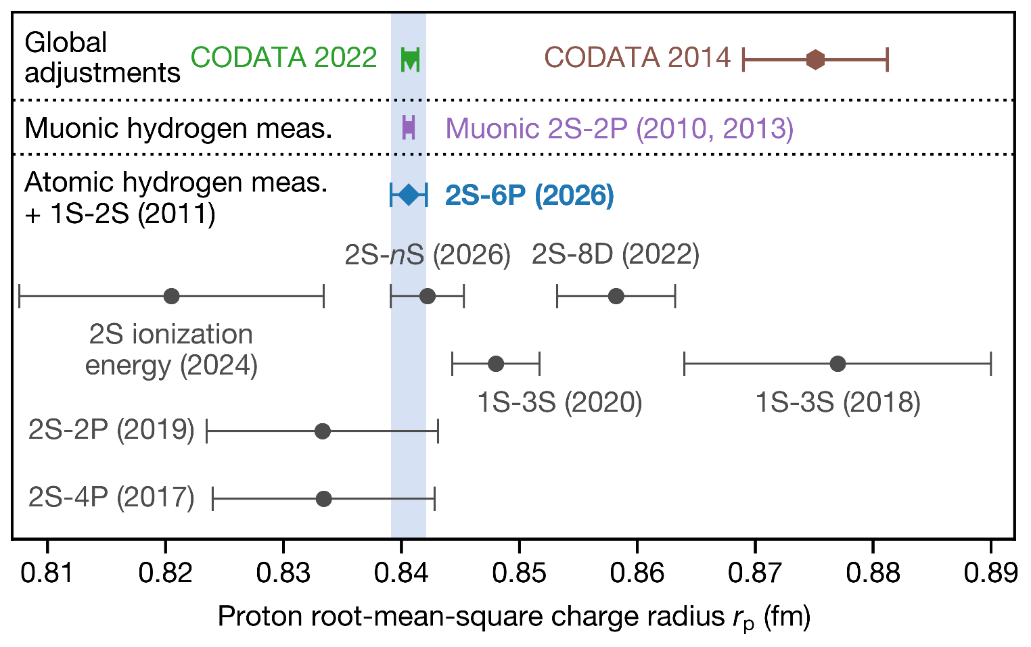
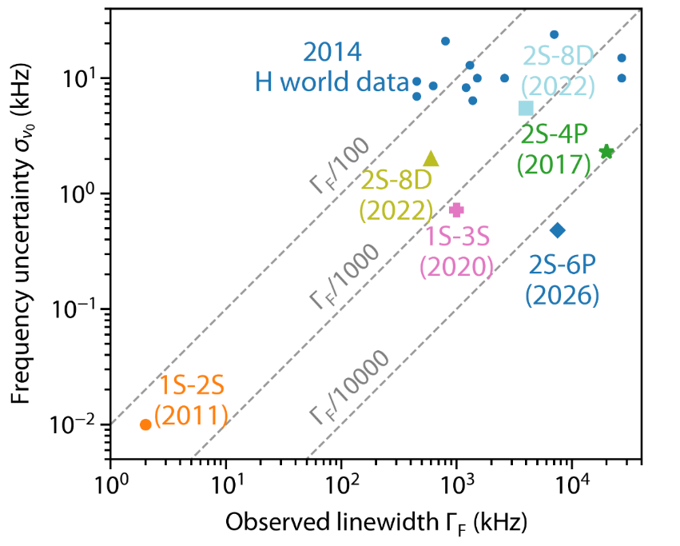
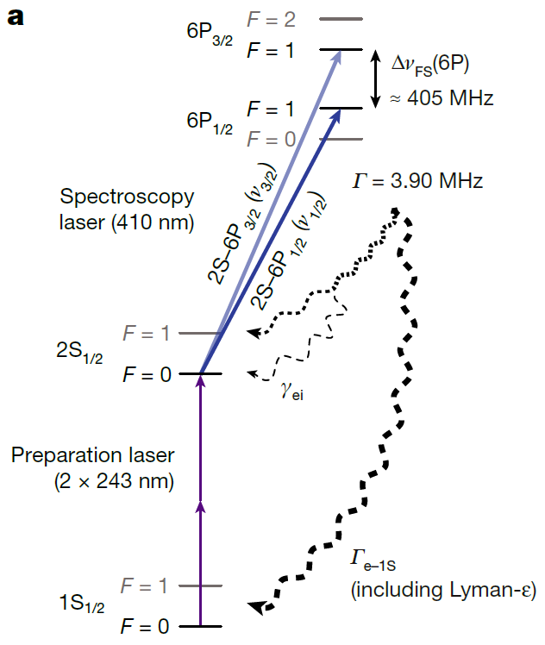
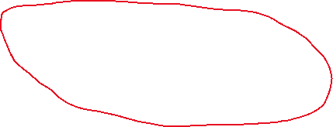

Proton radius from hydrogen spectroscopy
nS
?
Laser
Two-photon
Laser
Two-photon
2S-6P:
Record for laser spectroscopy!
Continuous-wave (CW) laser
One-photon transitions
One-photon
Microwave
One-photon
Direct frequency comb (pulsed laser)
Laser
Two-photon transitions
One-photon transitions tend to have:
Larger linewidths,
but lower systematic shifts
Two-photon transitions tend to have:
Low linewidths,
but higher systematic shifts
(mostly ac-Stark shift)

Slide 4
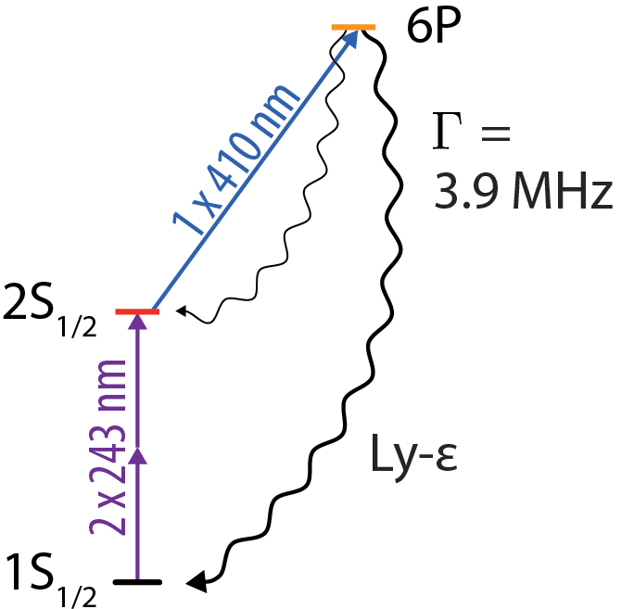
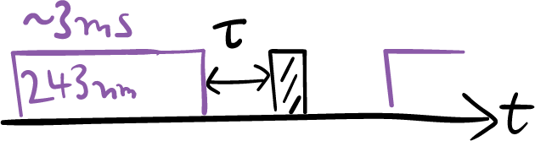
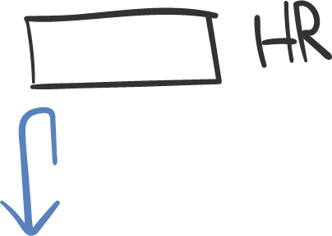
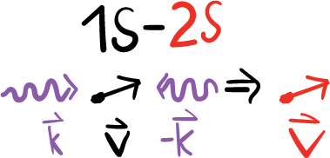


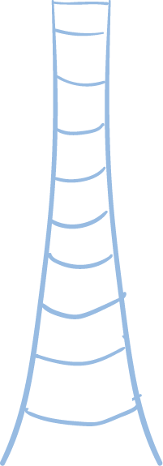
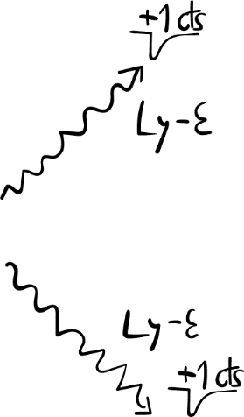

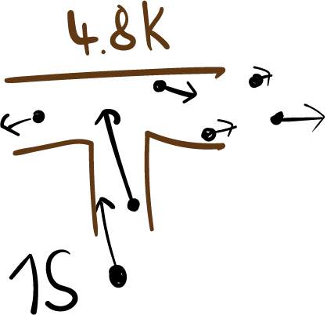
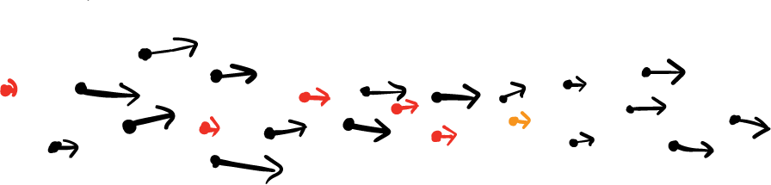
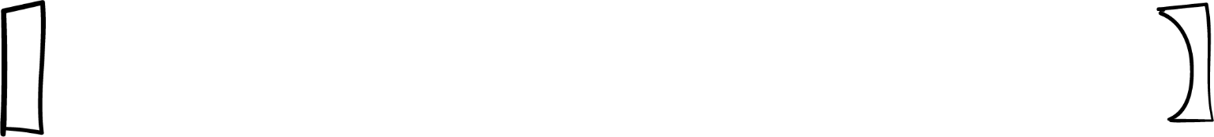

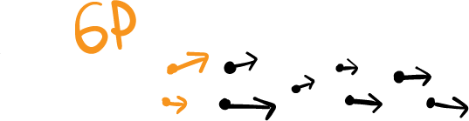
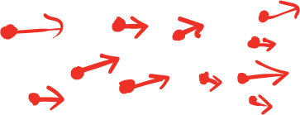

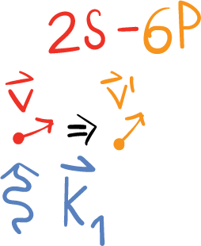
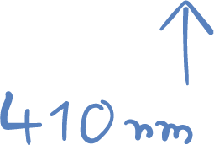
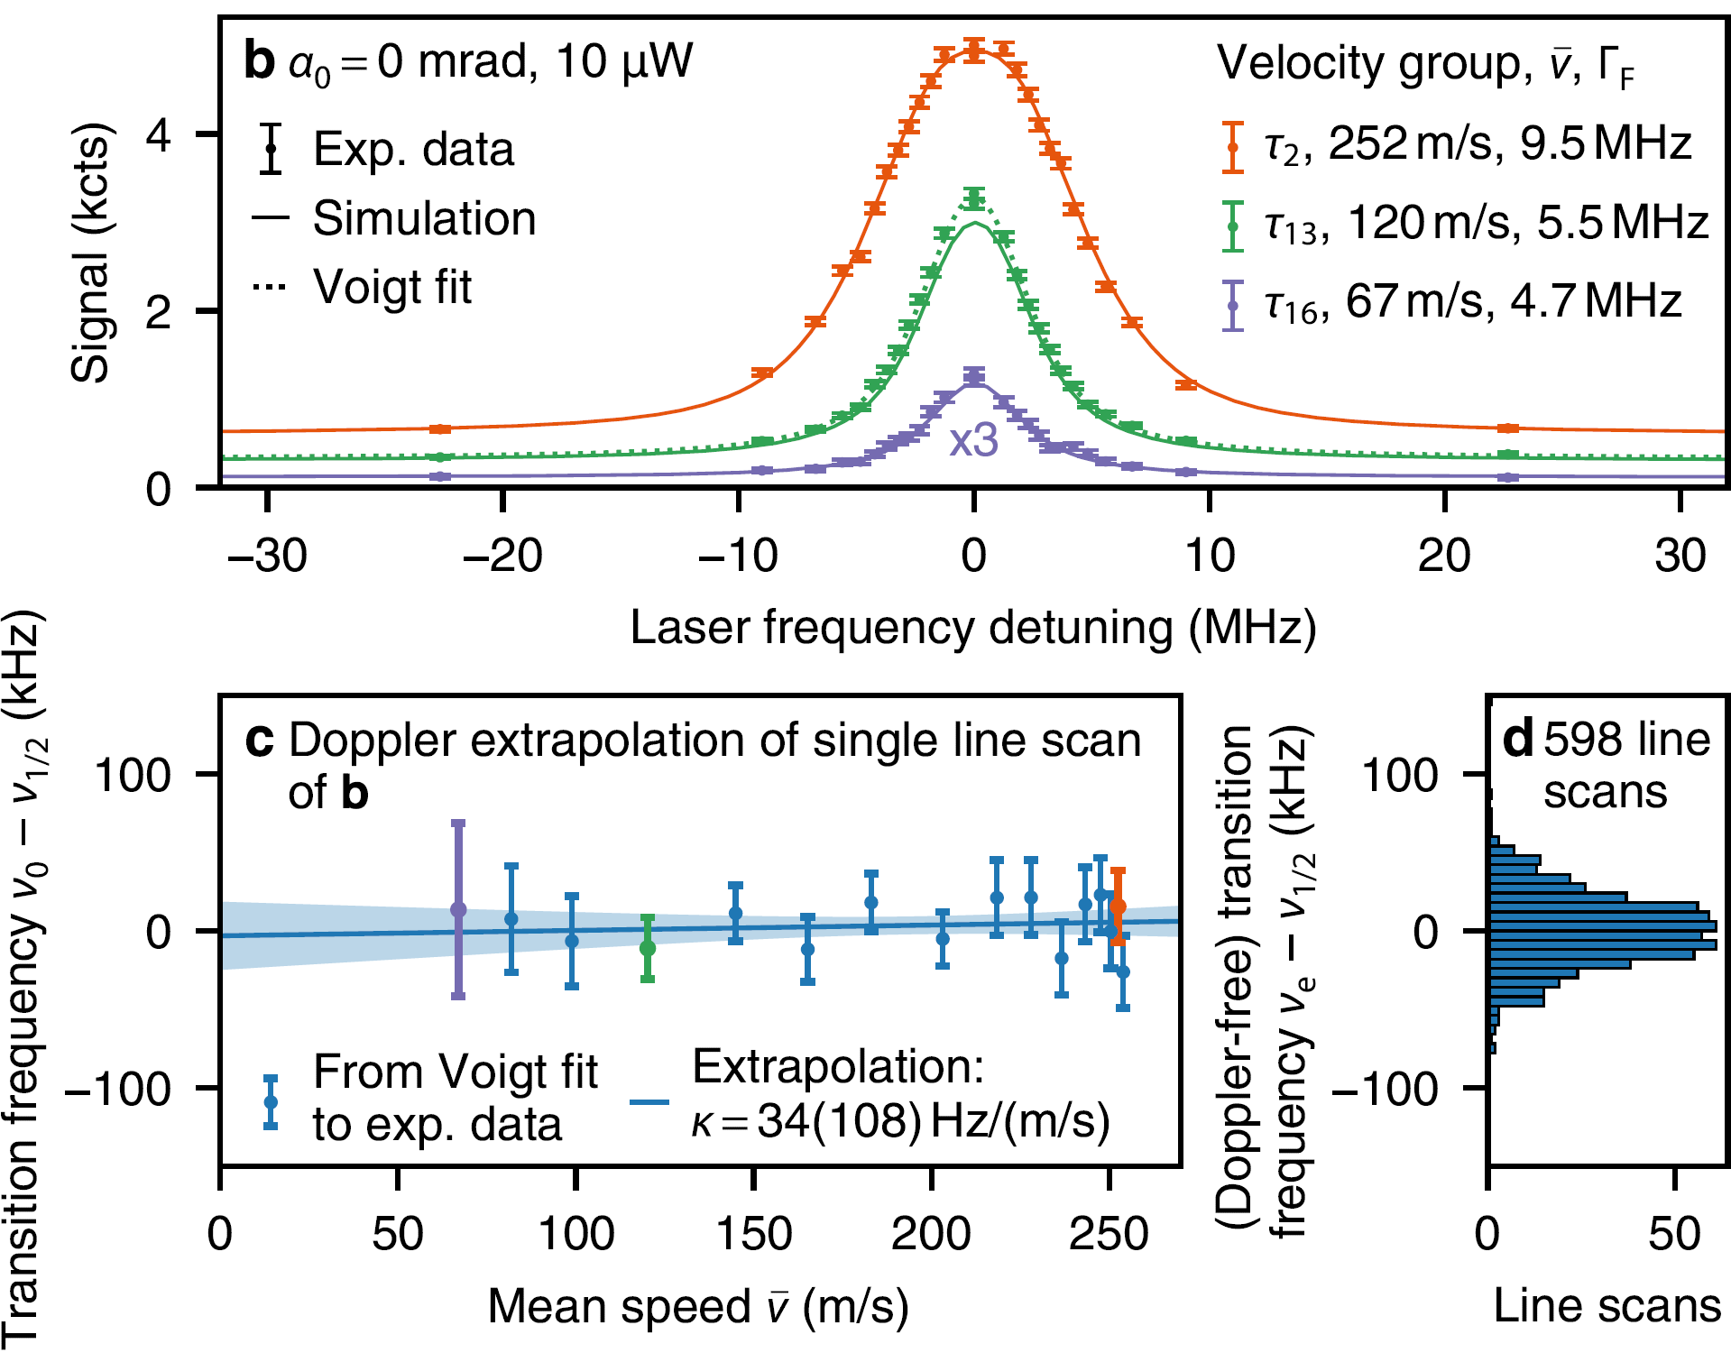


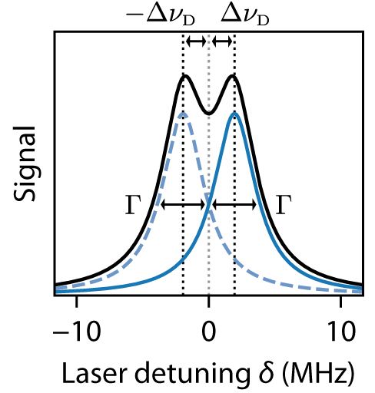
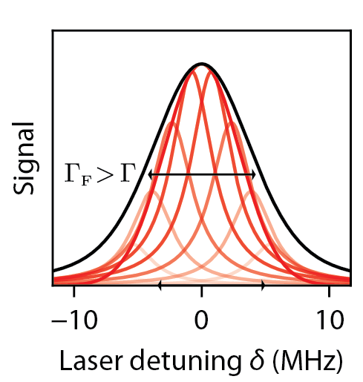
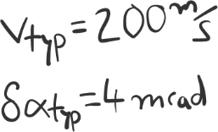
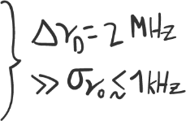

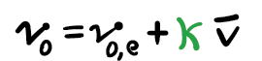





Doppler-free one-photon spectroscopy of the 2S-6P transition
~40 s of data
Doppler slope of 2S-6P dataset:
κ = 1.6(3.0) Hz/(m/s).
Suppression by 30,000 of Doppler slope (for α₀ = 1 mrad).
Details on optics for Doppler suppression:
V. Wirthl, LM et al. Optics Express 29, 7024 (2021)
Details on apparatus:
LM et al., Nature 650, 845–851 (2026)

Slide 5
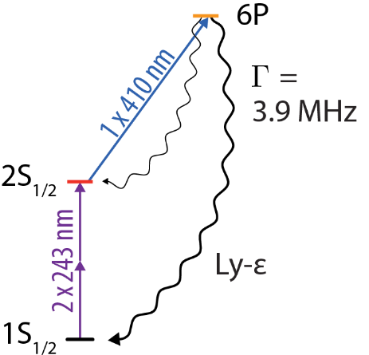
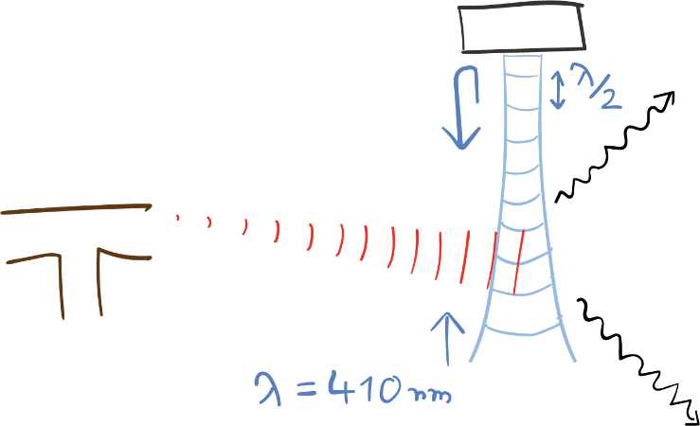
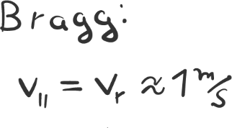
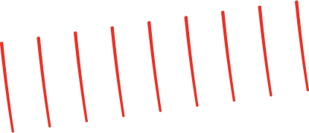
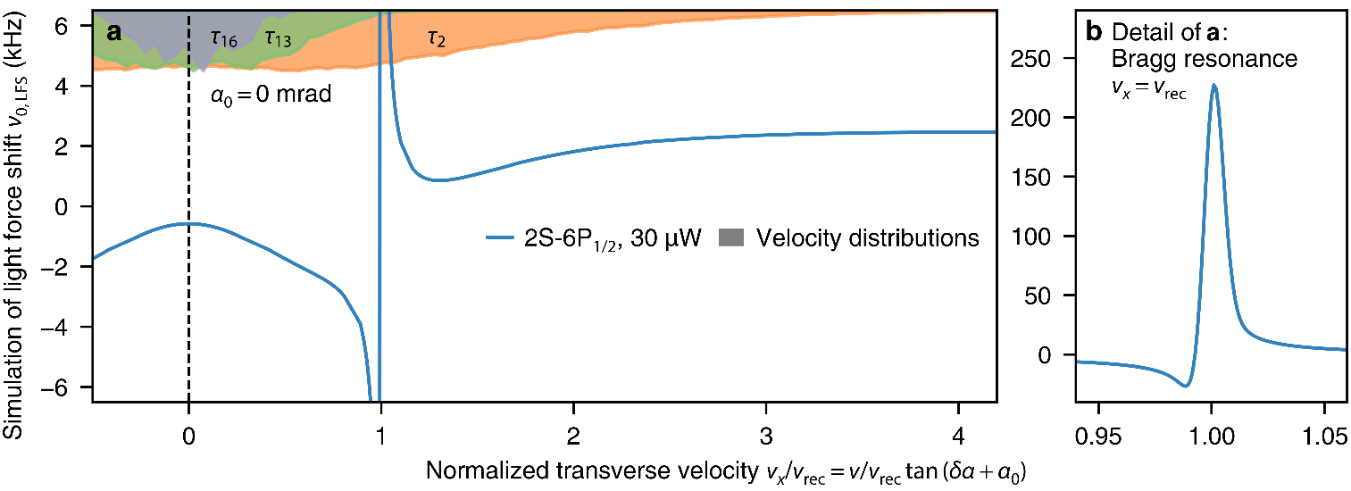
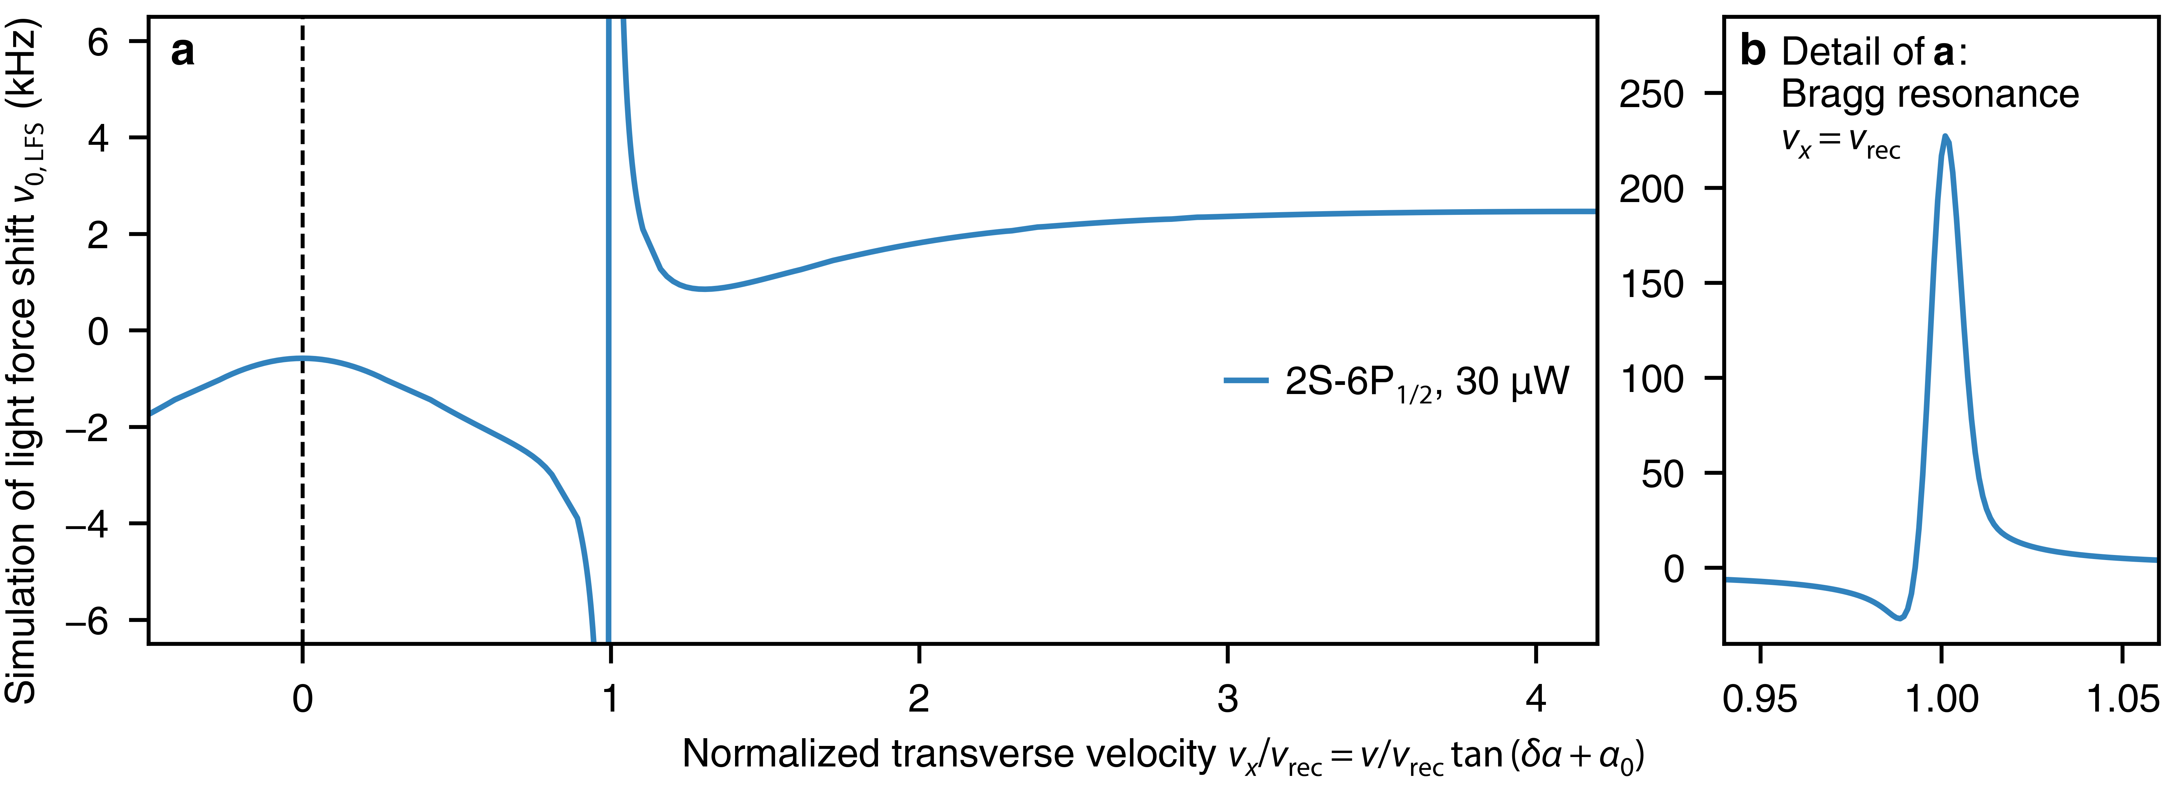
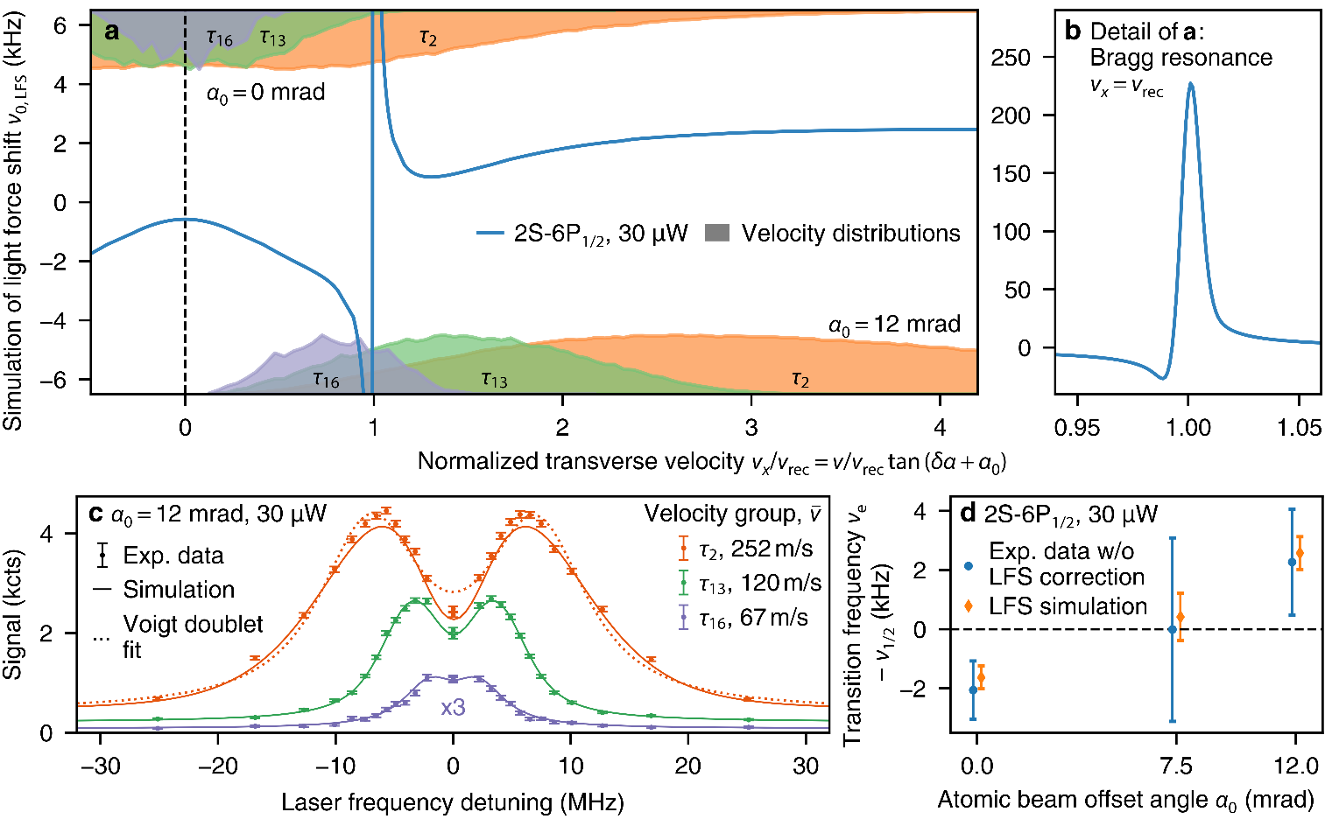
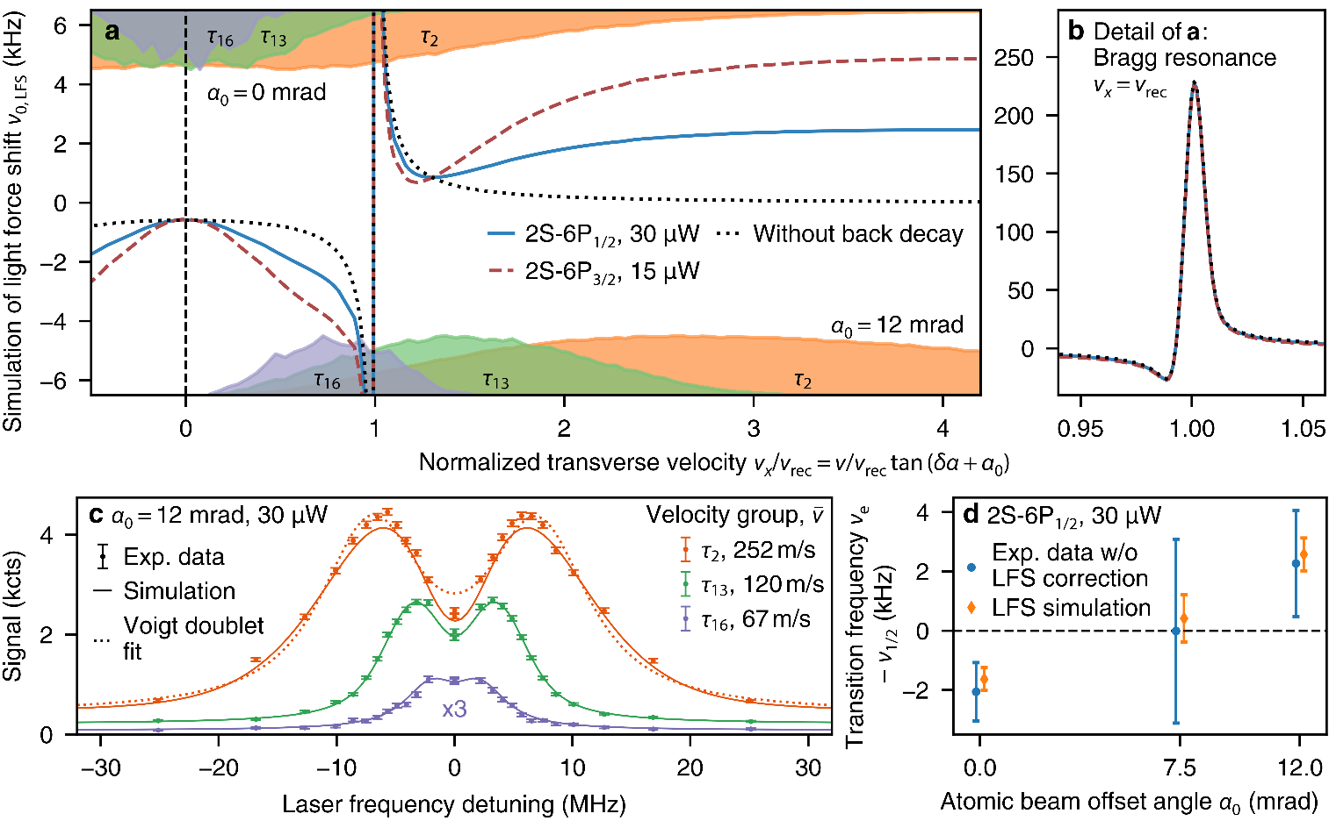
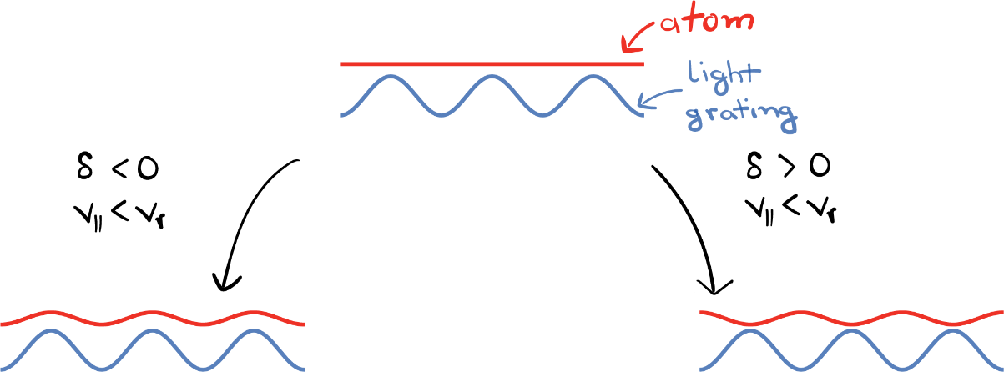
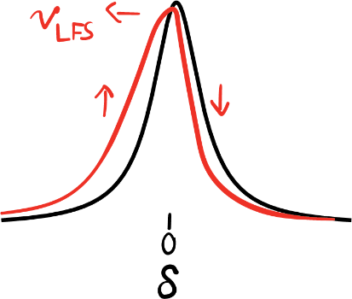
Key systematic effect of 2S-6P measurement: Light force shift
x
Overall contribution to 2S-6P fine-structure centroid: 1.15(17) kHz
Largest correction by far!
x
x
ν_{e}(12 mrad) – ν_{e}(0 mrad):
Experiment: 4.32(1.83) kHz
Simulation: 4.21(0.61) kHz
Uncertainty corresponds to
~1/10000 of linewidth
LM et al., Nature 650, 845–851 (2026)

Slide 6
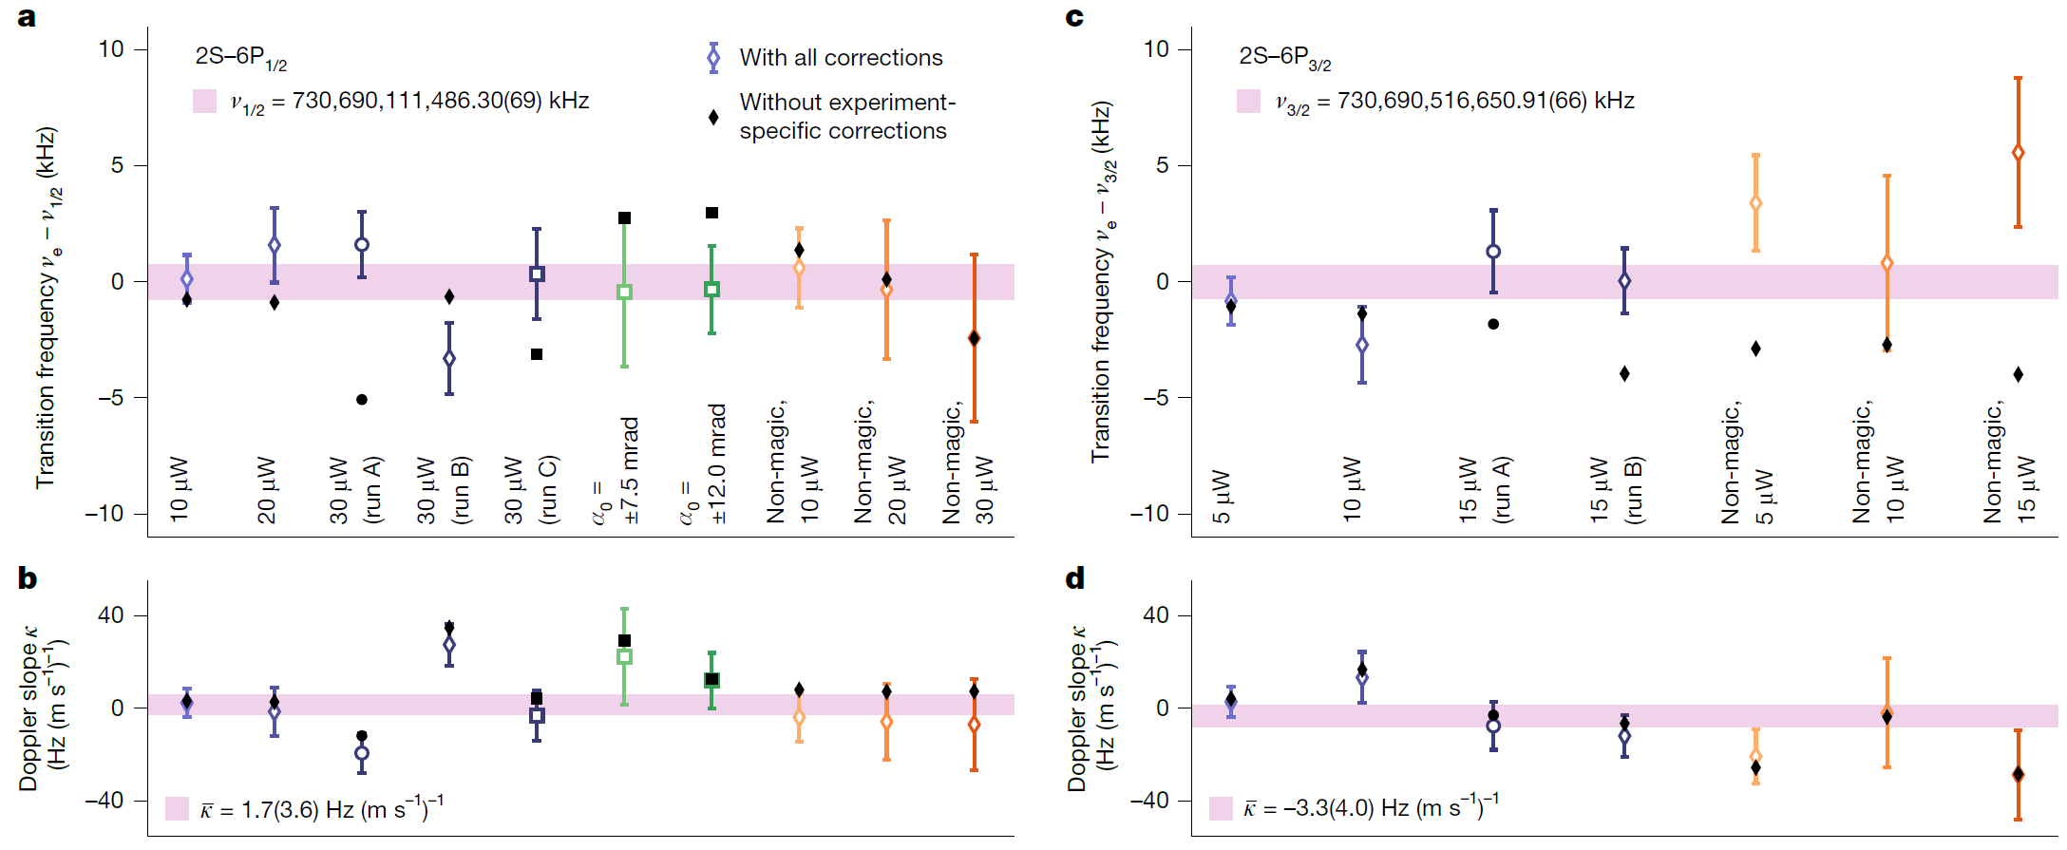

Complete 2S-6P dataset
LM et al., Nature 650, 845–851 (2026)

Slide 7
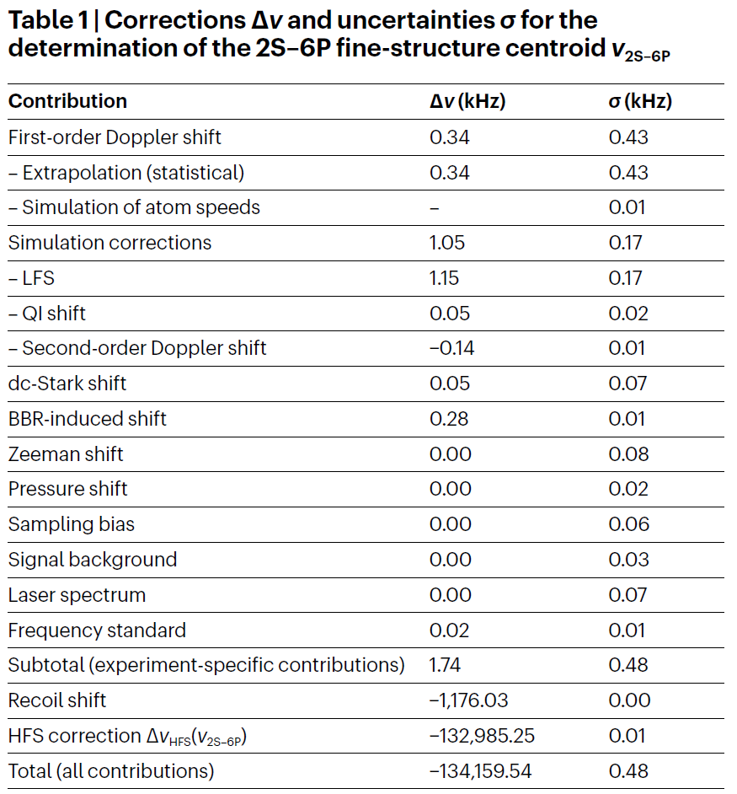




Proton charge radius from 2S-6P measurement
1S-2S transition frequency (Parthey 2011)
QED from CODATA 2022
(proton charge radius)
4-fold more precise, but 5.5 σ from “large radius”
Total experiment-specific corrections: 3.6 σ
LM et al., Nature 650, 845–851 (2026)

Slide 8
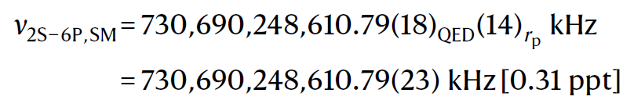





Test of bound-state QED and the Standard Model
Theory prediction for 2S-6P transition:
QED (CODATA 2022)
R∞ from 1S-2S transition frequency (Parthey 2011)
r_{p} from muonic 2S-2P
Test of Standard Model to 0.7 ppt
Experiment:
LM et al., Nature 650, 845–851 (2026)
Notes:
QED uncertainties of individual transitions:
1S-2S: 1.4 kHz (CODATA 2018)
2S-6P: 199 Hz (CODATA 2018)

Slide 9
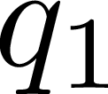






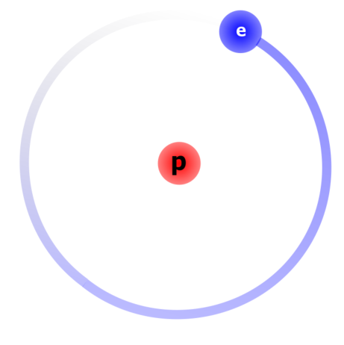
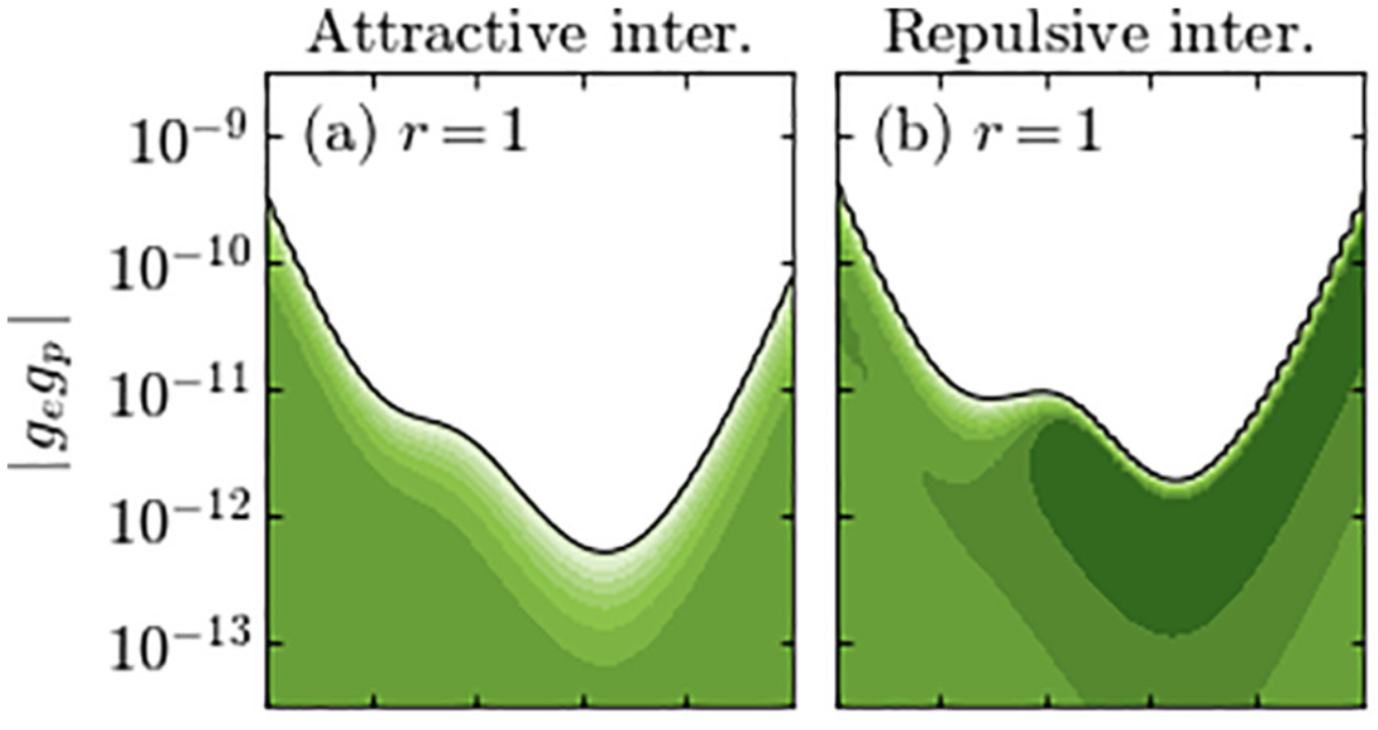
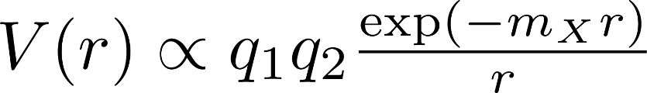

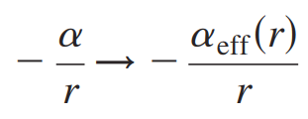
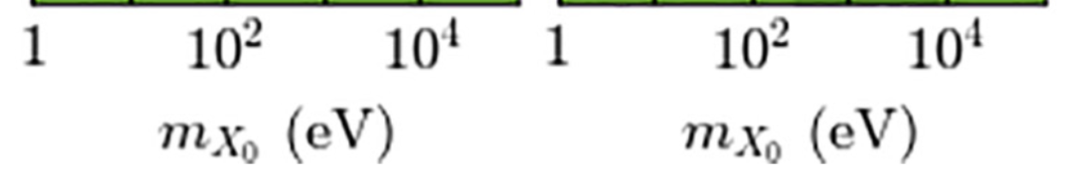
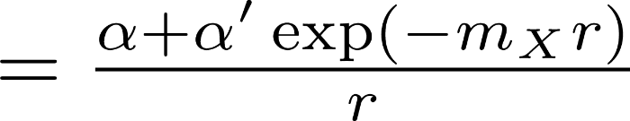
New physics constraints from hydrogen spectroscopy
Hypothetical new light boson
Constraint on g_{p}g_{e}
(electron–proton coupling)
Hydrogen is a unique system for probing
new bosons with masses in the keV range,
our 2S-6P result pushes bounds to
relative couplings down to 10⁻¹³
e
vs
Modified Coulomb potential:
Coulomb potential from
close-to-proton vs far-away-from-proton
(wave function size scales as n²)
with 2S-6P
with 2S-6P
Contraints mass scale from ~keV to ~eV when 0.5 Å compared to 500 Å
  Potvliege et al., PRA 108, 052825 (2023)

Slide 10
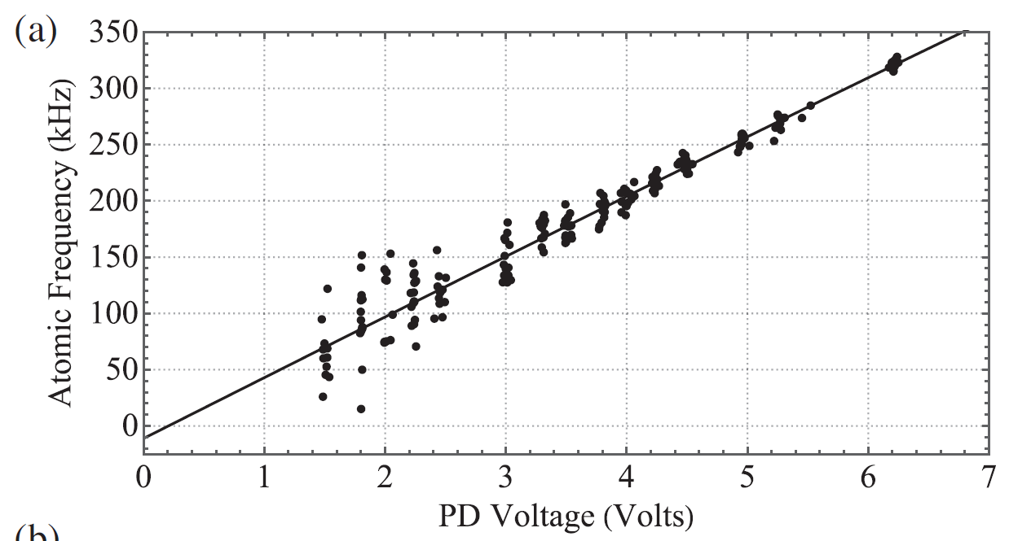
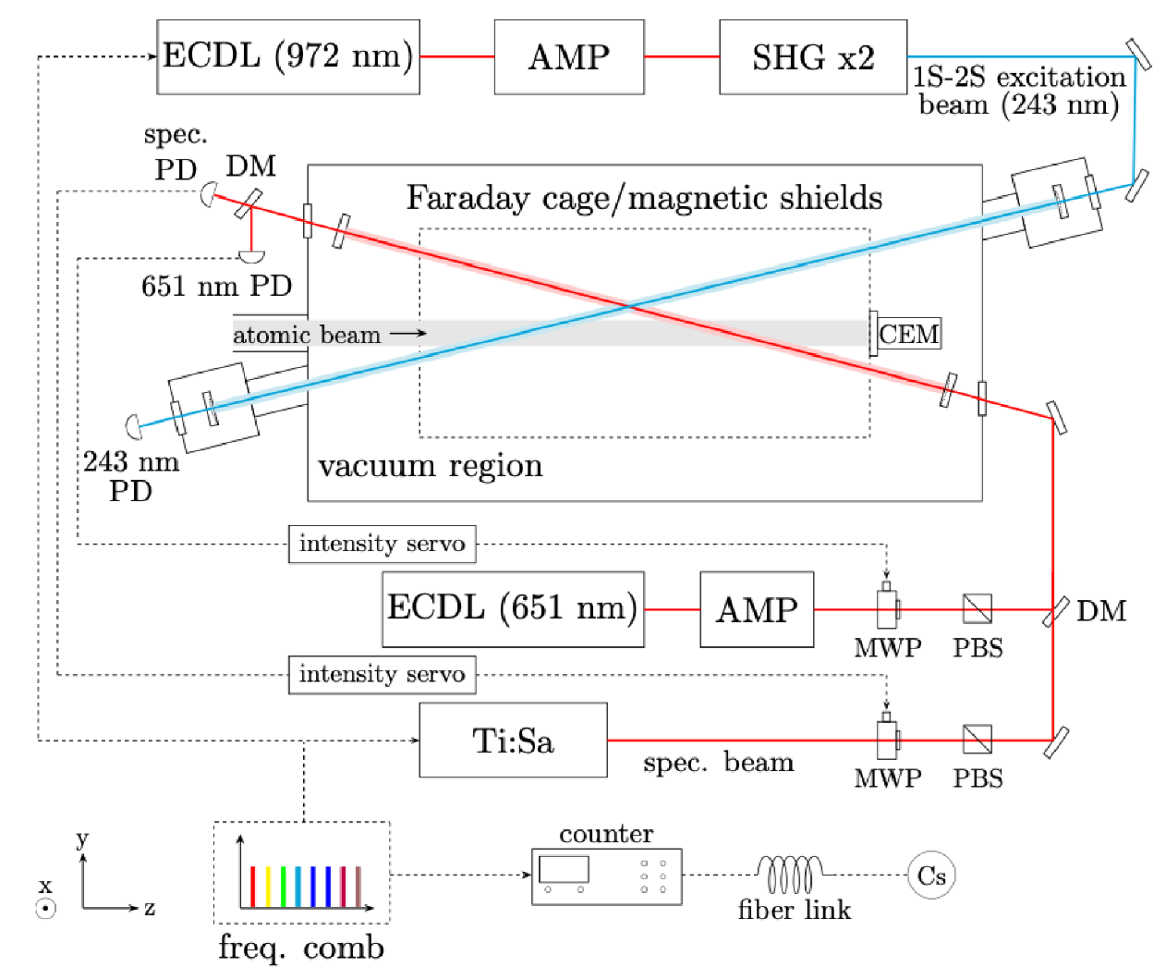
Example of two-photon spectroscopy
Example of CW two-photon spectroscopy:
2S-8D and 2S-nS transitions studied at group of Dylan Yost at Colorado State University, Fort Collins
Typical two-photon spectroscopy challenge:
large ac-Stark shift because of large required laser intensity
(Mostly) ac-Stark shift (kHz)
Laser power (arb. u.)
2S-8D (2022; Brandt et al., Physical Review Letters 128, 023001)
Bullis et al., Physical Review Letters 136, 123001 (2026)

Slide 11
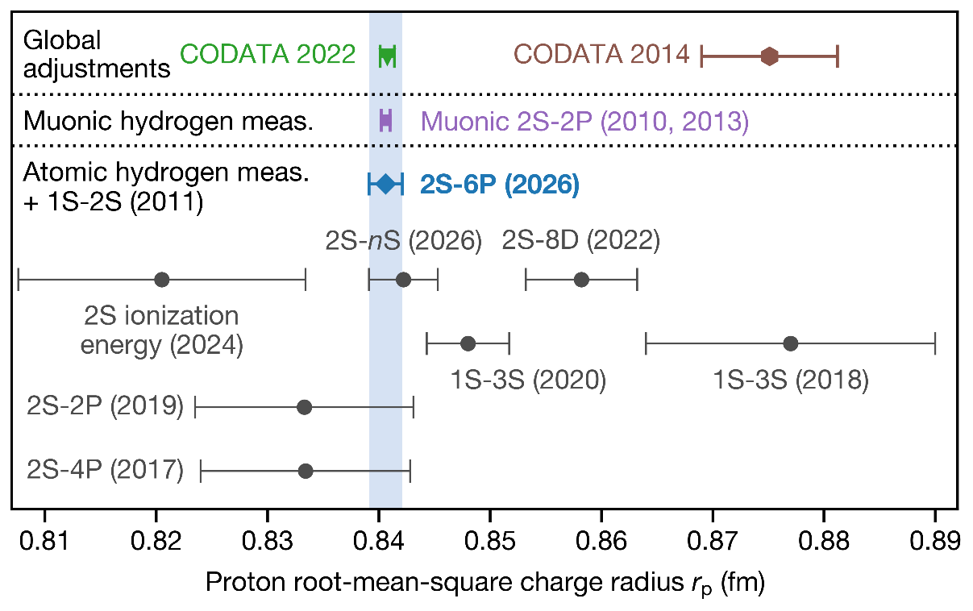
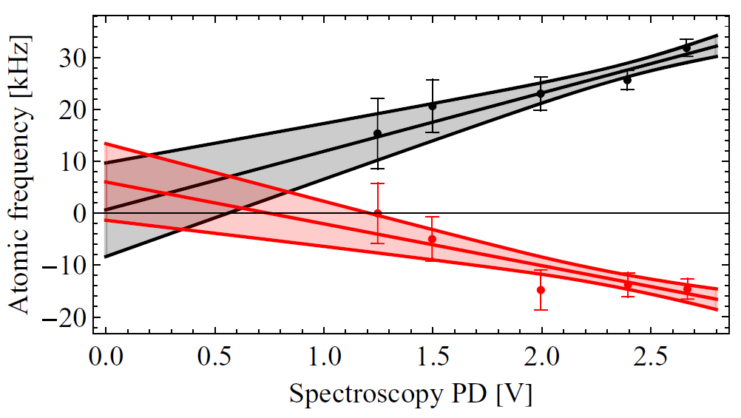

Recent progress in CW two-photon spectroscopy
2S-8D (2022; Brandt et al., Physical Review Letters 128, 023001)
(Mostly) ac-Stark shift (kHz)
Laser power (arb. u.)
Additional compensation laser beam reduces ac-Stark shift by order of magnitude
[…] we have not been able to find a likely theoretical issue or underestimated systematic
effects which would explain this discrepancy. This can be compared with the 2S-nS measurements […], which have well-separated
hyperfine structure, no near-degenerate states of opposite
parity, and negligible Zeeman shifts.
(Mostly) ac-Stark shift (kHz)
Laser power (arb. u.)
2S-nS, n = 8,9,10 (2026; Bullis et al., Physical Review Letters 136, 123001)

Slide 12

Deuterium spectroscopy and the deuteron charge radius
Deuterium theory:
Additional effects in deuterium:
Deuterium measurement in progress at MPQ (2S-6P), planned at LKB (1S-3S) and CSU (2S-nS)

Slide 13






New physics constraints from deuterium spectroscopy
Constraint on g_{n}g_{e}
(electron-neutron coupling)
n
R. M. Potvliege, New. J. Phys 27, 045002 (2025)
e
vs
tightest constraint:
1S-2S isotope shift
with r_{p}, r_{d} from μH, μD
Coulomb potential for hydrogen vs deuterium:
Isotope shift measurement in 1S-2S
with proton/deuteron radii from muonic atoms
Contraints mass scale from zero to ~ keV

Slide 14


Future direction: Cold, trapped hydrogen?
Proposal for trapping atomic hydrogen at mK temperatures in magic wavelength dipole trap:
Demonstration of laser intensities for dipole trap deep enough to trap hydrogen at K temperatures (arXiv:2602.23476):

Slide 15







Thank you for your attention!
2S-6P team at MPQ
LM*
(now: UC Berkeley)
Vitaly Wirthl
Alexey Grinin
(now: Northwestern)
Arthur Matveev
Randolf Pohl
(now: U Mainz)
Theodor
W. Hänsch
Thomas Udem
*lothar.maisenbacher@berkeley.edu

