Slide 1
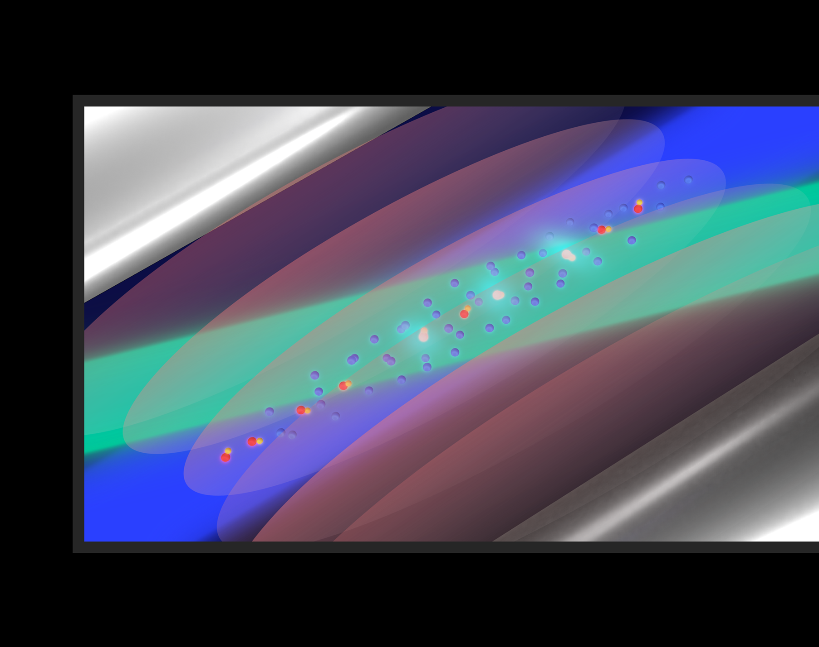
Nuclear Charge Radii from the Simplest Molecules: Status and Perspectives
S. Alighanbari, S. Schiller
Institut für Experimentalphysik, Heinrich-Heine-Universität Düsseldorf, Germany
M. Schlösser, V. Hermann
Institute for Astroparticle Physics, Karlsruhe Institute of Technology, Germany
NREC 2026
Stony Brook University, April 2026

Slide 2

Why molecular hydrogen ions (MHIs)?
($H_{2}^{+}$, $D_{2}^{+}$, $T_{2}^{+}$, ${HD}^{+}$, ${HT}^{+}$, ${DT}^{+}$)
m_{e}
m₁
N
Mass spectrometry
& magnetic resonance of single particles;
m₂
Spectroscopy of hydrogen-like atoms and ions
Experiments: Düsseldorf, Amsterdam, Paris, Heidelberg, Zürich, Wuhan,….
Particle masses
g-factors
electron-baryon mass ratios
g-factors
Experiments: Heidelberg, Mainz, Stockholm, CERN, Evanston, Tallahassee, Argonne,…
Experiments: München, Paris, Villigen, Heidelberg, Toronto, Zürich, Fort Collins, Mainz, …
Rydberg constant
Nuclear radii
Rydberg constant
Nuclear radii
QED
QED
QED
lepton-baryon interaction baryon-baryon interaction
lepton-baryon interaction
CPT
CPT
CPT
[1] Schiller, Contemp. Phys. 63, 247 (2023).

Slide 3
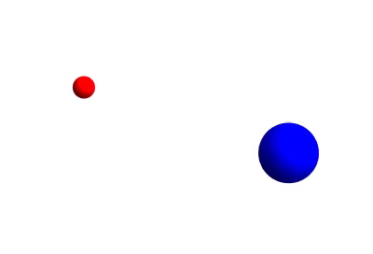
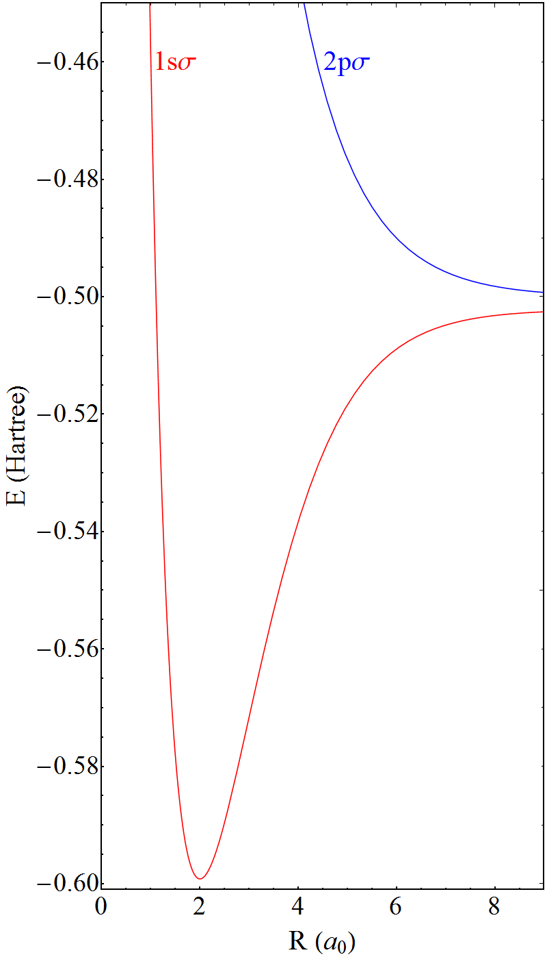
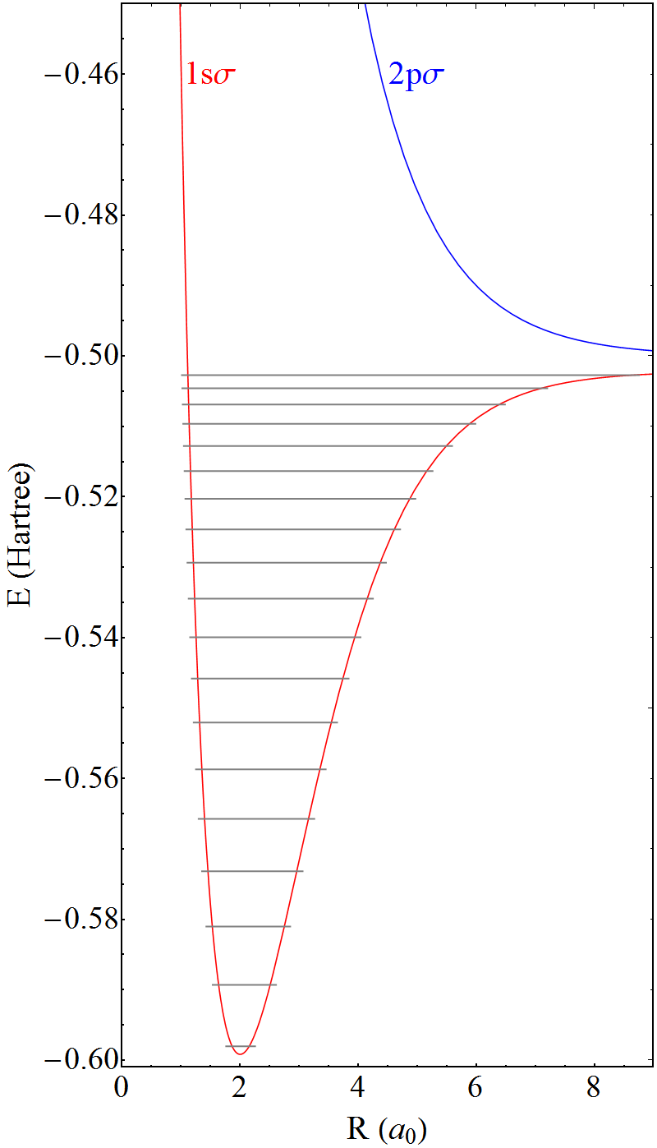
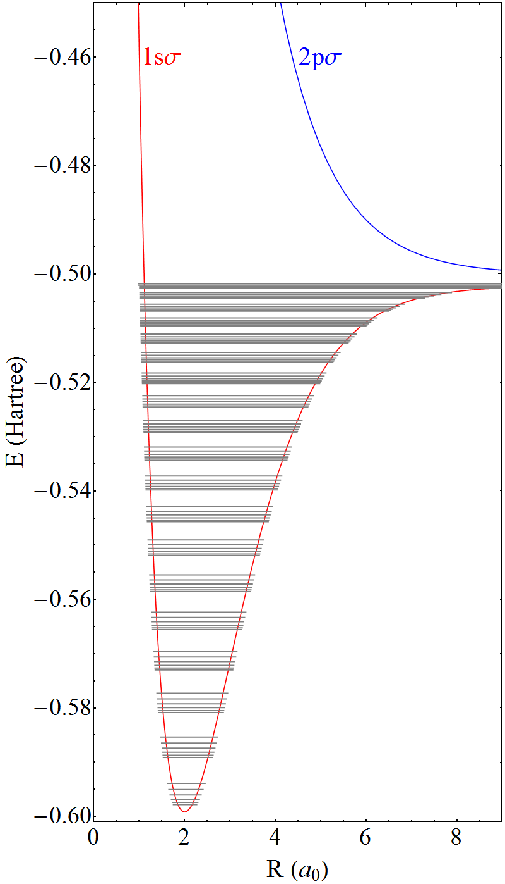
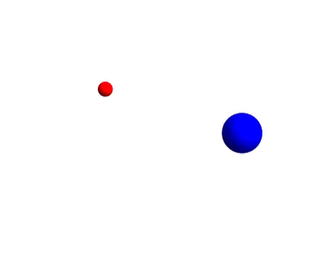




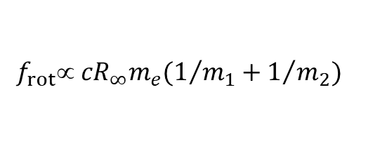

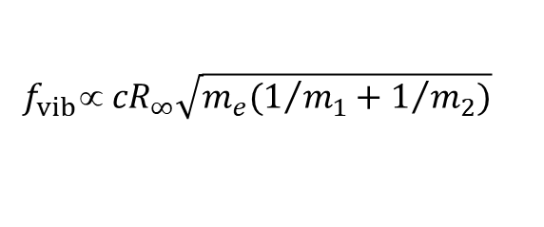
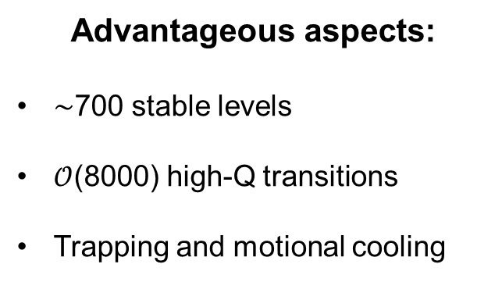

MHIs: basics
HD⁺
$$f_{vib}∝ {cR}_{∞}\sqrt{m_{e}(1/{m_{1}+1/{m_{2}})}}$$
Advantageous aspects:
$\sim$700 stable levels
$𝒪$(8000) high-Q transitions
Trapping and motional cooling
+ relativity + QED + nuclear charge radii
$$v=2$$
$$f_{rot} {cR}_{∞}m_{e}(1/{m_{1}+1/{m_{2}})}$$
$$v=1$$
$$N=2$$
$$N=1$$
+ relativity + QED + nuclear charge radii
$$v=0$$
$$N=0$$

Slide 4


Contribution of fundamental constants
$$E(v,L,G_{1},G_{2},F)=E_{non−relativistic}+E_{relativistic}+E_{QED}+E_{spin}$$
$$E(v,L,G_{1},G_{2},F)=E_{non−relativistic}+E_{relativistic}+E_{QED}+E_{spin}$$
spin quantum numbers
Transition frequency:
f_{spin-avg}
$$(vL,v^{′}L′)$$
+ f_{spin}
$$(vLG_{1}G_{2}F,v^{′}L′G_{1}′G_{2}′F′)$$
[dominant dependencies only]
Spin-averaged theory: Korobov and Karr, Phys. Rev. A 104, 032806 (2021).
Korobov, et al. Mol. Phys. e2563023 (2025).
f_{non-relativistic}(R∞, m_{n}/m_{e})
relative order ≈ 1
f_{spin-avg}
f_{relativistic}(α, r_{n})
relative order ≈ 2×10⁻⁵
Spin theory: Haidar, et al. Phys. Rev. A 106, 042815 (2022).
Haidar, et al. Phys. Rev. A 106, 022816 (2022).
f_{QED}(α)
relative order ≈ 4×10⁻⁶
f_{spin}(g_{e}, g_{p}, g_{d}, Q_{d})
relative order: ≈ 10⁻⁵ [rotational trans.] ≈ 10⁻⁷-10⁻⁸ [vibrational trans.]
Fractional contribution of nuclear radii to total transition frequencies: $𝒪({10}^{−9})$

Slide 5
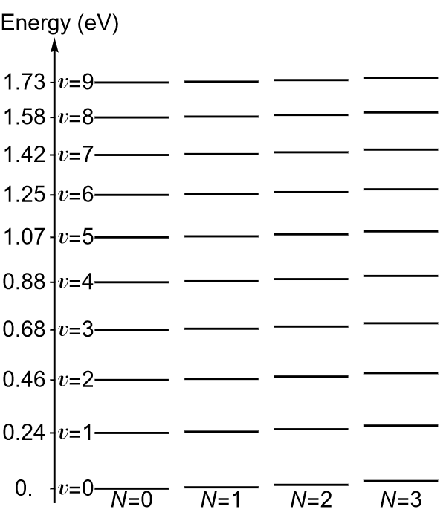
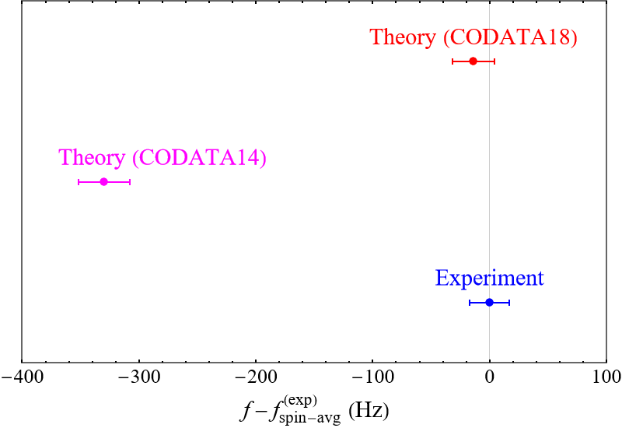


First nuclear charge radii confirmation by MHI
Rotational spectroscopy of HD⁺
Alighanbari, et al. Nat. Phys. 14, 555 (2018).
Alighanbari, et al. Nature 581, 152 (2020).

Slide 6
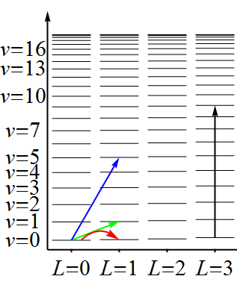
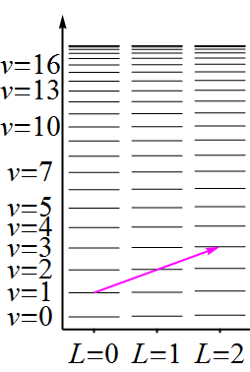
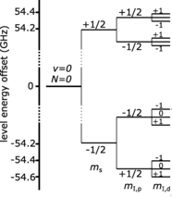
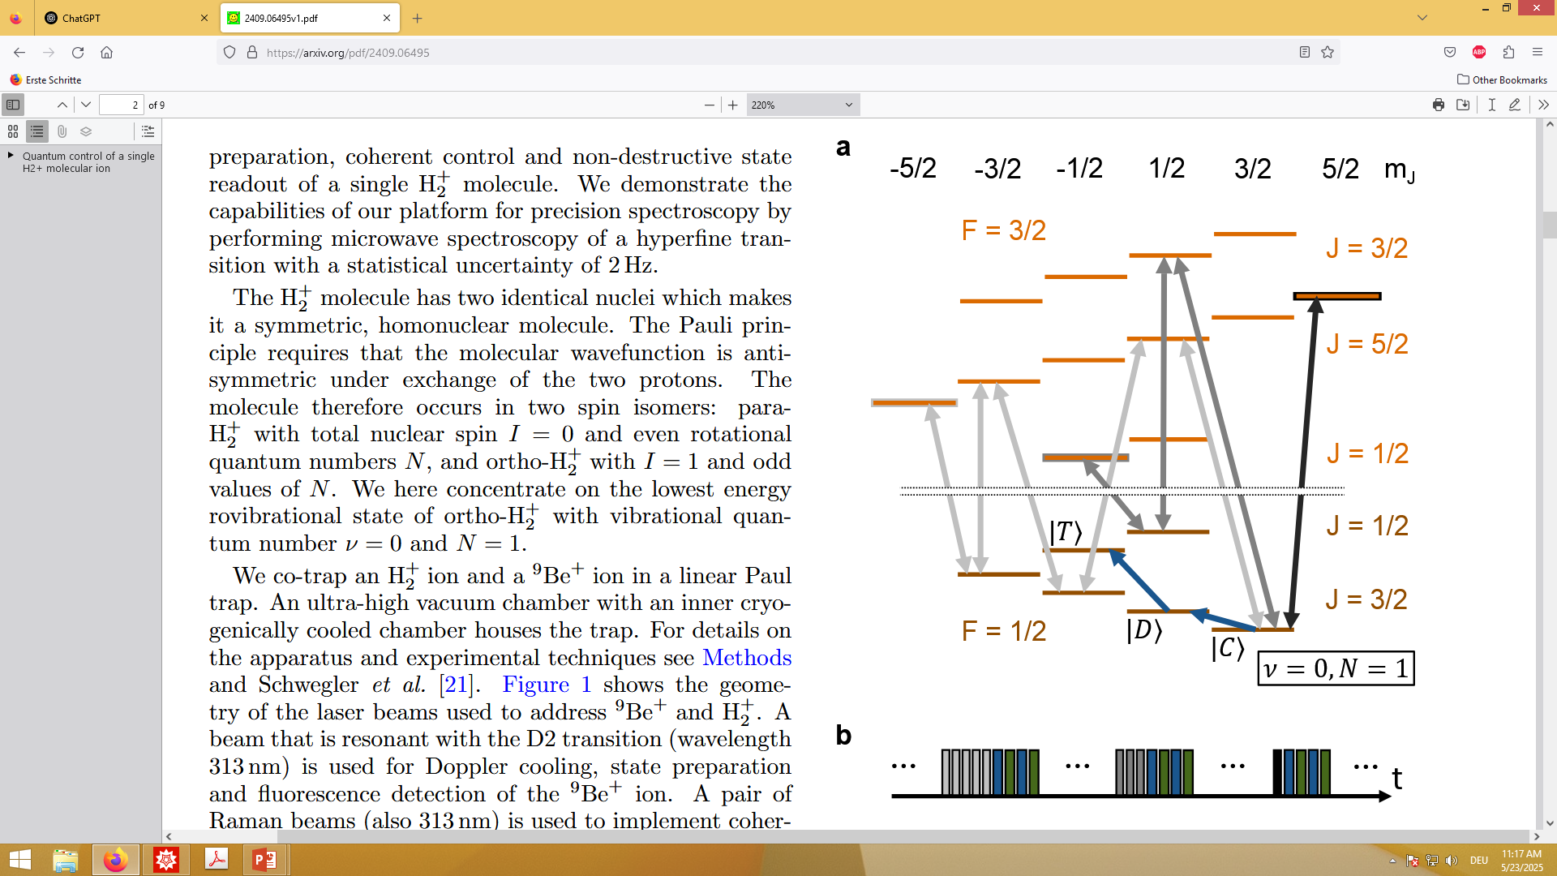


Overview of high-precision experimental studies
$${HD}^{+}$$
$$H_{2}^{+}$$
[1] Alighanbari, et al. Nature 581, 152 (2020).
[2] Kortunov, et al. Nat. Phys. 17, 569 (2021).
[3] Alighanbari, et al. Nat. Phys 19, 1263 (2023).
[4] Schenkel, et al. Nat. Phys. 20 (2024).
[5] Patra, et al. Science 369, 1238 (2020).
[6] König, et al. PRL 136 (2026).
[7] Alighanbari, et al. Nature 644, 69 (2025).
[8] Holzapfel, et al. PRX 15, 031009 (2025).
Ion cluster
One-photon
Doppler-free
(HHU)
HHU
Ion cluster
Two-photon
Doppler-free
(VUA)
[3]
Ion cluster
One-photon E2
Doppler-free
(HHU)
[4]
[5]
[7]
[2]
[1]
[6]
[8]
Single ion
ESR
(MPI-K)
Single ion
QLS
(ETH)

Slide 7
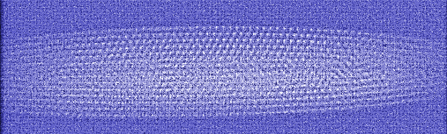
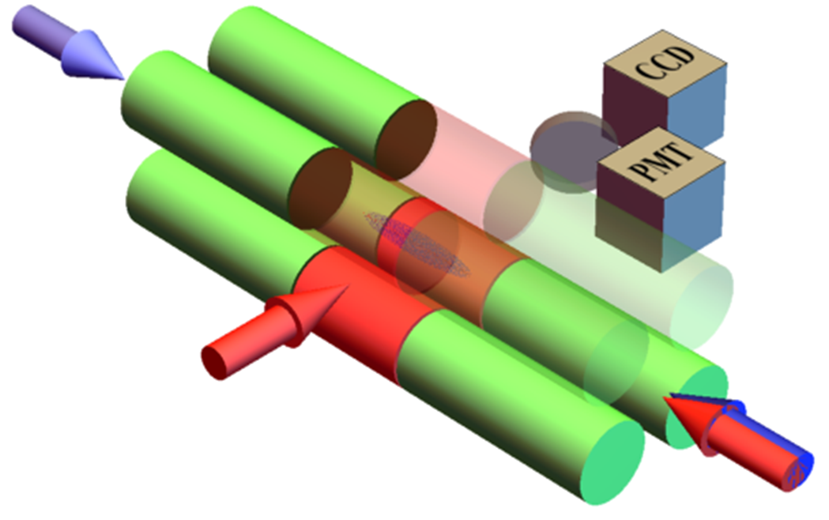
MHI spectroscopy technique
Blythe et al., Phys. Rev. Lett. 95,183002 (2005)
CCD image: Be⁺ and MHIs
A 3D Coulomb cluster of few thousand
Doppler-cooled Be⁺ ions
Simultaneous trapping of few hundred MHIs
MHI cluster temperature: few mK
No fluorescence of MHI
Destructive detection: dissociation of MHI from excited spectroscopy level
Spectroscopy signal is fractional loss of MHI
405 nm
Spectroscopy
Wave (transverse)
313 nm
Spectroscopy
Wave (axial)

Slide 8
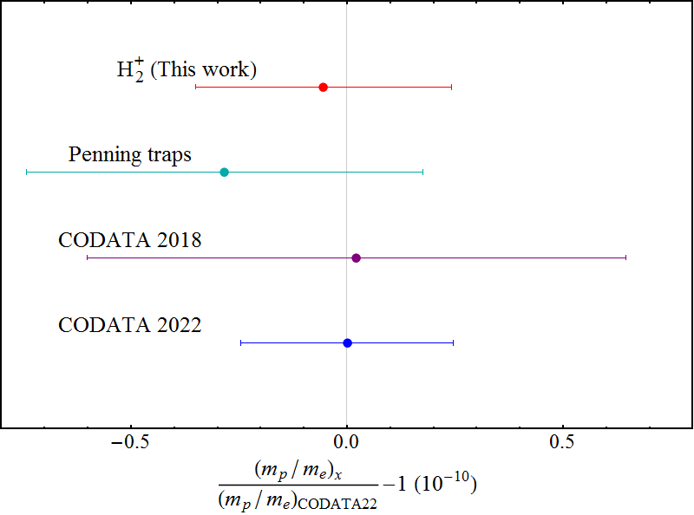
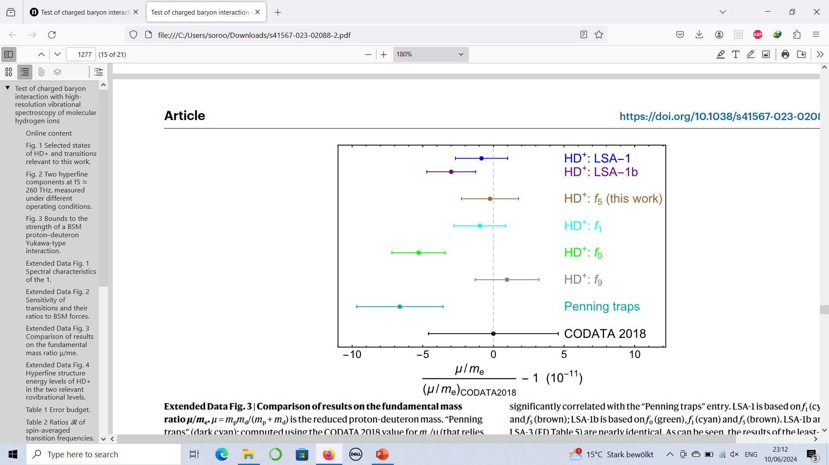
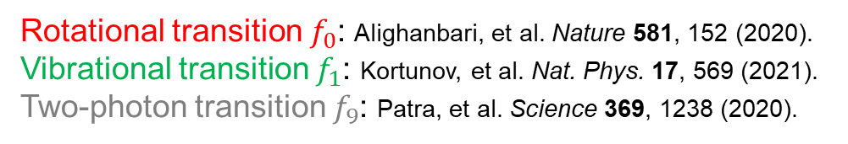
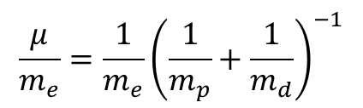
Determination of fundamental constants
$$\frac{μ}{m_{e}}=\frac{1}{m_{e}}{\left(\frac{1}{m_{p}}+\frac{1}{m_{d}}\right)}^{−1}$$
CODATA 2022
Rotational transition $f_{0}$: Alighanbari, et al. Nature 581, 152 (2020).
Vibrational transition $f_{1}$: Kortunov, et al. Nat. Phys. 17, 569 (2021).
Two-photon transition $f_{9}$: Patra, et al. Science 369, 1238 (2020).
[1] Alighanbari, et al. Nature 644, 69 (2025).
[2] Heiße, et al. Phys. Rev. A 48, 022518 (2019).
[3] Korobov and Karr, Phys. Rev. A 104, 032806 (2021)
[4] Haidar, et al. Phys. Rev. A 106, 022816 (2022)

Slide 9
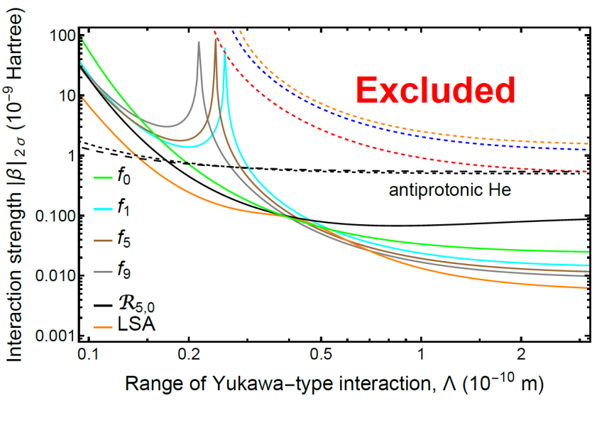
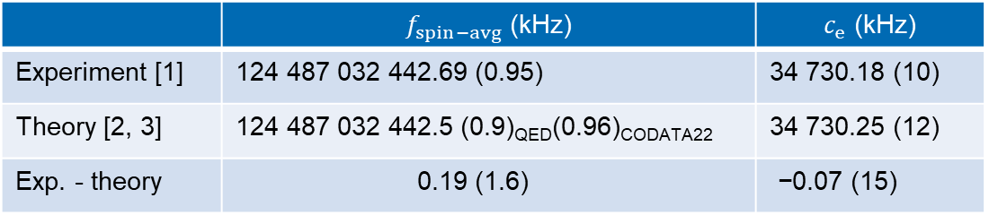

Test of existing theories and search for new forces
E2 spectroscopy of $H_{2}^{+}$
 | $f_{spin−avg}$ (kHz) | $c_{e}$ (kHz)
Experiment [1] | $$\text{124 487 032 442.69} \text{(0.95)}$$ | $$\text{34 730.18 (10)}$$
Theory [2, 3] | $$\text{124 487 032} \text{442.5} \text{(0.9)}\text{QED}\text{(0.96)}\text{CODATA}\text{22}$$ | $$\text{34 730.25 }\text{(1}\text{2}\text{)}$$
Exp. - theory | $$\text{ 0}\text{.}\text{19 }\text{(1.}\text{6}\text{) }$$ | $\text{−}\text{0}\text{.}\text{07 }\text{(}\text{15}\text{)}$
HFS Hamiltonian
coefficient
Agreement!
[1] Alighanbari, et al. Nature 644, 69 (2025).
[2] Korobov and Karr, Phys. Rev. A 104, 032806 (2021).
[3] Haidar, et al. Phys. Rev. A 106, 022816 (2022).
Alighanbari, et al. Nat. Phys. 19, 1263 (2023).

Slide 10
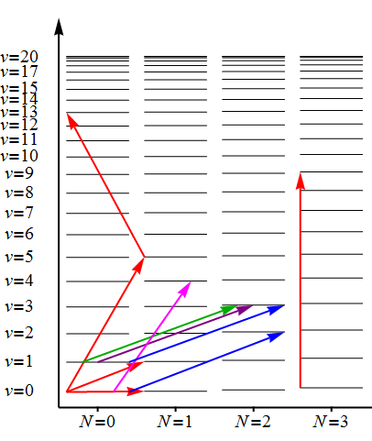
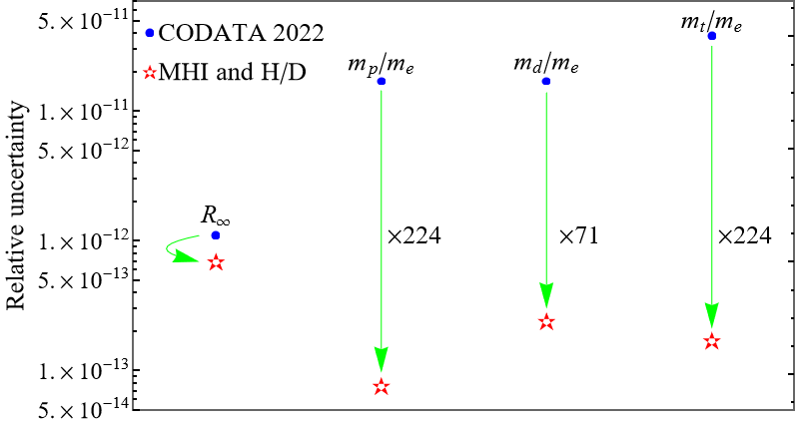
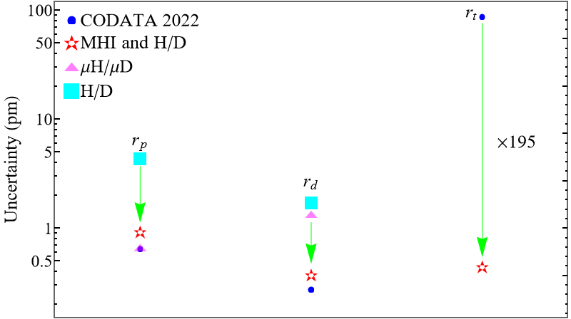



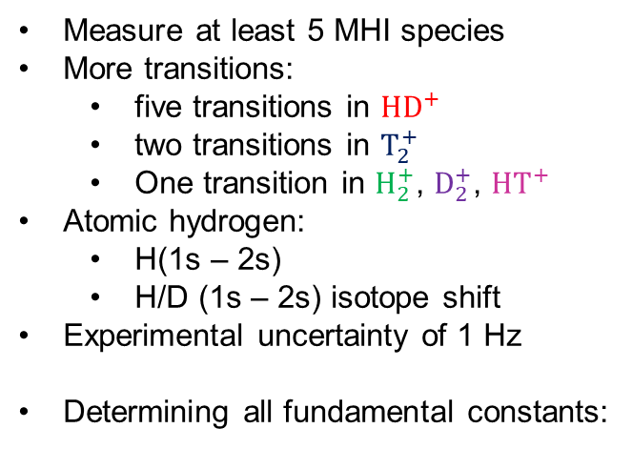





Determination of FCs with improved uncertainty
Measure at least 5 MHI species
More transitions:
five transitions in $HD^{+}$
two transitions in $T_{2}^{+}$
One transition in $H_{2}^{+}$, $D_{2}^{+}$, $HT^{+}$
Atomic hydrogen:
H(1s – 2s)
H/D (1s – 2s) isotope shift
Experimental uncertainty of 1 Hz
Determining all fundamental constants:
$$HD^{+}$$
$$HD^{+}$$
$$HD^{+}$$
$$HT^{+}$$
$$D_{2}^{+}$$
$$H_{2}^{+}$$
(*) Amroun, et al. Nucle. Phys. A 579 (1994).
$$T_{2}^{+}$$
*
A test of $χ$EFT
Schiller and Karr, Phys. Rev. A 109, 042825 (2024).
Karr, Schiller, Korobov, Alighanbari, Phys. Rev. A. 112, 022809 (2025).
A test of lepton universality
L. Maisenbacher, et al. Nature 650 (2026).
Talk by Lothar Maisenbacher

Slide 11
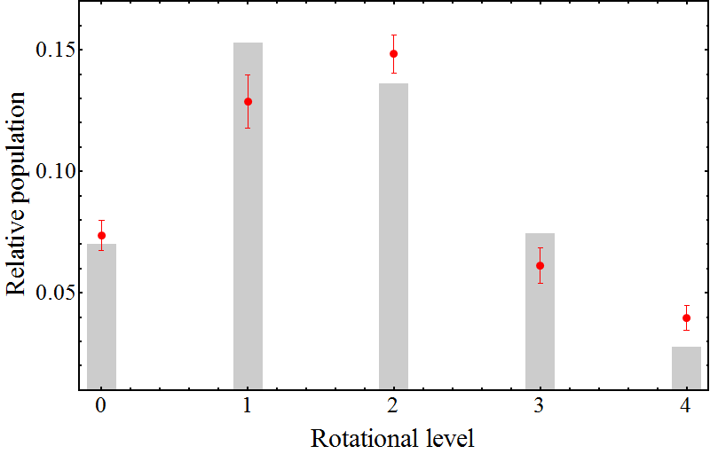
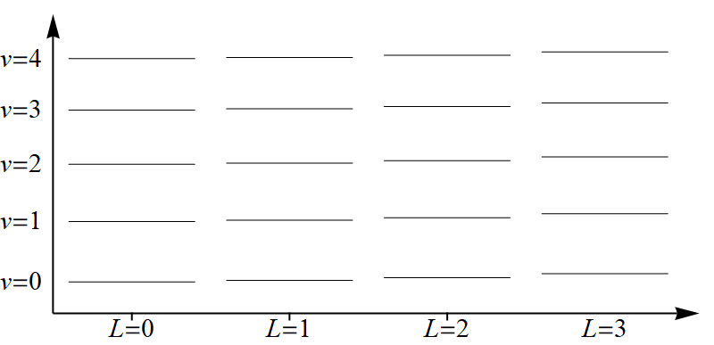


Ionization and rovibrational state preparation
Electron impact ionization (HHU [1-3], VUA [4])
Heteronuclear MHIs:
Spontaneous decay to the lowest vibrational level within few milliseconds
BBR redistributes the population among excited rotational levels
Laser rotational cooling [5]
Cryogenic environment [6]
[1] Alighanbari, et al. Nature 581, 152 (2020).
[2] Kortunov, et al. Nat. Phys. 17, 569 (2021).
[3] Alighanbari, et al. Nat. Phys 19, 1263 (2023).
[4] Patra, et al. Science 369, 1238 (2020).
[5] Schneider, et al. Nat. Phys 6, 275 (2010).
[6] König, et al. PRL 134 (2025).
HD⁺ @ 300 K

Slide 12
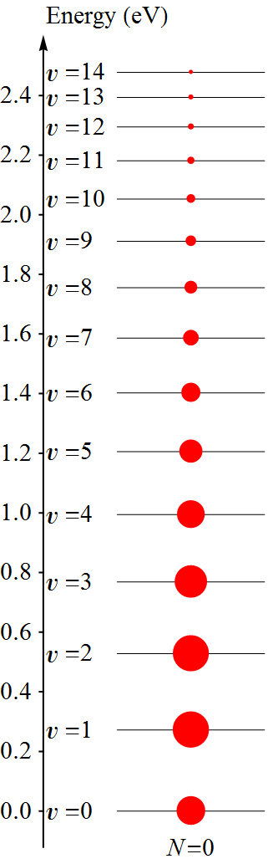
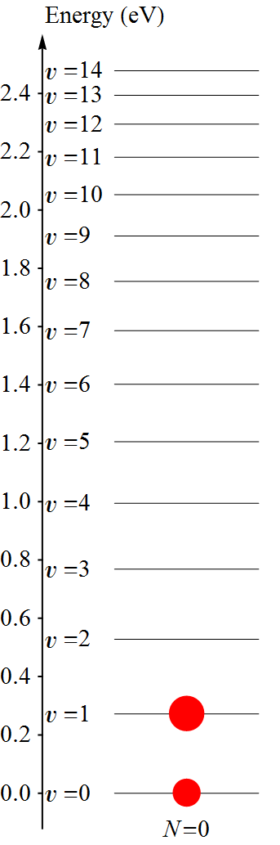
Ionization and rovibrational state preparation
Electron impact ionization (HHU [1-3], VUA [4])
Heteronuclear MHIs:
Spontaneous decay to the lowest vibrational level within few milliseconds
BBR redistributes the population among excited rotational levels
Laser rotational cooling [5]
Cryogenic environment [6]
Homonuclear MHIs:
Partial state preparation via selective dissociation [7, 8]
Buffer gas cooling [9]
405 nm
313 nm
[1] Alighanbari, et al. Nature 581, 152 (2020).
[2] Kortunov, et al. Nat. Phys. 17, 569 (2021).
[3] Alighanbari, et al. Nat. Phys 19, 1263 (2023).
[4] Patra, et al. Science 369, 1238 (2020).
[5] Schneider, et al. Nat. Phys 6, 275 (2010).
[6] König, et al. PRL 134 (2025).
[7] Schenkel, et al. Nat. Phys. 20 (2024).
[8] Alighanbari, et al. Nature 644, 69 (2025).
[9] Holzapfel, et al. PRX 15, 031009 (2025).

Slide 13
Ionization and rovibrational state preparation
Electron impact ionization (HHU [1-3], VUA [4])
Heteronuclear MHIs:
Spontaneous decay to the lowest vibrational level within few milliseconds
BBR redistributes the population among excited rotational levels
Laser rotational cooling [5]
Cryogenic environment [6]
Homonuclear MHIs:
Partial state preparation via selective dissociation [7, 8]
Buffer gas cooling [9]
REMPI
Heteronuclear MHIs:
BBR is still a problem [10]
Homonuclear MHIs [11, 12]
[1] Alighanbari, et al. Nature 581, 152 (2020).
[2] Kortunov, et al. Nat. Phys. 17, 569 (2021).
[3] Alighanbari, et al. Nat. Phys 19, 1263 (2023).
[4] Patra, et al. Science 369, 1238 (2020).
[5] Schneider, et al. Nat. Phys 6, 275 (2010).
[6] König, et al. PRL 134 (2025).
[7] Schenkel, et al. Nat. Phys. 20 (2024).
[8] Alighanbari, et al. Nature 644, 69 (2025).
[9] Holzapfel, et al. PRX 15, 031009 (2025).
[10] Zhang, et al. Phys. Rev. A 112, 032801 (2025).
[11] Hilico, et al. ECTI 8, (2025).
[12] Kim, et al. arXiv:2509.03625v2 (2025).

Slide 14
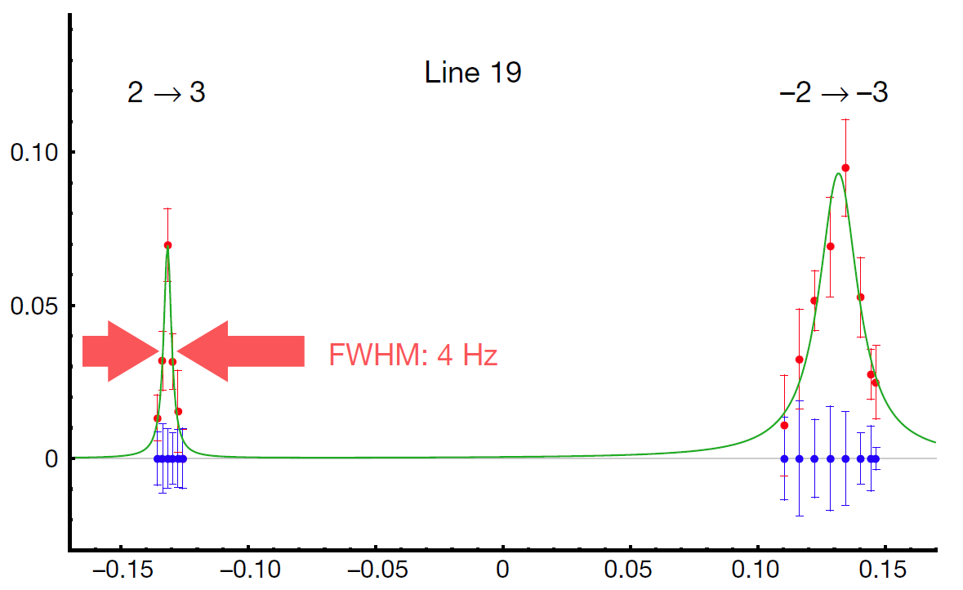
Frequency uncertainty and control of systematics
Ion cluster
FWHM as low as 4 Hz is achieved [1-4]
Destructive detection → fit‑error not reliable; use the FWHM as the transition‑frequency uncertainty.
Some systematic shifts are difficult to mitigate (field inhomogeneity, etc.)
Single ion
Employ QLS and ODF [5]
Fit-error can be used → sub-Hz frequency uncertainty
Better mitigation and control of systematics
[1] Alighanbari, et al. Nature 581, 152 (2020).
[2] Kortunov, et al. Nat. Phys. 17, 569 (2021).
[3] Alighanbari, et al. Nat. Phys 19, 1263 (2023).
[4] Alighanbari, et al. Nature 644, 69 (2025).
[5] Holzapfel, et al. PRX 15, 031009 (2025).

Slide 15
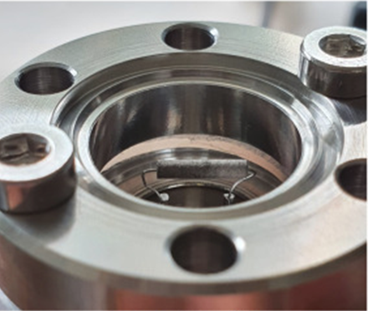

Radioactive MHIs
No spectroscopy of tritium bearing MHIs (TMHIs) so far
Safety regulations for radioactive gas handling
Activities ≤ 1 GBq → can be performed in a standard laboratory environment.
Must remain sealed inside the experimental apparatus—even for activities < 1 GBq.
Tritium Laboratory Karlsruhe has successfully transferred a legally authorized quantity of tritium to spectroscopy laboratories [1, 2].
1 GBq: 11.3 mbar.cm³ for T₂
[1] Hermann, et al. Vacuum 230, 113708 (2024).
[2] Cozijn, et al. Phys. Rev. Lett. 132, 113002 (2024).

Slide 16
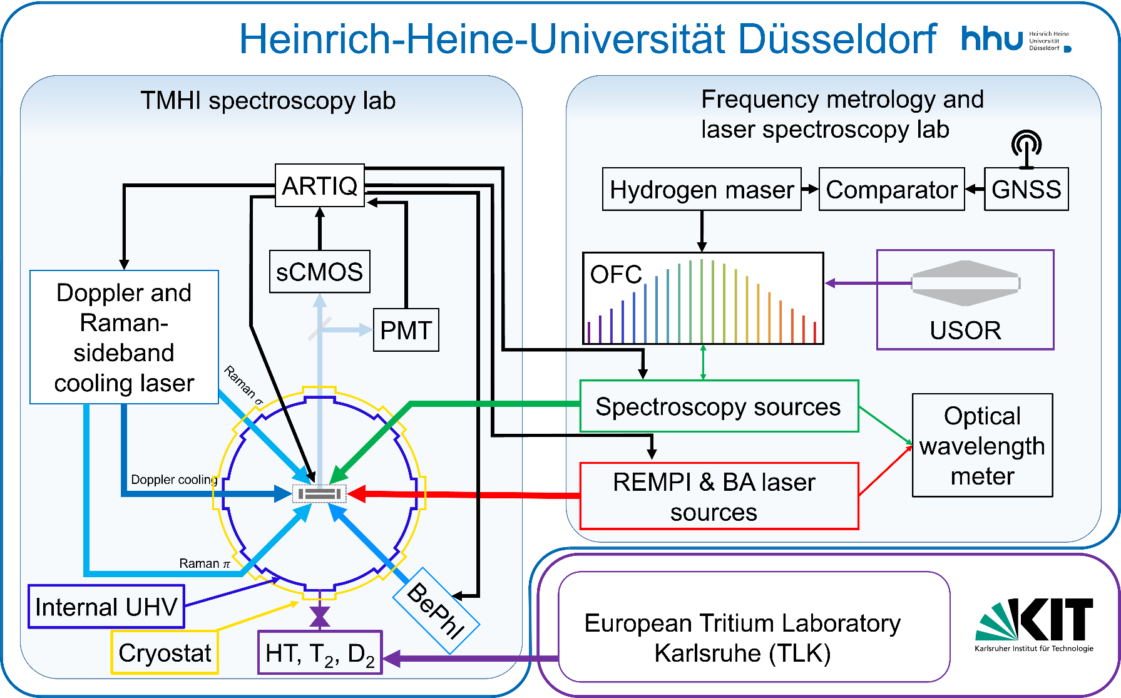
Next-phase blueprint
Ultra-narrow SI traceable spectroscopy sources
Pulsed UV laser for REMPI
Transportable tritium source
Cryogenic ion trap
Single MHI
Nondestructive detection: QLS and/or ODF

Slide 17






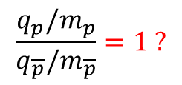




CPTI test via comparison of $H_{2}^{+}$ and anti-$H_{2}^{+}$
Hydrogen to antihydrogen comparisons (ALPHA @ CERN)
Proton to antiproton comparison (BASE @ CERN)
Compare one vibrational frequency in $H_{2}^{+}$ with the same in anti-$H_{2}^{+}$ [1, 2]
$\frac{f_{vib}}{{\overline{f}}_{vib}}∝\frac{{\left(m_{e}\right)}^{\frac{3}{2}}{\left(m_{p}\right)}^{−\frac{1}{2}}{\left(q_{e}\right)}^{4+κ}{\left(q_{p}\right)}^{−κ}}{{\left(m_{\overline{e}}\right)}^{\frac{3}{2}}{\left(m_{\overline{p}}\right)}^{−\frac{1}{2}}{\left(q_{\overline{e}}\right)}^{4+κ}{\left(q_{\overline{p}}\right)}^{−κ}}=1?$ $κ≈0.02$
(assuming Coulomb interactions have usual characters)
$${ E}_{h}$$
$${(q_{e})}^{2}{(q_{p})}^{2}{ m}_{e}$$
$$m_{e}/m_{p}$$
$$\frac{ }{ }∝$$
$$\frac{ }{ }=1 ?$$
( weak dependence on )
$${\overline{E}}_{h}$$
$${(q_{e^{+}})}^{2}{(q_{\overline{p}})}^{2}{ m}_{e^{+}}$$
$$m_{e^{+}}/m_{\overline{p}}$$
$$\frac{q_{p}/m_{p}}{q_{\overline{p}}/m_{\overline{p}}}=1 ?$$
(Simple model)
+ comparison of $p$ - $p$ interaction and $\overline{p}$ - $\overline{p}$ interaction
[1] Schiller, Contemp. Phys. 63, 247 (2023). Dehmelt, H.G. Phy. Scr. T59, 432 (1995). Zammit, M.C. et al. Phys. Rev. A 100, 042709 (2019).
Vargas, Phys. Rev. D 111, 015032 (2025).
Shore, arXiv:2412.09730 (2025).
[2] Myers, E. Phys. Rev. A 98, 010101(R) (2018). Schenkel, et al. Nat. Phys. 20, 383 (2024).

Slide 18
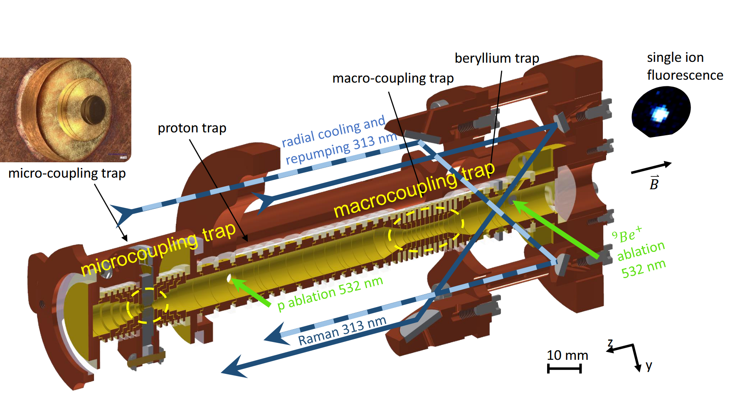
Proposed apparatus
Penning trap with continuous-Stern-Gerlach read-out [1] (Evolution of design from BASE)
Penning trap with sympathetic laser cooling by a single Be⁺ ion, non-destructive read-out [2]
[1] Latacz, et al. Nature 644, 64 (2025).
[2] Cornejo, et al. Phys. Rev. Research 6, 033233 (2024).

Slide 19

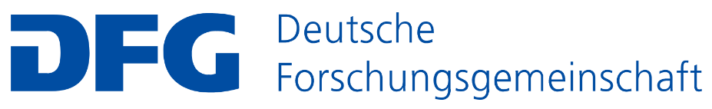


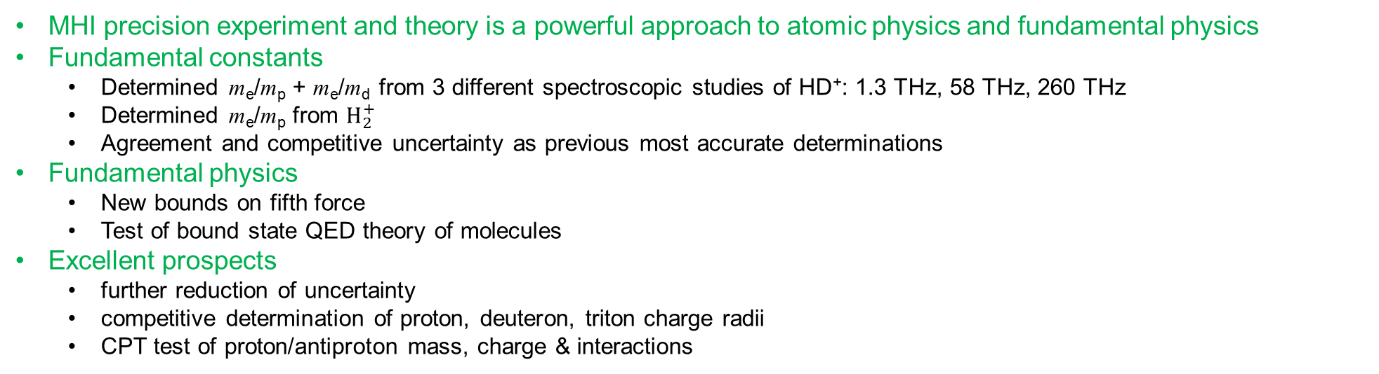
Summary
MHI precision experiment and theory is a powerful approach to atomic physics and fundamental physics
Fundamental constants
Determined m_{e}/m_{p} + m_{e}/m_{d} from 3 different spectroscopic studies of HD⁺: 1.3 THz, 58 THz, 260 THz
Determined m_{e}/m_{p} from $H_{2}^{+}$
Agreement and competitive uncertainty as previous most accurate determinations
Fundamental physics
New bounds on fifth force
Test of bound state QED theory of molecules
Excellent prospects
further reduction of uncertainty
competitive determination of proton, deuteron, triton charge radii
CPT test of proton/antiproton mass, charge & interactions
Experimental support:
HHU Universität Düsseldorf
Alexander Nevsky
Victor Vogt
Ivan V. Kortunov
Eugen Wiens
Magnus Schenkel
Maryam Bakhshi
ERC European Union’s Horizon 2020 grant: 786306, “PREMOL”
DFG grant:AL 2825/2-1

